Slide 1



LPNHE (IN2P3 CNRS)

Slide 2
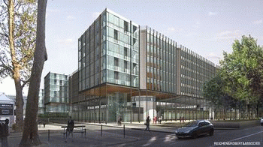
Laboratoire de Physique Nucléaire et de Hautes Energies
Mixed research unit (UMR) of Institut National de Physique Nucléaire et de Physique de Particules (IN2P3 CNRS) and Pierre et Marie Curie university (UPMC) and Paris Diderot university.
~ 100 researchers + 50 technical staff

Slide 3
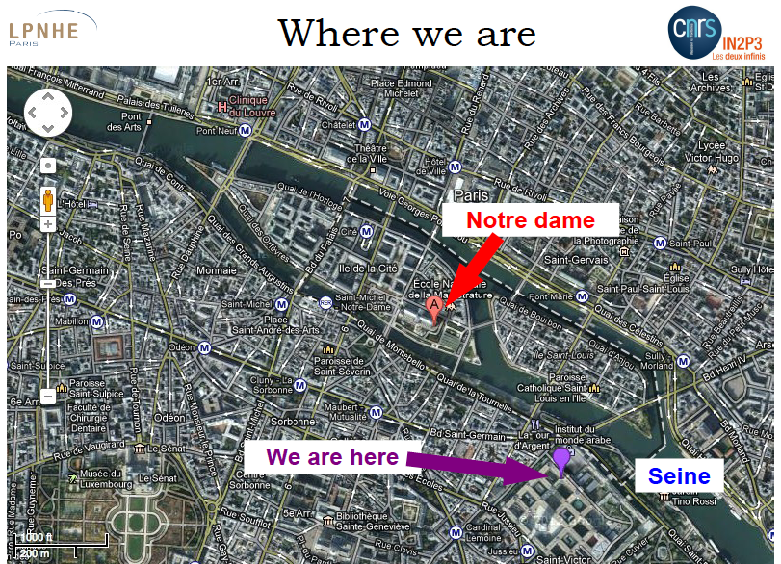

Slide 4
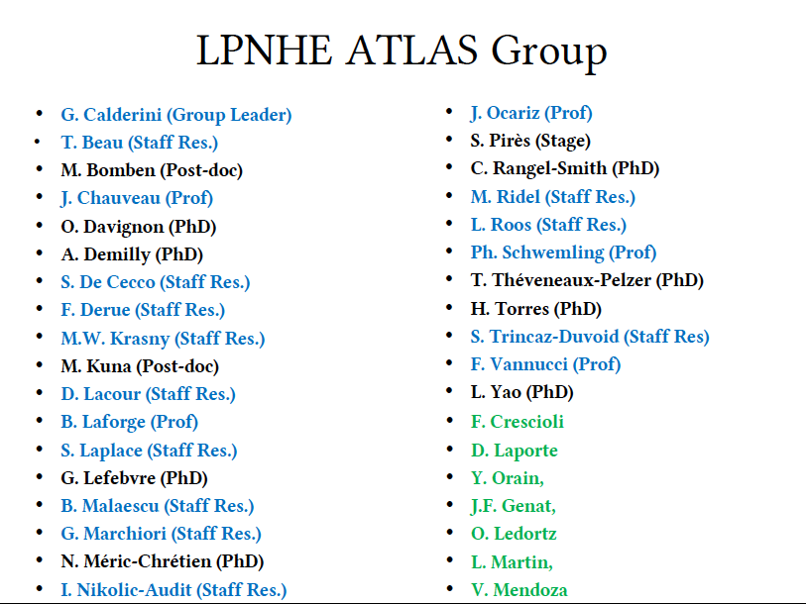

Slide 5
People with implications in Si sensors and FTK
Giovanni Calderini – Director of research
Former BaBar tracker project leader
Planar pixels for ATLAS upgrade
Giovanni Marchiori – Researcher
Experience in Silicon detectors
Marco Bomben – Post-doc
Experience in Silicon detectors
ATLAS pixel test beam coordinator
Jacques Chauveau – Professor UPMC
Experience in Silicon detectors
Francesco Crescioli – Research Engineer
FTK experience
Jean-Francois Genat – Research Engineer
Experience in chip design
Olivier Le Dortz – Research Engineer
FPGA and perif. electronics experience
in IAPP
in IAPP

Slide 6
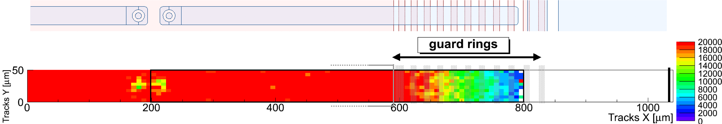
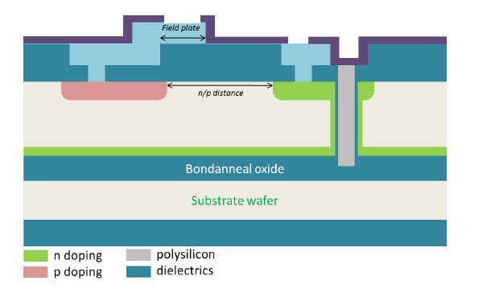
Sensors
Contribution to ATLAS IBL
Simulations (Silvaco)
pixel-over-guard rings design
several n-in-n and n-in-p productions
Edgeless planar sensors (FBK-LPNHE)
Aim to phase-II ID (mid-outer layers)
Reduced dead area at periphery (~100 μm)
Sensors designed & simulated via TCAD
Tests started in our clean room
Next: CCE at periphery w/ laser, sources, beams
Cut line

Slide 7
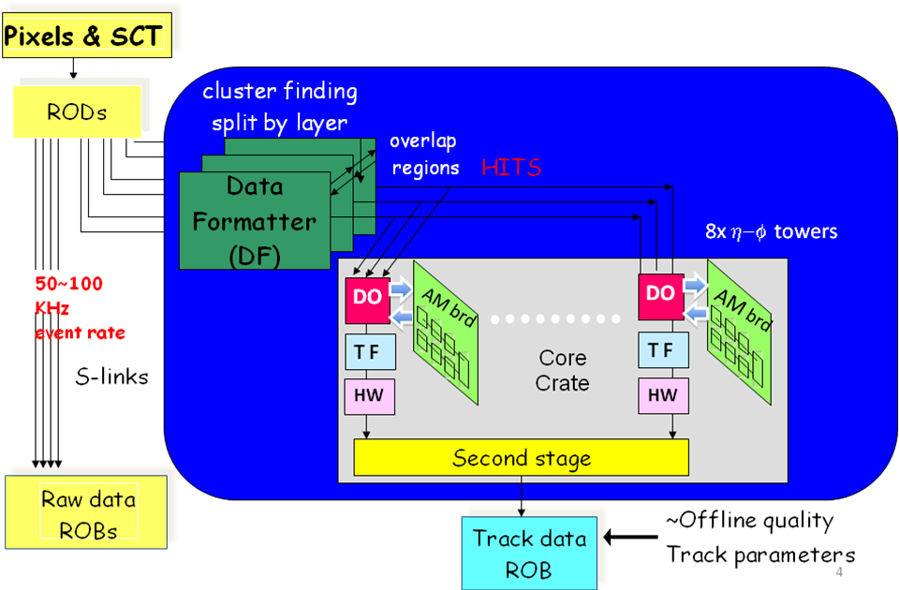
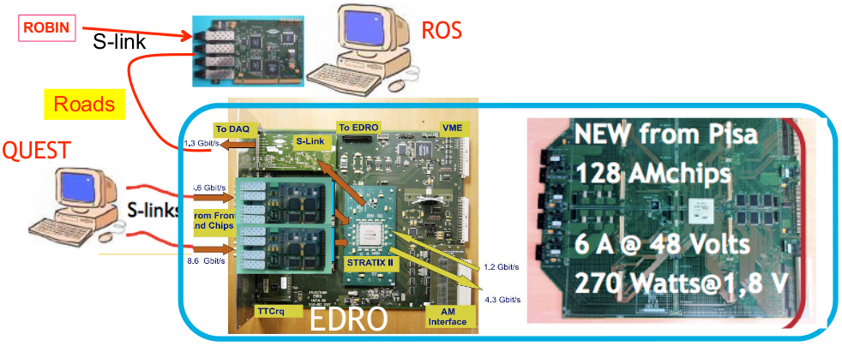
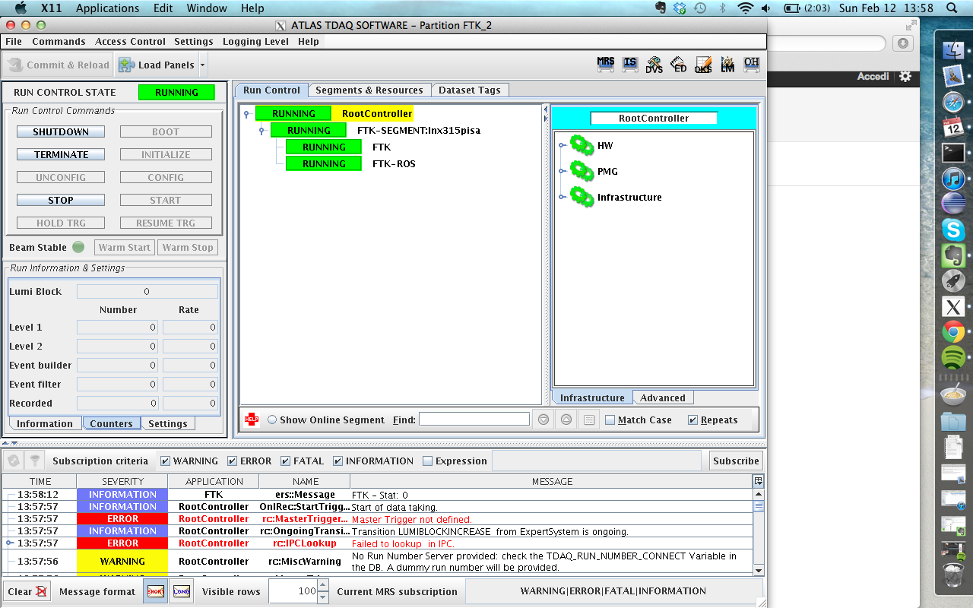
FTK experience
Hardware
Software
FTK simulation &
data preparation software
FTKSim
Pattern generator
from data & constants
FTKSim in ATHENA
JobOptions for trigger
studies
AMchip
dev
FTK Vertical Slice
FTK VS integration with ATLAS online software

Slide 8
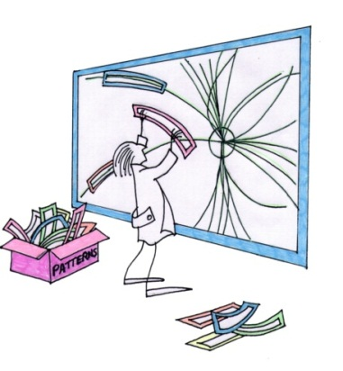
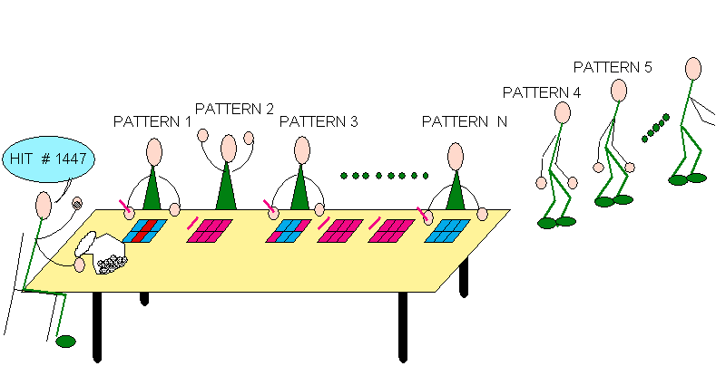
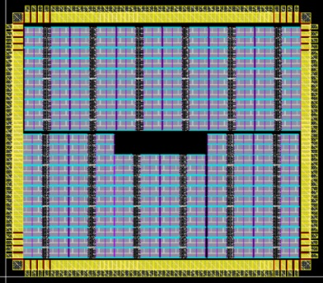
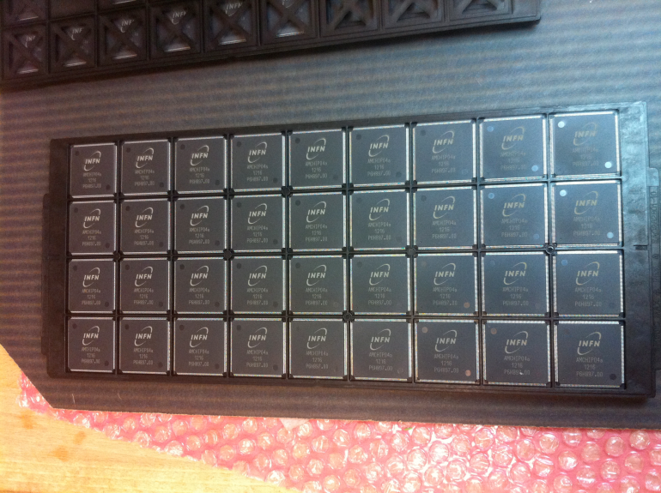
Associative Memory ~ AMchip
The associative memory is the core component of the pattern recognition stage of FTK
Performs the higly demanding task of coarse tracks finding in the full event.
The associative memory hardware is based on a custom made ASIC: AMchip
AMchip-based associative memory device first used
in CDF (Amchip03).
AMchip03
6-layers patterns @ 18-bit
~5kpatt/chip
40 MHz
FTK needs more advanced technology:
AMchip04
8-layers @ 15-bit (configurable3-7 bit w/ ternary logic)
~8kpatt/chip
100 MHz
AMchip05
High speed serial I/O
~32kpatt/chip
Stream merge function
Used by
FTK VS
ASIC
design
AMchip04
Design phase

Slide 9
LPNHE activities in FTK/IAPP
Development of a low-noise alimentation framework for radiation damaged ATLAS sensors
(collaboration with CAEN)
Test-stand development for FTK board validation
and commissioning
AMchip tests
Boards tests
Integration HW/SW

