Slide 1
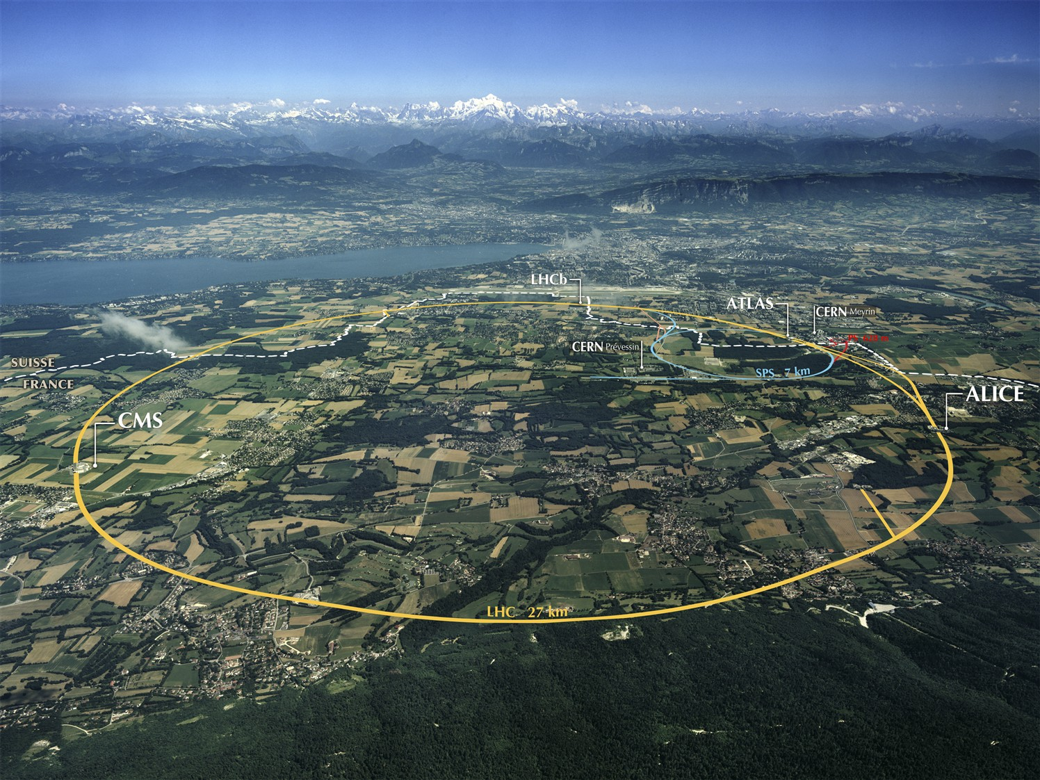

CERN
Accelerating Science and Innovation
FTK - Pisa 130311 B. Magnin
Notes:
1

Slide 2
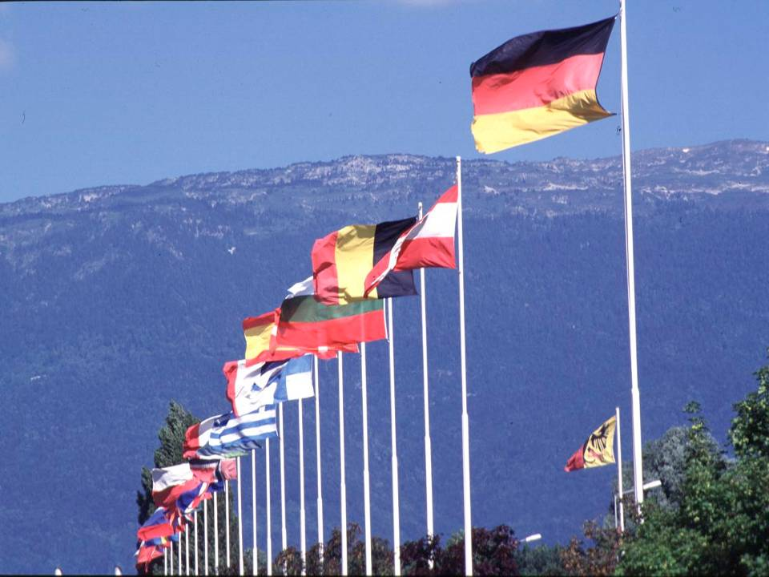
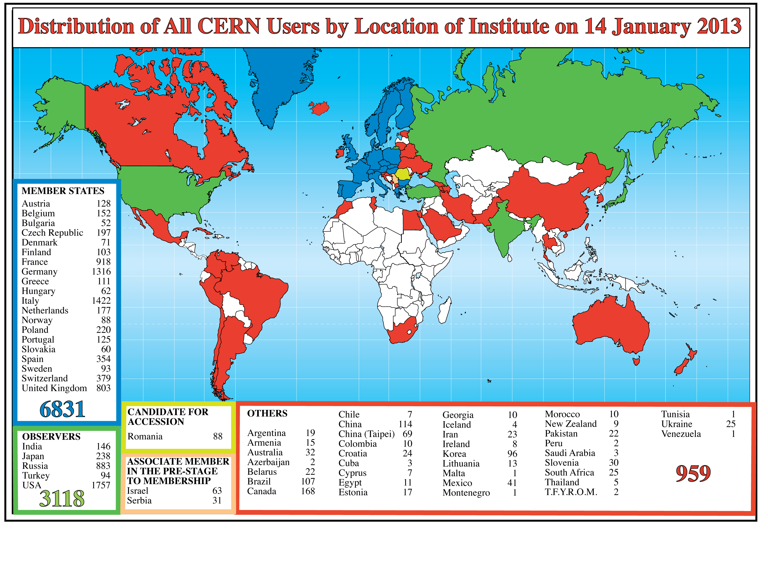

CERN was founded 1954: 12 European States
“Science for Peace”
Today: 20 Member States
~ 2300 staff
~ 1000 other paid personnel
> 11000 users
Budget (2013) ~1000 MCHF
2
Notes:
2
----- Meeting Notes (09/01/2013 14:16) -----
nnn

Slide 3
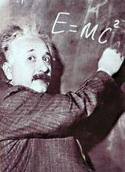
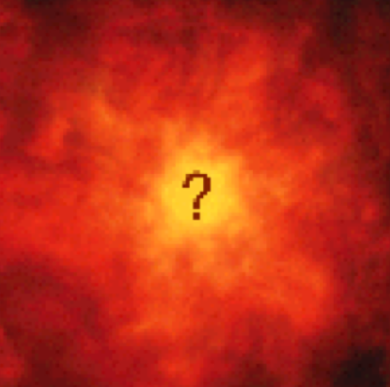

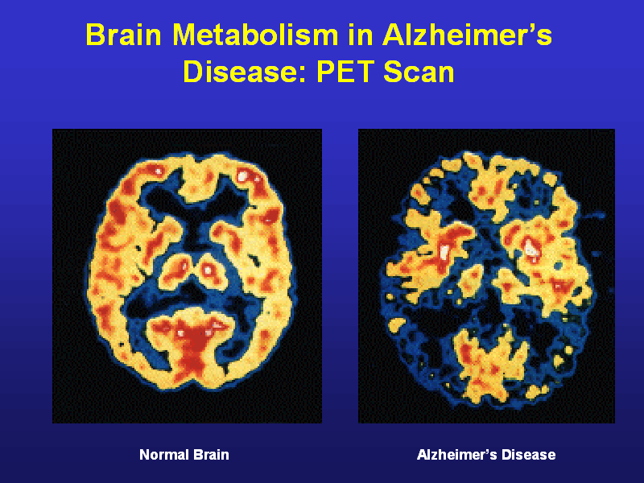
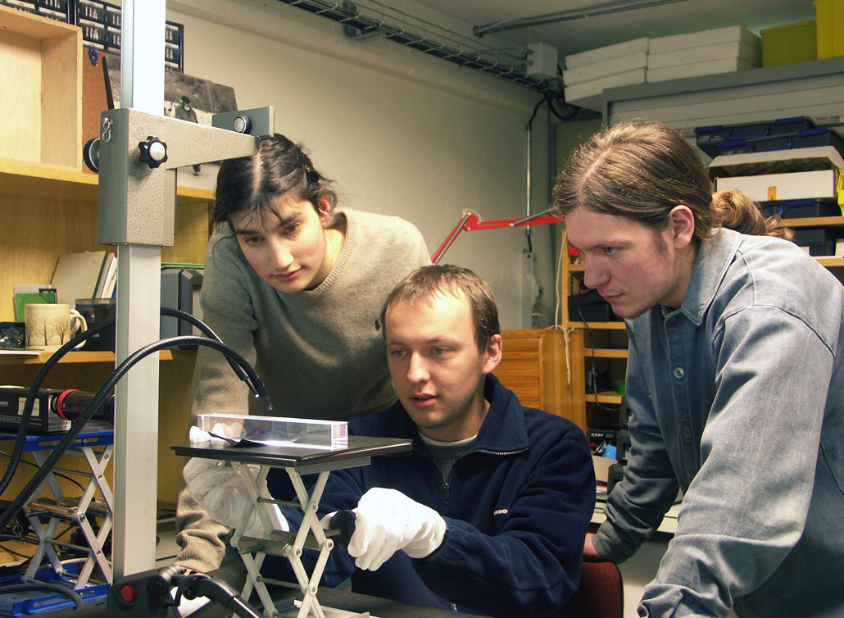
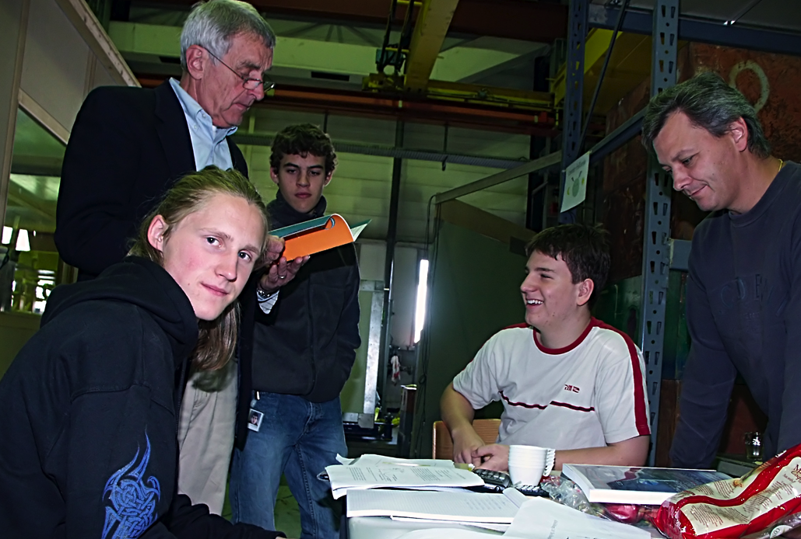
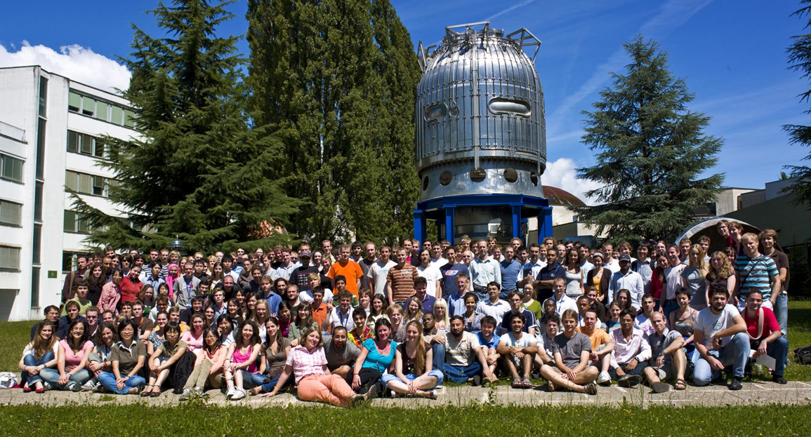
The Mission of CERN
Push forward the frontiers of knowledge
E.g. the secrets of the Big Bang …what was the matter like within the first moments of the Universe’s existence?
Develop new technologies for accelerators and detectors
Information technology - the Web and the GRID
Medicine - diagnosis and therapy
Train scientists and engineers of tomorrow
Unite people from different countries and cultures
Notes:
3

Slide 4
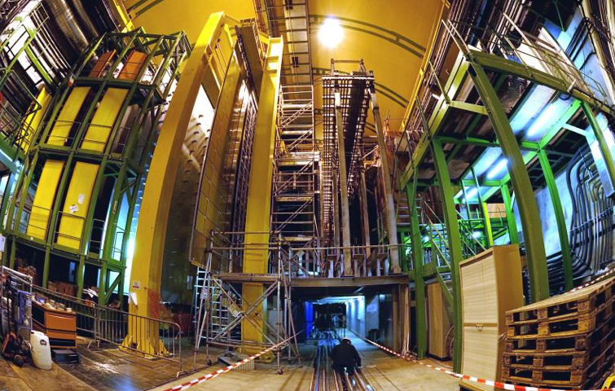
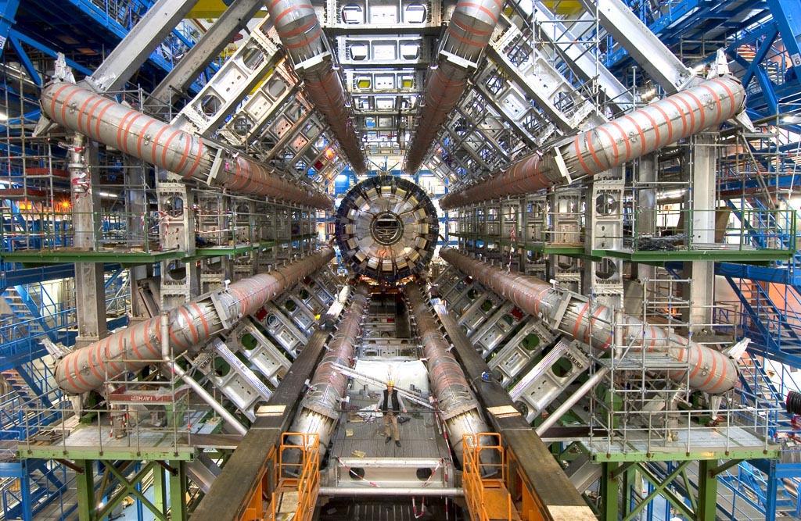
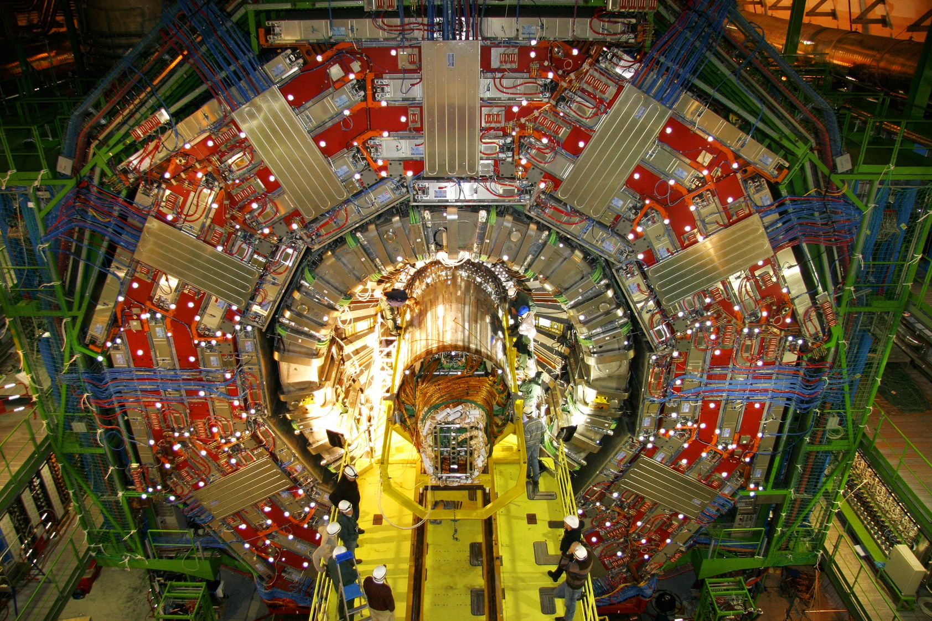
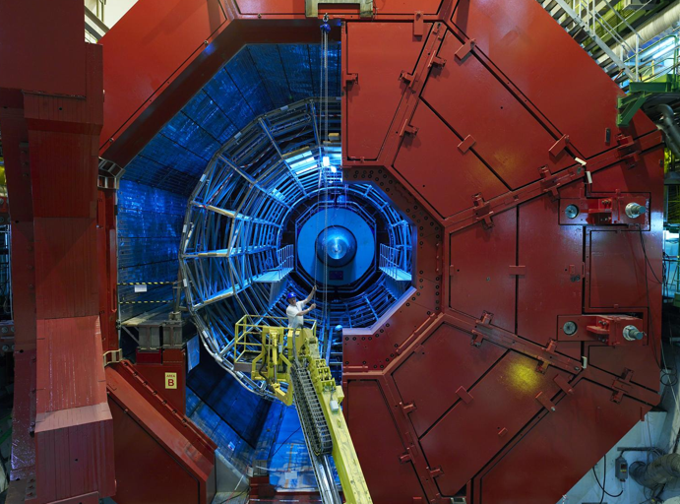
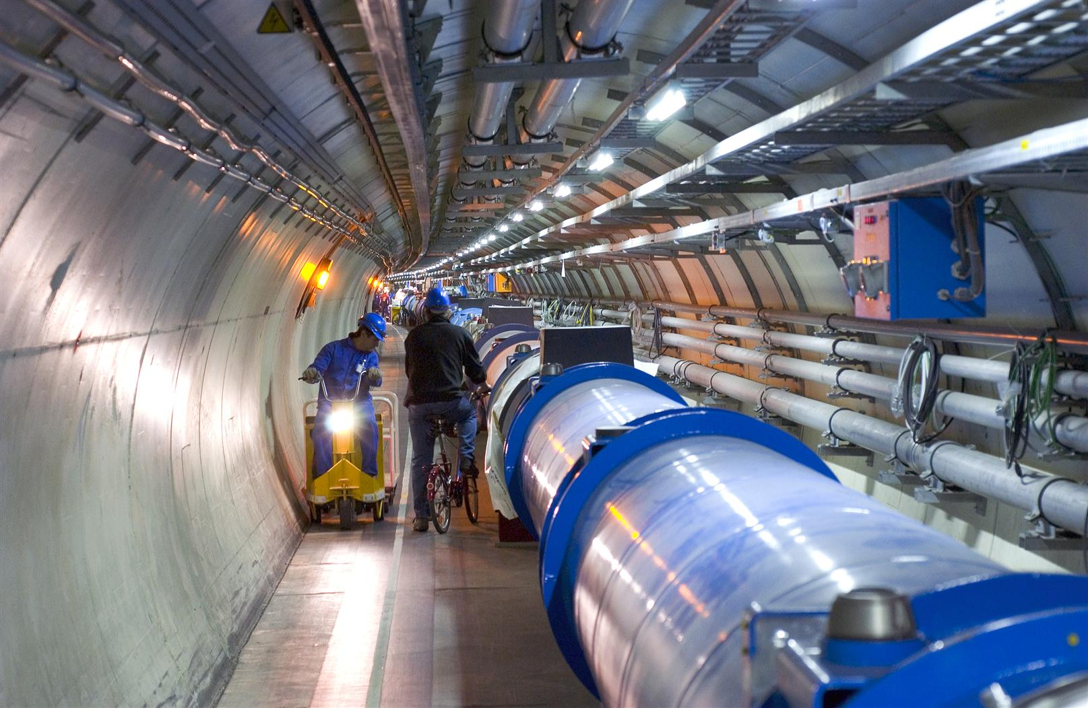
Enter a New Era in Fundamental Science
LHCb
CMS
ATLAS
Exploration of a new energy frontier
in p-p and Pb-Pb collisions
ALICE
LHC ring:
27 km circumference
Notes:
4

Slide 5
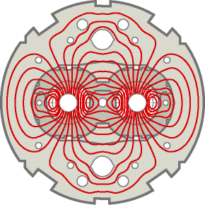
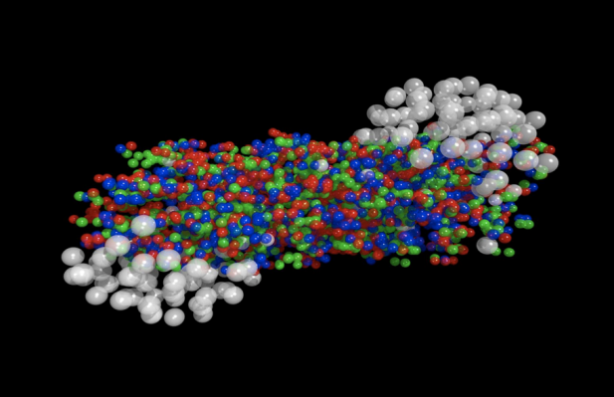
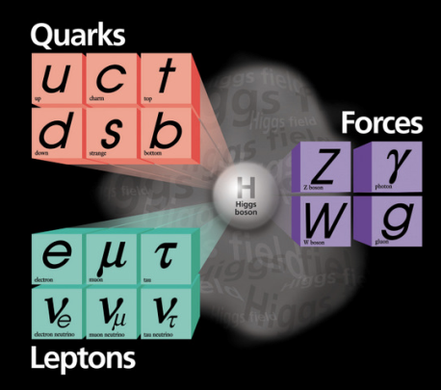

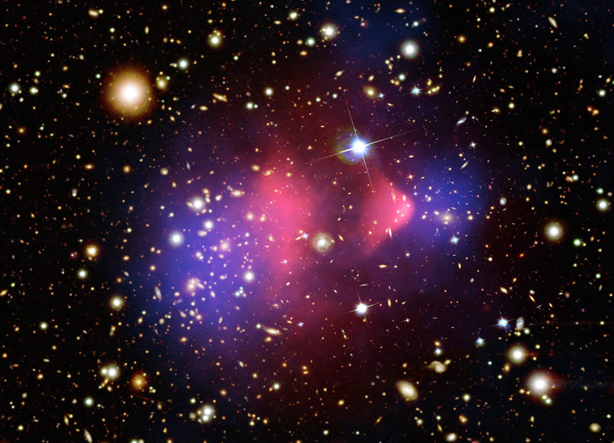
The study of LHC data will allow us to answer some of the big questions ...
Will we understand the primordial state of matter after the Big Bang before protons and neutrons formed?
Have we found the Higgs particle that is responsible for giving mass to all particles?
Will we find the reason why antimatter and matter did not completely destroy each other?
Will we find the particle(s) that make up the mysterious ‘dark matter’ in our Universe?

Slide 6
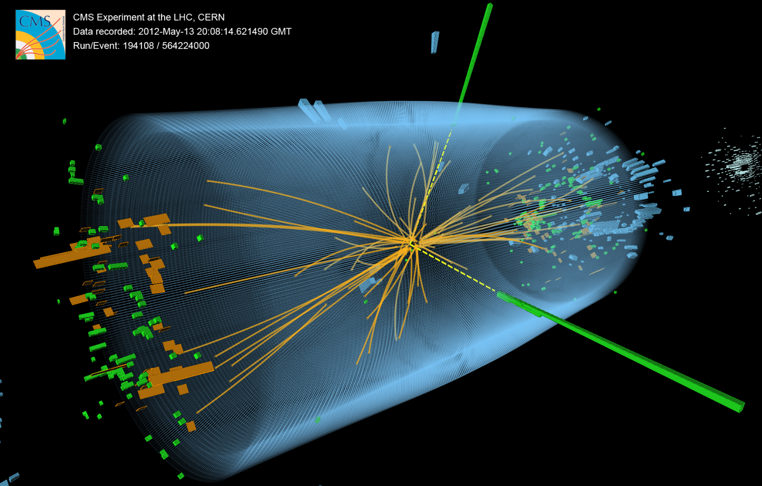
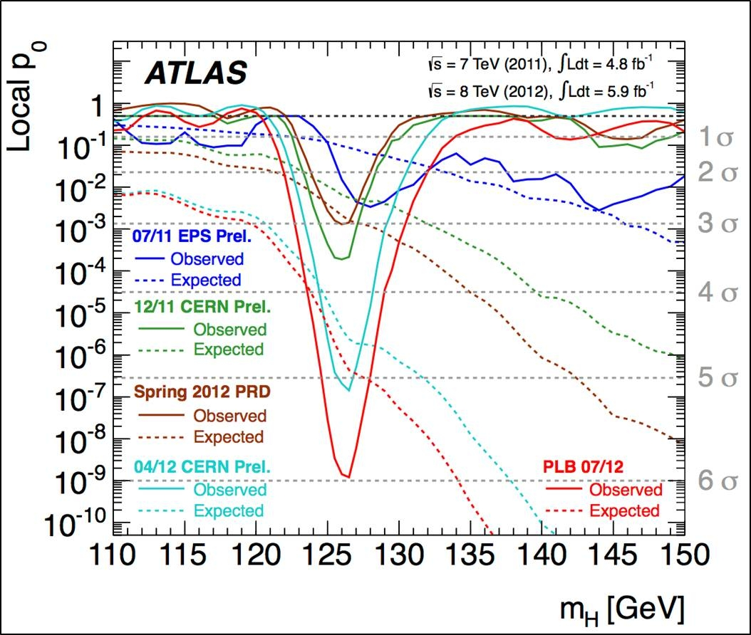
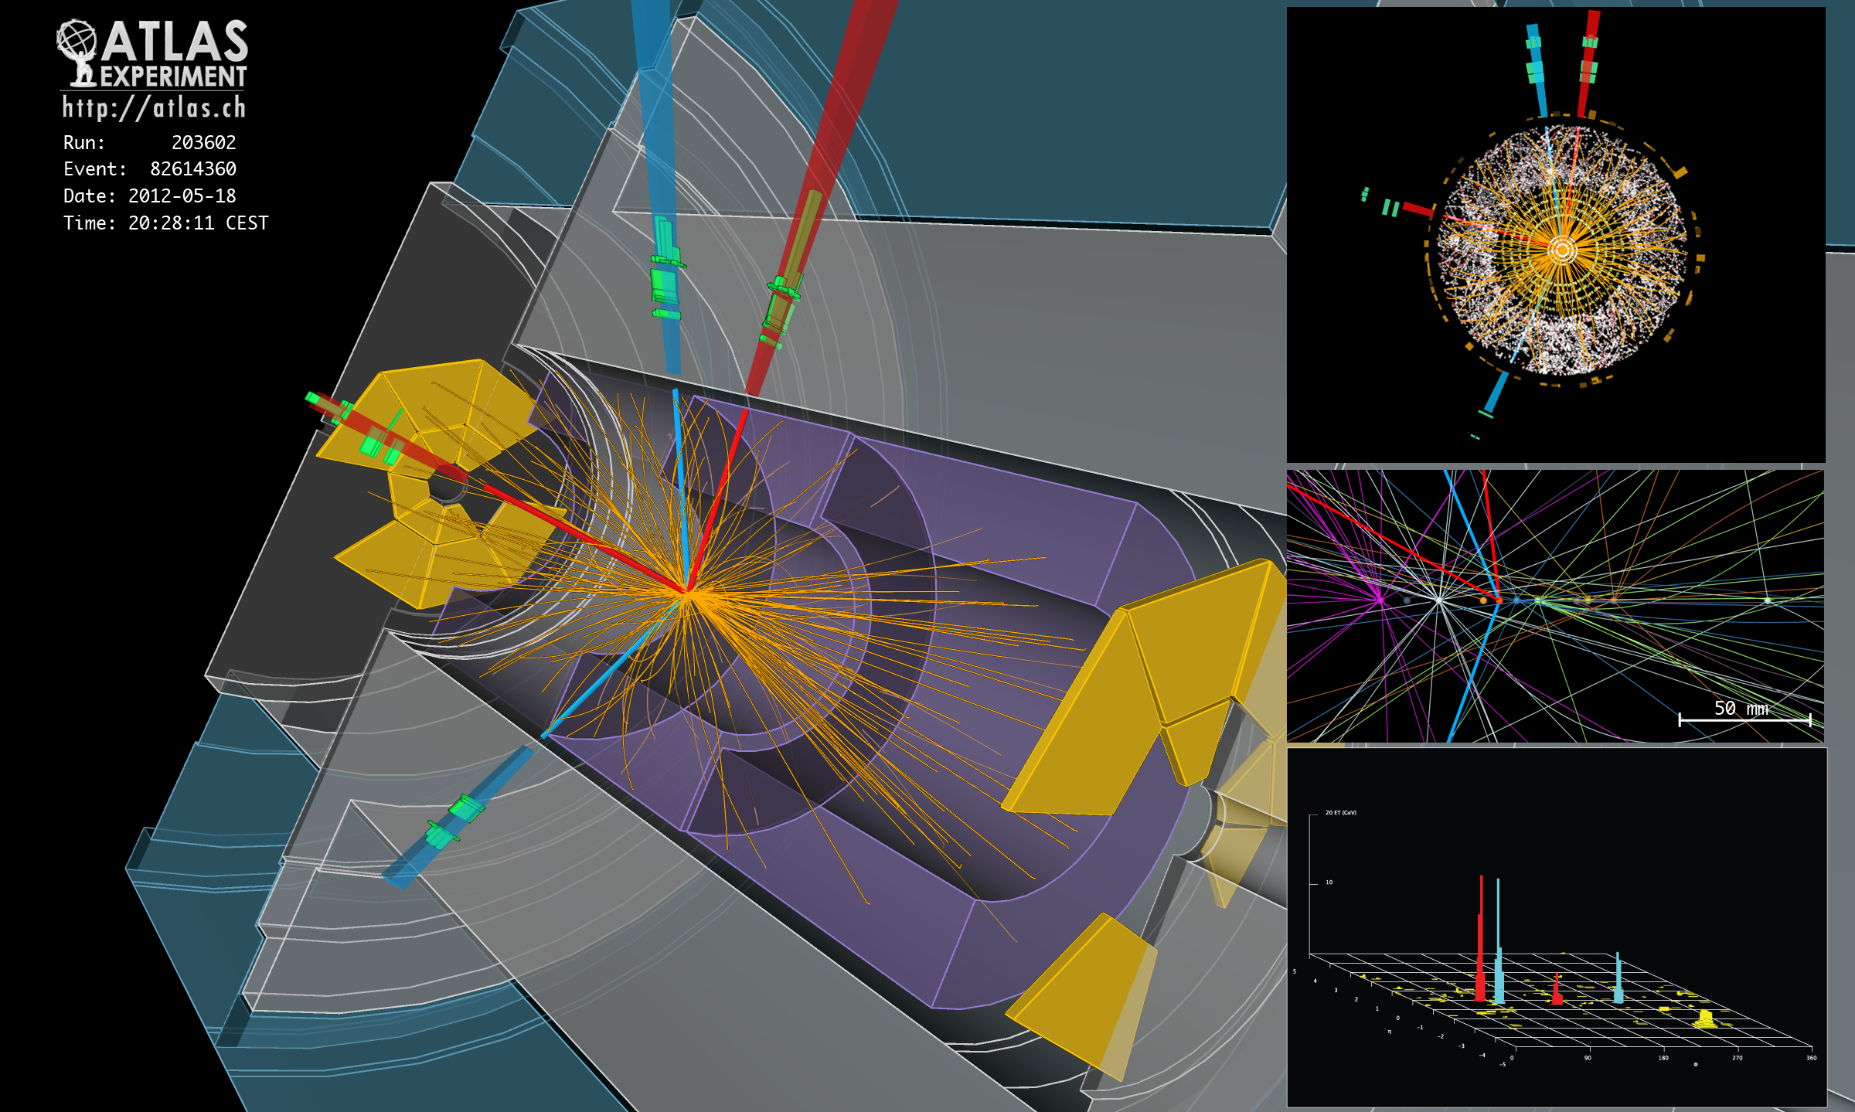
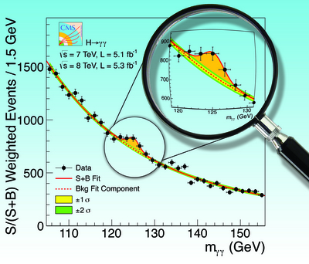
4 July 2012: “CERN experiments observe particle consistent with long-sought Higgs boson”

Slide 7
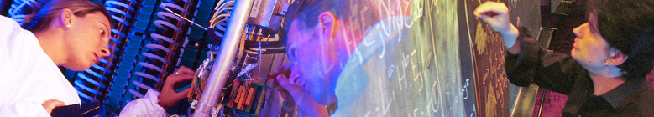
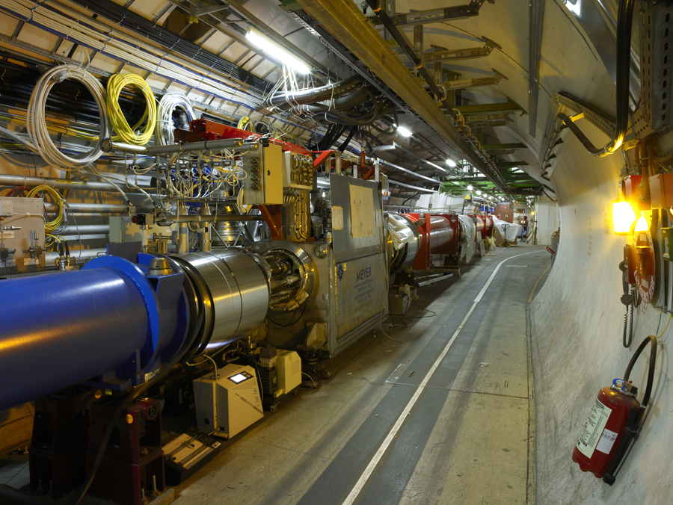
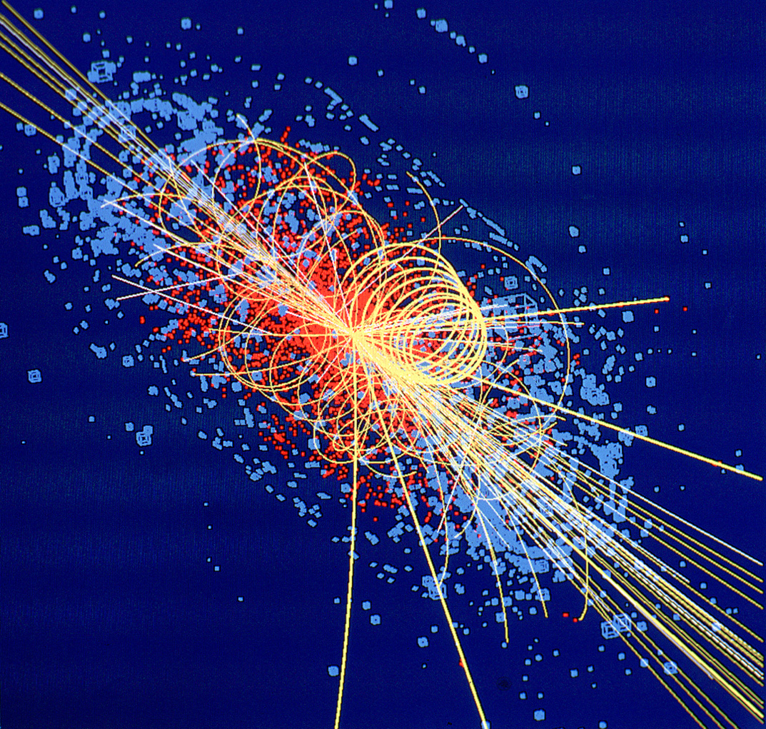
CERN: Particle Physics and Innovation
Interfacing between fundamental science and key technological developments
CERN Technologies and Innovation
Accelerating particle beams
Detecting particles
Large-scale computing (Grid)
Notes:
7

Slide 8
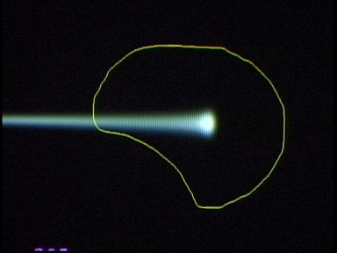
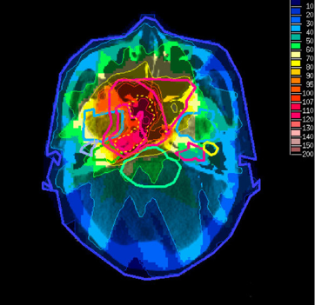
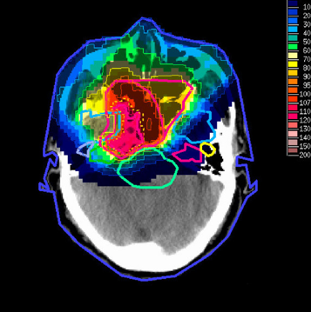
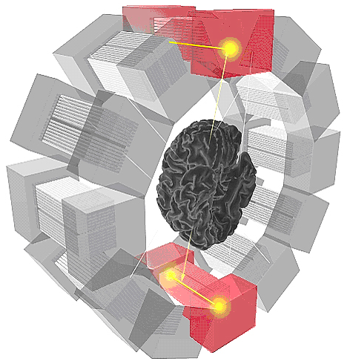
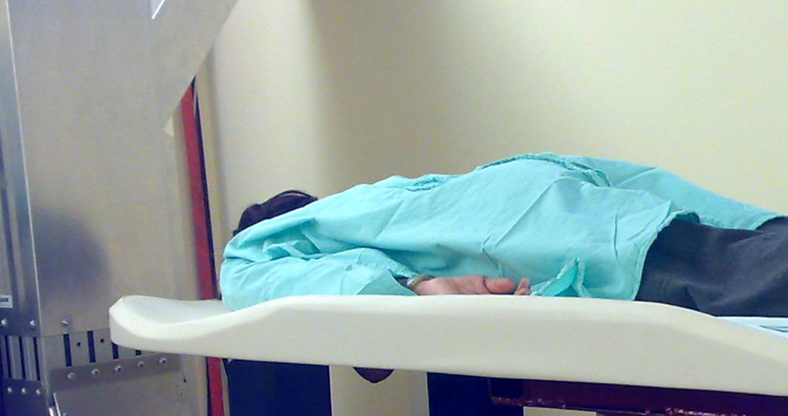
Medical Application as an Example of Particle Physics Spin-off
Combining Physics, ICT, Biology and Medicine to fight cancer
Hadron Therapy
Tumour Target
Leadership in Ion Beam Therapy now in Europe and Japan
Protons
light ions
Accelerating particle beams
~30’000 accelerators worldwide
~17’000 used for medicine
X-ray
protons
>70’000 patients treated worldwide (30 facilities)
>21’000 patients treated in Europe (9 facilities)
Imaging
PET Scanner
Clinical trial in Portugal for new breast imaging system (ClearPEM)
Detecting particles
Notes:
8

Slide 9
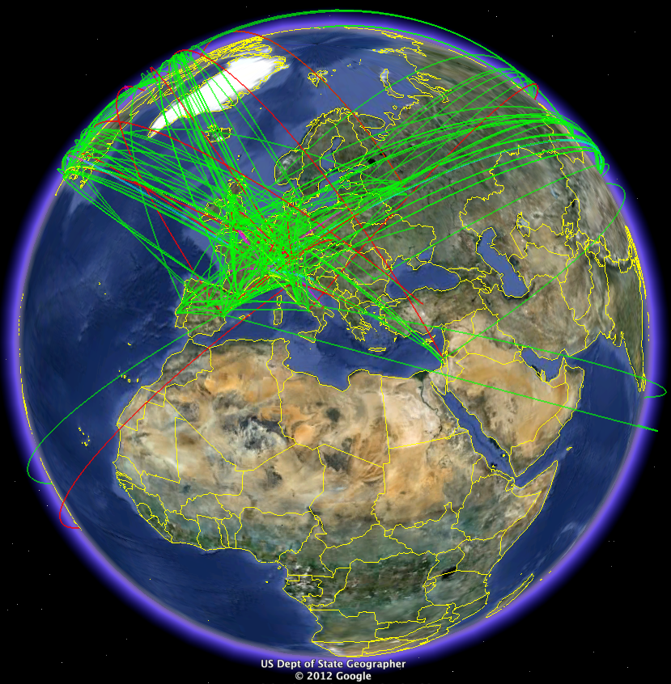
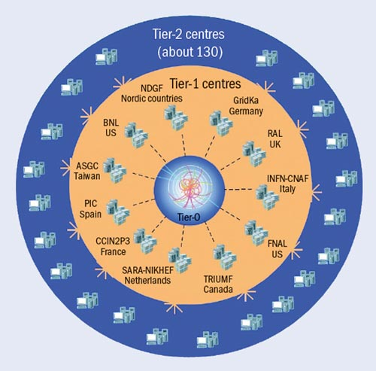
The Worldwide LHC Computing Grid
Tier-0 (CERN): data recording, reconstruction and distribution
nearly 160 sites, 35 countries
~250’000 cores
Tier-1: permanent storage, re-processing,
analysis
173 PB of storage
> 2 million jobs/day
Tier-2: Simulation,
end-user analysis
10 Gb links
WLCG:
An International collaboration to distribute and analyse LHC data
Integrates computer centres worldwide that provide computing and storage resource into a single infrastructure accessible by all LHC physicists

Slide 10
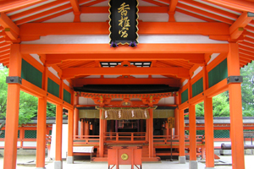
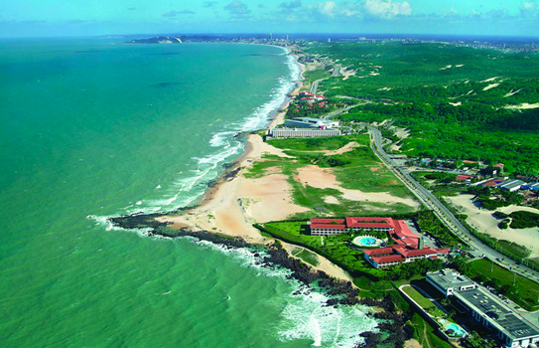
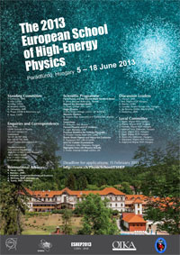
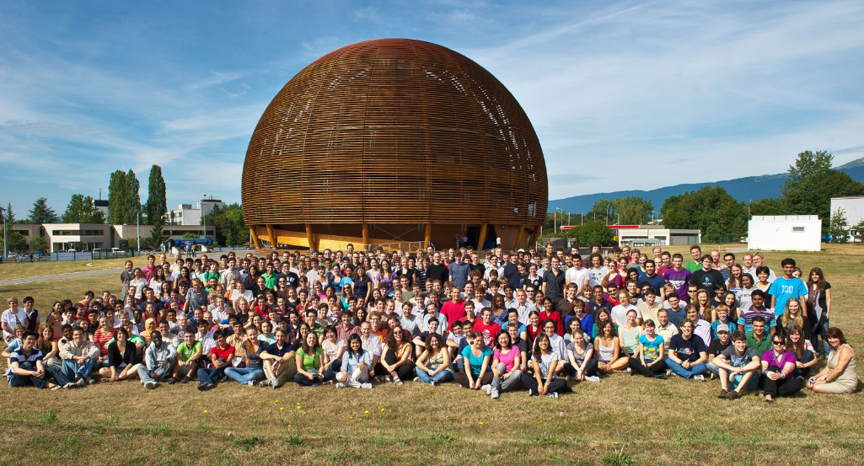
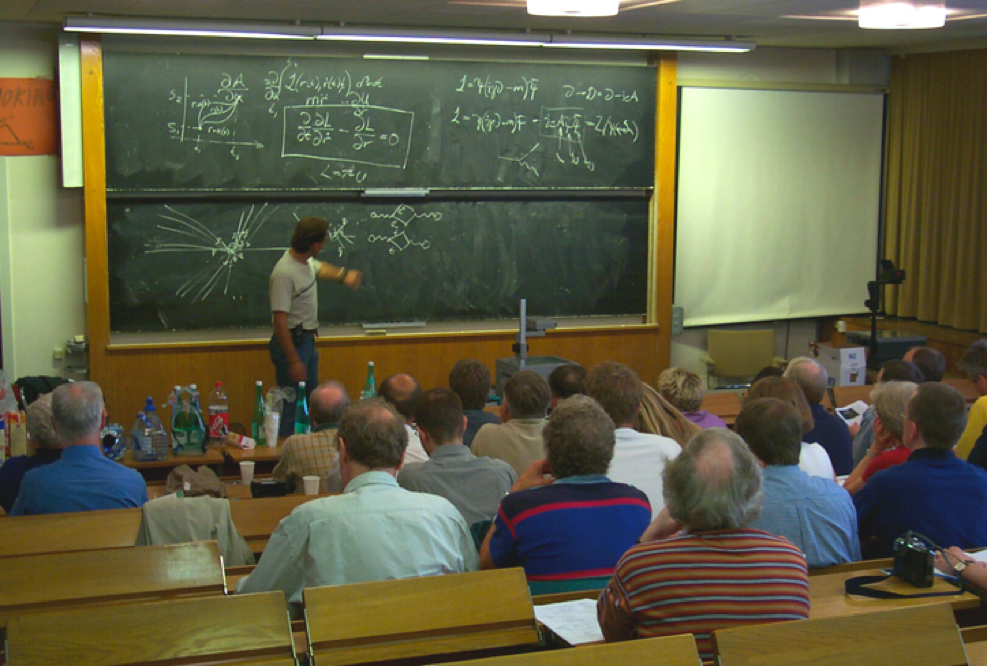
CERN Education Activities
Latin American School
Natal, Brazil, 2011 Arequipa, Peru, 2013
NEW:
Asia-Europe-Pacific School of High-Energy Physics
Fukuoka, Oct 2012
India, 2014
Scientists at CERN
Academic Training Programme
Young Researchers
CERN School of High Energy Physics
CERN School of Computing
CERN Accelerator School
CERN School of Physics Hungary, June 2013
Physics Students
Summer Students
Programme
CERN Teacher Schools
International and National Programmes

Slide 11
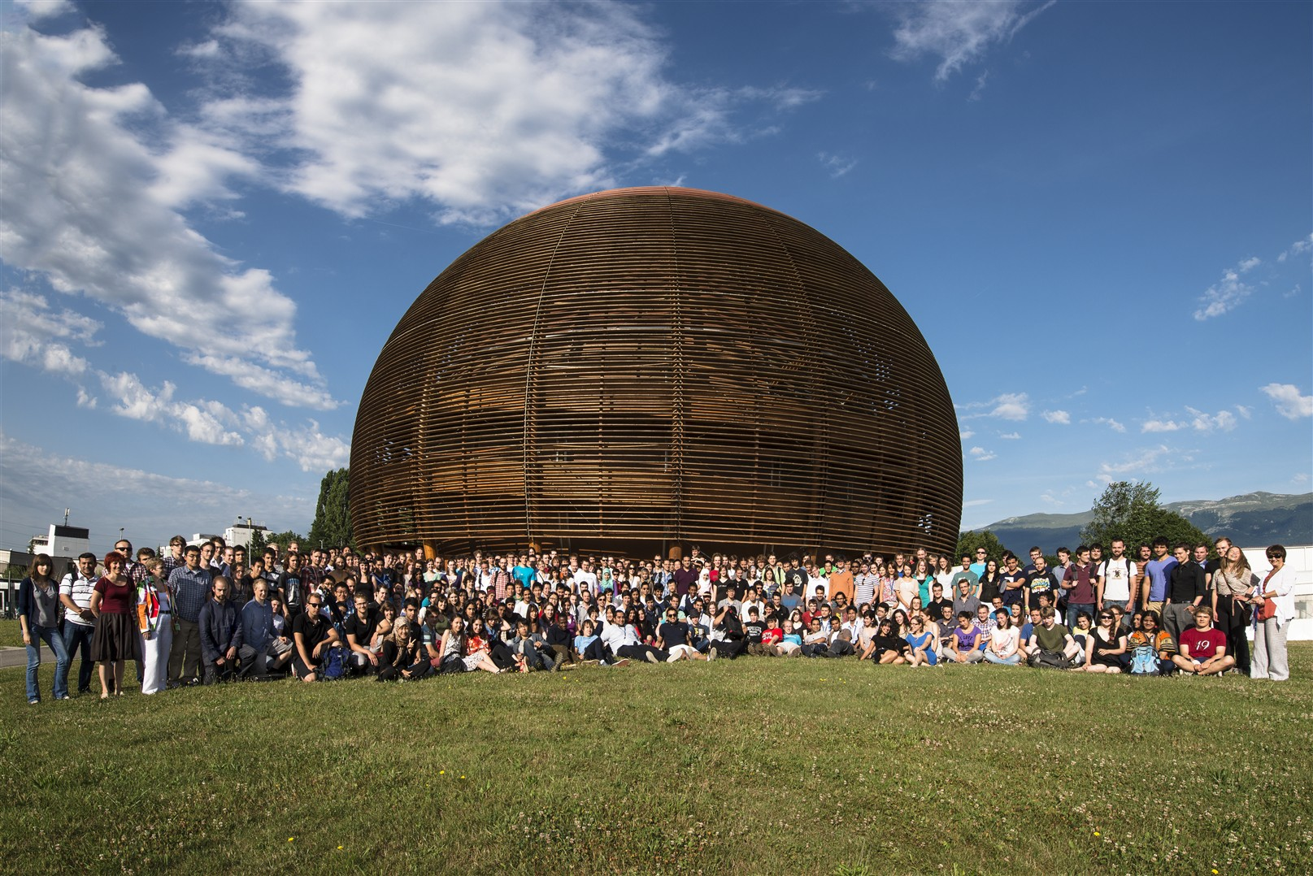
Thank You !
Notes:
11

