Slide 1


Software for tests: AMB and LAMB configuration - Available tools
Daniel Magalotti
University of Modena and
Reggio Emilia
INFN of Perugia
FTK Workshop – Pisa 13/03/2013

Slide 2
Outline
VME standard protocol description
AMBoard & LAMB configuration
AMchip configuration and control
Tools and software for testing

Slide 3
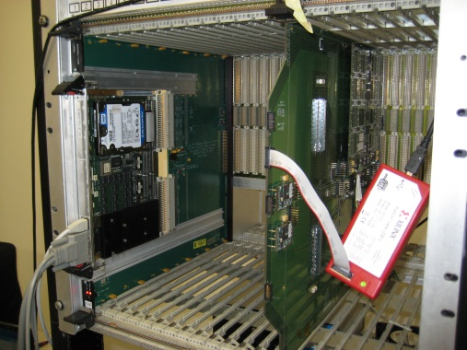
VME crate interface
VME crate
Link to the document for the VME protocol
http://www.interfacebus.com/Design_Connector_VME.html
21 slot for the VME crate
In the first slot there is the
master CPU
Until 20 slot for the AMBoard
that is the slave
A geographical address
identifies the position of the
board
Notes:
In this slide we see the vme crate. The crate provides the power to the board and the signal of the vme standard through two connector P1 e P2.
A description of the protocol is at this link.
There are 21 slot: in the first slot there is positioned a CPU that handles the communication protocol and is the master for the standard.
IN the other slot we can be inserted the AMBoards which are the slave of the standard. To identify each card a fixed geographical address is defined for each slot.

Slide 4
VME data distribution
The VME data bus distribution inside the AMBoard
MASTER
AMBOARD SLAVE
V
M
E
B
A
C
K
P
L
A
N
E
VMEDATAINP
SCT
PIXEL
CONTROL
VMEDATA
VMEDATA
REPEATER
FPGA
VMEDATAOUT
CPU
VMEDATA
ROAD EVEN
ROAD ODD
VMEDATA
VME INTERFACE
FPGA
VMEDATAAUX
AUX
CARD
Notes:
The data bus is distributed within the board with dedicated fan-out chip to all the board.
The VME interface chip control the protocol signals and distribute the address to the chip.

Slide 5
VME address distribution
The VME address bus is distribute to all chip of the AMBoard with the Read/Write signal
MASTER
AMBOARD SLAVE
V
M
E
B
A
C
K
P
L
A
N
E
VMEADDRESS_INP
SCT
PIXEL
CONTROL
Read/Write
VMEADDRESS_OUT
CPU
VMEADDRESS
VMEADDRESS
VME INTERFACE
FPGA
ROAD EVEN
ROAD ODD
Read/Write
VMEADDRESS_AUX
AUX
CARD
Read/Write

Slide 6
LAMB configuration
The VME data bus is also distributed to the all 4 LAMBs
8 vmedata to each LAMB so each one is controlled in parallel
The data is received from BSCAN chip that perform the conversion from VME to JTAG interface
There is 8 AMChip JTAG chain so each chain is controlled in parallel
A 3 bit address is received
to identify the JTAG
operation (write TDI o TMS
read TDO)
VM
E
B
A
C
K
P
L
A
N
E
VMEDATA
VMEDATA
REPEATER
FPGA
VMEDATAINP[7:0]
BSCAN
LAMB
VME INTERFACE
FPGA
RBSCAN
VMEDATA
WRPAM
L_ADDR[2:0]
Notes:
The vme data bus is distributed to all 4 LAMB in particular 8 lines for each LAMB in such a way that they are controlled in parallel.
The data are received by bscan chip that makes the conversion from VME to JTAG.
Remember that the LAMB there are 8 JTAG chains each chain presents on the board is controlled in parallel.
The address bits identify the three JTAG operations: TDO reading and TDI and TMS writing

Slide 7
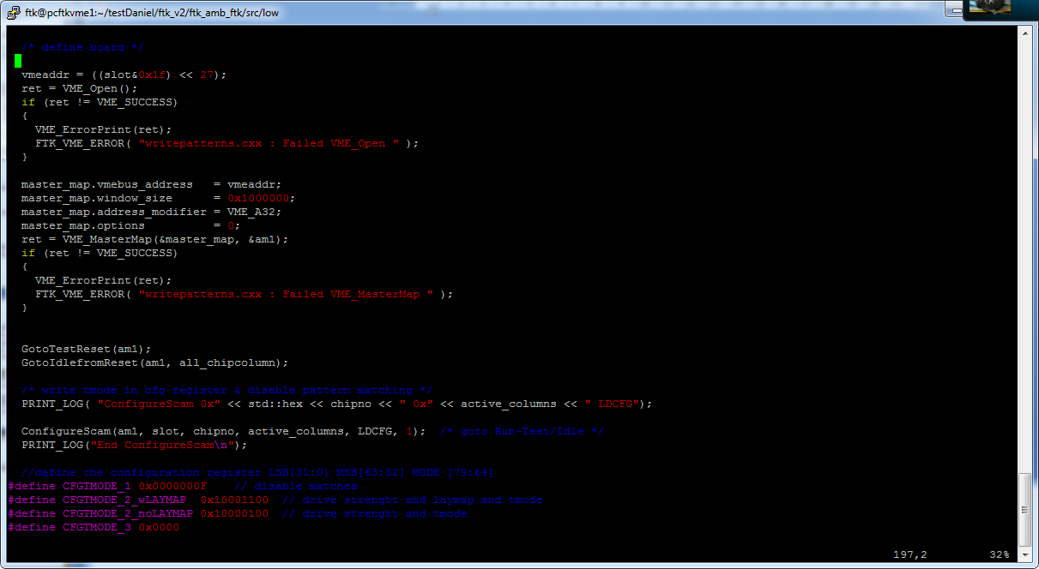
Software for test
The CPU master controls the VME protocol: function in C++ code are implemented
All the functions are based on the basic read and write operation of a register
VME_ReadSafeUInt (int master_mapping, u_int address_offset, u_int* value);
Read register of a specific location address
Write register of a specific location address
VME_WriteSafeUInt (int master_mapping, u_int address_offset, u_int value);
Notes:
The basic operations of the protocol are the reading and writing oparation that are controlled by the master CPU.
Therefore, two basic functions are used to read or write a specific address.
All the software functions are implemented in C code.

Slide 8
Software for test
The principal operations with the software are
Configure and control the AMchips
Testing the hardware connection to/from AMchips with JTAG standard
Readout of the SpyBuffer and writing of VmeFifo
Automatic script to testing the entire system
Notes:
The main operations of the software are the control and configuration of Amchip: loading pattern of the bank and check pattern operation to control that the pattern has been correctly written.
Test of the connection with the Amchip using the JTAG standard.
Monitor the flow of data within the AMboard with operations of reading and writing of registers and memories.
Definition of an automated script for test and debug the entire system

Slide 9
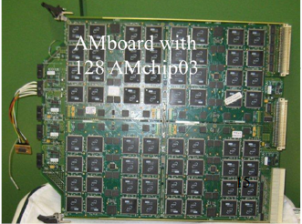
AMChip pattern configuration
Crate the map of the AMchip present into the board
A JTAG operation to define the mapping
Number of the LAMB present in the board
Define the active columns present in each LAMB
Total number of AMchips
Notes:
The procedure for loading patterns in Amchip provides a series of JTAG operations.
A map of the number of LAMMB, number of chips and the active chain of each LAMB is done through JTAG operation.

Slide 10
AMChip pattern configuration
Crate the map of the AMchip present into the board
A JTAG operation to define the mapping
Write the “CONFIGURATION REGISTER” of the AMchip
DEF_THR <= JPATT_CTRL (3 downto 0) := Threshold
DEF_required_layers <= JPATT_CTRL (5 downto 4);
GEOADDR <= JPATT_CTRL(14 downto 8) := geografhical address
BOTTOMchip <= JPATT_CTRL(32) := input bus mirror
test_mode <= JPATT_CTRL(40);
enable_layermap <= JPATT_CTRL(44);
LASTchip <= JPATT_CTRL(48);
disable_PATT_FLOW <= JPATT_CTRL(52);
drive_strength <= JPATT_CTRL(60);
DCBits<=JPATT_CTRL(79 downto 64);
Notes:
After the configuration register is loading.
The main options are: the threshold to match the patterns, the latest chip, the geographical address and the option bottom chip that takes into account mirroring.

Slide 11
AMChip pattern configuration
Crate the map of the AMchip present into the board
A JTAG operation to define the mapping
Write the “CONFIGURATION REGISTER” of the AMchip
Start the writing pattern operation into the AMchips
Write the value of the first address location into the ADDRES_DATA register
An iterative procedure on all the pattern
Write the pattern data into the DATA REGISTER
Send the OPERATIONE_WRITE_INCREMENT to write the pattern and increment the value of the ADDRESS REGISTER
Notes:
Finally the write operation of the pattern is realized. We set the value of the address to write the pattern and load the value of the pattern. Then we start the write operation of the pattern. This procedure is iterated for all patterns to be written and it is performed in parallel on each chip.

Slide 12
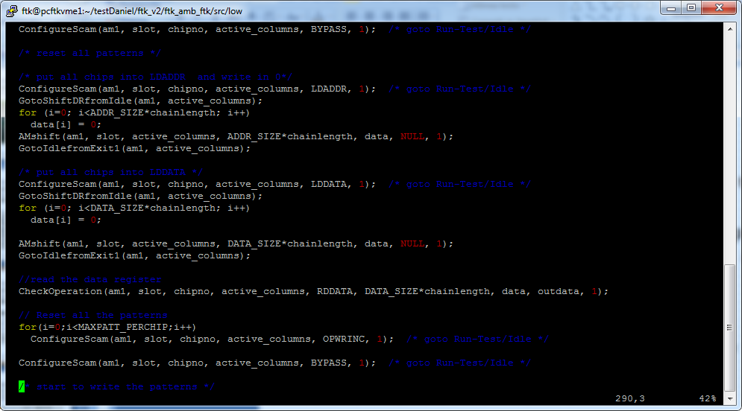
AMChip pattern configuration
Crate the map of the AMchip present into the board
A JTAG operation to define the mapping
Write the “CONFIGURATION REGISTER” of the AMchip
Start the writing pattern operation into the AMchips
Write the value of the first address location into the ADDRES_DATA register
An iterative procedure on all the pattern
Write the pattern data into the DATA REGISTER
Send the OPERATIONE_WRITE_INCREMENT to write the pattern and increment the value of the ADDRESS REGISTER
Write the IR JTAG of AMchip
Write the data into the register addressing
Notes:
Finally the write operation of the pattern is realized. We set the value of the address to write the pattern and load the value of the pattern. Then we start the write operation of the pattern. This procedure is iterated for all patterns to be written and it is performed in parallel on each chip.

Slide 13
AMChip configuration
Check pattern operation control the pattern bank written
This operation is done only with JTAG operation
Set the AMchip into TMODE operation so the input/output data is disable
Loading the pattern data into the DATA REGISTER of the AMchip
Send a INIT_OPCODE command to enable the match of the pattern
Control the ADDRESS REGISTER to compare the current value with the expecting value
Send an SELECTION_BANK command to clear the output match for the next pattern
Notes:
The operation of check pattern allows you to control the bank that was written by JTAG operations. Is set in the chip tmode so as to disable inputs and outputs. Then replicated a precedura iterative uploaded the pattern to check; is enabled with a match operation INIT; veine checked the address of the pattern scatttato, is cleaned up the match with a sel_bank operation to control the next pattern.

Slide 14
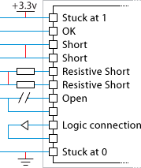
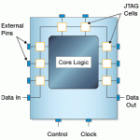
LAMB JTAG Testing
Testing with JTAG allows you to test printed circuit boards for manufacturing defects and functional failures
Chip manufacturers includes
special cell on each of the ICs
pins to facilitate test.
Notes:
With the JTAG we can test defects of the board in particular between short chip-connections to ground open circuits.
The pads of the chips includoni a special cell that allows to facilitate testing

Slide 15
LAMB JTAG Testing
Testing with JTAG allows you to test printed circuit boards for manufacturing defects and functional failures
By driving signals between connected devices, nets can be tested for opens, shorts and stuck-at failures.
For testing all the pad of the AMchip we have to check
INput DIstributor to input pad of AMchips [DONE]
AMchips output to GLUE [TO-DO]
AMchips output to AMchips input pad (pipeline connection) [TO-DO]

Slide 16
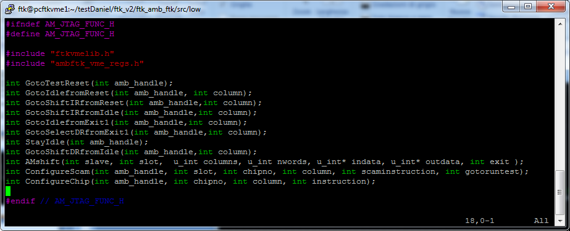
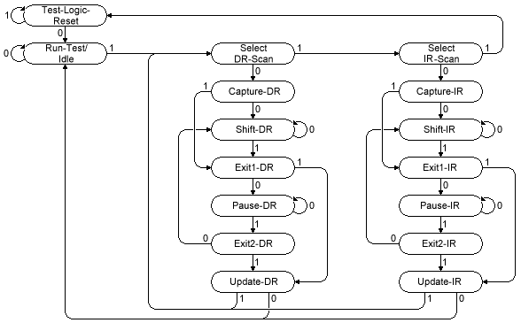
LAMB JTAG Testing
Testing with JTAG allows you to test printed circuit boards for manufacturing defects and functional failures
By driving signals between connected devices, nets can be tested for opens, shorts and stuck-at failures.
For testing all the pad of the AMchip we have to check
INput DIstributor to input pad of AMchips [DONE]
AMchips output to GLUE [TO-DO]
AMchips output to AMchips input pad (pipeline connection) [TO-DO]

Slide 17
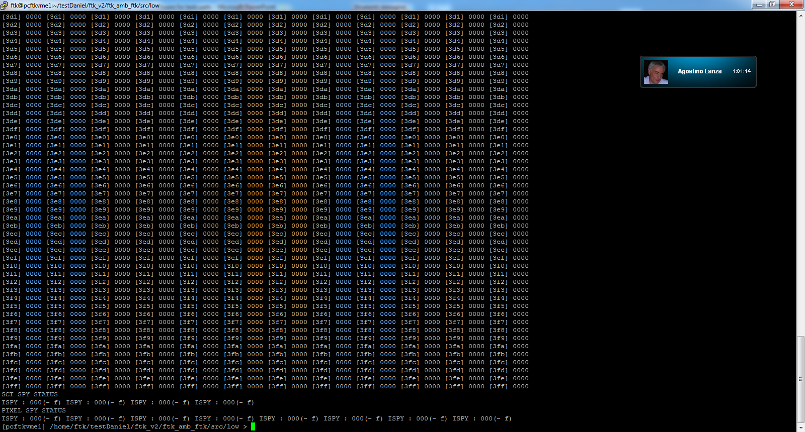
Monitoring and testing tools
The Spybuffer is used to monitoring the data flow in each input and output link between AMBoard and AUX card
A function give this output file format
Notes:
The VME interface allows to read the contents of spybuffer to monitor the flow of data and to achieve test functions.
A function has been implemented and we can see the output

Slide 18
Monitoring and testing tools
The Spybuffer is used to monitoring the data flow in each input and output link between AMBoard and AUX card
A function give this output file format
In the red box is report the output of one Spybuffer:
address of memory location
value of the memory
In the green box the are the information of the status of Spybuffer
first free address location
overflow status
freeze status
Notes:
In particular we have two collonna draw each of information which are written the location address and the value contained life inside of the memory location.
Also shows the status information of sppybuffer: the first free location in memory is not written, the overflow bit and the bit of freeze

Slide 19
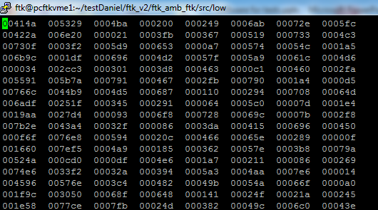
Monitoring and testing tools
The Spybuffer is used to monitoring the data flow in each input and output link between AMBoard and AUX card
A function give this output file format
The VmeFifos are instantiate in each link for the input and output to simulate the eternal data flow
An hit file is loading into the FIFOs
FPGA on the AMBOARD
FIFO BUS 0
FIFO BUS 7
Notes:
To emulate the flow of data input and output to the eternal AMBoard of FIFO writable VME have been instantiated for test. In particular, we define a file hit with 8 input bus and each column is loaded on the respective input fifo.

Slide 20
Automatic test
An automatic script is implemented to testing the entire system using tools describe above
The list of operation
A simulation functions generate the pattern bank and both the hit files and the expected road files
The hit file is loading into the VmeFifos
A start command is sent to enable the hit distribution to the AMchip
The output road from the AMchip is stored into the output Spybuffer
The content of the Spybuffer is compared with the expected road file
Notes:
To test the hardware so intensive a precedura iterative has been implemented.
Iteratively creates a bank of pattern and is the file that the file hit the road waiting.
The file is loaded through the VME hit in FIFO
Once you have loaded is sent a start to distribute HLI hit the Amchip.
The road match are stored in spybuffer and the reading is conffrontato with Rooad expect.

