Slide 1
IAPP - FTK workshop – Pisa 11-15 march, 2013
AMsystem: errors detection & monitoring task
Cadence tool
Marco Piendibene – University of Pisa & INFN

Slide 2
Outline
Error detection
Monitoring/debug tools: spyuffers
Cadence

Slide 3
Errors to be monitored into the INPUT Chips
Parity or CRC error – for each link (8 pixel & 4 SCT) Parity (PA). Error detection should be registered in a 8 bit (or 4 bit word)
FIFO Overflow – each FIFO full flag should produce error if set. Again 8 (or 4) bit word.
Invalid Input data (for example invalid HIT from ROD) ??
Lost Synchronism (event tags in different streams do not match) – Again 8 (or 4) bit word
Truncated output (for example too many hits in input) - Again 8 (or 4) bit word.
We can communicate to Control Chip the error using:
4 bits to identify the kind of error + 8 (or 4) bits to say which is the faulty stream.

Slide 4
VME registers
Error register
For each FIFO: flag register (empty, AFull, Full)
For each FSM: state of th machine
Output Status (Hold flags)
For each Spy Buffer: Spy Buffer register: Pointer, OVFL flag, status(freeze/spy).
firmware ID.
Input FiFos: R/W
Input Spy Buffers memories
Timing measurements: each chip has a counter. When Init_event is received it is started. When all the input EE event words are received it is stopped. All incoming words are written in the spy buffer with the counter content.

Slide 5
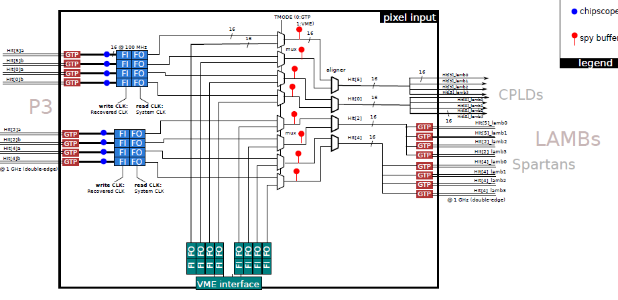
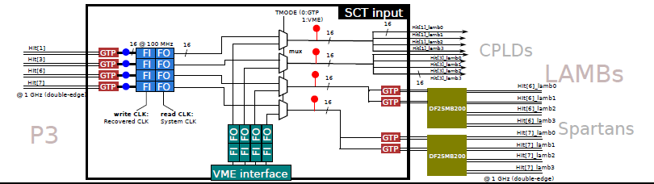
Spybuffers
INPUT
FPGAs

Slide 6
Spybuffers
Data flow
Dual port “circular” memory
In case of error we stop writing memory (freeze condition)
And we can read memory and status register by VME
Copy of data
Write pointer
Freeze: check that the event involved in the error is totally processed and than generate the freeze to all AMBFTK FPGAs. Send Freeze upstream.
Status register

Slide 7
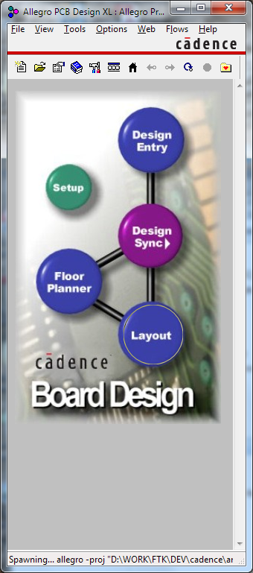
CADENCE tool
Cadence version: 16.5
Schematic entry: Allegro design entry HDL
PCB: Allegro PCB design

Slide 8
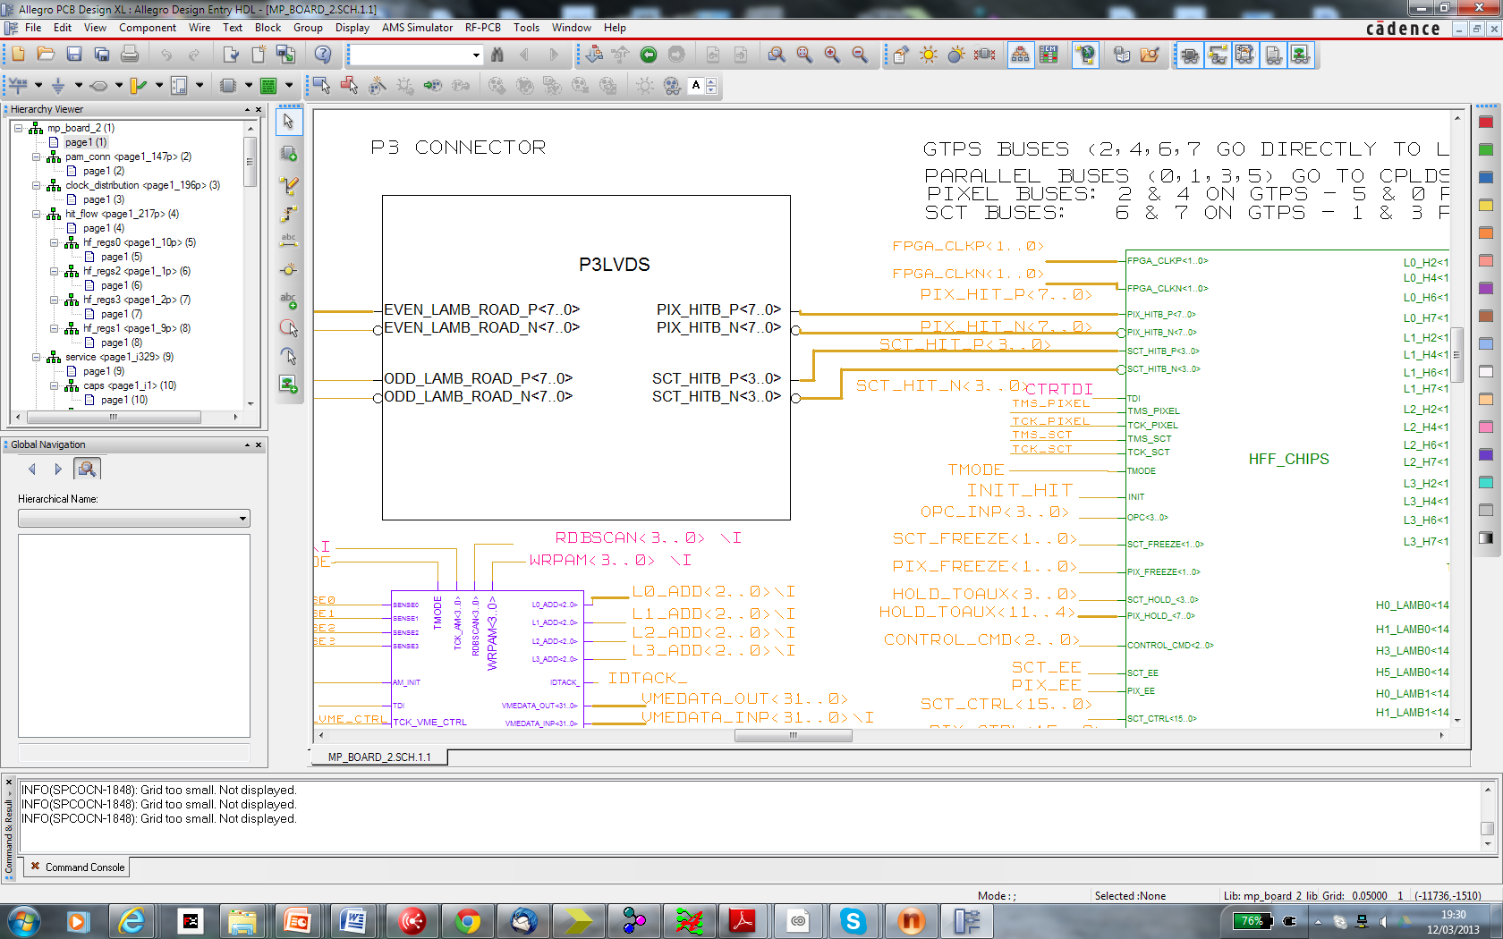

Slide 9
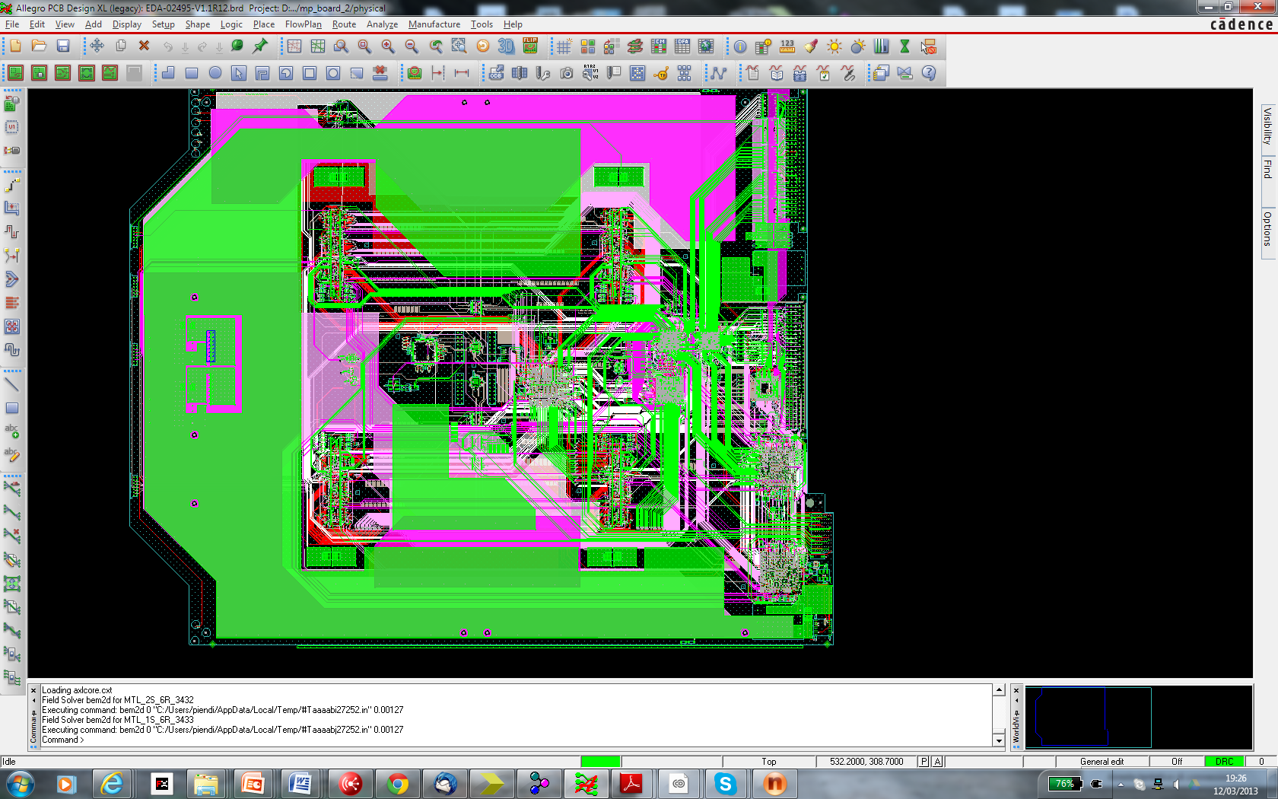

Slide 10
Backup

Slide 11
Error detection
Lost sync error: we have to check that all the EE word have the same event tag
Input fifos
FPGA logic

