Slide 1
FTK crates, power supplies and cooling issues
Racks, crates and PS: requirements
Wiener crates
Rittal crates
Mixed crates
Cooling tests and first results
Next steps

Slide 2
FTK racks
Core racks (5 to 7)
Detector
hits to FTK
core crates
FTK tracks
to FTK ROSes
DF #2
FTK core
#2
FTK core
#8
S-Links from Pixel and SCT RODs
DF #1
DF #3
FTK core
#1
FTK core
#7
FTK ROD
+ test brds
FTK tracks
to FTK RODs

Slide 3
Example of a core Crate
Power limit for the single crate: 5kW
Hits from DF
Pix+axial SCT
Stereo SCT
hits from DF
VME Controller
7layer tracks
EXS + TF + HW (Final)
AM04 + TSP(DC) + DO + TF + HW
AM06 + TSP(DC) + DO + TF + HW
AM07 + TSP(DC) + DO + TF + HW
EXS + TF + HW (Final)
AM08 + TSP(DC) + DO + TF + HW
AM09 + TSP(DC) + DO + TF + HW
AM10 + TSP(DC) + DO + TF + HW
AM11 + TSP(DC) + DO + TF + HW
EXS + TF + HW (Final)
AM12 + TSP(DC) + DO + TF + HW
AM13 + TSP(DC) + DO + TF + HW
AM14 + TSP(DC) + DO + TF + HW
AM15 + TSP(DC) + DO + TF + HW
EXS + TF + HW (Final)
AM00 + TSP(DC) + DO + TF + HW
AM01 + TSP(DC) + DO + TF + HW
AM02 + TSP(DC) + DO + TF + HW
AM03 + TSP(DC) + DO + TF + HW
AM05 + TSP(DC) + DO + TF + HW
11 layers FTK tracks
Extrapolate to SCT stereo + 11-layer fits + removal of 11-layer fit duplicates
FTK Output tracks
to FTK ROD
7-layer (3 pixel + 4 axial SCT) AM + fits
1 η−φ
tower

Slide 4
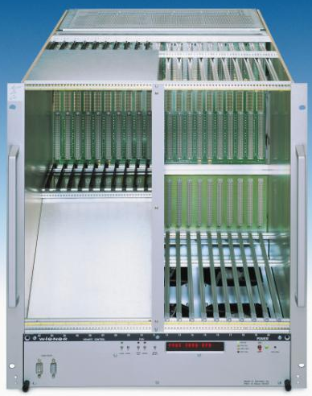
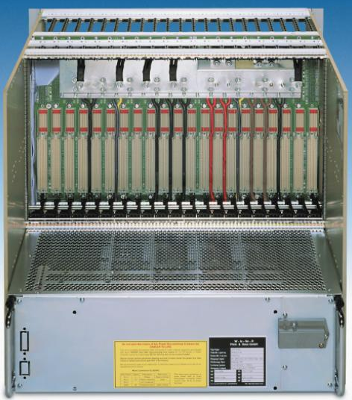
Crates
Requirements:
9U with VME64X backplane with 21 slots
power supply (PS) with 48V@81A, 3.3V@115A, 5V@115A (5kW) -> PS must be customized
rear card cage up to 28 cm deep for the AUX boards
For good cooling of AUX boards, the PS must be placed externally to the bin
We need four 48V pins on the VME backplane, in order to deliver the full necessary current. We decided to use the V1 and V2 power pins and their returns, V1ret and V2ret. The 48V ground is connected to the common ground
Commercial crates on the market:
Wiener is at present the main producer of VME64X 9U crates, available in two versions: 6021 and 6023.
In the past, Rittal USA produced VME 9U crates for CDF. Some of them are available
Constraints of Wiener crates:
3U PS(UEP6021) is only 3kW, 6U needed to extend to 6kW with 48V@81A
6023 is 12U high, while 6021 is 11U. In order to fit the ATLAS standard 52U rack with three crates, model 6021 is preferred
Cost!!
Wiener VME64X-9U 6021

Slide 5
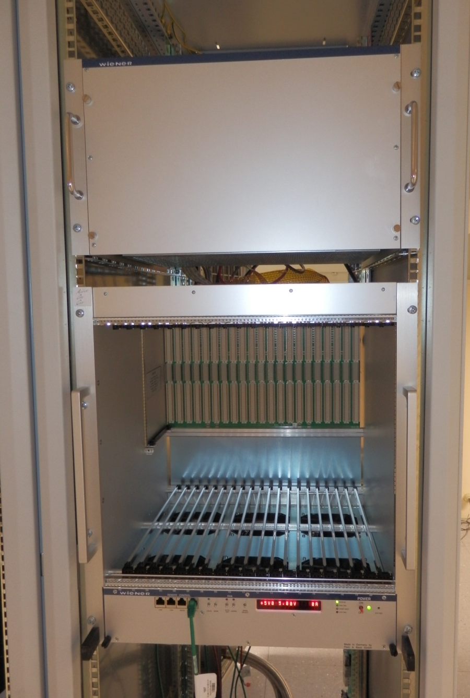
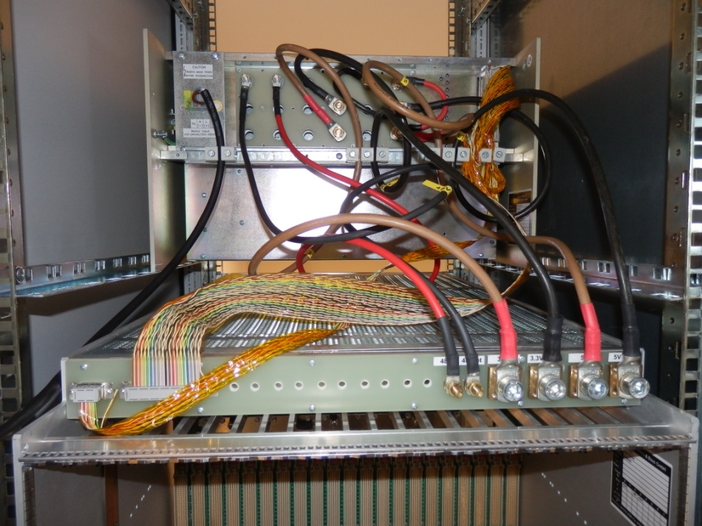
Wiener crates
One Wiener crate was installed last year at Cern. It is composed of a standard bin + fan unit, and a special PS (PL 500 customized) . The total height, including the heat exchanger in between PS and bin not yet installed, is 18U. The PS was properly customized and can deliver 3.3V @115A, 5V@345A and 48V@81A. The big current on the 5V is due to the original CDF AMBoard requirements

Slide 6
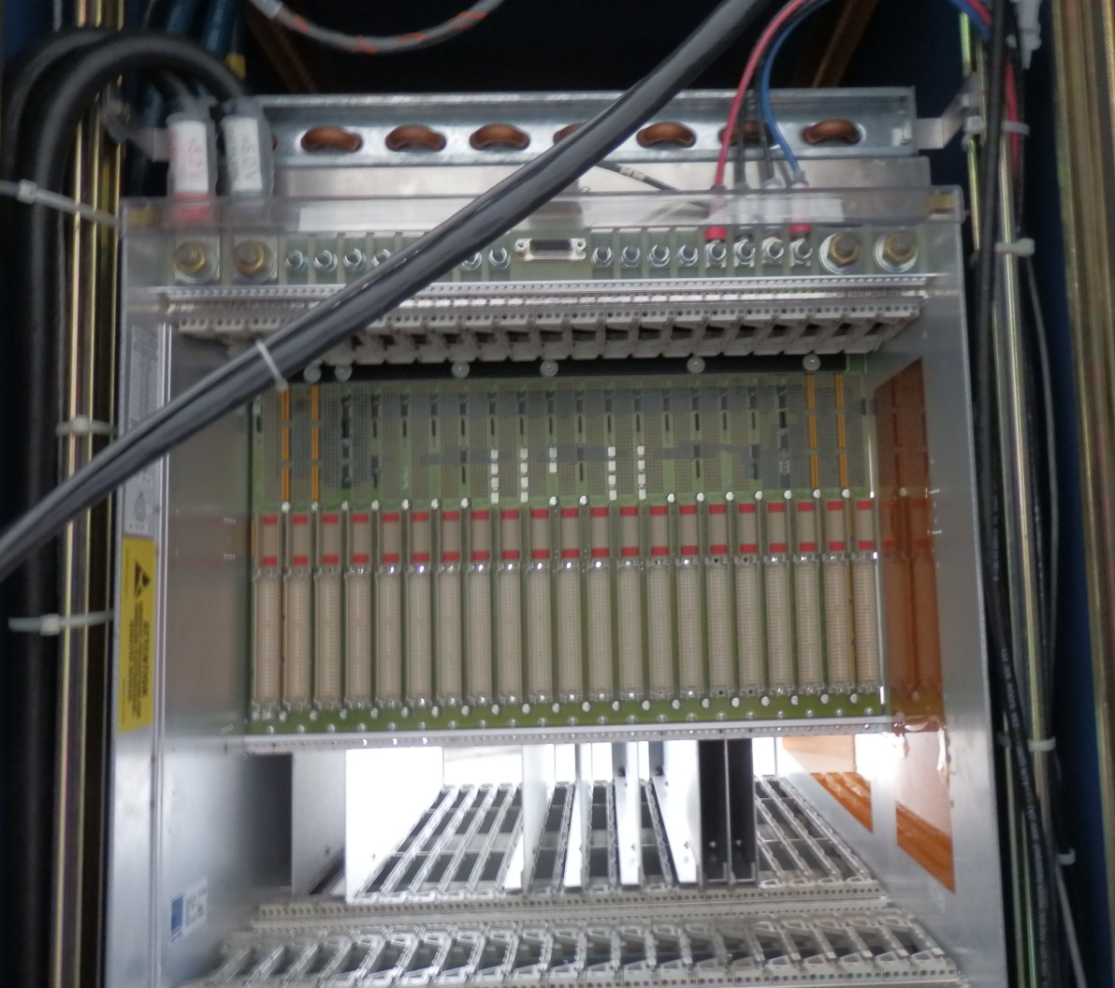
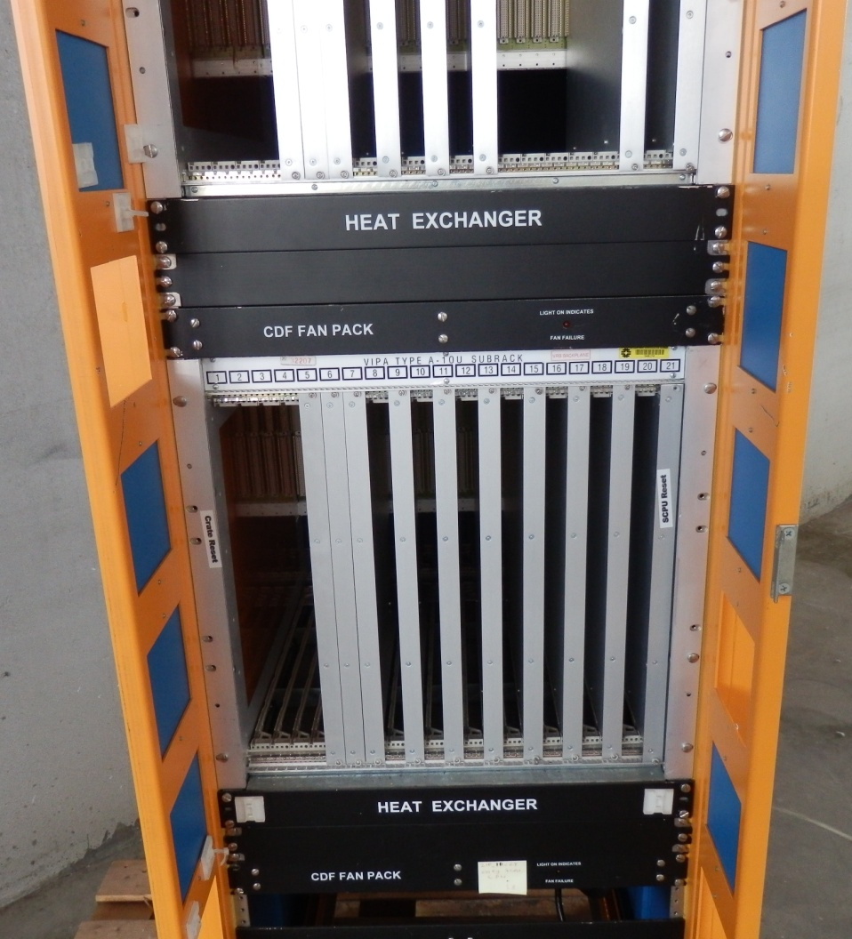
Rittal crates (CDF)
Used in CDF and very old (and dirty). Their PS must be replaced (not compliant) and the fan unit must be modified (working at 115 VAC). The original 5V PS was rated at 315A

Slide 7
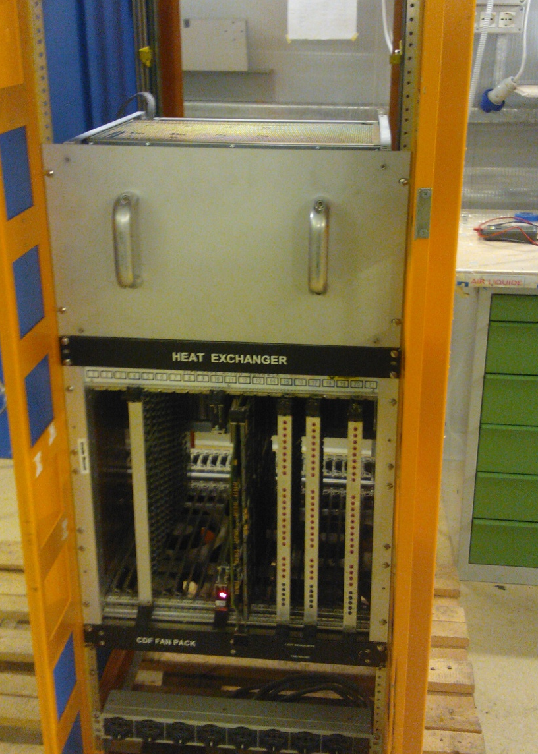
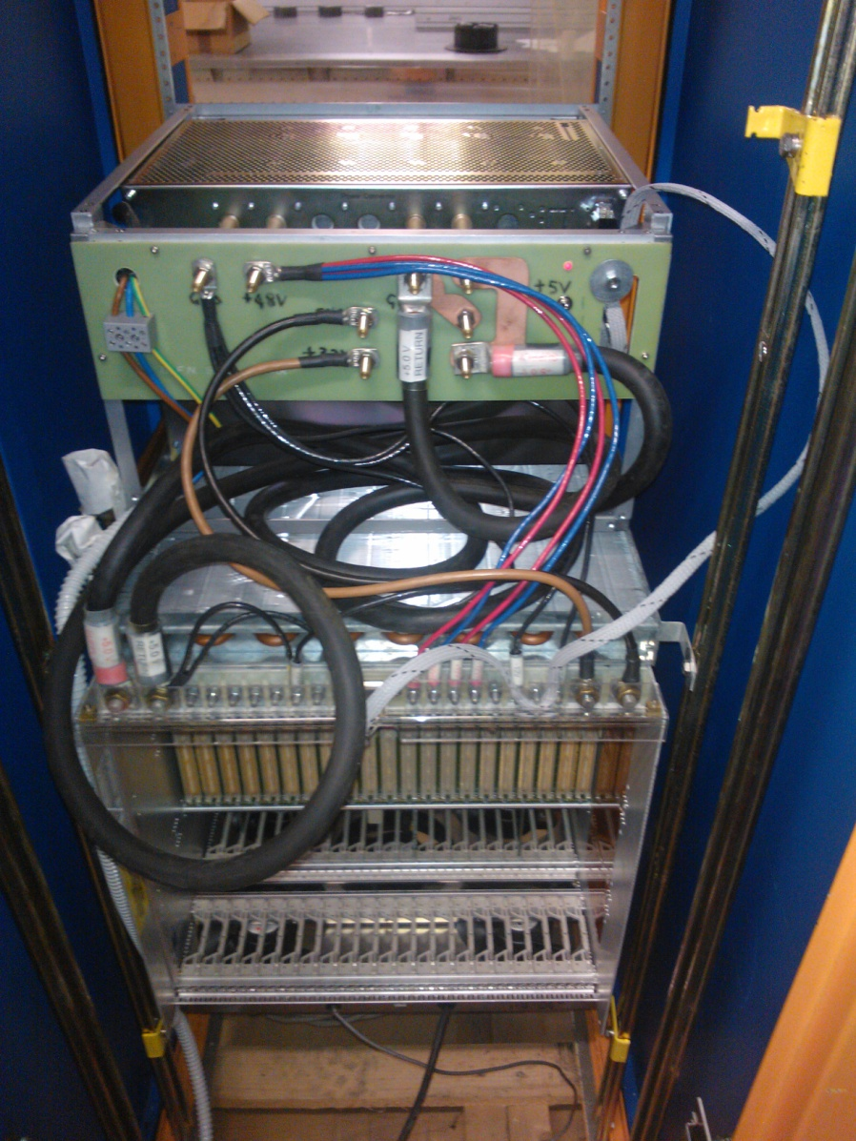
Mixed crates
We are now testing a mixed crate composed of the Wiener PS (same as installed at Cern) and of the CDF bin, heat exchanger and fan unit, properly modified to allow operation with 230 VAC. PS cabling is quite chaotic because of the huge and heavy CDF cables on the 5V@345A

Slide 8
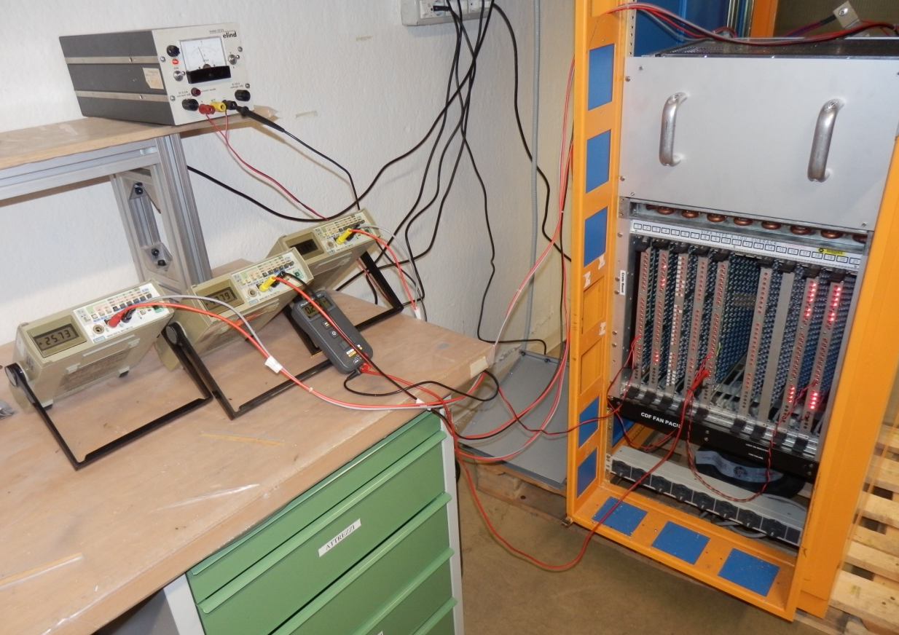
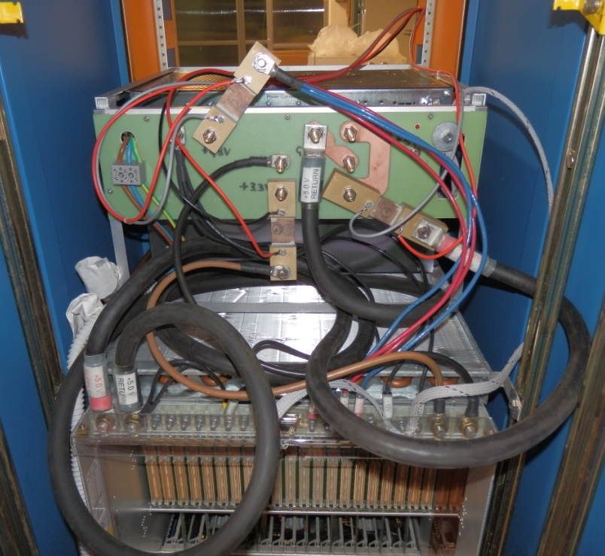
Cooling test setup
The setup is based on the mixed crate described before. Three shunts were added to the PS for reading out currents. Shunt voltage drops are displayed by three voltmeters. The load is composed of nine (at the moment) load boards, detailed in the next slide.
Three load boards are equipped with 4 T sensors each, supplied by and external power supply and read out by a multimeter

Slide 9
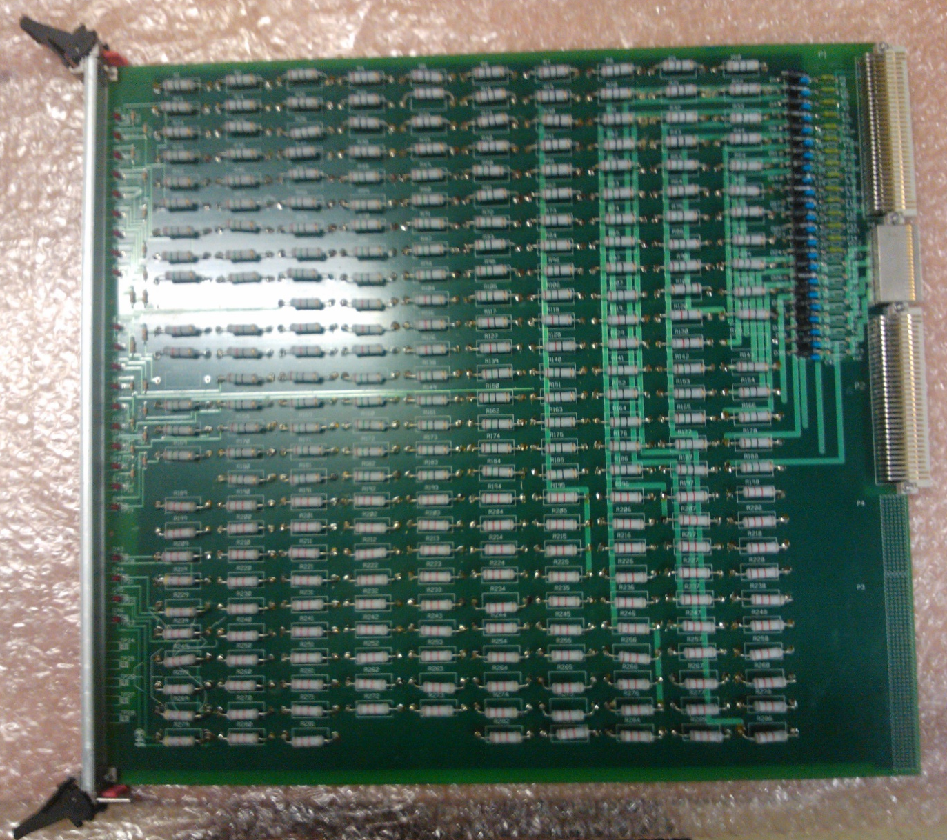
Load boards
They were produced by CDF. Current load is composed of various resistor banks supplied by the 3.3V, 5V, ±12V, V1 and V2.
V1 and V2 were properly modified to allow their use with the special 48V.
Resistor banks can be connected or disconnected by means of fuses placed close to the VME connectors.
Three load boards were modified inserting T sensors at the four corners

Slide 10
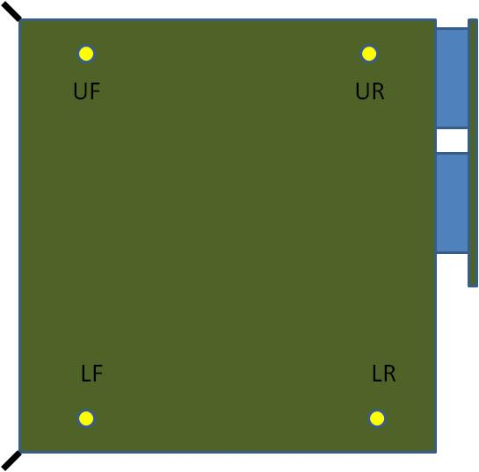
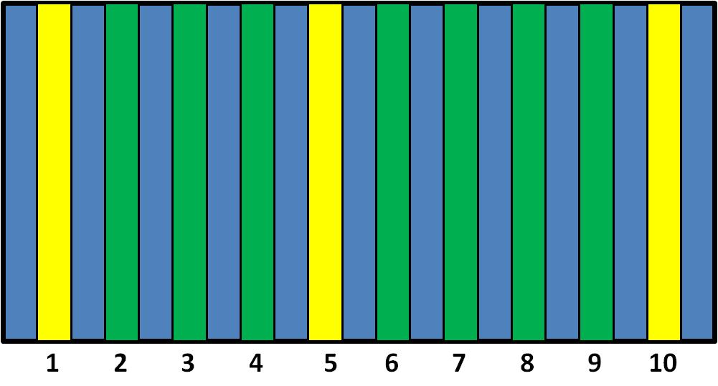
Layout of load boards
Load boards are installed into the crate as shown in the below picture at the left, occupying positions from 1 to 10. The three of them in positions 1, 5 and 10 are equipped by T sensors, placed in the four corners of each board as shown in the right picture.
The first cooling tests were performed with 4, 7 and 9 boards, placed respectively in positions 1, 5, 9 and 10 (first test); 1, 2, 4, 5, 6, 9 and 10 (second test); 1, 2, 3, 4, 5, 7, 8, 9 and 10 (third test)

Slide 11
First results
First test with only 4 loads reached 1.3kW. T on the Loads 1, 5 and 10 are plotted here ->
The max T was recorded on the load 5, lower front sensor (46.2 °C), but on average T were quite low.
Second test used 7 loads and reached 2.2kW. On average there is a T increase of about 6-7 °C.
The third test used 9 boards and reached 2.7kW. The T increase is quite moderate, at the level of 2-3 °C

Slide 12
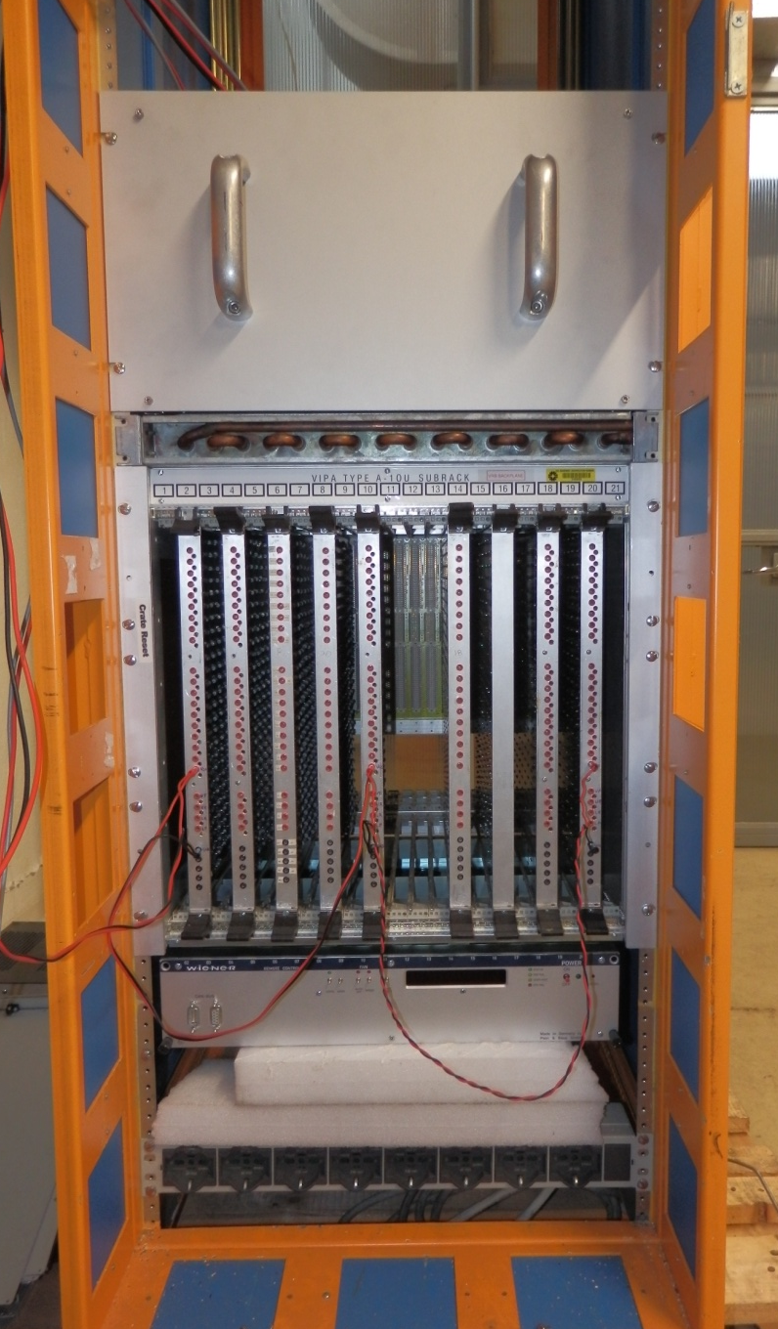
Next steps
1 – Power dissipation must be increased up to 5kW. This will require to install some additional loads (available) and probably to add some resistor banks to the 48V
2 – T sensor coverage must be extended to the central regions, adding there a couple of them, and other loads need to be equipped with sensors
3 – A standard Wiener fan unit, with 6 fans, is available and it can be compared with the CDF unit. At the moment we are not able to switch on this unit, help of Wiener was required. This fan unit equipping the crate under test is visible in the picture

Slide 13
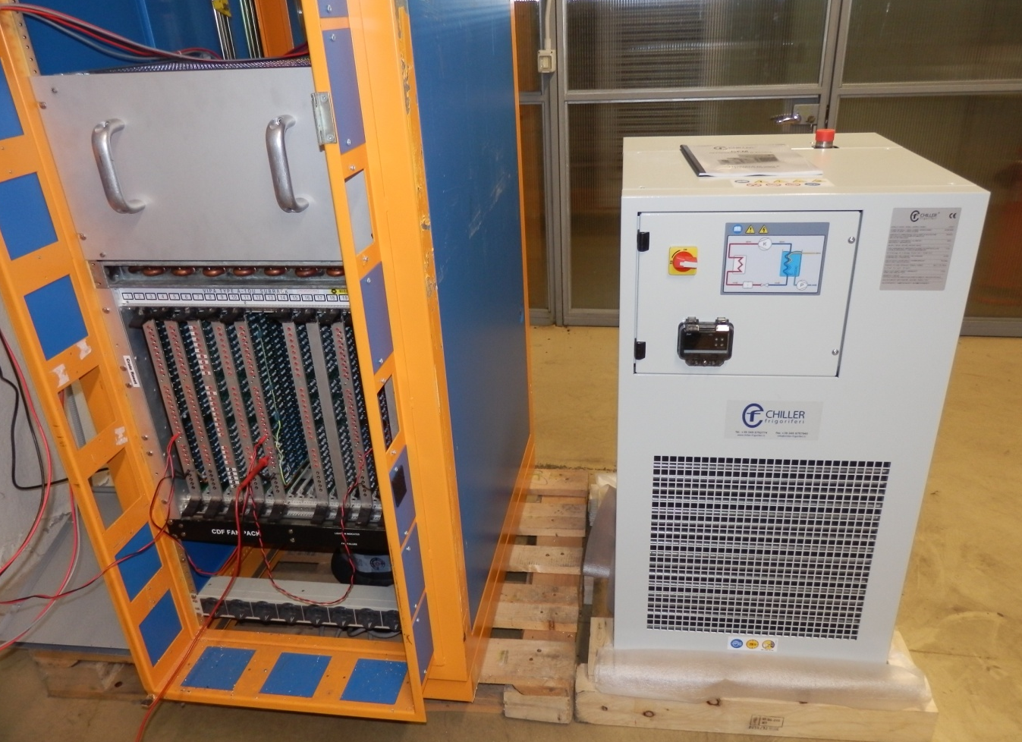
Next steps – cont’d
4 – Read/write accesses to an AMBoard can be performed using a VME CPU (VP110). Hardware is available
5 – A chiller is ready to connect to the heat exchanger, realizing a system fully compatible with the Atlas ones. This should the test with the final conditions

