Slide 1
IAPP - FTK workshop – Pisa 11-15 march, 2013
AMboard HW & FW
Marco Piendibene – University of Pisa & INFN

Slide 2
Outline
Associative Memory Board for FTK (AMBFTK)
Hardware description AMBFTK
Firmware implementation of AMBFTK
Evolution of the board: serial link processor (AMBSLP)

Slide 3
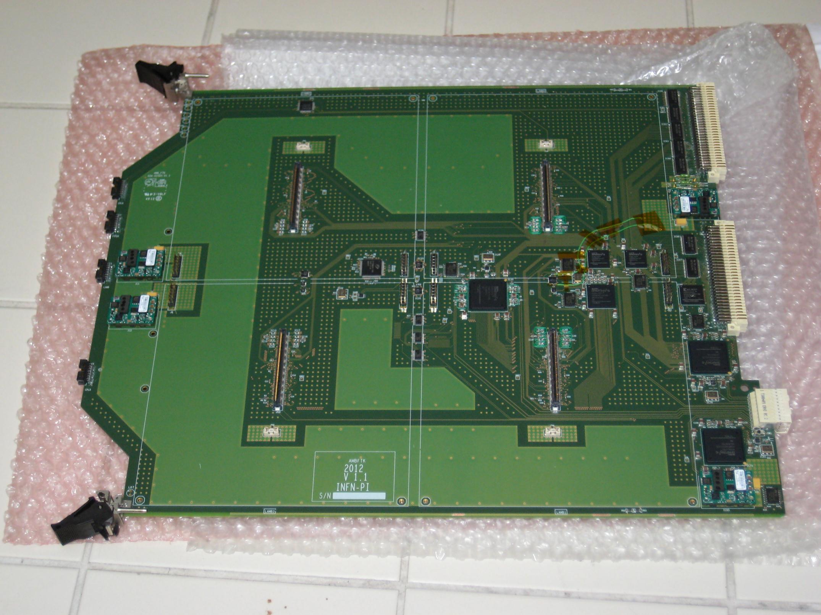
AMBftk
EUROCARD 9U
(400mm x 360mm)
CONTROL FPGA
CLOCK DISTRIBUTION NETWORK
100 MHz, lvds, ttl
ERNI high speed connector (data I/O)
INPUT FPGAs
Direct connection to AUX card
(no backplane)
OUTPUT FPGAs
Custom shape for placing the dc-dc converters

Slide 4
AMBftk
VME connectors
(power, configuration, debug)
LAMB connectors
JTAG connectors
VME slave
Bottom side: cpld for parallel buses (refresh)
VME data fan out
LAMB connectors

Slide 5
AMBftk
48V, 3.3V
(from vme connector)
4 dc-dc converter 48 to 1,2V (25 A each)
Lamb power connectors

Slide 6
AMBftk
White lines: parallel distribution
Red lines: serial distribution, 2Ghz
4
12
8
12 input serial links @2GHz
4 Layers (SCT) on 4 serial links
4 Layers (PIXEL) on 8 serial links
=> 12 input serial links

Slide 7
AMBftk
4 serial link per LAMB, total 16 output links
blu lines: serial connection, 2GHz
16
16 output serial links @2GHz

Slide 8

FPGA on the board: XILINX
Input FPGAs: Xilinx Spartan6 with Low Power Gigabit Transceiver (GTP) xc6slx45T / xc6slx75T
Output FPGAs: Xilinx Spartan6 with Low Power Gigabit Transceiver (GTP) xc6slx75T
Control FPGA: Xilinx Spartan6 (xc6slx16)
VME slave FPGA: Xilinx Spartan6 (xc6slx16)
VME data fan out: XILINX CPLD
GTP: Ultra-fast data transmission between chips, over backplanes, or over longer distances
Power distribution : each Lambs needs a lot of power: 25A @ 1.2V
High speed on PCB => signal integrity issue

Slide 9
AMBFTK: firmware (Input FPGA)
Simple logic
GTP implementation to receive data from AUX card
GTP implementation to send data (for half of the buses) to LAMBS
Temporary buffers to store data (FIFO)
Diagnostic/debug tools (spybuffers)
xc6slx45T / xc6slx75T
Parallel distribution
GTP
From AUX card
To Lambs
fifo
GTP
Serial distribution
spy

Slide 10
AMBFTK: firmware (Output FPGA)
Simple logic
GTP implementation to receive data from Lambs
GTP implementation to send data to AUX card
Temporary buffers to store data (FIFO)
Diagnostic/debug tools (spybuffers)
xc6slx75T
4 serial links
(LAMB0)
GTP
GTP
to AUX card (all serial links)
from Lambs
(all serial)
fifo
8 serial links
4 serial links
(LAMB1)
spy

Slide 11
AMBFTK: firmware (CONTROL FPGA)
Very simple State Machine (FSM)
RESET
Wait ee
Send_init_ev
Receive and distribute hits.
Collect roads and send them out to AUX card.
Wait end event from input and output fpgas (the previous event has been processed)
Send init event to fpga and Lambs
Generate INIT_event when: (a) EE is received by SCT, PIX and ROAD chips (4 signals)
Receive error (code & stream info) and generate an action (freeze or stopless-removal) comparing with Severity error
For Freeze: check that the event involved in the error is totally processed and than generate the freeze to all AMBFTK FPGAs. Send Freeze upstream.
Generate Operation Code to the LAMBs

Slide 12
AMBFTK: firmware (vme FPGA and fanout cpld)
The VME fpga implements the slave VME functions
Decode the incoming addresses
Send read/write instruction to correct fpga
Write configuration registers
Read status register
Configuration of the pattern banks (Amchips)
VM
E
B
A
C
K
P
L
A
N
E
VMEDATAINP
SCT
PIXEL
CONTROL
CPLD
LAMBS
VMEDATA
VMEDATA
REPEATER
FPGA
VMEDATAOUT
ROAD EVEN
ROAD ODD
xc6slx16
VMEDATA
VME INTERFACE
FPGA
VMEDATAAUX
AUX
CARD

Slide 13
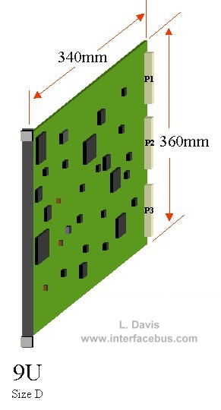
AMBFTK: actual PCB
400mm
9U eurocard (400mm x 360mm)
14 layers (6 routing, 8 power)
Minimum track widh/clearance: 3 mils (75 um)
Fineline BGA: 0,8 mm pitch
Smallest package: 0402

Slide 14
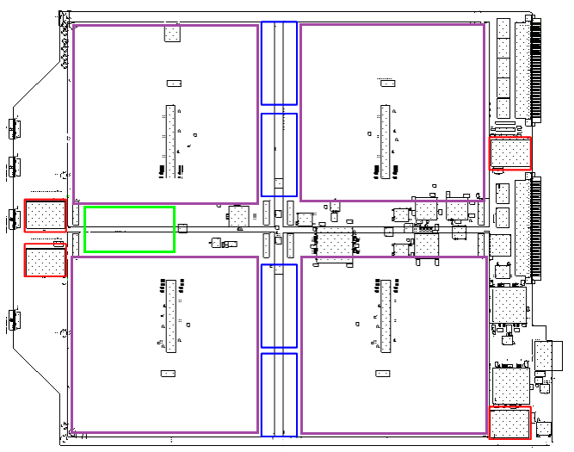
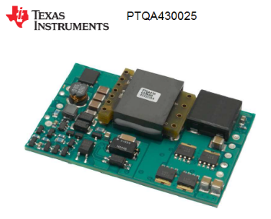
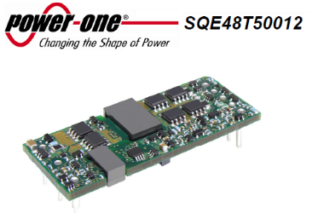
AMSYSTEM:AMBSLP, the new amboard for amchip05
- Bus distrubuted all serially
Power:
1,0V AMchip & FPGA cores
1.2V AMchip IP core
2.5V I/O
New Lambs dimension

Slide 15
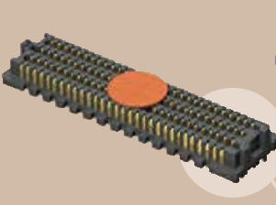
AMSYSTEM:AMBSLP
Power:
From 48V? How many pin?
40 A per Lamb @1.0 V – dc-dc converter
1.2 V for AMchip IP.
Where? From 2.5V? On the Lamb?
2.5 V
connector LAMB/AMboard
Samtec connector

Slide 16


