Slide 1
IAPP - FTK workshop – Pisa 11-15 march, 2013
FTK and the AM system
Marco Piendibene – University of Pisa & INFN

Slide 2
Outline
FTK: introduction
  where it is
  pattern matching
FTK: global architecture
The AM system
  the boards (AMB, LAMB)
  the AMchip
Evolution of the AM system
Evolution of FTK

Slide 3
FTK introduction

Slide 4
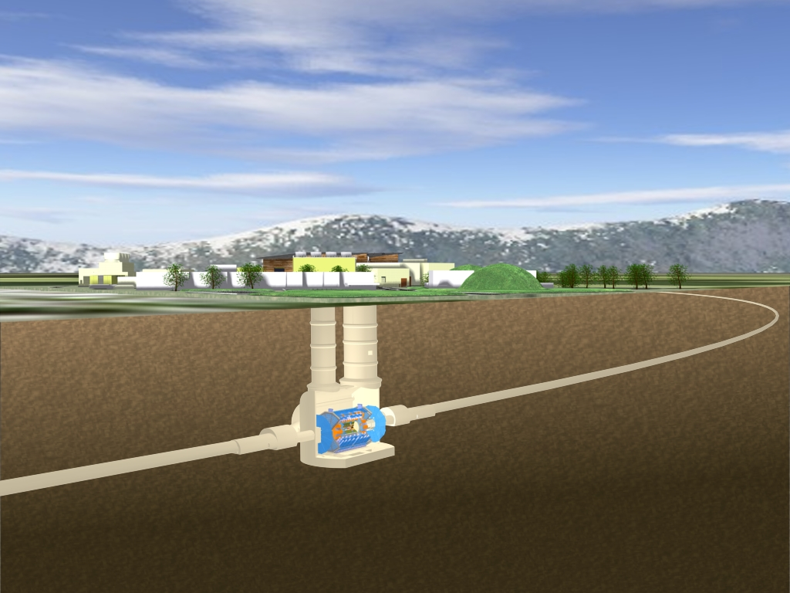
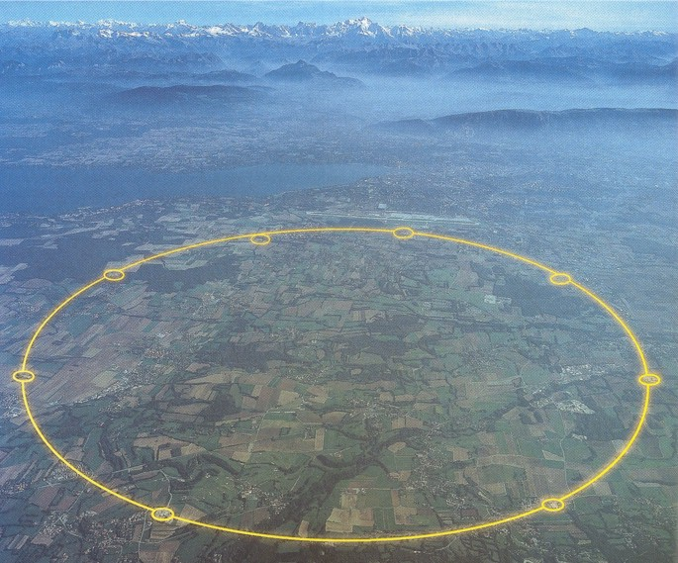
FTK: LHC
ATLAS (point 1)

Slide 5
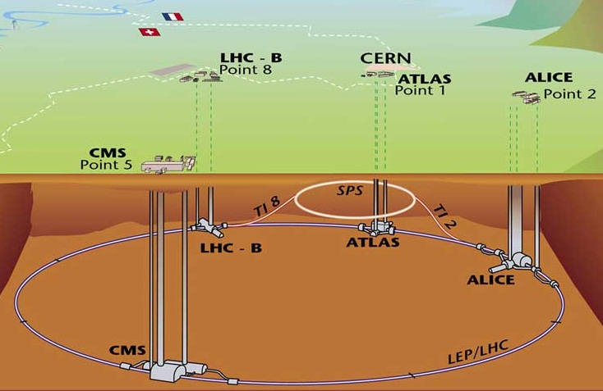
Large Hadron Collider
D= 8.5 Km
20 MHz

Slide 6
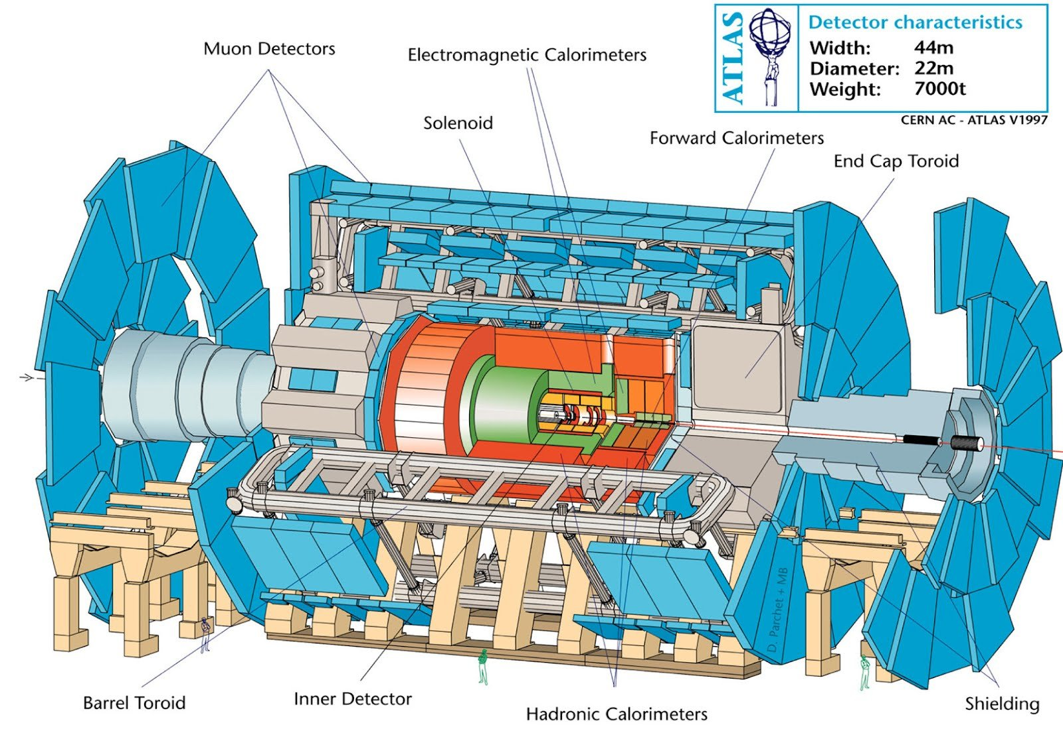
Atlas: the detector

Slide 7
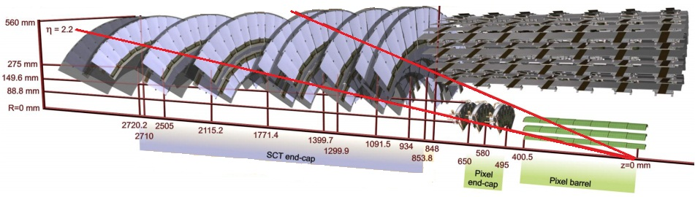
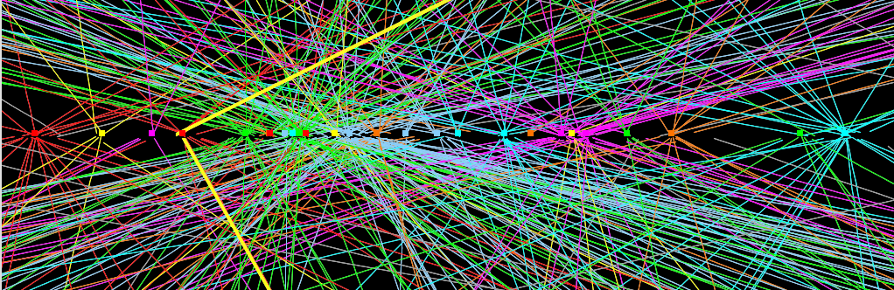
FTK: LHC
  Silicon sensor (Pixel e Microstrip); 100.000.000 channels.
  Reconstructs the trajectory of charged particles.
  Hundreds of particles per collision.
  Sensor output data: ~1.5 Mbyte per collision (20 MHz).

Slide 8
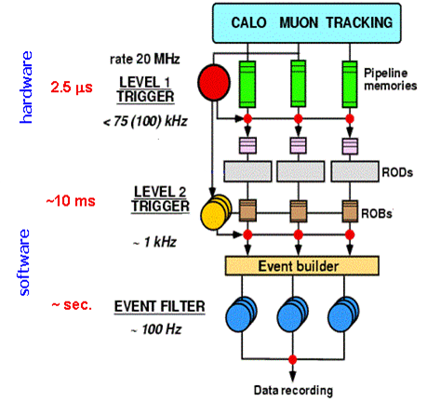
Atlas trigger system: where is FTK?
We need to reduce the amount of data
Atlas 3 levels trigger
FTK
FTK is an hardware system to reconstruct the particles tracks
FTK gives tracks information to Level2 trigger.

Slide 9
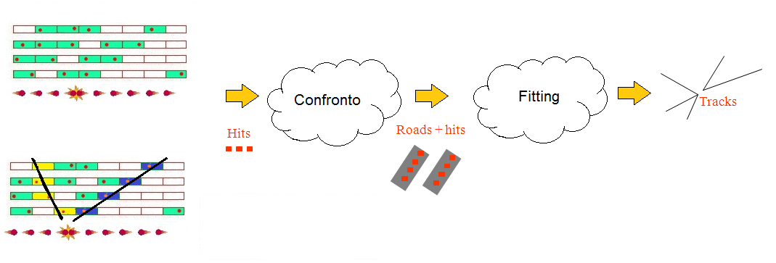
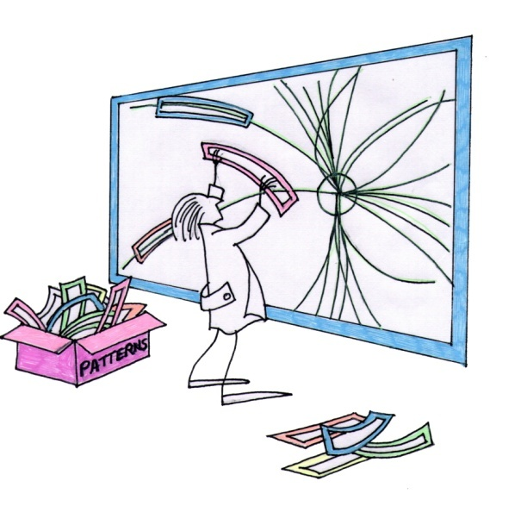
Fast TracKer processor (FTK): pattern matching
comparison
Road = candidate track
The pattern matching compares the event with ALL the candidates tracks stored in a local memory (Pattern Bank).
The pattern matching can be very fast for online track reconstruction thanks to the Associative Memory (AM) parallelism

Slide 10
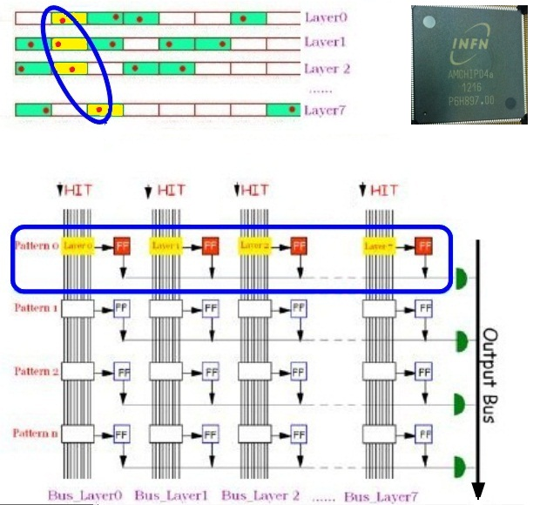
Associative Memory
In each row is stored a ROAD
data from different layer arrive to different columns
Programmable matching threshold

Slide 11
FTK global architecture

Slide 12
Atlas trigger system: where is FTK?
We need to reduce the amount of data
Atlas 3 levels trigger
FTK
FTK is an hardware system to reconstruct the particles tracks
FTK gives tracks information to Level2 trigger.

Slide 13
FTK global view
16400 AMchips
~2000 FPGAs
Thousands of serial links
AMBoard
8 VME core crates
SSB: Final Fit-HW
ATCA
ATCA
4 DOs
4 TFs
4 HWs
~80 FTK_IM: Clustering in parallel
32 DF: cross-point for clusters -
ROS
>300
ROLs
AMBoard
4 DOs
4 TFs
4 HWs
32
boards
FLIC: FTK-to-Level-2 Interface Crate
RODS
128 PUs =
512 pipelines
ROS
SSB: Final Fit-HW
AMBoard
PU
To
TDAQ
ROS
4 DOs
4 TFs
4 HWs
Board-board
Connector
AUX CARD
fibers

Slide 14
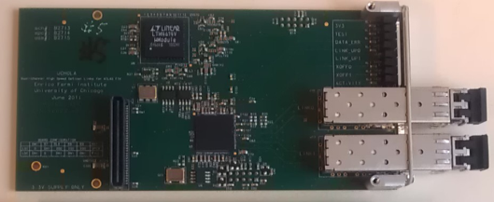
Dual-output HOLA (U. of Chicago)
ATCA
~80 FTK_IM: Clustering in parallel
32 DF: cross-point for clusters -
Sends SCT & pixel data to DAQ & FTK.
All required boards produced and tested.
32 boards installed at P1.
More SCT RODs→ produce 40 more HOLAs.
IBL RODs have it built in.
  We will pay for ½ of the QSFPs.
RODS
To
DAQ
ROS

Slide 15
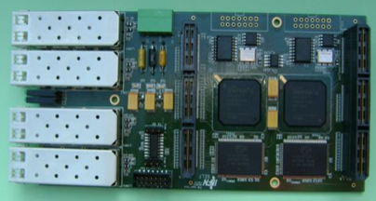
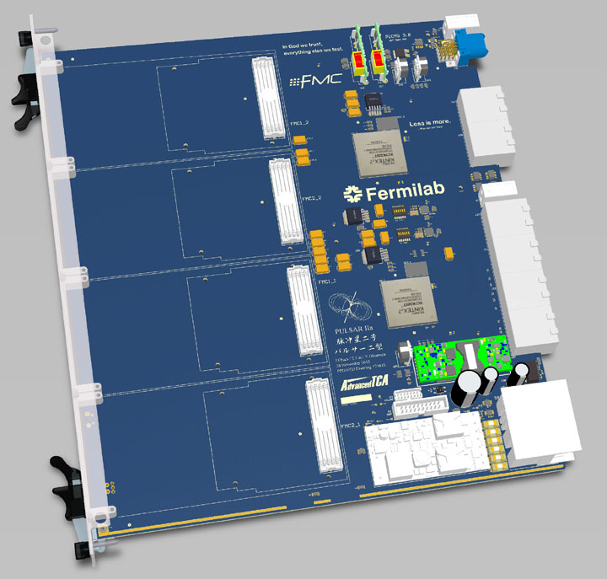
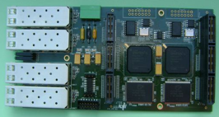
Data Formatter (DF - Fermilab)
FTK input mezzanine
(FTK_IM Frascati &Waseda)
4 FTK_IM/DF receive ROD’s data and do cluster finding.
Prototypes produced, tested, and used @P1.
Few changes needed for DF compatibility.
Final Production after tests with IBL BOC (summer)
ATCA
32 DF: cross-point for clusters -
~80 FTK_IM: Clustering in parallel
Distributes found clusters to 64 FTK η-φ towers. ATCA for complex fiber-to-tower mapping.
Designed and being manufactured.
First task: test high speed serial data transfer and ATCA control functionality. Firmware being written.
RODS
>300
ROLs

Slide 16
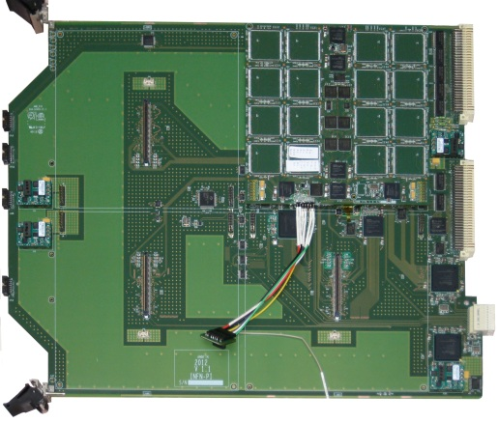
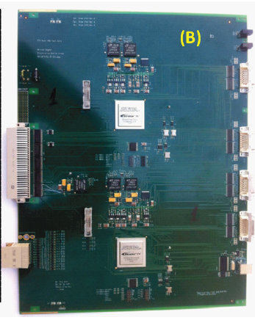
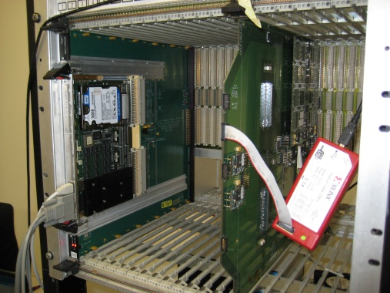
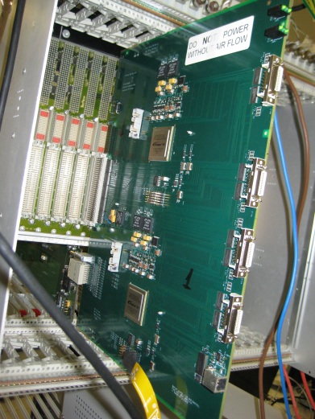
FTK Processor Unit (PU)
SSB:
Final Fit-HW
(a)
Proto
AUX
Crate: front
DF
AMBoard
128 PUs do pattern matching and the 1st stage track fitting.
A PU consists of an Associative Memory VME board (a)(AMB-Europe) and a large Auxiliary Card (b) (AUX-UoC) behind it.
Crate: back
AMBoard
PU
4 DOs
4 TFs
4 HWs
AUX
CARD
We have tested them together
in the Pisa test stand

Slide 17
Remember: 128 PU in term of AM system means:
128 Amboard
128x4=512 LAMBs
512x32 =16384 Amchip
...and thousand of FPGA

Slide 18
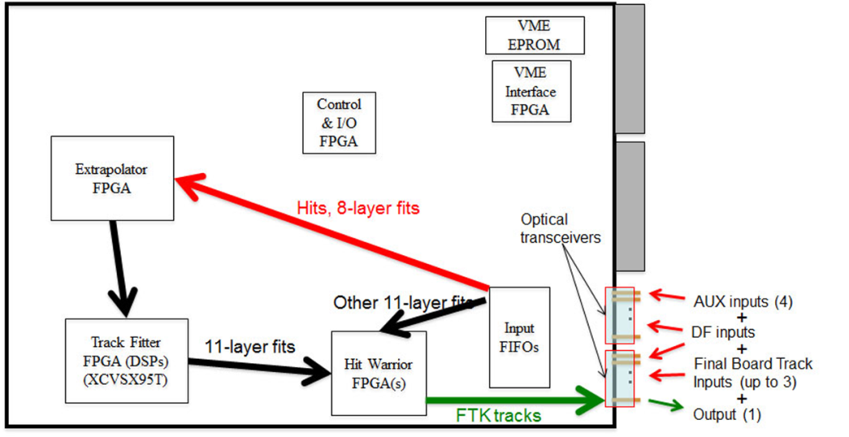
Second Stage Board (SSB-University of Illinois)
AMBoard
PU
8 layer tracks
+ Hits
4 DOs
4 TFs
4 HWs
3 missing layers
DF
FLIC
SSB: full 11-layer fit: (a) receives 8-layer good tracks from the PU (b) find hits in the missing 3 silicon layers, (c) fit tracks with 11 lay, (d) removes duplicates.
basic firmware functions written, testing in progress.
After that, board design will be finalized.
An engineering review is planned for late March or early April, with a prototype to be built shortly after.

Slide 19
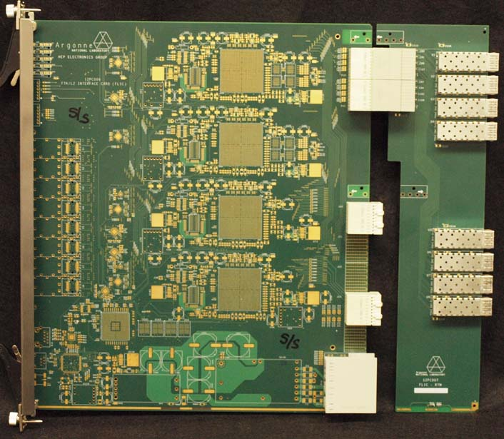
FTK-to-Level-2 Interface Crate (FLIC-Argonne)
SSB:
Final Fit - HW
ROS
FLIC sends tracks to ROS’s
ATCA favors communication for global functions like primary vertex finding.
As with the DF, an early prototype is needed to start exercising the new (to us) ATCA standards.
first prototype board is now being loaded.

Slide 20
The AM system
(Associative Memory system)
Definition:
AMboard, AMB, AMBFTK, …
Lamb, LambFTK, …

Slide 21
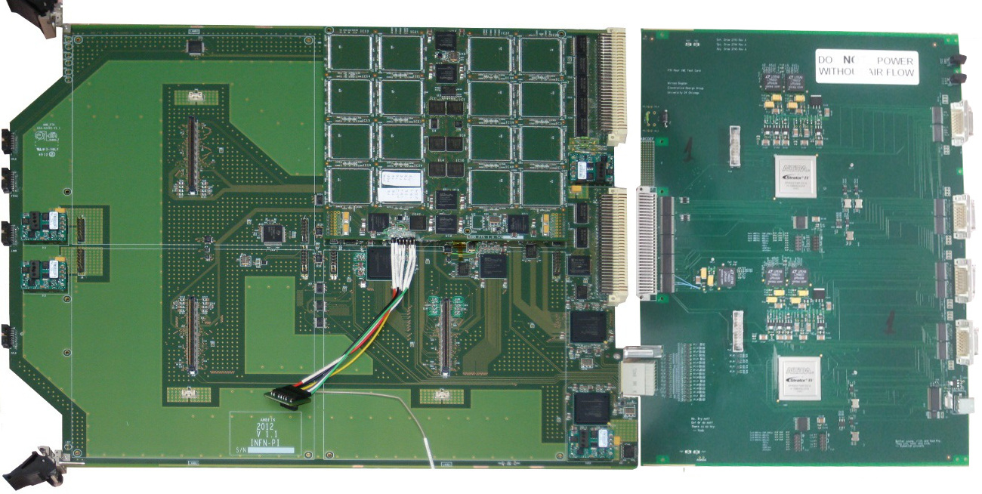
Processing unit:
LAMB-FTK
AUX-Board
Tracks
Track fitting
(first stage)
Pattern matching
Hit
AMB-FTK
Erni connector
AM system: Amboard + Lamb + Amchip
FTK:128 “Processing Unit”.
Each Processing Unit: 128 AMchip for a total of 8 milioni di pattern.
=> Each HIT has to be compared with 8 million patterns inside the PU !

Slide 22
AM system: data path
HITS
8x15 bits
(serialized)
Each HIT has to be compared with 8 million patterns inside each Amboard

Slide 23
AM system: data path
ROADS

Slide 24
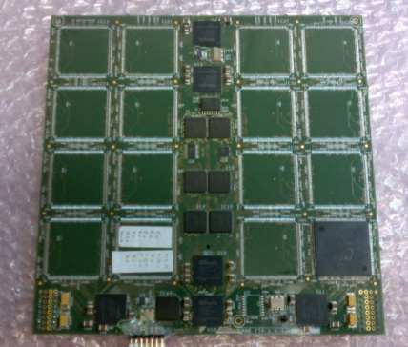
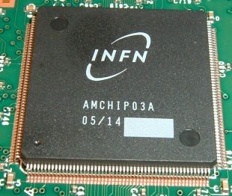
AM system: actual system (data distribution)
AMBftk
Input (HITS) received serially (from AUX card) but distrubuted half serially and half in parallel
Totally serialized outputs (ROADS)
3,3V for I/O
1,2V for cores (fpga and Amchips)
LAMBftk
Converts serial data in parallel (with fpga)
Distributes parallel data to ALL Amchips
Collect parallel Amchips outputs and convert them to serial
AMchip04
Needs parallel inputs, gives parallel outputs
LQ208 package

Slide 25
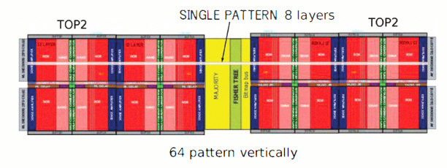
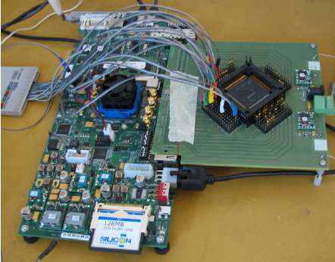

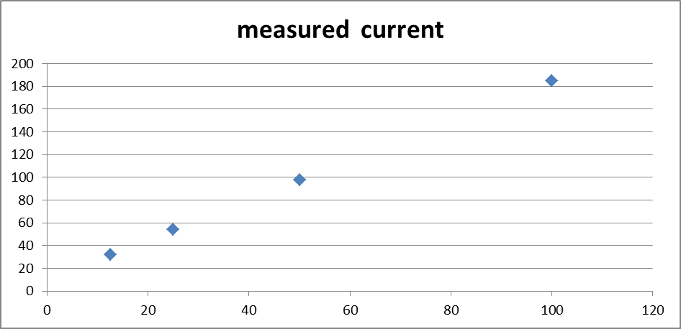
AM System: AM chip04: TMSC 65 nm (actual Amchip)
custom cell to reduce pattern size: 8k patterns in 14 mm^2.
Yield>80% - tests successful
64kpatt power consumption lower than AMchip03 (180 nm)
but slightly higher than desired.
mA
AMchip03 (5 kpatt): 1 A → 1,8 W
AMchip05 (64 kpatt): 1,45 A→ 1,7 W
expected 1,6 W
Extremely good result but
we would like to have
current/LAMB < 40 A
~180 mA
@100 MHz
46 A/LAMB
MHz - Clock frequency

Slide 26
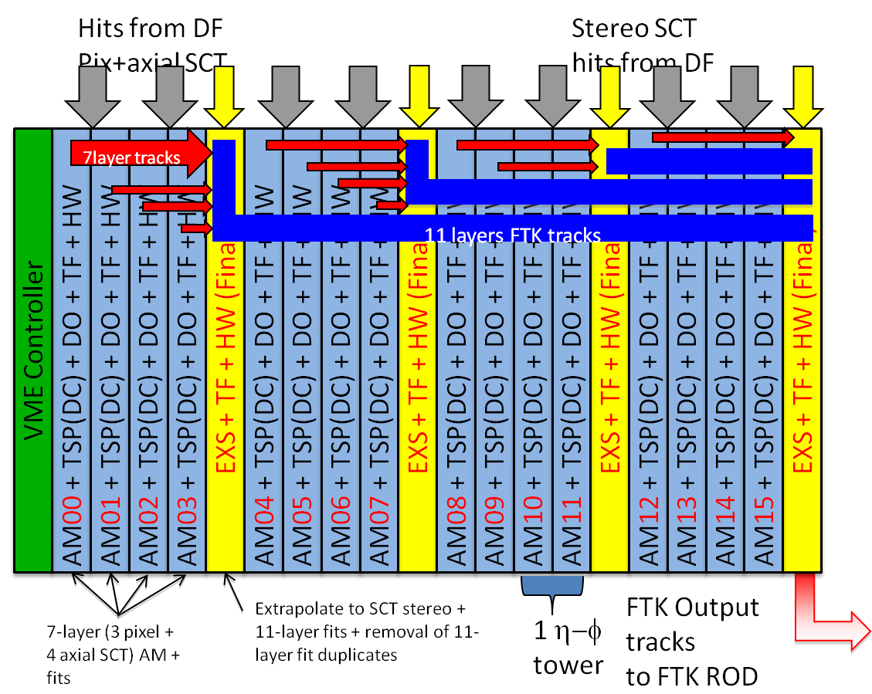
AM system: a lot of power..
AMBftk
Power > 200 W per AMboard!
16 AMboards per crate
(plus AUXcard, SSB, CPU)
Up to 4KW per crate
Cooling tests
Power supply tests

Slide 27
Evolution of the AM system

Slide 28
AM System: AM chip05: new package (BGA)
AMCHIP04
AMCHIP04: we have saturated all the pin of the LQ208 package
Incresing the current, we need more power pin…
Solution: AMCHIP05
AMchip05→ all buses serialized → recently purchased IP.
use 23x23 mm^2 BGA instead of LQ208
mini@sic → tape out March 2013.
32k or 64k patt chip → tape out Jan 2014.
For AMchip05 core down from 1.2 v to 1.0 v to reduce further the power.
BGA

Slide 29
AM System: new AM chip05: FLIPCHIP BGA
BGA with Flip chip technique:
high frequency solution for 2.5 Gb/s links
Caps included in the package to be able to solder BGA on both sides (32 BGA/LAMB)
(3) Possibility of multi-packaging
(4) AMchip05 more expensive than expected (IP, flip chip BGA, multipackaging)
INFN budget insufficient → the AM system try to become EUROPEAN

Slide 30
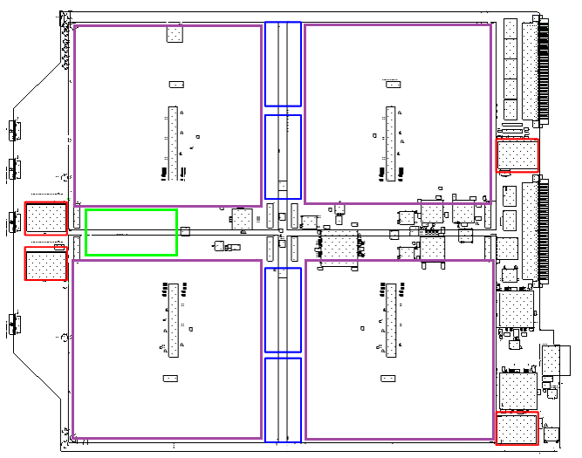
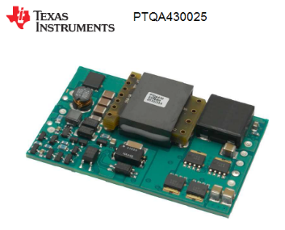
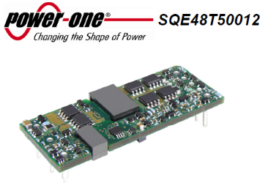
AMSYSTEM:AMBSLP, the new amboard for amchip05
- Bus distrubuted all serially
Power: 1,0V – 1.2V – 2.5V
New Lambs dimension

Slide 31
AMSYSTEM: a new LAMB for AM chip05: all buses on serial links
LAMBFTK: Challenging routing
New LAMBSLP:
Simplified
routing
FPGAs on LAMBFTK
LAMBSLP reduced size
no FPGAs

Slide 32
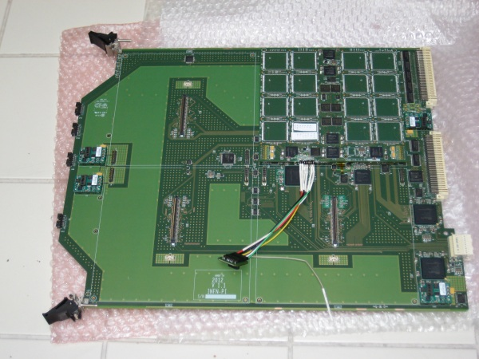
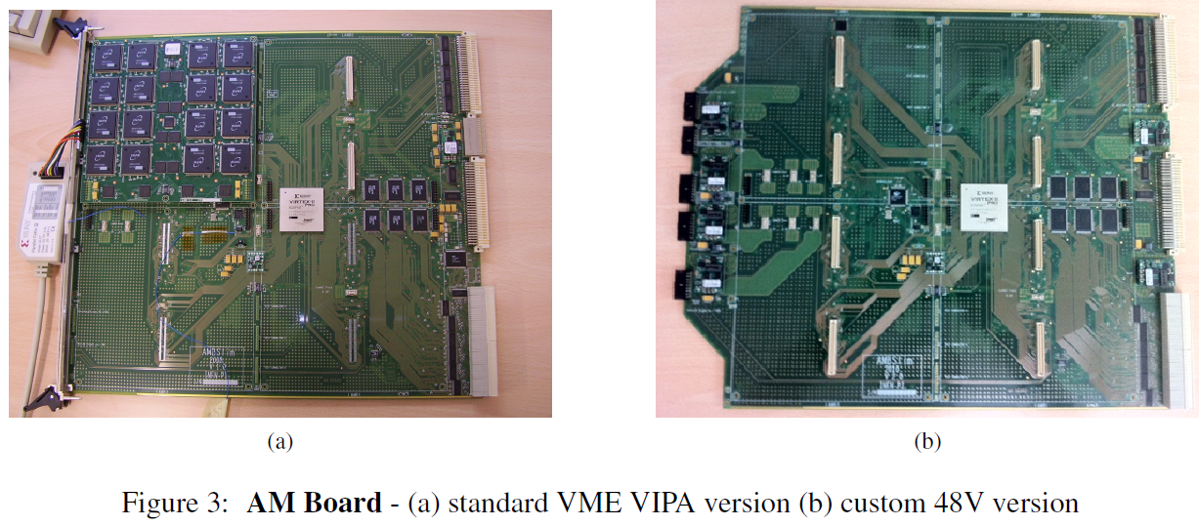
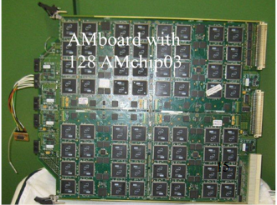
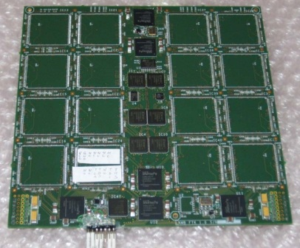
AM System: The story of AMB
AMBSLP
for AMC05 (Europe)
AMBslim5 64 AMC03
for Vertical slice
AMBslim5++ 128 AMC03
for cooling tests
AMBFTK for
AMC04(PI-MI-PV))
160 W @1
6 A @ 48 Volts
270 W@1,8 V
120 W @1,2
128 AMchip04s
128 AMchip05s
To be tested
In summer
2014
4 mezzanines (LAMB) with 32 AM chips on a AMB (128 Amchips/AMB)
Older version used in the vertical slice.
AMBFTK consistent with AMchip04 - tested with the Proto-AUX.
VME communication and the high speed serial links are OK.
New Serial Link Processor needed: AMBSLP and LAMBSLP

Slide 33
Evolution of FTK

Slide 34
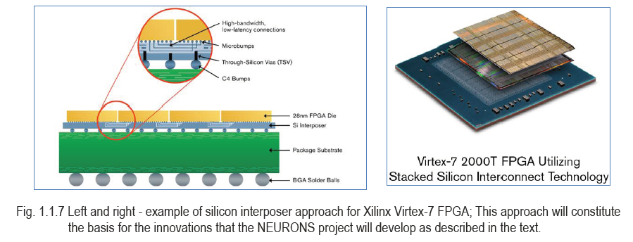
New Ideas for the future - FTK could become smaller and smaller
Multi-packaging FPGA & Amchip – mini FTK
Pattern matching
& track fitting (TF)
sqweezed in a
SIP (BGA 23x23)
TF highly parallelized
We have a very interesting quotation for FPGA bare dies to be packaged with AMchips
IMEC support for feasibility studies
FTK SIP (System In Package) becomes a real possibility – large impact on AM bank sizes

Slide 35
FTK miniaturization for long latency applications
Few future LAMBs could cover the whole detector if used for long latency applications (simulation-offline)
Goal: build a Lamb that can fit in a PC or can be accessed by a PC.
What about this size ?
FP7 IAPP - STREP PROGRAM
Coordinated by University of Pisa and INFN-Pisa
FTK

Slide 36
Backup
Backup

Slide 37
FTK vertical slice goals and status
Goals
  Use of old FTK prototypes to verify integration with ATLAS TDAQ
  Verify real data FTK output roads agree with FTK simulation
Status
  Data flow and integration tested up to 70kHz
  even with low SCT threshold sending huge "noise" events
  Cosmics run with FTK included for a few days
  Real bank loaded and decoding real data format active
  Simulation applied to real events with real bank ready
  Stopless removal is working
  Debugging problems that appears only with data
Results

Slide 38
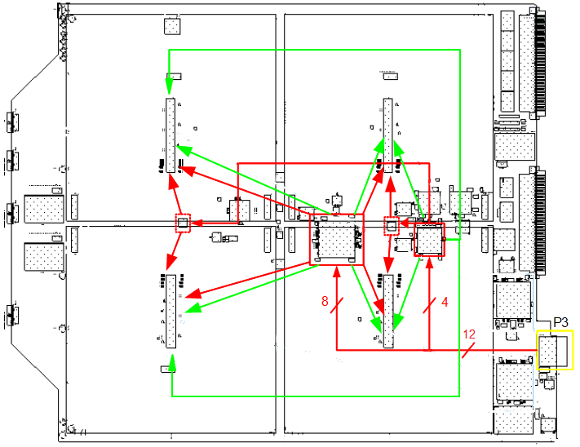
Prototipo AMB-FTK
Distribuzione dei dati:
  Formato Parallelo
  Formato Seriale
Interfaccia seriale FPGA:
  GTP I.P. Xilinx
  3.2Gbit/s
Scelta ibrida:
  Testare i link seriali
  Impossibile
  parallelizzare tutti i
  bus per ogni chip.

Slide 39
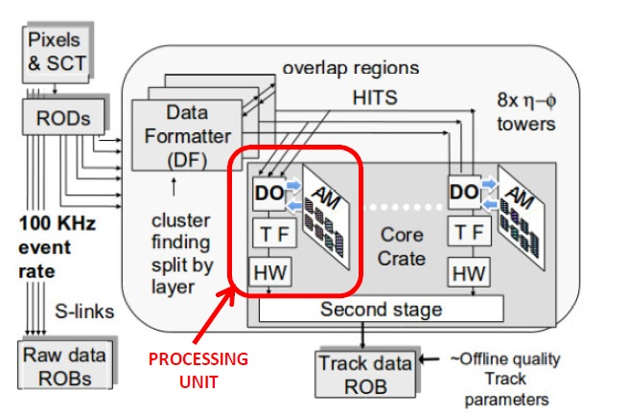
Architettura di FTK
Struttura di FTK:
Ogni Core Processor analizza
i dati di 1/8 di rivelatore.
Ogni Processing Unit analizza
1/8 di dati affidati ad un
Core Processor.

Slide 40

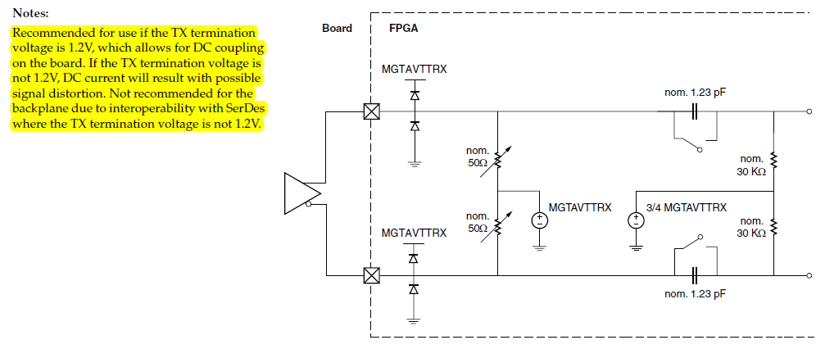
Accoppiamento AC GTP
Il distributore a monte
Non rispettava la condizione poiché alimentato a 3.3V
Necessario accoppiamento AC

Slide 41
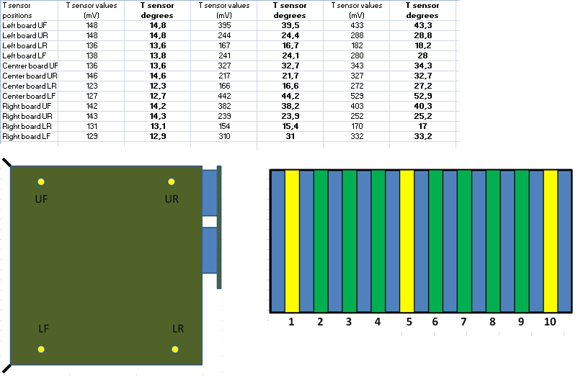
Raffreddamento
Misure INFN Pavia.
Raffreddamento con
ventole e scambiatori.
Simulazione pot. Dissipata
con resistenze di potenza.

Slide 42
