Slide 1

KICK OFF meeting - project presentation
Mauro Dell’Orso
University of Pisa
FTK
b
e
b
μ
τ
b
b
μ
b
τ
h
e
τ

Slide 2
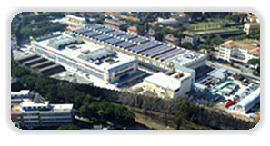
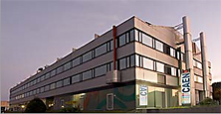
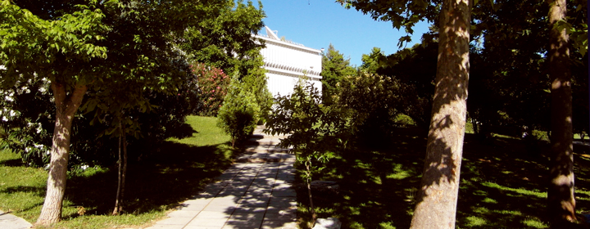
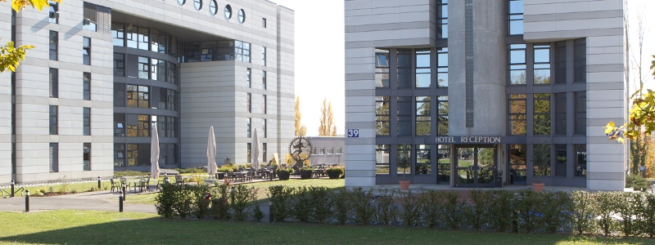
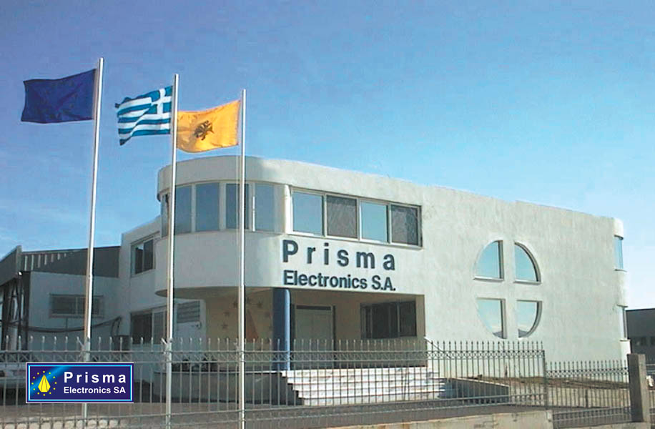
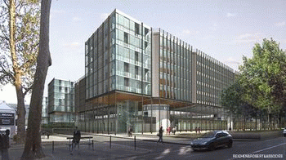
Participants
UNIPI
CAEN
AUTH
CERN
PRIELE
CNRS

Slide 3
List of Work Packages & WP leaders
Prototype Construction & Production Validation (PRIELE, M1-M42)
Infrastructure & Integration (CAEN, M1-M48)
Commissioning (CERN, M12-M48)
Architecture Simulation (UniPisa, M1-M48)
Image Processing (UniPisa, M25-M48)
Silicon Detectors (CNRS,M1-M48)
Outreach (AUTH, M1-M48)
Workshops & Trainings (AUTH, M1-M48)

Slide 4
Participation to Work Packages

Slide 5
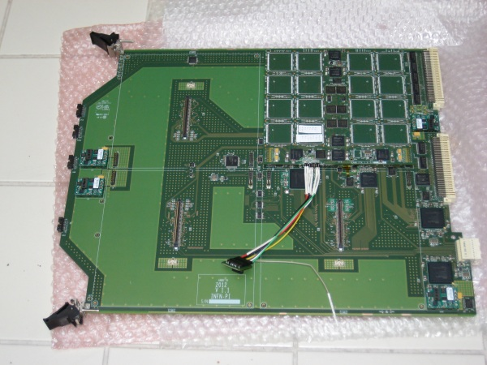
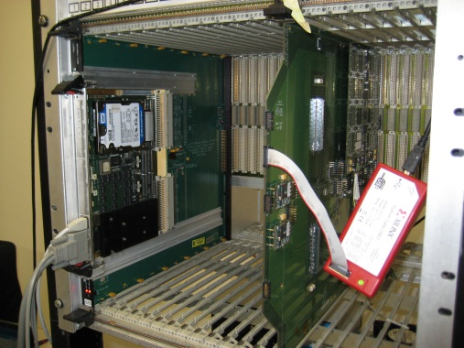
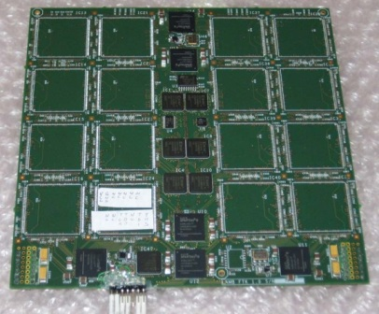
WP1: Prototype Construction & Production Validation
(Priele)
Objectives
Construction and standalone validation of an FTK processor based on
Serial Link technology for Level 1 and Level 2 trigger applications
Transfer of Knowledge to PRIELE for board assembly and validation
of SLP2 to PRIELE before integration at CAEN
and among all research institutions about Associative Memory technology
128 AMchip04s
Task 3: prototype test
Task 1: design
Task 2: prototype design & assembly

Slide 6
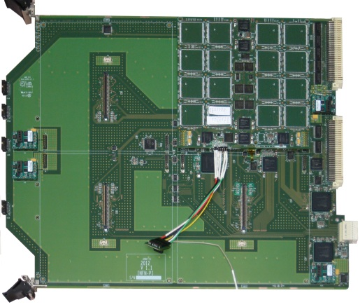
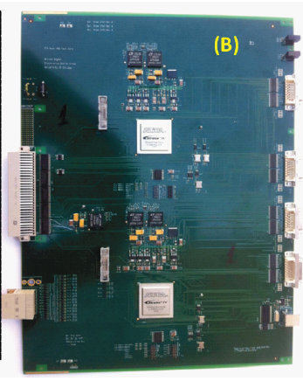
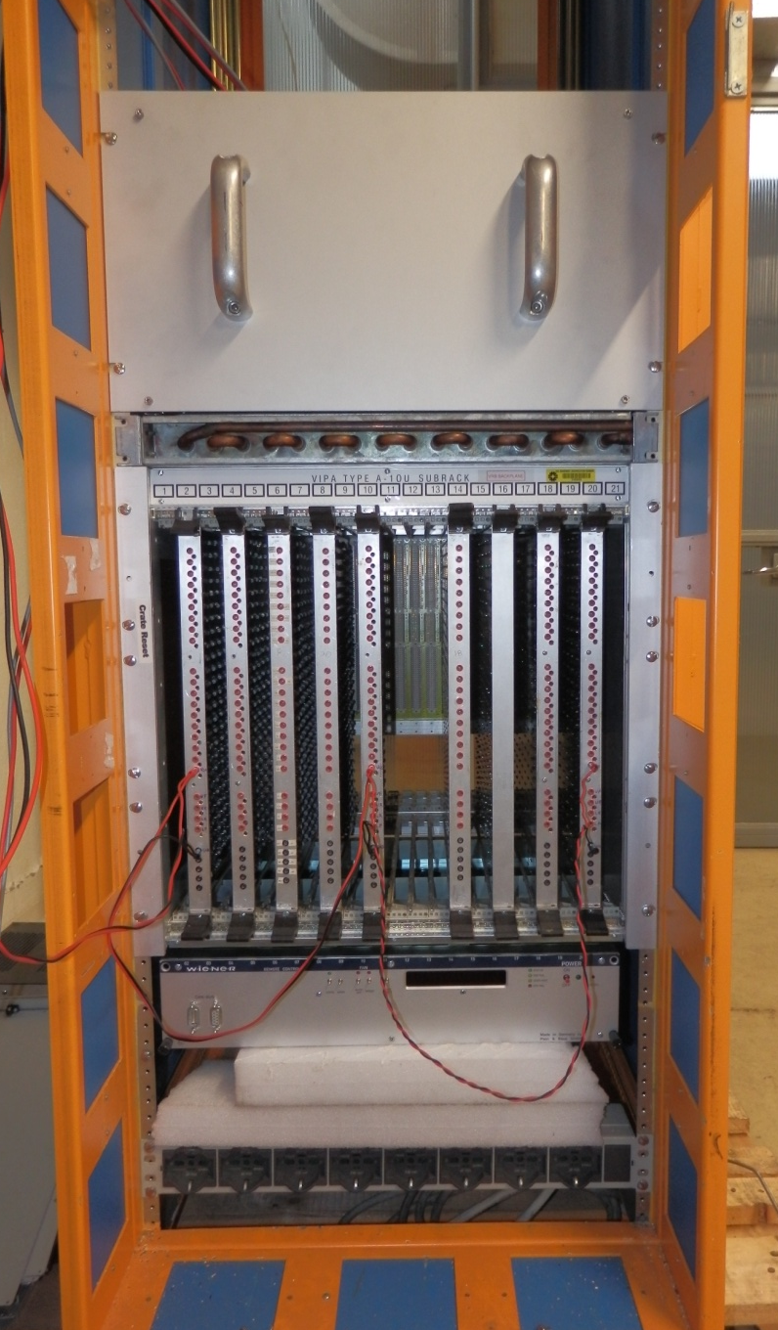
WP2: Infrastructure & Integration (CAEN)
Objectives
Infrastructure construction and validation (racks, crates, power supplies, cooling)
Validation/integration of prototypes from Europe, Japan and USA
Software development for system test/control/monitoring
Transfer of Knowledge among CAEN and research institutions
Description of work
T.2.3. Software development for tests of the Vertical Slice
T.2.4. Tests and validation of the baseline FTK system for the demonstrator
T.2.2. Prototyping of a CAEN power supply
for the final crate (5kW)
T.2.5. Tests and validation of the SLP2-based system
T.2.6. Tests and validation of the SLP1-based system
T.2.7. Tests of cooling and mechanics of a rack with complete final crates
SSB:
Final Fit-HW
DF
ITALY
USA
USA

Slide 7

WP3:Commissioning (CERN)
Objectives
Infrastructure installation and validation at point 1 (racks/crates/power supplies)
Board installation/validation and running control/functional monitoring
Transfer of Knowledge among CAEN and research institutions for board commissioning/maintenance
Description of work
T.3.1. Installation of Infrastructures, validation tests & ToK
T.3.2. Installation of boards (SLP2 or FTK baseline) for the demonstrator
T.3.3. Tests and validation of the FTK demonstrator
T.3.4. T.3.5 as T.3.2, T.3.3. for the first production
T.3.6. T.3.7. as T.3.2, T.3.3. for the second production

Slide 8
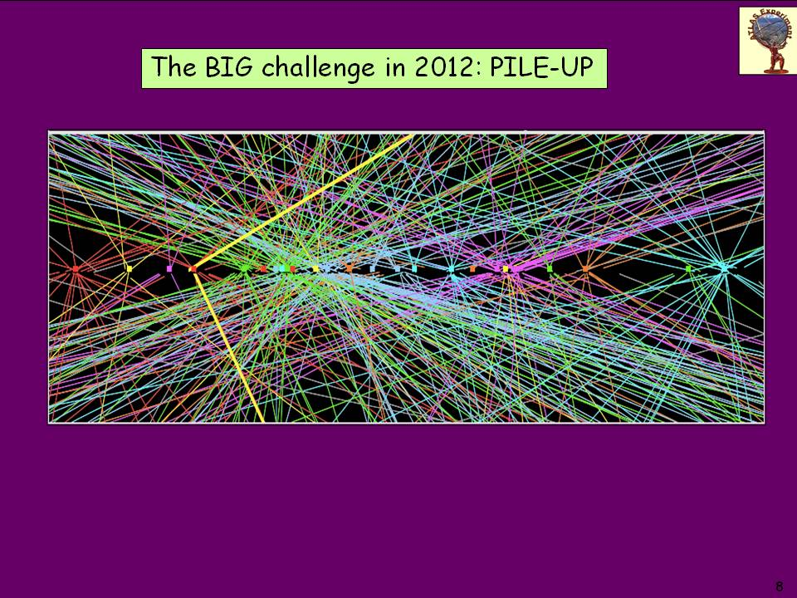
WP4: Simulation (University of Pisa)
Objectives
Production of test vectors to validate hardware configurations
Definition of Level 1/Level 2 architectures to optimize physics reach
:

Slide 9

WP5: Image Processing (University of Pisa)
Objectives
Test Associative Memory capability to extract relevant features from
natural/medical images
Evaluate impact on medical imaging/diagnosis and robotic automation

Slide 10
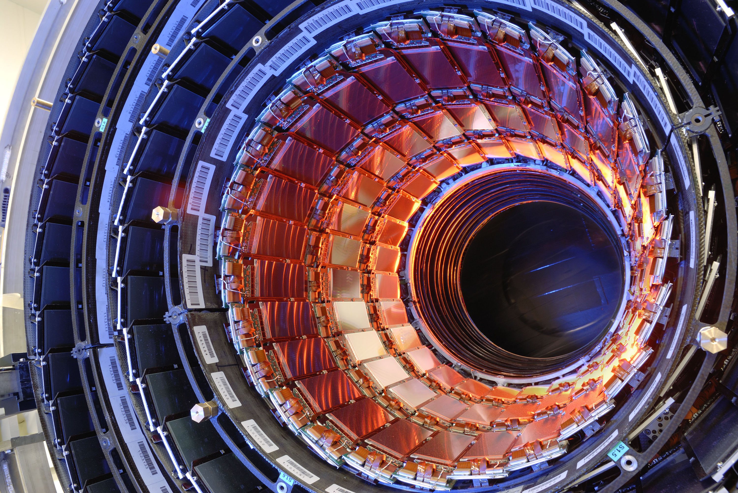
WP6:Silicon Detectors (CNRS)
Objectives
Optimization of CAEN power supply for LHC pixel detectors (phase-II)
Description of work
T.6.1. Setup of a test bench for PS performance evaluation at CAEN
T.6.2 Measurements on PSes equipped with undamaged readout chips (FEI4 devices)
T.6.3. Optimization of PS with irradiated devices
T.6.4. Tests with optimized PS

