Slide 1




www.caen.it
ISO 9001:2008
CERT. N. 9105.CAEN
Electronic Instrumentation
FTK Workshop
Pisa, 12/03/2013

Slide 2
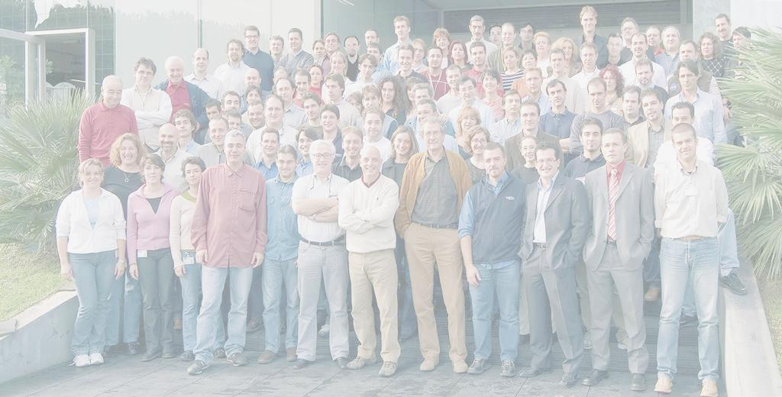




CAEN Network’s Companies
CAEN SpA
Electronic Instrumentation
Founded in 1979
100 people
Headquarters and main operation unit in Viareggio, Italy; operation unit in Elba Island
Core business: Electronic Instrumentation for Physics experiments (world leader)
Spin-off activities:
Microelectronics-Aerospace (1995), RFID (2003), CAENels (2010), CAEN SSp (2011)
Notes:
2

Slide 3
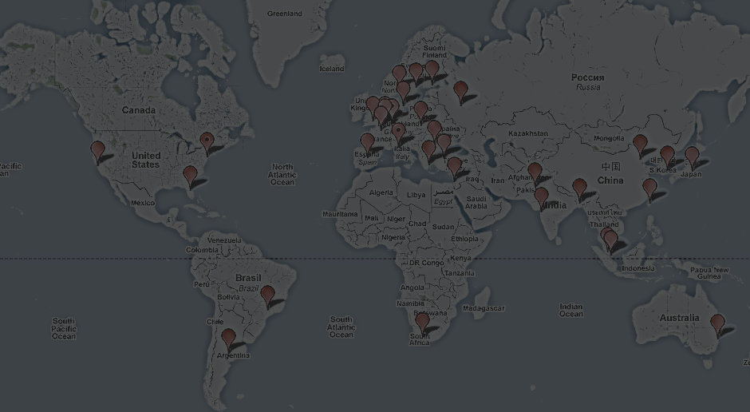
Global Coverage
Worldwide sales network
  CAEN offices in Italy, Germany, USA
  Distributors in more than 30 countries
Portfolio: 1000 customers
Includes world leading research centres
  Europe: CERN, INFN, GSI, ESO, ISIS, Ganil, PSI, …
  USA: FNAL, SLAC, Los Alamos, BNL, JLab, …
  Asia: J-Park, KEK, Riken, IHEP, TIFR, …
  Africa: iThemba Labs, …
Notes:
3

Slide 4
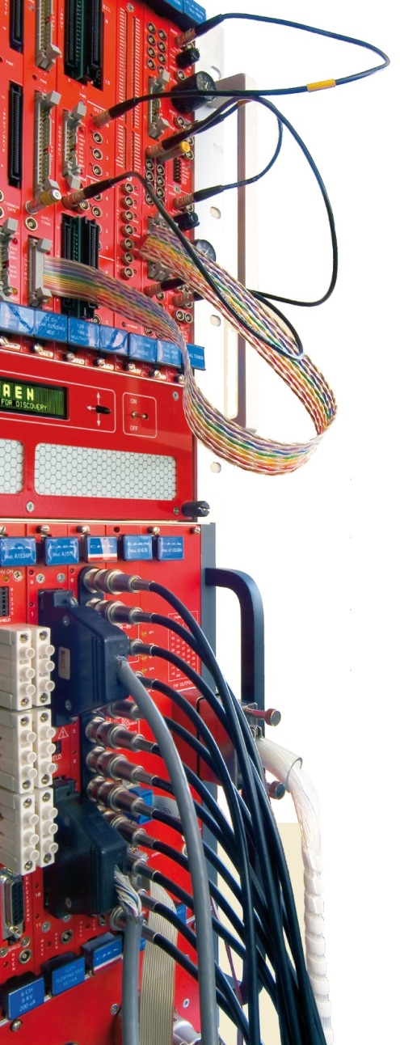
Market
For 30 years CAEN has been providing Scientists and Engineers with the most advanced electronic instrumentation for any particle or radiation detectors
Strong of an extremely close collaboration with the world major research laboratories CAEN is proud to produce the best tools for:
  High Energy Physics
  Astrophysics
  Neutrino Physics
  Dark Matter Investigation
  Nuclear Physics
  Material Science
  Medical Applications
  Homeland Security
  Industrial Applications
  and more …
Notes:
4

Slide 5
Products
Power Supply
  High Voltage and Low Voltage Systems
  Multichannel NIM, VME and Desktop HV Modules
Signal Conditioning & Read-out Electronics
  Preamplifiers, Digitizers, TDC, Logic, …
  VME, CAMAC, PCI/PCI-Express, NIM and Desktop Front-End/Data Acquisition Modules
  Digital Pulse Processing
Powered Crates
  Low Ripple Linear NIM powered Crates
  New Hi-End VME64/VME64x Crates
Custom Developments
Notes:
5

Slide 6
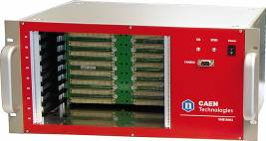
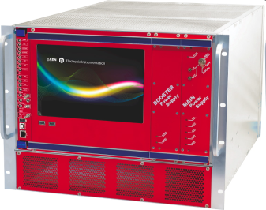
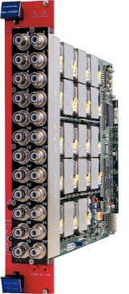
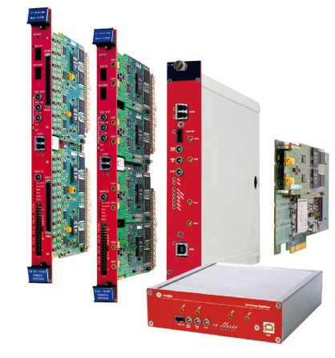
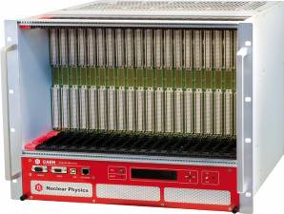
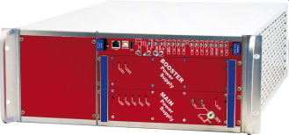
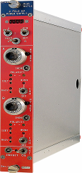
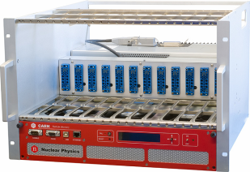
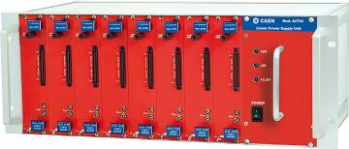
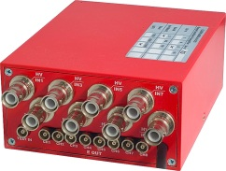
Products
More than 250 products
Custom developments up to 40% of CAEN production (not included in the catalogue)
Notes:
6

Slide 7
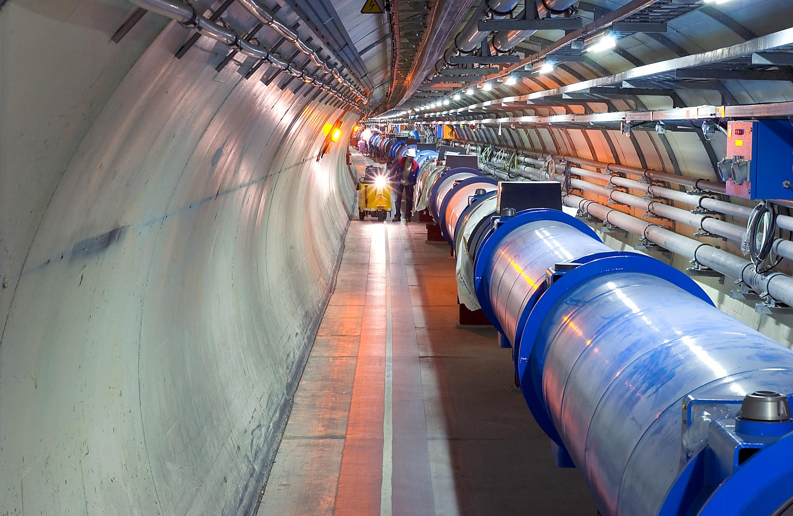
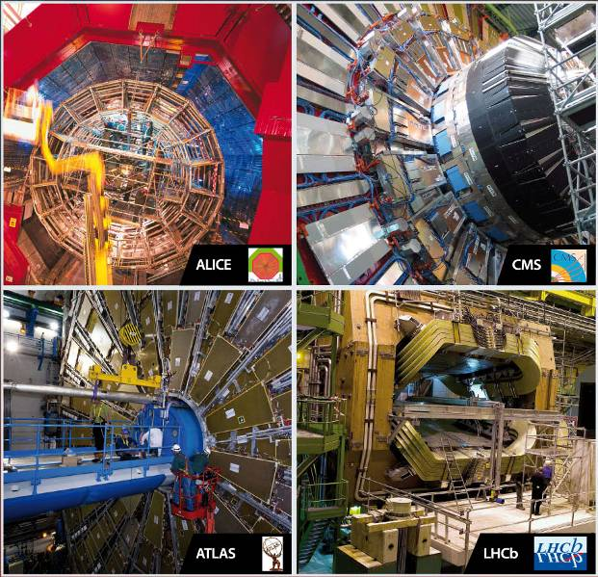
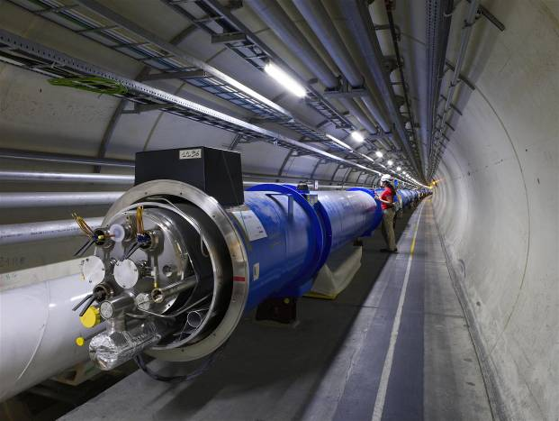
CAEN & LHC Experiments
1998 – 2008
SYNERGY for SUCCESS
10 years of joint efforts
to achieve top performances
6.500 electronic units delivered
  190.000 sub-boards
Designed for Hostile Environments
  Magnetic Field resistant (up to 5000 Gauss)
  Radiation tolerant
Experiments:
CMS, ATLAS, ALICE, LHC-B, TOTEM
Notes:
7

Slide 8
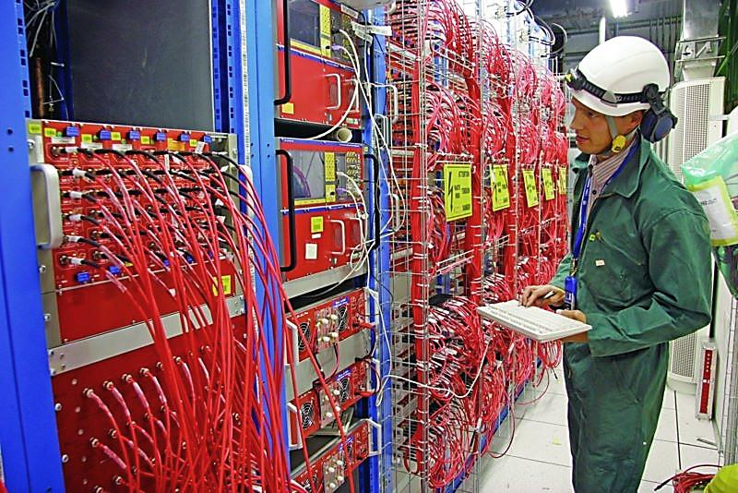
CAEN & LHC Experiments
Notes:
8

Slide 9
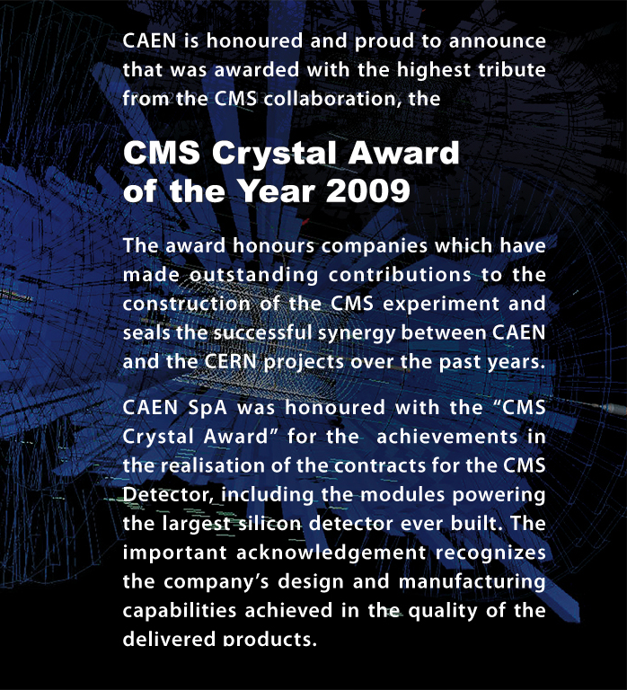
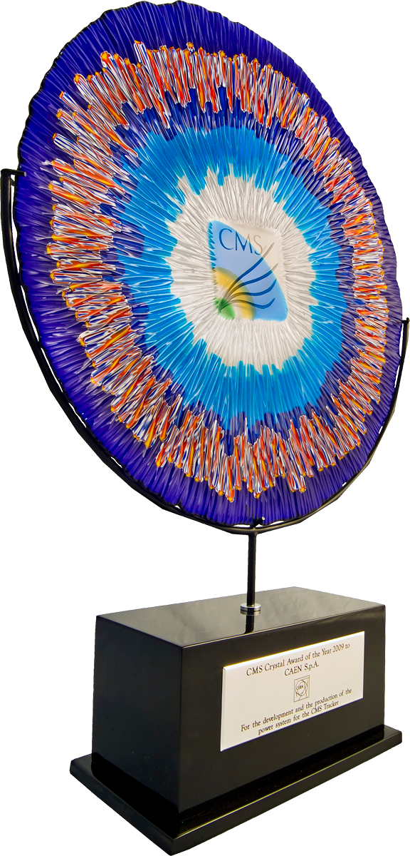
Notes:
9

Slide 10
Key Strengths
R&D Division at the forefront of technology
Excellent pre- and post-sales support either remote or on-site
Flexibility and capability of facing new markets and new products (Spin-offs)
Capable of providing custom solutions
Notes:
10

Slide 11
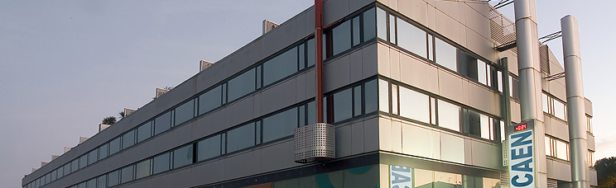

CAEN S.p.A.
Via Vetraia, 11
55049 Viareggio - Italy
Tel. +39.0584.388.398
Fax +39.0584.388.959
info@caen.it
www.caen.it

