Slide 1
FTK high level simulation & the physics case The FTK simulation problem
G. Volpi
Laboratori Nazionali Frascati, CERN Associate
FP07 MC Fellow

Slide 2
Introduction
The FTK (high-level) simulation it is a set of C++ programs
Designed to interface with simulated and real data
It is able to reproduce the logic of the main electronic components within the pipeline
Allows to evaluate the load of the different boards
Can allow to evaluate the size of FIFOs and predict the bottlenecks
This simulation has been extensively used as test bed for the algorithm and makes decisions on the design
In the past years was the place where the algorithms have been decided or studied: AM, track fitting, filtering techniques, …

Slide 3
Physics case: ATLAS simulation
The ATLAS experiment has developed a multi step MC to simulate the detector response
The response of the full detector is simulated with great accuracy
Physics and electronic effects are included: pileup, noise, inefficiency
FTK result should be added during digitization
Generation
Digitization
Analysis
Simulation
Main physics signals (hard scattering)
Simulate the detector response with Geant4
DAQ and Trigger
Add the pileup
Apply the event reconstruction algorithms

Slide 4
Physics case: FTK Simulation
FTK simulation reads data from ATLAS after digitization
Only silicon tracker information is retrieved
Using a special format
Same procedure can be used to read RAW data
The data are fed in a logical simulation of the FTK processor
The output can merged back to the original ATLAS stream
FTK Input preparation
AM+TF preparation
FTK merging and output
Digitization result is converted for FTK
AM and fitter result
Result for each event collected
Each event simulated many times (256)
Output converted in ATLAS standard
ATLAS format
FTK tracks are converted in ATLAS-like formats

Slide 5
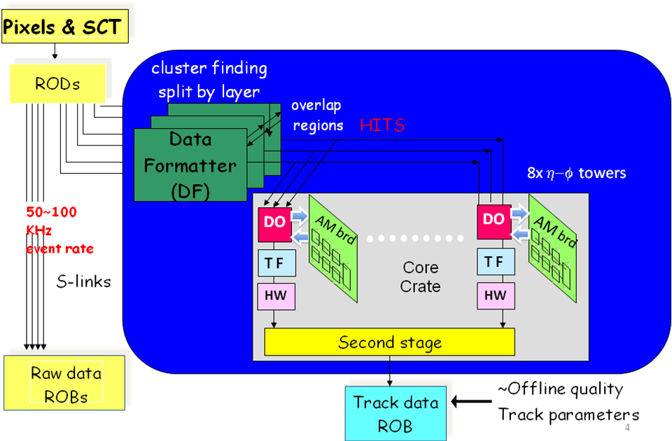
FTK Simulation vs FTK system
AM simulation
Wrapper
Athena I/O
TF Simulation
Analysis tool
FTK Merger

Slide 6
Why the simulation is a core component?
The FTK simulation allows to study and to extend the Silicon Vertex Trigger idea to a different experiment
ATLAS inner track wasn’t designed for trigger (CDF tracker was)
The simulation allows to define the units where the linear fit procedure can work (the sectors)
The simulation prepares the configuration files
Pattern banks generation and setup of the “don’t care bits”
Linearized fit constants preparation
It is the most important test-bench for the algorithms
Issues in performance or data flow can be predicted and solution studied.

Slide 7
Simulation outcomes for the current architecture
Improved majority logic track fitting w.r.t SVT, limiting the number of constants
Duplicate tracks suppression method (hit-warrior)
Decision to drop the duplicate roads removal algorithm (a.k.a. road-warrior)
Simulation studies on high pileup sample revealed a modest benefits compared to the additional complexity
Detail comparison among two main architectures:
two stages road finding and track fitting
single stage of partial road finding and two stage fits
Identical performance but simpler implementation
Use of the “don’t care” (DC) feature in the AM chip
Initial study on a system with AM chip + “Tree search processor”
DC feature was found more effective

Slide 8
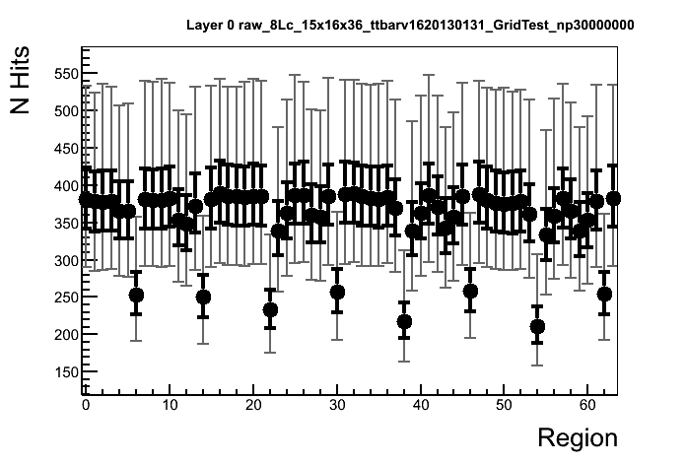
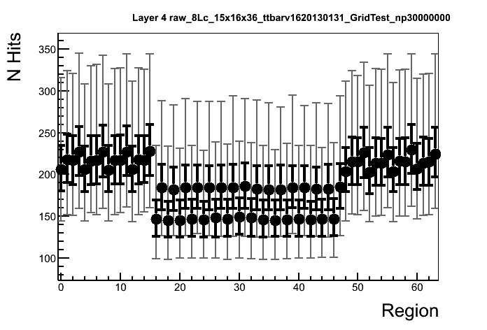
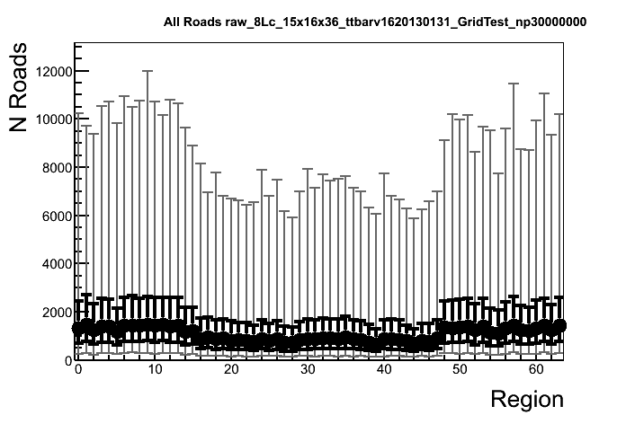
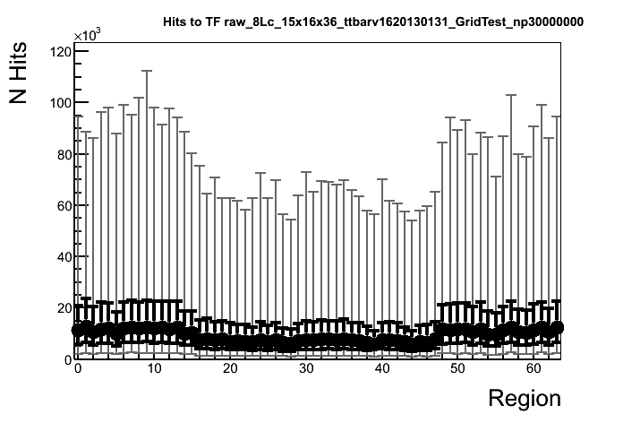
Result: Dataflow
N Hits Layer 0
N Hits Layer 4
N Roads
N Hits within AUX

Slide 9
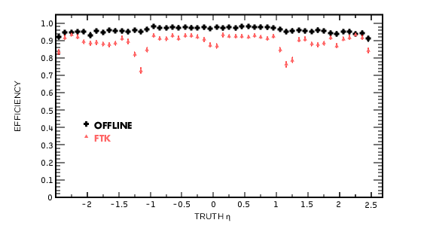
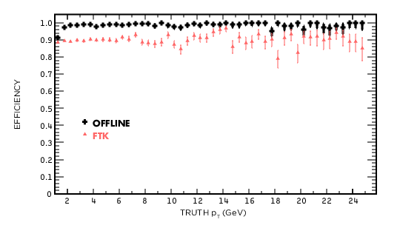
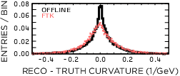
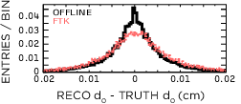
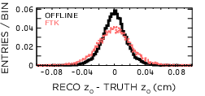
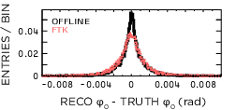
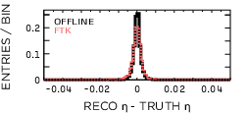
Result: Single Track performance

Slide 10
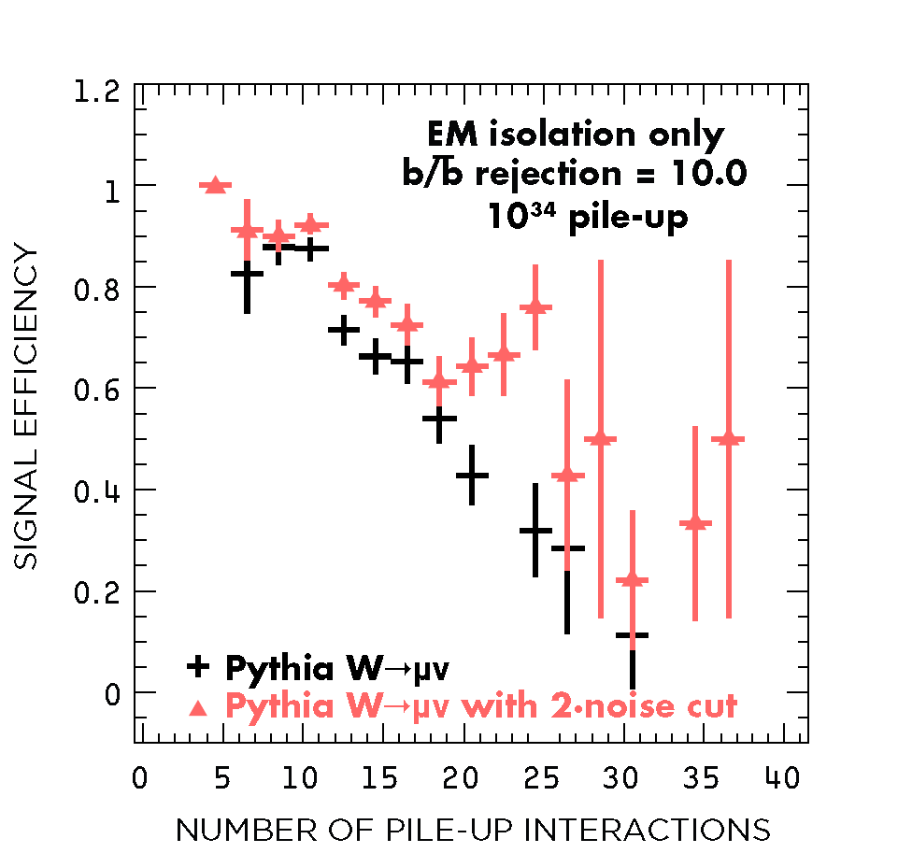
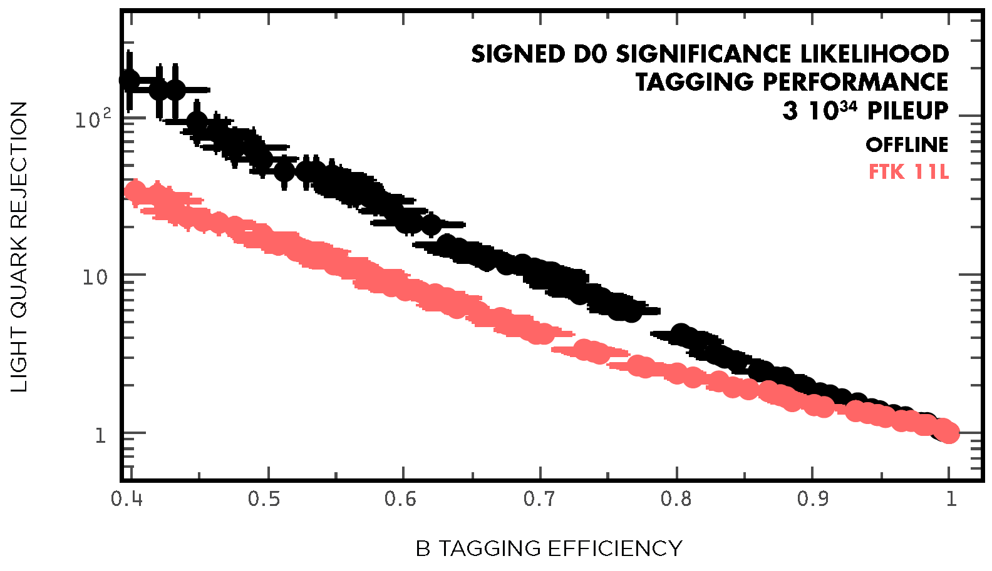
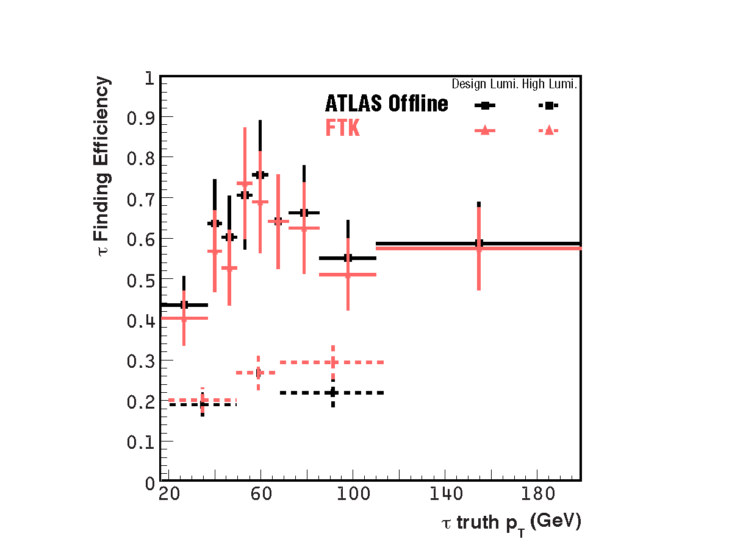
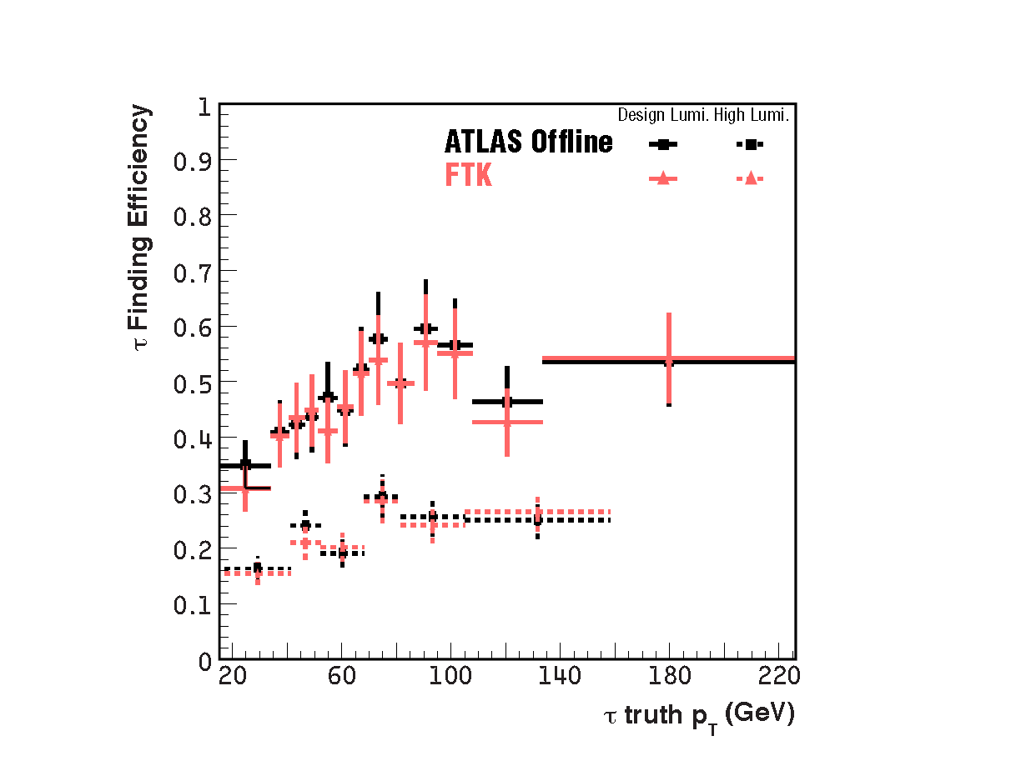
Result: Basic Performance

Slide 11
FTK Simulation challenge
The algorithms used by FTK are very inefficient on a CPU
Designed to make intensive use of memory and I/O
Pattern matching algorithm is particularly tricky
The final hardware will be able to contain 1 Gpatterns
Each pattern is now described using 36 bytes
Additional indexing structures are required to improve the performance (almost double the memory/pattern)
Target HW is the typical grid WN: 3 GB/core
We developed a strategy to simulate each event against a part of the pattern bank
Each job remains within the memory limit
Many parallel jobs allow a more effective use of the GRID
There is the need to merge the output

Slide 12
Memory budget
Single Job
Required during initialization only
128 Jobs
Required to improve road finding speed
Minimum
Not including the memory required to store the hits, other algorithms, libraries …

Slide 13
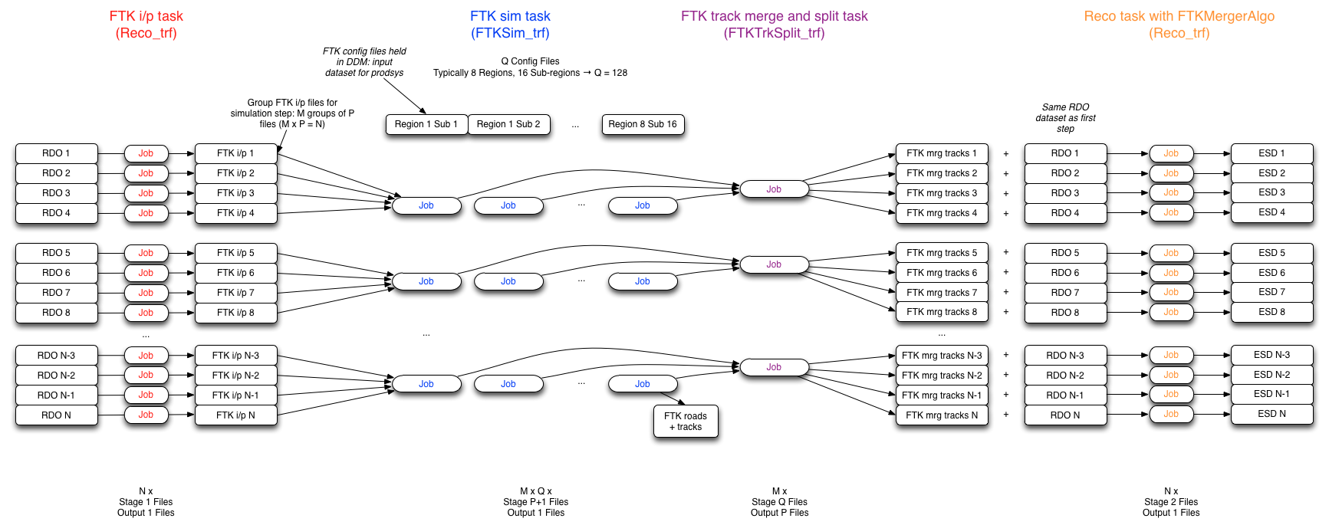
The grid simulation flow
The job segmentation results in a complicated submission scheme
The average processing time per event is 12 minutes
A substantial time is spent in initialization and book keeping

Slide 14
1.9 GP (x2, pessimistic)
PU 70
No code optimization (yet)

Slide 15
Possibilities with coprocessors
Having a mixed hardware (CPU + ???) solution can improve the simulation performance
FTK algorithm are designed to be parallel
Porting the algorithms has technical difficulties but there aren’t logical problems
Commercial parallel processors exist and are currently on the spot: GPU and MIC more
Designed to make easy the porting of C/C++ code
Small proof of porting of FTK algorithms done
Special cards with AM chips to be installed in a PC
SIP or other cards proposed in European funding requests

Slide 16
Future of the simulation
FTK simulation will change from a prediction only to a monitoring (and prediction) tool
It will be possible to feed RAW data and compare the hardware and simulation output
The Vertical Slice experience was the first example
Better matching between hardware and simulation configuration or algorithms required
Software implementation of HW techniques can be considered. Need to carefully check the performance
Complexity of the simulation can limit how frequently of the monitoring
Any improvements in the simulation will be good also for the HW monitoring

Slide 17
Monitoring with FTK Simulation
The VS slice experience shows that we need to improve our debugging tools
The combination between the online simulation, by Federico, and the offline simulation allowed to spot issues
A problem in the SCT decoding was suggested
The two codes need to be merged or better integrated
In the short term some algorithms may need to be duplicated in two versions: HW and logic version
The redundancy will allow to spot issues
For the long term the simulation should be integrated in the Point-1 system running a low rate (~1 Hz) and check differences between real FTK and simulated result

Slide 18
Conclusions
The FTK simulation it is a core component of the system
It allows to predict and tune the performance
It allows to study the benefits for the experiment in using a similar coprocessor
In a working system it can help monitoring the system and be part level diagnostic
Can integrate some features of the online detailed simulation
Simulating a highly parallel system with commercial computing units is challenging
The AM chip allows an enormous memory at very high bandwidth
CPU implementation pays huge penalties
Memory allocation has enormous limits

