Slide 1
Simulation and Debug The Vertical Slice experience Federico Lasagni Manghi

Slide 2
Why a simulation?
To provide feedback:
During the development of boards
During the development of firmware
Assembling the boards
To determine the characteristics of the system:
Efficiency
Purity

Slide 3
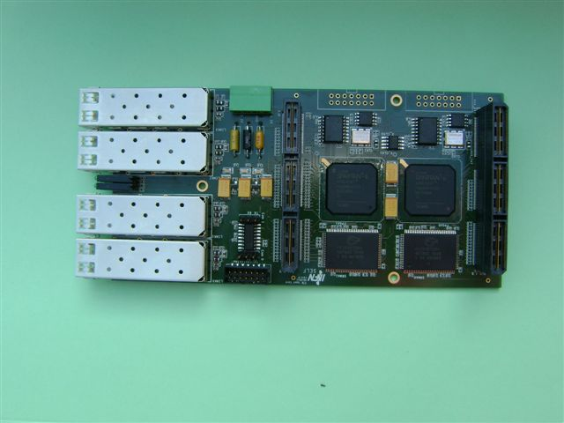
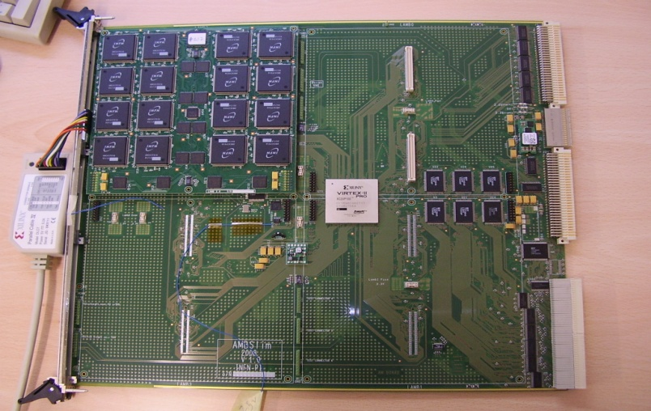
Structure (now) for the VS
C++ program, ROOT analysis tools.
Evolved together with the Vertical Slice:
Data reading class
FTK_IM mezzanine simulation: clustering
EDRO simulation
AM simulation
Compare results at all steps
EDRO
AM

Slide 4
Validation of VS online simulation
Debugged “VS online simulation” versus FTKSim
Difference traced to different format
Imported “bystream decoder” for SCT into FTK online simulation
Differences found and corrected in VS online simulation
Inversion of strip number for SCT side = 1
Renumbering of link number

Slide 5
What we obtain
The HW and the simulation are compared for:
Hits after mezzanine data clusterization
Roads from the AMBoard
We can read Simulated values (event per event) of:
Hits after EDRO data conversion
Roads from AM Simulation
These are useful if we have saved the spy-buffers with the
corresponding info in the hardware

Slide 6
When has it been used?
To test the EDRO-AMB system
Firmware
Communication
To test the communication with the FTK_IM
To test the FTK_IM firmware
To test the whole VS system
To better understand the necessary setup

Slide 7
Tests
Offline Tests of components
Offline tests of full VS
Online Tests without data
Tests with real data:
Period January – February 2013
P-Pb collisions at 8 TeV and p-p collisions at 2.76 TeV
focusing on run 219171 p-p collisions at 2.76 TeV
Level 1 Rate ≈ 30 kHz

Slide 8
The EDRO-AMB System
We have tested the system from the arrival of the hits in the EDRO board to the road firing.
DEFINITIONS
Efficiency = Correct fired roads / expected roads
Purity = Correct fired roads / total fired roads
Expected and correct means “predicted by simulation”

Slide 9
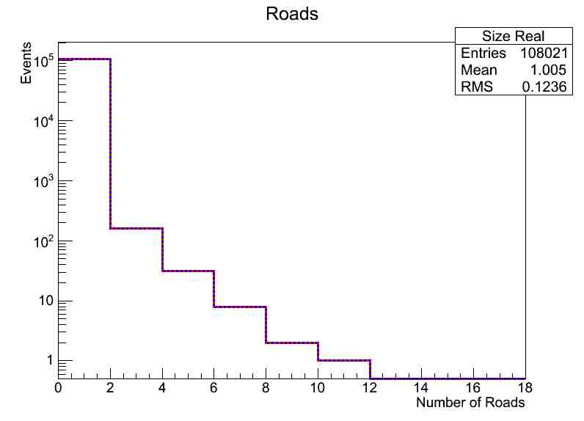
Analyzing data from this part Sim vs real VS
0 Errors / 276 roads
Efficiency > 88%, at 95% CL

Slide 10
Issues Discovered in FTK_IM
Wrong interpretation of the hit values in different layers
Mezzanine Firmware production of wrong Module ID
Hit duplicated in mezzanine
We should have solved these issues, however we had no time to do it before shutdown

Slide 11
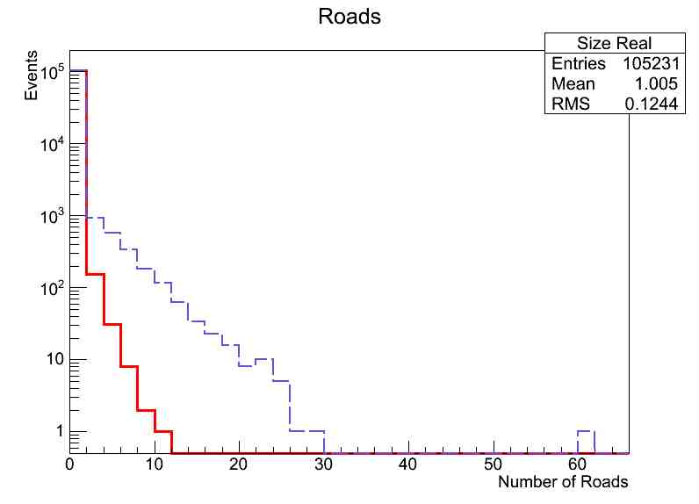
What we observed: many roads are lost by the VS
Patterns fired in simulation
Patterns fired by VS

Slide 12
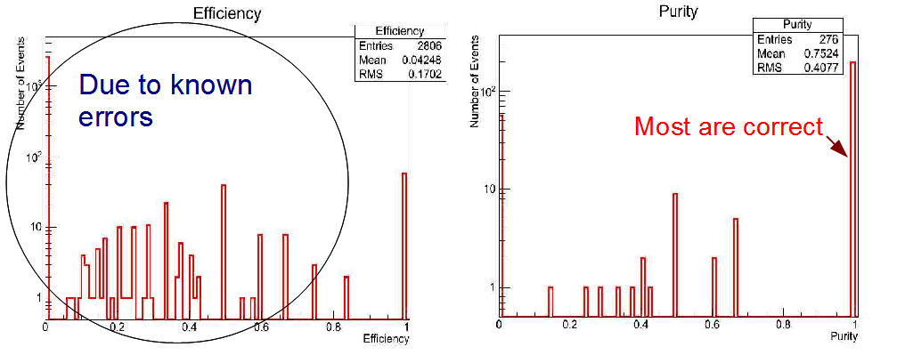
Efficiency and Purity
Both should go to 1 when correcting for known errors

Slide 13
Dataflow problems also…
Rare data-flow problems for roads
Wrong end-words
Missing end-words
Very rare missing FTK fragments
Data-flow stops (unclear origin)
At warm start
After long periods of data-taking

Slide 14
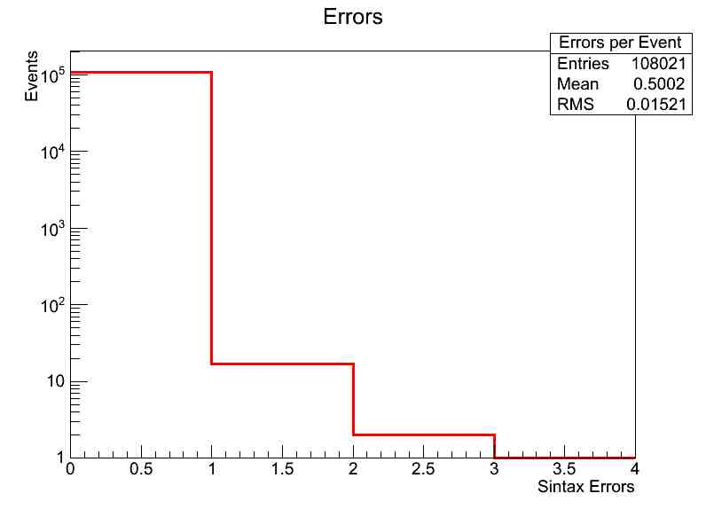
Data-flow error rate (much lower)
Errors/event in the sample

Slide 15
Conclusions
Validated VS Simulation using FTKSim
Used it to test the VS and its components from development to integration in ATLAS
Found several issues and the sources of some
Provided efficiency and purity of the components and the whole VS system
TODO: fix data-manipulation issues, investigate data-flow issues

