Slide 1


LAMB: Hardware & Firmware
Daniel Magalotti
University of Modena and
Reggio Emilia
INFN of Perugia
FTK Workshop – Pisa 13/03/2013

Slide 2
Outline
Local Associative Memory Bank (LAMBFTK)
Hardware description of LAMBFTK
Firmware implementation of LAMBFTK
Evolution of the board: serial link processor (LAMBSLP)

Slide 3
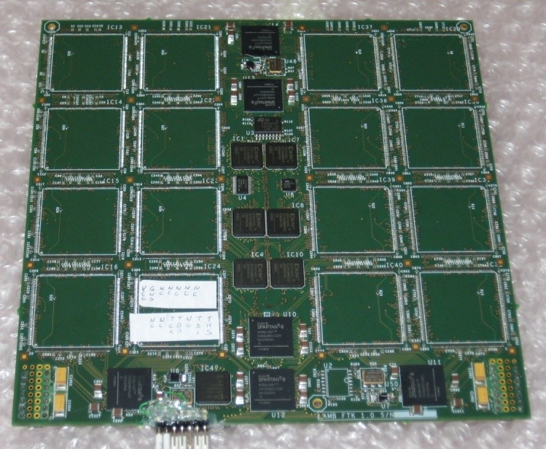
AM system: Local Associative Memory Bank (LAMB)
Some definition of the board…
AMchip
INput DIstributor
(INDI)
Boundary
SCAN
GLUE
Notes:
In this slide we see a picture of the current board in which we have highlight the principal component of board.
The board hosts 32 chip associative memory (now not mounted)
The chips in the middle of the board is involved in the distribution of hit and call INDI
A chip that handles the JTAG Amchip
And two chips in the red box that manage the output from the AMChip called GLUE

Slide 4
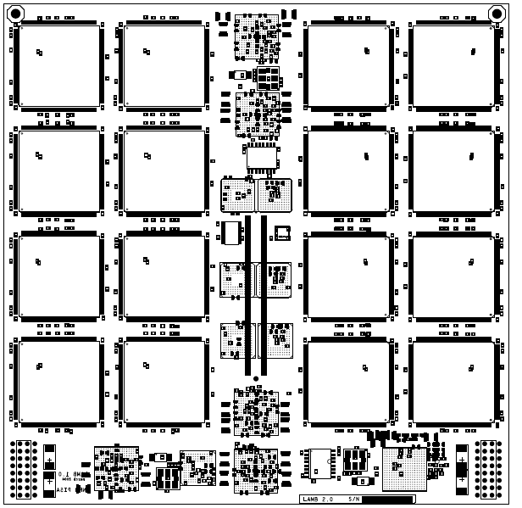
LAMBFTK – Interface and Power
Core voltage @ 1.2 V
I/O voltage @ 3.3 V
Input signal
4 bus parallel (0,1,3,5)
4 bus serial(2,4,6,7)
Output signal
2 from the right part
2 from the left
Notes:
Some detail of the board
Two connectors in yellow distribute the power of the core 1.2V
A central connector distributes the power for the I / O together with the input / output signals: 8 input buses 4 output buses

Slide 5
LAMBFTK – Parallel Busses Distribution
Core voltage @ 1.2 V
I/O voltage @ 3.3 V
CPLD – Input Distributor for parallel buses
4 bus parallel (0,1,3,5)
XC95144XL
Notes:
Of the 8 bus input 4 are received in parallel with the CPLDs that distribute to all AMchip

Slide 6
LAMBFTK – Serial Busses Distribution
Core voltage @ 1.2 V
I/O voltage @ 3.3 V
CPLD – Input Distributor for parallel buses
4 bus parallel (0,1,3,5)
Spartan 6 – Distributor for serial buses
4 bus serial(2,4,6,7)
GTP transceiver
Notes:
4 are received serially. The 4 bus are received by the integrated receiver of FPGA in the bottom of the board. The data are sent in parallel to the Amchip and also transmit serially to the high FPGA of the board that distribute them to the Amchip.

Slide 7
LAMBFTK – Road data flow
Core voltage @ 1.2 V
I/O voltage @ 3.3 V
CPLD – Input Distributor for parallel buses
4 bus parallel (0,1,3,5)
Spartan 6 – Distributor for serial buses
4 bus serial(2,4,6,7)
Spartan 6 – GLUE for output road
Notes:
The outputs of the Amchip are received by two other FPGA that manage the handshake with the chip

Slide 8
LAMBFTK – JTAG AMchip connection
The AMchips are connected in 8 JTAG chain controlled from the BSCAN chip.
4 JTAG chain of 4 chip on the top and on the bottom of the board
The BSCAN chip manages each JTAG chain distributing the TMS, TCK, TDI and TDO
The BSCAN manages the conversion from the VME protocol into JTAG protocol
BSCAN chip
Notes:
Infine il BSCAN chip controlla le catena JTAG degli Amchip convertendo l’interfaccia VME in JTAG e controllando tutti I segnali JTAG delle catene.
The JTAG chian is also controlled from the VME interface so a conversion from VME to JTAG is performed from the BSCAN CHIP

Slide 9
LAMBFTK – Firmware development
The logic of the board is very simple
controls the data distribution of the input buses to the AMchip
Manage the handshake with the AMchip and merge the 8 flows into 4 output streams
A control of the Spartan-6 FPGA GTP Transceivers need to be implemented for the serial link connections
Notes:
The logic of the card is very simple. We manage the data distribution of the input bus and define the logic to manage the outputs from Amchip.

Slide 10
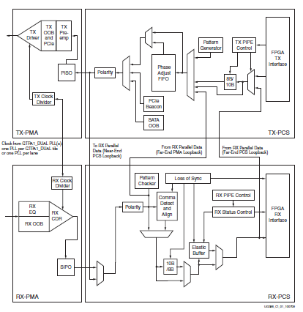
LAMBFTK – Firmware development
The logic of the board is very simple
controls the data distribution of the input buses to the AMchip
Manage the handshake with the AMchip and merge the 8 flows into 4 output streams
A control of the Spartan-6 FPGA GTP Transceivers need to be implemented for the serial link connections
Definition of a protocol between transmitter and receiver
Firmware implementation of the TX and RX transceiver
TRANSMITTER
RECEIVER
Notes:
It’s implemented a logic firmware to control the GTP transceiver integrated into the FPPGA. We have defined the control logic for the transmitter and the receiver

Slide 11
LAMBFTK: critical issue
Complexity of the board:
High number of the FPGA and CPLD: for the mixed standard in I/O (parallel and serial)
Routing of the board of the all parallel data to the AMchips: each AMchip receives all the busses in parallel
Notes:
This current card has some critical aspects: for example, the high number of programmable devices and the presence of mixed standard, serial and parallel, that make the development of the card very complex.
In fact, the routing of the bus of the card has been very complex and it took 8 levels of routing

Slide 12
Problem…
Complexity of the board:
High number of the FPGA and CPLD: for the mixed standard in I/O (parallel and serial)
Routing of the board of the all parallel data to the AMchips: each AMchip receives all the busses in parallel
8 routing plane
8 power plane

Slide 13
LAMBSLP: Serial link LAMB
The new version of the board is totally based on the serial link connection
The new AMchip will have 8 input serial link for the hit and 1 output serial link for the road
The LAMBSLP will hosts again 32 AMchip maintaining the same structure of the old board
A list of issue in the design of LAMBSLP
Notes:
Then, we are developing a new version of the board, that is based totally on serial connections with a number of advantages: reduced number of connections and then the number of routing plane is simplest than the current board. Infact the new Amchip will have only serial connections fot the input and the output.
The common things with the current Lamb will be the number of Amchip on board that remains 32 .
Now I will shown a list of issue for the design of the new board

Slide 14
LAMBSLP: Serial link LAMB
Left/right part
Distribution
Component placement
AMchip
Fan-out buffer
Place 32 AMchip
16 on the top
16 on the bottom.
Input data distribution
Chain of two fan-out buffers (1:4 CML (SY58020U Micrel))
distribute the input bus to the left/right part of the LAMB (blank arrow)
replicate one bus to four AMchip (blue box)
Notes:
In this figure, we can see a first placement of the 32 Amchip.
One problem is the strategy of the input buses distribution to all the Amchip.
We think to use a cascade of two fanout buffer 1:4.
The first fan-out buffer, place on the with box, distributes the buses on the right and left part of the Lamb while the second fan-out distributes a single bus to the 4 amchip visible in the blue box

Slide 15
LAMBSLP: Serial link LAMB
An example strategy of routing for the input buses to the AMchip
Notes:
Here we see a possible strategy for routing: the bus to the left and right sides of the lamb are ruoting of horizontal buses while the true amchio vertically.
This picture shown the result of a new tool cadence that allows you to create a map of the bus on the card.

Slide 16
LAMBSLP: Serial link LAMB
Power distribution network
AMchip will need a core voltage of 1.2V for the Silicon Creation IP Serializer/Deserializer
1 V for the core of the AMchip
Voltage 2.5V for the I/O for both FPGAs and AMChips
~2 W per chip
The LAMBSLP needs to be squeezed with respect the size of the LAMBFTK
DC-DC converters and eventual filters.
Notes:
The power for the board are 1.2V for Ipcore of Amchip, 1V for the core and 2.5 for I / O
Each Amchip is estimated to consume about 2W
The crate is powered by a 48 volt so to achieve the step-down voltage we need to put more DC-DC converter in cascade and therefore the size of the lamb must be reduced

Slide 17
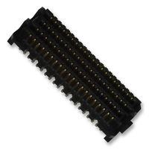
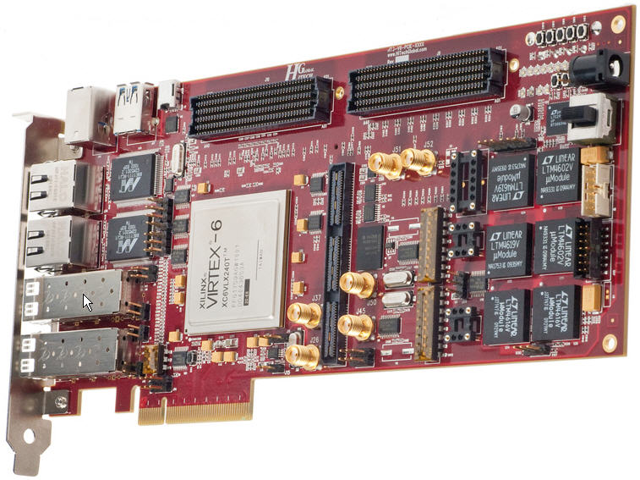
LAMBSLP: Serial link LAMB
The interface connector for the I/O signals is
High speed/high density open pin field
Power distribution
This connector is select to interface the board with the Xilinx evaluation board
Few number of the pin to
give all different voltage
power to the board
Notes:
Another specification is the interface LAMBSLP with the evaluation board.
This involves the use of this connector on the card.
This is a very good connector with 400pins and each pin can support until to 2 A of current.
So through this connector we can distribute both the input / output signals and the power supply.
But we can not connect directly to xilinx card because there are few power pins and the evalution board fails to give the power to the LAMB

Slide 18
LAMBSLP: Serial link LAMB
An interface board need to be development to interface the evaluation board and the ALMBSLP board
INTERFACE
BOARD
TO
Eval
TO
LAMB
POWER
Notes:
An interface card between the lamb and the evaluation board must be design.
In this board there are a connector to the xilinx evaluation card, a connctor to the LAMB and a connector to power the board.

Slide 19
LAMBSLP: Serial link LAMB
Clock distribution
Each AMchip receives a single LVDS input clock, a low jitter signal.
The local signal clock is generated by a quartz placed in the middle of the four chips
The yellow box shows the quartz and a fan-out buffer to provide the clock to all the 8 chips in the LAMB fourth
Notes:
Finally for the clock distribution. Each AMchip receives a single LVDS input clock.
The local signal clock is generated by a quartz placed in the middle of the four chips.
A fan-out buffer 1:8 distributes them to all 8 chips.

