Slide 1
The AM Chip Ser/Des IP
Protocol – Test Procedure
Matteo Beretta

Slide 2
Summary
Parallel bus VS Serial link
Ser/Des architecture
MiniAsic in/out architecture
Ser/Des test features
On board connection test
Spread spectum modulator
MiniAsic data protocol

Slide 3
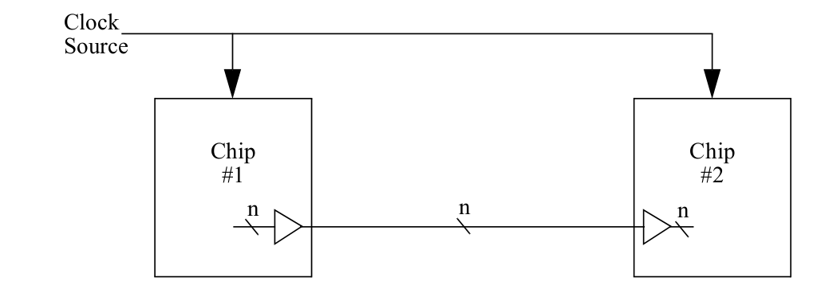
Parallel vs Serial
Parallel data bus
The simplest method of transferring data through the inputs or outputs of a silicon chip is to directly connect the datapath from one chip to the next chip.
There are two problems of the parallel data bus shown in Figure.
1 - n input/output (I/O) pins are required on each chip to transfer the data.
2 - meeting timing requirements. The data is launched synchronously by Chip #1 and is captured synchronously in Chip #2 using the same clock. The data at the inputs of Chip #2 must meet setup and hold times relative to the clock input of the chip. These setup and hold times must be calculated with sufficient margin to allow for differences in delay of the clock distribution path to the two chips, and through the chips to the launch and capture flip-flops.

Slide 4
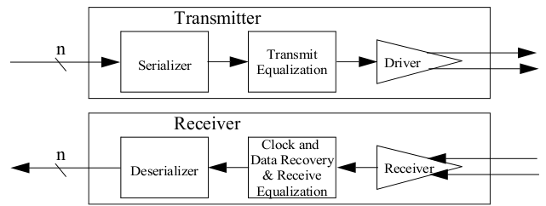
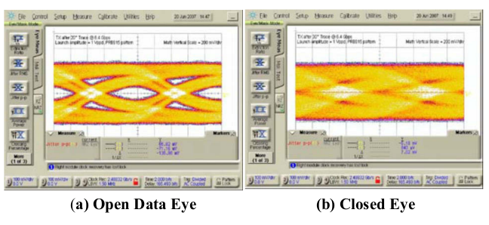
Parallel vs Serial
High Speed Source Synchronous Interfaces
Reduce the number of connection needed to exchange data between chips. Only one differential pairs for data path is needed.
Clock information is extracted directly from the data rather than relying on a separate clock.
High Speed Serdes problems are due mainly to signal integrity in the data path.

Slide 5
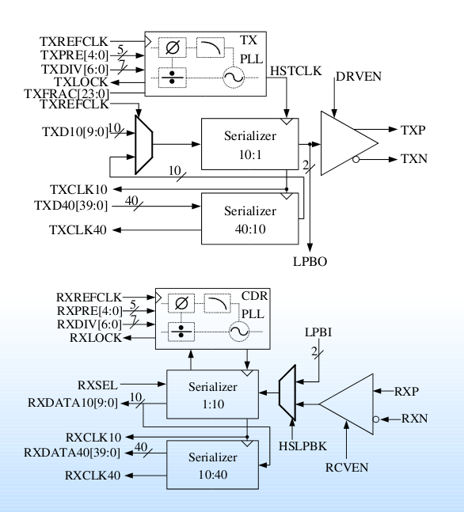
Ser/Des analog core
Features
• Supports spread spectrum modulation with external modulator
• Data rates of 584bps to 2.4Gbps
• Compatible with Gigabit Ethernet,and other standards
• Separate PLLs for Tx and Rx
• Separate Serializer and Deserializer macros simplify assembly of arbitrary single or multilane configurations on single chips or separate chips
• Trimmable on-die termination ensures excellent signal integrity
• High-speed loop-back path simplifies production testing when used together on one chip
• 40bit datapath
• Flexible driver and receiver circuits compatible with LVDS and CML standards with programmable low power settings
• Low power

Slide 6
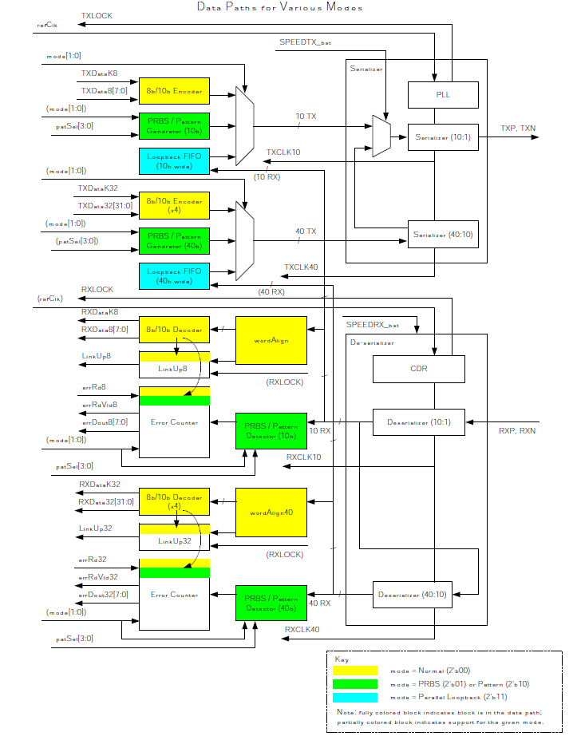
Pipe Interface
The Pipe Interface Module is a block of digital logic that aids in data reception and transmission. It works in conjunction with existing analog Silicon Creations Serializer and De-Serializer modules. The Pipe Interface has several purposes:
to encode 8-bit (32-bit) data into a 10-bit (40-bit) entity to be transmitted by the serializer
to decode a 10-bit (40-bit) entity from the de-serializer into 8-bit (32-bit) data
to perform Built-In Self Testing (BIST) of the Serializer/De-serializer pair
to monitor and count reception errors
to detect comma characters and align bits to word boundaries
optionally, spread-spectrum modulation can be added to control the PLL in the Serializer

Slide 7
Amchip Ser/Des channels scheme
Deserializer
40 bits
Pipe
Interface
32 bits
JTAG
Rx Stream Decoder
Data From other AMchip
16 bits
Serializer
40 bits
32 bits
16 bits
Serializer
Tx Stream Encoder
Core Output
16 bits
Deserializer
40 bits
Pipe
Interface
32 bits
AM chip
Memory Core
Rx Stream Decoder
16 bits
16 bits
Deserializer
40 bits
Pipe
Interface
32 bits
Rx Stream Decoder
16 bits
16 bits
OpCode
50 MHz
100 MHz

Slide 8
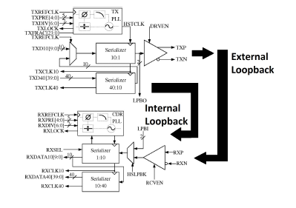
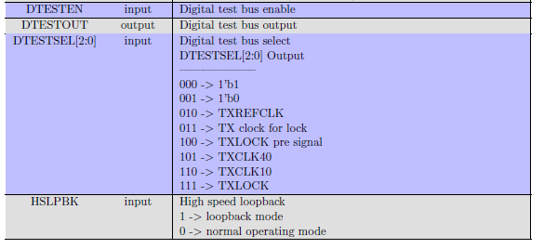
SerDes Test Features
Test Features:
A digital test bus is included for debugging. The bus is enabled by asserting the DTESTEN input. The DTESTSEL[3:0] bits are used to select a signal for observation on the DTESTOUT
pin.
Some of the signals observed by the digital test bus are DC (such as a digital 1 or digital 0 value) or should only transition once per locking event (RXLOCK, TXLOCK).
The reference clock to the TX and RX PLLs is made observable for a PLL bypass observation. This provides a confirmation that the reference clock is the desired signal and a baseline jitter reference for the digital test bus can be set by observing this signal.
The RXCLK10, RXCLK40, TXCLK10, and TXCLK40 are divided clock signals from the RX and TX PLLs. Observing these clock signals gives some visibility to the PLL behavior without having to observe the high speed data. The digital test output is intended for a clock and signal functionality check rather than a quality check such as jitter measurement.
A baseline for jitter should rst be established by observing the reference clock over the digital test bus before analyzing the PLL jitter.
The Phy contains an internal loopback feature that can be used to route the output of either TX channel serializer to the RX as seen in fugure. If desired, external loopback is possible by implementing a load board.
HSLPBK controls which type of loopback the testchip is in. To enable internal loopback, assert HSLPBK high, HSLPBK = 1'b1. Conversely, to enable external loopback, assert HSLPBK low, HSLPBK = 1'b0. HSLPBK accomplishes this selection by multiplexing the input to the deserializer.

Slide 9
SerDes other Test Features
TX Testing
Testing the transmitter can be accomplished by applying a stimulus and viewing the eye diagram on the oscilloscope. If the functionality is available, it is beneficial to see time interval errors due to the transmitter additive noise. The expected time interval error (TIE) due to the serializer and TX PLL should be less than 0.01UI from 100kHz to 20MHz.
PRBS Testing
In order to evaluate the quality of the serial link PRBS testing should be done using the PRBS-7 pattern from the pattern generator. To properly transmit the PRBS test pattern across the serial link, HSLPBK should be enabled. The serial bit rate should be swept from a value near the lower end of the specied range to a value near the maximum data transmission rate to stress the link and test its robustness.

Slide 10
Amchip PCB Connection Test
The Silicon Creation SerDes does not include JTAG (neither 1149.1 nor 1149.6) boundary scantest.
The HSS conncetion test between AM chip on the PCB actually cannot be performed.
In the IP it is not possible (and could be dangerous) to add boundary scan cells to the LVDS driver and receiver.
To implement such a test other solutions can be used:
Use PRBS test to check the conncetions
Putting logical '1' at the input bus of the serdes and transmitting this data without 8b/10b coding.
Generating a '101010' sequence at low frequency (perhaps 0.1KHz) and transmitting it without 8b/10b conding.
All these solutions assumes that the serializer and deserializer on the AM chip work properly. This assumption should be correct because all chips are tested before mounting on the LAMB.
Moreover, another assumpion is that the clock and high speed signal distribution on the LAMB board have to work properly.
Actually no other solutions to test chip to chip connections are available.

Slide 11
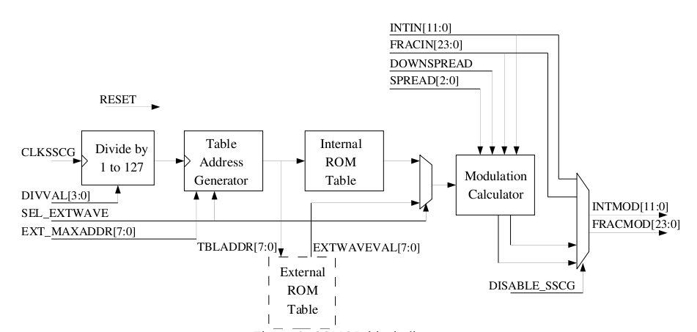
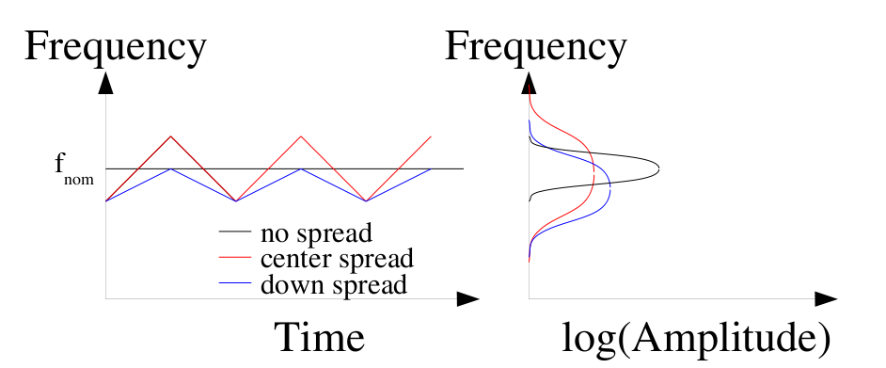
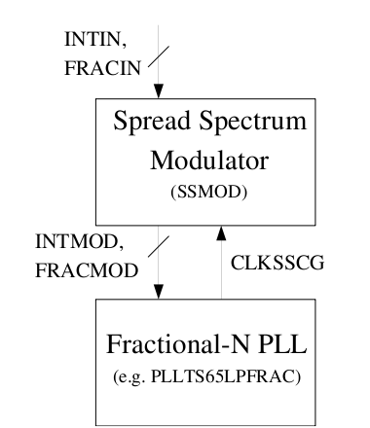
SSMOD
SSMOD internal scheme
The Silicon Creations' Spread Spectrum Modulator (SSMOD) macro works with a Fractional Phase Locked Loop (PLL) to produce spread spectrum clock generation (SSCG). SSCG uses a modulated output clock signal to reduce peak EMI. The lowering of peak EMI can enable significant reductions in expensive shielding costs or reduce interference with other sensitive circuits.
Spread Spectrum in the time and frequency domain
SSMOD and PLL connection

Slide 12
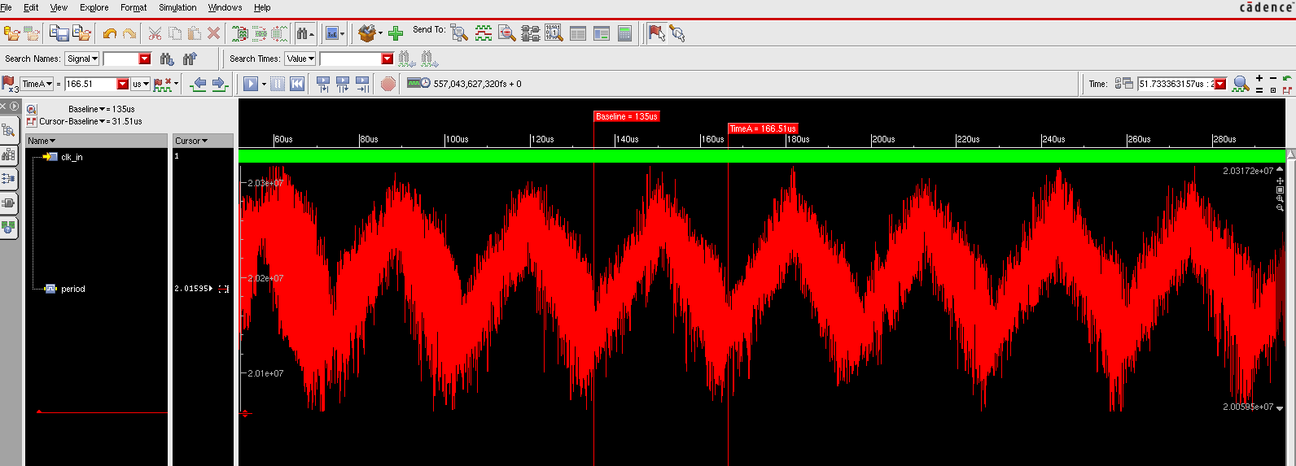
SSMOD simulation
40 bits output reconstructed clock:
Average = 20.198 ns -> 49.50 MHz
Minimum = 20.0497 ns -> 49.87 MHz
Maximum = 20.326 ns -> 49.198 MHz
Recovered clock modulation freq.: ~32KHz

Slide 13
AMchip Data Protocol
IDLE: (32 bits)K.28.5 K.28.5 K.28.0 K.28.0
DATA: 16 BITS word at 100MHz multiplexed in a 32 bit double word at 50MHz
OPCODE : (32 bits) K.29.7 K.29.7 XX XX
The data packet length ( distance between idle character) is programmable by user: 24 bits word (default 5000)
The number of idle character between two data packet is programmable from 0 to 255 (default 8)
The OPCODE are sent together with the data on a data channel.
IDLE
IDLE
DATA
DATA
DATA
IDLE
IDLE
IDLE
DATA
IDLE
IDLE
DATA
DATA
DATA
IDLE
IDLE
OPCODE
IDLE

Slide 14
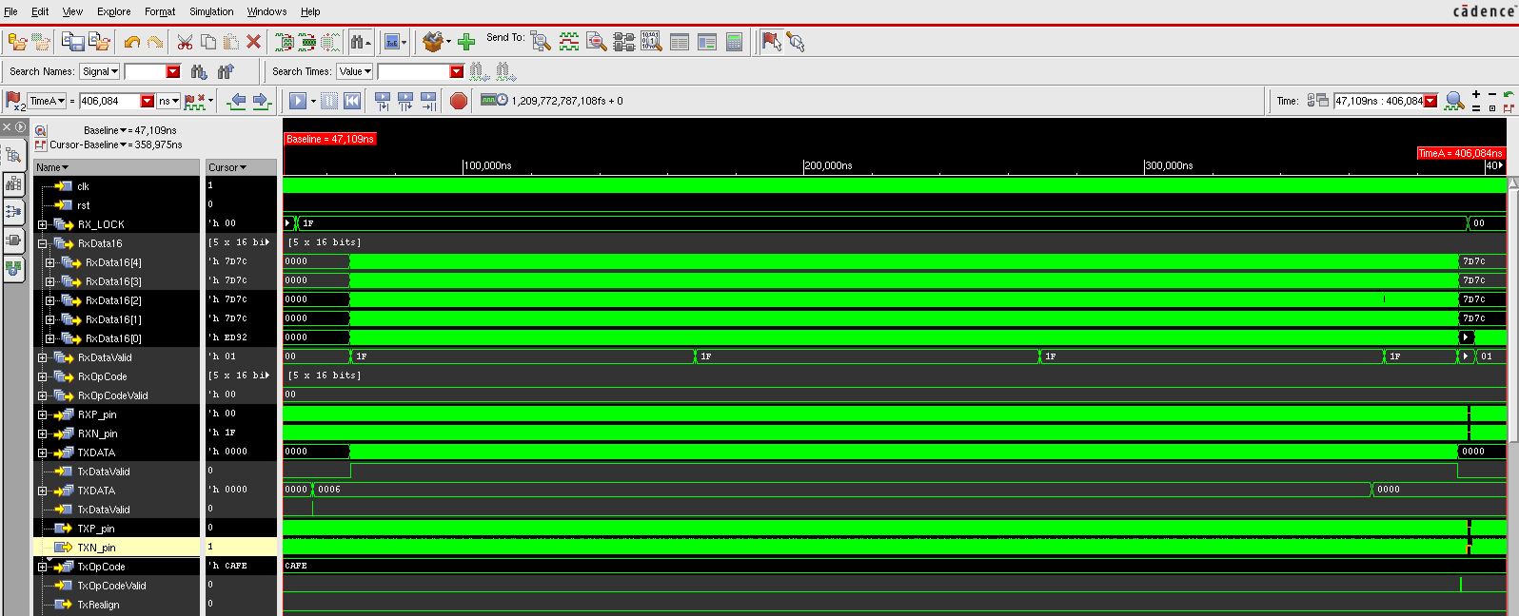
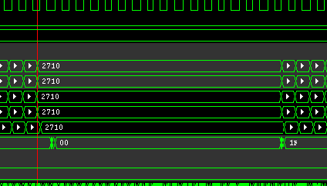
Behavioral simulation results

