Slide 1
What is Neuroplasticity?

Slide 2
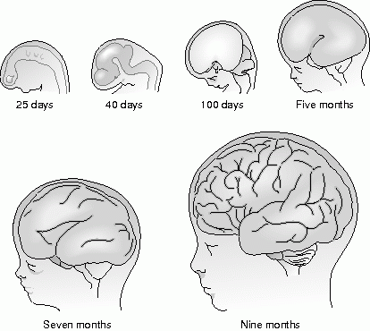
The Traditional View
Development of the Brain during Ontogeny

Slide 3
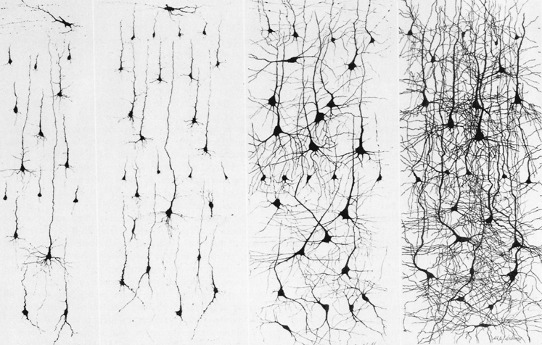
Neuronal Staining during First Two Years
Newborn 3 months 15 months 24 months

Slide 4
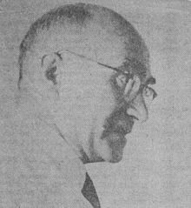
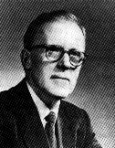
Classic View on Neuroplasticity
Classic View of Neuroplasticity across lifespan
„hard-wired“
Neuronal Devlwopment
of the Brain
Age
in utero child adult
Das Konzept der „Neuroplastizität“
Neuroplasticity
(Konorski 1948, Hebb, 1949)

Slide 5
Classic View on Neuroplasticity
Classic View of Neuroplasticity across lifespan
„hard-wired“
Neuronal Devlwopment
of the Brain
Age
in utero child adult
In the classic view there are no structural changes
in the brain after reaching adulthood

Slide 6
Neuroplasticity
Any functional and/or structural change in neural pathways and synapses which may be due to changes in
- behavior
- environment
- neural processes
- or being part of brain development or
- or resulting from bodily injury
modified after Pascual-Leone et al. 2011

Slide 7
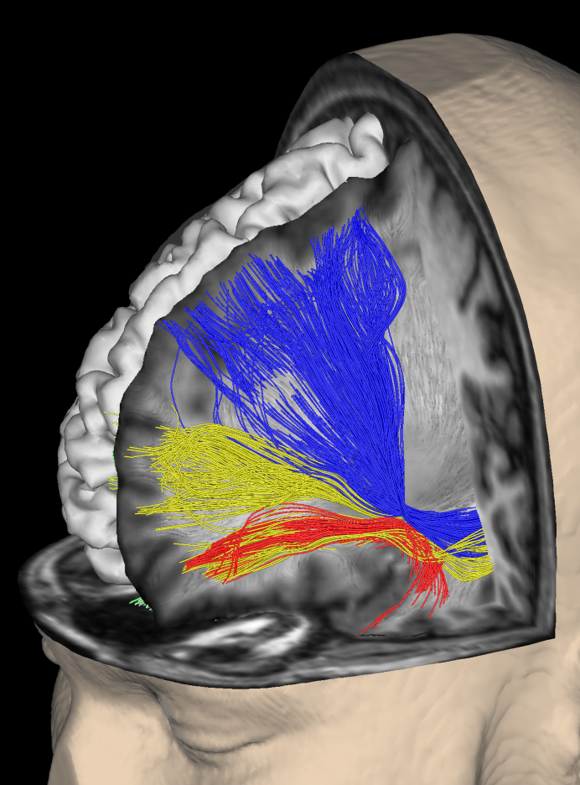
n
Neuroplasticity

Slide 8
n
Outline: Neuroplasticity

Slide 9
n
Outline: Neuroplasticity
Neurons&Molecules

Slide 10
n
Outline: Neuroplasticity
Neurons&Molecules
Neuroimaging&Humans

Slide 11
n
Outline: Neuroplasticity
Neurons&Molecules
Neuroimaging&Humans
Rules&Principles

Slide 12
n
Outline: Neuroplasticity
Neurons&Molecules
Neuroimaging&Humans
Rules&Principles
Lesions&Plasticity

Slide 13
n
Outline: Neuroplasticity
Neurons&Molecules
Neuroimaging&Humans
Rules&Principles
Lesions&Plasticity
Intervention&Therapy

Slide 14
n
Outline: Neuroplasticity
Neurons&Molecules

Slide 15
In the Classical View:
How would one learn anything new?

Slide 16
In the Classical View:
How would one learn anything new?
by making
synapses more or less efficient

Slide 17
In the Classical View:
How would one learn anything new?
by making
synapses more or less efficient
Long-Term Potentiation: LTP (facilitation)
Long-Term Depression: LTD (inhibition)

Slide 18
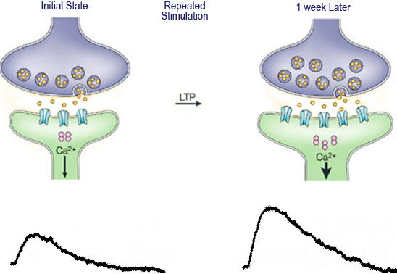
Somatosensory System:
Long Term Potentiation (LTP)

Slide 19
In the Classical View:
How would one learn anything new?
by making
synapses more or less efficient
Long-Term Potentiation: LTP (facilitation)
Long-Term Depression: LTD (inhibition)
BUT NO STRUCTURAL CHANGES

Slide 20
Findings which challenged the
traditional view on neuroplasticity?

Slide 21
Findings which challenged the
traditional view on neuroplasticity?
1) Formation of NEW Dendrites/Synapses
2) Neurogenesis in the adult brain

Slide 22
Findings which challenged the
traditional view on neuroplasticity?
Formation of NEW Dendrites/Synapses
were observed in the brain

Slide 23
Findings which challenged the
traditional view on neuroplasticity?
Formation of NEW Dendrites/Synapses
were observed in the brain
  - during „enriched environement“

Slide 24
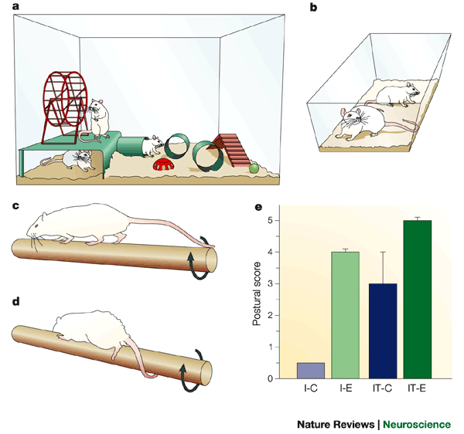
“standard“ laboratory cages
Enriched environment

Slide 25
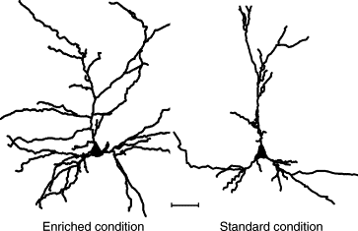
“standard“ laboratory cages
Enriched environment

Slide 26
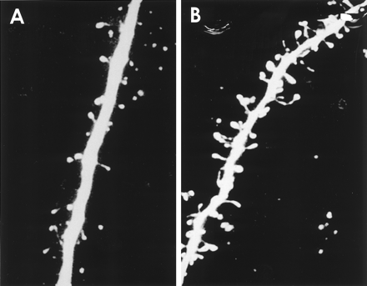
“standard“ laboratory cages
Enriched environment

Slide 27
Findings which challenged the
traditional view on neuroplasticity?
Formation of NEW Dendrites/Synapses
were observed in the brain
  - during „enriched environement“
  - following peripheral nerve damage

Slide 28
Somatotopy in the Brain

Slide 29
Findings which challenged the
traditional view on neuroplasticity?
Formation of NEW Dendrites/Synapses
were observed in the brain
  - during „enriched environement“
  - following peripheral nerve damage

Slide 30
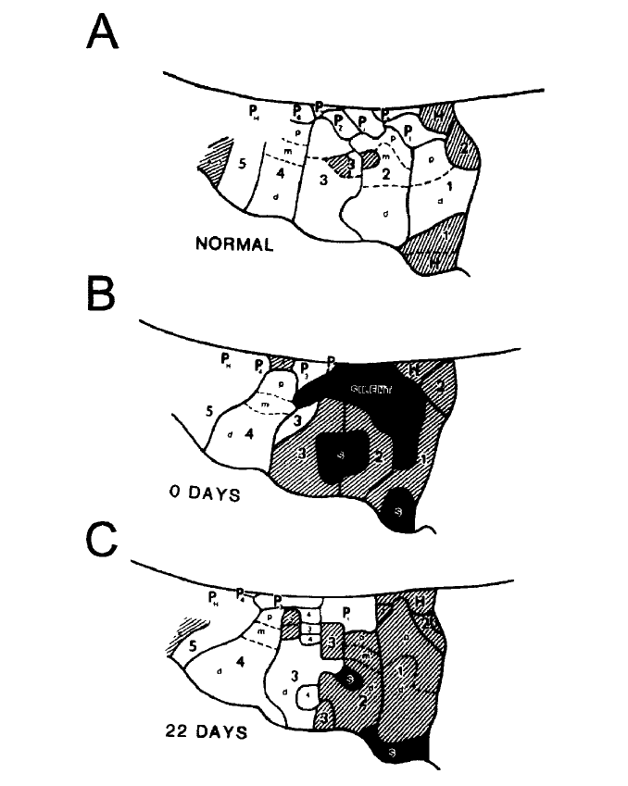
Cortical Map Plasticity after Transection of Median Nerve
Merzenich et al. Neuroscience, 10:639-665, 1983

Slide 31
Findings which challenged the
traditional view on neuroplasticity?
Formation of NEW Dendrites/Synapses
were observed in the brain
  - during „enriched environement“
  - following peripheral nerve damage
  - during learning

Slide 32
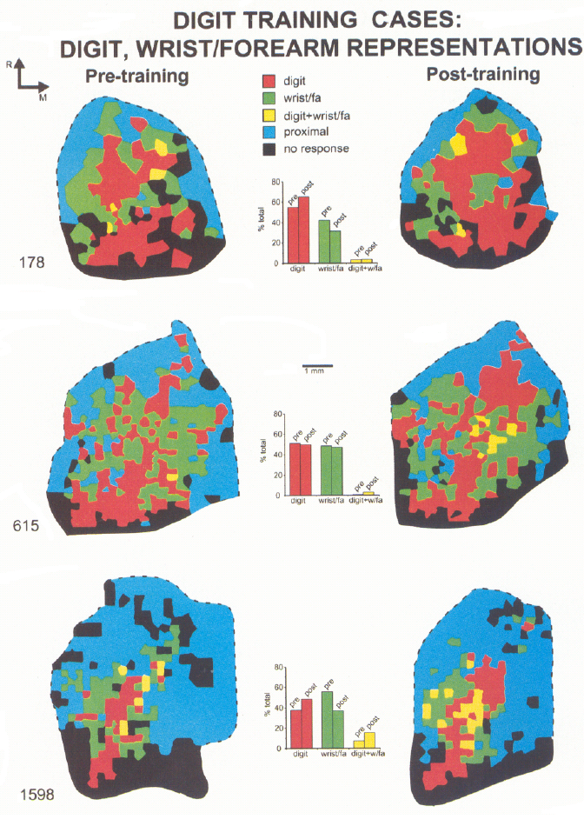
Effects of Learning a new Skill?
Effects of Motor Learning on Cortical Representations in Monkeys
Nudo et al., J Neurosci 1996

Slide 33
Findings which challenged the
traditional view on neuroplasticity?
Formation of NEW Dendrites/Synapses
were observed in the brain
  - during „enriched environement“
  - following peripheral nerve damage
  - during learning

Slide 34
Somatosensory System:
Temporal Dynamics of
Dendrite Development?

Slide 35
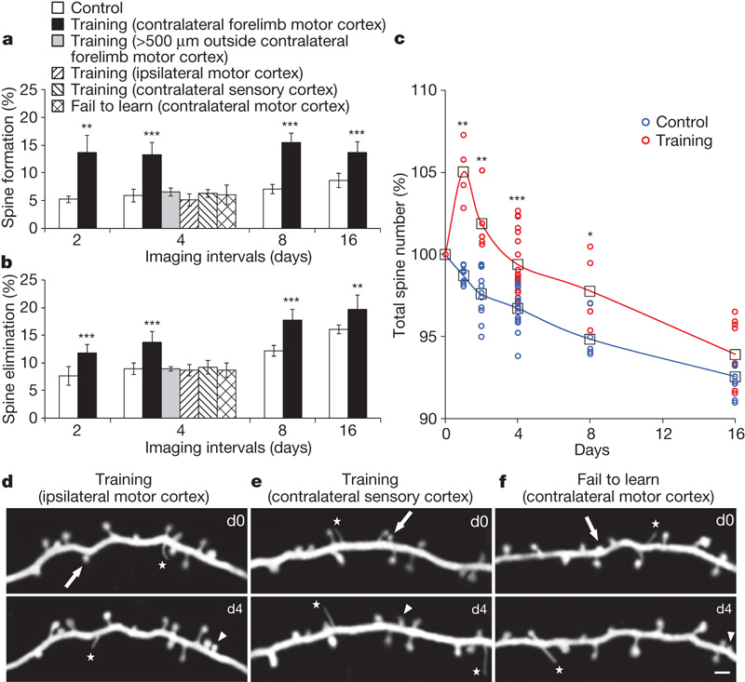
Somatosensory System:
Xu et al. Nature 2009

Slide 36
Somatosensory System:
New Dendrites Appear already within 1h
during Learning a Motor Task
Xu et al. Nature 2009

Slide 37
Somatosensory System:
Observing Dendrites
during Learning a Motor Task
Xu et al. Nature 2009

Slide 38
Somatosensory System:
Observing Dendrites
during Learning a Motor Task
Xu et al. Nature 2009

Slide 39
Somatosensory System:
Formation/Elimination/Stabilization of Dendrites during Learning
1) New dendrites
Xu et al. Nature 2009

Slide 40
Somatosensory System:
Formation/Elimination/Stabilization of Dendrites during Learning
1) New dendrites
2) Selective stabilization
Selective elimination
Xu et al. Nature 2009

Slide 41
Somatosensory System:
Formation/Elimination/Stabilization of Dendrites during Learning
1) New dendrites
2) Selective stabilization
Selective elimination
3) Permanent connections
Xu et al. Nature 2009

Slide 42
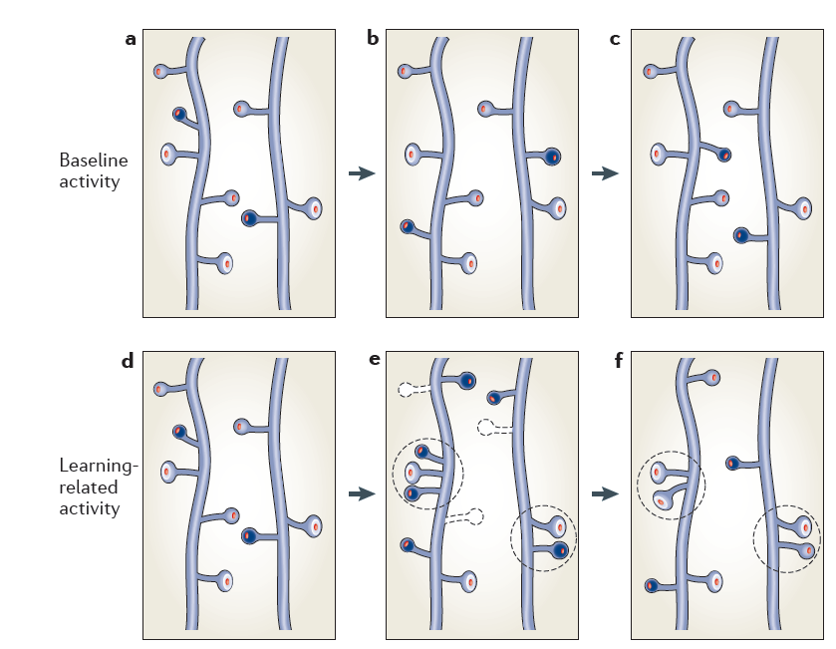
Formation/Elimination/Stabilization of Dendrites during Learning

Slide 43
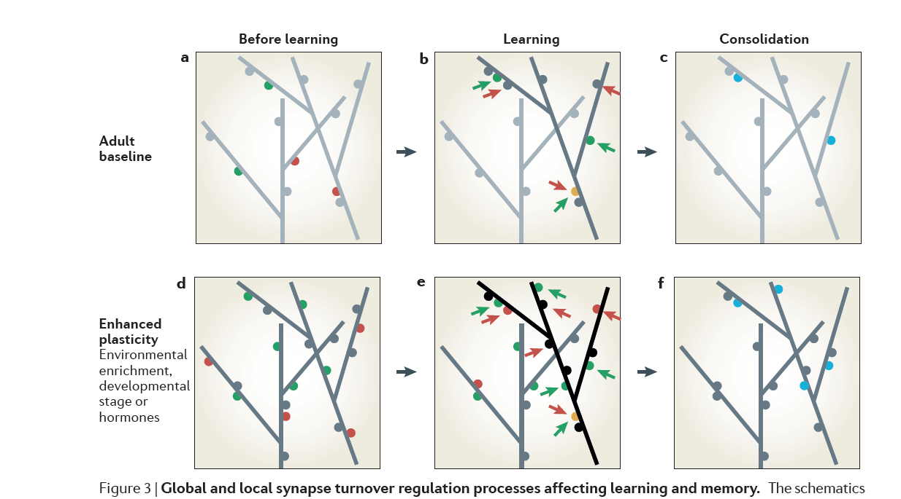
With Antecedent Enriched Environment
Dendrite Formation&Survival is Faster

Slide 44
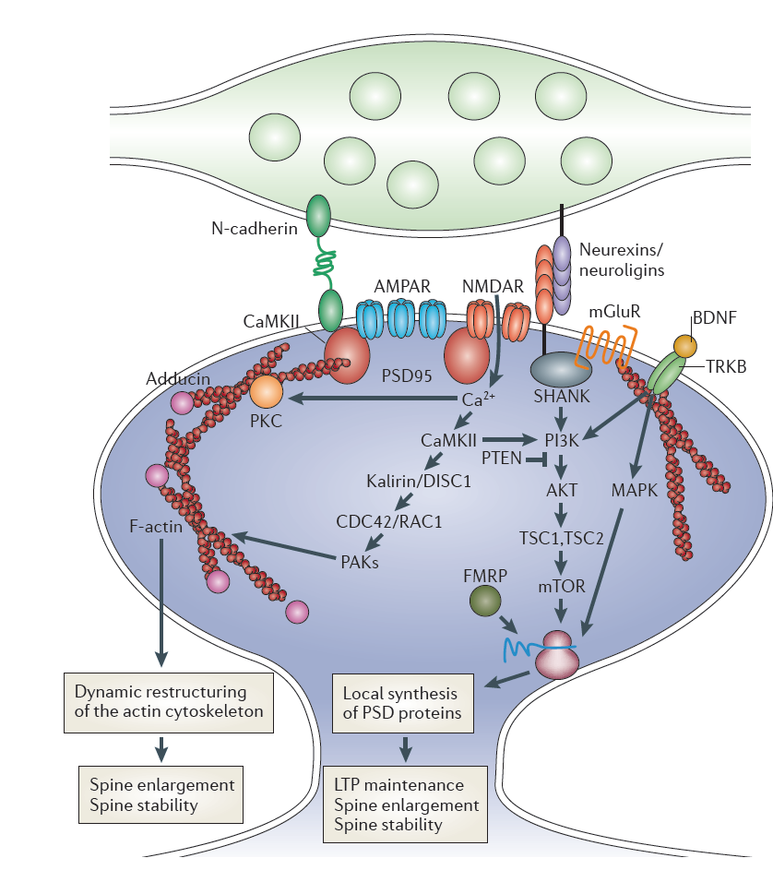
Molecules involved in Plasticity of Synapses

Slide 45
Molecules involved in Plasticity of Synapses
LTP maintenance
Spine enlargement
Spine stability

Slide 46
Molecules involved in Plasticity of Synapses
Glutamate Receptors
AMPA-R
NMDA-R
mGluR
LTP maintenance
Spine enlargement
Spine stability

Slide 47
Molecules involved in Plasticity of Synapses
Glutamate Receptors
AMPA-R
NMDA-R
mGluR
BDNF (Brain Derived Neurotrophic Factor)
LTP maintenance
Spine enlargement
Spine stability

Slide 48
Molecules involved in Plasticity of Synapses
Glutamate Receptors
AMPA-R
NMDA-R
mGluR
BDNF (Brain Derived Neurotrophic Factor)
LTP maintenance
Spine enlargement
Spine stability

Slide 49
Adult Neurogenesis?
(new neurons)
Exists!
Sites:
definitely in subventricular zone (SVZ) of lateral ventricles and subgranular zone (SGZ) in hippocampus
Controversial for other parts of the brain

Slide 50
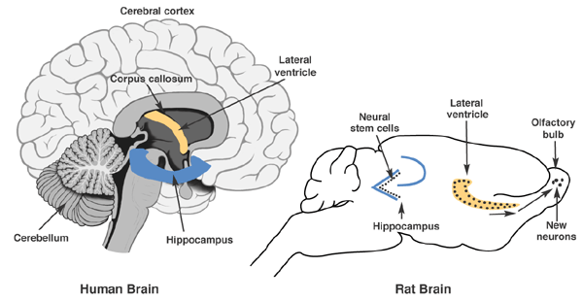
Sites of Human Neurogenesis

Slide 51
Adult Neurogenesis?
Exists!
Sites:
definitely in subventricular zone (SVZ) of lateral ventricles and subgranular zone (SGZ) in hippocampus
Controversial for other parts of the brain
Function:
Plays probably a role in learning&memory, but not yet unequivocally proven

Slide 52
n
Outline: Neuroplasticity
Neurons&Molecules

Slide 53
Take Home: Neurons&Molecules
Neuroplasticity is associated with
- Neurogenesis
Occurs in subventricular zone (SVZ) of lateral ventricles and subgranular zone (SGZ) in hippocampus, function not known yet
- Formation&modulation of Synapses leading to changes in connectivity
is by far the dominant feature of neuroplasticity:
Modulation of synapse efficiency: LTP, LTD
Formation of new dendrites&synapses.
selective elimination and stabilization
Synapse formation&maintanence is
  mediated by Glutamate receptors (AMPA, NMDA, mGluR)
  modulated (enhanced) by BDNF

Slide 54
n
Outline: Neuroplasticity
Neurons&Molecules
Neuroimaging&Humans

Slide 55
What happens in HUMANS
Can We Identify it by Noninvasive Imaging?
Notes:
Towbin Zitat
Bogousslavski Zitat

Slide 56


<
Marco Taubert
Patrick Ragert

Slide 57
Can we identify (signs of) neuroplasticity in HUMANS by noninvasive brain imaging?
Notes:
Towbin Zitat
Bogousslavski Zitat

Slide 58
Methods for Noninvasive Imaging
Imaging Approach | Methods for Analysis | Type of Information | Underlying Physiology& Anatomy
T1-Weighted MRI | Voxel Based Morphometry Cortical Thickness | Brain Structure (grey matter) | neuron density number of dendrites& synapses
Diffusion Imaging | Diffusion Tensor Fibre tracts | Structural connectivity | Nerve fibres
Resting-State fMRI | Seed based ICA-based Centrality | Functional Connectivity | Connected networks
Activation fMRI | Statistical Parametric Mapping (SPM) | Changes in neuronal activity | Transient neuronal activity
Notes:
Towbin Zitat
Bogousslavski Zitat

Slide 59
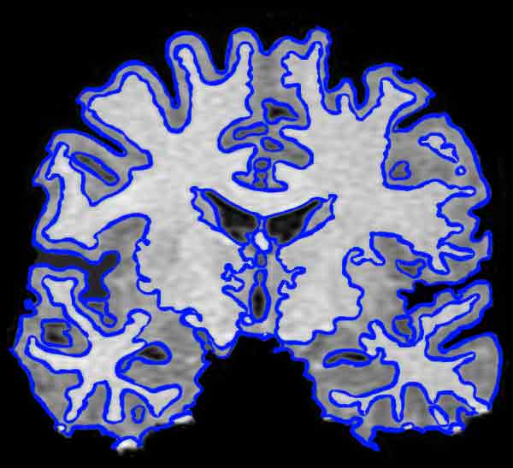
T1-weighted Imaging
Voxel Based Morphometry
Notes:
Towbin Zitat
Bogousslavski Zitat

Slide 60
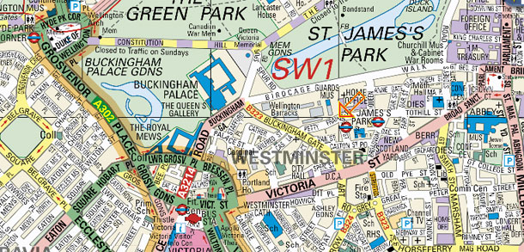
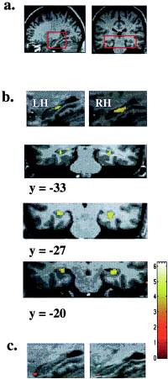

Cross-Sectional Study: Anterior Hippocampus is Bigger in London Taxi Drivers
Notes:
Towbin Zitat
Bogousslavski Zitat

Slide 61
Cross-Sectional Study: Posterior Hippocampus is Bigger in London Taxi Drivers
Notes:
Towbin Zitat
Bogousslavski Zitat

Slide 62
What is special in the Brain of Top Athletes?

Slide 63



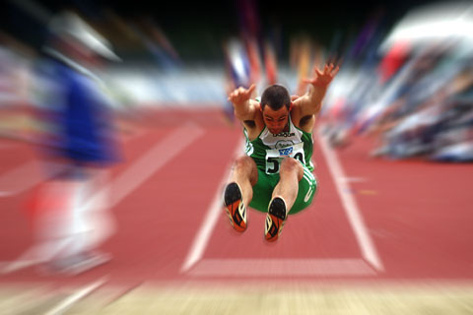
What is special in the Brain of Top Athletes?
Marco
Taubert
Javelin thrower
Long jumper
♂ 27 Jahre, former German Champion
♂ 30 Jahre, former German Vice-Champion
♂ 28 Jahre, PB > 7.9 m

Slide 64
Neuronal Correlates for Velocity?

Slide 65
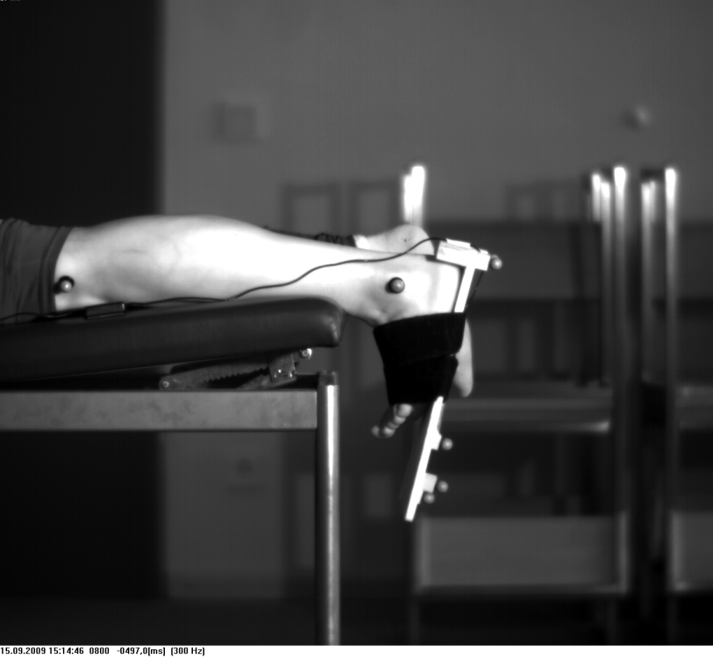
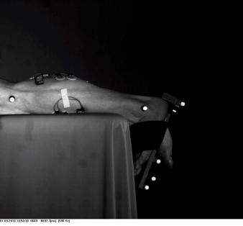
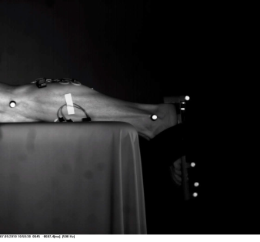
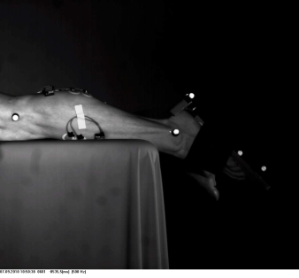
Neuronal Correlates for Velocity?
Plantar Flexion (PF) Test
(left foot)
16 Power Athletes
(sprinter, jumper etc)
(3 ♀/13 ♂) 23.6 ± 3.9 yy
18 Endurance Athletes
(middle- long distance runners)
(5 ♀/13 ♂) 26.5 ± 3.4 yy
**
2.6
2.2
Vmax [m/s]
1.8
1.4
Functional and structural correlates for slow and fast PF?
Wenzel, Taubert, Ragert, Krug, Witt, VIllringer, in preparation 2013

Slide 66
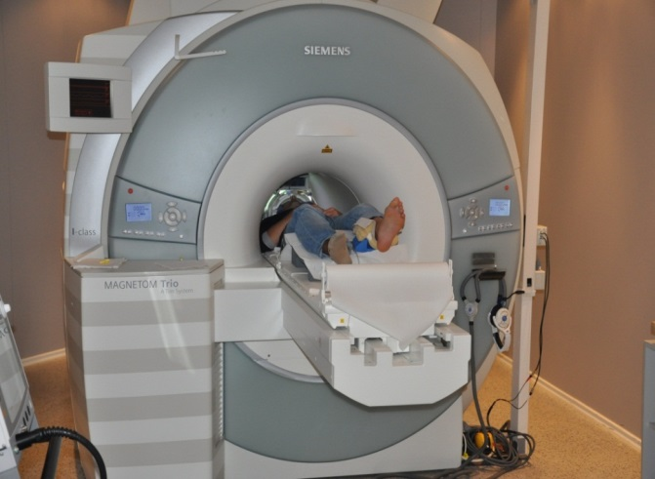
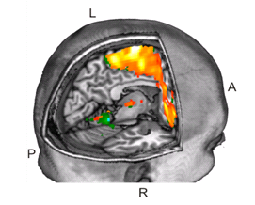

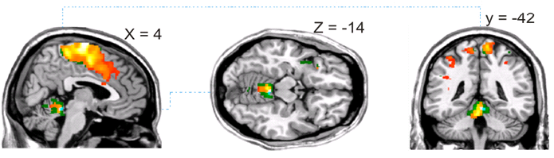
Neuronal Correlates for Velocity
30 s
30 s
30 s
30 s
30 s
PF slow/
fast
30 s
30 s
30 s
30 s
30 s
Rest
Time
PF fast > slow
SM1
PF slow
PF fast
SMA
PMC

Slide 67
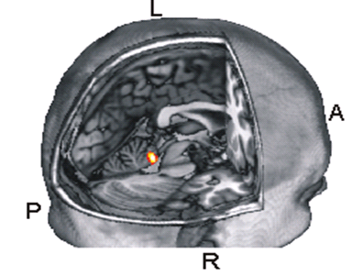

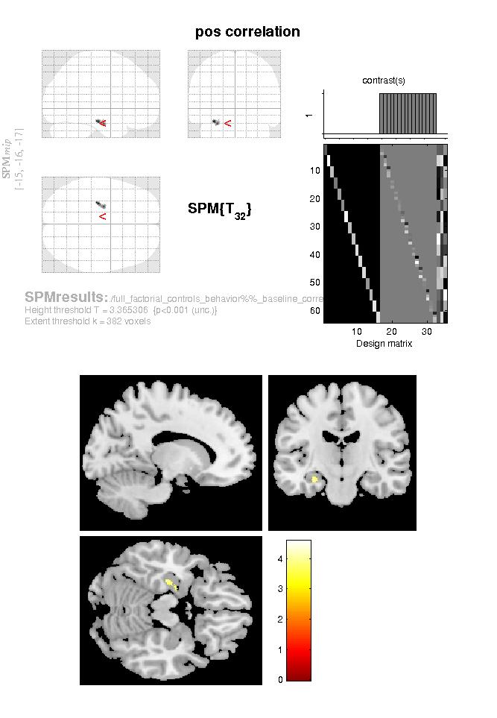
Neuronal Correlates for Velocity
Functional differences in the cerebellum
PF fast > PF slow
x=4 y=-42 z=-14
Structural differences in the cerebellum
Power > Endurance athletes
x=3 y=-39 z=-18
t-Wert

Slide 68
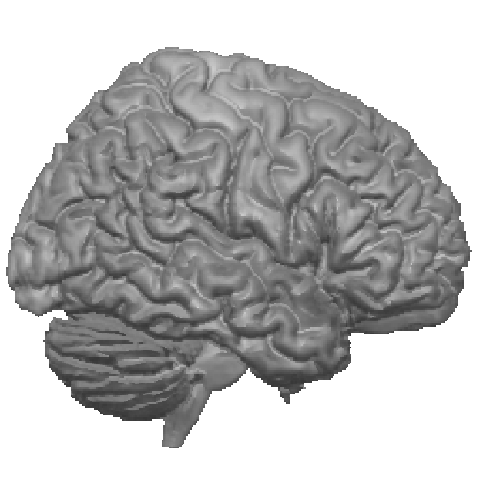
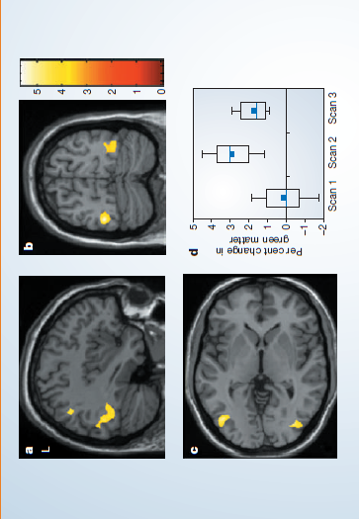
First longitudinal Study by Bogdan Draganski
Pre
- 3 months -
Post
- 3 months -
Recovery
Learning induces structural grey
matter changes in the adult
human brain.
Draganski et al. (2004) Nature
Notes:
Four years ago – at the end of …

Slide 69
What neuroimaging changes do we expect when
following the time course of learning
Notes:
Viele neue Erfahrungen, aber kein linearer Zuwachs an Synapsen erscheint plausibel (ökonomisches Prinzip)
Die Stabilität von erlernten Fertigkeiten spiegelt sich nicht in der Stabilität der induzierten Veränderungen im Gehirn wieder.

Slide 70
What neuroimaging changes do we expect when
following the time course of learning
Dendrite Numbers during Learning
Xu et al. Nature 2009
Notes:
Viele neue Erfahrungen, aber kein linearer Zuwachs an Synapsen erscheint plausibel (ökonomisches Prinzip)
Die Stabilität von erlernten Fertigkeiten spiegelt sich nicht in der Stabilität der induzierten Veränderungen im Gehirn wieder.

Slide 71
What neuroimaging changes do we expect when
following the time course of learning
Dendrite Numbers during Learning
Potential Time Course of Imaging
?
brain structure/
function
Xu et al. Nature 2009
time
Notes:
Viele neue Erfahrungen, aber kein linearer Zuwachs an Synapsen erscheint plausibel (ökonomisches Prinzip)
Die Stabilität von erlernten Fertigkeiten spiegelt sich nicht in der Stabilität der induzierten Veränderungen im Gehirn wieder.

Slide 72
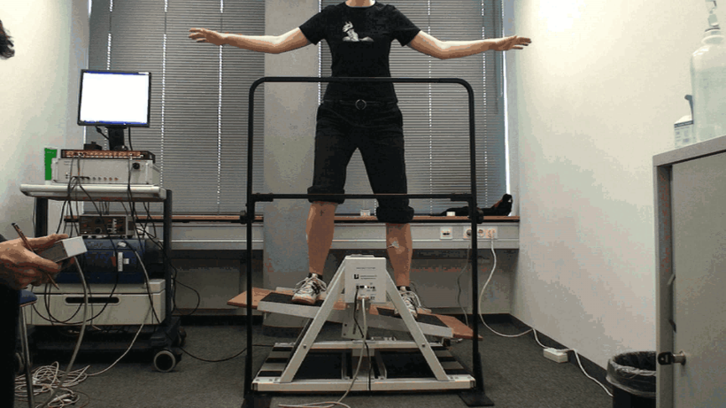
Methods: Balancing Task
= 45 min. per week
week1
week2
week3
week4
week5
week6
3 months
15 months
= T1-weighted MRI, DWI, resting-state fMRI (n=28, Ø age 26 y)
Taubert et al. (2010) J Neurosci
Taubert et al. (2011) Neuroimage

Slide 73
Results: Behavioral
20
15
time in balance [s]
10
~3 months
~15 months
5
0
week1
week2
week3
week4
week5
week6
Skill retention
Taubert et al. (2010) J Neurosci

Slide 74
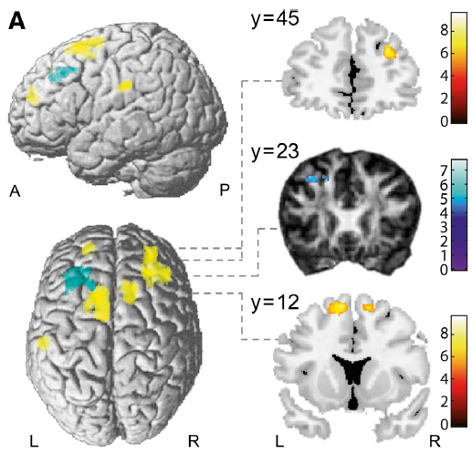
Results: Structural Changes after Two Weeks
mo
mo
mo
t
= grey matter↑
= fractional anisotropy↓
t
t
p<0.05 corrected
Taubert et al. (2010) J Neurosci

Slide 75
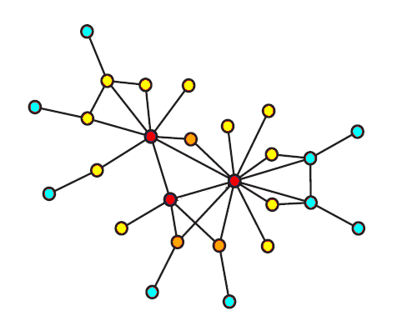
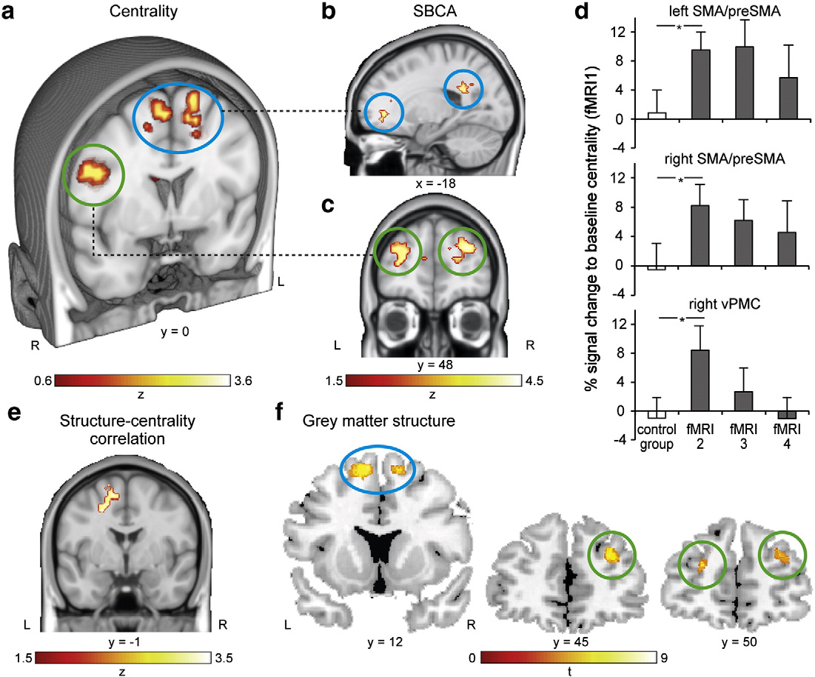
Results: Functional Changes after Two Weeks
mo
mo
mo
Centrality
Connectivity
Eigenvector Centrality Mapping
Lohmann et al. (2010)
Structure-Centrality
Correlation
Grey matter
vPMC
DLPFC
Taubert et al. (2011) NeuroImage
p<0.05 corrected

Slide 76
Structural&Functional Changes after Four Weeks
mo
mo
mo
No changes in structure and function
from baseline to week 4
Early changes in structure and function
are transient!
brain
plasticity
?
What about performance-related changes?
1 2 4 6
week
Taubert et al. (2010) J Neurosci
Taubert et al. (2011) Neuroimage
Notes:
Nicht nur erstaunt, dass 2 x 45 min Training bereits Veränderungen induzieren, sondern das diese Veränderungen beim nächsten MRT Scan wieder weg waren.

Slide 77
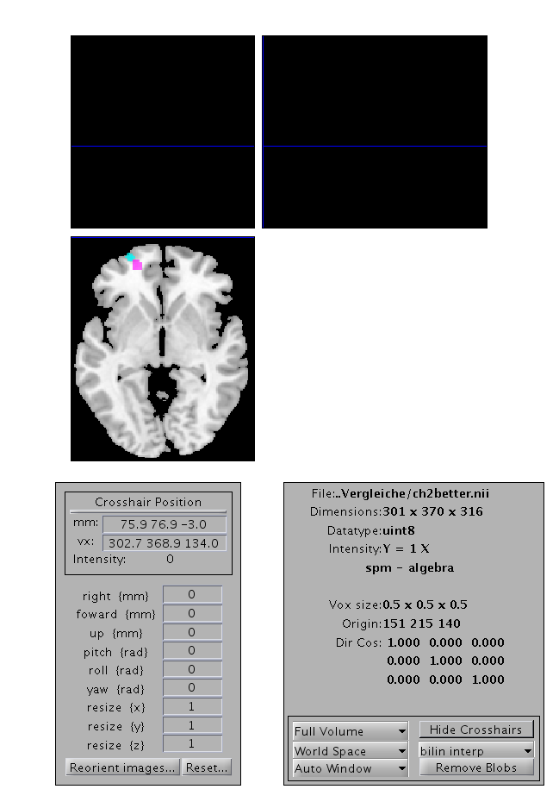
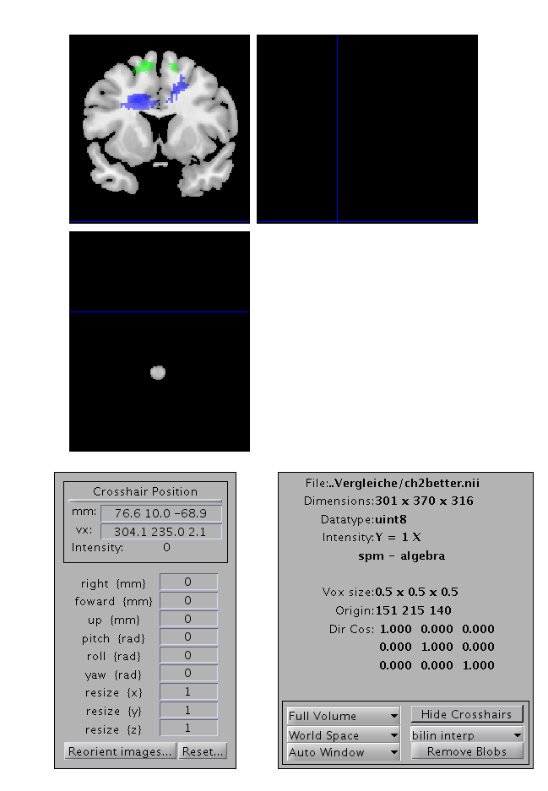
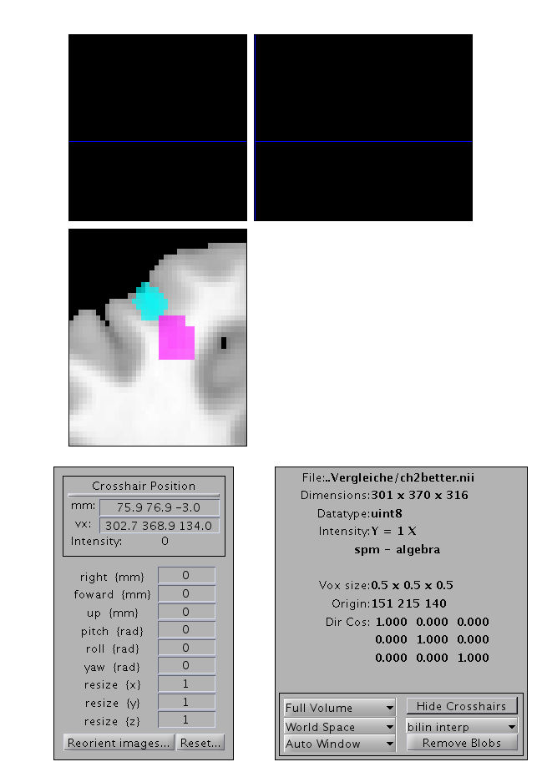
Correlation of Structural Changes with Performance
Prefrontal grey matter, fibre tracts
Prefrontal cortex
Transcallosal fibres
z = -3
Performance
y = 12
30
20
10
0
1
2
4
6
Training day
L
R
L
R
= grey
matter↑
(correl.)
= fractional
anisotropy↓
(correl.)
= mean
diffusivity↓
(correlation)
= grey
matter↑
(0-2 weeks)
p<0.05 corrected
Taubert et al. (2010) J Neurosci

Slide 78
Permanent Changes Correlating with Performance
Changes in
Prefrontal gray matter
Prefrontal white matter
Fronto-parietal functional connectivity
Fibre tracts (structural connectivity)
brain
plasticity
1 2 4 6
week
Taubert et al. (2010) J Neurosci
Taubert et al. (2011) Neuroimage
Notes:
Nicht nur erstaunt, dass 2 x 45 min Training bereits Veränderungen induzieren, sondern das diese Veränderungen beim nächsten MRT Scan wieder weg waren.

Slide 79
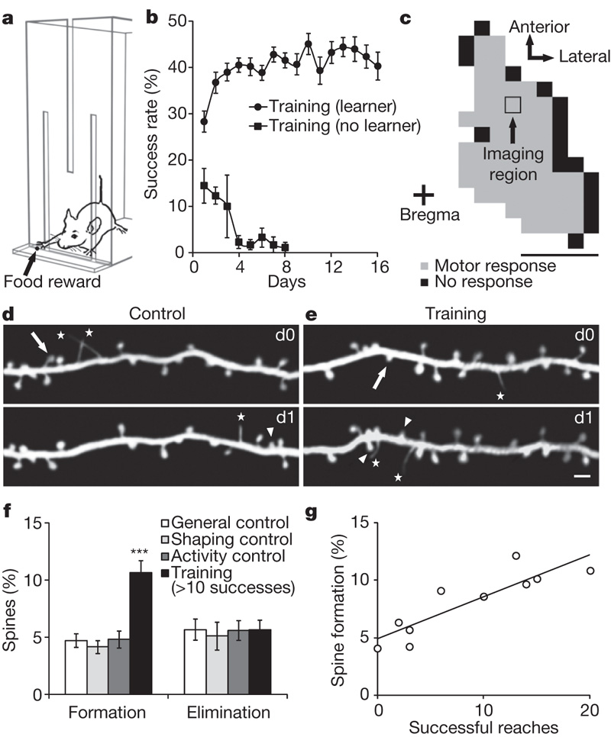
after 1hr
training
Xu et al. (2009) Nature

Slide 80
In Rats New Dendrites Appear after 1 hour:
Earlier Findings also in Humans?
after 1hr
training
Xu et al. (2009) Nature

Slide 81
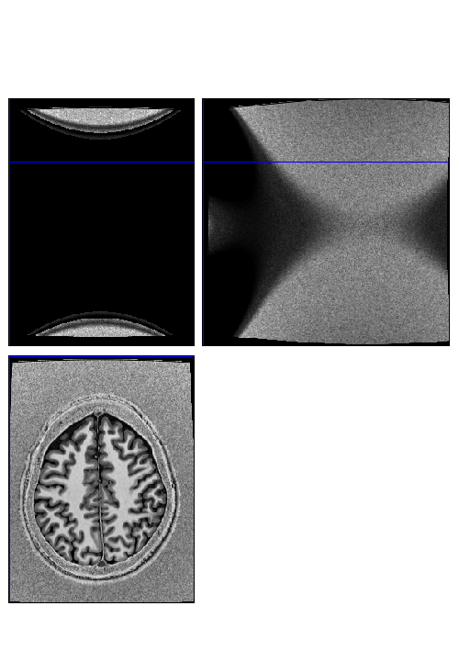
Signs of Rapid Plasticity in Humans?
7 Tesla MRI
25 min 45 min 25 min
… 1 week
= MP2RAGE (0.7x0.7x0.7 mm)
(n = 33)
Taubert et al. (submitted)

Slide 82
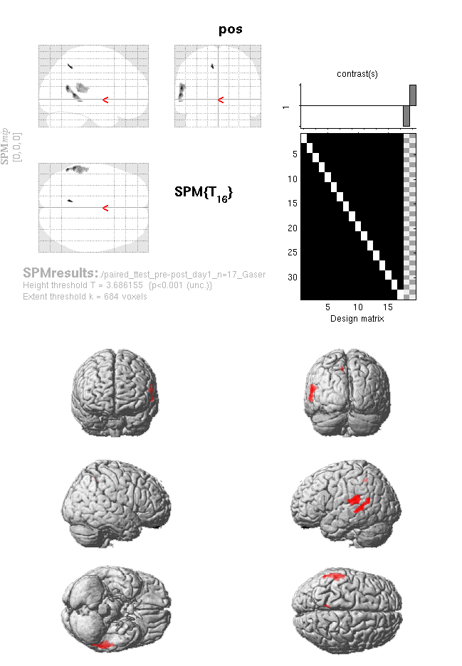
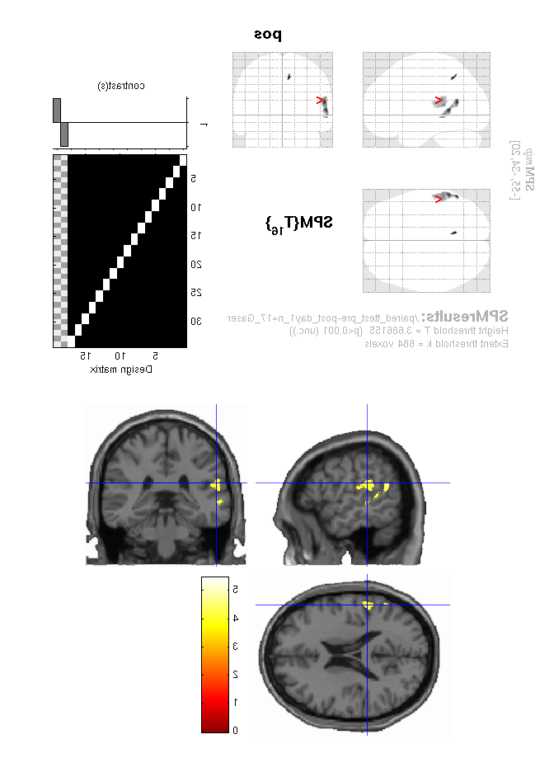
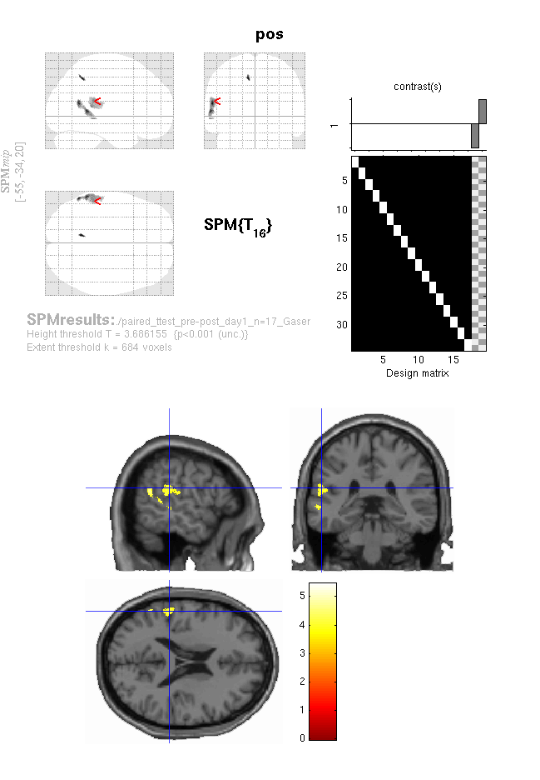
Rapid (Structural?) Changes on T1-Weighted Images
skill level
[% maximum performance]
left superior temporal
gyrus (STG)
trials
STG signal
change [% scan 1]
t value
0 1 2 3 4 5
training control training
scan 2 scan 2 scan 3
p<0.05 corrected
Taubert et al. (submitted)

Slide 83
Different Dynamics of Functional&Structural Changes
Transient structural changes after 45 minutes of training in the
vestibular cortical network
Brain
plasticity
time
Notes:
The traditional understanding of training-induced structural changes as a rigid process developing over a long time period in specific brain areas might be refined by a much more dynamic process of formation and elimination of structural elements taking place in different brain areas depending on the metabolic/computational load on these areas at different learning stages.

Slide 84
Different Dynamics of Functional&Structural Changes
Transient structural changes after 45 minutes of training in the
vestibular cortical network
Transient structural and functional changes after 2 weeks
of training in SMA and DLPFC
Brain
plasticity
time
Notes:
The traditional understanding of training-induced structural changes as a rigid process developing over a long time period in specific brain areas might be refined by a much more dynamic process of formation and elimination of structural elements taking place in different brain areas depending on the metabolic/computational load on these areas at different learning stages.

Slide 85
Different Dynamics of Functional&Structural Changes
Transient structural changes after 45 minutes of training in the
vestibular cortical network
Transient structural and functional changes after 2 weeks
of training in SMA and DLPFC
Persistent and slowly-evolving structural and functional changes
in aPFC (grey, white matter) and fronto-parietal connectivity
Brain
plasticity
time
Notes:
The traditional understanding of training-induced structural changes as a rigid process developing over a long time period in specific brain areas might be refined by a much more dynamic process of formation and elimination of structural elements taking place in different brain areas depending on the metabolic/computational load on these areas at different learning stages.

Slide 86
Discussion:
Presumable Different Phases of Motor Learning?!
sensory
structure and
function
motor-related
executive system
time
Short-term memory
(seconds/hours)
memory
strength
Long-term memory
(hours/months)
Long-lasting memory
(months/lifetime)
t
McGaugh (2000) Science
Notes:
The traditional understanding of training-induced structural changes as a rigid process developing over a long time period in specific brain areas might be refined by a much more dynamic process of formation and elimination of structural elements taking place in different brain areas depending on the metabolic/computational load on these areas at different learning stages.

Slide 87
n
Outline: Neuroplasticity
Neurons&Molecules
Neuroimaging&Humans

Slide 88
Take Home: NeuroImaging&Humans
Cross-sectional studies show increased grey matter density and enlargement of grey matter with presumable long-term functional increase
During learning, structural changes have been observed in grey matter, as well as changes in functional and structural connectivity
Structural changes during learning can be reversible despite continuous learning
During learning a motor balance task, three phases can be differentiated:
- Immediate activity in vestibular area (sensory areas)
- 1-2 weeks: Changes in GMD, functional connectivity in motor areas
- long-term changes correlating with behavior: prefrontal grey matter density, structural and functional connectivity (executive areas)

Slide 89
n
Outline: Neuroplasticity
Neurons&Molecules
Neuroimaging&Humans
Rules&Principles

Slide 90
Somatosensory System:
Rules for formation and survival
of dendritic spines / connections?

Slide 91
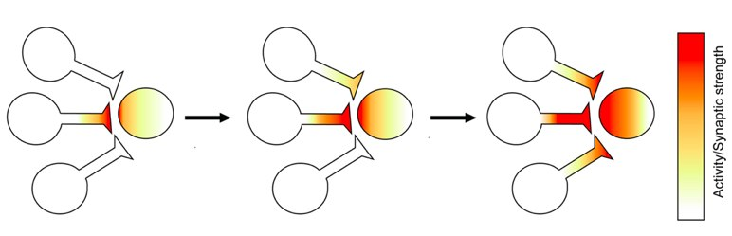
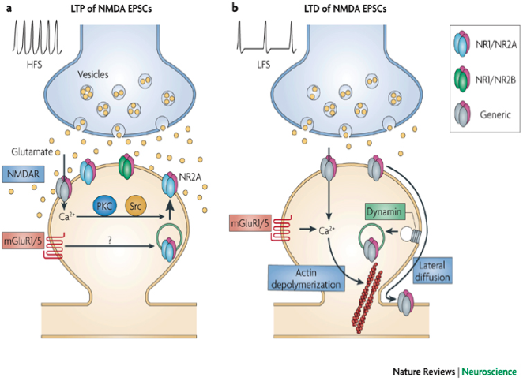
Somatosensory System:
Rules for formation and survival
of dendritic spines / connections?
“neurons that fire together wire together” (Hebb, 1949)
LTP
LTD
Lau & Zukin (2007)

Slide 92
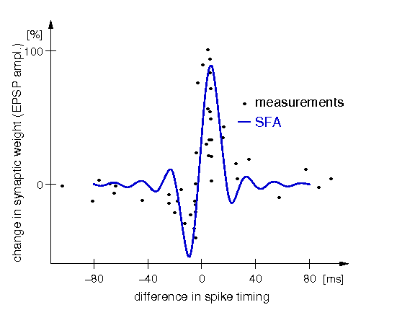
Spike timing-dependent plasticity (STDP)
in animals
“neurons that fire together wire together”
↑ LTP
pre synapse
post synapse
↓ LTD
Bi and Poo et al., J Neurosci 1998; Hebb 1949

Slide 93
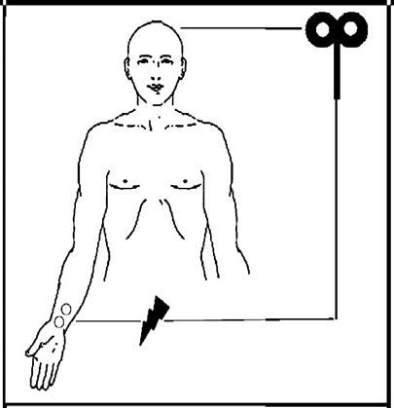
Hebbian Effects in Humans: Combine
Sensory Stimulation&TMS
Paired associative stimulation (PAS)

Slide 94
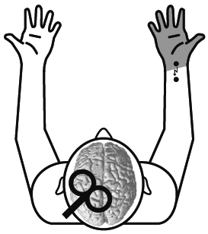
Paired associative stimulation (PAS)
TMS
M1
M1
MNS
5ms
S1
S1
20ms
TMS
Stefan et al., Brain 2000

Slide 95
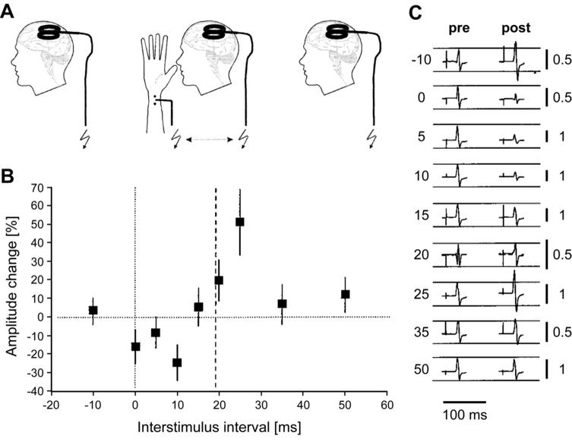
PAS as model for STDP in Humans?
Timing-dependent PAS effects
in humans
PAS
↑PAS_{LTP}
↓PAS_{LTD}
Wolters et al., J Neurophysiol 2003

Slide 96
PAS as model for STDP in Humans?
Timing-dependent PAS effects
in humans
Spike timing-dependent plasticity (STDP)
in animals
PAS
“neurons that fire together wire together”
↑PAS_{LTP}
↑ LTP
pre synapse
post synapse
↓PAS_{LTD}
↓ LTD
Wolters et al., J Neurophysiol 2003
Bi and Poo et al., J Neurosci 1998; Hebb 1949

Slide 97
PAS as model for STDP in Humans?
resembles time dependence of (experimental) spike-timing dependent plasticity (STDP-like)
can induce bidirectional functional plasticity
is NMDA-receptor dependent and induces long-lasting
(LTP/ LTD-like) changes

Slide 98

Virginia Conde

Slide 99
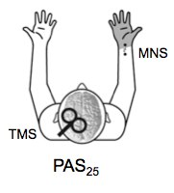
What Explains the Variability of PAS?
Variability of PAS effects
% change
Determinants of plasticity
most studied
some study
50
least studied
120
40
Young
Age
Old
100
30
Synaptic History *
Physically very active
Aerobic Exercise
Sedentary
Focussed
Attention
Distracted
NMDAR-AG
DA-AG
ACh-AG
NE-AG
80
20
Pharmacology
Afternoon
Time of Day
60
↑PAS₂₅
10
PAS_{LTP} after-effects [%]
Female
Gender
40
0
facilitation
Genetics
20
-10
sedentary
Morning
0
-20
inhibition
-30
-20
NMDAR-ANT
GABAR-AG
BDNF SNP:
Val66Met, Met66Met
-40
-40
-50
- inhibition
adopted from Ridding and Ziemann, J Physiol 2010

Slide 100

Can differences in cortical thickness explain the pronounced variability of PAS?
120
100
80
60
40
50
*
20
0
40
PAS₂₅
S1 (MNI: -28, -34, 51)
r²=0.45
-20
-40
30
PAS_{LTP} effect [%]
1
1.2
1.4
1.6
1.8
2
2.2
20
PAS_{LTP} effect [%]
120
100
10
80
0
60
40
20
pre
post1
post2
post3
0
M1 (MNI: -24, -31, 60)
r²=0.33
-20
-40
1
1.1
1.2
1.3
1.4
1.5
1.6
1.7
1.8
VBCT values [mm]
Conde et al. NeuroImage 2012

Slide 101
Modulate networks across the hemispheres (via interhemisph. connection)?
Standard PAS protocol (PAS₂₅)
Ipsilateral PAS protocol (iPAS)
TMS
?
TMS
↑LTP
?
M1
M1
M1
M1
5ms
?
S1
S1
S1
S1
20ms
MNS
MNS

Slide 102
Contralateral PAS Protocol (PAS 25)
LTP-like (facilatory) Effects
180
PAS₂₅
160
140
120
facilitation
MEP change in left M1 [%]
100
80
inhibition
60
40
pre
post1
(0-5 min)
post2
(15-20 min)
post3
(30-35 min)

Slide 103
Modulate networks across the hemispheres (via interhemisph. connection)?
Standard PAS protocol (PAS₂₅)
Ipsilateral PAS protocol (iPAS)
TMS
?
TMS
↑LTP
?
M1
M1
M1
M1
5ms
?
S1
S1
S1
S1
20ms
MNS
MNS

Slide 104

Is there an interhemsipheric S1-S1 communication and what is its delay?
S1-S1communication
left S1
right S1
1.2
facilitation
1.1
1
0.9
N20 SEP ratio (CS/TS)
inhibition
0.8
0.7
0.6
*
left MNS
right MNS
*
0.5
0.4
5
10
15
20
25
30 ms
ISI
CS
TS
CS conditioning stimulus
TS test stimulus
Ragert et al. PLoS One 2011

Slide 105

PAS Effect via S1-S1 connection?
Ipsilateral PAS protocol (iPAS 45)
TMS
?
M1
M1
excitation
5ms
Ragert et PLOS one 2011
20ms
inhibition
S1
S1
20ms
MNS
Conde et al. J Neurophysiol 2011

Slide 106
PAS Effect via M1-M1 connection?
Ipsilateral PAS Protocol (iPAS 35)
TMS
?
^{(Ferbert et al. 1992)}
10ms
M1
M1
excitation
5ms
inhibition
S1
S1
20ms
MNS

Slide 107
PAS Effect via S1-S1 connection?
Ipsilateral PAS protocol (iPAS 45)
TMS
?
M1
M1
excitation
5ms
20ms
inhibition
S1
S1
20ms
MNS
Conde et al. J Neurophysiol 2011

Slide 108
Ipsilateral PAS Protocol (iPAS45)
LTD-like Effects via S1-S1 connection
180
PAS₂₅
160
140
120
facilitation
MEP change in left M1 [%]
100
80
inhibition
60
iPAS₄₅
40
pre
post1
(0-5 min)
post2
(15-20 min)
post3
(30-35 min)
Conde et al. J Neurophysiol 2011

Slide 109
PAS Effect via M1-M1 connection?
Ipsilaleral PAS protocol (iPAS₃₅)
TMS
?
^{(Ferbert et al. 1992)}
10ms
M1
M1
excitation
5ms
inhibition
S1
S1
20ms
MNS

Slide 110
Ipsilateral PAS Protocol (iPAS₃₅)
No Effects via M1-M1 connection
180
TMS
PAS₂₅
160
X
M1
M1
140
120
iPAS₃₅
MEP change in left M1 [%]
S1
100
S1
80
MNS
60
iPAS₄₅
40
pre
post1
(0-5 min)
post2
(15-20 min)
post3
(30-35 min)
Conde et al. J Neurophysiol 2011

Slide 111
Timing-dependent Plasticity through Interhemispheric S1-S1 Communication
80
TMS before MNS
TMS after MNS
PAS25
60
iPAS
iPAS60
PAS
40
MEP change [%]
20
iPAS35
iPAS75
0
PAS45
-20
-10
0
10
20
30
-20
iPAS25
PAS10
iPAS45
-40
Whether Synchronous Firing leads to LTP or LTD-like effects
depends on the SM1 network state
(SM1 excitation LTP-like, SM1 inhibition LTD-like)
Conde et al.
J Neurophysiol 2011

Slide 112
Other Principles?

Slide 113


Negative BOLD during Subliminal Stimulation
contral.
S-I
contral.
S-I
SMA
SMA
SMA
contral.
S-II
contral.
S-II
contral.
S-I
Blankenburg, Taskin, Ruben, Moosmann, Ritter, Curio, Villringer Science 2003

Slide 114


Patterned vs Non-Patterned Stimulation
Effects on Brain Connectivity
L
R

Slide 115
Other Principles
Patterned (predictable) stimulation seems to increase connectivity in secondary cortices (e.g. somatosensory)
Predictive coding (top down prediction interacts with bottom up information) seems to be general principle of brain function (see Garrido …Friston et al. 2009):
Prediction error (see e.g. - Mismatch negativity)
a starting point for inducing plasticity

Slide 116
n
Outline: Neuroplasticity
Neurons&Molecules
Neuroimaging&Humans
Rules&Principles

Slide 117
Take Home: Rules&Principles
PAS: Hebbian Plasticity can be induced in Human Subjects
- LTP-like (facilatory) and LTD-like (inhibitory) effects
- Effects depend on “Phase” of two stimuli
- Affects bihemispheric networks
- Effects depend on cortical thickness of primary sensorimotor cortex
Patterned Stimulation induces increases in connectivity of secondary areas
Predictive Coding as principle of brain function&plasticity

Slide 118
n
Outline: Neuroplasticity
Neurons&Molecules
Neuroimaging&Humans
Rules&Principles
Lesions&Plasticity

Slide 119


How to assess brain plasticity after stroke ?

Slide 120
How to assess brain plasticity after stroke ?
Problem:
Pronounced heterogeneity of lesion size and location
Every patient different, difficult to look at larger groups

Slide 121
How to assess brain plasticity after stroke ?
Problem:
Pronounced heterogeneity of lesion size and location
Every patient different, difficult to look at larger groups
Approach: Collect patients with lesions as similar as possible

Slide 122

Birol Taskin

Slide 123


Thalamic Stroke affecting the
VPL(ventral posterolateral nucleus)
Taskin et al. Cerebral Cortex 2006

Slide 124


Plasticity after Thalamic Stroke: fMRI
- reduced contralateral S1 activation
- preserved (upregulated?) contralateral SII activation
Control
Thalamic stroke
Taskin et al. Cerebral Cortex 2006

Slide 125
Thalamic Stroke affecting the
VPL(ventral posterolateral nucleus)

Slide 126

Plasticity after Thalamic Stroke: sMRI
- Increased grey matter density in bilateral S II
- Increased grey matter density in bilateral insula
day 6 > day 0
Taskin et al.
In preparation

Slide 127
How to assess brain plasticity after stroke ?
Lesions should affect the networks of which the lesion site belongs to.
A more general approach could take into account heterogeneity of strokes may be based on assessing the impact on the different networks…….

Slide 128

Breakdown of cortical connectivity in neglect patients
He et al., 2007
Notes:
On going BOLD signal has been recently used for the diagnosis and investigation of various brain pathologies, such as Alzheimer's, disorders of consciousness, as well as in stroke.
In this study, by He and colleagues, functional connectivity (using on-going BOLD signal) was computed within the attention network in areas that are structurally intact. They have found a breakdown of cortical connectivity (can be seen on the time courses plotted on the right figure) which recovered later on. This breakdown in functional connectivity was shown to correlates with behavior in spatial attentional task (shown on the left graphs).
So the network is impaired although the region is structurally intact. These results contradict the traditional views of the brain as being localized (one area in charge of one function) and supports the more current views of the brain as being comprised of networks.
NEGLECT: a deficit in attention to and awareness of one side of space is observed.

Slide 129

Smadar Ovadia-Caro

Slide 130

The network approach
8-networks template identified in healthy controls
Beckmann et al., 2005
N=10
Notes:
In order to address our research question at the network level, and to be able to asses different lesions, we have adopted a template of 8 spatially independent networks computed by Beckmann and colleagues. This template contains networks such as the visual network, auditory/ executive control networks, and is based on PICA analysis done on 10 healthy controls. Our choice of this template was guided by the fact that these networks have been shown to be of functional relevance and high inter-subject consistency.

Slide 131
Advantages of using resting-state fMRI in stroke patients
No task bias
Able to address several affected networks and not one modality
Relatively easy to acquire (in severe patients as well)
Notes:
Can limit severity for only mild-moderate.

Slide 132


Mapping individual lesions into affected/unaffected networks
the eight-networks template
individual lesions
Notes:
The first step of our analysis was mapping individual lesions into affected and unaffected networks. To that end, FLAIR and DWI images were used for manual drawing of lesion masks. As can be seen here, lesions varied both in location and size. We then used a binarized version of the 8 networks template I introduced earlier and computed the overlap between the two, such as any overlap would result in assigning this network into the affected category. We thus get a binarized matrix which tells us for each subject, which are the affected and which are the unaffected networks by the individual lesion.
For example, for patient 1, the lesion was located in the left putamen and left insular cortex. According to the network approach suggested here, the affected networks by the lesion were networks c (auditory system) d (sensorimotor system) and f (executive control).

Slide 133


Functional connectivity analysis: dual regression and concordance
Dual regression analysis
Concordance computation
Template
Day 1
Day 7
Day 90
Lesion area was excluded from concordance computation!
Notes:
The second step of our analysis was functional connectivity analysis.
For each subject, for each of the three scans, the eight networks were used as predictors in a GLM analysis. This analysis yields individualized spatial maps for each one of the components/networks. As can be seen in the figure here for one component; the visual component; individualized spatial maps were computed for each time point; day 1, day7 and day 90.
Next, in order to quantify the change over time in the spatial pattern, we have computed spatial correlation using concordance correlation coefficient. (ranges between -1 and 1). The lower the value is, the larger the change in the spatial pattern.
Importantly, the lesion area was removed prior to concordance computation as we were interested in the indirect effects of the lesion on functional connectivity.

Slide 134


Concordance as a measure of change in functional connectivity
Δ concordance
(One - sample t test, p < 0.05)
Ovadia-Caro et al., J Cereb Blood
Flow Metab 2013, in press
Notes:
In order to statistically compare concordance values for affected and unaffected networks, we have computed delta concordance, which is the average concordance over unaffected networks minus the average concordance over affected networks. Given our hypothesis, we expect positive difference, i.e. a lager change in the spatial pattern over affected networks. As can be seen on the plot on the right, we found significant differences between affected and unaffected networks concordance. This effect is largely evident in the single subject level.

Slide 135
Conclusions, Limitations, Perspectives
Affected networks preferentially decrease in their concordance over time
A novel general methodological approach for assessing plasticity after stroke (spontaneous, during therapy)
Correlation between behavioral change and concordance over time
Limitations and perspectives: Optimizing network template, validation in larger cohort, optimizing behavioral measures

Slide 136
n
Outline: Neuroplasticity
Neurons&Molecules
Neuroimaging&Humans
Rules&Principles
Lesions&Plasticity

Slide 137
Take Home: Lesions&Plasticity
Problem of Lesion Assessment in patient after stroke:
Heterogeneity of sites and sizes of lesions
Two approaches to overcome this problem
- Collect patients with lesions as similar as possible
- A generalized network-based approach

Slide 138
n
Outline: Neuroplasticity
Neurons&Molecules
Neuroimaging&Humans
Rules&Principles
Lesions&Plasticity
Intervention&Therapy

Slide 139
How to Improve Function?
Training / Practising
Transcranial Stimulation Methods
Drugs

Slide 140

Bernhard Sehm

Slide 141
Training in the elderly and
Patients with Parkinsons’s disease?

Slide 142


Elderly Subjects / Patients with Parkinson’s disease
Patients with Parkinson‘s disease (PD)
Tremor
Rigor
Slower movements
Postural Instability
Dysfunction of balance

Slide 143

Improvement in Balance Control
in elderly subjects AND patients with Parkinson’s disease
20
Elderly (control)
PD Patients with Parkinson‘s disease
18
16
Zeit in waagerechter Position [s]
14
12
10
8
TD1
TD2
TD3
TD4
TD5
TD6
Retention
20 Monate nach TD6
Sehm, Taubert, Conde, Weise, Classen, Draganski, Villringer, Ragert, in review 2012

Slide 144


In PD patients different brain areas seem to be involved in improving balancing as compared to healthy elderly
mo
mo
mo
Cerebellum
(lobule V-VI)
t-Wert
Sehm, Taubert, Conde, Weise, Classen, Draganski, Villringer, Ragert, in review 2012

Slide 145
How to Improve Function?
Training / Practising
Transcranial Stimulation Methods
Drugs

Slide 146


How can we improve motor skill learning?
FOR
REF
+
up
time lag
down
time [s]
sham
tDCS_{M1}
tDCS_{pre-SMA}
tDCS_{SMA}
Transcranial direct current stimulation
(tDCS)
*
35
*
anodale tDCS
30
cathodale tDCS
25
20
Verbesserung im SPFT [%]
15
10
5
0
Nitsche et al., J Physiol 2003, J Neurophysiol 2009
sham
tDCS_{M1}
tDCS_{pre-SMA}
tDCS_{SMA}
Vollmann, Conde, Sewerin, Taubert, Sehm, Witte, Villringer, Ragert, Brain Stimul 2012

Slide 147



tDCS effects on complex whole body motor skill learning
+
Kaminski et al., in review 2013
motor learning
motor learning
In complex behavioral paradigms, the “active” tDCS reference electrode can interfere with skill learning!

Slide 148
Improving Somatosensory Function

Slide 149


Improving Somatosensory Function

Slide 150

Improving Somatosensory Function
Anodal TDCS
Ragert et al. Clin Neurophyiol 2008

Slide 151

Improving Somatosensory Function
Sham TDCS
Ragert et al. Clin Neurophyiol 2008

Slide 152

Improving Somatosensory Function
in Patients after Stroke ?

Slide 153
Effect of Anodal TDCS in Chronic
Stroke Patients (n=10)
anodal tDCS
20 min
5.50
5.00
4.50
4.00
GOT threshold [mm]
3.50
3.00
2.50
s1
s2
s3
s4
during
post
60min
nonparetic
nonparetic
pre
post

Slide 154
How to Improve Function?
Training / Practising
Transcranial Stimulation Methods
Drugs

Slide 155
How to Improve Function?
Training / Practising
Transcranial Stimulation Methods
Drugs
  Dopaminergic (reward system)
  Nerve growth factor (BDNF)
  Anti-NOGO

Slide 156

Stroke: Improvement in motor function
after training with L-Dopa
Scheidmann et al. Lancet 2002

Slide 157


Enhance learning and brain plasticity - How to enhance BDNF?
Cotman & Berchtold (2002) TINS

Slide 158

Enhance learning and brain plasticity - Combine exercise and motor learning
pilot study - 2 weeks of exercise
*
Learning and brain plasticity can be enhanced
through an exercise-induced and genetically
modulated increase in BDNF.
BDNF_{Serum}[pg/ml]

Slide 159
n
Outline: Neuroplasticity
Neurons&Molecules
Neuroimaging&Humans
Rules&Principles
Lesions&Plasticity
Intervention&Therapy

Slide 160
Take Home: Intervention&Therapy
The corner stone of functional improvement (recovery) is optimized training (physical therapy). Still too few clinical trials to really provide information about optimal therapy!!!!
Transcranial Stimulation can improve effects of training
L-Dopa (and probably SSRI) can enhance effects of training
BDNF can endogeneously be increased via aerobic training
Anti-NOGO Ak are exciting approaches for the future

Slide 161
n
Outline: Neuroplasticity
Neurons&Molecules
Neuroimaging&Humans
Rules&Principles
Lesions&Plasticity
Intervention&Therapy

Slide 162






Danke
Smadar
Ovadia-Caro
Burkhard Pleger
Marco Taubert
Bogdan
Draganski
Patrick Ragert
Virginia Conde
Gabi
Lohmann
Daniel Margulies
Bernhard Sehm
Birol
Taskin
Henning Vollmann

Slide 163
n
Neuroplasticity

