Slide 1
From Dirac to MRI: the creativity of the human mind
John Womersley
Chief Executive, STFC
International School of Science Journalism ~ 4th course: Brain imaging and Cognitive Neuroscience
Ettore Majorana Centre, Erice, Italy ~ May 25th – May 29th 2013

Slide 2
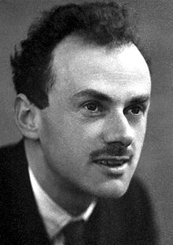
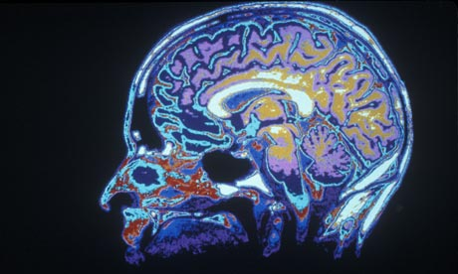
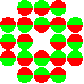
From Dirac to MRI
Paul A M Dirac
The original spin doctor
Imaging spins
Just a thought …
Nobel Laureate in Physics, 1933

Slide 3
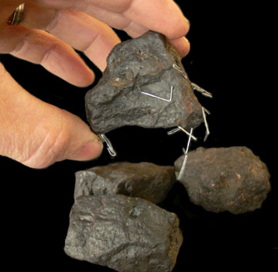
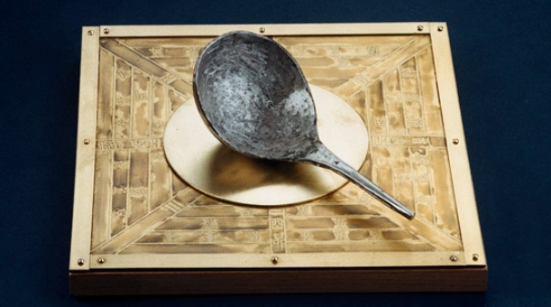
Consider magnetism
Lodestone (Magnetite Fe₃O₄)
Chinese compass (invented Qin dynasty 221-206 B.C.)
Notes:
https://en.wikipedia.org/wiki/Lodestone

Slide 4
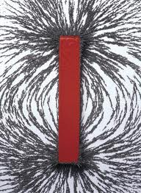
How does it work?
N
S
Bar magnet
Chinese compass (invented Qin dynasty 221-206 B.C.)
Notes:
https://en.wikipedia.org/wiki/Lodestone

Slide 5
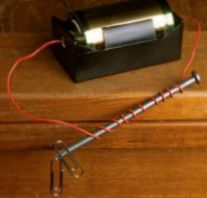
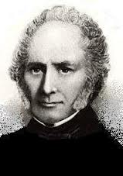
How does it work?
N
S
Bar magnet
Electromagnet
William Sturgeon (1824)
Notes:
http://en.wikipedia.org/wiki/Electromagnet

Slide 6
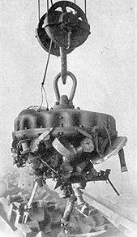
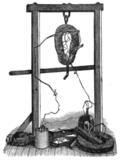
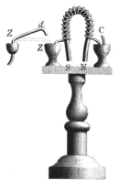
Circulating currents make magnetic fields
Industrial electromagnet lifting scrap iron (1914)
Electromagnet
lifting >100kg
(Henry, 1830)
Electromagnet
(Sturgeon, 1824)
Sturgeon (1824)
Notes:
http://en.wikipedia.org/wiki/Electromagnet

Slide 7
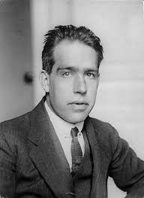
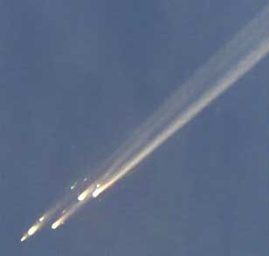
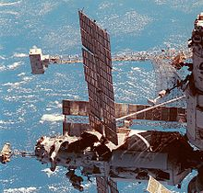
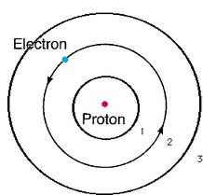
But …
Niels Bohr
Nobel Prize in Physics (1922)
Mir (1986–2001)
Mir
Notes:
http://en.wikipedia.org/wiki/Electromagnet

Slide 8
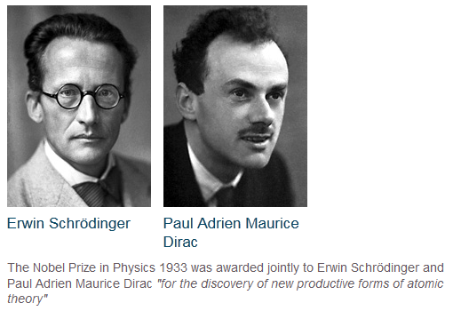
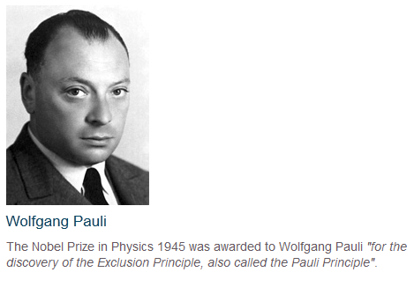
Magnetism needs quantisation!

Slide 9
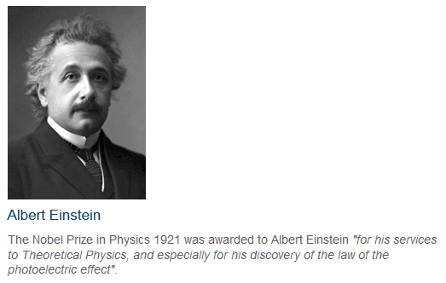
Magnetism needs spin!
QUANTUM MECHANICS
SPECIAL RELATIVITY
Magnetism is an everyday manifestation of both quantum mechanics and special relativity

Slide 10
Resolving Quantum Mechanics and Special Relativity
Paul A M Dirac
The original spin doctor
Nobel Laureate in Physics, 1933

Slide 11
Living in a quantum, relativistic world
Paul A M Dirac
The original spin doctor
Imaging spins
Just a thought …
Nobel Laureate in Physics, 1933

Slide 12
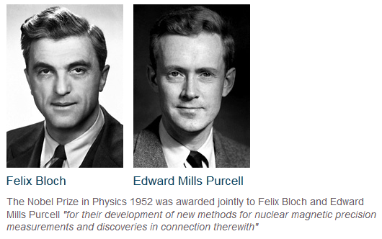
Living in a quantum world: nuclear spins
Nobel Laureate in Chemistry, 1991
Nobel Laureates in Physics, 1952

Slide 13
2003 – The Nobel Prize for Medicine
Notes:
The 2003 award was not without controversy

Slide 14
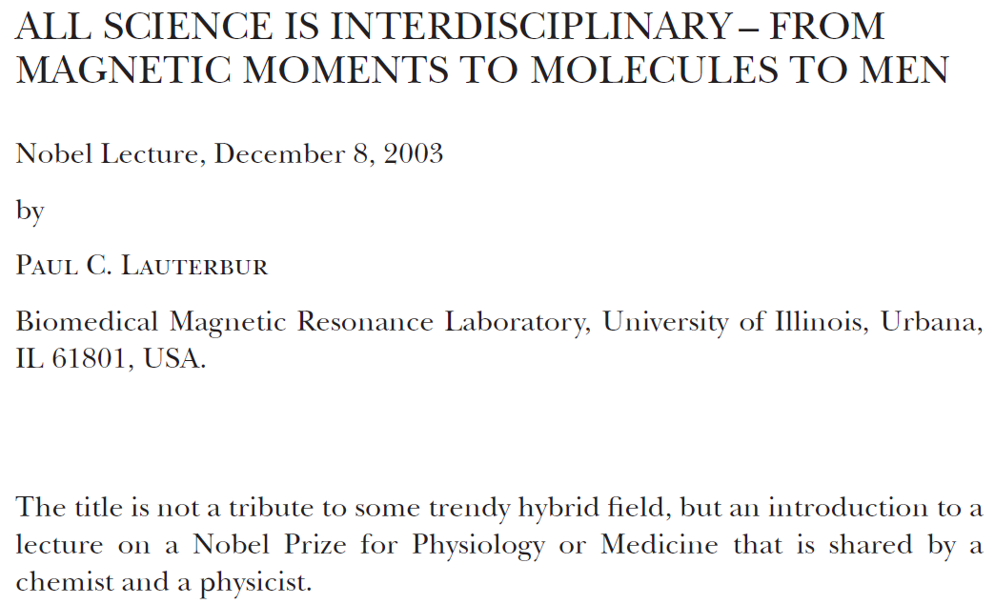
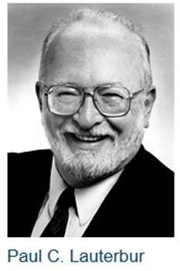

Slide 15
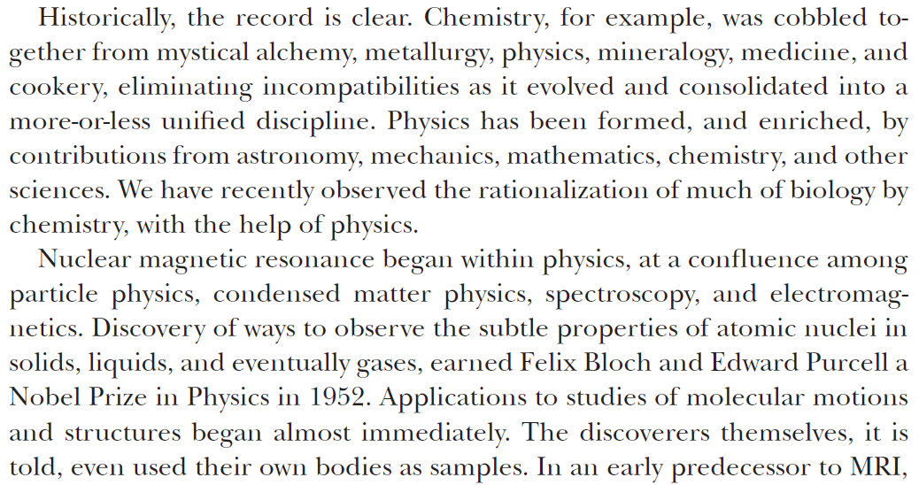

Slide 16
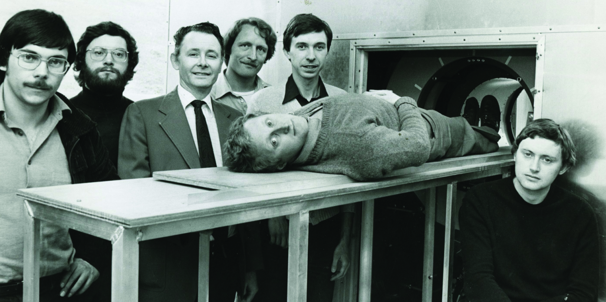
State-of-the-art MRI – Nottingham, UK (ca. 1980)

Slide 17
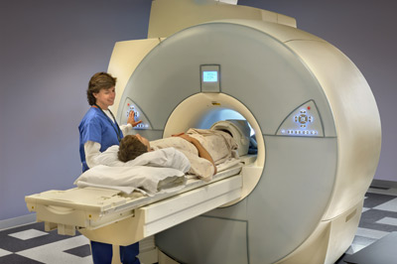
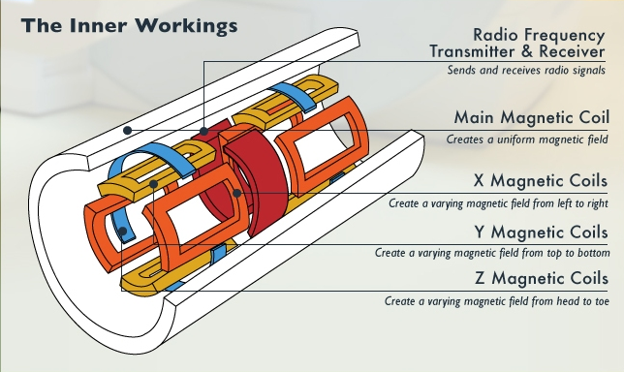
State-of-the-art MRI – 2013
Superconducting magnets
Electronics
What’s inside an MRI machine?

Slide 18
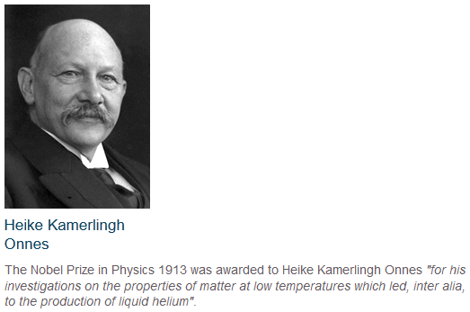
The power of magnetism
… and the discovery of zero resistance
a truly quantum effect
Nobel Laureate in Physics, 1913
Electromagnet

Slide 19
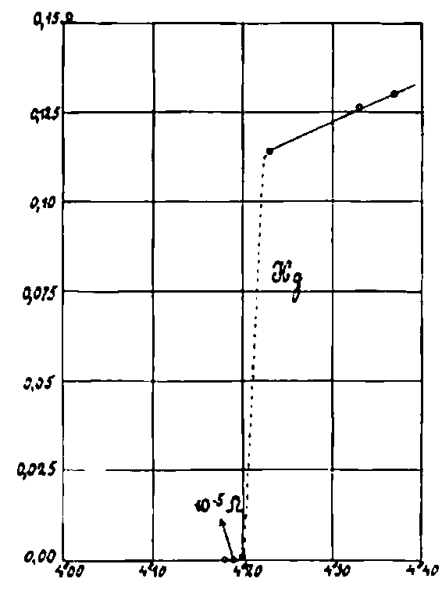
The power of superconducting magnets
… and the discovery of zero resistance
a truly quantum effect
Nobel Laureate in Physics, 1913

Slide 20
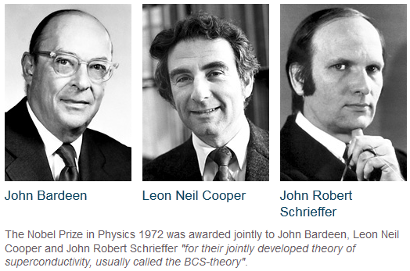
The power of superconducting magnets
Nobel Laureates in Physics, 1972

Slide 21
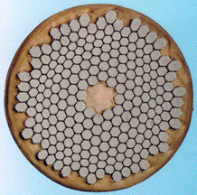
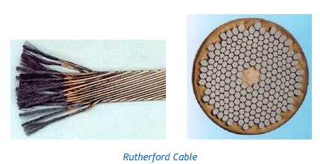
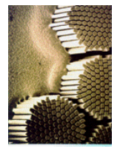
Developing the technology
Rutherford cable

Slide 22
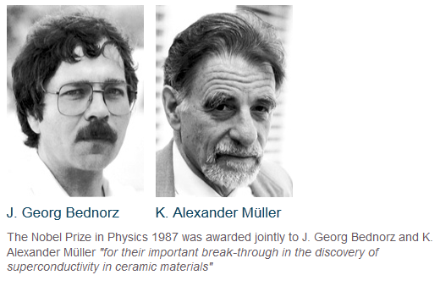
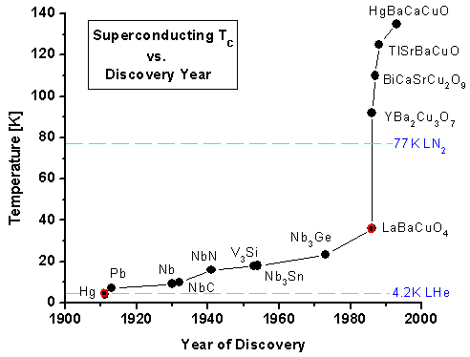
New materials – improved technology opportunities (1986) La_{2-x}Ba_{x}CuO₄ 36K superconductor

Slide 23
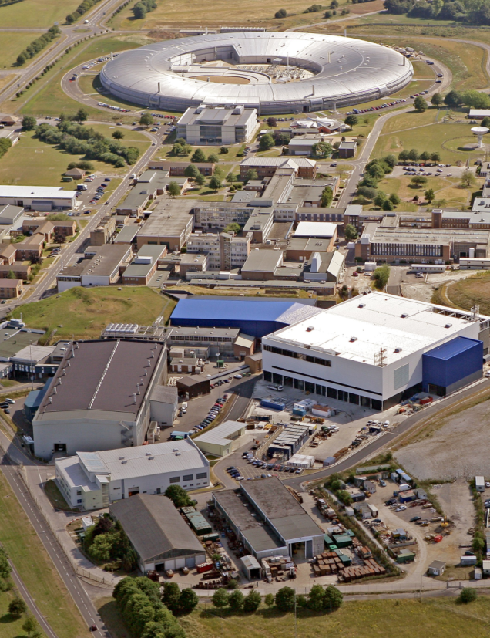
Above liquid nitrogen: YBa₂Cu₃O₇ Cu-based brittle ceramics
Nature (1987) 327 310-312

Slide 24
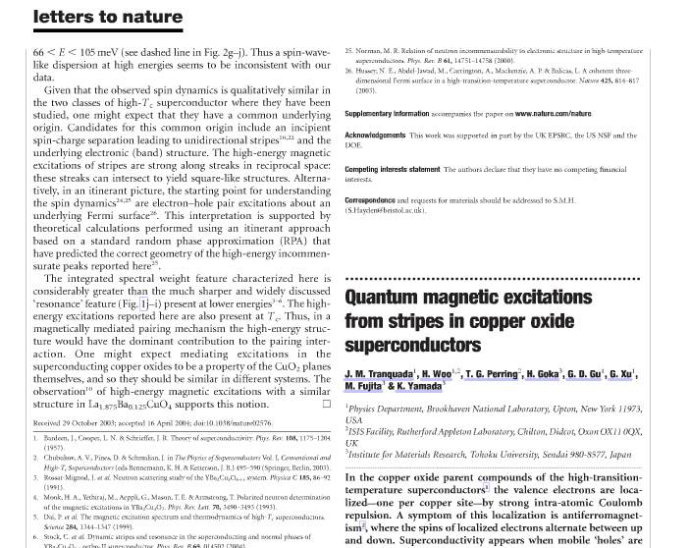
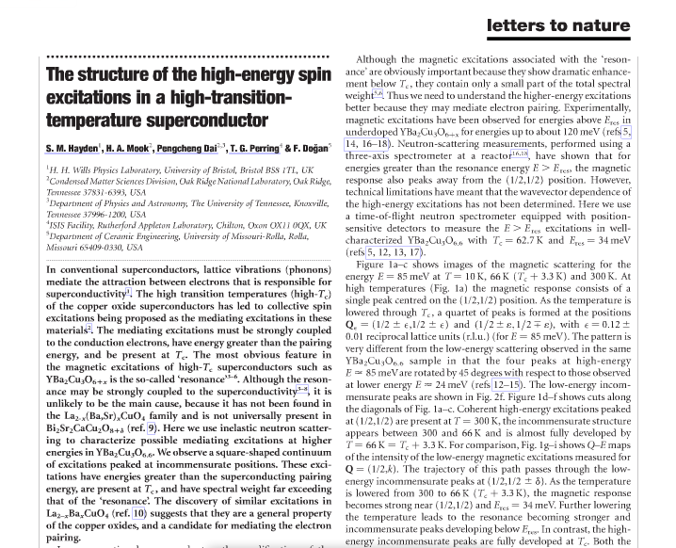
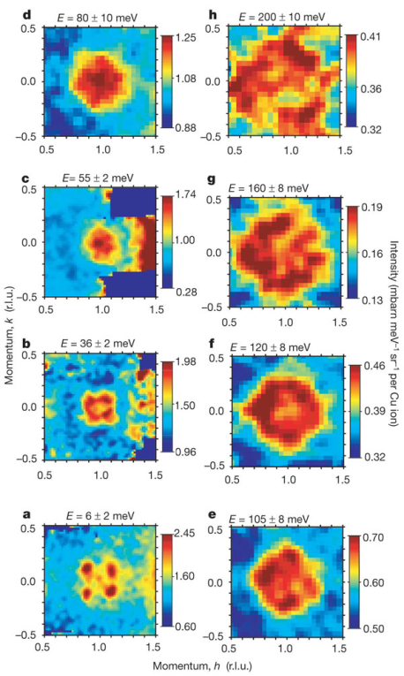
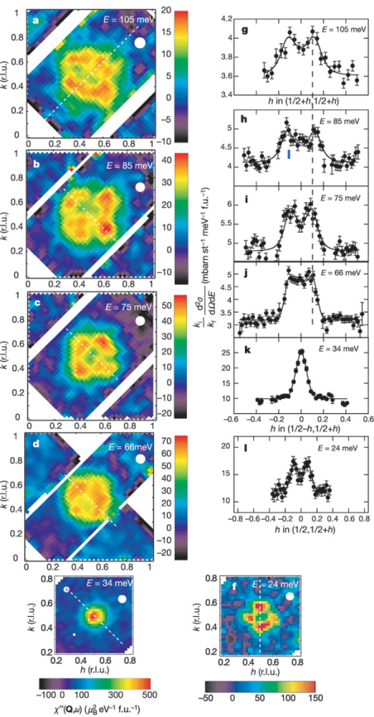
Understanding high temperature superconductors: spin excitations probed by neutron scattering
Nature 429 534-538 (2004)
Nature 429 531-534 (2004)

Slide 25
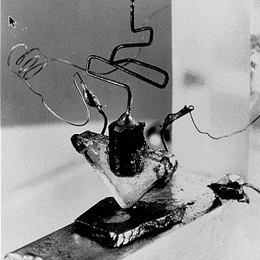
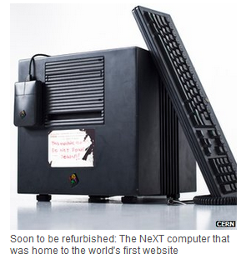
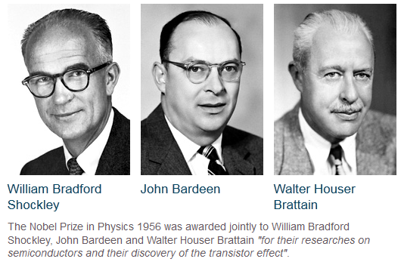
The ubiquitous power of computers
The semiconductor revolution
… from the transistor to the Internet
Bell Labs (1947)
CERN (1993)

Slide 26
From Dirac to MRI
Paul A M Dirac
The original spin doctor
Imaging spins
Just a thought …
Nobel Laureate in Physics, 1933

