Slide 1
Science is in the air

Slide 2
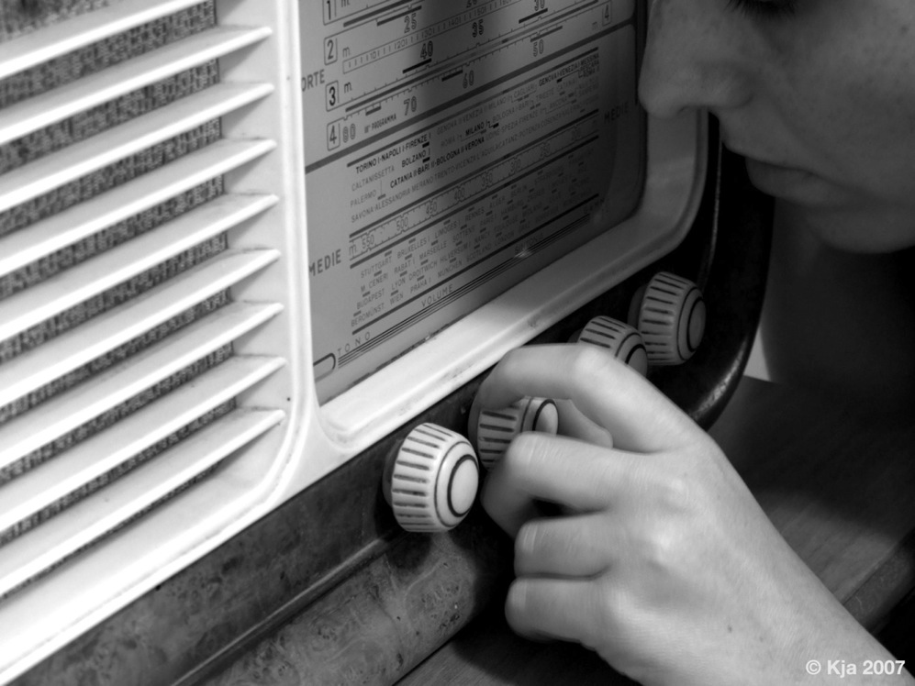

Slide 3
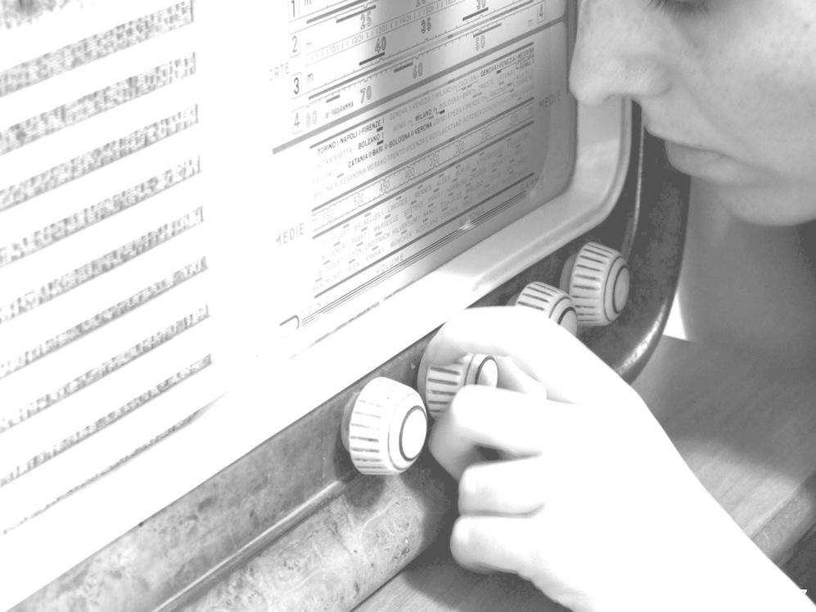
Science is in the air?! Radio + science
A radio program: how does it work?
The contents and the words

Slide 4
It’s not true I had nothing on I had the radio on!
Notes:
The radio is an old medium, compared to television or internet. It has a long history (which i won’t tell to you in this moment…) and a lot of peculiarityes…
having no images, it has to deal with emotions and to communicate with emotions… (it may be a challenge)
And the radio has a lot of listeners…
Almost everyone of us listens to the radio in some part of the day: in the morning, mostly, or while driving in the traffic. In metro station, waiting for the train, or while doing homework or while writing…
But why is radio listening so common and so widespread?
Because of its obvious values… The radio is…
Flexible, volatile, light and cheap, immediate, narrative, intimate , interactive, warm, “close to listener”, cheap to produce and cheap to listen to. And you can listen to it everywhere.
includes the listeners in events, mixes private and public spaces, promotes participation and engagement, allows controversies to be discussed gently, invites to relate what is discussed with outside world, allows the expression of intentions and intimate motivations of the scientists (what you do, but also why you do it...), accompanies life

Slide 5
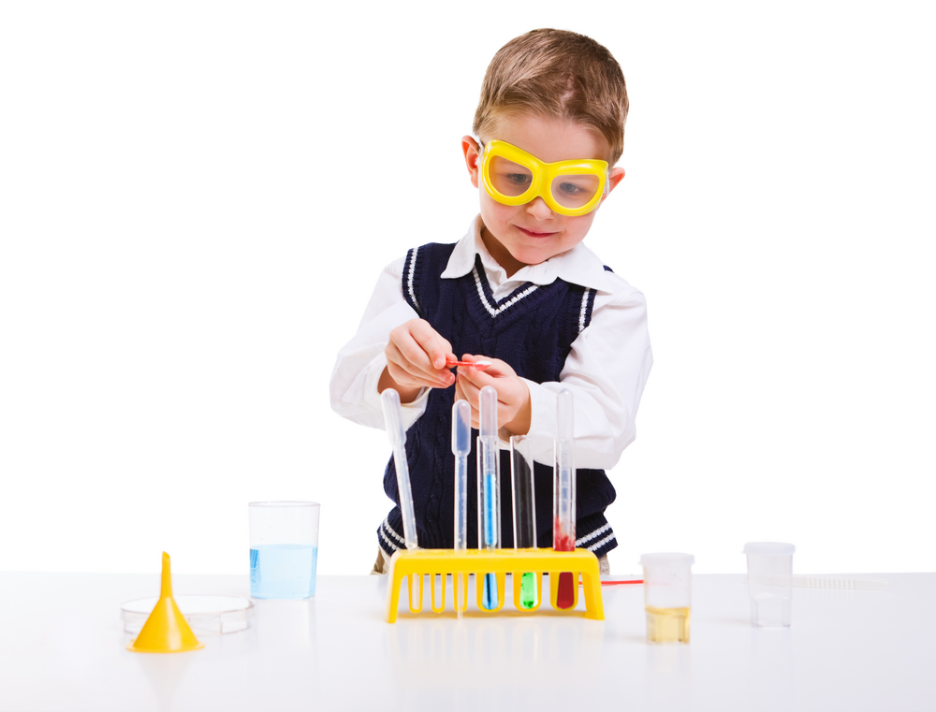
Notes:
The science appear to be the opposite: it is
complex, It works with images and cumulates knowledge…
But science is even debate: energy policy, living will, health policy, climate changes, stem cells, laws on research…
That’s how science works in the radio. Debate.

Slide 6
1. The public 2. The scientists 3. The editorial staff
Notes:
Three components
From now on, i’ll talk mostly about the radio program i know best: radio3 scienza, which is the one i work for, since 2005.

Slide 7
1. The public 2. The scientists 3. The editorial staff

Slide 8
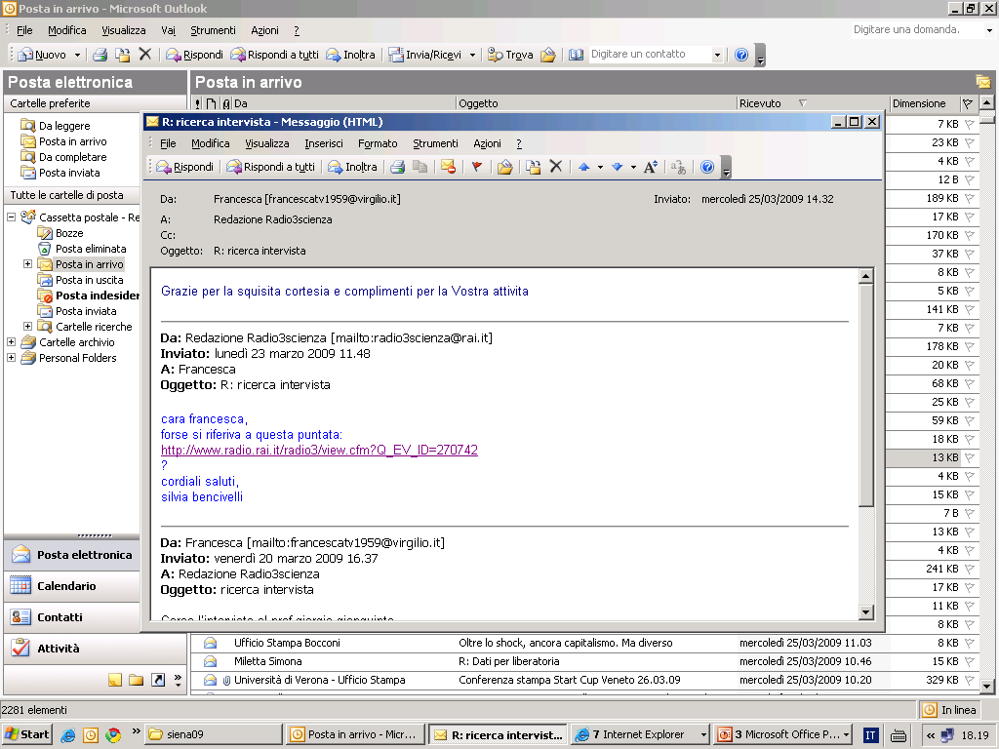
Notes:
At radio rai we used to have statistics, but we dont’ have it anymore because counting is far more complicated now that we listen the radio through the internet
In the radio program i’ve worked for seven years we had three ways (we still have) to communicate with our public:
First: the email
First of all, we have an email and they often write to us. They ask information (as in this case), they give us ideas, they make questions, they criticize…
I’ve copied some of these emails. They are in italian (and i have copied them exactly how they came, without changing a word. I just cutted something, if it was too long).

Slide 9
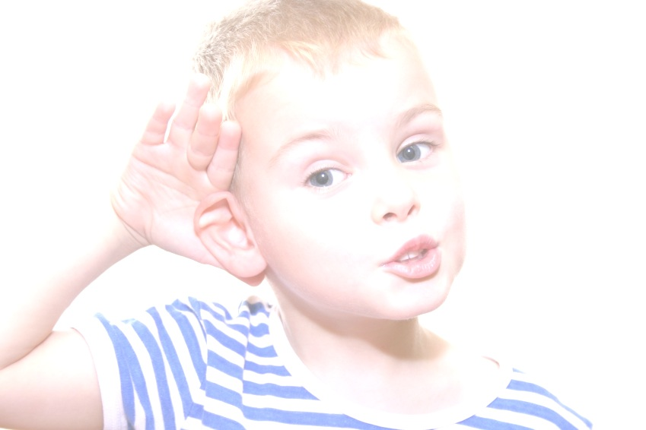
Me ne frego del prezzo del petrolio…
Perchè a casa mia, a Trento, un impianto fotovoltaico copre tutto il fabbisogno energetico, elettrico e termico, alimentando anche una pompa di calore geotermica che provvede al riscaldamento…
Il saldo sarà sicuramente a mio credito per cui prevedo il distacco dal gas e l'acquisto di una cucina elettrica. Ho cominciato i lavori il primo di agosto…
Avete già parlato di pompe di calore qualche tempo fa su mio suggerimento.
Oggi alle 11 non posso chiamare perchè sono dal dentista.
Grazie dell'attenzione e cordiali saluti.
Marcello Pxxxx
348.xxxxx

Slide 10
I don’t care of oil price…
…as at home, in Trento, I have a photovoltaic facility covering all my energy need, heat and electricity; it also powers a geothermal heat pump to warm up the house.
The balance will definitely be in my favour, and I plan to give up the gas connection and to buy an electric stove…
Following my advice you have already spoken of heat pumps.
Today at 11 o’clock I cannot call you, as I will be at the dentist.
Thank you for your attention; best wishes, Yours…

Slide 11
Salve, mi chiamo Gabriele, ho 32 anni e sono non vedente dalla nascita.
Insegno informatica a disabili della vista per conto dell'Istituto per la ricerca e la formazine dell'Unione Italiana dei ciechi e degli ipovedenti.
La mia proposta è di dedicare una puntata, o parte di una puntata di Radio3Scienza alle A.T. Assistive teconolgies, cioè tutti quegli apparati tecnologici che consentono l'uso del personal computer a chi non può leggere lo schermo.
Sono disponibili ad essere intervistato in diretta.
Cordiali saluti.
Gabriele 349 xxxxxxx
Notes:
Sometimes we really do it: we call them, we speak with them. And sometimes we invite them. It has happened to on blind guy. And it has been one of the best program we did. He was blind, he had no problem to talk without looking the others in the eyes!

Slide 12
Hi, my name is Gabriele I am 32 and I was born totally blind.
I teach informatics to visually impaired persons…
My proposal is to dedicate one of your programs, or part of it, to the assistive tehnologies, that is all the devices designed to allow the use of a computer to individuals unaable to read a monitor.
I am available for a live interview….
Gabriele 349 xxxxxxx
Notes:
Sometimes we really do it: we call them, we speak with them. And sometimes we invite them. It has happened to on blind guy. And it has been one of the best program we did. He was blind, he had no problem to talk without looking the others in the eyes!

Slide 13
Ho avuto un problema col profilattico, e per precauzione sono dovuto ricorrere alla pillola del giorno dopo.
La mia ragazza è francese, ed era con due ragazze francesi… Le francesi mi dicevano "In Francia basta andare in farmacia". Siamo dovuti andare ad Ancona...
Le francesi erano allucinate (ma ancora non sapevano che avrebbero dovuto fare una coda interminabile in autostrada!).

Slide 14
I had a problem with my condom, so we decided to use the morning-after pill.
My girlfriend is french, and she was with two French friends… They said “In France all you have to do is go to a chemist’s”. We had to go as far as Ancona…
The French girls were appalled (and they did not know yet that they were expected by an endless queue in the motorway)…
Notes:
He feels very close to us and he writes after a program about abortion and abortive pills: you know that the italian law (and the italian way to implement (?) laws) is in this case very restrictive, compared to other european country.
They were astonished.
As you see, he give us his experience as he could write to a friend. He knows, he imagine, that we are agree with him and with the french girls.
Two italian problems…

Slide 15
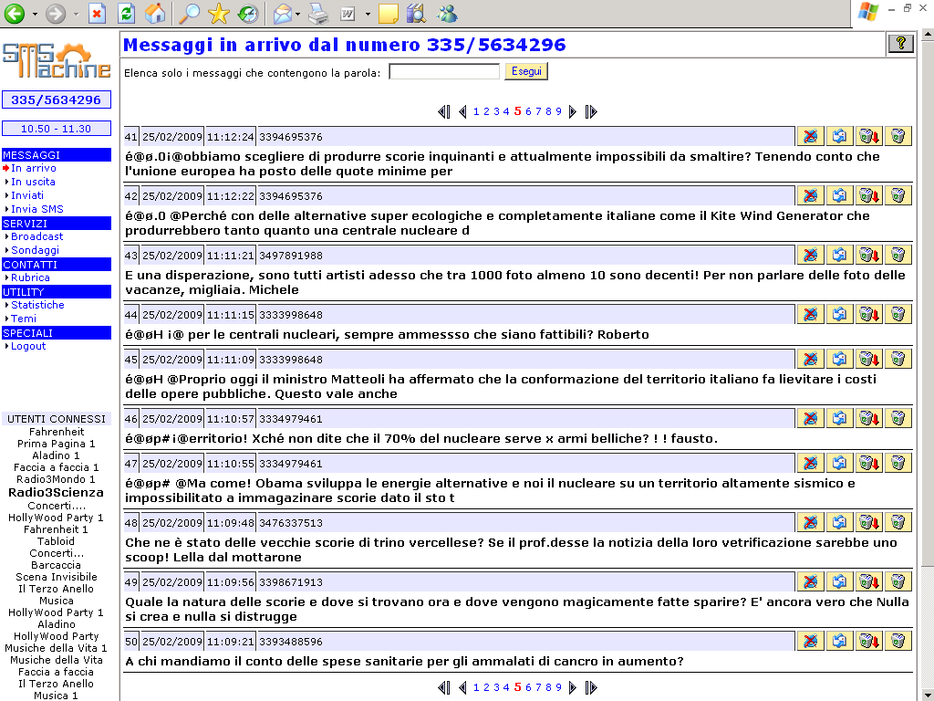
Notes:
Then, as i told you, we receive the sms. These are just some of the sms we have received that morning. The nuclear debate is a perfect example of a scientific subject that you can treat at the radio and just in this day we have received more then a hundred messages!
The sms arrive to us in this way. This is a computer and we download the messages while we are on air. So, we can read it, the speaker can do it. And this is the voice of the listeners: they often make questions or, more often as in this case, they are saying that they are not agree with the guest we have invited. In these cases, we are obliged to do other programs: we read very seriously the emails and the messages we receive and we try to adapt the program to the feelings of the listeners. (but, attention: people who writes are often the people who do not agree. That’s why, in this case, we did many programs, once with someone pronuclear and once with someone antinuclear. It’s also an occasion to know the public!) And then, not every one writes email or sms: our radio, i told you some slides ago, is listened mostly by elderly and they do not use the computer as the youngest listeners do. So, in this way, we collect just the opinion of the youngest. But it’s the only one we can collect…

Slide 16
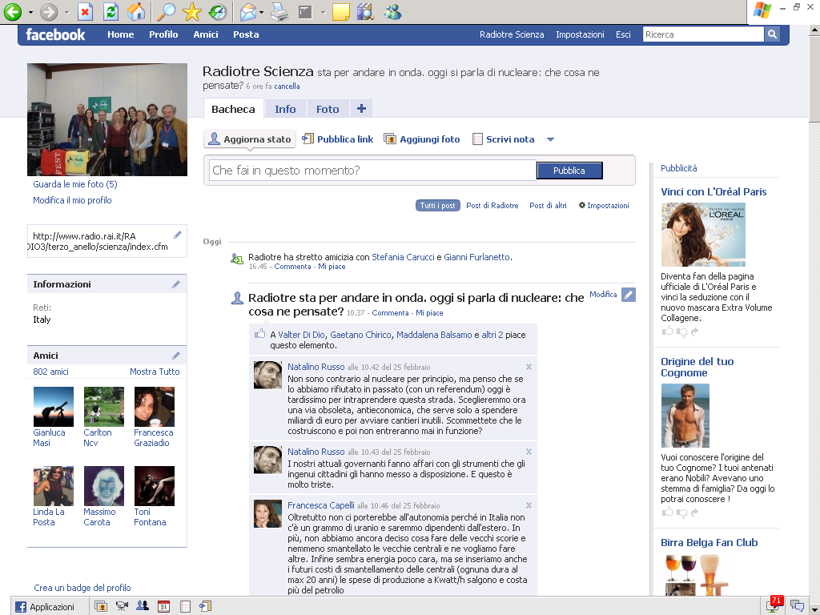
Notes:
This is an old facebook profile. Here we are!
This guy is now living in my house: we became friend.
With facebook i can remember to the listeners that we are going to be on air and with which subject. I can remind them the link to our website.but this is better then a mailing list, because it expands itself whitout my intervention: i just have to wait until the friends of the friends see me as a friend and choose to ask me for a friendship. In this way: look, we had 802 friends. Today they are a hundred of people more.
Then, and it’s the funniest thing for me, but also the most interesting, the listeners can talk to each, they can go on with the debate and i can understand who they are.
In this case… tribal drum!

Slide 17
1. The public 2. The scientists 3. The editorial staff
Notes:
This was the public. Without them, we don’t exist…
As you have seen, it the public of scientific subject: demanding and active, aware and collaborative. But it’s different from the public of a scientific tv program: when they listen to the radio, they feel the science closer and with deep effects on the society.
The second component involved in science on the radio are the scientists.

Slide 18
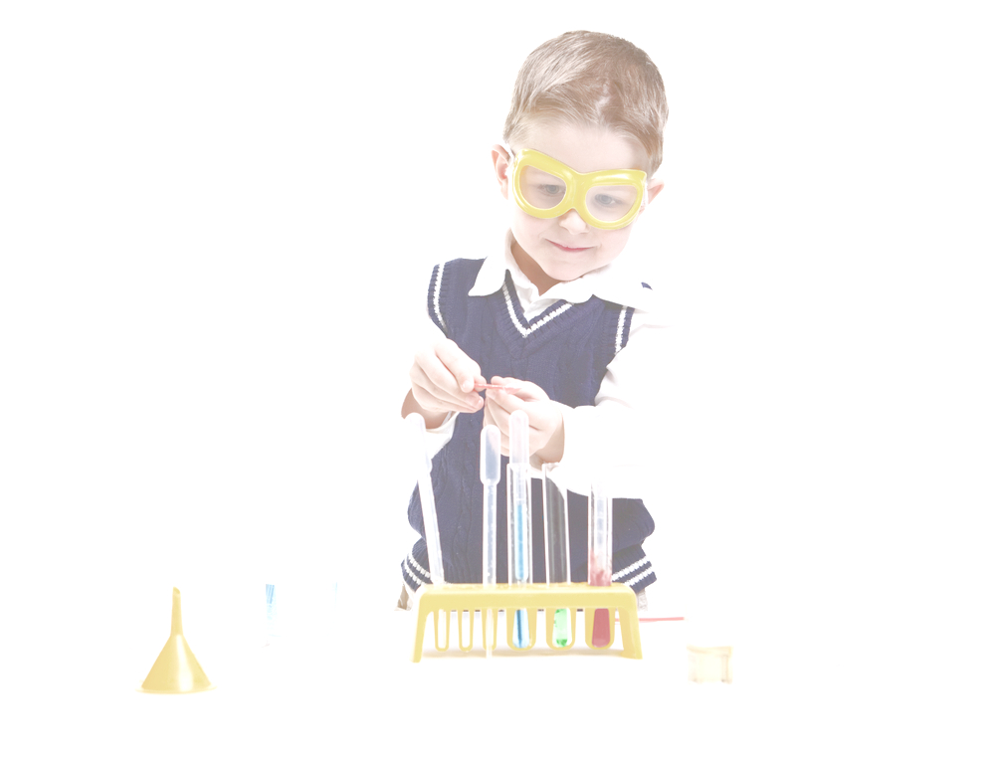
A good scientist for us is
talkative, lively, able to present examples
and to tell histories,
precise, able to construct short sentences, able to discuss without getting angry or escape.

Slide 19
They have some facilities:
they can stay in their lab or studios,
they can talk at the telephone as with a friend,
they don’t have to be well dressed!
Notes:
In exchange…
We have a lot of scientists among the listeners: scientists are curious about science, even if it’s not their specific field. And they are rarely aware that they are the expert just in a little piece of human culture. They tend to feel that their science is more difficult then the rest: it’s impossibile to talk about. And everyone of them is very conviced about this.
But what we feel is that there are no border beetween the scientists and the public. And maybe, if they stop and think, they also could recognize that they have the same place in a public debate then the others, just because in another public debate they are no more the expert. The one we interviewed for the nuclear plants is part of the general public when we talk about abortion or stem cells. (consider also that we have a very acculturated public, as you saw before… but it doesn’t change so much).

Slide 20
1. The public 2. The scientists 3. The editorial staff

Slide 21
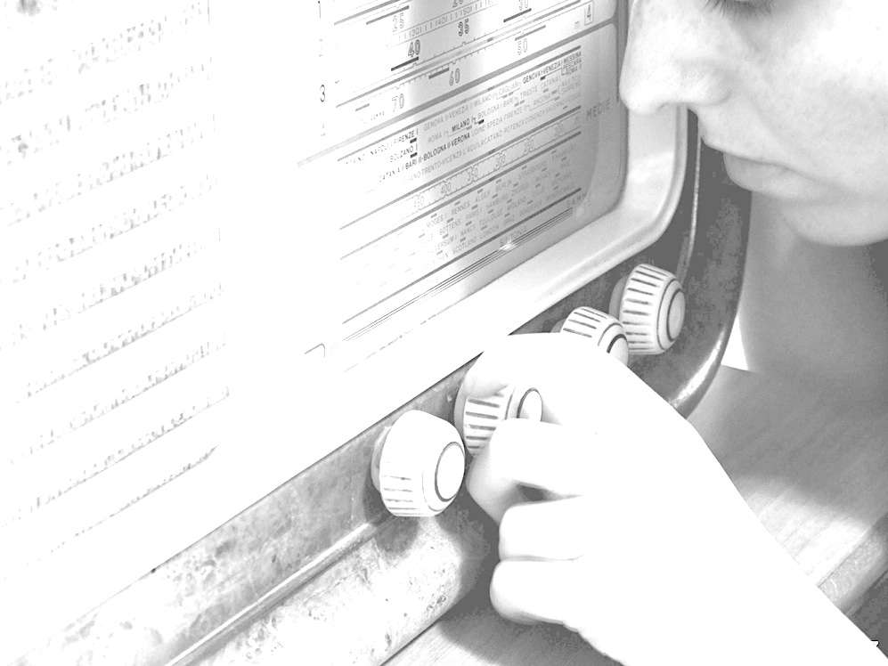
We choose the subject (weekly or daily)
We choose the way to talk about it and how long
We choose the guests and we discuss with them about the interview
We prepare all that is needed for the program: the list of songs, the recorder, the podcast…
We call the guests while the program is on air
We write the website, we answer to the emails, we write press releases, we call publishers and press office…
We prepare the special events

Slide 22
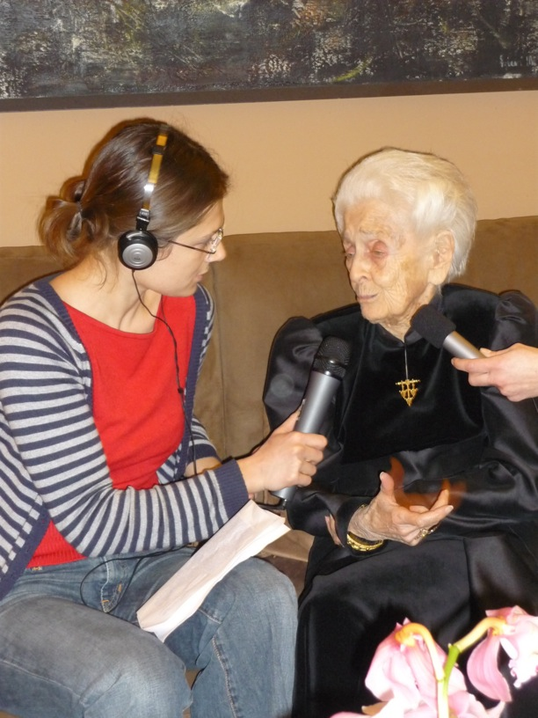
Notes:
Sometime we record, as in this case, sometime we go live (more often).

