Slide 1
On writing a neurosomething book
Notes:
Thank you for inviting me
sorry for my english (far from being perfect) and for my tuscan accent (perfect).
About neuro something, I might accasionally switch auf deutsch – I have recently revised a german serial and I am still tuned to german. I apologize in advance.

Slide 2
My talk
Notes:
compito = task
i wrote one and i’m currently working to another one. The first book was about music, the second book neuroeconomy. in both cases i did not write about the brain itself, and about how it works. i wrote and i’m writing about something who has to do closely with the brain

Slide 3
My talk
Why write about neurosomething?
Some tools
Some more tools
My advice
Few caveat and warnings
Words and metaphores
Notes:
in this short presentation i’ll will describe you my method.
My method is not the only possible method.
Also it is probably not the best method, but the method i know better.

Slide 4
Why write about neurosomething?
Notes:
Because it sells.
There is a large part of the general public who loves to talk about mental processes, psichology, psichosomething… it’s a sort of fashion theme, and it’s always a fashion theme: evergreen.
Like Armani… we have had the fashion period of mirror neuron, the period of autism, the period of ethics…and so on
It’s quite normal: it’s marketing.
There are a lot of me-too books: every publisher wants to have one and that’s a reason for so many books about the brain.
Maybe also my books are me too books: music had its period.
Neuroeconomy, hopefully, is growing, likely because of the crisis.

Slide 5
Me too
Notes:
Those are the neuroscience books I bought myself or received just in the last few years.

Slide 6
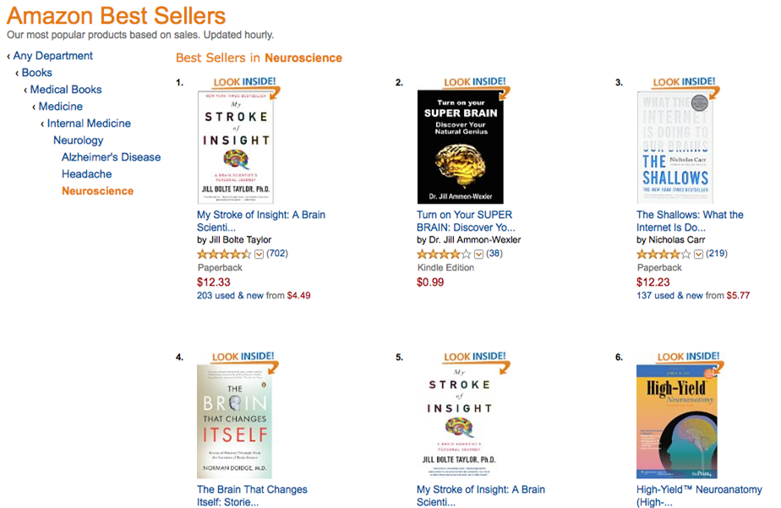
Notes:
you have every type of public: cultivated, simple, young, old, female and male, students and people who know nothing about science. You may find hard books on neuroscience and pop books on neuroscience, or very pop, often on the same shelf. you seldom find the same thing in other fields, like phisics or mathematics.
As marco said before lunch there are many magazines on psichology and neuroscience, many, and at many levels
Only Informatics has such a number of popular magazines. All the the other sciences are grouped in general magazines like
Focus
Le Scienze

Slide 7
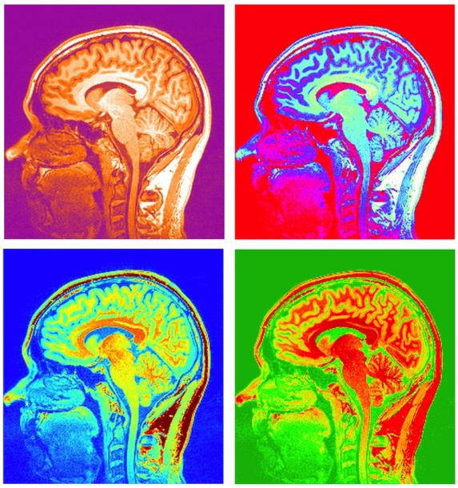
Why write about neurosomething?
“If Warhol were around today, he’d have a series of silkscreens dedicated to the cortex; the amygdala would hang alongside Marilyn Monroe”. Jonah Lehrer
Notes:
Or, at least i found this phrase in an article signed by Jonah Lehrer.
Jonah Lehrer is an american neuroscience writer. After a PhD in neuroscience he has written a few very successful books, until he was accused to write fake quotations.
He is still one of the most famous, and sold, neuroscience writers in the world, although its reputation is now a bit oscured.

Slide 8
Notes:
How many neuroscience books are there? In 2010 the Dana Foundation estimated 30 000, quoting Bowker as its source of data.
Bowker is provider of bibliographic informations for publishers, libraries and booksellers.
30 000 brain-related books just in english, presently on sale or being published.
To the best of my knowledge, there are no data relative to other languages.

Slide 9
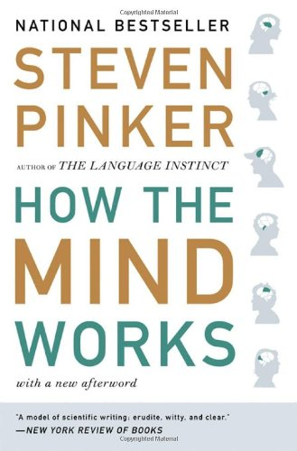
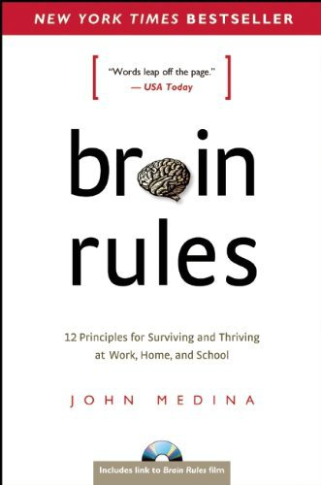
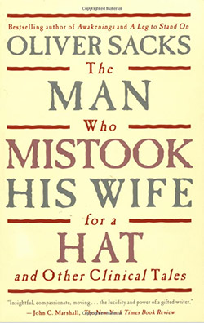
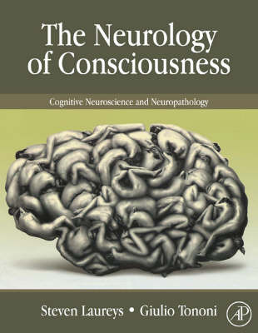
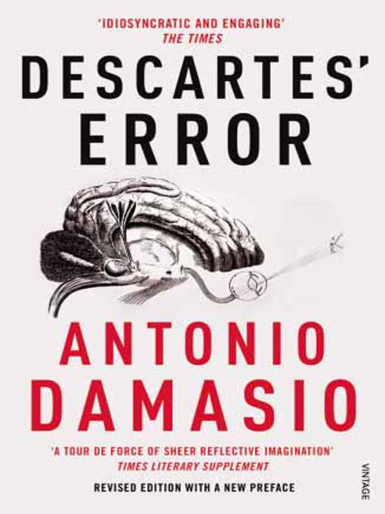
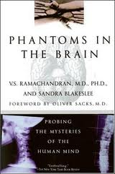
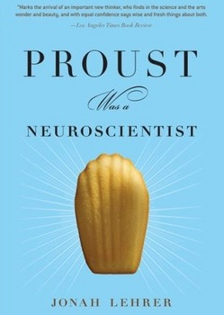
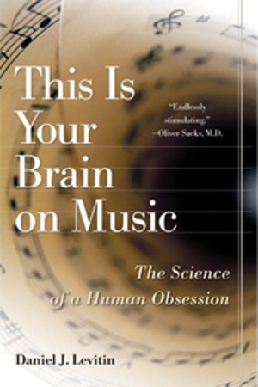
The topics
Notes:
Topics in neuroscience can be classified, for instance
general, 2. development, 3. Cognition, Learning, and Memory, 4. consciousness, 5. senses (arts… my book is in this category), 6. emotions, 7. diseases, 8. history…

Slide 10
The tools
Notes:
In my cases it was a matter of explaining somebody else’ researches. I’m not a scientist, so i don’t talk about my ideas.
Therefore i need to find interesting subjects,
and to evaluate their interest to the general public,
to read and understand the relevant literature,
to explain them to non-specialists.
I have to say that my training is in medicine. I am a registered physician. As such I have a little bias, and I tend to use the tools I know better.
for all the biological and medical fields, the best tool is pubmed (vedere: c’è altro?), kindly offered, free, by the united states government.
Pubmed is the widest data base available containig virtually every scientific journal worth reading in biomedicine.
You can search by author, if you already know whom to look for…

Slide 11
The tools
Notes:
Or by key words, in this case consciousness.
Better to be precise…
Consciousness for example lists most the anesthesiology papers…
But in the “related fields box” it suggests to look for “consciousness brain”

Slide 12
The tools
Notes:
You can also search by using both, keywords and name.
as i’ve learned to do in my medical studies, i start from an article and i begin to dig.
These are all papers in peer reviewed journals, so the relevance may be evaluated by tools like
the impact factor of the journal,
the citation index
the h index of the authors and so on.

Slide 13
The tools
Notes:
In Pubmed you have free access to the abstract of the vast majority of the listed papers.
In this way i can read the abstract.
For this paper, this is a free article, and i can have its full text by clicking here, thanks to a public library.
In other cases i have to ask to friends in university…
Or i may find the full text of plos library directly in this website. Like this(in alto a destra)
It is to be said that I seldom need the full paper.

Slide 14
The tools

Slide 15
The tools
Notes:
Once i have the article, i may study the bibliography.
The biblography is also very interesting.

Slide 16
The tools
Notes:
The webpages of the interesting authors, in the websites of their universities
are also very useful.
You find
who he is,
what he is working on,an
His books and papers…
And some are free…

Slide 17
The tools

Slide 18
The (obvious) tools
Notes:
Press releases or the webpages of the communication staff of universities or research institutes…they may all have important news and references. You may also find videos or podcasts.
Ok, always rememeber that this is a sort of advertisement, a sort of. The goal of this kind of communication is to make you write about the institute, but in general this is a serious presentation and you can always trust.

Slide 19
The (obvious) tools
Notes:
There are general public magazines (as i said: it’s a fashion subject!): they are a good starting point (they often have archives!).
They often host blog, written by journalist (as daniela ovadia for the italian version of sciam) or by scientists, and you can quote them.

Slide 20
The (obvious) tools
Notes:
Also the very large public magazine like this (website of a newspaper) contain neuroscience news. This is important mostly because you can have an idea of what the general public know or has read or listened to. And it’s a nice starting point when you have to write: you probabily know that… or: some year ago…

Slide 21
The (less obvious) tools
Congresses, science festivals, public events…
“Dear professor Neurosmith, my name is Silvia Bencivelli and I’m currently writing a book about… May I come to your place and visit your lab?”.
University press books
All you can invent….
Notes:
This tools depend on what you are going to write, on what you need.
I also write interviews by email
So: i don’t think that Steven Pinker or Oliver Sacks needed to do all the work i did in the web, but if you are the journalist describing the ongoing science i think that those i had described are the tools you have to know.

Slide 22
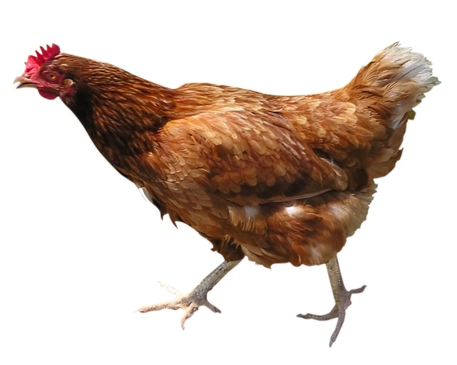
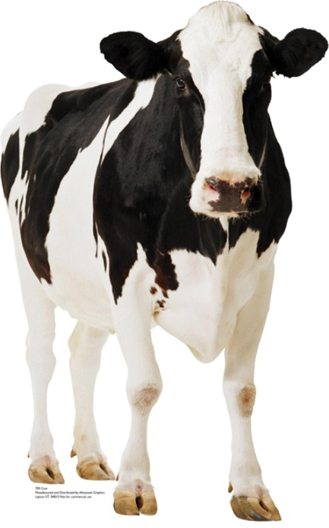
Some risks
Not-so-serious-research: no double blind, poor statistics, false correlations…
Notes:
the problem you have to face is that in these field it’s quite easy to find researches that are too poor in statistics: they are very appreciated by the general public by they are not so rigid (?) in their formal costruction.
Most of them have never been reproduced.
In my former field, music and neuroscience, i found hundreds of studies about animals and the listening music, cows, chicken, even sharks… NO double blind, of course, but not even blind. In this case I wrote to a scientist whom I had met in a congress, a serious scientist, and I asked for a clarification. He explained me the many problems of these studies. therefore i avoided to quote them.

Slide 23
Notes:
Not everyone avoided it and the news spread. They are the most fashionable news and they often have more success then the serious one. They create urban legends.
I sometimes think that it’s not too bad, because these claims make people interested in brain research.
But i would never base my books on this kind of claims, ulnless i have controlled them first.

Slide 24
Some risks
What do the neuroimaging really say? The Achilles’ heels of fMRI:
The cognitive subtraction
The reverse inference
The distributed reverse inference
Notes:
This is a problem of the neuroscience (and maybe others will talk about it): in our case it’s important to be aware of it.

Slide 25
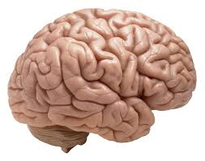
Some risks
What do the neuroimaging really say? The Achilles’ heels of fMRI:
The cognitive subtraction
The reverse inference
The distributed reverse inference
Notes:
The cognitive subtraction is the method to isolate a mental process indirectly and it’s the only method we have.
We’re not able to see subject “love” and then track the neurons that fire. Rather, we observe subject during state-1 and during state-2, and we subtract the neuronal activity between the two states. We then call that difference “Love,” but we can only do so if we’ve designed the experiment such that we can credibly claim that the only difference in mental processes between state-1 and state-2 is in fact Love. As you’re probably guessing, such a claim often isn’t valid.

Slide 26
Some risks
What do the neuroimaging really say? The Achilles’ heels of fMRI:
The cognitive subtraction
The reverse inference
The distributed reverse inference
A
A
Notes:
In our brain there is a certain degree of redudance: not every part has a single precise function, and viceversa. Not every single function (however we define it) comes from a single brain portion.
So, when we see with neuroimaging that a part of the brain is working during an activity, like the pleasure center during music listening, we tend to say “oh listening to the music gives us pleasure”, which probably is correct but some has questioned about his validity
Because all depends on having decided that this part is “pleasure part”, and it has been done by a previous forward inference, wich is based on cognitive subtraction!

Slide 27
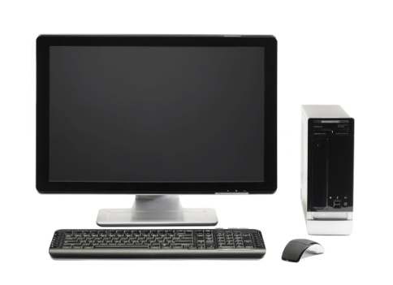
Some risks
What do the neuroimaging really say? The Achilles’ heels of fMRI:
The cognitive subtraction
The reverse inference
The distributed reverse inference
Notes:
Let us see your brain's entire activity and based on the distribution of activation we can accurately predict what you’re thinking about … so long as you’re thinking about one of the things that we’ve trained our computer program to recognize
neuroscientists can’t be sure that their predictive models will work accurately outside the things that the computer has been trained to recognize. This has big implications for lie detection, namely that current technology does not allow for scientifically valid claims about the ability to detect lies.

Slide 28
Some risks
Neuromaniac!
Notes:
In Italy we have had the same criticism.
“According to claims made by supposedly respectable neuroscientists, reported by supposedly respectable newspapers, it is possible actually to pinpoint the locus of love, wisdom or whatever as parts of the brain that "light up" under functional magnetic resonance imaging”.
It comes out from the fallacies i described before but it’s a more general problem: what can neuroscience tell to us? Often, we tend to imagine a brain part for everything. A brain part for love, for instance. We like to think that is so.

Slide 29
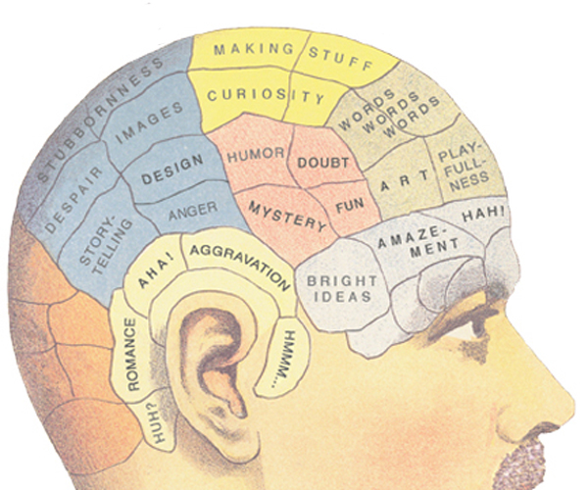
Some risks
Neuromaniac!
Notes:
Nothing very far from ancient phrenology. So writing a book about neurosomething requires having thought a bit on what neurosomething is.

Slide 30
Some risks
Notes:
Cognitive equivalent of snake oil

Slide 31
Some risks
Pop E-P!
Notes:
Antoher debate that we must be aware of is about what is called pop-ep, pop evolutionary psychology:
This is the field that promotes evolutionary explanations for many human behaviors
-- Evolution by natural and sexual selection has endowed all humans with morphological adaptations such as hearts and kidneys, Pop EP says, so it has endowed all humans with a set of psychological adaptations, or “mental organs.”
Some evolutionary psychologists have made widely popularized claims about how the human mind evolved, but other scholars argue that the grand claims lack solid evidence (cannot be disproven: you can’t have animal models!).
In general, the idea of applying natural selection to human behaviour is controversial.^{[2]} The reason is that in order for natural selection to occur, a trait must both be genetically inherited and exposed to sufficient selective pressure.
Exemples: with an air of credibility that justifies sexism and discriminatory behavior. Just as jealousy (men are more distressed by a mate’s sexual infidelity, women by emotional infidelity).
An example is a supposed "study" which explains why boys prefer blue and girls prefer pink. In the view of pop-evolutionary psychology, this is because women being gatherers and men being hunters, liking pink was most likely to allow you to find berries so women grew to be attracted to pink. So far, so common sense, however, the idea completely ignores many established facts (and blueberries). Such that colour preferences change from place to place, and even that in the western world (where the concept of gender specific colours is strongest) 100 years ago it was reversed; i.e., the soft colour of blue was associated with the Virgin Mary, and was thus feminine, while men preferred associations with strong, passionate colours such as red and pink

Slide 32
Words and metaphores
From images to words: “to light up”, “to color”…
“Love area”, “shopping neuron”, “brain fitness” (the equivalent of “God’s particle)
“Last frontier” of research, “the ultimate dream”, “the secret of life…”
“Change your brain!”: from pop E-P to self-help manual
Notes:
Always consider that images of the brain are popular, can be recognized, have really changed communication of neuroscience. Remember warhol. So you may use words that recall us images, pictures, art… i think it’s correct and no problem.
I would suggest to avoid expression like Love area… but, as a journalist i must confess that i seldom use them. They are the equivalent of God’s particle and they may be really useful. What is important is that we are aware of what we really are saying and that we are honnest and precise with our readers.
There are metaphore that, in the same way we do for cancer, recall us battles, fights, discovers… we would nevere say that th kideny research is “the last frontier” but with the brain we do. Imo, it would be more correct to avoid. Human nature is far more complex. And vor allem, they are not so nice.
Avoid to be tricky, in general. Even supposed that we now really know how the brain work, it’s not true that we can consider it like any other phisical organ…
I often ask to myself what I really have to know about brain in order to write a book about brain. I don’t have an unique answer, but at this point of my carrier i decided that it’s not compulsory to me to know neuroanatomy rather then how to deal with neuroanatomy.

