Slide 1
The technology behind (f)MRI
Federico Giove
federico.giove@roma1.infn.it

Slide 2
Why NMR
Non invasive
  No ionizing radiation
Multiparametric
  a lot of biological info is available

Slide 3
Focus on technology
NMR physics is well consolidated
Recent developments focus on technology and refinements
A negative example…

Slide 4
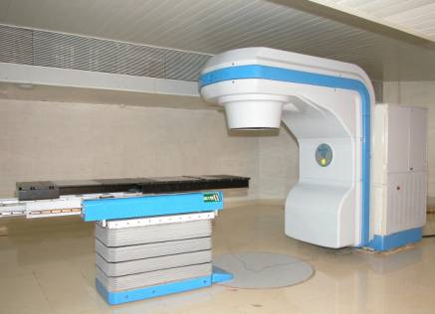
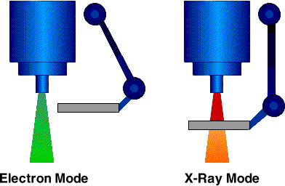
Therac-25 operation modes
The Therac-25

Slide 5
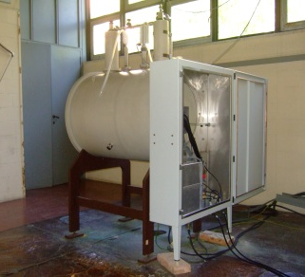


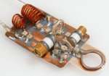
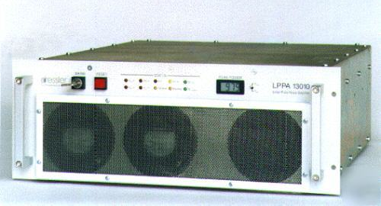
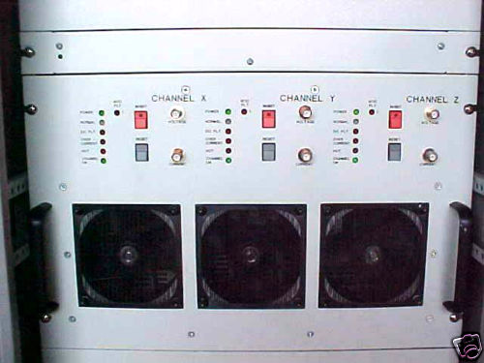
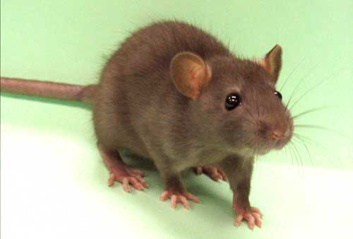
Shopping list
=€€€
=€
=€€
=€€
=€

Slide 6



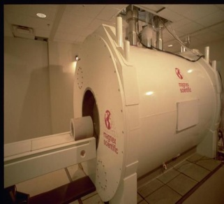
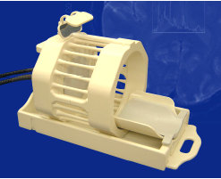
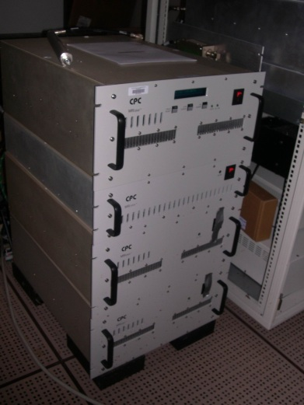
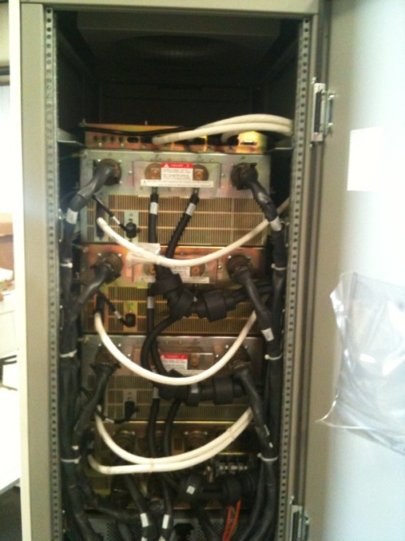
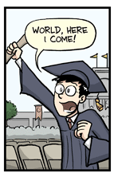

Slide 7
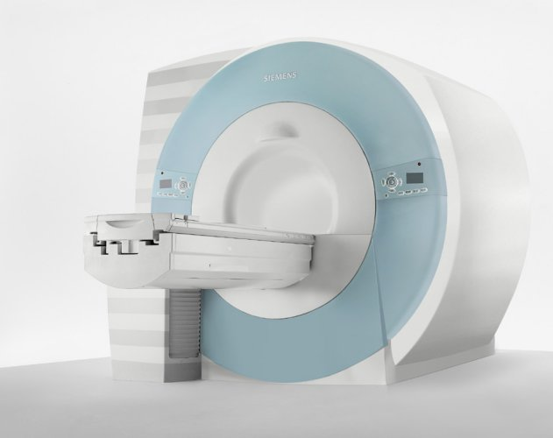
The magnet
You need a BIG one

Slide 8
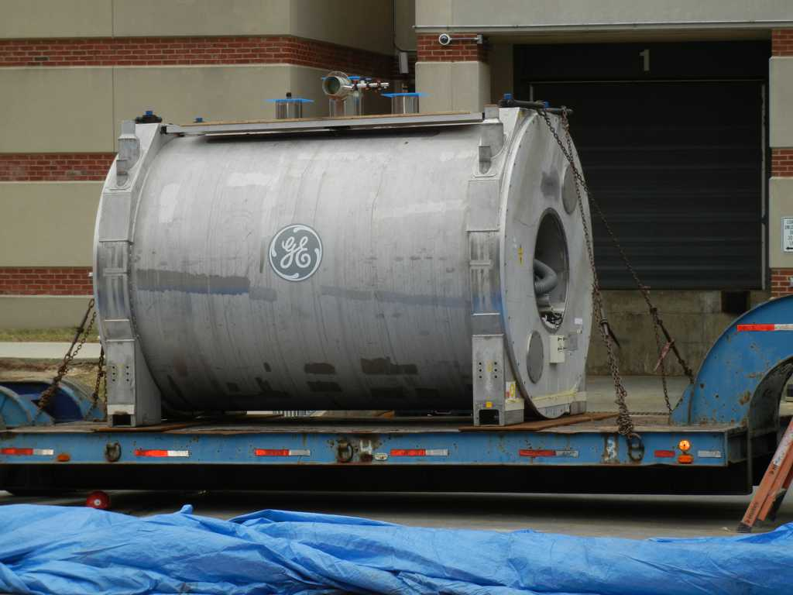
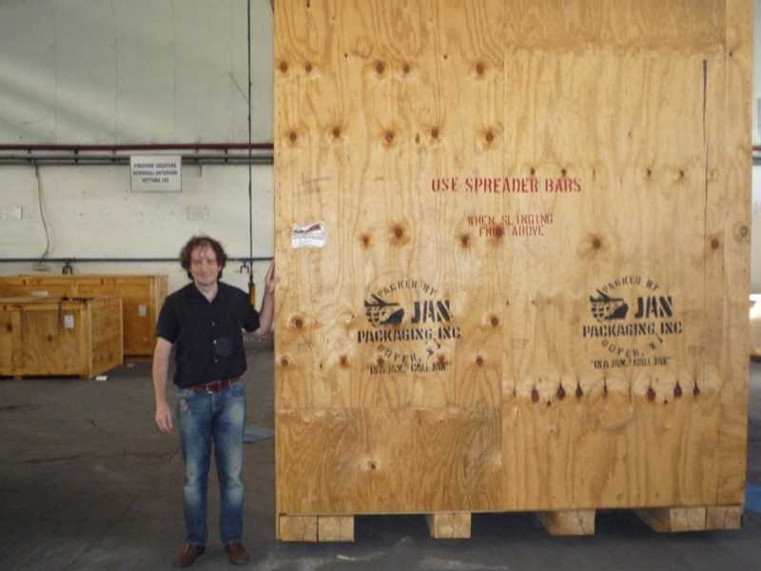
Why you need such a large magnet?

Slide 9
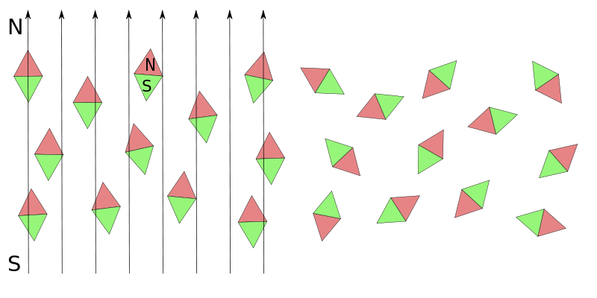
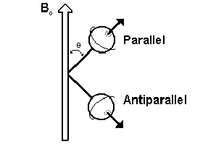
Some nuclei have magnetic (dipole) moment: the simplest is the hydrogen nucleus (proton)
They show nuclear paramagnetism
Please note that those symbols on the left represent macroscopic pieces of matter. single nuclei can be only in discrete states, like those on the right

Slide 10
Once a magnetization of the sample builds up, it starts to precess around
The NMR signal is created by manipulations of that magnetization, so the higher the magnetization of the sample, the larger the signal you obtain

Slide 11
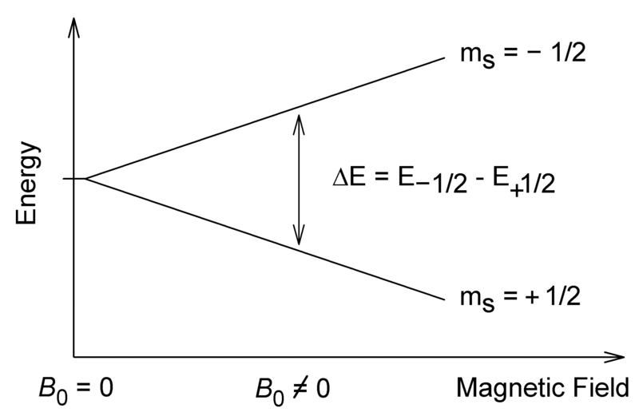
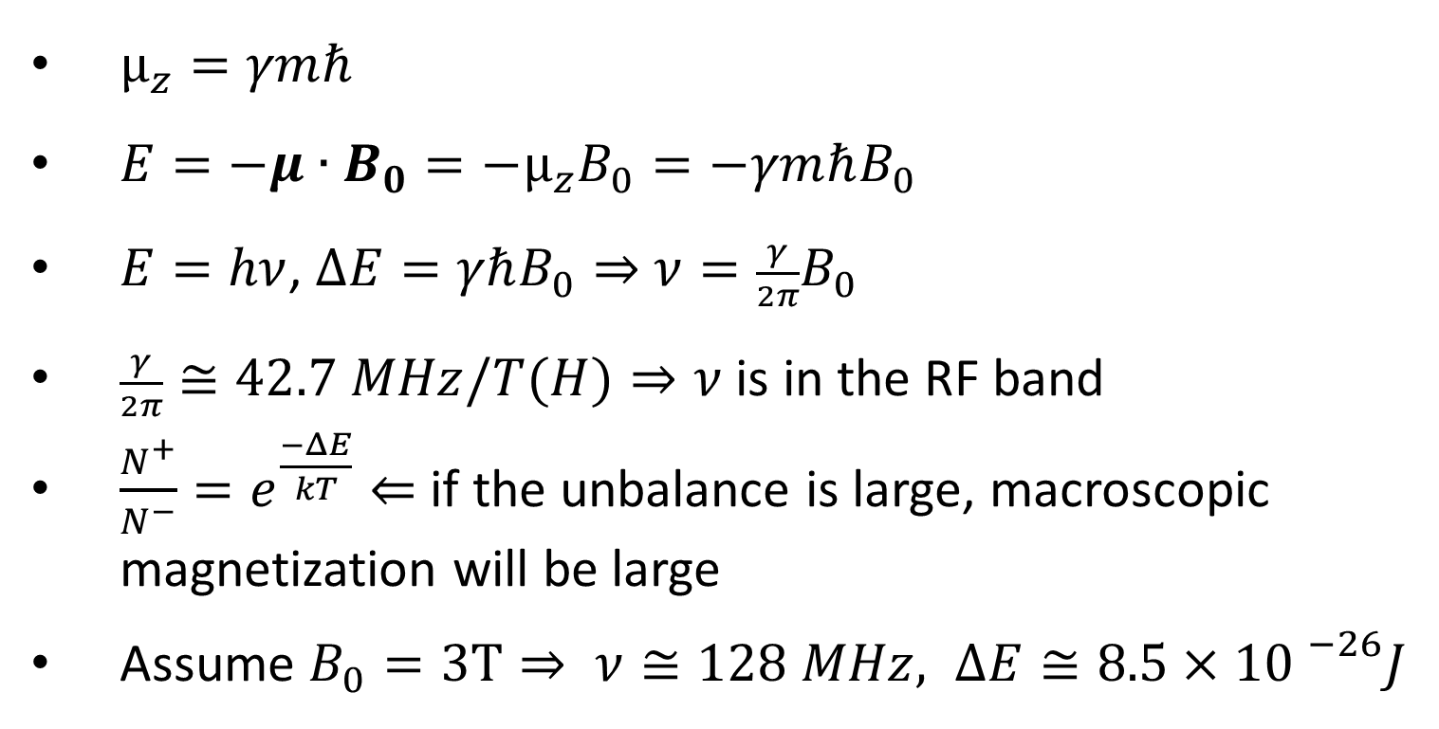
$μ_{z}=γmℏ$
$E=−μ∙B_{0}=−μ_{z}B_{0}=−γmℏB_{0}$
$E=hν$, $ΔE=γℏB_{0}⇒$ $ν=\frac{γ}{2π}B_{0}$
$\frac{γ}{2π}≅42.7 MHz/T(H)⇒ν$ is in the RF band
$\frac{N^{+}}{N^{−}}=e^{\frac{−ΔE}{kT}}⇐$ if the unbalance is large, macroscopic magnetization will be large
Assume $B_{0}=3T⇒ ν≅128 MHz, ΔE≅8.5×{10 }^{−26}J$
Notes:
To put it in numbers

Slide 12
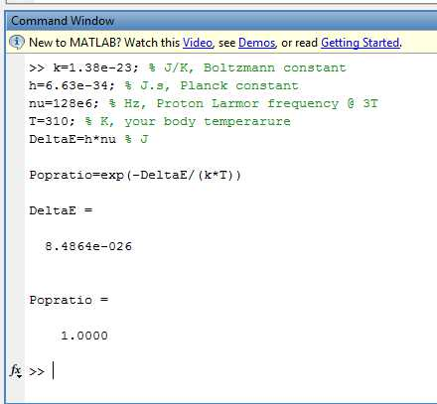

Slide 13
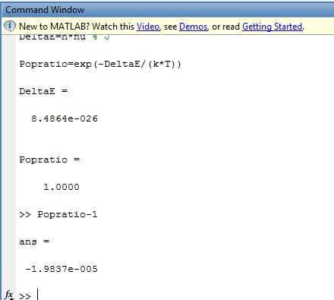

Slide 14
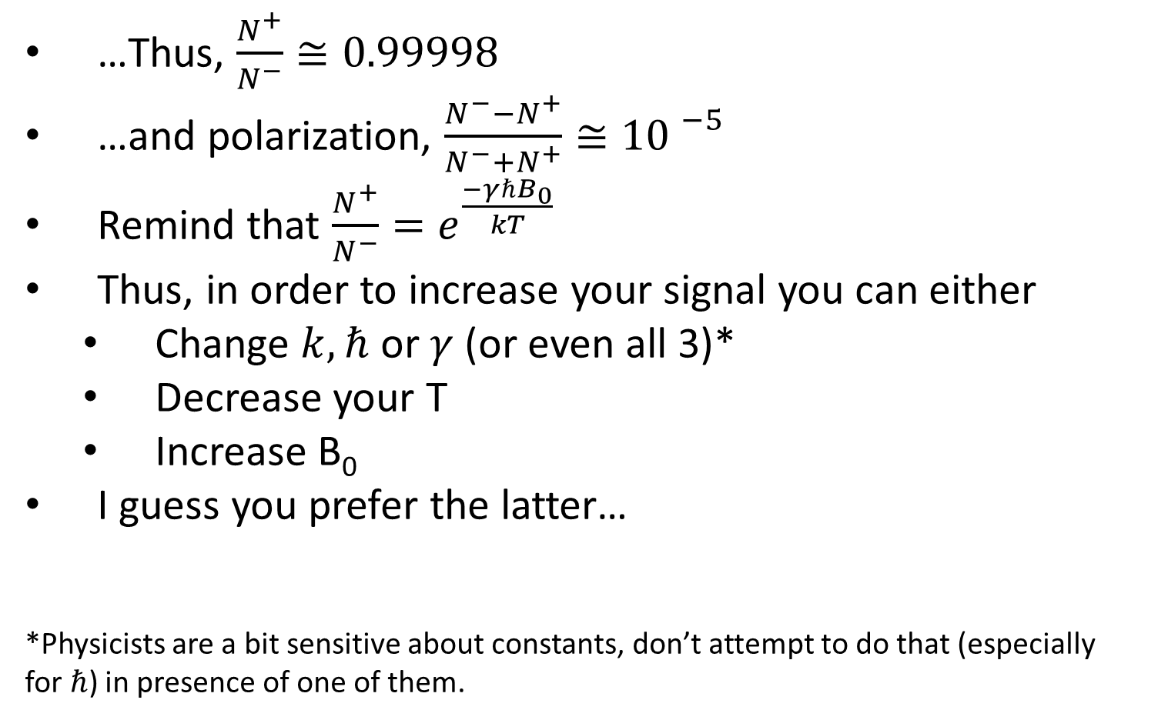
…Thus, $\frac{N^{+}}{N^{−}}≅0.99998$
…and polarization, $\frac{N^{−}−N^{+}}{N^{−}+N^{+}}≅{10 }^{−5}$
Remind that $\frac{N^{+}}{N^{−}}=e^{\frac{−γℏB_{0}}{kT}}$
Thus, in order to increase your signal you can either
  Change $k,ℏ$ or $γ$(or even all 3)*
  Decrease your T
  Increase B₀
I guess you prefer the latter…
*Physicists are a bit sensitive about constants, don’t attempt to do that (especially for$ℏ$) in presence of one of them.

Slide 15
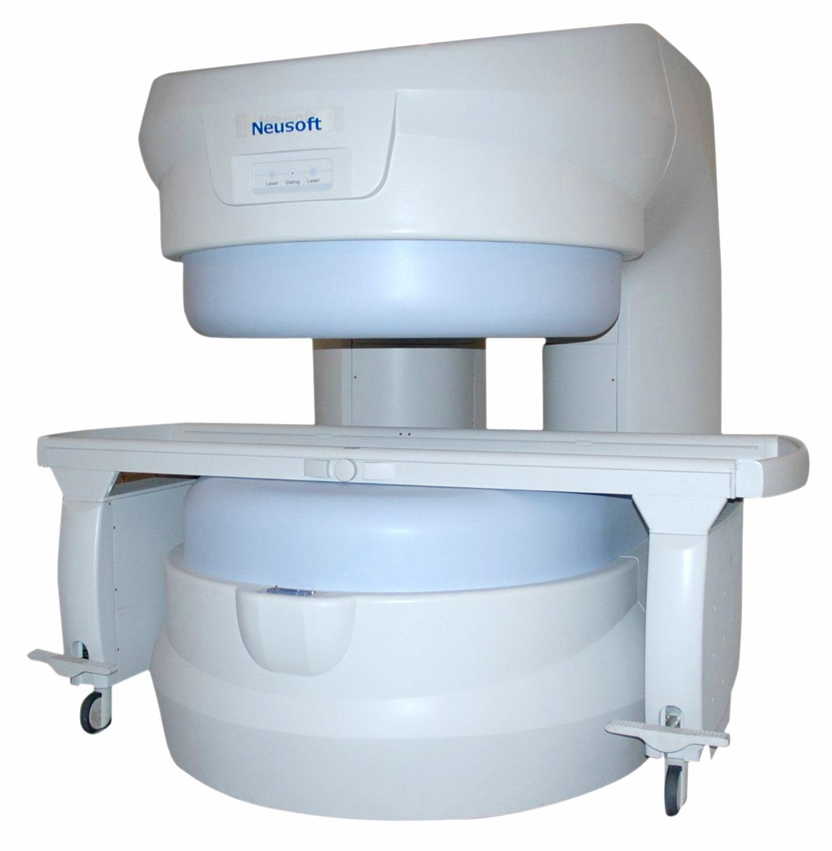
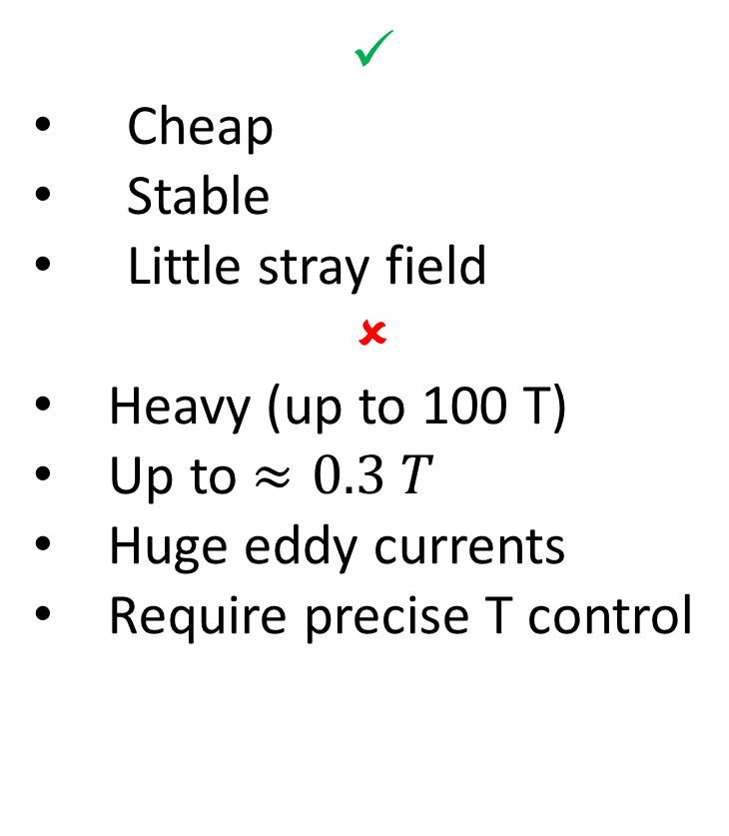
Permanent magnets
✓
Cheap
Stable
Little stray field
✗
Heavy (up to 100 T)
Up to $≈0.3 T$
Huge eddy currents
Require precise T control

Slide 16
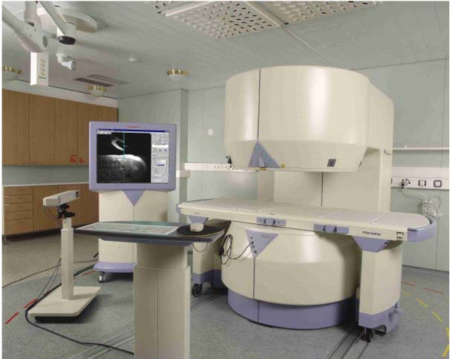
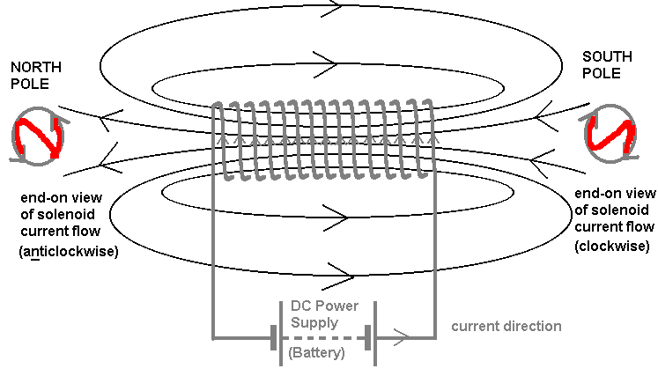
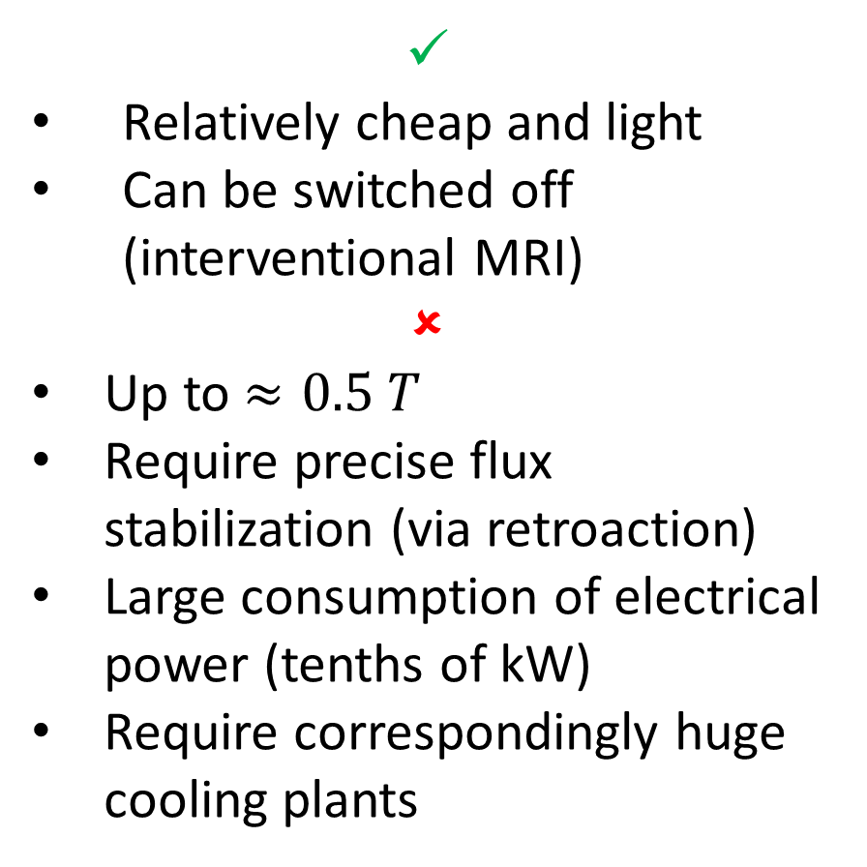
(resistive) electromagnets
✓
Relatively cheap and light
Can be switched off (interventional MRI)
✗
Up to $≈0.5 T$
Require precise flux stabilization (via retroaction)
Large consumption of electrical power (tenths of kW)
Require correspondingly huge cooling plants

Slide 17
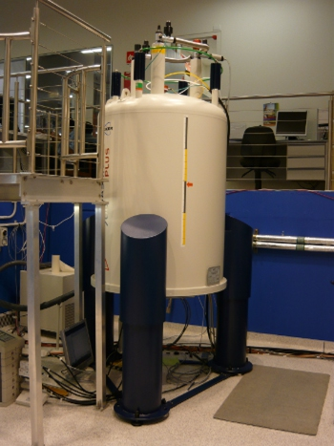
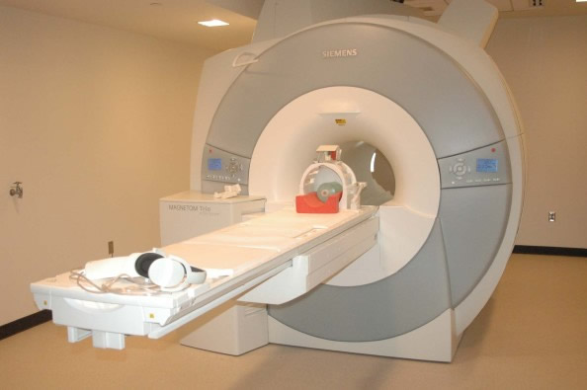
Superconducting magnets
✓
Can reach very high magnetic fields:
  3T current clinical use
  7T for humans in an increasing number of research centers
  9.4 Tand 11.5 T built some prototypes
  16 T for small animals
  20 T for in vitro studies
Stable
✗
VERY expensive
Require liquid He
Large fringe fields (but can be reduced with active shields)

Slide 18
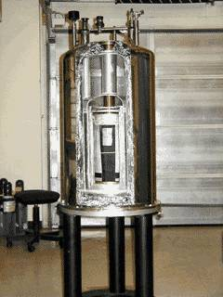
Vacuum chamber
Thermic radiation shield
Liquid N₂ vessel
Thermic radiation shield
Liquid He vessel
Superconductor solenoid
and shims

Slide 19
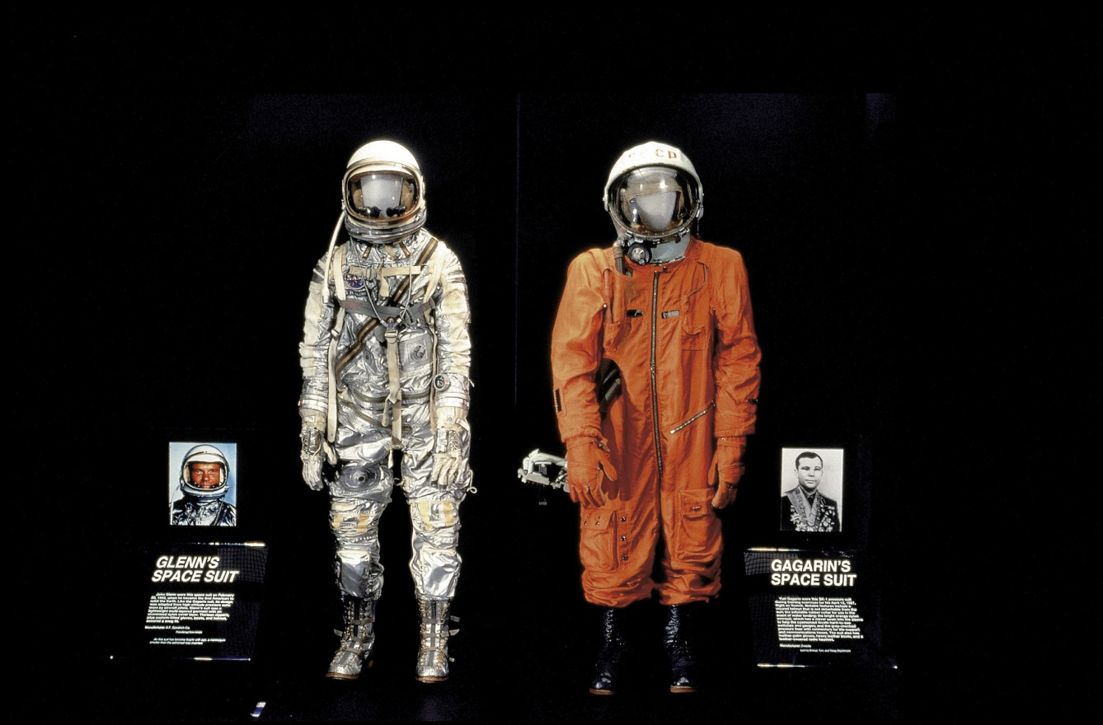

Slide 20
2 questions arise
  Why the Juri Gagarin’s spacesuit is orange?

Slide 21
2 questions arise
  Why the Juri Gagarin’s spacesuit is orange?
  And, why the hell it is at the space museum in Washington, DC?

Slide 22
Vacuum chamber
Thermic radiation shield
Liquid N₂ vessel
Thermic radiation shield
Liquid He vessel
Superconductor solenoid
and shims

Slide 23
Variations on the theme and other features:
  He/He gas
  Cryocoolers (“zero” boiloff)
  Active shielding
  Superconductive shimming
  Ferromagnetic shimming
  Resistive shimming
  Quench protection
Installation
  Pumping
  Cooling
  Ramp-up
  shimming

Slide 24
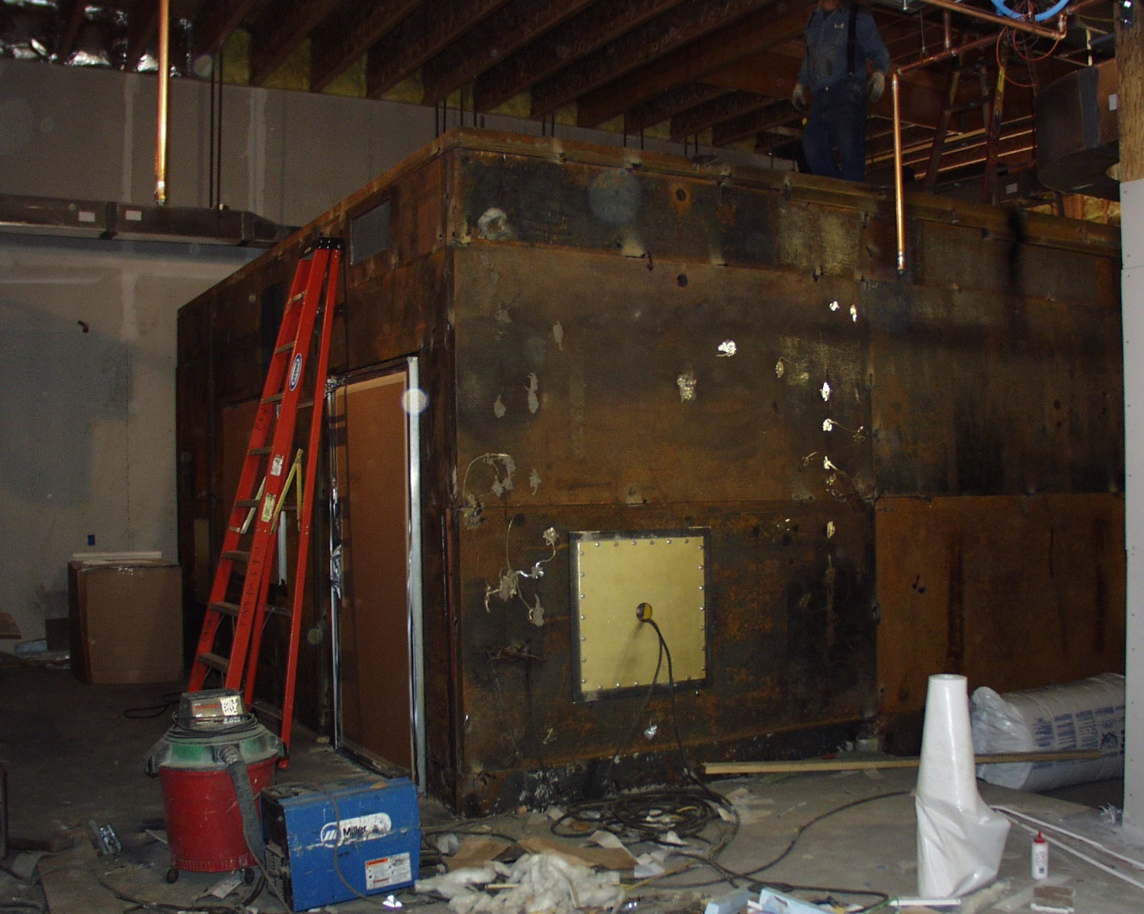
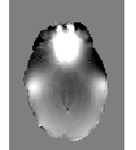

Slide 25
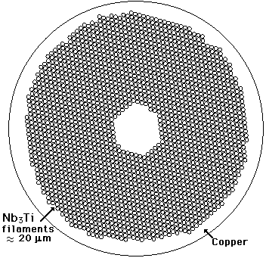
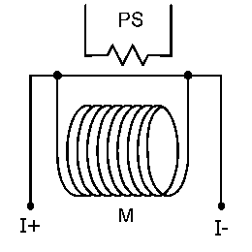

Slide 27
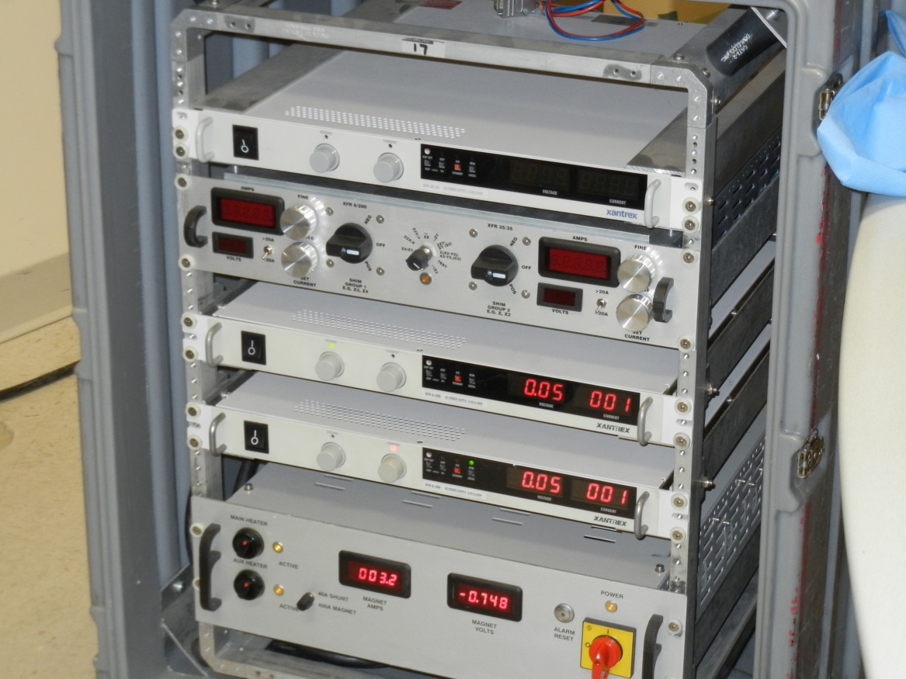
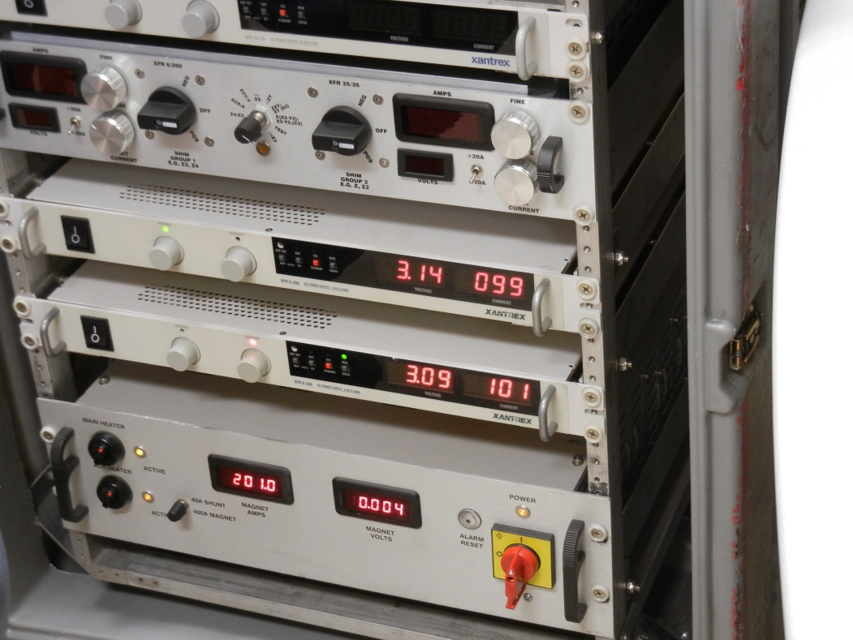

Slide 28
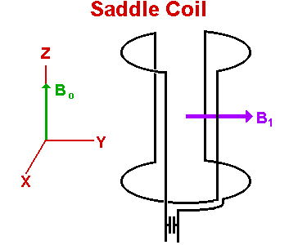
RF Coils
Create the RF field needed to manipulate the spins
Receive the signal (induction) coming from the magnetization precession

Slide 29
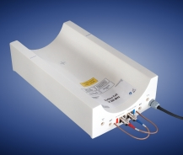
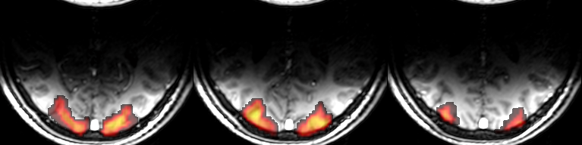
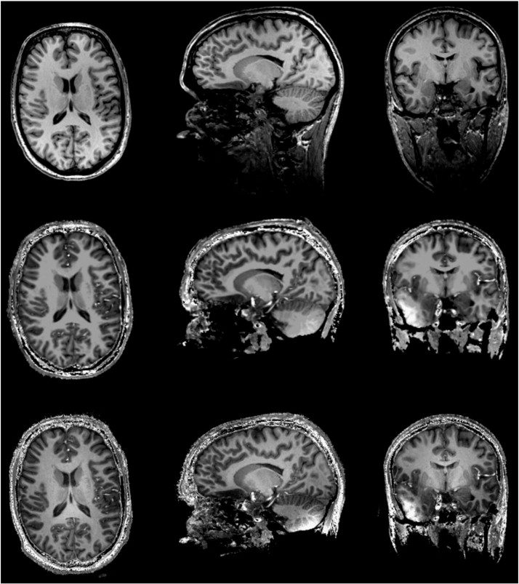
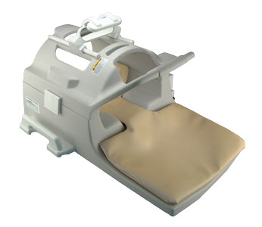
Volume or surface coil

Slide 30
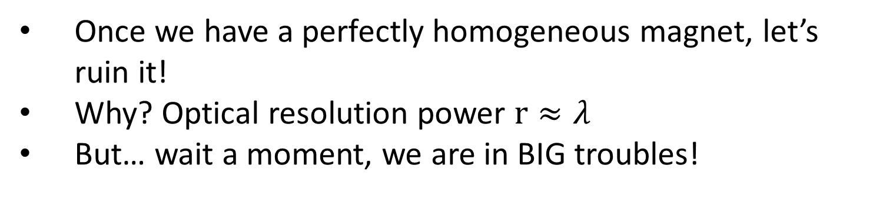
Gradient coils
Once we have a perfectly homogeneous magnet, let’s ruin it!
Why? Optical resolution power $r≈λ$
But… wait a moment, we are in BIG troubles!

Slide 31
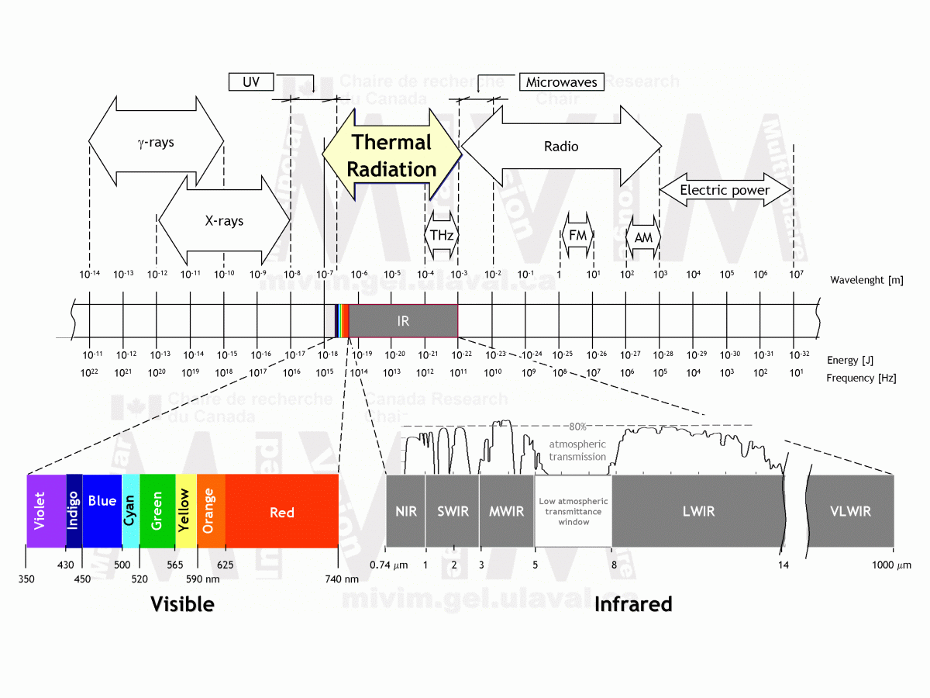

Slide 32
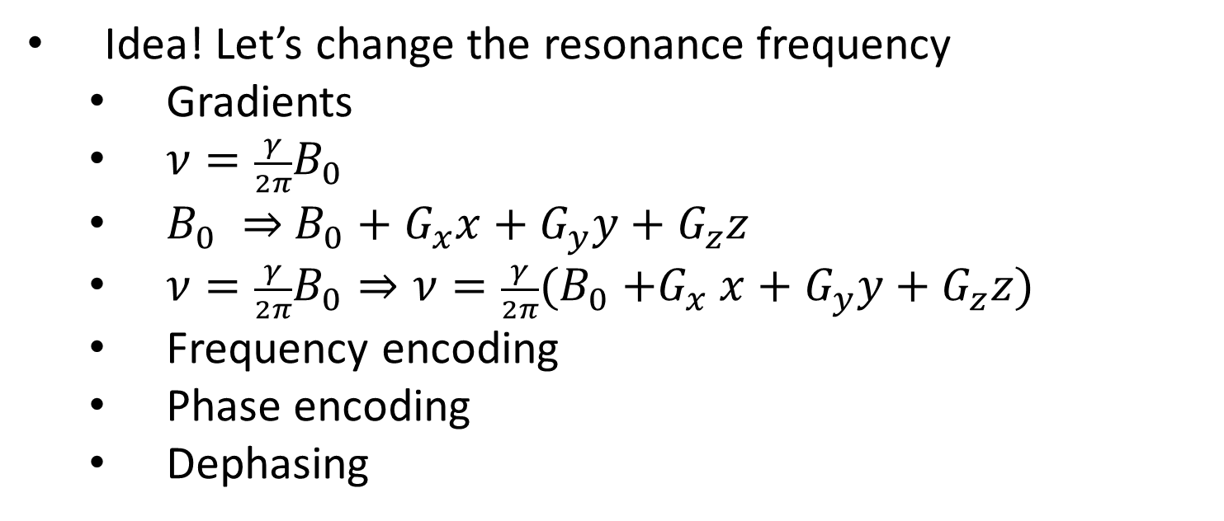
Idea! Let’s change the resonance frequency
  Gradients
  $ν=\frac{γ}{2π}B_{0}$
  $B_{0} ⇒$ $B_{0}+G_{x}x+G_{y}y+G_{z}z$
  ${ν=\frac{γ}{2π}B_{0}⇒ν=\frac{γ}{2π}(B}_{0}{+G}_{x}x+G_{y}y+G_{z}z)$
  Frequency encoding
  Phase encoding
  Dephasing

Slide 33
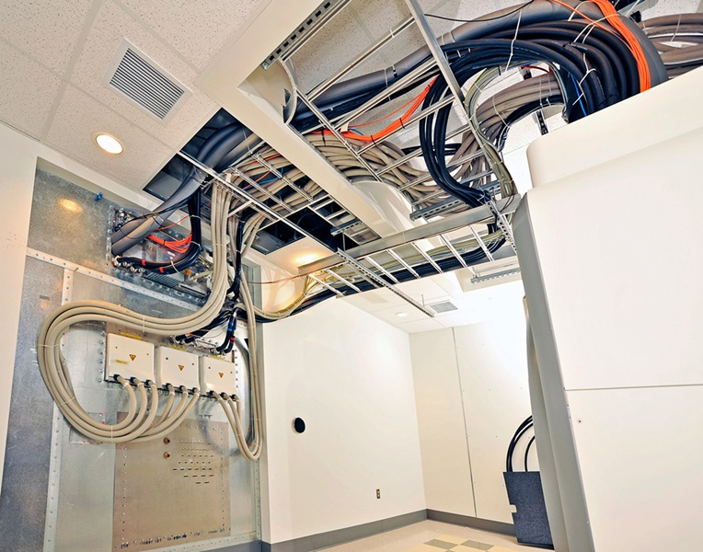
Gradients need to be fast and powerful
  Huge amplifiers, cables and cooling plants
  «Acoustic» band
  Peek current and voltage in the order of 1 kA and 1 kV

Slide 34
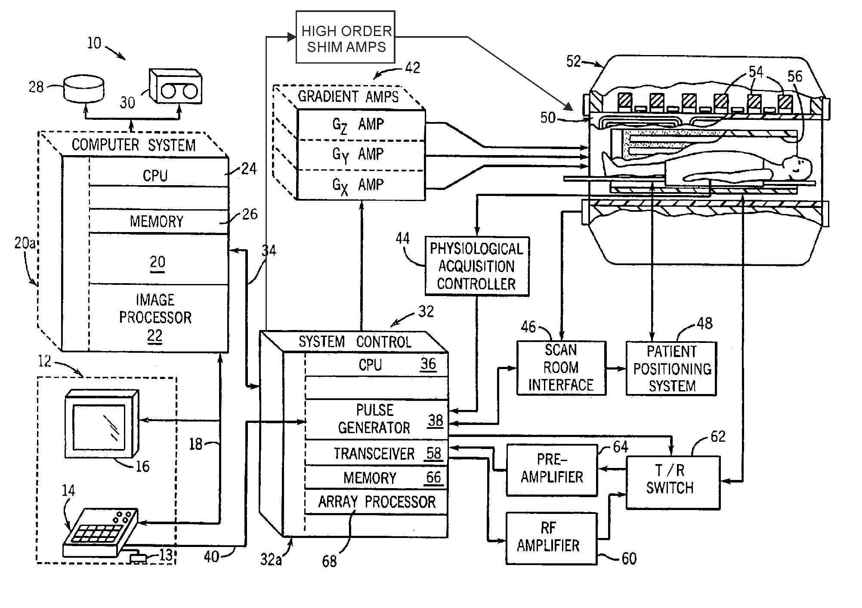
The scanner at a glance

Slide 35
A scanner for the neurosciences
DTI
Morphometry
fMRI
fMRS

Slide 36
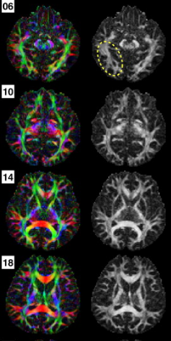
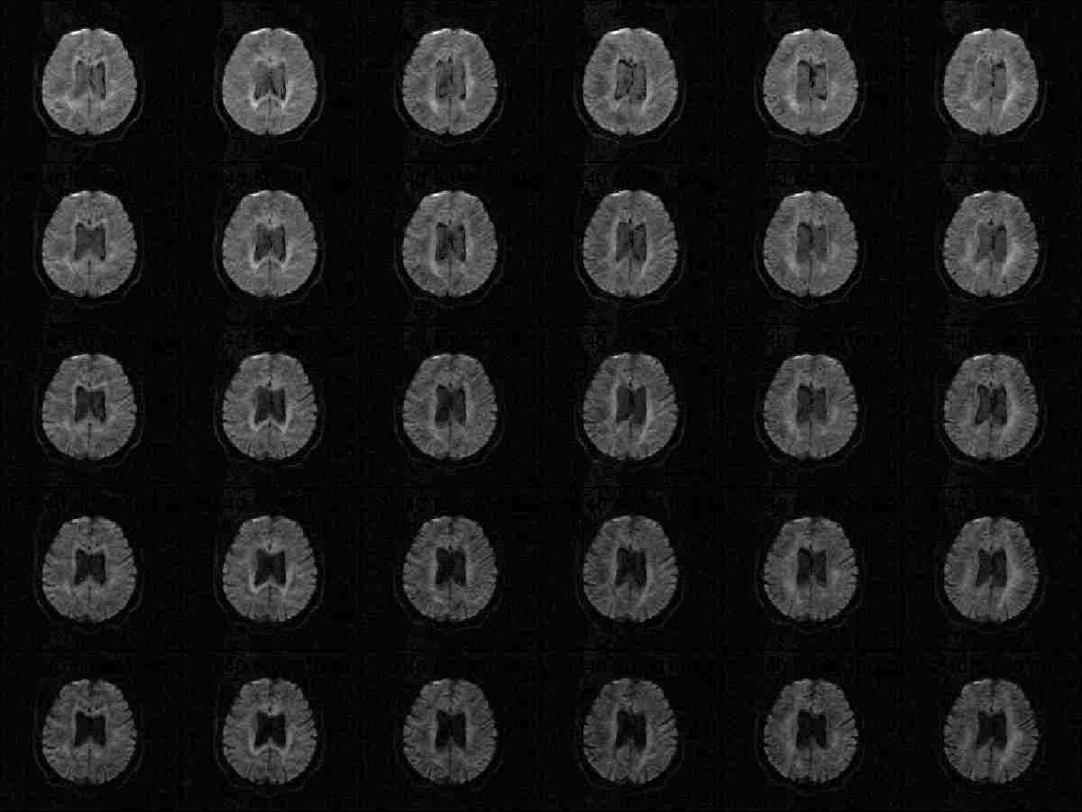
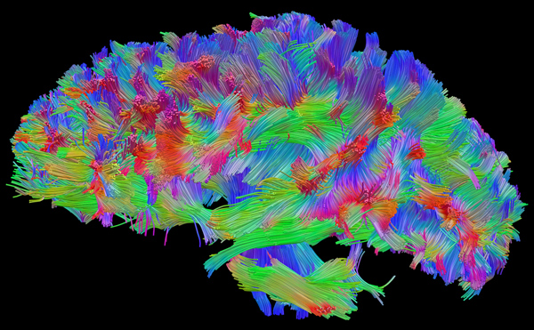
DTI

Slide 37


Morphometry

Slide 38





fMRI

Slide 39



Slide 40





Slide 41


Slide 42


Slide 44





Slide 45


Slide 46



fMRS

Slide 47

Physiological effects of NMR
… be careful if you think that there aren’t any
But it is true that the technique is non-invasive, and uses non-ionizing radiation

Slide 48
Hundred of millions of examinations, and very few accidents
Main risk is the improper management of ferromagnetic or metallic objects (including oxygen bottles, wheelchairs, vascular clips) or biostimulators (pacemakers, neurostimulators…)

Slide 49


Slide 50
Effects of the static magnetic field
No reproducible evidence of any chronic effect
Some transient effects during the access to the magnet (nausea, vertigo, metallic taste
Some (disputed) in vitro effects at fields beyond 10T

Slide 51
Flow and motion induced currents
Flowing blood and moving muscles (heart, respiration) within a strong magnetic field cause the induction of an electric field
Albeit the relevant currents sum with the endogenous ones (and in some cases visibly modify the pattern of biological electric potentials) , no biological effect have been reported up to now (but see magneto hydrodinamic effects)

Slide 52
Effects on chemical reactions
It is possible that the magnetic field reduce the recombination rate of free radicals, by splitting their levels. An increase of radicals that escape the recombination is possible, albeit no evidence of hazards has emerged

Slide 53
Magneto hydrodinamic forces
In presence of ionic currents in the blood, a force is applied on the vessels
No evidence of increased cardiac effort
Perhaps very small tissue/vessels displacements are at the origin of the only effects consistently reported at high field (nausea, etc.)

Slide 54
Effects of gradients switching
An electric field il generated
If gradient switching is fast and strong enough, peripheral nerve and cardiac stimulation can occur. Safety regulations usually prevent this effect.
Nerve stimulation occur at lower values than cardiac one, so the subject can feel the effect and stop the scan before it eventually becomes dangerous

Slide 55
Effects of RF
RF does not ionize the tissues (ie no actual damage to chemical bounds or change of atomic state), but heat them (as do cellular phones)
Safety regulations limit the SAR (specific absorption rate) to a level that should not cause dangerous increase of temperature (eg below 1°C).
However, SAR calculations are difficult, especially at high field, and some tissues/organs does not dissipate well the heath (eg the eyes)
Moreover, SAR increase quadratically with RF frequency (and thus B). High fields are problematic.

Slide 56
Effects of noise
No damage if adequate protection in used

Slide 57
Effects of the scanner itself
Anxiety
Claustrophobia
Panic
Quench

