Slide 1
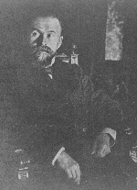
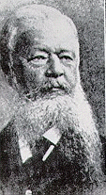
ERICE 2013:
Three talks on the brain and its function
SUNDAY: Principles of Brain Anatomy&Function
MONDAY: Neuroplasticity
TUESDAY: Why do we eat to much?

Slide 2
ERICE 2013:
Three talks on the brain and its function

Slide 3
ERICE 2013:
Three talks on the brain and its function
SUNDAY: Principles of Brain Anatomy&Function
MONDAY: Neuroplasticity
TUESDAY: Why do we eat to much?

Slide 4
Part 1: Some “Classical” Debates
about our Mental Functioning

Slide 5
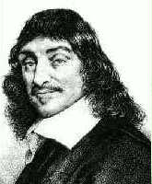
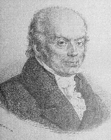
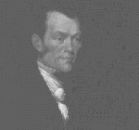
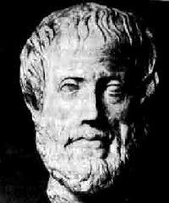
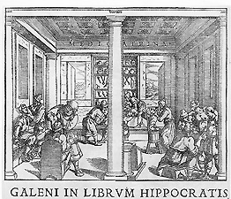
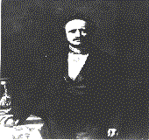
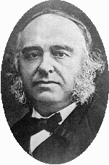
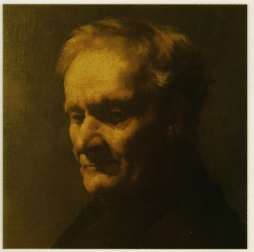
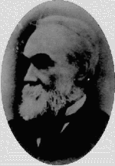
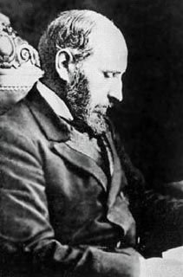
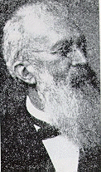
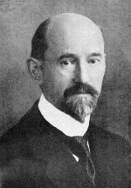
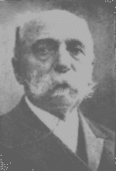
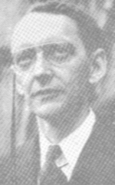
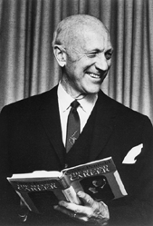

Slide 6
The “Classical” Debates
about our Mental Functioning

Slide 7
The “Classical” Debates
about our Mental Functioning
Site of Mental Function in the Body

Slide 8
The “Classical” Debates
about our Mental Functioning
Site of Mental Function in the Body
The Heart?

Slide 9
The “Classical” Debates
about our Mental Functioning
Site of Mental Function in the Body
The Brain?

Slide 10
The “Classical” Debates
about our Mental Functioning
Site of Mental Function in the Body
The Body?

Slide 11
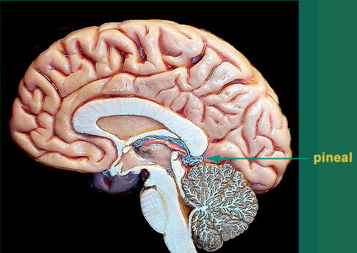
Pineal Gland / Epiphysis

Slide 12
The “Classical” Debates
about our Mental Functioning
Site of Mental Function in the Body
Pineal Gland (Epiphysis)?

Slide 13
Galen
130-200
Descartes
1596-1650
Plato
427-347
Aristotle
384-322

Slide 14
The “Classical” Debates
about our Mental Functioning
Site of Mental Function in the Body

Slide 15
The “Classical” Debates
about our Mental Functioning: TODAY?
Site of Mental Function in the Body
The Brain: But
what role play…
the autonomous nervous system?

Slide 16
The “Classical” Debates
about our Mental Functioning: TODAY?
Site of Mental Function in the Body
The Brain: But
what role play…
the autonomous nervous system?

Slide 17
The “Classical” Debates
about our Mental Functioning: TODAY?
Site of Mental Function in the Body
The Brain: But
what role play…
the autonomous nervous system?

Slide 18
The “Classical” Debates
about our Mental Functioning: TODAY?
Site of Mental Function in the Body
The Brain: But
what role play…
the autonomous nervous system?
nerve cells in the gut?

Slide 19
The “Classical” Debates
about our Mental Functioning: TODAY?
Site of Mental Function in the Body
The Brain: But
what role play…
the autonomous nervous system?
nerve cells in the gut?
other brains?

Slide 20
The “Classical” Debates
about our Mental Functioning
Site of Mental Function in the Body
Mind versus Brain (Dualism Monism)

Slide 21
Galen
130-200
Descartes
1596-1650
Plato
427-347
Aristotle
384-322

Slide 22
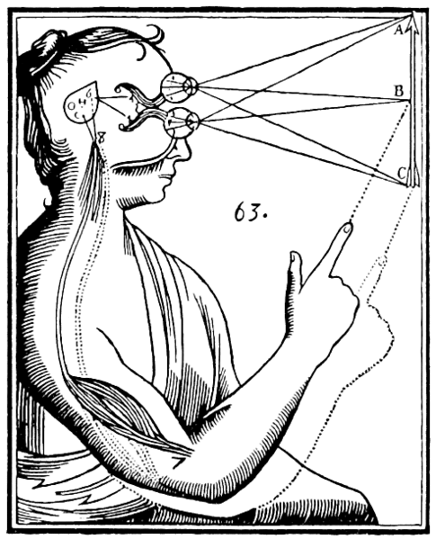
The “Classical” Debates
about our Mental Functioning
Site of Mental Function in the Body
Mind versus Brain (Dualism Monism)

Slide 23
The “Classical” Debates
about our Mental Functioning
Site of Mental Function in the Body
Mind versus Brain (Dualism Monism)

Slide 24
The “Classical” Debates
about our Mental Functioning: Today?
Mind versus Brain (Dualism Monism)

Slide 25
The “Classical” Debates
about our Mental Functioning: Today?
Mind versus Brain (Dualism Monism)
Most neuroscientists reject dualism, but
Fundamental questions are unsolved:
How does consciousness emerge?

Slide 26
The “Classical” Debates
about our Mental Functioning: Today?
Mind versus Brain (Dualism Monism)
Most neuroscientists reject dualism, but
Fundamental questions are unsolved:
How does consciousness emerge?
Is there cognition anywhere outside a brain?

Slide 27
The “Classical” Debates
about our Mental Functioning: Today?
Mind versus Brain (Dualism Monism)
Most neuroscientists reject dualism, but
Fundamental questions are unsolved:
How does consciousness emerge?
Is there cognition anywhere outside a brain?
Could complex computers gain cognition?

Slide 28
The “Classical” Debates
about our Mental Functioning
Site of Mental Function in the Body
Mind versus Brain (Dualism Monism)
Holism versus Localism

Slide 29
Johannes
Spurzheim
1776-1832
Franz Gall
1758-1828
Pierre Flourens
1794-1867
J. Hughlings Jackson
1835-1911
Pierre Paul Broca
1824-1880
Carl Wernicke
1848-1904
Gustav Fritsch
1838-1907
Eduard Hitzig
1838-1927
K. S. Lashley
1890-1958
Wilder Penfield
1891-1976

Slide 30
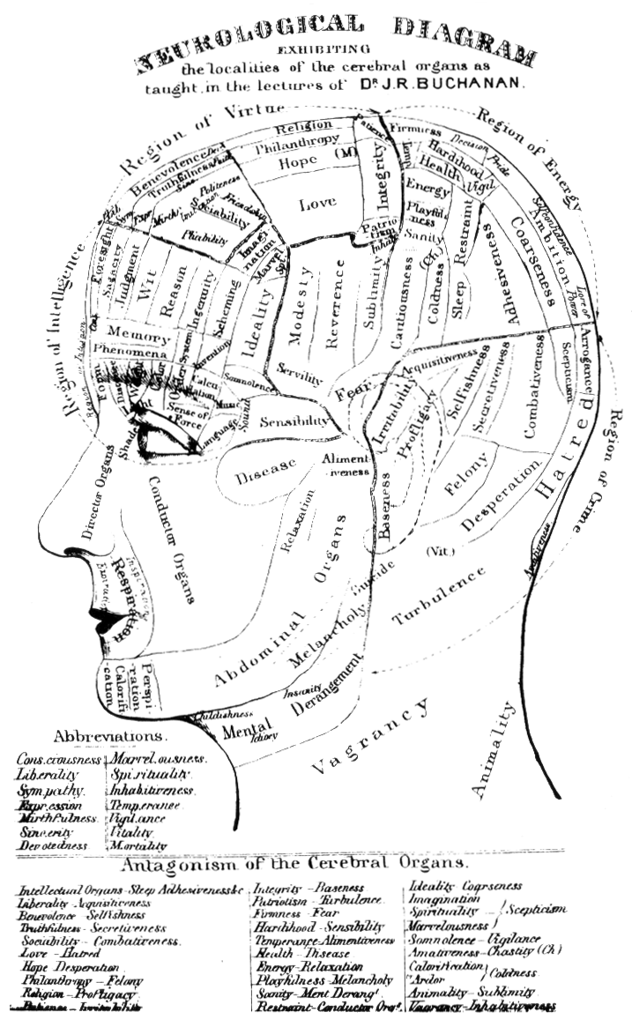
Example of Localism: Phrenology
Notes:
Towbin Zitat
Bogousslavski Zitat

Slide 31
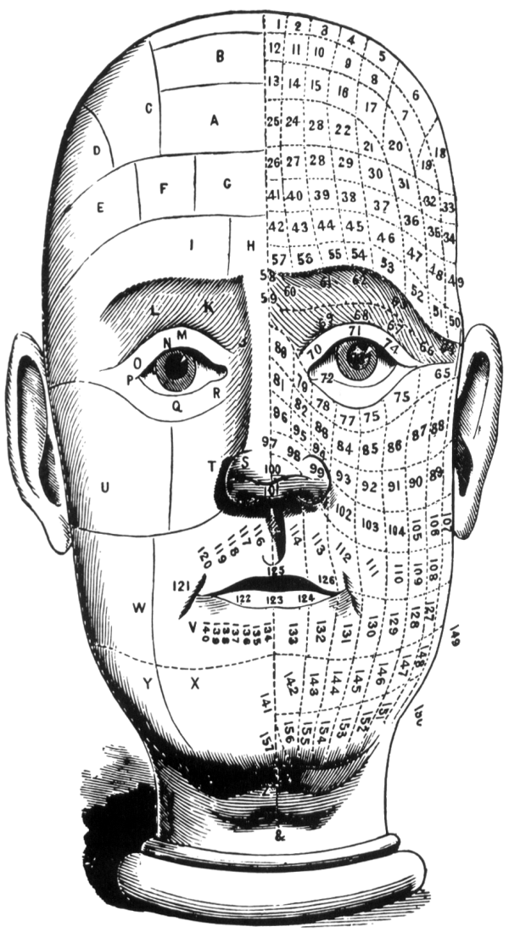
Example of Localism: Phrenology
Notes:
Towbin Zitat
Bogousslavski Zitat

Slide 32
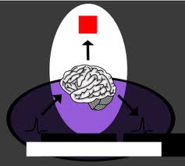
Localism versus Holism
Localism
Key functions
of the Brain
(language, motor function etc.)
can be ascribed to
„neural correlates“
in specified brain areas
Holism
The brain can only seen as
one overall entity. Any subdivision into smaller units / problems (Reductionism)
cannot achieve an adequate description of the integrated
“whole“
Notes:
Towbin Zitat
Bogousslavski Zitat

Slide 33
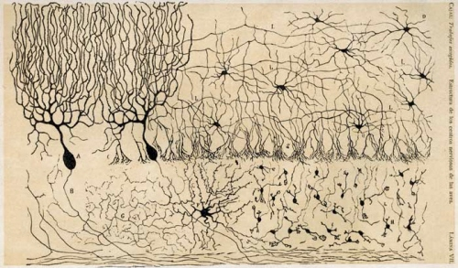
Localism versus Holism: Connectivity

Slide 34
The “Classical” Debates
about our Mental Functioning: Today?
Holism versus Localism

Slide 35
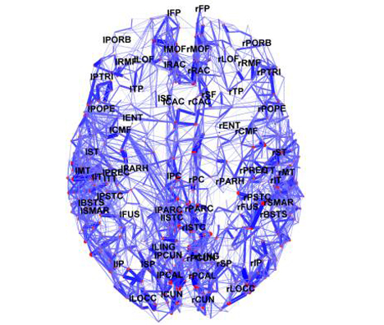
Localism versus Holism: Connectivity
The Brain as a Small World Structure
Notes:
Towbin Zitat
Bogousslavski Zitat

Slide 36
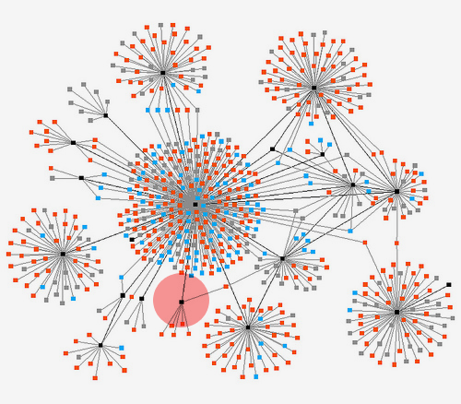
Small World Connectivity
Notes:
Towbin Zitat
Bogousslavski Zitat

Slide 37
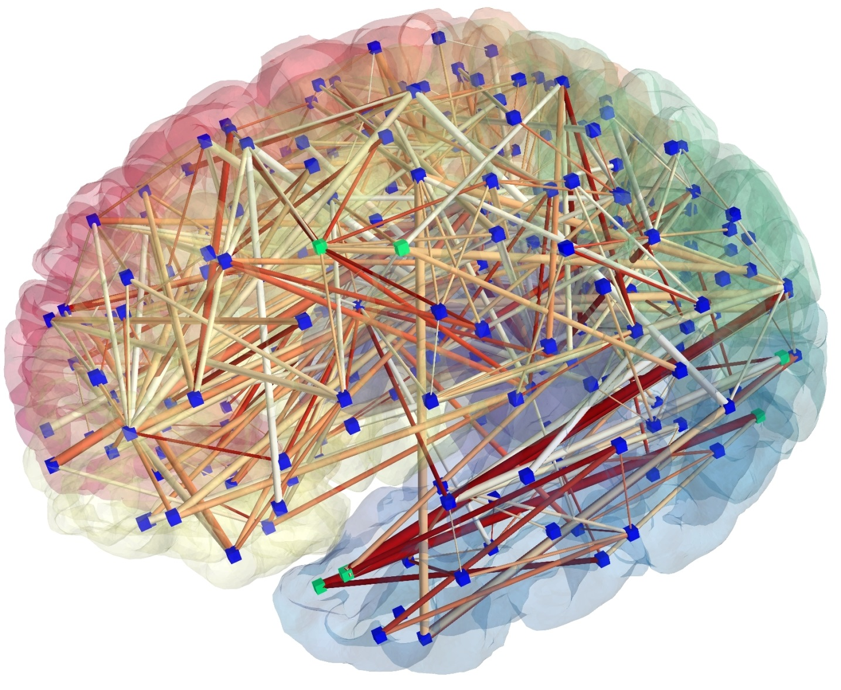
Small World Connectivity
Notes:
Towbin Zitat
Bogousslavski Zitat

Slide 38
The“Classical” Debates
about our Mental Functioning: Today?
Holism versus Localism
Most favored model today: Small World Connectome

Slide 39
The “Classical” Debates
about our Mental Functioning
Site of Mental Function in the Body
Mind versus Brain (Dualism Monism)
Holism versus Localism
The smallest functional unit?

Slide 40
Santiago Ramón
Y Cajal
1852-1934
Camillo Golgi
1843-1956

Slide 41
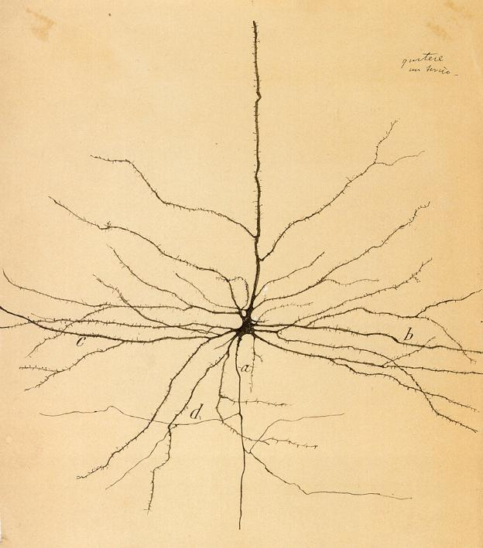

Slide 42
The “Classical” Debates
about our Mental Functioning
Site of Mental Function in the Body
Mind versus Brain (Dualism Monism)
Holism versus Localism
The smalles functional unit? The Neuron Doctrine!

Slide 43
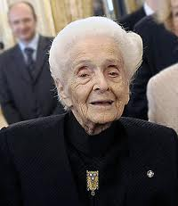
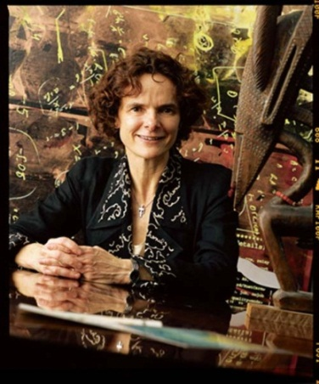
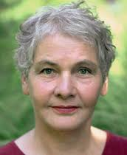
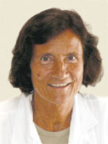
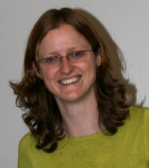
Leading Neuroscientists today
Rita Levi Montalcini
Leslie Ungerleider
Nora Volkow
Gitte Moos Knudsen
Angela Friederici
Maiken Nedergaard
Chrstiane
Nüsslein-Volhard
Marie-Germaine
Bousser
Heidi Johansen-Berg
Uta Frith

Slide 44
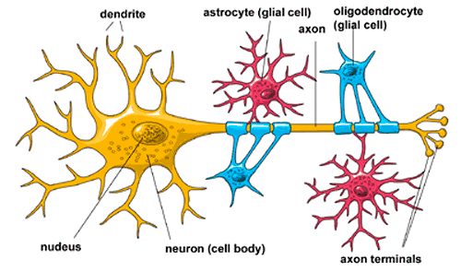
Different Brain Cells
Neurons and Glial Cells

Slide 45
The BIG “Classical” Debates
about our Mental Functioning: Today?
Neuron Doctrin?
While neurons are the main carrier of
brain function, glial cells, especially
Astrocytes may also play an important role,
e.g. in neural communication

Slide 46
The century old classical Debates About
our Mental Functioning are still ongoing today!
Site of Mental Function in the Body
Mind versus Brain (Dualism Monism)
Holism versus Localism
Neuron Doctrin

Slide 47
Part 2: Some Basics about the Brain

Slide 48
Part 2: Some Basics about the Brain
2a: A Macroscopic View

Slide 49
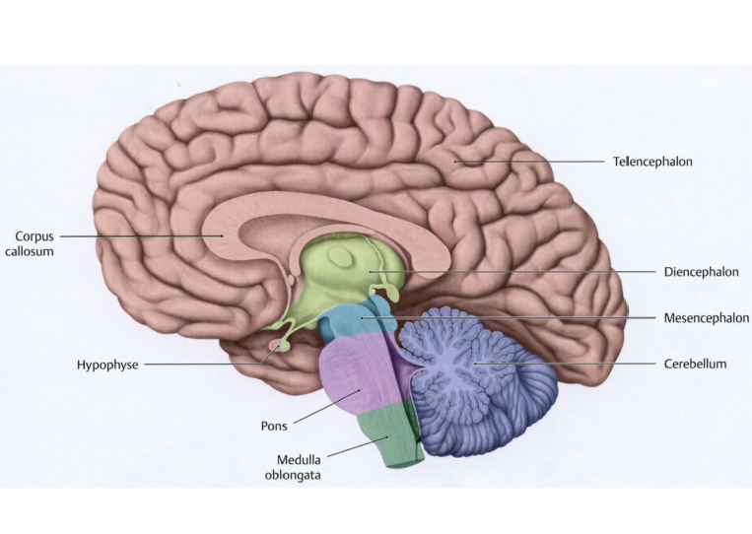
Forebrain
Brainstem
Cerebellum

Slide 50
Brain Stem
Regulating basic physiology
heart rate
blood pressure
gut function

Slide 51
Forebrain
Brainstem
Cerebellum

Slide 52
Cerebellum
Optimizing performance of
Motor function (velocity, precision)
Cognitive Function

Slide 53
Forebrain
Brainstem
Cerebellum

Slide 54
Forebrain
All „higher“ (and conscious) functions
Acting, thinking, speaking
Motor, sensory etc.

Slide 55
Forebrain
Subdivisions
frontal lobe
parietal lobe
occipital lobe
temporal lobe

Slide 56
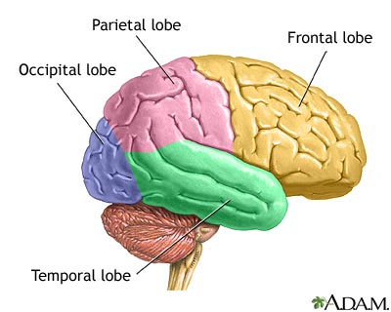
Vision

Slide 57
Somatosensory
(sense of touch)
Motor
(movement)

Slide 58
Vision

Slide 59
Executive functions,
thinking, planning,
organizing,
problem solving,
behavioral control,
personality

Slide 60
Perception
Making sense of the world
Arithmetic
Spelling

Slide 61
Memory
Language

Slide 62
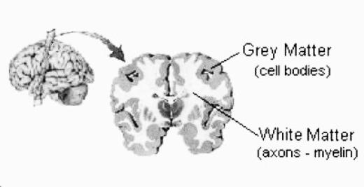

Slide 63
Grey matter, white matter

Slide 65
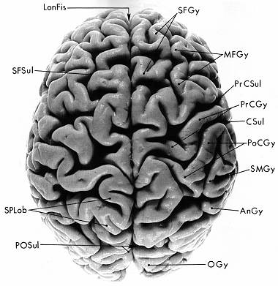

Slide 66
Gyri and Sulci

Slide 67
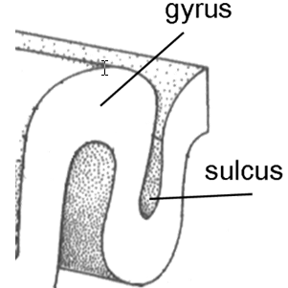
Gyri and Sulci

Slide 68
Part 2: Some Basics about the Brain
2a: A Macroscopic View
Brain Stem, Cerebellum, Cerebrum
Brain Stem: subconscious, autonomous functions
Cerebellum: optimizing performance
Cerebrum: Sensory functions, high cognitive function
Grey Matter / White Matter
Grey matter contains neuron, white matter: axons which connect neurons
Gyri / Sulci
Some gyri correspond to functional entities
but overall there is a poor correlation
Brain Lobes
Some very general functional divisions follow the
the major brain lobes

Slide 69
Part 3: Units of Brain Function
From Small Scale to Large Scale

Slide 70
Part 3: Units of Brain Function
From Small Scale to Large Scale
Neuron

Slide 71
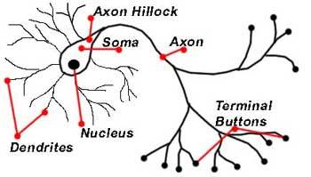
The Neuron
Anatomical Features: Nomenclature

Slide 72
Essence of Neuron Function
1) Receives information:
From Receptors or other neurons via Synapse
2) Transforms information
Into electrical code
3) Transmits information:
To other neurons, via Synapse, inner organs

Slide 73
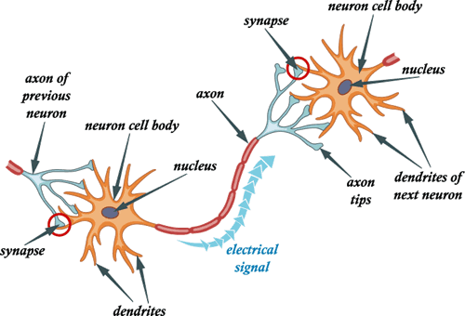
Information Transfer
LS

Slide 74
Synaptic Potential
LS

Slide 75
5 fundamental types of Neurons
Inhibitory Neurons with local contacts
(e.g. GABA ergig interneurons)
Inhibitory Neurons with distant contacts
(e.g., Punkinje Cells in Cerebellum)
Excitatory Neurons with local contacts
(e.g. Spiny cellate cells of cerebral cortex)
Excitatory Neurons that make distant contacts
(e.g. Pyramidal neurons in cerebral cortex)
Neuromodulatory neurons which influence neurotransmission
often at large distances

Slide 76
Inhibitory (IPSP), Excitatory (EPSP)
Action Potential (“Firing”)
LS

Slide 77
From EPSP, to Firing
LS

Slide 78
At the Synapse…….
LS

Slide 79
Types of Synapses
LS
Electrical Synapses
Chemical Synapses

Slide 80
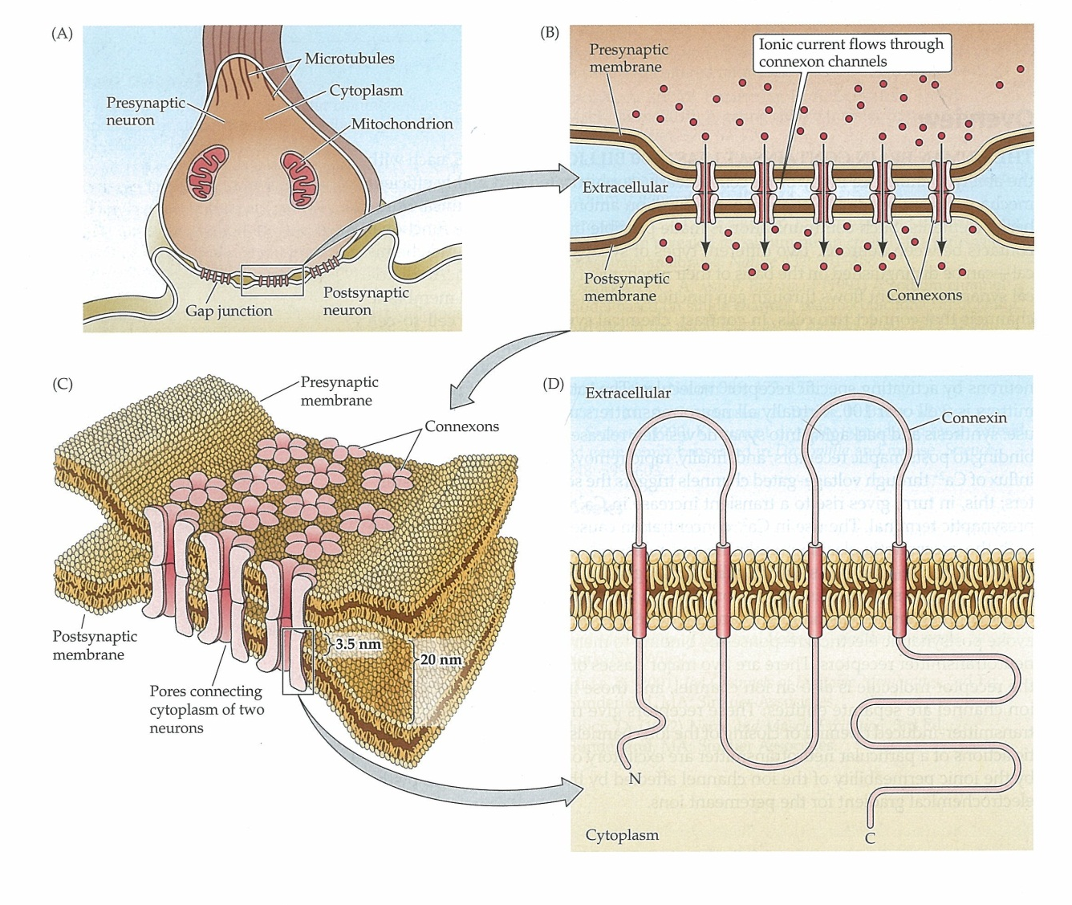
Electrical Synapse
Figure 51
LS

Slide 81
Types of Synapses
LS
Electrical Synapses
Chemical Synapses

Slide 82
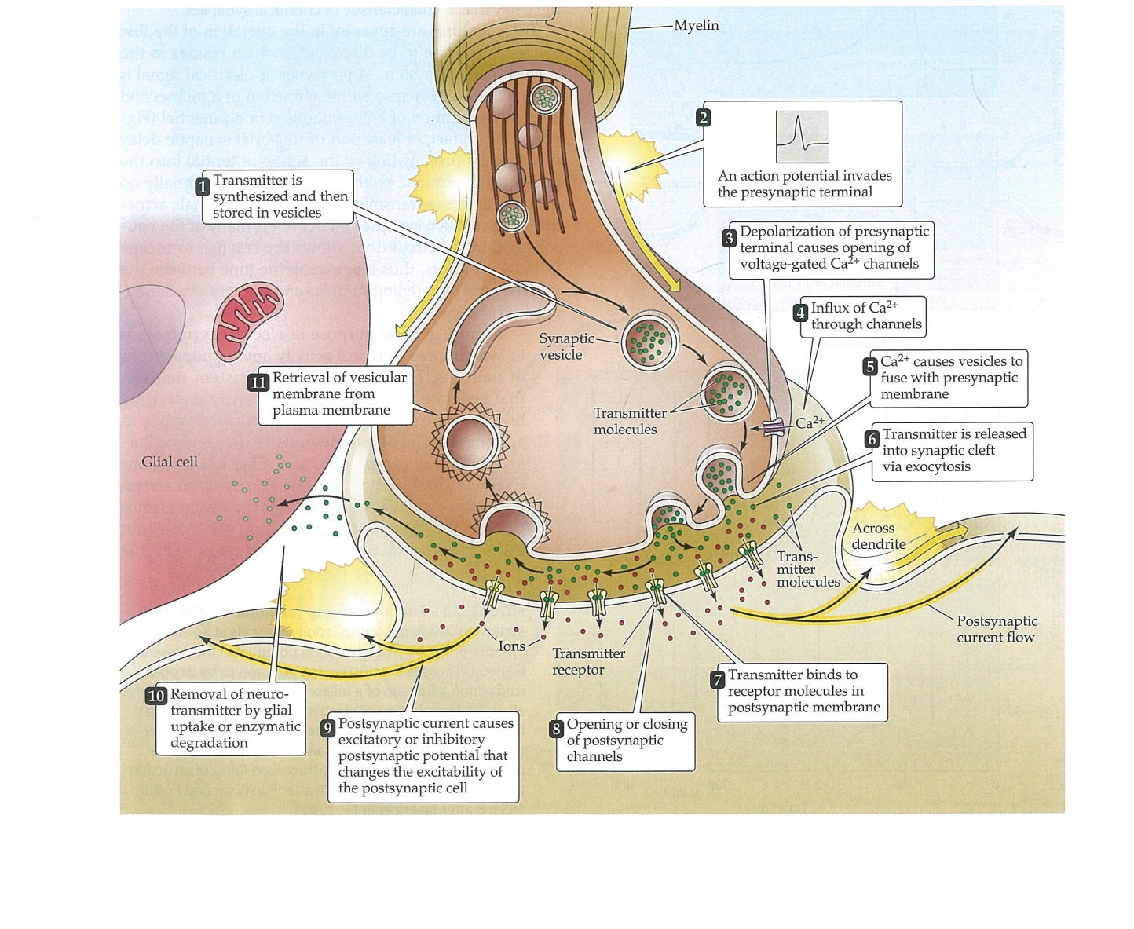
Events during Neurotransmission at Chemical Synapse
LS

Slide 83
Types of Neurotransmitters?
LS

Slide 84
Two Types of Neurotransmitters
Small-Molecule Transmitter (e.g. Gutamate, GABA etc.)
Enzymes to synthesize them are transported (slow axonal transpot) from nucleus to pre-synaptic terminal (Small clear-core vesicles)
Transmitter produced presynaptically
Small Peptide transmitter
Produced in the cell nucleus, proforms transported (fast axonal transport) together with enzymes
Large dense-core vesicles
LS

Slide 85
Part 3: Units of Brain Function
From Small Scale to Large Scale
Neuron
Cortical Layers

Slide 86
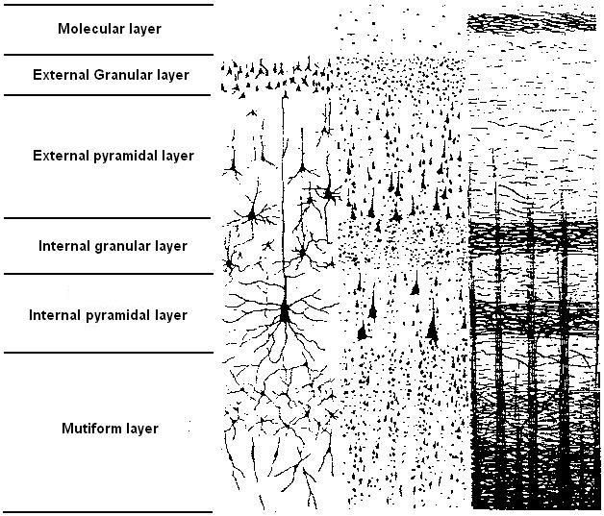
6 Cortical Layers

Slide 87
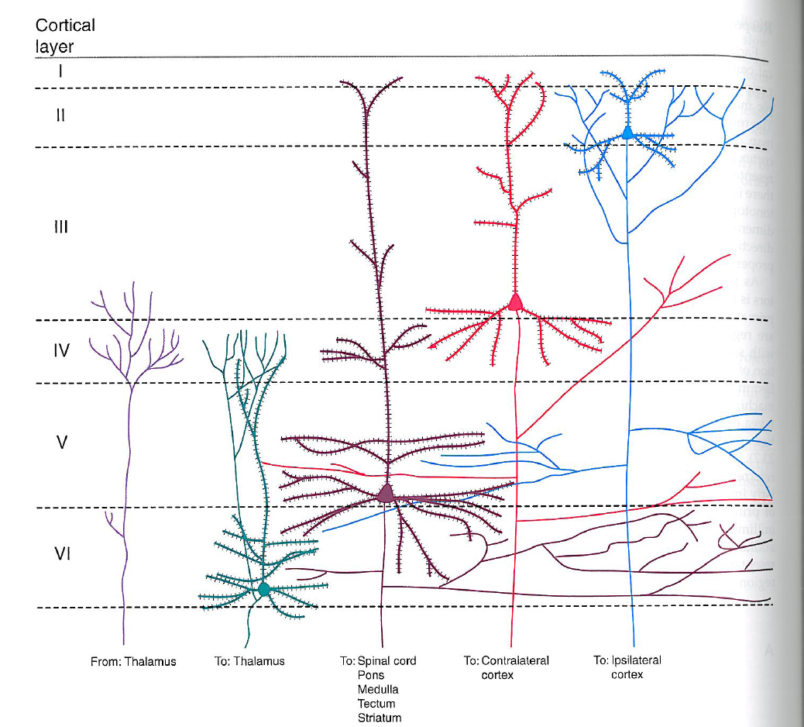
6 Cortical Layers

Slide 88
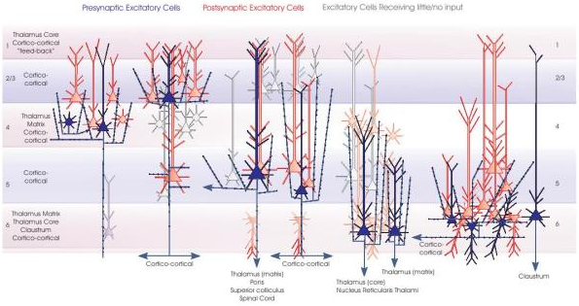
Integration of Neurons across Layers

Slide 89
Part 3: Units of Brain Function
From Small Scale to Large Scale
Neuron
Cortical Layers
Microcircuits

Slide 90
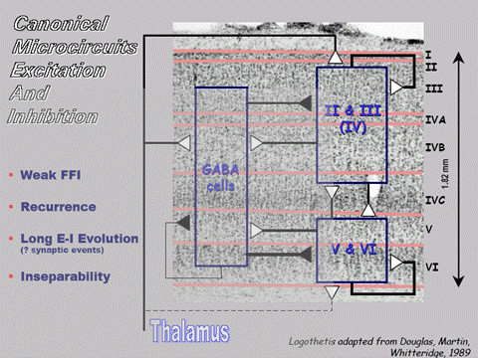
Canonical Cortical Microcircuit

Slide 91
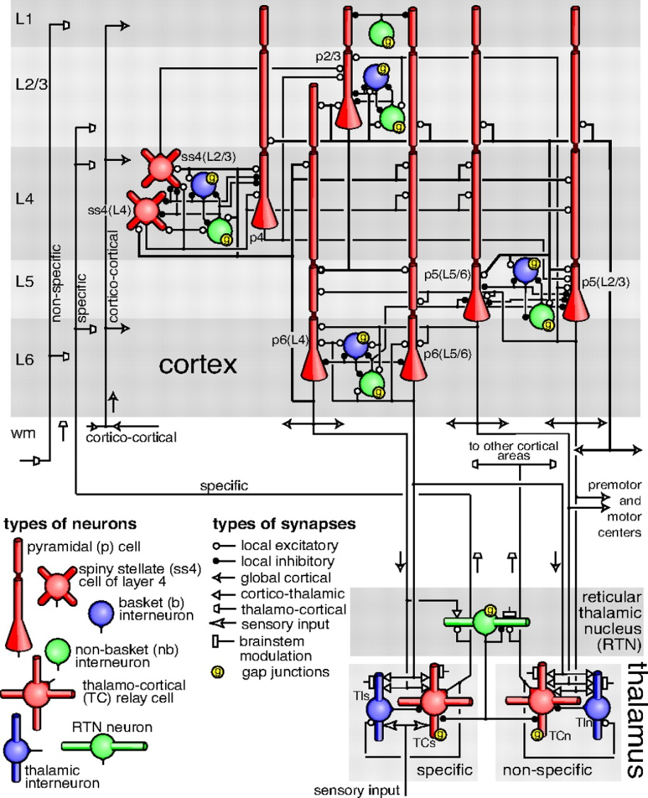
(More Elaborate) Cortical Microcircuit

Slide 92
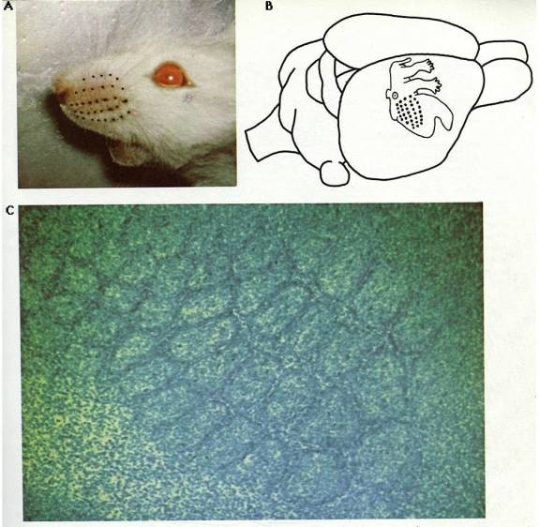
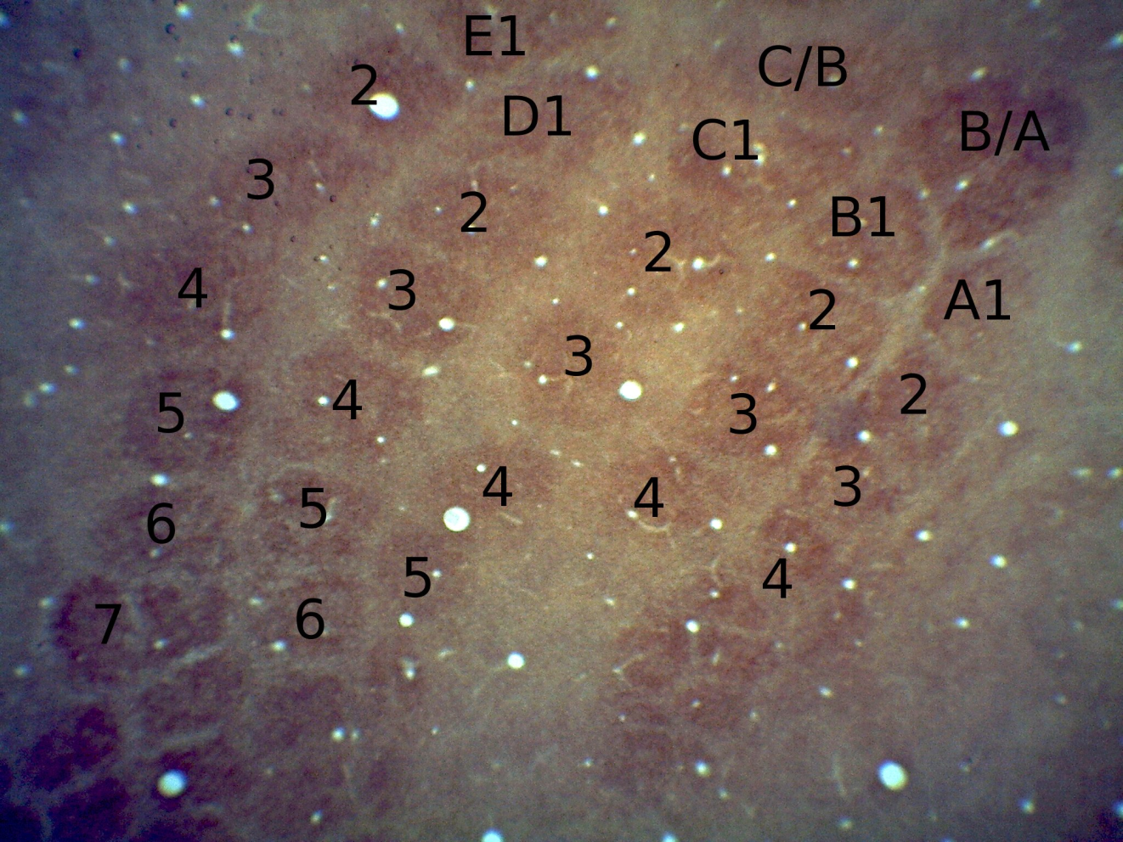
Cortical Columns: The whisker barrel cortex

Slide 93
Part 3: Units of Brain Function
From Small Scale to Large Scale
Neuron
Cortical Layers
Microcircuits
Cortical Columns

Slide 94
Cortical Columns: The whisker barrel cortex

Slide 95
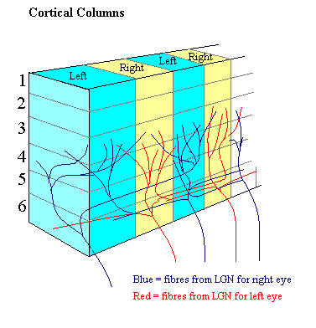
Cortical Columns

Slide 96
Part 3: Units of Brain Function
From Small Scale to Large Scale
Neuron
Cortical Layers
Microcircuits
Columns
Brodmann Areas

Slide 98
Brodmann Areas
Each has a different cytoarchitectonic appearance

Slide 99
Part 3: Units of Brain Function
From Small Scale to Large Scale
Neuron
Cortical Layers
Microcircuits
Columns
Brodmann Areas
Networks of brain areas

Slide 100
Networks underlying Brain Function
Beckmann et al., 2005, N=10
Notes:
In order to address our research question at the network level, and to be able to asses different lesions, we have adopted a template of 8 spatially independent networks computed by Beckmann and colleagues. This template contains networks such as the visual network, auditory/ executive control networks, and is based on PICA analysis done on 10 healthy controls. Our choice of this template was guided by the fact that these networks have been shown to be of functional relevance and high inter-subject consistency.

Slide 101
Primary Cortices and Associative Cortices

Slide 102
Top-Down and Bottom-Up Processing
In Sensory Systems
Associative Cortex
Primary Sensory Cortex
Thalamus
Ganglion Cells
Receptor
Associative Cortex
Primary Sensory Cortex
Thalamus
Ganglion Cells
Receptor

