Slide 1
NEUROSCIENCE, BEHAVIORAL GENETICS AND THE LAW.
Brain imaging and
cognitive neuroscience
Erice 2013
Barbara Bottalico
barbara.bottalico@unipv-lawtech.eu

Slide 2
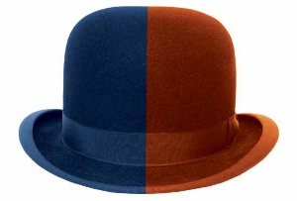

WHO AM I ?
LAWYER
RESEARCH FELLOW
European Center for Law,
Science and New Technologies, Univ. of Pavia (Italy)
http://www.unipv-lawtech.eu/lang1/index.html

Slide 3
Why
NEUROSCIENCE and
LAW
?

Slide 4
Neurolaw
Annabelle Belcher and Walter Sinnott-Armstrong
WIREs Cogn Sci 2010 1 18–22
Less than three decades ago, the fields of cognitive psychology and neuroscience joined forces to form cognitive neuroscience. More recently, neuroscience has combined with social psychology and with economics to produce social neuroscience and neuroeconomics. Each of these amalgamations has been revolutionary in its own way.
Neurolaw extends this trend.
Neurolaw studies legal issues raised by recent developments in neuroscience, including cognitive and social neuroscience.

Slide 5
How neuroscience may affect the legal systems ?
Prediction
.. of future criminal behavior
Assessment & treatment of mental illness:
Criminal responsibility
mens rea (assessing guilt)
sentencing purposes
Mind reading:
Deception
Pain
Bias
Vegetative States:
End of Life Decisions
Neuroscience and free will?
The concept of free will is an illusion and the fallacy of a basic premise of the judicial system will become more apparent – Choices reflect a summation of their genetic and environmental history (Cashmore, 2009)

Slide 6
A NEW SPECIAL ATTENTION FOR THE ISSUE
Research groups
MacArthur Foundation Law & Neuroscience project - USA –
http://www.lawneuro.org/
EANL European Association for Neuroscience and Law
(website under construction…)
b) Legal and philosophical literature
New journals: Neuroethics
Blog: Law and Neuroscience Blog http://lawneuro.org/blog/
Neuroethics and the Law Blog (Adam Kolber, Brooklyn Law School)
http://www.adamkolber.com/
Working papers: e.g. Brain Imaging for legal thinkers: a guide for the perplexed, Owen D. Jones, Joshua W. Buckholtz, Jeffrey D. Schall, Rene Marois
c) Courses for jurists
CSM (Italy)
Brooklyn Law School’s Science for Judges
Penn Neuroscience Boot Camp

Slide 7
TODAY’S OUTLINE
Possible impacts of Neuroscience on the Law
End of Life decisions
Neuroscience and Civil Law (e.g. recognition of damages in tort claims)
Neuroscience & Behavioral Genetics and Criminal Law

Slide 8
(1) END-OF-LIFE DECISIONS
PROMISES OF NEUROSCIENCE
Recent studies indicate that patients who are diagnosed with vegetative states may retain more awareness than their clinical assessments
suggest….
(Fisher C.E., Appelbaum P.S. (2010). Diagnosing Consciousness: Neuroimaging, Law, and the Vegetative State, Journal of Law, Medicine and Ethics)
In several cases, functional MRI has been used to show that aspects of speech perception, emotional processing, language comprehension and even conscious awareness might be retained in some patients who behaviorally meet all of the criteria that define the vegetative state. This work has profound implications for clinical care, diagnosis, prognosis and medical–legal decision making (relating to the prolongation, or otherwise, of life after severe brain injury), as well as for more basic scientific questions about the nature of consciousness and the neural representation of our own thoughts and intentions.
(Owen A.M., Coleman M.R., Functional neuroimaging of the vegetative state, Nature Reviews Neuroscience, vol. 9, march 2008, 235)

Slide 9
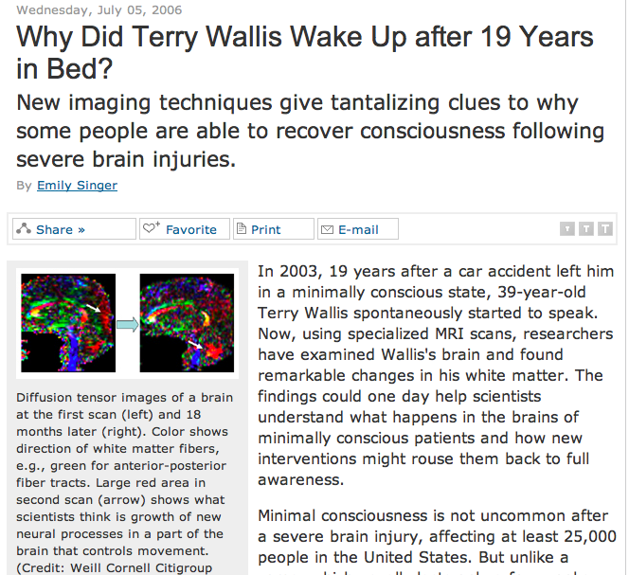

Slide 10
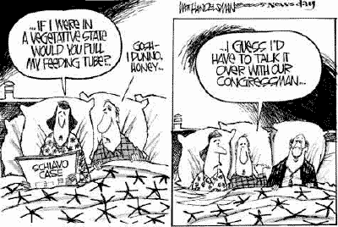
source: NYT, 26.03.2005
Notes:
Schiavo case: Terry Schiavo was an American woman who was diagnosed by doctors as being in a persistent vegetative state. Her husband wanted to withdraw life support but the woman’s parents were convinced that shw was still aware and they strongly opposed to the termination of the sustaining treatment.
In 2005, a judge ordered the removal of Terry’s fedding tube, but several appeals and federal government intervention followed, including George Bush signing legislation designed to keep her alive.

Slide 11
2) Neuroscience and Pain Assessment
Back pain is the most common reason for filling worker compensation claim and accounts for 40% of absences from work, second only to the common cold as a cause for sick leave (Guo et al., 1999).
Pain is perceived by the brain
No feasible tests or procedures which can objectively determine if chronic pain is present and it magnitude
WE HAVE TO RELY ON A SUBJECTIVE EVALUATION OF THE CHRONIC PAIN BY THE PATIENT!

Slide 12
David Foster Wallace
“Consider the lobster”
“pain is a totally subjective mental experience,
we do not have access to pain except our own”

Slide 13
Health Care Costs of Chronic Pain in the US
Source: National Research Council – Washington DC –

Slide 14
Psychological Aspects
All pain experience has psychological or psychic factors
e.g. distraction of attention from pain-producing stimuli
(athletes; hypnosis)

Slide 15
Chronic Pain
Debilitating
Often entitles to compensation
HOW TO OBJECTIVELY DETERMINE THE PRESENCE OF CHRONIC PAIN AND QUANTIFY IT?
$

Slide 16
Polaski v. Hecker 739, F. 2d 1320 (1984)
“HOW TO DETECT CHRONIC PAIN IN COURT:
claimant's prior work record, observations by third parties and treating and examining physicians relating to such matters as:
1. the claimant's daily activities; 2. the duration, frequency and intensity of the pain; 3. precipitating and aggravating factors; 4. dosage, effectiveness and side effects of medication; 5. functional restrictions.
The adjudicator is not free to accept or reject the claimant's subjective complaints solely on the basis of personal observations. Subjective complaints may be discounted if there are inconsistencies in the evidence as a whole. “

Slide 17
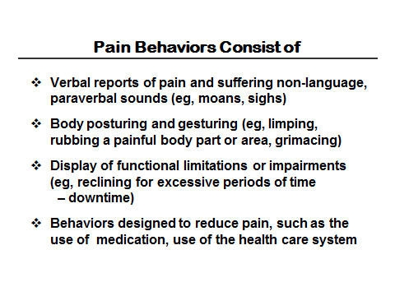

Slide 18
Malingering
Because of its subjective qualities, pain is a favorite symptom of malingerers (persons who consciously feign illness or disability).
3 forms:
Invention
Exaggeration
Perpetuation

Slide 19
The root of the problem
Pain is perceived by the brain
No feasible tests or procedures which can objectively determine if chronic pain is present and it magnitude
WE HAVE TO RELY ON A SUBJECTIVE EVALUATION OF THE CHRONIC PAIN BY THE PATIENT!

Slide 20
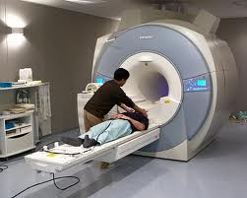
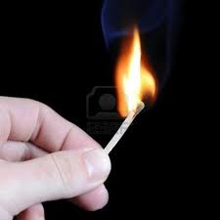
Neuroscientific attempts to measure pain
1) U.S. Pat. N. 6018675 (Apkarian)
1, 2, 3, 4, 5, 6, 7, 8, 9, 10……

Slide 21
Variable pain
Brain responses are recorded (fMRI)
Subjective indications of the level of discomfort are recorded
CORRELATION
In order to characterize the brain’s representation of the pain in relation to the patient’s perception
and
Irrespective of the details of the stimulus

Slide 22
Limitations of the Apkarian’s patent
The patient may be externally manipulated (e.g. movement of a leg in patients with chronic back pain)
The method does not distinguish between chronic pain and transitory pain
The method cannot establish the presence and/or magnitude of chronic pain on an objective basis

Slide 23
Future demonstrative techniques Pain and Suffering Cases?
Brain Scans?
Among the reasons to be cautious…
The variability in terms of baselines for pain of different individuals
The heterogeneity of “chronic pain”: which subset of patients are we talking about?
How beliefs (expectancy) can influence pain perception
The unknown rate of false positive and false negatives
……

Slide 24

3) Neuroscience, Behavioral Genetics And Criminal Law

Slide 26
www.thewarriorgene.com

Slide 27
Before analyzing cases….
Some legal basics for non-lawyers
The techniques
Criteria for the admissibility of scientific evidence in court
Insanity defense

Slide 28
The techniques.
a. fMRI
[…] it provides high resolution, noninvasive reports of neural activity detected by a blood oxygen level dependent signal (Ogawa, et al, 1990 a and b, 1992, 1993; Belliveau, et al, 1990, 1991).
This new ability to directly observe brain function opens an array of new opportunities to advance our understanding of brain organization, as well as a potential new standard for assessing neurological status and neurosurgical risk.
The particular imaging methods and procedures vary from center-to-center because each group has independently developed the methods and analysis procedures required to acquire and process functional data. There is not yet a commercial package of software and standardized tasks for clinical use (Source: Columbia University medical centre, 2009)

Slide 29
Positron emission tomography (PET)
A highly specialized imaging technique that uses short-lived radioactive substances to produce three-dimensional colored images of those substances functioning within the body (pet scans)
PET scanning provides information about the body's chemistry not available through other procedures: Unlike CT (computerized tomography) or MRI (magnetic resonance imaging), techniques that look at anatomy or body form, PET studies metabolic activity or body function. PET has been used primarily in cardiology, neurology, and oncology
Brain Fingerprinting:
The Technique aims to determine whether specific information is stored in a subject’s brain. It measure electrical brainwave responses to words, phrases, or pictures that are presented on a computer screen (invented by Lawrence Farwell).
The theory is that the brain processes known, relevant information differently from the way it processes unknown or irrelevant information. The brain’s processing of known information, such as the details of a crime stored in the brain, is revealed by a specific pattern in the EEG (electroencephalograph) . Farwell’s brain fingerprinting originally used the well known P300 brain response to detect the brain’s recognition of the known information. Later Farwell discovered the MERMER ("Memory and Encoding Related Multifaceted Electroencephalographic Response"), which includes the P300 and additional features and is reported to provide a higher level of accuracy.

Slide 30
The scientific evidence – admissibility
Common Law Systems (UK, US, Australia)
Plaintiff
The Judge decides the admissibility of scientific evidence in trial
Defendant
If admitted:
Expert witness (plaintiff)
CROSS EXAMINATION
The Jury renders a verdict (black box)
Expert witness (defendant)

Slide 31
The scientific evidence in civil-law systems
JUDGE
Court-appointed expert
PLAINTIFF or
PUBIC PROSECUTOR
(+ Expert)
DEFENDANT
(+ defense Expert)
Written reports

Slide 32
Admissibility of scientific evidence TESTs
(common law systems)
a. Frye “general acceptance” rule: Scientific evidence is admissible when the scientific technique, data or method has “gained generally acceptance” by the relevant community.
Frye v. United States, 293 F. 1013, 1014 (D.C. Cir. 1923).
b. Daubert “validity” rule
  Trial judges possess “gate-keeping responsibility” in determining validity of scientific evidence and all expert testimony. Factors in assessing validity:
    “Whether the technique can be (and has been) tested;” is it falsifiable?
    “Whether the theory or technique has been subjected to peer review and publication.”
    “In the case of a particular scientific technique, the court ordinarily should consider the known potential rate of error.”
    “the existence and maintenance of standards controlling the technique’s operation”
    “‘General acceptance’ can yet have a bearing on the inquiry.”
Daubert v. Merrel Dow Pharms., Inc., 509 U.S. 579 (1993).

Slide 33
A quick glance at the admissibility of neuroscientific evidences in ITALY
Are brain imaging techniques suitable to prove a fact?
Do them affect defendant’s
self-determination or moral liberty?

Slide 34
The Insanity Defense
A criminal defense asserting that at the time of the commission of the acts constituting the offense, the defendant, as a result of a severe mental disease or defect, was unable to appreciate the nature and quality or the wrongfulness of his acts
(in the Italian system: lack of cognitive and volitional capacity at the time of the crime)
The defendant has the burden of proving the defense of insanity by clear and convincing evidence.

Slide 35

The Brian Dugan Case –
Chicago 2009
For the first time fMRI was brought up in the court as a 'mitigating circumstance', in a case in which death penalty was at stake.
fMRI was admitted as scientific evidence (Frye Test) aimed to demonstrate that Dugan suffered from psychopathy, but scans were rejected on the grounds that bright colors could confound and bias the jury. The Court allowed jurors to only power point slides representing graphics and bars of the scans.
The verdict was death penalty, for a murder committed by Dugan 26 years ago.

Slide 36
The Brian Dugan Case - Remarks
The test was not contingent (date of crime: 1983!)
Before discussing the modality of its presentation, the admissibility itself of the evidence should be discussed
The judge’s decision is inconsistent: data already interpreted by the expert witness

Slide 37
Dr. Semrau,
Tennessee District Court (USA), 2010
  Semrau’s defense asks the Judge to admit FMRI as a
  Lie Detector (In order to demostrate the veridicity of Semray’s declarations)
The method doesn’t pass the Daubert Standard
Error Rates ?
General Accepted?
the probative value of Dr. Laken’s testimony is substantially outweighed by the danger of unfair prejudice to the jury(F.R.E. 403)
“courts in this circuit have consistently found that the high risk of unfair prejudice associated with the admission of testimony regarding unilaterally obtained polygraph results will preclude such testimony from being admissible”.
The error rate of real life fMRI- based lie detection is unknown!
The method has not yet been accepted by the scientific community

Slide 38
Questions about memory: how can we explore it?
The memory is not a safe element, especially many years after the event we ask to remember. The brain become older and what the person does is: Memory recall

Slide 39
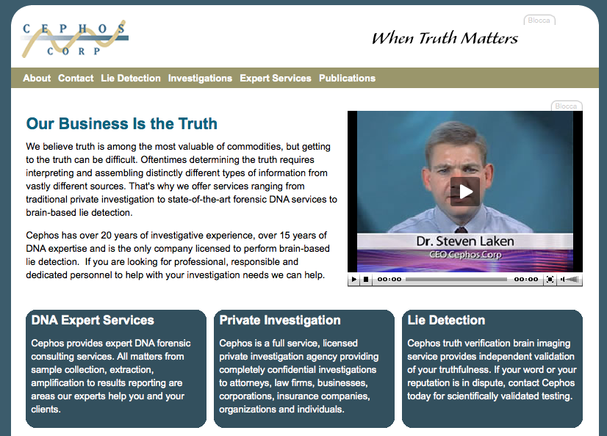

Slide 40
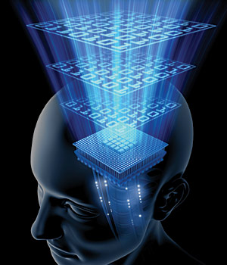
VISUAL IMAGES
What are data, what do they show and what are unable to show?
This inquiry requires assessing the computer data processing tools that interpret the flood of data obtainable.
What are the capabilities of data processing and computer-generated images?
What are their limitations?
What are the dangers of non-scientists being misled by ignorance of what the images show?

Slide 41
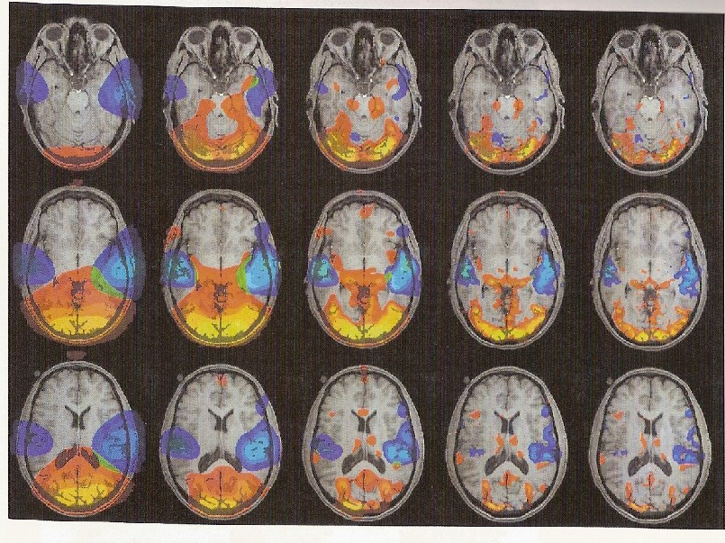
Source: S.M. Smith, Preparing fMRI data for statistical analysis, in P. Jezzard et al., eds. Functional MRI: An introduction to methods, Oxford University Press, 2001.
Five different ways to reproduce same data originate different fMRI visual images.
Each sequence applies a different statistical filtering to the same data set.
Differences between visual images results are noticeably

Slide 42
What should legal and scientific community do?
A CRITICAL POINT
To establish criteria for the conversion of data into visual images with trial purposes

Slide 43
Behavioral genetics
the field of study that examines the role of genetics in human behavior
"nature versus nurture" debate
highly interdisciplinary (biology, genetics, psychology, and statistics.)

Slide 44
“ Behavioral Genetics applications in the criminal justice system are quickly outpacing the advances in the science ”
(N. Farahany & W. Bernet)

Slide 46
THE FIRST TIME BEHAVIOURAL GENETICS ENTERED THE COURT
Stephen Mobley - USA – 1994
(murder of a 24-year man)
He filed a motion seeking funds to hire experts witnesses to assess his potential deficiency in MAOA enzymatic activity, based on the then-recent studies suggesting a possible genetic basis for violent and impulsive behavior .
The court denied Mobley’s motion: lack of scientific verificability
- Mobley was executed by lethal injection in 2005 in Georgia

Slide 47
THE STARTING POINT
In 1978 a Dutch woman walked into University Hospital in Nijmegen with a problem
Genetic investigation on her family
15 years later - first outcomes: a genetic defect on the X chromosome
The Gene coding for an enzyme (MAOA) that may help regulate aggressive behavior

Slide 48
Caspi, Moffit (Science, 2002): Monoamine oxidase A (MAOA).
Low activity of this gene neurotransmitters in the brain (serotonine, dopamine, norepinephrine) are not properly metabolized low activity of MAOA in males + maltreated as children = a much greater likelihood to manifest violent antisocial behavior in the future.
Caspi, Moffit et al. (2003): SLC6A4 gene
Individuals with one or two copies of the short allele = more depressive symptoms, suicidability in relation to stressful events

Slide 49
Cases – since 2002
USA
Expert witnesses mostly based on gene SLC6A4
State v. Jon Hall
Hines v. State
State v. Payne
State v. Godsey
People v. Uncapher
State v. Sanders
State v. Newton
(Source:
Bernet W. Et al. , Bad Nature, Bad Nurture, and Testimony regarding MAOA and SLC6A4 Genotyping at Murder Trials, J.Forensic Sci., Nov. 2007, Vol. 52, n.6)
COMMENTS:
More attempts to mitigate the sentence than attempts to obtain a declaration of insanity
Use by the prosecutors: social dangerousness

Slide 50
2004 - annual anthropologists’ meeting in Florida – scientific jounalist Ann Gibbons coins the phase “Warrior Gene”, describing MAOA gene
Media &
Behavioral Genetics

Slide 51
http://www.youtube.com/watch?v=sMfWSGi3Y2k
http://topdocumentaryfilms.com/born-rage-inside-warrior-gene/
http://www.familytreedna.com/landing/warrior-gene.aspx

Slide 52
ITALY – BAYOUT CASE
Court of Appeal of Trieste
September 2009
The convicted man [Abdelmalek Bayout] was an adult male affected by schizophrenia who was found guilty at the first level of judgement and was given a reduced sentence (9 years) owing to his mental illness.
At the appeal court, a new expert assessment took place, and behavioral genetic testing was requested by the defence.
The judge reduced the sentence from 9 to 8 years, based on the fact that the accused had tested positive for genetic
variants that made him particularly prone to be aggressive under stressful circumstances and therefore he was even more vulnerable because of that

Slide 53
“ A person should be judged on the basis of his actual condition and mental capacity at the moment of the act, independent of any theoretical predisposition to develop some disease or inappropriate behavior even assuming that there is really a link between abnormal behavior and specific genetic variants”
(Forzano et al. , in: European Journal of Human Genetics)
Issue: reliability of the method!

Slide 54
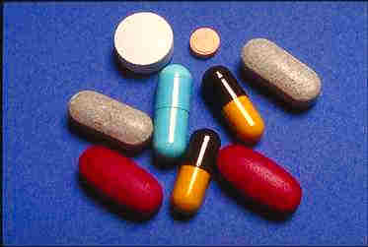
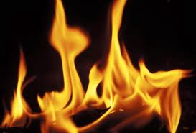
Albertani case: the factual background
STEFANIA ALBERTANI
MARIAROSA
(STEFANIA’S SISTER)
STEFANIA’S PARENTS

Slide 55
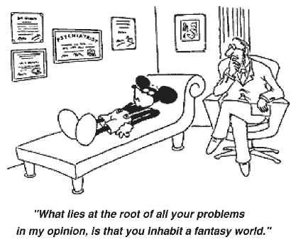
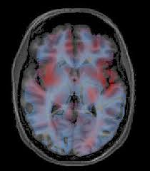

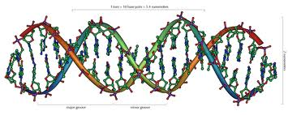
The experts’ opinion

Slide 56
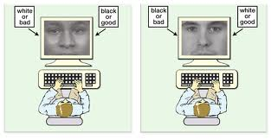
aIAT TEST
“the test aims to establish whether an autobiographical memory trace is encoded in the respondent's mind, allowing one to evaluate which of two contrasting autobiographical events is true for a given individual “
Since pairing of a truly autobiographical event with the true-bottom should facilitate responses, the specific pattern of response times in the two blocks indicates which autobiographical event is true and which is false.
92% accuracy

Slide 57
BUT
..many doubts surround this method
The retrievable literature about aIAT method is mainly ascribable:
to the experts themselves or
to researchers who critically conducted experiments that showed how easily the test is subjected to countermeasures:
it is sufficient for the subject to be instructed to slowly answer the questions,
or to answer using particular accuracy.

Slide 58
VBM (Voxel-Based Morphometry)
VBM based on structural MRI yielded significant results. According to the experts’ report, the defendant’s cerebral grey matter was compared with that of an appropriate control group consisting of 10 female subjects, without relevant disorders and with analogous personal data
there were statistically significant differences between Albertani’s cerebral grey matter volumetry and controls’ one. This would cause an impairment in those functions regulated by the anterior cingulated gyrus, namely: 1) inhibiting automatic behavior and replacing it with another one 2) regulate lying phenomena, causing high levels of suggestibility 3) regulating decision making processes

Slide 59
MAOA Genetic Test
The experts wrote that, according to many published studies, the analyses revealed that the defendant is carrier of susceptibility alleles associated to a major risk of developing aggressive and impulsive behavior (MAOA)
“With reference to Albertani’s genotype at MAOA-uVNTR locus, she is heterozygous 3/4 and the allele 3 is associated with a low efficiency form of the enzyme, notoriously related to aggressive and antisocial behavior in men. In women these findings cannot be clearly interpreted: Due do the epigenetic mechanism of X inactivation, heterozygous women show a intermediate phenotype. However, it’s not possible to exclude the association. In addition, allele 4 is associated with criminal behavior, especially associated with psychosocial adverse events. Miss Albertani carries both the adverse alleles at MAOA-uVNTR locus.”

Slide 60
Judicial Decision and Sentence
Diminished cognitive and volitional capacity
art. 89 Italian Penal Code (Vizio Parziale di mente)
Sentence reduced from 30 to 20 years imprisonment
‘At least’ 3 years in a mental health hospital

Slide 61
Decision and Sentence
Prevalence of the defense experts’ opinion on the court-appointed one:
“the neuroscientific investigations carefully arranged by the defense’s experts integrating the traditional psychiatric and neuropsychological investigations are welcome.”
A Copernican revolution is not being introduced in terms of assessment, evaluation and diagnosis of mental pathologies
NO Introduction of deterministic criteria to infer some behavior from morphological alterations.
Rather, the knowledge about cerebral morphology and genetic structure should be considered valuable in order to find possible correlations
between brain anomalies and lack of capacity to control impulsivity
between genes’ alleles and the risk of a greater vulnerability to the development of socially unacceptable behaviors when more exposed to the effect of environmental stress factors.

Slide 62
CONCLUSIONS
Neuro-techniques, as such, follow a method based on statistical analysis: they can be a useful tool to assess brain damages and infer considerations on mental illness, but they cannot replace the comprehensive analysis of a person, from her experience to her behavior.
Behavioral genetics: there is a serious risk of reductionism. The most common mistake surrounds the difference between behaviors and traits. A trait can be described as a sort of broad inclination. Behaviors are actions rising from those inclinations. Traits are selected for over long stretches of time, while behaviors rise as their current, context-sensitive expressions.
Notes:
So, for instance, curiosity is a trait, and people might express it in behaviors ranging from talking to new persons every day to climbing a mountain. Genes do not directly cause this specific behavior, which represents a choice that people consciously and rationally made (unless they are affected by mental illness) on the basis of a mix between biological make up, past experience and interests and goals for the future

Slide 63
THANK YOU !
barbara.bottalico@unipv-lawtech.eu

