Slide 1

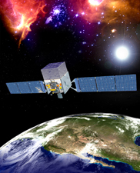
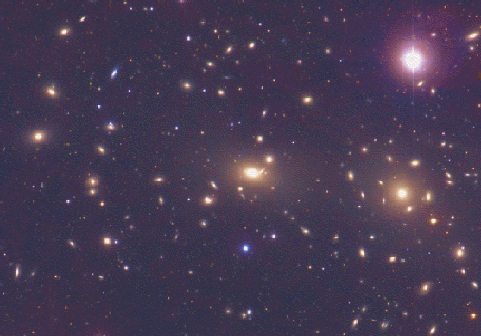
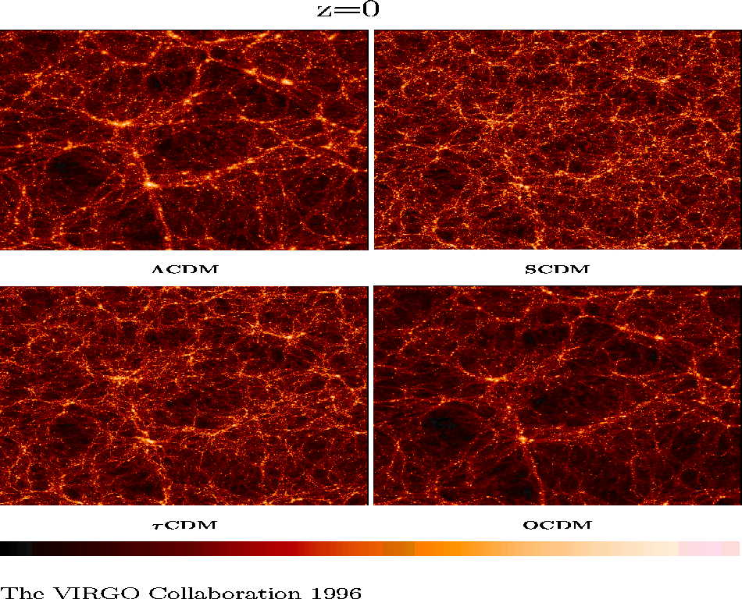
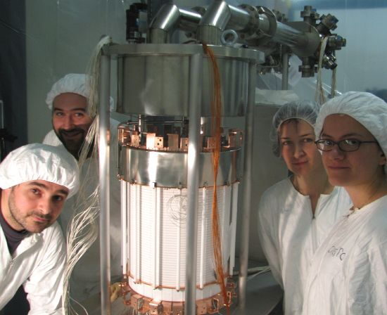
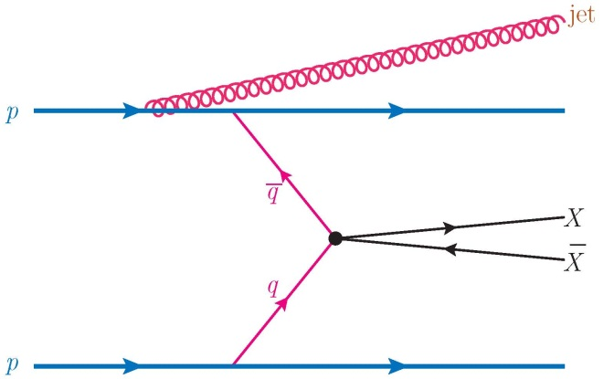
The Decade of the WIMP
(Weakly Interacting Massive Particle)
Rocky Kolb
University of Chicago
Feb. 2013
Bologna

Slide 2
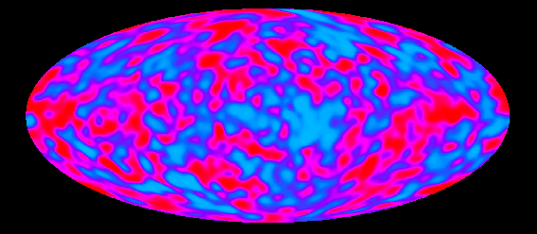

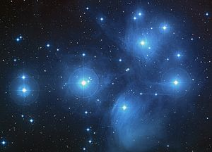
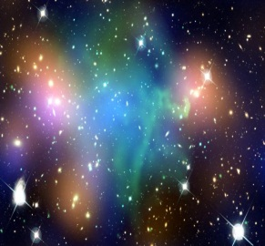
Radiation:
0.005%
Chemical Elements:
(other than H & He) 0.025%
Neutrinos:
0.17%
ν_{e}
ν_{μ}
ν_{τ}
Stars:
0.8%
H & He:
gas 4%
WIMP?
Dark Matter: 25%
Λ?
Dark Energy: 70%

Slide 3
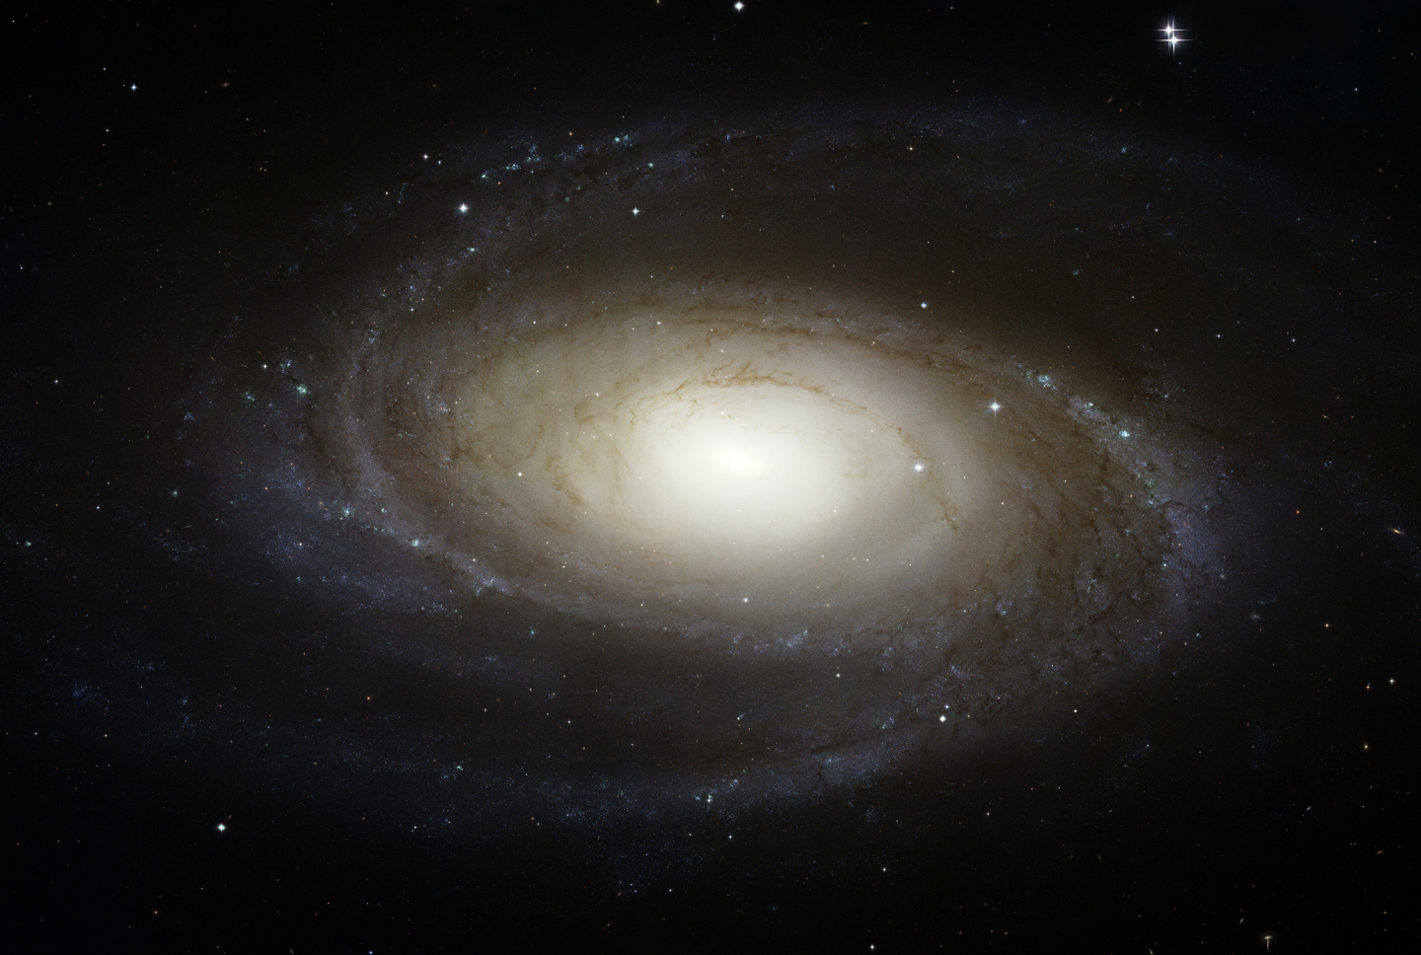
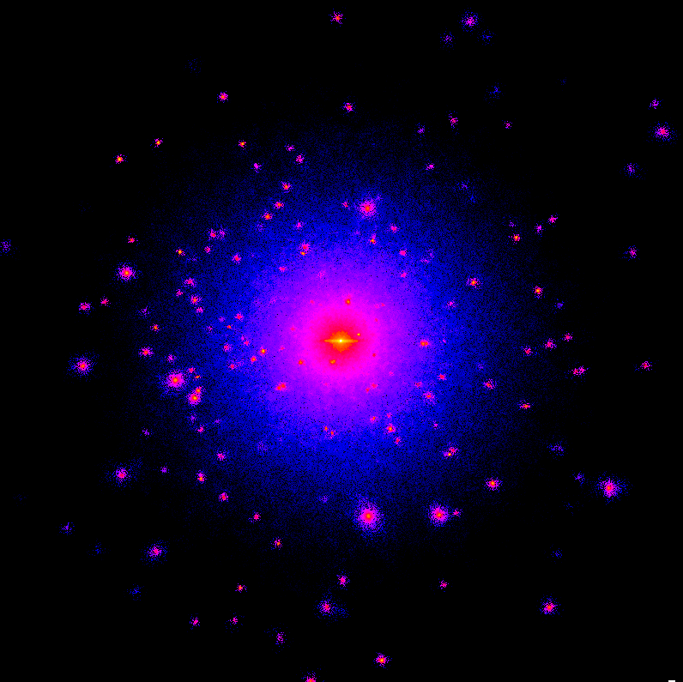
Image: Navarro et al.

Slide 4
Don’t look now, but …
… you are surrounded by invisible things!
A mysterious, invisible particle species is all around us,
a relic of the first fraction of a second of the Universe,
and a few hundred million are in this room at any instant
flying around at about a million kilometers per hour, and
about million-million will pass through you during this talk,
but you can’t see them, feel them, or smell them, and yet
they shape the large-scale structure of the Universe…and
we may finally be at the threshold of “discovering” them!
A Fantastical Story!
Image: Navarro et al.

Slide 5
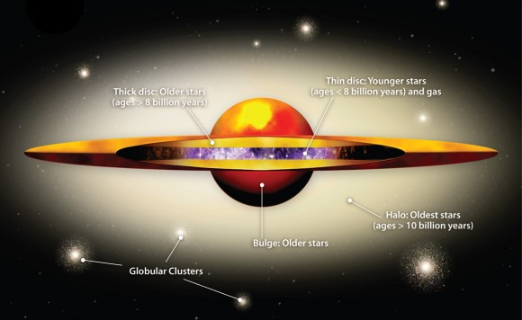
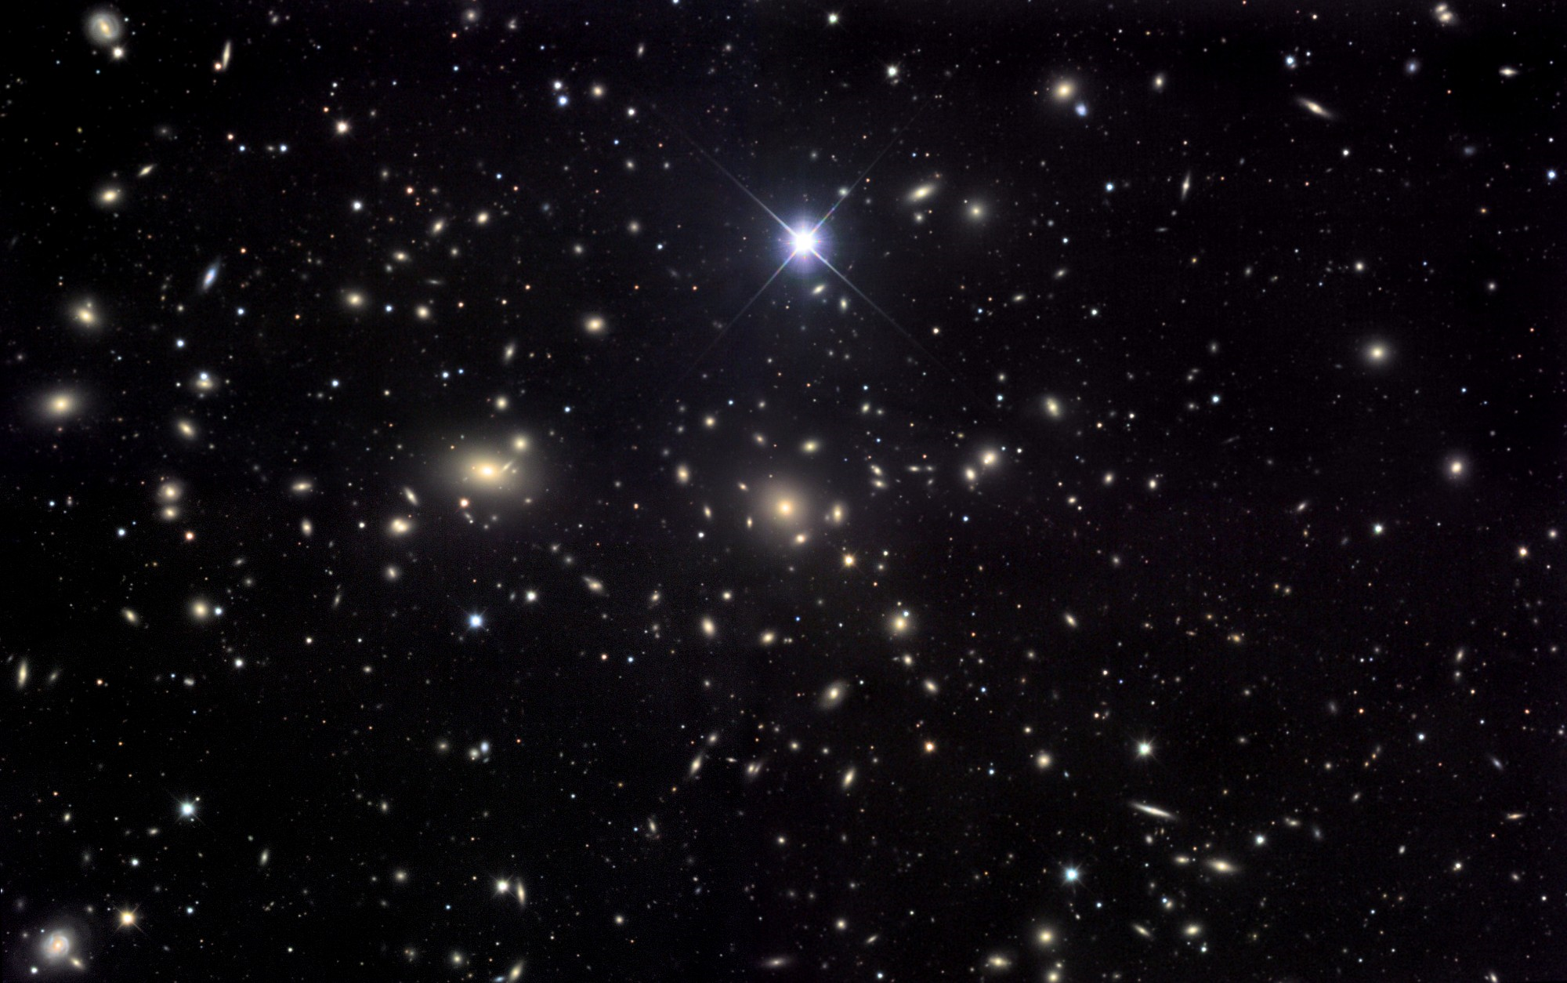
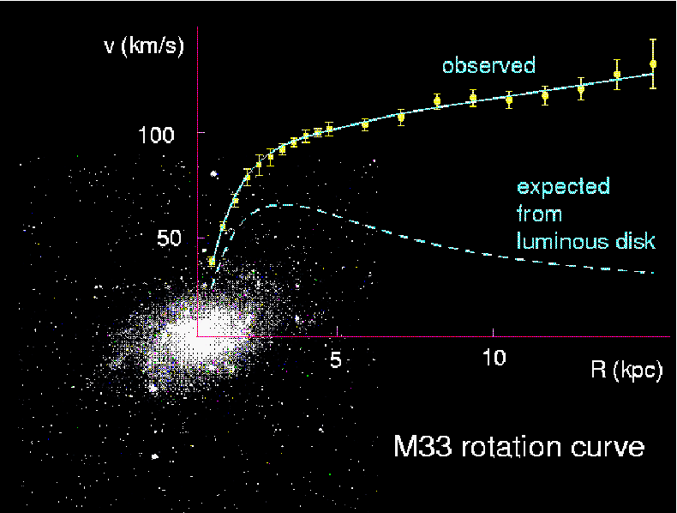
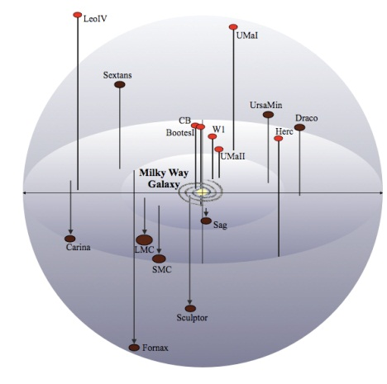
Eighty Years of Dark Matter
Oort 1932 Local Neighborhood a Little Dim (M/L) ~ 2−3
Zwicky 1937 Galaxy Clusters Really Dark (M/L) ~ 500
Rubin & Ford 1970s Individual Galaxy Halos Also Dark (M/L) ~ 60
Dwarf Observers 1990s Dwarf Galaxies Really, Really Dark (M/L) ~ 3000
Coma Cluster
Image: Amanda Smith
Image: Jim Misti
velocity
observed
100 km/sec
dark matter
expected from stars
20,000 light years
distance
Image: M. Geha

Slide 6
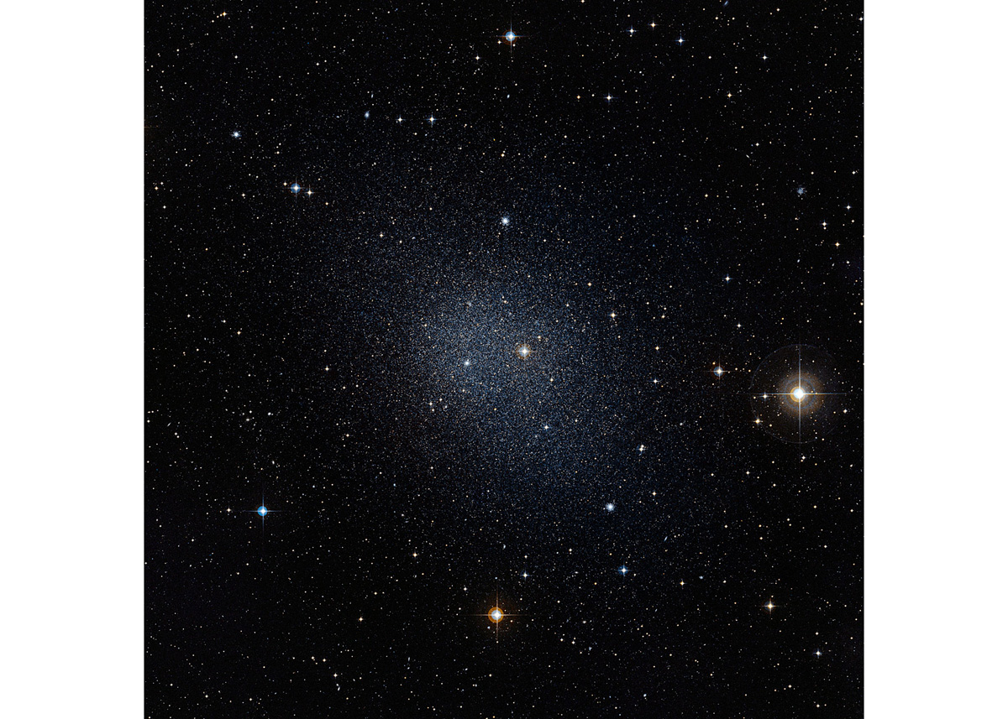
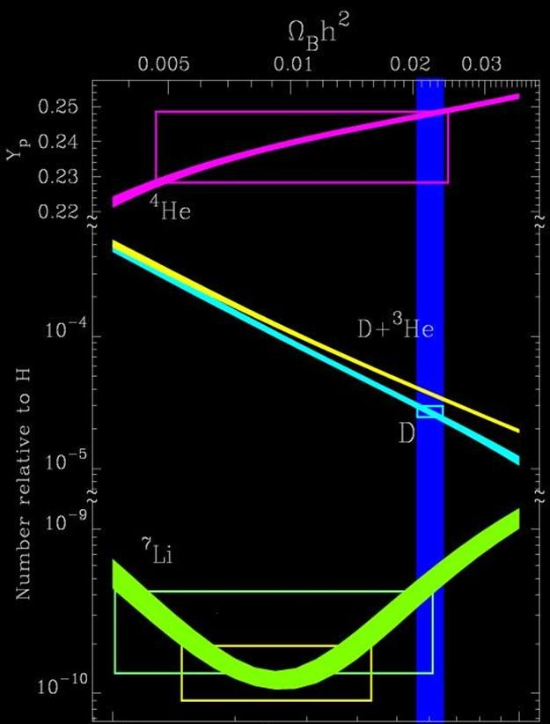
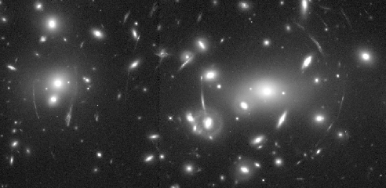
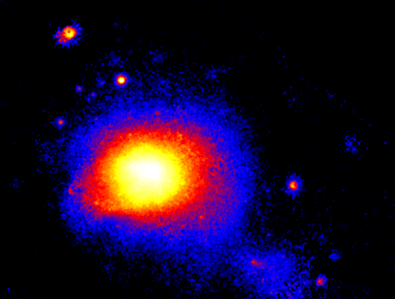
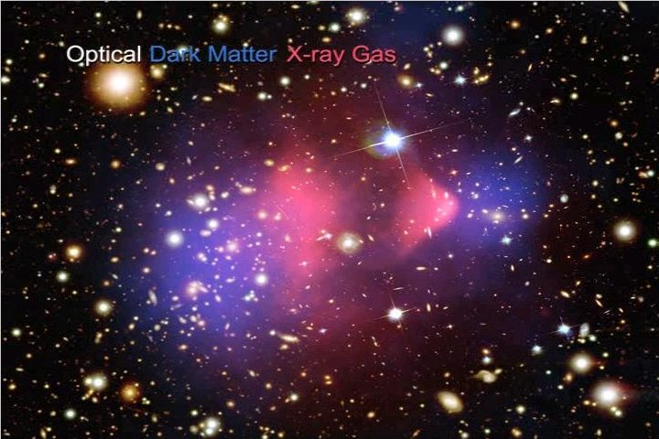
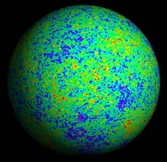
observed
luminous
disk
cluster dynamics
dwarf galaxies
galactic rotation curves
observed
luminous
disk
nucleosynthesis
gravitational lensing
cluster gas in x-rays
background radiation
structure formation
cluster collisions

Slide 7
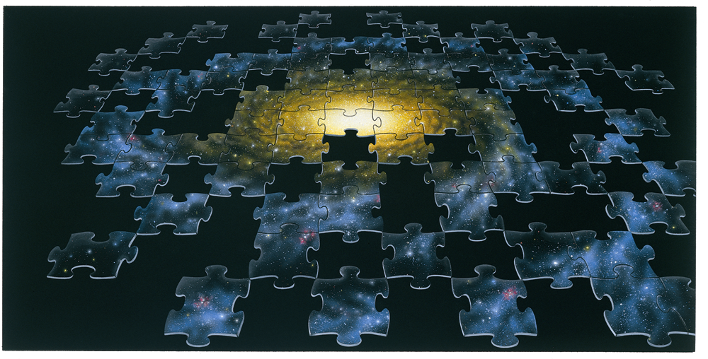
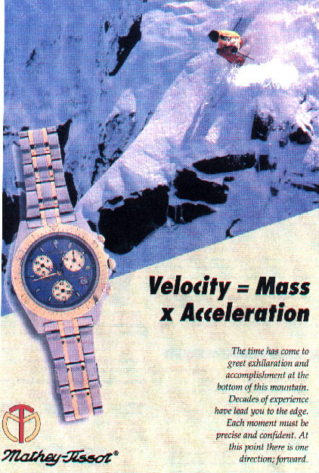
Dark Matter
Newton & Einstein didn’t have the last word
Modified Newtonian Dynamics, i.e., F ≠ m a
Rocky Rogue Planets
Massive Compact Halo Objects
(MACHOs)
Mass Challenged Stars
Black Holes
Weakly Interacting Massive Particles
(WIMPs)
New Particle Species

Slide 8
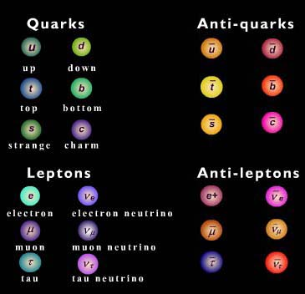
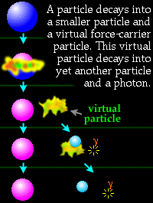
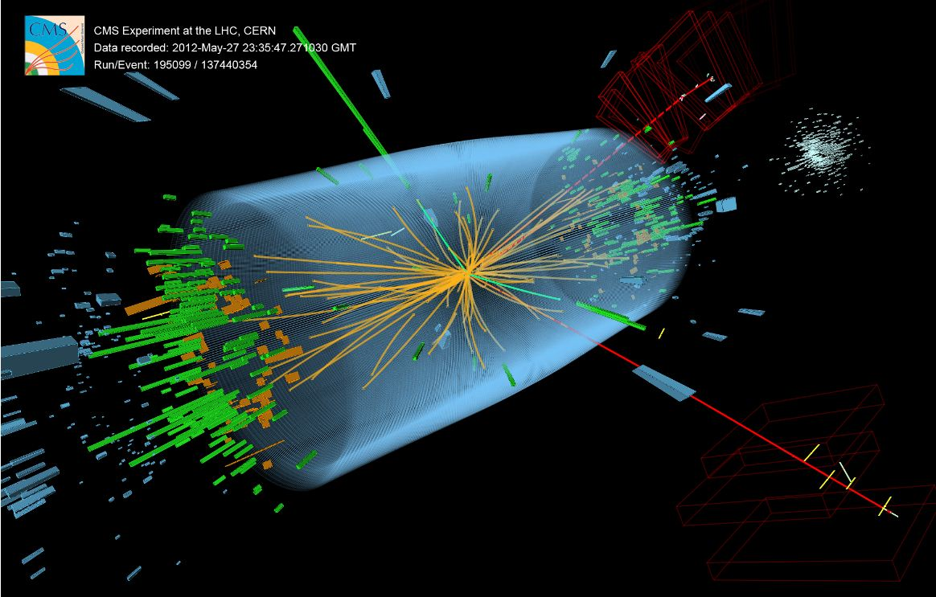
Known Particle Species
Quarks
Antiquarks
Force Carriers
?
up down
photon gluon W Z graviton
top bottom
and now the HIGGS!
strange charm
Leptons
Antileptons
electron electron neutrino
muon muon neutrino
tau tau neutrino
Images: CERN
Dark particle must be stable and massive and interact weakly
Dark particle must be “A New Particle Species”

Slide 9
Particle Dark Matter Taxonomy
neutrinos (WIMPs exist!!!) (hot)
sterile neutrinos, gravitini (warm)
Lightest supersymmetric particle (cold)
Lightest Kaluza-Klein particle (cold)
Bose-Einstein condensates
axions, axion clusters
solitons (Q-balls, B-balls, …)
supermassive wimpzillas from inflation
thermal relics
or decay of or
oscillation from thermal relics
coherent
state of a
scalar field
nonthermal
relics
Mass
10⁻²² eV (10⁻⁵⁶ g) Bose-Einstein
10⁻⁸ M_{ʘ} (10⁺²⁵ g) axion clusters
Interaction Strength
only gravitational: wimpzillas
strongly interacting: B balls

Slide 10
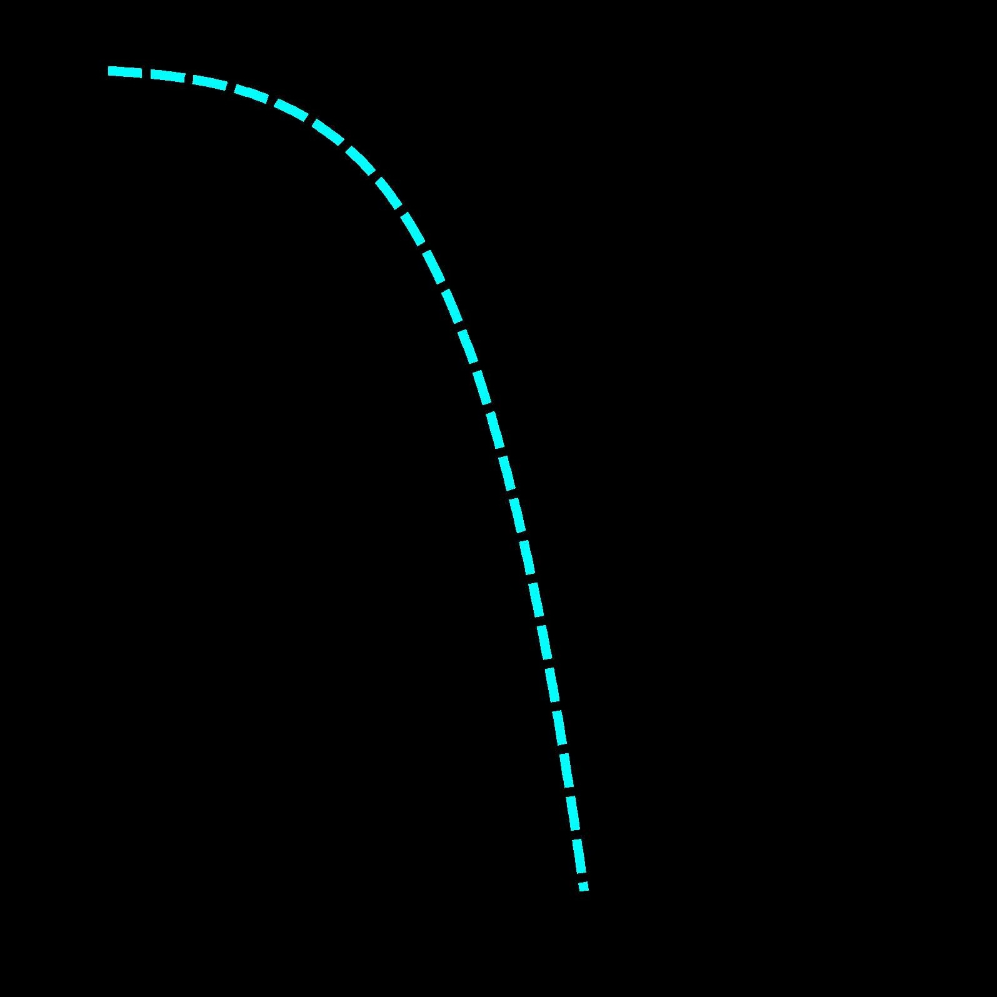
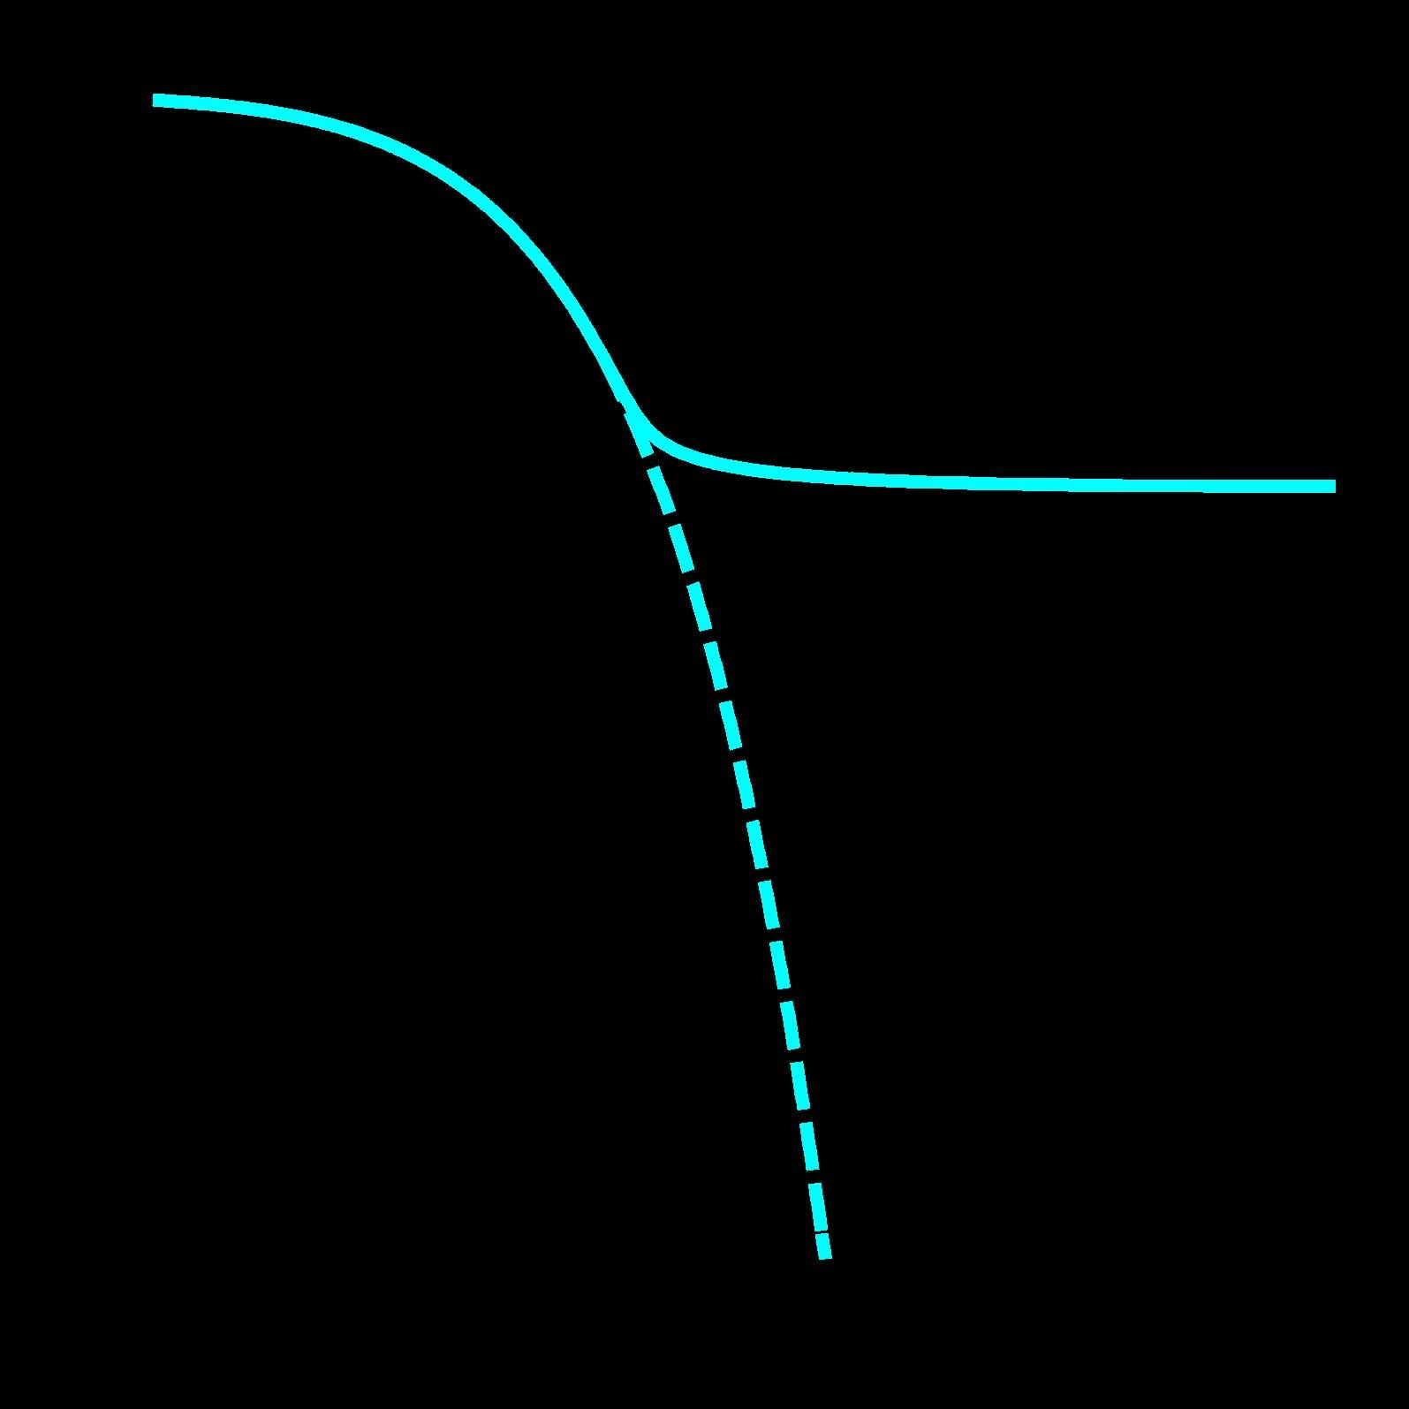
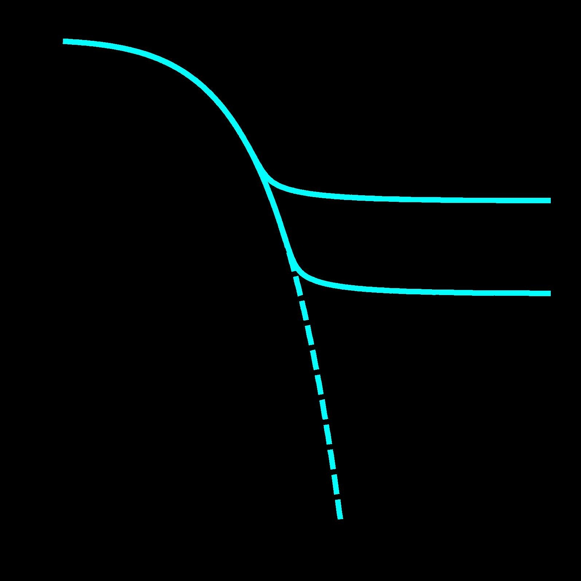
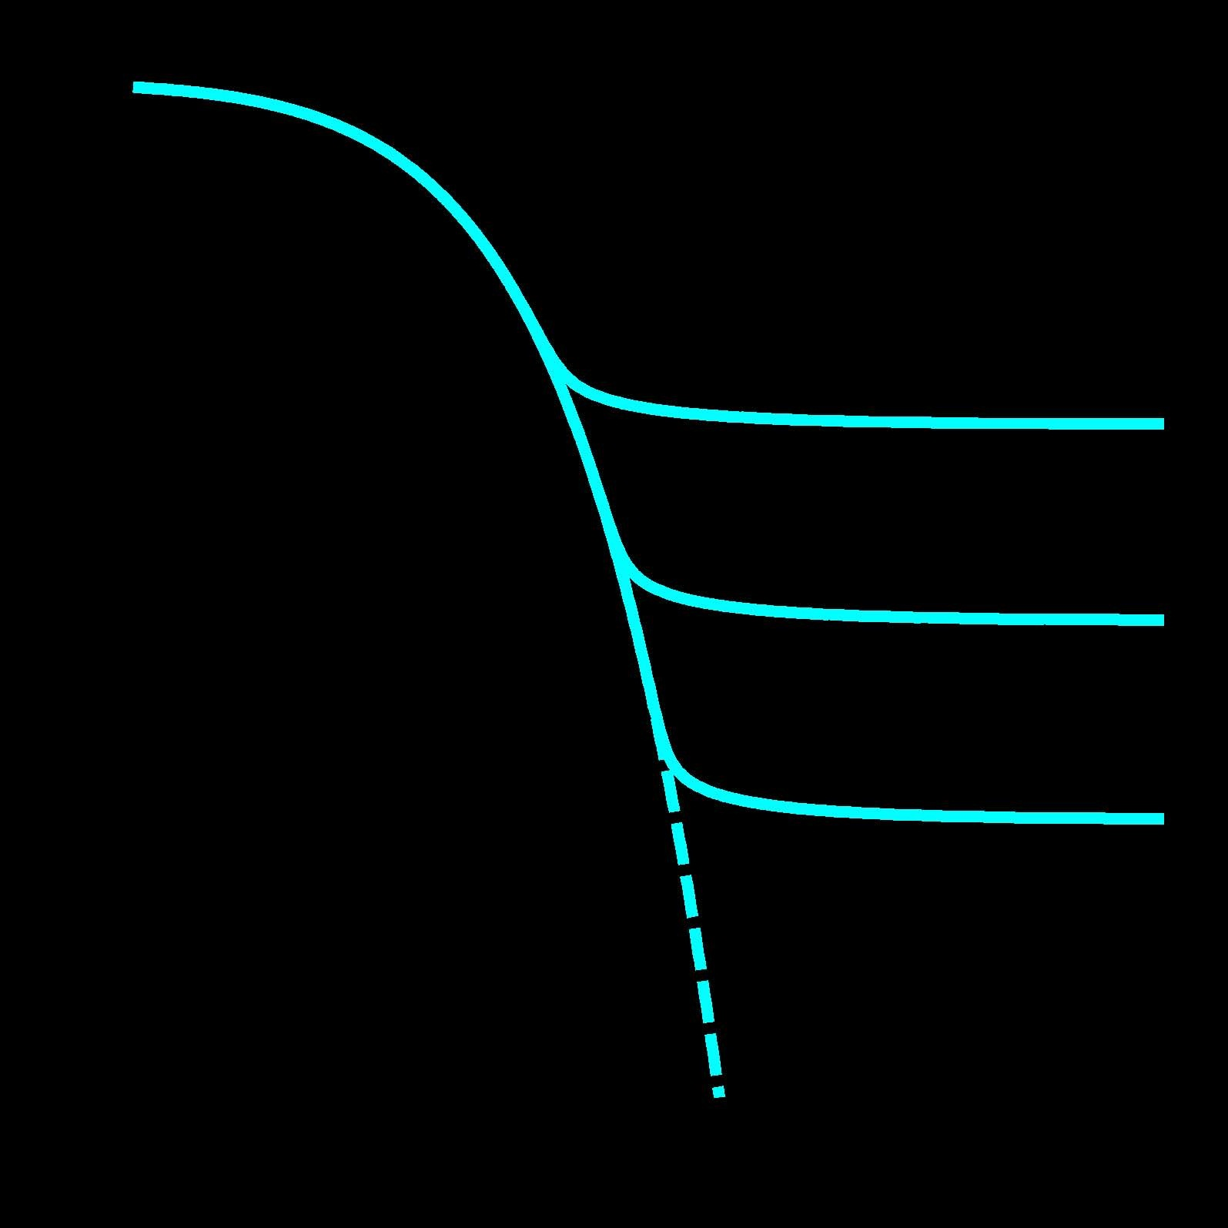
Cold Thermal Relics*
1
10⁻⁵
increasing σ_{A}
Ω
Relative abundance
10⁻¹⁰
Ω
Ω
10⁻¹⁵
decreasing Ω
e^{−M / T}
e^{−M / T}
equilibrium
e^{−M / T}
equilibrium
equilibrium
e^{−M / T}
equilibrium
10⁻²⁰
1
10¹
10²
10³
M / T
* An object of particular veneration.

Slide 11
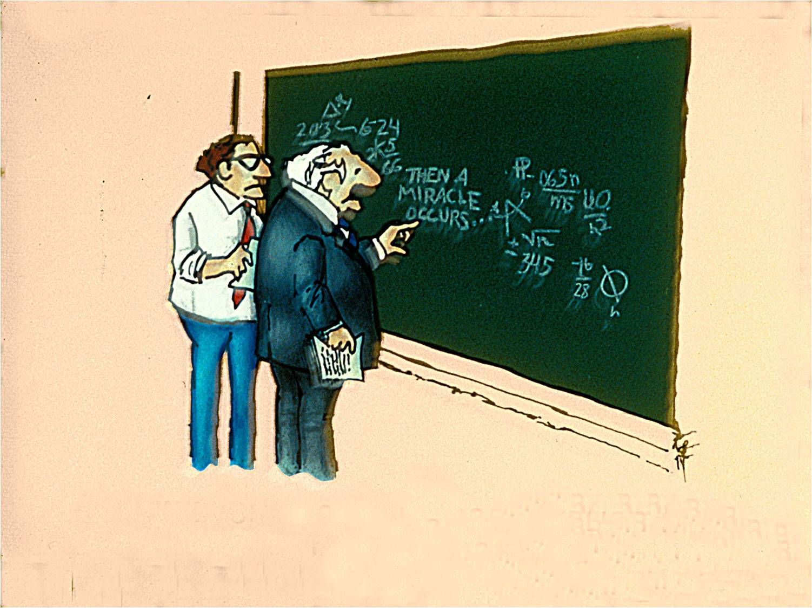

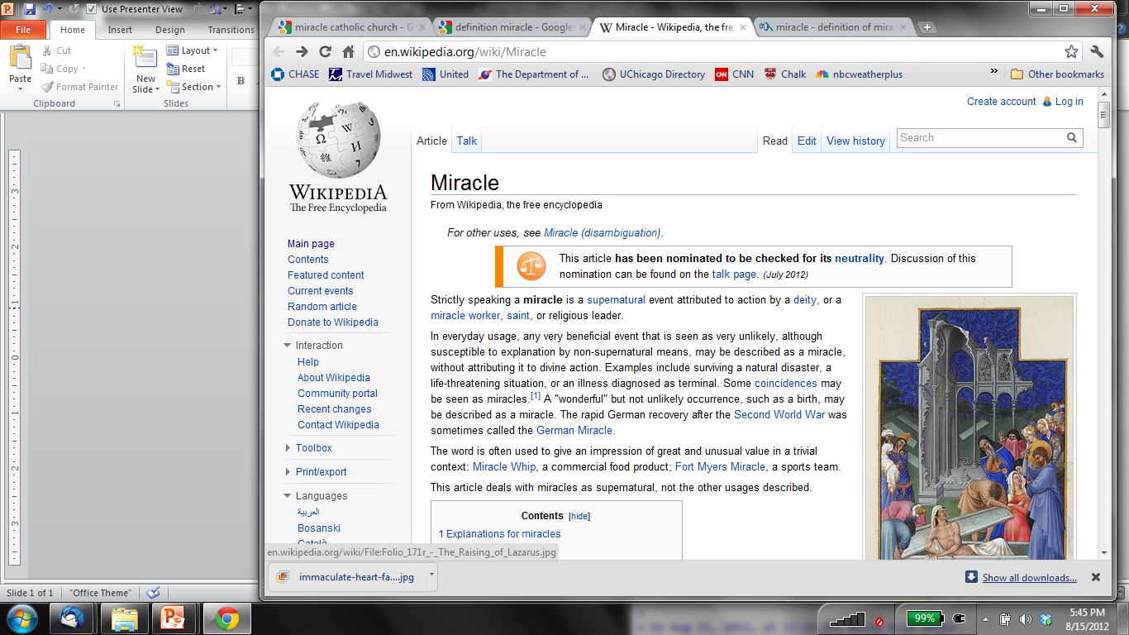
The WIMP “Miracle”
Cold thermal relic: weak scale cross section (and mass?)
(1 GeV − 1000 GeV ) WIMP (Weakly Interacting Massive Particle)
WIMPs are BSM, but not far BSM
mir·a·cle
\ˈmir-i-kəl \
noun
1 : an extraordinary event manifesting
divine intervention in human affairs
S. Harris
… often used to give an impression of great and
unusual value in a trivial
context …
I think you should be more
explicit here in step two

Slide 12

WIMPs Connect to Standard Model
WIMP + WIMP
SMs
Relic Abundance
WIMP
Ω_{DM} h² = 0.112
SM particles
WIMP + SM WIMP + SM
WIMPs SMs
SMs WIMPs
Direct Detection
Indirect Detection
Collider Production

Slide 13
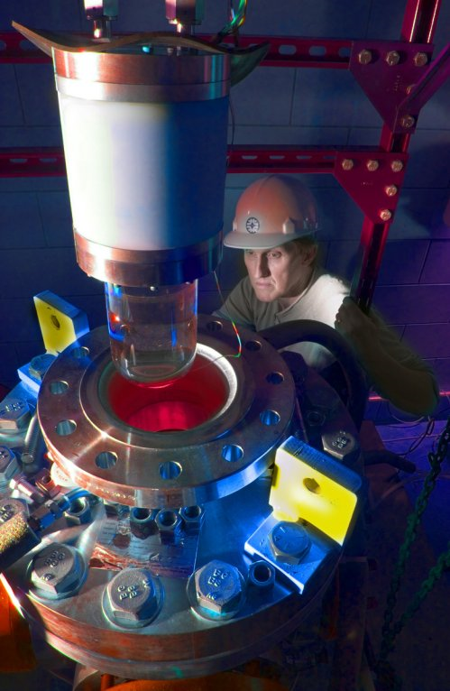
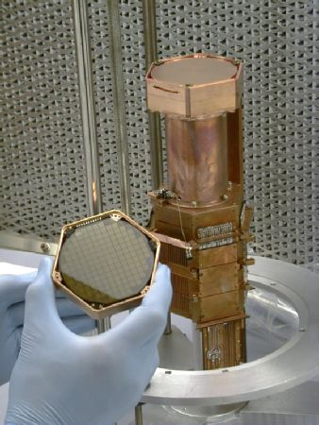
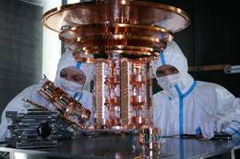
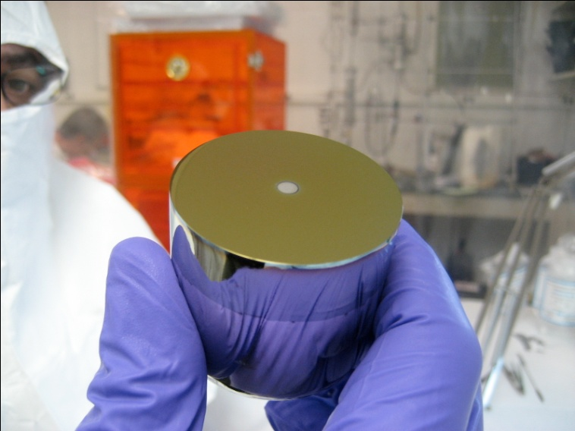
Direct Detection
COUPP
CDMS
CRESST
Xenon
CoGeNT
( + EDELWEISS,
DAMA, EURECA,
ZEPLIN, DEAP, ArDM,
WARP, LUX, SIMPLE,
PICASSO, DMTPC,
DRIFT, KIMS, …)

Slide 14
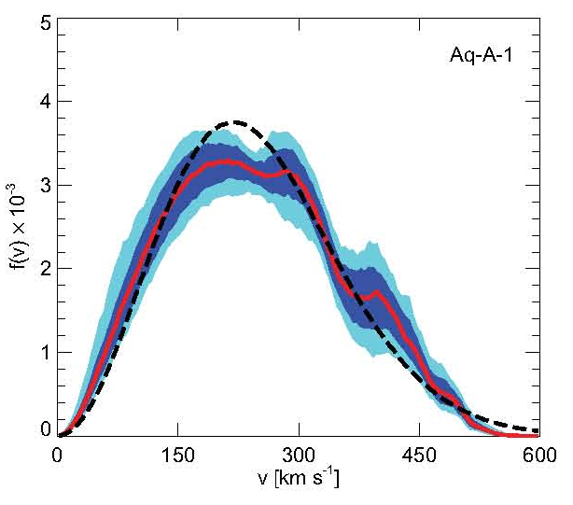
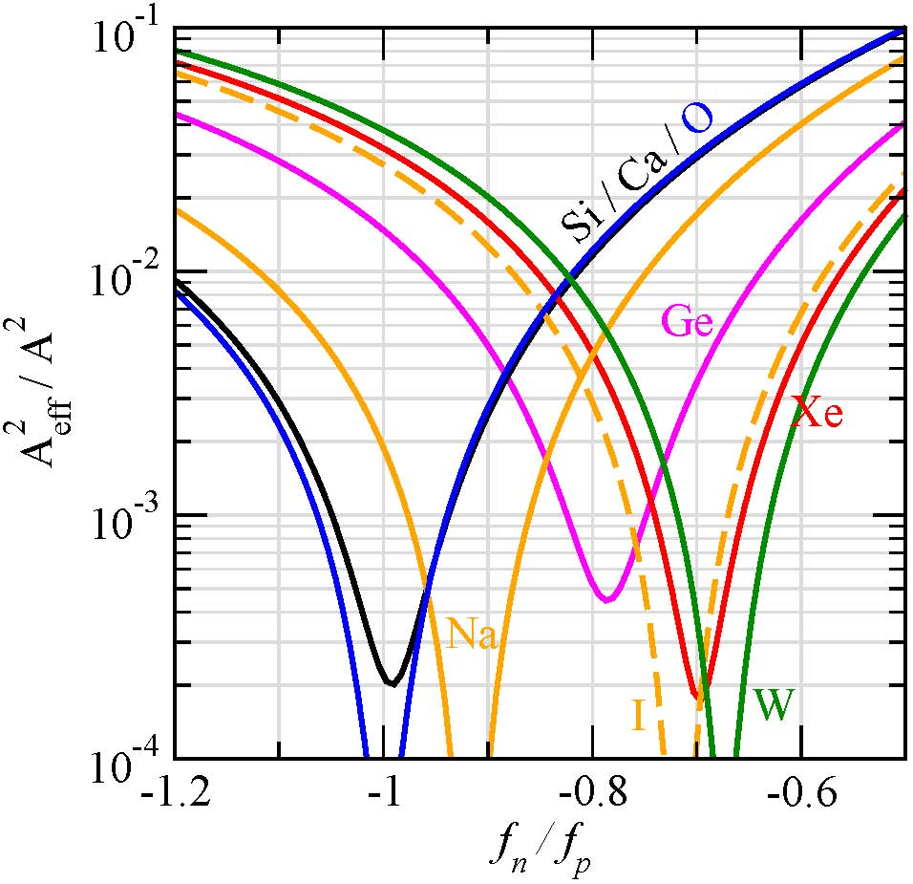
Direct Detection
Vogelsberger et al.
Local WIMP phase-space density
  Assume: ρ_{DM} = 0.3 GeV cm⁻³
    (subclumps, streams, cusps,…?)
  Assume: Maxwellian velocity distribution ↑v²^{1/2} = 220 km s⁻¹
Spin dependence (A, T)?
Kopp et al.
Same coupling to p and n (scalar)?
Compare different expts. w/ caution

Slide 15
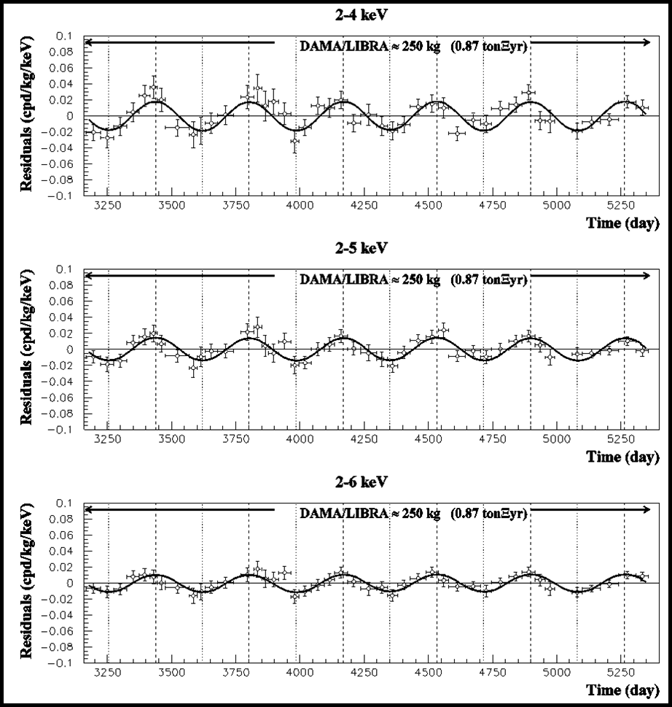
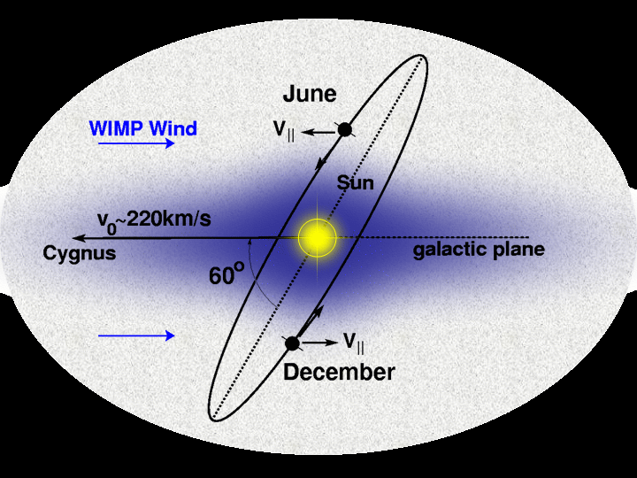
DAMA/LIBRA (NaI)
cos ω (t − t₀)
T = 2π /ω = 1 year
t₀ = 152.5^{d} (2 June)
Amplitude of modulation surprisingly high
KIMS (CsI) → modulation not due to WIMP scattering on Iodine

Slide 16
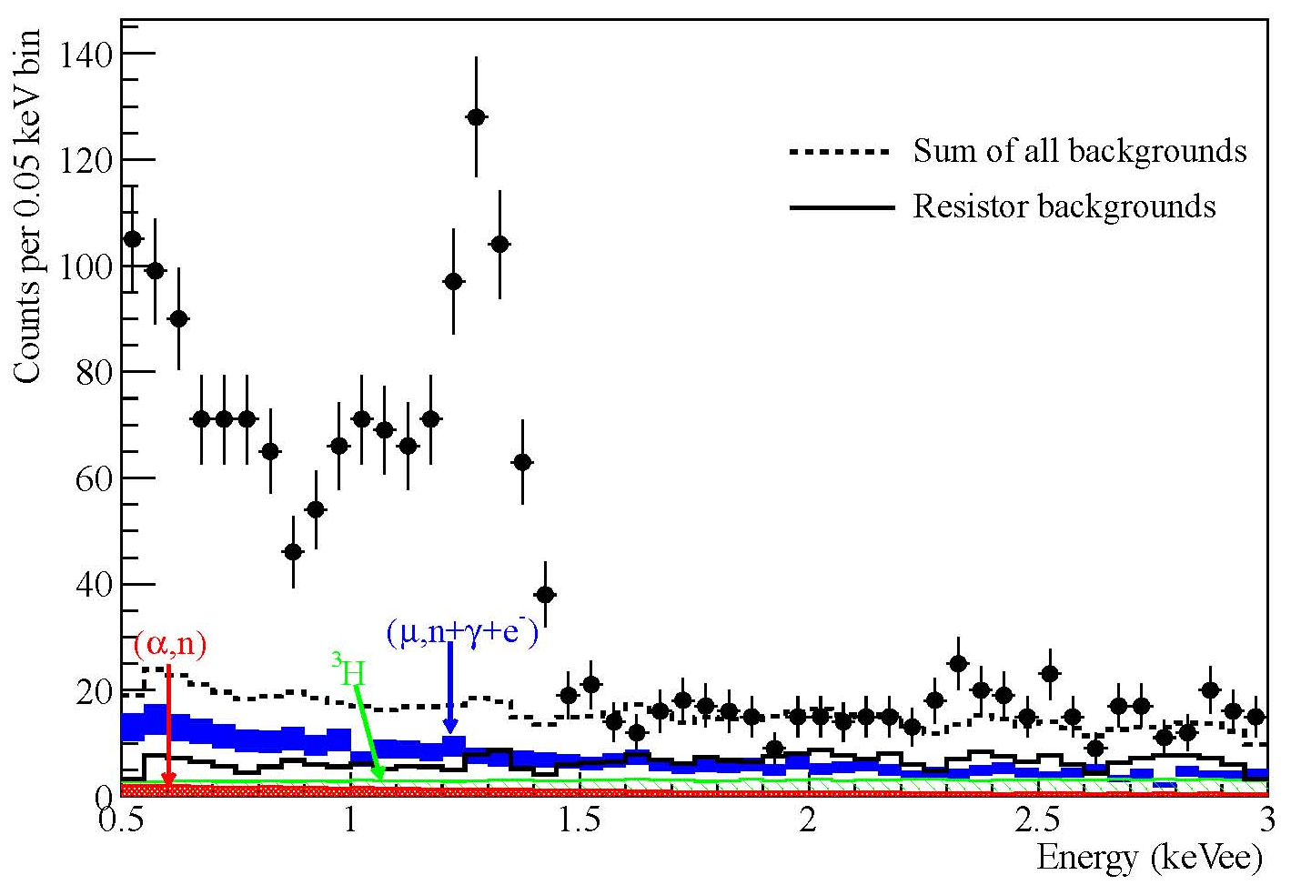
CoGeNT (Ge)
1208.5737
30% surface events, low-mass (10 GeV) WIMP with large cross section (10⁻⁴ pb)

Slide 17
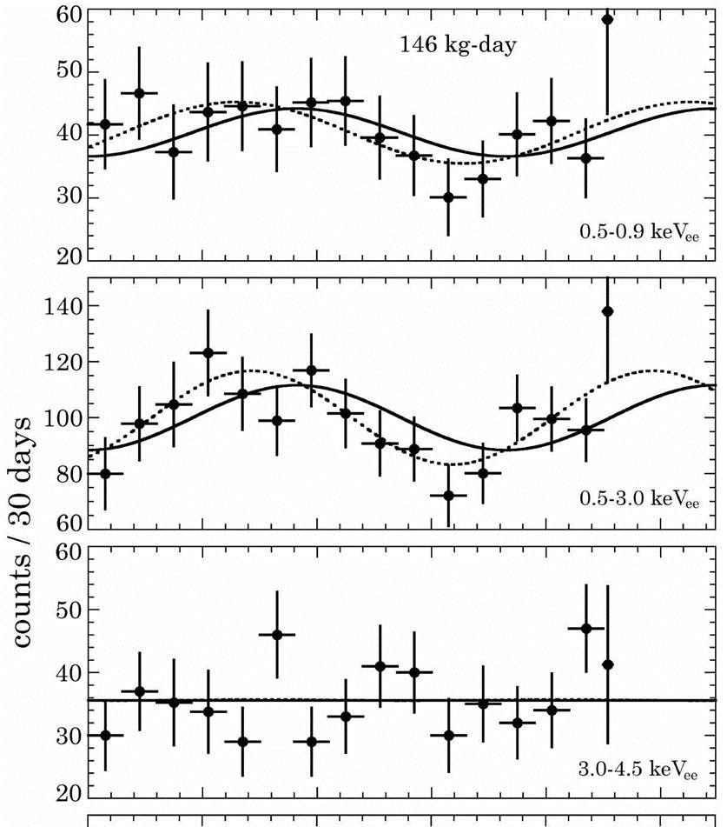

CoGeNT (Ge)
In 2011 data: 2.8σ annual modulation signal Aalseth et al.
Including 2012 data results in smaller significance
Skeptic:
Signal was never there in the first place (it was a fluctuation). Evidence for light WIMP weaker.
True Believer:
Amplitude of modulation was too high anyway. Evidence for light WIMP even stronger!

Slide 18
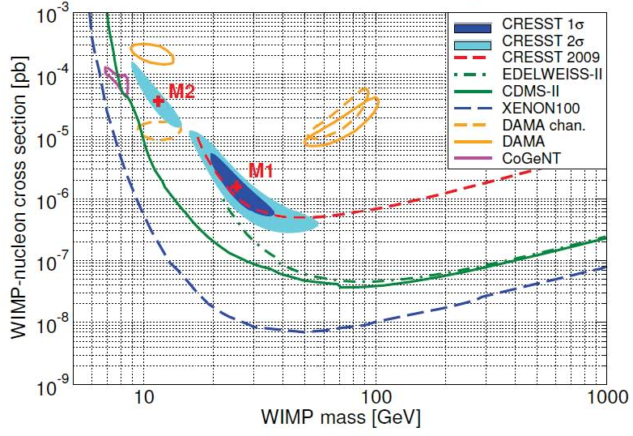
CRESST (CaWO₄)

Slide 19
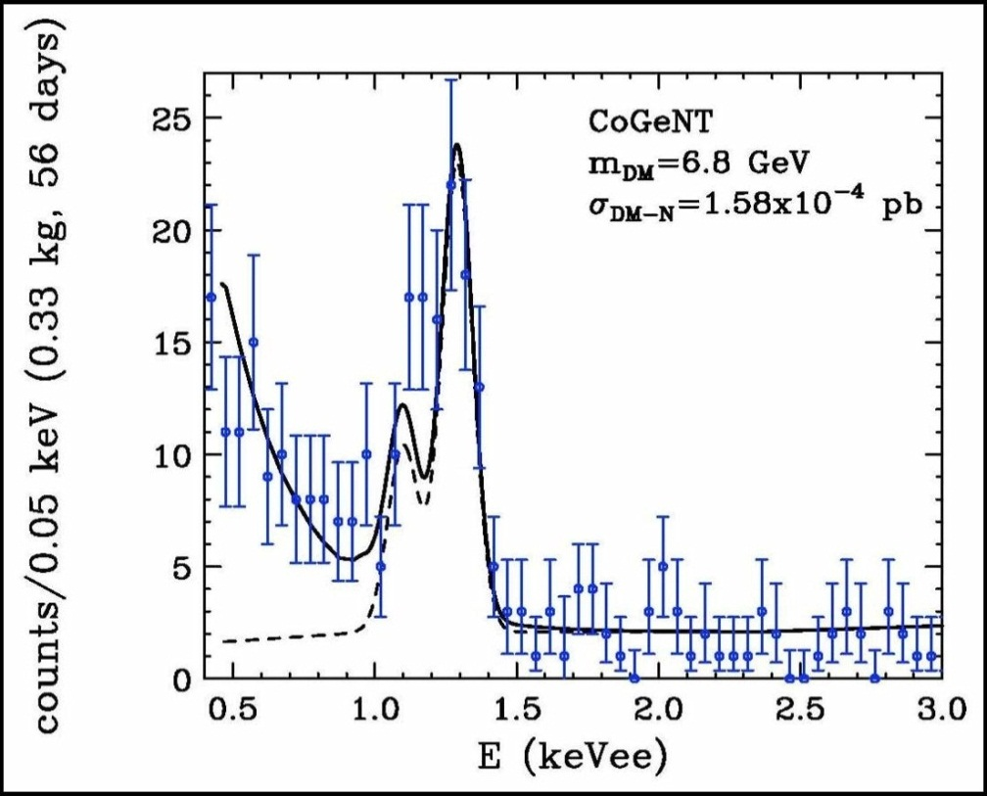

Light WIMPs From Direct Detection?

Slide 20
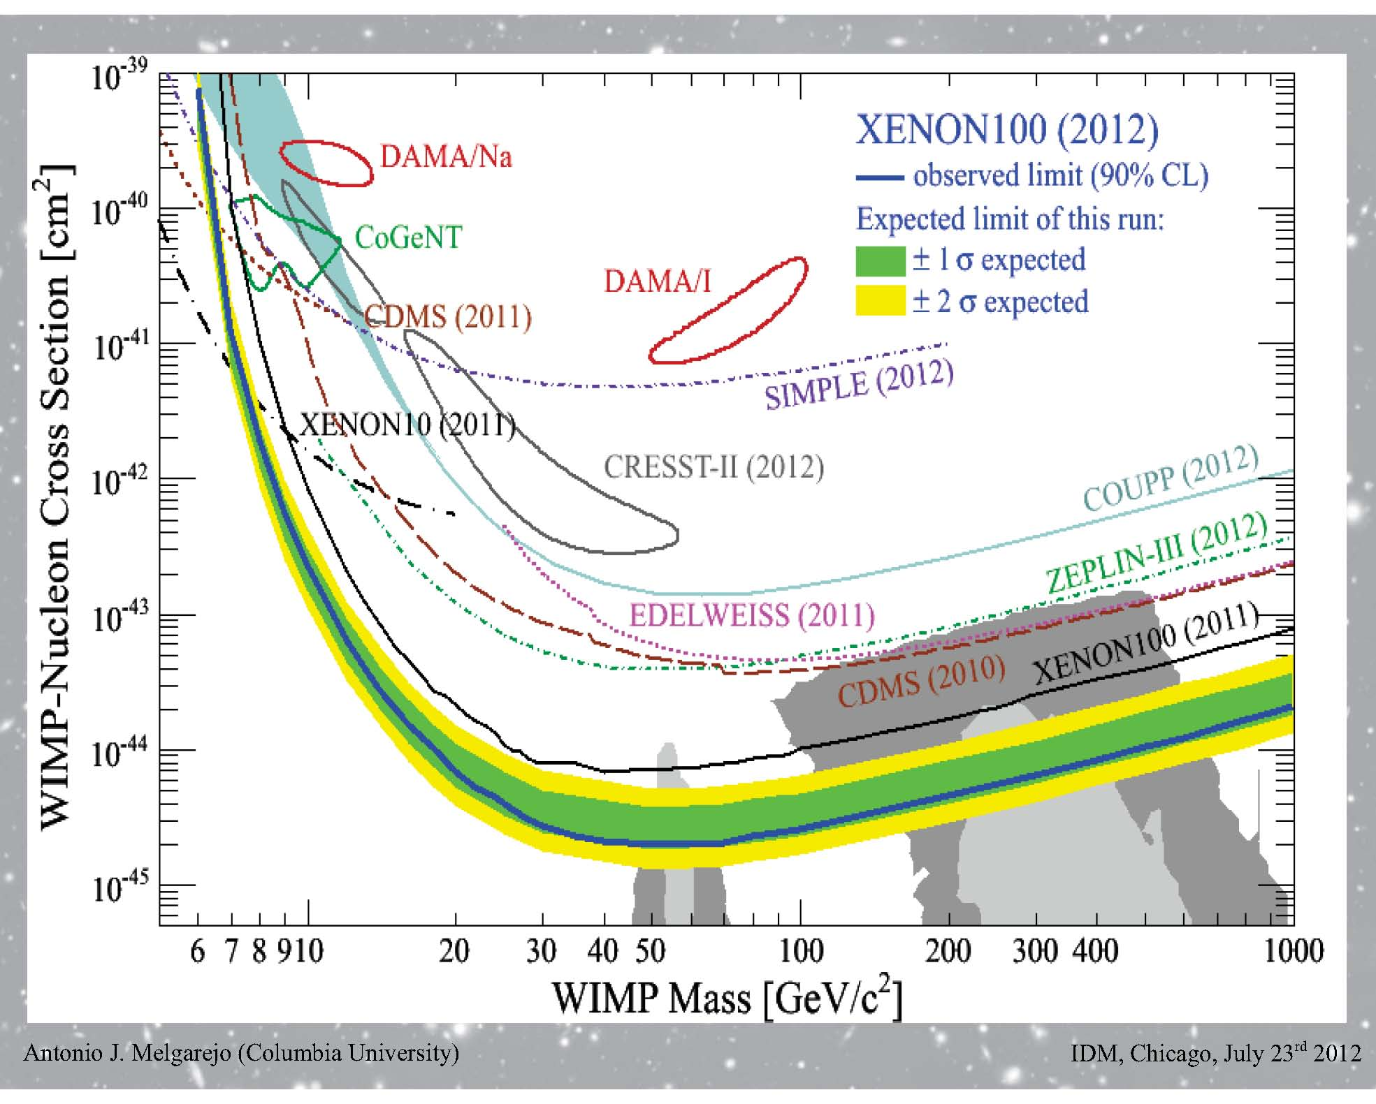
Direct Detection
Low-mass region:
either unexplained
backgrounds in
DAMA, CoGeNT,
and CRESST-II, …
or
… other experiments
do not understand low recoil energy calibration, …
or
… can’t compare different experiments
High-mass region:
Reaching shades of grey of the CMSSM iceberg, just as heat from LHC melts it!

Slide 21
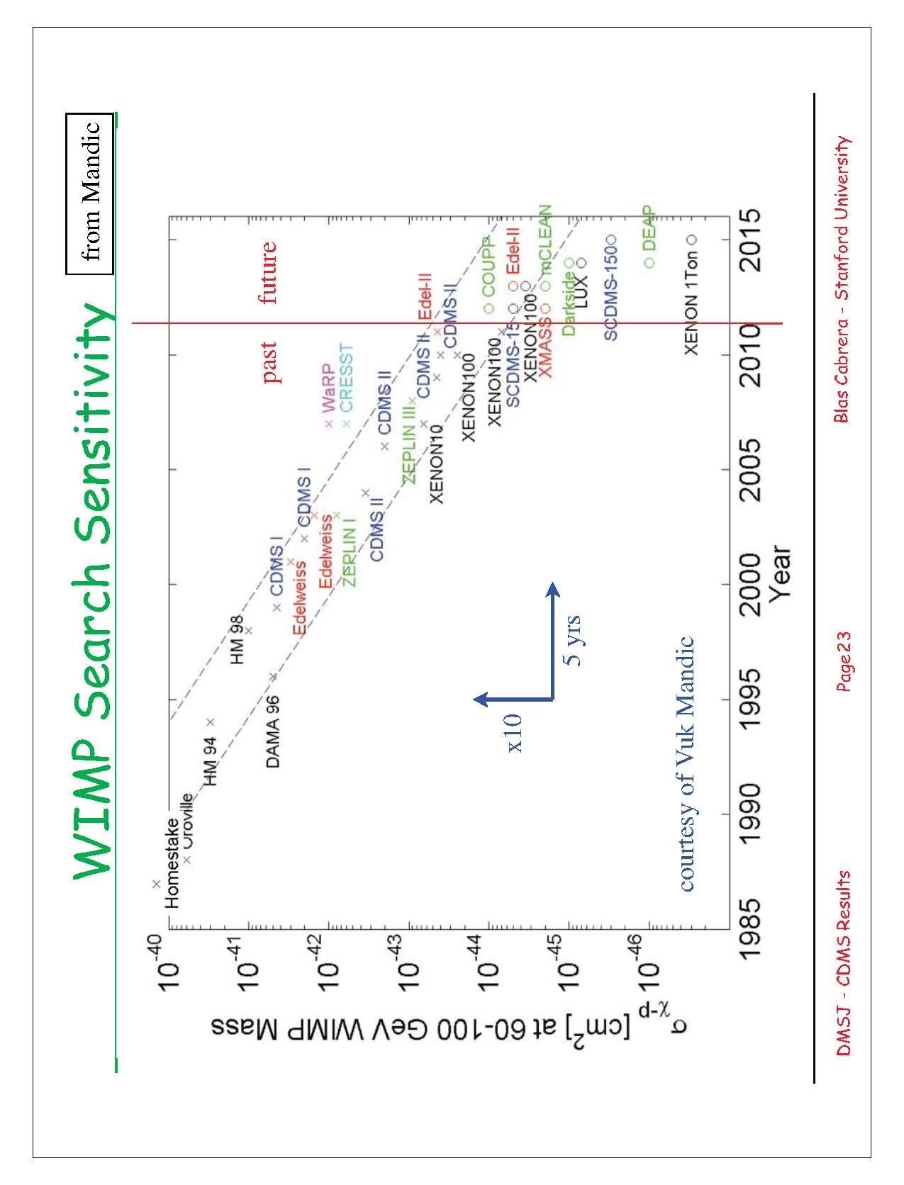
The Past Is Prelude to the Future
order of magnitude
every 5 years!
Vuk Mandic via Blas Cabrera

Slide 22
WIMPs Connect to Standard Model
WIMP + WIMP
SMs
Relic Abundance
WIMP
Ω_{DM} h² = 0.112
SM particles
WIMP + SM WIMP + SM
WIMPs SMs
SMs WIMPs
Direct Detection
Indirect Detection
Collider Production

Slide 23
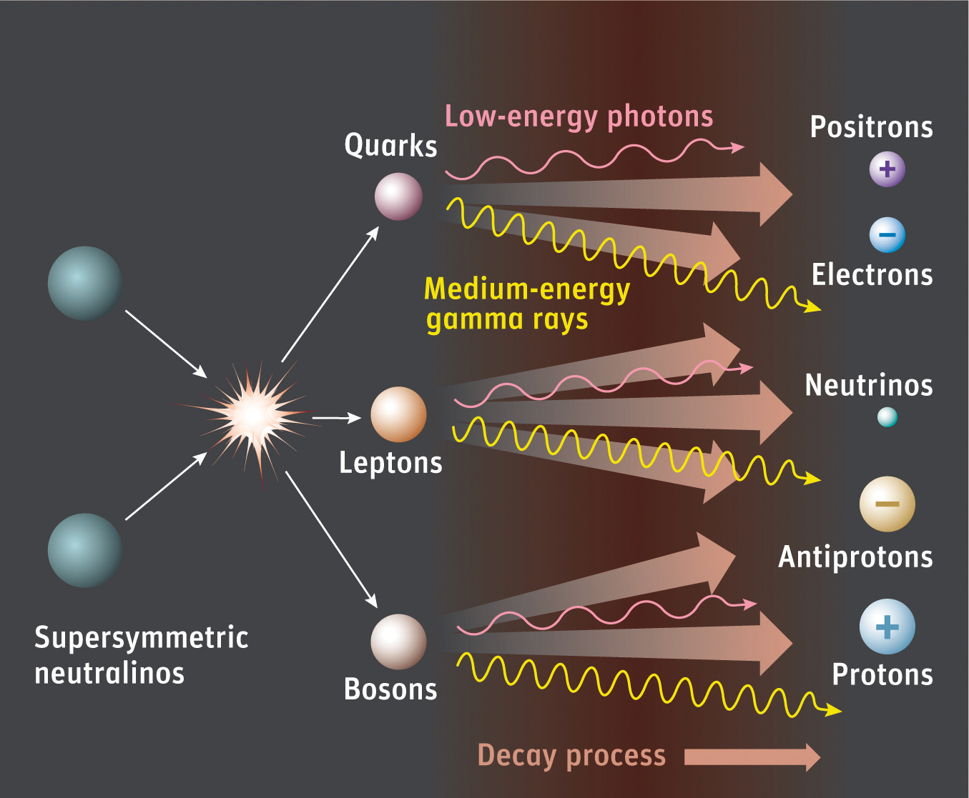
Indirect Detection
Galactic Center
Dwarf spheroidals
DM clumps, Sun
Wimps

Slide 24
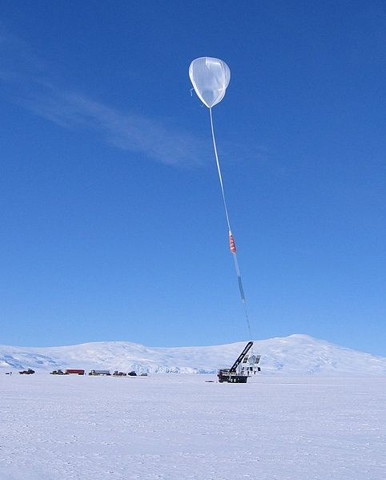
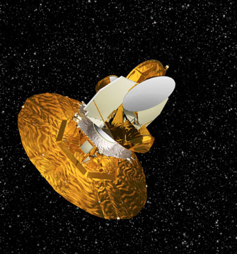
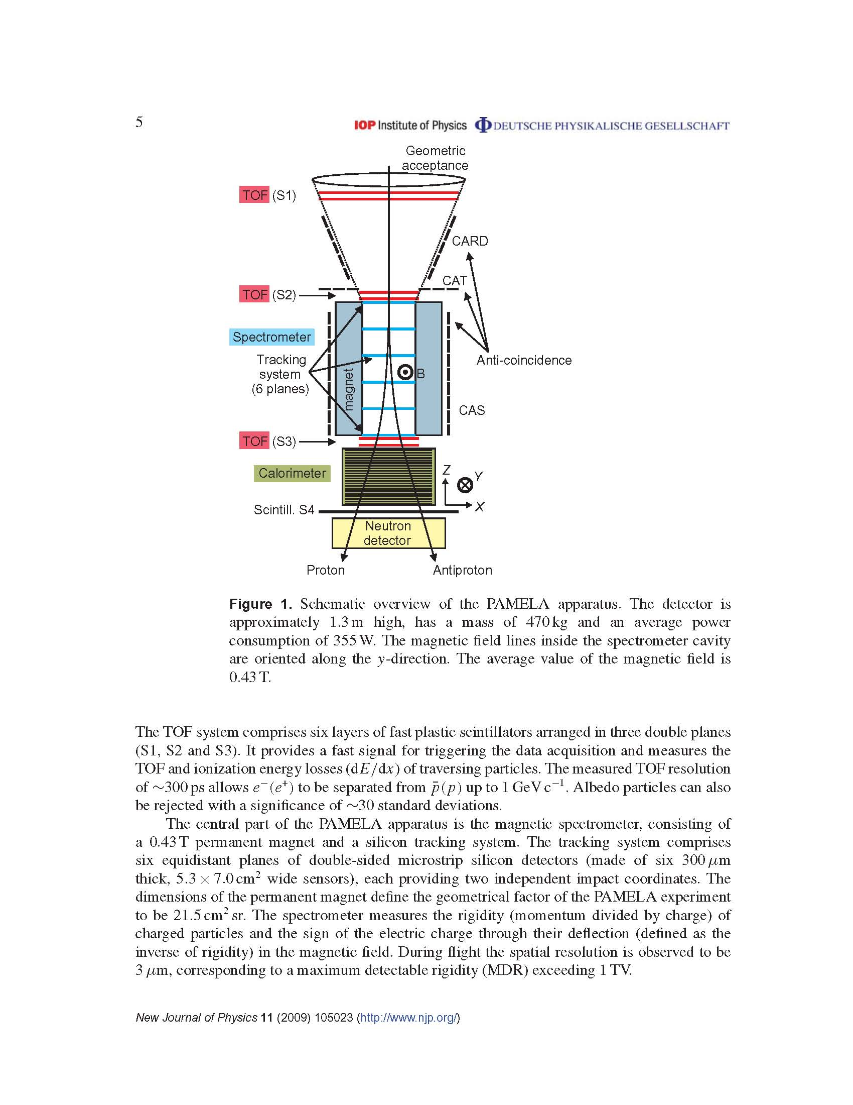
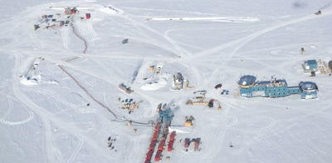



Indirect Detection
PAMELA
WMAP
ATIC
Fermi/GLAST
Veritas
IceCube
H.E.S.S.
AMS

Slide 25
Indirect Detection
What to look for
Where to look for it
Charged particles easier to see
  p, high-energy e⁺e⁻
  bent by magnetic field
  astronomical backgrounds
Galactic Center
  largest signal
  largest backgrounds
  know where to look
Continuum photons, neutrinos
ν usually not dominant channel
neutrinos hard to see
background from astro. sources
Nearby subclump
signal down 10⁻³
clean: no baryons
don’t know where it is
Photon line
low background
(probably) low signal
“golden” detection channel
Dwarf spheroidals (M/L) > 3000
signal down another 10⁻³
clean: few baryons
know where to look (about 20)

Slide 26







Indirect Signals Have Come (and Gone?)
Chang et al, 2008
Fermi LAT: PRL 12
Fermi LAT: PRD 10
Withdrawn
Hooper & Goodenough 2010
Han et al. (2011)

Slide 27

Fermi/GLAST Line
(3.3σ w/ look elsewhere)
Weniger 1204.2797

Slide 28




Fermi/GLAST Line(s)
Dwarf stacking inconclusive Geringger-Saneth, & Koushiappas 1206.0796
129 GeV
χ + χ → γ + γ
111 GeV
χ + χ → γ + Z
Six stacked galaxy clusters: 3.2σ signal
Hektor, Raidal, Tempel 1207.4466
About 3σ: Finkbeiner & Su 1207.7060

Slide 29

Fermi/GLAST Line(s)
WIMP−charged particle coupling → decays to γ γ + γ Z + ZZ + ...).
Bergstrom
& Ullio 97
But also decays at tree-level to e⁺e⁻, quarks, …, producing “continuum” γ -ray background. Loop smaller than tree by (α ²/4π).

Slide 30

from Seigel-Gaskins

Slide 31

Fermi/GLAST Line(s)
WIMP−charged particle coupling → decays to γ γ + γ Z + ZZ + ...).
Bergstrom
& Ullio 97
But also decays at tree-level to e⁺e⁻, quarks, …, producing “continuum” γ -ray background. Loop smaller than tree by (α ²/4π).
Continuum constrained by observations, BR(γ γ) must be (1).
Inner bremsstrahlung also produces γ ’s, only suppressed (α).
Models with no tree-level annihilation: e.g., Jackson et al. 0912.0004
Could take effective field theory approach (in progress w/ Liantao Wang and Jingyuan Chen; also Tait et al.),
e.g., Λ⁻⁴ χ γ_{μ} γ ⁵χ B^{μα} Φ† D_{α} Φ
χ
γ
χ
γ , Z, H

Slide 32



Fermi/GLAST Line(s)
TANSUO
Fermi/GLAST
HESS-II 600 m²
Cherenkov Telescope Array
Notes:
Fermi collaboration not streamlined, agile, fast-responding, and un-bureaucratic like CMS or ATLAS

Slide 33
WIMPs Connect to Standard Model
WIMP + WIMP
SMs
Relic Abundance
WIMP
Ω_{DM} h² = 0.112
SM particles
WIMP + SM WIMP + SM
WIMPs SMs
SMs WIMPs
Direct Detection
Indirect Detection
Collider Production

Slide 34

WIMP Production at the LHC
Looking for an
invisible
needle in a haystack

Slide 35



WIMPs: Socialists or Mavericks?
Socialist WIMPs:
Socialist WIMPs are part of a social network.
Pal around with new un-WIMPy particles.
Part of a larger framework.
Find the WIMP through its friends.
Example: SUSY
Maverick WIMPs:
Maverick WIMPs don’t relate to others.
Not friended by any new particles.
Have no discernible reason for existing.
Find the WIMP through what is not seen.
Example: Neutrinos before late 1960s.

Slide 36


upersymmetry & Dark Matter
Developed in the early 70’s—still of great interest.
Every known particle has an undiscovered superpartner.
Superpartners are massive.
Lightest superpartner should be stable!
In many realizations, lightest superpartner is weakly interacting.
Lightest Supersymmetric Particle is a candidate WIMP.
Particles
Superpartners
Quarks
Squarks
Leptons
Sleptons
photon
W, Z
gluon
graviton
photino
wino, zino
gluino
gravitino
Higgs
Higgsinos
Notes:
Lee & Weinberg 35 years ago
SNOOZY 29 Years ago

Slide 37

Supersymmetry & Dark Matter: A Match
I’m looking for a superpartner
Super, mature, 41-year-old theory (SUSY) desperately seeking a species to develop a physical aspect.
I’m weakly Interacting
Weak, lonely 35-year-old WIMPy particle species seeking a theory in which to be embedded.
Very high degree of compatibility

Slide 38

SUSY WIMPs at the LHC
Favorite cold thermal relic: the neutralino
neutralino:
m_{χ0} and interactions:
100+ SUSY parameters
gluinos, squarks, charginos
will be discovered first
analysis model dependent
LHC chewing away
allowed region
can swiggle out …
… but it is getting harder
don’t throw in towelino quite yet

Slide 39

Collider Searches for WIMPs
SUSY Trickle Down
D
g
∼
∼
l⁺
∼
U
W⁺
g
∼
ν_{l}
ν_{l}
_
U
∼
∼
g
χ⁰
D
∼
∼
U
W⁺
l⁺
∼
∼
ν_{l}
g
ν_{l}
_
g
U
∼
χ⁰
Complicated decay chain—very model dependent

Slide 40

Maybe, just maybe, SUSY won’t be seen at the LHC, and dark matter is not a neutralino (or sneutrino, or gravitino, or any ino).

Slide 41
Maverick WIMPs
Expect terms that break SU(2)_{L} via SM Yukawa couplings → operators that flip quark chirality should be ∝ m_{q} (S,P)
Some terms vanish for Majorana χ
Can write G ∼ M*⁻²
(S,P) G ∼ m_{q} M*⁻³
F ∼ M*⁻¹
(S,P) F ∼ m_{q} M*⁻²
Fierz identities relate various combinations
Dirac fermion Maverick WIMP, χ
L
Complex scalar Maverick WIMP, φ
L

Slide 42
Maverick WIMPs
operator annih. direct detec.
φ†φ q q 1 SI
φ†φ qγ ⁵ q 1 v²
(φ†^{μ}φ + h.c.) qγ_{μ} q v² SI
(φ†^{μ}φ + h.c.) qγ_{μ5} q v² SD
i(φ†^{μ}φ − h.c.) qγ_{μ} q v² SI
i(φ†^{μ}φ − h.c.) qγ_{μ5} q v² SD
χχ q q v² SI
χχ qγ ⁵ q v² v²
χγ ⁵χ q q 1 SI
χγ ⁵χ qγ ⁵ q 1 v²
χγ ^{μ}χ qγ_{μ} q 1 SI
χγ ^{μ5}χ qγ_{μ} q v² SI
χγ ^{μ}χ qγ_{μ5} q 1 SD
χγ ^{μ5}χ qγ_{μ5} q v² SD
χσ^{μν}χ qσ_{μν} q 1 SD
Possible WIMP—gluon couplings
Some term vanish for Majorana fermions
Possible “light” mediators (not a true Maverick)
Range where effective field theory valid
Could also include couplings to leptons
Fermion WIMPs Scalar WIMPs
χ
χ
Ψ
q
q
χ
χ
q
q

Slide 43

Direct Detection & Collider Production
CoGeNT
LHC
Model Dependent
nonrelativistic
χ + N → χ + N
10⁻⁴ pb – 10⁻⁶ pb
Probably described by
effective field theory
(several operators?)
relativistic
q + q → χ + χ
???
Assume described by
effective field theory
“Maverick” WIMPs

Slide 44

Collider Searches for Maverick WIMPs
protons → WIMPs
protons → JET + WIMPs
JET
proton
gluon
WIMP
WIMP
WIMP
WIMP
WIMP
WIMP
WIMP
WIMP
JET
proton
Discover WIMPs by searching for monojets

Slide 45

Neutrino Background for Mavericks
Once thought that ν ν background Renormalizible
q + q → Z → ν + ν
q
Z
ν
σ ∝ s⁻¹ (parton level)
q
ν
Swamps WIMP signal Nonrenormalizible
q + q → χ + χ
q
χ
σ ∝ s (parton level)
q
χ
Judicious cuts on MET can pull out signal

Slide 46
Collider Searches for Maverick WIMPs
Maverick Monojets
MadGraph/MadEvent:
  Feynman diagrams,
  cross sections,
  parton-level events
Pythia:
Hadron-level events
via Monte Carlo showering
PGS:
Reconstructed events
at collider
coupling from Ω
or direct/indirect
Backgrounds (neutrinos, QCD, …)
Only signal (other than mono-γ )
Largely model independent
Beltran, Hooper, Kolb, Krusberg, Tait 2009
Goodman, Ibe, Rajaraman, Shepard, Tait, Yu 2010
Rajaraman, Shepherd, Tait, Wijangco
Bai, Fox, Harnik; Fox, Harnik, Kopp, Tsai
CDF, CMS, ATLAS

Slide 47

Predicted LHC Sensitivity
Rajaraman et al. PRD 2011

Slide 48

Predicted LHC Sensitivity
Rajaraman et al. PRD 2011

Slide 49

CMS Results JHEP 2012

Slide 50

ATLAS Results 1210.4491
1 = Scalar
5 = Vector
(G_{μν})²

Slide 51

BHKKT
M_{χ} = 50 GeV
LHC 14 TeV
100 fb⁻¹

Slide 52



Work in Progress
S & P couplings ∝ m_{q}
m_{c} : m_{b} : m_{t} :: 1 : 3.3 : 135
No direct detection limit on P
So far analysis includes only c
(w/ Lian Tao Wang & Tongyan Lin)
g b → X X + b
g g → X X + b
Limit improves by factor of 30
Top PDF very uncertain
g g → X X + t t
Looks like stop signal
Limit improves by factor of 1000

Slide 53


Work in Progress
(w/ Lian Tao Wang & Jingyuan Chen)
Most analyses assume WIMP couples to fermions
If photon lines observed (e.g., 130 GeV line) this appears untenable
Some models constructed where WIMP annihilates to bosons
Effective Field Theory analysis of gauge/Higgs di-boson couplings
47 possible dimension-6, 7, & 8 operators
Different final states (energy spectrum of γ -ray lines) and continuum

Slide 54
The Decade of the WIMP
Is WIMP “miracle” coincidence or causation?
Situation now is muddled
Ten years from now the WIMP hypothesis will have either:
  convincing evidence or near-death experience
Direct, indirect, & colliders potential for discovery
Suppose by 2020 have credible signals from all three???
Do we need three WIMP miracles for WIMP sainthood ?

Slide 55
The Decade of the WIMP
(Weakly Interacting Massive Particle)
Rocky Kolb
University of Chicago
Feb. 2013
Bologna

Slide 56
SUSY WIMPs at the LHC
Typical SUSY models consistent w/ collider and other HEP data have too
small annihilation cross section → too large Ω
Need chicanery to increase annihilation cross section
  s-channel resonance through light H and Z poles
  co-annihilation with or
  large tanβ (s-channel annihilation via broad A resonance)
  high values of m₀: Higgsino- like neutralino annihilates into W & Z pairs
  (focus point region)
  …
Higgs mass limit constrains SUSY models
Squark/gluino ssearchs constrain SUSY models
Or, unconstrained, nonminimal

Slide 57
WIMP Questions
Why only one WIMP?
  The 4% of matter we see is pretty complex and varied.
  If social network of several WIMPs, stronger interacting ones:
    Easier to detect
    Smaller Ω
Thermal Production of WIMPS?
    Super-WIMPs
    Asymmetric freeze out
    Dilution after freeze out via entropy production
Maverick WIMPs?
    Suppose LHC only sees SM Higgs?
    Wither SNOOZY?
Leptophilic, Leptophobic, Flavorful, Self-Interacting, Dynamical, Inelastic, …
Annual modulation: do we really understand DM phase space?
Indirect detection gives indirect information

Slide 58

CMS Results JHEP 2012

Slide 59

ATLAS Results 1210.4491
8 = Axial
9 = Tensor

Slide 60

CMS Results JHEP 2012

