Slide 1
Elettronica per l‘upgrade di MEG
31 Gennaio 2013
Donato NICOLO’
(per conto di MEG-Pisa)

Slide 2
Schema attuale
funzioni di DAQ e trigger separate
DAQ
  schede DRS (WFD @ 1.6 (0.8) GS/s, BW = 200 MHz)
  tot. canali : 900 (XEC) + 128 (TC) + 1700 (DC) + 30 (aux)
  occupazione: 5 crate standard VME64x 6U
trigger
  schede Type1 (WFD 100 MHz + FPGA)
  “ Type2 (deserializzatori+FPGA)
  “ Type3 (WFD 100 MHz)
  “ ancillary (distribuzione CLK e segnali di controllo)
  occupazione: 3 crate VME64x 6U + 1 crate 9U
splitter
  uscite 1:1 high BW per DRS, 1:1 e 4:1 low BW per trigger
  occupazione: 4 crate 6U
Previsione per l’upgrade
  canali: 3000(DC) + 2600(XEC) + 1200(TC) ➔ spazio insufficiente
  necessaria BW piu`larga (risetime MPPC + DC cluster timing)

Slide 3
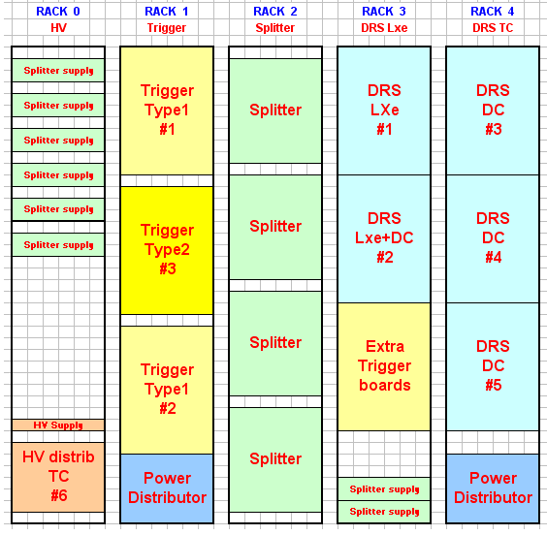

Extending current electronics
Will it fit?
XEC part would require 4-5 times rack space (excluding HV for MPPCs)
Trigger latency would increase due to longer cables
DC part needs upgrade from 200 MHz to 1 GHz
PSI VME board is at end of life (some parts are not produced any more)
Estimated cost: 3 MCHF

Slide 4
Schema proposto
Ogni crate ospita:
  16 schede “integrate” DAQ+trigger (WaveDREAM)
    formato Euro-Card 3U (custom backplane per handshaking segnali controllo)
    front-end con amplificazione a 2 stadi, BW > 700 MHz
    Chip DRS4/5 per campionamento @1.6 GS/s + PLL per sincronizzazione CLK
    ADC 12-bit seriale @ 80 MS/s ➔ campionamento segnali (limitati in banda) per trigger
    comparatori veloci ➔ timing per trigger
    FPGA Spartan6 (con Gbit link per trasmissione dati via GTP)
    implementazione stessi algoritmi di ricostruzione su schede “Type1”
  1 DAQ “concentrator” board
    ricezione bus dati da 16 schede sullo stesso crate
    invio a PC mediante socket ethernet
  1 trigger board
    1 FPGA Virtex6 e implementazione algoritmi “Type2”
    1 chip di memoria associativa per pattern recognition di tracce
    trasmissione a scheda “concentrator” master via transceiver GTX

Slide 5
Old vs. New DAQ layout
640 channels
256 channels

Slide 6
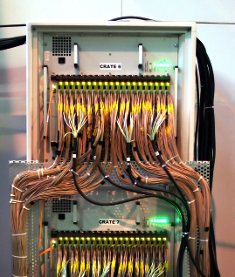
New electronics scheme
Integrate HV, DRS and trigger on same board
  Digitize all inputs continuously
  with 85 MHz/12 bit
  Upon trigger, read DRS through
  same ADC
  Put MPPC HV (70-210V) on boards
Go away from VME
  Higher density
  Cheaper
  Faster
“Added value” to DAQ boards
  Switchable gain amplifiers
  Second level trigger
DRS4
trigger
FPGA
analog front end
DRS
AD9222
12 bit
65 MHz
global trigger bus
MUX
LVDS
Inputs
“Dead” space

Slide 7
New crate standard
3 HE 19” crates
Custom backplane
Venting from front to back
half height backplane
→ no dead space
16 DAQ boards (256 channels)
One power supply (24V)
One “DAQ data concentrator” board
  GBit Ethernet
  Global Clock Input
One “Trigger concentrator” board
  Trigger bus
  Interface to global trigger boards
Allows compact design
  Up to 14 crates (3584 channels) in standard rack
  Less crates if we allow space for bending cables

Slide 8
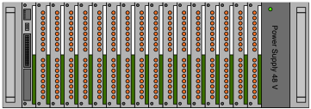
Struttura ad albero
Master
CLKGen
CLKGen
CLKGen
CLKGen
CLKGen
CLKGen
TRIG
TRIG
TRIG
TRIG
TRIG
TRIG
TRIG
TRIG
TRIG
TRIG
TRIG
TRIG
TRIG
TRIG
TRIG
TRIG
. . .
to the PC
. . .
DAQ
TRIG
WaveDREAM
from detectors

Slide 9
WaveDREAM block schematics
MPPCs need high gain range for calibration and low gain range for DAQ
→ switchable gain
First version showed 3x expected noise, re-designed prototype currently in production

Slide 10
Altre caratteristiche
Risoluzioni
  t_{eγ}
    comparatori DAQ su singoli ingressi
    latch time corretto per time-walk mediante look-up tables ➔ σ < 1 ns
  E_{γ}
    campionamento piu`lento (80 vs 100 MHz) compensato da migliore risoluzione (12 vs 10 bit) ADC
    range dinamico piu`ampio ➔ OK per risoluzione sul singolo phe dei nuovi fotosensori
  θ_{eγ}
    raccolta della luce piu`fine (sia su XEC che TC) ➔ migliore risoluzione in posizione e direzione relativa
Riduzione dati
  event size
    on-line zero suppression, grouping 4:1, 9:1 per segnali a bassa ampiezza
  event rate (trigger di secondo livello)
    uso del chip di memoria associativa in combinazione con FPGA ➔ implementazione algoritmi di pattern recognition e track filter

Slide 11
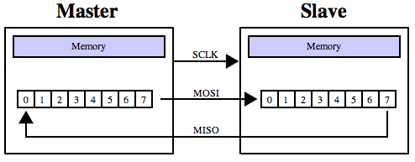
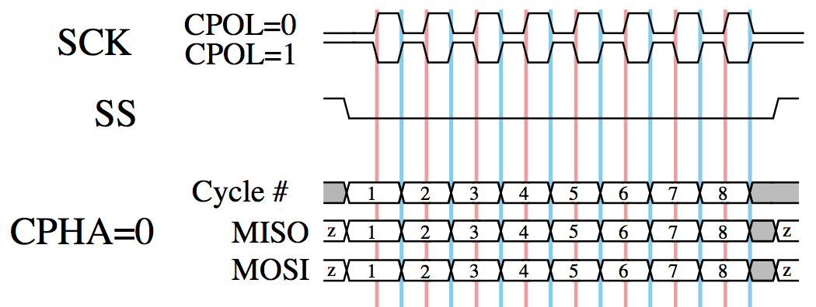
Backplane connectivity
Star connectivity for
  GTP
  SERDES
  Slave Select
Bus connectivity for
  SPI (except SS)
  MISC
  Clock
  Trigger
Serial Peripheral Interface Bus

Slide 12
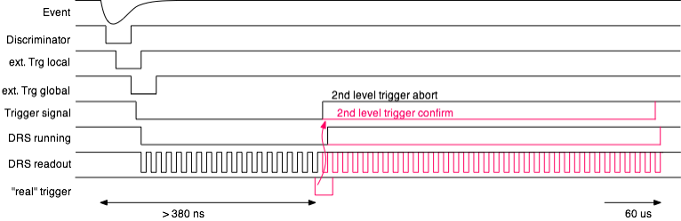
2nd level trigger
Can accommodate longer trigger decision times than the current 380 ns
Local trigger for TC causes DRS readout (now possible with WaveDREAM boards)
Missing global trigger causes abort and restart of DRS boards
Good global trigger confirms DRS readout
Run at higher sampling speed → better timing resolution

Slide 13
DAQ readout data rate
Currently: 10 Hz @ 3x10⁷ μ/s, 99% lifetime, 68 MB/s per 640 channel
Planned: 54 Hz @ 7x10⁷ μ/s, 99% lifetime ⇒ 6x higher data rate
  Crate readout: 100 MB/s per 256 channels ⇒ 3.7x
  Improved trigger (finer XEC/TC granularity, improved timing) ⇒ 1.6x
  3.7 x 1.6 = 6x
Optional:
  10 Gbit Ethernet 500 MB/sec ⇒ 7x
  2nd level trigger ⇒ 2 x 3.7 = 7x
PC’s: dual core vs. 2x8 cores ⇒ 16x
Local disks: 500 MB vs. 4 GB ⇒ 8x
PSI network: 1 Gbit vs 10 Gbit (?) ⇒ 10x
Offline storage: 300 TB/year vs. 600 TB/year
⇒ requires online filtering (pre-selection)

Slide 14
Planned High Voltage
Whole circuit works on virtual +68 V ground
Connectors can stay on ground
Regulation +68 V … +73 V
Current sense ~1 nA resolution
Cheap 5V DAC & ADC, estimated costs: <8 CHF / channel
Option for staggered SiPMs:
+138 V … +143 V (Two)
+208 V … +213 V (Three)
Keep old HV for PMTs

Slide 15
HV piggy back
DC – DC
68 V
DAC
Op-Amp
Op-Amp
Same DAQ board can be used with/without HV
Broken HV can be easily replaced
68 V / 200 V generation either on-board or through backplane
DC – DC
68 V

Slide 16
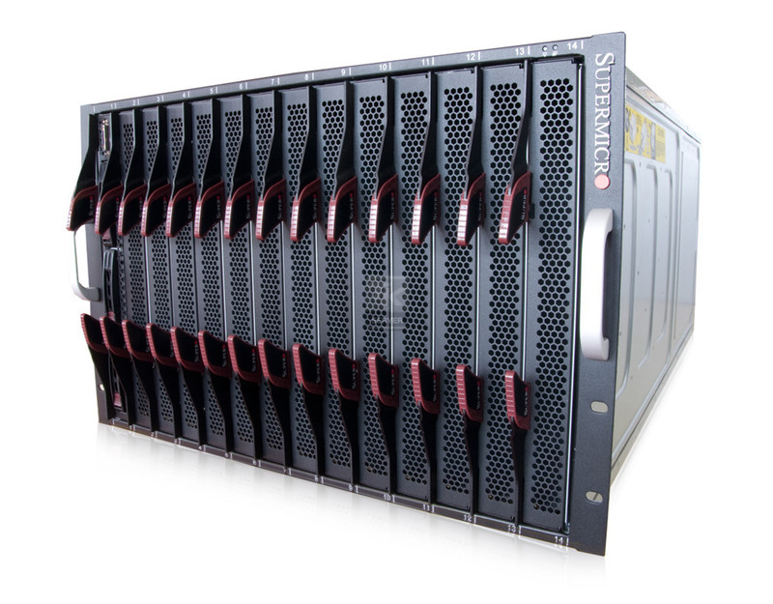
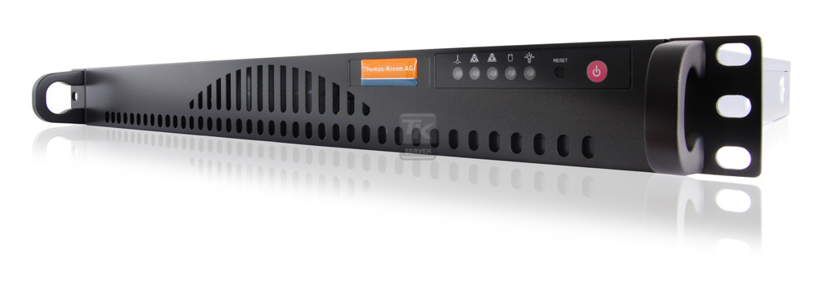
Putting it all together
14 Blades on 7 HE
1 PC on 2 HE

Slide 17
DAQ Cost Estimate
Subdetector | # Channels | # DRS Board | # Crates
XEC MPPC | 4092 | 256 | 16
XEC PMT | 630 | 40 | 3
pTC | 1200 | 75 | 5
DC | 2760 | 172 | 11
Total | 8672 | 542 | 35
Costs WaveDREAM boards @ 2k |  | 1084 kCHF
Costs crates @ 2k DAQ Interfaces @ 2k TRG Interfaces @ 2k PCs @ 2k |  |  | 280 kCHF
Cables & connectors excluded
WaveDREAM costs based on certain estimations (PCB, assembly, chip costs)
DC boards get cheaper w/o preamp
Overall cost ~10-20% accuracy
Σ 1364 kCHF

Slide 18
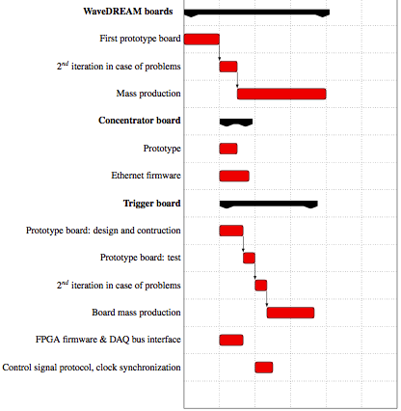
Milestones
2013
2014
2015
PSI
Pisa

Slide 19
Stima dei costi
Scheda trigger, costo unitario
  Circuito stampato + montaggio componenti 200 E
  FPGA 1000 E
  Memoria associativa 200 E
  PLL 150 E
  DC/DC 100 E
  EEPROM 50 E
  Passivi 100 E
  1800 E x 50 = 90 kE
Distribuzione CLK
  Schede ancillary (cristallo + fan-out LVDS) 5 kE
  Cavi schermati a basso skew 5 kE
  10 kE
Tot. 100 kE
  30 kE (2013)
  70 kE (2014)

Slide 20
Richieste manpower
trigger concentrator hardware
  Disegno schede 0.5 FTE 2013
  Costruzione prototipi e test 1 FTE 2013/2014
  Costruzione finale 0.5 FTE 2014/2015
Sviluppo firmware
  Algoritmi 0.5 FTE 2013/2014
  Protocollo master-slave
Backplane
  ?

Slide 21
Conclusions
New DAQ & Trigger system is capable to fulfill our requirements for a MEG upgrade
This is a NEW system build from ground up, but relying on proven technologies and ten years of experience
New DRS4 timing calibration indicates improvement 35 ps → 9 ps
(to be confirmed in next weeks)
Total cost ~1.3 MCHF (PSI laboratory budget + REQUIP grant + ???)
Schedule:
  WaveDREAM HW ready spring 2013 (delay because of pre-amplifier redesign)
  First firmware framework summer of 2013 → board available for tests
  Concentrator boards & crates design in 2013/14
  Production 2014, commissioning in 2015

