Slide 1
Measurement of the differential cross section of $t\overline{t}$ pairs in $pp$ collisions at $\sqrt{s}=7$ TeV with the ATLAS detector at the LHC
Candidato: Marino Romano
Relatore: Prof. Antonio Zoccoli
Correlatori: Dott. Lorenzo Bellagamba
Dott. Graziano Bruni
Coordinatore Dottorato: Prof. Fabio Ortolani
Dottorato XXV Ciclo

Slide 2
Outline
The top quark: characteristics and production
The ATLAS detector
Data and Monte Carlo samples
Event selection
Reconstruction of the $t\overline{t}$ system
Results
Conclusions

Slide 3
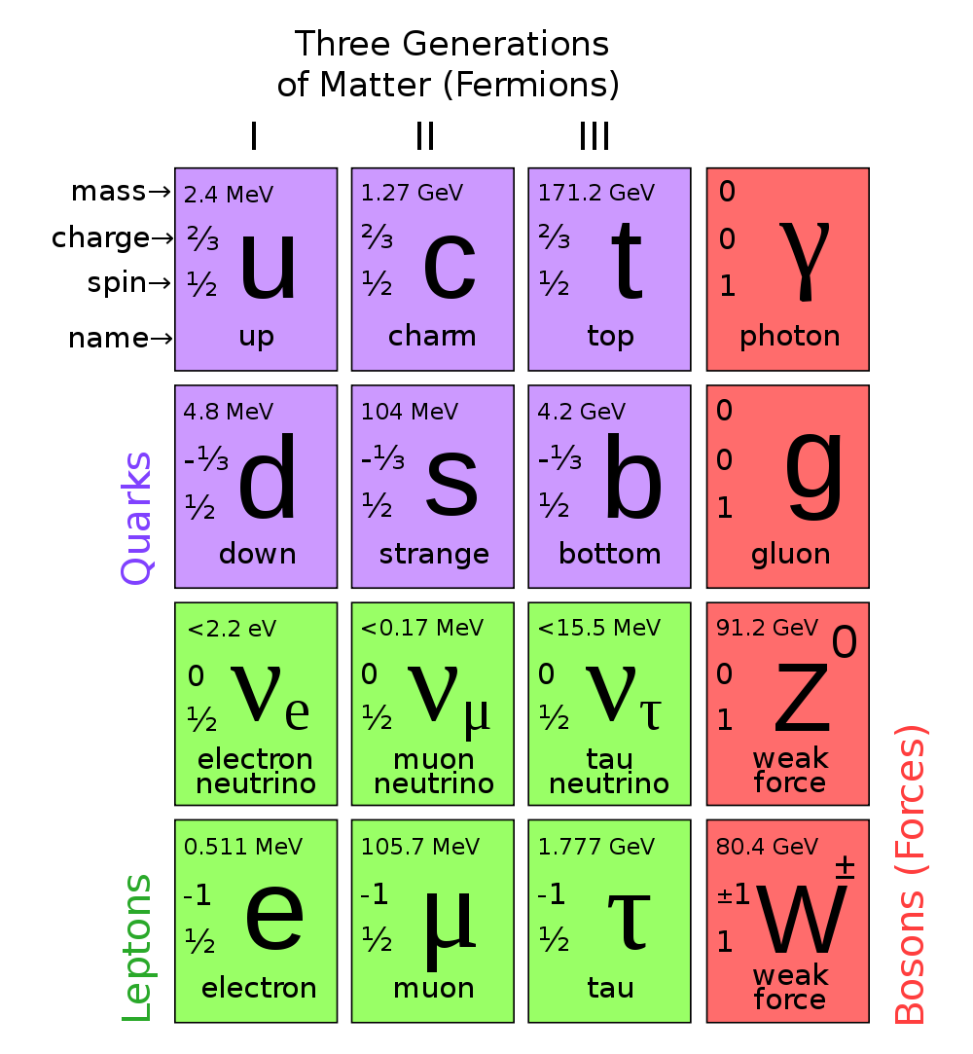
The Top Quark – Basics
Name: top quark
Theorized: Kobayashi and Maskawa (1973)
Discovered: CDF and D0 Collaborations (1995)
Mass: 173.5 ± 0.6 ± 0.8 GeV (PDG, PR D86, 010001 (2012))
Decays: charged current weak decays in
$t→Wb$ ($\sim 100\%$)

Slide 4
The Top Quark – Production mechanisms
Single top production:
Intermediate W boson (s and t channel)
Wt final states
Top pair production:
Gluon fusion (dominating at LHC, 85%)
$q\overline{q}$ annihilation (dominating at Tevatron)
$σ_{st}$ @ 7 TeV (LHC) $\sim 85$pb
$\sim 400000$ single top events produced at ATLAS in 2011
$σ_{st}$ @ 1,96 TeV (Tevatron) $\sim 3,06$pb
$\sim 30600$ single top events produced at CDF ($\sim$10fb-1)
$σ_{tt}$ @ 7 TeV (LHC) $\sim 166$pb
$\sim 820000$ top pairs produced at ATLAS in 2011
$σ_{tt}$ @ 1,96 TeV (Tevatron) $\sim 7,65$pb
$\sim 76500$ top pairs produced at CDF (full run, $\sim$10fb-1 )

Slide 5
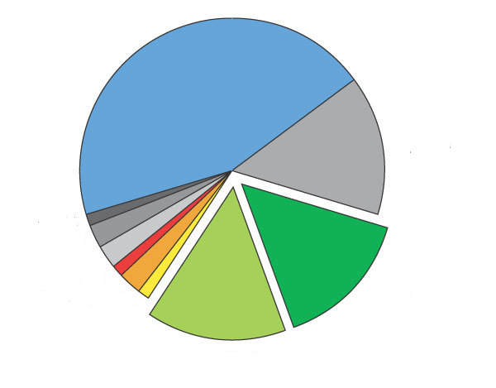
The Top Quark – Decay channels
Three different topologies for the $t\overline{t}$ final states
‘Leptonic’ channel
$$\sim 33\%$$
All jets (46%)
$τ$+jets (13,5%)
‘Hadronic’ channel
$$\sim 66\%$$
$$\sim 66\%$$
Dilepton (10%)
$μ$+jets (13,5%)
$e$+jets (13.5%)

Slide 6
The Top Quark - Why do we care?
Very large mass ($\sim$ the mass of an atom of tungsten, $\sim 40$ time the b quark)
Top events are important probes for new physics particles such as Z’, KK gluons and SUSY
Its very large mass ($\sim$ the mass of an atom of tungsten, $\sim 40$ times greater than its electroweak partner, the b quark) leads to:
Extremely short lifetime
Doesn’t form bound (colorless) states
Unique opportunity to study a ‘colored’ object
Large Yukawa coupling with the Higgs field
Important role in the Electroweak Spontaneous Symmetry Breaking
Top events are important probes for new physics particles such as Z’, KK gluons and certain flavors of SUSY
Extremely short lifetime
Large Yukawa coupling with the Higgs field
Top quarks are a privileged window to access pQCD
Total ${ σ}_{t\overline{t}}$ measurements show very good agreement with the SM
Doesn’t form bound (colorless) states
Important role in the physics of the Higgs
$t\overline{t}$differential cross section:
tool for precision SM measurements and BSM discoveries

Slide 7
What we measure
Top-antitop differential cross section $\left(\frac{dσ}{dX}\right)$ with respect to:
$X=M\left(t\overline{t}\right)$
$X=p_{T}(t\overline{t})$
$X=Y(t\overline{t})$
Absolute $\frac{dσ}{dX}$ and relative $\frac{1}{σ}\frac{dσ}{dX}$differential cross sections have been measured →lower systematic uncertainties in $\frac{1}{σ}\frac{dσ}{dX}$
Channel under study: ‘lepton plus jets’
Lepton can be either an electron or a muon
Analysis performed on data from $pp$ collisions collected by the ATLAS detector @ $E_{cm}=7$ TeV, $\int{Ldt}=4,7{\text{f}\text{b}}^{−1}$

Slide 8
The ATLAS detector
Muon detectors
Calorimeters
Inner detector
Solenoid magnet
Toroid magnet
The reconstruction of $t\overline{t}$ pairs in the semileptonic channel relies on the information from all ATLAS subsystems

Slide 9
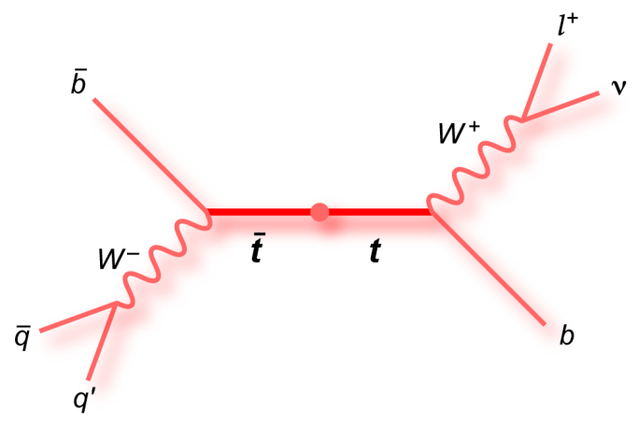
Typical $t\overline{t}→e$+jets event
Secondary vertex from b-jet

Slide 10
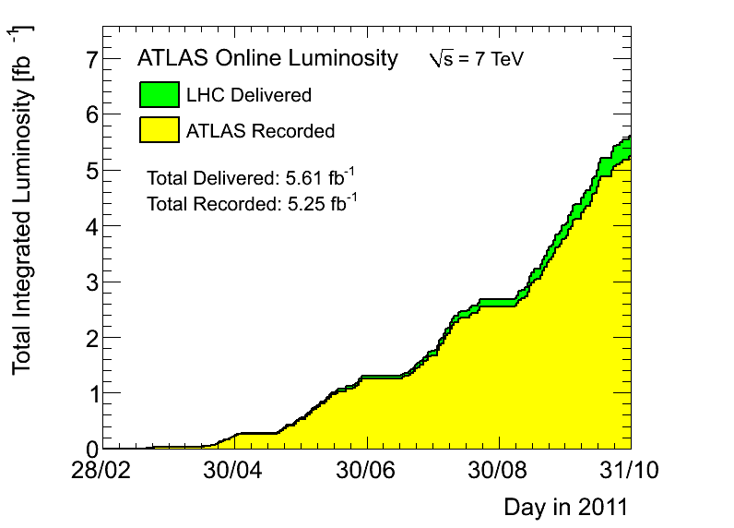
Data samples
Data: The total luminosity analyzed is 4,7 ${\text{fb}}^{−1}$ at $\sqrt{s}$= 7 TeV, collected by ATLAS during 2011
Only data for which all the ATLAS subsystems are operational are used in the analysis ($\sim 95\%$ of the total recorded luminosity).
Events are recorded using the appropriate lepton trigger
Notes:
Z>

Slide 11
Standad Model predictions
The McAtNlo generator is used for the signal modelling. Other LO generators, in particular Alpgen and AcerMC, are used to evaluate the uncertainty on the theory
The main backgrounds are:
W+jets
QCD multijet processes
single top
Z+jets
Diboson
Data driven method are used for the estimation of the QCD background and the normalization of the W+jets sample
Standard ATLAS Monte Carlo samples are used for the description of the remaining backgrounds

Slide 12
Event selection
The channel under investigation is the ‘lepton+jets’ channel
The lepton can be either an electron or a muon candidate
Events are required:
To have only one isolated lepton ($p_{T}>25$ GeV)
$≥4$ jets ($p_{T}>25$ GeV)
High missing transverse energy ($E_{T}^{miss}>30$ GeV)
W boson transverse mass greater than 35 GeV
At least a jet tagged as ‘b’

Slide 13
Systematic uncertainties
Three main ‘categories’ for the systematic uncertainties:
signal modeling: the systematics affecting the simulation of the hard-process, the parton shower and the PDF;
background modeling: the systematics affecting the estimates made by the data-driven methods;
detector modeling: all the uncertainties due to the non perfect understanding of the detector
Separate measurement have been performed by varying the prediction within each systematic uncertainties
The final systematic uncertainty has been assessed by adding in quadrature all the deviations, assuming their independence
Signal modelling
Background modelling
Detector modelling
Hard scattering Parton shower
PDF
Initial and final state radiation
Data driven BG uncertainties
Generator parameters (for the W+jets sample)
Trigger
bTag
Pile-up
Object identification & reconstruction
Dominating:
Isr&Fsr, hard scattering
Dominating:
QCD normalization
Dominating:
Jet energy scale, bTag
Systematics are dominating with respect to the statistical uncertainties

Slide 14
Data/Prediction Yields
 | Electron + jet channel |  | Muon + jet channel
Sample | No b-tag | $≥1$ b-jet | No b-tag | $≥1$ b-jet
$t\overline{t}$ signal | 16208 | 13964 | 19330 | 16628
$t\overline{t}$ dilepton | 2019 | 1765 | 2332 | 2039
Single top | 1434 | 1147 | 1699 | 1355
W+jets | 12943 | 2246 | 17985 | 3053
Z+jets | 2574 | 397 | 1247 | 206
Diboson | 225 | 45 | 256 | 50
QCD | 4996 | 3872 | 975 | 340
Total Prediction | 40339 | 21012 | 43827 | 23673
Data | 38987 | 20910 | 45909 | 25063
Predicted yields are in good agreement with the data within the uncertainties ($∼10\%)$

Slide 15
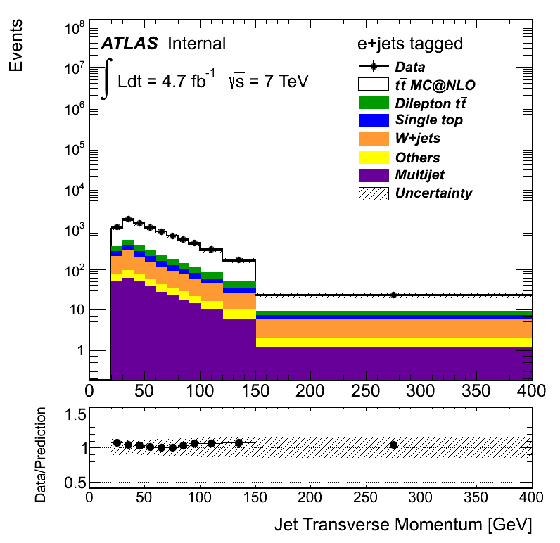
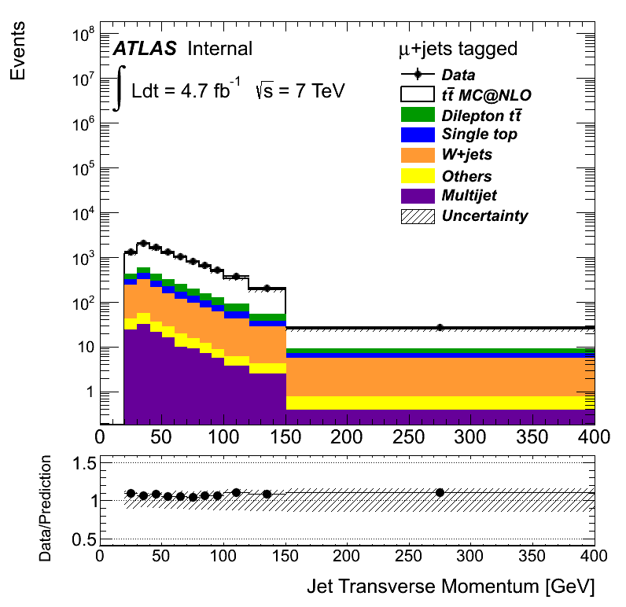
Data/Prediction Control Plots
Electron + jets channel, $≥1$b-jet
Muon + jets channel, $≥1$b-jet
Data/Prediction agreement
$p_{T}$ (Jets)
Reconstruced objects are correctly described by the prediction

Slide 16
Reconstruction of the $tt$ system
Kinematic Likelihood Fit
$m_{t }, m_{W}$ and Breit-Wigner amplitudes from PDG
Reco final state objects 4-vectors (5 hardest jets, lepton, missing $E_{T}$)
Likelihood:
$$\text{(}\text{Brei}\text{t}\text{−}\text{Wigner}\text{)} \text{x}$$
$$\text{(}\text{Transfer} \text{functions}\text{)}\text{x}$$
$$\text{ (}\text{btagging} \text{probability}\text{)}$$
$L=B\left({\tilde{E}}_{p,1},{\tilde{E}}_{p,2}|m_{W}Γ_{W}\right)⋅$ $B\left({\tilde{E}}_{l},{\tilde{E}}_{ν}|m_{W}Γ_{W}\right)⋅$
$$B\left({\tilde{E}}_{p,1},{\tilde{E}}_{p,2},{\tilde{E}}_{p,3}|m_{t}Γ_{t}\right)⋅B\left({\tilde{E}}_{l},{\tilde{E}}_{ν},{\tilde{E}}_{p,4}|m_{t}Γ_{t}\right)⋅$$
$$W\left({\hat{E}}_{x}^{miss}|{\tilde{p}}_{x,ν}\right)⋅W\left({\hat{E}}_{y}^{miss}|{\tilde{p}}_{y,ν}\right)⋅W\left({\hat{E}}_{l}|{\tilde{E}}_{l}\right)⋅$$
$$\prod_{i=1}^{4}{W\left({\hat{E}}_{jet,i}|{\tilde{E}}_{p,i}\right)⋅P\left(btag|quark\right)}$$
4jet+lepton+MET combination with highest likelihood

Slide 17
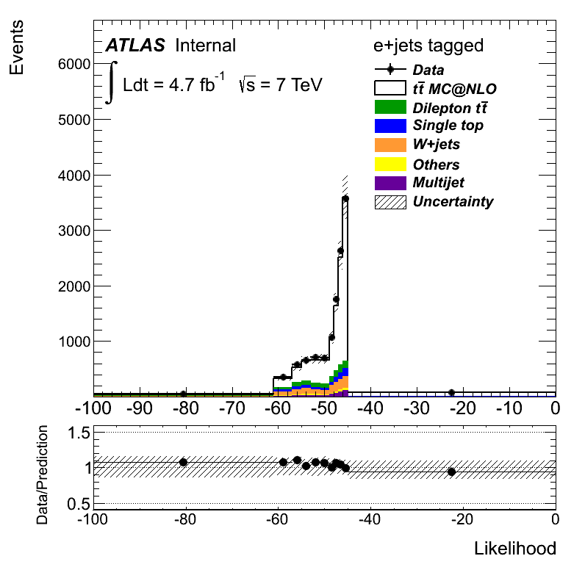
Fit likelihood distribution
The likelihood of the fit in the data is well described by the simulation
A cut on $logL=−52$ is applied
helps to discard poorly reconstructed events
enhances S/B
‘Bad’ likelihood region
‘Good’ likelihood region

Slide 18
Results

Slide 19
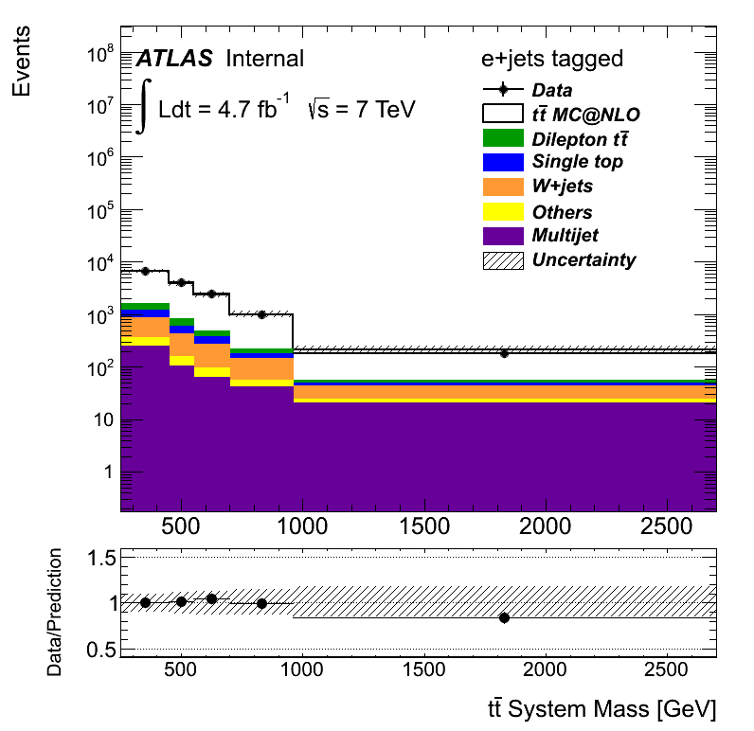
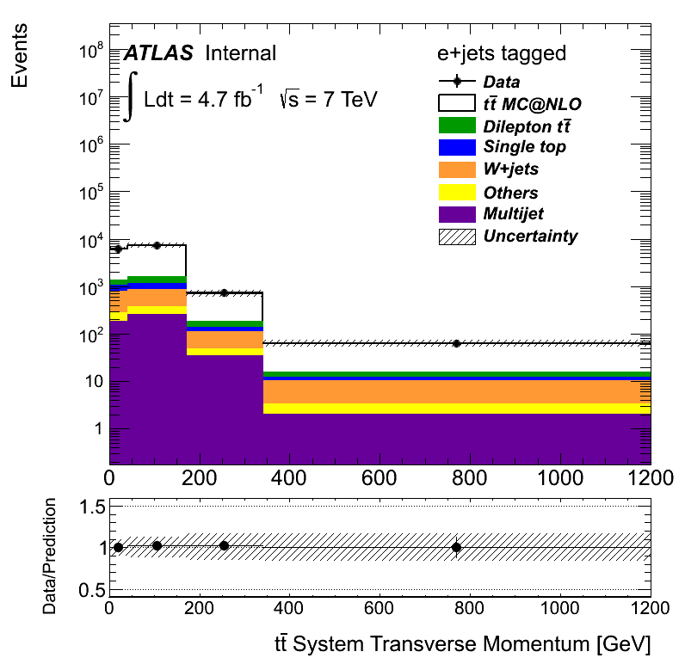
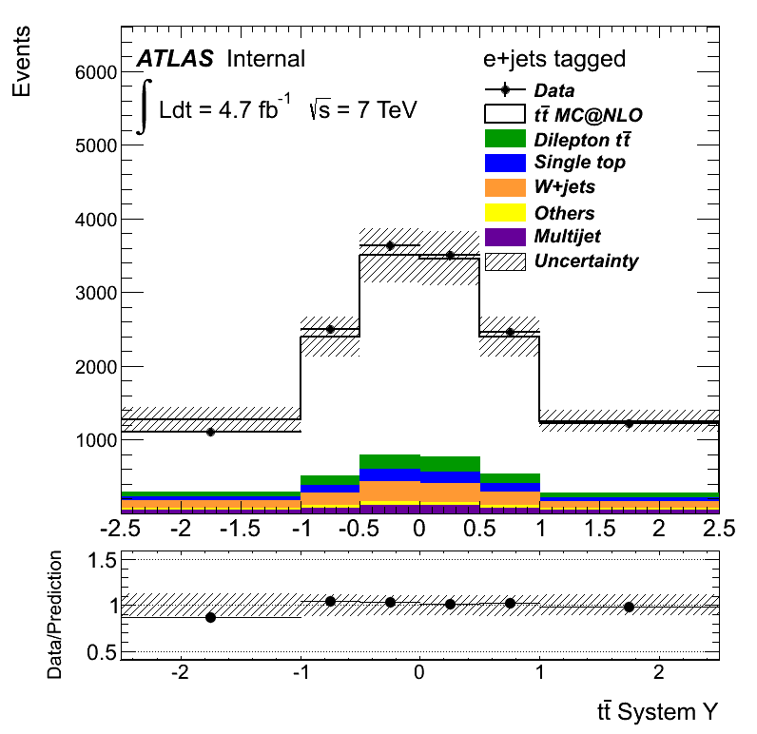
Reconstructed spectra
$M(t\overline{t})$ [GeV]
$p_{T}(t\overline{t})$ [GeV]
$$Y(t\overline{t})$$
Choice of the bin based on the resolution of each variable and on the optimization of the migrations due to the systematic uncertainties

Slide 20
From the detector-level spectra to the cross section measurement
The ‘detector-level’ spectra are linked to the ‘parton level’cross section $σ_{j}$ via
$$N_{i}=\sum_{j}{{M_{ij}ε}_{j}σ_{j}βL+B_{i}}$$
Background$B_{i}$
Measured spectrum ($N_{i}$)
‘Real process’ ($σ_{j}$)
Real detector, selection and reconstruction response
Evaluated via simulations (${M_{ij}ε}_{j}$)
Unfolding

Slide 21
The migration matrix $M_{ij}$
Reconstructed objects are ‘smeared’ because of the limited resolution of the detector and the reconstruction algorithms

Slide 22
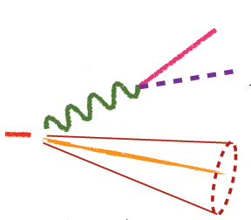
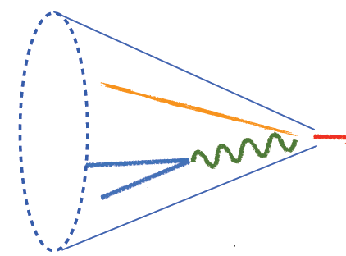
The efficiency $ε_{j}$
‘Signal’ events can be discarded because of the limited acceptance of the detector and efficiency of the selection cuts
The Alpgen-McAtNlo discrepancy is used as systematic uncertainty
‘Resolved’ topology
‘Boosted’ topology
t
t

Slide 23
Unfolding
$$N_{i}=\sum_{j}{{M_{ij}ε}_{j}σ_{j}βL+B_{i}}$$
$$σ_{j}=\frac{\sum_{i}{M_{ij}^{−1}(N_{i}−B_{i})}}{ε_{j}βL}$$
Inverse problem
Procedure to estimate, from a “measured” distribution, the “true” distribution
Basic methods
Bin-by-bin method: only valid when $M_{ij}→I$
Simple $M_{ij}$ matrix inversion
Unbiased (indipendent on the ‘training’ samples)
Statistical fluctiations can lead to highly oscillating results
Regularized methods:
Single Value Decomposition
Iterative Bayesian
Statistical fluctuations are ‘dumped’ by the regularization process
Can be biased towards the training samples
SVD method has been used
The bias introduced by the regularization is not significant

Slide 24
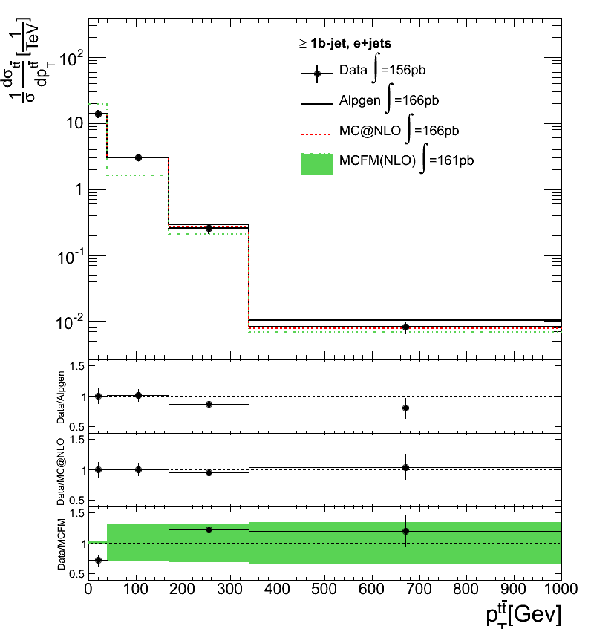
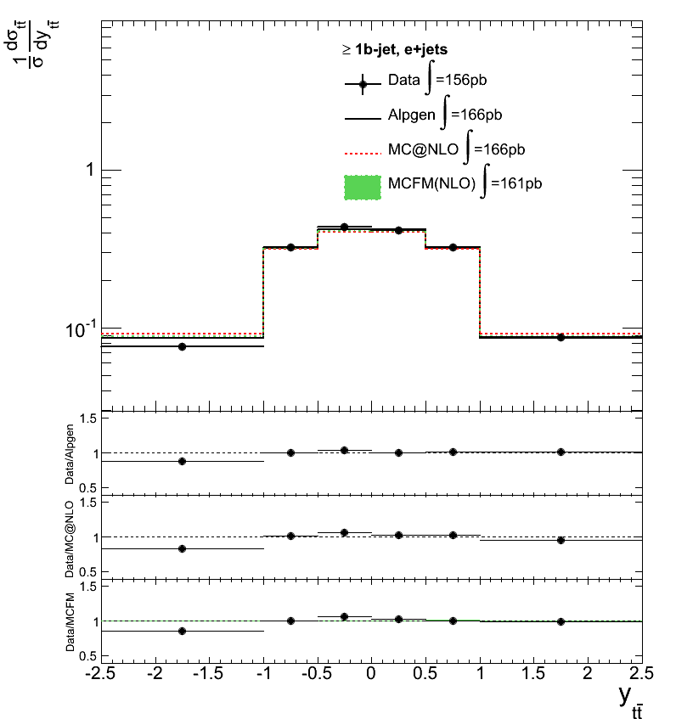
Results: Unfolded spectra
Electron channel
$$\frac{1}{σ}\frac{dσ}{dm_{tt}}$$
$$\frac{1}{σ}\frac{dσ}{dp_{T,tt}}$$
$$\frac{1}{σ}\frac{dσ}{dY_{tt}}$$
Alpgen
McAtNlo
MCFM
Alpgen and McAtNlo prediction evaluated using standard Atlas paramaters
MCFM uncertainty evaluated by varying the renormalization scale $μ$between $m_{t}/2$ and $2m_{t}$ (the central value being $μ=m_{t}$), using MSTW2008NLO as PDF

Slide 25
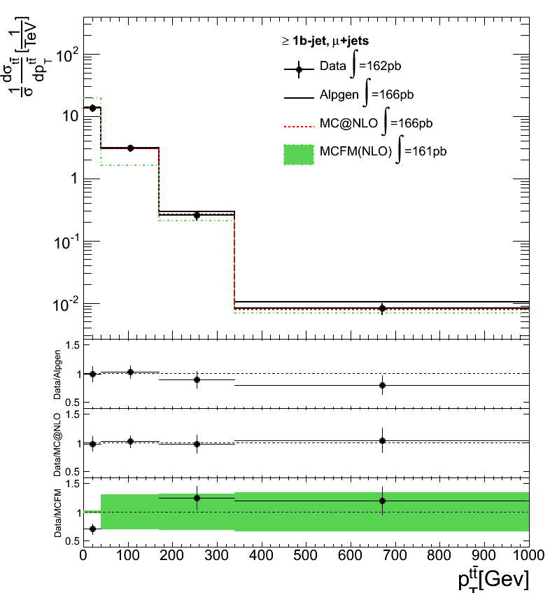
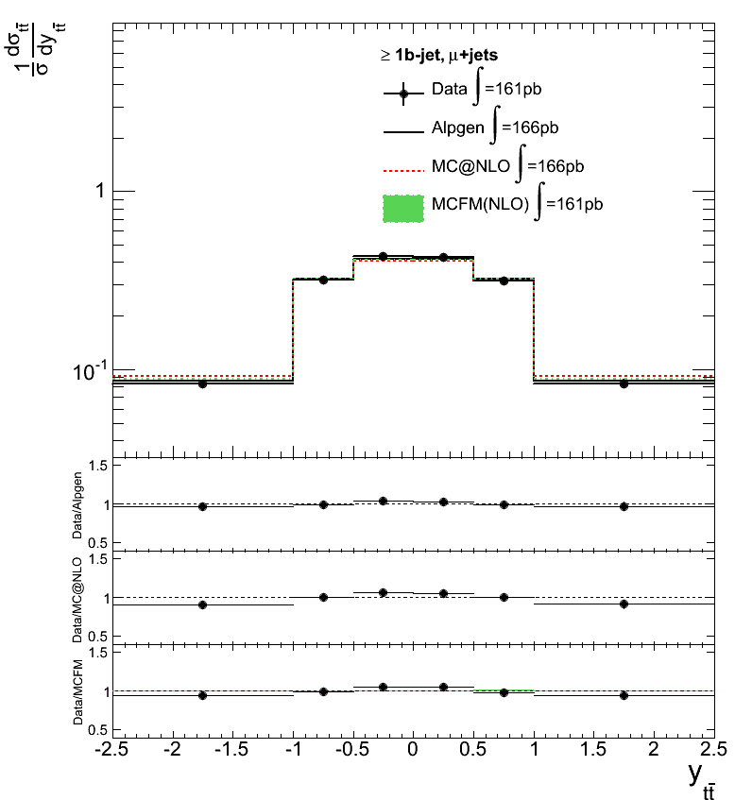
Results: Unfolded spectra
Muon channel
$$\frac{1}{σ}\frac{dσ}{dm_{tt}}$$
$$\frac{1}{σ}\frac{dσ}{dp_{T,tt}}$$
$$\frac{1}{σ}\frac{dσ}{dY_{tt}}$$
Alpgen
McAtNlo
MCFM
Only the for the $p_{T}$ spectrum the prediction from MCFM shows significant shape uncertainties
Overall good agreement with the SM predictions
$\frac{1}{σ}\frac{dσ}{dp_{T,tt}}$ is not well described by MCFM due to the lack of Parton Shower simulation

Slide 26
Conclusions & outlook
We have measured the relative (and absolute) differential cross section for $t\overline{t}$ production in $pp$ collisions at $\sqrt{s}=7$ TeV
All results are compatible with the SM predictions within the systematic uncertainties
The analysis is in the final approval stage and is documented in ATL-COM-PHYS-2012-1137
The results are expected to be made public soon

Slide 27
Backup

Slide 28
Results: measured cross sections

Slide 29
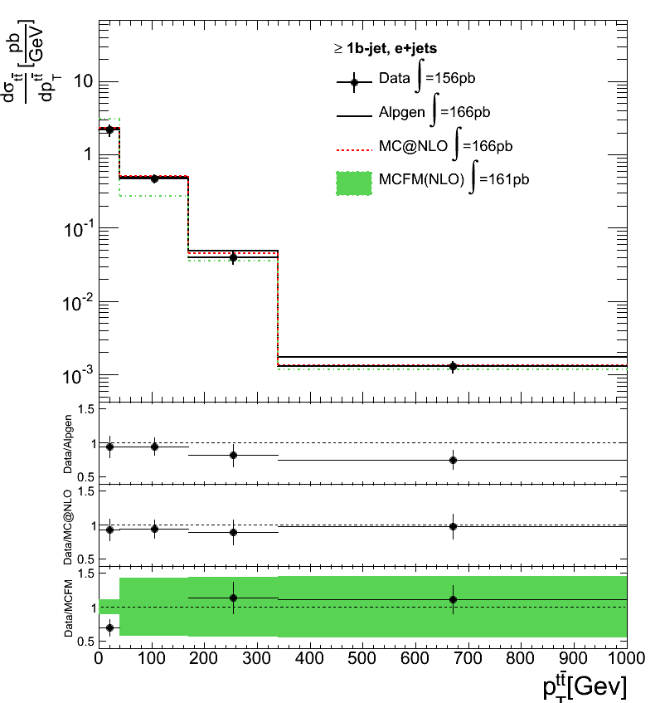
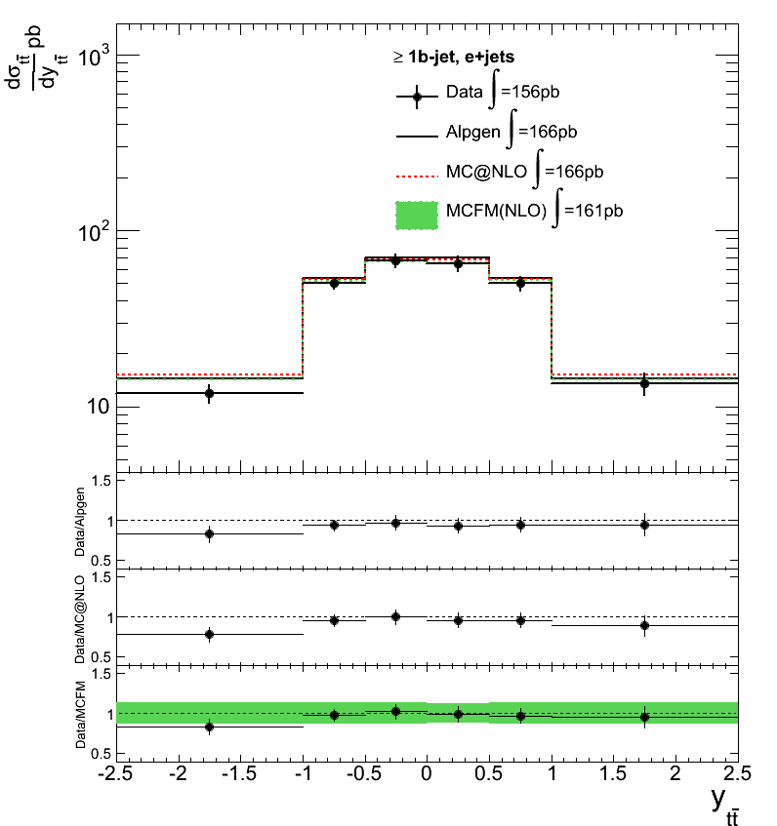
Results: Unfolded spectra
Electron channel
$$\frac{dσ}{dm_{tt}}$$
$$\frac{dσ}{dp_{T,tt}}$$
$$\frac{dσ}{dY_{tt}}$$
Alpgen
McAtNlo
MCFM

Slide 30
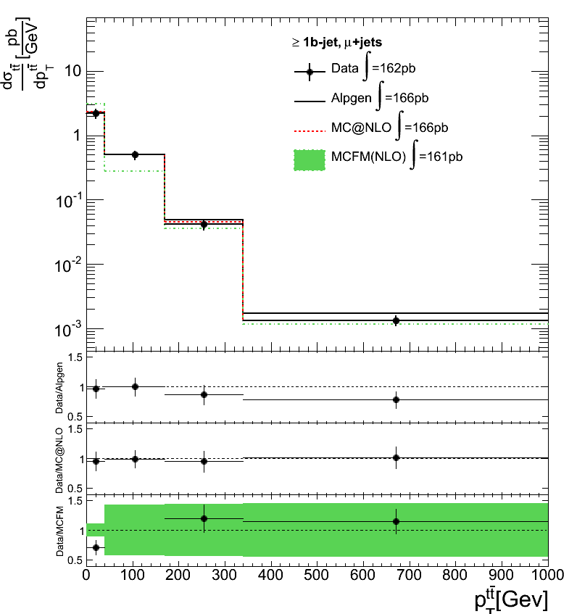
Results: Unfolded spectra
Muon channel
$$\frac{dσ}{dm_{tt}}$$
$$\frac{dσ}{dp_{T,tt}}$$
$$\frac{dσ}{dY_{tt}}$$
Alpgen
McAtNlo
MCFM

Slide 31
Full cutflow
Cuts are the same for both the ‘electron’ and ‘muon’ channels
one primary vertex with more than four tracks coming from it;
one, and only one, good electron/muon with pT > 25 GeV;
no good lepton of the other flavor with pT > 15 GeV;
lepton must match the corresponding leptonic trigger object;
there must be no bad jet in the events;
at least four jets;
missing transverse energy greater than 30 GeV;
W boson transverse mass greater than 35 GeV;
Quality cut on the reconstruction of the $t\overline{t}$ system ($logL>−52$)
at least one jet tagged as b-jet.

Slide 32
Efficiency: alpgen vs mcatnlo

Slide 33
Efficiency: all samples

Slide 34
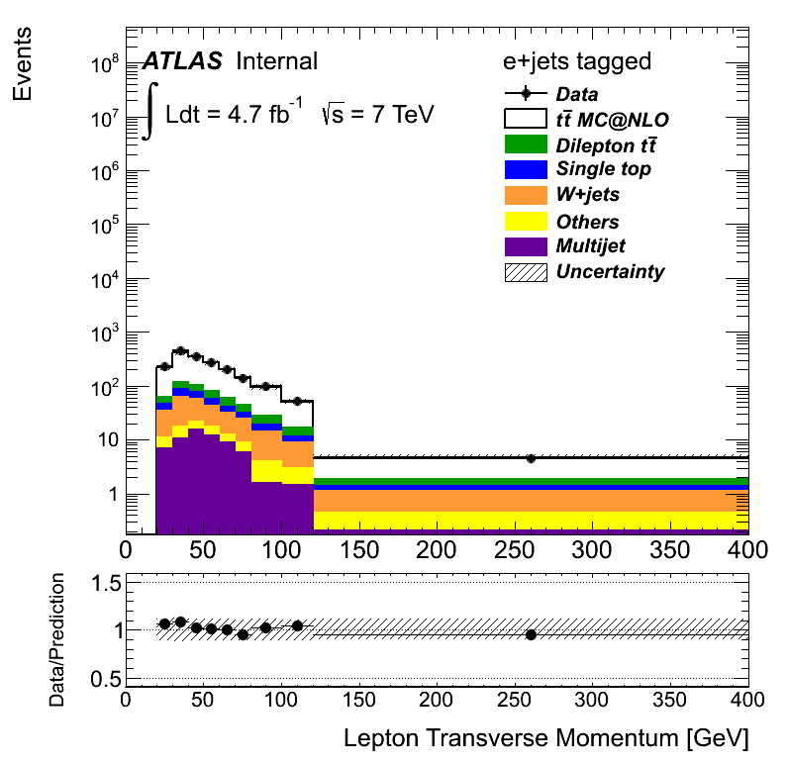
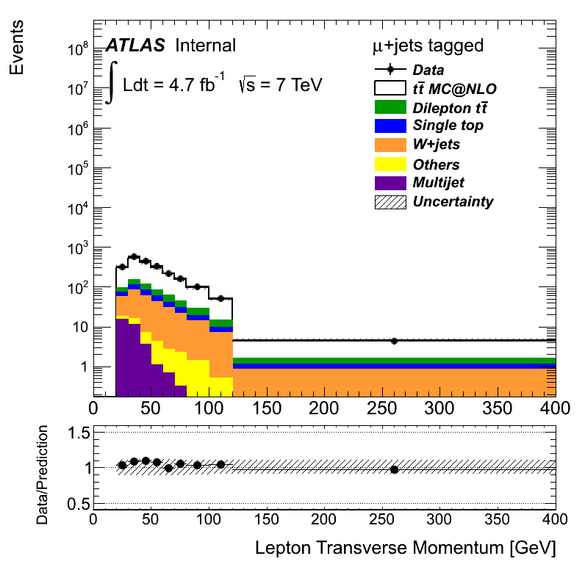
Data/Prediction Control Plots
Electron + jets channel, $≥1$b-jet
Muon + jets channel, $≥1$b-jet
$p_{T}$ (Lepton)

Slide 35
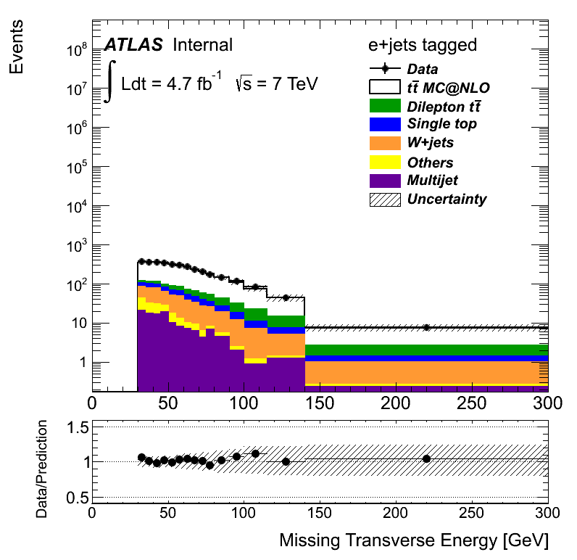
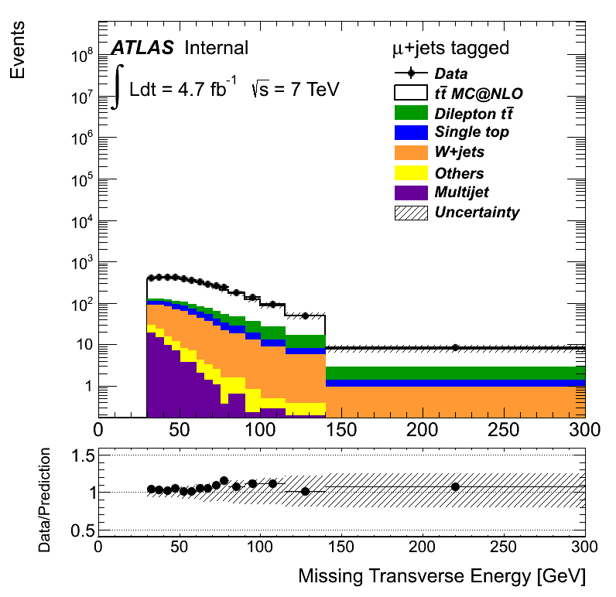
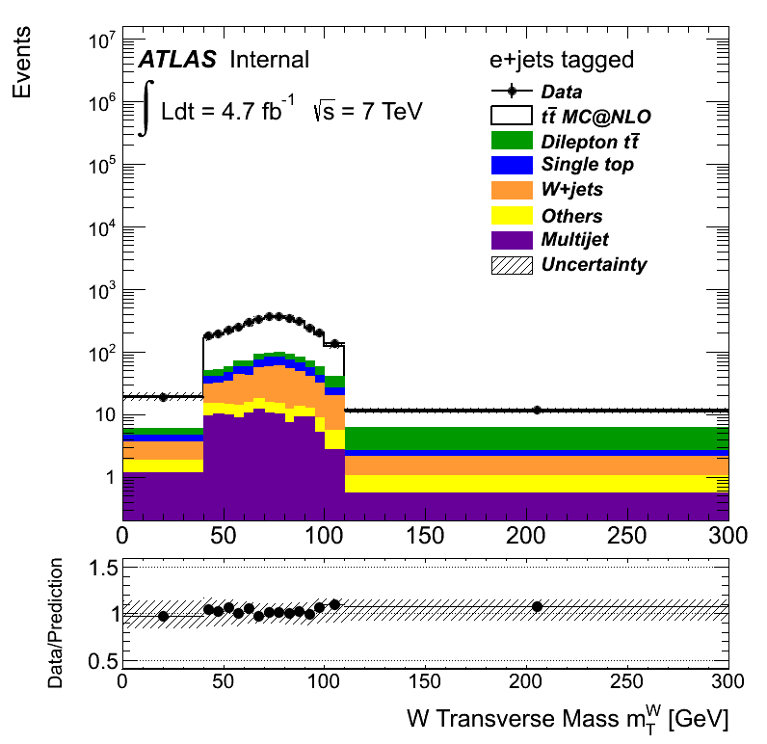
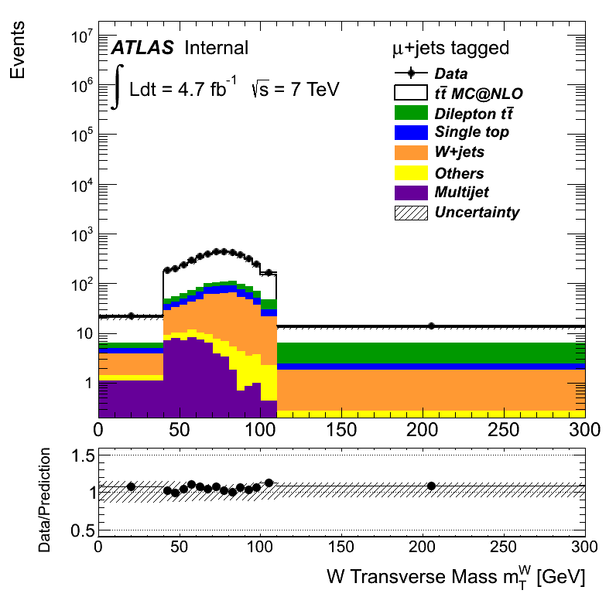
Event selection – Control Plots
Missing transverse momentum
W transverse momentum

Slide 36
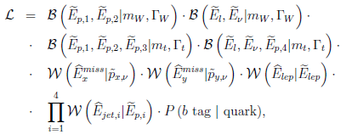
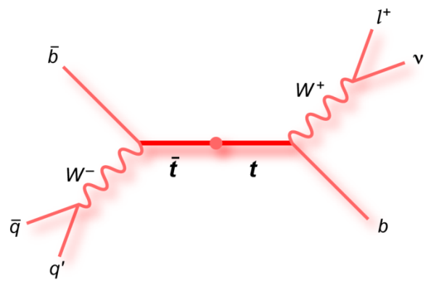
Reconstruction of the $tt$ system
The tt system reconstruction is performed trough a kinematic fit using a maximum likelihood approach
The likelihood assesses the compatibility of the event with a typical ttbar pair
The algorithm is fed with the 5 reconstructed highest-pt jets (and their b-tag info), the lepton and the $E_{T}^{miss}$
The output is the permutation of the four jets, lepton and $E_{T}^{miss}$ that maximizes the likelihood

Slide 37
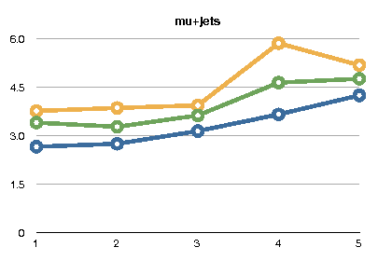
A cut on the best likelihood value ($logL>−52)$ has been implemented in order to reject poorly reconstructed events
SB(good)/SB(bad) for each bin. Pretag (blue), tagged (green), two tags (yellow) where:
$$SB\left(good\right)=\frac{S(good lhood)}{B(good lhood)}$$

Slide 38
KLFitter: transfer functions

Slide 39
Likelihood cut: efficiency

Slide 40
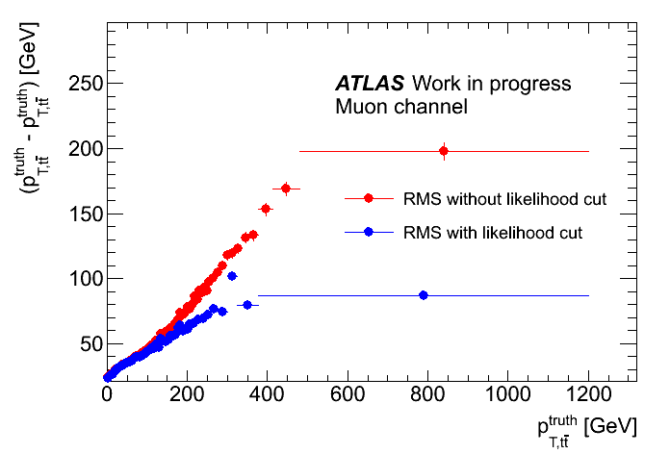
Likelihood cut: resolutions

Slide 41
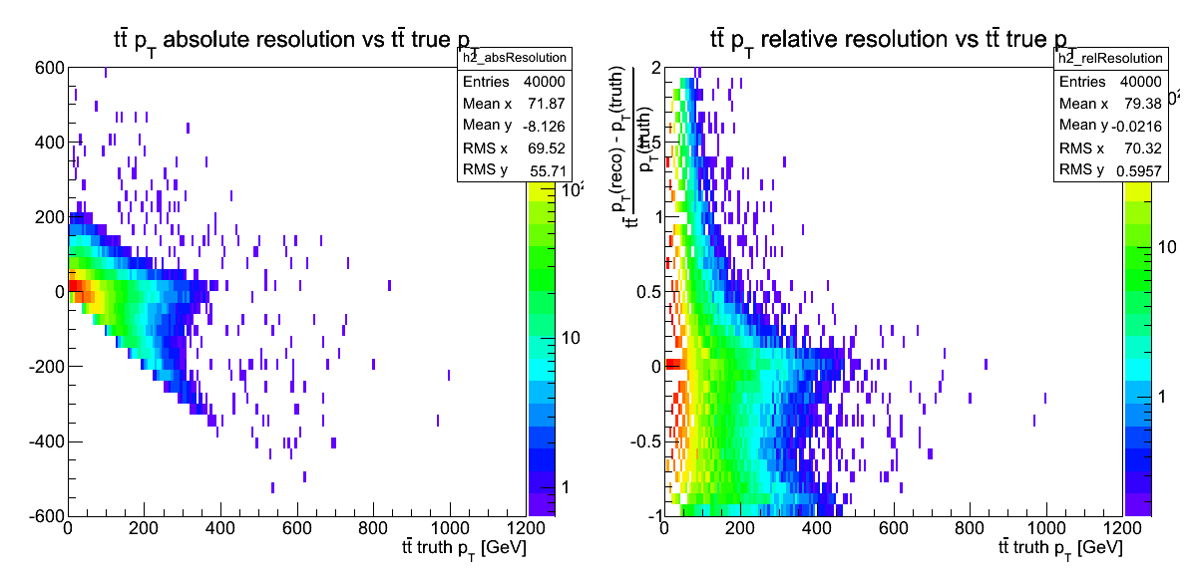
Some checks
Pt resolution:
There are two branches:
one, horizontal, for the «good» reconstructed pt
One, with angular coefficient = -1 for the poorly reconstructed pt
The likelihood cut can suppress the second branch

Slide 42
Pt binning
The choice for the binning must meet (at least) 3 requirements:
Must reduce as much as possible the migrations → bin width >= resolution * $δ$
$δ=1$ in the ideal, gaussian response
Must give statistically significant result
Must be stable against systematic shifts
(Bonus request) Must be as fine as possible (we are talking about *differential* cross sections….)

Slide 43
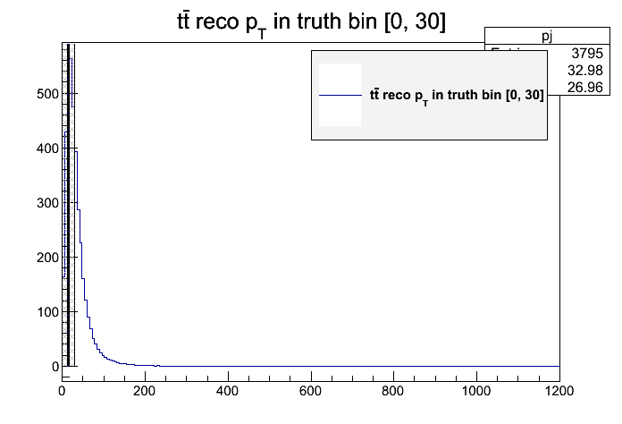
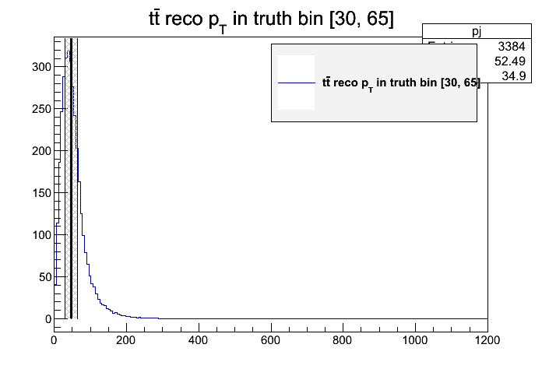
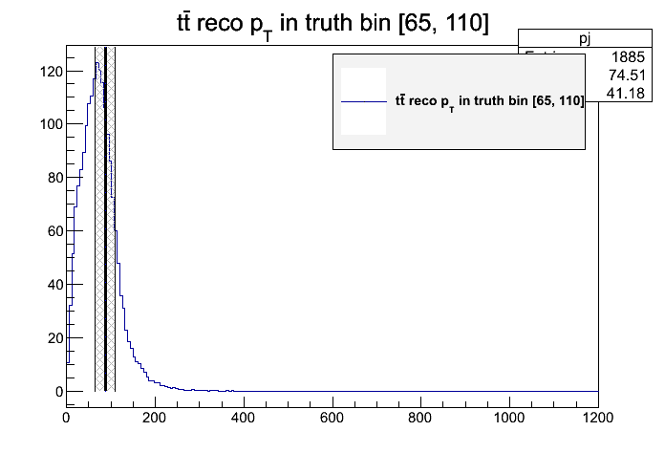
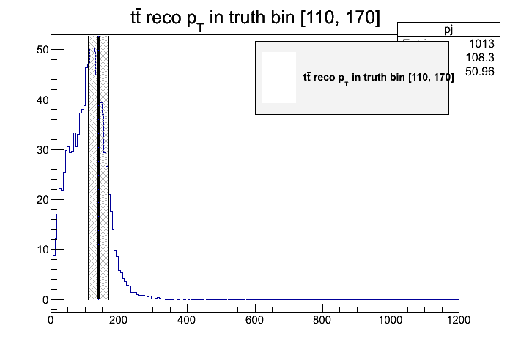
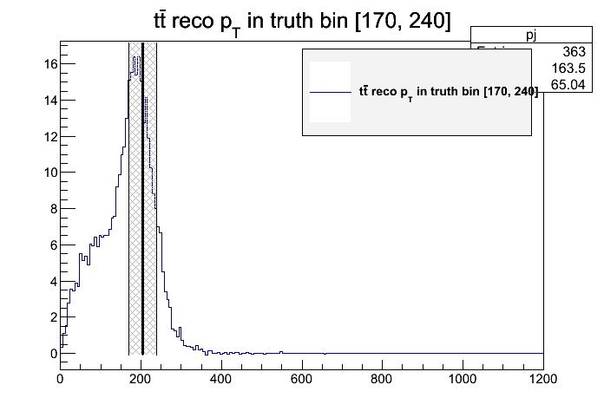
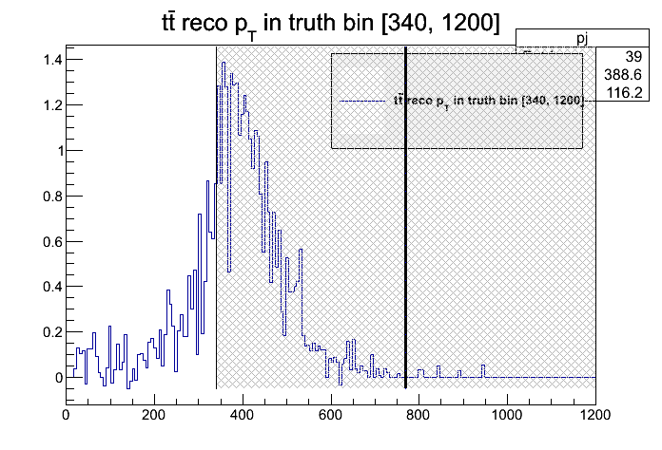
Some checks
«Good» likelihood selection
Ttbar pt reco distributions in a set of truth bins
The response of the the kinematic fit is strongly non-gaussian
$δ>1$ is then advisable

Slide 44
Pt binning
Must reduce as much as possible the migrations → bin width >= resolution
We calculated the pt resolution function f(x) by fitting the RMS of the reconstructed pt vs the true pt
The binning is extracted by solving the recursive equation:
$$x_{0}=0$$
$$f\left(\frac{x_{i}+x_{i−1}}{2}\right)<δ∗\left(x_{i}−x_{i−1}\right)$$
$$x_{i}<MAX_BIN$$
In our case, $δ$=1.4 and MAX_BIN = 1200 GeV/c

Slide 45
Pt binning, response matrix
Merged in order to have $\sim 68\%$ in the diagonal element
Merged to increase the diagonal element and reduced to increase statistics in the last bin

Slide 46
Stress tests
Procedure:
Reprocess the signal and reweight the events at the truth level by $1+\frac{p_{T}}{400}$
In order to constrain the cross section, rescale the reweighted distributions (before and after the cuts) by
$$r=\frac{N_{generated}^{nominal}}{N_{generated}^{reweighted}}$$
The final effective reweight will be $r+r\frac{p_{T}}{400}$
Use the reweighted reco distribution as pseudo data, and the nominal migration and efficiency

Slide 47
Distributions after cuts (1)

Slide 48
Unfolded & generated spectra
SVD Unfolding, k = 3

Slide 49
Unfolded & generated spectra
Simple matrix inversion Unfolding

Slide 50
Unfolding: Migration Matrices (Mass)

Slide 51
Unfolding: Migration Matrices (Pt)

Slide 52
Unfolding: Migration Matrices (Rapidity)

Slide 53
Unfolding: Efficiencies (Mass)

Slide 54
Unfolding: Efficiencies (Pt)

Slide 55
Unfolding: Efficiencies (Rapidity)

Slide 56
Event selection – Discrimination power

Slide 57
Reconstructed $t\overline{t}$ spectra
Mass
Bins [GeV]: 250 $−$450, 450 $−$550, 550 $−$700, 700 $−$960, 960 $−$2700

Slide 58
Reconstructed $t\overline{t}$ spectra
Pt
Bins [GeV]: 0 $−$40, 40 $−$170, 170 $−$340, 340 $−$1200

Slide 59
Reconstructed $t\overline{t}$ spectra
Rapidity
Bins: -2.5$−$-1, -1$−$-0.5, -0.5$−$0, 0 $−$0.5, 0.5 $−$1, 1 $−$2.5

Slide 60
$\frac{1}{σ}\frac{dσ}{dp_{T,tt}}$, PS dependence

Slide 61
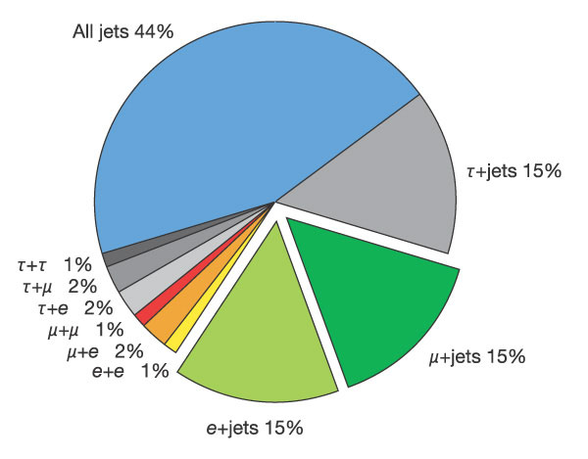
The Top Quark – Decay channels
‘Leptonic’ channel
‘Hadronic’ channel
$$\sim 33\%$$
$$\sim 66\%$$
Three different topologies for the $t\overline{t}$ final states
Name | Final state | BR(%)
All hadronic | $$b\overline{b}q\overline{q}q′\overline{q′}$$ | 46,2
Single lepton | $$b\overline{b}q\overline{q}l\overline{ν_{l}}$$ | 43,5
Dilepton | $$b\overline{b}\overline{l}υ_{l}l\overline{ν_{l}}$$ | 10,3
Highest statistics, High QCD background contamination
Good statistics, much lower bg contamination
Very low statistics, extremely low background

Slide 62
From the detector-level spectra to the cross section measurement
The ‘detector-level’ spectra are linked to the ‘parton level’cross section $σ_{j}$ via
$$N_{i}=\sum_{j}{{M_{ij}ε}_{j}σ_{j}βL+B_{i}}$$
Where
$N_{i}$ is the number of observed data events in the bin j.
L is the luminosity
$B_{i}$ is the number of background events in the bin i.
$β$ is the branching ratio
$M_{ij}$ is the ‘migration matrix’
$ε_{j}$ is the efficiency of the selection

