Slide 1


The NESSiE concept for Sterile Neutrinos
The Sterile Neutrino Issue
with SPS beam at CERN
Eduardo Medinaceli (INFN and Padova University)
for the NESSiE collaboration
IFAE 2013 - April 5, 2013

Slide 2
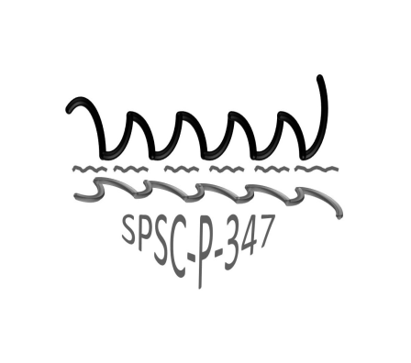
Proposal SPSC-P347 (March 2012)
OUTLINE
Physics ground & different scenarios
SPSC-P347 proposal
Latest beam & new simulation
Spectrometers
Performances
IFAE 2013 E. Medinaceli- NESSiE 1

Slide 3
The 3ν oscillation paradigm
ν-oscillations: the first physics BSM → ν are massive!
decades of experiments → mixing of 3 active ν, PMNS unitary matrix
BUT
Some observations are in tension with the 3ν scheme, pointing to a new
∆m² ∼ eV² (predominantly from single detector experiments…)
LEP Z invisible decay width N_{active}= 3 (with m_{ν} < M_{Z} /2),
the extra state does not couple to Z/W
The extraordinary consequence of a possible sterile neutrino discovery
calls for a conclusive experimental search
IFAE 2013 E. Medinaceli- NESSiE 2

Slide 4
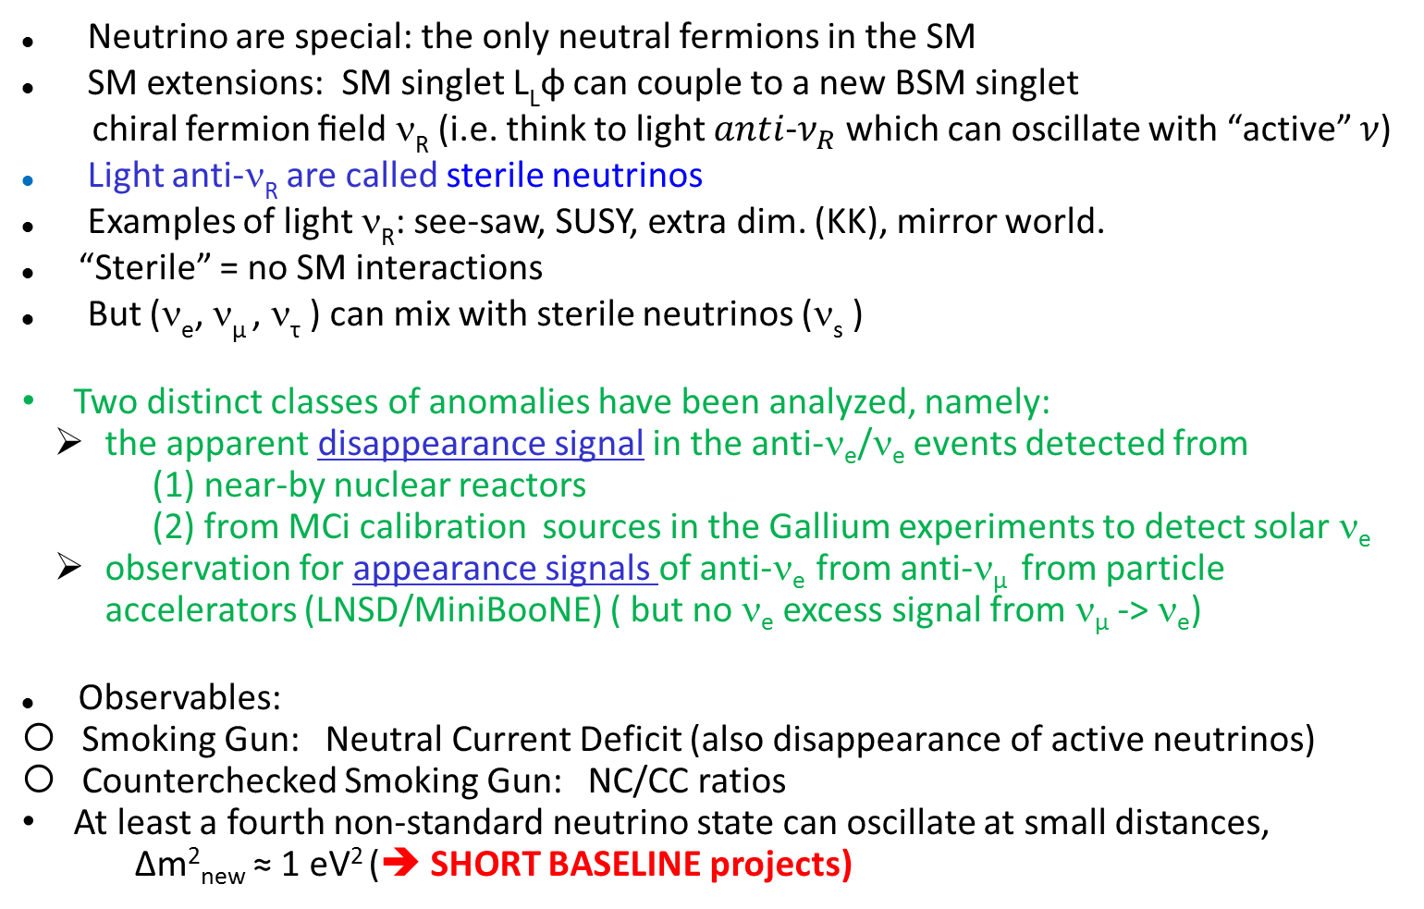
Sterile neutrinos
Neutrino are special: the only neutral fermions in the SM
SM extensions: SM singlet L_{L}φ can couple to a new BSM singlet
chiral fermion ﬁeld ν_{R} (i.e. think to light $anti$-$ν_{R}$ which can oscillate with “active” $ν$)
Light anti-ν_{R} are called sterile neutrinos
Examples of light ν_{R}: see-saw, SUSY, extra dim. (KK), mirror world.
“Sterile” = no SM interactions
But (ν_{e}, ν_{µ} , ν_{τ} ) can mix with sterile neutrinos (ν_{s} )
Two distinct classes of anomalies have been analyzed, namely:
  the apparent disappearance signal in the anti-ν_{e}/ν_{e} events detected from
  (1) near-by nuclear reactors
  (2) from MCi calibration sources in the Gallium experiments to detect solar ν_{e}
  observation for appearance signals of anti-ν_{e} from anti-ν_{μ} from particle
  accelerators (LNSD/MiniBooNE) ( but no ν_{e} excess signal from ν_{μ} -> ν_{e})
Observables:
Smoking Gun: Neutral Current Deficit (also disappearance of active neutrinos)
Counterchecked Smoking Gun: NC/CC ratios
At least a fourth non-standard neutrino state can oscillate at small distances,
Δm²_{new} ≈ 1 eV² (➔ SHORT BASELINE projects)
IFAE 2013 E. Medinaceli- NESSiE 3
Notes:
Neutrini attivi si possono accoppiare con campi fermionici di neutrini predetti da modelli BSM

Slide 5
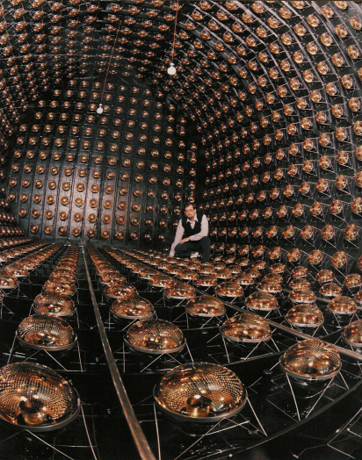
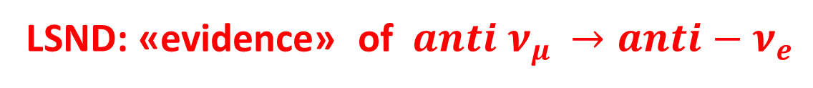
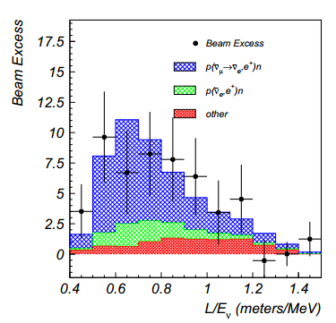
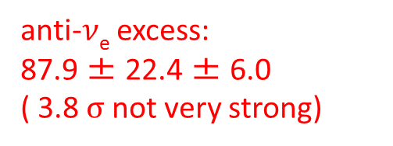
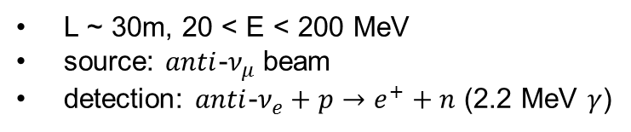
L ~ 30m, 20 < E < 200 MeV
source: $anti$-$ν_{μ}$ beam
detection: $anti$-$ν_{e}+p→e^{+}+n$ (2.2 MeV $γ$)
data points before
background subtraction
beam related
backgrounds
expectation for
oscillations
PRL 75 (1995) 2650; PRC 54 (1996) 2685;
PRL 77 (1996) 3082; PRD 64 (2001) 112007
the experimental result so far has not been challenged experimentally
IFAE 2013 E. Medinaceli- NESSiE 4
Notes:
rate di disappearance ha una dipendenza con la distanza

Slide 6
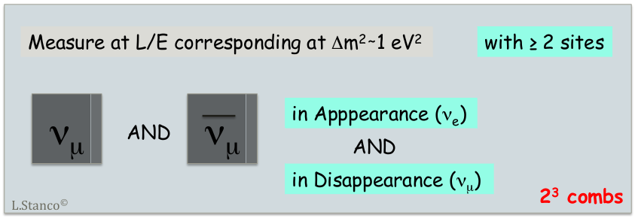

Approach at the CERN SPS
A direct unambiguous measurement of an oscillatory pattern requires
necessarily the (simultaneous) observation at several different distances:
the only way to identify both $Δm^{2}$and $\sin^{2}2θ$
We need a Superior Class Experiment: 3 kton Fe + 1 kton LAr
ICARUS imaging detector unambiguous identification of ALL channest w. a LAr-TPC
NESSiE magnetic spectrometers to determinate μ charge and momentum
L. Stanco ©
IFAE 2013 E. Medinaceli- NESSiE 5
Notes:
Disappearance: alcuni neutrini possono oscillare in esterili ed avremo una dipendenza con la distanza del rate di oscillazione
Appearance: anche qua ma especialmente nel canale anti neutrino e.g anti nu mu beam, excess anti nue LNSD

Slide 7
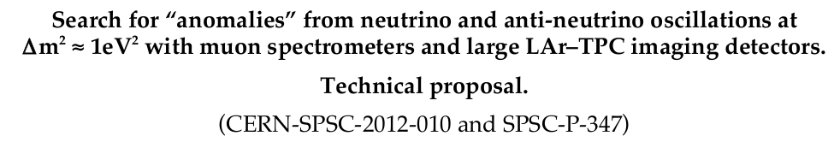
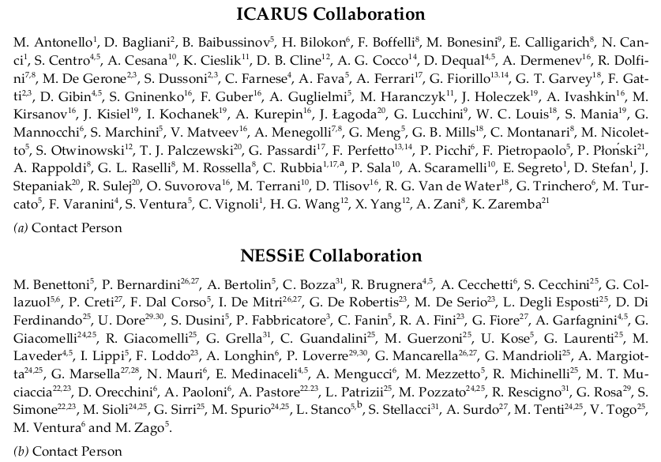
2 collaborations
30 institutions
~ 140 people
arXiv:1203.3432
IFAE 2013 E. Medinaceli- NESSiE 6

Slide 8
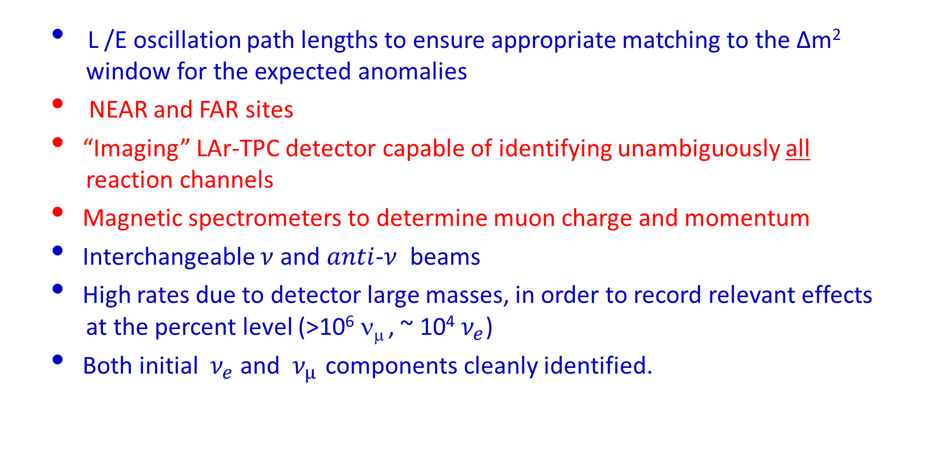
The ICARUS-NESSiE P-347 proposal at the CERN-SPS
SPSC-P-347 (arXiv:1203.3432)
Scientific Approval (CERNS’ SPSC) middle of January 2013!!!
IFAE 2013 E. Medinaceli- NESSiE 7

Slide 9
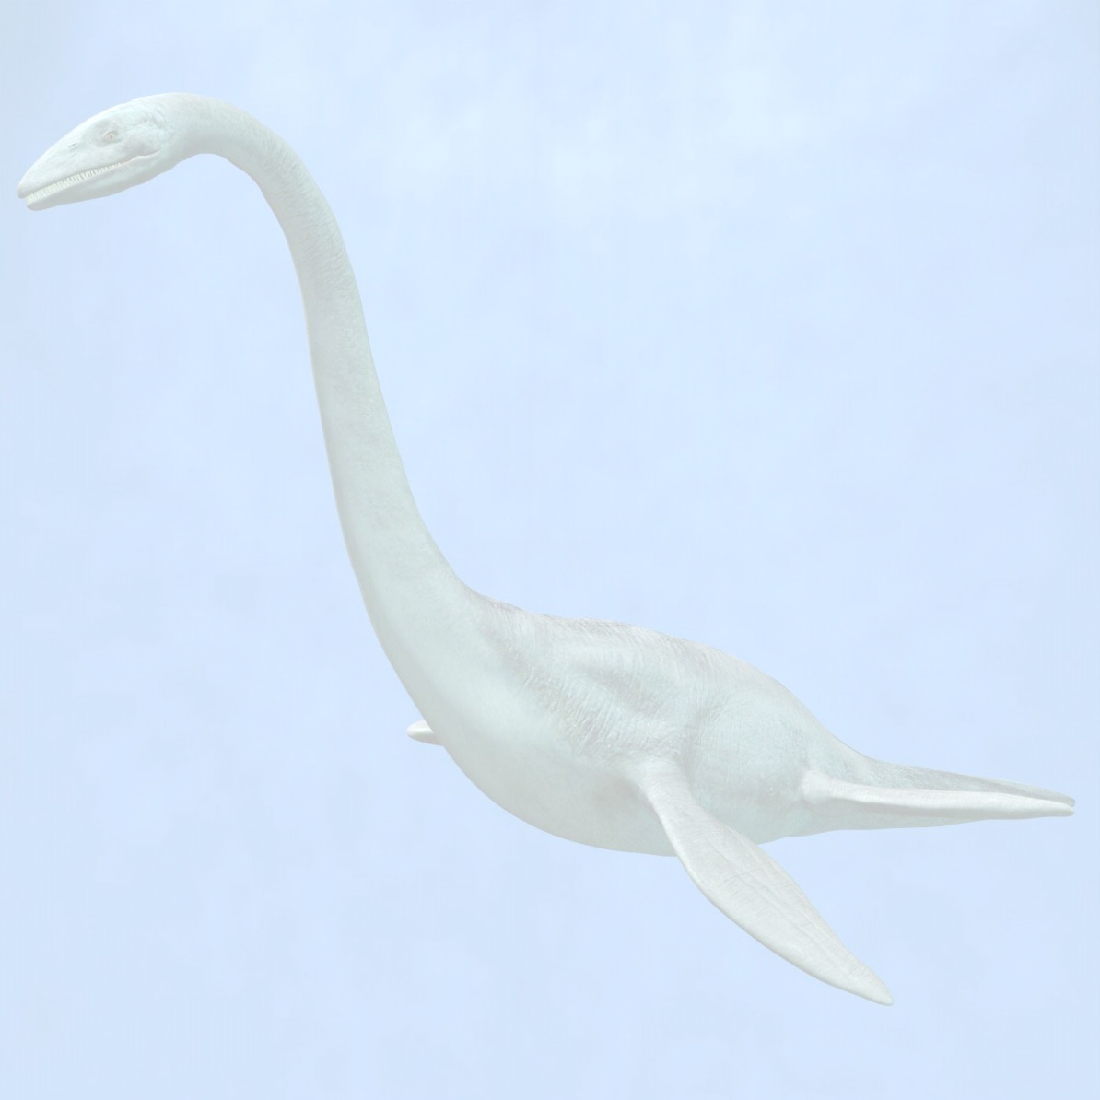

NESSiE (Neutrino Experiment with Spectrometers in Europe)
charge and momentum measurements in
the CC neutrino interactions
Fundamental because:
Increase the $Δm^{2}$ range (low P $→$ low$Δm^{2}$)
Measure precisely $ν_{μ}$ dissapearance in a
wide energy range
Large statistics $→$ low $\sin^{2}2θ$
Separate $ν_{μ}$ from $anti$- $ν_{μ}$
Measure the $φ_{ν}$ the near detector,
to keep systematics as low as possible
Normalize NC/CC
Δm²
Statistics
Spectrun
sin²2θ
IFAE 2013 E. Medinaceli- NESSiE 8

Slide 10
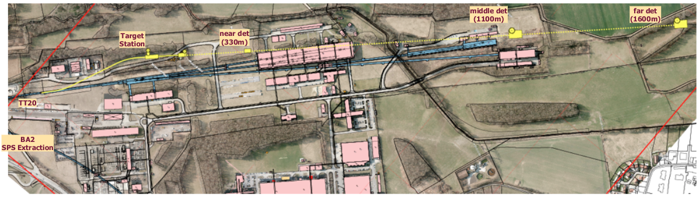
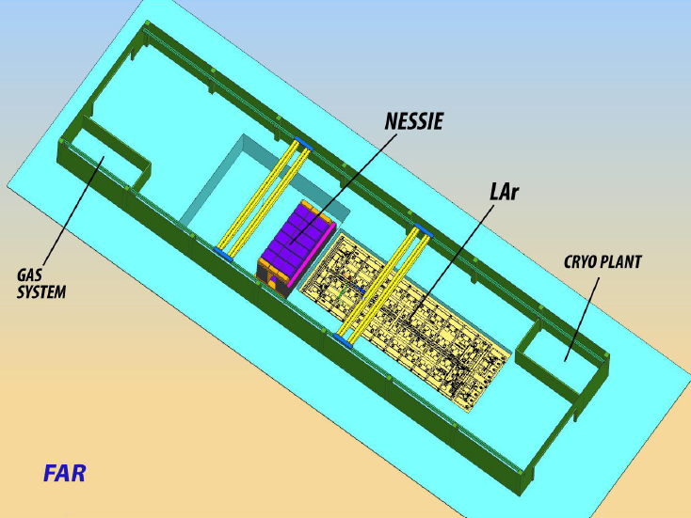
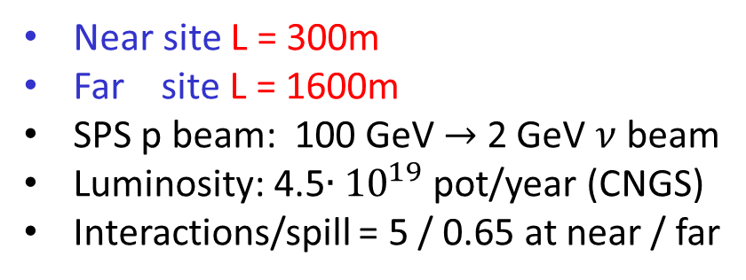
Preliminary SBL layout at the CERN’s North Area
Near site L = 300m
Far site L = 1600m
SPS p beam: 100 GeV $→$ 2 GeV $ν$ beam
Luminosity: 4.5$∙{10}^{19}$ pot/year (CNGS)
Interactions/spill = 5 / 0.65 at near / far
IFAE 2013 E. Medinaceli- NESSiE 9

Slide 11
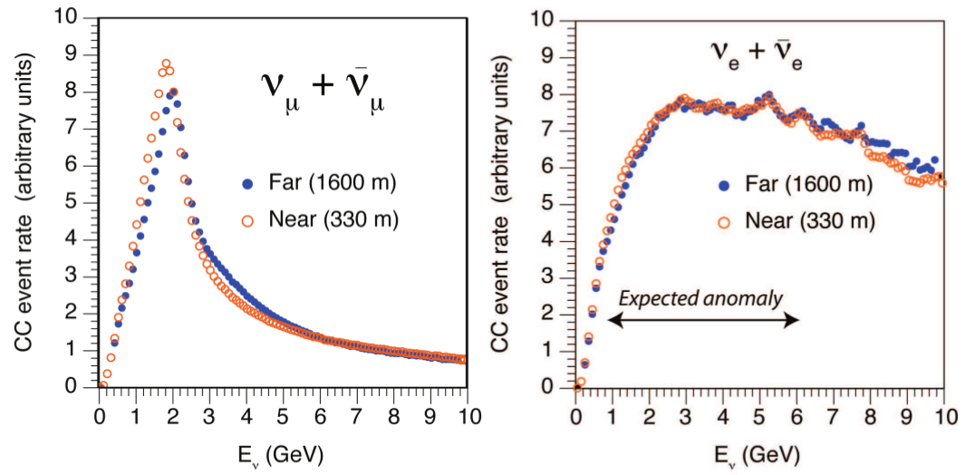
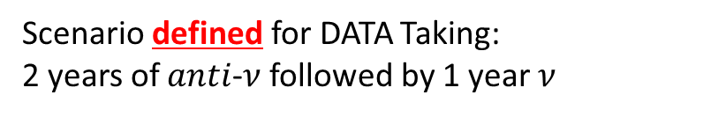
Latest beam studies at SPS
Un-oscillated ν_{e} fluxes are ~ identical
→ N/F deviations = oscillations
The oscillated signals are clustered
below 6 GeV of visible energy
IFAE 2013 E. Medinaceli- NESSiE 10

Slide 12
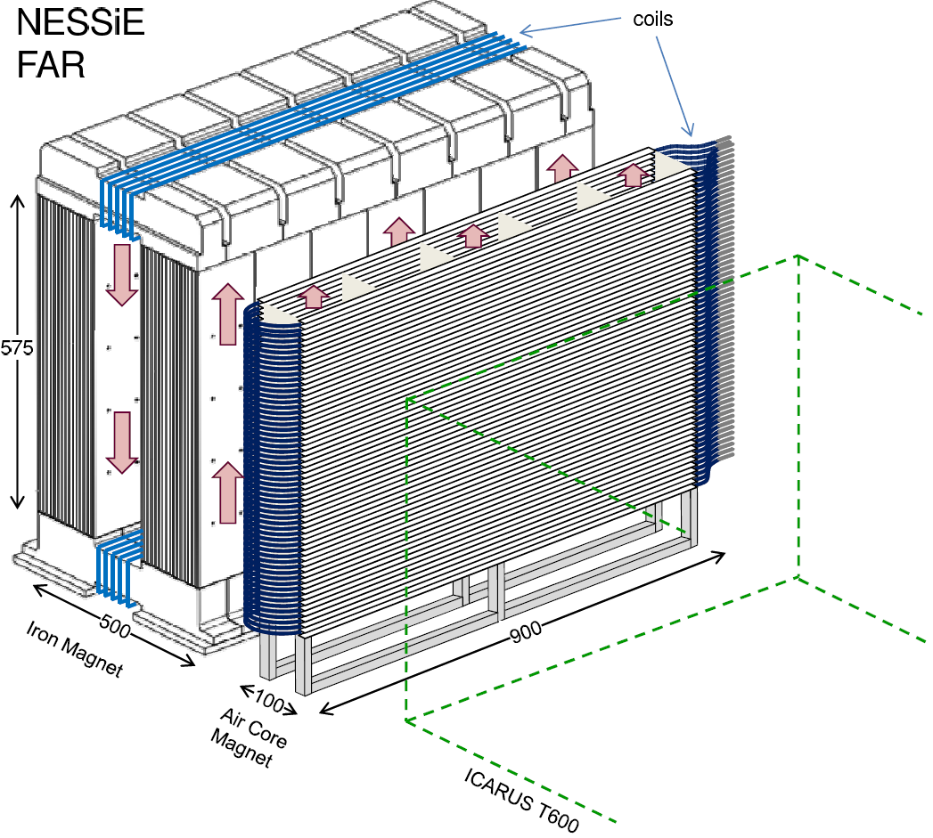
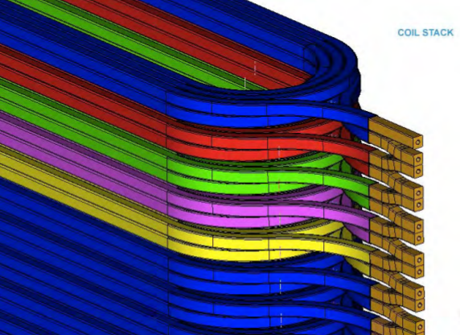
NESSiE (initial design)
ICM
IRON CORE MAGNETS
Two Iron spectrometers (ICM),
FAR 1500 t (LAr 476 t) + NEAR 800 t (LAr 119 t), instrumented with:
1800 + 700 m² of RPC
«sandwich style» assembly to be made
in situ, one piece per time
20 000 + 12 000 digital channels
AIR CORE MAGNETS
Two Air Core Magnets (ACM)
pre-assembled and installed in one shot
B = 0.17 T
Precision Trackers preassembled and installed in one shot
ACM
ν
ACM
Cross section of the Al coils
with circular water cooling
channel ( ~ LHCb)
IFAE 2013 E. Medinaceli- NESSiE 11

Slide 13
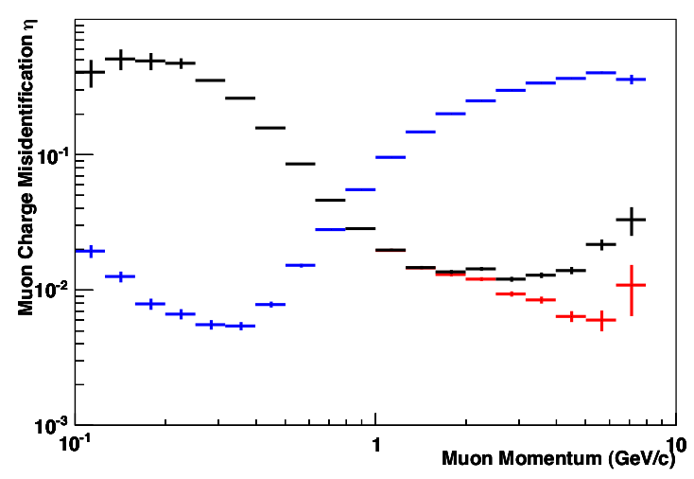
NESSiE performances
Complementary of NESSiE spectrometers in the
low (<1 GeV) and high energies domanis
ACM
Transverse profile of the global
magnetic field (iron + air)
Charge missidentification percentage
including selection, efficiency and
reconstruction proceadures
ICM
1st arm ICM
Air Core Magnet
ACM
2nd arm ICM
IFAE 2013 E. Medinaceli- NESSiE 12

Slide 14

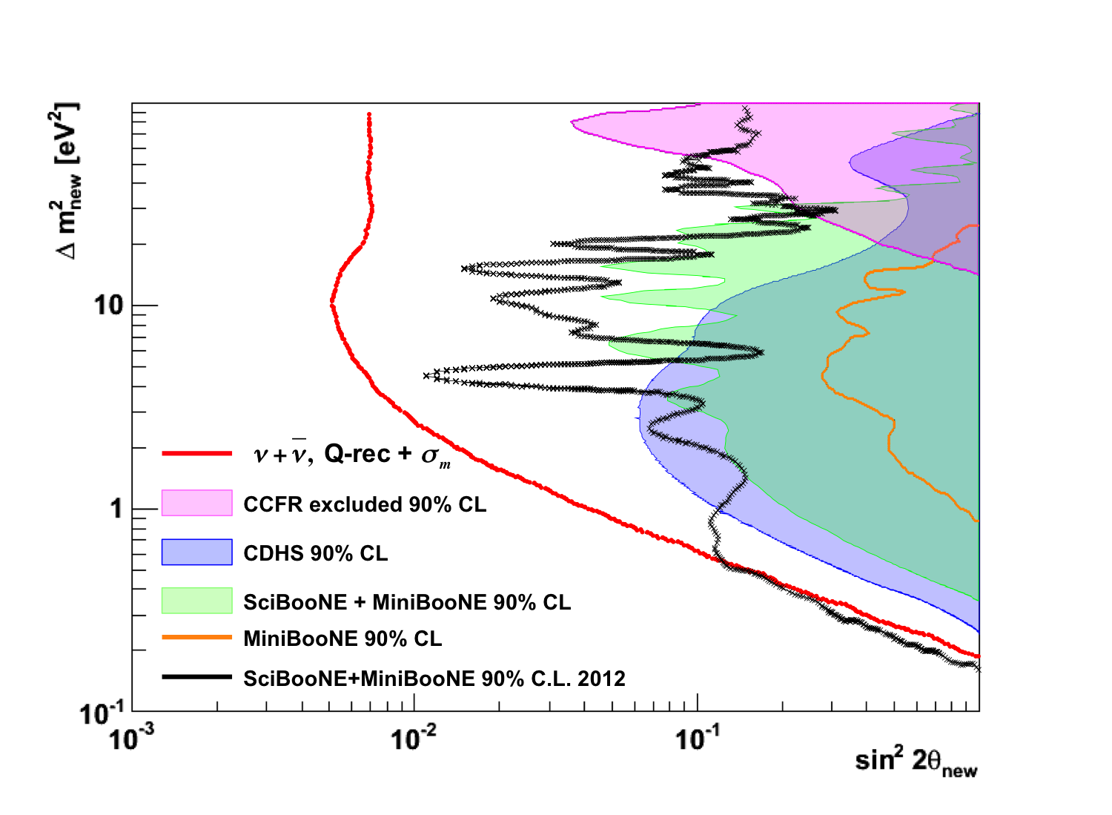
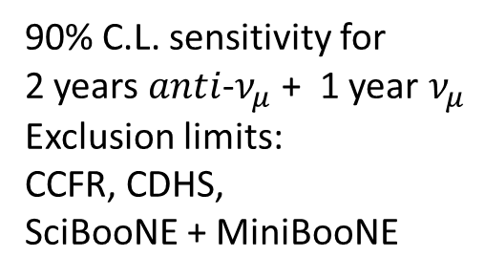
NESSiE can disentangle $ν_{μ}$ $anti$-$ν_{μ}$ (interplay of diff. oscillation scenarios)
Present proposal
(2+1 years)
90% C.L. sensitivity for
2 years $anti$-$ν_{μ}$ + 1 year $ν_{μ}$
Exclusion limits:
CCFR, CDHS,
SciBooNE + MiniBooNE
IFAE 2013 E. Medinaceli- NESSiE 13
Notes:
rate di disappearance ha una dipendenza con la distanza
Modeli sterili predicono un effetto di dissappearance molto alto di nu mu insieme a nue appearance, disappearance

Slide 15
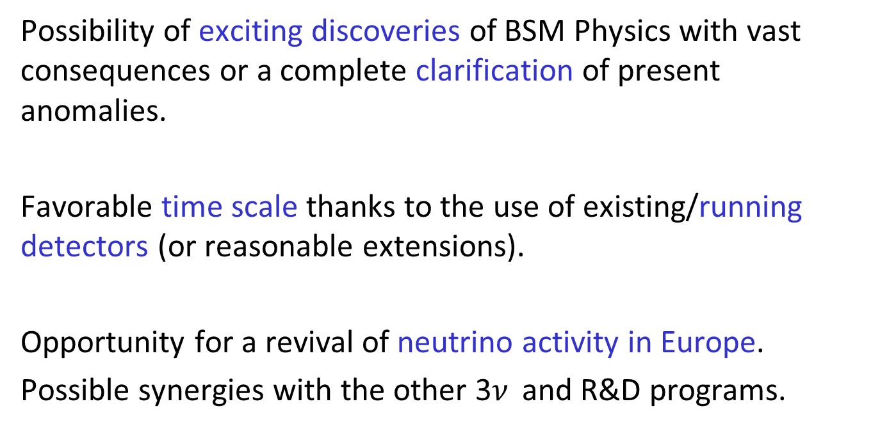

Conclusions
Large room and availability
for contributions in NESSiE
IFAE 2013 E. Medinaceli- NESSiE 14

Slide 16
Backup slides

Slide 17
Status of approval and further steps
CERN
Group established by CERN in order to realize SPS based new short-
baseline ν beam in the North Area (project leader M. Nessi)
Scientific Approval (SPSC) middle of January 2013
Feasibility document submitted to CERN Directorate on February 7th 2013
Research Board evaluation on March 4th 2013
SPC
CERN Council
INFN: Currently Major contributor to the experiments (not beam)
Scientific approval
Under evaluation by the Technical Scientific Committee (CTS)
as for costs, manpower
In-Kind contribution of Opera Spectrometers
E. Medinaceli IFAE 2013

Slide 18

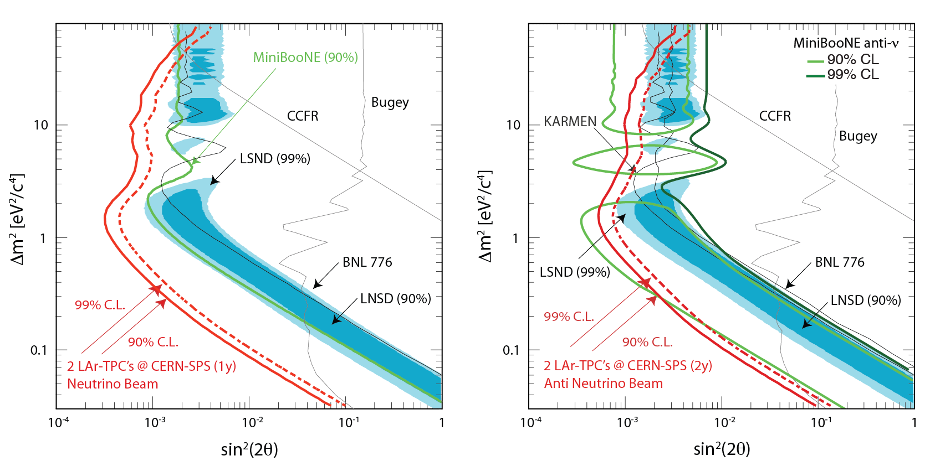
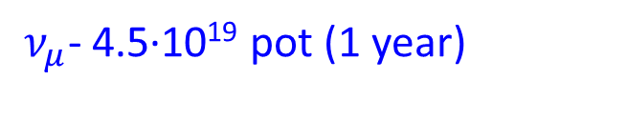
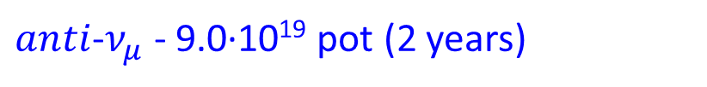
2 LAr-TPCs at CERN-SPS
LSND allowed region is fully explored in both cases

Slide 19
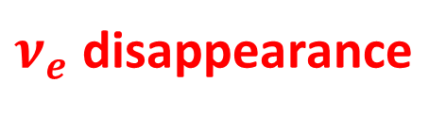
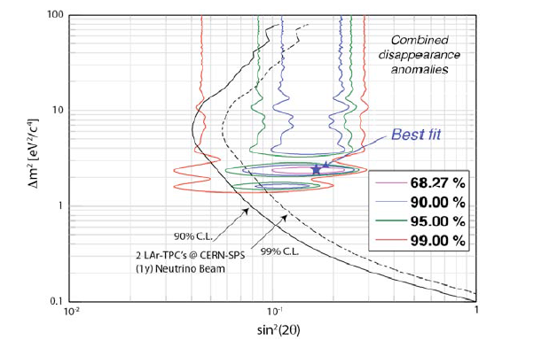
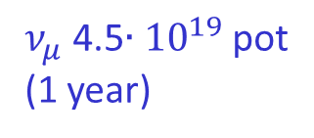
$ν_{μ}$ 4.5$∙{10}^{19}$ pot
(1 year)
2 LAr-TPCs at CERN-SPS
The reactor/Gallium anomalies can be fully addressed

Slide 20
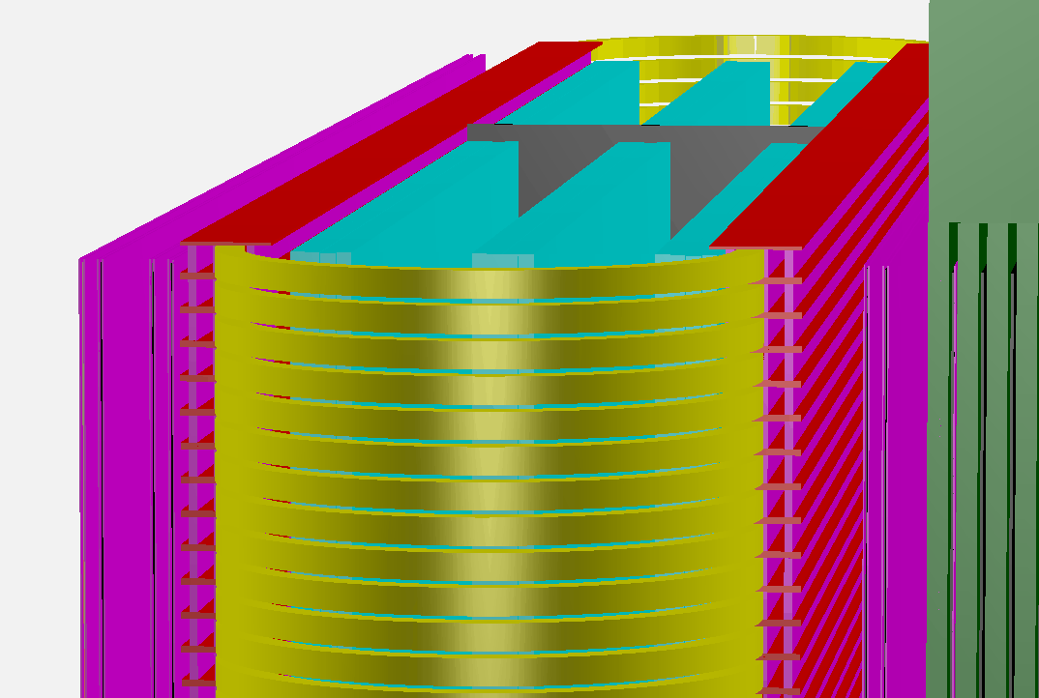
Possible Instrumentation, ACM
Precision Trackers
to be placed inside the Air Core Magnet
several open options for detector technology. Under study: triangular scintillator bars with SiPM analog R/O, drift tubes, TPC, wire chambers, analog RPC …
room for new ideas and collaborators
Average muon momentum at vertex ~ 4 GeV
e.g. 3 drift tube layers inside (example), RPCs outside
@ spectrometer entrance

Slide 21
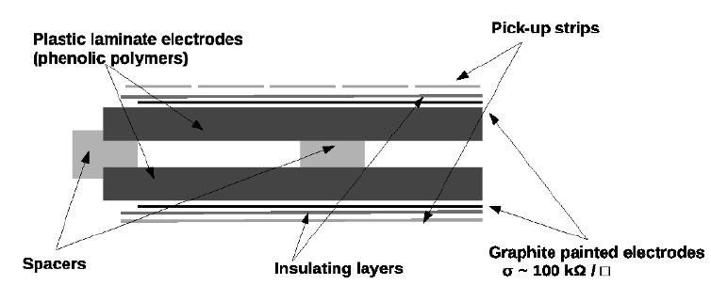
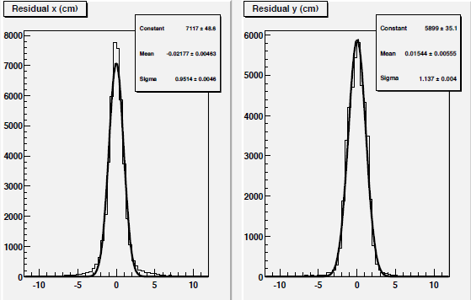
Resistive Plate Chambers RPC, ICM
RPC resolution (digital read-out)
Fe magnets: operation V = 5.8 kV (I < 100 nA/m²)
resolution position ~ 1 cm, time ~ ns
gas mixture Ar / C₂H₂F₄ / I-C₄H₁₀ / SF₆
digital read-out
NEAR: exposed surface ~ 20 m²
240 internal chambers
40 layers (2 columns x 3 rows)
FAR: exposed surface ~ 50 m²
600 internal chambers
40 layers (3 columns x 5 rows)
[cm]
[cm]

Slide 22
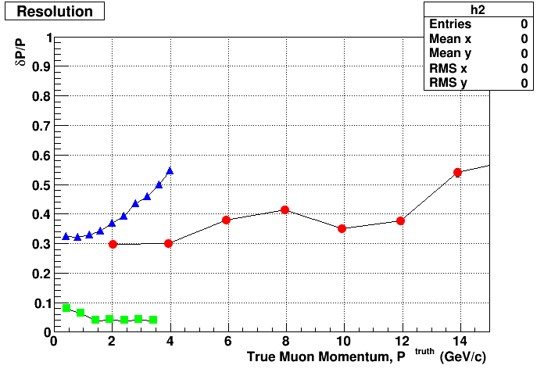
Momentum measurement at 4% with dE/dx up to 3.5 GeV
At 30% with Prec.Tracker above 3 GeV
At 30% with ACM below 1.5 GeV
dE/dx range
ACM
ICM
Latest configuration (OPERA-2), algorithms not optimized …

Slide 23
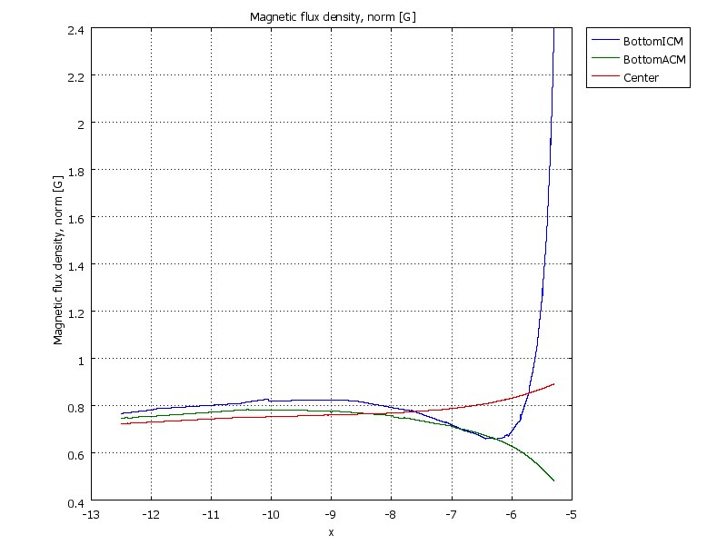
… and the fringe field is under control
G
(latest optimization)
2 iron slabs 5 cm thick
+ 1 cm of Vacoflux-50
1 Gauss
… and the Power Supplies
(almost) as well:
230 kW (Near)
450 kW (Far)
0.4
Fringe Fields
LAr
ACM (x=-3.5)
23

Slide 24
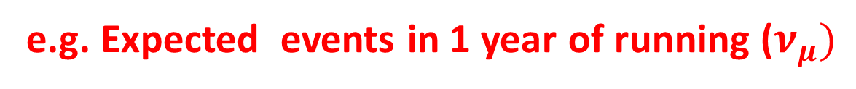
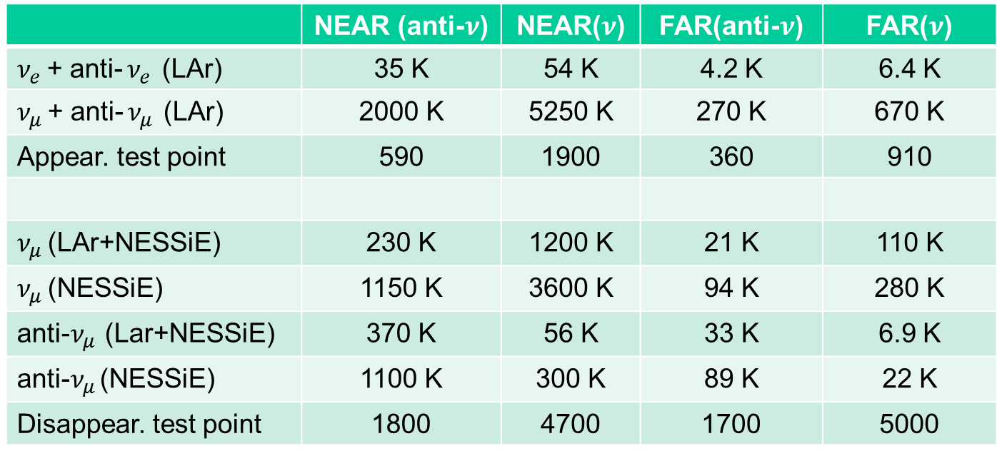
To reconstruct: 5.3 M muons in LAr (Near), 0.67 M muons in Lar (Far)
pos. foc. 5.2 M muons in Nessie (Near), 0.42 M in Nessie (Far)
(with factor 2 in overhead of triggers, positive focussing)
 | 35 K | 54 K | 4.2 K | 6.4 K
 | 2000 K | 5250 K | 270 K | 670 K
Appear. test point | 590 | 1900 | 360 | 910
 | 230 K | 1200 K | 21 K | 110 K
 | 1150 K | 3600 K | 94 K | 280 K
 | 370 K | 56 K | 33 K | 6.9 K
 | 1100 K | 300 K | 89 K | 22 K
Disappear. test point | 1800 | 4700 | 1700 | 5000
produced
“NESSiE” = fiducial volume of 241 t (N) and 661 t (F)
detected
Values for Δm² (sterile model) around 2 eV² are reported as example
E. Medinaceli IFAE 2013 15

Slide 25
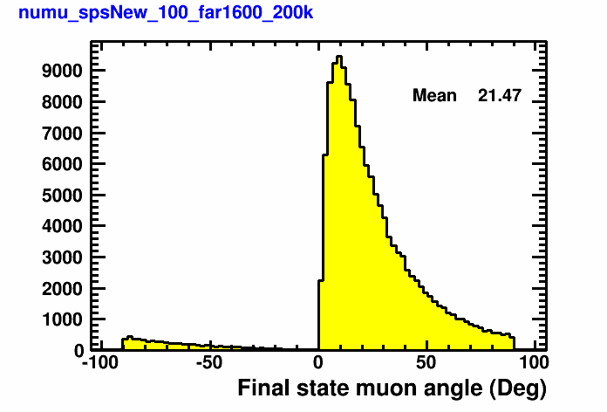
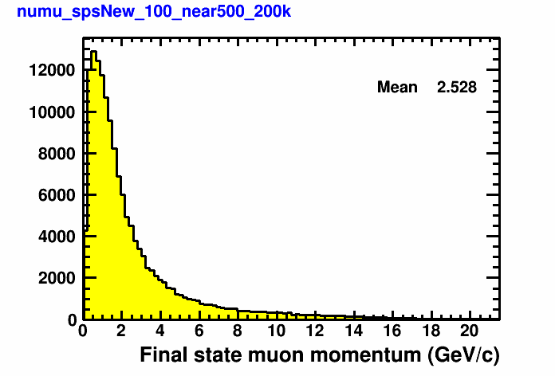
Muons’ distributions
Muon momentum
Muon angle

Slide 26
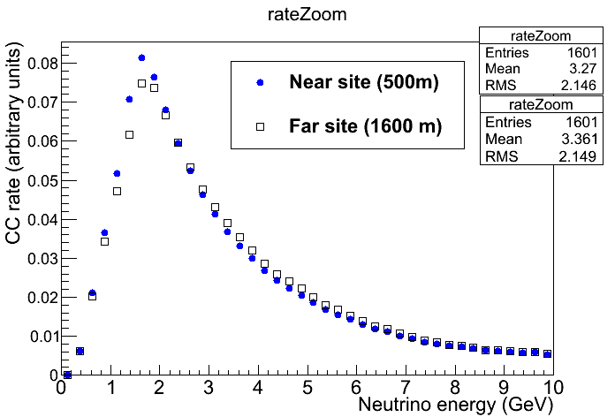
Latest Beam Studies at SPS
100 GeV proton, Fast Extraction (10.5 μs), Luminosity as at CNGS
On-axis configuration
Event rates 4.5 10¹⁹ pot (≈1 year)
CC muons
Unoscillated ν_{e} fluxes are ~ identical → N/F deviations = oscillations
The oscillated signals are clustered below 6 GeV of visible energy
Scenario defined for DATA Taking: 2 years of anti-ν followed by 1 year ν
26

Slide 27
Opera re-use
2 Spectrometers “available”, with Detectors and Servicing
Possibility to full re-use for Far and Near ICM
Need two new sets of Yokes (Top & Bottom)
new Electronics for RPC
Mechanical Tools
PT detectors
Scintillators
Other: ACMs
T0 availability for dismantling
and transportation at CERN: Autumn 2014
OPERA discussion:
possible start dismantling July-December 2014

Slide 28
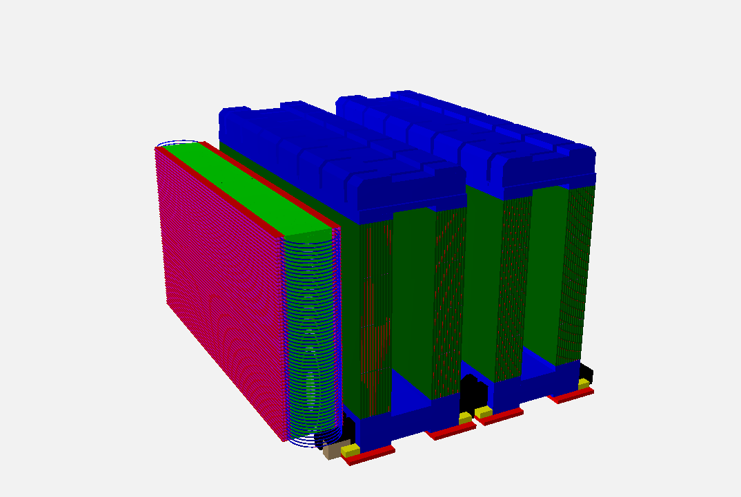
Arrangement with OPERA Spectrs.
ν_{μ}
Far site

Slide 29
CERN Schedule
29

Slide 30
Nessie Schedule
2013: ACM prototype construction,
iron SM, ACM, HPT and ancillaries design
2013 - end: start tenders process
2014 - early: issue tenders for production/modification
(copper. yokes, slabs, rpc, strips, tools/frames)
2014: parts and tools production/modification
2014 – end: first deliveries at Cern
(copper coils, yokes, slabs, strips, tools/frames, RPC)
2015 - early: start assembly
2016 - mid: finish assembly
2016 – fall: commissioning and start of data taking
3
6
0
30

Slide 31
MONEY estimation
Iron magnets: in-kind value 5940 K€ (from OPERA )
Cost for transportation to CERN and refurbishing: 3000 K€
In-kind value of Precision Tracker: 1900 K€
possible refurbishing: 700 K€
In-kind value of Scintillators: 1900 K€
possible refurbishing: 300 K€
Cost ACM: 700 (Near) + 1800 (Far)
TOTAL: 3+1+1+2 = 7 M€
might be staged at 2nd phase (after LS2)

Slide 32
Spare slides

Slide 33

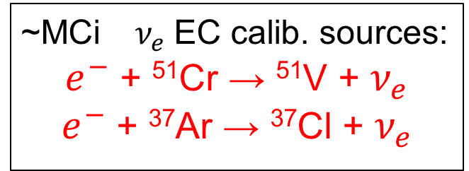

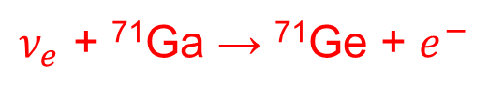
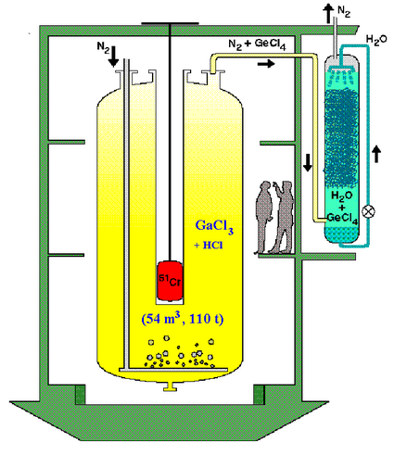
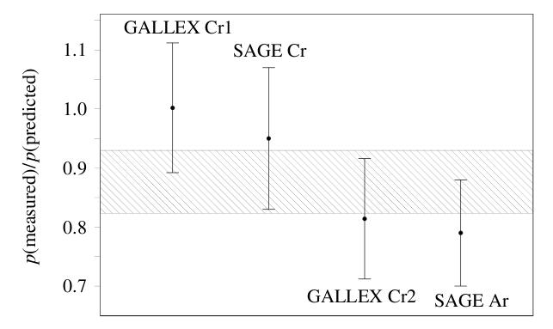

Acero, Giunti, Laveder, 0711.4222
Giunti, Laveder, 1006.3244
Radiochemical detection
E ~ 0.7 MeV
<L_{SAGE}> = 0.6 m
<L_{GALLEX}> = 1.9 m
5-20% deficit in the $ν_{e}$
R= 0.86 ± 0.05 (2.8σ)
SAGE, PRC 73 (2006) 045805, nucl-ex/0512041]

Slide 34
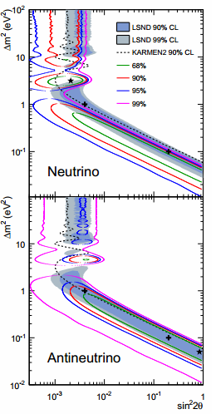
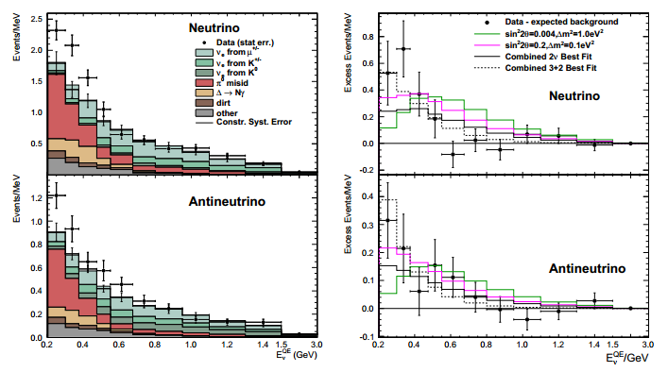


MiniBooNE: SBL ν_{e}/anti-ν_{e} appearance
arXiv:1207.4809v2
LSND L/E with higher L, E
L ~ 541 m, 0.2 < E < 3 GeV
n and anti- n data looks more similar than in the past. The (low-energy) excess (240±35±53 events, 3.8 σ!)
is hardly (especially for n) compatible with the LSND excess (which should occur at higher E).

Slide 35
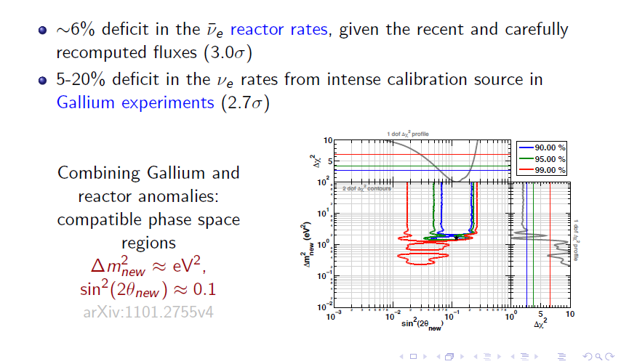
Galium and Reactors anomalies

Slide 36
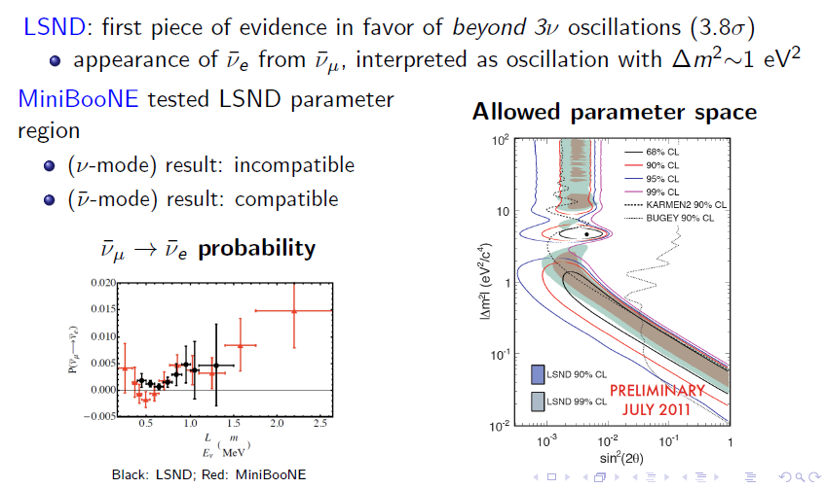

Slide 37


Which type of beam can CERN offer?
Neutrino beam (fast extraction)
North Area beam (slow extraction)
Fast extraction
Beam excitation via injection kicker in LSS1 + extraction in LSS2 via existing septa (incompatibility with simultaneous north area slow extracted beam !)
Solution tested for low intensities during recent beam tests
Magnetic septa (MST+MSE)
Inj. kicker (MKP)
50 ms
The beam time structure similar to CNGS :
2nd Injection
from PS
100 GeV
1st Injection
from PS
10.5 μs
2100 bunches
2nd Extraction
1st Extraction
14 GeV
1.2 s
3.5 10¹³ p/Cycle
Cycle / Pulse 3.6 sec. (every 6 seconds)
→ 4.5x10¹⁹ pot/yr

Slide 38

Neutrino Interactions in the Liquid Argon
(accepatances)
NEAR site
Icarus-LAr only
lost
LAr+NESSiE
NESSiE only

Slide 39

muon stopping in the iron spectrometer
FAR site

Slide 40

Near Nessie movable aside on air-pad
1 + 0.5 MW , 10 kA, power
(summed up for ACM and ICM)

Slide 41


POSITIVE FOCUSSING
μ- from neutrinos
μ+ from anti-neutrinos
up to 30% ν_{μ} in anti-ν_{μ} beam
(negative focussing)

