Slide 1
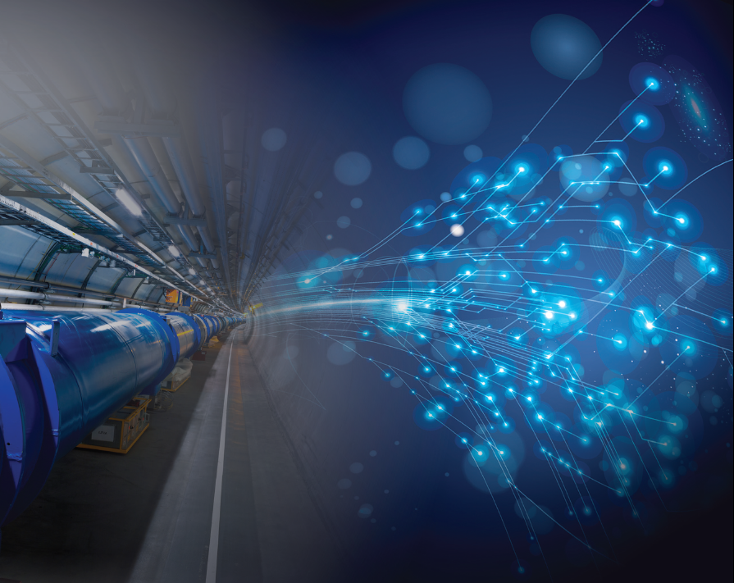
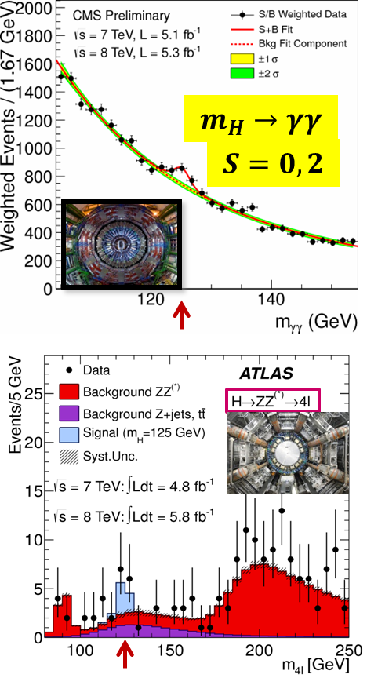
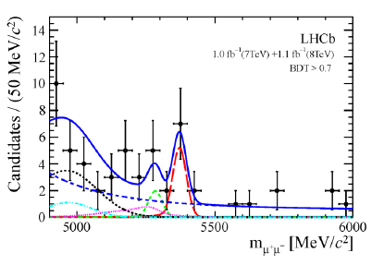
Update of the European Strategy for Particle Physics
Roy Aleksan
HF-Frascati
Feb. 14, 2013
The Frontiers of PP; what to do next?
Next Accelerator Technology Challenges for PP
Strategy
Conclusion
m_{H} ~ 125.5 GeV
Precision measurements
and
reaching higher energy
No direct sign of New Physics in range ~200 – 3000 GeVdepending on type of NP
B_{s}’μμ =(3.2 ±1.5)10⁻⁹
Θ₁₃ ~ 9°

Slide 2
Update of the European Strategy for Particle Physics
Roy Aleksan
HF-Frascati
Feb. 14, 2013
Habemus
Strategiam!
17 recommendations have been issued: https://indico.cern.ch/getFile.py/access?resId=0&materialId=0&confId=217656
They have still to be endorsed by the CERN Council (March 20).

Slide 3
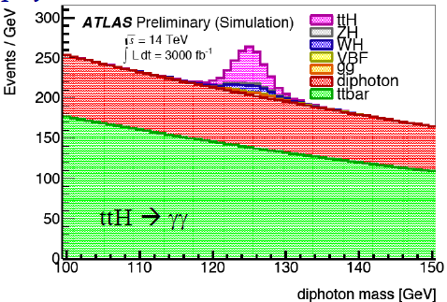
ElectroWeak Symmetry Breaking precision measurements
LHC is the benchmark Higgs Factory
Accelerator →Physical quantity ↓ | LHC 300fb⁻¹ /exp | HL-LHC 3000fb⁻¹ /exp
Approx. date | 2021 | 2030-35?
N_{H} | 1.7 x 10⁷ | 1.7 x 10⁸
Δm_{H} (MeV) | 100 | 50
ΔΓ_{H/}Γ_{H} | -- | --
ΔΓ_{inv/}Γ_{H} | Indirect (? ) | Indirect (?)
Δg_{Hγγ}/g_{Hγγ} | 6.5 – 5.1% | 5.4 – 1.5%
Δg_{Hgg}/g_{Hgg} | 11 – 5.7% | 7.5 – 2.7%
Δg_{Hww}/g_{Hww} | 5.7 – 2.7% | 4.5 – 1.0%
Δg_{HZZ}/g_{HZZ} | 5.7 – 2.7% | 4.5 – 1.0%
Δg_{HHH}/g_{HHH} | -- | < 30% (2 exp.)
Δg_{Hμμ}/g_{Hμμ} | <30% | <10%
Δg_{Hττ}/g_{Hττ} | 8.5 – 5.1% | 5.4 – 2.0%
Δg_{Hcc}/g_{Hcc} | -- | --
Δg_{Hbb}/g_{Hbb} | 15 – 6.9% | 11 – 2.7%
Δg_{Htt}/g_{Htt} | 14 – 8.7% | 8.0 – 3.9%
Δm_{t} (MeV) | 800-1000 | 500-800
Δm_{W} (MeV) |  | ~10
Coupling measurements with precisions:
in the range 6-15% with 300 fb⁻¹
in the range 1-4% with 3000 fb^{-1b}
Includes direct ttH observation

Slide 4
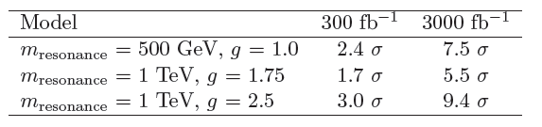
Search of new particles
Sensitivity on SUSY can be signicantly improved … in particular for stop
High energy and luminosity are necessary to probe the V_{L}V_{L} scattering
and verify that unitarity is preserved, thanks to the « Higgs » discovered
A statistical presicion of 15% on the SM VBS contribution (i.e. VV+ 2 forward jets) can be obtained with HL-LHC

Slide 5
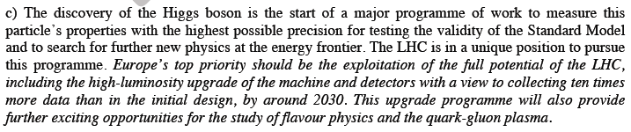
Recommendations from European Strategy Group
High-priority large-scale scientific activities
Recommendation #1

Slide 6
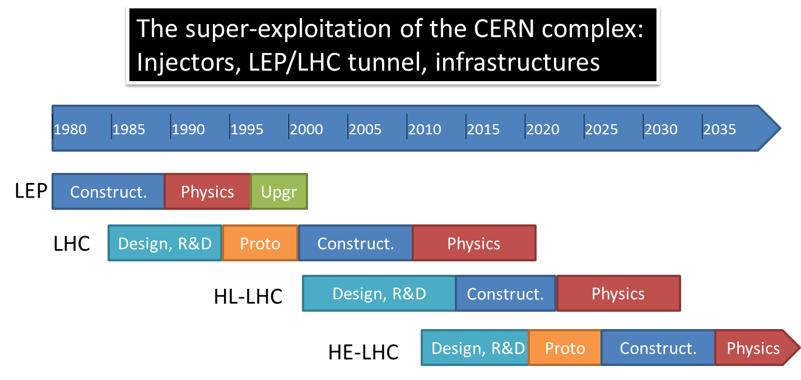
Strong R&D on these issues is necessary
Very substantial programme a collaborative R&D needed
All this work is a first step toward higher energy
Increase beam current a protect SC dipole (diffracted protons)
8T-15m a 11T-11m dipoles
Reduce beam size at IP a Larger aperture quads near IP
Change Quadrupole Triplets a 140T/m, 150mm (13T, 8m)
Protect Electrical Distribution Feedbox’s (DFBX)
a 2×100 kA ~500m HTS links
Improve and adjust the luminosity with beam overlap control
a SC RF «Crab» Cavity, for p-beam rotation at fs level!

Slide 7
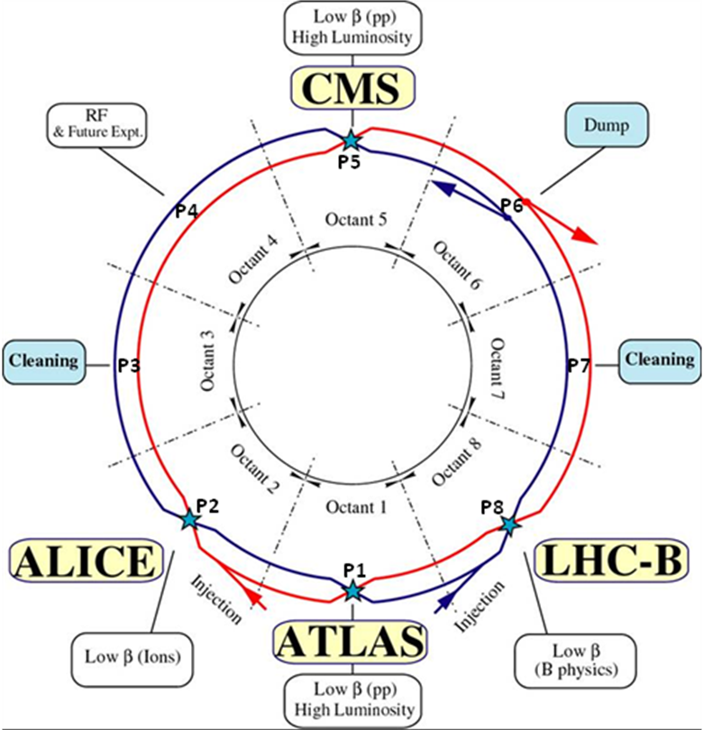
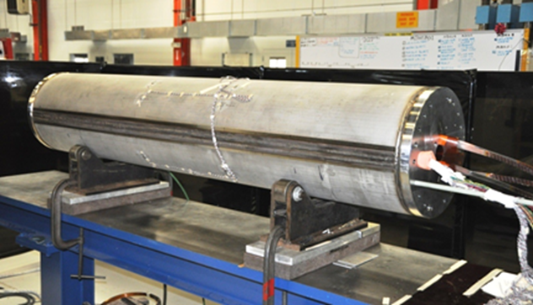
Upgrading LHC luminosity early 2020’s
Increase beam current a protect SC dipole (diffracted protons)
Reduce beam size at IP a Stronger focussing quads near IP
8T-15m a 11T-11m dipoles
5.5 m Nb₃Sn
3.5 m Collim
5.5 m Nb₃Sn
Fermilab/CERN Collaboration
Demo single bore 11T , 2m
Test: very good to 10.4 T
Next model by beginning of 2013
Change Quadrupole Triplets
200T/m, 70mm (~8T, <6m>)
a 140T/m, 150mm (13T, 8m)

Slide 8
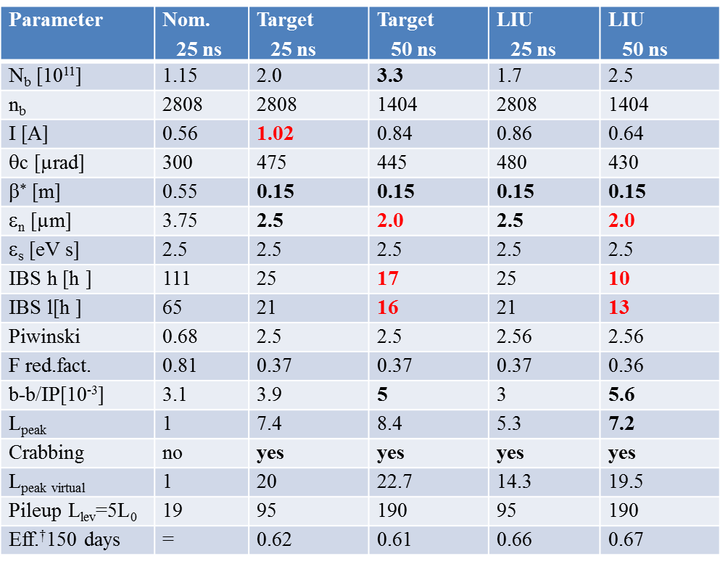
Target parameters for
HL-LHC run
Efficiency is defined as the ratio between the annual luminosity target of 250 fb⁻¹ over the potential luminosity that can be reached with an ideal cycle run time with no stop for 150 days: t_{run}= t_{lev}+t_{dec}+t_{turn}. The turnaround time after a beam dump is taken as 5 hours, t_{decay} is 3 h while t_{lev} depends on the total beam current
baseline

Slide 9

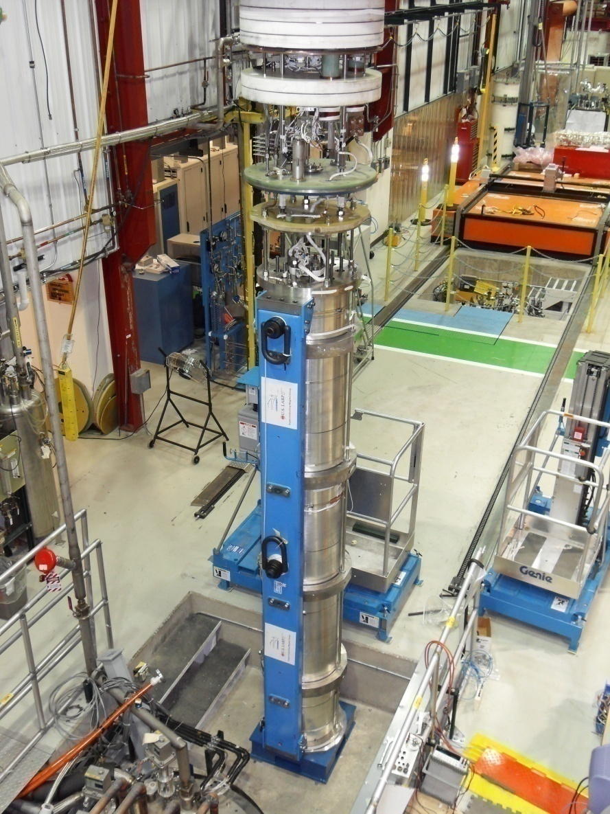
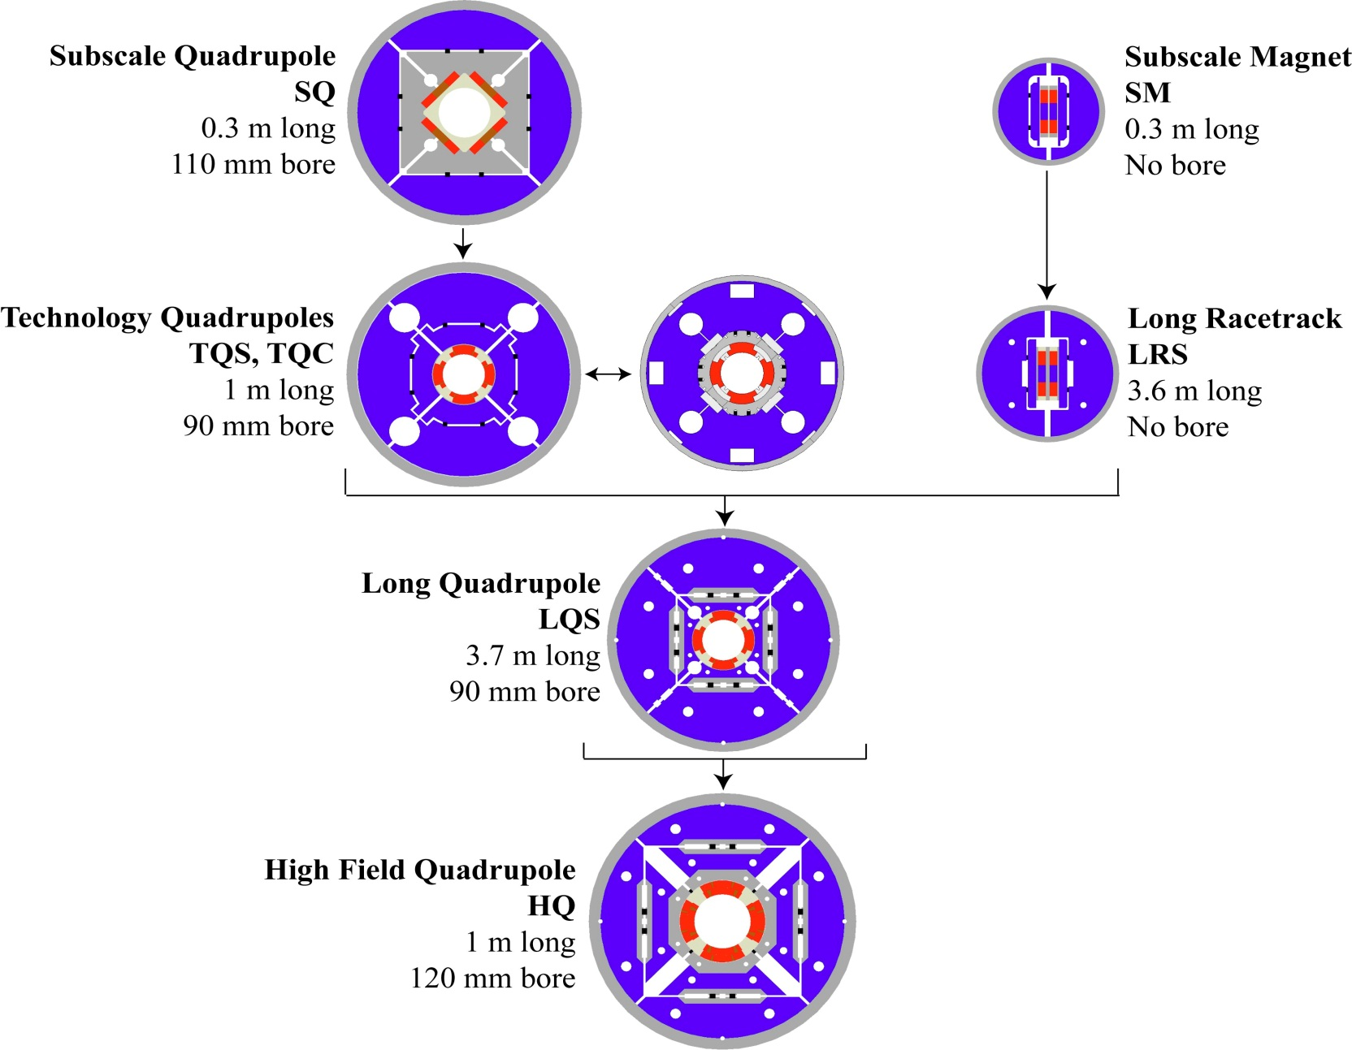
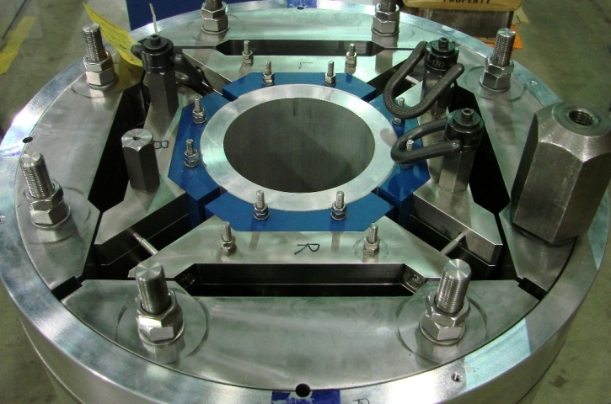
LQS-4m
LARP (US LHC program) Magnets
Test:~220T/m
~11T
G.L. Sabbi , LBNL
HQ
Test:~200T/m
13T

Slide 10
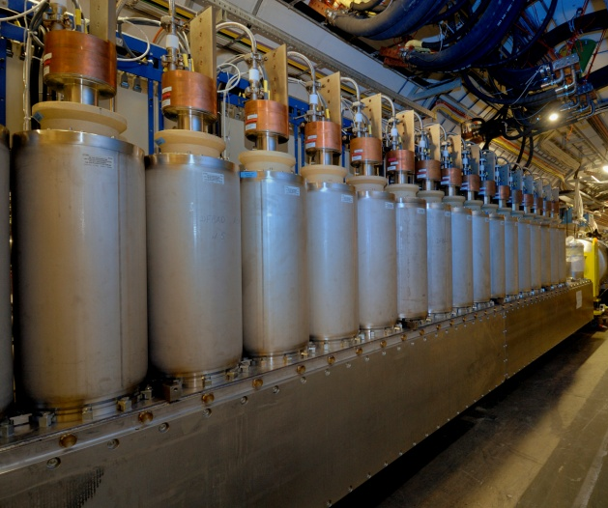
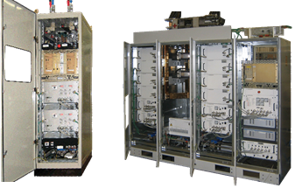
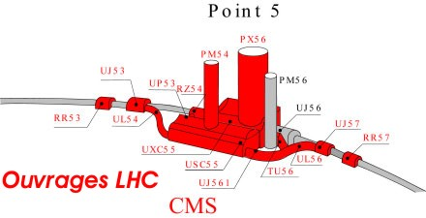
HTS links
Protection of Electrical Distribution Feedbox’s (DFBX)
In the tunnel, feed power from room temperature power converters to
the « cold world » of LHC. Actual LHC use short Nb-Ti links.
4.5 K
1.9 K
D1
DFBX
Q3,Q2,Q1
IP5
∼3 m
Need to be protected against radiation and provide easier access
Move DFBX on surface
To be decided
2×100 kA
~500m HTS links
Note: LHC uses 1400 Bi-2223
current leads

Slide 11
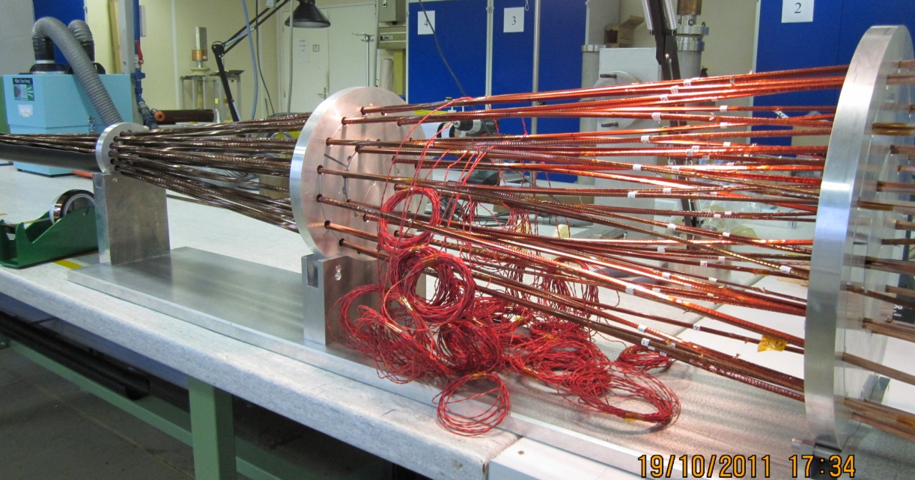
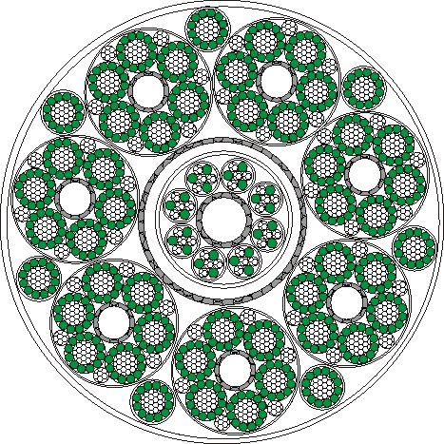
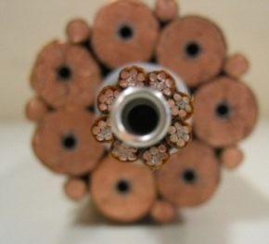
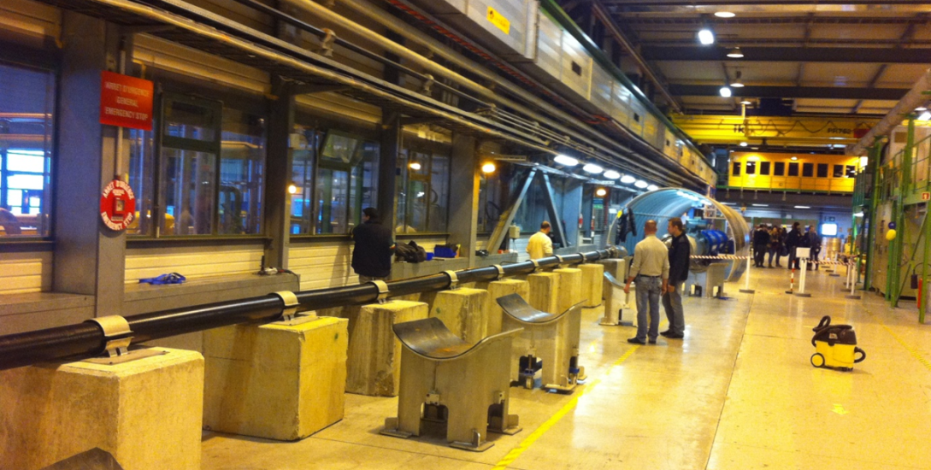
On going HTS link test at CERN
2m long MgB₂ cables tested
at 2x4500A
HTS cabling
Possible cable configuration for high current :
7 × 14 kA, 7 × 3 kA and 8 × 0.6 kA cables
Itot∼120 kA @ 30 K
Φ = 62 mm
Nexan Cryoflex® line (20 m long semi-flexible cryostat of link) procured and installed in the CERN SM-18 laboratory
20 kA – 4 to 80 K test
MgB₂, YBCO… tests
starting end 2012
A. Ballarino, CERN

Slide 12
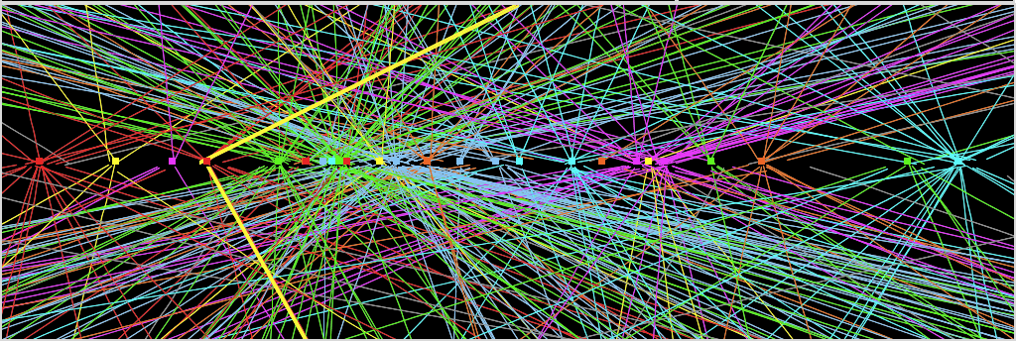
« Crab » Crossing
Improving further the luminosity by better overlap of the 2 beams
SC RF «Crab» Cavity, for p-beam rotation at fs level!
Technology pioneered successfully
on KEKB, Japan
Effort at SLAC-ODO and in BNL, USA
Effort in Daresbury (Cockcroft Institute and STCF) with CERN.
Also help to adjust the luminosity to ease
experiments’ life (Luminosity levelling)
Z→ μμ event from 2012 data with 25 reconstructed vertices

Slide 13
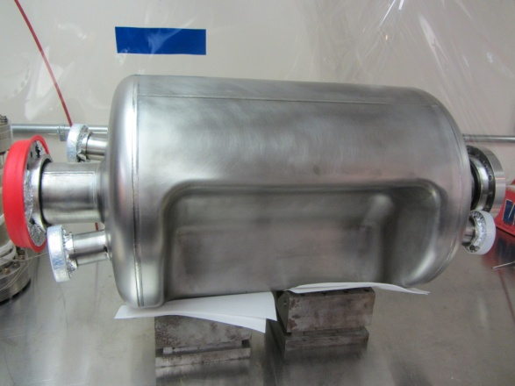
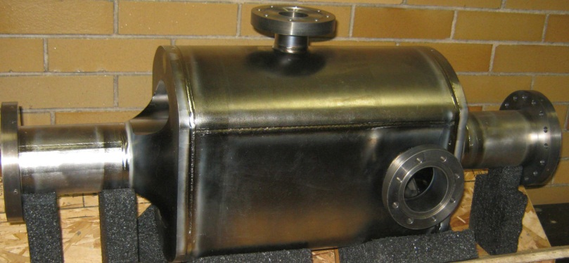
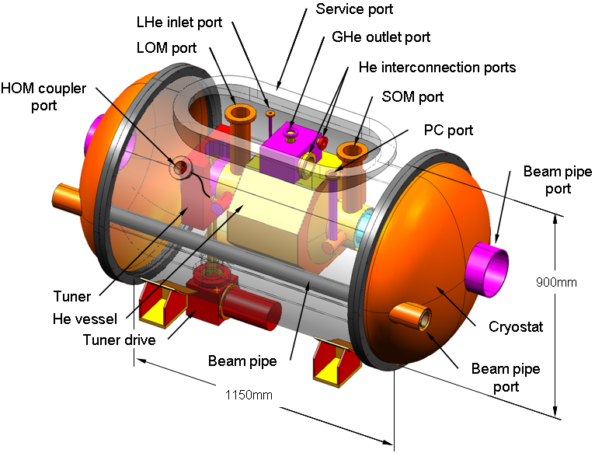
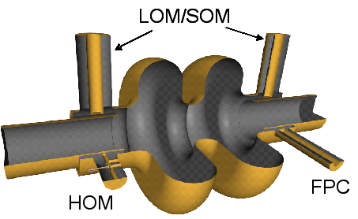
Progress in SC « Crab » Cavities
UK - Cockcroft
USA (ODU)
Several types
of prototypes
being designed
and made…
… as well as cryomodule
L. Xiao et al.
~250 mm outer radius
Y. Yakovlev et al.

Slide 14

Recommendations from European Strategy Group (cont’d)
High-priority large-scale scientific activities
Recommendation #2

Slide 15
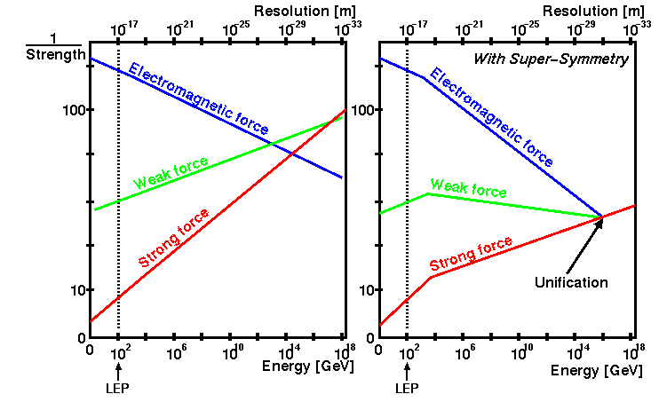



Grand unification of Interactions (Strong, Weak, Electromagnetic)
Additionnal particles (such as supersymmetric partners) with energy scales of TeVs affect the running of the coupling constants
$$\frac{1}{α_{1}}$$
$$\frac{1}{α_{2}}$$
$$\frac{1}{α_{3}}$$
Need to explore higher energy regions (up to ~10 TeV)

Slide 16
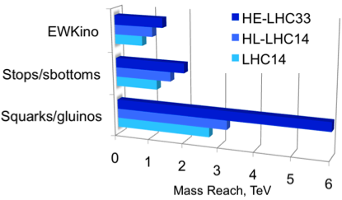
Whatever is found or not, reaching higher energies is unavoidable
To explore the up to 10 TeV region very high energy (>50) is necessary
It will also allow more precise SM measurements

Slide 17
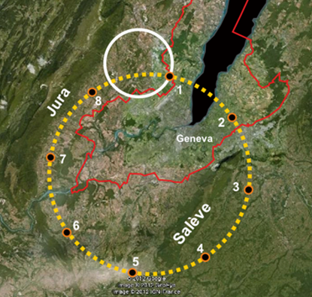
The detailed study of such a machine is needed, including the complete injection chain
Strong R&D on these new very high field magnet is necessary
a collaborative R&D needed
Either using existing
LEP/LHC tunnel to reach 26-32 TeV collisions
Or build (or reuse) a 80km tunnel to reach 80-100 TeV collisions
a more detailed study of such a tunnel needed
In both cases, SC challenge to develop 16-20 Tesla magnets!
Magnets for HL_LHC is an indispensible first step

Slide 18
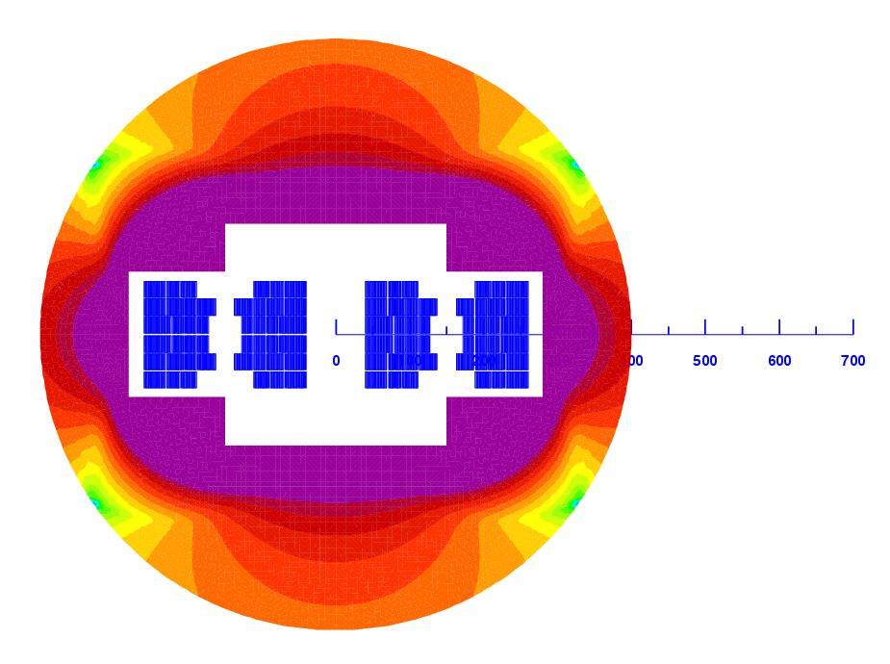
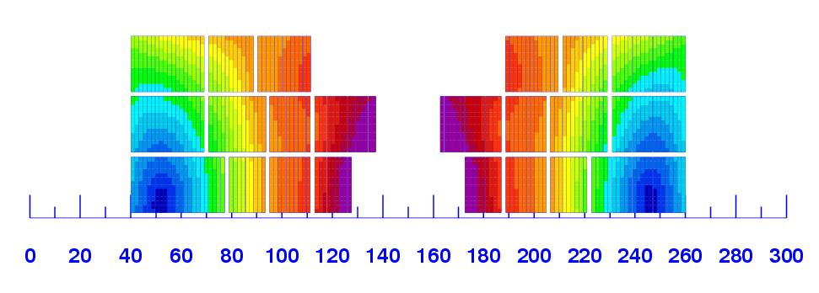
First consistent conceptual design
Using multiple SC material
L. Rossi
20 T field!
Magnet design: 40 mm bore (depends on injection energy: > 1 Tev)
Approximately 2.5 times more SC than LHC: 3000 tonnes! (~4000 long magnets)
Multiple powering in the same magnet for FQ (and more sectioning for energy)
Only a first attempt: cosϑ and other shapes needs to be also investigated

Slide 19
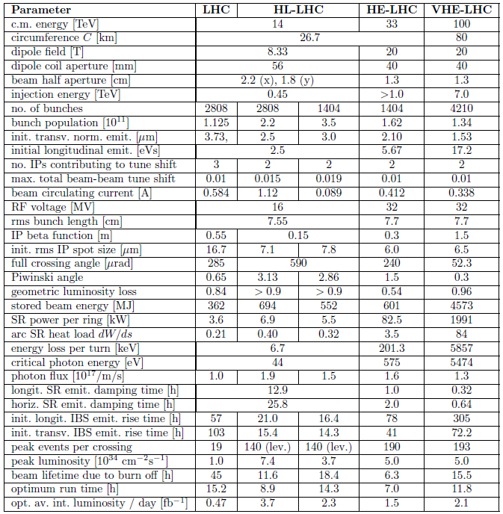

Slide 20
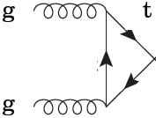
ElectroWeak Symmetry Breaking precision measurements
Is Higgs self-coupling (λ) as expected?
H
H
H
H
LHC
H
H
∝ λ^{1/2}M_{H}
H
∝ λ
H
Lepton collider
(<TeV)
H
H
One of the most difficult measurement both at LHC and LC
  Xsections very low
Lumi | 3000 fb-1 |  |  |  | 2000 fb-1
Energy | LHC 14 TeV |  | LHC 33 TeV |  | LC 600 GeV |  | LC 1000 GeV
Mode | σ (fb) | # ev | σ (fb) | # ev | σ (fb) | # ev | σ (fb) | # ev
HHZ | 34 | 102 000 | 206 | 618 000 | 0.16 | 320 | 0.12 | 240
HHνν | - |  | - |  | 0.02 | 40 | 0.10 | 200
Total | 34 | 102 000 | 206 | 618 000 | 0.18 | 360 | 0.23 | 440
Δg_{HHH}/g_{HHH} | ~30% |  | ~10% |  | 15-20% |  | 15-20%
Much higher luminosity and/or energy would be needed

Slide 21
e⁺e⁻ colliders «clean HIGGS FACTORIES»
e⁺ e⁻
Linear
Colliders
CLIC
Circular Colliders
CERN
Super
TRISTAN
ILC
250 GeV + Klystron based
500 GeV
250 GeV– 40, 60 km tunnel
400
500
250 GeV
500 GeV
LEP3 at LHC tunnel
> 500 GeV
DLEP – New tunnel, 53 km
TLEP – New tunnel, 80 km

Slide 22
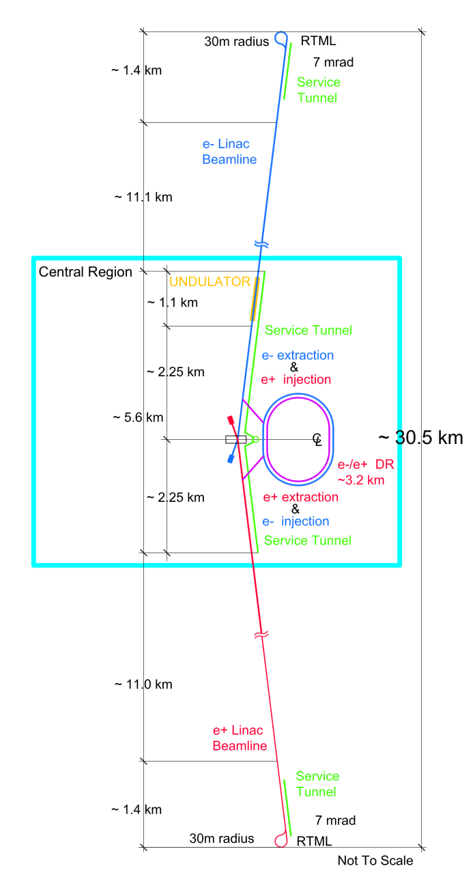
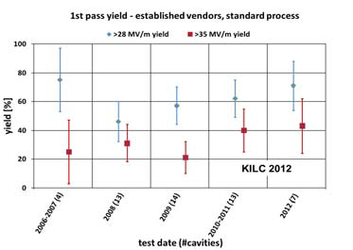
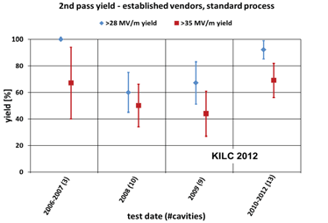
ILC
Gradient Range Yield Gain
~30km
500GeV
Energy CM (GeV) | 250 | 500
Luminosity (x10³⁴cm⁻²s⁻¹) | 0.75 | 1.8
Beam size (σ_{x}/σ_{y} nm) | 730/8 | 470/6
Pulse duration (ms) | 0.75 | 0.75
Beam power (MW) | 5.2 | 10,5
Total AC power (MW) | 128 | 162
Cavity Gradient (MV/m) | 31.5
#9-Cell cavities | ~16000
#Cryomodules (2K) | ~1800
#RF units (10MW Kly) | ~560

Slide 23
Some further ILC challenges
Achieving and maintaining nano beam size (σ_{y} =6-8nm) with 2x10¹⁰ e/bunch
ATF2 operating since 2009 at KEK objective: 37nm @1.28 GeV
February 2012 σ_{y}=166±7 nm
Dec. 2012 σ_{y}=72±5 nm with low b-intensity (2x10⁹ e/bunch)
Realization of very low emittance damping rings with ultra fast kickers for extraction
Strong R&D on these issues is on-going
Carried out by international collaborative
Proposal from the Japanese physics community
TIARA collaboration with SLS @PSI (<1pm @2.86 GeV)
Achieving the required positron rate
photons from 150 GeV beam through 150m of small-aperture SC undulator
or 125 GeV beam through 250 m of SC undulators
Industrialization of technology at very high scale
XFEL =5% of ILC

Slide 24
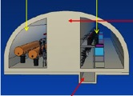

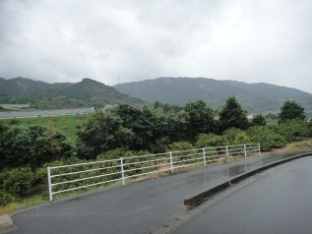
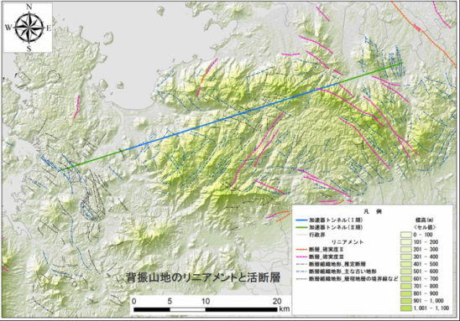
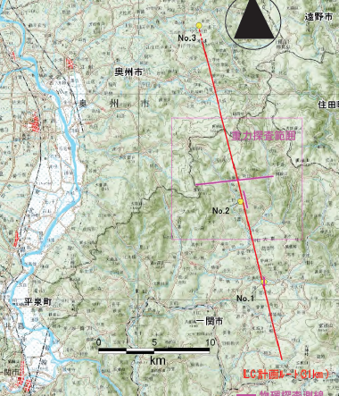
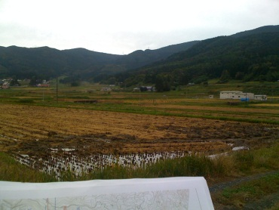
Two Candidate Sites in
Japanese mountainous locations
5 m
SEFURI
Japanese HEP community proposes to host ILC based on the “staging scenario” to the Japanese Government.

Slide 25
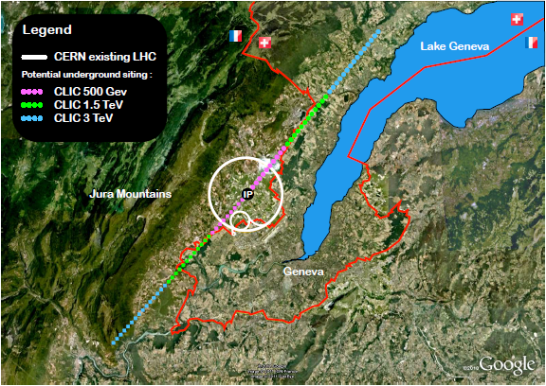
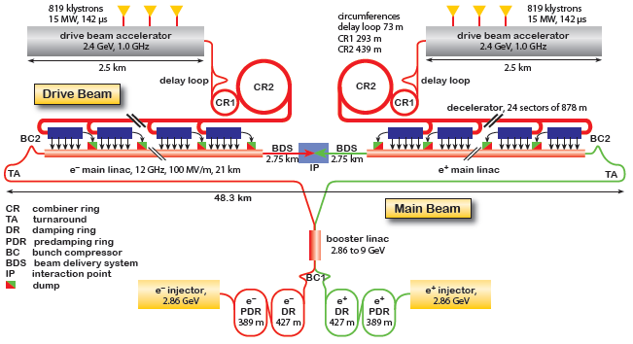
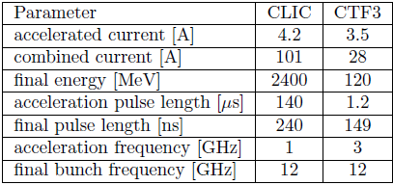
CLIC
International collaboration around CFT3 @CERN
Achieving very high gradiant (100Mv/m) with low enough breakdown rate (<10 ⁻⁶ )
Demonstrated with a few cavities

Slide 26
Some further CLIC challenges
Same type of difficulties as for ILC though more severe, e.g.
  smaller beam size (~1nm)
  Shorter bunch length (150ns)
  Normalized y emittance ~20nm and its preservation
    Ultra precise alignment and magnet stabilization
Strong R&D on these issues is on-going
Developed by international collaborative
Some difficulties are specific to CLIC, e.g.
  Production of RF power
  Stable deceleration of drive beam
  And main beam acceleration
Although a lot of progress have been achieved, still a lot of R&D needed to deliver a TDR

Slide 27
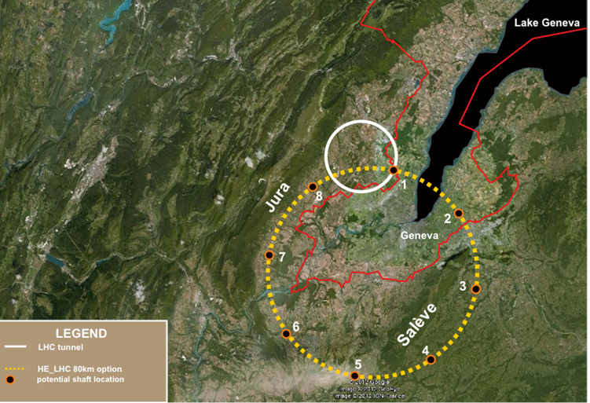
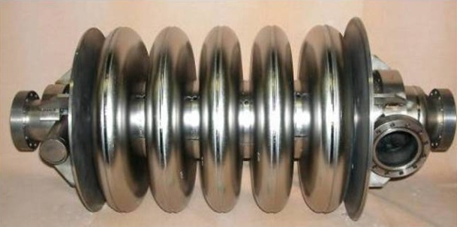
TLEP Ring e⁺e⁻ collider: Primary Cost Driver Tunnel: ~60% cost
Building on existing technologies and experience (LEP, KEKB, PEPII…)
LEP/LHC
80 km tunnel
Using SC cavities
Energy CM (GeV) | 90 | 240 | 350
Luminosity (x10³⁴cm⁻²s⁻¹) | 100 | ~5 | ~0.7
Cavity Gradient (MV/m) | 20 | 20 | 20
#5-cell SC cavities | 100 | 300 | 600
Beam lifetime (mn) | 37 | 16 | 27
Total AC power (MW) | 250 | 250 | 250
Could cover a wide range of energy up to 350 Gev collision energy.
Most parameters have been achieved or are planned at SuperKEKB

Slide 28
An important parameter is the power per unit of luminosity
*Luminosity not corrected
for peak1% factor

Slide 29
Although based on strong experience in building circular collider, several challenges have to be overcome:
Beamstrahlung:
a Beam lifetime reduction (should not be much smaller than bhabha limits
a Need to study the energy acceptance of the collider (2%)
Idea is rather new triggered by low Higgs mass but based on long and mature experience in circular colliders
Promising possibility but need to set up a international study
Bremstrahlung:
a Need to study heat extraction and radiation damage and shielding issues
Top up ring:
a Need to study the injection system and

Slide 30
LEP3/TLEP parameters -1
soon at SuperKEKB:
β_{x}*=0.03 m, β_{Y}*=0.03 cm
 | LEP2 | LHeC | LEP3 | TLEP-Z | TLEP-H | TLEP-t
beam energy Eb [GeV] circumference [km] beam current [mA] #bunches/beam #e−/beam [10¹²] horizontal emittance [nm] vertical emittance [nm] bending radius [km] partition number J_{ε} Momentum comp. α_{c}[10⁻⁵] SR power/beam [MW] β∗_{x} [m] β∗_{y} [cm] σ∗_{x} [μm] σ∗_{y} [μm] hourglass F_{hg} ΔE^{SR}_{loss}/turn [GeV] | 104.5 26.7 4 4 2.3 48 0.25 3.1 1.1 18.5 11 1.5 5 270 3.5 0.98 3.41 | 60 26.7 100 2808 56 5 2.5 2.6 1.5 8.1 44 0.18 10 30 16 0.99 0.44 | 120 26.7 7.2 4 4.0 25 0.10 2.6 1.5 8.1 50 0.2 0.1 71 0.32 0.59 6.99 | 45.5 80 1180 2625 2000 30.8 0.15 9.0 1.0 9.0 50 0.2 0.1 78 0.39 0.71 0.04 | 120 80 24.3 80 40.5 9.4 0.05 9.0 1.0 1.0 50 0.2 0.1 43 0.22 0.75 2.1 | 175 80 5.4 12 9.0 20 0.1 9.0 1.0 1.0 50 0.2 0.1 63 0.32 0.65 9.3
SuperKEKB:ε_{y}/ε_{x}=0.25%

Slide 31
LEP3/TLEP parameters -2
LEP2 was not beam-beam limited
 | LEP2 | LHeC | LEP3 | TLEP-Z | TLEP-H | TLEP-t
V_{RF,tot} [GV] δ_{max,RF} [%] ξ_{x}/IP ξ_{y}/IP f_{s} [kHz] E_{acc} [MV/m] eff. RF length [m] f_{RF} [MHz] δ^{SR}_{rms} [%] σ^{SR}_{z,rms} [cm] L/IP[10³²cm⁻²s⁻¹] number of IPs Rad.Bhabha b.lifetime [min] ϒ_{BS} [10⁻⁴] n_{γ}/collision Δδ^{BS}/collision [MeV] Δδ^{BS}_{rms}/collision [MeV] | 3.64 0.77 0.025 0.065 1.6 7.5 485 352 0.22 1.61 1.25 4 360 0.2 0.08 0.1 0.3 | 0.5 0.66 N/A N/A 0.65 11.9 42 721 0.12 0.69 N/A 1 N/A 0.05 0.16 0.02 0.07 | 12.0 5.7 0.09 0.08 2.19 20 600 700 0.23 0.31 94 2 18 9 0.60 31 44 | 2.0 4.0 0.12 0.12 1.29 20 100 700 0.06 0.19 10335 2 74 4 0.41 3.6 6.2 | 6.0 9.4 0.10 0.10 0.44 20 300 700 0.15 0.17 490 2 32 15 0.50 42 65 | 12.0 4.9 0.05 0.05 0.43 20 600 700 0.22 0.25 65 2 54 15 0.51 61 95
LEP data for 94.5 - 101 GeV consistently suggest a beam-beam limit of ~0.115

Slide 32
ElectroWeak Symmetry Breaking precision measurements require very high luminosity

Slide 33
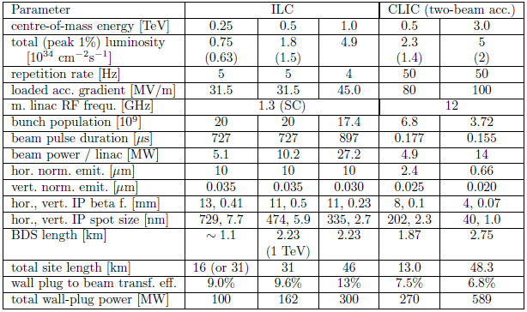
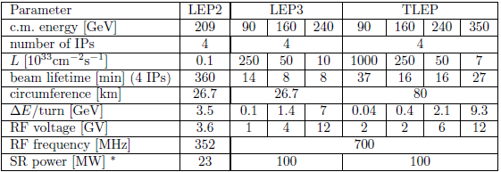
ILC – CLIC – LEP3/TLEP main parameters
Wall plug power = 250 ± 50

Slide 34
ElectroWeak Symmetry Breaking precision measurements
Accelerator →Physical quantity ↓ | HL-LHC 3000fb⁻¹ /exp | ILC (250) 250 fb⁻¹ | ILC (250+350+1000) | LEP3 240 4 IP | TLEP 240 +350 4 IP
Approx. date | 2030-35 | 2030-35? | >2045? | 2035? | 2035?
N_{H} | 1.7 x 10⁸ | 5 10⁴ ZH | (10⁵ ZH) (1.4 10⁵ Hvv) | 4 10⁵ZH | 2 10⁶ ZH
Δm_{H} (MeV) | 50 | 35 | 35 | 26 | 7
ΔΓ_{H/}Γ_{H} | -- | 10% | 3% | 4% | 1.3%
ΔΓ_{inv/}Γ_{H} | Indirect (?) | 1.5% | 1.0% | 0.35% | 0.15%
Δg_{Hγγ}/g_{Hγγ} | 1.5% | -- | 5% | 3.4% | 1.4%
Δg_{Hgg}/g_{Hgg} | 2.7% | 4.5% | 2.5% | 2.2% | 0.7%
Δg_{Hww}/g_{Hww} | 1.0% | 4,3% | 1% | 1.5% | 0.25%
Δg_{HZZ}/g_{HZZ} | 1.0% | 1.3% | 1.5% | 0.65% | 0.2%
Δg_{HHH}/g_{HHH} | < 30% (2 exp.) | -- | ~30% | -- | --
Δg_{Hμμ}/g_{Hμμ} | <10% | -- | -- | 14% | 7%
Δg_{Hττ}/g_{Hττ} | 2.0% | 3,5% | 2.5% | 1.5% | 0.4%
Δg_{Hcc}/g_{Hcc} | -- | 3,7% | 2% | 2.0% | 0.65%
Δg_{Hbb}/g_{Hbb} | 2.7% | 1.4% | 1% | 0.7% | 0.22%
Δg_{Htt}/g_{Htt} | 3.9% | -- | 15% | -- | 30%
Δm_{t} (MeV) | 500-800 | -- | 20 | -- | 20
Δm_{W} (MeV) | ~10 | -- | ~6 | -- | < 1

Slide 35
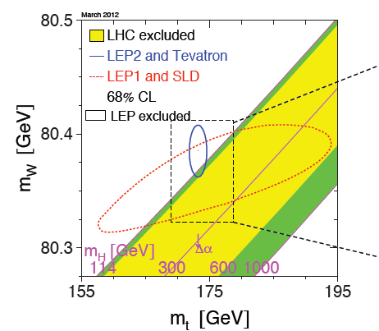
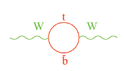
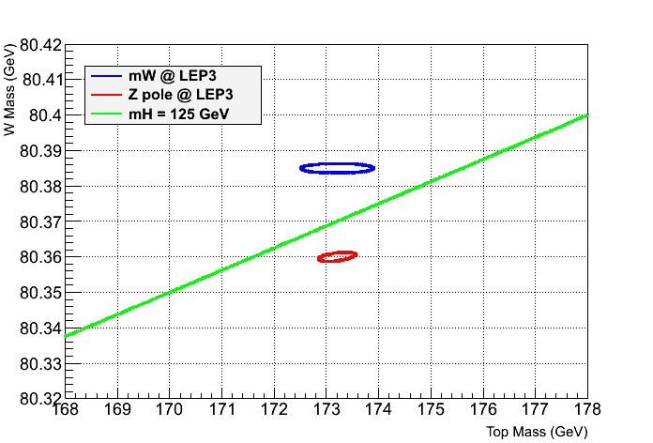



ElectroWeak Symmetry Breaking precision measurements
Are electroweak data compatible with this « Higgs »?
Significant reduction of error on M_{w} is possible @WW threshold
?
M_{w}
M_{w}
M_{t}
Z pole
studies
Z pole
studies
?
Lepton collider
Ultra precise Z pole measurements
allow one to reduce drastically the
errors on « LEP1+SLC elipse »
 | Now | LHC | ILC | LCLC
# Z @ 90GeV | Mega Z | - | Giga Z | Tera Z
σ(M_{w}) @ 160 GeV | ~15 MeV | ~10 MeV | ~6 MeV | <1MeV
$$Δm_{top}=±100MeV$$

Slide 36

Recommendations from European Strategy Group (cont’d)
High-priority large-scale scientific activities
Recommendation #3

Slide 37



Particle – antiparticle Asymmetry
Any interaction able to differentiate a particle and its antiparticle?
Essential to generate a Universe dominated by matter (over antimatter)!
Phenomenon initially observed in s quark decays in 1964 but underlying process was not experimentally understood
Observation of dissymmetric behavior in 2001 in b quark decays (BaBar, Belle) a Electroweak interactions are responsible
$e.g. B^{0}(\overline{b}d)→K^{+}(\overline{s}u)π^{−}(\overline{u}d)>$ $\overline{B^{0}} (b\overline{d})→K^{−}(s\overline{u})π^{+}(u\overline{d}$)
$$particle ≠antiparticle$$
Explained through interference mechanisms because:
Physical quarks are superpositions of flavor states
e.g. $m_{"b"}^{phys}=c_{1}m_{b}+{c_{2}m}_{s}+c_{3}m_{d}$
Thanks to H
All quark masses $≠0$
∃ at least 3 families of quarks !!!

Slide 38






Unfortunately the particle/antiparticle asymmetry generated at the electroweak scale by the SM in quark sector is too small to explain matter/antimatter asymmetry in Universe
Good news is however that mechanisms exist in Nature
May be different in lepton sector?
Physical neutrinos are superpositions of flavor states (neutrino mixing observed with cosmics, reactors and accel.)
∃ at least 3 families of leptons !!!
All lepton masses possibly $≠0$
ν are their own antiparticle (Majorana type)
Scenario 1
Scenario 2
H
H
H
$$m_{ν}∝Yv$$
ν
$$m_{ν}∝Y^{2}\frac{v^{2}}{Λ}$$
ν
ν
ν
New particles @ high energy scale
Distinct ν and anti-ν
(Dirac type neutrino)
Not possible with charged fermions
Search for asymmetric behavior of neutrino vs antineutrino
Search for heavy neutrinos (at high energy accelerators)

Slide 39





From neutrino superBeams toward ν-factories
Fast
5-10 GeV
ν,μ
$$τ_{μ}=2.2μs$$
Multi-MW
SC cavities
Goal: >10²¹ μ/year
stored
Do we have technology for multiMW proton driver ?
Indeed, see for example
ESS
5MW
~300K
~2 K
Cavity type | Gradient | #cav.(cell) | #cryomod.
Spoke | 8 MV/m | 48(2) | 16
Ellip. 1 | ~14 MV/m | 36(5) | 9
Ellip. 2 | ~21 MV/m | 112(5) | 14

Slide 40

More generally, we are going toward very high power proton accelerators a useful to many applications
SC cavities are vital
Courtesy of Mike Seidel, PSI

Slide 41


Do we have technology for cooling the muons?
Ionization cooling
Demonstrator being constructed
Cooling section consists of 100 cells 0.75m in length (total length 75m)
100 RF cavities (15MV/m) operating in high magnetic field
100 superconducting 0.15m coils (2.8T)
MICE @RAL
On-going R&D by international collaborative
Maintaining a Strong R&D on these issues is important
A project like nuStorm is also an interesting idea to test muon storing and decays to ν

Slide 42



From ν-factories toward the “dream” of muon collider
Some ultra-challenging components:
Very high field solenoids (>30T)
High gradient cavities in multi-Tesla field
$$φ≈5km$$
Require much smaller beam size (i.e. lower emittance)
Very efficient cooling
Recommendations from European Strategy Group (cont’d)
High-priority large-scale scientific activities
Recommendation #4

Slide 43
Many other accelerator R&D topics have not been discussed here e.g. e-p collider, γγ collider, plasma acceleration…
They should not be forgotten…
…but at present either the physics reach is limited and/or lead time seems too long
Proton-proton and electron-positron colliders appear as most promissing/practical options

Slide 44

Many R&D topics are useful to several fields/applications
From TIARA Key Accelerator Research Area Report

Slide 45

Many R&D topics are useful to several fields/applications
Collaboration with other fields could be promoted further by
Establishing joint workshop (including industry)
Developing joint R&D projects
Opening access and/or developing joint R&D infrastructures

Slide 46
Conclusion
The last few years were very exciting
Many teams have contributed to this success, they have to be warmly congratulated
Thanks to this work, Prospects for the Future looks very promising, with many new ideas emerging
The Strategy is an opportunity to bring these ideas on the table and provide further momentum toward our quest for understanding the fundamental laws of the Universe
The Strategy is an important opportunity to open up a long term ambitious vision for Particle Physics in Europe
Accelerator R&D is vital to enable the realization of our vision and should be at the highest priority topic of our strategy

Slide 47
My Conclusion
A Very Large Collider Complex (VLCC), such as VHE-LHC/TLEP or HE-LHC/LEP3, possibly with an e-p option, is a very promising and exciting possible roadmap for frontier leading science in Europe
Europe needs to study these options vigorously by setting up a coordinated international study consortium for
Physics studies
Accelerator studies
Detector studies
  Including Computing needs
Europe should create a collaborative framework to carry out the required technology R&D

Slide 48
My Conclusion
Ambitious milestones should be set up
CDR in 2 years
TDR in 5 years, in a timely fashion with an update of the European Strategy in 2017-18, after the first round of operation of the LHC@13-14 TeV
A possible timeline should be discussed
 | 2010 |  |  |  |  |  | 2015 |  |  |  |  | 2020 |  |  |  |  | 2025 |  |  |  |  | 2030 |  |  |  |  | 2035 |  |  |  |  | 2040
LHC
HL-LHC | R&D + constr
TLEP* |  |  |  | Design + R&D + construction
VHE-LHC* | Design + R&D + construction
*tentative timeline; similar timeline applies for LEP3/HE-LHC but installation requires stopping LHC

Slide 49


My Conclusion
M_{H}=94.0 ± 1.5
Actual M_{H}
TLEP
Note: This is indicative, a careful analysis still to be carried out

Slide 50
My Conclusion
Habemus
Cogitationem!

