Slide 1




A circular e⁺e⁻ collider to study H(125) properties - accelerator
Frank Zimmermann
Frascati, 14 February 2013
many thanks to Roy Aleksan, Alain Blondel, John Ellis, Patrick Janot, Mike Koratzinos, Katsunobu Oide, Valery Telnov, Rogelio Tomas, Marco Zanetti
work supported by the European Commission under the FP7 Research Infrastructures project EuCARD, grant agreement no. 227579

Slide 2
outline
motivation
machine proposals
parameters, lifetime, key concepts
various features
a long-term strategy
HF quality indicators
the path forward

Slide 3
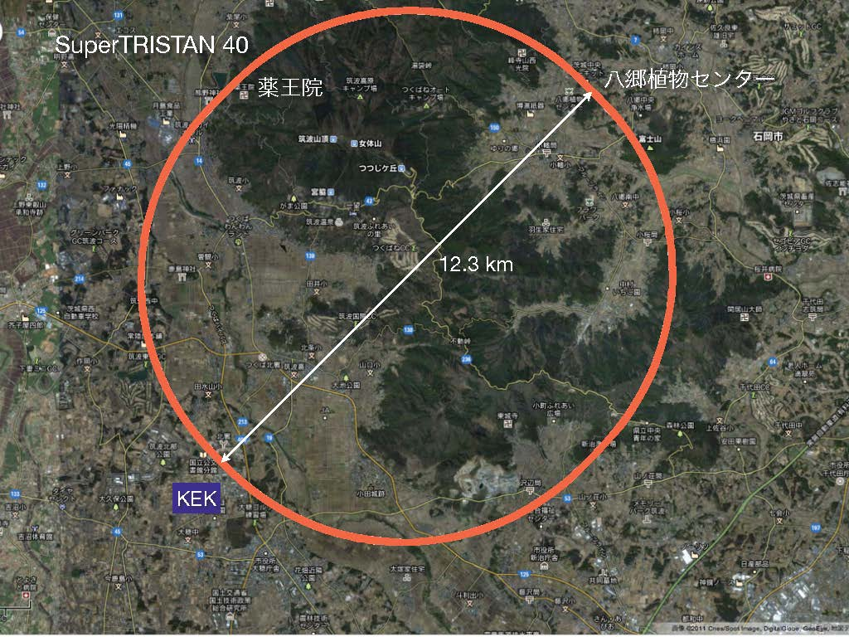
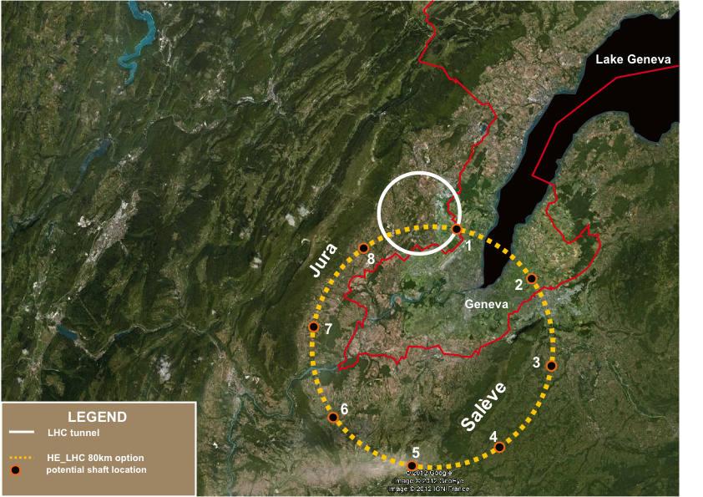
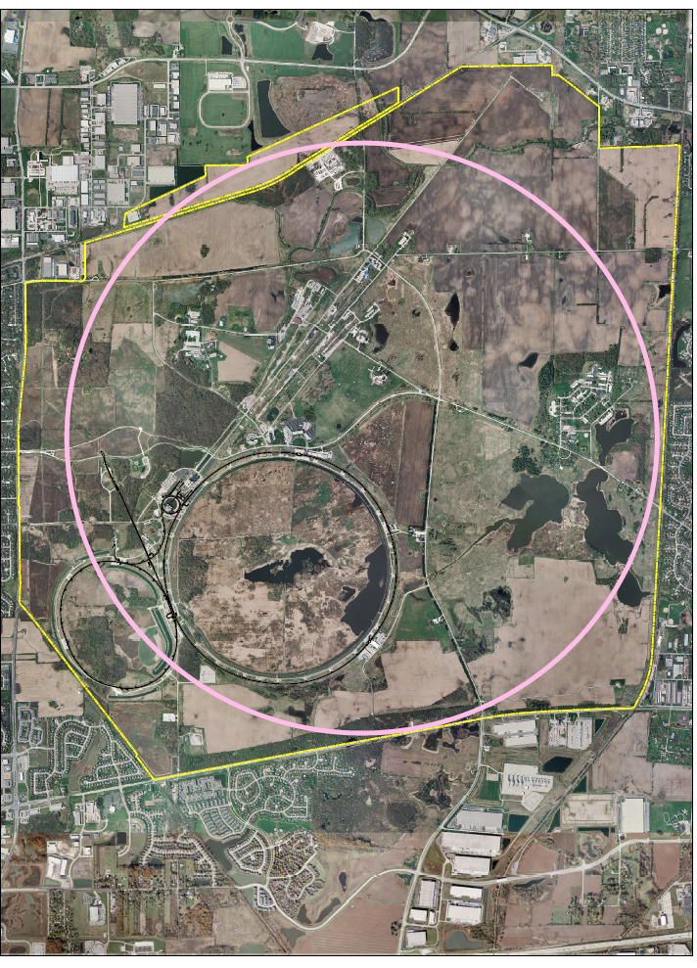
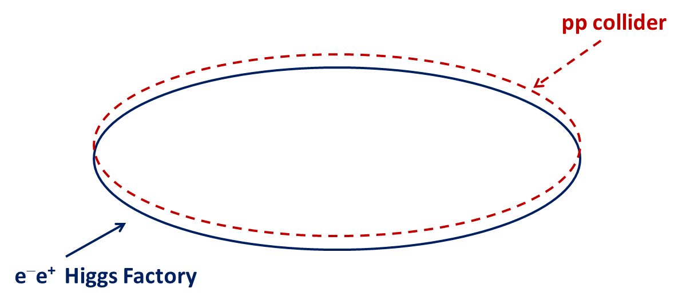
circular HFs – a few examples
SLAC/LBNL
design:
27 km
LEP3: 27 km
TLEP (LEP4): 80 km
near Geneva
SuperTRISTAN in Tsukuba: 40 km
Y. Cai, SLAC
A. Blondel, J. Osborne, F. Zimmermann
FNAL site filler, 16 km
& FNAL VLLC 233 km ring
K. Oide, KEK
IHEP Chinese HF
+ Super pp Collider
50 or 70 km
Q. Qin, IHEP
T. Sen, E. Gianfelice-Wendt, Y. Alexahin, FNAL

Slide 4
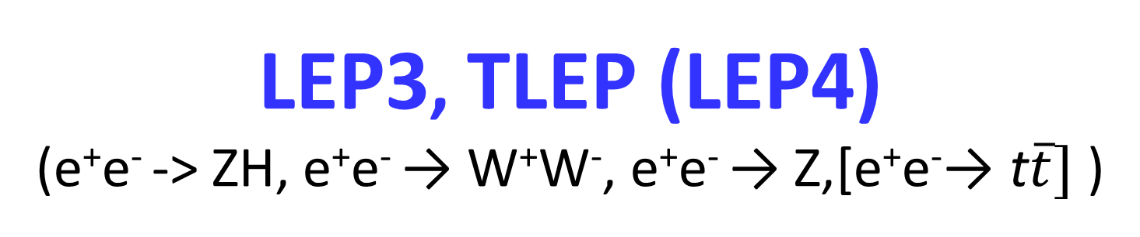
LEP3, TLEP (LEP4)
(e⁺e⁻ -> ZH, e⁺e⁻ → W⁺W⁻, e⁺e⁻ → Z,[e⁺e⁻→ t$\overline{t}]$ )
key parameters
 | LEP3 | TLEP (LEP4)
circumference | 26.7 km | 80 km
max beam energy | 120 GeV | 175 GeV
max no. of IPs | 4 | 4
luminosity at 350 GeV c.m. | - | 0.7x10³⁴ cm⁻²s⁻¹
luminosity at 240 GeV c.m. | 10³⁴ cm⁻²s⁻¹ | 5x10³⁴ cm⁻²s⁻¹
luminosity at 160 GeV c.m. | 5x10³⁴ cm⁻²s⁻¹ | 2.5x10³⁵ cm⁻²s⁻¹
luminosity at 90 GeV c.m. | 2x10³⁵ cm⁻²s⁻¹ | 10³⁶ cm⁻²s⁻¹
at the Z pole repeating LEP physics programme in a few minutes…

Slide 5
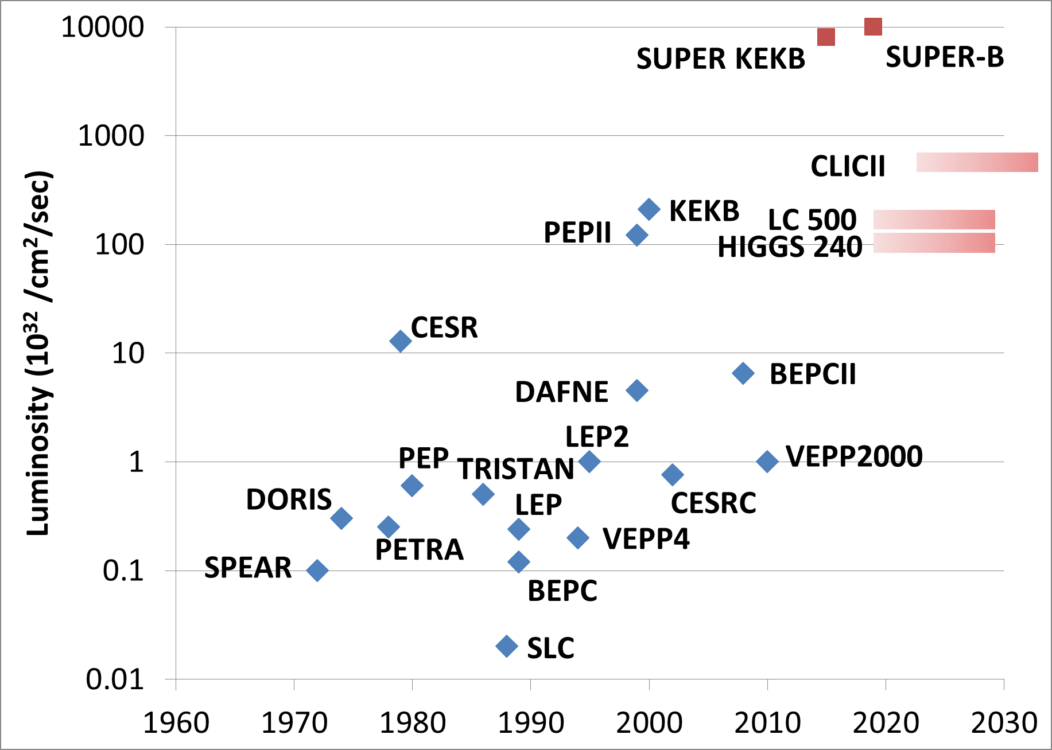
S. Henderson’s Livingston Chart: Luminosity
TLEP-Z
TLEP-W
adding TLEP to the chart!
TLEP-H
TLEP-t

Slide 6
circular HFs – beam lifetime
LEP2:
beam lifetime ~ 6 h
dominated by radiative Bhahba scattering with cross section σ~0.215 barn
LEP3:
with L~10³⁴ cm⁻²s⁻¹ at each of several IPs:
τ_{beam,LEP3}~18 minutes from rad. Bhabha scattering
    → solution: top-up injection
additional beam lifetime limit due to beamstrahlung:
(1) large momentum acceptance (η ≥ 3%), and/or
(2) flat(ter) beams and/or
(3) fast replenishing
(H. Burkhardt)
(A. Blondel)
(V. Telnov, K. Yokoya, M. Zanetti)

Slide 7
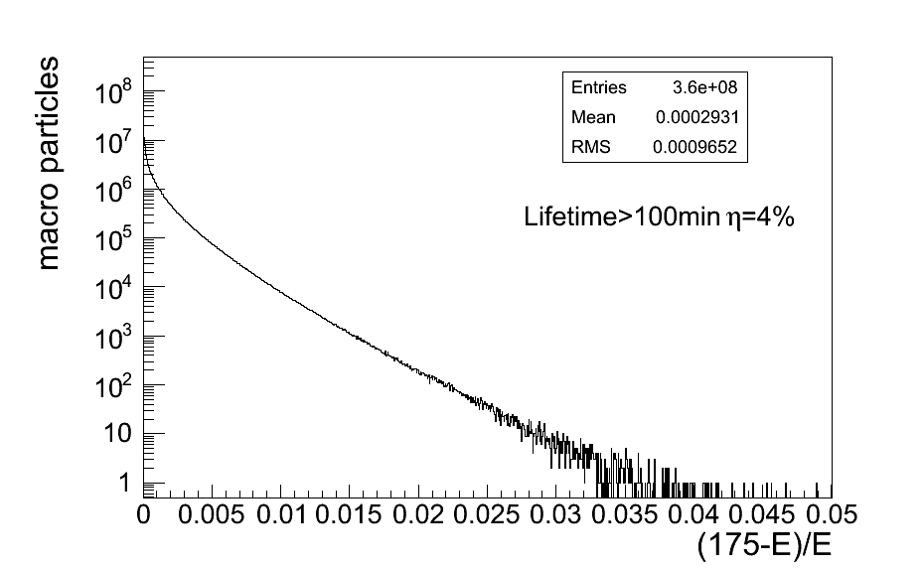
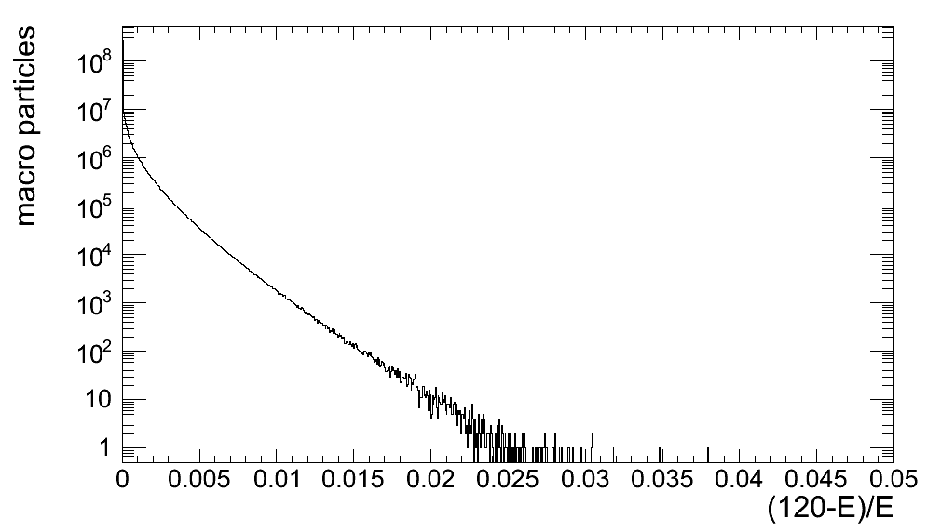
circular HFs – beamstrahlung
simulation w 360M macroparticles
τ varies exponentially w energy acceptance η
post-collision E tail → lifetime τ
TLEP at 240 GeV:
TLEP at 350 GeV:
τ>0.5 s at η=1.0% (4 IPs)
τ>5 s at η=1.5%
τ>50 s at η=2.0%
τ> 8 min at η=2.5%
τ>2 s at η=2.0% (4 IPs)
τ>12 s at η=2.5%
τ>50 s at η=3.0%
τ> 4 min at η=3.5%
M. Zanetti (MIT)

Slide 8
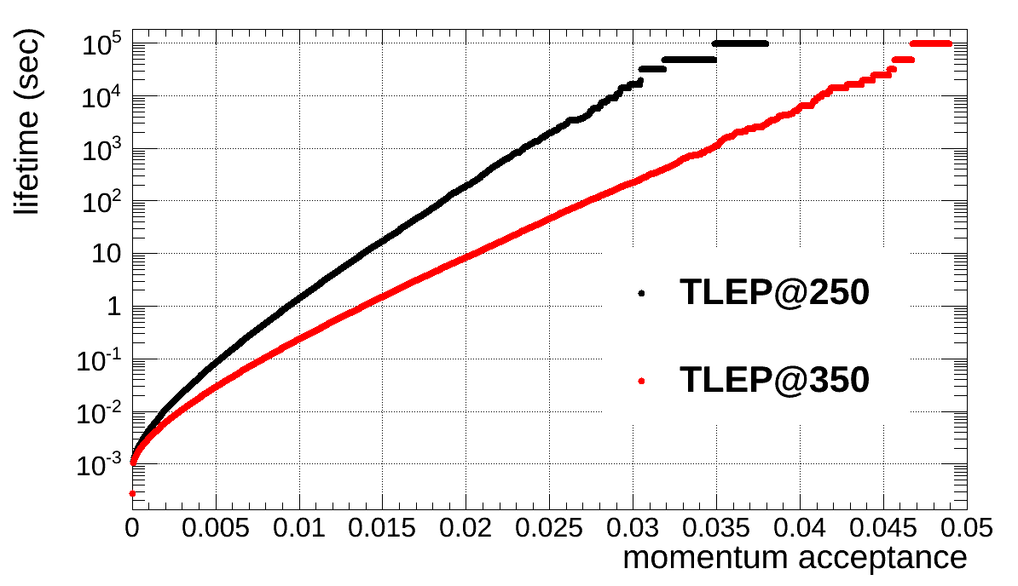
circular HFs – beamstrahlung
simulation w 360M macroparticles
τ varies exponentially w energy acceptance η
post-collision E tail → lifetime τ
beam lifetime versus acceptance η for 1 IP:

Slide 9
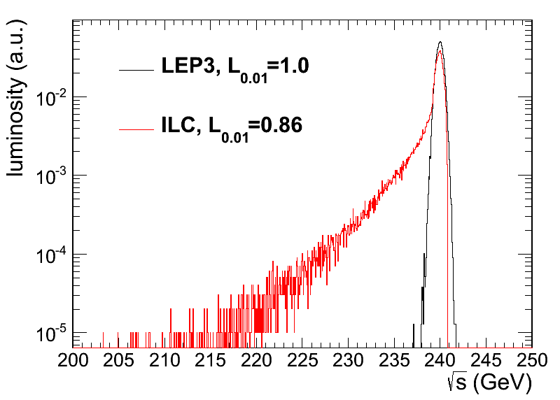
beamstrahlung luminosity spectrum
LEP3 & ILC:
LEP3 beamstrahlung more benign than for linear collider
M. Zanetti (MIT)

Slide 10
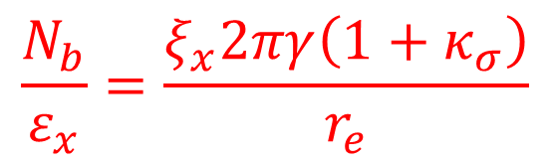
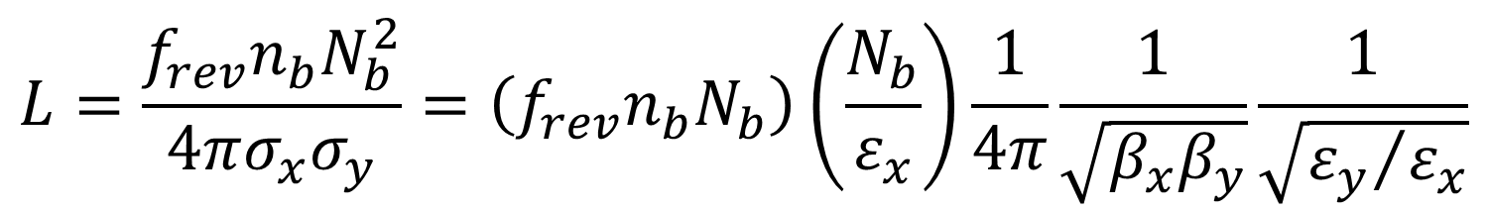
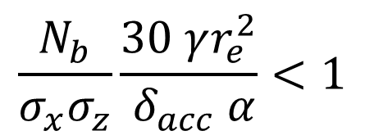
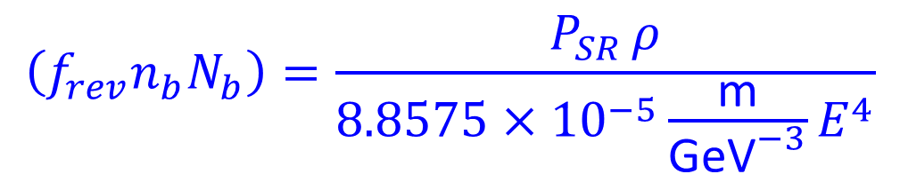
luminosity formulae & constraints
$$L=\frac{f_{rev}n_{b}N_{b}^{2}}{4πσ_{x}σ_{y}}=\left(f_{rev}n_{b}N_{b}\right)\left(\frac{N_{b}}{ε_{x}}\right)\frac{1}{4π}\frac{1}{\sqrt{β_{x}β_{y}}}\frac{1}{\sqrt{{ε_{y}}/{ε_{x}}}}$$
$$\left(f_{rev}n_{b}N_{b}\right)=\frac{P_{SR }ρ}{8.8575×{10}^{−5}\frac{\text{m}}{{\text{GeV}}^{−3}}E^{4}}$$
SR radiation
power limit
$$\frac{N_{b}}{ε_{x}}=\frac{ξ_{x}2πγ\left(1+κ_{σ}\right)}{r_{e}}$$
beam-beam limit
$$\frac{N_{b}}{σ_{x}σ_{z}}\frac{30 γr_{e}^{2}}{ δ_{acc} α}<1$$
>30 min beamstrahlung lifetime (Telnov) → N_{b},β_{x}
→minimize κ_{ε}=ε_{y}/ε_{x,} β_{y}~β_{x}(ε_{y}/ε_{x}) and respect β_{y}≥σ_{z}

Slide 11
LEP3/TLEP parameters -1
soon at SuperKEKB:
β_{x}*=0.03 m, β_{Y}*=0.03 cm
 | LEP2 | LHeC | LEP3 | TLEP-Z | TLEP-H | TLEP-t
beam energy Eb [GeV] circumference [km] beam current [mA] #bunches/beam #e−/beam [10¹²] horizontal emittance [nm] vertical emittance [nm] bending radius [km] partition number J_{ε} momentum comp. α_{c} [10⁻⁵] SR power/beam [MW] β∗_{x} [m] β∗_{y} [cm] σ∗_{x} [μm] σ∗_{y} [μm] hourglass F_{hg} ΔE^{SR}_{loss}/turn [GeV] | 104.5 26.7 4 4 2.3 48 0.25 3.1 1.1 18.5 11 1.5 5 270 3.5 0.98 3.41 | 60 26.7 100 2808 56 5 2.5 2.6 1.5 8.1 44 0.18 10 30 16 0.99 0.44 | 120 26.7 7.2 4 4.0 25 0.10 2.6 1.5 8.1 50 0.2 0.1 71 0.32 0.59 6.99 | 45.5 80 1180 2625 2000 30.8 0.15 9.0 1.0 9.0 50 0.2 0.1 78 0.39 0.71 0.04 | 120 80 24.3 80 40.5 9.4 0.05 9.0 1.0 1.0 50 0.2 0.1 43 0.22 0.75 2.1 | 175 80 5.4 12 9.0 20 0.1 9.0 1.0 1.0 50 0.2 0.1 63 0.32 0.65 9.3
SuperKEKB:ε_{y}/ε_{x}=0.25%

Slide 12
LEP3/TLEP parameters -2
LEP2 was not beam-beam limited
 | LEP2 | LHeC | LEP3 | TLEP-Z | TLEP-H | TLEP-t
V_{RF,tot} [GV] δ_{max,RF} [%] ξ_{x}/IP ξ_{y}/IP f_{s} [kHz] E_{acc} [MV/m] eff. RF length [m] f_{RF} [MHz] δ^{SR}_{rms} [%] σ^{SR}_{z,rms} [cm] L/IP[10³²cm⁻²s⁻¹] number of IPs Rad.Bhabha b.lifetime [min] ϒ_{BS} [10⁻⁴] n_{γ}/collision ΔE^{BS}/collision [MeV] ΔE^{BS}_{rms}/collision [MeV] critical SR energy [MeV] | 3.64 0.77 0.025 0.065 1.6 7.5 485 352 0.22 1.61 1.25 4 360 0.2 0.08 0.1 0.3 0.81 | 0.5 0.66 N/A N/A 0.65 11.9 42 721 0.12 0.69 N/A 1 N/A 0.05 0.16 0.02 0.07 0.18 | 12.0 5.7 0.09 0.08 2.19 20 600 700 0.23 0.31 94 2 18 9 0.60 31 44 1.47 | 2.0 4.0 0.12 0.12 1.29 20 100 700 0.06 0.19 10335 2 74 4 0.41 3.6 6.2 0.02 | 6.0 9.4 0.10 0.10 0.44 20 300 700 0.15 0.17 490 2 32 15 0.50 42 65 0.43 | 12.0 4.9 0.05 0.05 0.43 20 600 700 0.22 0.25 65 2 54 15 0.51 61 95 1.32
LEP data for 94.5 - 101 GeV consistently suggest a beam-beam limit of ~0.115 (R.Assmann, K. C.)

Slide 13
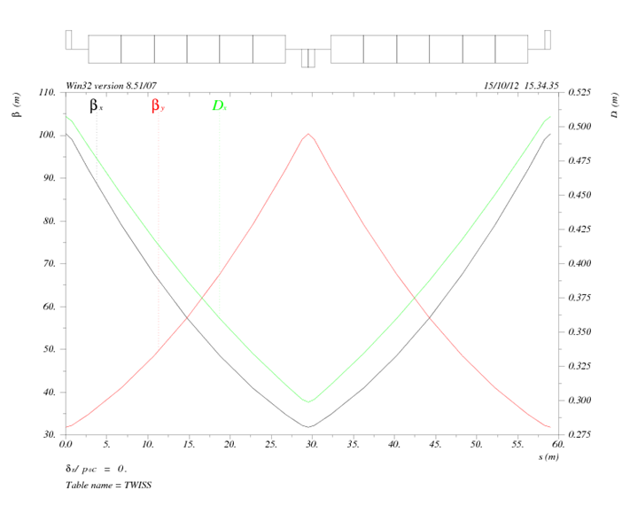
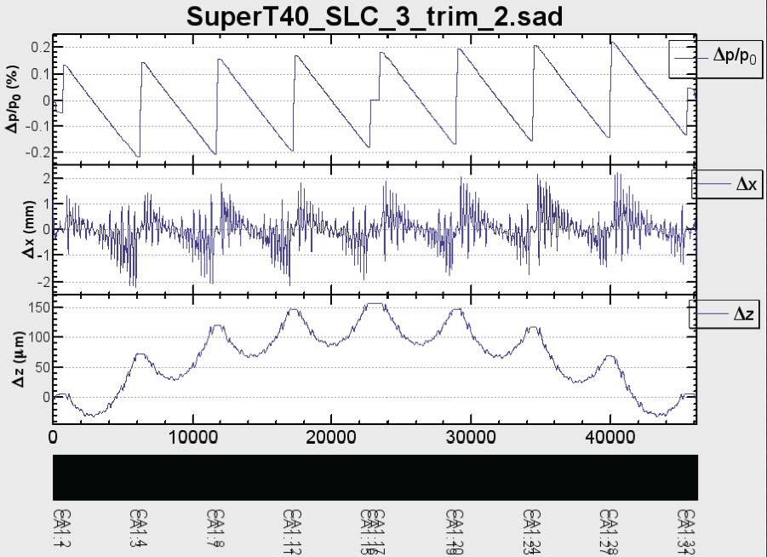
circular HFs – arc lattice
KEK design
IHEP design
Q. Qin
K. Oide
FNAL site filler
SLAC/LBNL design
Y. Cai
T. Sen, E. Gianfelice-Wendt, Y. Alexahin

Slide 14
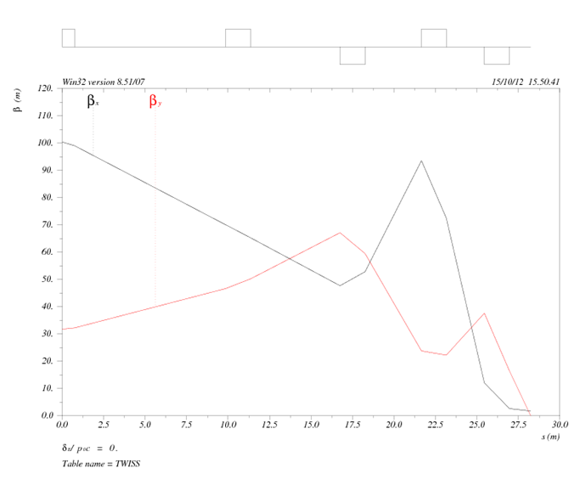
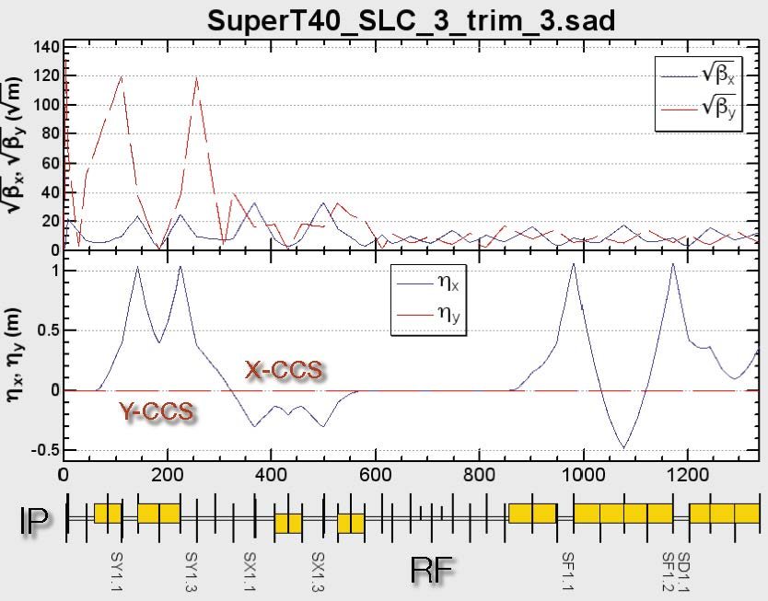
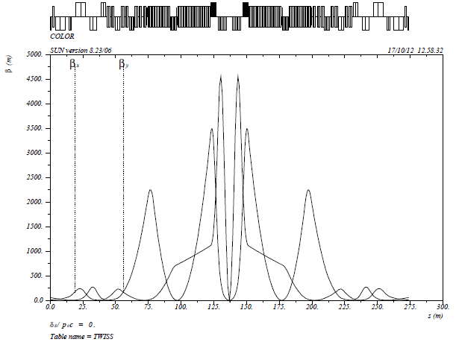
circular HFs – final-focus design
KEK design
IHEP design
K. Oide
Q. Qin
βx*=20cm,
βy*=0.5cm
FNAL site filler
SLAC/LBNL design
Y. Cai
T. Sen, E. Gianfelice-Wendt, Y. Alexahin

Slide 15
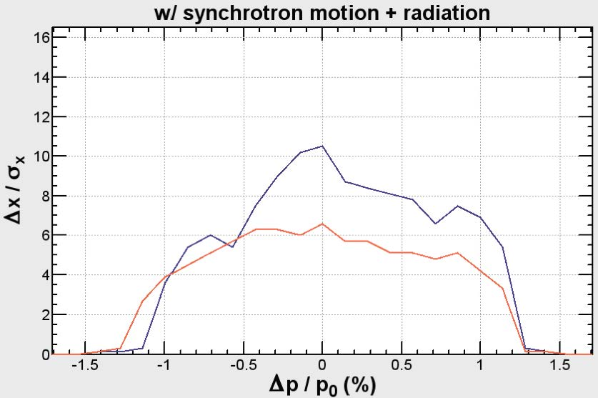
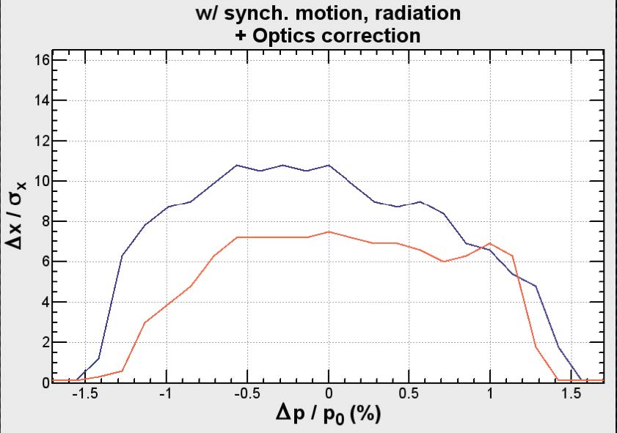
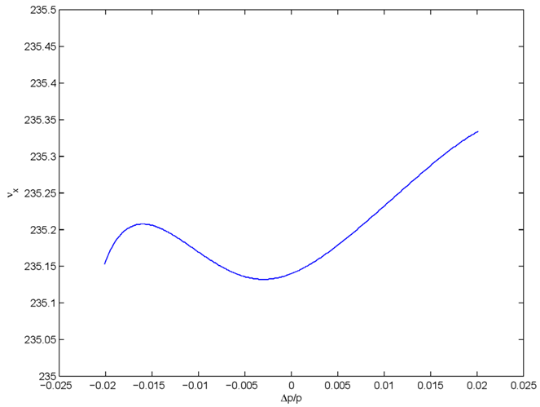
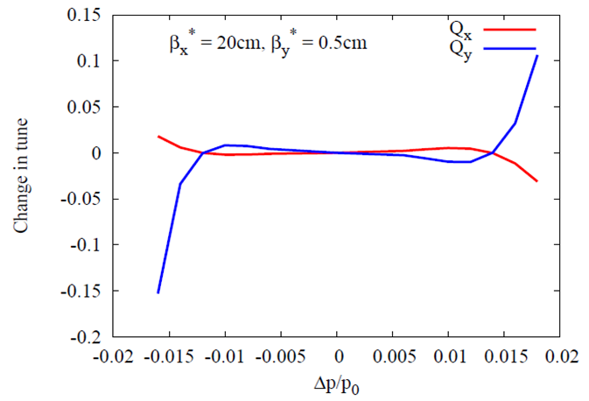
circular HFs - momentum acceptance
with synchrotron motion &
radiation
(sawtooth)
KEK design
before optics
correction
KEK design
after optics
correction
±1.1%
±1.3%
K. Oide
±2.0%
±1.6%
FNAL site filler
SLAC/LBNL design
Y. Cai
T. Sen, E. Gianfelice-Wendt, Y. Alexahin

Slide 16
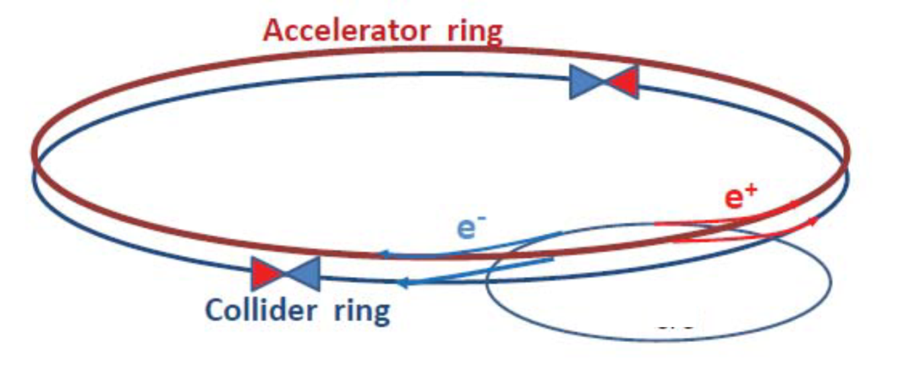
circular HFs – top-up injection
double ring with top-up injection
supports short lifetime & high luminosity
A. Blondel
top-up experience: PEP-II, KEKB, light sources

Slide 17
top-up injection
SPS as LEP injector accelerated e± from 3.5 to 20 GeV (later 22 GeV) on a very short cycle:
acceleration time = 265 ms or about 62.26 GeV/s
Ref. K. Cornelis, W. Herr, R. Schmidt, “Multicycling of the CERN SPS: Supercycle Generation & First Experience with this mode of Operation,” Proc. EPAC 1988
assuming injection from the SPS into the top-up accelerator at the same energy of 20 GeV and final energy of 120 GeV: acceleration time = 1.6 seconds
total cycle time = 10 s looks conservative (→ refilling ~1% of the LEP3 beam, for τ_{beam}~16 min)
Ghislain Roy & Paul Collier

Slide 18
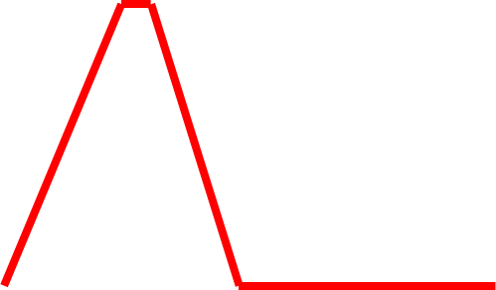
top-up injection: schematic cycle
beam current in collider (15 min. beam lifetime)
100%
99%
almost constant current
energy of accelerator ring
120 GeV
injection into collider
injection into
accelerator
20 GeV
10 s

Slide 19
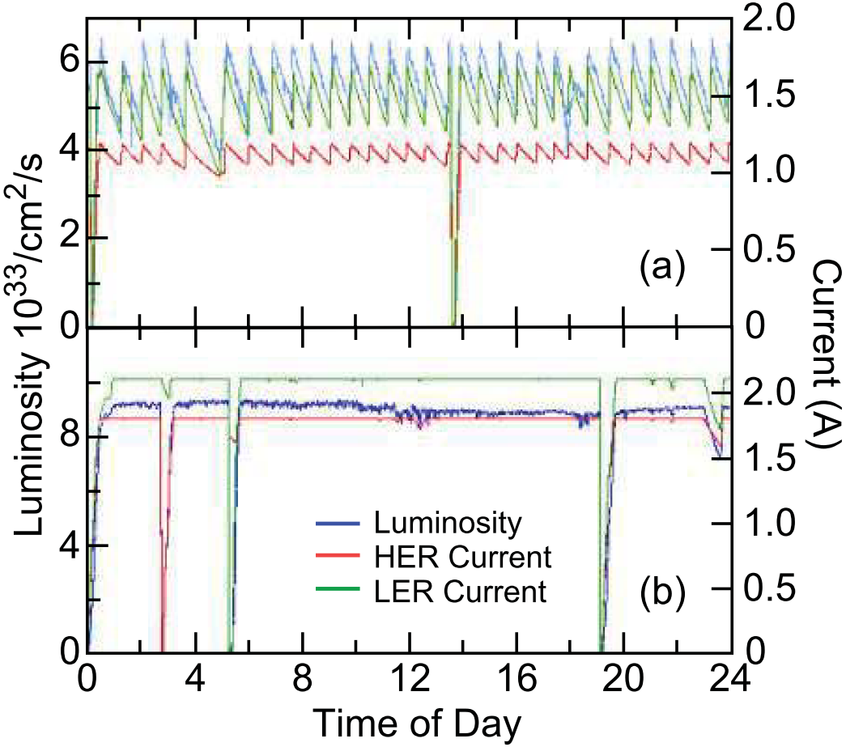
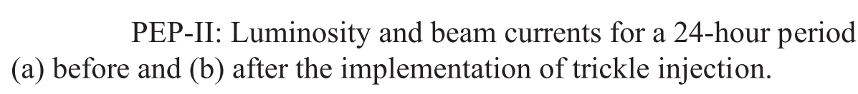
top-up injection at PEP-II/BaBar
Before Top-Up Injection
After Top-Up Injection
average ≈ peak
luminosity (H≈1)!
J. Seeman

Slide 20
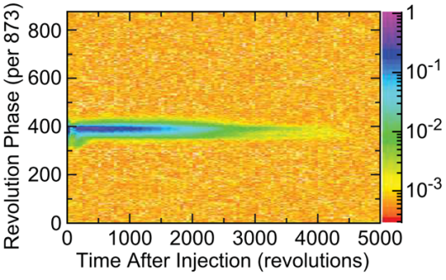
top-up injection: feasibility
HF 2012 conclusions (John Seeman, SLAC):
Top-up injection will work for a Circular Higgs Factory.
A full energy injector is needed.
A synchrotron injector will work the best, but is more than is needed (60 Hz!).
A rapidly ramped storage ring is likely adequate (4 sec).
The detectors will need to mask out the buckets with damping injected bunches during data taking as had been done for PEP-II/BaBar:
BaBar trigger masking:
Mask all of ring a few tens of turns.
Mask injected bunch area for 1250
turns or about 0.9 msec.

Slide 21
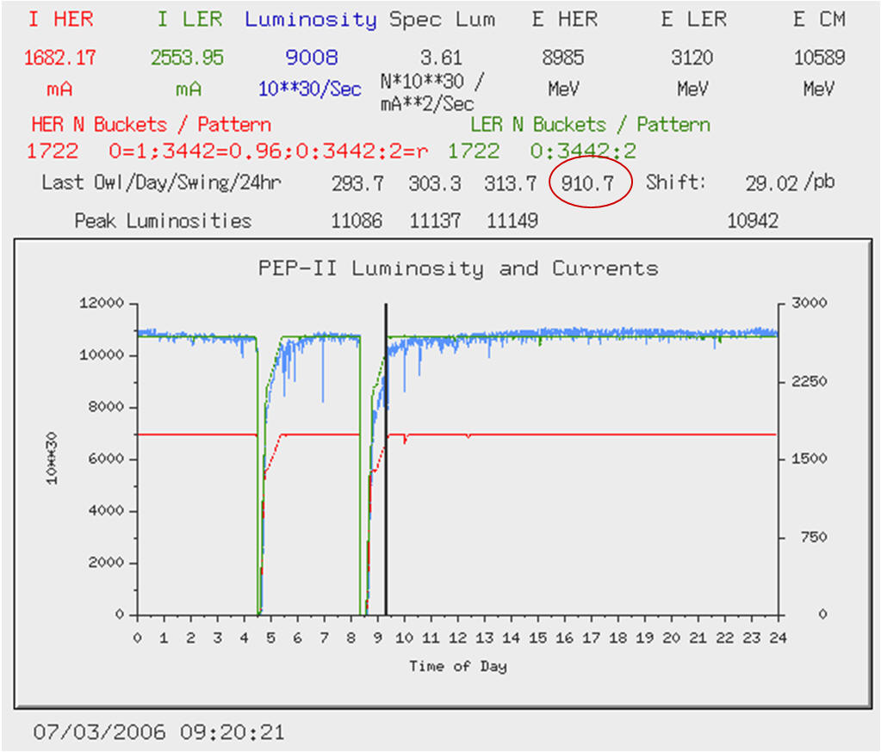
PEP-II Hübner factor
J. Seeman,
7 Dec. 2012
for one day (July 3, 2006): H≈0.95
for one month (August 2007): H≈0.63

Slide 22
Circular Collider & SR Experience
…
CESR
BEPC
LEP
Tevatron
LEP2
HERA
DAFNE
PEP-II
KEKB
BEPC-II
LHC
SuperKEKB (soon)
3rd generation light sources
1992 ESRF, France (EU) 6 GeV
ALS, US 1.5-1.9 GeV
1993 TLS, Taiwan 1.5 GeV
1994 ELETTRA, Italy 2.4 GeV
PLS, Korea 2 GeV
MAX II, Sweden 1.5 GeV
1996 APS, US 7 GeV
LNLS, Brazil 1.35 GeV
1997 Spring-8, Japan 8 GeV
1998 BESSY II, Germany 1.9 GeV
2000 ANKA, Germany 2.5 GeV
SLS, Switzerland 2.4 GeV
2004 SPEAR3, US 3 GeV
CLS, Canada 2.9 GeV
2006: SOLEIL, France 2.8 GeV
DIAMOND, UK 3 GeV
ASP, Australia 3 GeV
MAX III, Sweden 700 MeV
Indus-II, India 2.5 GeV
2008 SSRF, China 3.4 GeV
2009 PETRA-III, Germany 6 GeV
2011 ALBA, Spain 3 GeV
well understood technology &
typically exceeding design performance
within a few years

Slide 23
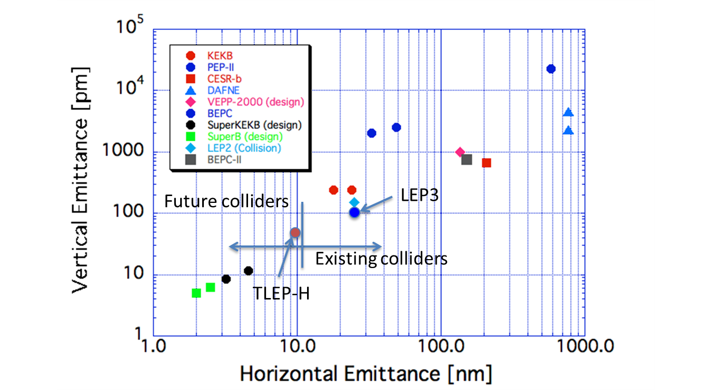
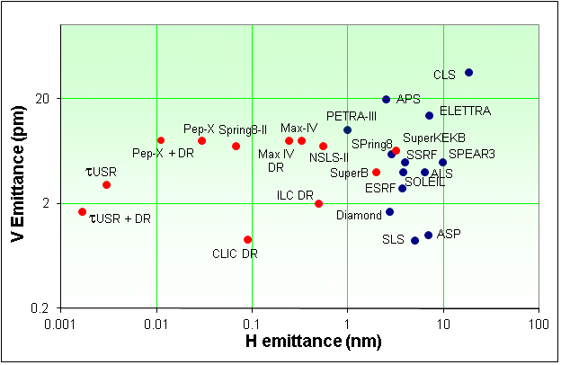
Emittances in Circular Colliders &
Modern Light Sources
Y. Funakoshi, KEK
Top up injection essential for achieving small vertical emittance
Lenny Rivkin, 2nd LEP3 Day
LEP3
TLEP (240)
R. Bartolini,
DIAMOND

Slide 24
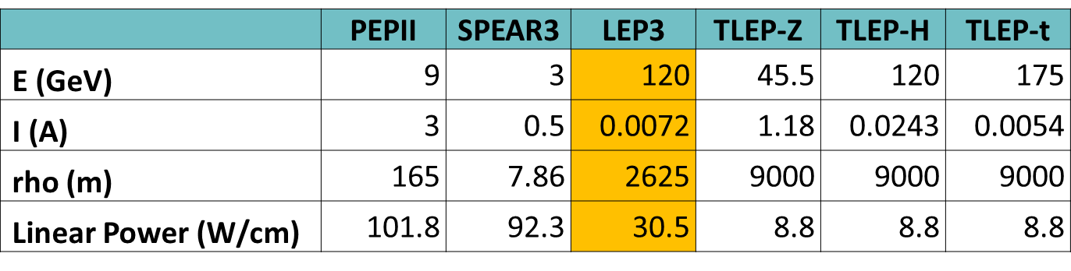
circular HFs: synchroton-radiation heat load
LEP3 and TLEP have 3-10 times less SR heat load per meter than PEP-II or SPEAR! (though higher photon energy)
N. Kurita, U. Wienands, SLAC

Slide 25
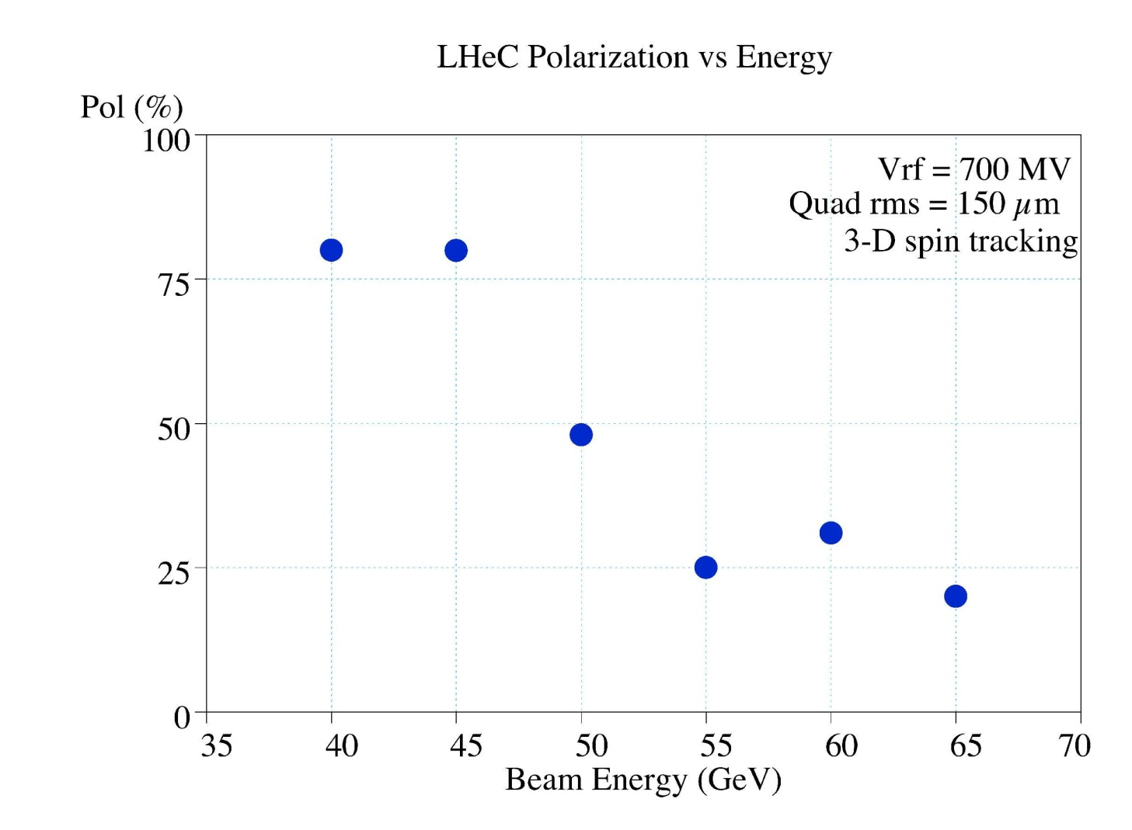
TLEP polarization
80% at the Z pole
LHeC equilibrium polarisation vs ring energy, full 3-D spin tracking results (D. Barber, U. Wienands, in LHeC CDR, J. Phys. G: Nucl. Part. Phys. 39 075001)
“… by adopting the levels of alignment that are now standard for synchrotron-radiation sources and by applying harmonic closed-orbit spin matching, there is reason to hope that high polarisation in a flat ring can … be obtained”

Slide 26
TLEP3 key components
tunnel
SRF system
cryoplants
magnets
injector ring
detectors
tunnel is main cost:
3x LEP tunnel = 2.1 BCHF
9x LHeC tunnel cost estimate = 2.25 BCHF
inofficial/official TLEP tunnel cost ~2.5 BCHF

Slide 27
TLEP3 key issues
SR handling and radiation shielding
optics effect energy sawtooth
[separate arcs?! (K. Oide)]
beam-beam interaction for large Q_{s}
and significant hourglass effect (K. Ohmi)
IR design with even larger momentum
  acceptance
integration in LHC tunnel (LEP3)
Pretzel scheme for TERA-Z operation?
impedance effects for high-current running
  at Z pole

Slide 28
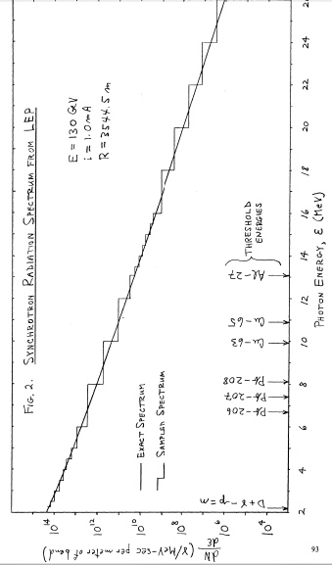
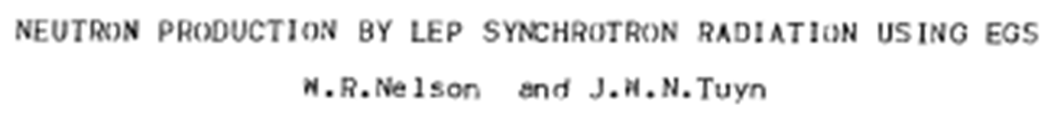

shielding & activation for E_{c}>1 MeV
A. Fasso
3rd TLEP3 Day
LEP design study extended up to 130 GeV

Slide 29
transverse impedance & TMCI
LEP bunch intensity was limited by TMCI: N_{b,thr}~5x10¹¹ at 22 GeV
LEP3 with 700 MHz: at 120 GeV we gain a factor 5.5 in the threshold, which almost cancels a factor (0.7/0.35)³ ~ 8 arising from the change
in wake-field strength due to the different RF frequency
LEP3 Q_{s}~0.2, LEP Q_{s}~0.15: further 25% increase in TMCI threshold?
only ½ of LEP transverse kick factor came from SC RF cavities ,
LEP3 beta functions at RF cavities might be smaller than in LEP ,
LEP3 bunch length (2-3 mm) is shorter than at LEP injection (5-9 mm)
M. Lamont, SL-Note-98-026 (OP)
instability threshold, feedback etc for Tera-Z operation w 1 A current? question by K. Yokoya, Feb. 2013

Slide 30
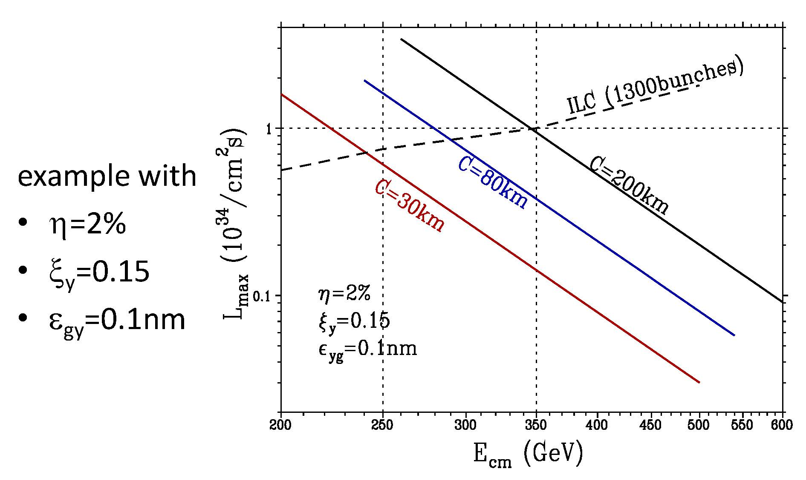
Circular & Linear HF:
peak luminosity vs energy
LEP3 , TLEP
x 4 IPs
LEP3/TLEP would be THE choice for e⁺e⁻ collision energies up to ~370 GeV
K. Yokoya, KEK

Slide 31
vertical rms IP spot sizes in nm
in regular
font:
achieved
in italics:
design
values
LEP2 | 3500
KEKB | 940
SLC | 500
LEP3 | 320
TLEP-H | 220
ATF2, FFTB | 72 (35), 65
SuperKEKB | 50
SAPPHiRE | 18
ILC | 5 – 8
CLIC | 1 – 2
β_{y}*:
5 cm→
1 mm
LEP3/TLEP
will learn
from ATF2 &
SuperKEKB

Slide 32
extrapolation from past experience
recent comment by eminent German particle physicist:
“TLEP is much riskier and its performance highly uncertain;
while the ILC performance numbers are very conservative” [?]
 | LEP2→TLEP-H | SLC→ILC 250
peak luminosity | x400 | x2500
energy | x1.15 | x2.5
vertical geom. emittance | x1/5 | x1/400
vert. IP beam size | x1/15 | x1/150
e⁺ production rate | x1/2 ! | x65
commissioning time | <1 year → ? | >10 years →?

Slide 33
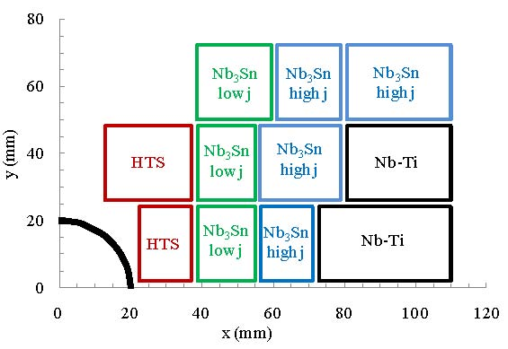
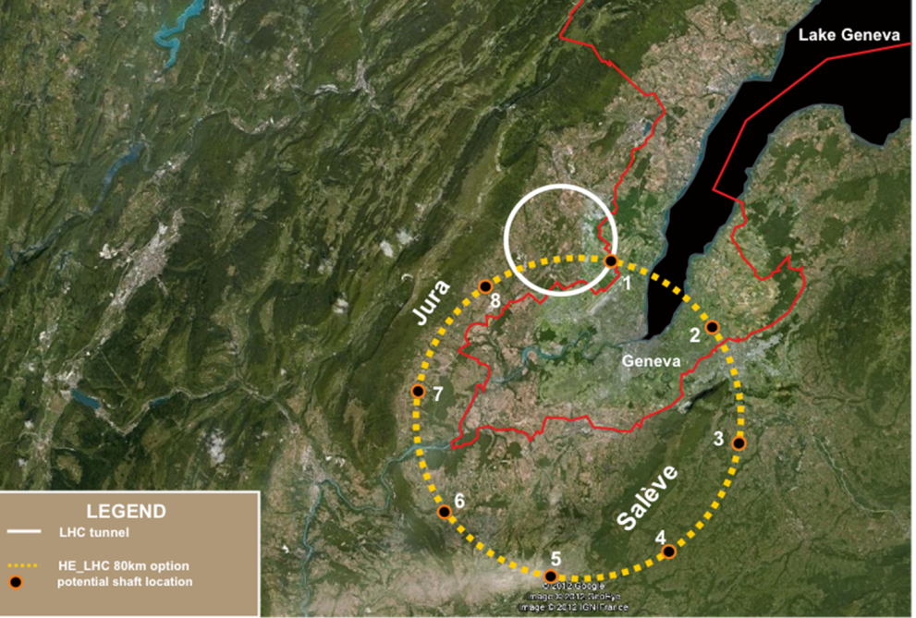
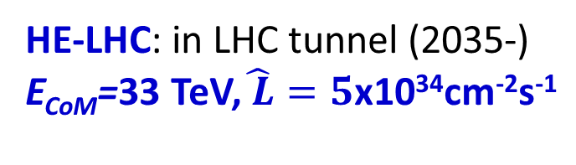
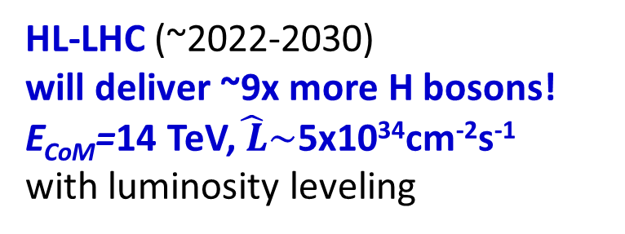
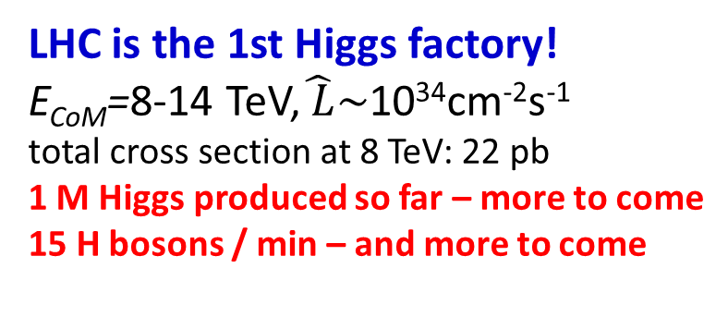
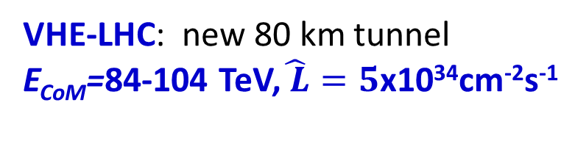
a glance at LHC & LHC upgrades
LHC is the 1st Higgs factory!
E_{CoM}=8-14 TeV,$\hat{ L}\sim$10³⁴cm⁻²s⁻¹
total cross section at 8 TeV: 22 pb
1 M Higgs produced so far – more to come
15 H bosons / min – and more to come
HL-LHC (~2022-2030)
will deliver ~9x more H bosons!
E_{CoM}=14 TeV,$\hat{ L}\sim$5x10³⁴cm⁻²s⁻¹
with luminosity leveling
8 → 14 TeV: ggH x1.5
F. Cerutti, P. Janot
VHE-LHC: new 80 km tunnel
E_{CoM}=84-104 TeV,$\hat{ L}=5$x10³⁴cm⁻²s⁻¹
HE-LHC: in LHC tunnel (2035-)
E_{CoM}=33 TeV,$\hat{ L}=5$x10³⁴cm⁻²s⁻¹
20-T dipole magnet
80 km tunnel
16 T magnets over 80 km (Ex6)
likely “easier” than 20 T
magnets over 27 km (Ex2.5)!?
14 → 33 TeV:
ggH→ HH x6
E. Todesco, L. Rossi, P.. McIntyre
J. Osborne, C. Waaijer, S. Myers

Slide 34
possible long-term strategy
TLEP (80 km,
e⁺e⁻, up to
~350 GeV c.m.)
PSB
PS (0.6 km)
SPS (6.9 km)
LHC (26.7 km)
LEP3
(e⁺e⁻, 240 GeV c.m.)
VHE-LHC
(pp, up to
100 TeV c.m.)
same detectors!
also: e± (120 GeV) – p (7 & 50 TeV) collisions
(E. Meschi)
≥50 years of e⁺e⁻, pp, ep/A physics at highest energies

Slide 35
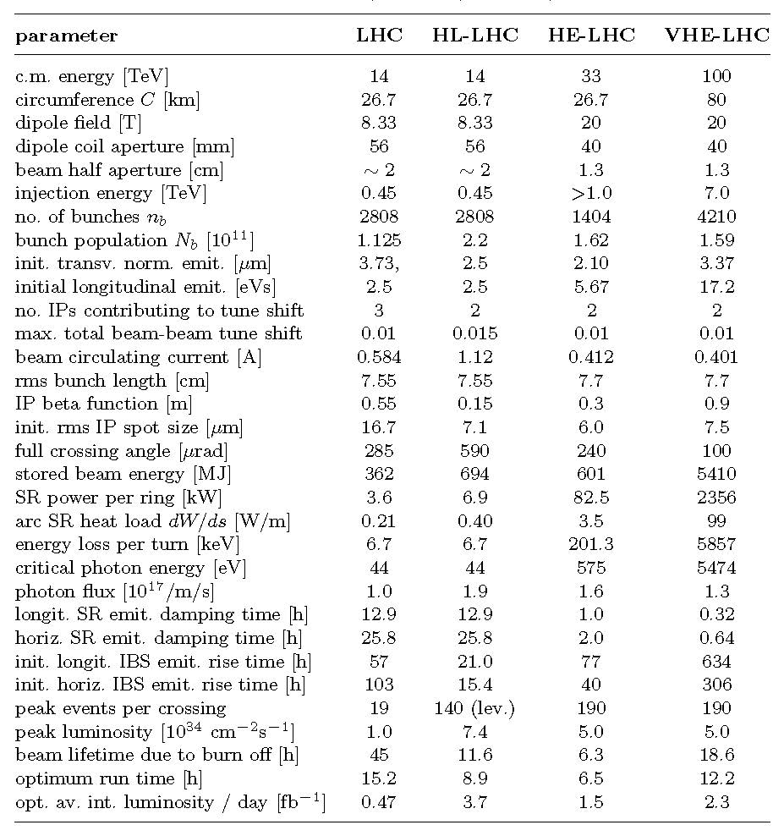
parameters
for LHC
HL-LHC,
HE-LHC
and
VHE-LHC
(examples)
O. Dominguez
& F. Zimmermann

Slide 36
parameters for TLHeC & VHE-TLHeC (examples)
collider parameters | TLHeC |  | VHE-TLHeC
species | e± | p | e± | p
beam energy [GeV] | 120 | 7000 | 120 | 50000
bunch spacing [μs] | 3 | 3 | 3 | 3
bunch intensity [10¹¹] | 5 | 3.5 | 5 | 3.5
beam current [mA] | 24.3 | 51.0 | 24.3 | 51.0
rms bunch length [cm] | 0.17 | 4 | 0.17 | 2
rms emittance [nm] | 10,2 | 0.40 | 10,2 | 0.06
β_{x,y}*[cm] | 2,1 | 60,5 | 0.5,0.25 | 60,5
σ_{x,y}* [μm] | 15, 4 |  | 6, 2
beam-beam parameter ξ | 0.05, 0.09 | 0.03,0.01 | 0.07,0.10 | 0.03,0.007
hourglass reduction | 0.63 |  | 0.42
CM energy [TeV] | 1.8 |  | 4.9
luminosity [10³⁴cm⁻²s⁻¹] | 0.5 |  | 1.6

Slide 37
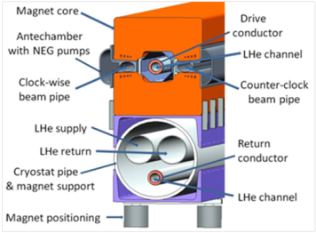
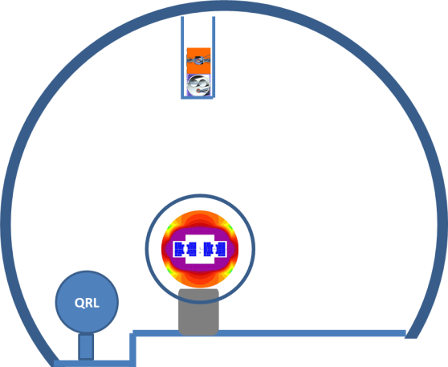
arrangement in VHE-LHC tunnel
Lucio Rossi
CLIC workshop
28 Jan. 2013
VHE-LHC injector ring “LER”
(using transmission line magnet)
H. Piekarz, Proc.
HE-LHC’10, p. 101
20-T magnet
30 mm V gap
50 mm H gap
Bin = 0.5 T
Bextr = 1.5 T

Slide 38
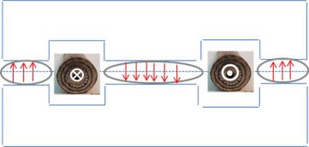
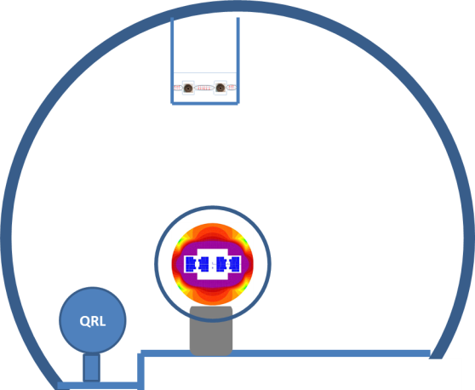
VHE-LHC’s LER magnets compatible with TLEP and VLHeC – 100 MW SR
Lucio Rossi
CLIC workshop
28 Jan. 2013
advantages:
cheap, like resistive magnets
central gap could be shortcircuited
magnets separated: provides electrons at 120 GeV and protons at 5 TeV/beam
limited cryopower (HTS) in shadow of SCRF cavities
SC cables developed already for SC links (HiLumi) and power applications
SR taken at 300 K

Slide 39
Lucio Rossi’s «plan for all»
Lucio Rossi
CLIC workshop
28 Jan. 2013
according to Physics needs, the 80 km tunnel can:
  be alternative to HE-LHC
  or be complementary to HE-LHC
  accomodate at negligible extra-cost TLEP and VLHeC
  modular detector design allows evolution from TLEP-H/TLHeC to VHE-LHC
2017-2020 is critical time!

Slide 40
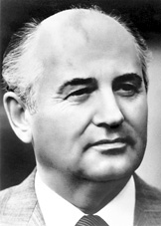
Mikhail S. Gorbachev
If what you have done yesterday
still looks big to you,
you haven’t done much today.

Slide 41

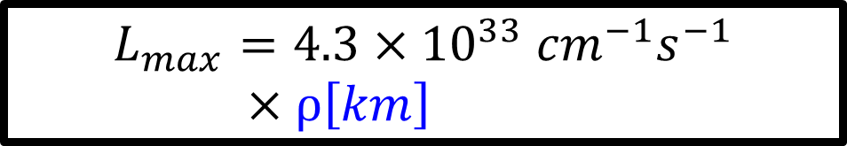


maximum TLEP luminosity
Mike Koratzinos
maximum theoretical luminosity is
$$L=\frac{{(f}_{rev}n_{b}N_{b}^{}) }{2}\frac{γ}{r_{e}}ξ_{y}\frac{R_{hourglass}^{}}{β_{y}^{∗}}$$
$$=1.7×{10}^{16}×ρ[km]$$
Max. of 0.1
total power limit (100 MW SR)
Beam-beam limit
For LEP3 this is =6cm⁻¹ (0.6/0.1cm⁻¹). For TLEP =0.75/0.1cm⁻¹. Difficult to go beyond this without nanobeam /crab-waist scheme
$$=8.42×{10}^{17}{cm}^{−1}$$
at 120 GeV
$$L_{max}=4.3{×10}^{33}{cm}^{−1}s^{−1}×ρ\left[km\right]$$

Slide 42
even higher TLEP luminosity?
charge compensation (CC) – counteracting the electric field of the incoming beam by a second beam of opposite charge
4-beam collisions at DCI, Orsay, 1971
- not a spectacular success
new idea (V. Telnov, M. Koratzinos): use charge compensation to suppress beamstrahlung and push luminosity in crab-waist scheme

Slide 43
artist’s impression of CC-TLEP
Mike Koratzinos
main ring magnets
Thermal power management
Vacuum management
Vacuum chamber
Accelerator ring magnets
Clockwise e+ anticlockwise e-
Clockwise e- anticlockwise e+

Slide 44
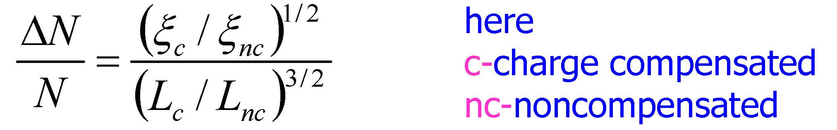

Valery Telnov’s estimate for CC TLEP
V. Telnov, 3 TLEP3 Day

Slide 45
HF quality indicators
readiness / maturity
cost , electrical power
peak luminosity , #IPs
integrated luminosity
  Hübner (H) factor = integrated lumi/(peak lumi x calendar time for physics)
  H_{LEP} ≈0.2, H_{LHC} ≈0.2, H_{KEKB}≈0.7, H_{PEP-II}≈0.7
  commissioning time
  expandability

Slide 46
HF Accelerator Quality (My Opinion)
 | Linear C. | Circular C. | LHeC | Muon C. | γ−γ C.
maturity | ☺ | ☺ ☺ | ☺ ☺ | ☹ | ☹
size | ☹ | ☹ | ☺ | ☺☺ | ☺
cost | ☹ | ☺ - 😐 | ☺ | ☹ | ☺
power | 😐 | 😐 | 😐 | 😐 | 😐
#IPs | 1 | 4 | 1 | 1 | 1
com. time | 10 yr | 2 yr | 2 yr | 10 yr | 5 yr
H factor | 0.2 (SLC) | 0.5 (1/2 PEP-II) | 0.2? | 0.1? | 0.1?
Higgs/IP/yr | 7 k [10 k] | 20-100 k | 5 k | 5 k | 10 k
expanda-bility | 1-3TeV e⁺e⁻, γγ C. | 100 TeV pp | γγ C. | 10 TeV μμ | LC later
inspired by S. Henderson, FNAL

Slide 47

the path forward

Slide 48
the path forward
set up international collaboration(s) & work structure
  ERC proposal on large-acceptance IR
  design by Rogelio Tomas
  TLEP Design Study Proposal for ECFA
  INFN-LNF could play a key role!
goal: publish TLEP Conceptual Design Study Report by end of 2014!

Slide 49


ERC Consolidation Grant
Proposal “LEAF” – Draft
PI: Rogelio Tomas
includes international
network for feeding new
ideas, guidance, local
support for experimental
tests, review & collaboration

Slide 50
draft work topics: TLEP accelerator
parameter optimization with regard to lifetime and luminosity, at different energies, & different tunnels
RF system design, prototyping & integration for collider and accelerator ring
optics design for collider ring including low-beta IRs, off-momentum dynamic aperture, different energies
beamstrahlung: lifetime, steady state beam distribution, dependence on tune etc.
beam-beam interaction with large hourglass effect
emittance tuning studies, errors, tolerances, etc.
optics design and beam dynamics for the accelerator ring, ramping speed etc
impedance budget, CSR, instabilities
cryogenics system design
magnets design: collider ring dipole, accelerator ring dipole, low-beta quadrupole
radiation, shielding, cooling for 100 MW SR power
vacuum system design
engineering study of 80-km tunnel
design of injector complex including e+ source, and polarized e- source
machine detector interface, integration of accelerator ring at detector (s), low-beta quadrupoles, shielding (e.g. against beamstrahlung)?
injection scheme
polarization, Siberian snakes, spin matching, acceleration & storage, polarized sources
(19 September 2012)

Slide 51

TLEP Design Study
Proposal
to be submitted to
ECFA

Slide 52


Slide 53
summary
TLEP is a great opportunity for HEP!
  unparalleled “ZH” luminosity in 4 IPs, allowing for highest-precision Higgs studies
  also Tera-Z and Mega-W factory, + t-tbar studies
  future conversion into 100 TeV pp collider with lots of synergies (tunnel, cryo, detectors), & ep option
LEP3 as backup
TLEP3 accelerator R&D to address key issues
  radiation shielding
  IR optics, beam-beam effects, and injector ring
  tunnel, RF system, arc magnets,…
plans for international collaboration & CDSR

Slide 54
TLEP events & references
A. Blondel, F. Zimmermann, “A High Luminosity e⁺e⁻ Collider in the LHC Tunnel to study the Higgs Boson,” arXiv:1112.2518v1, 24.12.’11
K. Oide, “SuperTRISTAN - A possibility of ring collider for Higgs factory,”
KEK Seminar, 13 February 2012
1st EuCARD LEP3 workshop, CERN, 18 June 2012
A. Blondel et al, “LEP3: A High Luminosity e+e- Collider to study the Higgs Boson,” arXiv:1208.0504, submitted to ESPG Krakow
P. Azzi et al, “Prospective Studies for LEP3 with the CMS Detector,”
arXiv:1208.1662 (2012), submitted to ESPG Krakow
2nd EuCARD LEP3 workshop, CERN, 23 October 2012
P. Janot, “A circular e⁺e⁻ collider to study H(125),” PH Seminar, CERN, 30 October 2012
ICFA Higgs Factory Workshop: Linear vs Circular, FNAL, 14-16 Nov. ’12
A. Blondel, F. Zimmermann, “Future possibilities for precise studies of the X(125) Higgs candidate,” CERN Colloquium, 22 Nov. 2012
3rd TLEP3 Day, CERN, 10 January 2013
4th TLEP mini-workshop, CERN, 4-5 April 2013
https://espace.cern.ch/LEP3
https://cern.ch/accnet

Slide 55
“A circle is a round straight line with a hole in the middle.”
  Mark Twain,
  in "English as She Is Taught",
  Century Magazine, May 1887

Slide 56
back-up slides

Slide 57



Circular HF HiTech option
H. Piekarz,
1st EuCARD LEP3 Day
transmission-line
HTS/LTS magnets
schematic HTS/LTS LEP3 magnet
SC magnets require typically 10 x less space than NC magnet of the same field and gap; the magnet weight is very significantly reduced.
HTS prototype dipole at FNAL
Test: B _{max} = 0.5 T, I_{max} = 27 kA, dB/dt _{max} = 10 T/s , T _{max} ~ 25 K
acceleration time ~0.1 s,
total cycle ~1 s; fast SC
magnets might support
1 minute lifetime
in collider ring!

Slide 58

UNK Higgs
Factory, 2012
FNAL site filler, 2012
LEP3 2011
West Coast
design, 2012
LEP3 on LI, 2012
LEP3 in Texas, 2012
Chinese Higgs
Factory, 2012
SuperTristan 2012
circular Higgs factories become
popular around the world

