Slide 1
SAPPHiRE*: A dedicated photon collider as Higgs factory
Marco Zanetti (MIT)
*Small Accelerator for Photon-Photon Higgs production using Recirculating Electrons
(Frank Zimmerman copyright)

Slide 2
Intro: γγ colliders
Old idea, proposed at beginning of the 80s
Ginzburg, Kotkin, Serbo, Telnov, Pizma ZhETF 34 514 (1981), JETP Lett. 34 491 (1982)
Over 1000 papers on the subject
So far tied to ILC
Possibility to have a photon linear collider (PLC) as a precursor of ILC discussed and then discarded (2009)
What is new then?
The Higgs candidate found by the LHC decaying into two γ
The 125 GeV mass makes a dedicate γγ collider is conceivable
Laser technology improvments
Such machine can be coupled to the LHC (LHeC):
e±p, e±A, γp, γA

Slide 3
Outline
An overview of the physics case and of technological issues and features
The Higgs candidate from LHC
Basics of γγ colliders
(HEP) Physics topics at a γγ collider
Technological challenges
Personal remarks
Material from F. Zimmermann, V. Telnov, M. Velasco, T. Takahashi, etc.

Slide 4
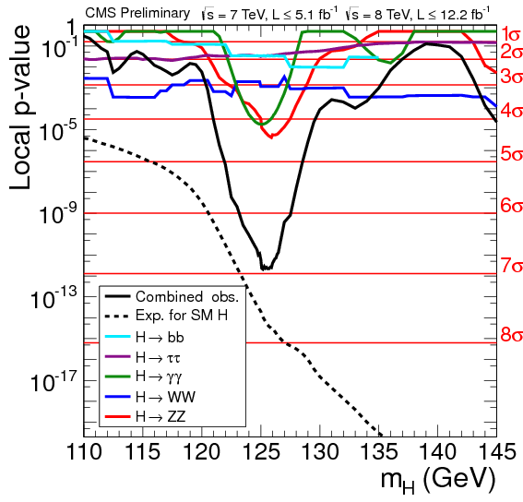
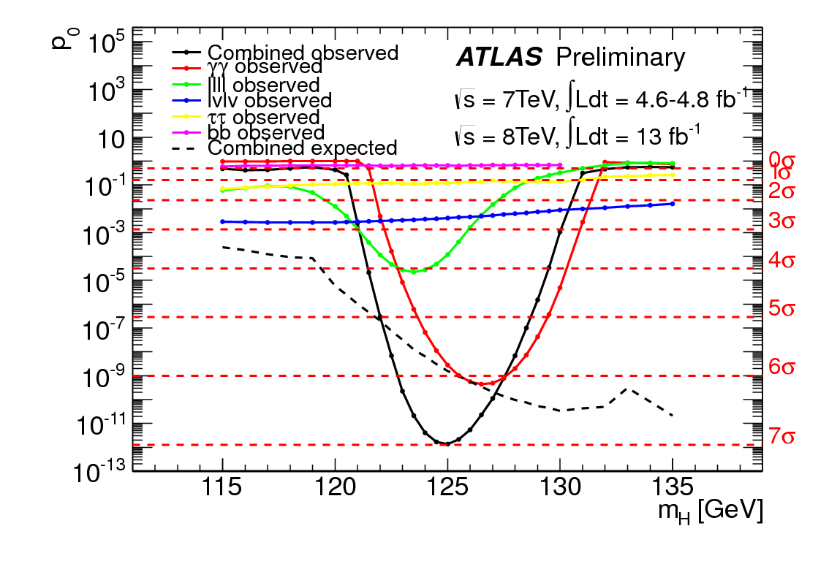
The X125 Observation
Since the discovery on 4th July, ATLAS and CMS analyses strengthened the significance of the signal
With the 8TeV dataset, several exclusive channels have >3σ sensitivity

Slide 5
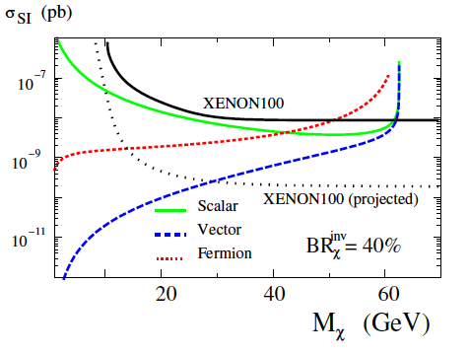
X125 as probe to new Physics
The pivotal role of the Higgs boson in the SM makes it the best probe for new physics phenomena
E.g. Higgs “portal” -> DM limits through invisible decay/total width
Sensitivity to new physics might require high precision on the coupling measurement
arXiv:1206.3560 (R. Gupta, H. Rzehak, J. Wells):

Slide 6
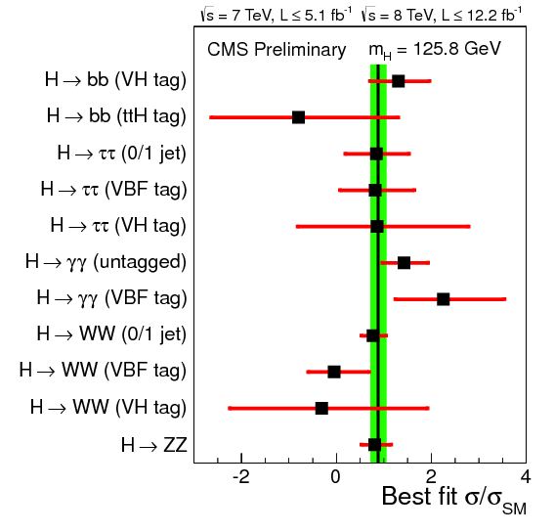
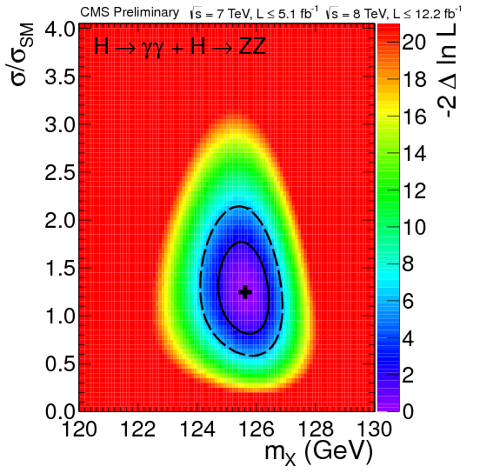
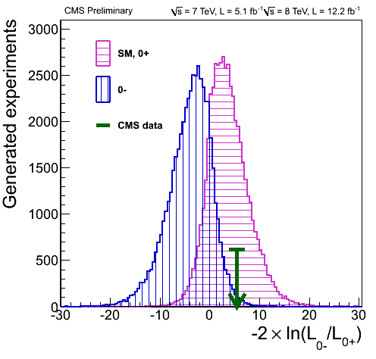
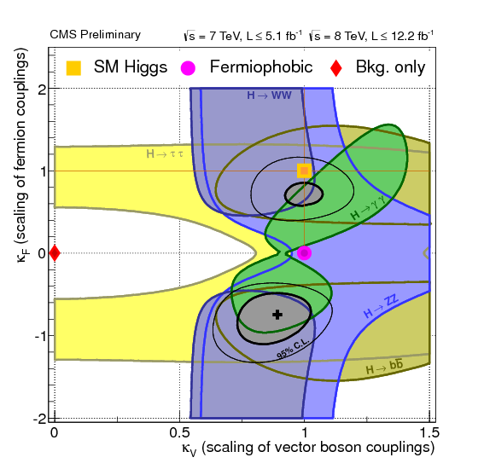
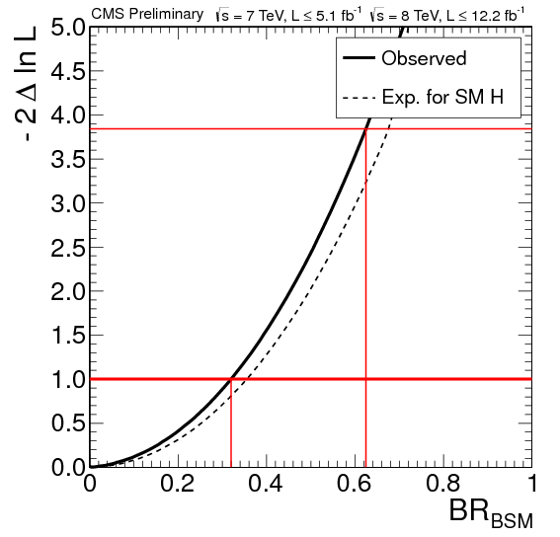
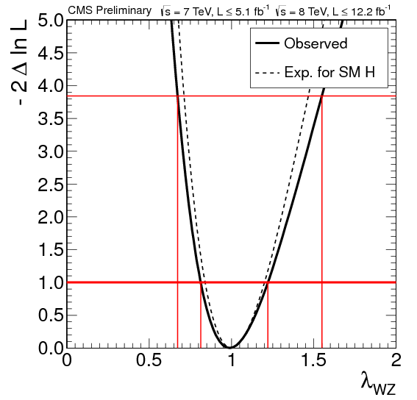
X125 as SM Higgs candidate
Properties are being assessed:
Mass, Coupling structure, JCP quantum numbers
High (integrated) lumi needed for ultimate precision
Do not have access directly to couplings, no total width w/o assumptions

Slide 7
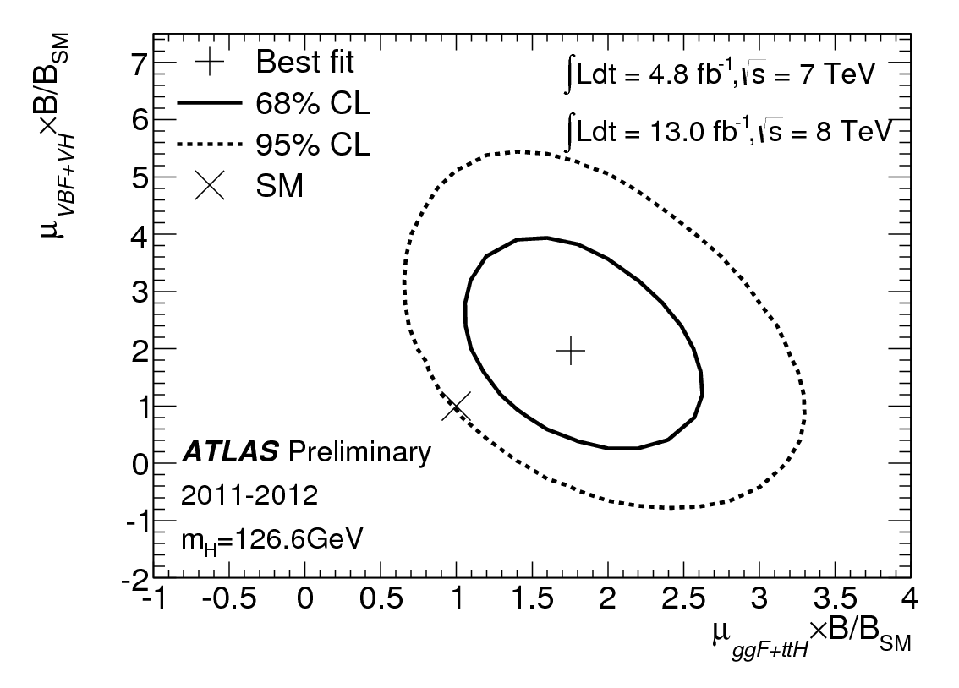
H->γγ
So far overall good agreement with SM predictions
But for the excess in the γγ channel
Sensitive to BSM physics in the decay loop
Observed by both experiments, but CMS result still from July
Might well be a fluctuation, should not get too excited..

Slide 8
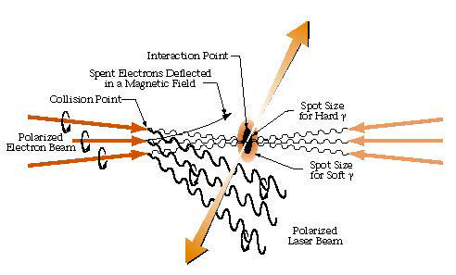
γγ colliders in a nutshell
e⁻e⁻ colliders equipped with high power laser beams
Compton backscattering of the lasers photon off the electron beams
Energy-angle correlation of the scatter photons => collimated γγ collisions at ~0.8√s_{ee}

Slide 9
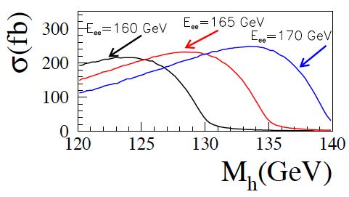
Features
Combine photon science and particle physics
Unique way of addressing Higgs physics
High signal production cross section, small background
Similar number of Higgs events per year as ILC
Hγγ vertex interesting probe for new physics
Polarized collisions => control of the initial state CP => probe for BSM
Precise mass measurement
Technical advantages
No need to mass produce positrons
s-channel production of the Higgs, smaller √s
Compact design, small budget
Interplay with other machines (LHeC)

Slide 10
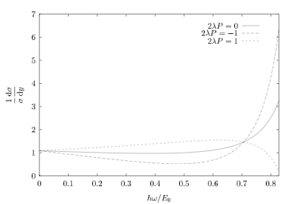
γγ collider basics
Compton scattering energy:
Max energy for back scattering γ energy:
Avoid e+e- pair production => limit √s of backscattered photon and laser => limit on x=> limit on laser photon ω:
Compton cross section depend on relative γ and e⁻ polarization (λ and P):
For the Higgs production need polarized beams

Slide 11
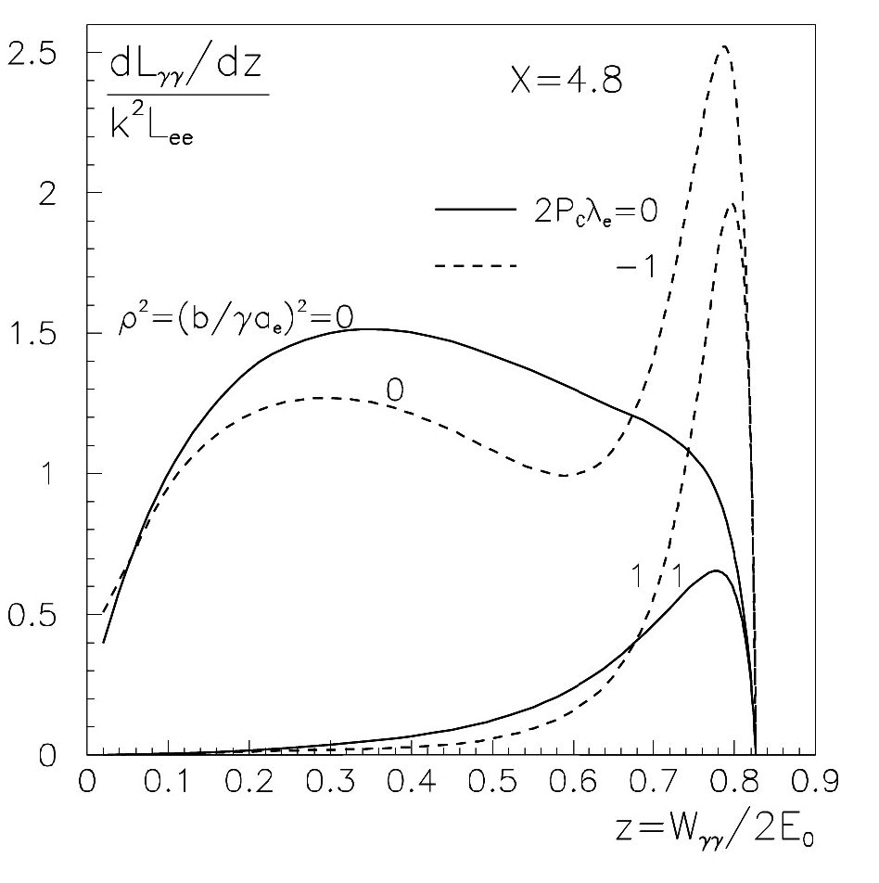
γγ collider Luminosity
γγ Luminosity depends on:
The number of beam electrons scattering at least once on laser beam
“thickness” k of the laser beam (related to the laser power and pulse duration)
Normalized distance ρ of the Compton Scattering point to the interaction point
Quasi monochromaticity of γγ interaction energy:
Thanks to energy-angle correlation, θ~1/γ

Slide 12
γγ collider Luminosity
Typically electron scatter more than once, low energy tails get populated
Level of low energy component can be regulated by tuning the CP-IP distance
Order of a few mm
Spent beams could provide additional luminosity (e⁻e⁻, e⁻γ)

Slide 13
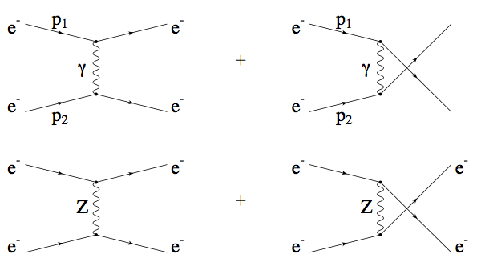
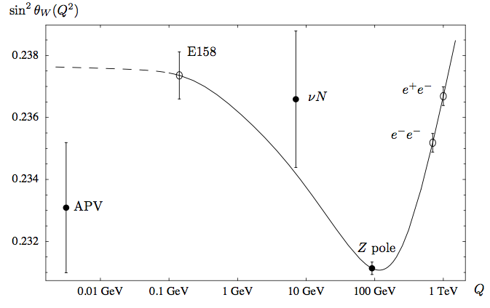
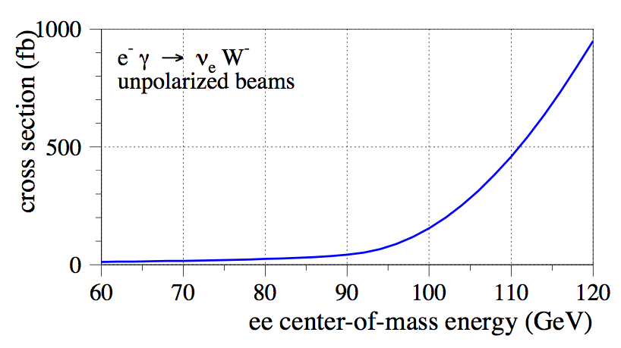
Physics with e⁻e⁻ and e⁻γ
Moeller Scattering (e⁻e⁻ -> e⁻e⁻): measure of running sinθ_{W}
W- mass from e⁻γ->W⁻ν. Experimental conditions critical for the measurement
Detector resolution
Pile-up
eγ vs eγ+γγ

Slide 14
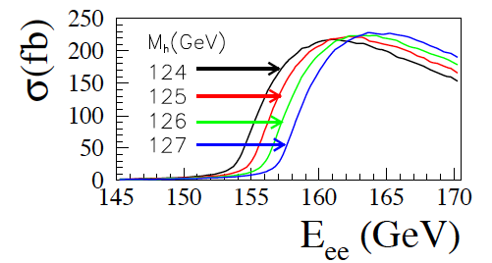
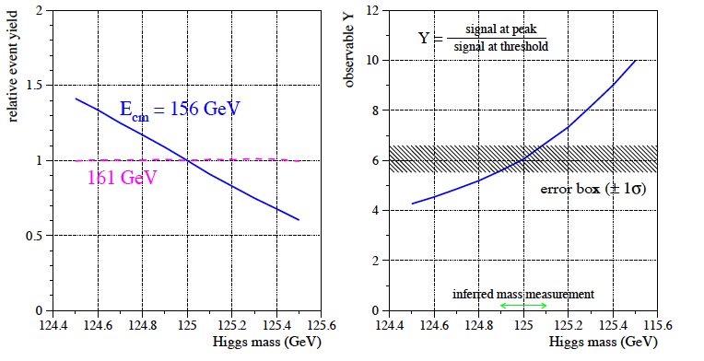
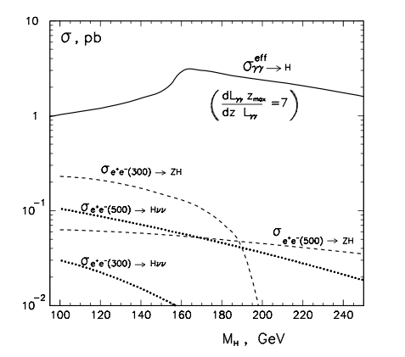
Higgs Physics
Very steep Higgs production cross section as a function of √s
Mass can be inferred by event counting during a √s scan
Complementary to mass peak measurement
Estimated precision with 1 year of data ~100 MeV

Slide 15
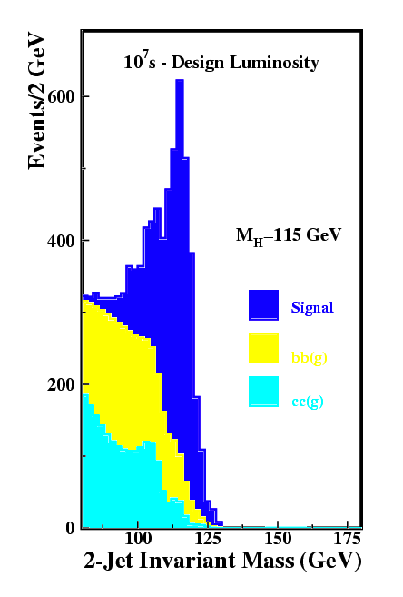
Higgs Physics
H->bb
High signal over background ratio
Cross section can be estimated at 2% level
H->WW
Hadronic or semileptonic final state
Good S/B, 5% precision on cross section expected
H->γγ
Small signal rate, small background
Possible probing of Hγγ loop
<10% precision on Γ_{γγ}²/Γ_{tot}
Other channels:
H->ZZ and H->Zγ doable (no studies available)
H->ττ to be checked, H->cc and H->gluglu not viable
Colliding photons polarization: unique mean to study CP properties

Slide 16
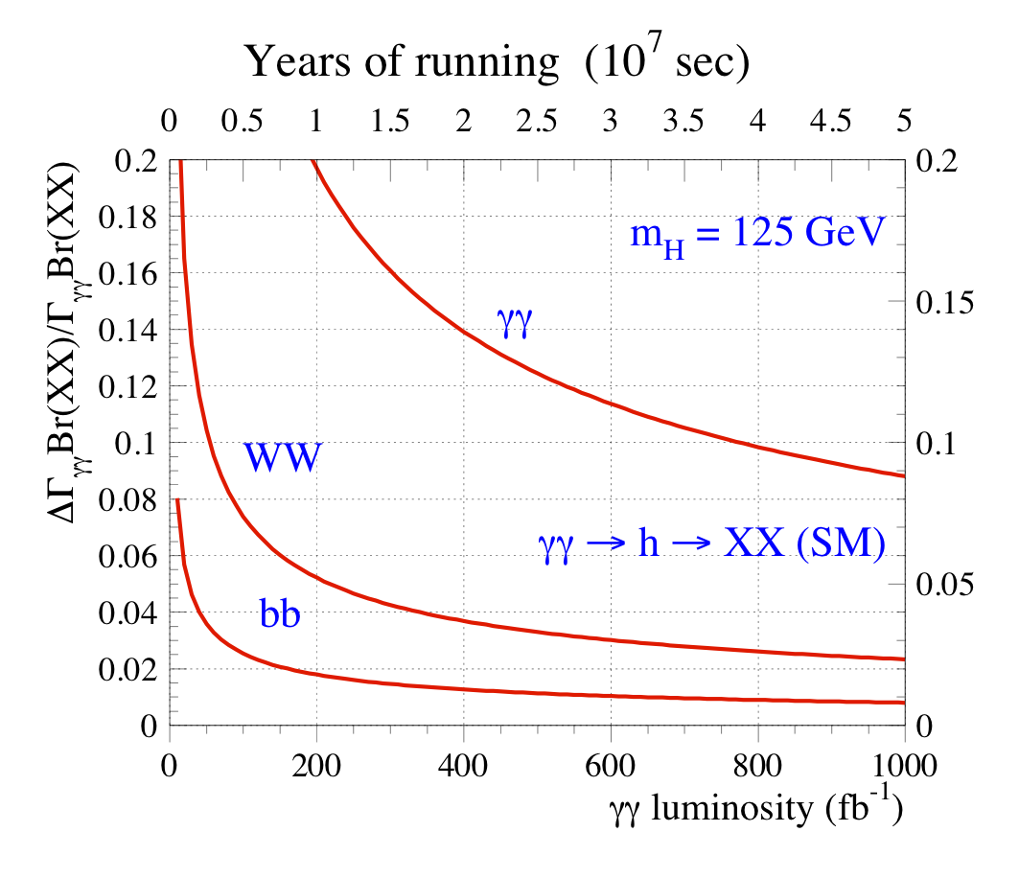
Higgs Channels

Slide 17
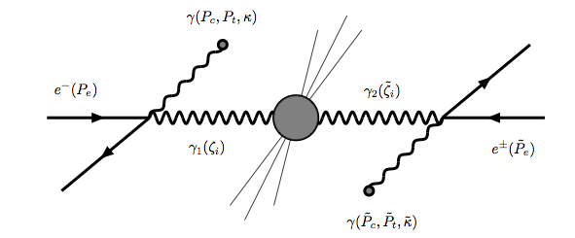
Higgs Quantum numbers
Spin and CP will be addressed by the LHC
A scenario where the Higgs is a mixture of CP state is more difficult to assess
Individual CP states can be probed by tuning the photons polarization
In bb final state a <1% asymmetry (CP violation) can be measured with ~100/fb
arXiv:0705.1089v2

Slide 18
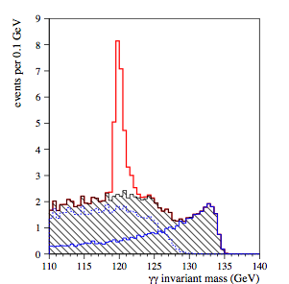
Higgs Partial and Total Widths
Assumption: get BR(H->bb) at 2% level from somewhere else
Need e⁺e⁻ (invisible recoil analysis), difficult from LHC
γγ->H->bb would then lead to ~2% precision on Γ_{γγ}
Sensitive to BSM contributions in the loop
Assess top Yukawa
Similarly, combination information form γγ and bb channels, the total width can be assessed at 10% level
Relevant e.g. for DM searches

Slide 19
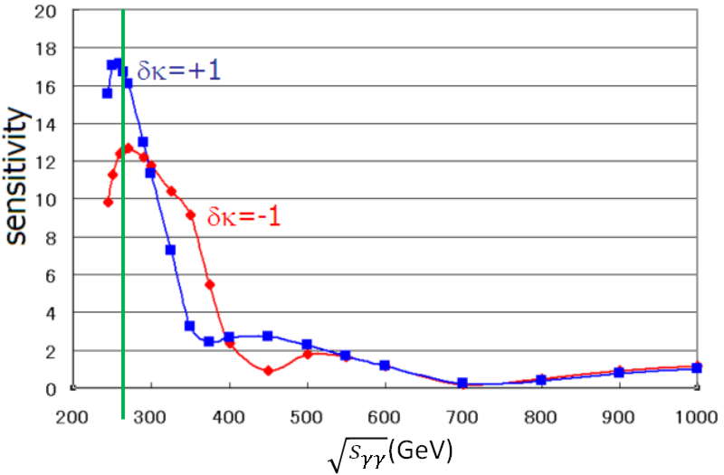
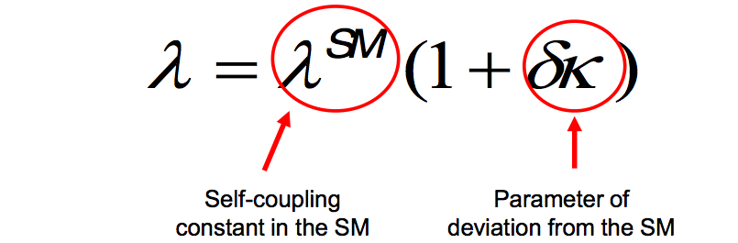
Higher energies?
Higgs self coupling accessible (S.Kawada et al, PRD 85, 1130009, 2012):
bbbb channel with a good S/B ratio
5 years of running at design lumi would yield ~5 σ
Sensitivity to tanβ regions not accessible at the LHC
Distinguish mass-degenerate A/H using polarization

Slide 20
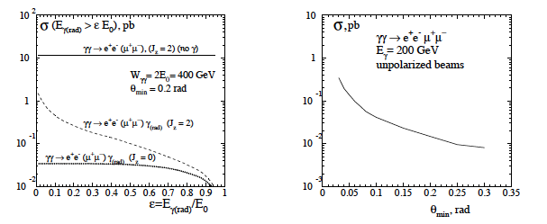
Luminosity measurement
No practical way to measure absolute lumi, rely on EM candles
Individual spin dependent components needs to be measured
γγ ->l⁻l⁺
High rate, but addressing only J=2 initial state
γγ ->γl⁻l⁺
Main candle for Higgs-like initial state
Factor ~300 smaller xsec than ll
γγ ->l⁻l⁺l⁻l⁺
Could address mixed J states but too low lrate

Slide 21
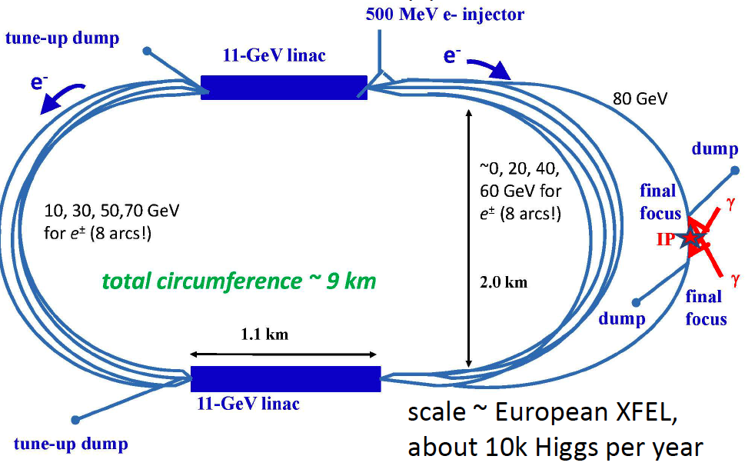
SAPPHiRE
LHC
SAPPHiRE: a Small Gamma-Gamma Higgs Factory, S.A. Bogacz, J. Ellis, D. Schulte, T. Takahashi, M. Velasco, M. Zanetti, F. Zimmermann, arXiv:1208.2827

Slide 22
SAPPHiRE parameters
4 arcs for each beam on each side
Overall length 8 km
1/6 of the geometrical e+e- lumi
10k Higgs per year

Slide 23
Energy Loss
Energy loss per arc:
Sapphire (LHeC) case, ρ=764m => electorns lose 4 GeV
Can be compensated by increase the linacs to 10.5 GeV
beam energy [ GeV] | ΔE_{arc} [GeV] | Δσ_{E} [MeV]
10 | 0.0006 | 0.038
20 | 0.009 | 0.43
30 | 0.05 | 1.7
40 | 0.15 | 5.0
50 | 0.36 | 10
60 | 0.75 | 20
70 | 1.39 | 35
80 | 1.19 | 27
total | 3.89 | 57 (0.071%)

Slide 24
e⁻ beam emittance growth
Horizontal emittance growth of the electron beam may be a severe limitation:
LHeC optics (l_{bend}=10m, ρ=764m, <H>=1.2e-3m) lead to a too high emittance growth (Δε_{N}=13μm)
80 GeV instead of 60, high price due to 6th power of energy
<H> scale as l³_{bend}/ρ² => shorten l_{bend} by factor 4=> down to 1μm at 80 GeV

Slide 25
Flat polarized e- guns
FNAL A0 line injector test facility:
starting with γε~4-5 μm at 0.5 nC, achieved emittances of 40 μm horizontally and 0.4 μm vertically (ε_{x}/ε_{y}~100)
SAPPHiRE needs only ε_{x}/ε_{y}=10 but:
Larger bunch charge 1.6 nC and smaller initial γε (~1.5 μm)
Altogether, within state of the art
Main question is whether we can get polarized beams with those parameters
Ongoing efforts:
low-emittance DC guns
MIT-Bates, Cornell, JAEA, KEK [E. Tsentalovich, I. Bazarov, et al]
polarized SRF guns
FZD, BNL, etc. [J. Teichert, J. Kewisch, et al]

Slide 26
Spent beams
Crossing angle in a crab-waist schema to get rid of e- beam
Minimize spurious collisions
Disruption angle (12mrad), outer radius of the last quadrupole (5-10 cm) and its distance from the IP (4m) determine the mininal crossing angle: ~25mrad
Beamstrahlung to be watched out (see later)
Special decay paths for hard photons

Slide 27
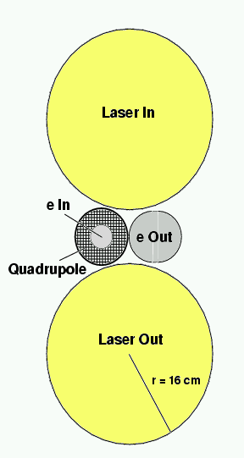
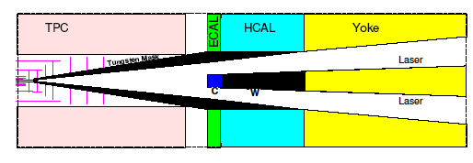
Spent beams
Integration of the laser, the incoming e⁻ beams and the spent beams with the detector (need good vertexing capabilities) is quite challenging
Beam background need to be dealt with:
Low energy remnants
pileup
Incoherent e+e- pairs
neutron background

Slide 28
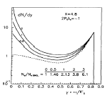
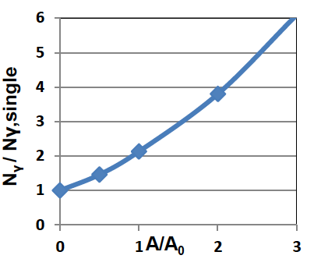
JLAB approach (Y. Zhang)
Give up high “thickness” of the laser beam (for efficient Compton conversions)
High thickness implies some bad features:
High power laser needed
Reduce non-linear effects (affecting √s)
Multiple Compton scattering=> dominant γγ collision energy tail
To keep the same luminosity need to increase e⁻ beam current
Energy recovery to not blow up power consumption
Beamstrhalung might be a showstopper

Slide 29
Beamstrahlung
Issue recently raised by Yukoya
Large amount of BS photons can be produced by the spent beams when they cross each other
Nasty background
Populating the low tail of the luminosity spectrum
Troubles in driving out the spent beams (e- and γ)
Prevent recirculation in the JLAB approach

Slide 30
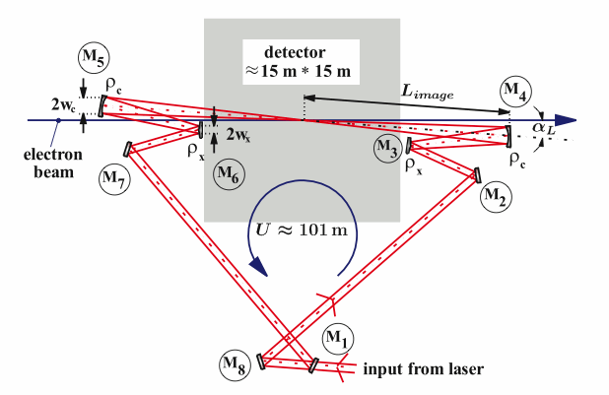
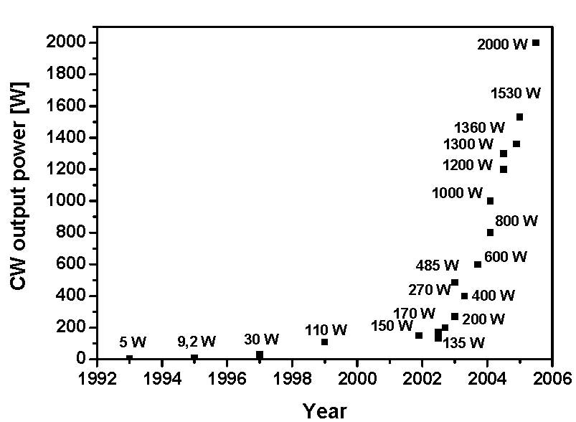
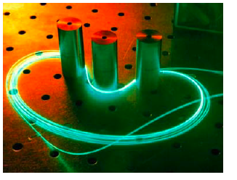
Laser
The most technologically challenging component
Need high power lasers for efficient conversion (k~1)
Pulse energy of a few J, 5 ps long pulse, 1MW average power
Fiber laser
Stacked passive optical cavity pumped by a laser via a semi-transparent mirror
Amplification of 100-1000

Slide 31
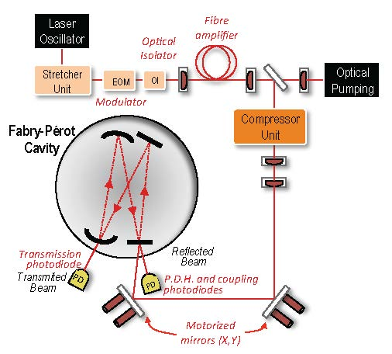
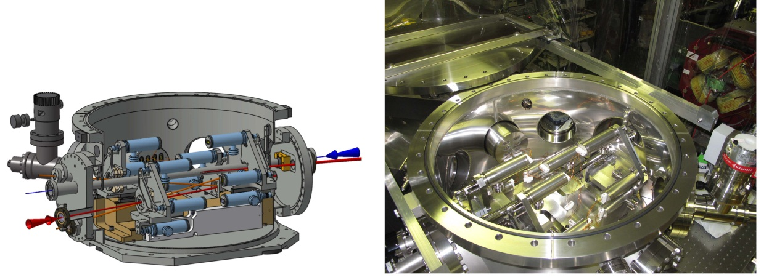
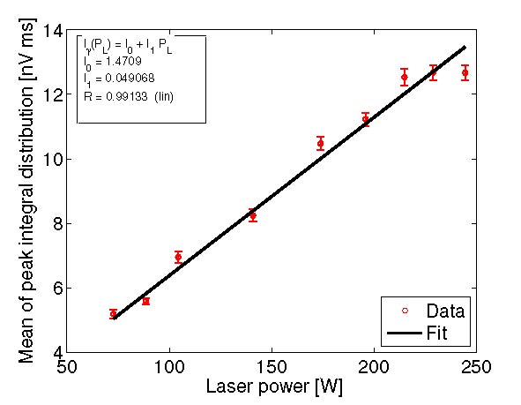
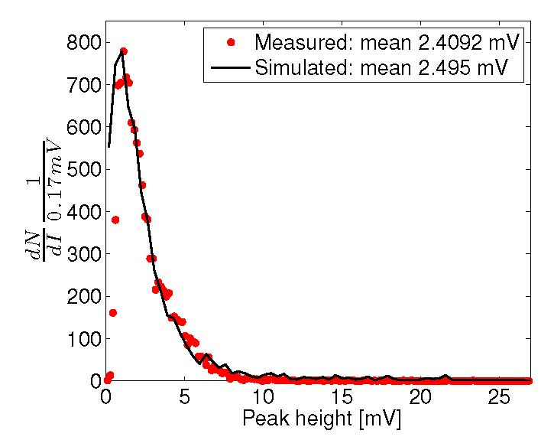
MightyLaser experiment at KEK-ATF
non-planar high finesse four mirror Fabry-Perot cavity;
first Compton collisions observed in October 2010
I. Chaikovska, N. Delerue, A. Variola, F. Zomer et al
Vacuum vessel for Fabry-Perot cavity installed at ATF
Optical system used for laser power amplification and to inject laser into FPC
Plan:
improve laser
and FPC mirrors
& gain several
orders
Comparison of measured and simulated gamma-ray energy spectra from Compton scattering
Gamma ray spectrum for different FPC stored laser power

Slide 32
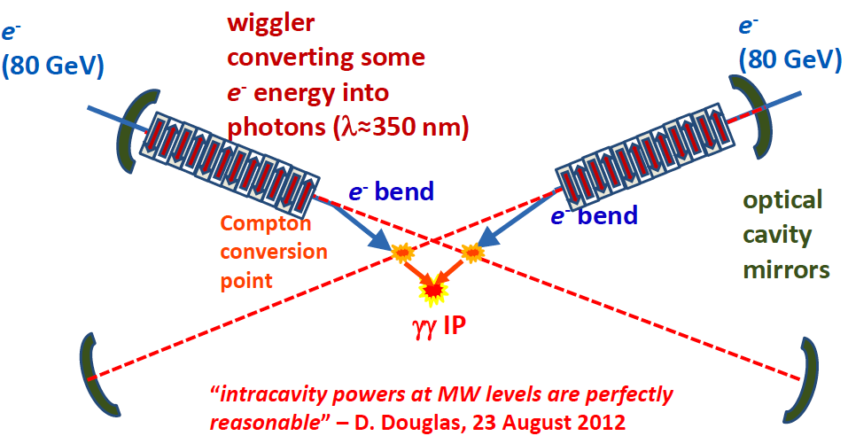
Alternative approach (FEL)
Possibility of coupling the setup to a free-electron laser is very interesting
Get synchronization for free
Reduction in cost and complexity

Slide 33
Sites: HERA
arc magnets -17 passes!
laser or auto-driven FEL
5.6 GeV
15.8
26.0
36.2
46.0
55.3
63.8
71.1
71.1
63.8
55.2
46.0
36.2
26.0
15.8
5.6
beam 1
beam 2
75.8 GeV
r=564 m for arc dipoles
IP
2x8+1 arcs
20-MV
deflecting
cavity (1.3 GHz)
20-MV
deflecting
cavity
3.6 GeV
linac
3.6 GeV
Linac
(1.3 GHz)
Real-estate linac
Gradient ~ 10 MV/m
Total SC RF = 10.2 GV
2x1.5 GeV
linac

Slide 34
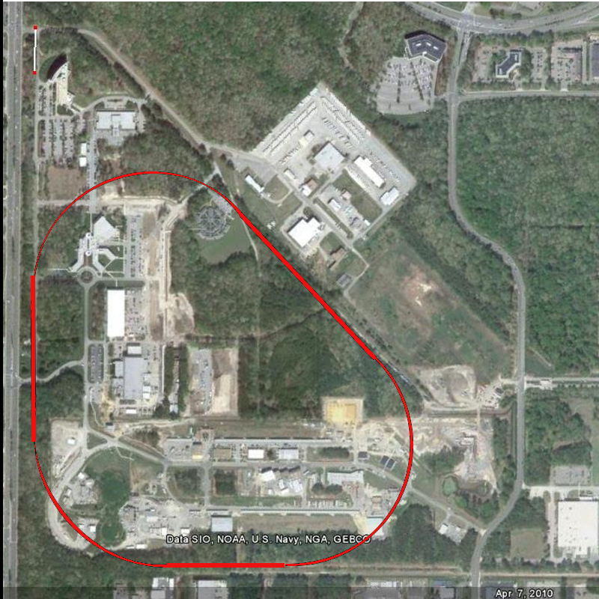
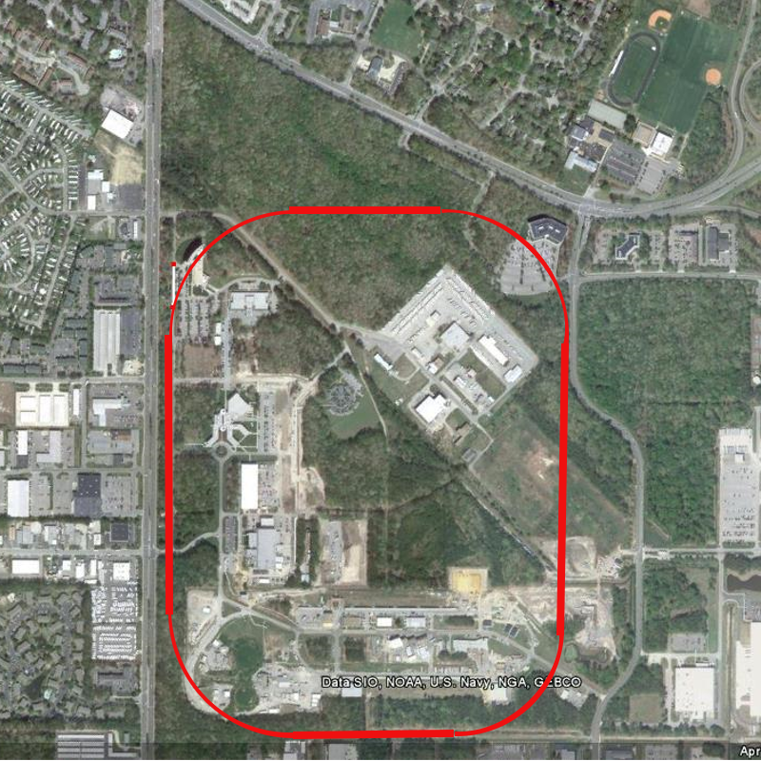
Sites: JLAB
85 GeV Electron energy
γ c.o.m. 141 GeV
103 GeV Electron energy
γ c.o.m. 170 GeV

Slide 35
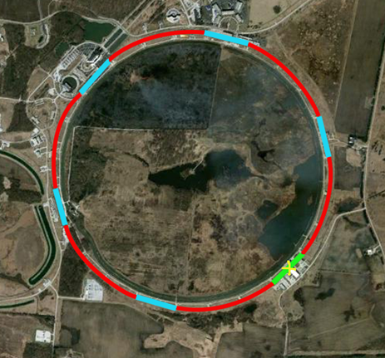
Sites: FNAL
Top Energy | 80 GeV | 80 GeV
Turns | 4 | 5
Avg. Mag. ρ | 661.9 m | 701.1 m
Linacs (2) | 10.68GeV | 8.64GeV
δp/p | 8.84x10⁻⁴ | 8.95x10⁻⁴
ϵ_{nx} Growth | 2.8μm | 2.85μm
2 Linacs
IP
Top Energy | 80 GeV | 80 GeV
Turns | 3 | 4
Magnet ρ | 644.75 m | 706.65 m
Linacs (5) | 5.59GeV | 4.23GeV
δp/p | 6.99x10⁻⁴ | 7.2x10⁻⁴
ϵ_{nx} Growth | 1.7μm | 1.8μm
5 Linacs
IP

Slide 36
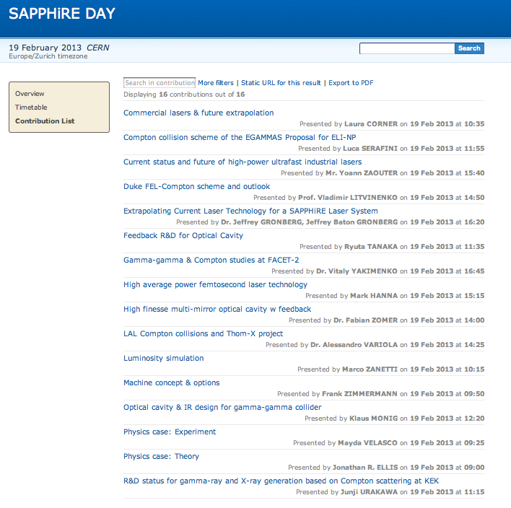
Sapphire Workshop, CERN - 19 Feb

Slide 37
Concluding (personal) remarks
Technology
A technologically fascinating project
Laser/FEL, e- gun, linac, recirculation, IP, etc
No showstoppers, but nothing off-the-shelf
HEP
Interesting Higgs physics reach, but alone cannot cover the whole program
Complementary to (circular!) e+e- machine
Other high precision measurements (e.g. with e⁻γ) and BSM physics
Would benefit very much from higher √s
Not for the “moment”
Just 1 IP

Slide 38
Concluding (personal) remarks
Cost
A small fraction of other future facilities budgets
Still O(1B$)..
Need a full HEP detector
Probably not worth pursuing it only as a HEP project
Interplay with other fields
Most appealing part of the project
Photon source (citing Telnov):
Bright source (directional, ultra-fast), monochromatic scattered light (after collimation), tunable wavelength, less expensive than XFEL, broad energy reach (keV, MeV, GeV TeV), polarization
Can be used for many other purposes
Even more appealing if coupled to other HEP facilities
SAPPHiRE+LHC+LHeC: pp, AA, Ap, ep, eA, γγ, γe, γp, γA

Slide 39
BACKUP

Slide 40
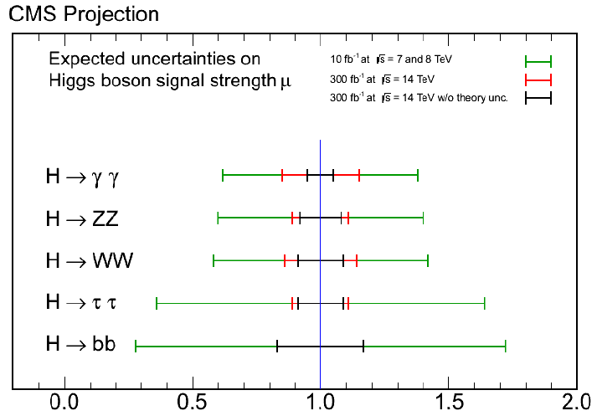
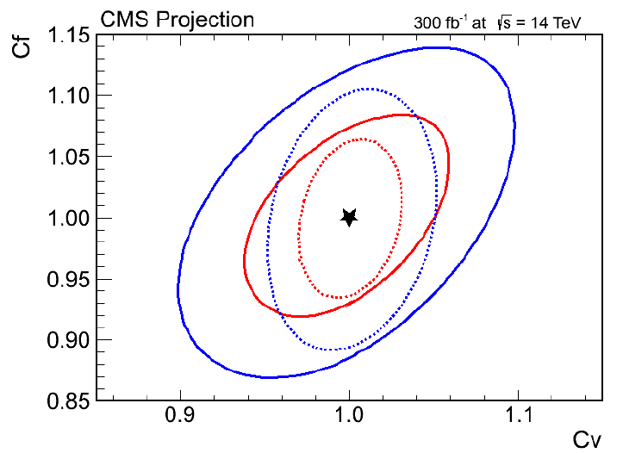
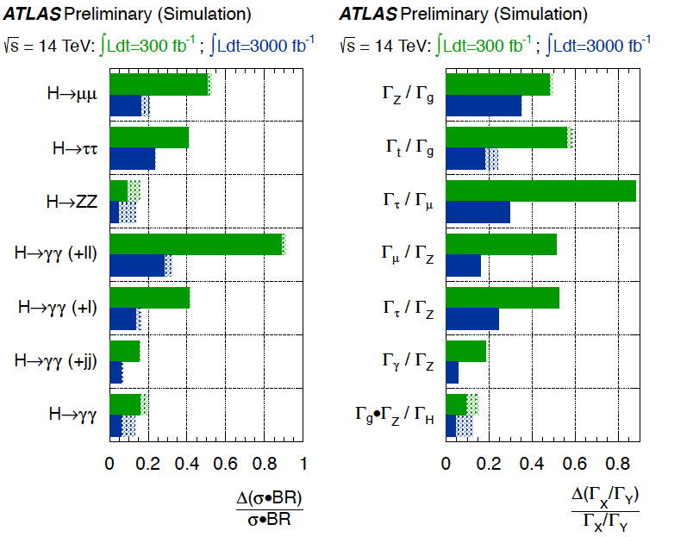
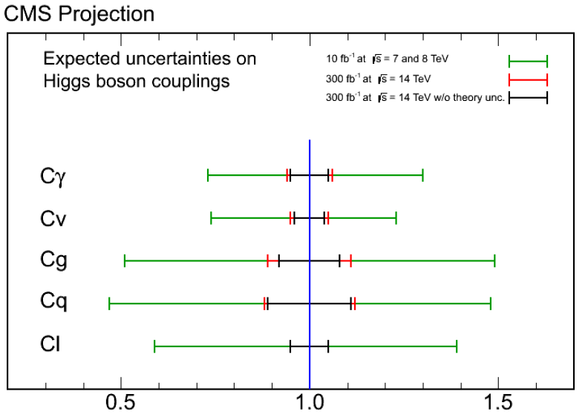
How well can the LHC do?
Projections made starting from current analysis, simply scaled by cross section and integrated luminosity
5-20% precision on the couplings within this decade

Slide 41
LHC luminosity projections
Currently:
8 TeV (σ_{inel}=75mb), ~7e33 cm⁻²s⁻¹, 20fb⁻¹/ year, pileup 35
Move to 13 TeV and resume operations in 2015
Target of 1e34 cm⁻²s⁻¹, 10/7*20 fb⁻¹/ year, pileup 50
Not major improvement in inst lumi till 2021
In 5 years: 150 fb⁻¹ realist, 300 fb⁻¹ optimistic
Luminosity scales 1-to-1 with pileup (number of bunches is fixed):
Rule of thumb: 2e32 for every PU event:
5e34 cm⁻²s⁻¹-> pileup 250..
Assuming no penalties due to PU, still a long way to go to integrate O(ab⁻¹):
5e34 cm⁻²s⁻¹ -> max 200 fb⁻¹/ year
Beam lifetime due to burn-off becomes short (<10h), luminosity leveling is required

Slide 42
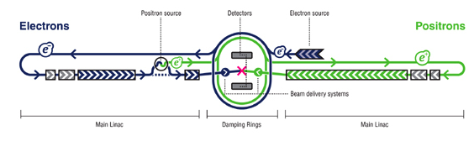
What is there beyond LHC
LHC will not be sufficient to fully investigate the Higgs sector, precision non-hadronic machine(s) are needed
Long standing proposal of an electron-positron linear collider
Large international collaboration, design effort and physics reach studies going on since the 90s.
Larger scale (complexity, budget) than the LHC
Approach not free of drawbacks. Are there alternative strategies? YES

Slide 43
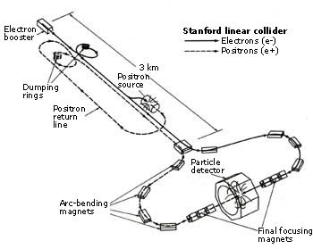
List of concerns on ILC
Cost (~10B$)
Small technological and operational experience
Robustness on luminosity
Nanometric beams
SLC is the only predecessor, never achieved
nominal luminosity
CoM Energy spectrum (beamstrahlung)
Single detector
Push-and-pull option is tough
Just fair share of the total luminosity

Slide 44
in LHC p-Pb γ−γ collisions
thanks to John Jowett
David d’Enterria, 17 October 2012

Slide 45
in LHC p-Pb γ−γ collisions
David d’Enterria, 17 October 2012
~34 events / yr with lots of effort

Slide 46
Cornell DC gun
The answer is a qualified 'yes‘. Presently we have demonstrated 90% emittances of 0.5mm-mrad at 80pC/bunch and 0.2mm-mrad at 20pC/bunch for 2ps rms bunches with the gun voltage and photocathode we are using. The scaling with charge is bunch_charge^(1/2) meaning that numbers around 2-3 mm-mrad should be doable from our gun today [for 1-2 nC charge].
We are working on further improving our gun and laser shaping, expecting to halve the emittance even when using the same photocathodes we have today. Better photocathodes automatically translate into smaller emittances and many pursue this venue as well
Ivan Bazarov, 7 Nov 12
SACLA pulsed “DC” gun
I think our gun almost meets your requirement except for the repetition rate
Hitoshi Tanaka, 7 Nov 12

Slide 47
Rossendorf polarized SRF gun
Für 2013 wollen wir die 2. Version der SRF-Gun in Betrieb nehmen. Das neue Cavity erreichte im Test am Jlab ein Peakfeld von 43 MV/m. Mit diesen Werten sollten wir 1 nC Ladung mit 500 kHz Reprate im CW (0.5 mA average current) erreichen. Die Emittanz könnte etwa 2 µm sein. Auf 1 µm könnte man etwa kommen, wenn wir vom Gausslaser zum Flat-top übergehen (analog zu PITZ/XFEL gun).
Mit der Inbetriebnahme der 2. Gun, wird dann auch das Kathodentransfersystem ausgetauscht, und wir denken dann auch die GaAs-Kathoden zu testen. Ergebnisse dann im Jahr 2014.
Jochen Teichert, 12 Nov 12
BNL QWT polarized SRF gun
simulations of 5 μm emittance at 10 nC with 112 MHz gun
Tor Raubenheimer, 14 Nov 2012

Slide 48
electron disruption angle
20
X=4.46
15
θ_{d}(mr)
10
5
0
0
10
20
30
40
50
60
70
80
P(GeV/c)

Slide 49
Outline
Higgs discovery and properties (review)
It is at hand (energy wise)
Higgs as a probe to new physics
Higgs portal, DM etc (study!)
The gg excess (atlas and CMS plots)
Basics of gamma-gamma production (xsec, polarization)
Concept (brief)
Some history
Imagine concept is realized, physics
The mass (how well in Sapphire?)
Channels
Properties
Luminosity
BSM channels
Collider Layout
IP layout
Laser system options
Standard laser
Self generated
Look at eli
Detector comments?
Interplay with other physics (look at eli)

Slide 50
Disclaimers
Higgs physics point of view with some expertise on accelerator
Feasibility of the machine not clear
High brillance/energy photon beam yes
High lumi not clear..
Issues:
Cost, 1 detector only
Higgs physics wise complementary to e+e-
Photon collider makes little sense alone (as a Higgs factory)
E.g also together with the LHC only, not direct access to total width (LHC doesn’t measure BRs but ratios of BRs)
Couple to LHeC
Couple to ELI
Photon colliders are 30 years old as a concepts:
Review of the working principles
updates on physics cases and technology state of the art
What is new is the HIGGS and ideas therein, i.e. Sapphire

