Slide 1
AM system Status
& Racks/crates issues
AMchip tests and design
New Board design
Power Supplies
RACK organization
Cooling tests

Slide 2
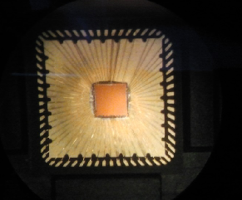
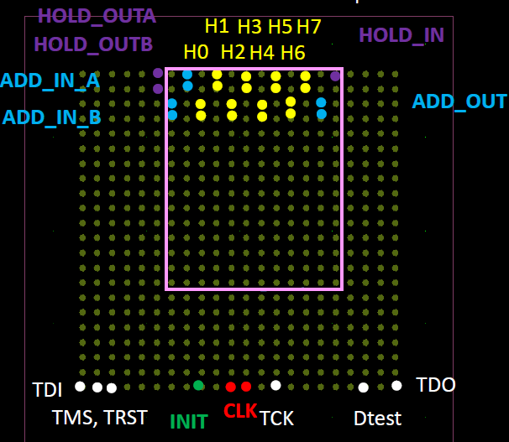
AMCHIP status
MiniAsic just received - ongoing tests at Milan
Design of AMchip05 advanced – Submission @ July end if IP core (SerDes) is working correctly
Design of AMchip06 expected for spring 2014

Slide 3
About new Boards
AMBSLP: Associative Memory Board Serial Link Processor (Designed by Andreas Sakelariou, Saverio Citraro, CERN)
MiniLAMBSLP: Little Associative Memory Board Serial Link Processor for Miniasic (Designed by Pierluigi Luciano)
LAMBSLP: Little Associative Memory Board Serial Link Processor for Amchip05 (Designed by Saverio Citraro)

Slide 4
AMBSLP
Main new features:
All data paths are differential serial link 2 Gbit/s.
All clocks are differential LVDS.
There are only 2 big FPGAs (Artix-7 1156 pads) for data distribution (larger available memory for Spy Buffers).

Slide 5
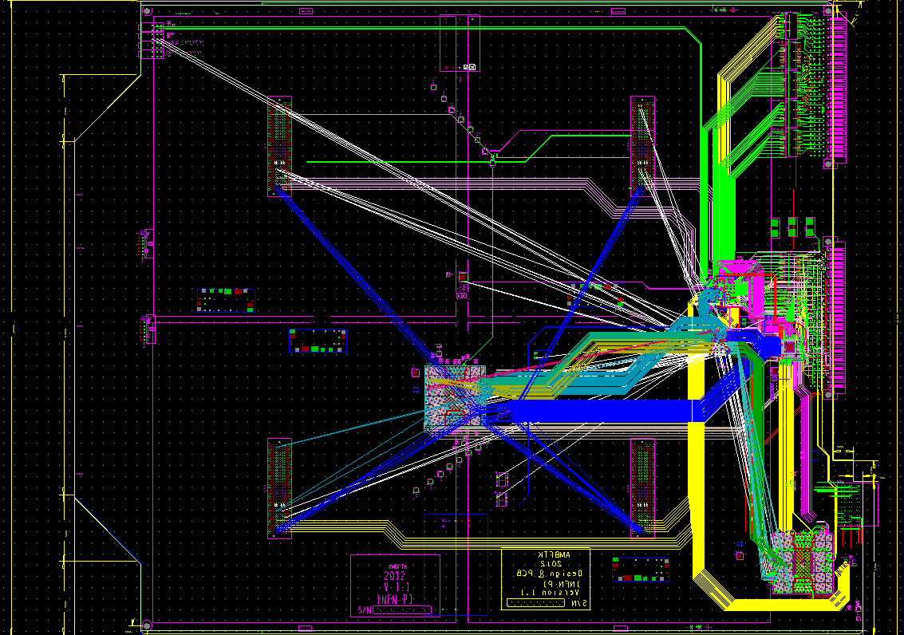
AMBSLP
Work plan:
April and May 2013: start schematic editing and routing.
Now: electronic group at CERN is completing the routing.
We should submit the PCB this week.
Ready for tests end of August
For MiniLAMBSLP and LAMBSLP
PCB layout at 21 June, 2013

Slide 6
MiniLAMBSLP
Main features:
A quarter of final LAMBSLP, with 4 chips only.
Designed for MiniASIC (little AMchip to test SerDes).
Designed to test the MiniASIC and new data-path (LVDS serial fanout).

Slide 7
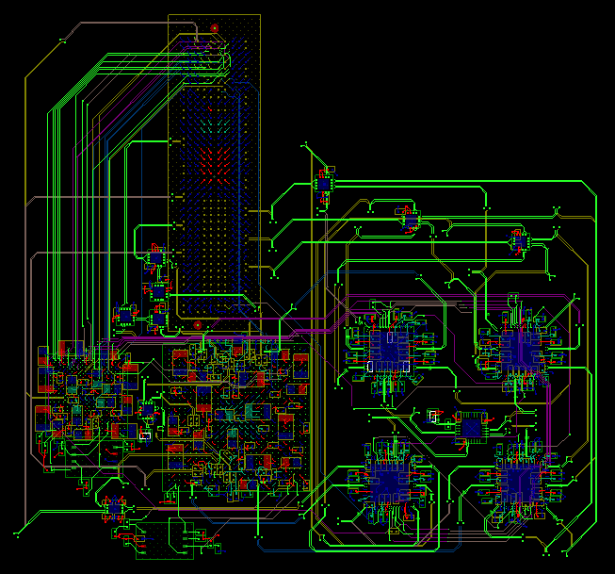
MiniLAMBSLP
Block
design
Work plan:
May and June 2013: design of schematic and routing.
Now: wait of MiniASIC chip test result (in Milan). Then submission of the board for production.
Final PCB
layout

Slide 8
LAMBSLP
Main new features:
All data paths are differential serial link 2 Gbit/s.
New high speed and high power connector.
Designed for AMChip05 (BGA 23mmx23mm)

Slide 9
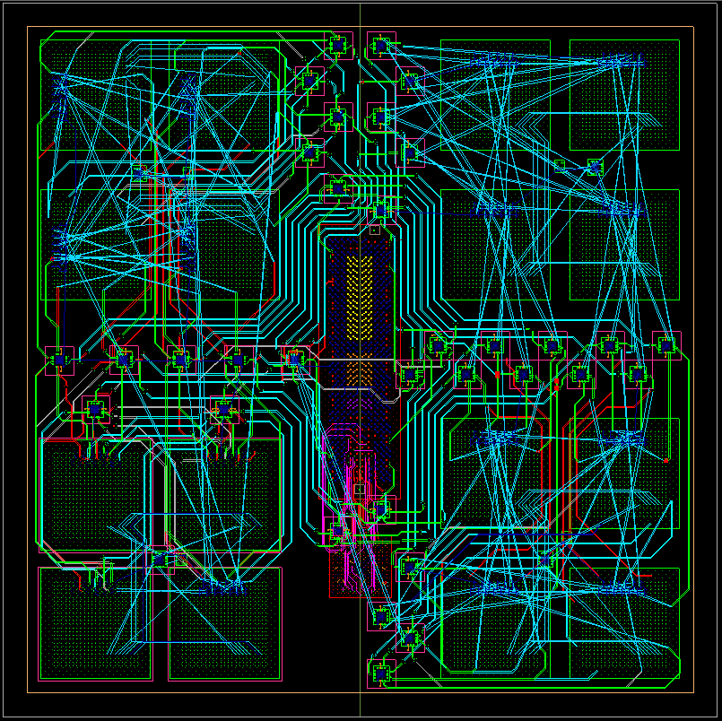
LAMBSLP
Work plan:
June 2013: start the schematic editing and routing.
Now: work in progress on PCB-layout.
After the test of MiniLAMBSLP (with MiniAsic chip) submission the board for production.
PCB layout at 25 June, 2013

Slide 10
Next steps
Early July submission of AMBSLP.
In July assembly of AMBSLP.
August send AMBSLP in Prisma Electronic for tests.
After test results on Amchip05 submission of LAMBSLP.

Slide 11
Power Supply Tot ~5320 W
Wiener proposal - CAEN proposal ??
5V: AUX expected need ~75 W→ 15 A/AUX →15 A*16 = 240 A + some spare current for VME → requested 260-270 A- ~ 1350 W; Wiener proposal: 3 modules 115 A each for a total of 345 A
14 V: AMchip core; goal~128 W→9.2 A/AMB→9.2 A *16 = 147 A-2048W Wiener proposal: 4 modules @15 V 550 W each for a total of 2200 W
@14 V 184 A 2200 W
48 V: for SerDes and fanouts: ~120 W→2,5 A/AMB →2,5 A *16 = 40 A
1920 W
Wiener proposal: 3 modules 13.5 A each for a total of 40.5 A

Slide 12
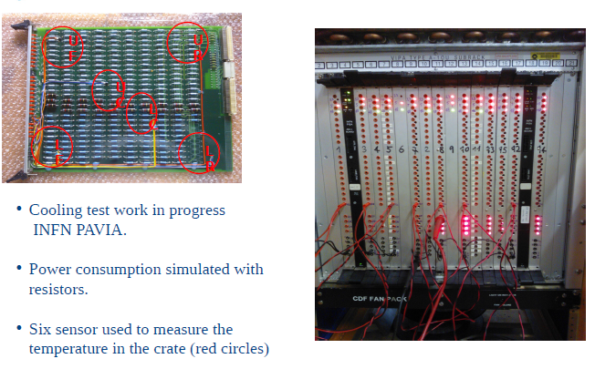
COOLING TESTS IN PAVIA
~ 4500 W

Slide 13
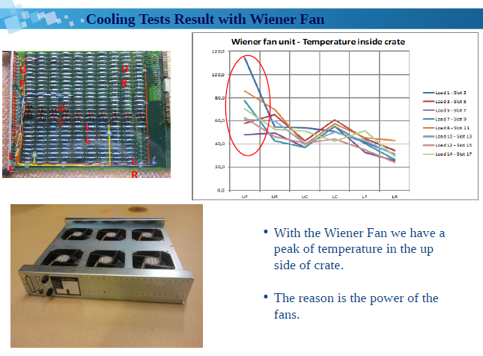
o
40-60
Unit fan: air mixed before crate
But 1 unit distance between wheel
and crate

Slide 14
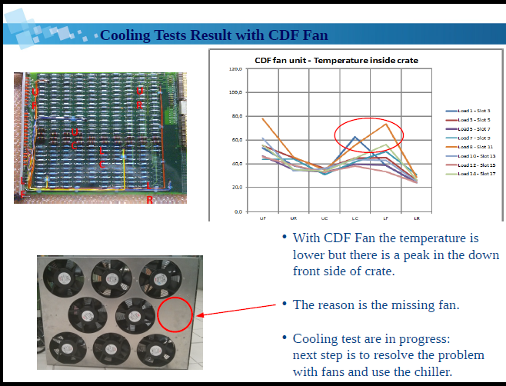
o
40-60
Unit fan: attached to crate bottom, but
No air mixing before entering the crate!

Slide 15
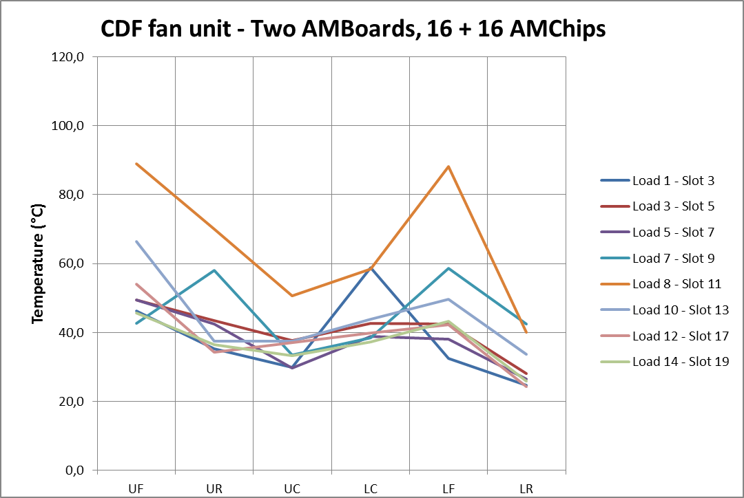
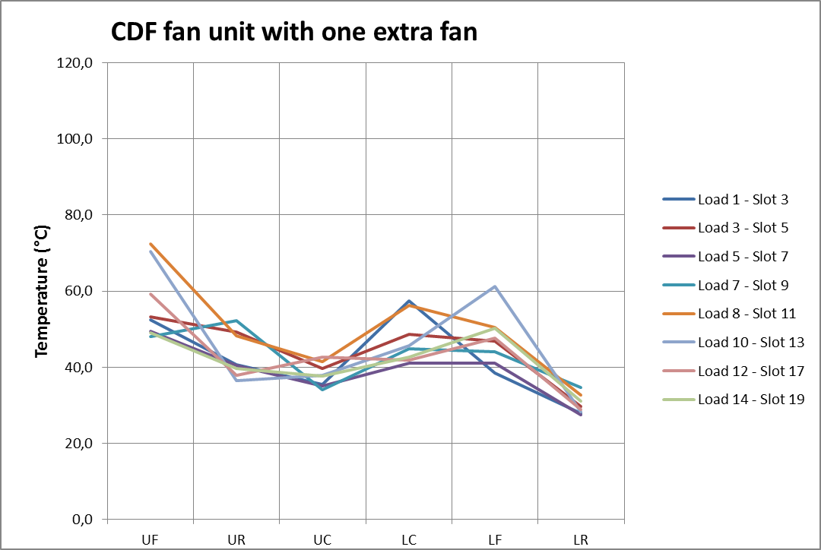
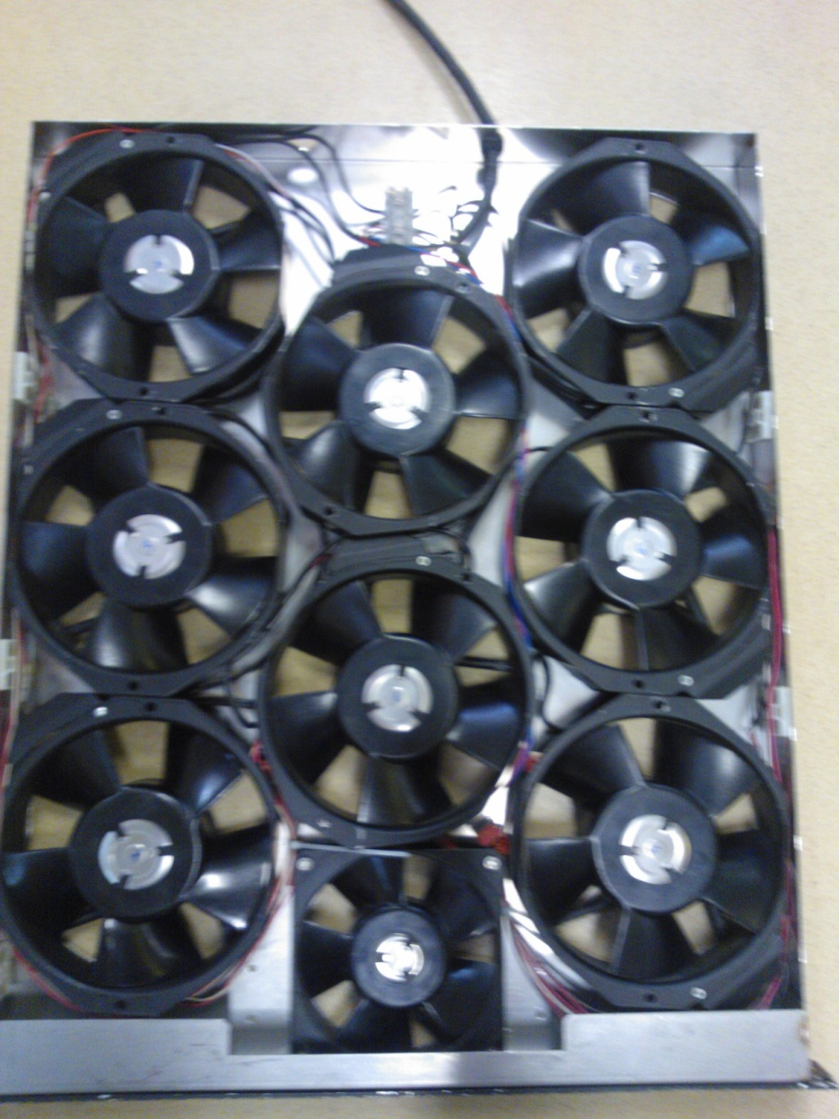
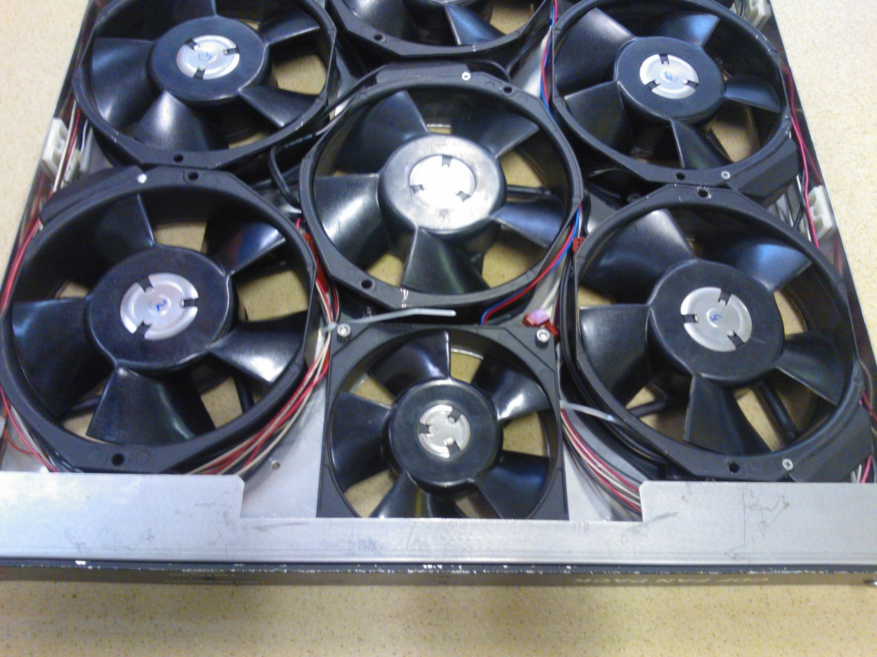

Slide 16
NEXT STEPS IN PAVIA
Turn on the chiller to cool the air
Add extra wheels to the 1 unit fan
Use last-version of Wiener fans to see if improved power gives better results
Close the Wiener fans on the side.
Turn on two old AMBoards (or 3) and see if they work correctly
Last: try the final boards and final chip in the crate
However work done up to now let us think that 5 kW could be cooled.

Slide 17
RACK OPTIONS
CAEN
How to fit 3 crates Too long cables?PS in the middle?
Green ~cable length
assuming Bins have
Connection tools on top
& PS output on top & bottom
AGOSTINO’S
STANDARD –
Wiener PS and FAN
CAEN IDEA
1 single PS
For 2 crates
In the middle

Slide 18
UNCERTAINTIES on made IPOTHESIS
Will AMCHIP core consumption be < 1 W /64 kpatterns ??
Will AUX board consumption be ~ 75 W ??
Which fan we will choose? 2 Unit fan or 1 Unit fan ??
Which power supplies we will use?
      Wiener 6 Units PS, one per crate
      CAEN 9-10 Units PS, one for 2 crates.
On 3 and 4 will influence the cost
Proposal: lets use what we have for 2015 as much as possible, let’s buy new stuff when uncertainties above are clarified.
RACK will be defined at that moment.

