Slide 1
Summary of Deliverables & reached Milestones
History and explanation of steps
Milestones this year
Deliverables: who is going to write what
Done & to be done Outreach

Slide 2
History
Demonstrator: AMBFTK, LAMBSLP and AMCHIP04 (14 mm^2); produced and tested (see Kostas talk)
It works but the Amchip package is not ok for large chip (>1 cm2) →new package, new IP core, new serialized I/O
See Saverio talk:
→ New AMBSLP PQ208 OLD
→ New LAMBSLP in two versions:
  Mini_LAMBSLP for Miniasic Amchip to test the IP core
  LAMBSLP for final BGA package for AMchip05 and 06.
BGA
23x23
NEW

Slide 3
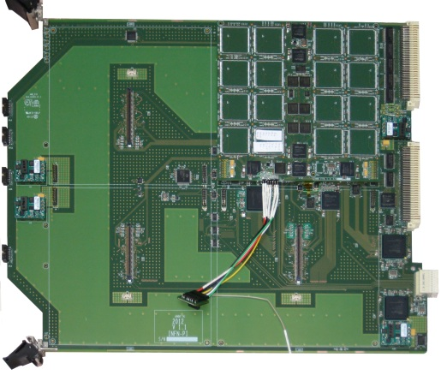
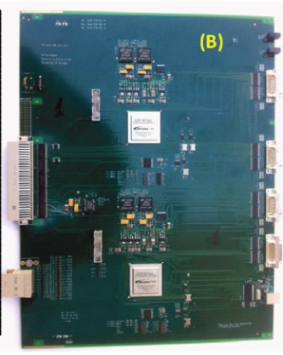
Deadlines under the corner:
Milestones in 2013
Milestone no. name WP Delivery Comments
Leader date
M.4.1. Demo general simulation ok UniPisa M6 Demonstrator simulated architecture ok
basical AMBFTK simulation OK, see tests described by Kostas Kordas
M.1.1. Slp2 prototype ok at Priele PRIELE M12 SLP2 prototype validated at PRIELE
Ongoing work (see Marco’s and Saverio’s talks)
M.1.2. Prototypes Atlas Review PRIELE M12 Atlas evaluation of FTK prototypes
M.2.1. Demonstrator ok at Caen CAEN M12 Demonstrator runs flawlessly at Caen
Integration with AUX card
SSB:
Final Fit-HW
(a)
Proto
AUX
AMBoard
DF

Slide 4
OUTREACH MILESTONES
M.7.1.-M.7.3. Open Days results verification AUTH M8, M20,M32
M.7.4. –M.7.6. WorkS. days results verification AUTH M6, M18,M30 JULY
M.7.7. –M.7.9. Summer schools results AUTH M7, M19,M31
Summer School: VHDL language and ISE Xilinx CAD July 1 – 4 2013
http://agenda.infn.it/conferenceDisplay.py?confId=6549
Workshop DAY: July 12 2013?
IAPP Open day: inside the “Department congressino” FTK communicates to students
April 17 2013 http://www.df.unipi.it/eventi/congressino-2013

Slide 5
SUMMER SCHOOL
Lessons and exercises immediately after
To complete a project (see figure)
and simulate it
Lab section the last day
Teacher:
Calliope-Louisa seconded from AUTH to Pisa
Teacher assistants:
Marco Piendibene to be seconded to Priele
Daniel Magalotti (INFN-PG)
: interested to recruitment
Between Students:
Kostas Kordas seconded from AUTH to Pisa
Dimitrios Dimas seconded from Priele to Pisa
Guido Volpi (CERN): interested to recruitment
Other students: Jafar Shojaii (Uni. Milan), Cinzia Decesare (Uni. Milan), + altro Milan, Takashi Kubota (Uni. Melbourne), Mariano Falcitelli (CNR Pisa), Emanuele Raffaele (studente ingegneria, S. Anna Pisa), + altra ragazza Uni Pisa (chi e’?)
See the school web site for details:
http://agenda.infn.it/conferenceDisplay.py?confId=6549

Slide 6
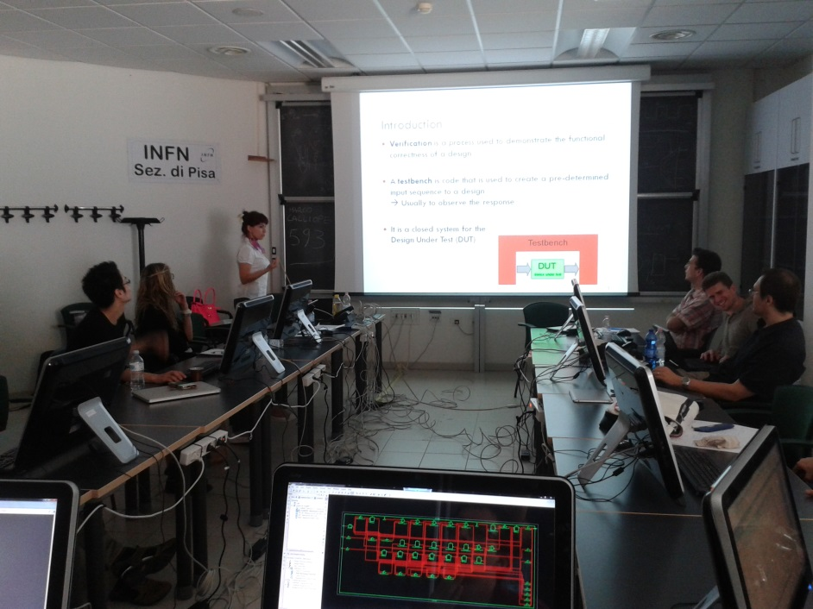
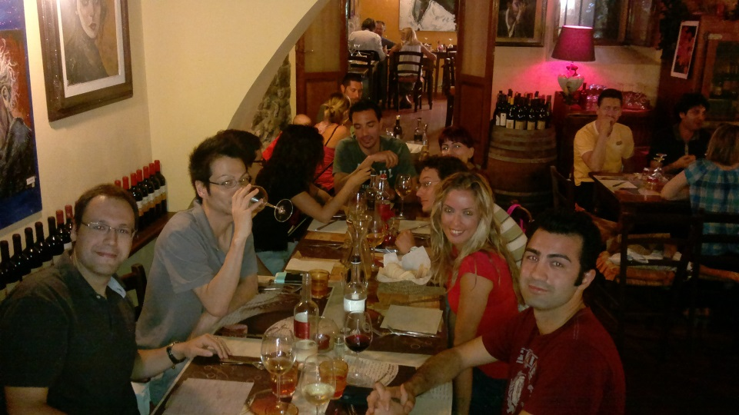
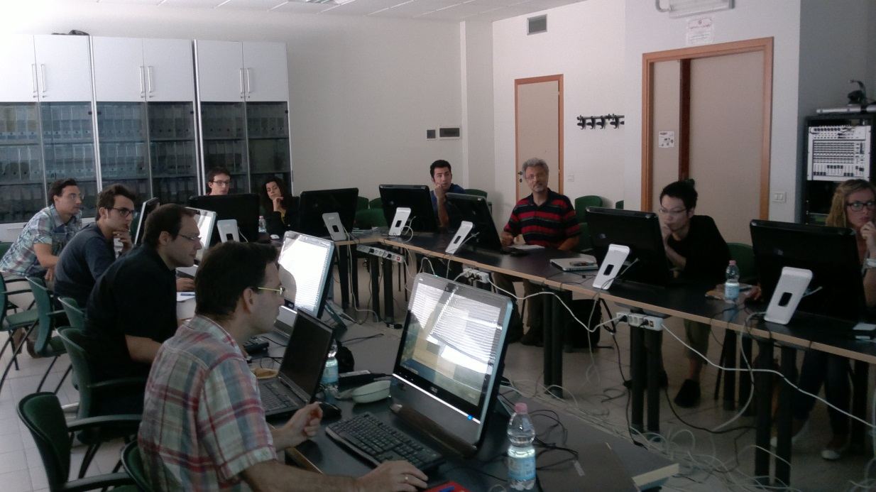
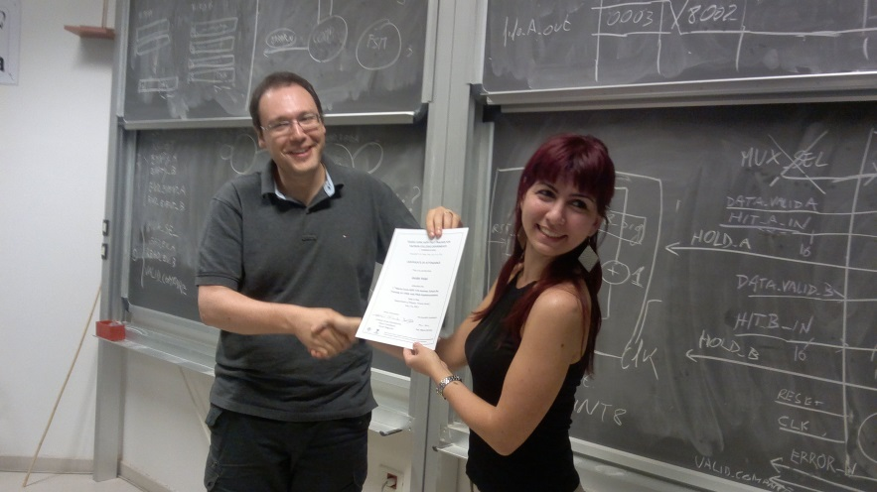
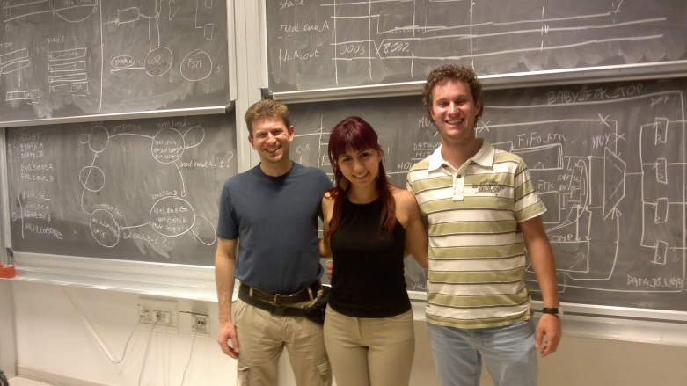
The School: Great success
For lunch all together
At the end: a document for each one
The teaching team

Slide 7
Workshop Day
Seminars to students for:
  Trigger in HEP
  FPGA applications outside HEP
  https://agenda.infn.it/conferenceTimeTable.py?confId=6648#20130712
Open IAPP Day
Open LAB – posters on FPGA-based Supercomputer
  Trigger in HEP & FPGA applications outside HEP
  FPGA power: parallelism, pipelining
  Available FPGA CAD station for students: how powerful it is!
WHEN? We decide for Friday July 12 2013 for Workshop day and
Continue the spring IAPP DAY (see next) ……..

Slide 8
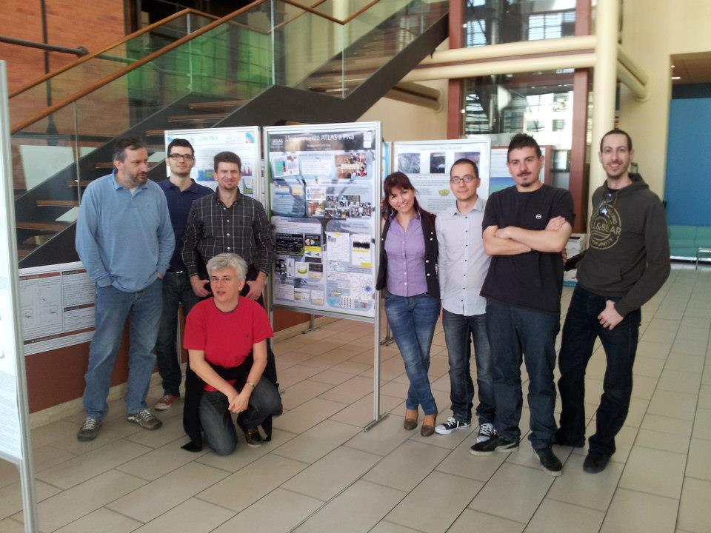
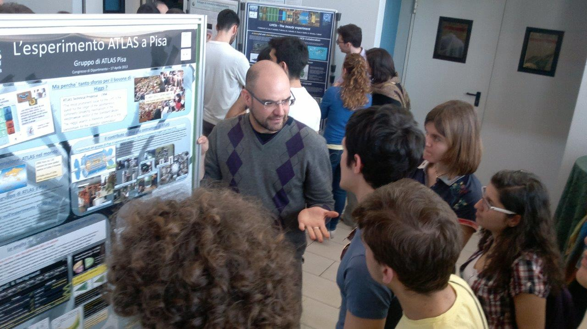
FIRST OUTREACH ACTIITY: April IAPP day
The FTK group at the IAPP Poster during the “UNIPI congressino”
Simone
from UNIPI
Marco
from
UNIPI
Calliope
from
AUTH
Andreas
from PRIELE
Federico from UNIPI
& the students

Slide 9
DELIVERABLE SUMMARY
ASK PO about Deliverables classified ad Report.
Del. no. Deliverable Title Nature Dissemination level Delivery date
D.2.1. VS infrastructure at CAEN for FTK demonstrator integration R RE M6
D.4.1. FTK Demonstrator detailed simulation R RE M9
D.4.2. Test Vectors for the FTK demonstrator R RE M10
D.2.2. FTK demonstrator fully integrated with old power supply Pub PU M12
D.1.1. SLP2 prototype constructed at PRIELE Pub PU M12
D.6.1 Test bench R RE M12
D.7.1. IAPP project open days R PU M7, M19, M31, M43
D.7.2. Workshop days R PU M5, M17,M29, M41
D.7.3. Summer school weeks R PU M6, M18,M30, M42
D.7.4 D.8.3 World wide web site for dissemination R PU M6, M18, M30, M48
what to report?
D.8.1. FTK Workshops R RE M1, M13, M30, M46
D.8.2. Trainings (next is CAEN) R RE M1, M5, M9,M19, M29, M47
Let’s do it in July!

Slide 10
OUTREACH SCHEDULE

Slide 11
CONCLUSIONS
TIME IS RUNNING FAST
A LOT OF REPORTS TO PREPARE (MAY BE)
OUTREACH AND TRAININGS ONGOING with high rate
HOWEVER WE HAVE IN HANDS THE EXPECTED RESULTS!

