Slide 1
The scientific case for a photon-photon collider
Edoardo Milotti
Università e INFN-Sezione di Trieste
milotti@ts.infn.it
LNF – 14/12/2012

Slide 2
The scientific case for a
(low-energy) photon-photon collider
Edoardo Milotti
Università e INFN-Sezione di Trieste
milotti@ts.infn.it
LNF – 14/12/2012

Slide 3
The main process at (high) energy photon-photon colliders

Slide 4
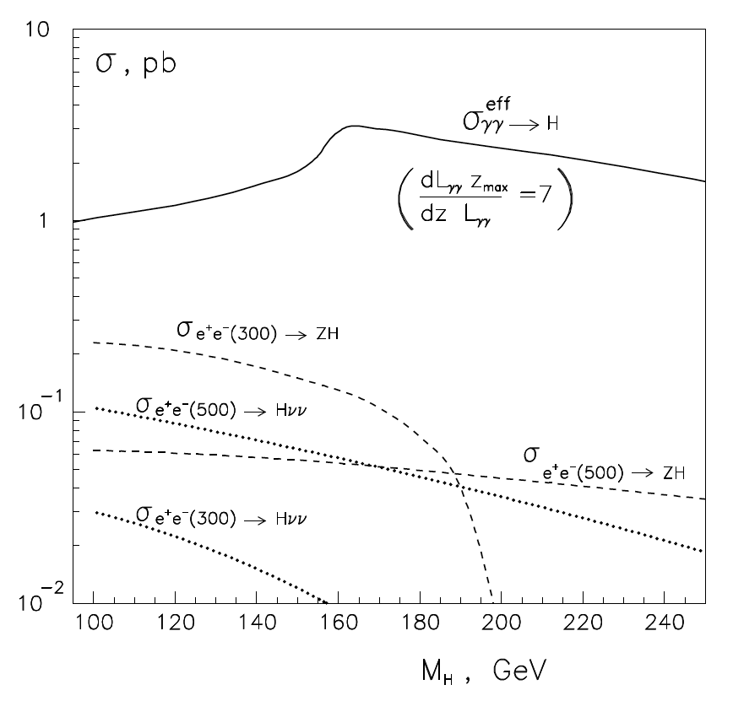

Slide 5
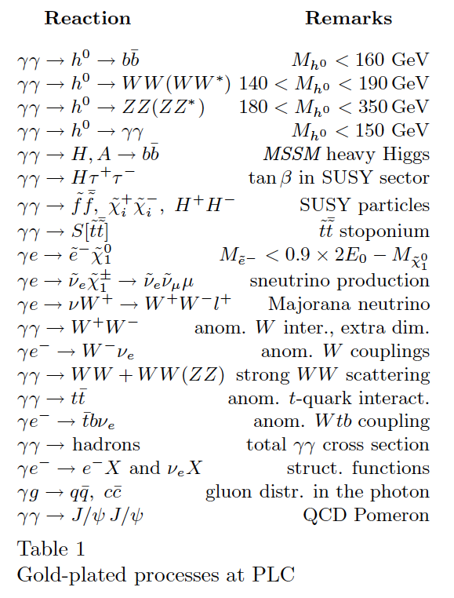
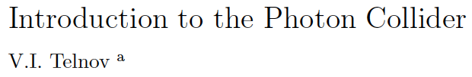

Slide 6
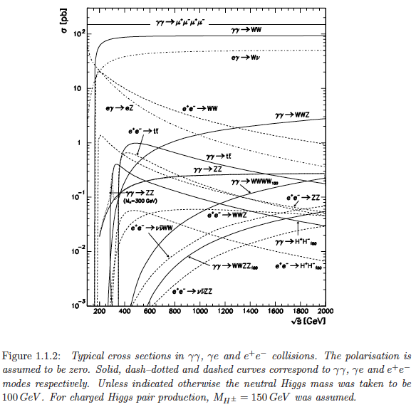
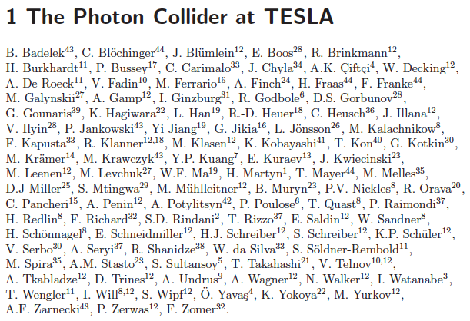

Slide 7
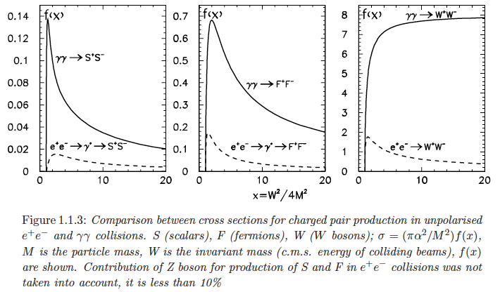

Slide 8
Given the present value of the Higgs mass, a 70+70 GeV photon-photon collider would suffice for a very rich physics program.
However, for all its potential, a high-energy photon-photon collider has not yet been built.
A low-energy photon-photon collider could lead to the necessary technology developments and prepare the ground for a higher energy complex, while still providing a rich testing ground for QED, and, more generally, QFT.

Slide 9
QED is a successful theory but there still are unsolved pitfalls.
Possibly, the most notable one is the “cosmological constant problem”.

Slide 10
The QFT vacuum: modes and energy density of the EM vacuum
Number of modes of em radiation in a box of volume V

Slide 11
energy density = (energy per mode)·(number of modes)/(volume of box)
EM energy density (integrate over all frequencies)
number of polarization states
density of modes
energy of one mode (ground-level of quantum oscillator)

Slide 12
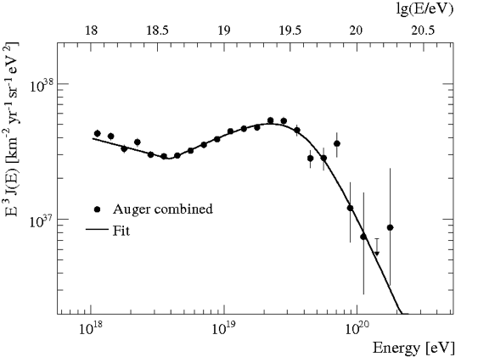
This result diverges at high frequency
ultraviolet cutoff
GZK cutoff at about 10¹⁰ GeV
(highest-energy known photons)
Pierre Auger collaboration, Phys. Lett. B 685 (2010) 239
A HUGE NUMBER !!!
about 10⁴¹ times the measured nuclear density

Slide 13
We can be even more ambitious and take the Planck energy for the ultraviolet cutoff
A HUMONGOUS
NUMBER !!!

Slide 14
Contributions to vacuum energy density (zero point energy) from other fields
Bosons (spin 1 particles):
  photon: 2 polarizations
  gluons: 8 types of gluons, 2 polarizations
  Ws and Z bosons: 3 bosons, 3 polarizations (massive force carriers)
total: 27 boson degrees of freedom
Fermions (spin 2 particles):
  6 massive quark fields, 2 polarizations
  3 massive lepton fields, 2 polarizations
  3 neutrino fields
total: 21 fermion degrees of freedom
Contribution of each degree of freedom total =
AN EVEN LARGER
NUMBER !!!
fermionic d.o.f.’s give a negative contribution

Slide 15
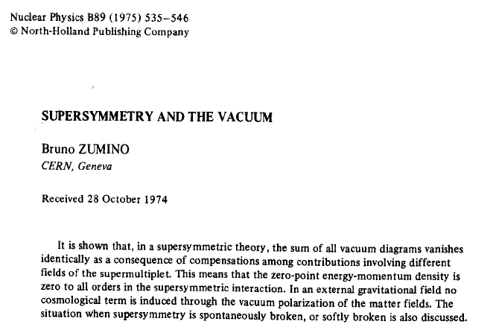

Slide 16
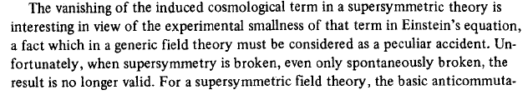
Supersymmetry (doubling of all bosonic and fermionic degrees of freedom) would thus solve the problem, leading to a vanishing energy density, but only when supersymmetry is not broken.
Therefore the problem of a high energy density of vacuum would still persist at low energy, even in a supersymmetric world.

Slide 17
Using the density of flat universe (critical density) as upper bound for the vacuum energy density we find
while using the radiation density alone we find
This stronger bound is 113 orders of magnitude smaller than the previously estimated value. Other estimates put this ratio at 120 orders of magnitude. This is the “cosmological constant problem”.
The QFT vacuum is a BIG problem !!!

Slide 18
This problem has actually been with us for a long time now.
It was already there after Dirac wrote his equation, and invented the Dirac sea, where an infinite number of degrees of freedom are occupied by unseen particles.

Slide 19
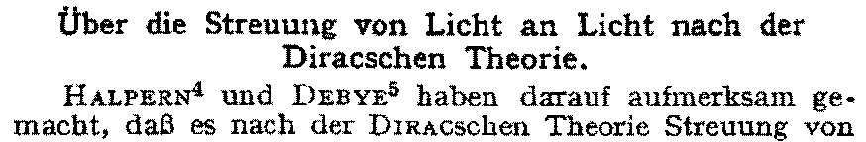
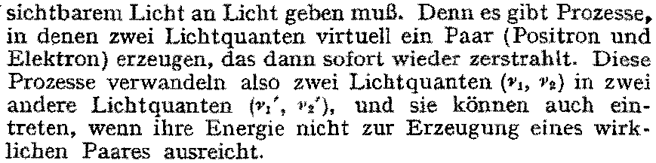
soon after Dirac’s theory of the positron, it was understood that this could lead to photon-photon scattering
...
Euler-Heisenberg and Weisskopf (EHW) Lagrangian

Slide 20
E
positive energy states
+m_{e}c²
-m_{e}c²
filled negative energy states

Slide 21
E
positive energy states
+m_{e}c²
e⁻
creation-destruction of electron-positron pair
-m_{e}c²
e⁺
filled negative energy states
the time-energy uncertainty principle allows the creation of electron-positron pairs for very short times

Slide 22
E
positive energy states
electron
+m_{e}c²
creation of electron-positron pair
-m_{e}c²
filled negative energy states
positron (hole)
E
creation of virtual electron-positron pair
photon scatters off virtual electron
virtual electron radiates and returns to negative energy state
electron and positron annihilate
+m_{e}c²
2
3
-m_{e}c²
1
4

Slide 23
E
positive energy states
electron
+m_{e}c²
creation of electron-positron pair
Not yet observed!
strong external electric field E
-m_{e}c²
filled negative energy states
positron (hole)
Extraction of electron pairs from vacuum under the action of a strong electric field: this is a sort of tunnelling (Schwinger effect).
Estimate of critical field: charge separation energy ≈ electron rest energy

Slide 24
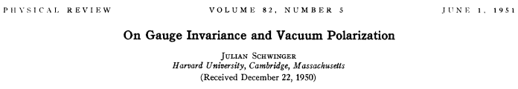
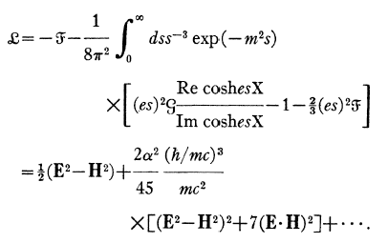

Slide 25
This Lagrangian contains the two invariants
where
The generic Lagrangian which is
Lorentz invariant
parity invariant
gauge invariant
has no derivatives of the fields of order greater than 1 (locality constraint)
has the form

Slide 26
the QED result (Schwinger Lagrangian) is
Other Lagrangians are possible and lead to different c’s, e.g., the Born-Infeld Lagrangian
this b is a max B field intensity in BI theory
as in the EHW
Lagrangian
in the EHW Lagrangian there is a 7 here

Slide 27
The full (classical) BI Lagrangian is
and it incorporates a “maximum field” b, thereby automatically resolving the problem of divergent quantities (no regularization-renormalization of charge is necessary)

Slide 28
it is interesting to notice that from the BI Lagrangian we find
and therefore when fields are present, vacuum becomes anisotropic (Denisov, PRD 61 (2000) 036004)

Slide 29
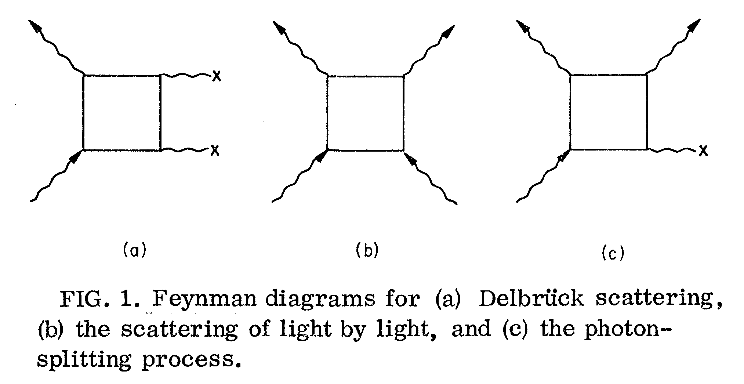
A few consequences of the phenomenological EHW Lagrangian
electric and magnetic birefringence of vacuum
low-energy photon-photon scattering
approximate description of Delbrück scattering
approximate description of photon-splitting

Slide 30

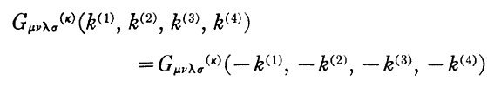

Photon-photon scattering
(first complete calculation by Karplus and Neuman in 1950-51, further refinements by De Tollis and collaborators in the following years)
electromagnetic polarization tensor
the em pol. tensor is completely symmetric with respect to indices and momenta and is divergenceless and P-invariant
tensor must be regularized

Slide 31
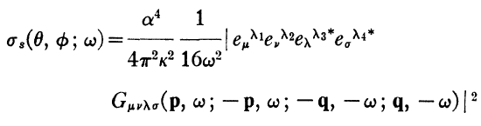

Differential cross-section
Polarization dependent amplitude

Slide 32
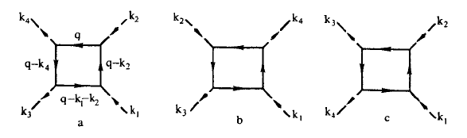
each polarization-dependent amplitude is associated to six different diagrams
the calculation involves several complex integrals, however it has been simplified considerably by De Tollis who introduced double-dispersion techniques in 1964

Slide 33


finally, for , the differential photon-photon scattering cross-section is
This cross-section is derived from a genuine non-linear QED effect (loop) and its value is critically dependent on the regularization procedure.
The importance of regularization has recently been emphasized by the a couple of wrong preprints, that claimed that the photon-photon cross section is actually
(see N. Kanda, arXiv:1106.0592, and T. Fujita and N. Kanda, arXiv:1106.0465, and the refutation by Y. Liang and A. Czarnecki, arXiv:1111.6126)

Slide 34
Why this discrepancy?
The origin of the error lies in neglecting the regularization-renormalization of the scattering amplitudes
Kanda and Fujita argued that there is no need of regularization-renormalization because the unrenormalized amplitudes are finite
However the regularization-renormalization process breaks the symmetry of the QED Lagrangian, and cannot be neglected even in this finite case
Although the issue is not quite clear, it can be conjectured that this is associated to the ABJ chiral anomaly

Slide 35
The origin of the chiral anomaly seems to lie very deep in the structure of spacetime and of quantum vacuum.
The standard approach (R. W. Jackiw, Int. J. Mod. Phys. A, 25 (2010) 659)
Both the massless and the massive Dirac equations share a common symmetry:
global gauge transformation

Slide 36
when we introduce the matrix
we find that the new matrix anticommutes with the other gamma-matrices.
We can also construct chiral projection matrices:
which select chiral components of the field:
This leads to decoupled equations for the massless case

Slide 37
Chiral charges and currents can also be defined:
and in the massless case, the charges are separately conserved.
The axial vector current
also satisfies a continuity equation, and the axial charge
is conserved.
This is related to the new gauge transformation

Slide 38
The same is not true for the massive case, where a mixing remains
On the other hand, if we include an external vector field in the massless equation
the previous gauge symmetries continue to hold, and can even be generalized to local gauge symmetries, if the vector field is also transformed

Slide 39
However, even the massless case has problems with the gauge symmetries when we step from classical functions to quantum fields.
With quantum fields the fundamental quantization condition for Fermi-Dirac fields must hold
This implies that
  there is a singularity at the same space-time point
  since charges and currents are defined by bilinears at the same space-time point, they are ill-defined
  a regularization/renormalization procedure is required
  every regularization/renormalization procedure in the presence of the vector field, breaks symmetries present at the classical level
  one or the other gauge symmetry is broken at the quantum level
  the usual choice is to abandon axial symmetry

Slide 40
2. Simple physical view (A. Widom and Y. Srivastava, Am. J. Phys. 56 (1988) 824)
1-dimensional, accelerated motion
(external field E)
positive energy states
+m_{e}c²
-m_{e}c²
negative energy states

Slide 41
overall density of states summed over all momenta
Therefore the induced current
has the rate of change
Since, in this 1D model
then the equation for the rate of change of the current becomes
linear charge density
vector potential

Slide 42
finally this leads to the anomaly equation in 1+1 dimensions
A simple extension of this line of reasoning finally leads to the 3+1 dimensional anomaly equation (Schwinger’s equation)

Slide 43
3. Further connections and conjectures
  Quantum anomalies are related to the topological properties of space: there is a deep connection with the Atiyah-Singer index theorem (where the index is closely related to the winding number and therefore to the connectivity of space)
  A derivation of the chiral anomaly by means of path integrals (Fujikawa, PRL 42 (1979) 1195; PRD 21 (1980) 2848; PRD 22 (1980) 1499; PRL 44 (1980) 1733; PRD 23 (1981) 2262) further indicates a connection with quantum paths
  A recent paper by Bender and Hook (“Quantum tunneling as a classical anomaly”, J. Phys. A: Math. Theor. 44 (2011) 372001) further points to an intriguing connection of anomalies with paths and with the nature of space
  A tantalizing hint: the Green-Schwartz mechanism cancels anomalies in string theory (Phys. Lett. B149 (1984) 117)

Slide 44
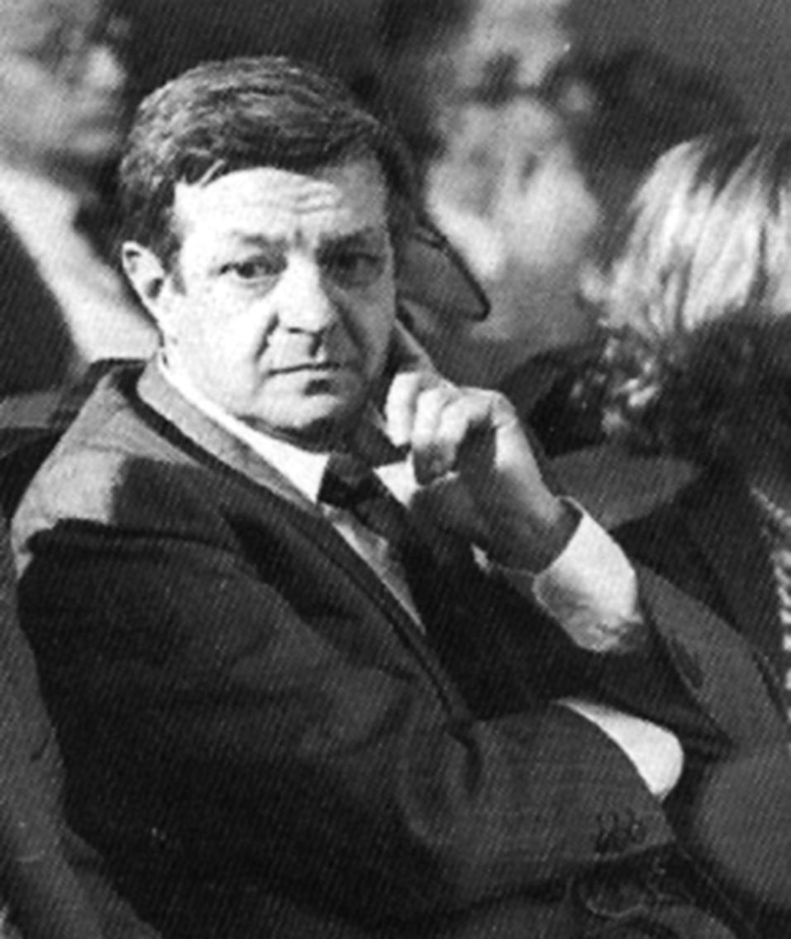
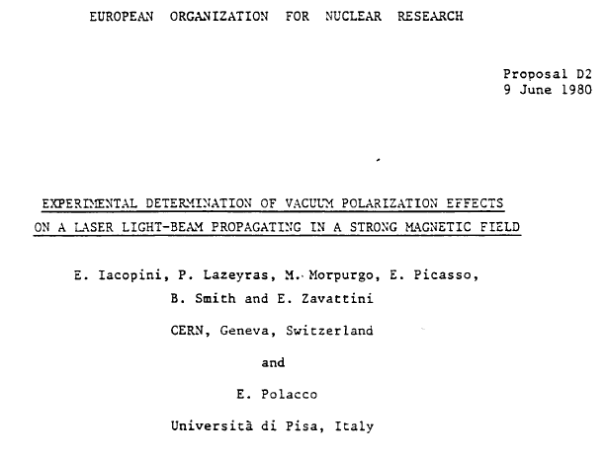
The PVLAS experiment: started back at CERN in the ’80’s
An attempt to unravel the mysteries of QFT vacuum, trying a direct measurement of the predicted birefringence

Slide 45
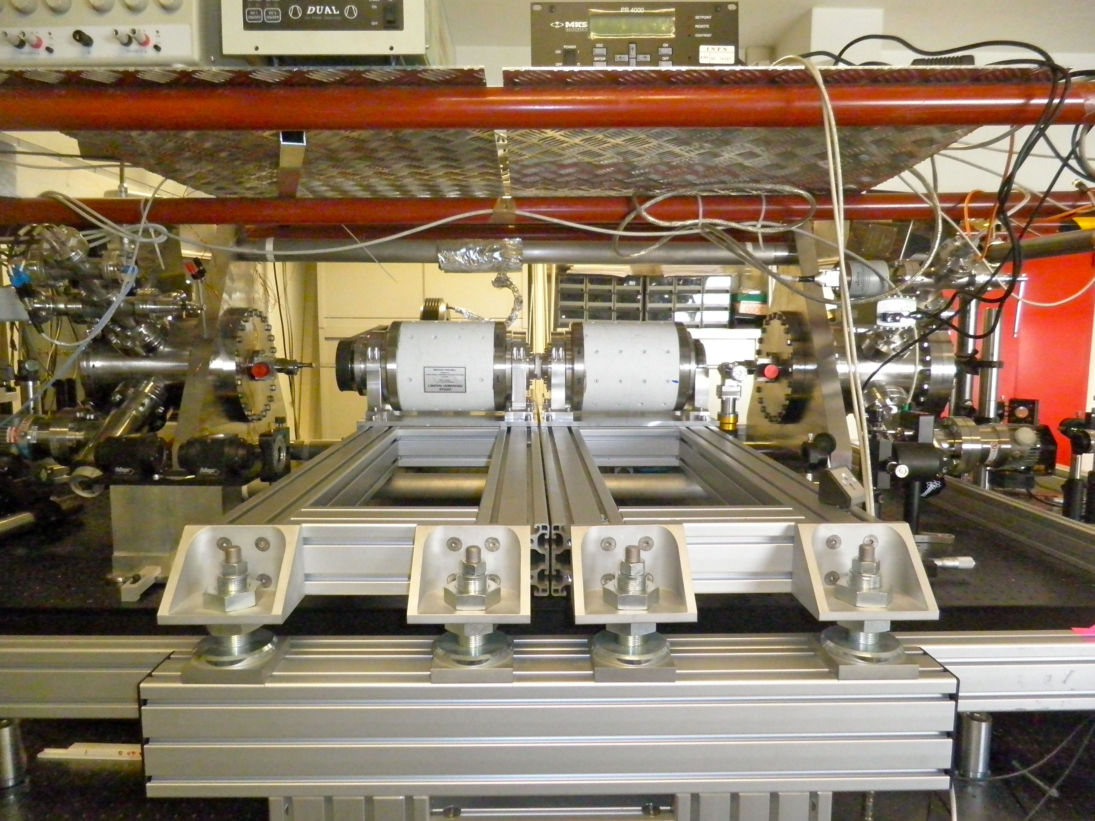
New prototype setup in the Phys. Dept. of the University of Ferrara

Slide 46

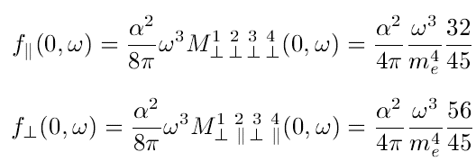
The observed birefringence can be related to the low-energy photon-photon cross-section using the optical theorem
(for details see, Haïssinski et al. LAL 06-140 (2006), PVLAS Collaboration, PRD 78 (2008) 032006)
We start from the relationship between index of refraction and forward scattering amplitude
then we note that

Slide 47
Results obtained with the old PVLAS apparatus are published in PRD 78 (2008) 032006)
With the new test apparatus we improve on that limit and find
while the QED prediction is

Slide 48
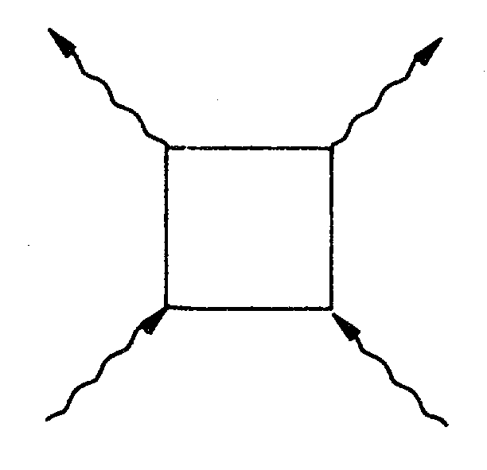

PVLAS is an extremely challenging and difficult experiment, however the cross-section for photon-photon scattering grows fast: could we aim at the direct detection of photon-photon scattering?
Low-energy cross-section

Slide 49
peak cross-section, ≈1.6 µbarn at
cross-section for unpolarized initial state
(average over initial polarizations)

Slide 50
approximate differential cross-section for low-energy photons
(E_{γ} < 0.7 m_{e}) (averaged over initial polarizations, summed over final)
parallel initial polarizations

Slide 51
Unpolarized and (linearly) polarized initial photons
CM energy (MeV)

Slide 52
Unpolarized and (linearly) polarized initial photons
12 and 21
22
11
1 = perpendicular to scattering plane
2 = parallel to scattering plane
CM energy (MeV)

Slide 53
Unpolarized and (circularly) polarized initial photons
CM energy (MeV)

Slide 54
Unpolarized and (circularly) polarized initial photons
+ + and - -
+ - and - +
CM energy (MeV)

Slide 55
Differential cross-sections for different circular polarizations at 1.6 MeV CM energy
+ + and - -
+ - and - +

Slide 56
CM energy (MeV)

Slide 58
Event rate calculation (at 1.6 MeV CM)
+ +
+ -
At least 13 events in the last bin for I₊₋
(cross-section ≈ 0.015 µbarn)
THEN, Luminosity must be

Slide 59
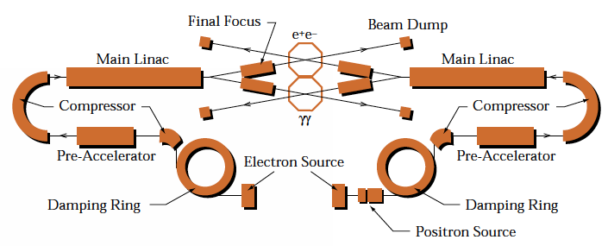
A long series of papers has definitely established that Compton backscattering of low-energy photons on energetic electrons is the most efficient way to produce beams of high-energy photons
Configuration of a high-energy photon-photon collider studied in many papers by Telnov, Sessler, Kim, Serbo, ...

Slide 60
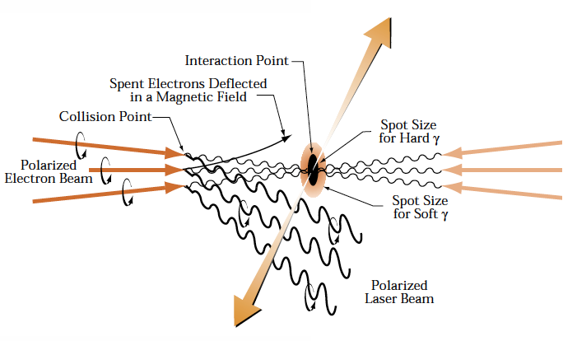

Slide 61
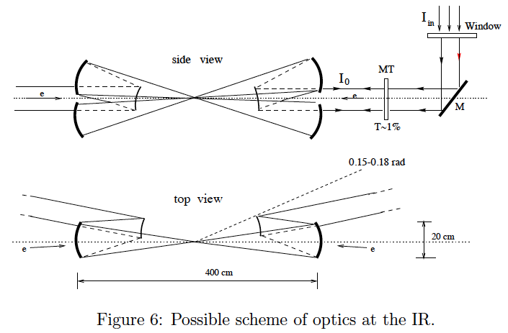

Slide 62
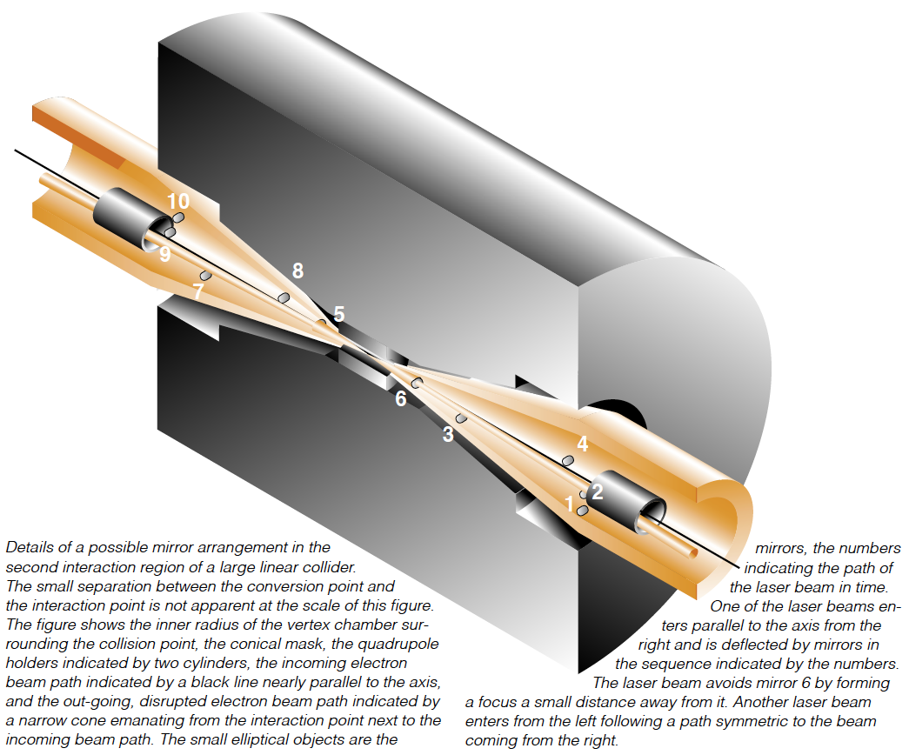

Slide 63
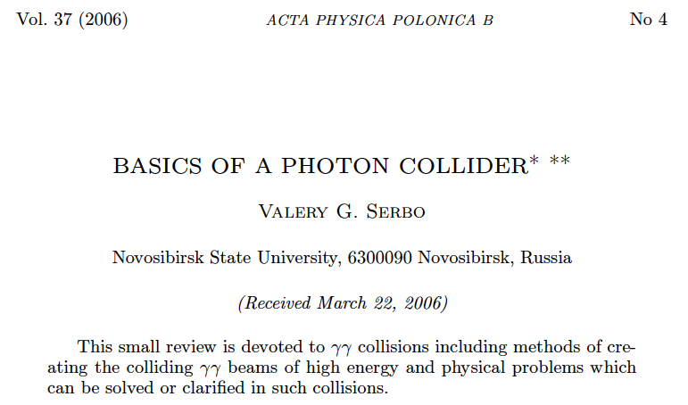
Deep understanding of CBS, current knowledge has been distilled in many very clear papers...
... for instance:

Slide 64
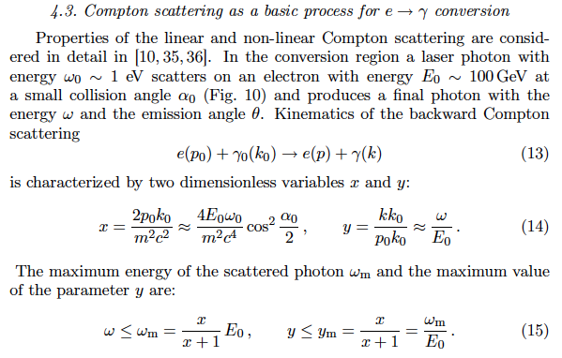

Slide 65
about 0.6% of scattered photons within 0.1% of max energy with
max laser photon energy just below
pair production threshold
x = 4.83
= -1
= 0
= 1
max backscattered photon energy ≈ 0.82 E₀

Slide 66
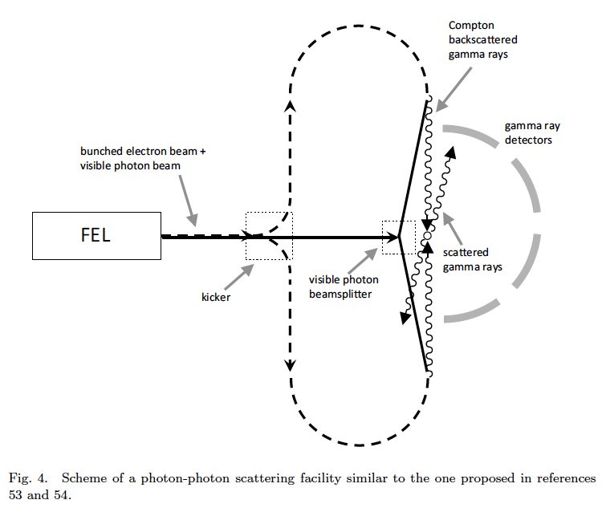

Slide 67
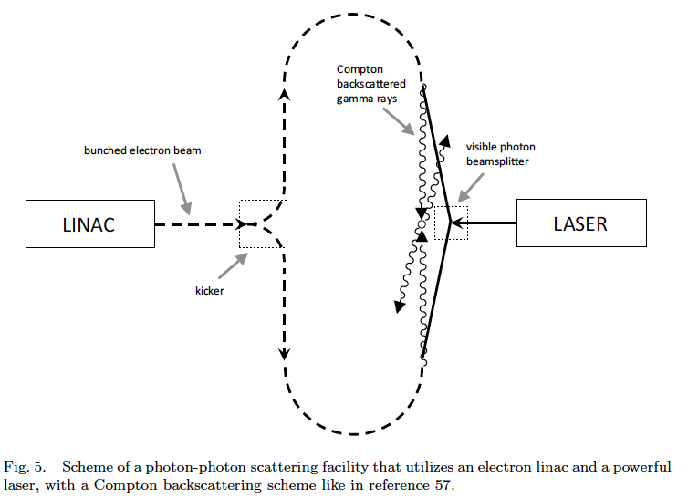

Slide 68
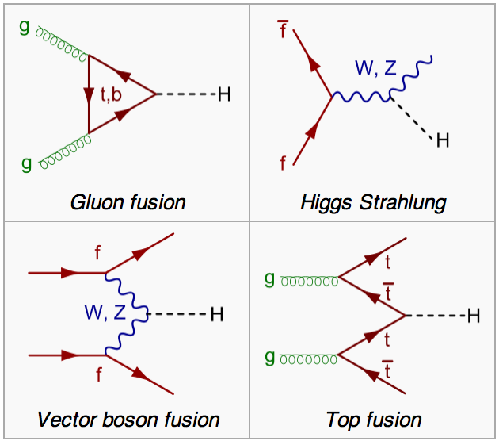
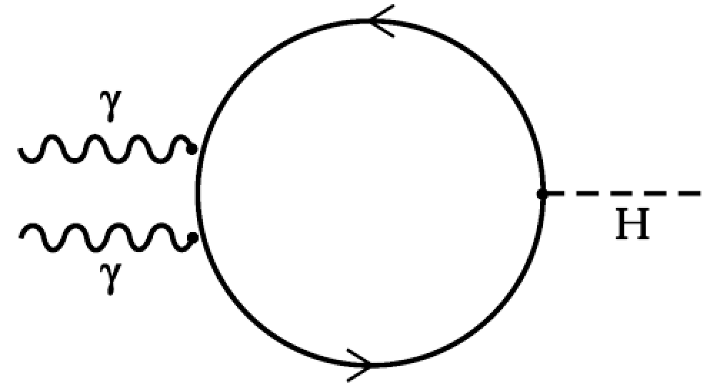
Final comments
  a high-energy photon-photon collider is an ideal tool to search for new physics by exploiting the reaction
  such a machine is highly efficient at this task, because it requires less energy and the cross-sections are higher than those in electron machines
vs.

Slide 69
  a high-energy machine works in a “discovery mode”
  by contrast, a low-energy machine verifies the fundamental tenets of the theory, and helps us reexamine the foundations of QED and QFT
  in my opinion, this “foundational mode” is quite important, and is an irreplaceable companion of the “discovery mode”.
People do not seem to realize that they are really departing from the original Heisenberg theory ...
Indeed there is some justification for that because rules can be set up to remove the infinities. This is the renormalization process.
It turns out that, sometimes, one gets very good agreement with experiments working with these rules. In particular if one has charged particles interacting with the electromagnetic field, these rules of renormalization give surprisingly, excessively good agreement with experiments.
Most physicists say that these working rules are, therefore, correct. I feel that this is not an adequate reason.”
P.A.M. Dirac: "The inadequacies of quantum field theory", 1984

Slide 70
... L’elettrodinamica quantistica (QED, Quantum Electro-Dynamics) era in quegli anni la più raffinata costruzione teorica di cui i fisici disponessero. Per tutti noi del sincrotrone italiano era il vangelo: i processi di base che dovevamo affrontare nella progettazione erano tutti previsti e calcolabili dalla QED. Poi, come una gigantesca macchina a raggi X da più di mille milioni di volt, le radiazioni prodotte secondo le regole della QED ci avrebbero permesso di osservare fenomeni nuovi e particelle nuove.
C’era una doppia concorrenza: da una parte le altre macchine per elettroni, a Cornell, Ithaca, e al Cal-Tech di Pasadena, in California, dove c’erano due sincrotroni molto simili al nostro; ...
... Ma il grosso dei fisici considerava queste radiazioni come smashers, “proiettili” troppo deboli, e preferiva le macchine a protoni, come quelle americane di Brookhaven o di Berkeley o di Argonne, ma soprattutto quella del CERN di Ginevra in costruzione contemporanea al sincrotrone: un protone è un proiettile di enorme brutalità, rispetto a un raggio gamma (i nostri raggi X ultraenergici) e quindi fa uno sconquasso “più produttivo” di effetti da studiare. ...
Carlo Bernardini, Fisica Vissuta (2006), Cap. 6 (Frascati negli anni ’50)

Slide 71
Con mio grande compiacimento, nel maggio del 2004 ho rimesso piede in Siberia, a Novosibirsk ... [c’era] Pief Panofski che, con l’età, era divenuto quasi affettuoso. ... Intorno, i più giovani, ignari dell’incessante fluire del tempo, cercano di farsi avanti con idee innovative, che mostrino a quei resti umani che li stanno a sentire quanta strada è stata fatta dopo di loro. ... Pief [Panofski] ed io ci guardiamo smarriti di fronte a un ragazzotto che propone un gamma-gamma collider, macchina inverosimile: ma bisogna accordare fiducia. ...
Carlo Bernardini, Fisica Vissuta (2006), Cap. 11

