Slide 1
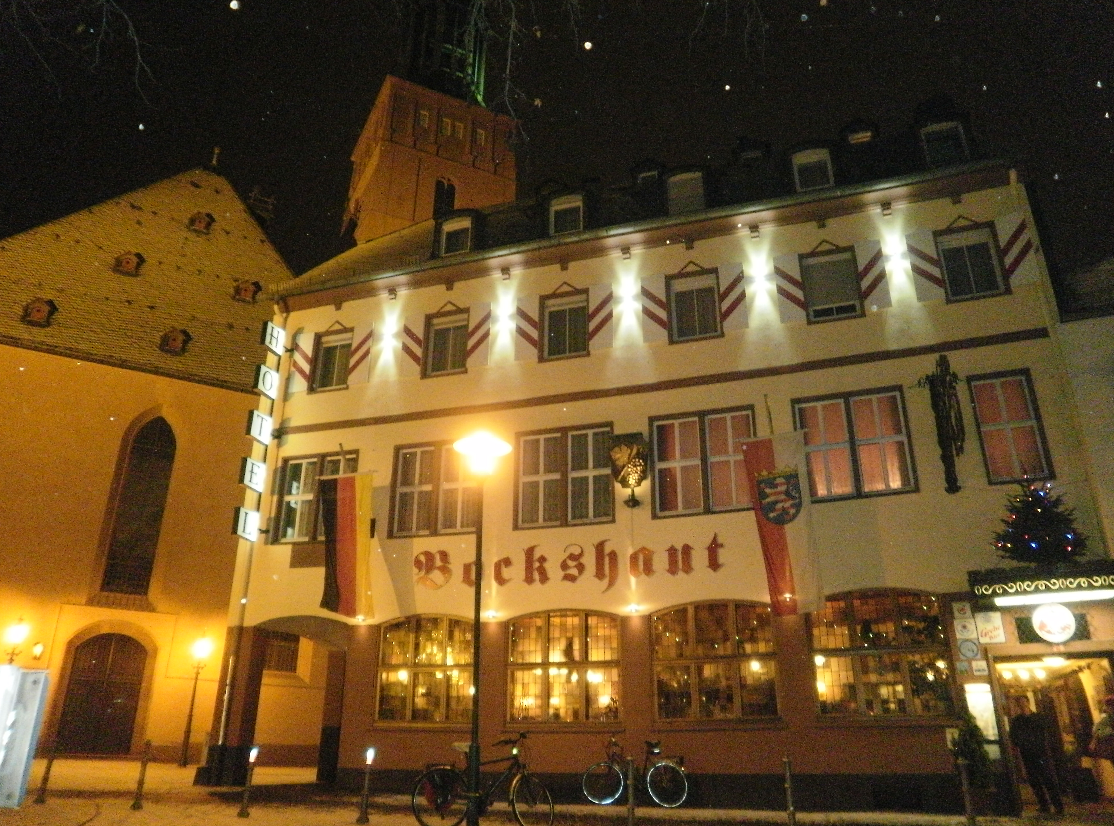
FIRST MEETING GSI 14 December 2012

Slide 2
SOME CONFERENCES 2013
The 25th International Nuclear Physics Conference (INPC 2013) will take place in Firenze (Italy) on 2-7 June 2013, INPC 2013 http://www.inpc2013.it/
Abstract submission deadline 15 January 2013
Crete, Greece CRETE13: The 2013 International Conference on Applications of Nuclear Techniques. The deadline for submission is February 1, 2013 http://www.crete13.org/
The Fourth International Conference on Nuclear Fragmentation "From Basic Research to Applications" Dates 29 Sep 2013 → 06 Oct 2013 http://fias.uni-frankfurt.de/nufra2013/ Kemer, Antalya, Turkey
IEEE 2013 http://www.nss-mic.org/ Seoul, Korea 27 October 2013

Slide 3
Policy Board
C.Agodi, M.Durante, V.Monaco, S.Leray, A.Sciubba
G.Cuttone, V.Patera

Slide 5
From LNS
F.Cappuzzello (Researcher Catania University)
M.Cavallaro (Post Doc)
M.Bondì (PHD)
D.Carbone (Post Doc)

