Slide 1

Highlights of Higgs Analyses
Atlas and CMS
21-12-2012
Francesco Conventi for the Atlas&CMS Higgs_Na groups

Slide 2
Outline:
Update analisi (HCP2012→Cern Council)
Misure: M_{H} accoppiamenti
Il contributo della sezione di Napoli

Slide 3
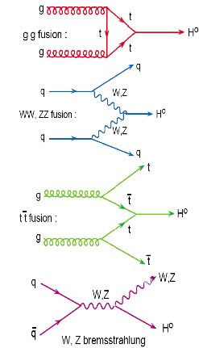
Higgs: produzione @ LHC(http://arxiv.org/abs/1101.0593)
Gluon-Gluon
Fusion
Vector Boson Fusion
Produzione Associata
Principali modalità di produzione dell’Higgs @ LHC:
Modalità Gluon-Gluon fusion è quella principale (“scoperta”)
VectorBoson Fusion e Produzione Associata studiate nelle analisi più recenti (2012)

Slide 4
Higgs: Analisi dei dati 2012
Risultati analisi dati 2011
Analisi del 2012 focalizzate nella regione di massa 117-129 GeV non esclusa dai dati 2011
Nell’osservazione ATLAS ha utilizzato solo i canali con maggiore sensitività:
– H→γγ
– H→ZZ
– H→WW
Altre modalità di decadimento utilizzati nelle analisi post “4/07/2012”
LEP
Excl.
ATLAS excluded

Slide 5

4/7/2012: Osservazione di una nuova particella

Slide 6
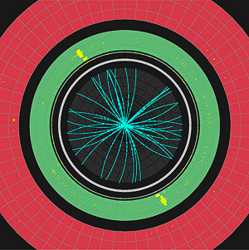
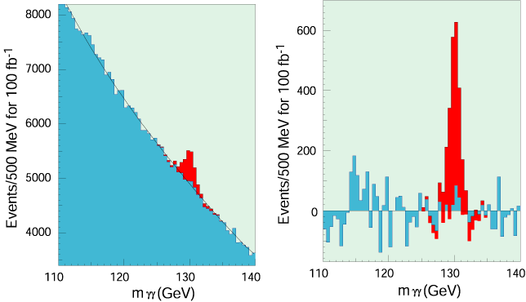
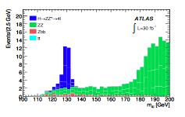
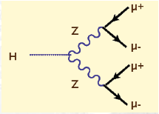
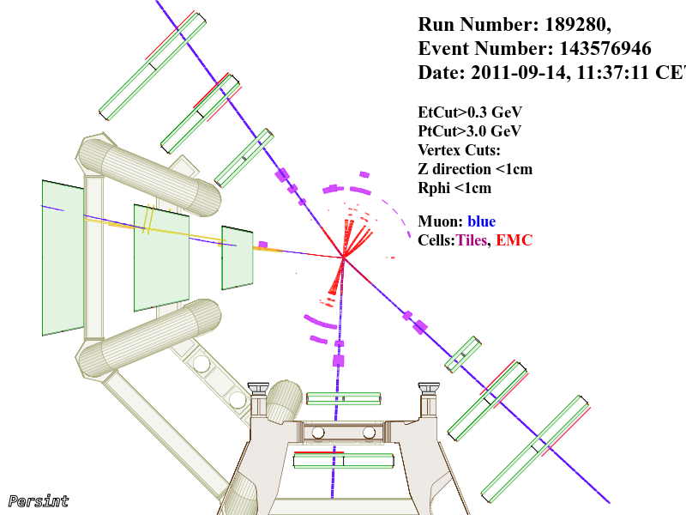
Higgs: stati finali γγ e ZZ→4 leptoni
Il processo fisico
Cosa prevediamo di osservare
2 fotoni
t
γ
H
γ
t
4 muoni

Slide 7
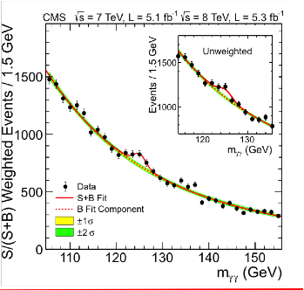
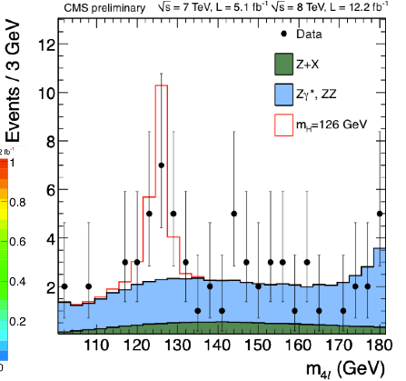
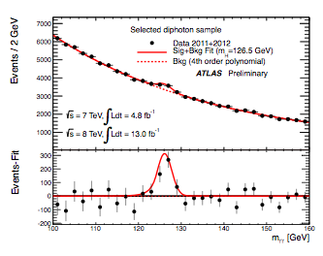
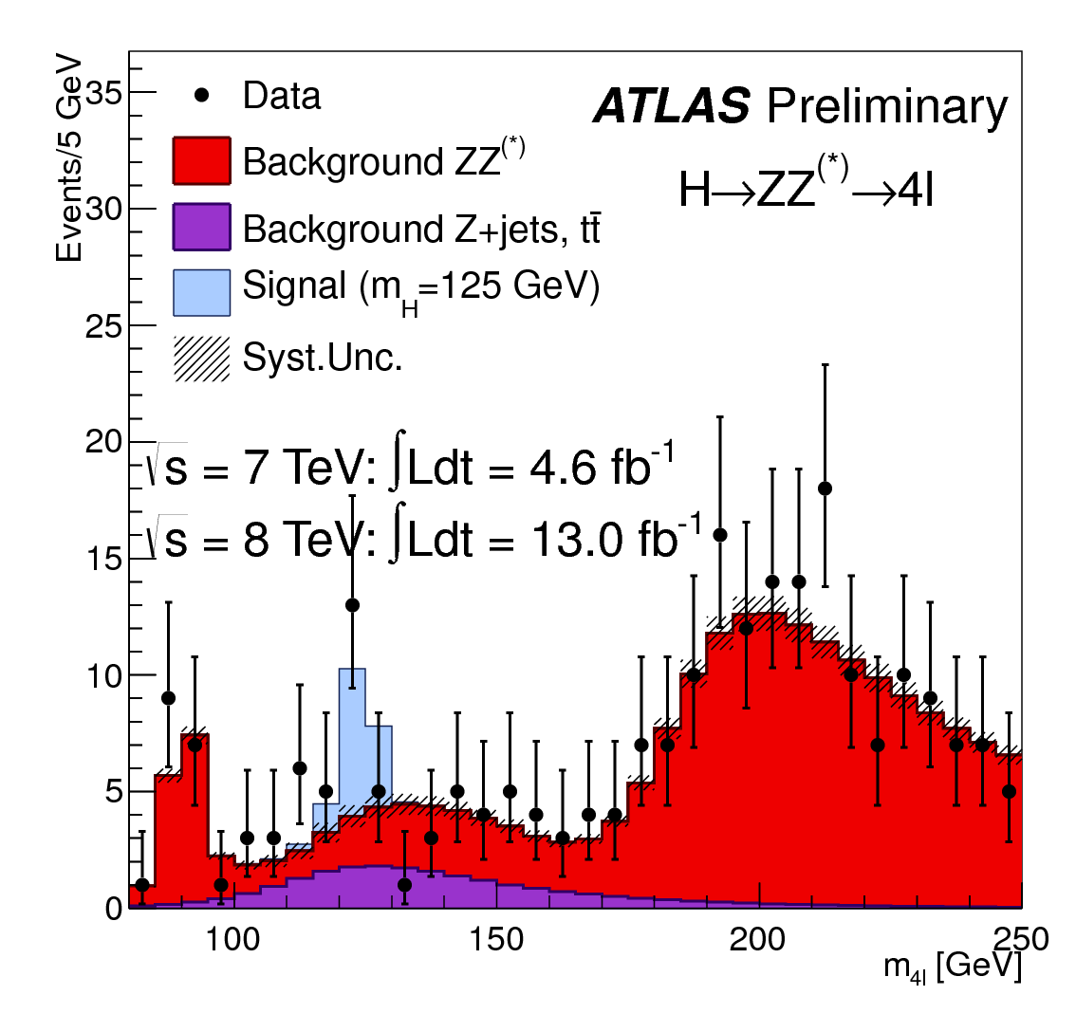
5+5 fb⁻¹
5+12.2 fb⁻¹
CMS
CMDCMSC
4.8+13 fb⁻¹
4.6+13 fb⁻¹
Atlas

Slide 8
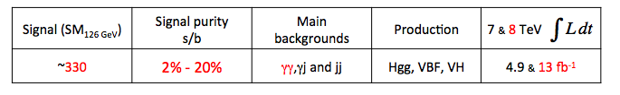
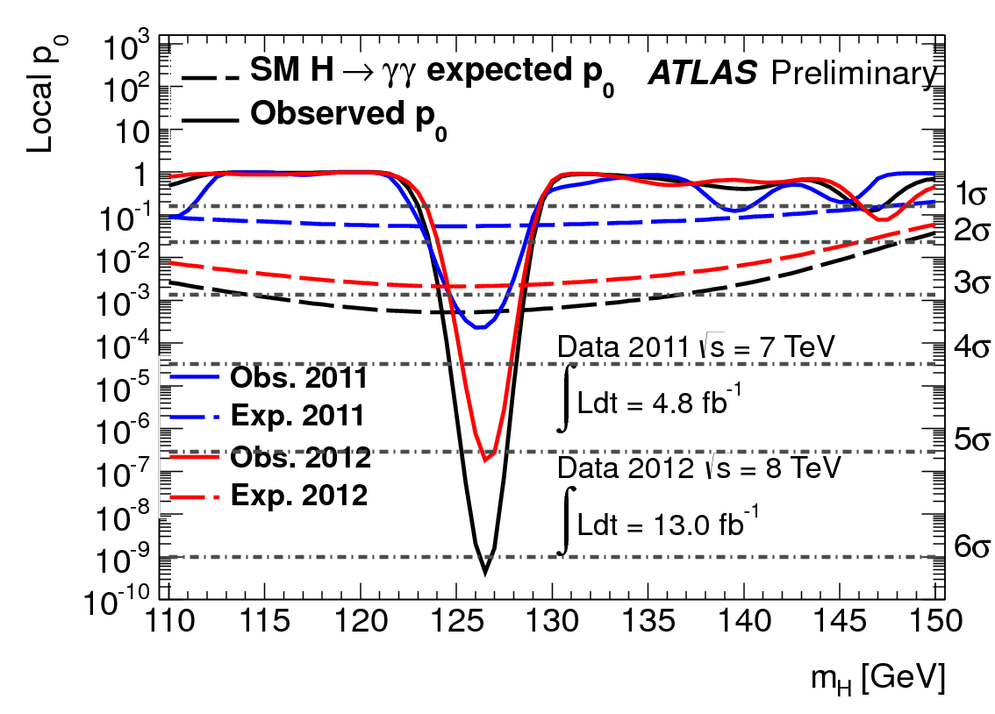
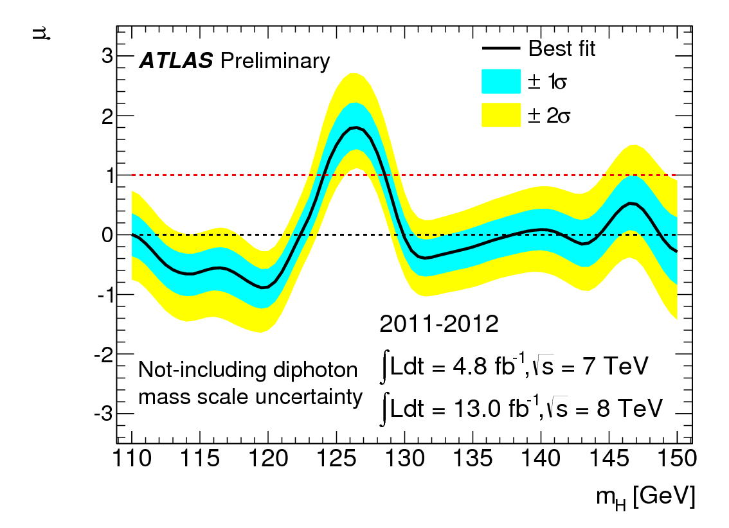
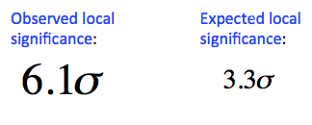

Higgs update: γγ
Atlas
Best Fit for signal strength:
μ=1.80 ±0.42±0.36
Best fit for mass:
m_{H}=126.6 ± 0.3 (stat) ± 0.7 (syst)

Slide 9
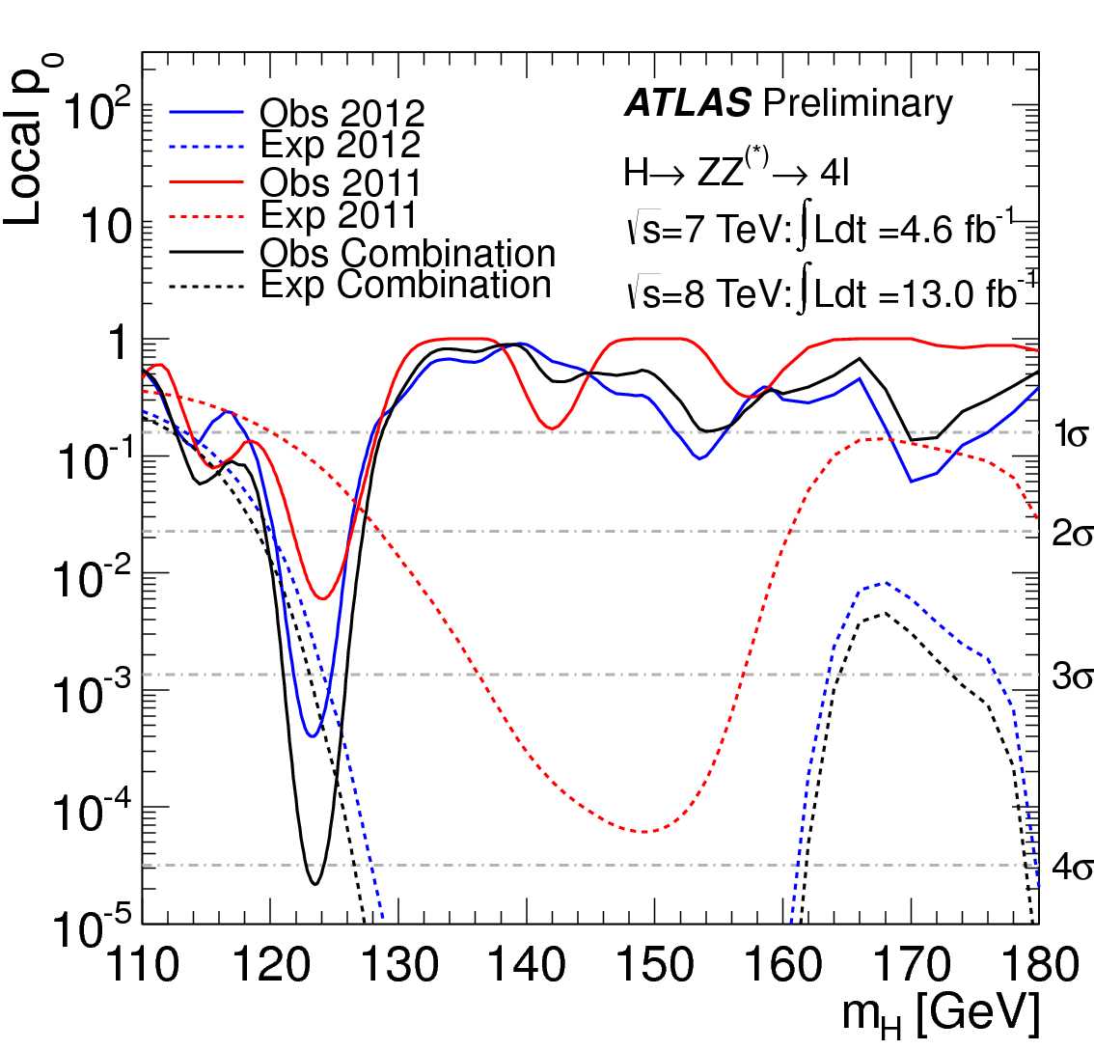
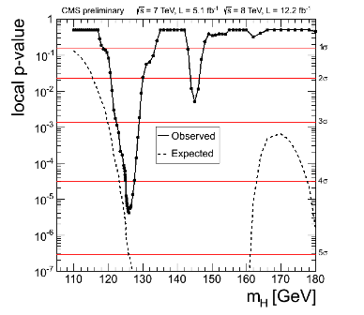
Higgs update: ZZ→4l
Atlas
Expected signal significance is 5σ, observed is 4.6σ
The signal is confirmed
Best Fit for signal strength: μ=0.80 ±0.3
Best fit for mass: m_{H}=126.2 ± 0.6 (stat) ± 0.2 (syst)
Expected signal significance is 3.6σ, observed is 4.1σ
The signal is confirmed
Best Fit for signal strength: μ=1.30 ±0.5
Best fit for mass: m_{H}=123.5 ± 0.9 (stat) ± 0.4 (syst)
CMS

Slide 10
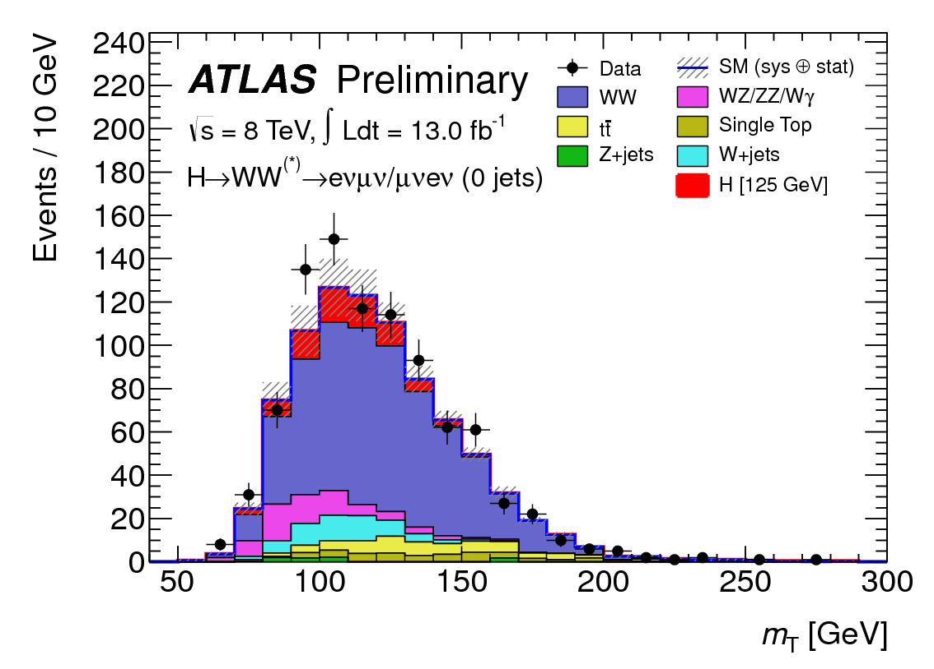
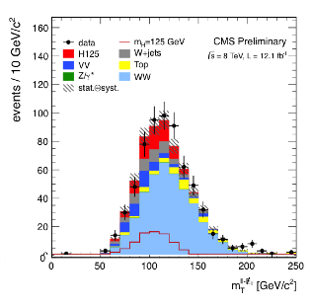
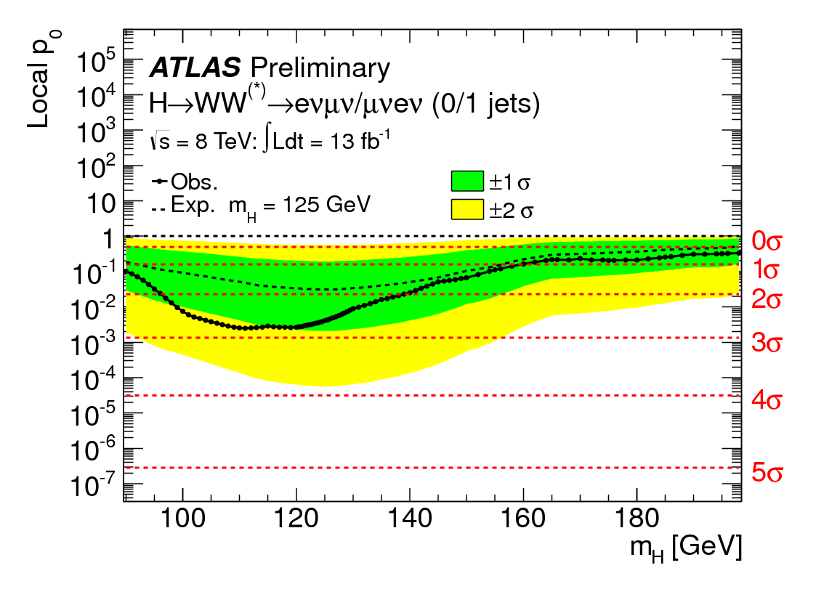
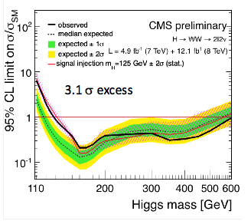

Higgs update: H→WW→2l2ν
CMS
Atlas

Slide 11
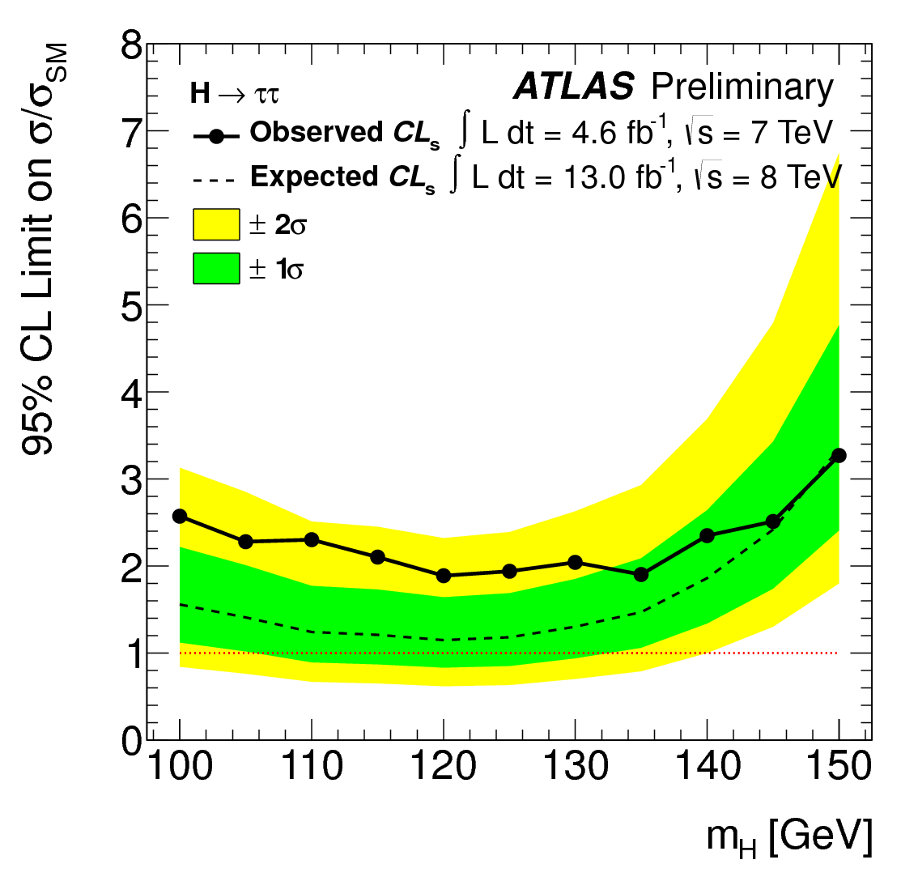
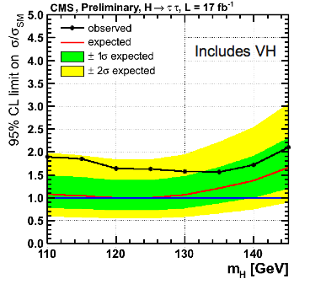

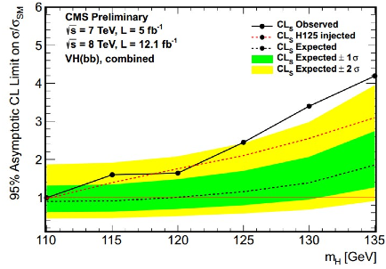
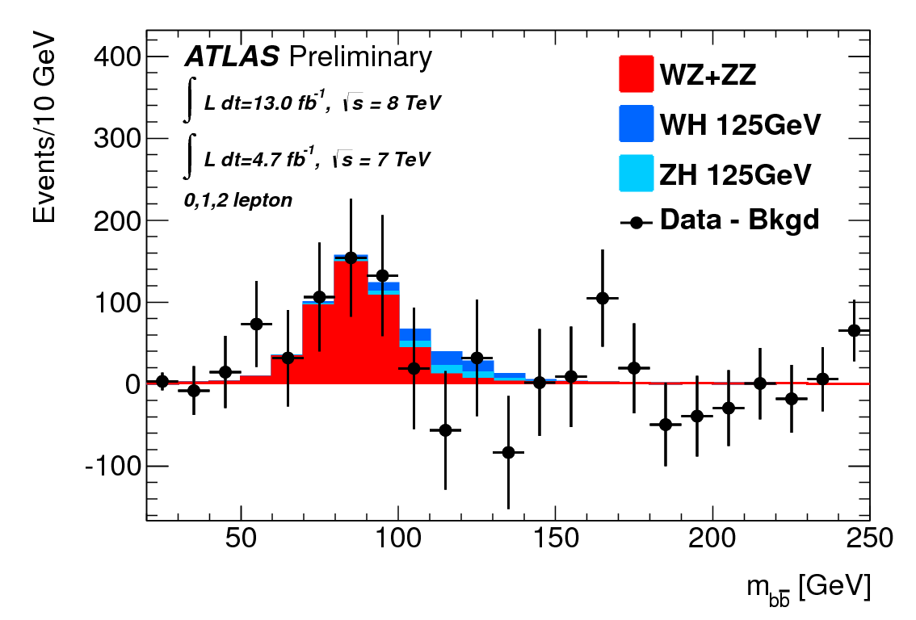
Higgs update: H→ττ and H→bb
95% CL limit for m_{H}=125 GeV is
1.9 x SM observed (1.2 expected)
Sensitivity is reaching the SM!
Results are consistent with either the background-only hypothesis or the signal+background one, with signal strength μ=0.7±0.7
4.6+13 fb⁻¹

Slide 12
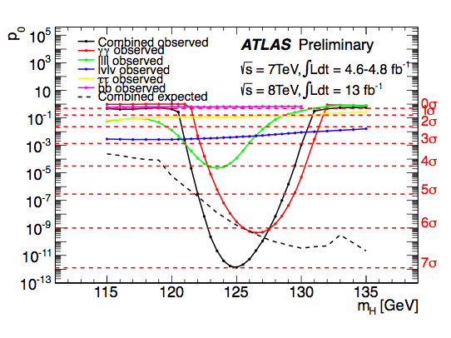
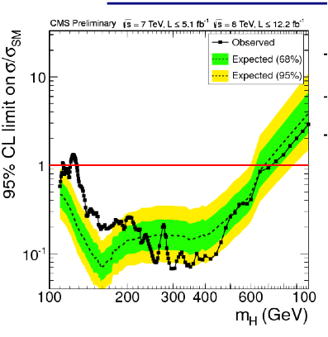
Higgs update: Combined results
CMS
Atlas
Observed signiﬁcance is:
Atlas: 7.0 σ, expected 5.9 σ
CMS: 6.9σ (for mH = 125.8)

Slide 13
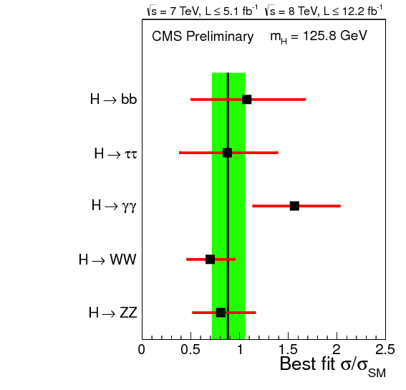
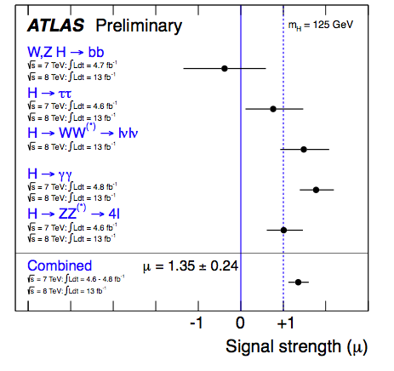
Higgs update: Combined results
Combined signal strength is
Atlas: μ = 1.35 ± 0.24
CMS: μ = 0.88± 0.21

Slide 14
The post-observation scenario
Until ICHEP, the aim of the Higgs searches was simple: find a SM-like Higgs, or exclude it in the full range allowed by the SM constraints.
Now that we have observed a new particle H126, the kind of questions changes to:
  What’s H126 like? is it “the” SM Higgs?
  Is there anything else?
The ATLAS and CMS analyses are progressively transitioning to these two new questions.

Slide 15
Low mass: Higgs @126GeV study
Update searches especially in the channels where the picture was not fully clear at ICHEP because of limited sensitivity (e.g bb, ττ, WW)
Try to update/add exclusive modes to test further the SM: VBF, ttH, WH/ZH production.
Improve the mass measurement
Test JCP, couplings
Gluon-Gluon
Fusion
Vector Boson Fusion
Produzione Associata

Slide 16
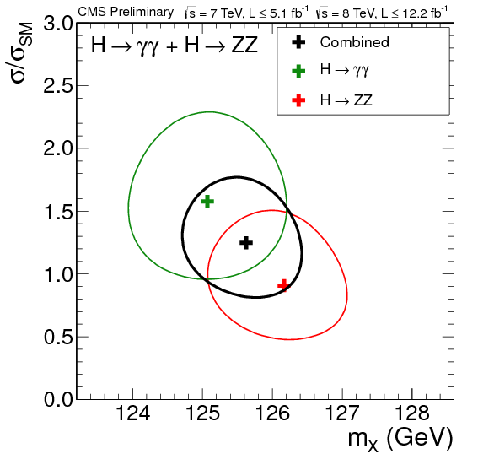
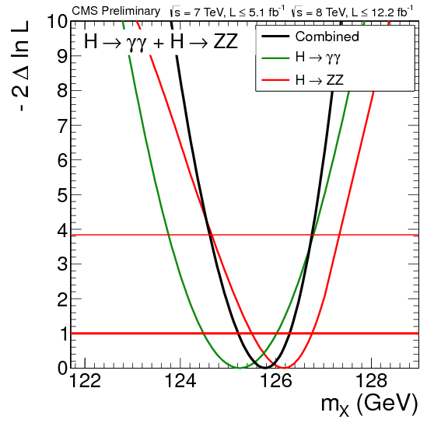
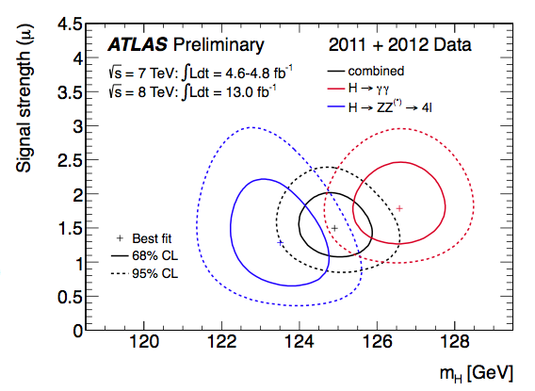
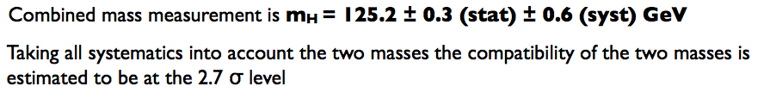
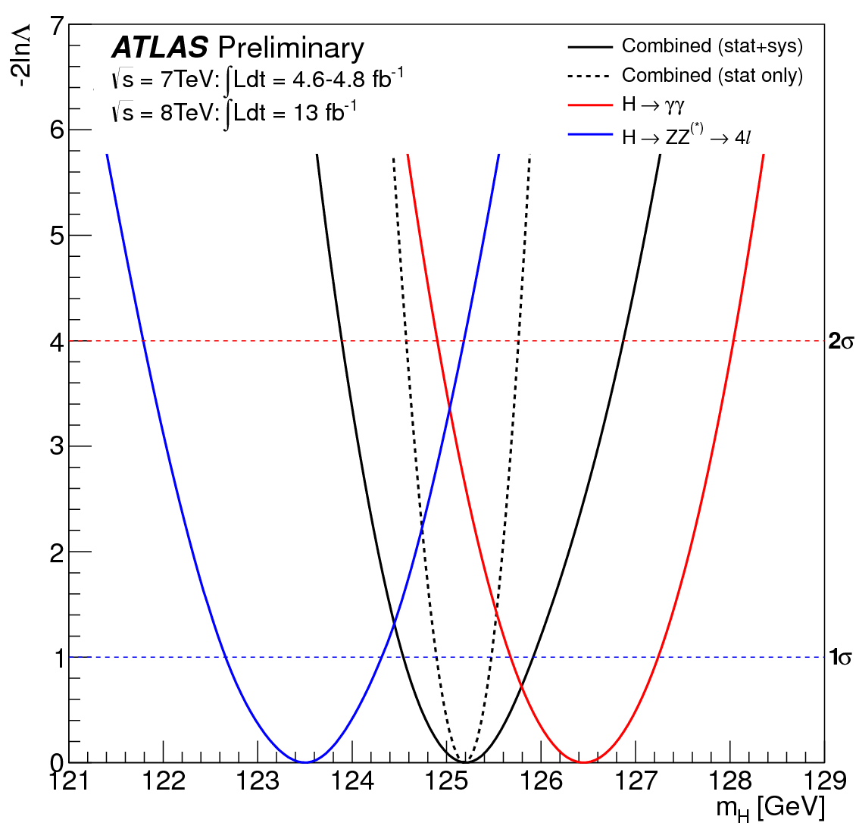
Higgs: Mass Measurement
CMS
m_{H}= 125.8 ± 0.4 (stat.) GeV.
Atlas

Slide 17
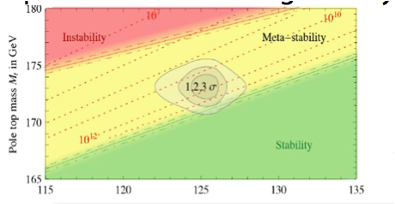
Higgs Mass measurement
The last SM parameter still to be measured
Important in electroweak precision tests
Important in determining stability of SM
arXiv: 1205.6497

Slide 18

Measurement of Higgs couplings
Assumptions (LHC HXSWG, arXiv:1209.0040):
    The signal observed in different channels originate from a single narrow resonance with mass near 125 GeV.
    The width of the assumed Higgs boson near 125 GeV is neglected, hence the signal cross section can be decomposed in the following for all channels:
    Only modifications of couplings strengths are taken into account, while the tensor structure of the couplings is assumed to be same as in the SM prediction (CP-even scalar). [ATLAS-CONF-2012-127]

Slide 19
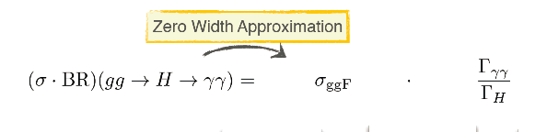
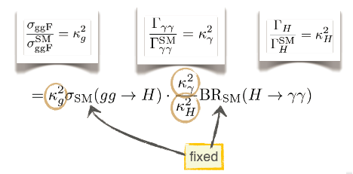
Measurement of Higgs couplings (ϒϒ example)
Depending on the benchmark model, k_{g}, k_{ϒ} and k_{H} are either functions of other couplings or independent parameters.

Slide 20
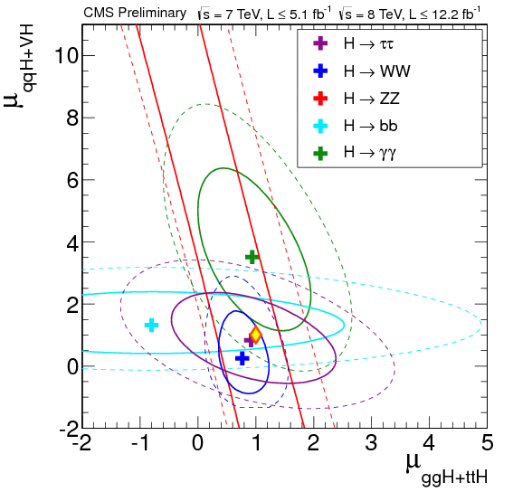
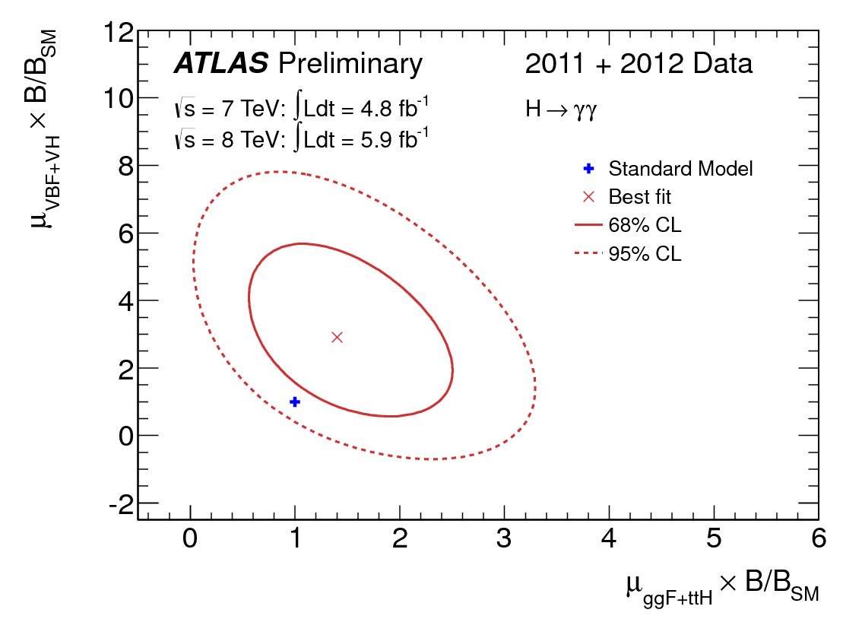
SM Higgs couplings
I couplings per lo SM Higgs sono di 2 tipi:
    “Gauge” couplings (to bosons)
    Yukawa couplings (to fermions)
E’ possibile studiare possibili deviazioni dalle previsioni dello SM utilizzando le diverse modalità di decadimento:
μ(VBF+VH) vs. μ(ggF+ttH)
CMS
Atlas

Slide 21

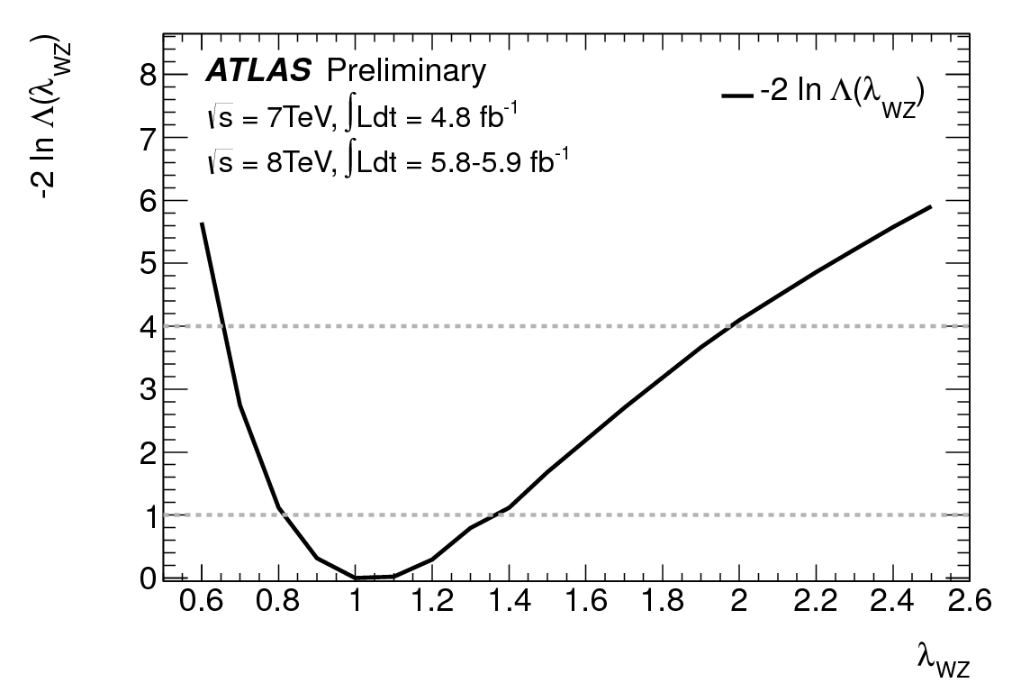
Higgs couplings:
Gauge sector: W vs. Z bosons
To investigate the (weak) gauge sector, now suppose the W and Z couplings have independent strengths wrt SM: K_{W} = gW/g_{W}(SM) and K_{Z} = g_{Z}/g_{Z}(SM)
K_{f} (fermions) profiled as nuisance parameter and Higgs width left free for generality
Consistency with SM expectation → no violation of custodial symmetry observed
Note many BSM models respect custodial symmetry….
Atlas
CMS
λ_{WZ} = K_{W}/K_{Z} = 1.07 (+0.35 -0.27)
The 95% CL interval for λ_{wz} obtained in a combination of all channels is [0.67,1.55]

Slide 22

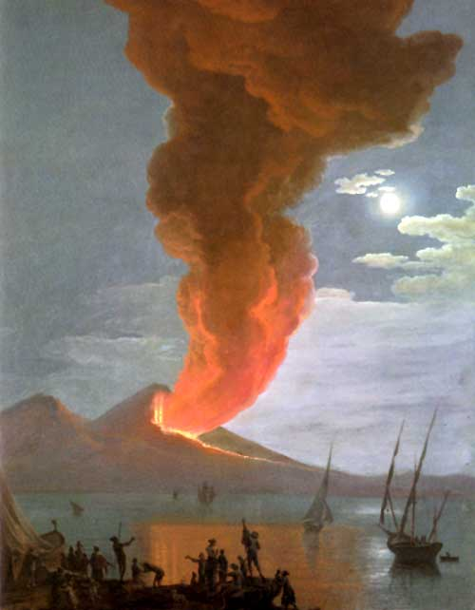
Analisi Higgs: sezione di Napoli

Slide 23
H→ZZ→2l2q
CMS
A. de Cosa, F. Fabozzi

Slide 24
Motivation
CMS
H->ZZ->2l2q channel
Higher BR than H->ZZ->4l channel
  BR(ZZ->2l2q) ~ 20* BR(ZZ->4l)
But large background, mainly Z+Jets and tt events
Signature: 2 leptons and 2 jets in the final state:
  both peaking at the Z boson mass
Looking for 2 leptons and 2 b-jets in the final state allows to drastically reduce Z+Jets (light flavour) background

Slide 25
Analysis workflow
CMS
Two ranges of reconstructed di-boson candidates mass investigated:
  High Mass: 183 < m_{ll}< 800 GeV
  Low Mass: 125 < m_{ll}< 170 GeV

Slide 26
High mass analysis
CMS
Reconstruction of hadronic and leptonic Z bosons from reconstructed leptons and jets
  Mass windows: 75 < m_{ll}< 105 GeV and 70 < m_{JJ}< 110 GeV
Reconstruction of Higgs candidates (hadronic Z + leptonic Z)
  Kinematic Fit applied to the di-jet system to improve di-boson mass resolution
Classification of the events in 3 exclusive categories according to the number of jets tagged as b-jet
Further selection based on a Likelihood Discriminant cut (exploiting the 5 angles describing the kinematics of the Higgs boson production and decay)
Data driven background estimation
Statistical analysis of the di-boson invariant mass distribution

Slide 27
Analysis workflow
CMS

Slide 28
Low mass analysis
CMS
Low mass analysis strategy differs slightly from the high mass one
Constraint on dilepton mass is released
  m_{ll} < 80 GeV
No angular LD cut
  low separation power below the on-shell Z threshold
Data-driven bkg estimation uses different strategy

Slide 29
Leptons and jets
CMS
Leptons
High quality muons and electrons (ID criteria)
p_{T} (leading lepton) > 40 GeV and p_{T} (subleading lepton) > 20 GeV
|η| < 2.4 for μ and |η| < 2.5 for electrons
Combined Detector Isolation / p_{T} < 0.15
Jets
AK5 (anti-kT clustering algorithm with R=0.5) ParticleFlow jets
p_{T} > 30, |η| < 2.4

Slide 30
Btag categorization
CMS
b-jets are identified using an algorithm called Track Counting High Efficiency, TCHE.
  Exploits the long lifetime of B hadrons and is based on the computation of the impact parameters significance of good tracks in the jet
  Standard working points for b-tagger (Loose, Medium, Tight)
3 exclusive categories defined according to the number of b-tagged jets:
2 b-tag candidates: 1Medium + 1 Loose
1 b-tag candidates: 1 Loose + !1Medium
0 b-tag candidates: No tagged jets
Medium(>0.545) and Loose (>0.275) are the working point considered for the algorithm

Slide 31
Angular likelihood discriminant
CMS
Kinematics of the event described univocally by 5 helicity angles
Likelihood discriminant built up from these angles

Slide 32
Angular likelihood discriminant
A cut on the final Likelihood discriminant variable is performed to reject background
Cut optimized for each category and as a function of the reconstructed mass, m_{ZZ}

Slide 33
Bkg estimation
Data-driven estimation of the background
Sideband region (SB)
  60 < m_{JJ}< 75 GeV and 105<m_{JJ}<130 GeV
Normalization and shape correction
  Number of bkg events in signal region extrapolated from SB using factor α(m_{ZZ}) taken from MC
  Background shape in signal region extracted from SB
fit to sideband region m_{ZZ} distribution corrected by α(m_{ZZ})

Slide 34
Bkg estimation

Slide 35
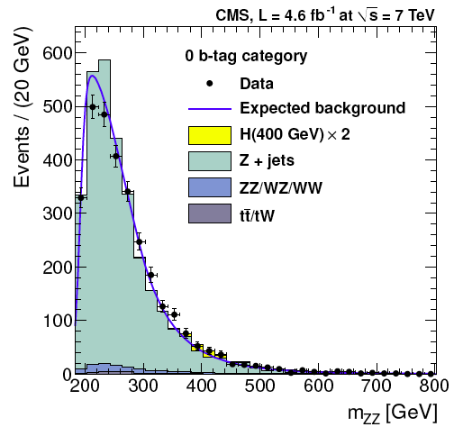
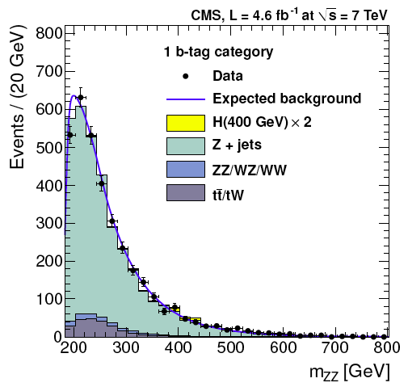
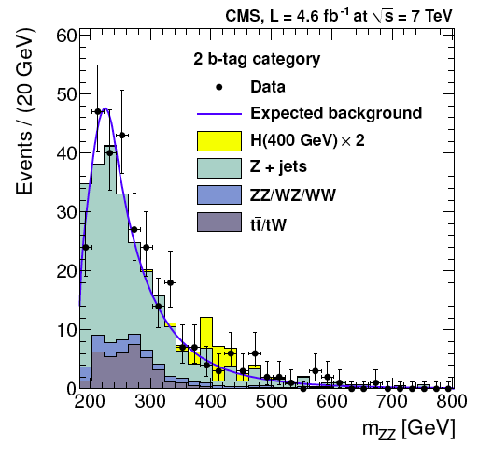
m_{ZZ} distributions - high mass

Slide 36
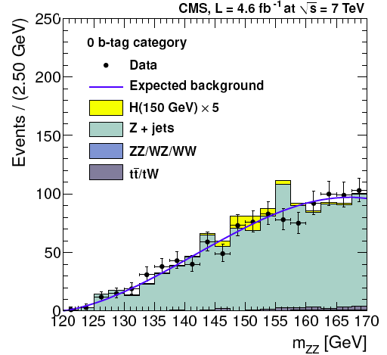
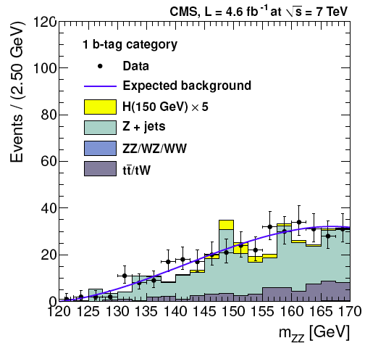
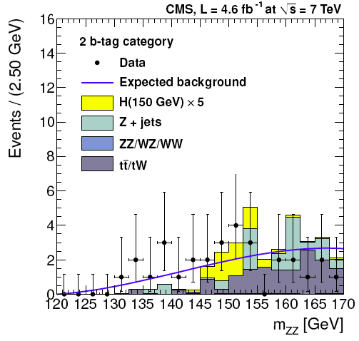
m_{ZZ} distributions - low mass
Background estimation strategy slightly different from high mass
Always comes from mjj sidebands, but:
  Normalization is taken from m_{ZZ} sidebands as costant (α(m_{ZZ}) = cost)
  unique shape for the 3 categories

Slide 37
Limit extraction
Statistical analysis on the m_{ZZ} distribution:
  background shape and normalization in signal region determined by data
  Signal shape is determined by MC
Upper limits are calculated in the mass range [130, 163] and [200, 600] GeV for 43 and 73 mass points respectively
  Interpolation performed for mass points in between
  Upper limit computed with the CLs method combining 6 EXCLUSIVE channels
    3 btag categories x 2 lepton flavour channels
Official CMS tool used to compute the limit

Slide 38
Limit extraction
Analysis on 7 TeV data (4.6 fb-1) published on the Journal of High Energy Physics:
JHEP 1203 (2012) 040

Slide 39
Limit extraction - SM4

Slide 40
Next goals
Update 7 TeV limits
  adding a few additional luminosity (now 4.9 fb-1)
  Improved H lineshape description for m_{H} > 400 GeV
Analysis on 8 TeV data is ongoing
  Improved lepton ID / isolations (Particle Flow)
  PileUp correction/rejection strategy
  Improved H lineshape description for m_{H} > 400 GeV
  Extend to m_{H} > 600 GeV

Slide 41
H→ZZ→qqll Analysis
Atlas
Supporting documentation: ATL-COM-PHYS-2012-1140
https://cdsweb.cern.ch/record/1470629
Public note: ATLAS-COM-CONF-2012-168
https://cdsweb.cern.ch/record/1474915
A. Sanchez, M. Casolino, G.Zurzolo

Slide 42
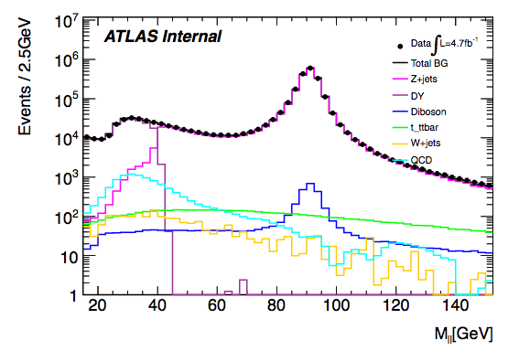
H→ZZ*→llqq low mass search
Idea was to extend the qqll analysis in the low mass range m_{H}<200
Two distinct class of H→ZZ*→llqq signal events:
Z → qq or Z* → qq
Consider only the first as the Z+jets is otherwise overwhelming and no constraint available for reducing the impact of jet energy resolution
Choose 20 GeV <M_{ll}<76 GeV fixed window
Divide in e/μ & tagged/untagged channel to improve sensitivity
Atlas
Challenging analysis to the high background expected:
  Drell-Yan/Z lepton pairs → control region using mjj sidebands
  Top (single top and ttbar) → control region with high missing E_{T}
  QCD multijet → data driven technique (ABCD & Template fit)
Notes:
Idea was to extend this in the low mass range m_{H}<200:
~20 x more signal produced w.r.t. to H→4l
fully reconstructable (using Z mass constraint ~ 3 GeV core resolution, see later)
Develop additional techniques using “known” 7 TeV data (kinematic fit/jet pairing/quark-gluon separation) to be used in next iteration analysis in both the low and high mass range with 8 TeV data
CMS published a similar analysis in the 130-165 GeV along with their H→ZZ→llqq in Spring

Slide 43
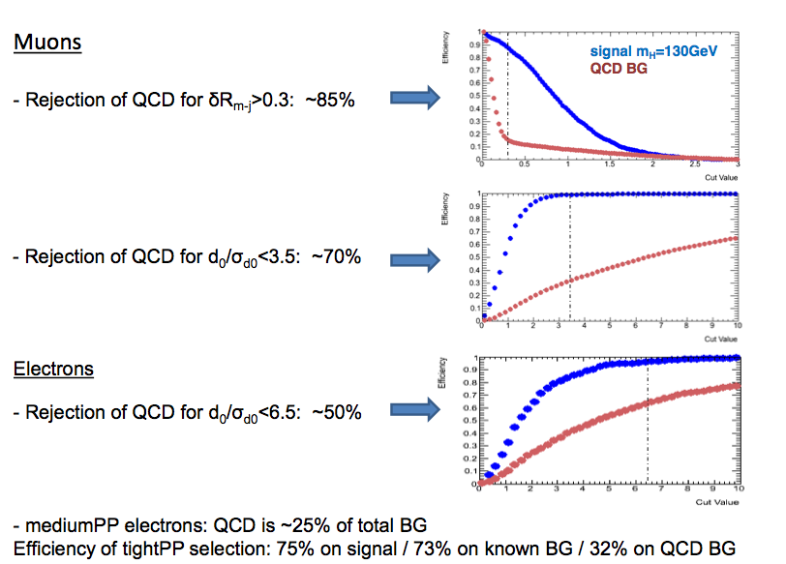
Lepton and Jet selection
Atlas
Leptons:
  STACO combined/segment-tagged muons; tight++ [medium++] electrons
  Track isolation; minimum pT > 7 [20]GeV; |η| < 2.5 |d0|/σ(d0) > 3.5 for muons (6.5 for electrons) [no d0 significance cut]
Jets:
  Anti-kT 0.4 jets with pT > 20 [25] GeV and |η| < 2.5
  Standard |jvf| > 0.75
  b-tag: MV1 at 70% efficiency working point
  5% scale correction applied to b-jets in tagged subchannel
MET_RefFinal
Low mass specific cuts

Slide 44
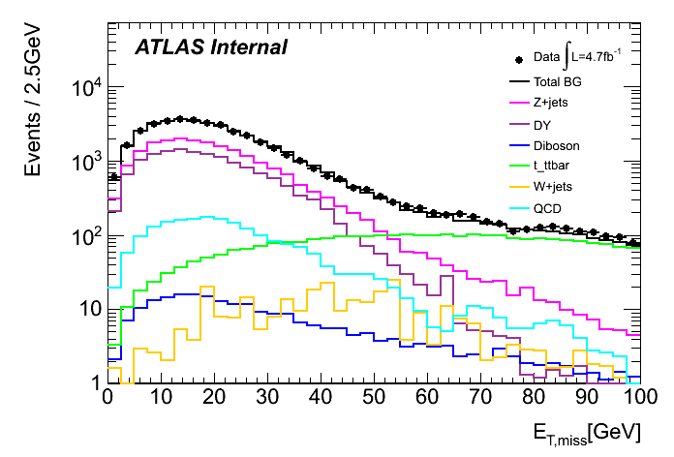
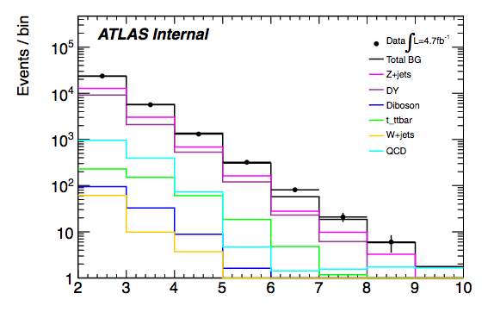
Event selection
Atlas
Trigger: single and double lepton trigger menu for 2011 (+30% data)
Exactly two SFOS leptons [OS only for muons in the high mass]
leading pT > 20 GeV/c and subleading pT > 7 GeV (L1) [20-20 GeV/c]
both pT > 14 (12) GeV/c for electrons (muons) (L2)
MET
20 < mll < 76 GeV/c²
ET^{miss} < 30 [50] GeV
At least two jets:
  untagged channel
  tagged channel (2 b-jets)
Kinematic fit to select the good jets (see next slide)
60 < mjj < 115 GeV/c² [70-105 GeV/c²]
Number of jets
Notes:
ET miss riduco il top
tagged esattamente 2 b-jet
untagged piu’ jet: per selezionare quale coppia di jet usare uso il kinematic fitter

Slide 45


Kinematic fit (1)
Atlas
Mimimize a “χ²” function defined as (top reconstruction inspired) for every di-jet combination in an event
jet energy resolution
(JERProvider tool by the
Jet/EtMiss group)
The jet pair providing the minimum “χ²” is chosen for further analysis in the untagged channel
In the tagged channel always the two tagged jets are used
“χ²” distribution tails well reproduced
X² (e)

Slide 46



Kinematic fit (untagged channel)
The jet pT is corrected according to the fit result when building mllqq
Resolution improved by ~50% w.r.t. to just raw mass (width = 2.7/c² GeV for mH = 130 GeV/c²)
The significance after full selection is improved wrt/ taking all combinations: 0.058 → 0.089 (+50% @ 130 GeV mass)
mH = 130 GeV/c²
With Kinematic Fitter
Without Kinematic Fitter
mH = 150 GeV/c²
mH = 180 GeV/c²

Slide 47




Results – Signal Region
Atlas
untag
tag
muons
electrons
Notes:
multijet =QCD
segnale x 20

Slide 48

H→ZZ*→llqq results
Atlas
No excess obseved w.r.t. the espected background but extracted the 95% C.L. upper limit on the production of an Higgs-like resonance decaying in ZZ^{(*)} in the mass range 120-180 GeV

Slide 49


Quark gluon tagging
Motivazione:
Il segnale ha jet provenienti solo da quarks, mentre il fondo dominante Z+jets ha un grande contributo proveniente da jets da gluone
(Gallicchio,Quark gluon tagging at LHC Phys. Rev. Lett. 107(17):172001)
Calcoli al NNLO conducono al rapporto delle molteplicità medie di ogni tipo di particella all’interno di jets da gluoni rispetto ai jets da quark(uds):
Dissertori, Knowles and Schmelling, Quantum Chromodynamics: High energy experiments and theory, Oxford Monographs
Al polo della Z questo rapporto è ≈ 1.7

Slide 50



Quark gluon tagging
Distribuzioni per jet con pT=200 GeV e |η|<0.8
Tracce cariche all’interno del jet
Larghezza del jet
NB: Il flavour del jet è quello del partone più energetico all’interno del jet

Slide 51
Quark gluon tagging and SOM
Mappe con N = 4 (ntrack_jet1, ntrack_jet2, width1, width2).
Migliore performance ottenuta con una mappa rettangolare di neuroni 4X4.
Training (non supervisionato!!) fatto su un dijets sample.
Mappe divise pT bins
Individuazione dei cluster di neuroni vicini → categoria SOM
Individuazione delle categorie interessanti
4x4 SOM
maps
Events with 2 gluon jets
Events with 2 lf jets
Events with 2 hf jets
51

Slide 52
Short and long term plans
Finally the 2011 analysis is over and a conf note is now available (poster at HCP)
Of course very difficult for the SM Higgs @ 125 GeV
2012 analysis already started both for low and high mass
With 6 X statistics:
The SM Higgs will still not be visible in this channel in the inclusive but:
  Athens group looking into VBF/VH exlcusive channels and MVA
  Can produce a combined llqq analysis from low up to the highest masses with the time scale of Moriond to look for additional resonances
  Possibly bringing further improvements (q/g separation)

Slide 53
H→ZZ^{(*)}→4l Spin properties
Atlas
G. Zurzolo, N. Bruscino, F. Cirotto

Slide 54


Higgs: Spin properties
Atlas
Model-independent approach to extract the resonance spin, parity and couplings
Explore Higgs properties using decay Kinematics angular analysis of decay products

Slide 55


Higgs: Spin properties
Atlas
Let us consider the X→VV→4fermions final state
θ₁,θ_{2,} Φ helicity angles
θ*,Φ₁ production angles
(production angles uncorrelated with spin-0 kinematics and used for background suppression)

Slide 56

Higgs: Spin properties
Atlas
Spin 0
Spin 1
Spin 2
Spin 0
Spin 1
Spin 2
Θ*
θ₂
Φ₁
Φ
Θ₁
The signal hypotheses shown are:
J+ minimal (red circles; a2 = 0)
J+ (green squares; a2 ≠ 0)
J − (blue diamonds)
2012: http://arxiv.org/abs/1208.4018v1
2010: http://arxiv.org/abs/1001.3396v2

Slide 57



Spin/CP Analysis
Atlas
Fully reconstructed final state allows measuring Spin/CP:
  5 angles ( production, decay )
  m12, m34
  Discriminate 0+ (SM) hypothesis against:
    0⁻
    2⁺m (graviton-like tensor with minimal couplings)
    2⁻ (pseudo-tensor)

Slide 58

MELA discriminant
Build a Bayes Likelihood Ratio multivariate discriminant to separate two JP hypotheses for the Higgs particle:
  pMELA shapes computed on full simulation and data‐driven control samples: JHU for signal (0+,0-,2+,2-), PowHeg ZZ MC, reducible
  background from data control regions
Systematics:
  correlation among observables (shape)
  variation of wrong‐paired fraction (shape)
  Bin normalization systematics (electron E scale, mH uncertainty..)
phase space
matrix elements
from theory
detector effects
from full sim.
On the spin and parity of a single-produced resonance at the LHC: http://arxiv.org/abs/1208.4018
Higgs look-alikes at the LHC: http://arxiv.org/abs/1001.5300
Identifying the Higgs Spin and Parity in Decays to Z Pairs: http://arxiv.org/abs/hep-ph/0210077v1

Slide 59


Test hypothesis: 0+ vs 0-
  Data strongly favour 0+ vs 0-: 2.3 σobserved separation (1.7 expected)
  0- hypothesis is excluded
  at ~99% C.L.

Slide 60


Test hypothesis: 0+ vs 2-
  0+ also favoured vs 2- (~2.0σ observed separation)

Slide 61


Test hypothesis: 0+ vs 2+m
  Less discriminating power vs 2+m, but 0+ still favoured
  2+ excluded at ~85% C.L

Slide 62
Short and long term plans for H→ZZ(*)→4l
Extend the analysis to all 2012 data
Repeat same optimization studies:
  MassConstraint
  Decrease m4l range from 115-130 GeV to 120-130 GeV
  MVA: use MELA/BDT to improve the analysis sensitivity
MC and models
New models: gg/qq production mechanisms for spin-2, spin-1 exclusion, more generic spin-2 models (2-h)
Possible spin mixtures: The discussion is on-going in the HSG7 group
A new version of the JHU is available and new generators start appearing: MG5 and MC@NLO
  First step: validation of MG5 against JHU
  The ZZ→4l FS will be available in aMC@NLO soon
Possible spin mixtures: The discussion is on-going in the HSG7 group

Slide 63
Short and long term plans for H→ZZ(*)→4l
Hypothesis testing
  update hypothesis testing with all available samples (including J=1 and various qq/gg fractions for J=2)
  possibly switch to 2D fit (J^{P}-MELA vs m4ℓ / J^{P}-MELA vs MELA or/and BDT vs m4ℓ)
Mass measurement
  modified-MELA gives S/B separation (ratio of 0⁺ and background likelihoods, function of m1,m2,Ω)
  study residual correlations with m4ℓ for mass measurement (2D fit in m4ℓ/modified-MELA or/and BDT plane)
MEGA extended likelihood fit to study tensor structure of H→ZZ vertex (normalization and theory coupling parameters)
  use full S+B likelihood in J=0 hypothesis
  fit signal yield (µ) and CP-odd fraction (∝a3∝g4)
REMINDER
J^{P}-MELA (m4ℓ,m1,m2,Ω): p(ev | J1) / [p(ev | J1)+p(ev | J2)]
MELA (m4ℓ,m1,m2,Ω): p(ev | 0⁺) / [p(ev | 0⁺)+p(ev | bkg)]
modified-MELA (m1,m2,Ω): p(ev | 0⁺) / [p(ev | 0⁺)+p(ev | bkg)]

Slide 64
the end

Slide 65
the end

Slide 66


Higgs: Spin properties
Expected separation significance (Gaussian σ) between the SM Higgs boson scenario (0+m) and various J^{PC} hypotheses. Expectations are given for the scenario of a 5.0 σ signal-to-background separation observed in the search for the SM Higgs boson in each channel.
Estimated Expected separation significance for an LHC experiment 8 TeV with L= 35 fb−1
Notes:
TABLE: Expected separation significance (Gaussian σ) between the SM Higgs boson scenario (0+m) and various JxP hypotheses defined in Table I. Expectations are given for the scenario of a 5.0 σ signal-to-background separation observed in the search for the SM Higgs boson in each channel, and therefore interpretation in terms of integrated luminosity and pp collision energy at the LHC may differ significantly between the three channels X → ZZ, WW, and γγ. We rely on the expected signal-to-background significances reported by the LHC experiments for the integrated luminosity of about 10 fb−1, which we take as 3.8, 2.4, and 2.8σ in the X → ZZ, WW, and γγ channels, respectively [2]. In Table III we show examples of hypothesis separation expectations, per each LHC experiment, by the end of the 8 TeV LHC run, assuming 35 fb−1 of integrated luminosity.

Slide 67




Ricerca dell’Higgs in Atlas: H->γγ
Ricerca condotta nell’intervallo di massa 110 ≤ m_{H} ≤ 150 GeV
Subdetector maggiormente coinvolti sono InnerTracker e Calorimetro EM
Stato finale semplice:
2 fotoni isolati con alto p_{T} e E_{T} (γ₁, γ₂) > 40, 25 GeV
Atlas:
Ricostruzione di m_{H} per il processo H->γγ
(mH = 120 GeV/c²) σ(mH) = 1.7 GeV
Composizione dei campioni | 7TeV | 8TeV
eventi selezionati | 23788 | 35271
γγ | 80±4% | 75±3%
γ+jet | 19±3% | 22±2%
jet+jet | 1.8±0.5% | 2.6±0.5%
2011
2012
Notes:
I due plot che ti ho aggiunto sono le composizioni del campione al variare della massa gg per 2011 e 2012 nella tabella ho messo le percentuali integrali del colore relativo alla curva nel plot (gg in blu, g+jet in verde e jet+jet in rosso)

Slide 68


Ricerca dell’Higgs in Atlas: H->γγ
σ(γγ) x BR ≅ 40 fb
(70 eventi attesi per m_{H} = 130 GeV)
0.01 < S/B < 0.1
Processo gluon fusion (GGF) dominante (87%) + WH (7%)
Deviazione massima dall’ipotesi di solo fondo oservata per m_{H}~126.5 GeV:
  valore p₀ locale per mH =126.5 GeV e’ 2 x 10⁻⁶ o 4.5σ
  atteso per un Higgs SM: ~ 1.4σ locale
  valore p₀ globale: include la probabilità di avere questo eccesso altrove nel range di massa investigato 110-150 GeV (“Look-Elsewhere-Effect”): 7 x 10⁻³ (3.6σ)
2011 + 2012
Notes:
Significativita’ locale 4.5 sigma mentre quella globale con il “look-elsewhere-effect” a 3.6sigma
plot massa:
Invariant mass distribution for the combined sqrt(s) = 7 TeV$and sqrt(s) = 8 TeV data samples, overlaid with the total background obtained from summing the fitted background only models to the distributions in the individual categories. The bottom inset displays the residual of the data with respect to the total background. The Higgs boson expectation for a mass hypothesis of 126.5 GeV corresponding to the SM cross section is also shown.
plot: p0:Expected and observed local p0 values for a SM Higgs boson as a function of the hypothesized Higgs boson mass mH for the combined analysis and for the sqrt(s)=7 TeV and sqrt(s)=8 TeV data samples separately. The observed p0 including the effect of the photon energy scale uncertainty on the mass position is included via pseudo-experiments and shown as open circles.

Slide 69



Ricerca dell’Higgs in Atlas: H→ZZ*→4l
Ricerca condotta nell’intervallo di massa 110 ≤ m_{H} ≤ 600 GeV
Quattro categorie di stati finali : 4μ, 2e2μ, 4e
Principali processi di fondo: ZZ(*) ttbar e Z+jets
(m_{H} < 180 GeV)
Idea base della selezione è relativamente semplice: I leptoni provenienti dal decadimento dell’Higgs sono “isolati” e provengono da un vertice comune.
I candidati Higgs sono selezionati richiedendo:
2 coppie di leptoni isolati con carica opposta
pT > pT_soglia (O(10 GeV))
minima separazione angolare: ΔR>0.1
Le 2 masse invarianti formate dalle 2 coppie di leptoni m₁₂ e m₃₄ :
50< m₁₂ <106 GeV
m_{soglia}(mH) <m₃₄ < 115 GeV
Notes:
plot massa:The distribution of the four-lepton invariant mass, m_4l, for the selected candidates compared to the background expectation for the 80-250 GeV mass range for the (a) sqrt{s}=8 TeV, (b) sqrt{s}=7 TeV and (c) combined datasets. Error bars represent 68.3% central confidence intervals. The signal expectation for several m_H hypotheses is also shown.
plot: p0: Figure 14a:The observed local p0 for the combination of the 2011 and 2012 datasets (solid line). The dashed curve shows the expected median local p0 for the signal hypothesis when tested at the corresponding m_H. The horizontal dashed lines indicate the p0 values corresponding to local significances of 1sigma, 2sigma, 3sigma and 4sigma.
plot: Limite: The expected (dashed) and observed (full line) 95% CL upper limits on the Standard Model Higgs boson production cross section as a function of m_H, divided by the expected SM Higgs boson cross section, for the combination of the sqrt{s}=7 Tev and sqrt{s}=8 TeV data samples. The dark (green) and light (yellow) bands indicate the expected limits with +- 1sigma and +- 2sigma fluctuations, respectively; (a) shows the low mass range, and (b) the full rangeunder consideration.

Slide 70

Higgs couplings:
Vector bosons vs. fermions
Suppose couplings to (weak) vector bosons are all scaled by some universal strength:
    K_{V} = K_{W} = gW/g_{W}(SM) = K_{Z} = g_{Z}/g_{Z}(SM)
And for all fermions unique K_{f} (Assume no invisible decays )
Propagate strengths to loop couplings (K_{g}, K_{γ}) by scaling expected functional dependence
No physical dependence on overall sign → choose K_{V}>0 (no loss of generality)
Perform 2D scan of profile likelihood ratio in (K_{V}, K_{f})
  – Double minimum from interference between vector bosons and fermions –
Vector boson and fermion couplings consistent with SM expectations

Slide 71



Higgs couplings:
Vector bosons vs. fermions
1D likelihood scan for each coupling
Asymmetry of double minima in K_{f} due to interference (constructive or destructive) between fermions and vector bosons in H->γγ
K_{V} = 1.20 +/- 0.10
K_{f} ∈ [-1.0, -0.7] ∪ [0.7, 1.3]
→ Fermiophobic Higgs (K_{f}=0) strongly disfavored

