Slide 1
Stellar Astrophysics: some aspects, some applications, some projects…
Santi Cassisi
INAF - Astronomical Observatory of Teramo, Italy

Slide 2












The group members
R. Buonanno
M. Cantiello
S. Cristallo
F. De Luise
E. Di Carlo
M. Dolci
L. Piersanti
A. Piersimoni
A. Pietrinferni
G. Raimondo
O. Straniero
G. Valentini

Slide 3
Outline
Theoretical Stellar Evolution
Galactic Stellar Populations
Stellar Populations in the Local Group
Unresolved Stellar Populations
The GAIA Mission
Supernovae Follow-up

Slide 4
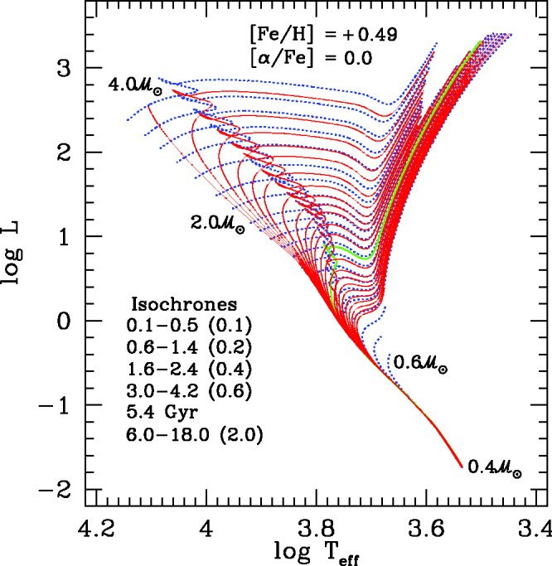
Evolutionary Stellar models: the “outputs”
Evolutionary lifetimes − Star counts
Bolometric luminosity
Effective temperature
Mass – different than the initial one
Nucleosynthesis
Surface gravity
T_{eff}
Bolometric corrections
+
color-T_{eff} relations
+
spectral library
Magnitudes & Colors
Spectral indices
Integrated spectra
Surface brightness fluctuations
It is mandatory to check the reliability and accuracy
of the theoretical evolutionary framework

Slide 5
The “ingredients”
An evolutionary code
Numerics
Boundary conditions
1D versus 3D
Equation of State
Radiative opacity
Conductive opacity
Nuclear reaction rates
Neutrino energy losses
Non canonical physics…
Physical inputs
Overshooting
Superadiabatic convection
Non-canonical processes
Mixing treatment
Microscopic mechanism
Atomic diffusion
Radiative levitation
Mass loss
Rotation
Magnetic field
Additional mechanism

Slide 6
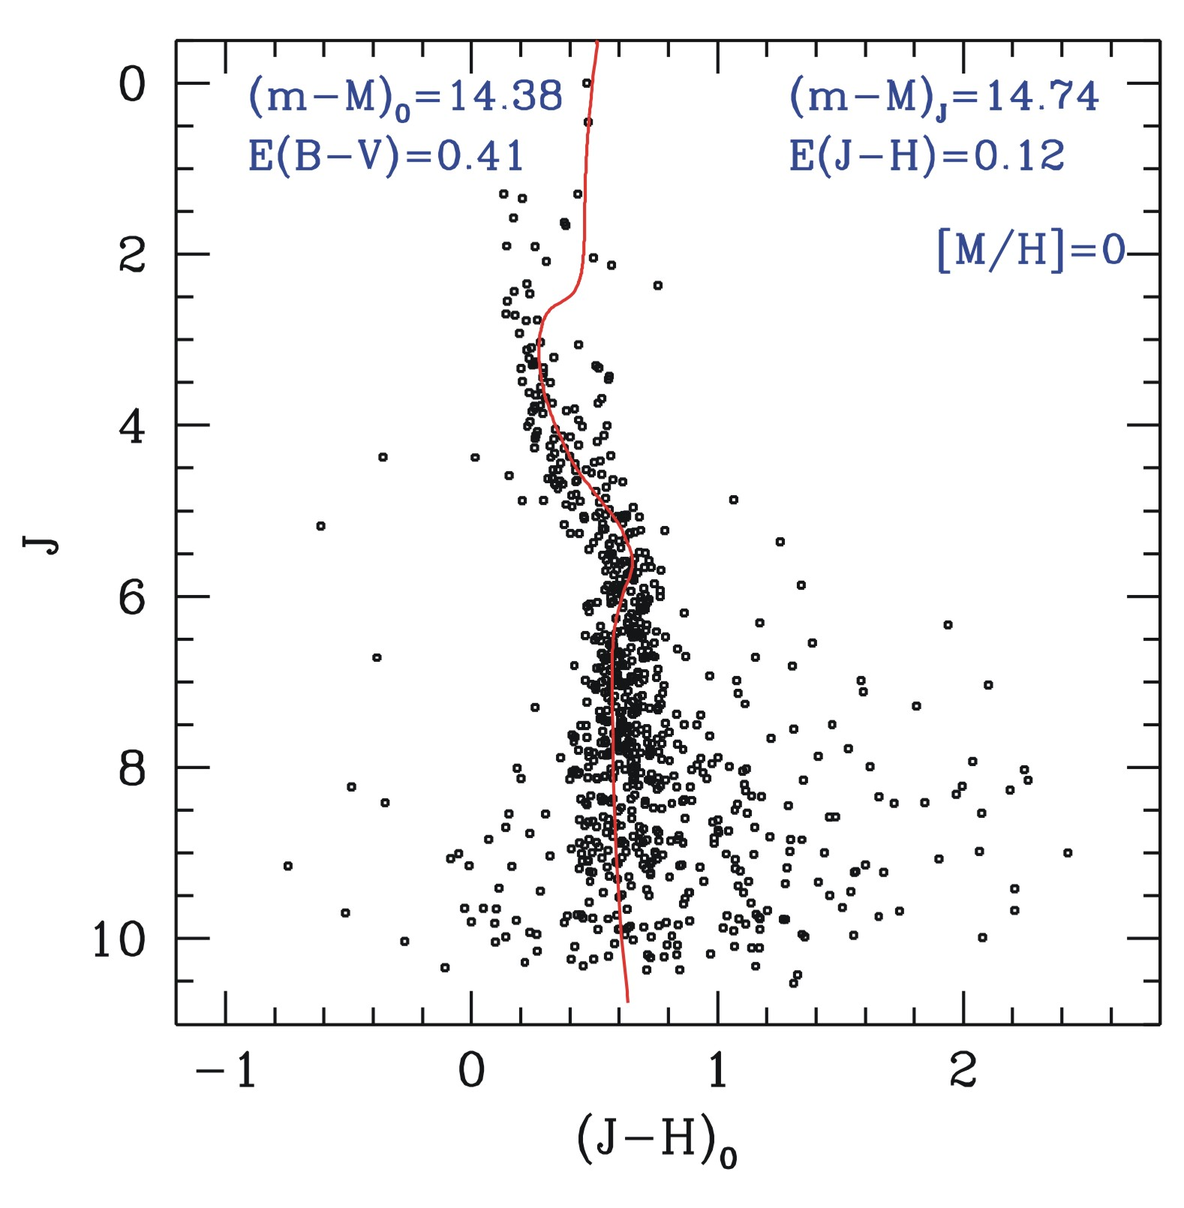
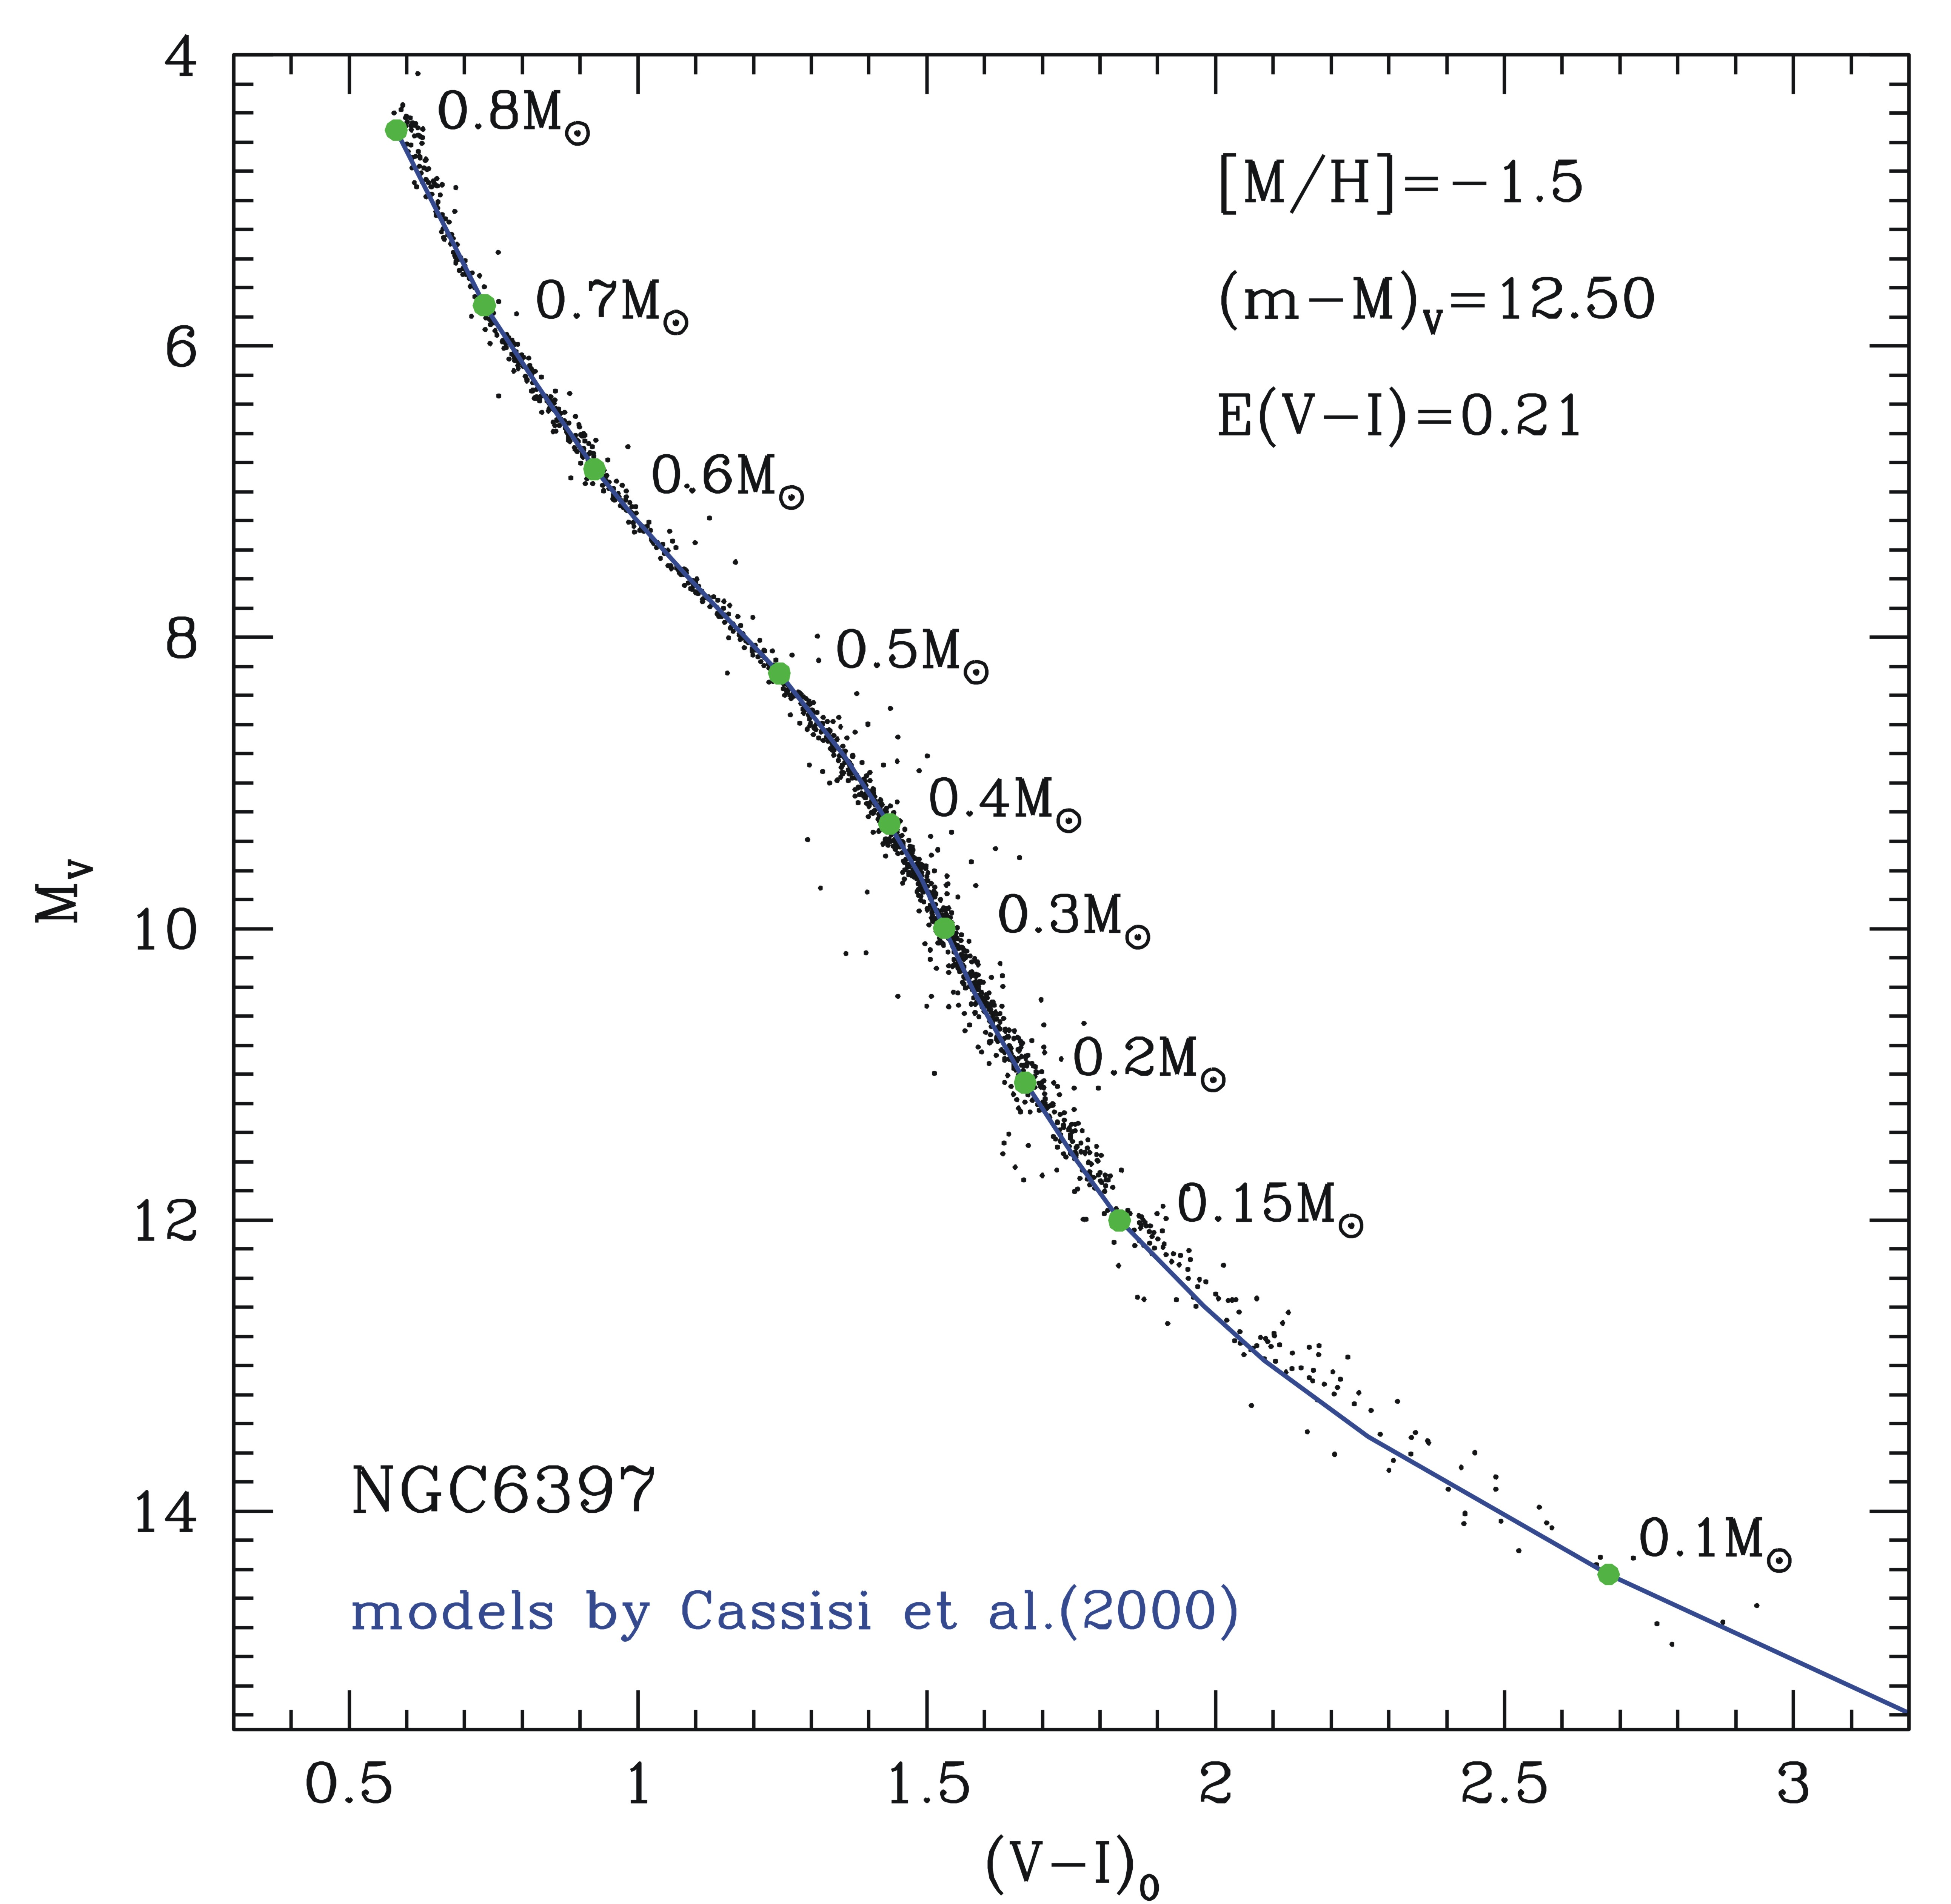
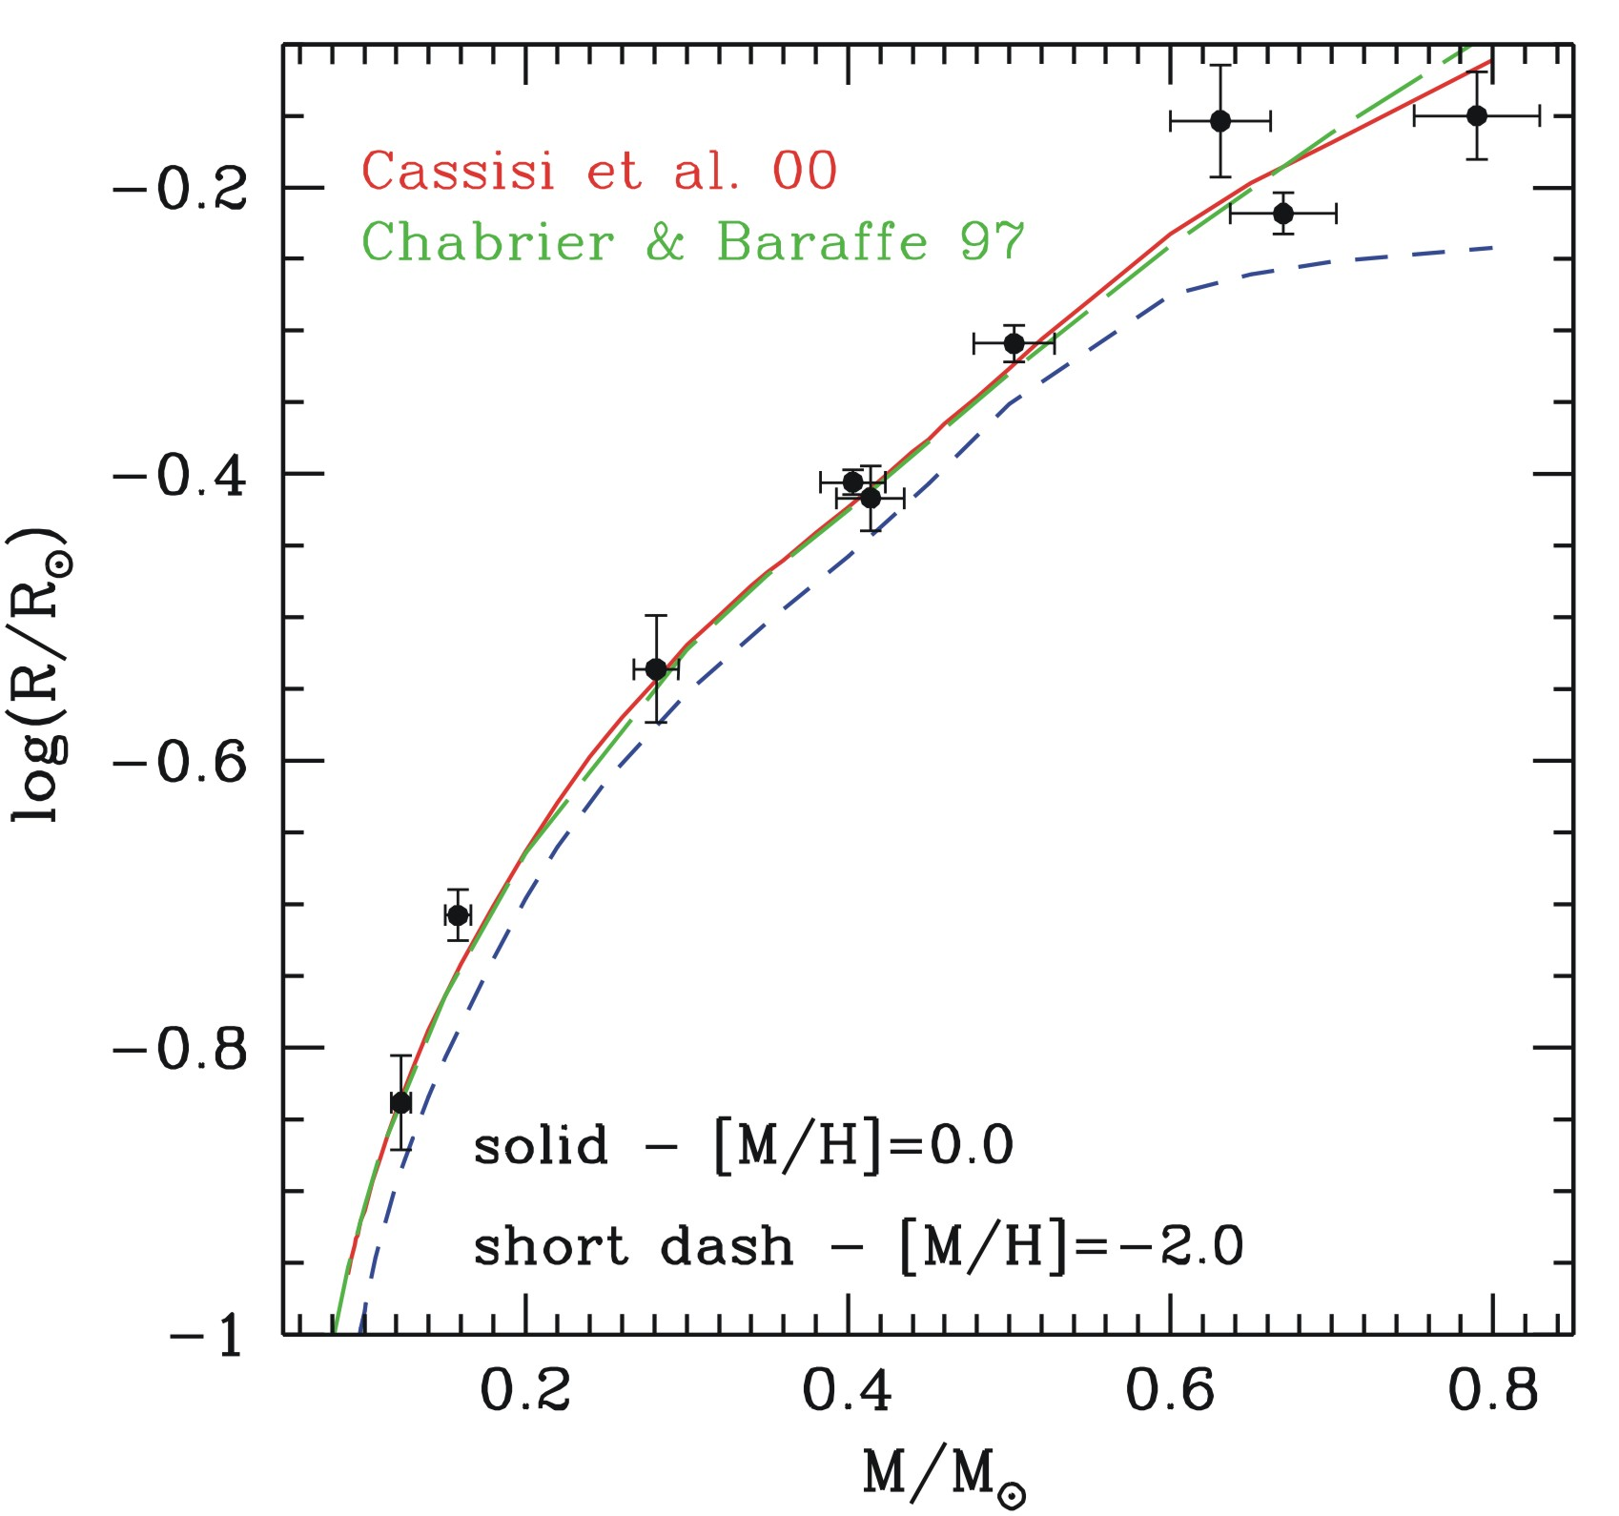
Some outstanding results…
Very Low Mass stars
King et al. (1998)
Segransan et al. (2003)
Zoccali et al. (2000)
✓
Surface boundary conditions
Equation of State
Opacity
✓
✓

Slide 7
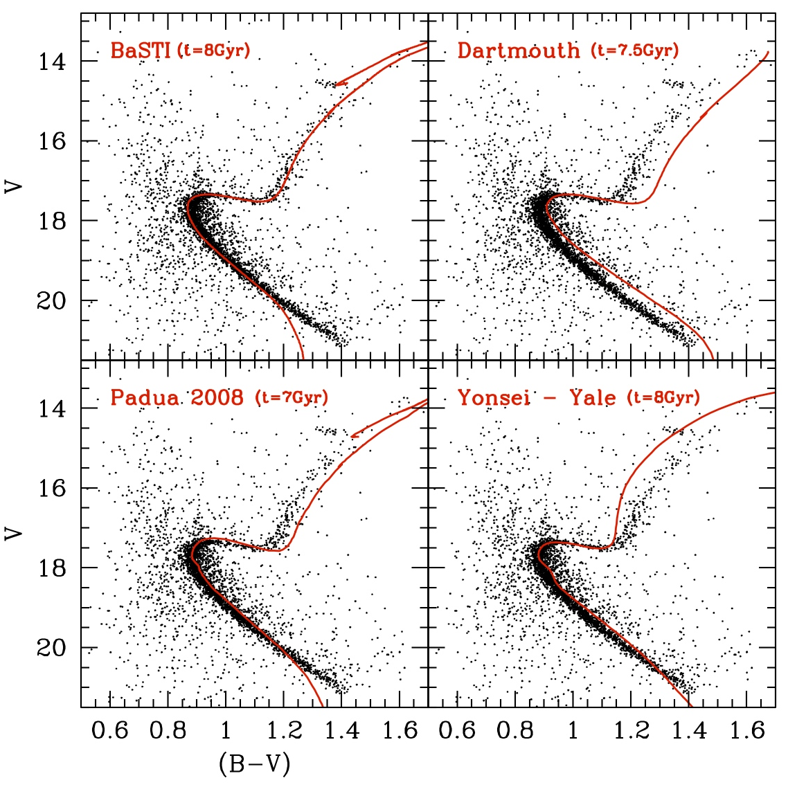
Eclipsing binary: an important benchmark
The case of V20 in the Galactic Open Cluster NGC6791
(m-M)_{V}=13.46 ± 0.10
E(B-V)=0.15 ± 0.02

Slide 8
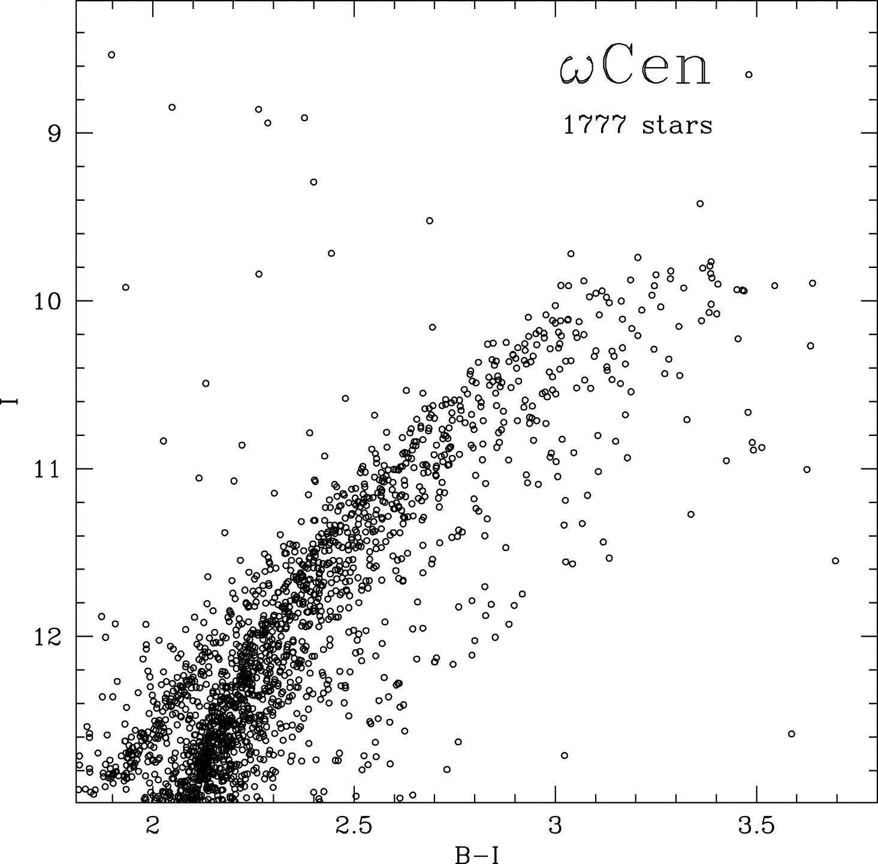
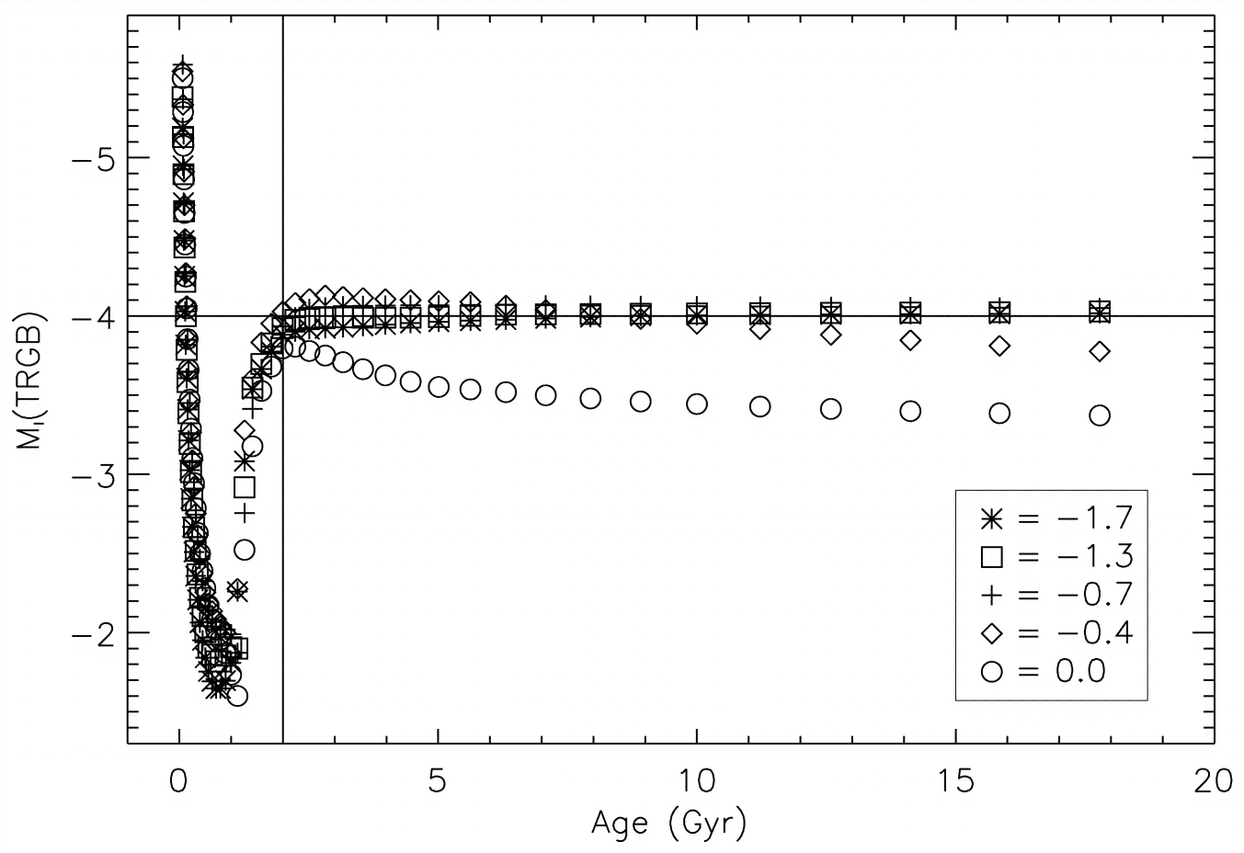
The brightness of the Red Giant Branch Tip
The I-Cousin band TRGB magnitude is one of the most important primary distance indicators:
RGB tip
age independent for t>2-3Gyrs;
metallicity independent for [M/H]<−0.9
The TRGB brightness is a strong function of the He core mass at the He-burning ignition
Being M_{cHe}@TRGB strongly dependent on the adopted “physical framework”,
it has been often used as benchmark for testing “fundamental theory”

Slide 9
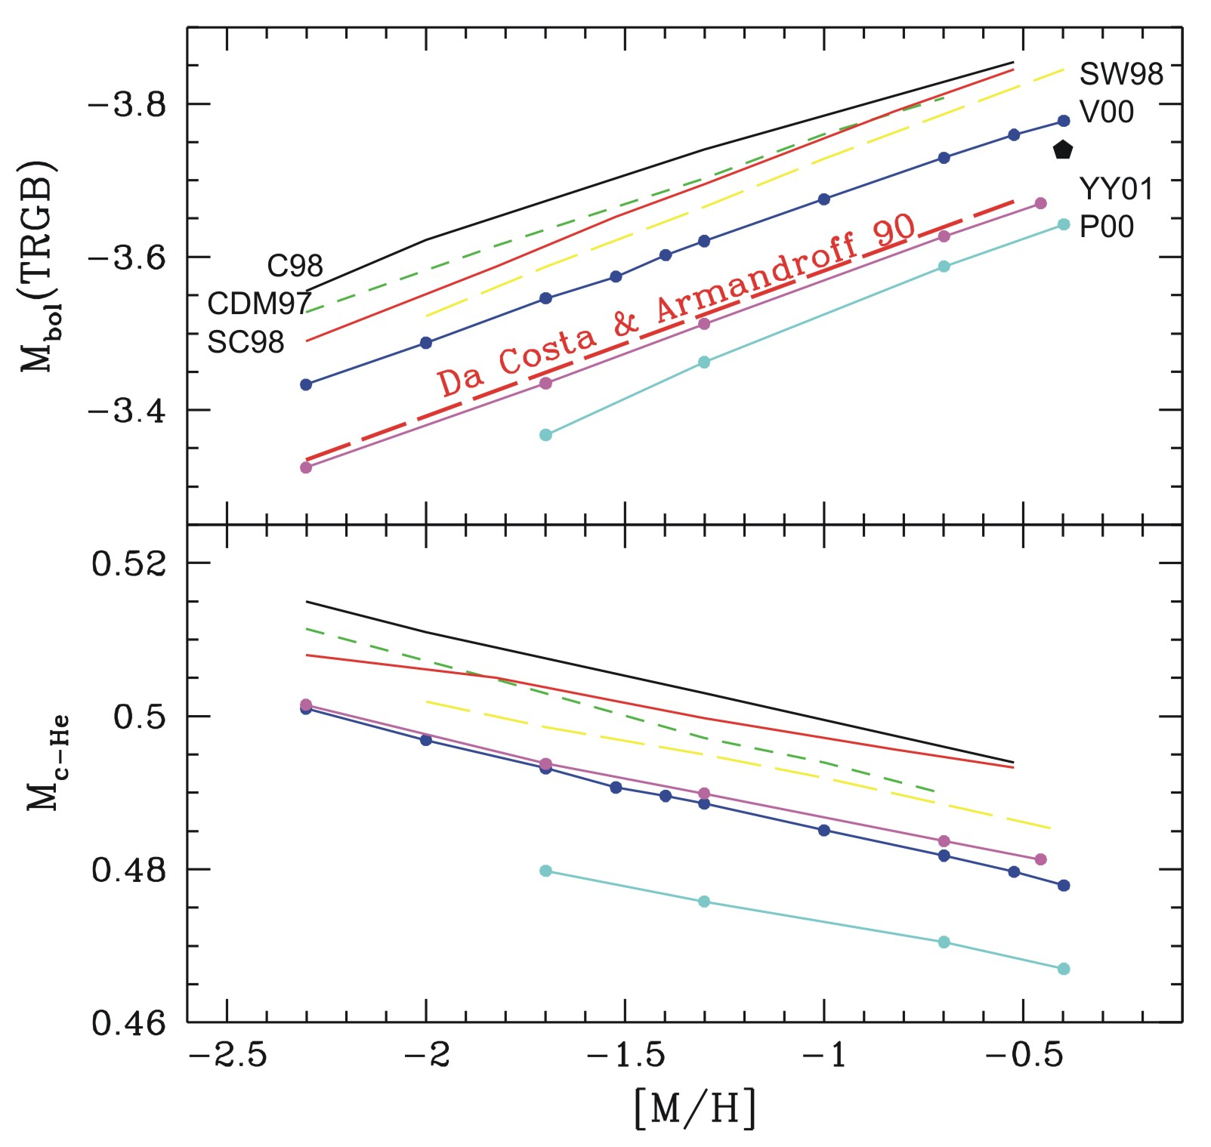
TRGB: He core mass – luminosity
≈ 0.03M
These differences are –often but not always…- those expected when considering the different physical inputs adopted in the model computations

Slide 10
The He core mass@TRGB
Who is really governing the uncertainty in the M_{cHe} predictions?
0.8M Z=0.0002 – Y=0.23 | M_{cHe} | ΔM_{cHe}
No diffusion | 0.5110 | −0.0043
Stand. diffusion | 0.5153 | //
Plasma ν +5% | 0.5166 | +0.0013
Plasma ν -5% | 0.5141 | −0.0012
3α +15% | 0.5143 | −0.0010
3α -15% | 0.5166 | +0.0013
κ +5% | 0.5158 | +0.0005
κ -5% | 0.5147 | −0.0006
κ_{cond} (HL) | 0.5148 | −0.0050
Diffusion ×1/2 | 0.5136 | −0.0017
Diffusion ×2 | 0.5187 | +0.0034
42%
conductive
opacity
36%
diffusion
efficiency
4%
radiative
opacity
8%
3α reaction
rate
10%
plasma
neutrinos
Δ^{MAX}M_{cHe} ≈ 0.01M
@TRGB
Cassisi et al. (1998) – Pietrinferni et al. (2011)
ΔM_{bol}~0.1 mag
@ZAHB

Slide 11
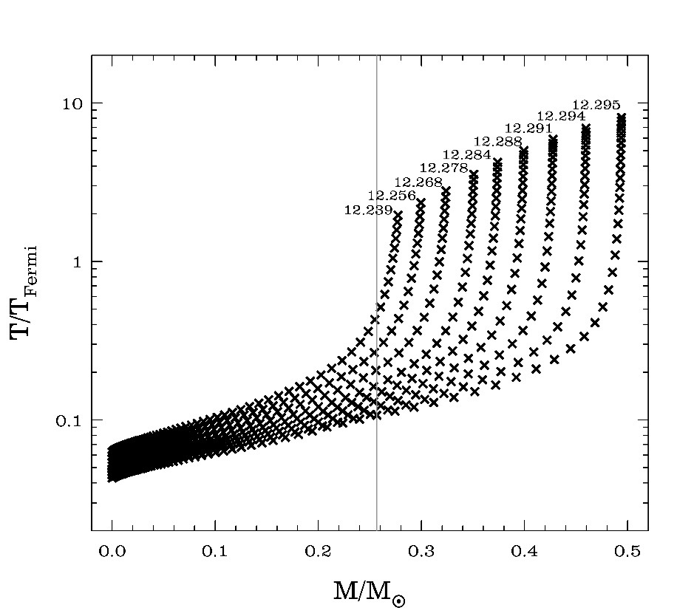
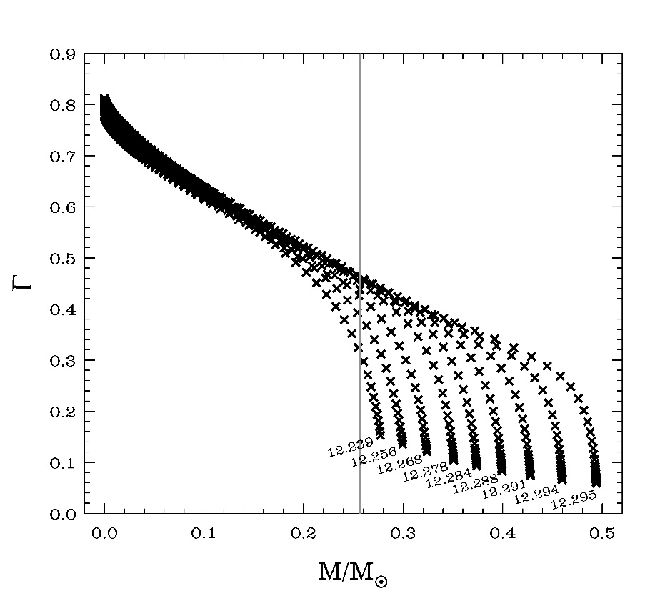
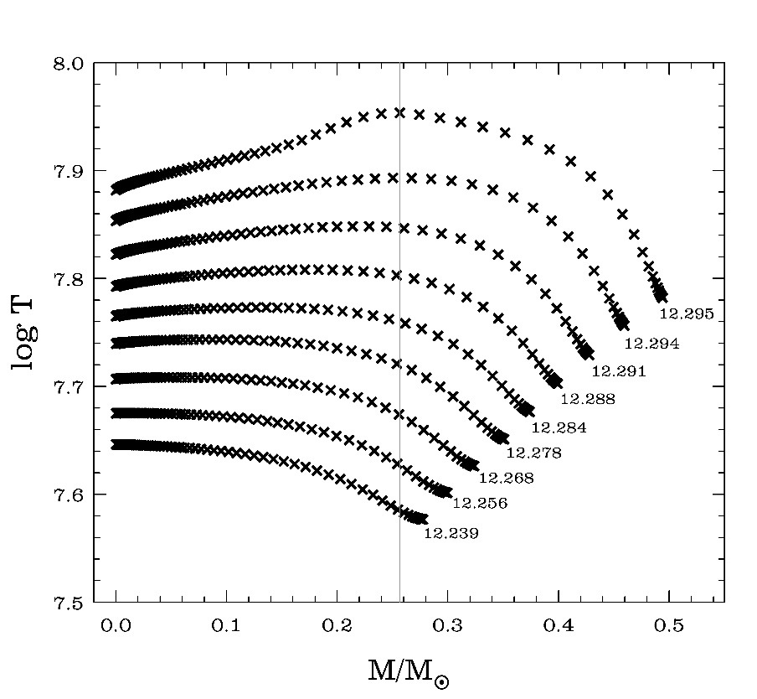
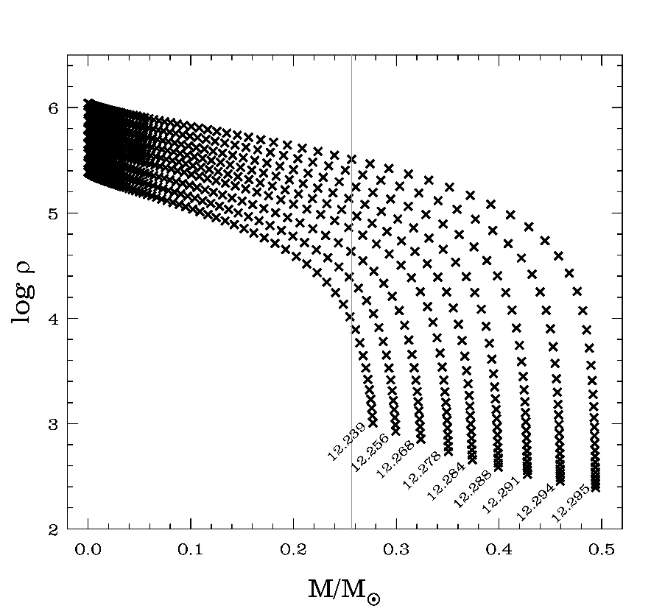
He CORE mass & conductive opacity:
electron conduction is the dominant energy transport mechanism in the electron degenerate He core
In order to obtain reliable κ_{cond} estimates, one has to properly take into account the “real” physical conditions of the He core
partial electron degeneracy
intermediate ion coupling regime

Slide 12
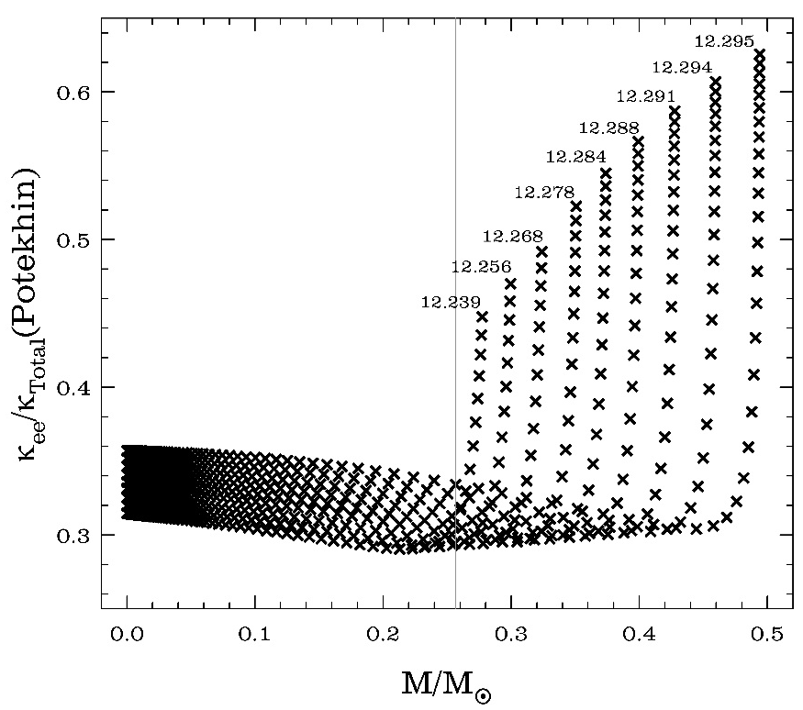
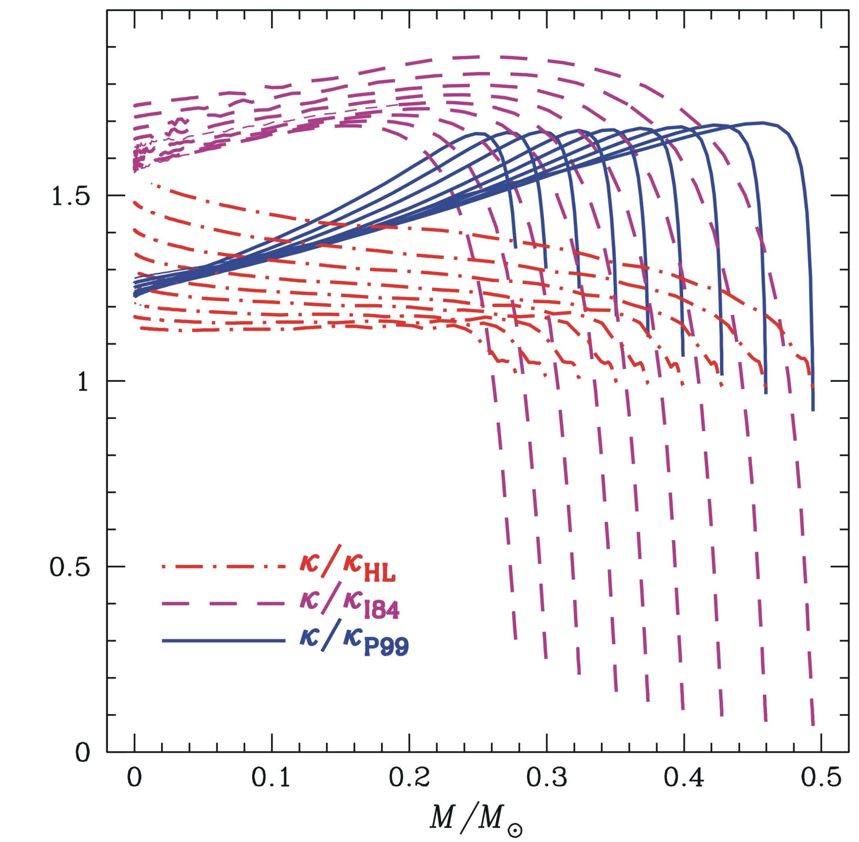
Conductive opacity: an update
Until few years ago, only 3 independent sources of κ_{cond} were available, each one with its own shortcomings…
Recently, a new set of κ_{cond} estimates has been provided - by an international collaboration - based on:
a full coverage of the parameter space;
the inclusion of the e⁻e⁻ scattering effects;

Slide 13
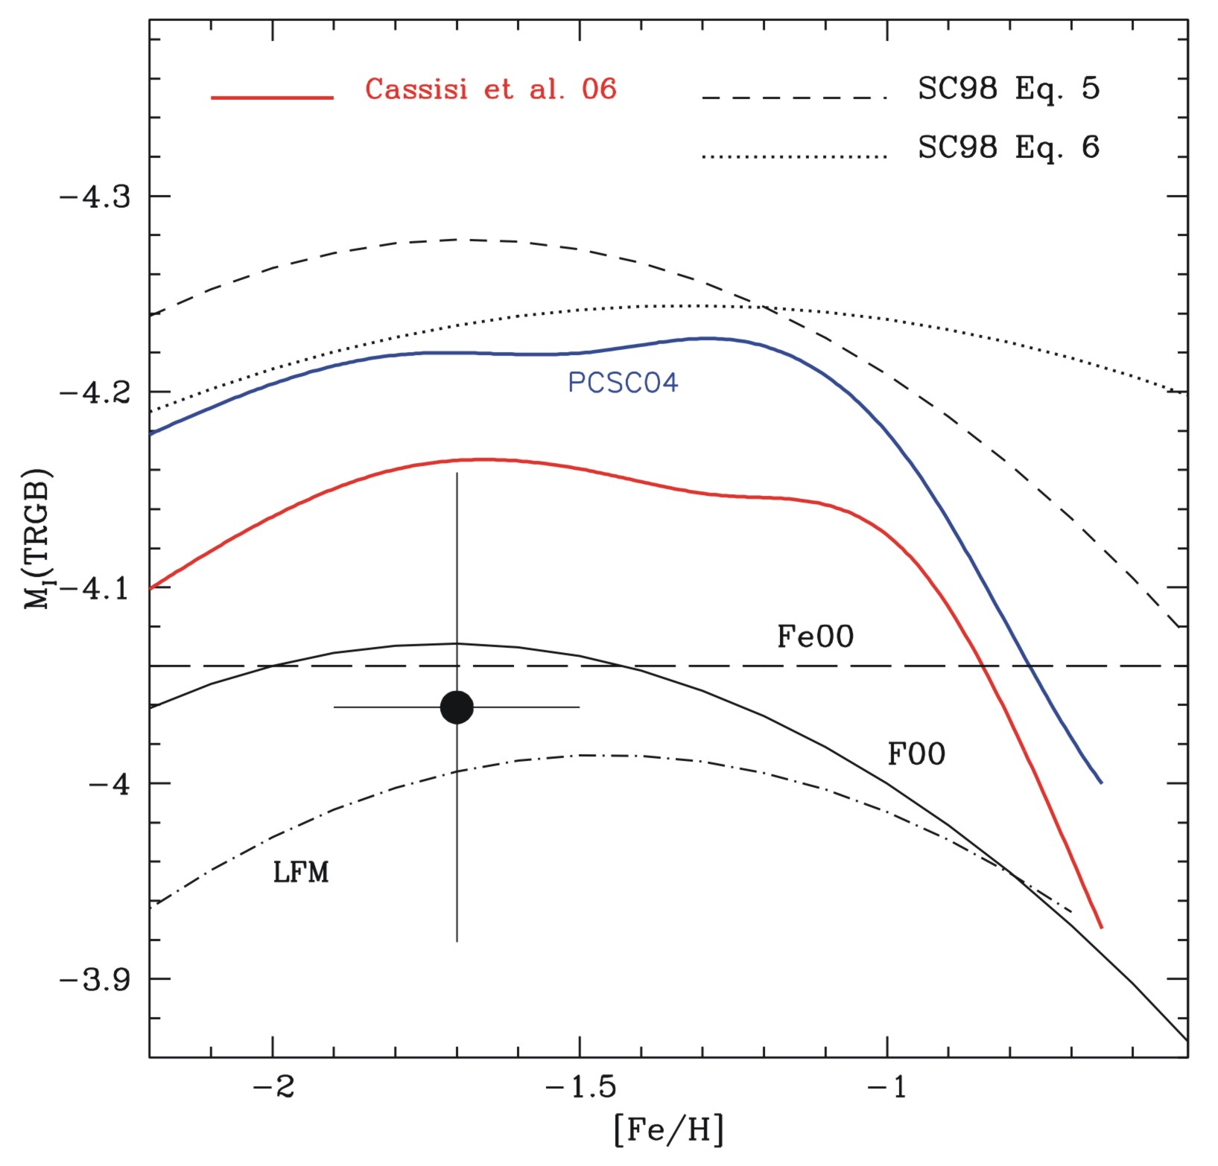
The TRGB brightness as Standard Candle: theoretical calibrations
The effect of
updated conductive opacity
ω Cen – Bellazzini et al. 01
The I-band theoretical calibrations appear sistematically brighter by about 0.15 mag

Slide 14
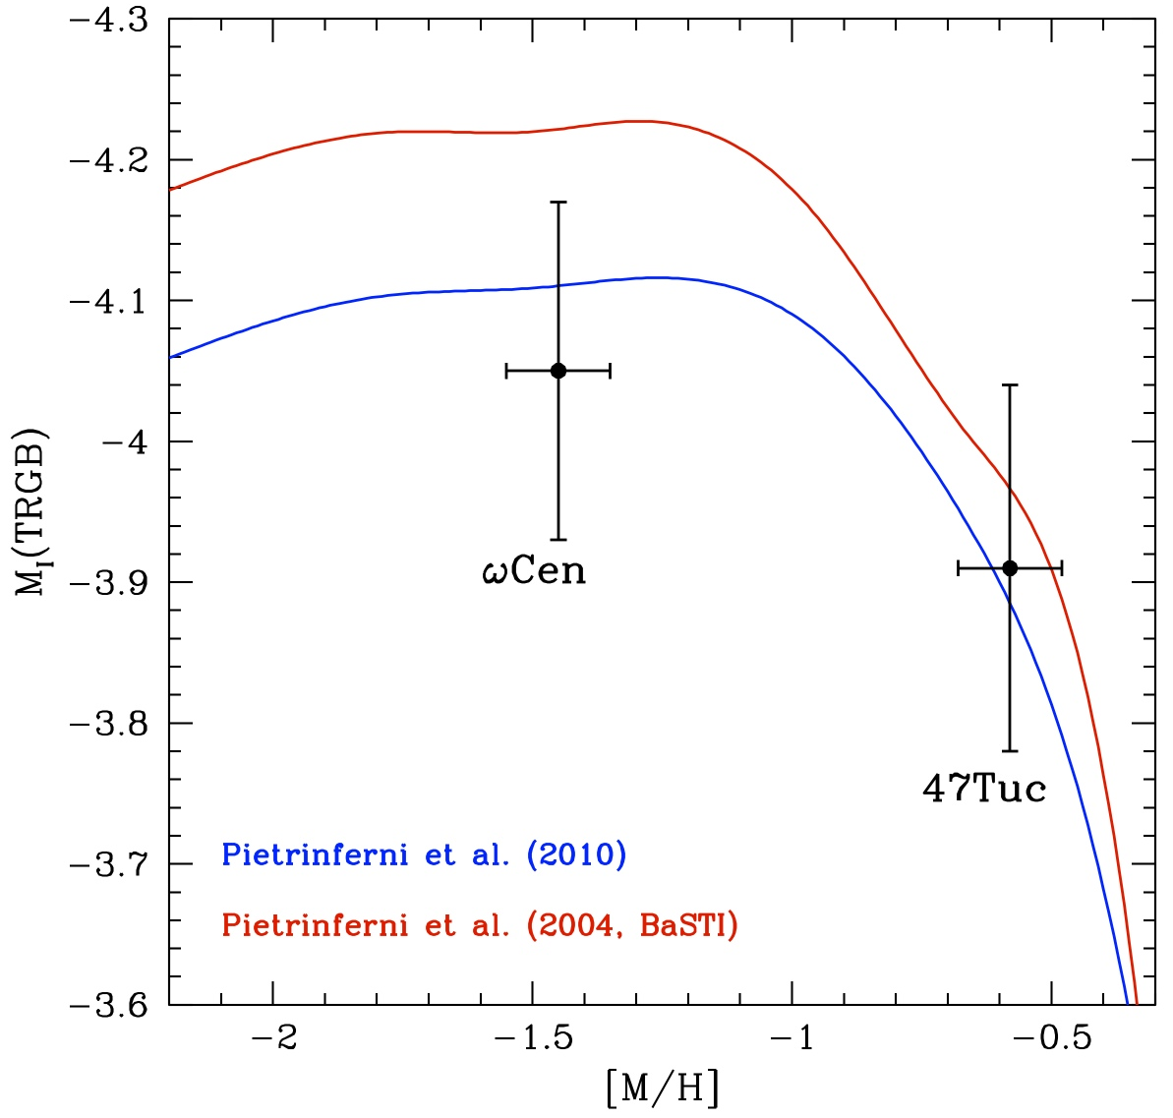
The TRGB brightness: theory versus observations
Updated RGB models – accounting for both new conductive opacity and an updated reaction rate for ¹⁴N(p,γ)¹⁵O - are now in agreement with empirical data at the level of better than 0.5σ

Slide 15
The Age dating of
Galactic Globular Clusters

Slide 16
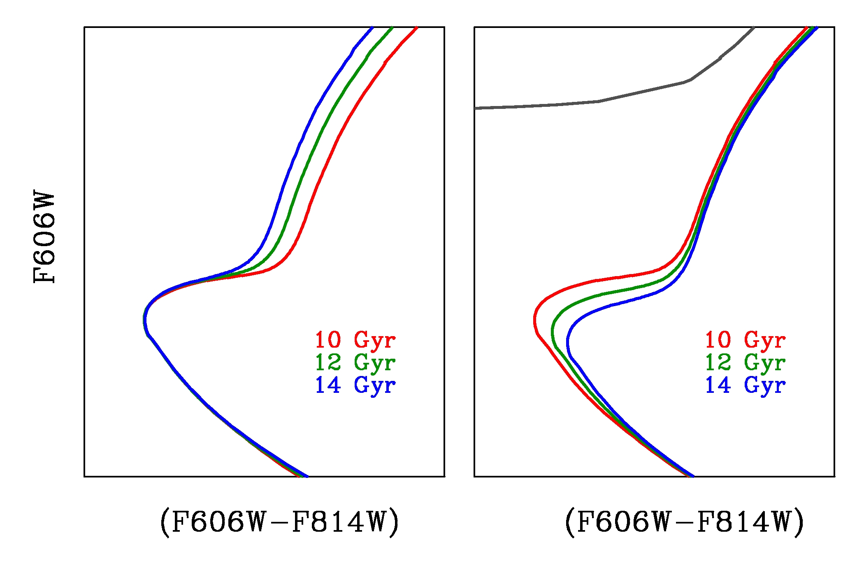
Globular Clusters are the oldest Galactic objects for which reliable ages can be measured.
- Absolute Ages place a lower limit to the age of the Universe. But significant uncertainties mainly related to the distance determination…
On the other hand, relative ages can be estimated to high precision by measuring the position of the main sequence turn off (MSTO) relative to CMD features that have little or no age dependence.
Relative Ages reveal fundamental information about Galactic formation mechanisms and timescales.
Horizontal
Method
Vertical
Method
MSTO

Slide 17
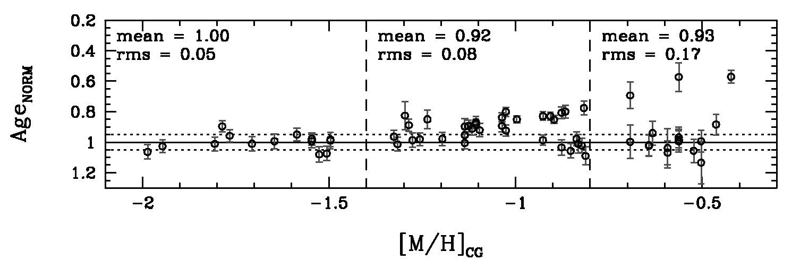
Old group: Age dispersion
“Old group”: Clusters with the same age and an intrinsic dispersion of ~0.4 Gyr. No age-metallicity relation. The old group of clusters formed within a fast assembling process of the halo, lasting ~0.8 Gyr.
Collapse of a single large protosystem?
The free-fall time of a homogeneous sphere of ~1.9×10^12 M⊙ and 170 kpc (Wilkinson & Evans 1999 estimation for the Milky Way dark matter halo) is ~0.84 Gyr!!
Hierarchical galaxy formation mechanisms supported by the ΔCDM scenario?
All ‘building blocks’ formed at the same time.

Slide 18
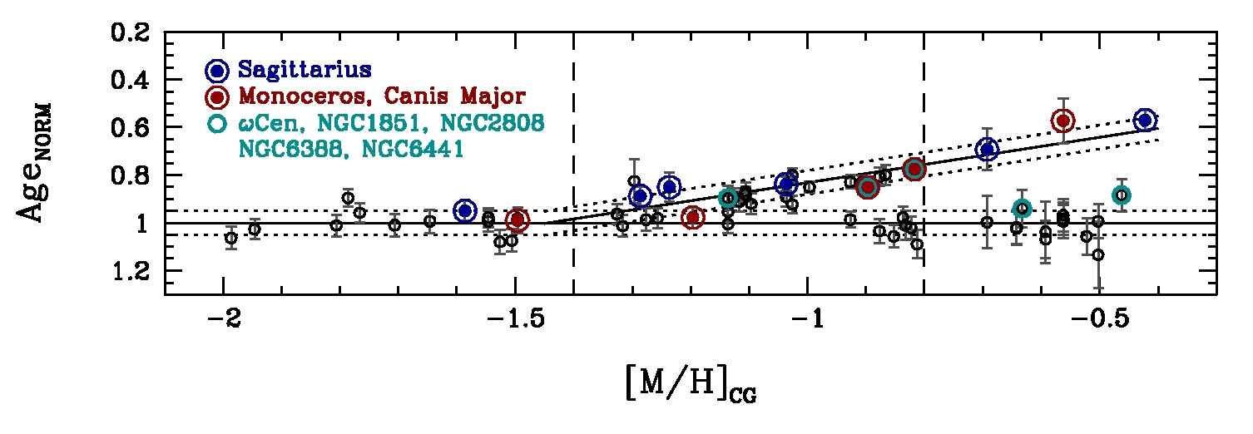
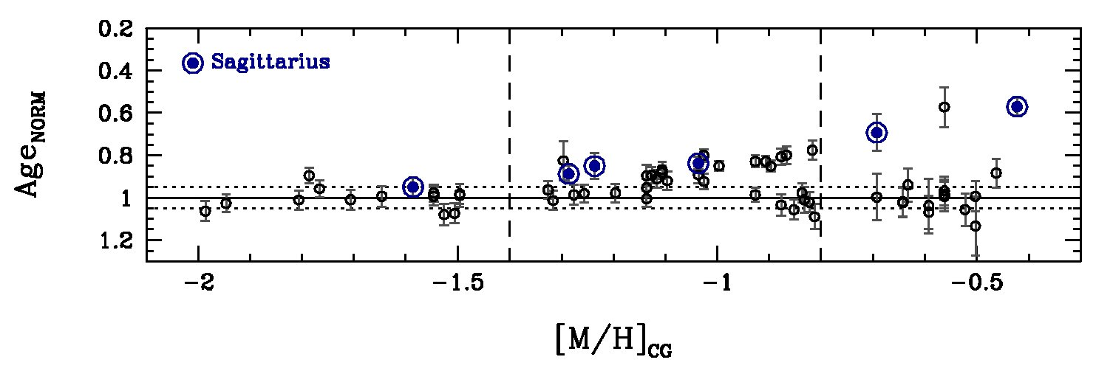
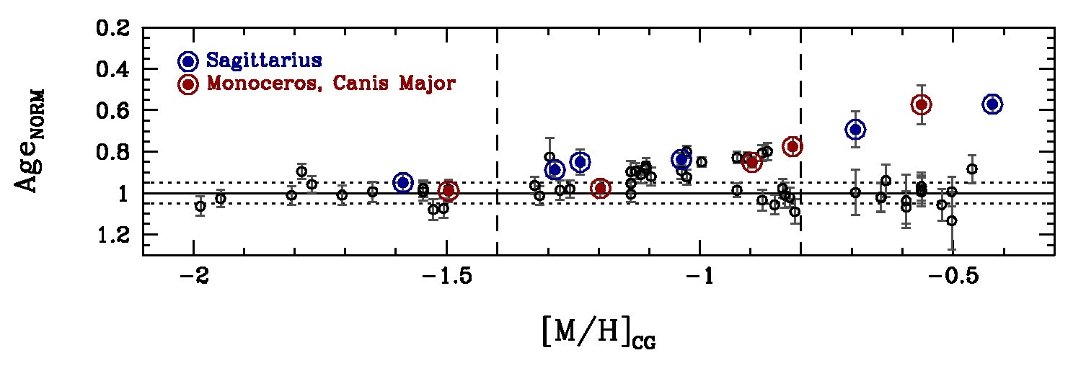
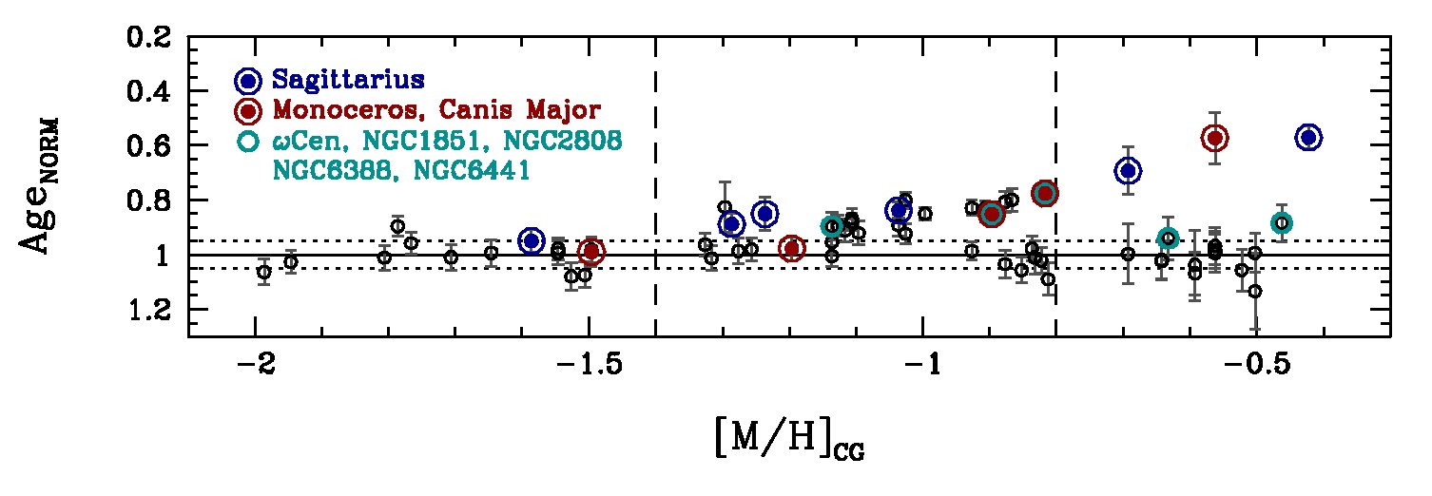
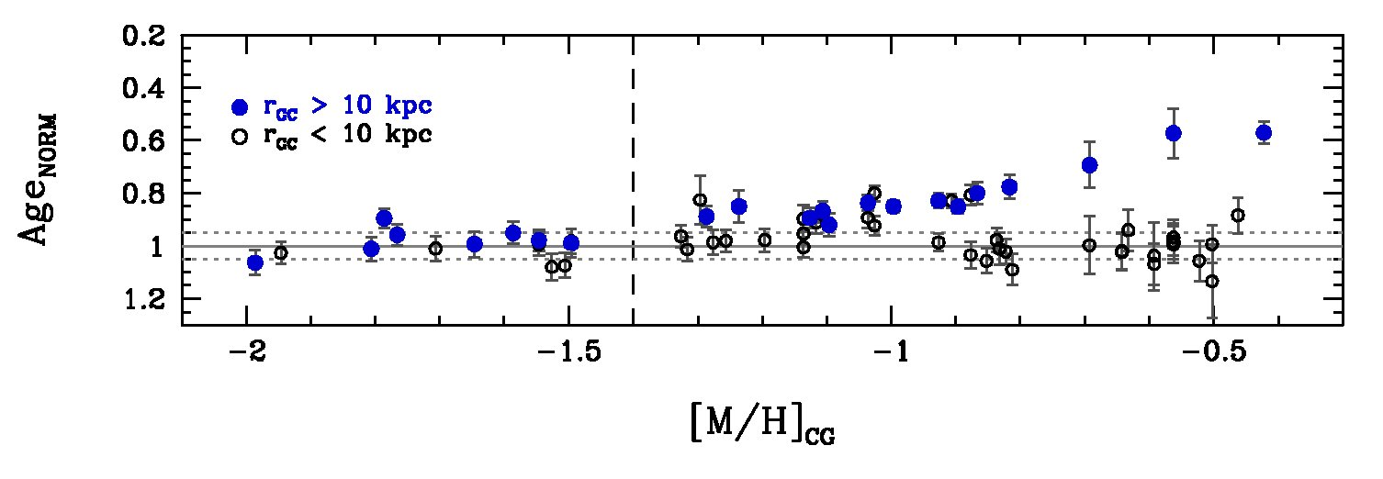
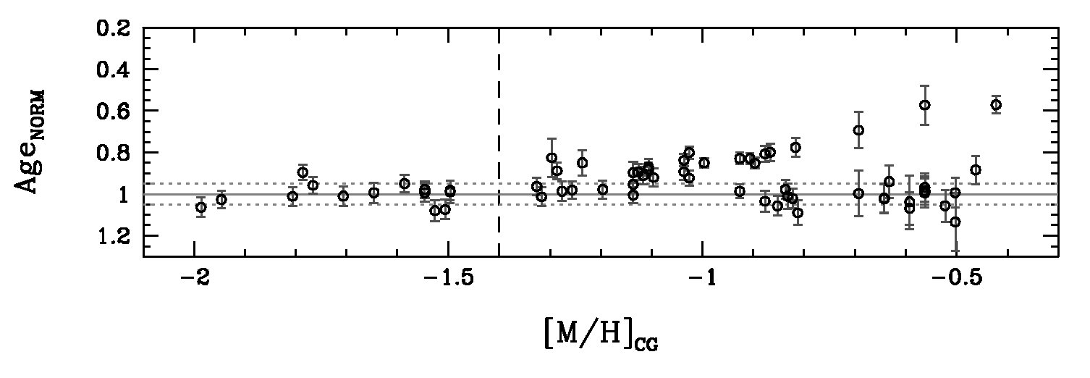
Young group: Age-metallicity relation
Young group GGCs
Age_{NORM} = -0.38[M/H]+0.45
“Young group”: Clusters with a clear age-metallicity relation and an intrinsic dispersion, with respect to this age-metallicity relation, of ~0.4 Gyr.
These results are consistent with a scenario in which young group clusters were formed in a second phase, which lasted much longer in time than the first one and resulted in a group of GCs with a clear age−metallicity relation.
It is very tempting to argue that the origin of this second group of clusters is the accretion of Milky Way satellite galaxies, in a way compatible to the scenario proposed by Searle & Zinn (1978).

Slide 19
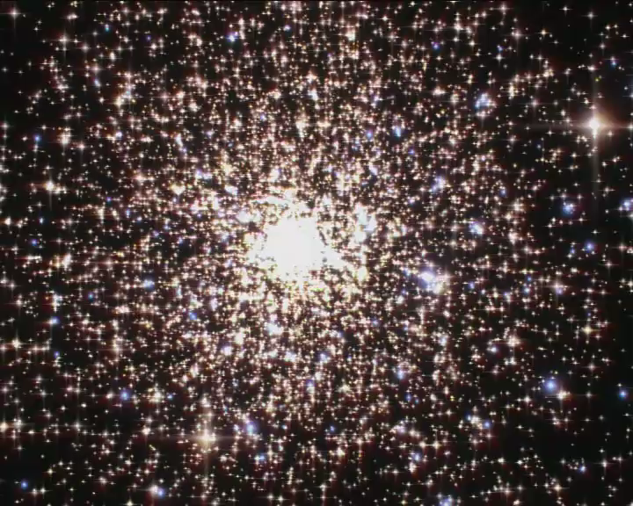
Multiple Stellar Populations in Globular Clusters: empirical evidence and theoretical insights

Slide 20
What is a “Simple Stellar Population”?
“A Simple Stellar Population (SSP) is defined as an assembly of coeval, initially chemically homogeneous, single stars.
Four main parameters are required to describe a SSP, namely its age, composition (Y, Z) and initial mass function.
In nature, the best examples of SSP’s are star clusters….”

Slide 21
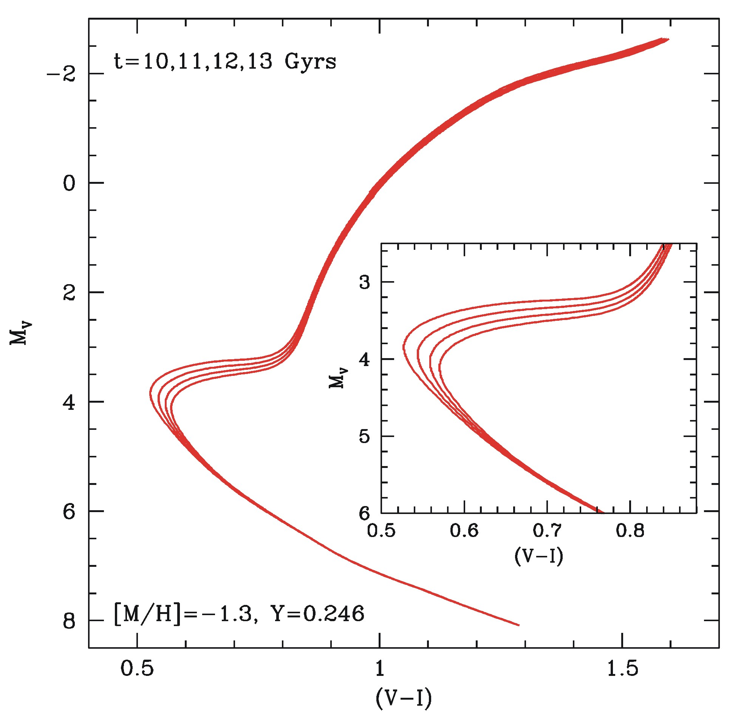
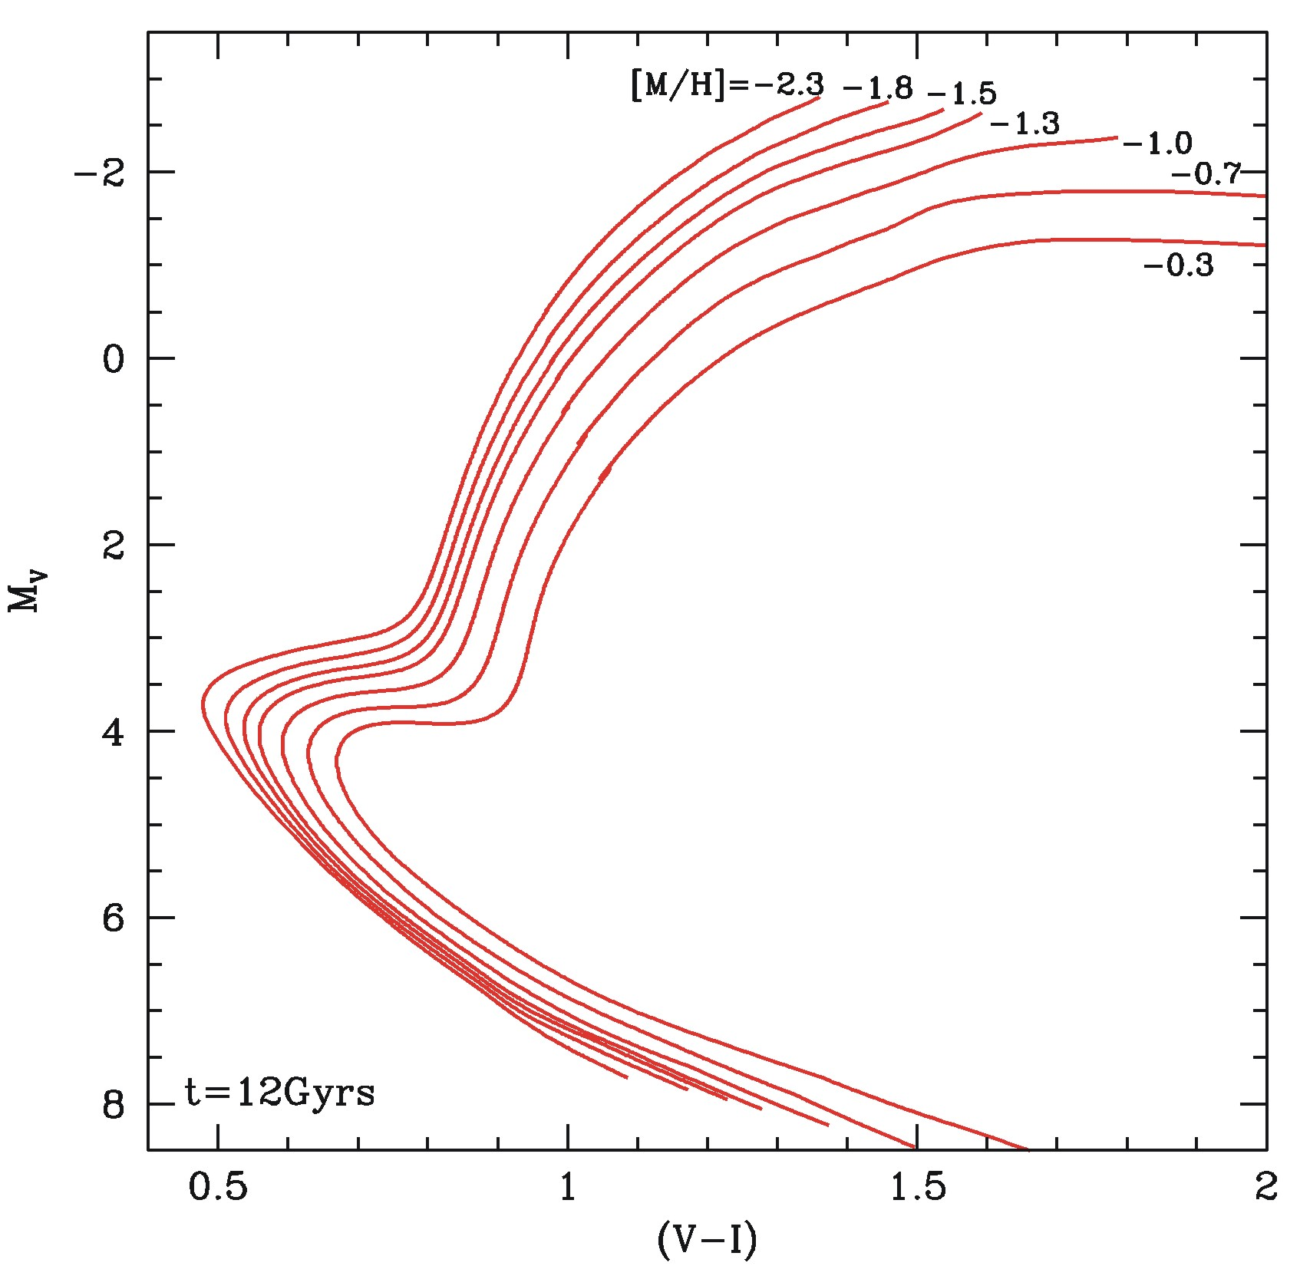
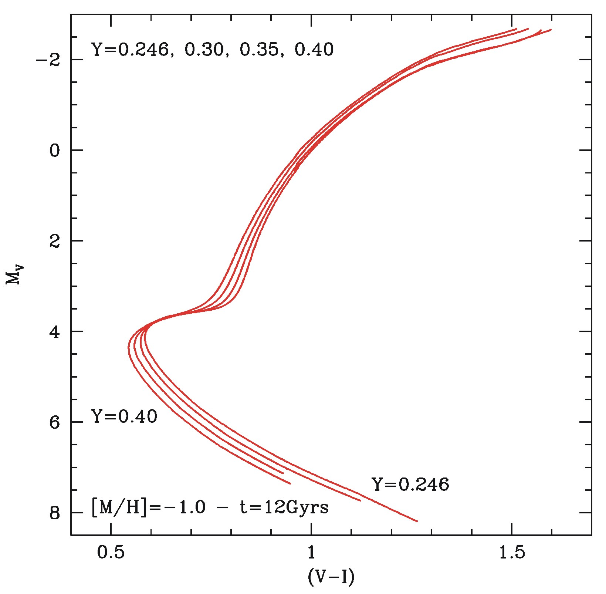
The stellar evolution prescriptions
The age effect
The metallicity effect
The Helium effect
With “good” observations, we should be able
to detect the presence of sub-populations in a stellar cluster

Slide 22
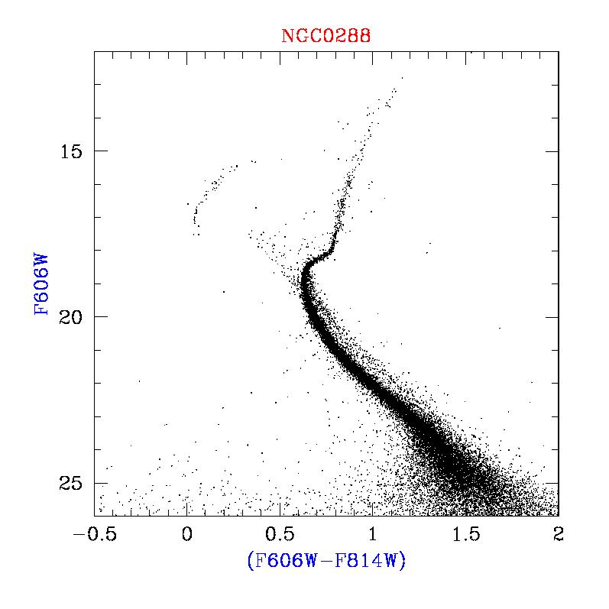
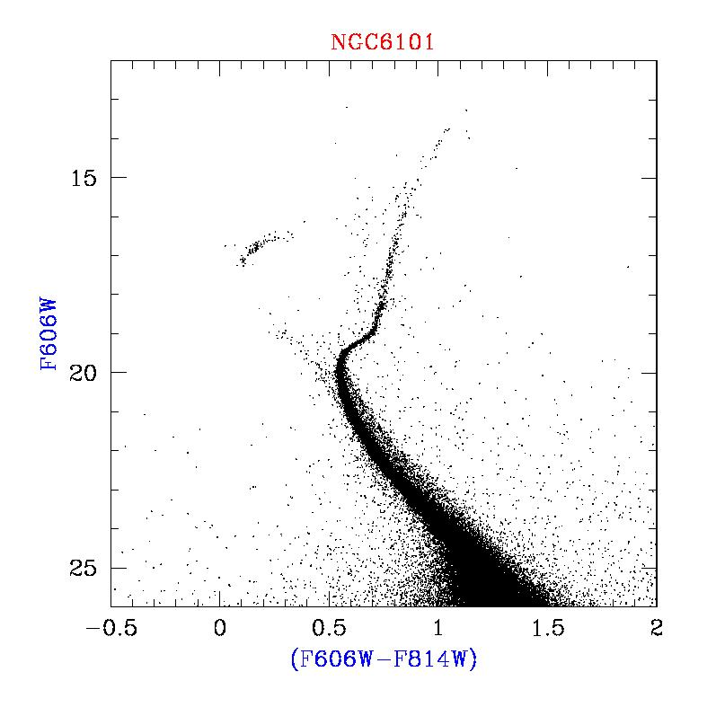
Globular Clusters
GCs represent an ideal laboratory for testing and calibrating stellar evolutionary models, as well as for dynamical studies…
Since long time, the comparison between empirical - mainly photometric - evidence and theoretical predictions supported the view of GCs as SIMPLE objects:
The GCs paradigma: they host single-simple stellar populations
For this reason, GCs have been – so far - a fundamental benchmark
for Population Synthesis Models

Slide 23

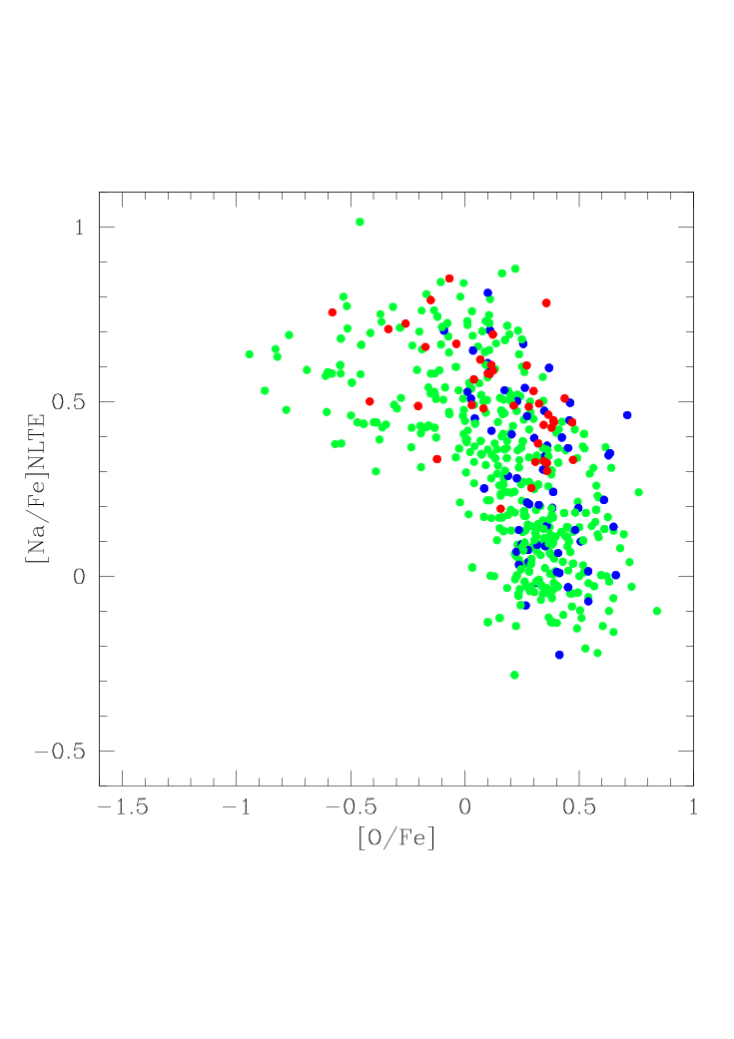
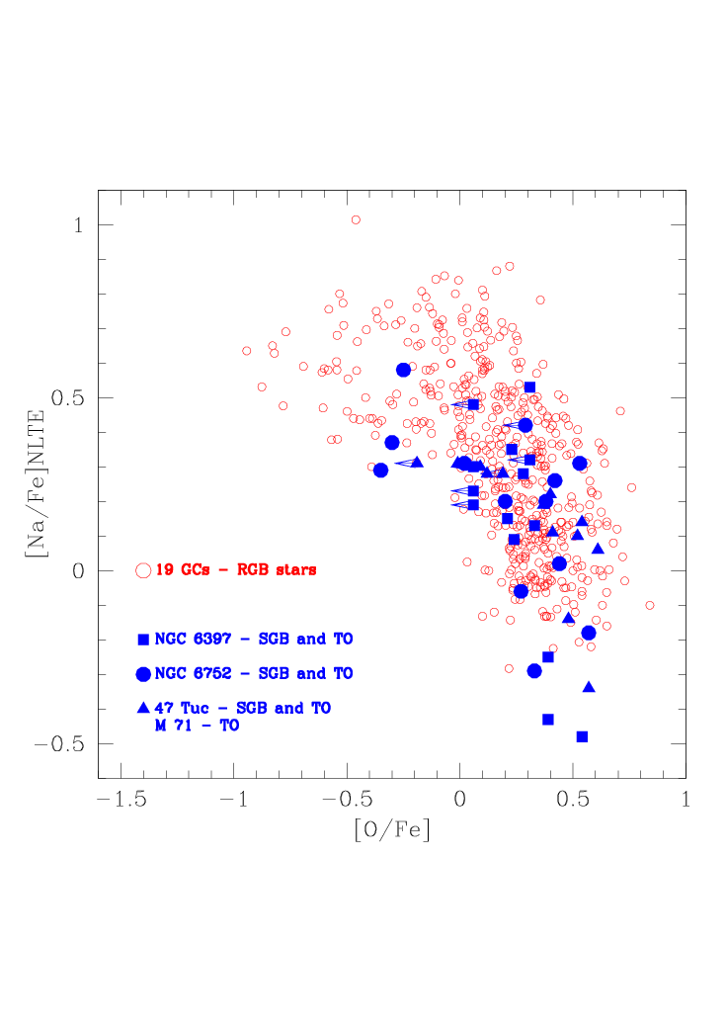
A short summary
Some GCs show a CN-bimodality on the RGB
The C & N abundances in GCs are very different than in field giants
The GC enviroment HAS to play a rôle
The O-Na anticorrelation in RGB stars
The Mg-Al anticorrelation in RGB stars
Clear signature of high-Temperature H-burning
These anticorrelations also in unevolved stars
These properties can NOT be due to evolutionary effects…
No “simply” surface pollution…
-2.4 < [Fe/H] < -1.8
-1.8 < [Fe/H] <-1.1
-1.1< [Fe/H] <-0.4
These peculiar chemical patterns must be related
to primordial chemical variations (Cottrell & Da Costa 1981)

Slide 24
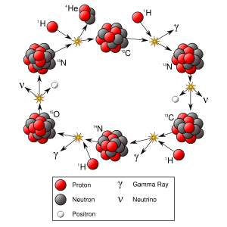
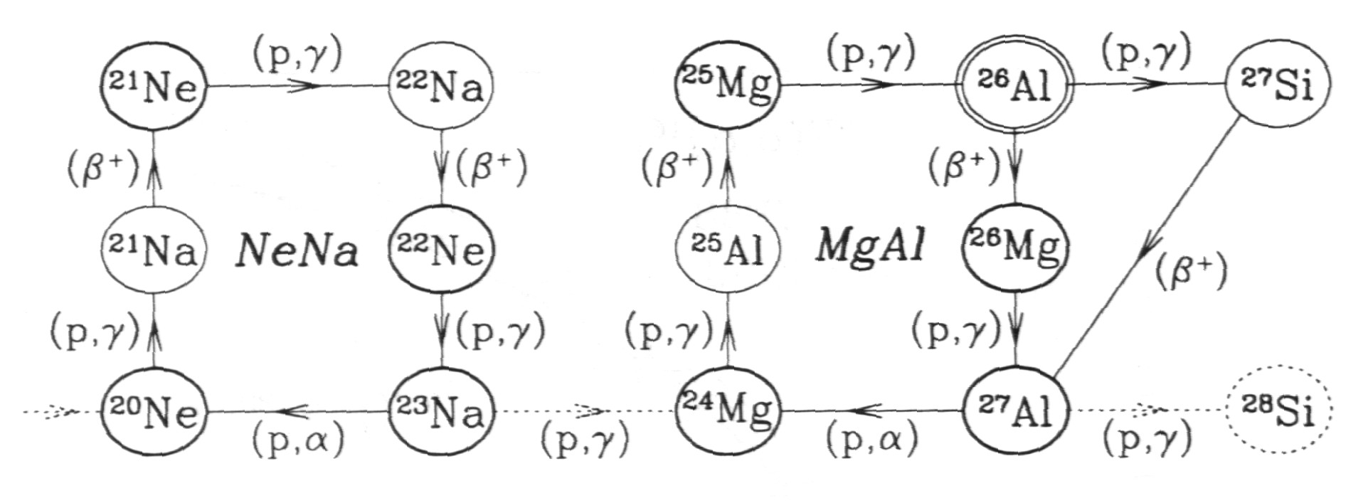
The nuclear burning processes
CNO cycle
NeNa cycle
MgAl cycle
T~20MK
T~35MK
T~50MK
Significant ²⁴Mg depletion →T~70MK
The NeNa cycle which enhances Na, is expected to operate in the same fusion zones in which the ON part of the CNO cycle is fully operative
The MgAl cycle which enhances Al, is expected to operate at very high temperature…
In the same zones where CNO, NeNa, MgAl cycles,
are expected to operate,
a significant amount of Helium is present…

Slide 25
Who are the candidate polluters?
1º candidate polluter: Intermediate mass AGB stars, i.e M>4M
Physical process: High-T p-captures (Hot Bottom Burning) + dredge up + mass loss
Time scales: 200Myr – 1Gyr
Advantages: no α– & Fe-peak elements synthesis, Helium production(?!),
low-speed winds, appropriate evolutionary lifetimes
Drawbacks: uncertainties in the yields (mixing efficiency?, mass loss?)

Slide 26
2º candidate polluter: Fast rotating massive stars
Physical process: High-T p-captures + rotational mixing + disk formation
Time scales: from few Myr to 50Myr
Advantages: no α– & Fe-peak elements synthesis, Helium production, low-velocity ejecta from the disk
Drawbacks: formation from outflowing disks is expected to result in a spread of He abundances… at odds with some empirical findings…
As we’ll note the most viable option seems to be
that related to AGB stars (Renzini 2008)

Slide 27

So, we are facing clear evidence supporting the presence of nuclearly processed matter in the intracluster medium in the early stage of the GC life.
Is it possible that some GC (Why?) could retain this matter and experience a second (only one?) star formation episode?
Can we find damning (photometric!!!) evidence of the existence of these sub-populations?
QUESTION

Slide 28
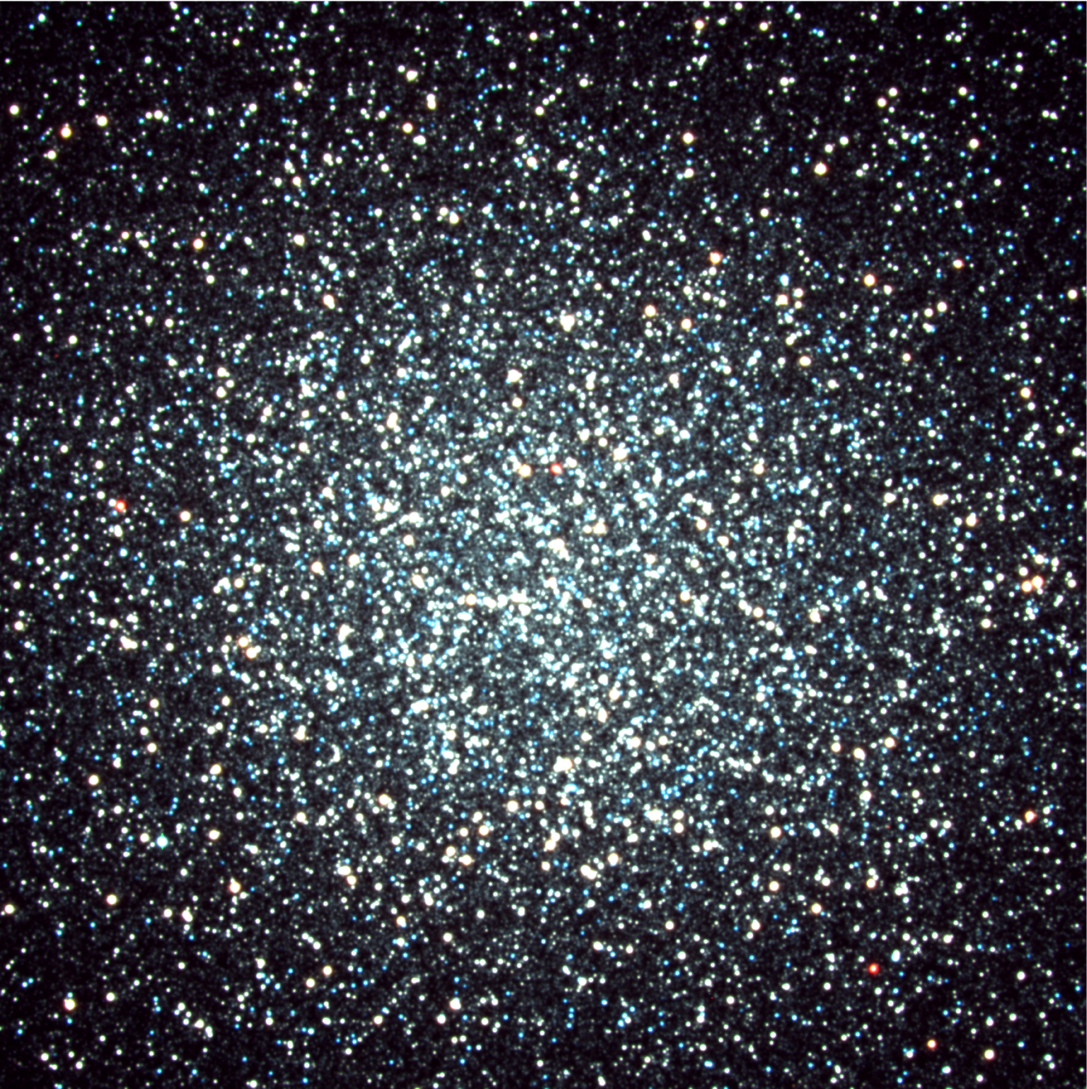
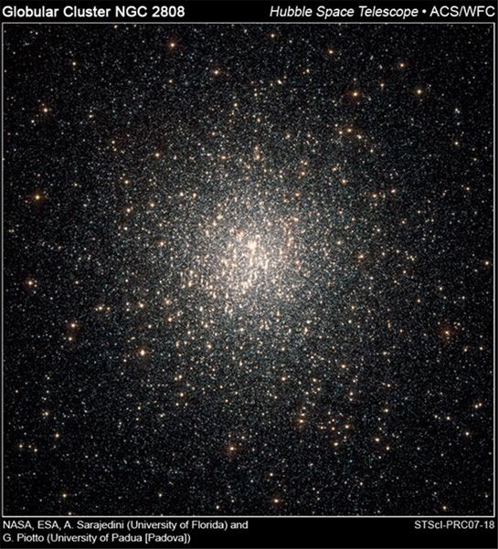
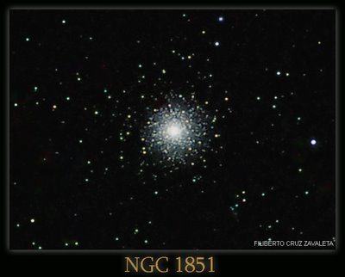
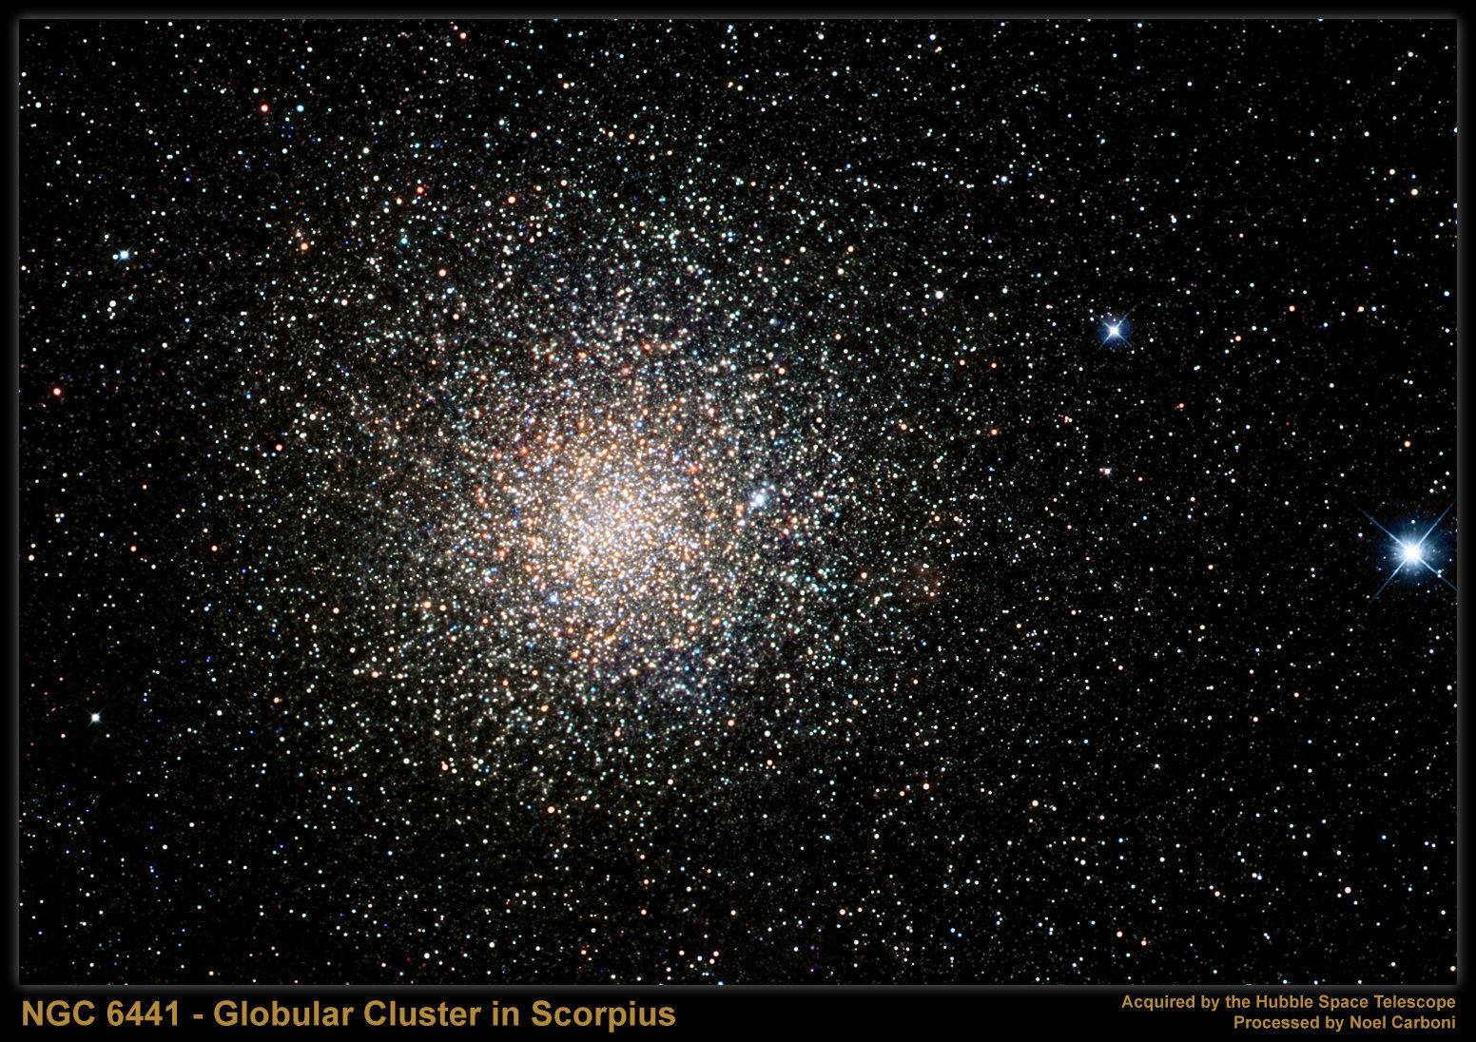
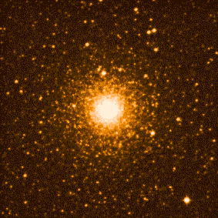
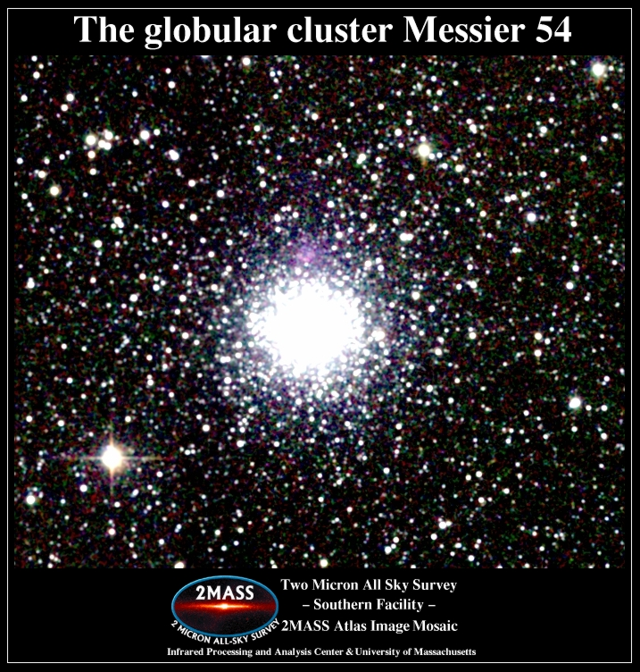
High-Quality Photometry & Spectroscopy: the damning evidence
The (first) “culprits”
The “funky”:ω Centauri
The “cool”: NGC2808
The “normal”: NGC1851
The “bad twins”: NGC6441 & NGC6388
“A dwarf galaxy nucleus”

Slide 29
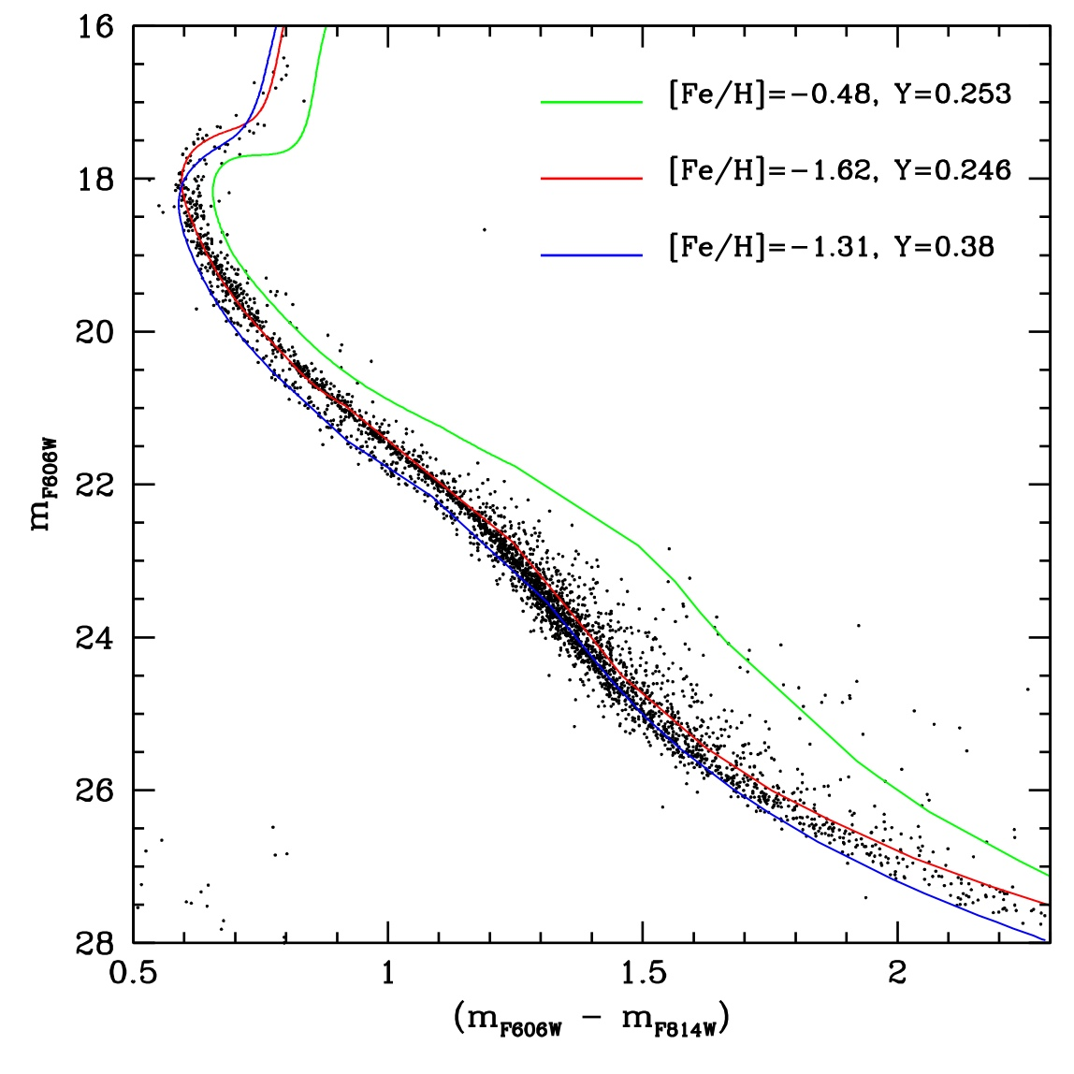
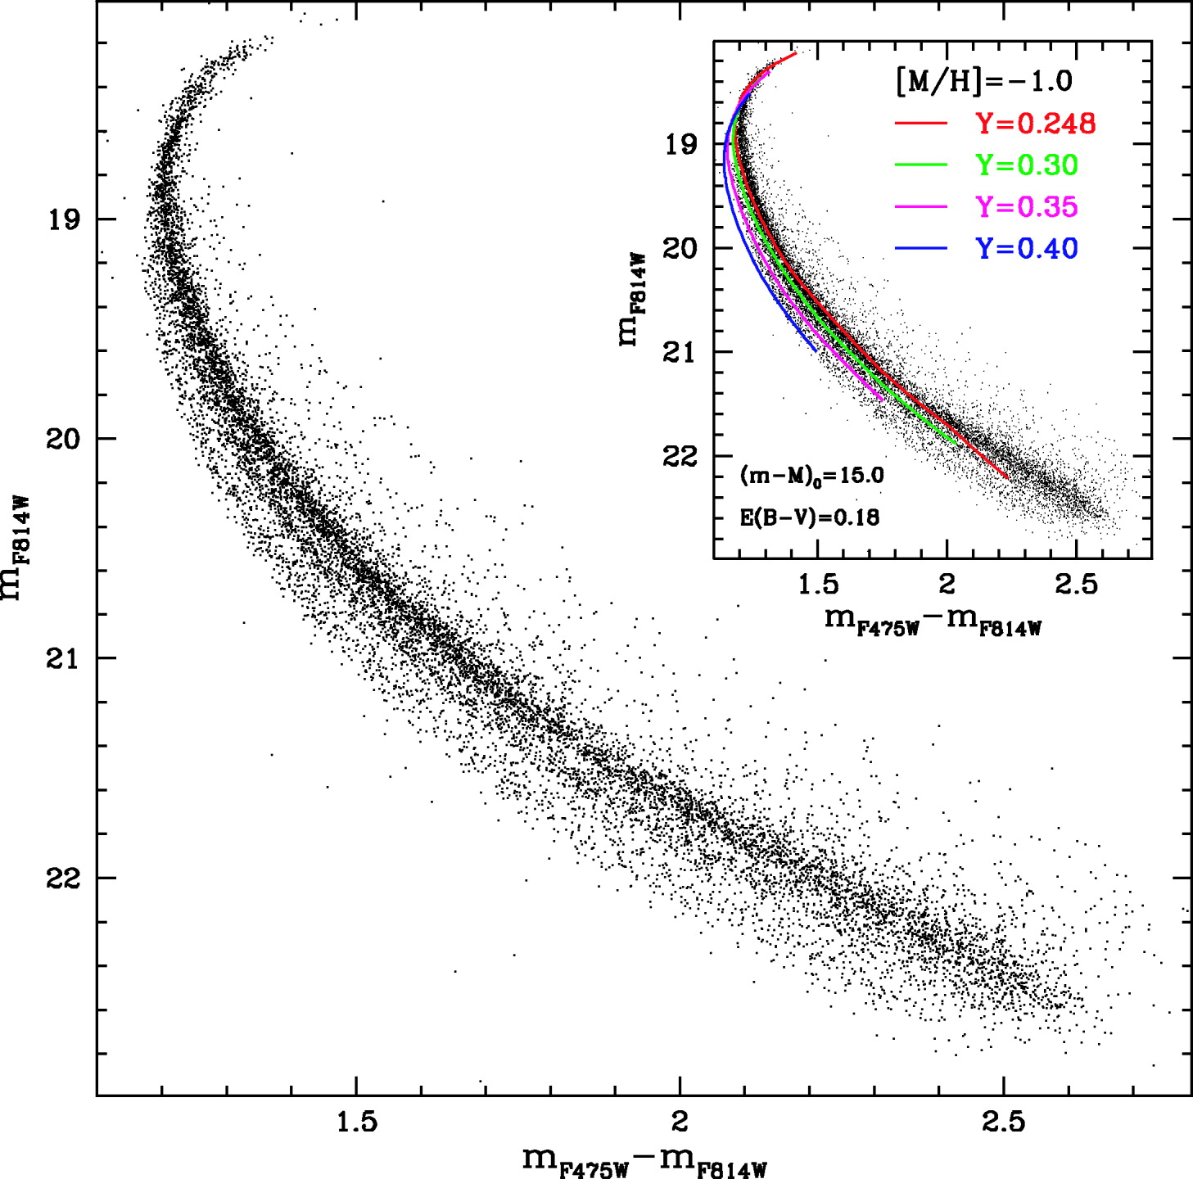
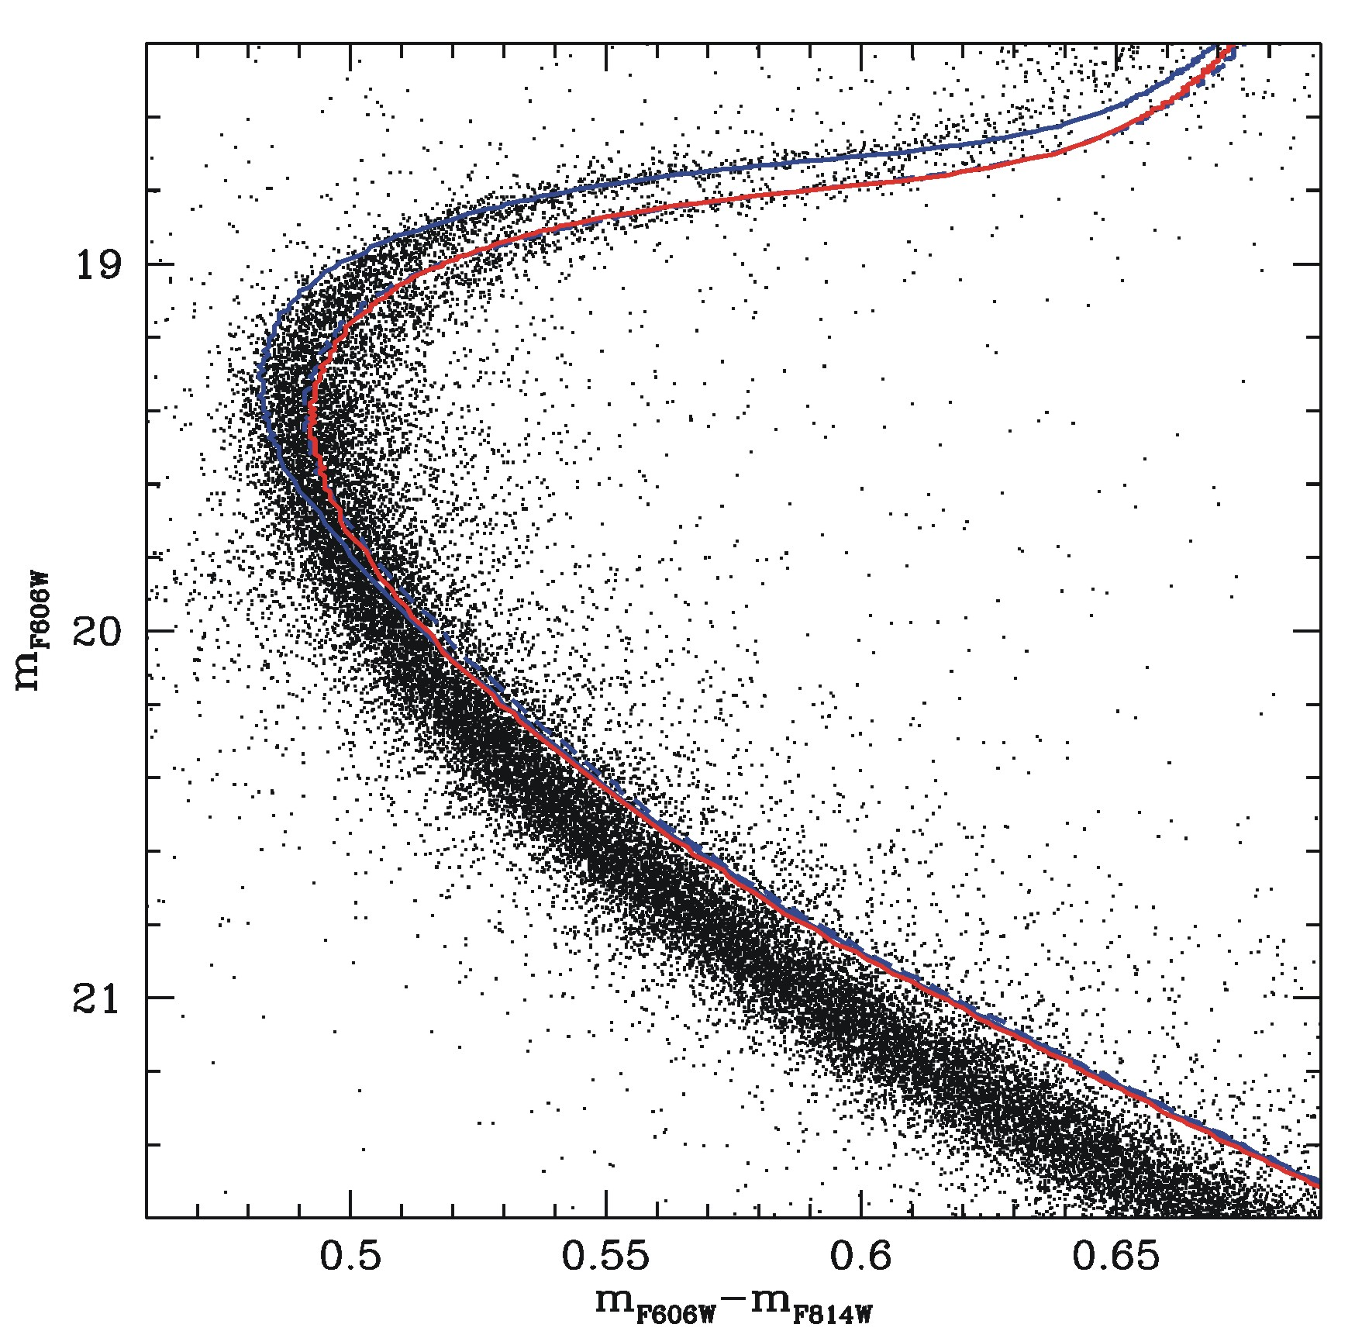
Some evidence
ω Cen
NGC2808
Bedin et al. 2009
Piotto et al. 2005
NGC1851
canonical mix
CNO enhanced
If GGCs are so “complicated”…, we need to reconsider the case of “ab initio” complex Stellar Populations…
Cassisi et al. (2008)

Slide 30
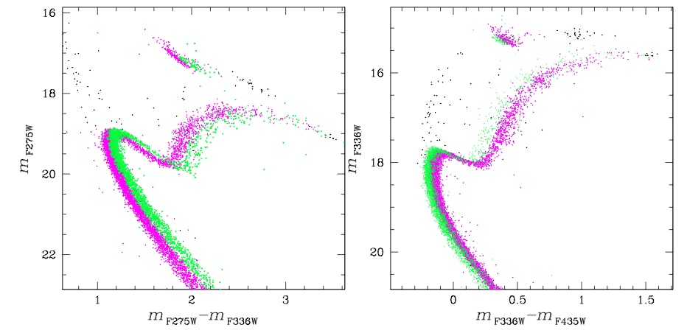
Tracing the various sub-populations along the evolutionary sequences

Slide 31
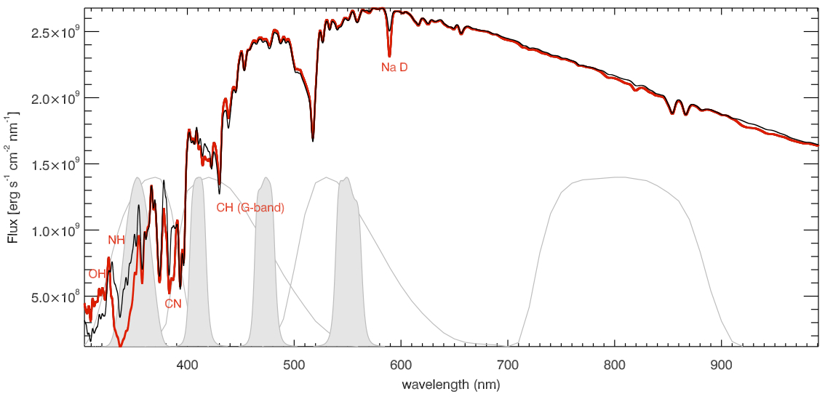
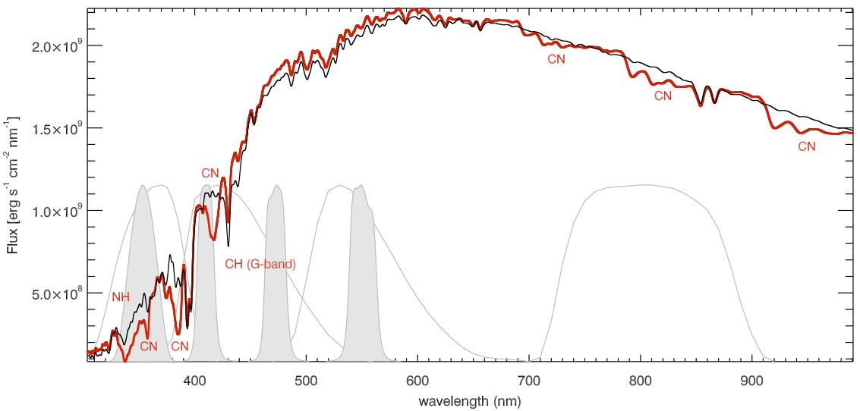
Photometric signatures of multiple stellar populations: the spectra
MS star
black – reference mixture
red – C,O depleted; N,Na enhanced; C+N+O × 2
U
B
V
I
u
b
v
y
The NH and CN bands play a fundamental role in the U-portion of the spectra!!!
RGB star

Slide 32
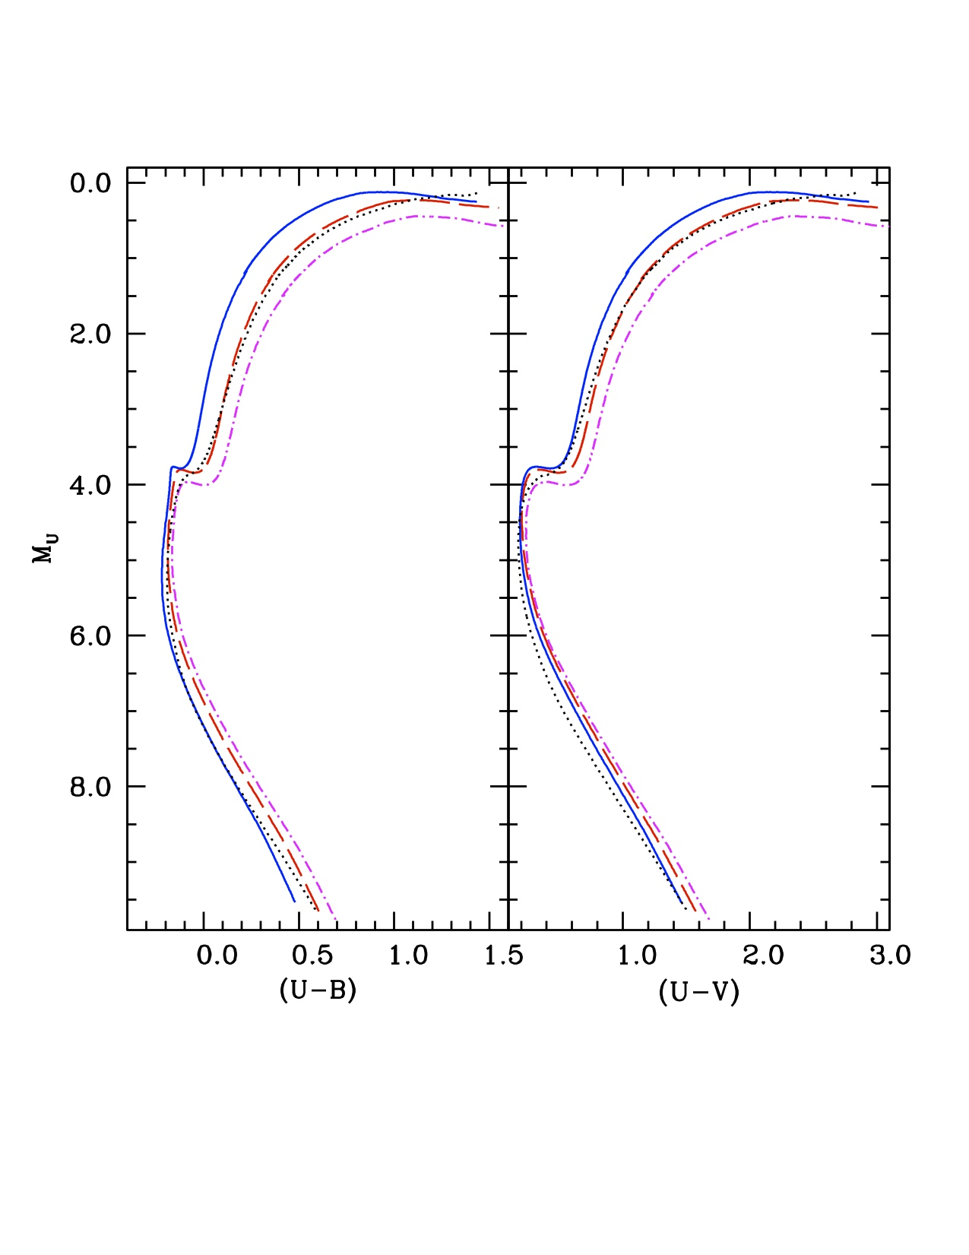
Photometric signatures of multiple stellar populations: the predicted CMDs
CNONa1: light elements anticorrelation; C+N+O×2; Y=0.246 / dotted Y=0.40
CNONa2: light elements anticorrelation; constant C+N+O; Y=0.246

Slide 33
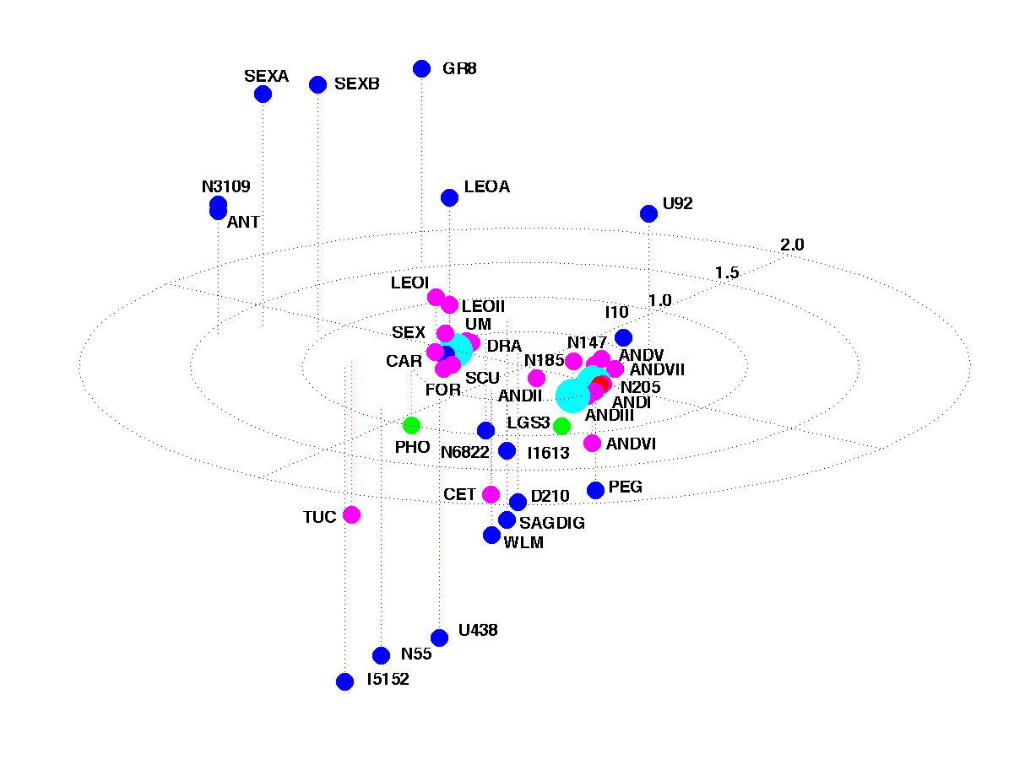
Stellar Populations in the Local Group

Slide 34
Star Formation History
Galaxy Formation and Evolution
Morphology and kinematics
Star formation, evolution and death
Mass assembly and interactions
Stellar populations
Morphological type
Dynamical evolution
Gas content
Induced star formation
Chemical evolution
Environmental effects
Notes:
Formación y evolucion de galaxias esta determinada por dos conjuntos de mecanismos paralelos:
-formacion evolucion y muerte estelar (...) y el ensamblado de la masa e interacciones (...)
La historia de formación estelar (…) es la que nos va a dar información sobre (…), mientras que la morfologia y cinematica nos va a dar información (…)

Slide 35
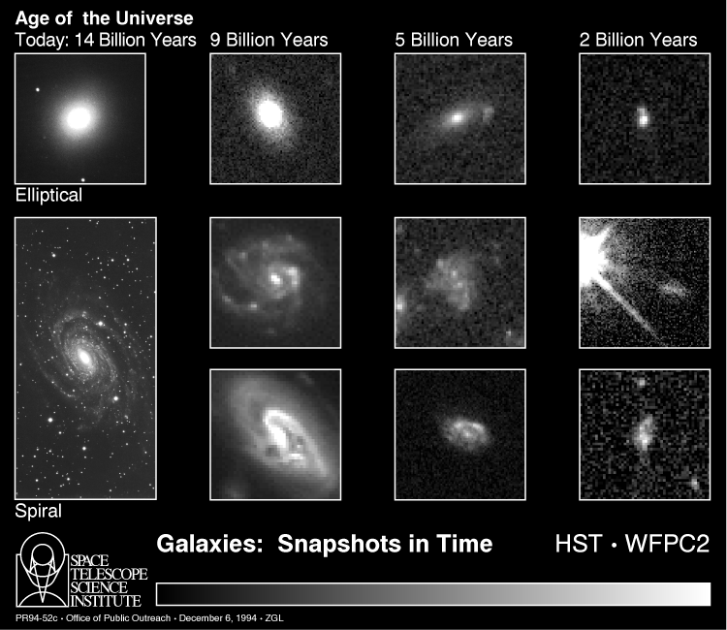

Slide 36
Recovering the ages of stars of a complex stellar population system
i.e.
The Star Formation History

Slide 37
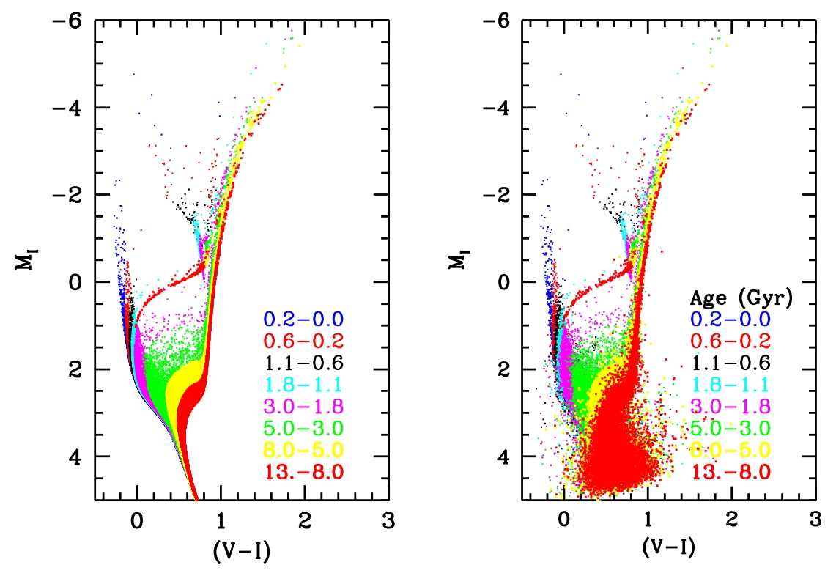
The comparison between “real” CMDs and synthetic ones provide
strong constraints on the Star Formation History (SFH)
The Main Sequence locus is one of the “best” evolutionary sequences
for retrieving the SFH
This is possible if theoretical predictions about
the MS location and evolutionary lifetimes are accurate

Slide 38

The SFH concept
The star formation history describes:
- The chemical enrichment law.
- Formation of the stellar populations.

Slide 39


An illustrative case:
The dwarf galaxy LGS3 (LCID project)
Teramo
library
F814W
(F475W - F814W)
BaSTI library
(Pietrinferni et al. 06)

Slide 40

Clues on Cosmic Reionization
Reionization time: 12.7Gyr, z ≈ 6

Slide 41
Unresolved stellar populations

Slide 42



Stellar Population Synthesis @ OA Teramo
Surface Brightness Fluctuations studies
The modeling: Based on the SPoT code (fully developed in Teramo and checked on CMDs of resolved stellar systems: GGCs & MC clusters). SBF and color models for various age and metallicities
SBF colours remove the age-metallicity degeneracy
Raimondo et al (2005)
Notes:
DIRE che le SBF una misura della pixel to pixel fluctuation
We tackle the SBF from two side : Theoretical and Observational Sides

Slide 43

Stellar Population Synthesis @ OA Teramo
Surface Brightness Fluctuations studies
The modeling: Based on the SPoT code (fully developed in Teramo and checked on CMDs of resolved stellar systems: GGCs & MC clusters). SBF and color models for pops with 10Myr ≤ AGE ≤ 15Gyr and 10⁻⁴ ≤ MET ≤ 2 Zo
SBF colours remove the age-metallicity degeneracy
Raimondo et al 2005
The measure: The SBF measurement requires High S/N, and high resolution images ..and a complex data analysis procedure (only a handful of research groups worldwide)
Main Results
⇒ SBF for measuring distances: calibration of SBF absolute magnitudes
SBF for tracing stellar populations in galaxies:
  Detection of SBF radial variations in ∼10 galaxies of various morphology
  Analysis of the field stellar populations in ∼40 galaxies
  SBF are suggested as a innovative and powerful diagnostic for revealing peculiar populations (eg blue components) in galaxies
Cantiello et al 2007
Notes:
DIRE che le SBF una misura della pixel to pixel fluctuation
We tackle the SBF from two side : Theoretical and Observational Sides

Slide 44


Secondary Distance Indicators
Surface Brightness Fluctuations
SBF method
Measure fluctuation in brightness across the face of elliptical galaxies
Fluctuations - due to counting statistics of individual stars in each resolution element (Tonry & Schneider 1988)
Consider 2 images taken by CCD to illustrate the SBF effect;
Represent 2 galaxies with one twice further away as the other
Can use out to 100 Mpc with HST
Compare nearby dwarf galaxy, nearby giant galaxy, far giant galaxy
Choose distance such that flux is identical to nearby dwarf.
The distant giant galaxy has a much smoother image than nearby dwarf.’

Slide 45
Surface Brightness Fluctuations
If we take an image of the target population at distance D with an angular resolution δφ, each resolution element will contain an average number of unresolved star <N>:
The average flux from the stars in each resolution element (surface brightness) is:
f is the flux at the Earth of a single star,; “we assume” that all stars have the same intrinnsici luminosity L
Due to the Poisson fluctuations in the number of star populating each resolution element, <F> is NOT constant and its variance will be:
Therefore
Estimated from model
Measured quantity
Measurements accurate to 1% are needed to detect fluctuations in galaxies at a distance of about 20 Mpc

Slide 46



Distance studies with SBF (a few examples)
1. Theoretical calibrations
  Comparison between theoretical and empirical calibration for ACS/HST F850LP filter: data from the Virgo and Fornax Cluster Surveys (∼150 objects) [Raimondo et al. 2013]
2. A standard candle from 10 kpc to 100 Mpc
  Optical ACS/HST SBF measurements for 4 elliptical-shell galaxies with cz up to 8000 km/sec [Biscardi et al. 2008]. We obtained
    Distance of galaxies from F814W ACS/HST data
    H0 = 76 +/-7 km/s/Mpc, in agreement with
HST Key Project Freedman+01
Riess+05 (multicolor LC shape method on 2 SNIa)
Wang+06 (109 SNIa)
3. SBF and SNIa distances
V and R SBF-based distances of two bright ellipticals are compared with SN Ia distances: NGC4621 + 1 SNIa and NGC4374 + 2 SNIa, indicating no systematic effect between SBF and SN Ia tecniques [Cantiello et al 2011, 2012]

Slide 47





II. Globular Cluster Systems (GCS) in Galaxies
The turn-over magnitude (TOM) of the GC Luminosity Function (GCLF) is a powerful distance indicator for early type galaxies: TOM M(V)= -7.35 ± 0.25
The study of the colour distribution of GCs is fundamental to understand the formation and evolution of galaxies
NGC 5866
An example, the GCS analysis for the NGC 5866 by using ACS/HST data and our models [Cantiello et al 2007a,b]
Distance to the galaxy based on the GCLF method
Photometric and spatial properties of the GC
First accurate determination of the radii for >100 GCs
Determination of a bimodality in the GC colour distribution
Simulations made using SPoT models reveal that nonlinear color-metallicity relations produce bimodal color distributions without invoking a bimodal [Fe/H]
This result allows to "relax" the need of a bimodal epoch/mechanism of formation of GCs in galaxies
with very different morphology.
Notes:
From the study of a sample of about 100 galaxies, Richtler (2003) obtained an absolute TOM M(V)=-7.35 ± 0.25

Slide 48
The GAIA mission

Slide 49

A brief presentation of Gaia
Full sky survey
1 billion stars in our Galaxy (~1% of the stars) and nearby galaxies;
70 epochs of observation (on average) per source over 5 years;
Positions in the Galaxy (incl. distances), velocities;
Physical characteristics: chemical composition, temperatures, etc...
Schedule
October 2013: Launch;
2018 – 2019: End of the mission;
2021: Publication of the final catalogue
2 telescopes
1 field of view (0.22 x 0.39 deg²)
106 CCDs (~ 1 billion pixels)
Quasi‐simultaneous astrometric, photometric and spectroscopic observations

Slide 50
Scientific benefits of GAIA
The history of the Galaxy: test hierarchic formation theories, inner bulge/bar dynamics, disk/halo interactions, dynamical evolution, what is the warp, star cluster disruption, star formation history, chemical evolution;
Stellar evolution: study rapid evolutionary phases, quantify pre-main sequence evolution, complete census of local neighbourhood;
Stellar formation: dynamics of star forming regions, luminosity function for pre- main sequence stars;
Planetary systems: complete census of (Jupiter size) planets around 3 × 10⁵ stars;
The Local Group: rotational parallaxes for LG galaxies, kinematic separation of stellar populations, galaxy orbits;
Beyond the Local Group: calibration of distance scale, zero proper motion QSO survey, photometry of 10⁸ galaxies;
The nature of matter: galactic rotation curve, disk mass profile from velocity dispersions, internal dynamics of LG dwarfs;
Fundamental physics: determine the space-curvature parameter;
Serendipity: the first all-sky, multi-colour, multi-epoch phase-space map.

Slide 51
Researchers@Teramo Astronomical Observatory are contributing to the realization of the Photometric Pipeline and to the external calibration of the photometry via ground based observations of standard stars.
Photometry with Gaia
Our tasks are:
classify sources as isolated, contaminated or blended;
select samples suitable for the sky estimate;
measure the contamination of nearby stars;
deconvolve the spectra of overlapped sources;
After crossing the Astrometric Field CCDs light crosses the BP (Blue Photometer) and RP (Red Photometer). The light falling on these CCDs is dispersed along scan by a fused-silica prism.
BP operates in the 330-660 nm range while RP in the 650-1000nm range;
The photometric measurements are of interest in themselves and are also essential for correcting systematic chromatic effects in the astrometric measurements.

Slide 52
Follow-up of SNe in the Near-Infrared Bands

Slide 53


NIR light-curves of type Ia SNe exhibit interesting peculiar morphological features, such as a secondary maximum light following the initial peak…
…a useful diagnostic tool of physical mechanism inside the innermost regions of the exploding star and that could constrain the theoretical progenitor model.
Due to the reduced effects of dust and to a shallower dependence of absolute NIR magnitudes on decline-rate compared with optical bands, SNe Ia ARE BETTER “STANDARDIZABLE CANDLES” IN THE NIR BANDS than in the optical ones (the scatter is ~0.13mag, while the B-band produces a scatter of 0.22mag)!
Valentini G., Di Carlo E. et al. (2003)
Notes:
1) BVRI light curves of SN 2000E overlaid with the fitting light curves (solid line) from the updated MLCS method [ = -0.54 ± 0.03, ₀ = 32.42 ± 0.06 mag, E(B-V) = 0.45 ± 0.03 mag]. The light curves from one of the MLCS fits (dotted lines) are also drawn [ = -0.19, ₀ = 32.05 ± 0.14 mag, AV = 1.34 ± 0.06 mag].
2) JHK light curves (from spline fits to data) of SN 2000E (solid line) compared with the light curves of SN 1998bu (Meikle 2000) and SN2000cx, a peculiar slow decliner (Candia et al. 2003). Data points are connected with dotted (SN1998bu) and dashed (SN2000cx) lines for the sake of clarity.

Slide 54

Because of reduced extinction suffered at NIR wavelengths (4-8 times less sensitivity to reddening), these observations are important in the search and follow-up of reddened Sne.
In the last decade, we studied more than 50 SNe in optical and infrared bands with dedicated telescopes (AZT-24@Campo Imperatore and TNT@OATe) that allowed us to obtain well sampled light curves with high quality photometry (e.g.: σj < 0.1mag for J~15mag) and spanning a wide wavelenght range.
The SN2002cv is invisible in optical bands
Notes:
SN2002cv e’ una delle SNe piu’ estinte mai osservate (Av=7.9mag), non visibile nelle bande ottiche.

Slide 55

SNe & Dust
Since SNe are believed to be a source of dust in galaxies, events showing signatures of interactions with circumstellar matter are of great interest to study how dust forms around these objects;
NIR observations until late epochs are instrumental in providing information on the ongoing processing: dust formation, interactions with dust and/or circumstellar medium.
Data analysis allows to deduce that rebrightening is produced by hot, newly formed dust surrounding the supernova.
Di Carlo et al. (2008)

