Slide 1
FASI EVOLUTIVE AVANZATE E FINALI DELLE STELLE:
Programmi ed expertise all’osservatorio di Teramo
***
Esperienza trentennale nel campo dell’evoluzione stellare.
Full network stellar models (up to 700 isotopes).
Collaborazioni internazionali: fisica nucleare, fotometria e spettroscopia stellare, presolar grains and meteorites….
Progetti tecnologici di frontiera: AMICA@IRAIT (Antarctic Multiband IR Camera)

Slide 2
M_{up} & M_{up}*
The transition between thermonuclear and core-collapse supernova progenitors.

Slide 3
Massive stars: H, He, C, O, Ne, Si
Fe core → core collapse (SNE II,Ib,c)
M_{up}*
?: H, He, C
Super AGB → O-Ne WD (SNE e-capture)
M_{up}
Low & intermediate mass: H, He,
AGB → C-O WD (SNE Ia)

Slide 4
Due to the steepness of the IMF, even a small change of M_{up} and /or M_{up}* would imply profound Astrophysical Consequences.

Slide 5
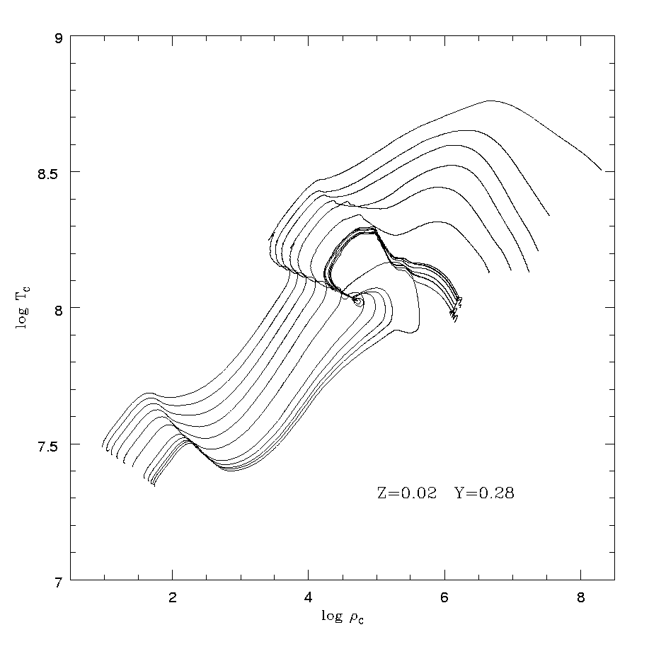
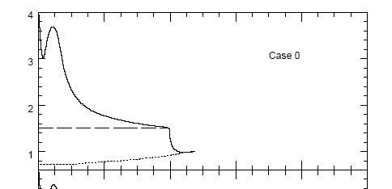

Beyond the core-He burning, approaching the C ignition
ν-cooling
H
He
CO
Conv. Env.
H burning
He burning
II dredge up

Slide 6

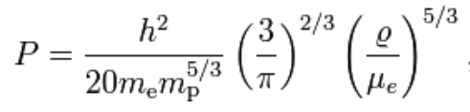
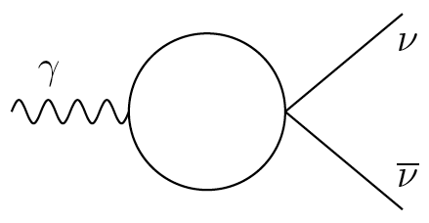

Main players within the C-O core
The pressure of degenerate electrons contrasts the (gravitational) contraction.
The cooling caused by the neutrinos production contrasts the heating induced by the core contraction….
These occurrences hamper the C ignition.
Plasmon Decay

Slide 7
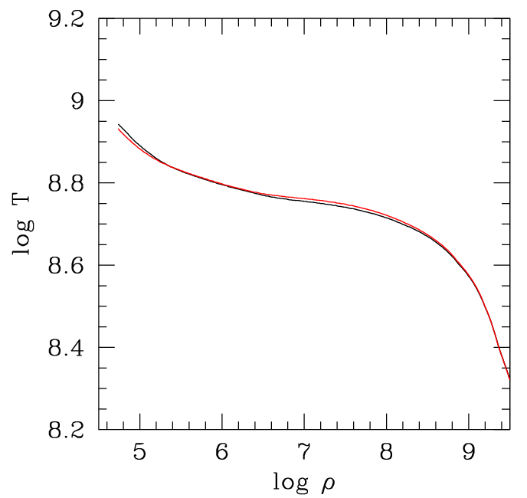
The ignition curve nuclear energy=neutrino energy loss
ε_{nuc}=|ε_{ν}|
Plasma neutrinos
Munakata et al. 1986 Haft et al 1995 Itoh et al. 1996 Esposito et al. 2003
&
¹²C+¹²C
CF88
M_{up}
Type Ia

Slide 8
The golden rule
It exists a critical-core mass for the C ignition.
M_{H}~1.08 M_{ʘ} with the “current” physics

Slide 9
How good is the physics needed to derive the value of the critical-core mass?
Neutrinos rate (good)
¹²C+¹²C rate (bad)
Amount of C left by the He burning (bad)
Thermodynamics of the high-density plasma C+O+electrons – EOS, ε_{g} (quite good)
Physics beyond the standard model (Axions?)

Slide 10
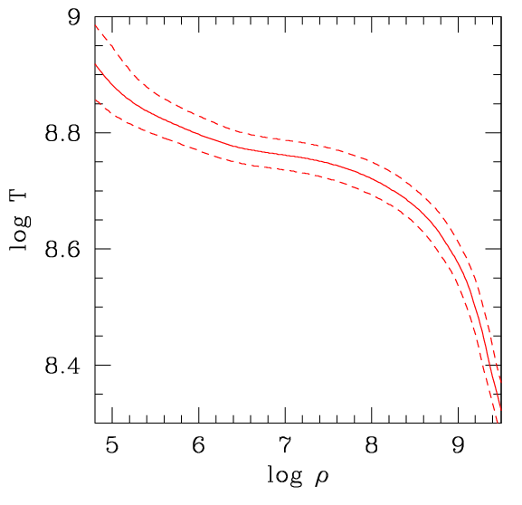
Varying ε_{ν} or X(¹²C)
ε_{ν}x5
ε_{ν}/5
Equivalent to a variation of X(C) from 0.1 to 0.5, as implied by a ±60% variation of the ¹²C+α→¹⁶O rate (Straniero et al. 2003).

Slide 11
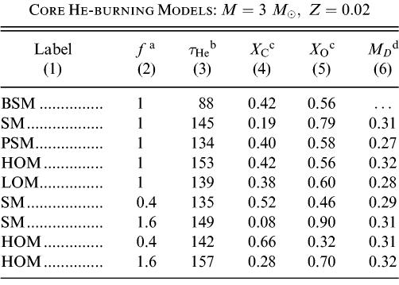
Enhancement factor of the ¹²C(α,γ)¹⁶O reaction rate. f = 1 corresponds to the Kunz et al. (2002) rate.
He-burning lifetime (Myr).
Final central mass fractions of C and O.
Location, in M_{ʘ}, of the sharp discontinuity that marks the separation between the innermost low-C zone, corresponding to the maximum extension of the convective core, and the external layer built up by the shell-He burning occurred during the AGB phase.

Slide 12
Varying the ¹²C+¹²C
A resonance near the Gamow peak (1.5 MeV) would significantly increase the rate, thus reducing the critical M_{H} and, in turn, M_{up} as well as M_{up}*.

Slide 13
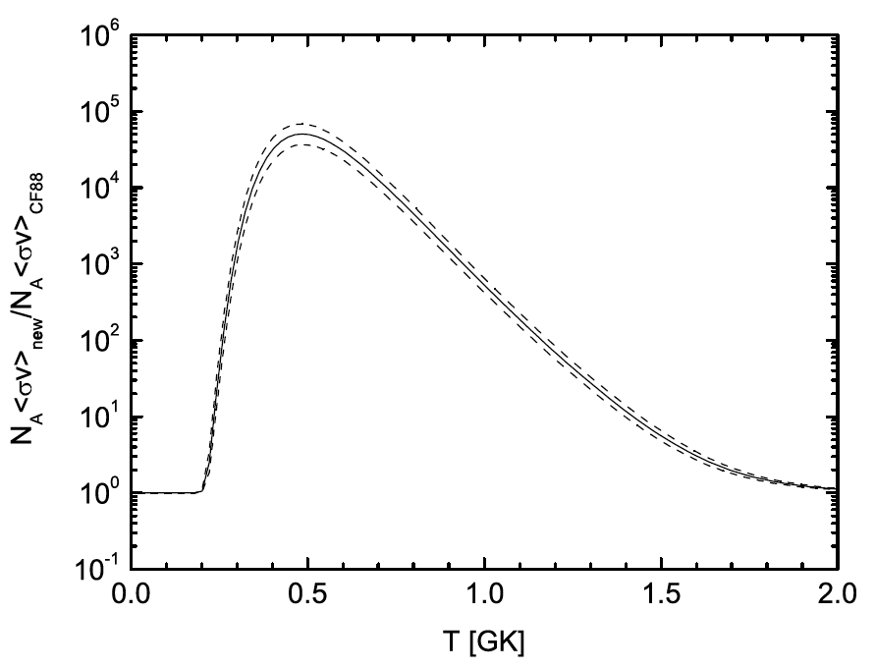
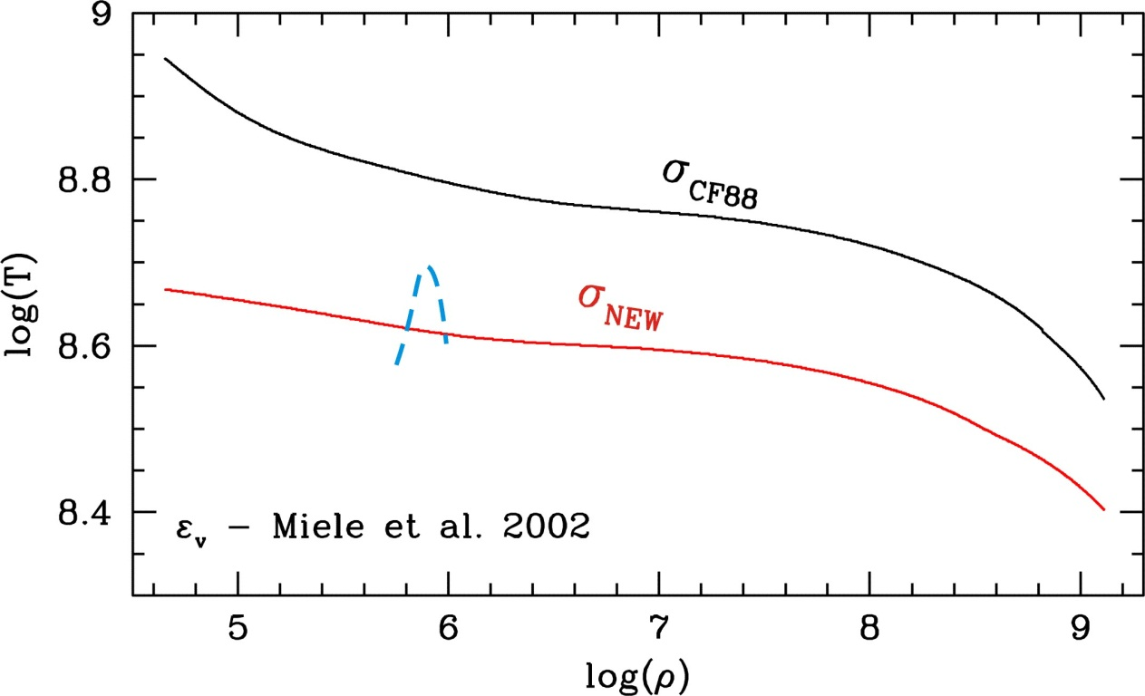
What a resonance at 1.5 MeV would imply
sne Ia
Core burning
M=7M

Slide 14
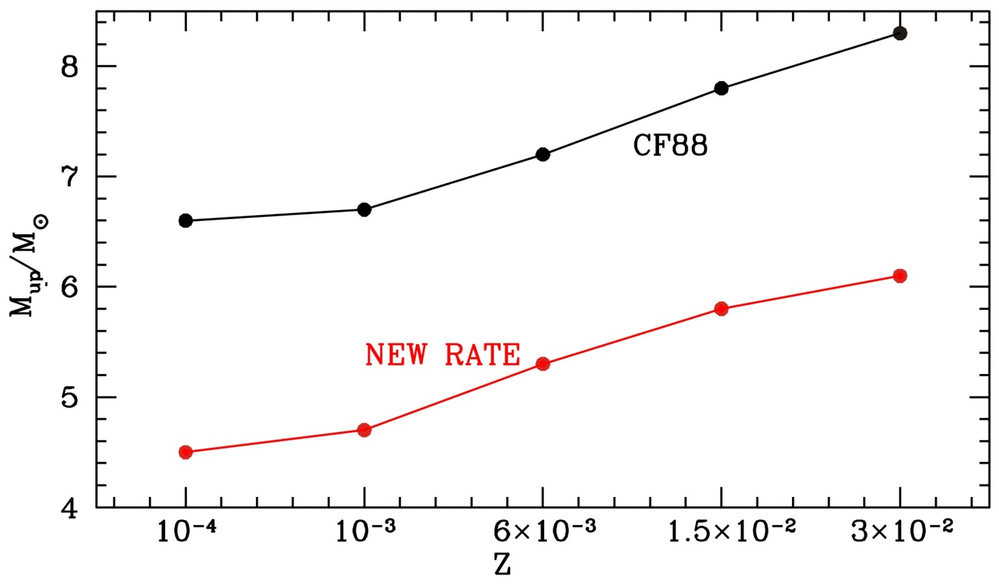
Varying the ¹²C+¹²C
Z | CF88 | NEW
0.0001 | 6.6 | 4.5
0.0010 | 6.7 | 4.7
0.0060 | 7.2 | 5.3
0.0149 | 7.8 | 5.8
0.0298 | 8.3 | 6.1
δM_{up} ~2 M

Slide 15
Summary
Combining uncertainties:
δM_{up} and δM_{up}* =2 M_{ʘ} (conservative error)
Astrophysical consequences
SNe rates (type Ia, e-capture and II)
WDs upper mass limits.
Massive AGB nucleosynthesis
How to improve this scenario
Precise measures of the ¹²C+α and ¹²C+¹²C
Better understanding of stellar convection

Slide 16
Astrophysical consequences V
More and less-massive core collapse SNe progenitors, down to ~7 M_{ʘ} (electron capture), down to ~9 M_{ʘ} (normal core collapse).
Perhaps in agreement with recent progenitors mass estimations: e.g. Smartt et al. 2008 found a minimum mass at 8.5 ± 1.5 M_{ʘ}

Slide 17
Why the progenitor evolution is so important for the comprehension of any type of SNe

Slide 18
SNe Classification
Based on Spectra and Light Curve morphology
II p
H
Type II H
Core collapse of massive stars
II L
SNe
I b (strong He
I c (weak He
No H
Type I
No-H
I a (strong Si
Thermonuclear explosion of WD

Slide 19
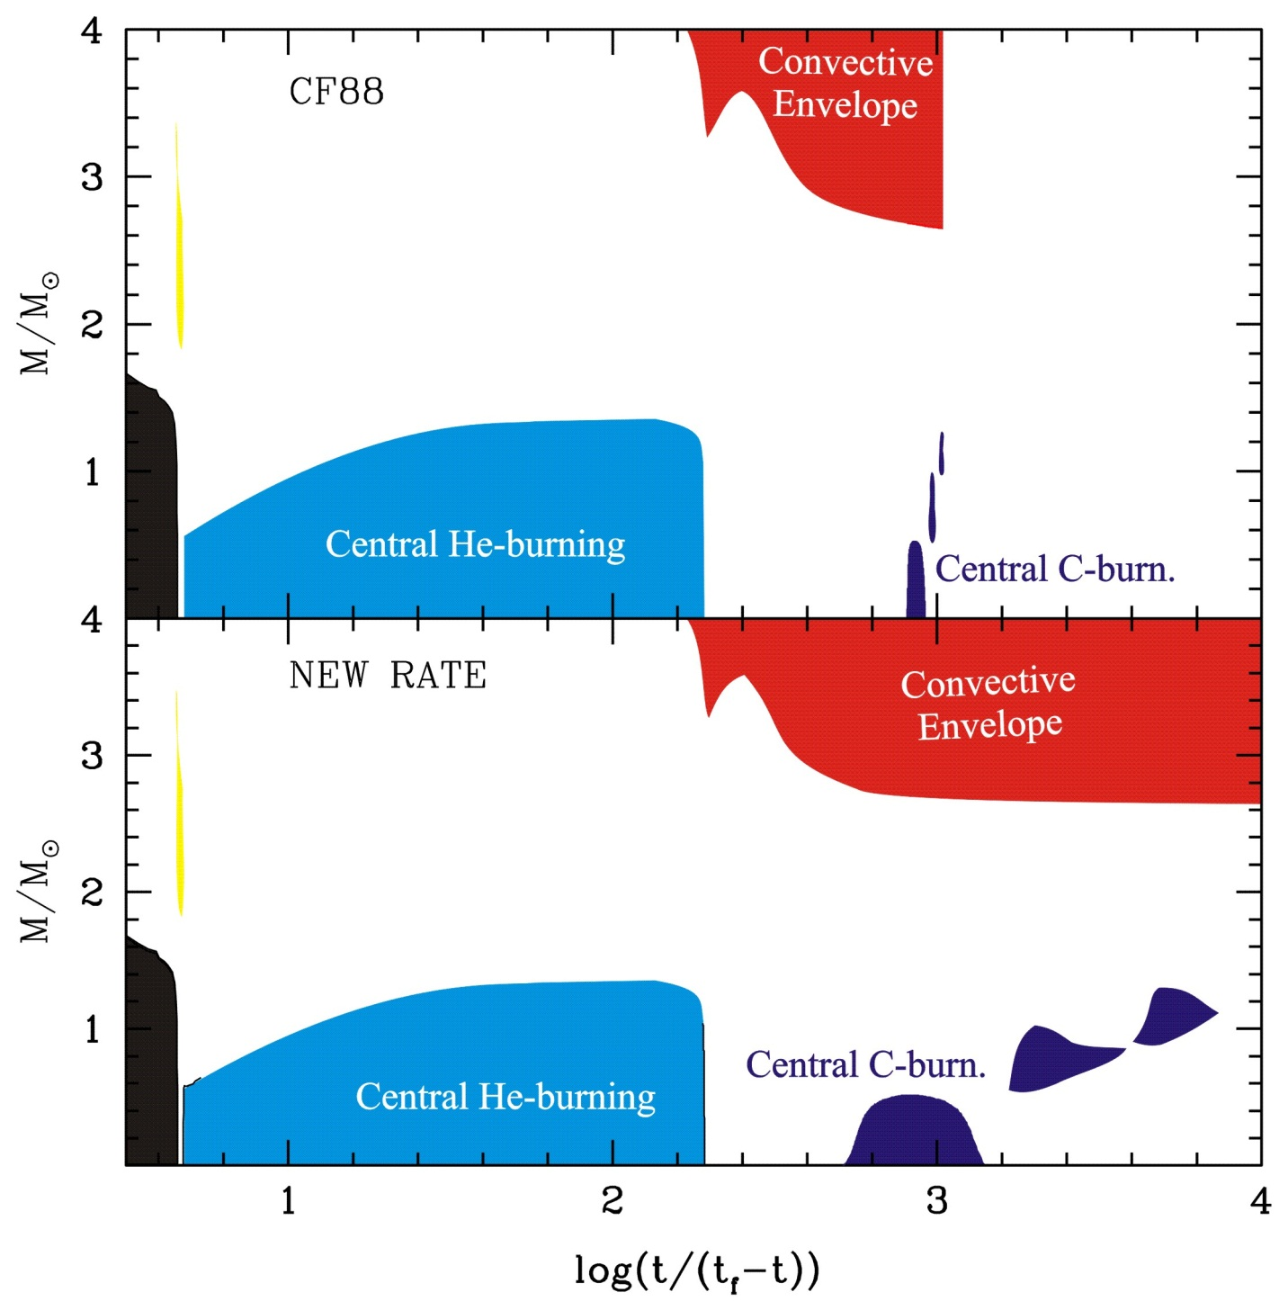
M=11.0 M
Z=0.0149
Y=0.2645

Slide 20
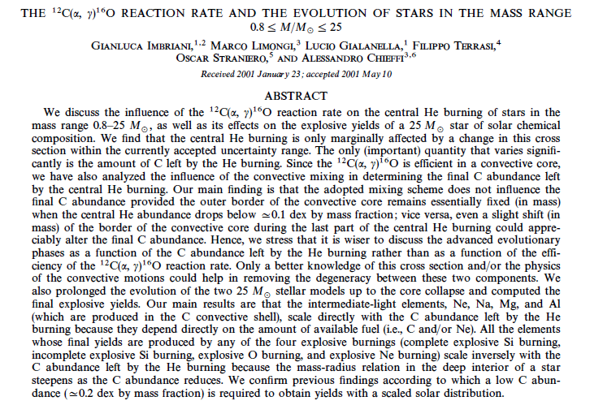
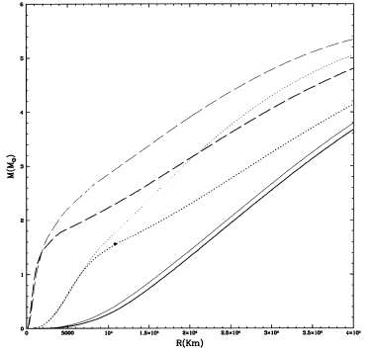
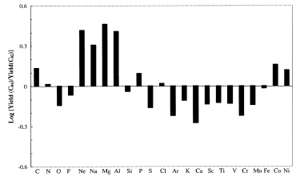

Slide 21
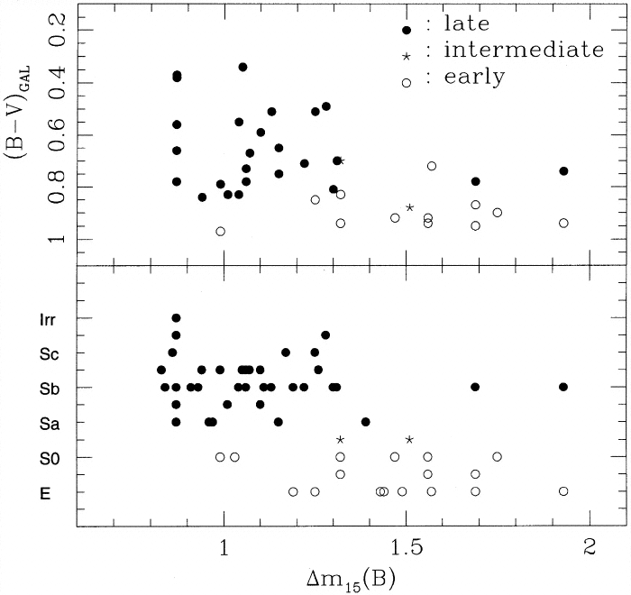
Type Ia Progenitors: Observational hints
Brighter SNIa
in Spiral Galaxies
SN Ia Rate
3 times  in late
Spiral Galaxies
Galaxy Type | SN Ia 10⁻¹¹ M 10⁻² yr H_{o}=65 km/s/Mpc
E-S0 | 0.12±0.02
S0a-Sb | 0.22±0.05
S0c-Sd | 0.35±0.08

Hamuy et al., 1995, 1996,2000
Ivanov et al. 2000 Branch et al. 1996
Cappellaro, Barbon, Turatto 2003

Slide 22
Changing the progenitor M & Z
Dominguez, Höflich, Straniero, ApJ 2001
Progenitor of the exploding WD
M_{MS}: 1.5 – 7 M initial mass
Composition: Z=0 (primordial) – 0.02 (solar)
Explosion  1D Delayed Detonation
Dependence on the initial Mass
M_{MS}  C/O (fuel)  ⁵⁶Ni mass  LC M_{max}
Z=0.02
M_{MS} C/O_{Ch} M_{Ni} (M) M_{V}
1.5 0.75 0.59 -19.25
5.0 0.72 0.56 -19.20
7.0 0.60 0.52 -19.11
Up to ΔM_{MAX} = 0.2 mag
Correlated with v_{ph} & t_{rise}

Slide 23
THE SYNTHESIS OF THE ELEMENTS

Slide 24
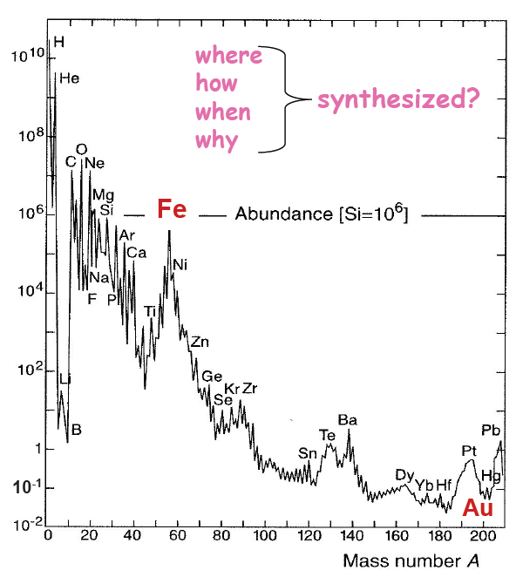
Neutron Captures
r-process
s-process
s-process
r-process
r-process
s-process

Slide 25
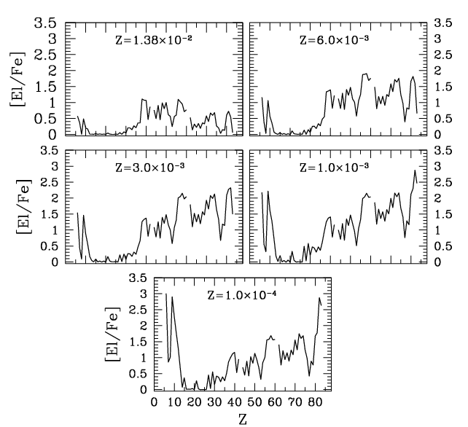
Final AGB composition for 0.0001<Z<Z
Straniero et al. 1995-1997, Gallino et al. 1998, Straniero et al. 2006, Cristallo et al. 2009-2011,
Pb, Bi
hs=Ba,La,Ce,Nd,Sm
ls=Sr,Y,Zr

Slide 26
