Slide 1
Radiation effects on position sensitive semiconductor detectors
Gregor Kramberger
Jožef Stefan Institute
Ljubljana, Slovenia

Slide 2
Purpose of the lecture is to understand the concepts rather than list numerous results.
In spite of 2h it is not possible to cover everything and I apology if some topics were left uncovered --- that does not mean they are not important!
Based on my personal experience too much equations and numbers confuse listeners and make them fall asleep. Avoiding them makes the lectures less “scientific”, but maybe more enjoyable. However it is not possible to be completely without …
It is impossible to start without any background. So the important numbers from yesterday…
Silicon detectors are essentially “solid state ionization cells”:
Important numbers
  signal of mip in 300 μm ~ 23000 e
  Saturated velocity of: electrons ~110 μm/ns , ~80 μm/ns (drift time >= 4ns)
  N_{eff} of orders 10¹² cm⁻³ -> in 300 μm 10¹² cm⁻³ corresponds to 70 V
  Required S/N>8 (more conservative 10)

Slide 3
Outline
Some overlap
with other lectures
Motivation and basics
  LHC …. HL-LHC, but also other fields
  What are the challenges?
Radiation damage
  Fluence, dose, NIEL
  Macroscopic effects on detector performance
  Influence of radiation to signal and noise
Radiation damage effects in silicon (material studies/engineering)
  Leakage current
  Effective doping concentration and electric field for different silicon materials: FZ, MCZ, DOFZ
  Trapping of the charge
Radiation effects in segmented detectors
  p-in-n, n-in-n and n-in-p sensors
  3D sensors and thin devices
Operation at very high fluences – recent highlights
  Active bulk
  Charge multiplication
Conclusions
Basics on Silicon Sensors and Detector Systems P. Giubilato
Microscopic damage in semiconductor detectors M.Bruzzi
At all points shown how to get more radiation hard detectors
Notes:
Je commence ma présentation avec la table des matières:
La première chose que je vais vous présenter est pourquoi nous avons besoin de nouveaux détecteurs:
Qu’elle est la motivation de développer de nouveaux détecteurs résistantes au rayonnement intense?
En suite je vais présenter la collaboration CERN-RD50 qui travaille sur ce sujet.
En suite je vais vous donnez une brève revue au sujet des dommages du rayonnement dans les détecteurs au silicium
Je vais commencer par les défauts microscopiques dans le cristal de silicium qui sont produit pendant l'irradiation. La production, la formation et les techniques de mesure des défauts microscopiques. Leur influence sur l'opération des détecteurs
Je vais parler des dommages macroscopiques qui (comme je le disais auparavant) sont provoqué par les dommages microscopiques:
les dommages macroscopiques sont:
(1) changement de la concentration effective de dopants
(changement de la tension de désertion)
(2) augmentation du courrant inverse (Ce qui provoque une augmentation du bruit)
(3) perte des charges collectées
En suite je vais parler de approches de RD50 pour développer des détecteurs résistant aux rayonnements: comme le « material and device engineering »cela veut dire :
on change la concentration des impuretés dans le cristal (par exemple en augmente la concentration en oxygène)
on change la conception du détecteur (par exemple on construit des détecteurs 3D)
À la fin je vais donner un récapitulatif et la conclusion.

Slide 4
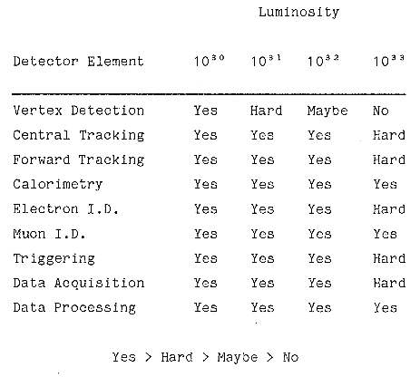
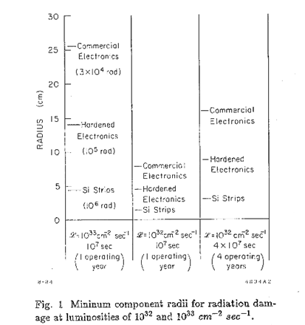
First considerations about radiation hardness for HEP - SSC
(Detectors and Experiments for the Superconducting Super Collider, pg. 491, Snowmass 1984
1984 considerations for SSC
(Detectors and Experiments for the Superconducting Super Collider, pg. 491, Snowmass 1984
“Silicon strip detectors (near the beam pipe) appear to be limited to…≤ 10³²....the 10³² limit could be optimistic.” (PSSC Summary Report pg. 130, 1984)
Now 105 upra
T. Kondo et al, Radiation Damage Test of Silicon Microstrip Detectors, pg. 612, Snowmass 1984

Slide 5
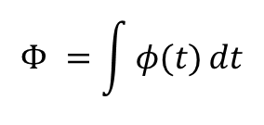
And we are we know now …
LEP HERA , Tevatron LHC HL-LHC
e⁺e⁻ 1.5∙10³¹ cm⁻² s⁻¹
ep 7∙10³¹ cm⁻² s⁻¹
pp 1.4∙10³² cm⁻² s⁻¹
pp ~10³⁴ cm⁻² s⁻¹
pp 10³⁵ cm⁻² s⁻¹ ?
90’
2020
high collision rates -> more particles hitting the detectors -> larger damage
(at LHC ~20 collisions every 50 ns at present)
$$Φ =\int{φ(t)}dt$$
Amount of particles that hit the detectors is called fluence:
But we are not alone …
medicine – smaller damage
space – smaller damage
fusion reactors – larger damage

Slide 6
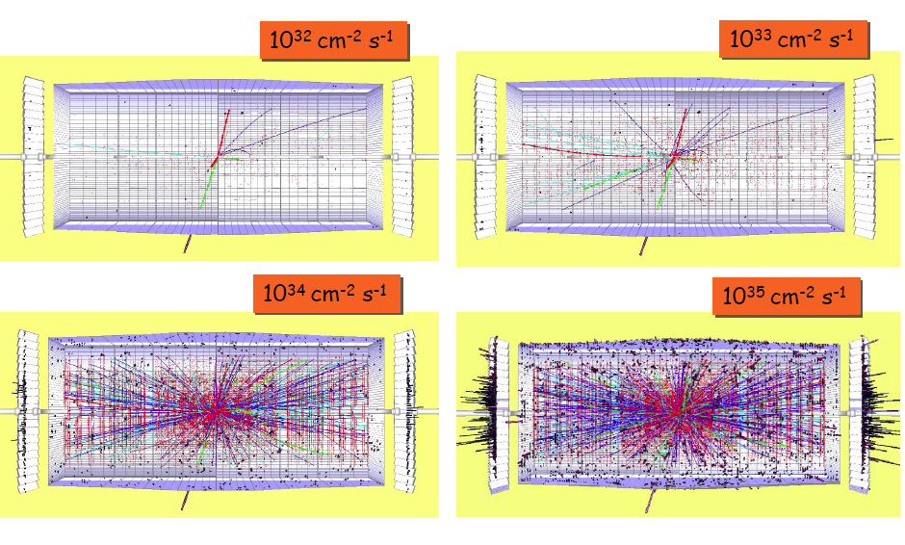
The challenge: HL-LHC - visually
LHC luminosity
SLHC luminosity ~200-400 interactions/bx

Slide 7
Motivation for R&D on Radiation Tolerant Detectors HL-LHC
-
HL
-
L
H
C
(
1
5
y
e
a
r
s
,
2
5
0
0
f
b
)
LHC upgrade
LHC (2009) L = 10³⁴cm⁻²s⁻¹
φ(r=4cm) ~ 3·10¹⁵cm⁻²
HL-LHC (>2020) L = 10³⁵cm⁻²s⁻¹
φ(r=4cm) ~ 1.6·10¹⁶cm⁻²
LHC (Replacement of components)
e.g. - LHCb Velo detectors
- ATLAS IBL
P
i
x
e
l
M
i
n
i
s
t
r
i
p
1
1
6
10 years
0
M
a
c
r
o
p
i
x
e
× 5
l
5
500 fb⁻¹
Φ
t
Φ
t
o
o
t
t
a
a
l
l
f
f
l
l
u
u
e
e
n
n
c
c
e
]
e
e
e
q
2
q
-
m
1
1
5
c
0
3000 fb⁻¹
[
5
q
Φ
e
n
Φ
e
u
t
r
o
n
s
e
q
p
Φ
i
o
n
1
s
1
4
0
e
q
5
o
t
h
e
r
c
h
a
r
g
e
d
h
Φ
a
d
r
o
n
s
e
A
T
L
A
S
S
C
T
-
b
q
a
r
r
e
A
T
L
A
S
P
l
i
x
e
l
(
m
i
c
r
o
s
t
r
i
p
d
e
t
e
c
t
o
r
s
1
)
1
3
0
0
1
0
2
0
3
0
4
0
5
0
6
0
[
M
.
M
o
l
l
,
s
i
m
p
l
i
f
i
e
d
,
s
c
a
l
e
d
f
r
o
m
A
T
L
A
S
T
D
R
r
[
]
c
m
]
HL-LHC compared to LHC:
Higher radiation levels ⇨ Higher radiation tolerance needed!
Higher multiplicity ⇨ Higher granularity needed!
Power Consumption ?
Cooling ?
Connectivity
Low mass ?
Costs ?
⬄
⇨ Need for new detectors & detector technologies
Notes:
7

Slide 8
Signal degradation for LHC Silicon Sensors
Pixel sensors:
max. cumulated fluence for LHC
Note: Measured partly under different conditions! Lines to guide the eye
(no modeling)!
Strip sensors:
max. cumulated fluence for LHC

Slide 9
Signal degradation for LHC Silicon Sensors
Pixel sensors:
max. cumulated fluence for LHC and SLHC
Note: Measured partly under different conditions! Lines to guide the eye
(no modeling)!
SLHC will need more radiation tolerant
tracking detector concepts!
Strip sensors:
max. cumulated fluence for LHC and SLHC

Slide 10
PART 2
Radiation damage and its impact

Slide 11
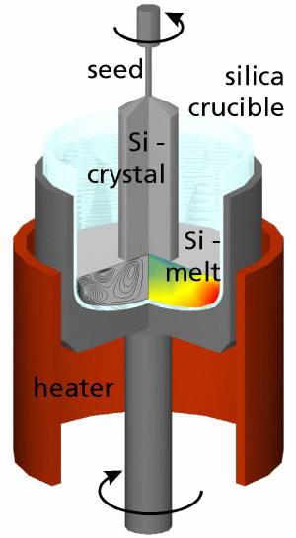
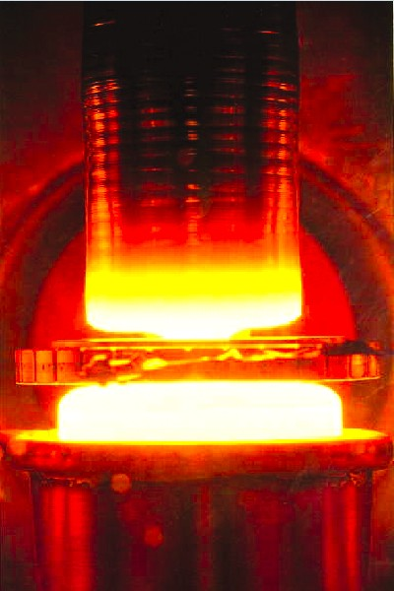
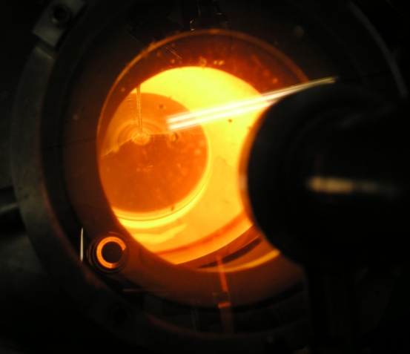
Silicon Growth Processes
Float zone Silicon (FZ)
Czochralski Silicon (CZ)
The growth method
used by the IC industry.
Difficult to produce
very high resistivity
[O_{i} ] ~ 5 × 10¹⁷ cm⁻³
Poly silicon
RF Heating coil
Single crystal silicon
Czochralski Growth
Float Zone Growth
Epitaxial Silicon (EPI)
Basically all silicon tracking detectors
made out of FZ silicon [O_{i} ]< 5 × 10¹⁶ cm⁻³
Some pixel sensors: Diffusion Oxygenated FZ (DOFZ)silicon [O_{i} ]~ 1-2 × 10¹⁷ cm⁻³
Chemical-Vapor Deposition (CVD) of Si
up to 150 μm thick layers produced
growth rate about 1μm/min

Slide 12
Types of radiation damage
Two types of radiation damage in detector materials:
• Bulk (Crystal) damage due to Non Ionizing Energy Loss (NIEL)
- displacement damage, built up of crystal defects –
•Surface damage due to Ionizing Energy Loss (IEL)
- accumulation of charge in the oxide (SiO₂), traps at Si/SiO₂ interface –
Region affected by ionizing energy loss - surface damage
SiO₂
Si
Region affected by non-ionizing energy loss - bulk damage

Slide 13
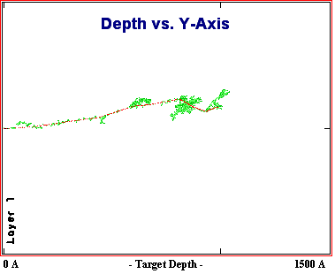
Generation of bulk damage (I)
Imping particle hits the lattice atom and knocks it out of the lattice site.
energy of E_{k}>25 eV is required for formation of a Frenkel pair (point defects)
for E_{k}>5 keV than knocked off atom displaces further lattice atoms (cluster defects)
E_{K} > 5 keV
E_{K} > 25 eV
V
I
dense region of displacements - cluster
TRIM simulation of 50 keV ion
Frekel pair – ( Vacancy-Interstitial pair)
Vacancies and Interstitial migrate in the crystal and react with other V,I or impurities.

Slide 14
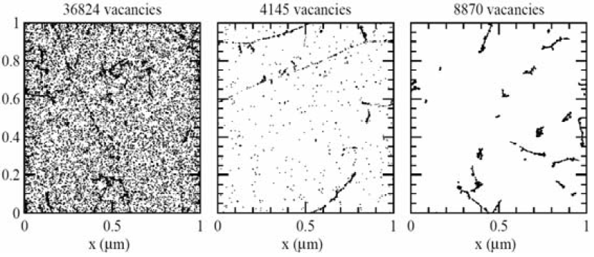
Generation of bulk damage (II)
How much clusters/point defects are produced by impinging particle depends on particle type and energy.
reactor neutrons – more clusters , less point defects
24 GeV protons – both in similar share
10 MeV protons – more point defects less clusters
γ with < 8 MeV – only point defects
10 MeV p
24 GeV p
1 MeV n

Slide 15
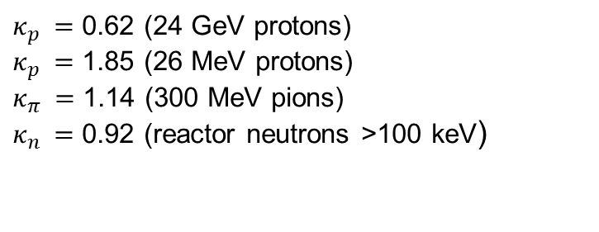

Generation of bulk damage (III)
How do we then compare the fluences of different particles?
NIEL hypothesis – the damage effects in silicon depend only on the non-ionizing energy loss regardless of the particle type and energy.
It is wrong (not extremely) for some radiation damage effects, but correct for leakage current. Still serves as a reference point.
One can normalize different particle fluences to the equivalent fluence of 1 MeV neutrons – equivalent fluence.
$Φ_{eq}=$ ${κ_{x }Φ}_{x}$
$κ_{p }=$ 0.62 (24 GeV protons)
$κ_{p }=$ 1.85 (26 MeV protons)
$κ_{π }=$ 1.14 (300 MeV pions)
$κ_{n }=$ 0.92 (reactor neutrons >100 keV)

Slide 16
Effects of bulk damage to detector operation
I. Increase of leakage current (increase of shot noise, thermal runaway)
II. Change of effective doping concentration
(higher depletion voltage, under- depletion)
III Increase of charge carrier trapping (loss of charge)
IV. Increase of silicon resistivity
The resistivity of silicon bulk increases with fluence
-deep defects push Fermi level close to mid-gap and the material becomes highly resistive. The upper limit is set by intrinsic silicon.
Irradiated
silicon

Slide 17
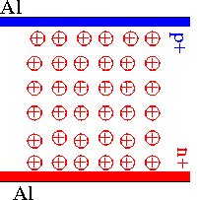
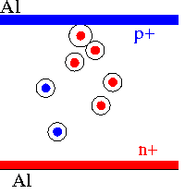
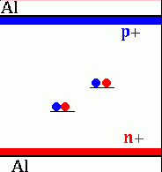
Effects of bulk damage to detector operation
charged defects
⇒ N_{eff} , V_{dep}
e.g. donors in upper and acceptors in lower half of band gap
Trapping (e and h)
⇒ CCE
shallow defects do not contribute at room temperature due to fast detrapping
generation
⇒ leakage current, N_{eff}
Levels close to mid-gap
most effective

Slide 18
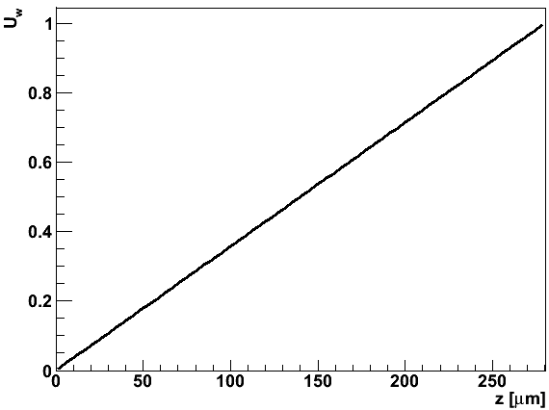
Signal in semiconductor detector (pad)
p⁺
Weighting field
hole
sensing electrode
all other electrodes
d
v(t)
r₀
electron
n⁺
HV
Q_{h}=0.5 q
Q_{e}=0.5 q
sensing electrode
What if the drift is not completed?
Ballistic deficit – short integration
Charge trapping
r₀

Slide 19
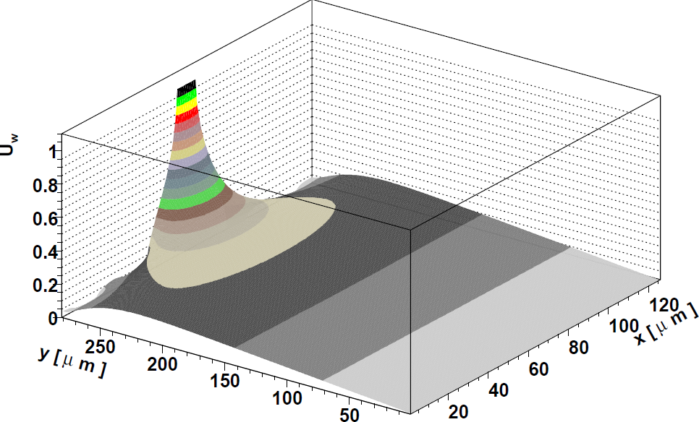
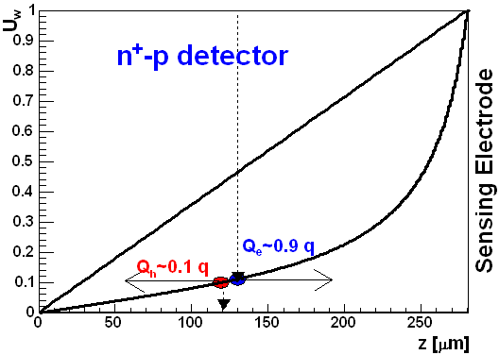
Signal in semiconductor detector (strip)
Weighting field
holes
sensing electrode
all other electrodes
q
electrons
implant=18 μm
p⁺-n detector
pitch=80 μm
Q_{h}=0.9 q
Q_{e}=0.1 q

Slide 20
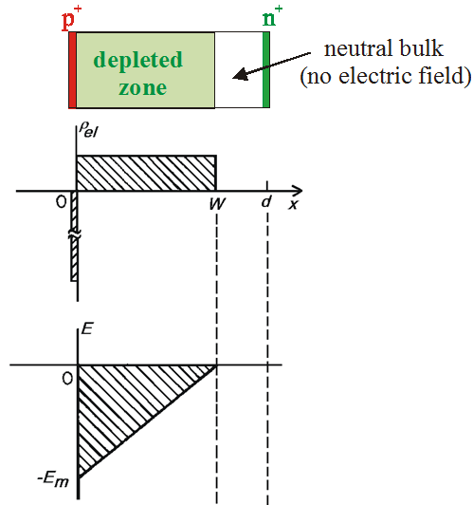
Signal in semiconductor detectors (electric field)
We are really interested in the electric field:
SIMPLEST CASE OF ALL : 1D , N_{eff}=const.
Positive space charge, N_{eff} =[P]
(ionized Phosphorus atoms)
Electrical
charge density
Electrical
field strength
Full charge collection only for V_{B}>V_{dep} !
depletion voltage
effective space charge density

Slide 21
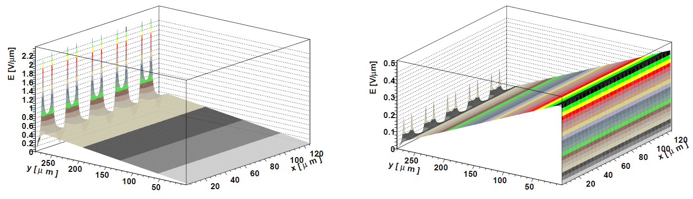
Signal in semiconductor detectors (electric field)
A MORE COMPLICATED CASE : 2D , N_{eff}=const.
e.g. : 280 μm thick detector, 25 μm strip pitch, 10 μm strip width
N_{eff} determines the electric field in the detector!

Slide 22
Signal in semiconductor detector - trapping
In irradiated detector there comes the trapping term. Each individual charge drifts until it is trapped – the probability that it will drift over certain distance decreases exponentially (for v_{d}<<v_{th}):
For point charge(s) – integral along the line of particle drift
Exploit the design of the detector to minimize the effects of trapping and increase of N_{eff} device engineering
(PART III of the lecture)
Influence on material properties to minimize the effects of irradiation
material engineering
(PART II of the lecture)
Everything is much simpler in pad detector – suitable for material studies.

Slide 23
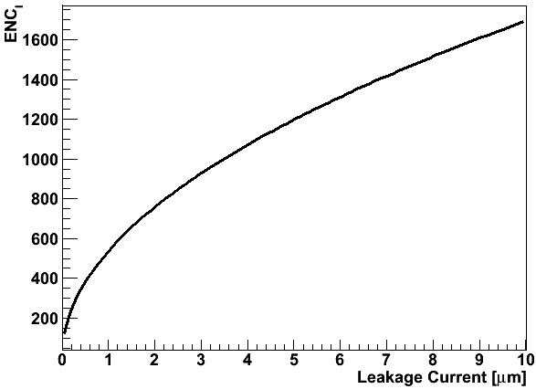
Noise in semiconductor detectors
Remember we look for high Signal/noise ratio (most important quantity)
Inter-strip capacitance can change due to interface states/traps, but at typical frequencies of 1 GHz the impact is questionable.
a and b should be optimized for the readout, to render ENC_{p} less important.

Slide 24
PART 3
Radiation damage effects in silicon (material studies/engineering)

Slide 25
Leakage current
Change of Leakage Current (after hadron irradiation) -> increase of noise
…. with particle fluence:
…. with time (annealing):
80 min 60°C
80 min 60°C
Damage parameter α (slope in figure)
Leakage current
per unit volume
and particle fluence
α is constant over several orders of fluence
and independent of impurity concentration in Si
 can be used for fluence measurement
Leakage current decreasing in time (depending on temperature)
Strong temperature dependence
Consequence:
Cool detectors during operation!
Example: I(-10°C) ~1/16 I(20°C)

Slide 26
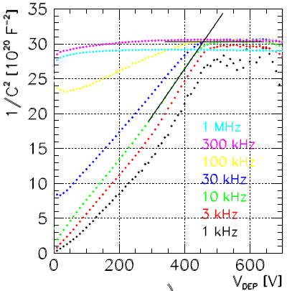
How do we measure N_{eff} and V_{dep}?
Effective doping concentration - N_{eff}
Capacitance measurement
V_{dep} from looking at C_{geom}
The capacitance measurement has been the workhorse of radiation damage studies for decades.
C-V becomes unreliable at high fluences:
Undepleted bulk becomes highly resistive
Charging and discharging the traps is frequency and temperature dependent

Slide 27
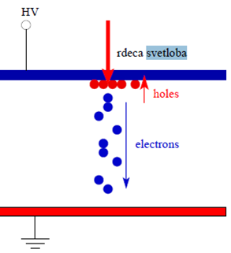
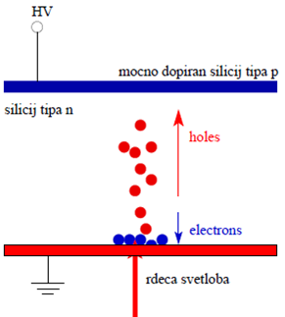
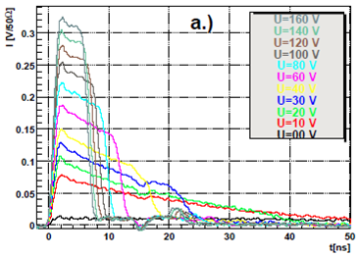
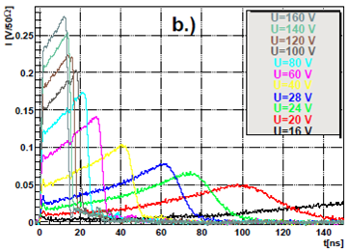
Transient current technique and space charge
red laser pulse
n-type silicon
Non-irradiated
sensor

Slide 28
Evolution of V_{dep} with fluence …
+
+
+
+
+
+
+
+
+
+
+
+
+
+
+
+
+
Electric field at Vdep
+
+
+
+
+
+
+
+
+
+
+
+
+
x
d
RD48: Comparison of different materials with respect to oxygen/carbon concentration.
Idea! Oxygen/Carbon may influence defect formation and reduce N_{eff} after irradiation.
The material used was produced by using a so called Float-zone silicon, which ensures the silicon with least impurities and defects.

Slide 29
Evolution of V_{dep} with fluence …
+
+
+
+
+
+
-
+
+
+
+
-
-
+
+
+
+
-
-
+
+
Electric field at Vdep
+
+
-
+
+
+
+
+
+
-
+
+
+
x
d
Not only the effective acceptors are introduced by irradiation, but also the initial donors are removed.
Initial acceptors – boron - are removed also for p-type material.

Slide 30
Evolution of V_{dep} with fluence …
+
-
+
-
+
-
+
-
+
+
-
-
+
+
+
+
-
-
-
+
Electric field at Vdep
-
+
-
-
+
+
+
+
+
-
-
+
+
+
x
d
Inversion of the detector type (Φ_{eq}=1-5∙10¹³ cm⁻²)
Detector of n-type turns effectively into p-type detector. This has a major consequence on detector operation. Using detector with higher initial dopant concentration shifts the inversion point towards higher fluences.

Slide 31

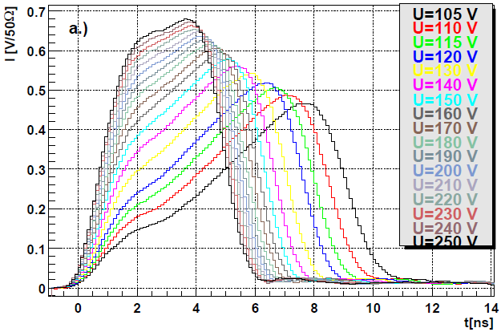

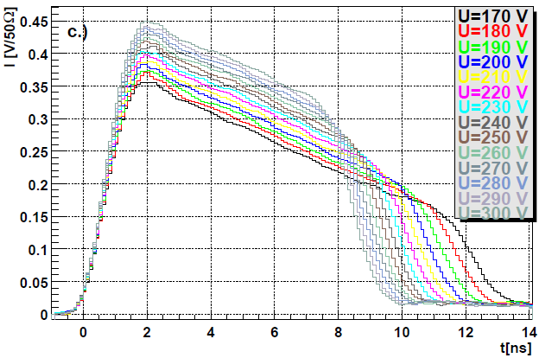
Evolution of V_{dep} with fluence
p⁺
n bulk
n⁺
Electron injection
Φ_{eq}=5∙10¹³ cm⁻²
V_{dep}=20 V
V_{dep}=70 V
n bulk
Hole injection
p⁺
Φ_{eq}=5∙10¹³ cm⁻²
n⁺
Remember – the shape of I gives you the shape of E

Slide 32
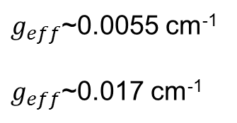

Evolution of V_{dep} with fluence …
-
-
-
-
-
+
-
-
-
+
-
-
-
-
+
+
-
+
+
-
-
-
-
-
-
-
Electric field at Vdep
-
-
-
-
-
-
+
+
+
-
-
-
-
-
-
-
-
x
d
The increse of Vdep i.e. |Neff| is almost linear with fluence.
The donor removal is almost complete.
$$N_{eff}\sim g_{eff}Φ_{eq}$$
$g_{eff}$~0.0055 cm⁻¹
$g_{eff}$~0.017 cm⁻¹
oxygeneted
standard

Slide 33
Evolution of V_{dep} with fluence …
-
-
-
-
-
-
-
-
-
-
-
-
-
-
-
-
-
-
-
-
-
-
-
-
-
-
-
-
-
-
-
Electric field at Vdep
-
-
-
-
-
-
-
-
-
-
-
-
-
-
-
-
-
-
-
-
-
-
-
-
-
-
x
d
Standard float-zone n-type silicon detector would be at the limit of the power supply (500 V for ATLAS SCT), however V_{dep} is not enough – low field require some over depletion to avoid ballistic deficit and reduce trapping.

Slide 34
Evolution of V_{dep} with fluence …
-
-
-
-
-
-
-
-
-
-
-
-
-
-
-
-
-
-
-
-
-
-
-
-
-
-
-
-
-
-
-
-
-
-
-
-
-
-
-
-
-
-
-
-
-
-
-
-
-
-
-
-
-
-
Electric field at Vdep
-
-
-
-
-
-
-
-
-
-
-
-
-
-
-
-
-
-
-
-
-
-
-
-
-
-
-
-
-
-
-
-
-
-
-
-
-
-
-
-
-
-
-
-
-
-
-
-
-
-
-
-
-
-
-
x
d
With further fluence the detector break down voltage or power supply limit becomes smaller than V_{dep}

Slide 35
Evolution of V_{dep} with fluence …
-
-
-
-
-
-
-
-
-
-
-
-
-
-
-
-
-
-
-
-
-
-
-
-
-
-
-
-
-
-
-
-
-
-
-
-
-
-
-
-
-
-
-
-
-
-
-
-
-
-
-
-
-
-
Electric field at Vdep
-
-
-
-
-
-
-
-
-
-
-
-
-
-
-
-
-
-
-
-
-
-
-
-
-
-
-
-
-
-
-
-
-
-
-
-
-
-
-
-
-
-
-
-
-
-
-
-
-
-
-
-
-
-
-
x
d
Reduce the voltage = not fully depleted detector
Detector is not fully efficient and has to run partially depleted. Huge problem for n-type detectors.
-
-
-
-
-
-
-
-
-
-
-
-
-
-
-
-
-
-
-
-
-
-
-
-
-
-
-
-
-
-
-
-
-
-
non-depleted part
-
-
-
-
-
Electric field at Vdep
-
-
-
-
-
-
-
-
-
-
-
-
-
-
-
-
-
-
-
-
-
-
-
-
-
-
-
-
-
-
-
-
-
-
x
d

Slide 36
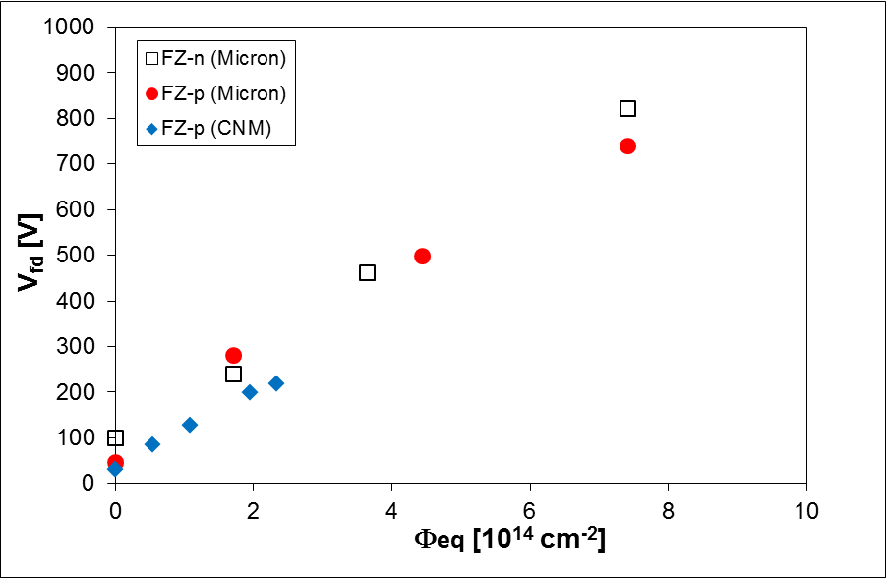
What about the p-type material?
p-type FZ material:
No inversion (material stays always effectively p-type)
There is some initial acceptor removal, but is not so well studied
The rate with which the negative space charge is introduced is comparable to n-type detectors
As will be explained later p-type material is more suitable (cheaper) for building detector for very harsh radiation environments.

Slide 37
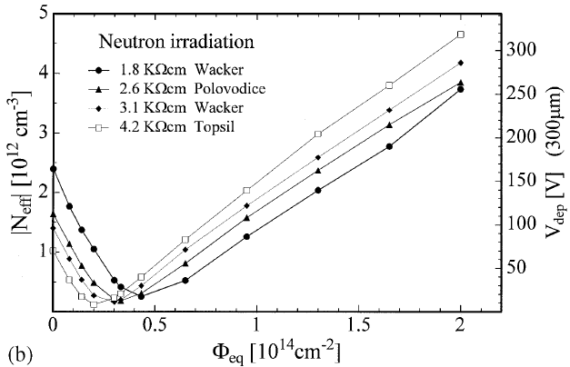
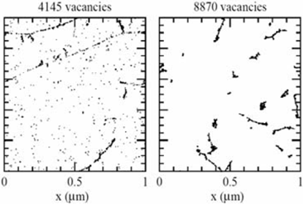
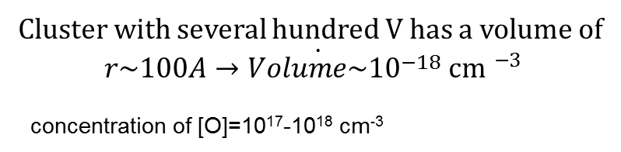
Neutron irradiations
The neutron irradiations show:
incomplete donor removal – not all initial donors are removed
no influence of any impurity – after neutron irradiations all materials behave the same – similar to the standard material irradiated with protons.
24 GeV protons
neutrons
Cluster with several hundred V has a volume of
$$r\sim 100\dot{A→Volume\sim {10}^{−18} }{\text{cm} }^{−3}$$
concentration of [O]=10¹⁷-10¹⁸ cm⁻³
Approximately few O atoms per cluster = the density of O is simply to small to have an effect!

Slide 38
Add more oxygen…
If the oxygen has such a positive role why not taking the material with most oxygen – Czochralski (only recently available with high enough resistivity)
[O]~10¹⁸ cm⁻³
The material seem not to invert – that means it stays effectively n-type after irradiation with charged hadrons – radiation introduces effective donors
But the rate of increase is about the same as for diffusion oxygenated float zone detector.
Coincidence ?

Slide 39
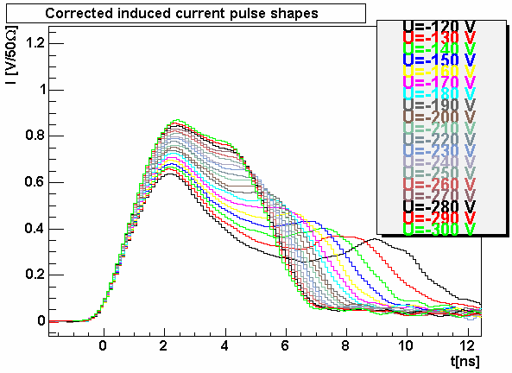
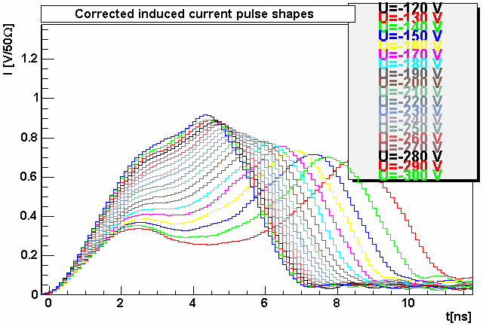
Double junction – polarization effects
Φ_{p}=5∙10¹⁴ cm⁻²
Φ_{p}=5∙10¹⁴ cm⁻²
electron injection
MCz-n = not inverted
electron injection
Fz-n = inverted
Induced current has a non-monotonic shape – sign of different space charge
j_{e}+j_{h}
This effect is present in all detector types
It gets more pronounced at high fluences
It is more pronounced for charged hadron irradiated detectors and oxygen rich material – point defects dominant?
It gets more pronounced at low temperatures
p⁺
j_{h}
n⁺
j_{e}
p⁺
N_{eff}<0
n⁺
N_{eff}>0

Slide 40
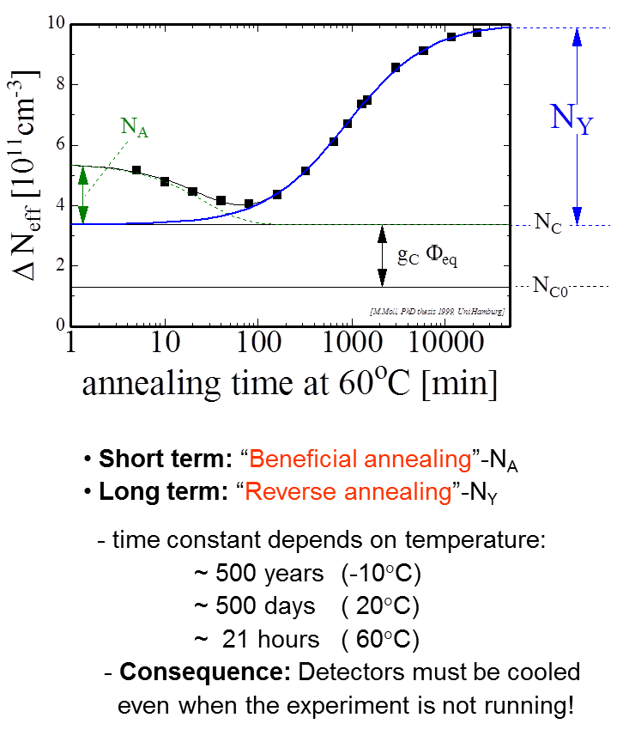
Evolution with time - Hamburg model
Short term : reduction of negative space charge
Long term: introduction of negative space charge
-
-
-
-
-
-
-
-
-
-
-
-
-
-
-
-
-
-
+
+
-
-
-
-
-
-
-
-
-
-
-
-
-
-
-
-
-
+
+
-
+
-
-
-
+
-
-
-
-
-
-
-
-
-
-
-
-
-
-
Electric field at Vdep
-
-
-
-
-
-
-
-
-
-
-
-
-
-
-
-
-
-
-
-
-
-
-
+
-
-
+
-
-
+
-
-
-
-
-
-
-
-
-
-
-
-
-
-
-
-
-
-
-
-
-
d
x

Slide 41
Evolution with time - Hamburg model
Short term : reduction of negative space charge
Long term: introduction of negative space charge
-
-
-
-
-
-
-
-
-
-
-
-
+
-
-
-
+
-
-
-
+
-
-
-
+
-
+
-
-
-
-
-
-
-
-
-
-
-
Electric field at Vdep
-
-
-
-
-
-
-
-
+
-
+
-
-
-
-
-
-
-
-
-
-
-
-
-
-
-
x
d

Slide 42
Evolution with time - Hamburg model
Short term : reduction of negative space charge
Long term: introduction of negative space charge
-
-
-
-
-
-
-
-
-
-
-
-
-
-
-
-
-
-
-
-
-
-
-
-
-
-
-
-
-
-
-
-
-
-
+
+
-
-
-
-
-
-
-
-
-
-
-
-
-
-
-
-
-
-
-
-
-
+
+
-
+
-
-
-
+
-
-
-
-
-
-
-
-
-
-
-
-
-
-
-
-
-
-
Electric field at Vdep
-
-
-
-
-
-
-
-
-
-
-
-
-
-
-
-
-
-
-
-
-
-
-
-
-
-
-
-
-
-
-
-
-
-
-
-
-
-
-
+
-
-
+
-
-
+
-
-
-
-
-
-
-
-
-
-
-
-
-
-
-
-
-
-
-
-
-
-
-
-
-
-
-
-
-
-
-
-
-
-
-
-
-
x
d

Slide 43
Annealing behavior of MCz-n, FZ-n detectors
Finger print of positive space charge seen in annealing
decay of acceptors -> increase of V_{fd}
local maximum of V_{fd} (plateau)
generation of acceptors -> decrease of V_{fd}
inversion of space charge at late stages, but V_{fd} never really goes to ~0 (double junction)
further generation of acceptors increase of V_{fd}
DOFZ-n – N_{eff}<0, MCz-n N_{eff}>0
2.)
1.)
3.)
5.)
end of HL-LHC at RT
4.)

Slide 44
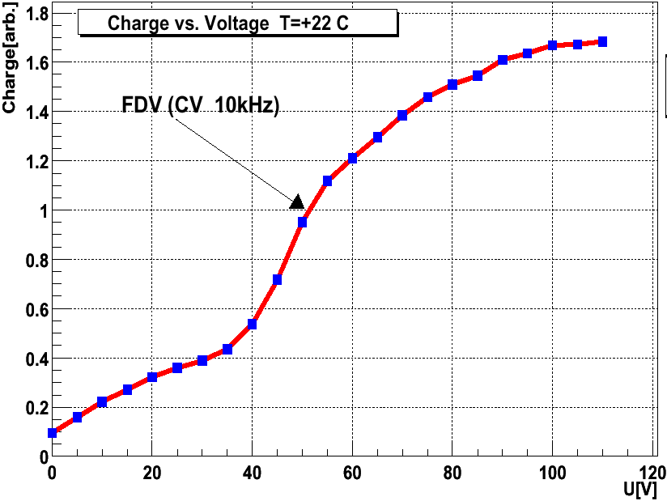

Trapping of drifting charge
higher voltages(i.e. higher field)
shorter drift
less charge trapped
$$Q=\int_{0}^{t_{drift}}{I_{m}\left(t\right)dt}$$
increase of charge(V>V_{dep})
G. Kramberger et al, Nucl. Inst. Meth. A476 (2002) 645.
correction
in the way that
Q=constant for V>V_{dep}

Slide 45
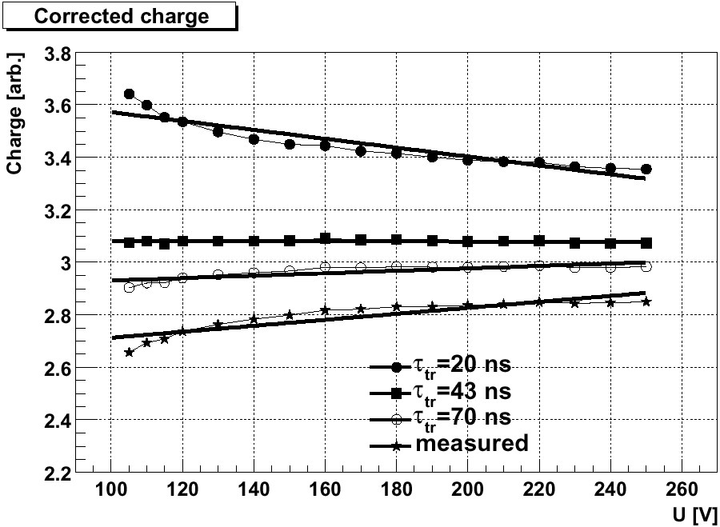
τ_{eff} = τ_{tr} that gives equal current integral above V_{FD} (compensate the trapping)
τ_{tr} > τ_{eff} - lower voltages are under weighted
τ_{tr} < τ_{eff} - lower voltages are over-weighted

Slide 46
Trapping of drifting charge
β(-10ºC, t=min Vfd) [10⁻¹⁶ cm²/ns] | 24 GeV protons 200 MeV/c pions (average ) | reactor neutrons
Electrons | 5.3 ± 0.7 | 3.5 ± 0.6
Holes | 6.6 ± 0.8 | 4.7 ± 1
The β_{e,h} was so far found independent on material;
resistivity
[O], [C]
type (p,n)
wafer production (FZ, Cz, epitaxial)
somewhat lower trapping at Φ_{eq}>10¹⁵ cm⁻²
β_{e,h} ~ 0 for ⁶⁰Co irradiated samples
The trapping probability:
gets smaller with time for electrons
gets larger with time for holes

Slide 47
PART 4
Radiation effects in segmented detectors
Can we design a detector where the effects of the irradiation are mitigated?

Slide 48
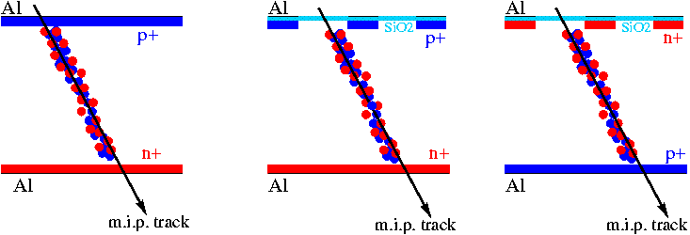
Drift equation for the mip signal
drift current of a single carrier
geometry factor
peaked at electrodes
trapping term ( τ_{eff,e}~τ_{eff,h} )
drift velocity ( μ_{e}~3μ_{h} )
electrons get less trapped
they should drift to the strips/pixels and
contribute most to Q (n⁺ readout for silicon)
Remember: in segmented detector one carrier type always contributes more than the other – U_{w} determines the difference.
n
n
p
Thickness ~ 300 microns
electric field region
+V
+V
-V

Slide 49
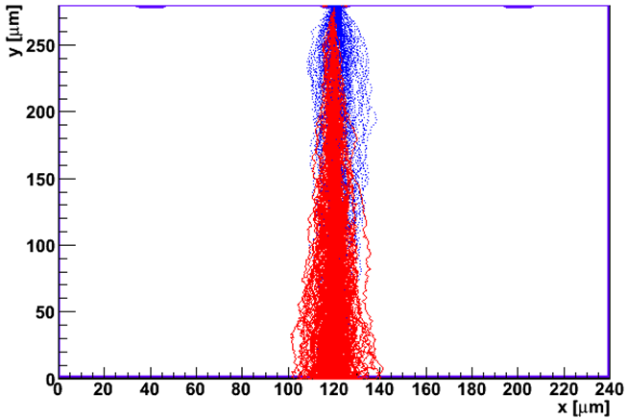
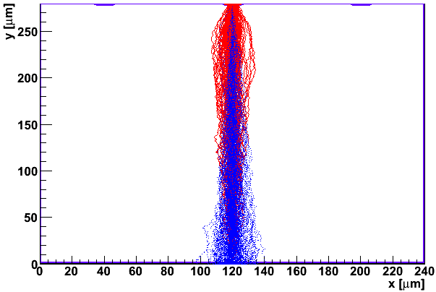
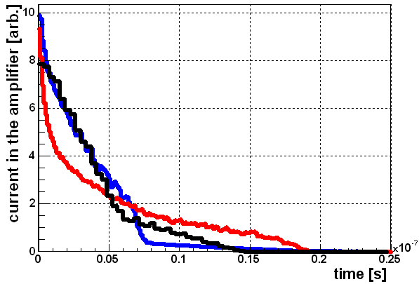
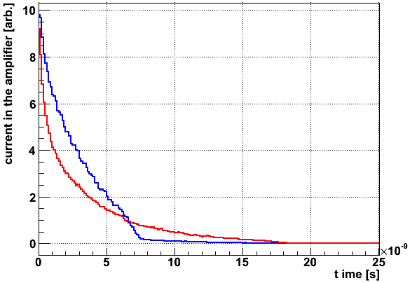
Influence of geometry on charge collection
19% signal from holes
81% signal from electrons
81% signal from holes
19% signal from electrons
pitch 80- width 20
280 μm thick @ 100V, N_{eff}=1e12 cm⁻³
τ_{e}=12.5 ns
τ_{h}=10 ns
Notes:
Electric field region

Slide 50
Device engineering – n+ readout
p⁺
n⁺
Segmented readout
Segmented readout
diode
good 😐
worse ☹
better ☺
even worse: p⁺ readout
(p⁺-n detector)
even better: n⁺ readout
(n⁺-p, n⁺-n detector)
  How to get maximum signal?
  use of n⁺-n or n⁺-p device (electron collection) with pitch<<thickness
  implant width close to pitch (depends on FE elec. – inter-electrode capacitance)
  for a given cell size of a pixel detector

Slide 51
The difference between n+ or p+ readout is obvious!

Slide 52
Device engineering – thin detectors
If bias is too small to deplete thin detector: benefit due to weighting field!
If bias is larger the if it better to have larger field and less trapping than larger deposited charge.
p⁺
n⁺
p⁺
n⁺
U_{w,thick}
U_{w,thin}
V>V_{dep,thin}

Slide 53
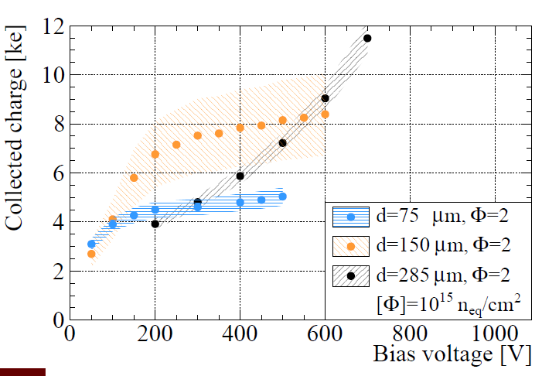
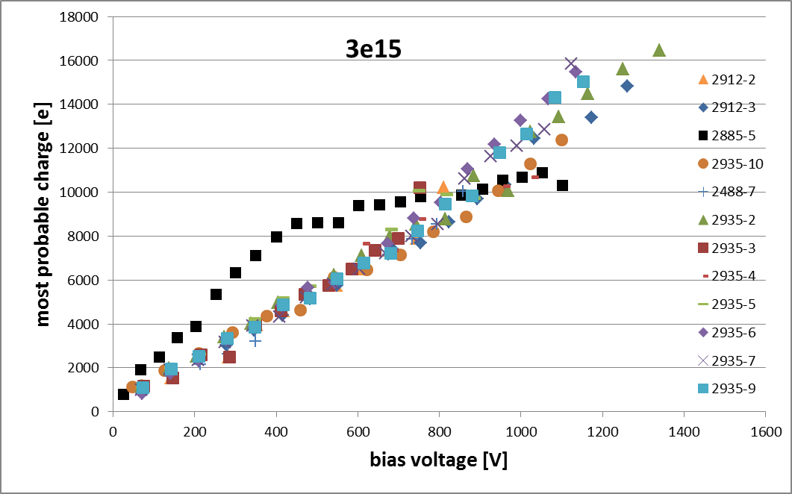
Device engineering – thin detectors
250x150 μm² pixel detector
pad detectors
MPI data
150 μm device
Examples of the thin vs. thick detector operation!
NOTE: before irradiation and up to certain (large) fluence thick detector outperforms thin!

Slide 54
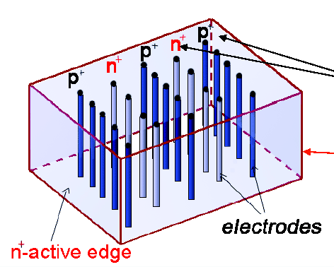
3D n⁺-p pixel detectors
Combine traditional VLSI processing and
MEMS (Micro Electro Mechanical Systems) technology.
Both electrode types are processed inside the
detector bulk instead of being implanted on the wafer's surface.
The edge is an electrode. Dead volume at the Edge < 5 microns! Essential for forward physics experiments and material budget
S.I. Parker, C.J. Kenny, J. Segal, Nucl. Instr. and Meth. A395 (1997) 328.

Slide 55
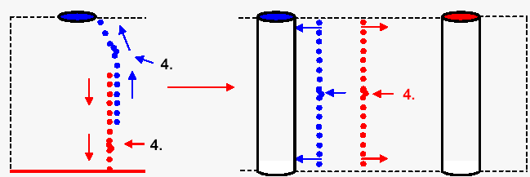
3D n⁺-p pixel detectors
Pros.
Better charge collection efficiency
Faster charge collection (depends on inter-column spacing)
Reduced full depletion voltage and by that the power
Larger freedom for choosing electrode configuration
Cons.
Columns are dead area (aspect ratio ~30:1)
Spatially non-homogenous CCE (efficiency=function of position)
Much higher electrode capacitance (hence noise), particularly if small spacing is desired – small drift length
Availability on large scale
Time-scale and cost

Slide 56
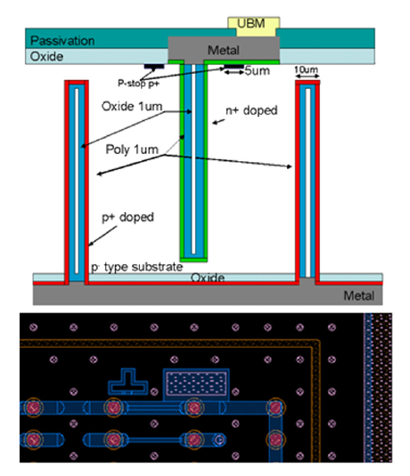
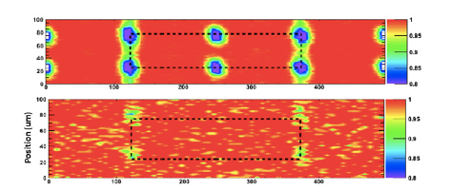
3D sensors:
used in IBL, excellent up to Φ_{eq} = 5·10¹⁵ n/cm², promising results also for HL-LHC,
operation at lower voltage in innermost HL‐LHC tracking layer(s)
➔ More in other presentations at this conference!
Work of ATLAS 3D Sensor R&D Collaboration:
Test beam, CNM, sensors,
Φ_{eq} = 5·10¹⁵ n/cm², Bias voltage = 160 V
Track efficiency > 98%
0°
15°
Track incidence angle
[S. Grinstein, NIMA 699 (2013) 61–66 ]
[S. Tsiskaradze, 19th RD50 workshop]
CNM 3D sensor
[G. Pellegrini, et al., NIMA 592 (2008) 38].

Slide 57
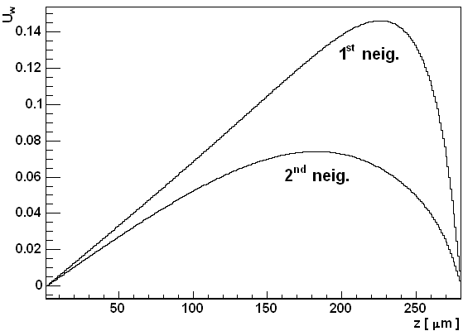
Trapping induced charge sharing
If drift of the carriers is not completed – the charge is induced in the neighbors:
E field is not present in entire detector
Large trapping
80 um pitch
20 um im. width
1st 2nd
measuring
±U
I(t)
Electric field present whole volume and no trapping – the charges complete the drift. The bipolar induced current gives no net induced charge.
t

Slide 58
Trapping induced charge sharing
If drift of the carriers is not completed – the charge is induced in the neighbors:
E field is not present in entire detector
Large trapping
80 um pitch
20 um im. width
low or no E field
1st 2nd
measuring
±U
Electric field not present in the whole volume? Charges induced in the neighbors (e.g. 13% on the first, 7% on the second ones).
Large number of strips with relatively small signal – wide clusters – this is where the charge was induced if E_{w}∙E is small for the hit strip.

Slide 59
Trapping induced charge sharing
If drift of the carriers is not completed – the charge is induced in the neighbors:
E field is not present in entire detector
Large trapping
80 um pitch
20 um im. width
1st 2nd
measuring
±U
Electric field present in the whole volume, but large trapping. The bipolar induced charge doesn’t give zero net charge.
There is a big difference between n⁺-p and p⁺-n !

Slide 60
electrode
hit in the center by ionizing particle
p⁺ elect.
n⁺ elect.
diode
same polarity
Signals in the neighbors few % of the hit strip
Depends strongly on fluence position of the hit and electrode geometry!
opposite polarity
wider clusters
larger signals

Slide 61
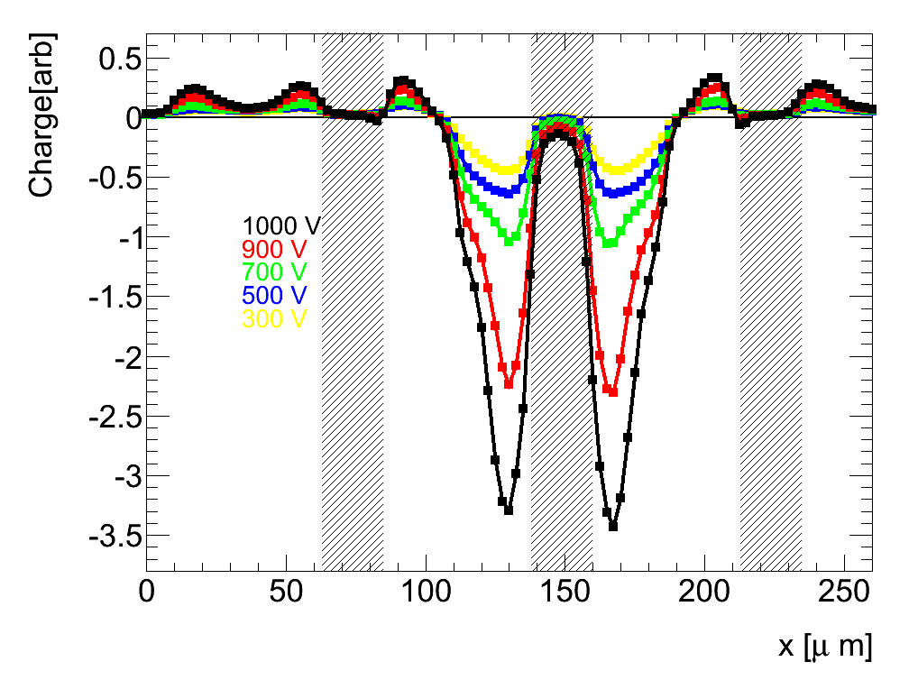
Trapping induced charge sharing – infra red TCT
300 μm, 80 μm pitch, 20 μm width
10¹⁵ cm⁻²
different sign
Laser scan over the detector surface (8μm FWHM beam width – 1064 nm) :
induced charge in the central strip vs. laser position.

Slide 62
PART 5
Operation at very high fluences recent highlights and challenges

Slide 63


What about operation above 10¹⁵ cm⁻²?
CCE measurements show excellent results – much better than predicted?
Problems to understand why:
  V_{dep} – CV doesn’t work
  Time resolved TCT does not work, trapping to severe
Expected signal 2-3x too low!
1st observation of unexpectedly high CCE
[A.Affolder, Liverpool, NIMA 623, 2010, 177–179]
G. Casse (4th RD50 workshop, 2004, CERN)

Slide 64


SIMULATION BASED ON MEASURED DAMAGE PARAMETERS FAILS COMPLETELY!
Even if trapping is off - the active region assumed by depletion is not enough to reproduce the signal!
Black: measured, Red: simulation
Black: measured, Red: simulation
β_{e} = 3.2·10⁻¹⁶ cm²/ns
β_{h} = 3.5·10⁻¹⁶ cm²/ns
No trapping, only N_{eff}:
Trapping and expected Neff
No trapping and expected Neff
NOTE:
Very high voltage applied
CCE >=1

Slide 65




Charge multiplication
High Φ
large N_{eff}
high V
High E
Impact ionization
$$dN_{e}=N_{e} ∙α∙ dx$$
Electrons undergo multiplication in electric fields >10-15 V/μm
CCE > 1 observed for all types – larger in segmented detectors due to “field focusing”
3D p-type detector
CCE=1 for thin sensors
M. Köhler, 16th RD50 workshop, Barcelona, 2010
T. Affolder et al., IEEE NSS-MIC, Orlando, 2009.
planar p-type detectors

Slide 66

Charge multiplication
285 μm thick n-in-p FZ pixels
Expected charge of ~2.5-3 ke
is largely surpased at 10¹⁶ cm⁻²
threshold
Both planar and 3D detectors are capable of surviving HL-LHC fluences in terms of signal!
Answers to be provided:
How to see it in the induced current?
How to measure the field?

Slide 67

Edge-TCT
Classical TCT: information of the field from I(t)
  Edge-TCT: information of the field from I(depth)
A narrow 8 μm beam is used to generate e-h pairs at known depth
Measured current is average over the width of the strip
Edge-TCT meritev
G. Kramberger et al., IEEE TNS, VOL. 57, NO. 4, AUGUST 2010, 2294
d
t=0
y

Slide 68

Edge-TCT
Classical TCT: information of the field from I(t)
  Edge-TCT: information of the field from I(depth)
A narrow 8 μm beam is used to generate e-h pairs at known depth
Measured current is average over the width of the strip
VELOCITY PROFILE:
d
t~0, t<<τ_{eff,e,h}
y

Slide 69
Edge-TCT
Classical TCT: information of the field from I(t)
  Edge-TCT: information of the field from I(depth)
A narrow 8 μm beam is used to generate e-h pairs at known depth
Measured current is average over the width of the strip
Electrons finish their drift.
d
y

Slide 70

Edge-TCT
Classical TCT: information of the field from I(t)
  Edge-TCT: information of the field from I(depth)
A narrow 8 μm beam is used to generate e-h pairs at known depth
Measured current is average over the width of the strip
End of drift
d
t<t_{int}
y

Slide 71

Velocity profiles
strips
back-plane
5e14
nirr.
2e15 cm⁻²
1e16
whole detector volume is active (velocity in the saddle-30% of v_{sat})
the high field region penetrates deeper in the detector than predicted

Slide 72


Velocity profiles
N. Pacifico et al., presented at RESMDD 10
FZ-p detector irradiated to
Φ_{eq}=1.6∙10¹⁵ cm⁻² 300 MeV pions
Almost symmetrical electric field.
Elmost saturated drift velocity in the sensor at already 500V
MCz-n detector irradiated to
Φ_{eq}=3∙10¹⁵ cm⁻² neutrons
symmetrical electric field.
dominant p⁺ side at small/moderate voltages

Slide 73

Charge multiplication
5∙10¹⁵ cm⁻²
1000 V
(2)
(4)
(5)
(6)
(1)
(3)
(3)
y
(1)
d
y
(2)
d
y
d
(4)
(6)
y
d
y
(5)
d
y
d

Slide 74


Charge multiplication and annealing
Long term annealing seem not be a problem
  Electric field present in the whole detector
  Electric field is high at the strips
  Effective trapping times beneficially anneal
  Additional acceptors even increase multiplication at high voltages
Micron; FZ n-p, neutrons 5e15 cm⁻²
HPK FZ n-p, neutrons 5e15 cm⁻²
Edge-TCT signal
160 min
320 min
640 min
1280 min
2560 min
5120 min
y=150 μm
700 V
SCT128A – Sr90
Multiplication peak

Slide 75



Multiplication current and noise
increase of current correlated with increase of signal – thermally generated carriers are multiplied
current increase results in the increase of noise according to
excess factor
Gain in S/N expected for small electrodes where the series noise dominates!
shot noise with multiplication
$${ENC}_{MI}=ENCI∙\sqrt{F}∙M_{I}$$
current multiplication
Noise without multiplication for the generation current I
HPK FZ n-p, neutrons 5e15 cm⁻²
Current larger than expected for full volume already at low voltages.
SCT128A – Sr90

Slide 76
Conclusions – Radiation Damage
Radiation Damage in Silicon Detectors
  Change of Depletion Voltage (internal electric field modifications, “type inversion”,
  reverse annealing, loss of active volume, …)
  (can be influenced by defect engineering!)
  Increase of Leakage Current (same for all silicon materials)
  Increase of Charge Trapping (same for all silicon materials)
Signal to Noise ratio is quantity to watch (material + geometry + electronics)
Approaches to obtain radiation tolerant devices:
  Material Engineering: - explore and develop new silicon materials (oxygenated Si)
  - use of other semiconductors (Diamond)
  Device Engineering: - look for other sensor geometries
  - 3D, thin sensors, n-in-p, n-in-n, …
Excellent radiation hardness of silicon detectors at HL-LHC fluences
  active bulk - velocity in the saddle can be >30% of the saturated one
  active region - penetrates deeper in the bulk than extrapolated
  Charge multiplication - increase of N_{eff} leads to impact ionization at high bias
              - the leakage current and noise also increase – improvement in S/N requires optimization of geometry
              - long term annealing seem not to be harmful
Notes:
76
76

Slide 77
Acknowledgements & References
Most references to particular works given on the slides
Some additional material taken from the following presentations:
  RD50 presentations: http://www.cern.ch/rd50/
  Anthony Affolder: Presentations on the RD50 Workshop in June 2009 (ATLAS fluence levels)
  Frank Hartmann: Presentation at the VCI conference in February 2010 (Diamond results)
Books containing chapters about radiation damage in silicon sensors
  Helmuth Spieler, “Semiconductor Detector Systems”, Oxford University Press 2005
  Frank Hartmann, “Evolution of silicon sensor technology in particle physics”, Springer 2009
  L.Rossi, P.Fischer, T.Rohe, N.Wermes “Pixel Detectors”, Springer, 2006
  Gerhard Lutz, “Semiconductor radiation detectors”, Springer 1999
Research collaborations and web sites
  CERN RD50 collaboration (http://www.cern.ch/rd50 ) - Radiation Tolerant Silicon Sensors
  CERN RD39 collaboration – Cryogenic operation of Silicon Sensors
  CERN RD42 collaboration – Diamond detectors
  Inter-Experiment Working Group on Radiation Damage in Silicon Detectors (CERN)
  ATLAS IBL, ATLAS and CMS upgrade groups

