Slide 1
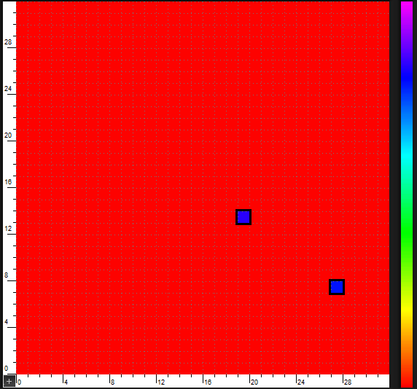
MONOLITHIC PIXEL DETECTORS
Walter Snoeys
  Acknowledgements
  Collegues in ESE group and Alice Pixel, LHCb RICH, NA57, WA97, RD19, TOTEM and LePIX Collaborations
  S. Parker, C. Kenney, C.H. Aw, G. Rosseel, J. Plummer
  E. Heijne, M. Campbell, E. Cantatore, …
  K. Kloukinas, W. Bialas, B. Van Koningsveld, A. Marchioro…
  A. Potenza, M. Caselle, C. Mansuy, P. Giubilato, S. Mattiazzo, D. Pantano, A. Rivetti, Y. Ikemoto, L. Silvestrin, D. Bisello, M. Battaglia
  P. Chalmet, H. Mugnier, J. Rousset
  T. Kugathashan, C. Tobon, C. Cavicchioli, L. Musa
  A. Dorokhov, C. Hu, C. Colledani, M. Winter
  I. Peric

Slide 2
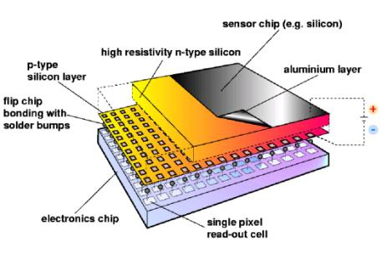
MONOLITHIC DETECTORS : definition
Readout circuit
Collection electrode
Sensitive layer
High energy particle
Integrate the readout circuitry – or at least the front end – together with the detector in one piece of silicon
The charge generated by ionizing particle is collected on a designated collection electrode

Slide 3
MONOLITHIC DETECTORS
Motivation:
  Easier integration, lower cost, possibly better power-performance ratio
  Promising not only for pixel detectors, but also for full trackers
  Potential of strong impact on power consumption and hence on material in high energy physics experiments
Difference between high energy physics and traditional imaging:
  single particle hits instead of continuously collected signal
Now in two experiments:
  DEPFET pixels in Belle-II
  MAPS in STAR experiment
both relatively slow (row by row) readout, not always applicable
Not yet in LHC, considered for upgrades (eg Alice) and for CLIC/ILC

Slide 4
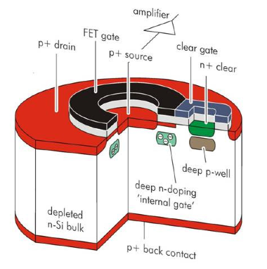
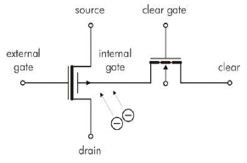
DEPFET (MPI MUNICH)
An example in special technology
  An annular PFET on top of a fully depleted substrate (back side junction).
  A potential well under the gate area collects the charge generated in the substrate.
  The potential of this potential well changes with collected charge and modulates the PFET source-drain current.
  Charge collection continues even if DEPFET is switched off.
  Clear gate allows reset of the potential well.
  The readout can occur via the source (voltage out), or via the drain (current out)
  Very small collection electrode capacitance, allows high S/N operation.
  Need steering and rest of readout off chip or on another chip.
500pA/e-

Slide 5
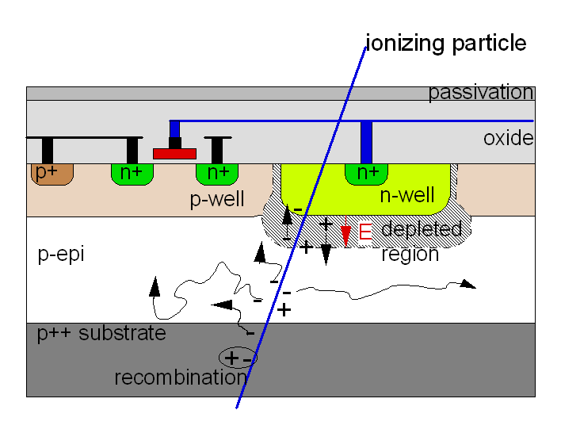
Monolithic Active Pixel Sensors (MAPS)
  Cfr M. Winter’s presentation
  Commercial CMOS technologies
  Very few transistors per cell
  Pixel size : 20 x 20 micron or lower
  Charge collection by diffusion, more sensitive to bulk damage (see next slides)
  Serial readout, slower readout
  Time tagging can be envisaged but would like to have faster signal collection, and will need extra power.
cfr. M. Winter et al
RESET
COLUMN BUS
ROW SELECT
Example: three transistor cell

Slide 6
MONOLITHIC DETECTORS
Main challenges in high energy physics:
          radiation tolerance and power consumption
Key parameters:
    Charge collection mechanism: drift vs diffusion
        Collected charge over input capacitance ratio & architecture
            Technology

Slide 7
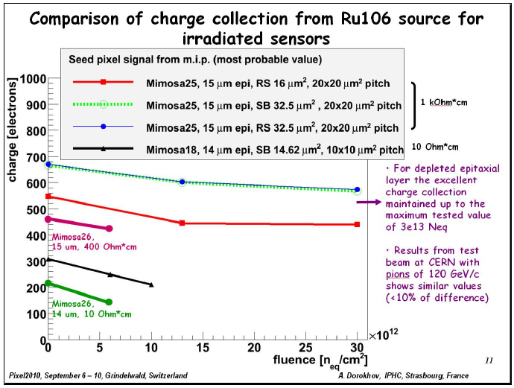
Collection by diffusion – ex.: standard MAPS*
MAPS: Monolithic Active Pixel Sensors
(A. Dorokhov et al., IPHC, France)
Need collection by drift for radiation tolerance beyond a few 10¹³n_{eq}/cm² !

Slide 8
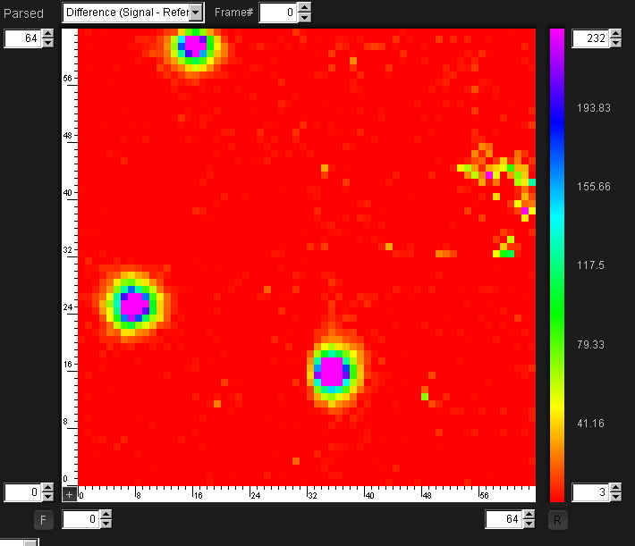
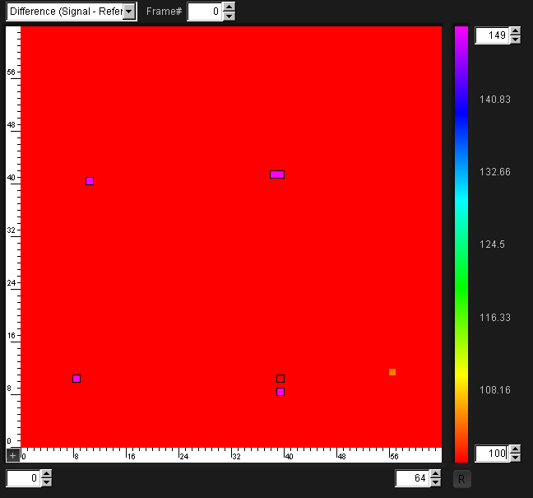
Drift vs diffusion – influence on cluster size
Measurement on LePIX prototypes (50x50 micron pixels !)
0 Volts bias
60 Volts bias
Diffusion: at zero bias, incident protons generate on average clusters of more than 30 50x50 micron pixels.
Drift: for significant reverse bias (60V) cluster reduced to a few pixels only

Slide 9
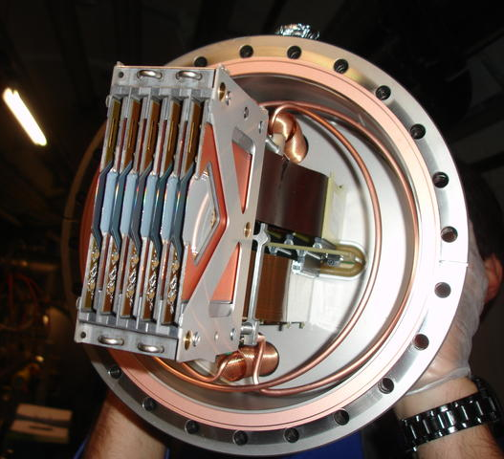
Low power is key to low mass
Services: cables, power suppliers, cooling etc… represent signficant effort and fraction of the total budget
Subject to severe spatial constraints, limit for future upgrades
Power often consumed at CMOS voltages, so kWs mean kAs
                Even if power for detector is low, voltage drop in the cables has to be minimized: example analog supply one TOTEM Roman Pot:
                ~ 6A @ 2.5 V
                ~100m 2x16mm² cable: 0.1 ohm or 0.6 V drop one way
                26kg of Copper for ~ 15 W
W. Snoeys – Legnaro, April 2013

Slide 10
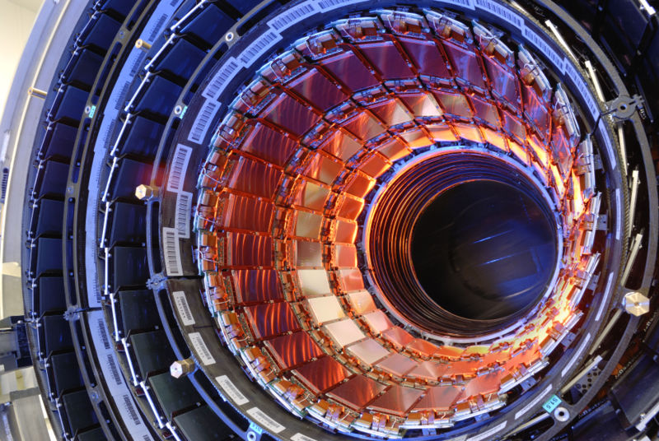
The CMS tracker before dressing…

Slide 11
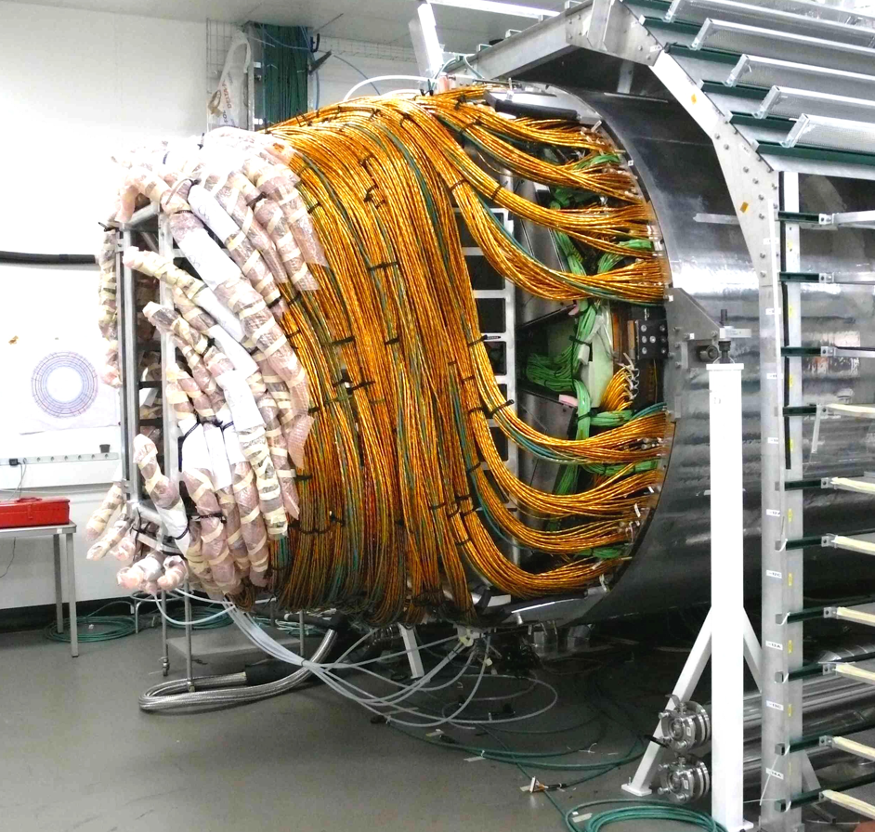
… and after
33 kW in the detector and… 62 kW in the cables !
11

Slide 12
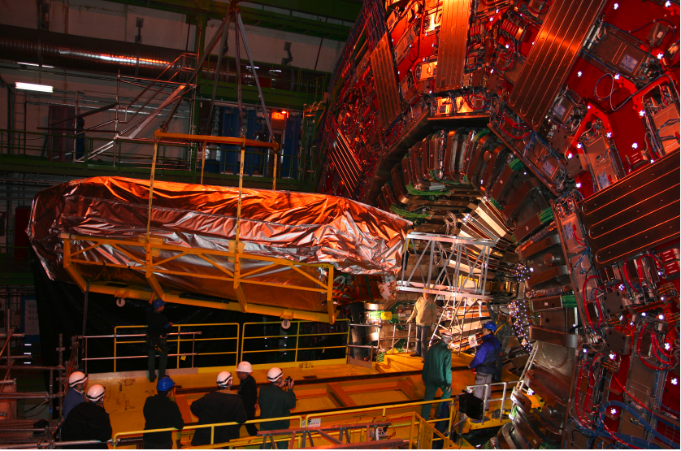
12

Slide 13
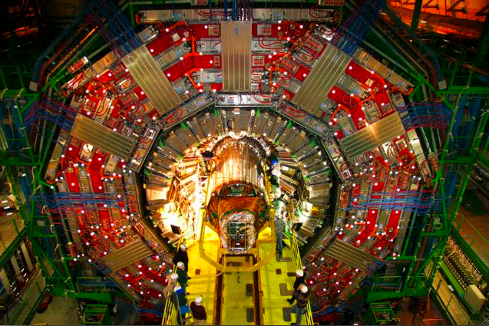
… and after
13

Slide 14
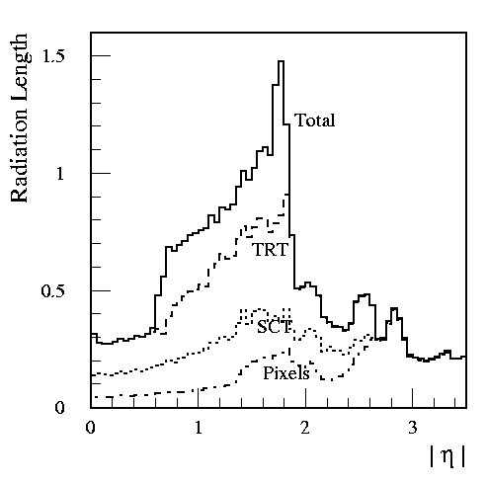
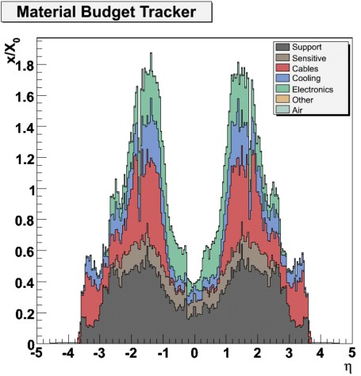
Tracker power and material budget
ATLAS
CMS
W. Snoeys – Legnaro, April 2013

Slide 15
Low power is key for low mass
Now ~ 20mW/cm² for silicon trackers and > 200 mW/cm² for pixels
Cannot increase this by much, but upgrades consider more luminosity & functionality (trigger…), so more for less or equal power.
  Lower analog power: see next slides
  Lower digital power: look for new architectures (example next slide)
  Lower power for data transmission: may well be ultimate limit
  Lower detector power after radiation damage cannot exploit 300 microns thick depletion : after heavy fluence (except 3D detectors).
Would like to improve assembly/integration, need to profit from industry’s automation
What next ?
W. Snoeys – Legnaro, April 2013

Slide 16
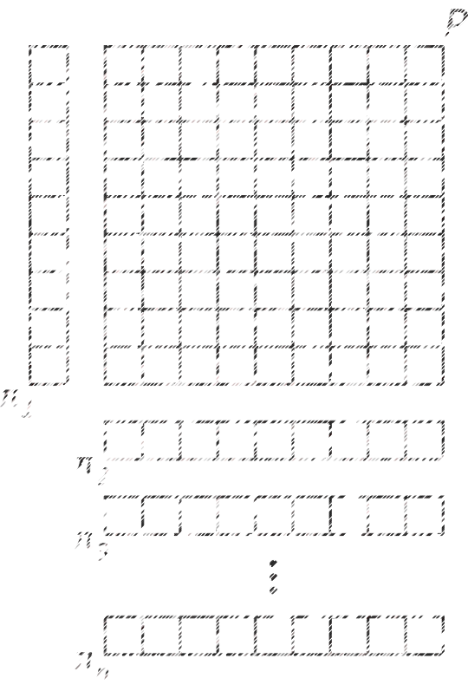
Architecture example: reduce number of signals
Orthopix n-maps orthogonal static sparsification
Encoding
Decoding
Purity
X
X
(x₁,y₁)
(x₂,y₂)
…
(x_{p},y_{p})
(x_{p+1},y_{p+1})
(x_{r},y_{r})
…
(x_{n},y_{n})
X
O
X
X
Minimize ambiguity introducing orthogonal projections
For 4 projections reduction from N² to 4N

Slide 17
Analog Power Consumption:
Noise sources in a FET
EQUIVALENT WITH :
di_{eq}²
di_{eq}² = g_{m}²dv_{eq}²
WHERE:
In weak inversion (WI): g_{m} ~ I
dv_{eq}² = (K_{F} /(WLCox²f^{α})+ 2kTn/g_{m})df
In strong inversion (SI) g_{m} ~ √I
dv_{eq}² = (K_{F} /(WLCox²f^{α})+ 4kTγ/g_{m})df
Transconductance gm related to power consumption
W. Snoeys – Legnaro, April 2013

Slide 18
Noise sources in a FET (2)
PMOS
NMOS
Note : Radiation tolerance (0.25 μm CMOS) !
Deeper submicron generally even more rad tolerant
W. Snoeys – Legnaro, April 2013

Slide 19

Signal-to-noise, charge over input capacitance ratio and
analog power consumption for MOS input transistor
or
For constant S/N:
Analog power is very strongly dependent on Q/C
Want SMALL electrode for low C
m = 2 for weak inversion up to 4 for strong inversion
W. Snoeys – Legnaro, April 2013

Slide 20
HIGH Q/C FOR LOW POWER
Transistor noise ≈ 0.16 mV at 40 MHz BW for 1 uA
(1uA/100x100 um pixel = 10 mW/sq cm)
n+
-
+
-
+
-
+
-
+
Collection depth
300 μm
30 μm
3 μm
-
+
-
+
Monolithic
-
+
-
+
doubling Q/C allows
(at least) 4x power reduction for same S/N
-
+
-
+
p=
-
+
+
-
Q/C = 50mV (0.25fC/5fF=50mV) can be achieved
(e.g. for 20 um collection depth and 5fF)
but need collection by drift
Much better than that would almost be a ‘digital’ signal
V=
W. Snoeys – Legnaro, April 2013

Slide 21
What is a ‘digital signal’ ?
The Boltzmann tyranny
Vgs
Ion
Exp( )
nkT/q
Strong
inversion
Weak
inversion
Ioff
Weak inversion slope ~ 60 mV/decade, Ion/Ioff=10⁴ => 250 mV
Need this on a single pixel !!
W. Snoeys – Legnaro, April 2013

Slide 22
Standard charge sensitive pulse processing front end
(no integration over a fixed time)
RESET
Pulse
Processing
OTA
H(s)
Charge Sensitive
Amplifier
Shaper
ENC: total integrated noise at the output of the pulse shaper with respect to the output signal which would be produced by an input signal of 1 electron. The units normally used are rms electrons.
RESET: switch or high valve resistive element
W. Snoeys – Legnaro, April 2013

Slide 23
ANALOG POWER
‘standard’ front end noise equations
Transconductance gm related to power consumption
thermal
1/fnoise
shot noise
Ref.: Z.Y. Chang and W.M.C. Sansen : ISBN 0-7923-9096-2, Kluwer Academic Publishers, 1991
W. Snoeys – Legnaro, April 2013

Slide 24
Influence of shaper order n
Ref.: Z.Y. Chang and W.M.C. Sansen : ISBN 0-7923-9096-2, Kluwer Academic Publishers, 1991
Ref. 2 : V. Radeka “Low-noise techniques in detectors” Ann. Rev. Nucl. Sci. 1988, 38, 217-77
Ref. 3 : E. Nygard et al. NIM A 301 (1991) 506-516
W. Snoeys – Legnaro, April 2013

Slide 25
Note: for longer integration times
rolling shutter architectures, etc…
Noise often leakage current dominated (shot noise), but significant progress (4T cells, leakage reduction…)
Impressive noise numbers (ENCs of a few electrons down to even subelectron ENC using multiple sampling of reset and signal level.
For high energy physics longer integration not always applicable, also investigating different architectures for lower power
W. Snoeys – Legnaro, April 2013

Slide 26
High Q/C yields DEVICE DESIGN challenge
uniform depletion layer with a small collection electrode
Collection electrode
High energy particle
Collection electrode
High energy particle
A uniform depletion layer for uniform response: larger pixels more difficult
Optimal geometry and segmentation of the read-out electrode (minimum C)
Effective charge resetting scheme robust over a large range of leakage currents
Pattern density rules in very deep submicron technologies very restrictive.
Insulation of the low-voltage transistors from the high voltage substrate.
Sensor needs to be designed in close contact with the foundry!
W. Snoeys – Legnaro, April 2013

Slide 27
DEVICE DESIGN challenge
Collect only on collection electrode, not elsewhere
Pwell
Collection Electr
Nwell collection electrode
Pwell
With circuitry
Nwell collection electrode
Nwell with circuitry
Psubstrate
Psubstrate
Psubstrate
Back side N diffusion
Additional N-diffusion will collect and cause loss of signal charge
→ Need wells to shield circuitry and guide charge to the collection electrode for full efficiency
Wells with junction on the front
Uniform depletion with small Nwell and large Pwell difficult
Large fields or important diffusion component (MAPS)
Wells with junction on the back. Need full depletion
W. Snoeys – Legnaro, April 2013

Slide 28
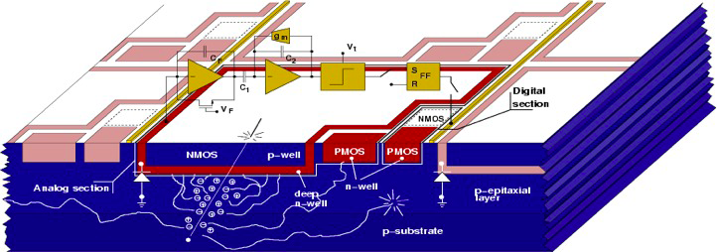
No shielding well
Nwell collection electrode
Psubstrate
G. Vanstraelen (NIMA305, pp. 541-548, 1991)
V. Re et al., superB development: Nwell containing PMOS transistors not shielded
Nwell much deeper than rest of circuit to limit inefficiency
W. Snoeys – Legnaro, April 2013

Slide 29
Nwell collection electrode surrounded by Pwell containing circuitry
Pwell
With circuitry
Nwell collection electrode
Psubstrate
Uniform depletion with small Nwell and large Pwell difficult
Large fields or important diffusion component (cfr MAPs)
  MAPS (NMOS only) or Quadruple well technologies: INMAPS for full CMOS in-pixel
Cfr: Alice ITS upgrade, see also M. Winter’s presentation, also here positive influence of reverse substrate bias
Nwell Collection Electrode
Pwell
Nwell
Pwell
Nwell
Deep Pwell
P-epitaxial layer
P-substrate
W. Snoeys – Legnaro, April 2013

Slide 30
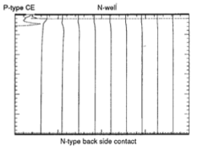
USE OF A WELL with BACK SIDE JUNCTION
Example of device design and simulation
P-type collection electrode covers 1/10 of the width.
Full depletion required (otherwise short between the collection electrodes)
At zero well bias and full depletion punchthrough between Nwell and N-diffusion on the back
W. Snoeys – Legnaro, April 2013

Slide 31
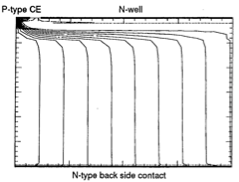
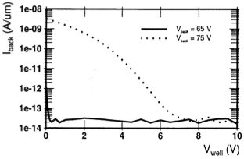
USE OF A WELL with BACK SIDE JUNCTION
Example of device design and simulation
A few volts on the well (with 65 V on the back) diverts all flow lines to the collection electrode because a potential barrier is formed underneath the well.
The back side to Nwell current drops by orders of magnitude as the punchthrough is eliminated.
W. Snoeys – Legnaro, April 2013

Slide 32
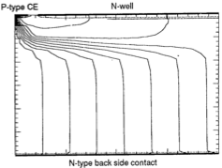
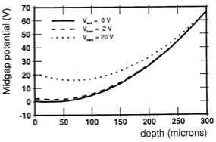
USE OF A WELL with BACK SIDE JUNCTION
Example of device design and simulation
Increasing the well bias increases the potential barrier and moves the potential valley deeper into the substrate
W. Snoeys – Legnaro, April 2013

Slide 33
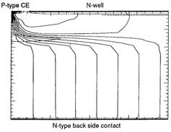
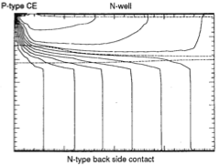
USE OF A WELL with BACK SIDE JUNCTION
Example of device design and simulation
Increasing the well bias increases the potential barrier and moves the potential valley deeper into the substrate
W. Snoeys – Legnaro, April 2013

Slide 34
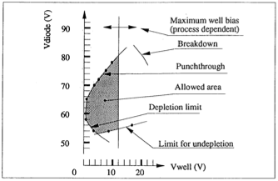
USE OF A WELL with BACK SIDE JUNCTION
Example of device design and simulation
Operational limits
W. Snoeys – Legnaro, April 2013

Slide 35
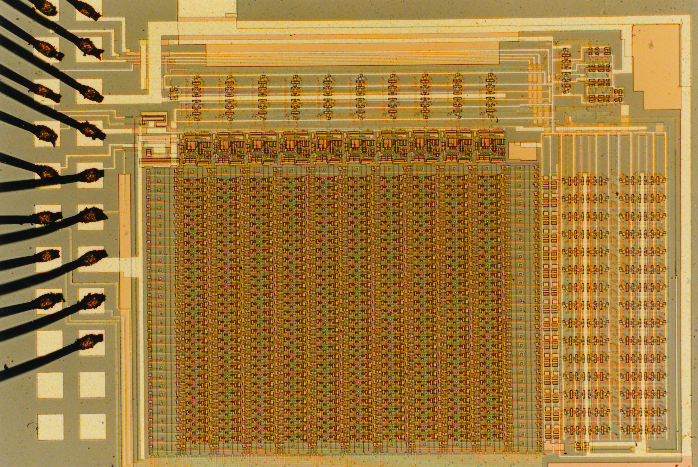
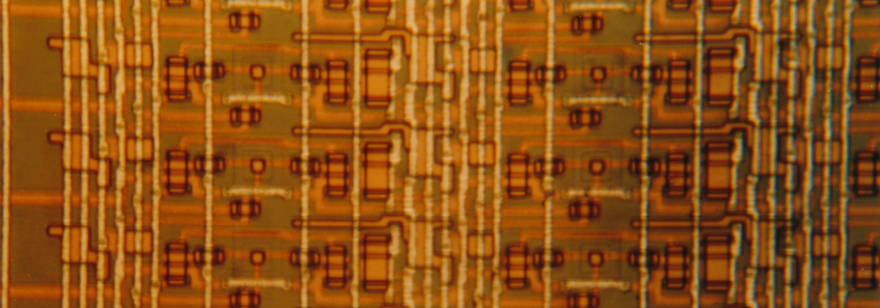
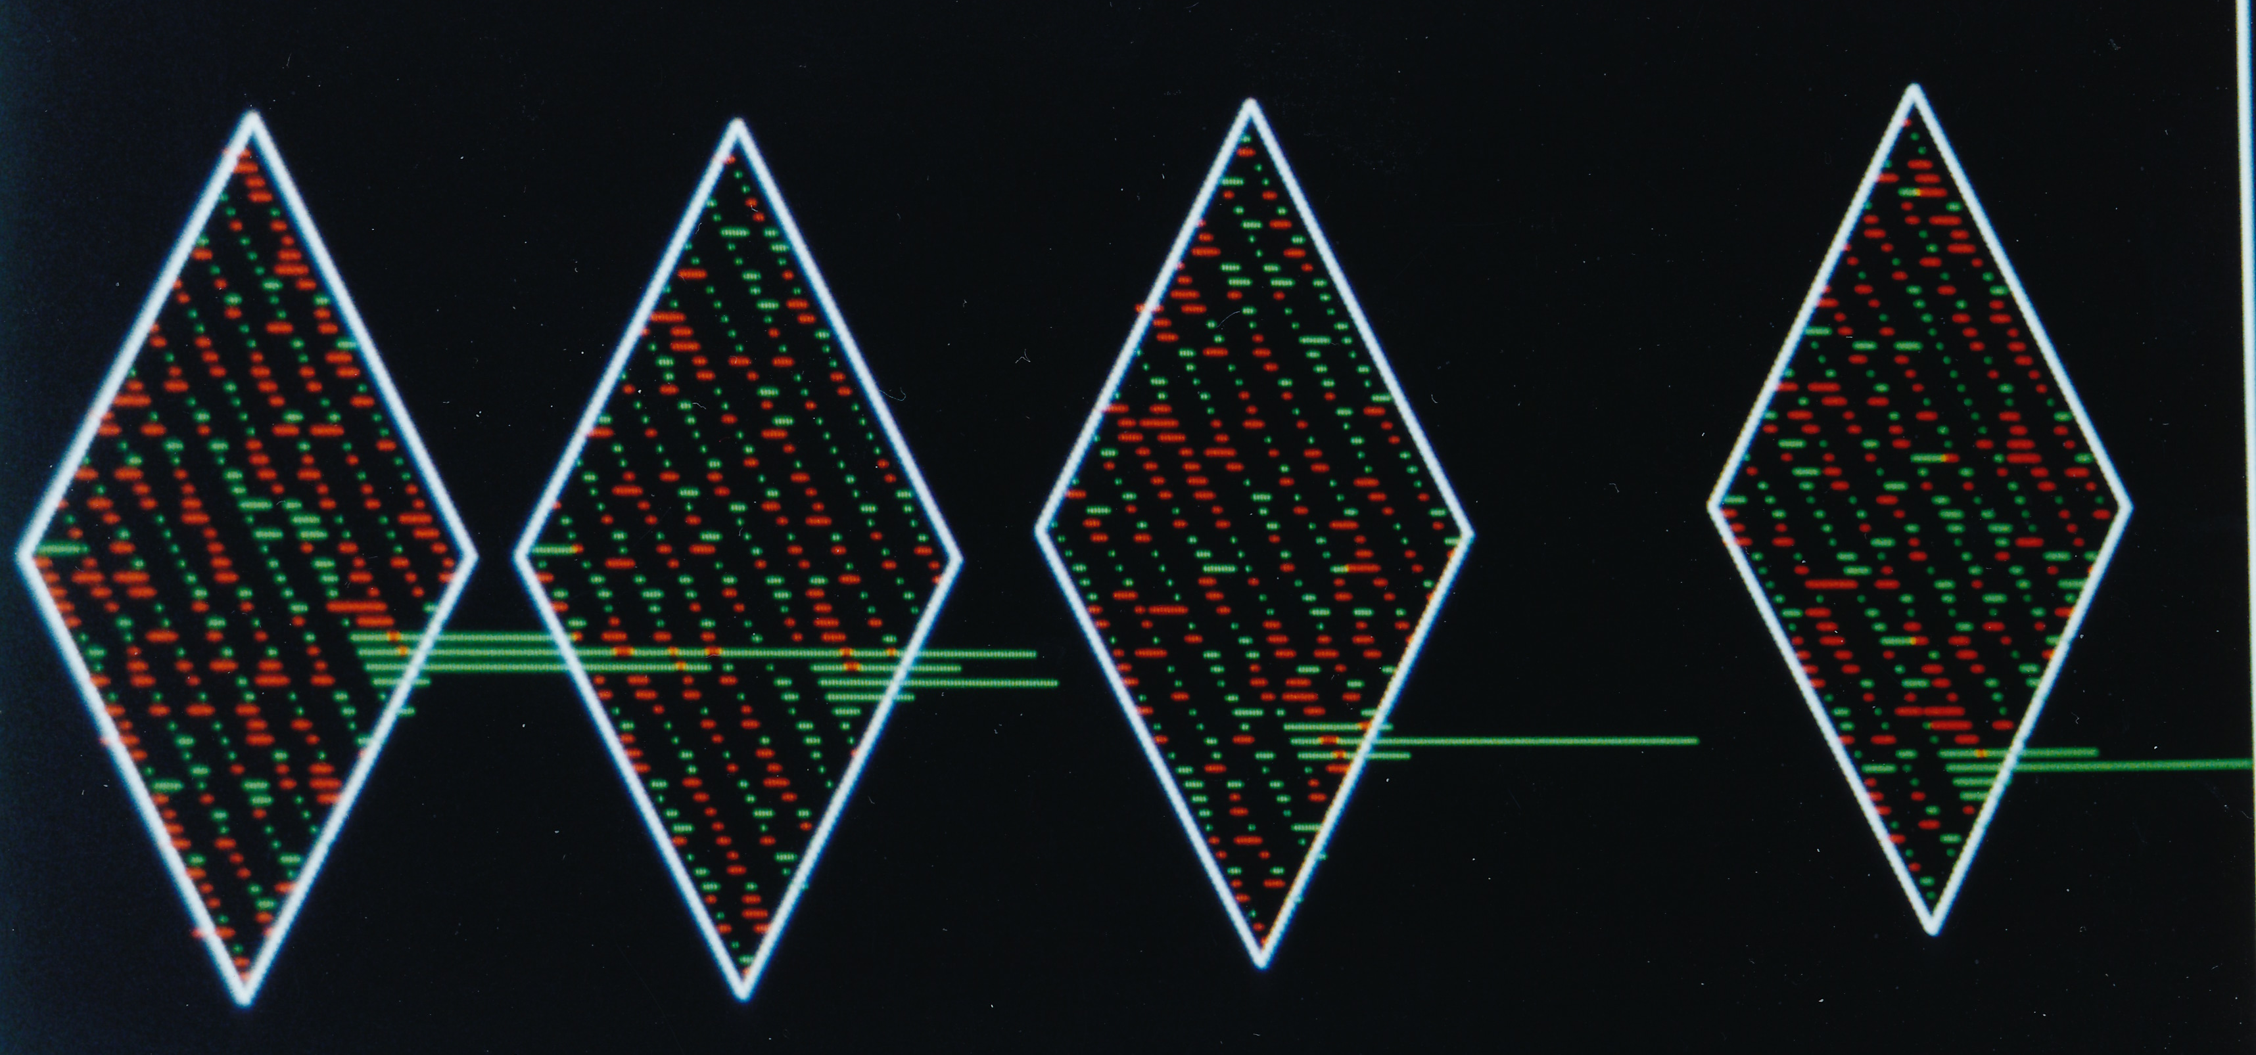
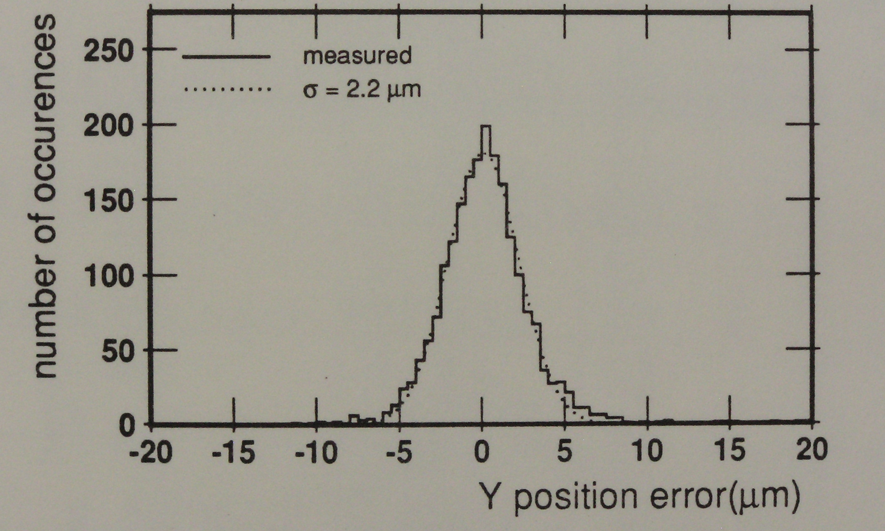
WELL & BACK SIDE JUNCTION (34x125 μm pixel)
Need full depletion, works well
but double-sided process difficult
Nwell with circuitry
Psubstrate
Back side N diffusion
C=26fF P-type 1E12 cm³

Slide 36
ALTERNATIVE: ALL CIRCUITRY IN COLLECTION ELECTRODE
CIRCUIT DESIGN challenge: minimize in-pixel circuit for low C
NMOS in Pwell
PMOS in Nwell
Pwell
Nwell collection electrode
P-substrate
Would like small collection electrode for minimum capacitance (C)
In-pixel circuitry placed in the Nwell collection electrode prevents loss of signal charge, but:
    Higher input capacitance, unless in-pixel circuit very simple
      special architectures (see P. Giubilato & Y. Ono, pixel 2012, Japan)
      ‘rolling shutter’ or frame readout as in MAPS
      hybridization and use it as smart detector (see next slide & presentation) in hybrid configuration
    Risk of coupling circuit signals into input
W. Snoeys – Legnaro, April 2013

Slide 37
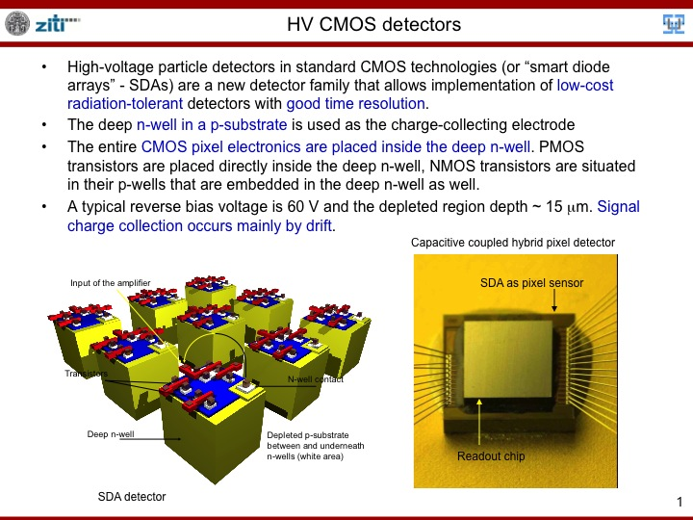
I. Peric et al.
HEIDELBERG SLIDE 1
Radiation tolerance !

Slide 38
LePIX: 90 nm CMOS on high resistivity
One cell
Readout
Biasing diode
Peripheral readout circuit embedded in Nwell and also surrounded by the guard ring
P+
P+
N+
P+
Pixel cells with Nwell diffusion
N well
Collection electrode
Guard ring structure
D
-V
Edge of depletion layer
Substrate contact
Minimize size
D
Edge of depletion layer
P- substrate.
P- substrate
Try to maximize Q/C: small collection electrode, and high resistivity substrate of several 100 Ωcm, 40 microns depletion for ~40 V, 90nm CMOS
-V
W. Snoeys – Legnaro, April 2013

Slide 39
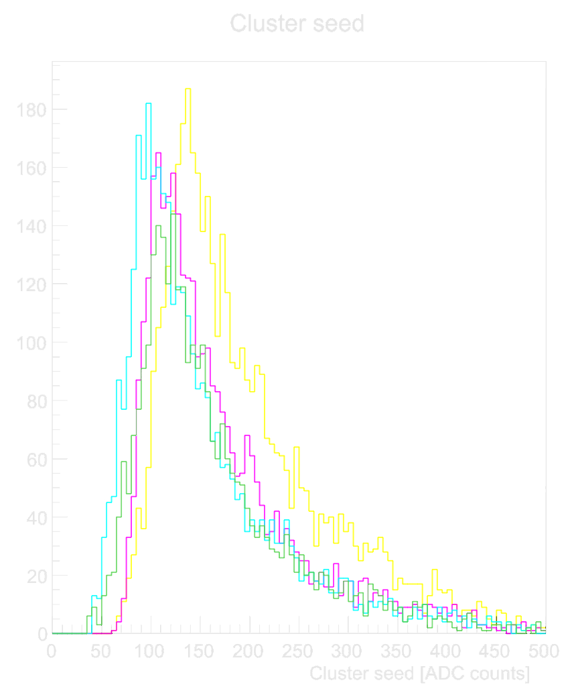
LePIX: 90 nm CMOS on high resistivity
(cfr P. Giubilato et al, Pixel 2012, Japan)
Counts [-]
Cluster peak [ADC counts]
LePIX: 300 GeV pions at SPS
W. Snoeys – Legnaro, April 2013

Slide 40
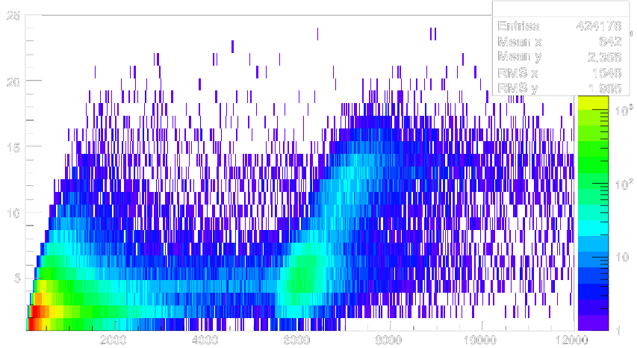
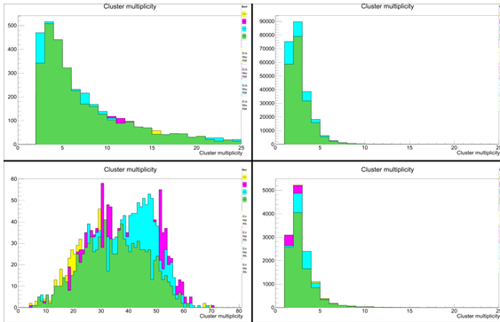
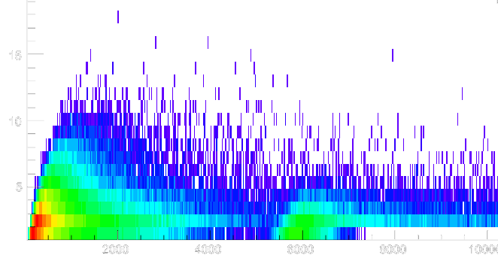
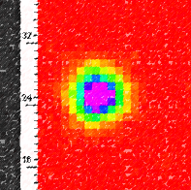
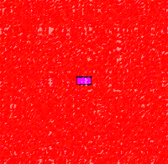
LePIX: 90 nm CMOS on high resistivity
Influence of back bias
Low bias (20V)
p Landau tail
π
π
Cluster multiplicity [pxls]
p
High bias (60V)
π
p
p
Cluster mass [ADC counts]
p Landau tail
LePIX with 300 MeV pions and protons at PSI cyclotron
W. Snoeys – Legnaro, April 2013

Slide 41
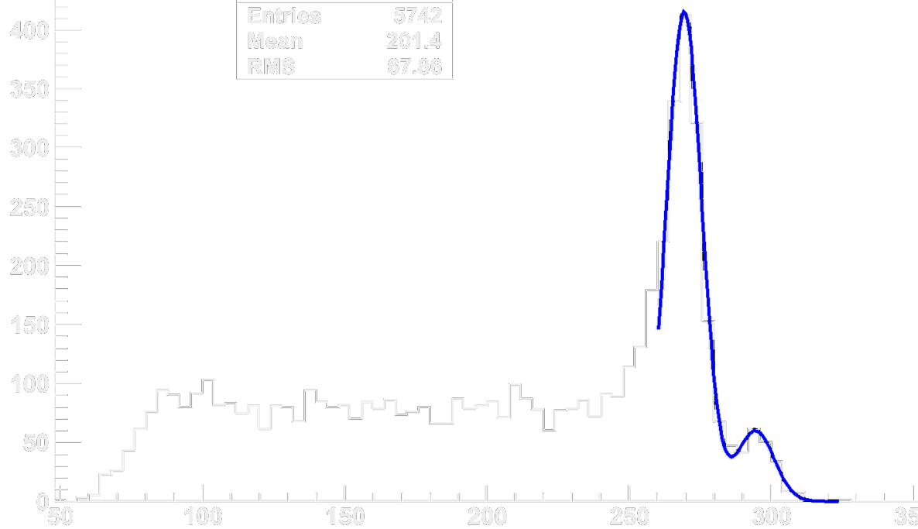
LePIX: 90 nm CMOS on high resistivity
(cfr P. Giubilato et al, Pixel 2012, Japan)
Small peak (6.49 keV)
m: 6.45 keV (294 ADC)
σ: 143 eV (6.5 ADC)
Counts [-]
Calibration peak (5.9 keV)
m: 5.90 keV (269 ADC)
σ: 136 eV (6.2 ADC)
ADC counts [-]
LePIX with 55Fe source at room temperature
W. Snoeys – Legnaro, April 2013

Slide 42
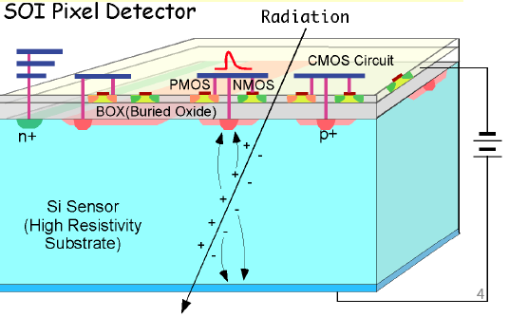
Silicon on Insulator (SOI)
Y. Arai et al
Very impressive technology development … offers good Q/C
BOX causes reduced radiation tolerance, double BOX likely to improve this.
W. Snoeys – Legnaro, April 2013

Slide 43
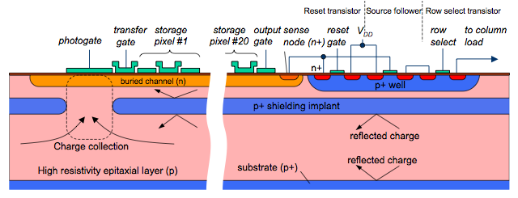
CHARGE COUPLED DEVICES (CCD)
  Signal charge is collected in potential well under a gate and then transferred from one location to the next => serial readout needing large drive currents for large area devices
  Increase speed ColumnParallelCCD (CPCCD) Readout per column in parallel
  Interesting development (figure above LCFI collaboration): In Situ Storage Sensor: store hits and read out during quiet periods, need special technology (combination of CCD and CMOS)
W. Snoeys – Legnaro, April 2013

Slide 44
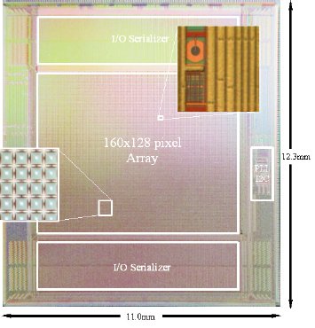
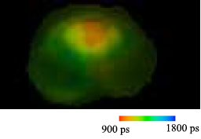
Silicon Avalanche Photo Diodes
  Single photon avalanche diodes (SPAD)
  E. Charbon et al ISSCC 2011
  Large and fast signals, radiation tolerance to be investigated further
  TOTEM experiment is looking at avalanche photodiodes as one of the possibilities to try to reach 10 picoseconds in its Roman Pots
  One nice development by Sebastian White et al.(separate APD matrix)
W. Snoeys – Legnaro, April 2013

Slide 45
just a few remarks: PROCESSING
CMOS standard processing now on 200 or 300 mm diameter wafers
Processing very high resistivity silicon has some particularities:
High resistivity (detector grade) to be found at larger diameter
Float-zone silicon has many less impurities/defects than Czochralski. These defects pin down dislocations, rendering the material more robust. Float-zone material is MUCH MORE FRAGILE
Several process steps can introduce impurities increasing detector leakage
  Work at higher leakage current (often quickly dominated by radiation induced leakage anyway)
  Try to make certain steps cleaner
  Use gettering techniques, which during processing render defects more mobile and provide traps for these where they are no longer harmful.
More technologies interesting for particle detectors become available
also with high resistivity epitaxial layers
3D assembly might provide ‘holy grail’ of monolithic
significant progress recently(eg SOI development, quadruple well technology)
W. Snoeys – Legnaro, April 2013

Slide 46
MONOLITHIC DETECTORS
Clearly have transformed the world of photography and imaging in general
Very significant progress even recently, eg subelectron noise by multiple correlated sampling (eg. S. Kawahito, pixel2012).
Presented noise performance, the possibility to simulate and design the device, different approaches for the device, the influence of reverse bias on radiation tolerance and cluster size
In High Energy Physics:
  Already adopted for two experiments (Belle-II and STAR)
  Main option for ITS upgrade in Alice using quadruple well technology, less stringent requirements for radiation tolerance and speed, but high occupancy numbers
  A possible option in CMS, in Atlas HV CMOS also considered for use as a smart sensor
W. Snoeys – Legnaro, April 2013

Slide 47
MONOLITHIC DETECTORS for HEP
More processes interesting for high energy physics become available
Power consumption: Approaching digital signal from particle hit => ultimately eliminate analog power
  Need sufficient and uniform depletion/collection depth and small collection electrode for sufficient Q/C
  Need appropriate architecture to match or improve present day power consumption (Pixels ~200 mW/cm²,trackers ~20 mW/cm²). Clock distribution to every pixel will eat significant fraction of the total power budget
  Need to reduce power to transmit the data off-chip, may well be ultimate limit.
Radiation tolerance very challenging for inner layers but promising results with HV CMOS
Not ready at the time of LHC detector construction, but might get there for some of the upgrades.
W. Snoeys – Legnaro, April 2013

Slide 48
Thank You !
W. Snoeys – Legnaro, April 2013

