Slide 1



Front-end electronics
for silicon trackers
Valerio Re
Università di Bergamo
Dipartimento di Ingegneria
INFN
Sezione di Pavia

Slide 2

Outline
Processing of signals from semiconductor detectors: general concepts (amplification, shaping) and electronic noise
Discussion of fundamental design parameters of front-end electronics for silicon trackers: signal-to-noise ratio, speed, power dissipation, radiation hardness,…
Architecture of mixed-signal integrated circuits for the readout of silicon pixel and strip detectors for tracking and vertexing in high energy physics experiments

Slide 3
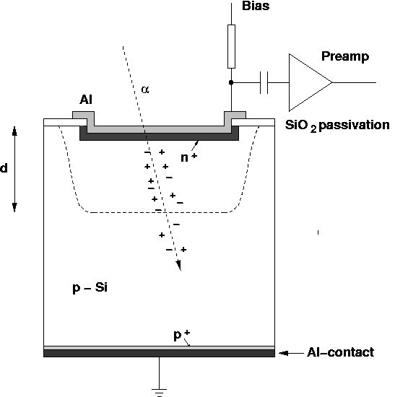
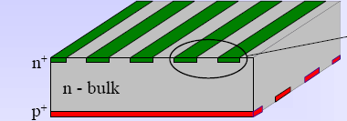
From a single semiconductor sensor…
Ionization sensor converts the energy deposited by a particle to an electrical signal. In a fully-depleted semiconductor sensor, electron-hole pairs are swept to electrodes by an electric field, inducing an electrical current.
Position-sensitive detector:
Information about the coordinates of the interaction point in a segmented region (presence of a hit, amplitude measurement, timing)
(single-sided or double-sided strip detector, pixel sensors)
Particle track

Slide 4
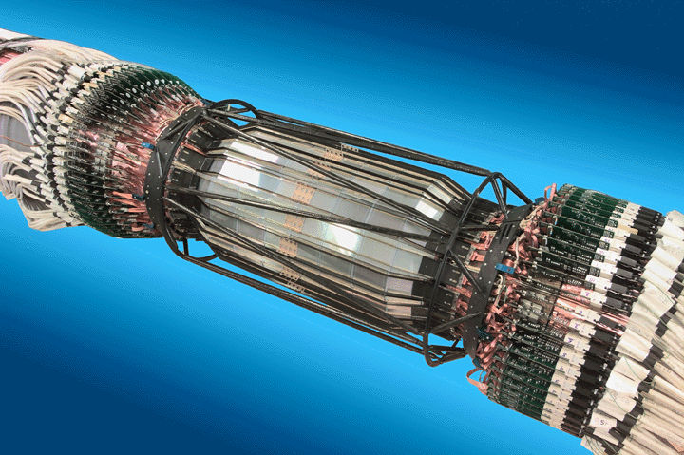
…… to a full silicon tracker
Multiple layers of segmented detectors (pixel, strips) provide space points to reconstruct particle trajectories
20 cm
30 cm
40 cm
BaBar Silicon Vertex Tracker at the Stanford Linear Accelerator Center, 1999-2008: CP violation in B meson decay

Slide 5
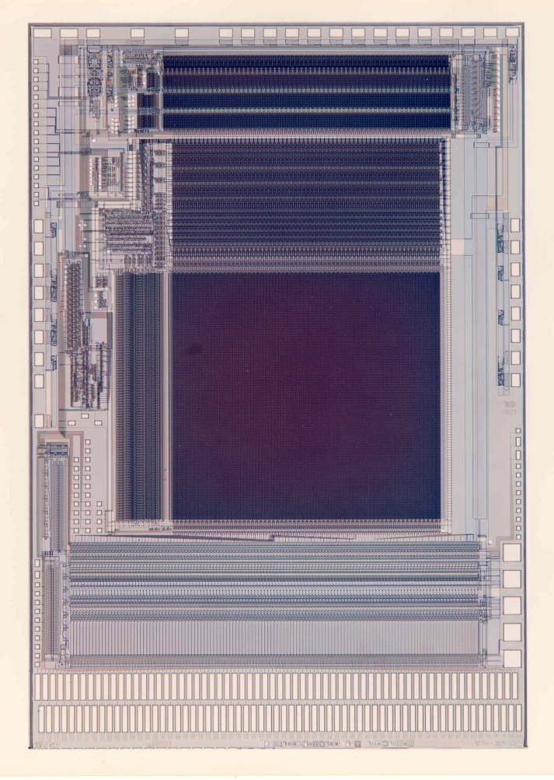
Readout electronics
Silicon strip detectors need miniaturization of front-end electronics
They were the driving force for the development of integrated circuits for these applications
This is a mixed-signal chip, with 128-channel analog processing, A/D conversion, data storage and serial data transmission.
The AToM chip was fabricated in Honeywell rad-hard 0.8 μm CMOS (300k transistors) for the readout of the BaBar SVT (1998).

Slide 6
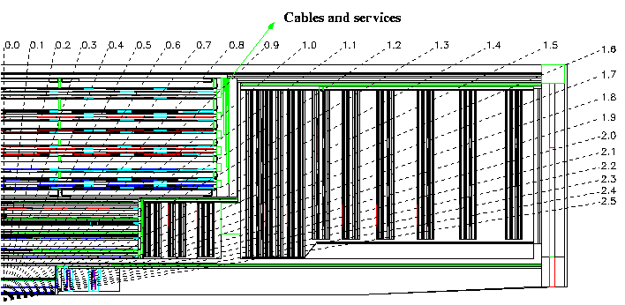
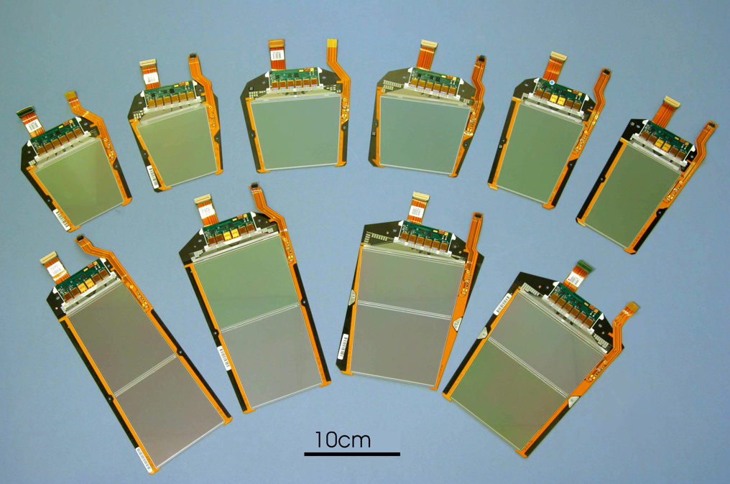
Current CMS Tracker system
Two main sub-systems: Silicon Strip Tracker and Pixels
  pixels quickly removable for beam-pipe bake-out or replacement
Microstrip tracker | Pixels
~210 m² of silicon, 9.3M channels | ~1 m² of silicon, 66M channels
73k APV25s, 38k optical links, 440 FEDs | 16k ROCs (CMOS 250 nm, 2k olinks, 40 FEDs
27 module types | 8 module types
~34kW | ~3.6kW (post-rad)
Geoff Hall,
TIPP09
TOB
TOB
TEC
TEC
TIB
TIB
TID
TID
PD
PD

Slide 7
Hybrid pixel sensors

Slide 8
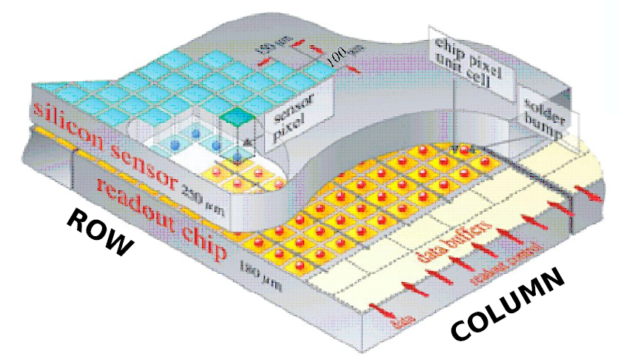
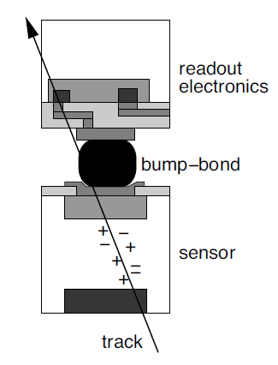
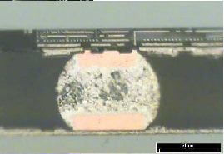
A mature technology: hybrid pixel sensors
A pixellated sensor chip is connected to a matching readout chip by an array of solder bumps
Sensors
  Particle sensitive volume is a high resistivity silicon bulk (1-10 kΩcm, 250 μm typical thickness, thinner for higher radiation hardness and less material), can be fully depleted for fast charge collection by drift
  Typical pixel dimensions at LHC: 50 μm × 400 μm (will decrease for HL_LHC)
  Radiation-hard to 50 Mrad (hundreds of Mrad for HL_LHC)
Front-end chips (Deep submicron CMOS)
  For any event (particle hit in the sensor) provide pixel position, timing, pulse amplitude
  Only a small number of pixels are hit in any event
  Analog pre-amplification, discrimination, time stamping, digitization, zero suppression (sparsification)…

Slide 9
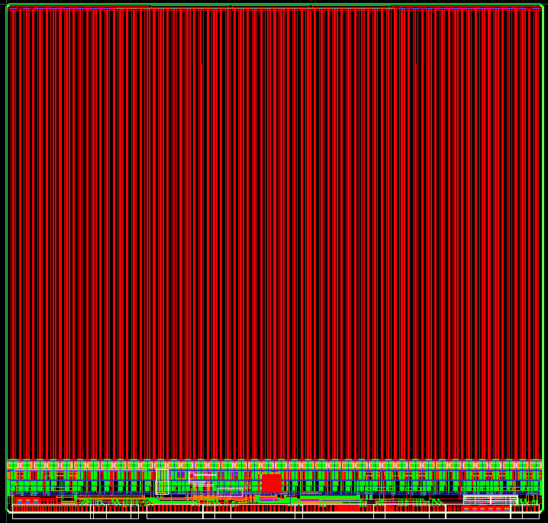
FE-I4 readout chip for pixel sensors in ATLAS IBL
20.2 mm
Test pads
(from Marlon Barbero, “FE-I4 chip development for upgraded ATLAS pixel detector at LHC”, PIXEL 2010 workshop)
CMOS 130 nm mixed-signal chip
Digital readout of hit pixels with analog information (signal amplitude) and time stamp
Store hits locally in region until L1T.
336×80 pixel array
16.8 mm
Periphery
2 mm
IO pads

Slide 10
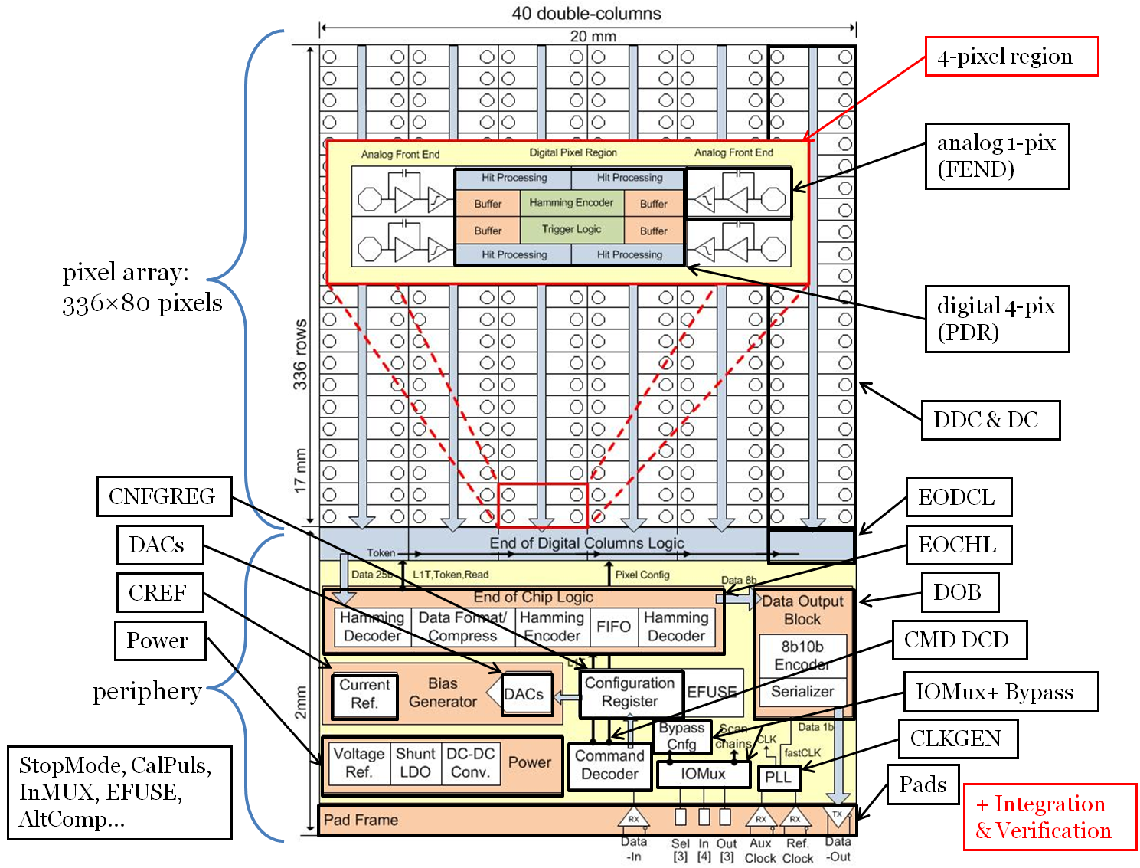
FE-I4 readout chip for pixel sensors in ATLAS IBL

Slide 11
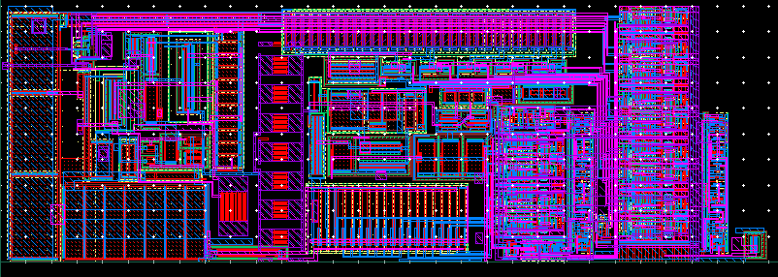
FE-I4 readout chip for pixel sensors in ATLAS IBL: the analog pixel cell
TDAC
Amp2
50 μm
discri
Preamp
FDAC
Config Logic
150 μm

Slide 12
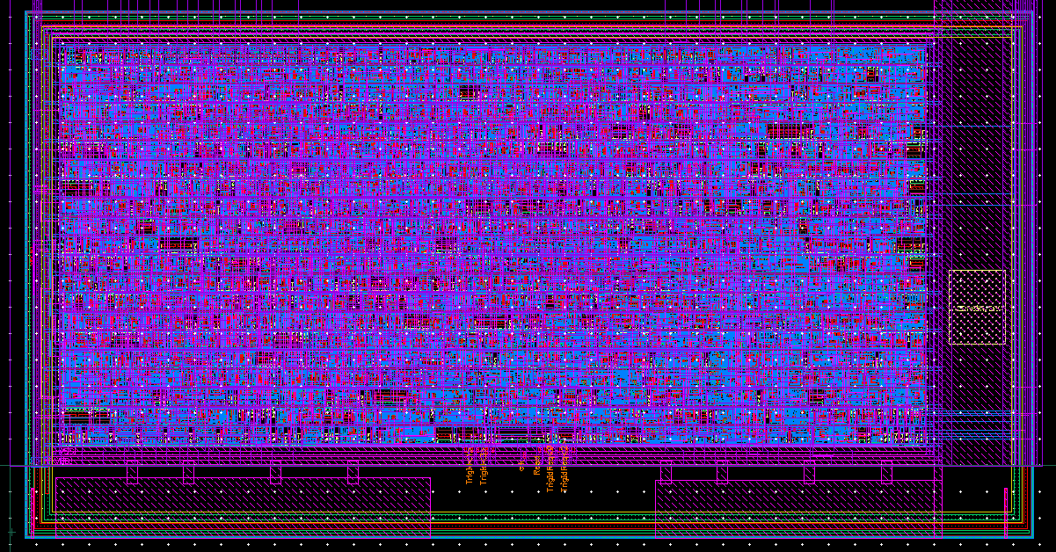
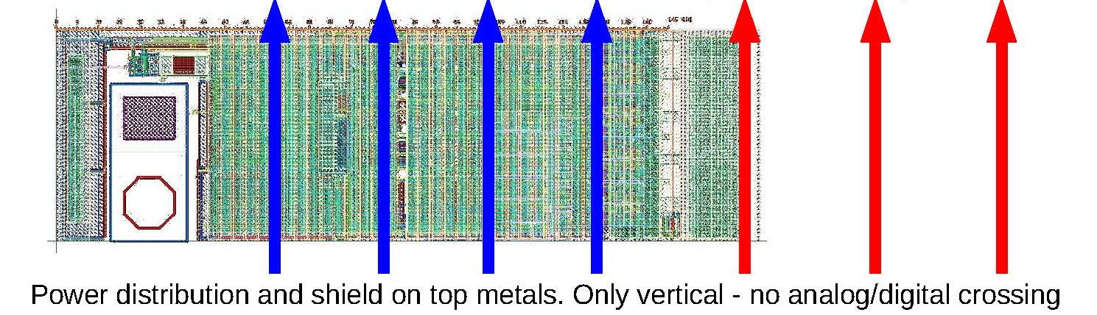
FE-I4 pixel cell layout
250 μm
TDAC
Amp2
synthezised digital region (1/4th )
50 μm
discri
Preamp
FDAC
Config Logic

Slide 13
Analog front-end design
for detector charge measurements
Radiation detectors
A measure of the information appears in the form of an electric charge, induced on a set of two electrodes, for which ultimately only one parameter (capacitance) is important.
Front-end electronics
amplifying device
    (charge-sensitive preamplifier)
filtering, signal shaping
    optimize the measurement of a desired quantity such as signal amplitude as a measure of the energy loss of the particle

Slide 14
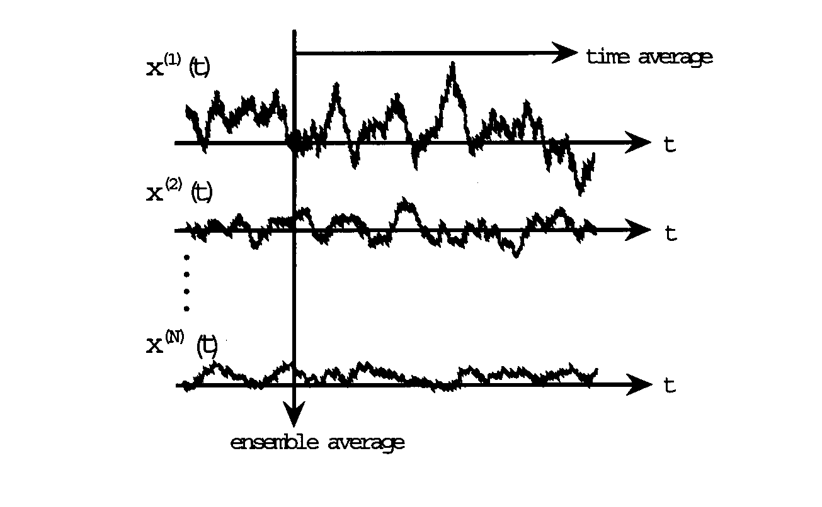
Effect of electronic noise on charge measurements
        Inherent to the conduction of current in an amplifying device is a random component, depending on the principle of operation of the device.
        This random component (noise) associated with amplification gives an uncertainty in the measurement of the charge delivered by the detector or of other parameters such as the position of particle incidence on the detector.
        Compromises must be made in very large and complex detector systems such as modern silicon trackers.

Slide 15
Statement of the problem of front-end electronics
Measurement of a charge delivered by a capacitive source with the best possible accuracy compatible with noise intrinsically present in the amplifying system, and with the constraints set by the different applications.
(noise - power - speed)
The discussion of design of front-end electronics will be based on the nuclear electronics noise theory.
(basic equations recalled for discussion purposes)

Slide 16
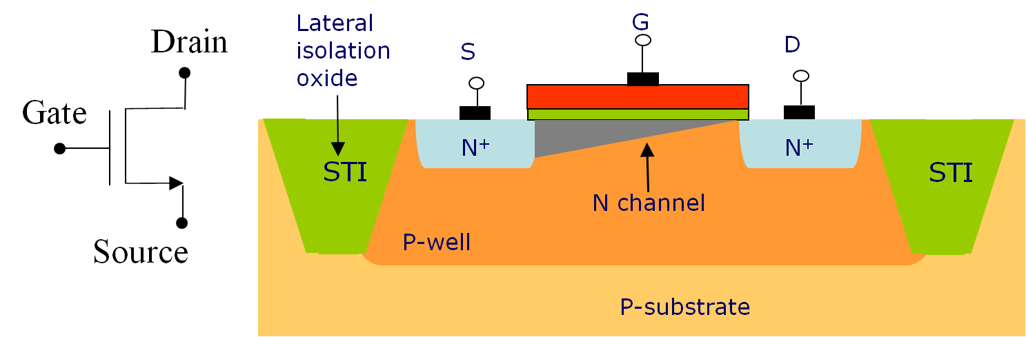
Basic element of modern electronics: the MOSFET
Three-terminal device: an electrode controls the current flow between two electrodes at the end of a conductive channel.
The transconductance g_{m} = dI_{D}/dV_{GS} is the ratio of change in the output (drain) current and of the change in the potential of the control (gate) electrode

Slide 17
MOSFET essential parameters: the transconductance g_{m}
Under reasonable power dissipation constraints, devices in deep submicron CMOS operate in the weak inversion region
Typical operating point in low-power pixel sensor readout
In weak inversion:
(n =1.2 in 100-nm scale CMOS)

Slide 18
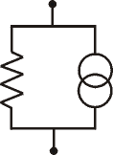
MOSFET essential parameters: channel thermal noise
Thermal noise arises from random velocity fluctuation of charge carriers due to thermal excitation. The spectral density (noise power per unit frequency bandwidth) is white, i.e. frequency independent. In a resistor, this can be modelled in terms of a fluctuating voltage across the resistor, or of a fluctuating current through the resistor.
The channel of a MOSFET can be treated as a variable conductance. Thermal noise is generated by random fluctuations of charge carriers in the channel and can be expressed in terms of the transconductance g_{m}.

Slide 19
MOSFET essential parameters: channel thermal noise
Thermal noise in a MOSFET can be represented by a current generator in parallel to the device, or by a voltage generator in series with the gate (fluctuation of the drain current can be seen as due to fluctuations of the gate voltage).
e_{n}
i_{n}
k = Boltzmann’s constant, T = absolute temperature
Γ = coefficient (≅ 1) dependent on device operating region, short channel effects…

Slide 20
Acquiring the signal from the sensor: the charge-sensitive preamplifier
The detector signal is a current pulse i(t) of short duration
The physical quantity of interest is the deposited energy, so one has to integrate the sensor signal
i(t)
C_{D}
The detector capacitance C_{D} is dependent on geometry (e.g. strip length or pixel size), biasing conditions (full or partial depletion), aging (irradiation)
Use an integrating preamplifier (charge-sensitive preamplifier), so that charge sensitivity (“gain”) is independent of sensor parameters

Slide 21
Acquiring the signal from the sensor: the charge-sensitive preamplifier
Circuit for charge restoration on the feedback capacitor
Q/C_{f}
C_{F}
0
_
This guarantees a return to baseline of the preamplifier output, avoiding saturation.
It can be achieved with a resistor R_{F} or, in an integrated circuit, with a CMOS circuit (transconductor).
Compensation of detector leakage current can also be performed in the preamplifier feedback (dc coupling)
Q i(t)
C_{D}

Slide 22
Acquiring the signal from the sensor: the charge-sensitive preamplifier
R_{F}
g_{m}
C_{F}
_
Q i(t)
C_{D}

Slide 23
Forward gain stage: CMOS version
The forward gain stage is an inverting amplifier which can be based on the common source configuration
_
G
D
g_{m} v_{GS}
r_{DS}
R
V_{DD}
S
R
v_{out}
v_{in}
r_{DS} ÷ (I_{D})⁻¹
r_{DS} ÷ L (device gate length)

Slide 24
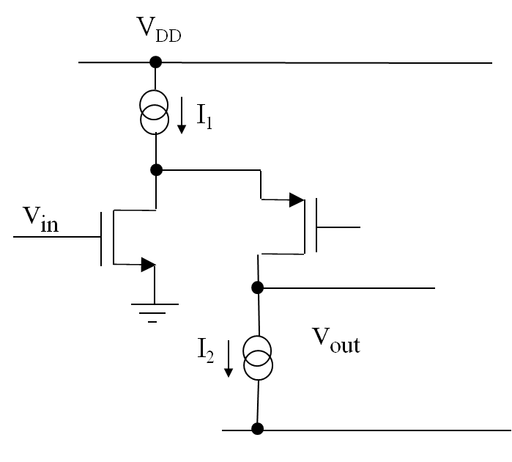
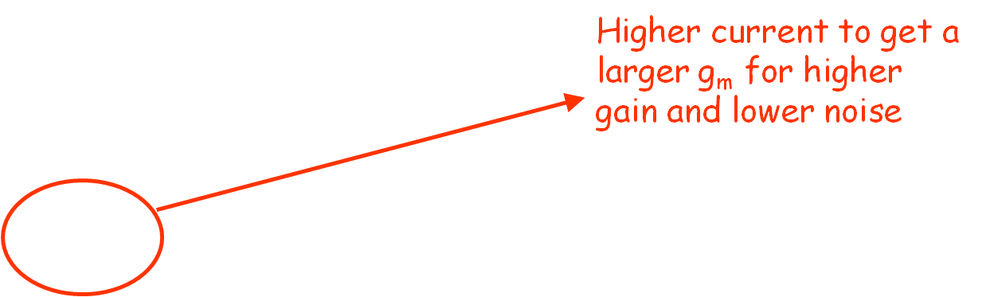
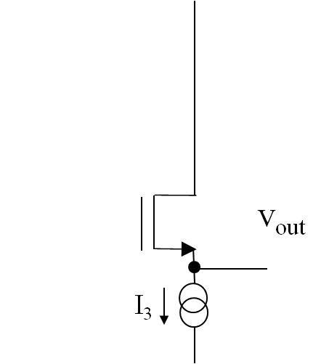

Forward gain stage: CMOS version
A higher forward gain can be achieved with a folded cascode configuration. A smaller current in the cascode branch makes it possible to achieve a high output impedance.
An output source follower can be used to reduce capacitive loading on the high impedance node and increase the frequency bandwidth (high gain in a large frequency span)

Slide 25
CMOS feedback network
Single feedback MOSFET
Reset switch
Linear resistor
Control signal
Reference voltage
C_{F}
C_{F}
_
_
Q . δ
Q . δ
C_{D}
C_{D}
Can be used when you can reset
the preamp at fixed times

Slide 26
CMOS feedback network
A large feedback resistor is needed for low noise, since
It is difficult to fabricate a large physical resistor in monolithic form, or to effectively control the resistance of a MOSFET biased in the linear region
A large resistor can be simulated by a CMOS circuit, such as a transconductor, which can be considered to be equivalent to a resistor R = 1/G_{m}
+ V_{DD}
i_{F}
I/2
g_{m}
i_{F} = (g_{m}/2)v_{OUT} = G_{m} v_{OUT}
C_{F}
_
V_{REF}
M2
M1
V_{OUT}
Q i(t)
C_{D}
V_{OUT}
I

Slide 27
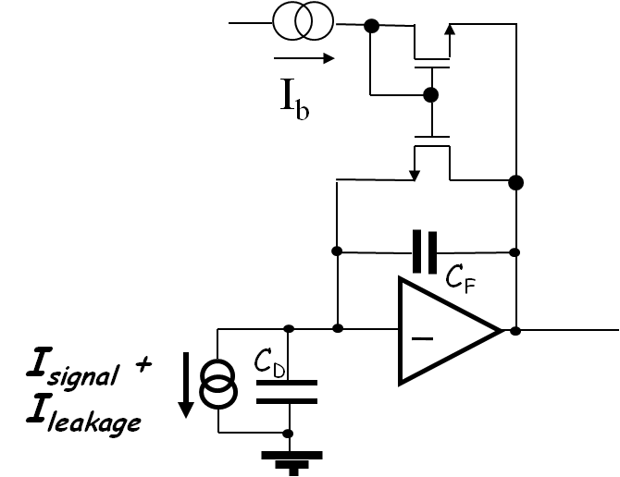
Compensation of detector leakage current
Irradiated, dc-coupled pixel sensors may have a considerable leakage current, which may saturate the feedback transconductor or, flowing in the feedback resistor, considerably affect the dc voltage at the preamplifier output.
A CMOS circuit can be designed to accomodate for this leakage current. A popular solution is the following:
The feedback capacitor is discharged linearly by a constant current. The output signal lends itself to an amplitude-to-time conversion (time-over threshold measurement).
v_{out}
-I_{b}/C_{F}
V_{th}

Slide 28
Processing the signal from the sensor: the shaper/filter
Signal shaping: the voltage step at the preamplifier output has to be constrained to a finite duration to avoid pileup of successive signals
Preamplifier output
Shaper output

Slide 29
Processing the signal from the sensor: the shaper/filter
A unipolar “semigaussian” shaper can be built with 1 differentiator (high pass) and n integrators (low-pass).
This is a compact (n=1) implementation:
Feedback resistor implemented with a CMOS device or circuit
R₂
Differentiating capacitance
From the preamplifier
C₂
Q/C_{f}
_
0
For correct values of the time constants associated to the feedback network and to the gain stage, the transfer function has two coincident poles
C₁
Bandwidth-limited gain stage

Slide 30
Processing the signal from the sensor: the shaper/filter
In the AToM (BaBar) and FSSR2 (BTeV) chips (microstrip trackers), a second order (n=2) shaper was implemented with an additional integrator before the shaper.
For an n^{th}-order unipolar shaper (higher n: more symmetrical pulse, higher signal rates for the same peaking time):
Time domain
Frequency domain
Increasing n
Increasing n

Slide 31
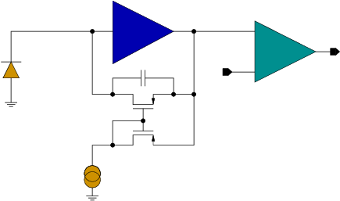
“Shaperless” analog channel
In future applications for imaging and vertexing detectors, very small pixels may be needed (< 10x10 μm²) with no room in the pixel for a shaper
Under these constraints, a viable solution consists in artificially reducing the preamplifier bandwidth
Preamplifier response to an 800 e⁻ pulse
Preamplifier
22T
-G(s)
14T
C_{F}
V_{t}
Discriminator
i_{F}

Slide 32
Charge measuring system and the effect of noise
        Filter minimizes the measurement error with respect to noise and the effect of pulse overlap (finite duration)
        Ionization detectors can be modeled as capacitive signal sources
        Charge collection is very fast in semiconductor detectors
Noise arises from two uncorrelated sources at the input (series and parallel noise):

Slide 33
Noise sources
White series noise
White parallel noise
White noise in the main current (drain, collector) of the input device
other components in the input stage
stray resistances in series with the input
Shot noise in detector leakage current
shot noise in input device gate (base) current
thermal noise in feedback resistor
1/f series noise
1/f component in the drain current
Parallel noise sources
Current generators at the preamplifier input
Series noise sources
Voltage generators at the preamplifier input

Slide 34
Shot noise
Shot noise is associated to device currents when charge carriers have to cross a potential barrier (P-N junctions in diodes and bipolar transistor)
In irradiated silicon detectors, leakage current and the associated shot noise may strongly increase

Slide 35
1/f noise
gate
oxide
source
drain
substrate
Interaction between charge carriers in the MOSFET channel and traps close to the Si-SiO₂ interface leads to fluctuations in the drain current.
This can be modeled with a noise voltage generator in series with the device gate, with a 1/f spectral density.

Slide 36
Effect of electronic noise on charge measurements
Ideally indefinitely narrow
distribution of detector charge
(neglecting statistics in energy deposition
and charge creation)
Broadening of pulse amplitude distribution
at the shaper output due to electronic noise
        Because of electronic noise, the signal amplitude at the shaper output has a Gaussian probability density function

Slide 37
Effect of electronic noise on charge measurements
referred to the input
(dividing by the analog channel
charge sensitivity)
The signal amplitude at the output
of the linear analog channel is
characterized by a Gaussian probability
density function
Equivalent Noise Charge = standard deviation in the charge measurement
charge injected at the input producing at the output of the linear processor a signal whose amplitude equals the root mean square output noise

Slide 38
Equivalent Noise Charge (ENC)
The mean square value of the noise voltage at the shaper output can be calculated as follows:

Slide 39
Equivalent Noise Charge (ENC)
t_{P} = peaking time of the signal at the shaper output
A₁, A₂, A₃ = filter-dependent coefficients

Slide 40
Equivalent Noise Charge (ENC)
C_{T} = C_{D} + C_{i} + C_{F}
= total capacitance at the preamplifier input
In a well designed preamplifier, the noise is determined by the input device.

Slide 41
Equivalent Noise Charge (ENC)
White series noise:
Neglecting noise in parasitic resistors:
White parallel noise:
I = I_{B} (BJT)
I = I_{G} (gate tunneling current in nanoscale CMOS)
I = I_{leak} Detector leakage current
Γ = 0.5 (BJT)
Γ = 2/3 (Long channel FETs)
Γ ≈ 1 (Short-channel FETs)

Slide 42
Equivalent Noise Charge (ENC)
Series 1/f noise (MOSFET):
1/f noise parameter;
depends on the gate oxide quality
Oxide capacitance per unit gate area
Transistor geometry
(gate Width and Length)
The ENC contribution from 1/f noise is independent of the peaking time of the signal at the shaper output; it is weakly dependent on the shape of the transfer function of the shaper.

Slide 43
In trackers for high luminosity colliders, event rate is very high, and the peaking time has to be short (< 100 ns).
White series noise is usually dominant here, except with irradiated sensors, where leakage current (and the associated shot noise) may increase to a very large extent.

Slide 44
ENC: BJT vs MOSFET
Bipolar transistors have a larger g_{m}/I ratio with respect to MOSFET, which means a lower series white noise for a same current
BiCMOS (SiGe) technologies are an appealing alternative for fast readout systems; since they are less dense (and more expensive) than CMOS, their use is mostly limited to strip front-end chips

Slide 45
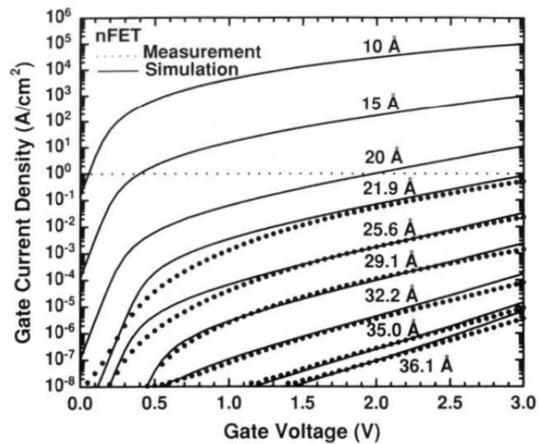
Gate leakage current shot-noise in nanoscale CMOS
90 nm CMOS process:
Current density = 1 A/cm²
W = 1000 μm
L = 0.1 μm
I_{G}= 1μA
S_{IG}=2qI_{G}=0.56 pA/√Hz
Non negligible noise contribution

Slide 46
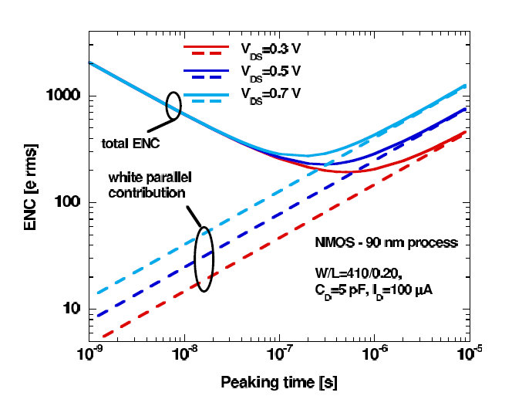
Rad-hard, low-noise charge preamplifier design:
short strip readout with 90 nm electronics, NMOS input
CMOS looks not too different from bipolar transistors
White noise
Parallel noise
1/f noise
Weak inversion region:
(n =1.2 in 100-nm scale CMOS, n=1 in bipolar transistors)
⇒ Expect ~ 20% higher ENC contribution from white series noise for the same device current
Series white noise is dominant at t_{P} < 100 ns

Slide 47
Noise and detector capacitance
White and 1/f series noise terms (dominant in CMOS) give a contribution to ENC linearly increasing with the detector capacitance (C_{T} =C_{D} + C_{IN} + C_{F}).

Slide 48
Capacitive matching
It is possible to minimize ENC by a correct choice of the dimensions of the preamplifier input device (gate width W and length L)
Conditions for optimum matching between the preamplifier input capacitance (C_{IN} = C_{OX}WL) and the detector capacitance C_{D} depend on the input device operating region (most often, weak or moderate inversion) and on which series noise contribution is dominant (white or 1/f)
This optimization has to comply with constraints on the power dissipation, which limit the drain current in the input device (in weak inversion, A_{W} ÷ 1/g_{m} ÷ 1/I_{D})

Slide 49
Capacitive matching in a deep submicron technology
1/f noise dominant
At t_{P} = 10 - 100 ns C_{IN} ≈ 0.1 C_{D} gives minimum ENC
White noise dominant
0.18 µm technology

Slide 50
Capacitive matching in a deep submicron technology
Optimum ENC and input NMOS gate width in the C_{D} region of pixel detectors

Slide 51
Extracting a hit information from the sensor signal: the discriminator
Binary readout: hit/no hit information from a discriminator
This can also be associated to an ADC system, providing an information about the charge delivered by the detector
PREAMPLIFIER
C
F
SHAPER
DISCRIMINATOR
Q
.
δ
C
D
V_{th}
V_{th}
In a multichannel readout chip, channel-to-channel threshold variations due to device mismatch may degrade detection efficiency and spurious hit rate

Slide 52
Efficiency and noise occupancy
An excessive threshold dispersion can lead to channels with high noise hit rate or reduced efficiency in signal detection.
Noise gaussian distribution
(σ = ENC)
Most probable value depends on:
detector thickness (80 e-h pairs/μm for 300 μm thickness)
charge collection efficiency (degraded in irradiated silicon)
Discriminator threshold
Landau distribution of detector charge for a M.I.P.

Slide 53
Threshold dispersion
Discriminator threshold dispersion is given by statistical variations of the threshold voltage of MOSFETs in the differential pairs used in the discriminator input stage:
+ V_{DD}
Large area transistors help reduce the effect of threshold mismatch
M3
M4
v_{OUT}
v_{th}
v_{in}
M1
M2
I

Slide 54
As for the noise, the discriminator threshold and its dispersion (divided by the analog channel charge sensitivity) can be treated in term of input-referred charges, Q_{th} and σ_{qth} respectively.
For a second-order semigaussian shaper, and series white noise as the dominant contribution to ENC, the frequency of noise hits can be calculated as:
In practical conditions, the number of noise hits can be kept at acceptably low values by satisfying this condition:
To maintain an adequate efficiency, a channel-by-channel threshold adjustment may be necessary (threshold DAC in the pixel cell)

Slide 55
Analog-to-digital conversion
Latched binary output
S
R
PREAMPLIFIER
V_{th}
C
F
ToT
Time-Over-Threshold binary code
SHAPER
COMPARATOR
counter
Q
.
δ
C
D
clock
V_{th}
Amplitude information (binary code)
A
C_{st}
D
Flash, ramp, SAR,……

Slide 56
Time-Over-Threshold (ToT) analog-to-digital conversion
The ADC conversion of ToT is straightforward, avoiding circuit complexity
in a chip with a very high functional density.
Compression type characteristic
Pseudo-linear characteristic

Slide 57
Readout architecture
Digital information of hit signals is further processed by circuitry associated to each pixel (strip) and at the chip periphery. Position (pixel or strip address), timing (time stamp) and possibly pulse amplitude (from ADC) information must be provided.
All architectures perform data sparsification, processing only data from channels where the signal exceeds the discriminator threshold
Often, a trigger system selects only a fraction of the events for readout, reducing the data volume sent to the DAQ. In this case, information for all hits must be buffered for some time, waiting for a trigger signal (delay of a few μs).
Triggerless (data push architectures) are also available. All hits are read out immediately (as long as the rate is not too high). This allows the tracker information to be used for Level 1 Trigger

Slide 58
Block diagram of the front-end chip AToM
for signal processing in the BaBar Silicon Vertex Tracker

Slide 59
AToM digital section
Serial output
Channel address
Trigger L1
Time Stamp
Counter
Output buffer
1 start bit
4 chip address
1 read event/register
5 trigger tag
5 trigger time
Analog section
15 MHz
TOT Counter
60 MHz
193 RAM cells
7 channel number
5 time stamp
4 ToT

Slide 60
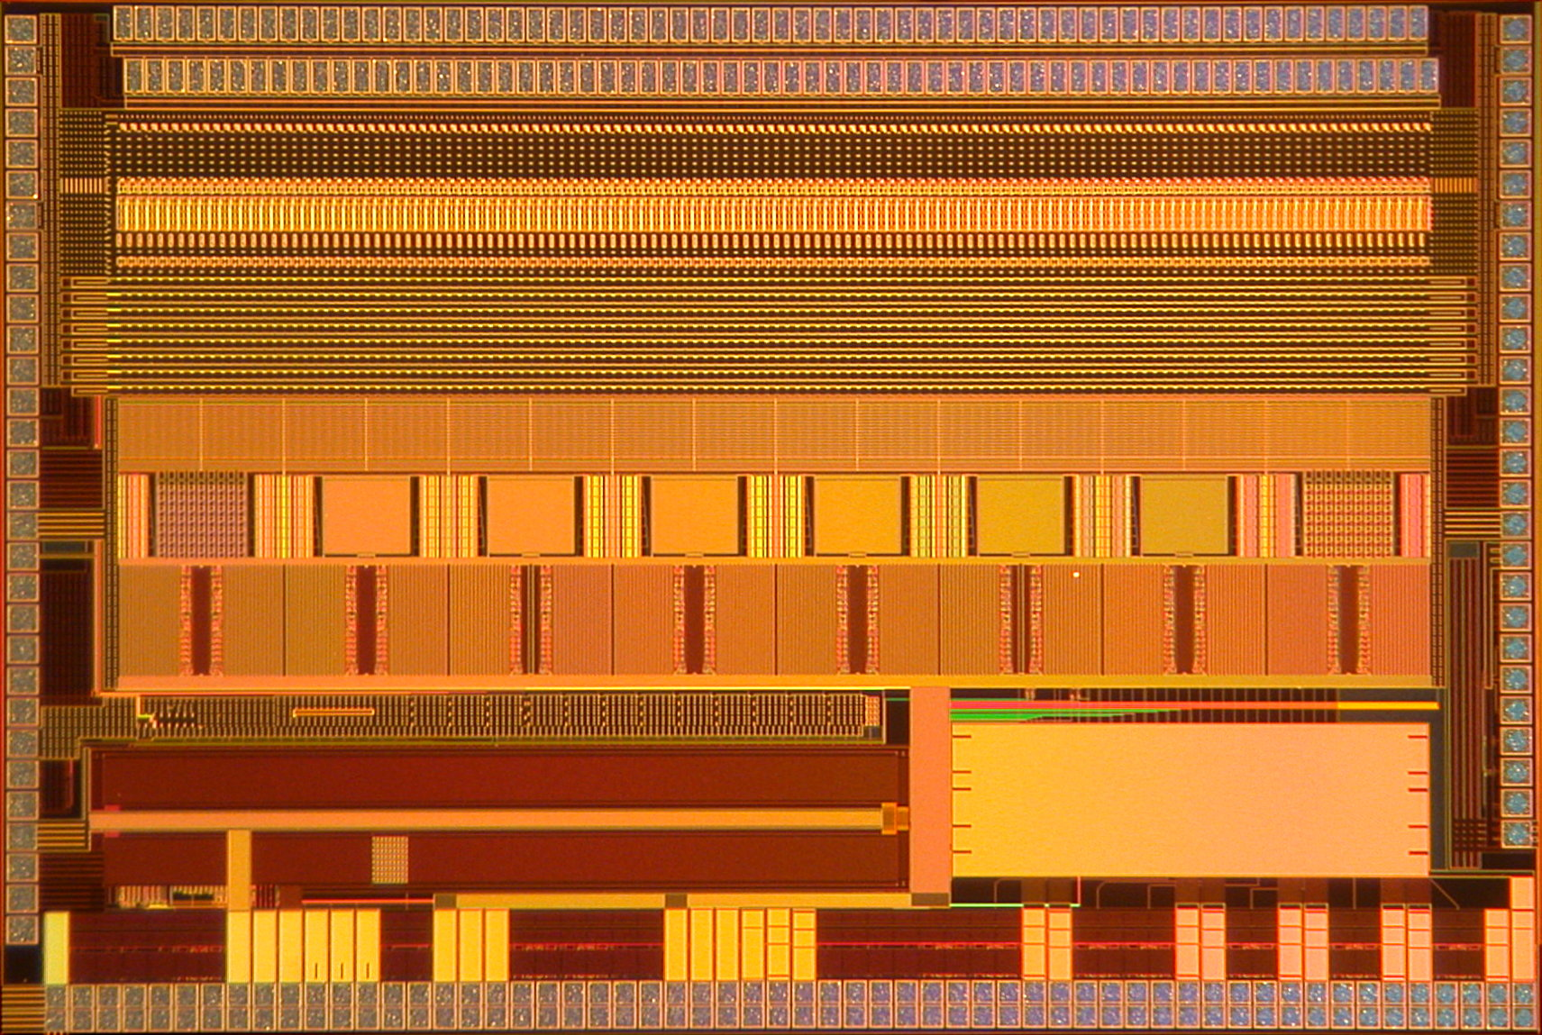
FSSR2 chip
(triggerless strip detector readout)
Front-End
Core Logic
Programming
Interface
Data output
Interface
7.5 mm x 5 mm, input pads with 50 μm pitch

Slide 61
FSSR2 block diagram
FSSR2 Core
  128 analog channels
  16 sets of logic, each handling 8 channels
  Core logic with BCO counter (time stamp)
Programming Interface (slow control)
  Programmable registers
  DACs
Data Output Interface
  Communicates with core logic
  Formats data output

Slide 62
The devil is in the details: integration of mixed-signal functions in a multichannel chip
Non-ideal effects may degrade the performance of low-noise analog circuits in strip or pixel readout integrated circuit:
Interferences from digital signals (clocks, commands, readout lines)
Voltage drops on interconnections distributing power supply voltages across large area chips
………

Slide 63
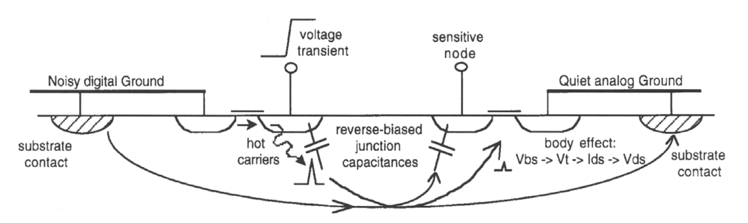
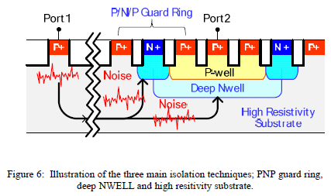
Digital-to-analog interferences
There are many ways by which interferences can propagate through the chip substrate…
These effects can be mitigated by using differential, low-level digital signals (LVDS), by isolation techniques, by layout tricks (separated analog and digital power and signal routing) …
I. A. Young (Intel), “Analog mixed –signal circuits in advanced nanoscale CMOS technologies for microprocessors and SoC”, 2010 ESSCIRC

Slide 64
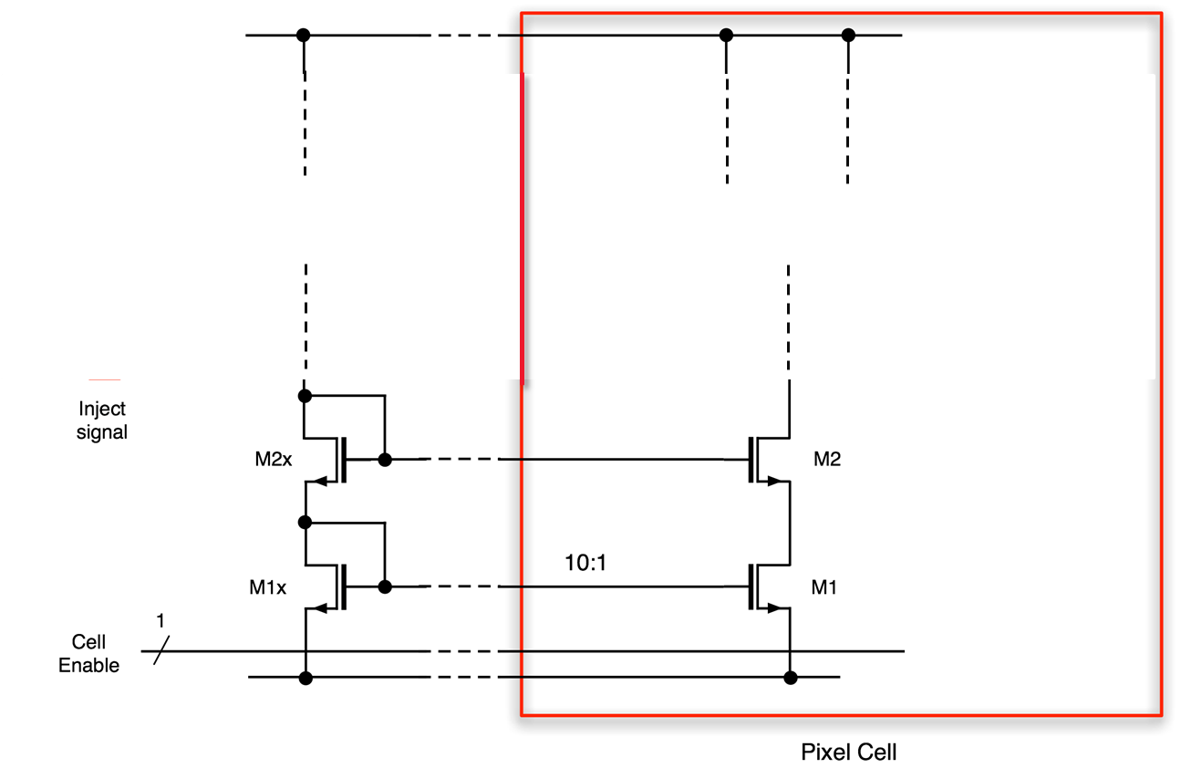
An example of system issues in front-end chip design: voltage drop on power supply lines
Analog VDD
Reference currents provided by DACs in the chip periphery are mirrored inside pixel cells by means of current mirrors. A voltage drop of a few mV along the ground line causes that the first and last pixels in column get different reference currents.
This has a detrimental effect especially for the cells far away from the chip periphery.
Analog ground

Slide 65
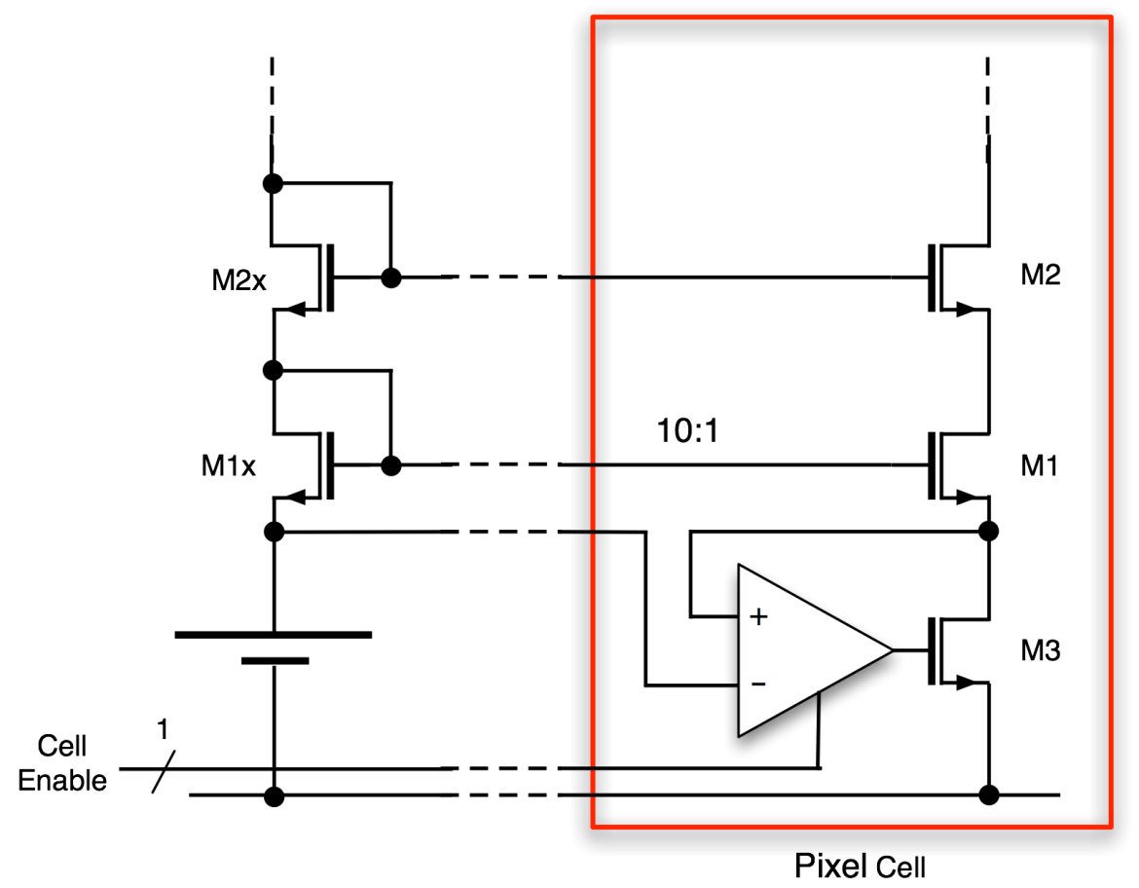
A solution to the problem of voltage drop on power supply lines
This problem can be solved by transferring a reference voltage in each pixel, so that a MOSFET in a pixel cell current source is biased at the same gate-to-source voltage as a transistor in the periphery reference network
M. Manghisoni et al., “High Accuracy Injection Circuit for Pixel-Level Calibration of Readout Electronics”, 2010 IEEE NSS Conference Record

Slide 66
Microelectronics for semiconductor detectors:
nanoscale CMOS and 3D integration
New applications of semiconductor detectors in high energy physics (silicon vertex trackers) and photon science (high-resolution imagers) set demanding and often conflicting requirements on the front-end electronics
More electronic intelligence squeezed in smaller pixel cells, larger amount of data stored in the chips and then transmitted outside, circuits operating at lower power and standing higher radiation levels, minimum amount of material and dead areas, ….
The potential of current microelectronic processes (including interconnections) has to be exploited; this may even require to use different technologies for different functions by 3D integration

Slide 67
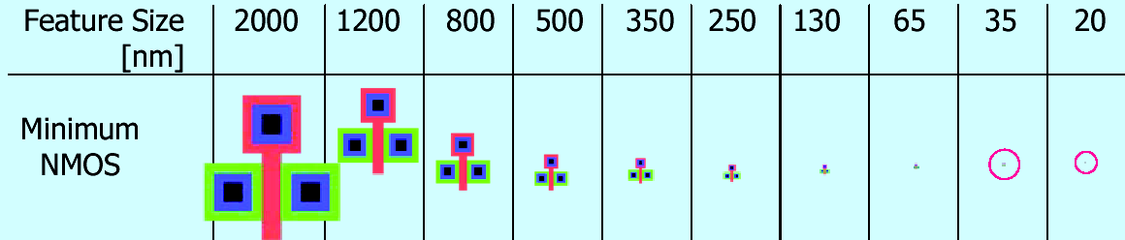
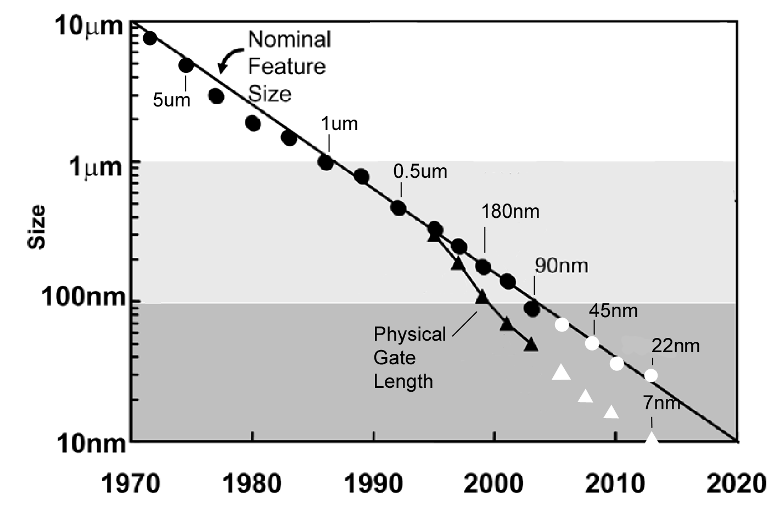
Industry Scaling Roadmap for CMOS
New generation every ~2 years with α = √2
L_{g} (1970) 8 μm (2007) 18 nm
HEP

Slide 69
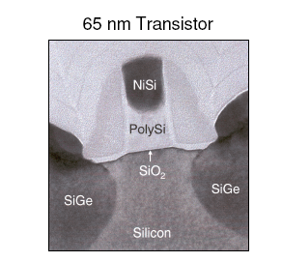
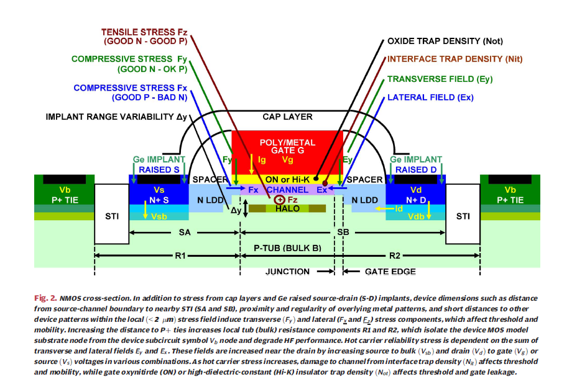
Nanoscale MOSFETs
Lewyn et al, “Analog circuit design in nanoscale CMOS technologies”, Proc. IEEE, Vol. 97, no. 10, Oct. 2009.

Slide 70
CMOS scaling: why
Industrial microelectronic technologies are today well beyond the 100 nm frontier, bringing CMOS into the nanoscale world
Digital performances (speed, density, power dissipation) are driving the evolution of CMOS technologies towards a continuous shrinking of physical feature sizes.
Analog performance remains essential for the processing of signals delivered by semiconductor detectors.
Front-end electronics may benefit from scaling in terms of functional density (small pitch pixels) and digital performance. Analog design is a challenge (reduced supply voltage and dynamic range, statistical doping effects, ………)
For a full integration of analog and digital circuits in the most modern semiconductor technologies, design advances are needed to exploit the full potential: digital signal processing may be used to overcome analog limitations, analog circuits may be used to monitor the performance of digital circuits and their power consumption.

Slide 71
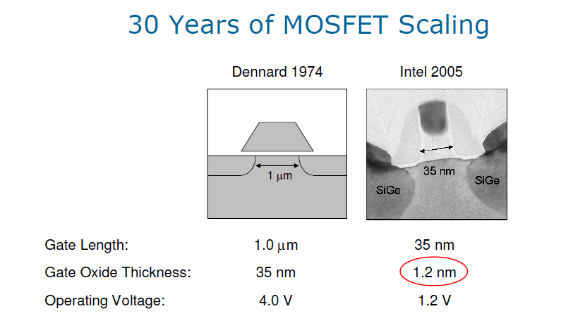
CMOS scaling: how
Shrinking of gate length leads to an increase in speed and circuit density. To avoid short-channel effects, drain and source depletion regions are made correspondingly smaller by increasing substrate doping concentration and decreasing reverse bias (reduction of the supply voltage)
Increasing substrate doping increases the device threshold voltage: this is overcome by decreasing the gate oxide thickness.
Classical scaling ended because of gate oxide thickness limits: in very thin oxides, direct tunneling of carriers leads to a large gate leakage current.

Slide 72
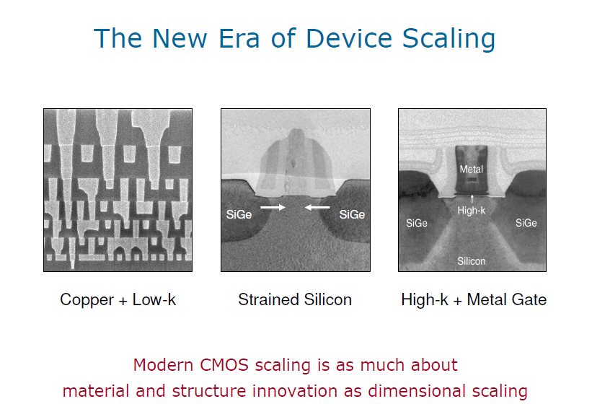
M. Bohr (Intel), “The new era of scaling in a SoC world”, ISSCC 2009.
Mechanical stress (compressive or tensile strain) is introduced in the silicon channel to enhance carrier mobility and drive current.
Gate dielectric is made thicker (still reducing gate capacitance) by using materials with higher dielectric constant than SiO₂.

Slide 73
Gate leakage current in nanoscale CMOS flavours and generations
Interestingly, the gate leakage current is observed to decrease for the types of stresses adopted by the industry in advanced CMOS (tensile and compressive stress for NMOS and PMOS, respectively)
These types of stresses increase electron and hole populations in energy bands where they have low tunneling probability through SiO₂ (in addition to enhancing their mobility in the channel)
We made tests on 130 nm and 90 nm GP (General Purpose) transistors and on 65 nm LP (Low Power) transistors (V_{DD} = 1.2 V). These LP devices were optimized for a reduced leakage (larger equivalent oxide thickness, different level of nitridation with respect to other flavours, different silicon stress).

Slide 74
CMOS 65 nm: the Low Power flavour
After the 250 nm (LHC) and the 130 nm node (LHC upgrades, XFEL,…), our community appears to be very interested in the 65 nm CMOS generation: several prototypes have been already fabricated and tested.
Among the wide choice of options of this technology, the Low Power flavour is less aggressive than other variants (thicker gate oxide, smaller gate leakage, higher voltage), and is more attractive for mixed-signal chips where analog performance is an essential feature.
Critical aspects for analog design in nanoscale CMOS (with focus on LP 65 nm) for detector readout integrated circuits:
Interaction of charge carriers with the gate oxide; tools for evaluating the quality of the gate dielectric
Gate leakage current
1/f noise
Charge carriers in the device channel (short channel effects, strained silicon)
Thermal noise
Radiation-induced positive charge in the gate oxide and in lateral isolation oxides
Radiation hardness

Slide 75
Gate current in 130 nm and LP 65 nm

Slide 76
Noise in NMOS:
CMOS generations from 250 nm to 65 nm
1/f noise has approximately the same magnitude (for a same WLC_{OX}) across different CMOS generations. White noise has also very similar properties (weak/moderate inversion).
1/f noise
k_{f} 1/f noise parameter
α_{f} 1/f noise slope-related coefficient
Channel thermal noise
k_{B} Boltzmann’s constant
T absolute temperature
α_{w} excess noise coefficient
γ channel thermal noise coefficient
In weak inversion:

Slide 77
65 nm LP process: 1/f noise
In older CMOS times, PMOS transistors had a considerably lower 1/f noise with respect to NMOSFETs. This difference tends to decrease with newer CMOS generations.
In the 65 nm LP process, NMOS and PMOS have similar 1/f noise.
This could be explained by a “surface channel” behavior for both devices, and/or by the fact that the gate dielectric nitridation decreases the barrier energy experienced by holes across the silicon-dielectric interface. This would make it easier for the PMOS channel to exchange charges with oxide traps.

Slide 78
Evolution of microelectronic technologies
No roadmap, room for new ideas: monolithic sensors, 3D integration
Evolutionary roadmap:
nanoscale CMOS

Slide 79
A further leap: 3D integration
The microelectronic industry has developed 3D integration of thinned and bonded CMOS tiers with vertical interconnections through the silicon layers as an alternative or complementary way to device scaling, with the goal of enhancing memory capacity and microprocessor speed (by reducing length of interconnections) and of improving the performance of image sensors (by including pixel level high-speed signal processing).
The semiconductor detectors and front-end electronics communities in HEP and photon science plan to take benefit from 3D integration for new pixel sensor with advanced functionalities, smaller form factor, less material and dead area, separation and optimization of sensing, analog and digital functions,… New concepts may also be enabled by this technology.

Slide 80
3D vertical integration
A “3D” chip is generally referred to as a chip comprised of 2 or more layers of active semiconductor devices that have been thinned, bonded and interconnected to form a “monolithic” circuit.
Often the layers (sometimes called tiers) are fabricated in different processes.
Industry is moving toward Vertical Integration to improve circuit performance.
  Reduce R, L, C for higher speed
  Reduce chip I/O pads
  Provide increased functionality
  Reduce interconnect power and crosstalk
This is a major direction for the semiconductor industry.

Slide 81
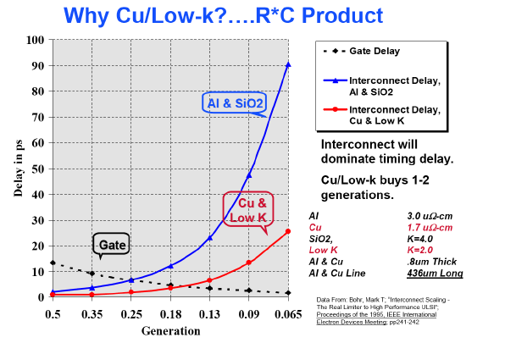
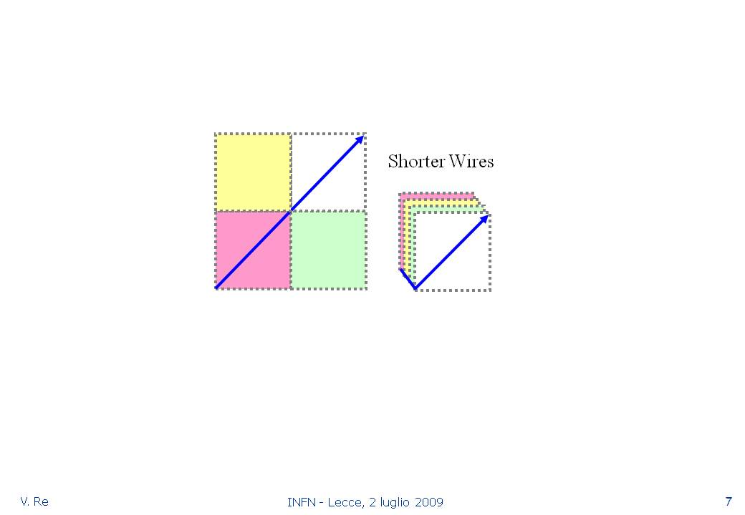
Advantages of going 3D: interconnections, delays and power
RAM, microprocessors, FPGAs,…
P_{avg} = VDD x I_{avg} = C_{tot} x VDD ² x f_{clk}
Since C is mostly due to wiring:
P_{avg} ∝ l_{avg}
t_{d} ≈ 0.35 x rcl ²

Slide 82
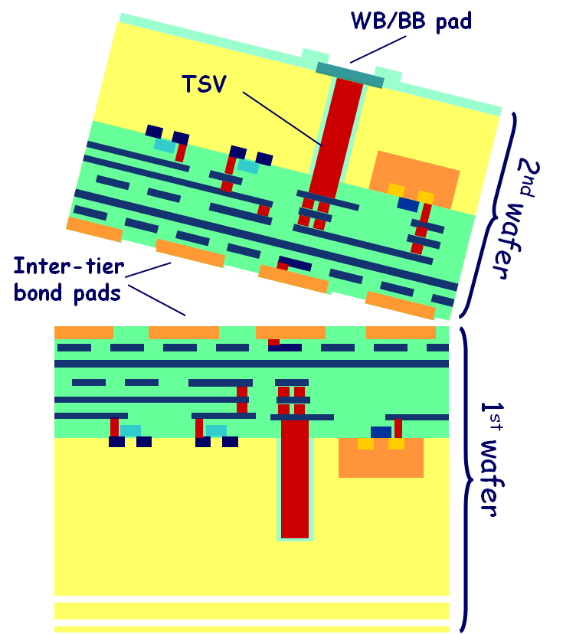
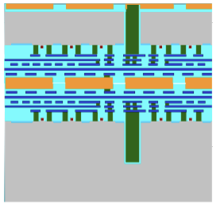
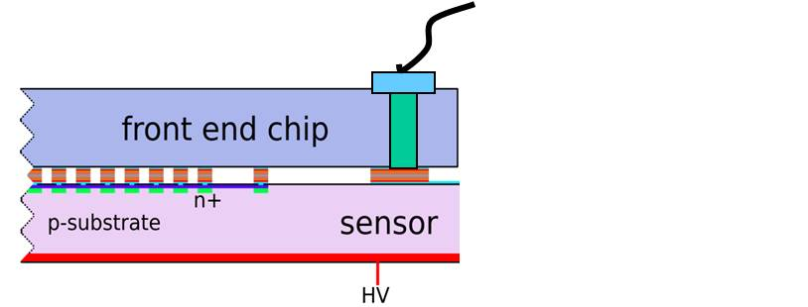
Two different approaches to 3D integration for pixel sensors
“via first” process for 3D integrated circuits, where TSVs are drilled at the foundry in the early stages of CMOS wafers processing. Very high density interconnections (< 10 μm) are possible (VIPIX-INFN and 3D-IC consortium).
Tezzaron vias are very small: Φ_{via}=1.2 μm, Φ_{landing_pad}=1.7 μm, d_{min}=2.5 μm
Wafer bonding pads are nominally on a 4 μm pitch
“via last” process for 3D integration of 2 layers in heterogeneous technologies (CMOS chip + high resistivity sensor), 4-side buttable device with low density interconnections (pitch > 50 μm) in the device periphery (AIDA project).
82

Slide 83
The experience of the 3D-IC consortium
The processing of 3D devices started about 3 years ago at Tezzaron/GlobalFoundries and, after many technical problems, only recently fully functional chips were delivered. This is a signature that these advanced 3D technologies have not yet reached a full maturity.
Encouraging test results and a more effective user interface (MOSIS-CMP) keep alive the promise of achieving high performance 3D systems in our field.
An example (INFN-VIPIX): a 3D Deep N-Well MAPS with pixel level time stamping and sparsification on a 20 μm pitch.
Successfully tested, communication between device layers demonstrated.

Slide 84
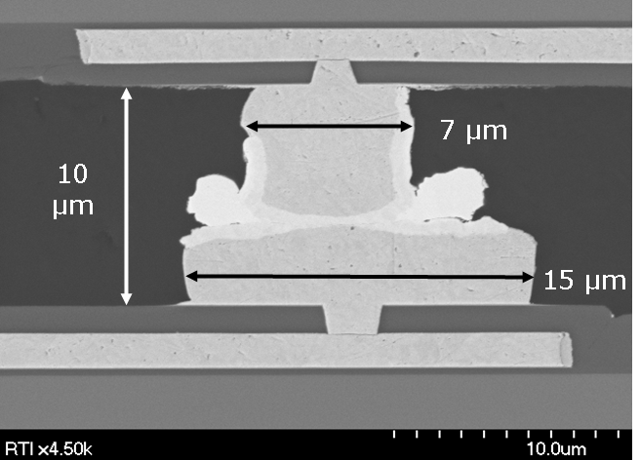
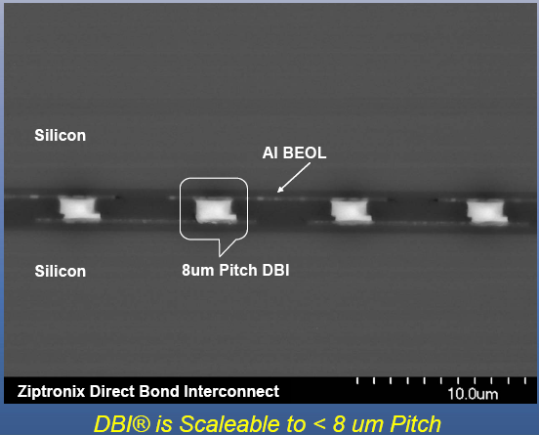
3D readout integrated circuits interconnected to high resistivity sensors:
standard bump bonding vs vertical integration
Digital section
CuSn
bond
cross
section
1st layer
  Conventional solder bumps or more advanced, low pitch CuSn bonding may still pose a problem for low mass assemblies
  Low-mass bonding of sensors to readout circuits is possible with advanced high-density interconnection technologies
Analog section
Bump bonding
2nd layer
detector layer
Digital section
1st layer
Analog section
2nd layer
Wafer bonding
detector layer

Slide 85
Exploiting 3D integration: the analog section of a 3D readout chip for high resistivity pixels
C_{F}
ANALOG
LAYER
C₂
Sensing layer
Discriminator
Preamplifier
C₁
Shaper
V_{TH}
Polarity selector
+
Qδ(t)
C_{D}
PS
AVDD
AGND
AVDD
I_{F}
HIGH_GAIN
V_{FBK1}
,
INJ_CK
Pulser
INJ_EN
V_{FBK2}
HIT
Digital Threshold Correction
MASK
In-pixel
logic
DATA_IN
B0
B1
B2
B3
MASK
INJ
Shift register
D
Q
D
Q
D
Q
D
Q
D
Q
D
Q
DIGITAL
LAYER
DATA_CK

Slide 86
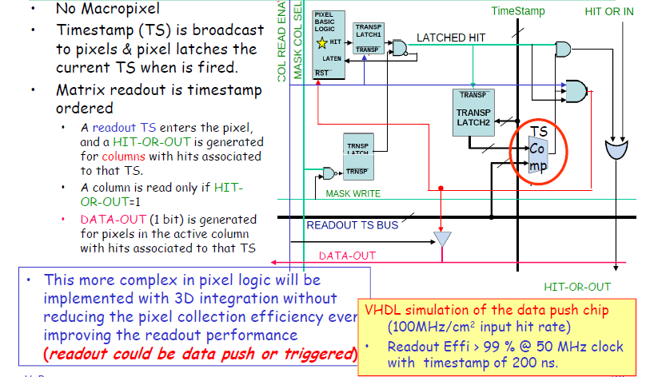
Exploiting 3D integration: pixel-level logic with time-stamp latch and comparator for a time-ordered readout

Slide 87
Perspectives and support to 3D integration in the semiconductor detector community
3D integrated circuits based on homogeneous layers (same CMOS technology) and high density TSVs and interconnections remain a very promising approach to advanced pixel detector readout and other applications.
The AIDA WP3 project is supporting the less aggressive “via last” variant of 3D integration, where low-density TSVs are etched in fully processed CMOS wafers. It is a mature technology, presently available at various vendors.
This technique makes it possible to use heterogeneous layers ( different technologies) for sensors and front-end electronics and to fabricate four-side buttable devices with minimal dead area.
A high-resistivity, fully depleted sensor can be combined in a low-mass assembly with a readout chip designed in an aggressively scaled CMOS generation (usually not available in the typical MAPS “Opto”processes), both with excellent radiation hardness (among other properties).
Low-density peripheral TSVs can be used to reach backside bonding pads for external connection. The interconnection technology can be chosen according to the pixel pitch.

Slide 89
Conclusions
Front-end electronics for silicon trackers in future experiments is an exciting challenge for integrated circuit designers
Classical analog problems (signal amplification and shaping, noise, threshold dispersion) will require clever solutions
New industrial technologies (nanoscale CMOS, 3D integration, …) will be exploited to achieve increasingly demanding specifications
3D integration is progressing in the microelectronic industry, and we have to be ready to exploit it. Ultimately, it may allow designers to avoid using sub-50 nm processes for analog and digital circuits in very small pixel readout cells.
R&D activities in these technologies have to be supported by our community, since they enable new concepts for detector systems. AIDA WP3 is doing this for 65nm CMOS (with CERN support) and for 3D integration.
Technology watch for novel devices and processes has to continue, since the evolution of microelectronics is not going to end soon.

Slide 90
References
E. Gatti, P.F. Manfredi: “Processing the signals from solid-state detectors in elementary-particle physics”, La Rivista del Nuovo Cimento, 1986
V. Radeka: “Low-noise techniques in detectors”, Ann. Rev. Nucl. Part. Sci., 1988
G. Lutz: “Semiconductor radiation detectors”
L. Rossi, P. Fischer, T. Rohe, N. Wermes: “Pixel Detectors. From Fundamentals to Applications”
H. Spieler: “Semiconductor detector systems”

Slide 91
Backup slides

Slide 92
Pixel detectors in future HEP experiments
Physics goals set severe requirements:
  High granularity ⇒ small pixel pitch
  Low material budget ⇒ low mass cooling, thin silicon wafers, small amount of material for support and interconnections
  Small distance to interaction point ⇒ large background
High data rate, Level 1 trigger
radiation hardness (deep submicron CMOS intrinsically rad-hard)
In MAPS, loss of efficiency due to in-pixel PMOS
Data sparsification
Digital-to-analog interferences
Full CMOS
Mixed-signal chips

Slide 93
Time stamp readout in pixel readout chips
A time stamp counter generates a time reference.
The time stamp code:
can be distributed to all pixels
The content of an in-pixel time stamp register is frozen when the pixel detects a hit and is then transmitted to the periphery.
2) can stay in the chip periphery or in the “end-of-column” control logic block.
When a pixel is hit, the end-of-column or periphery logic is informed that one or more hits have occurred and stores the relevant time stamp in a register.

Slide 94
Effect of noise on discriminator firing efficiency
Noiseless system
Effect of noise

Slide 95
Analog channels (FSSR2 chip)
Preamplifier
Programmable Gain
To 3-bit Flash ADC
C_{f1}
Programmable
Baseline
Restorer
Bias
C_{f}
Hit/NoHit Discriminator
+
G_{f}
Shaper
Threshold
circuit
C_{D}
Comparator
Single-ended/
Differential
conversion
-
Kill
BLR
-
CR-(RC)²
V_{th}
C_{AC}
+
C_{inj}
Test Input
(from Internal
Pulser)
Programmable
Peaking time
Threshold DAC
(chip wide)

Slide 96
Processing the signal from the sensor: the baseline restorer
Since the signal at the preamplifier output is not an ideal voltage step, but returns to baseline with a long time constant, the signal at the shaper output has a long tail. This results in a baseline shift at the discriminator input, with related statistical fluctuations, adding to the threshold dispersion.
Input signal discriminator scan without BLR
Input signal discriminator scan with BLR

Slide 97
Shift and fluctuations of the baseline at the discriminator input can be removed by a baseline restorer.

Slide 98
Pixel Unit Cell
Column
Bus
3 bit FADC
Amplifier
Vdda
Ifb
Binary Encoder
& Register
Pulse ht: [0:2]
-
Vth7
Token
Out
+
Vff
Vfb2
Token
& Bus
Controller
Row #
[0:7]
Command
Interpreter
4 pairs of lines,
4 commands each:
Latch Data
Output Data
Idle
Reset
Vth2
Sensor
Inject
Test
Vth1
Token
In
Vref
Hit
Bias voltages & currents are set by DAC’s.
Vth0
Kill

Slide 99
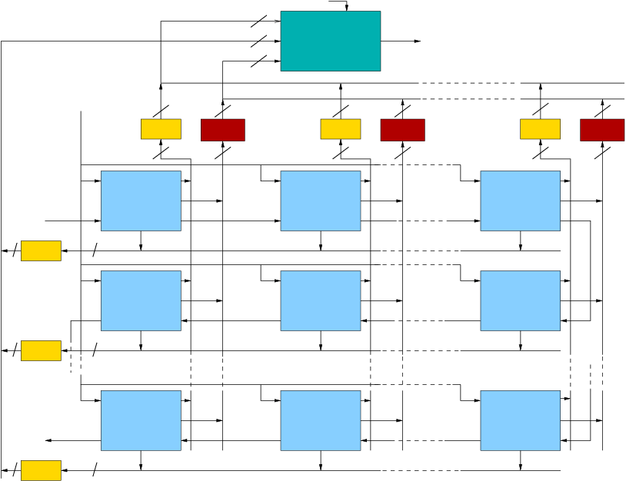
FNAL idea, implemented by INFN in a 130nm CMOS MAPS
ILC VTX pixel readout architecture
Readout CK
4
X
Readout phase:
4
Y
MUX
5
Serial data output
token is sent
T
token scans the matrix and
Cell CK
gets caught by the first
hit pixel
4
5
4
5
4
5
Time Stamp Buffer 1
Time Stamp Buffer 2
Time Stamp Buffer 16
X=1
X=2
X=16
the pixel points to the
X and Y registers at
the periphery and
1
1
1
Cell (1,1)
5
Cell (1,2)
5
Cell (1,16)
5
gXb
gXb
gXb
gXb=get_X_bus
gYb=get_Y_bus
TS=Time_Stamp
Tkin=token_in
Tkout=Token_out
First token in
TS
TS
Hit pixel
TS
sends off the time
stamp register content
Tkin
Tkout
Tkin
Tkout
Tkin
Tkout
4
1
gYb
gYb
gYb
data are serialized and
token scans ahead
Y=1
Cell (2,1)
Cell (2,2)
Cell (2,16)
gXb
gXb
gXb
TS
TS
TS
Tkout
Tkin
Tkout
Tkin
Tkout
Tkin
4
1
gYb
gYb
gYb
The number of elements may be increased without changing the pixel logic (just larger X- and Y-registers and serializer will be required)
Y=2
Cell (16,1)
Cell (16,2)
Cell (16,16)
Last token out
gXb
gXb
gXb
TS
TS
TS
Tkout
Tkin
Tkout
Tkin
Tkout
Tkin
4
1
gYb
gYb
gYb
Y=16

