Slide 1
Solid state detectors
a brief working principles overview
Piero Giubilato – V Scuola Nazionale Legnaro – 15 Apr 2013

Slide 2
Solid state detectors – overview
1
A bit of history
2
Basic solid state
4
Extrinsic semiconductors
3
Intrinsic semiconductors
5
PN junction
6
CCDs, CMOs practical detectors
7
Some detector properties

Slide 3
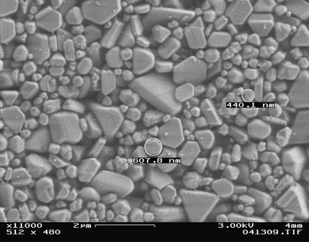
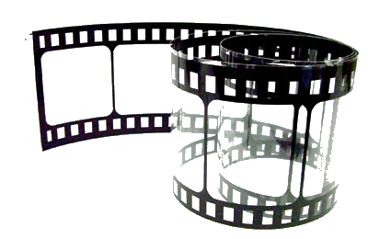
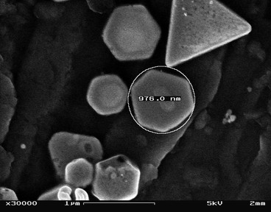
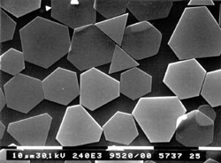
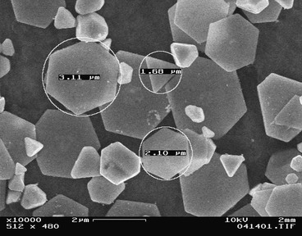
Solid state detectors – history
50 ISO
0.5 um
100 ISO
1 um
Actually, film is a solid state detector
200 ISO
Silver Halides
Pixel
3 um
1

Slide 4
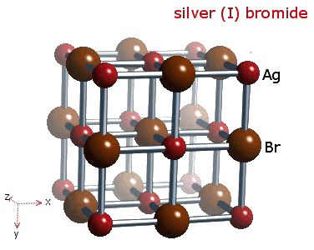
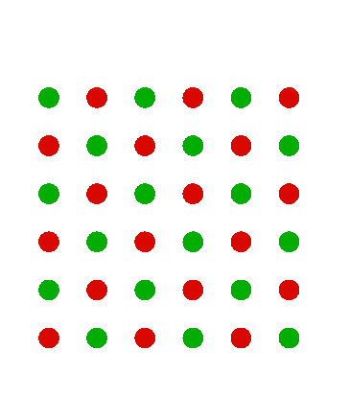
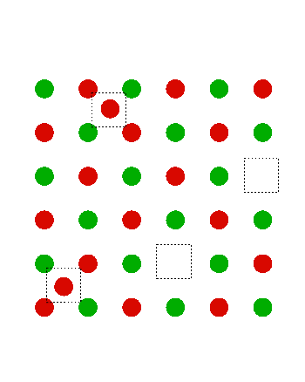
Solid state detectors – history: silver halides
Silver halides
e⁻
Ag Br
Ag X
Ag Cl
hν
γ
Ag I
Ag_{V}⁻ + hν → Ag_{V} + e⁻
Ag_{I}⁺ + e⁻ → Ag_{I}
Ideal lattice
Frenkel defects
1.16 eV formation
0.05 eV mobility
2

Slide 5
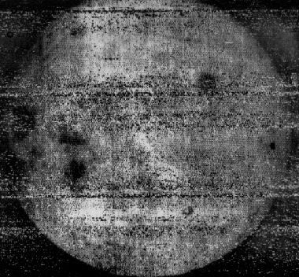
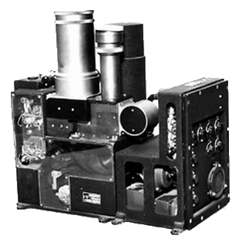
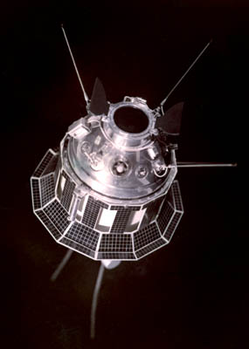
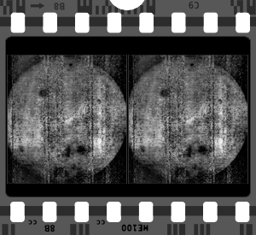
Solid state detectors – history: the dark side of the moon
Luna 3 - 1959
Yenisey camera system
The dark side of the Moon, first shot
Film main limits:
It doesn’t generate an electric signal
It is single use, you need a lot of it!
Need mechanics.
3

Slide 6
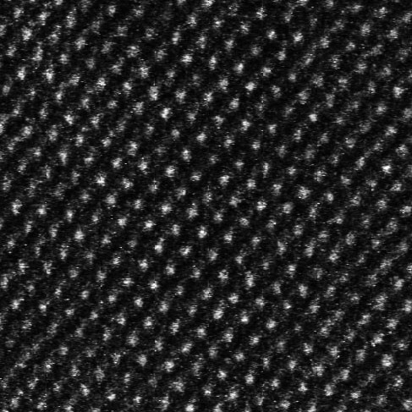
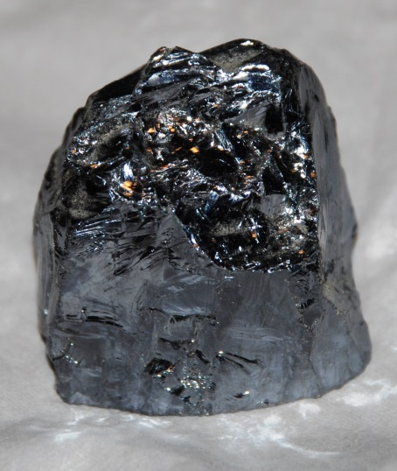
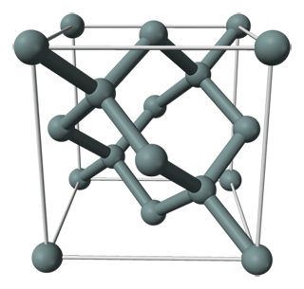
Basics – crystals
Si lattice, TEAM microscope
Si ore
Si lattice, diamond cubic
1

Slide 7
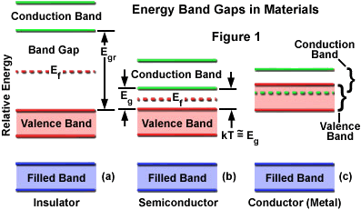
Basics – density of states function
The density of states function describes the bands energy levels structure defined by the physical properties of the crystal.
$$N\left(E\right)=M_{c}\frac{2^{1/2}{m_{de}}^{3/2}{\left(E−E_{F}\right)}^{1/2}}{ℏ^{3}}$$
M_{C} = equivalent minima
m_{de} = (m*₁m*₂m*₃)^{1/3}
m*_{x} = effective mass
h = Planck constant
$$\int_{0}^{∞}{N\left(E\right)=1}$$
2

Slide 8
Basics – electron wave equation
Schrodinger equation in 1D, time-independent potential (non relativistic)
$\frac{{−ℏ}^{2}}{2m}∙\frac{∂^{2}Ψ\left(x,t\right)}{{∂x}^{2}}+V\left(x\right)$ $Ψ\left(x,t\right)=jℏ\frac{∂Ψ\left(x,t\right)}{∂t}$
Variables separation to split space-dependent and time-dependent parts
$\frac{{−ℏ}^{2}}{2m}∙φ\left(t\right)\frac{∂^{2}ψ\left(x\right)}{{∂x}^{2}}+V\left(x\right)$ $ψ\left(x\right)φ\left(t\right)=jℏψ\left(x\right)\frac{∂ψ\left(t\right)}{∂t}$
cost
$$\frac{{−ℏ}^{2}}{2m}∙\frac{1}{ψ\left(x\right)}∙\frac{∂^{2}ψ\left(x\right)}{{∂x}^{2}}+V\left(x\right)=jℏ\frac{1}{φ\left(t\right)}∙\frac{∂ψ\left(t\right)}{∂t}$$
$$φ\left(t\right)=e^{−j\frac{n}{ℏ}t}$$
This depends upon the material lattice properties for an electron moving inside a crystal
space
time
$$\frac{{−ℏ}^{2}}{2m}∙\frac{1}{ψ\left(x\right)}∙\frac{∂^{2}ψ\left(x\right)}{{∂x}^{2}}+V\left(x\right)=E$$
$$\left[\frac{∂^{2}}{{∂x}^{2}}+\frac{2m}{ℏ^{2}}\left(E−V\left(x\right)\right)\right]ψ\left(x\right)=0$$
3

Slide 9
Basics – electron wave equation meaning
$Ψ\left(x,t\right)$is complex, no direct physical meaning:
1
$$Ψ\left(x,t\right)=ψ\left(x\right)φ\left(t\right)=ψ\left(x\right)e^{−j\frac{n}{ℏ}t}$$
But the associated probability density function (Bohr) gives the chances of finding an electron at a given position and time $\left(x,t\right)$:
2
$$e^{−j\frac{n}{ℏ}t}$$
$$e^{+j\frac{n}{ℏ}t}$$
$${\left|Ψ\left(x,t\right)\right|}^{2}=Ψ\left(x,t\right)∙\overline{Ψ\left(x,t\right)}=ψ\left(x\right)φ\left(t\right)∙\overline{ψ\left(x\right)}\overline{φ\left(t\right)}={\left|ψ\left(x\right)\right|}^{2}$$
Since ${\left|ψ\left(x\right)\right|}^{2}$ represents the probability density function, for a single particle it musts hold the boundary condition:
3
$$\int_{−∞}^{∞}{{\left|ψ\left(x\right)\right|}^{2}=1}$$
4

Slide 10
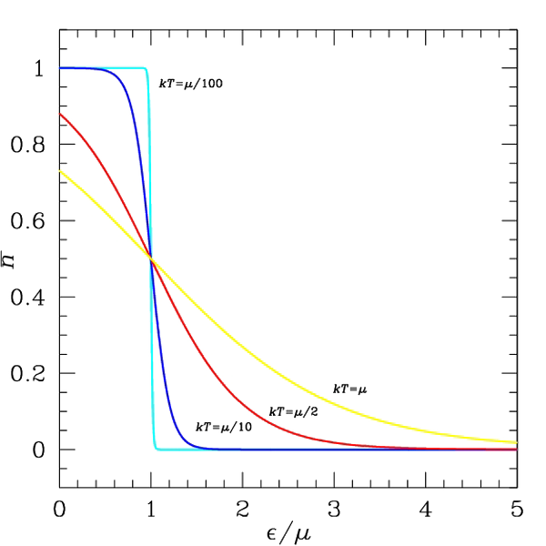
Basics – Fermi-Dirac distribution
Fermi-Dirac statistics describes semi-integer spin particles (which obey to Pauli exclusion principle) distribution in a system respect to their energy.
$$f\left(E\right)=\frac{1}{1+e^{\frac{E−E_{F}}{kT}}}$$
E_{F} = Fermi level (µ)
K = Boltzmann constant
T = temperature (kelvin)
5

Slide 11
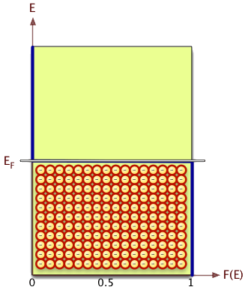
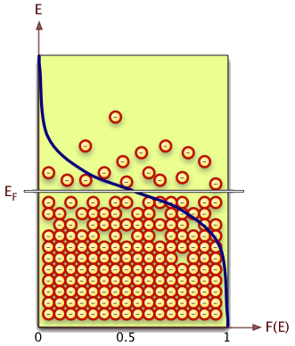
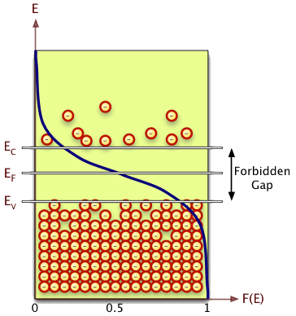
Basics – semiconductor outlook
T = 0
T > 0
T > 0
Electrons live inside the lattice
$$f\left(E\right)=\frac{1}{1+e^{\frac{E−E_{F}}{kT}}}$$
$$N\left(E\right)=M_{c}\frac{2^{1/2}{m_{de}}^{3/2}{\left(E−E_{F}\right)}^{1/2}}{ℏ^{3}}$$
f(E) gives the probability
that a state is occupied
N(E) gives where
Available states are
6

Slide 12
Semiconductors – some naming conventions
f_{F} is the Fermi-Dirac probability distribution
How many?
g_{x}(E) is the density of states
T > 0
E_{x} energy levels in eV
N_{c} effective conduction states density [1/cm³]
n₀ negative carriers densities [1/cm³]
N_{v} effective valence states density [1/cm³]
p₀ positive carriers densities [1/cm³]
1

Slide 13
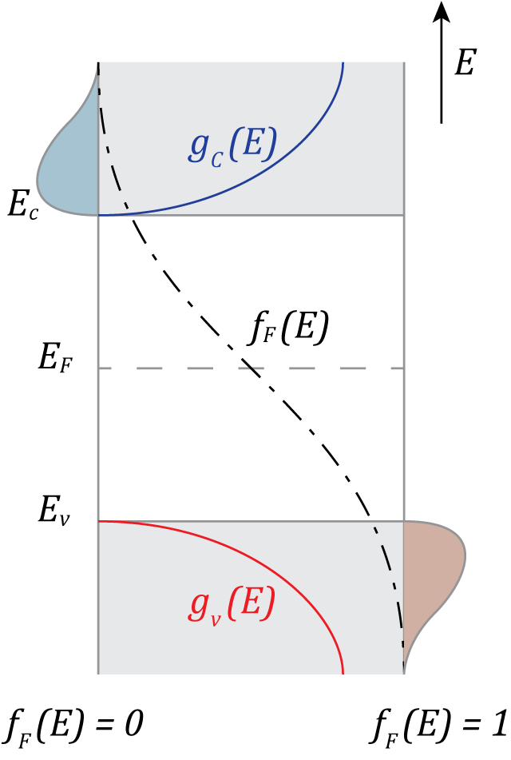
Intrinsic – $n\left(E\right)$ and $p\left(E\right)$ quantities
The lattice structure defines the density of quantum states function g(E), which describes the bands structure, while Fermi-Dirac statistics describes the states occupation.
Fermi-Dirac
probability
function
$${n\left(E\right)=g}_{c}\left(E\right){ f}_{F}\left(E\right)$$
Density of
quantum states
in valence
band
Electrons in
conduction
band
Density of quantum states in conduction band
Holes in
valence
band
Fermi-Dirac
probability
function
$${p\left(E\right)=g}_{v}\left(E\right)\left[{ 1−f}_{F}\left(E\right)\right]$$
2

Slide 14
Intrinsic – carrier densities $n_{0}$ and$p_{0}$ at equilibrium
Permitted energy levels overlaps forming bands
$${n\left(E\right)=g}_{c}\left(E\right){ f}_{F}\left(E\right)$$
Electrons/dE in conduction band
$${p\left(E\right)=g}_{v}\left(E\right)\left[{ 1−f}_{F}\left(E\right)\right]$$
Holes/dE in valence band
Integrating $n\left(E\right)$ a$nd p\left(E\right)$over the respective energy bands returns the total number of electron/holes in the conduction/valence band respectively.
$$n_{0}=\int_{E_{c}}^{∞}{g_{c}\left(E\right)f_{F}\left(E\right)dE}$$
Total electrons in conduction band
$$p_{0}=\int_{−∞}^{E_{v}}{g_{v}\left(E\right)\left[1−f_{E}\left(E\right)\right]dE}$$
Total holes in valence band
3

Slide 15
Intrinsic – expression of $f_{F}$ and$g_{c}$
Let use Boltzmann approximation to express $f_{F}$
$$f_{F}\left(E\right)=\frac{1}{1+e^{\frac{E−E_{F}}{kT}}}≅e^{\frac{−\left(E−E_{F}\right)}{kT}}$$
Within 5% as long as $\left(E−E_{F}\right)≥3kT$
Let also recall the form of $g_{c}\left(E\right)$ and $g_{v}\left(E\right)$
$$g_{c}\left(E\right)=\frac{4π{\left(2{m_{n}}^{∗}\right)}^{3/2}}{h^{3}}\sqrt{E−E_{c}}$$
Effective electron/hole mass. Accounts for interactions inside the lattice, both with ions and with other carriers.
$$g_{v}\left(E\right)=\frac{4π{\left(2{m_{p}}^{∗}\right)}^{3/2}}{h^{3}}\sqrt{E_{v}−E}$$
4

Slide 16
Intrinsic – calculating $n_{0}$
$$n_{0}=\int_{E_{c}}^{∞}{\frac{4π{\left(2{m_{n}}^{∗}\right)}^{3/2}}{h^{3}}\sqrt{E−E_{c}}{ e}^{\frac{−\left(E−E_{F}\right)}{kT}}dE}$$
$$η=\frac{−\left(E−E_{c}\right)}{kT}$$
Set
States density in band
Fermi dist.
$$n_{0}=\frac{4π{\left(2{m_{n}}^{∗}kT\right)}^{3/2}}{h^{3}}{ e}^{\frac{−\left(E_{c}−E_{F}\right)}{kT}}\int_{0}^{∞}{η^{\frac{1}{2}}e^{−η}dη}$$
$$Γ\left(z\right)\int_{0}^{∞}{t^{z−1}e^{−t}dt}$$
Gamma function
$$n_{0}=2{\left(\frac{2π{m_{n}}^{∗}kT}{h^{2}}\right)}^{3/2}{ e}^{\frac{−\left(E_{c}−E_{F}\right)}{kT}}$$
$$Γ\left(3/2\right)=\frac{1}{2}\sqrt{π}$$
Effective states density
$$n_{0}=N_{c}{ e}^{\frac{−\left(E_{c}−E_{F}\right)}{kT}}$$
$N_{c}≅3.2×{10}^{19}{ cm}^{−3}$ at 300k
5

Slide 17
Intrinsic – calculating $p_{0}$
$$p_{0}=\int_{−∞}^{E_{v}}{\frac{4π{\left(2{m_{n}}^{∗}\right)}^{3/2}}{h^{3}}\sqrt{E_{v}−E}{ e}^{\frac{−\left(E_{F}−E\right)}{kT}}dE}$$
$$η=\frac{−\left(E_{v}−E\right)}{kT}$$
Set
States density in band
Fermi dist.
$$p_{0}=\frac{4π{\left(2{m_{p}}^{∗}kT\right)}^{3/2}}{h^{3}}{ e}^{\frac{−\left(E_{F}−E_{v}\right)}{kT}}\int_{−∞}^{0}{η^{\frac{1}{2}}e^{−η}dη}$$
$$Γ\left(z\right)\int_{0}^{∞}{t^{z−1}e^{−η}dt}$$
Gamma function
$$p_{0}=2{\left(\frac{2π{m_{p}}^{∗}kT}{h^{2}}\right)}^{3/2}{ e}^{\frac{−\left(E_{F}−E_{v}\right)}{kT}}$$
$$Γ\left(3/2\right)=\frac{1}{2}\sqrt{π}$$
Effective states density
$$p_{0}=N_{v}{ e}^{\frac{−\left(E_{F}−E_{v}\right)}{kT}}$$
$N_{v}≅1.8×{10}^{19}{ cm}^{−3}$ at 300k
6

Slide 18
Intrinsic – some material dependent values
Material | N_{c} | N_{v} | $${{m_{n}}^{∗}}/{m_{0}}$$ | $${{m_{p}}^{∗}}/{m_{0}}$$
Si | 2.8 × 10¹⁹ cm⁻³ | 1.04× 10¹⁹ cm⁻³ | 1.08 | 0.56
GaAs | 4.7 × 10¹⁷ cm⁻³ | 7.0 × 10¹⁸ cm⁻³ | 0.067 | 0.48
Ge | 1.04 × 10¹⁹ cm⁻³ | 6.0 × 10¹⁸ cm⁻³ | 0.55 | 0.37
7

Slide 19
Intrinsic –$n_{i}$ in intrinsic semiconductors
These expressions for $n_{0}$ a$nd p_{0}$are valid for an intrinsic semiconductor at thermal and electric equilibrium.
$$N_{c}=2{\left(\frac{2π{m_{n}}^{∗}kT}{h^{2}}\right)}^{3/2}≅3.2×{10}^{19}{ cm}^{−3}$$
$$n_{0}=N_{c}{ e}^{\frac{−\left(E_{c}−E_{F}\right)}{kT}}$$
$$N_{v}=2{\left(\frac{2π{m_{p}}^{∗}kT}{h^{2}}\right)}^{3/2}≅1.8×{10}^{19}{ cm}^{−3}$$
$$p_{0}=N_{v}{ e}^{\frac{−\left(E_{F}−E_{v}\right)}{kT}}$$
$$n_{0} p_{0}=N_{c}N_{v}{ e}^{\frac{−\left(E_{c}−E_{v}\right)}{kT}}={n_{i}^{}}^{2}=e^{−\frac{E_{g}}{kT}}$$
Bandgap energy
At equilibrium, $n_{0}=p_{0}$
Material | n_{i} | E_{g}
Si | 1.5 × 10¹⁰ cm⁻³ | 1.12 eV
GaAs | 1.8 × 10⁶ cm⁻³ | 1.43 eV
Ge | 2.4 × 10¹³ cm⁻³ | 0.67 eV
8

Slide 20
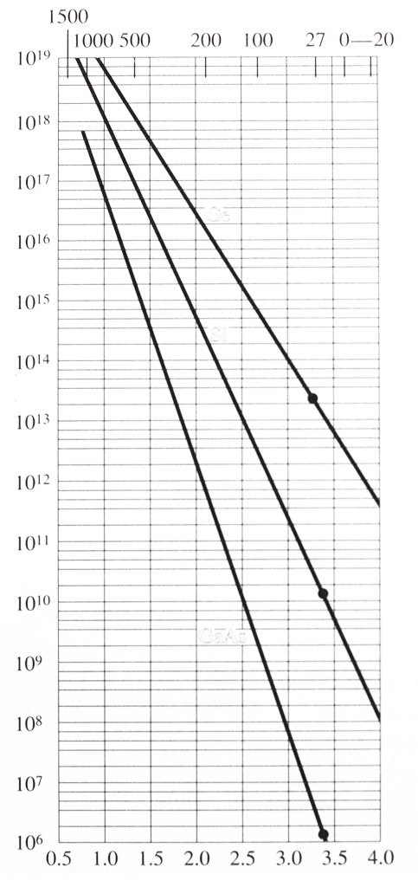
Intrinsic –$n_{i}$ in intrinsic semiconductors
Plot $n_{i}$ versus temperature for different semiconductors.
1500
1000
500
200
$T$ [Celsius]
100
27
GaAs
Si
Ge
0
-20
10¹⁸
10¹⁷
10¹⁶
10¹⁵
10¹⁴
10¹³
10¹²
10¹¹
10¹⁰
10⁹
10⁸
10⁷
10⁶
$n_{i}$ [1/cm³]
9

Slide 21
Intrinsic – validity range of calculations
The range of validity of the Boltzmann approximation we used sets the limits within the derived values of $n_{0}$ and $p_{0}$ are valid.
$$f_{F}\left(E\right)≅e^{\frac{−\left(E−E_{F}\right)}{kT}}$$
$${1−f}_{F}\left(E\right)≅e^{\frac{−\left(E_{F}−E\right)}{kT}}$$
Within 5% for $\left|E−E_{F}\right|≥3kT$
The $3kT$ value (≈ 1.24x10⁻²⁰ J/K = ≈ 0.074 eV at 300K) means that:
3kT
Validity range for E_{F}
being not to close (3kT) to E_{c} or E_{v}
E_{c}-E_{F} > 3kT : N_{D} < 1.6 × 10¹⁸ cm^{–3}
E_{F}-E_{v} > 3kT. N_{A} < 9.1 × 10¹⁷ cm^{–3}
3kT
10

Slide 22
Intrinsic – position of E_{F} in intrinsic semiconductors
To calculate the position of $E_{F}$ within the bandgap, let recall that $n_{0}=n_{i}$ in an intrinsic semiconductor at equilibrium:
$$n_{0}=N_{c}{ e}^{\frac{−\left(E_{c}−E_{F}\right)}{kT}}{, p}_{0}=N_{v}{ e}^{\frac{−\left(E_{F}−E_{v}\right)}{kT}}$$
$$\frac{2π{m_{p}}^{∗}kT}{h^{2}}$$
$$E_{F_{i}}=\frac{1}{2}\left(E_{c}+E_{v}\right)+\frac{1}{2}kt\ln{\frac{N_{v}}{N_{c}}}$$
$$\frac{2π{m_{n}}^{∗}kT}{h^{2}}$$
$$E_{F_{i}}=\frac{1}{2}\left(E_{c}+E_{v}\right)+\frac{1}{2}kt\ln{\frac{{m_{p}}^{∗}}{{m_{n}}^{∗}}}$$
Midgap energy
In words: E_{F} shifts respect the bandgap middle in order to maintain the number of electrons and holes balanced (${m_{p}}^{∗}$ and ${m_{n}}^{∗}$ both depend on the density of respective state function!)
$$E_{F_{i}}=E_{midgap}+\frac{3}{4}kt\ln{\frac{{m_{p}}^{∗}}{{m_{n}}^{∗}}}$$
11

Slide 23
Intrinsic – position of E_{F} in intrinsic silicon
As an example, we calculate the position of $E_{F}$ in silicon at 300 K. Effective carriers masses in silicon are:
$${m_{n}}^{∗}=1.08 m_{0}$$
silicon
$${m_{p}}^{∗}=0.56 m_{0}$$
$$E_{F_{i}}−E_{midgap}=\frac{3}{4}0.026\ln{\frac{0.56}{1.08}=−0.0128 eV=12.8 meV}$$
Silicon bandgap is about 1.12 eV: in many cases we can therefore approximate EF for silicon (at room temperature) being at 560 meV
12

Slide 24
Extrinsic – material doping
After discussing the properties of an intrinsic semiconductor, we now consider the effect of adding impurities of different materials to the semiconductor lattice
N_{d} Donor impurities density [1/cm³]
n_{d} extrinsic negative carriers densities [1/cm³]
N_{a} acceptor impurities density [1/cm³]
p_{a} extrinsic positive carriers density [1/cm³]
1

Slide 25
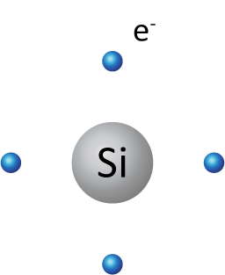
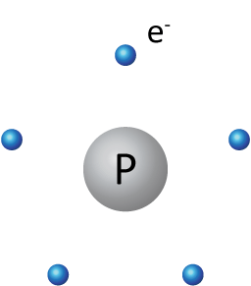
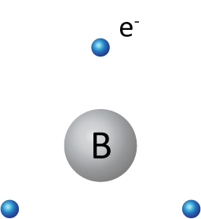
Extrinsic – silicon lattice with added impurities (doping)
Let focus on two classes of materials: material with 5 electrons in the outermost shell (group V elements) and materials with 3 electrons in the outermost shell (group III elements).
2

Slide 26
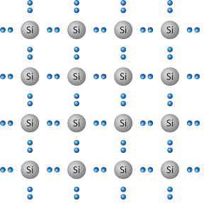
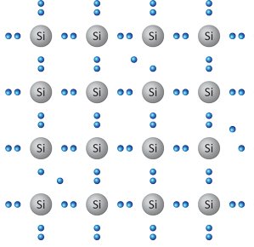
Extrinsic – qualitative impurities and temperature effect
Two major effects have to be considered at first: the change of the lattice properties due to the impurities introduction and the effect of temperature on the introduced electron/holes. At T = 0 nothing so exciting happens!
Pure silicon at T = 0
No free carriers (in an ideal lattice)
Pure silicon at T > 0
Appearance of thermally generated electrons and holes carriers
Doped silicon at T = 0
Impurities electrons/holes are bound to their atom, and cannot contribute to conduction.
Doped silicon at T > 0
Both thermally generated and dopant introduced carriers are available for conduction
3

Slide 27
Extrinsic – impurities intrinsic energy levels
Both electrons from donor materials and holes from acceptor materials sits in well defined energy levels, E_{d} and E_{a}. IMPORTANT: E_{d} and E_{a} are single, well defined levels as long as the densities of impurities N_{d} and N_{a} are small enough such that there is no interaction between the impurities carriers themselves
$$N_{d}$$
$$n_{0}$$
$$N_{a}$$
Electrons are rendered in gray as they are in electrical equilibrium as long as they sit on their original energy level E_{d}. They CANNOT act as carriers in this condition.
Holes are rendered in gray as they are in electrical equilibrium as long as they sit on their original energy level E_{a}. They CANNOT act as carriers in this condition.
n_{d} electrons = N_{d} @ T = 0
p_{a} holes = N_{a} @ T = 0
$$p_{0}$$
4

Slide 28
Extrinsic – impurities ionization
Electrons in excess from donor materials and holes from acceptor materials have a binding energy which must be overridden before the become available carriers.
Ionized donors
N_{d}⁺ = N_{d} - n_{d}
$$n_{0}$$
$$n_{0}$$
n_{d} electrons
Thermally generated electrons and holes
p_{a} holes
$$p_{0}$$
$$p_{0}$$
Ionized acceptors
N_{a}⁺ = N_{a} - p_{a}
5

Slide 29
Extrinsic – impurities ionization energy
Applying first quantization rules (Bohr’s atom model) it is possible to derive with good precision the ionization energy for the electrons.
$$\frac{e^{2}}{4πε{r_{n}}^{2}}=\frac{m^{∗}v^{2}}{r_{n}}$$
$$m^{∗}r_{n}v=n ℏ$$
$$r_{n}=\frac{{4πεm}^{∗}ℏ^{2}}{m^{∗}e^{2}}$$
$$a_{0}=\frac{{4πεm}^{∗}ℏ^{2}}{m_{0}e^{2}}=0.53Å$$
Momentum
quantization
Radius
quantization
Bohr radius
Forces balance
$$T={\frac{1}{2}m}^{∗}v^{2}=\frac{{−m}^{∗}e^{4}}{{2 \left(nℏ\right)}_{}^{2}{\left(4πε\right)}^{2}}$$
Dopant | Ionization Energy [eV]
 | In Si | In Ge
Intrinsic | 1.12 | 0.67
Phosphorous | 0.045 | 0.0120
Arsenic | 0.049 | 0.0127
Boron | 0.045 | 0.0104
Aluminum | 0.060 | 0.0102
Gallium | 0.065 | 0.0110
Kinetic energy
$$V=−\frac{−e^{4}}{4πεr_{n}}=\frac{{−m}^{∗}e^{4}}{{\left(nℏ\right)}_{}^{2}{\left(4πε\right)}^{2}}$$
Potential energy
$$E=T+V=\frac{{−m}^{∗}e^{4}}{{\left(nℏ\right)}_{}^{2}{\left(4πε\right)}^{2}}$$
Total energy
6

Slide 30
Extrinsic – donors/acceptors probability function
Donors and acceptors from dopant impurities densities are described by the very same Fermi-Dirac probability distribution.
Ionized donors
We are actually interested in the ionized donors/acceptors, as they are carriers which become available for conduction
Electrons in the energy level E_{d}
Donors
density
$$n_{d}=\frac{N_{d}}{1+\frac{1}{2}{ e}^{\frac{E_{d}−E_{F}}{kT}}}=N_{d}−{N_{d}}^{+}$$
Holes in the energy level E_{a}
Acceptors
density
$$p_{a}=\frac{N_{a}}{1+\frac{1}{g}{ e}^{\frac{E_{F}−E_{a}}{kT}}}=N_{a}−{N_{a}}^{−}$$
Ionized acceptors
7

Slide 31
Extrinsic – ionized donors/acceptors at room temperature
At room temperature (T = 300) acceptor/donors are mostly ionized, i.e. actually available as free carriers populating the valence/conduction band.
$$E_{d}−E_{f}≫k T$$
Boltzmann approx.
$$n_{d}=\frac{N_{d}}{1+\frac{1}{2}{ e}^{\frac{E_{d}−E_{F}}{kT}}}≈\frac{N_{d}}{\frac{1}{2}{ e}^{\frac{E_{d}−E_{F}}{kT}}}=2N_{d}{ e}^{\frac{E_{F}−E_{d}}{kT}}$$
$$n_{0}=N_{c}{ e}^{\frac{E_{F}−E_{c}}{kT}}$$
-0.045 eV
2.8×10¹⁹ cm³
$$\frac{n_{d}}{n_{d}+n_{0}}=\frac{2N_{d}{ e}^{\frac{E_{F}−E_{d}}{kT}}}{2N_{d}{ e}^{\frac{E_{F}−E_{d}}{kT}}+N_{c}{ e}^{\frac{E_{F}−E_{c}}{kT}}}=\frac{1}{1+\frac{N_{c}}{2N_{d}}{ e}^{\frac{E_{c}−E_{d}}{kT}}}$$
$$=0.0041=0.41\%$$
At room temperature 99.6% of the donors electrons are ionized, and therefore contribute to conduction. The same happens for holes.
2×10¹⁶ cm³
8

Slide 32
Extrinsic – deriving $n_{0}$ and $p_{0}$ from doping levels
Calculate carriers densities at thermal equilibrium with:
T = 300 k
N_{d} = 10¹⁶ cm⁻³
N_{a}=0 cm⁻³
n_{i}=1.5×10¹⁰ cm⁻³
$$n_{0} p_{0}={n_{i}^{}}^{2}→p_{0}=\frac{{n_{i}^{}}^{2}}{n_{0}}$$
$n_{0}+N_{a}=p_{0}+N_{d}$
Complete ionization
$${n_{0}}^{2}−\left(N_{d}−N_{a}\right)n_{0}−{n_{i}}^{2}=0$$
$$n_{0}=\frac{N_{d}−N_{a}}{2}+\sqrt{{\left(\frac{N_{d}−N_{a}}{2}\right)}^{2}+{n_{i}}^{2}}$$
$$n_{0}=\frac{{10}^{16}}{2}+\sqrt{{\left(\frac{{10}^{16}}{2}\right)}^{2}+{\left({1.5×10}^{10}\right)}^{2}}≅{10}^{16} {cm}^{−3}$$
Minority carriers decrease! Electrons redistribution among energy bands
$$p_{0}=\frac{{n_{i}}^{2}}{n_{0}}=\frac{{\left(1.5{×10}^{10}\right)}^{2}}{{10}^{16}}≅{2.25×10}^{4} {cm}^{−3}$$
9

Slide 33
Extrinsic – balance visualized
Visualizing previous example: in such a case we are “adding” only donors, so we will have electrons at the donors energy level, but no acceptors.
$$n_{0}$$
Ionized donors
N_{d}⁺ = N_{d} - n_{d}
}
Thermally
generated electrons and holes
n_{d} electrons
donors E_{g} ≈ 0.045 eV
A few donor annihilate some intrinsic holes
$$p_{0}$$
$n_{0}$ decreases!
10

Slide 34
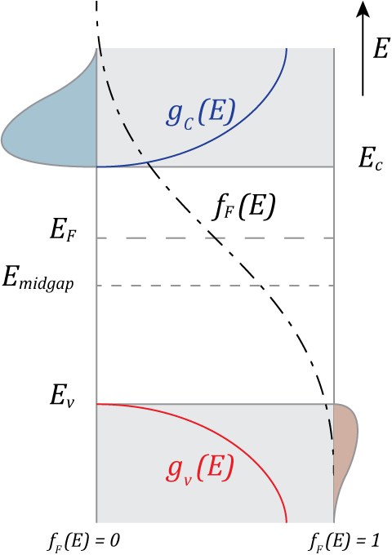
Extrinsic – doping moves the Fermi energy level
Added impurities change the lattice properties, shifting the Fermi energy level respect its position in a pure semiconductor.
$$n_{0}=N_{c}{ e}^{\frac{−\left(E_{c}−E_{F}\right)}{kT}}=n_{i}{ e}^{\frac{E_{F}−E_{F_{i}}}{kT}}$$
$$n_{0}$$
$$E_{F_{i}}=E_{midgap}+\frac{3}{4}kt\ln{\frac{{m_{p}}^{∗}}{{m_{n}}^{∗}}}$$
$$p_{0}=N_{v}{ e}^{\frac{−\left(E_{F}−E_{v}\right)}{kT}}=n_{i}{ e}^{\frac{{E_{F_{i}}−E}_{F}}{kT}}$$
11

Slide 35
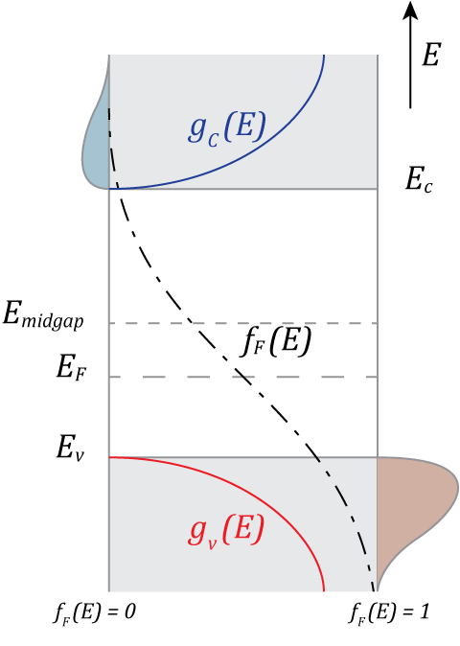
Extrinsic – doping moves the Fermi energy level
Added impurities change the lattice properties, shifting the Fermi energy level respect its position in a pure semiconductor.
$$n_{0}=N_{c}{ e}^{\frac{−\left(E_{c}−E_{F}\right)}{kT}}=n_{i}{ e}^{\frac{E_{F}−E_{F_{i}}}{kT}}$$
$$n_{0}$$
$$E_{F_{i}}=E_{midgap}+\frac{3}{4}kt\ln{\frac{{m_{p}}^{∗}}{{m_{n}}^{∗}}}$$
$$p_{0}=N_{v}{ e}^{\frac{−\left(E_{F}−E_{v}\right)}{kT}}=n_{i}{ e}^{\frac{{E_{F_{i}}−E}_{F}}{kT}}$$
12

Slide 36
Extrinsic – position of E_{F} in doped semiconductors
The position of $E_{F}$ within the bandgap changes with doping. Calling back equations derived for carriers concentration at thermal equilibrium:
$$n_{0}=\frac{N_{d}−N_{a}}{2}+\sqrt{{\left(\frac{N_{d}−N_{a}}{2}\right)}^{2}+{n_{i}}^{2}}$$
n
p
$$E_{c}−E_{F}=kt\ln{\frac{N_{c}}{n_{0}}}$$
$$E_{F}−E_{v}=kt\ln{\frac{N_{v}}{p_{0}}}$$
If $N_{d}≫n_{i}$ , $n_{0}≅N_{d}$
If $N_{a}≫n_{i}$ , $n_{0}≅N_{a}$
$$E_{c}−E_{F}=kt\ln{\frac{N_{c}}{N_{d}}}$$
$$E_{F}−E_{v}=kt\ln{\frac{N_{v}}{N_{a}}}$$
$$E_{F}−E_{F_{i}}=kt\ln{\frac{n_{0}}{n_{i}}}$$
$$E_{F_{i}}−E_{F}=kt\ln{\frac{p_{0}}{n_{i}}}$$
13

Slide 37
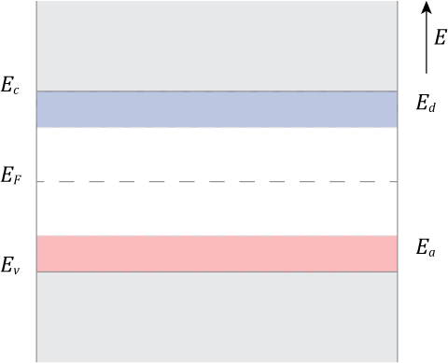
Extrinsic – assumption behind our model
Degenerate semiconductors: if the donors/acceptors density is too large, there is interaction between donor carriers, which hence distribute themselves indo band levels. The approximation of a single energy level for impurities is therefore no valid anymore.
No more one single level, but a bands filled semi-continuum
No more one single level, but a bands filled semi-continuum
14

Slide 38
Extrinsic – material doping overview
By doping the material by adding donors (electrons with V group material) and/or acceptors (holes with III group materials) the carriers densities will change, $n_{0}≠p_{0}$, but at equilibrium it will hold: $n_{0} p_{0}={n_{i}^{}}^{2}={N_{c}N_{v}e}^{−\frac{E_{g}}{kT}}$
$$n_{0}$$
Ionized donors
N_{d}⁺ = N_{d} - n_{d}
}
Thermally
generated electrons and holes
n_{d} electrons
donors E_{g} ≈ 0.045 eV in Si
A few donor annihilate some intrinsic carriers
p_{a} holes
acceptors E_{g} ≈ 0.045 eV in Si
}
Ionized acceptors
N_{a}⁺ = N_{a} - p_{a}
$$p_{0}$$
15

Slide 39
Extrinsic – balance at equilibrium
Ionized donors
N_{d}⁺ = N_{d} - n_{d}
e⁻ left by ionized acceptors (holes promoted in v-band)
$$n_{0}$$
Holes left by ionized donors (e⁻ promoted in c-band)
n_{d} electrons
Charge neutrality:
$n_{0}+{N_{a}}_{}^{−}=p_{0}+{N_{d}}_{}^{+}$
p_{a} holes
Complete ionization:
$n_{d}=0=p_{a}$
$$p_{0}$$
Carriers balance:
$n_{0}+N_{a}=p_{0}+N_{d}$
Ionized acceptors
N_{a}⁻ = N_{a} - p_{a}
16

Slide 40
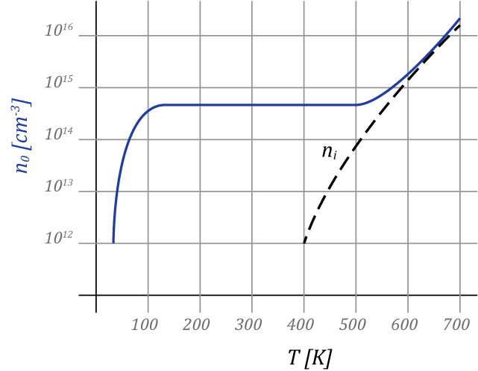
Extrinsic – balance is temperature dependent
${n_{i}^{}}^{2}$ strognly depends on T: i.e. using the previous value for N_{D} = 10¹⁶
Intrinsic
Extrinsic
$$n_{0}=\frac{N_{d}−N_{a}}{2}+\sqrt{{\left(\frac{N_{d}−N_{a}}{2}\right)}^{2}+{n_{i}}^{2}}$$
$${n_{i}^{}}^{2}=e^{−\frac{E_{g}}{kT}}$$
Partial ionization
17

Slide 41
PN Junction – depletion
Let start with one p doped and one n doped semiconductor regions.
Exposed lattice ions due to ionized carriers
Fermi levels are shifted from the intrinsic position accordingly to the doping levels
1

Slide 42
PN Junction – depletion
By mating the two regions, the Fermi level uniforms through the material.
The Fermi level is constant across the whole material
2

Slide 43
PN Junction – depletion
The equilibrium is actually reached through free carriers redistribution
At equilibrium the diffusion due to carrier density is balanced by the electric field due to “uncovered” ions in the lattice. Carriers can move, lattice ions cannot!
E
Be aware: carriers mutually screen their charge, they DO NOT annihilate physically (holes DO NOT exist as physical particles!)
3

Slide 44
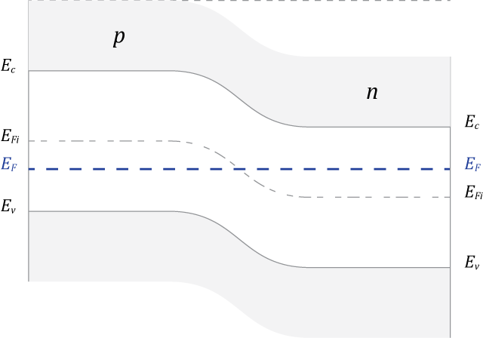
PN Junction – energy levels
Mating two differently doped semiconductor regions forces the Fermi energy level to uniform across the resulting body, as the system must stay in thermal equilibrium.
V_{bi}
25 mV
$$V_{bi}=\frac{kT}{q}\ln\left(\frac{N_{a}N_{d}}{{n_{i}}^{2}}\right)$$
4

Slide 45
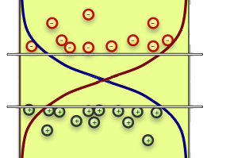
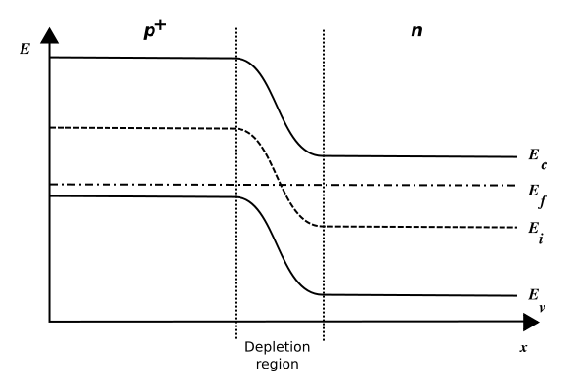
PN Junction – carriers
p
In a thermal equilibrium system, E_{F} is constant
n
p
E_{F}
E_{F}
n
E_{F}
E_{F}
Minority
carriers
E_{C}
Majority carriers
E_{I}
E_{C}
E_{F}
E_{V}
E_{F}
Majority carriers
E_{I}
Minority
carriers
E_{V}
5

Slide 46
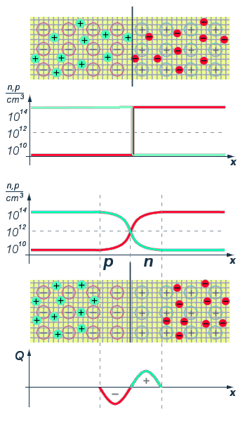
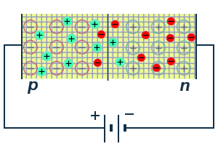
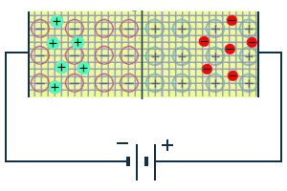
PN Junction – depletion
Direct bias
p
n
p
E = 0
n
E
Reverse bias
E
p
n
Depletion region
Depletion region
6

Slide 47
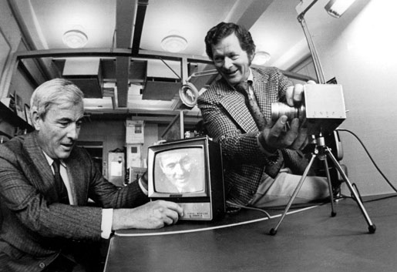
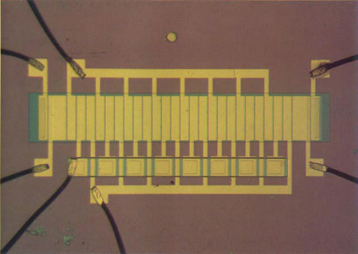
Detectors – the Cahrge Coupled Device
1969 at AT&T Bell Labs by Willard Boyle and George E. Smith. They were working on a semiconductor bubble memory, and called their design 'Charge "Bubble" Devices'.
2009 Physics Nobel prize
1

Slide 48
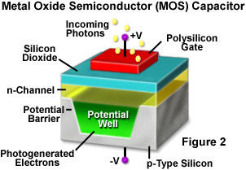
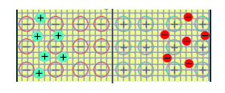
Detectors – CCD detection 1
The CCD basic building block is a MOS capacitor
+V
Gate
Insulator
γ
Capacitor
+
E
_
-V
2

Slide 49
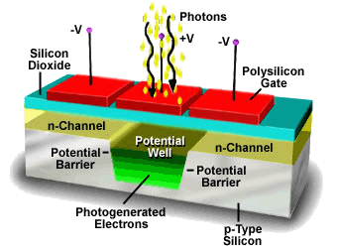
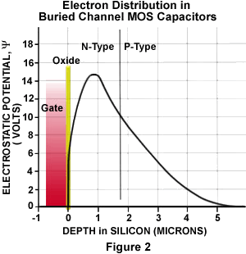
Detectors – CCD detection 2
By shaping the potential is possible to trap and move the collected charge
-V
+V
-V
3

Slide 50
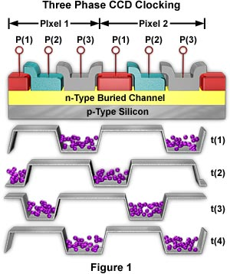
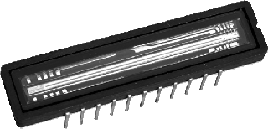
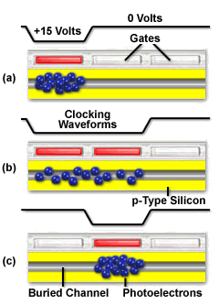
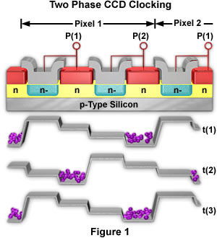
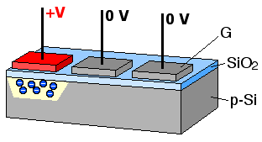
Detectors – CCD readout 1D
4

Slide 51
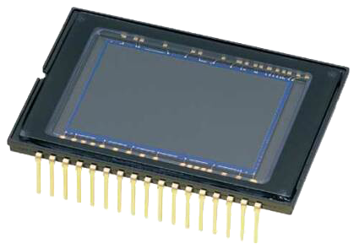
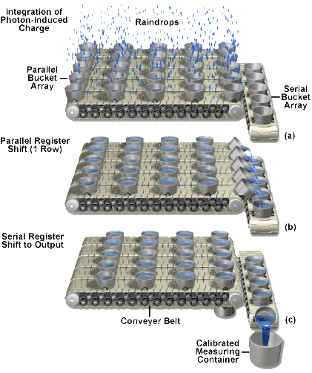
Detectors – CCD readout 2D
5

Slide 52
Detectors – CCD 2D array implementations
Full frame
Frame transfer
Interline
Needs mechanical shutter to shield pixel from light during readout
It is formed by two CCDs: the shielded is used as a storage frame. Expensive!
Sensitive and shielded storage regions alternate by column. Low fill factor
6

Slide 53
Detectors – CCD feeding
+
_
All clocks and different voltages have to be generated outside the chip.
7

Slide 54
Detectors – The CMOS active pixel 1
Active electronic elements are embedded into each detection element
Integrate
Accumulates the generated charge into the collection node
γ
OFF
OFF
+
_
E
OFF
8

Slide 55
Detectors – The CMOS active pixel 2
Reset
The stored charge is drained through the reset node
Read
The stored charge modulates a current into the periphery. Each cell is address by MOS switches.
OFF
ON
ON
ON
OFF
OFF
9

Slide 56
Detectors – The CMOS active pixel 2
Analog 3T pixel
20 μm
“Digital” pixel
Clocked current amplifier
Clocked comparator with current threshold
20 μm
10

Slide 57
Detectors – readout layout
Integrate
OFF
ON
ON
Read
OFF
OFF
OFF
Reset
ON
All this digital electronic is embedded into the chip itself
OFF
11

Slide 58
Detectors –CMOS feeding
Digital level clocking and power supply.
12

Slide 59
Detectors –CMOS and CCD compared
CMOS
CMOS
Low noise (no in-electronic)
Higher resolution
100% fill-factor for FF
Uses standard CMOS process
Camera-on-a-chip capable
Low power design available
Requires special process
More external components
More power hungry
More noisy
Less dynamic range
Lower resolution (maybe)
13

Slide 60
Detectors – Fill factor
Which parts of the device screen the incoming radiation actually depends on the radiation type and energy.
Sensitive
area
In case of visible photons we can use microlenses to increase the fill factor
14

Slide 61
Detectors – quantum efficiency in photons detection
The global sensitivity is the quantum efficency multiplied by the fill-factor
15

Slide 62
Detectors – back illumination
To reduce the amount of material incoming radiation pass through before reaching the depleted region, it is possible to thin and illuminate the device from the back.
16

Slide 63
Detectors – thermal noise
Thermal energy is enough to promote carriers into the conduction band, even without external light.
~ factor 2 every 6k
e⁻/p/s
Thermally promoted electron: noise
Temperature (k)
17

