Slide 1
V Scuola Nazionale "Rivelatori ed Elettronica per Fisica delle Alte Energie, Astrofisica, Applicazioni Spaziali e Fisica Medica"
15-19 Aprile 2013, Laboratori Nazionali di Legnaro dell'INFN
EFFETTI DA EVENTO SINGOLO NEI COMPONENTI ELETTRONICI
Prof. Alessandro Paccagnella
DEI, Università di Padova e INFN, Padova
paccag@dei.unipd.it

Slide 2
Outline
Introduction
Classification of SEE
SEE: a fundamental reliability issue in ICs
Charge generation by an ionizing particle in Si (and SiO₂)
  Collection mechanisms
  Evolution with Moore’s law
  SRAMs
  Metrics: cross section, threshold LET
Single Event Effects
  Sources
  Testing methods
Summary

Slide 3
SEE definition
If (some of) the charge generated by a single ionzing particle in a chip is collected at a sensitive node of the electronic device/circuit, and this charge is larger than the critical charge required to start an anomalous behavior, an effect (Single Event Effect) may be seen, affecting the electrical performance of the device/circuit:
  Soft errors
  Hard (destructive) errors

Slide 4
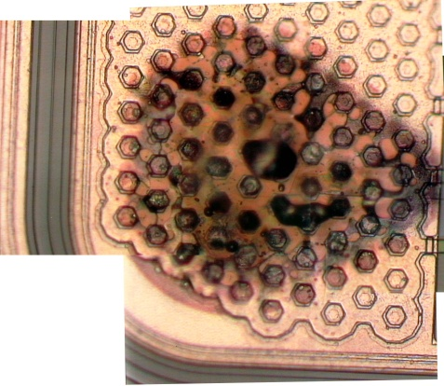
Classification of SEE’s
Non-destructive (soft errors):
  Single Event Transient (SET)
  Single Event Upset (SEU)
    Single Bit Upset (SBU)
    Multiple Bit Upset (MBU)
  Single Event Functional Interruption (SEFI)
  Single Event Latchup (SEL or SELU)… may be also destructive
Destructive (hard errors):
  Single Event Burnout (SEB)
  Single Event Gate Rupture (SEGR)
  Stuck Bits
Power devices do not follow down-scaling dimensions and voltages: they exhibit larger sensitivity to neutron-induced effects, even at sea level
Destructive event
in a COTS 120V
DC-DC Converter
K. LaBel, EWRHE 2004

Slide 5
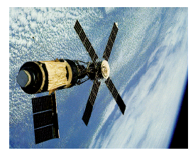

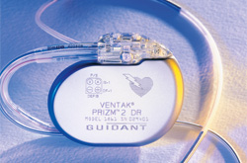
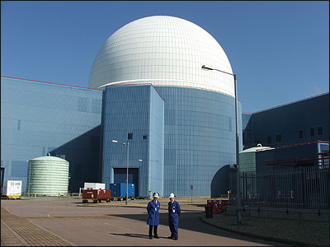
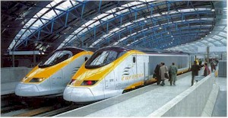

Industrial sectors
SEE concerns for electronics used in:
Aerospace
  Satellites
  Civilian and military aircraft
Medical
  Implanted electronic devices
  (pacemakers, defibrillators…)
Nuclear Industry
  Instrumentation and control
  in proximity to reactors
Transport
  Electronics in cars and trains
  Signalling and traffic control networks
IT Networks and Telecommunication…
5/35
Notes:
5

Slide 6
SEE countermeasures
Single Event Effects in devices/circuits can be mitigated by using different strategies at different levels. For instance:
  circuit level, by using specific technologies or processes for fabrication (such as epi-CMOS, SOI, additional capacitors in SRAM, or rad-hardened electronic components)
  design level, by using ad hoc logic structures aiming to SEE immunity (such as SEE immune latches)
  system level, by modifying the software and/or the hardware (such as triple redundancy)

Slide 7
Current interests in SEE’s
Societal needs for more reliable electronics
Reliability in advanced ICs is improving down to some 10-100 FIT
Electronics is now introduced in Active Security, especially visible in everyday vehicles (Airplanes, Automotives, Railways,…)
Avionic and space industry has a long standing tradition of radiation testing, especially Single Event Effects
More recently the SEE issue has been seriously investigated for its reliability implications even at sea level in everyday life by:
  Semiconductor companies: IBM (since’80s), Intel, STMicroelectronics, TI, Infineon, Cypress, Xilinx,…, but few SEE comprehensive data from companies are available in open literature
  Semiconductor IC customers: even less prone to show their interest, basically no data available
SEE at sea level is dominated by Soft Errors (SE) leading to the Soft Error Rate (SER) figure of merit; if not properly mitigated, SER may reach 10⁵ FIT
1 FIT = 1 failure / 10⁹ hrs

Slide 8
Charge generation
An ionizing particle generates a (dense) track of electron-hole pairs in semiconductors (Silicon) and dielectrics (SiO₂)
The number of generated carriers is proportional to the particle Linear Energy Transfer (LET) coefficient (MeVcm²/mg), i.e., the ionizing energy loss/unit path length (Energy / e-h pair: 3.6 eV in Si, 17 eV in SiO₂)
Dosimetry: 1 rad = 100 erg/g
1 Gy = 1 J/kg = 100 rad
Ion track
hole
electron

Slide 9
Charge generation and collection
Under an external electric field the two columns of carriers recombine and drift: many electrons and holes survive in Si, fewer in SiO₂
Eventually, a net negative/positive charge can be collected
at sensitive nodes: if this charge exceeds a threshold value (critical charge) an event may be observed affecting the circuit
hole
electron
Electric
field

Slide 10
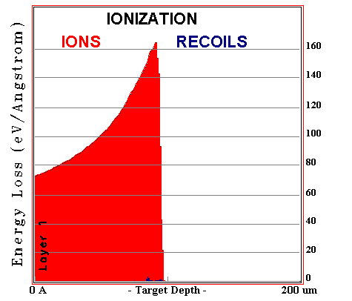
LET = (dE/dx)_{ionization} vs depth
Bragg peak
LET_{max}~170 eV/Å
one hundred
100 MeV ¹⁶O ions
in Silicon
Surface value
LET₀
average RANGE
from SRIM simulation (http://www.srim.org).

Slide 11
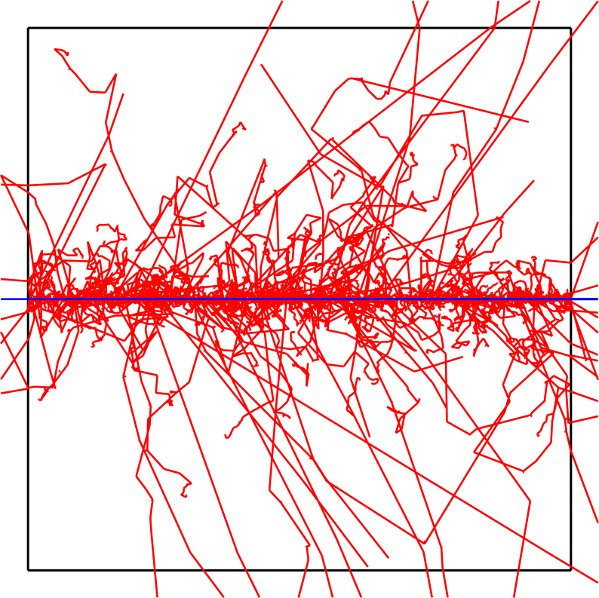
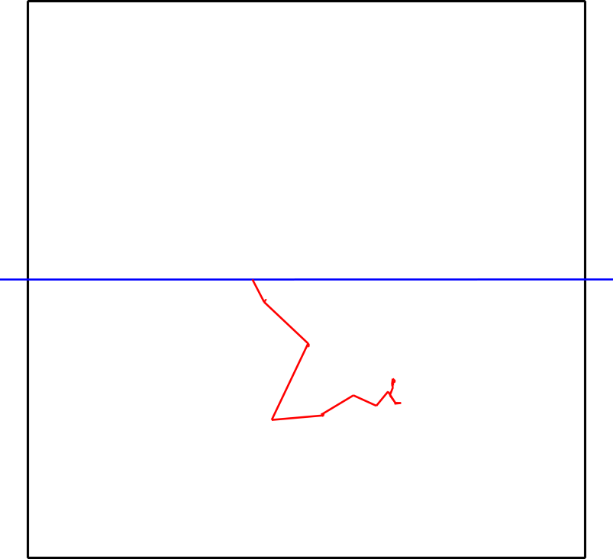
Myth of the Average Event
100 MeV p ⇒Si
e⁻
e⁻
Color code:
Red = e⁻
Blue = + ion
Green = n, γ, etc.
e⁻
e⁻
Average: Track with apparent radial structure, ΔE ≈ 1 keV
Single event: Proton + δ-ray ΔE = 7.8 keV
R. Schrimpf, EWRHE 2004
Notes:
Using current methods, an average track based on LET is calculated and usually a gaussian distribution of energy is fit around that track. The left picture shows many events in silicon. If the average is calculated, the energy deposited is approximately 1keV. The right graph shows a single event in silicon. It is obvious that this single event is significantly different than the average. It deposits 7.8 keV and has a very different track and energy deposition than is yielded by a straight line and a gaussian distribution.

Slide 12
Charge collection in a reverse biased p-n junction
Ion Track
+V
Vss
n+ Si
p-Si
Collection by Drift in the SCR
Electric Field
Potential Deformation
Funnel
Collection by diffusion from the neutral region
Electron-Hole Pairs Generation
Recombination of excess carriers
p+ substrate

Slide 13
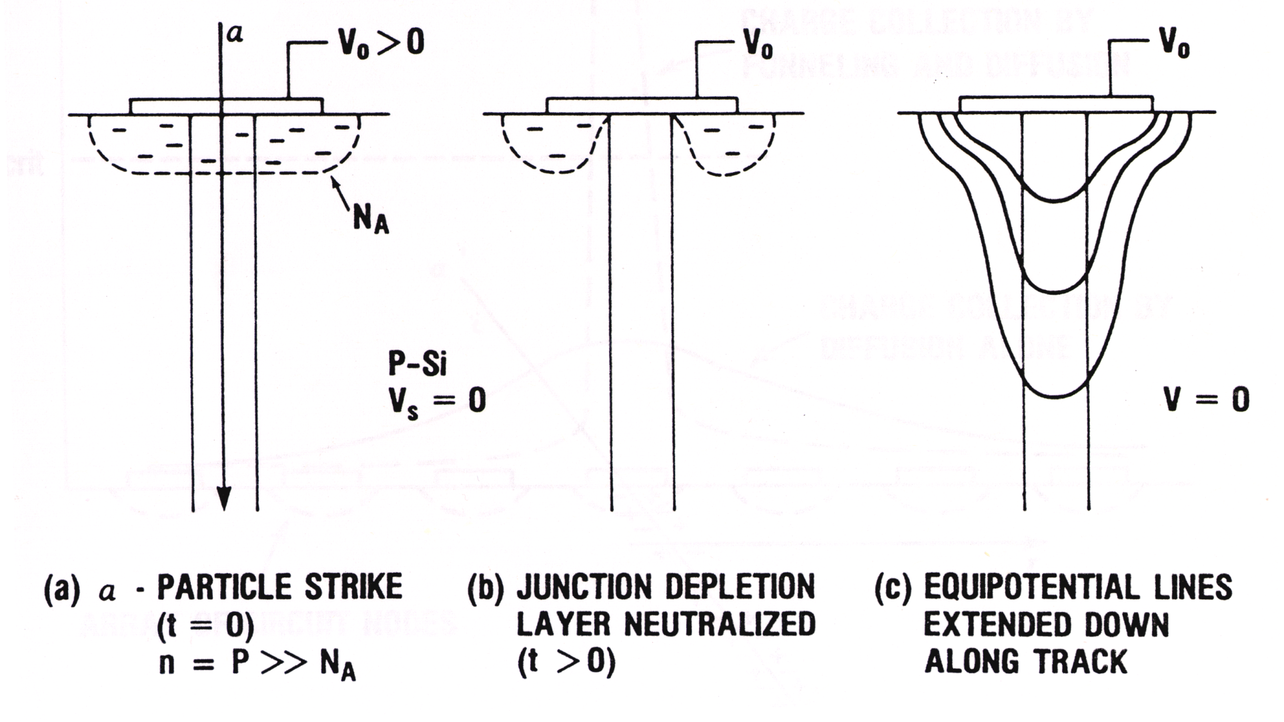
Charge funneling mechanism
Funneling on a Schottky diode (IBM, 1981):
F.B. McLean and T.R. Oldham, IEEE-TNS29, 1982
Notes:
-P-type material, pos voltage, neg depletion layer
-plasma wire collapses depletion region, makes contact with electrode, field extends down along track
-column expands until density approaches background doping level, then depletion region reforms

Slide 14
Time evolution of charge collection
R. Baumann, IEEE-TDMR, 2005

Slide 15
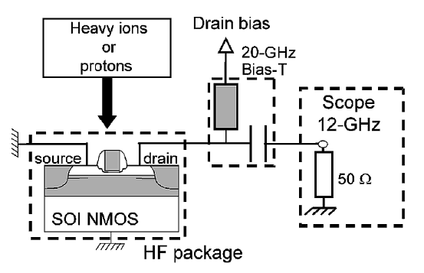
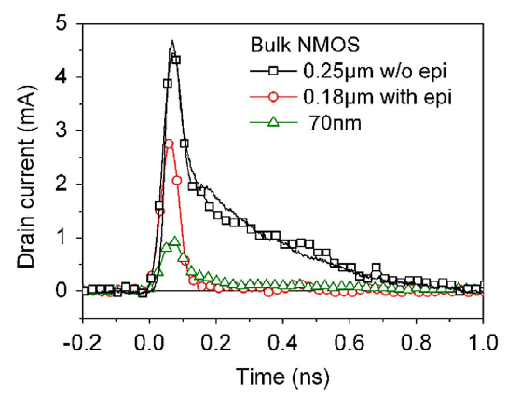
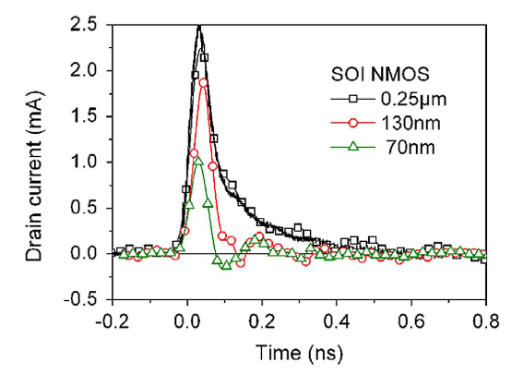
Measurements of SEE induced pulses
Tektronix TDS6124C,
40 Gsamples/s
V. Ferlet-Cavrois et al., IEEE-TNS, 2006
Bulk/SOI NMOSFETs, ⁴⁸Ca ions (LET ∼ 15 MeVcm²/mg)

Slide 16
SEL in CMOS
P. Dodd, IEEE-TDMR 5, 2005

Slide 17
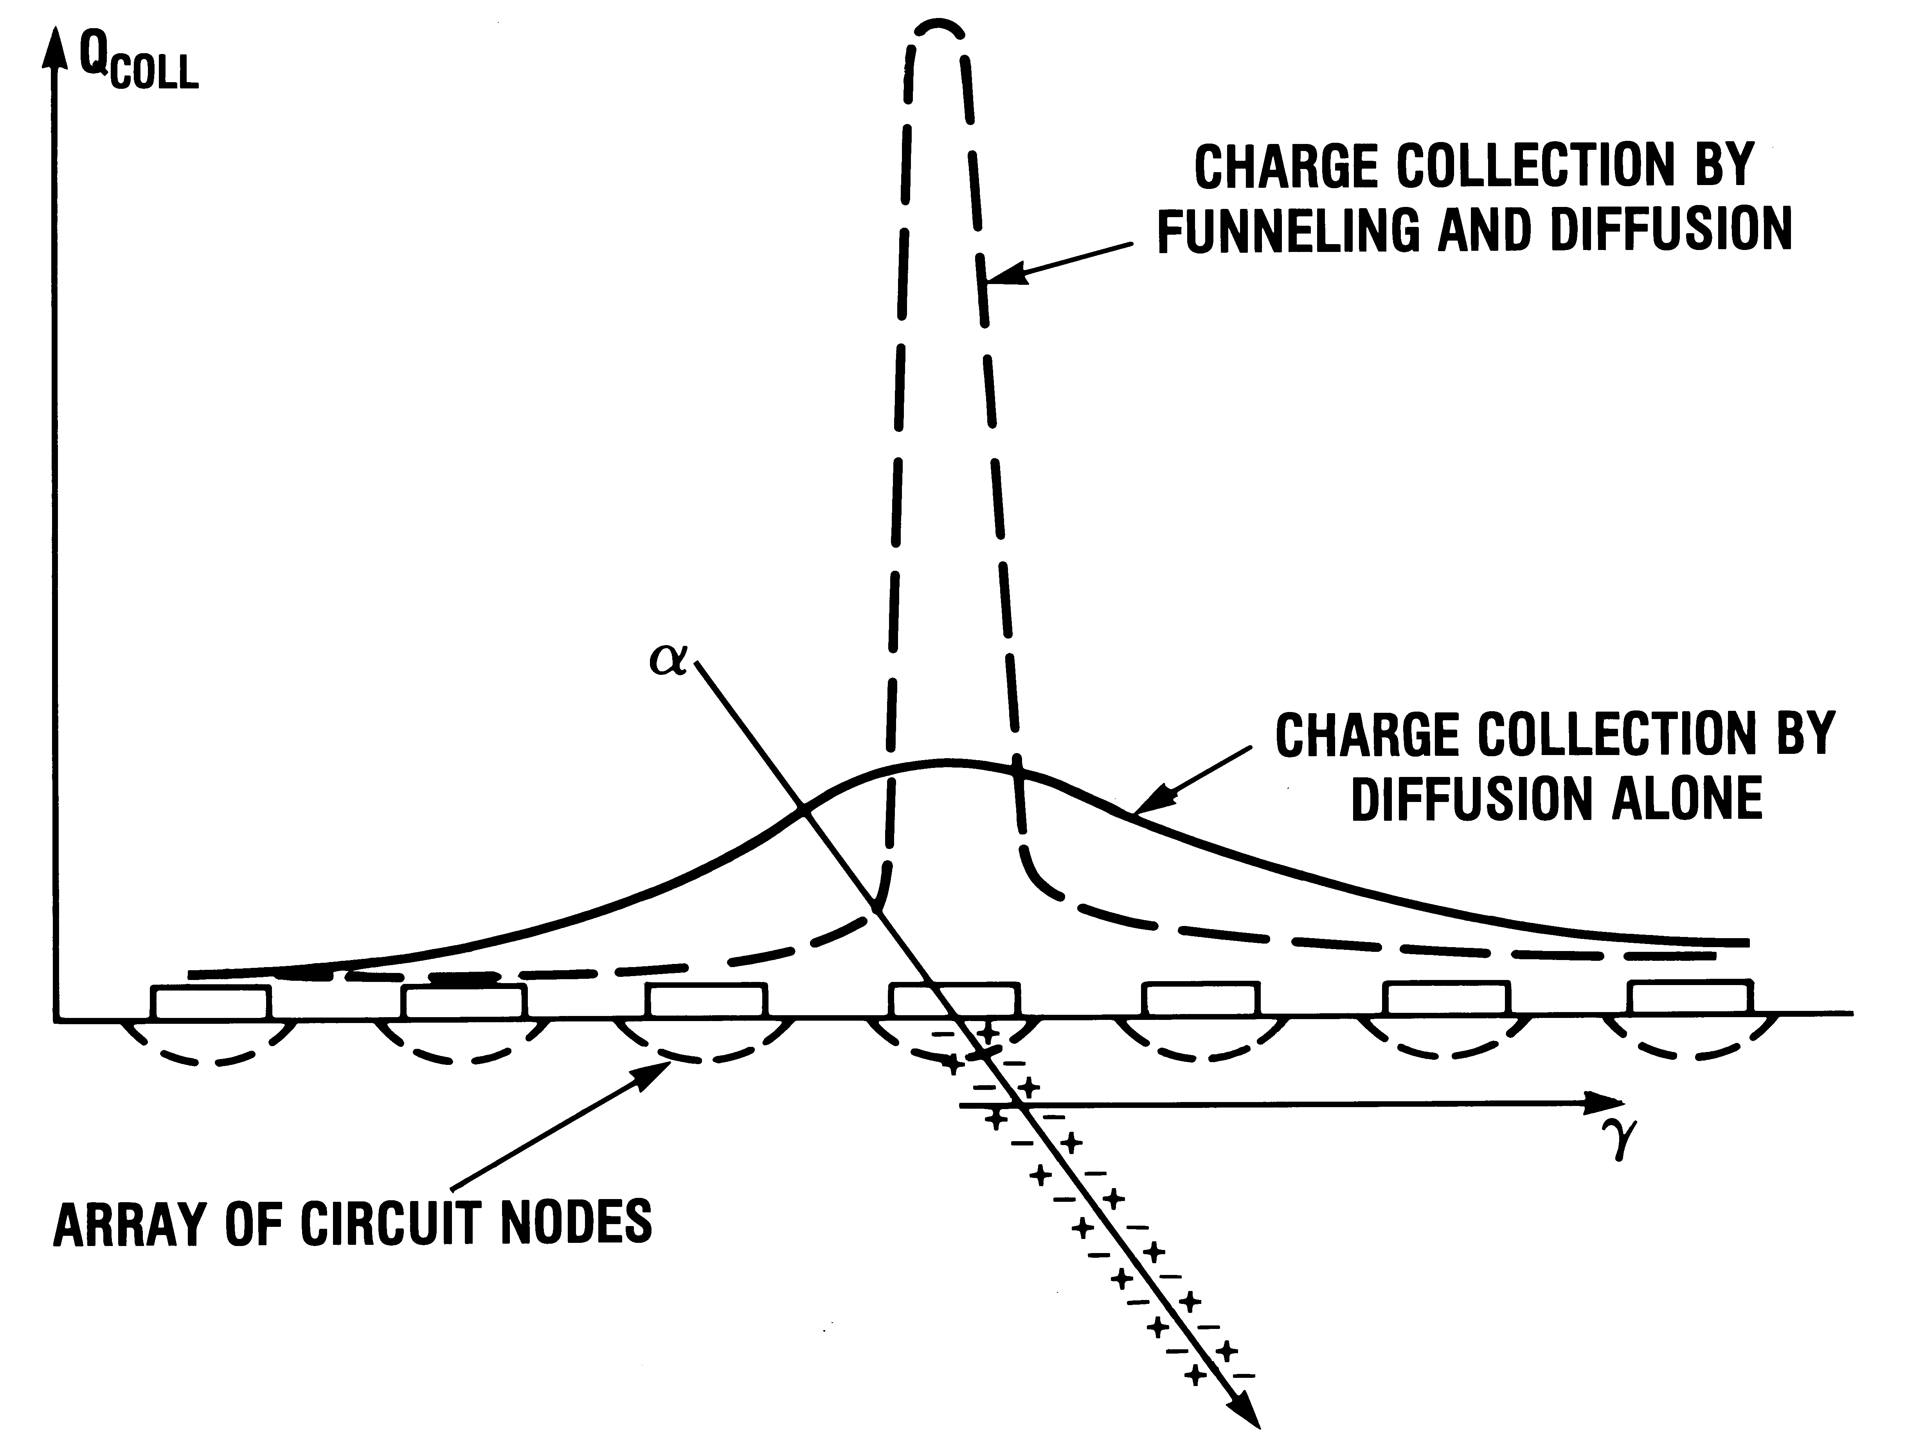
Charge collection across circuits
“Traditional” view of charge collection
in Si circuits fabricated with relaxed CMOS technologies
Only particles at low impact angles may affect different devices, if diffusion charge collection is excluded
T. Oldham, NSREC Short Course, 2003
Notes:
With funneling, enhanced drift collection at stuck node, because fiels extend down into substrate
Less charge collected at other nodes by diffusion
Originally viewed as problem—struck node more likely to upset
Now—rely on error correction to fix struck bit, multiple upsets less likely because of reduced charge collection on most nodes

Slide 18
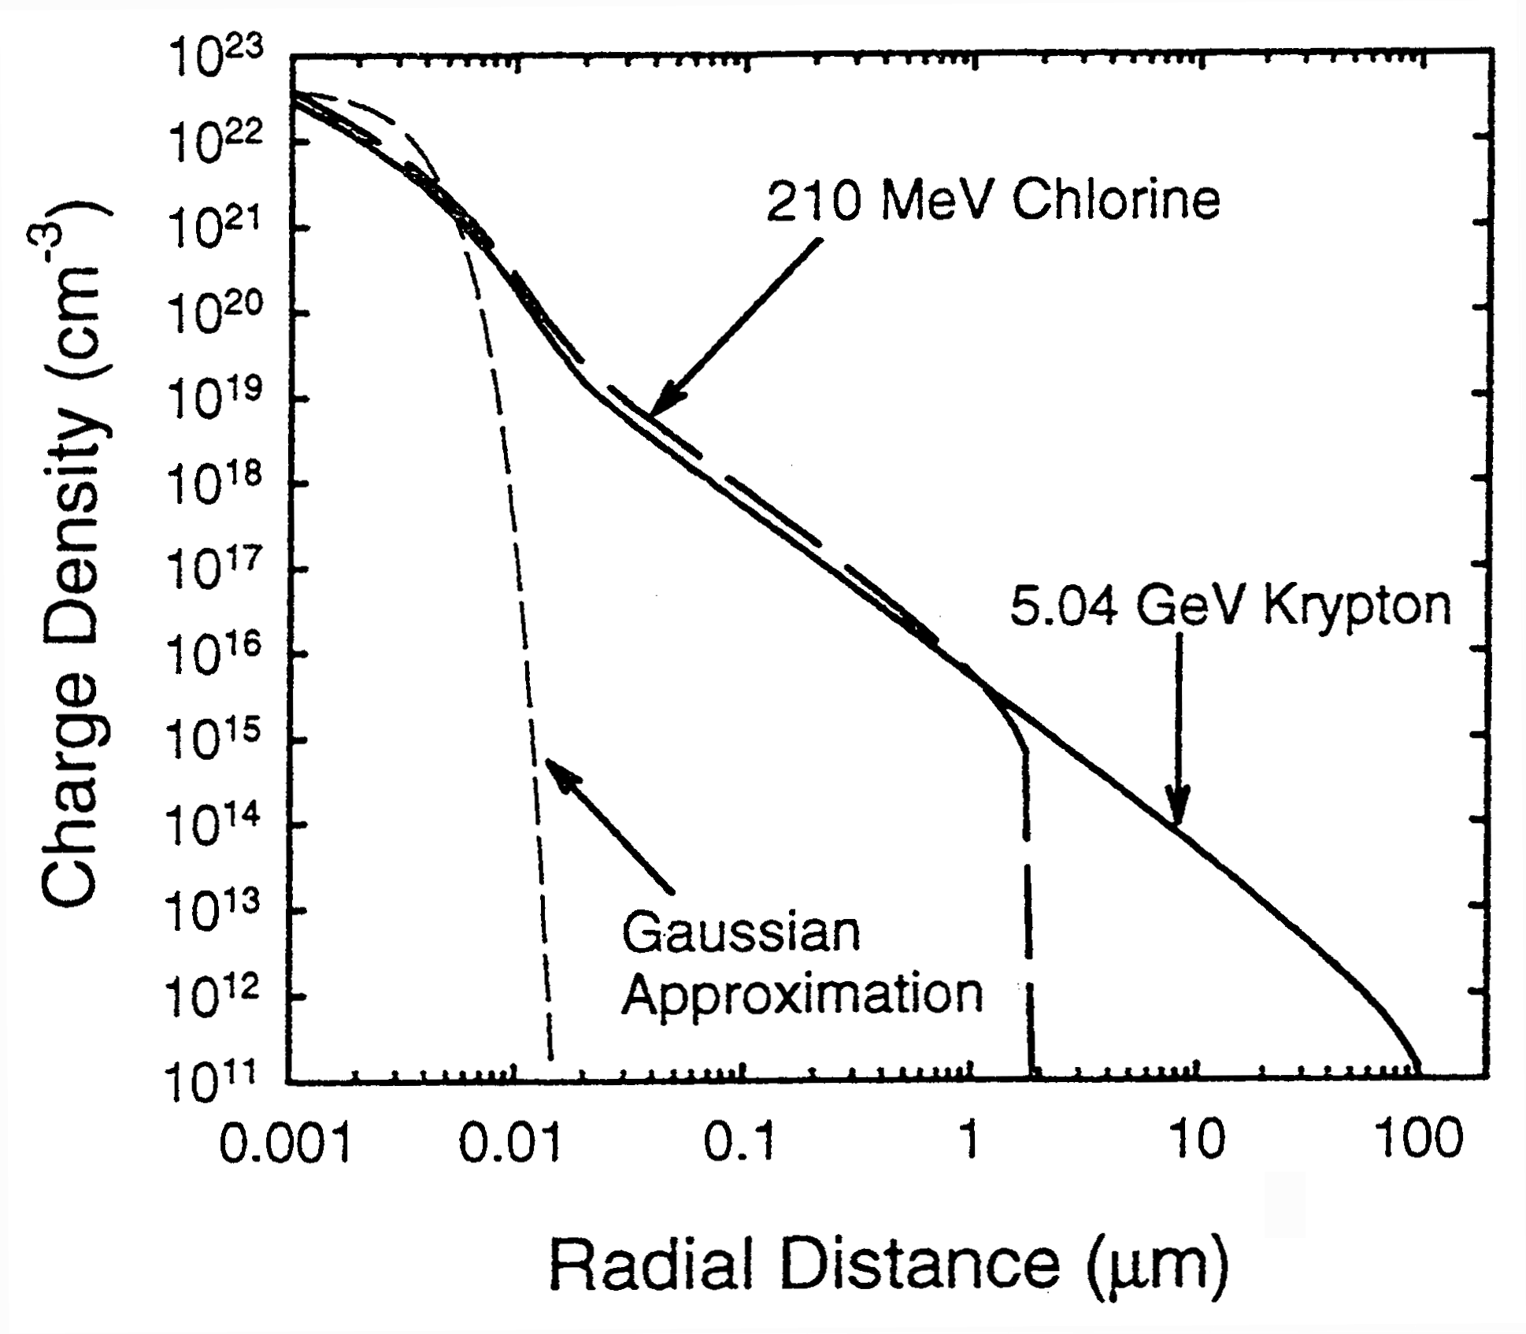
Simulated e-h track structure in Si
Minimum feature size
(∼20 nm) - commercial CMOS
P. Dodd, et al., IEEE-TNS45, 1998
Notes:
-Most charge in dense core
-Low density tail from delta ray electrons
-Deltas from different ions have different ranges, these ion have same LET
-In cases where experimental differences observed for ions with same LET, extent of the delta tail is the only real difference

Slide 19
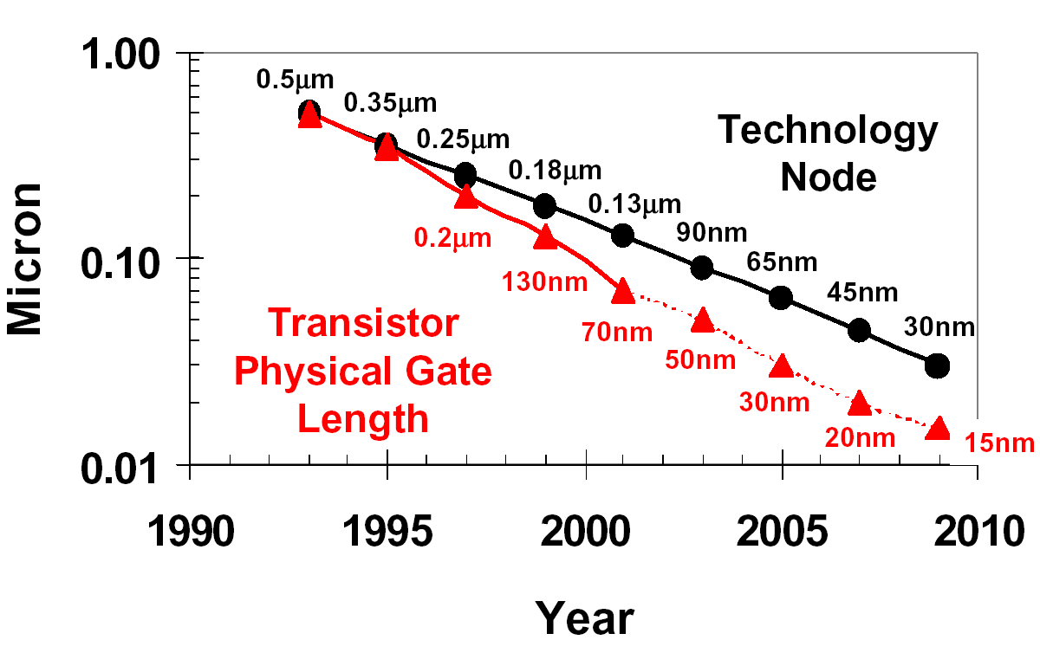
Moore’s Law
Moore’s law is (self-)validated by reducing the device dimension over the years, by scaling down the minimum feature size of the CMOS technology node
Source: INTEL

Slide 20
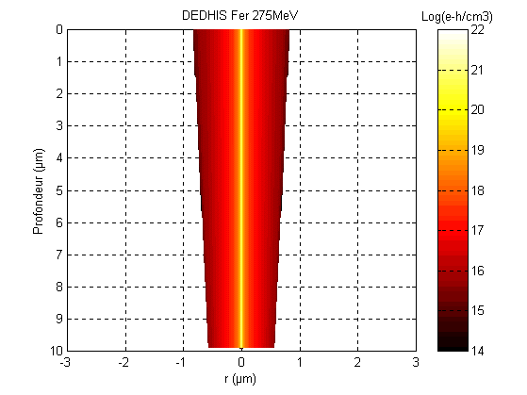
Simulated heavy ion e-h track in Si
Fe ions 275 MeV
LET=24 MeVcm²/mg
LET metrics in Si:
1 MeVcm²/mg
6.4.10⁴ e-h pairs/μm
10 fC/μm
Electron-Hole density (cm⁻³)
P. Foulliat, EWRHE 2004

Slide 21
Heavy ion e-h track in Si vs. CMOS minimum size
CMOS generation
0.35 μm
0.25 μm
0.18 μm
0.13 μm
90 nm
…
32 nm

Slide 22
6-Transistor (6T) CMOS SRAM Cell
WL
V
DD
M
2
M
4
Q
M
Q
M
6
5
M
1
M
3
BL
BL

Slide 23
SE in CMOS inverter: OUT = 1
V_{DD}
A current is observed
0
in
out
PMOS
The output node out is discharged
A current is injected by the PMOSFET into the out node to restore the initial charge and logic value
0
1
ION
V_{SS}
N+
N+
P substrate
P. Fouillat, EWRHE 2004

Slide 24
SE in CMOS inverter: OUT = 0
V_{DD}
No current is observed
1
in
out
PMOS
Only reversed biased junctions of off-state MOSFET drains may effectively collect charge and affect the out node voltage
1
0
ION
V_{SS}
N+
N+
P substrate
P. Fouillat, EWRHE 2004

Slide 25
SEU in SRAM cell
ION
V_{DD}
V_{DD}
0
1
V_{SS}
V_{SS}
1
0
Upsetting a memory cell
P. Fouillat, EWRHE 2004

Slide 26
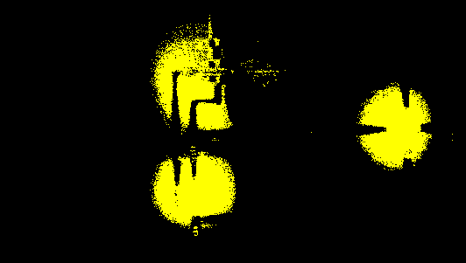
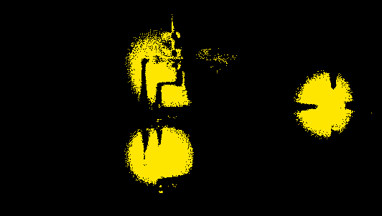
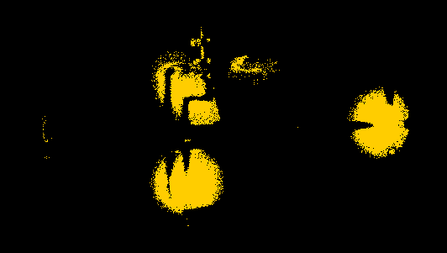
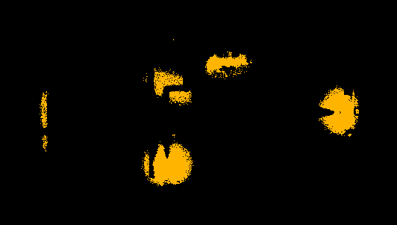
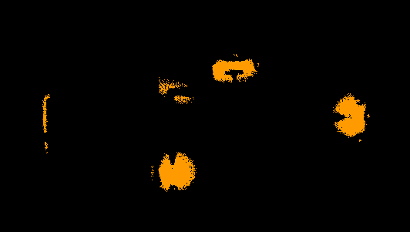
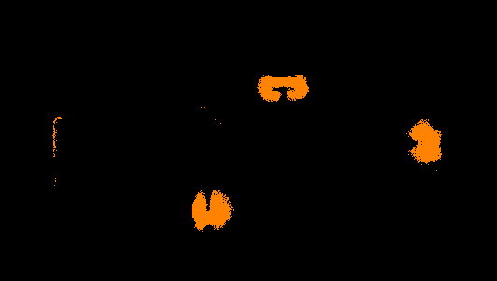
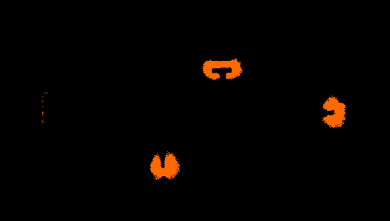
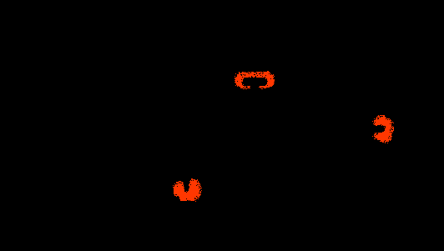
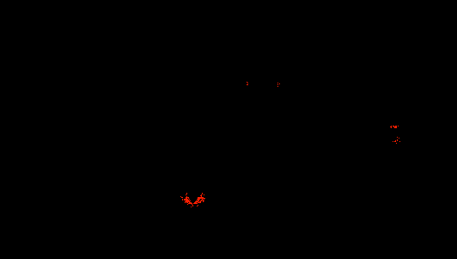
SEU mapping in an SRAM cell
Basic SRAM Test Vehicle (6 transistors)
1193pJ
10 μm
891pJ
588pJ
305pJ
SEU sensitivity map
177pJ
120pJ
Laser Pulse Energy
Red points
=
Single-Event Upset
=
flip of the logical state induced by a single laser pulse
49pJ
30pJ
10pJ
SEU mechanisms
Rate prediction
Design optimisation
P. Fouillat, EWRHE 2004

Slide 27
SEU Laser cross section in SRAM
891pJ
1193pJ
305pJ
588pJ
177pJ
120pJ
49pJ
30pJ
10pJ
P. Fouillat, EWRHE 2004

Slide 28
Testing SRAMs: heavy ions vs. laser
HITACHI A 4Mbits 0.5µm versus NEC 1Mbits 0.8µm
Laser Tests
Heavy ion Tests
P. Fouillat, EWRHE 2004

Slide 29
SEE cross section and threshold LET
LET_{th} is the minimum (threshold) LET to cause the specific SEE
The saturation cross section σ_{sat} is approached at high LET values
The σ(LET) curve is obtained by measuring the cross section at a few LET values and fitting data with a Weibull curve
LET_{th}
R. Velazco, EWRHE 2004

Slide 30
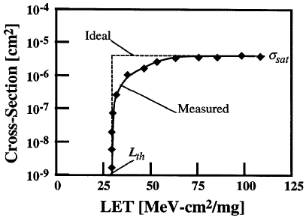
SEE Experiments
The cross section (σ) for Single Event Effects is σ = N_{SEE} / Φ
N_{SEE}: number (counts) of SEE observed
Φ: uniform fluence over some fiducial area
practical flux set by dead-time of DUT (typical few 10÷10⁴ ions cm⁻²s⁻¹)
Statistical Error improves with Fluence…
…however Fluence Limited by Total Dose
typical measured and ideal SEE cross section curves per bit, device, etc.
WEIBULL FIT of threshold curve
σ= σ_{sat}×{1-exp[-(L-L_{th})/W]^{S}}
σ_{sat}: saturation value
L_{th}: threshold LET value
W and s are fitting parameters

Slide 31
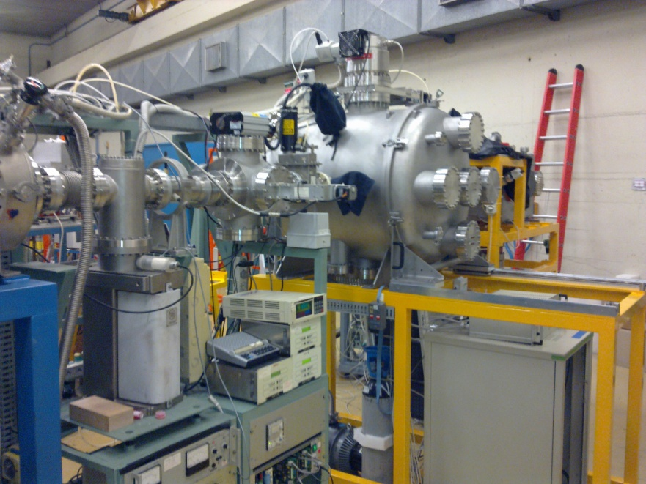
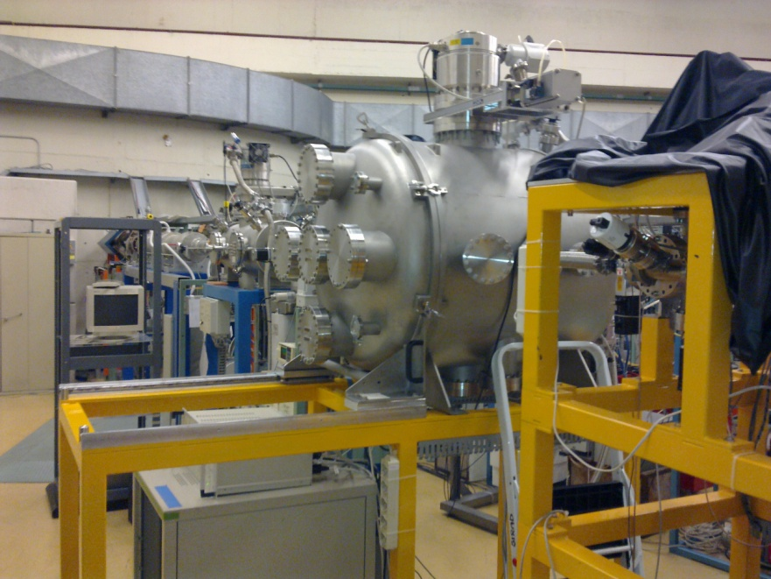
Ion beam test facility
The first Italian beam line dedicated to SEE testing of electronic components: the SIRAD facility at the INFN National Laboratories of Legnaro (Padova) developed by the Padova University group
Irradiation with various heavy ions (H→Au) to evaluate the cross section curve vs. Linear Energy Transfer (LET) for different IC failure mechanisms
X-rays, gamma rays and alpha
radioactive sources also currently
used for device testing

Slide 32
For SEE, the cross-section/bit tends to decrease with CMOS technology downscaling
Scaling trends of SEE sensitivity
[Ph. Roche, STMicroelectronics, QCA Days 2009]

Slide 33
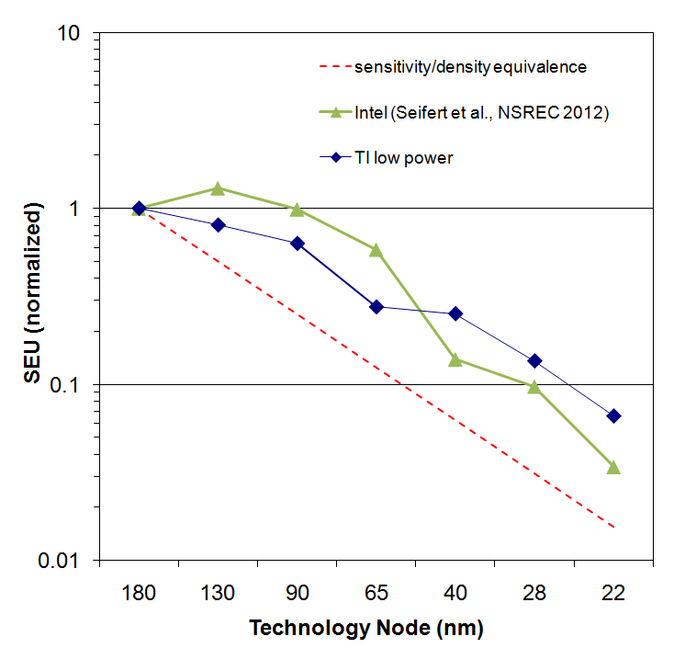
Bit vs. System SRAM SER
Since 180/130nm SEU sensitivity has been getting lower with each technology node for terrestrial applications.
Overall the sensitivity reduction has not kept up with density increases until the last 3 generations
R. Baumann, Radsol 2012

Slide 34
New features of SEE’s
New effects are observed on state-of-the art IC’s thanks to the shrinking of the transistors’ size:
  Multi-cell hits
  Charge sharing
  Grazing angle effects
  SEU bursts
  MBUs rising
  …

Slide 35
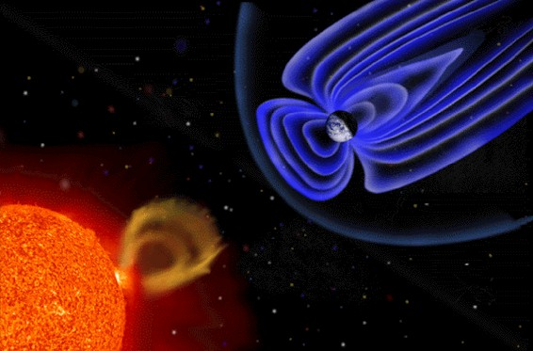
Geomagnetic/solar effects
Primary Cosmic Rays:
  Galactic Particles (E >> 1 GeV)
    Left-overs from the Big Bang?
    Super Nova remnants?
  Solar Wind (usually E < 1 GeV)
Composition (E up to 10²⁰ eV):
  92% Protons/Electrons
  6% Alpha Particles (He)
  2% γ rays and heavier nuclei
Courtesy NASA Homepage

Slide 36
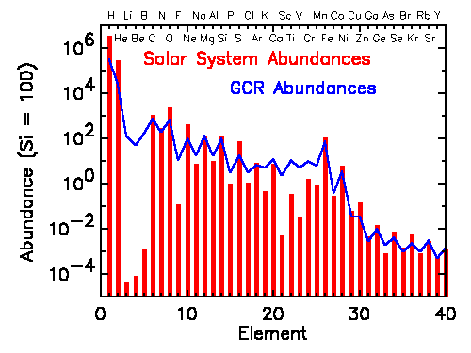
Cosmic rays composition
Primary Cosmic Rays:
  Galactic Particles (E >> 1 GeV)
    Left-overs from the Big Bang?
    Super Nova remnants?
  Solar Wind (usually E < 1 GeV)
Composition (E up to 10²⁰ eV):
  92% Protons/Electrons
  6% Alpha Particles (He)
  2% γ rays and heavier nuclei
Courtesy NASA-GSFC

Slide 37
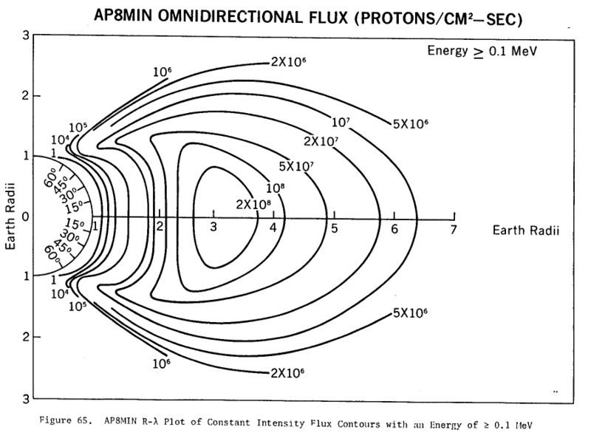
Protons in Van Allen belts
The proton belts contain protons with kinetic energies ranging from about 100 keV to over 400 MeV

Slide 38
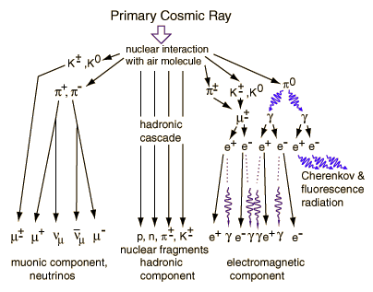
Cosmic Shower Composition
Galactic Cosmic Rays: diffuse galactic background,
heavy nuclei
most up to 10 GeV/amu. But some up to up to 10²⁰ eV (10¹¹ GeV) = 16 joules!
anti-correlated with solar activity: solar flux scatters incoming charged particles

Slide 39
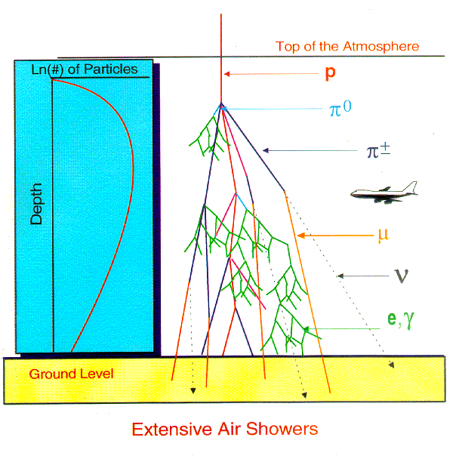
Extensive Air-showers
Pfotzer (1936)
discovered
maximum
ionisation
at ∼ 15 km altitude
⇒ thick atmosphere
sustains stable life
at sea level
nuclear debris (p, n, fragments)
max
crew 200 mrem/year
neutron flux
at sea (ground) level:
10⁵ neutrons/cm²-year
with E>20 MeV

Slide 40
Atmospheric particles flux
  Cosmic ray differential neutron flux at sea level
R. Gaillard, EWRHE 2004
  Cosmic ray induced particle flux at different altitudes

Slide 41
Sources of Single Event Effects
Space applications:
  High-energy heavy ions
    Long range in Si, large LET, direct interaction
  High-energy protons (trapped, solar, cosmic)
    Direct / Indirect interaction through nuclear reactions
Terrestrial and avionic applications:
  High energy neutrons (cosmic ray byproducts, E>1-10 MeV)
    Indirect interaction through nuclear reactions
  Low energy neutrons (thermal)
    Indirect interaction via ¹⁰B nuclear reaction
  Alpha particles from radioactive decay of contaminants (from U, Th decay chains) in the chip/package/solder
    Short range in Si, small LET, direct interaction
  Muons: a concern for future technolgical generations

Slide 42
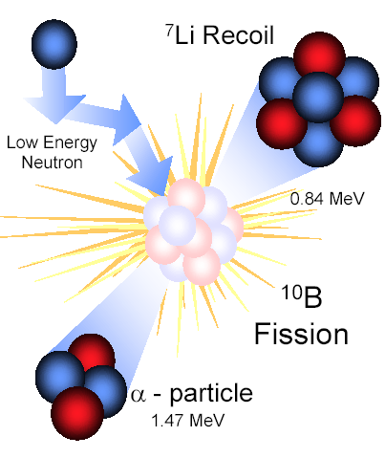
Thermal neutrons cross section

Slide 43
Alpha particle emission rates
Material | Emission rate (α/cm²-hr)
Bare Si | 0.00020
Plastic (epoxy) | 0.00080
Ceramic lid A | 0.15
Ceramic lid B | 3.10
Ceramic DIP A | 0.02320
Ceramic Dip B | 0.03230
Ceramic Dip C | 0.02610
Plastic DIP A | 0.00109
Plastic DIP B | 0.00124
Industrial
goal: 10⁻³
-10⁻⁴ Alpha/cm²h
as tradeoff
between
cost and
purity
L. Lantz, IEEE-TR45, 1996
Notes:
Plastic packaging as radiation hardening technique—alpha activity rate lower for plastic than most other pkg materials
Industry looked at plastic to reduce alpha problem, eventually discovered also cheaper—no holding back then

Slide 44
SEE ground testing
SEE tests are performed to evaluate the expected error / failure rate of the device/system in the specific operating environment (Space, HEP, Avionic, Sea level,…) by using:
  Ion beams from accelerators
  Neutron beams _{accelerated tests}
  Alpha sources
  Lasers
  A large number of devices operating under low intensity radiation (unaccelerated tests: the Rosetta experiment)
The SEE sensitivity of each SEE type (SEU, SEL, SEB, …) in any particular device is evaluated by measuring the corresponding
cross section vs LET:
  Cross section : σ(LET) = # Events / particle fluence →(cm²)
The error rates in operating condition is derived from cross sections and the features (nature of particles, corresponding fluxes, mission duration) of the actual environment
Error rate = # errors / device day

Slide 45
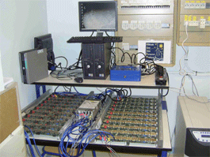
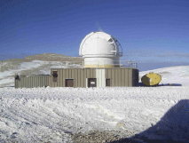
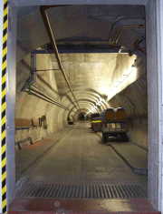
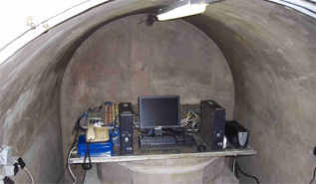
The Rosetta Experiment
How to discriminate between cosmic ray neutron and alpha induced SEEs in operating devices?
200 Xilinx VirtexII Pro devices under test
Pic de Bure, 2552 m
Rustrel, -550 m

Slide 46
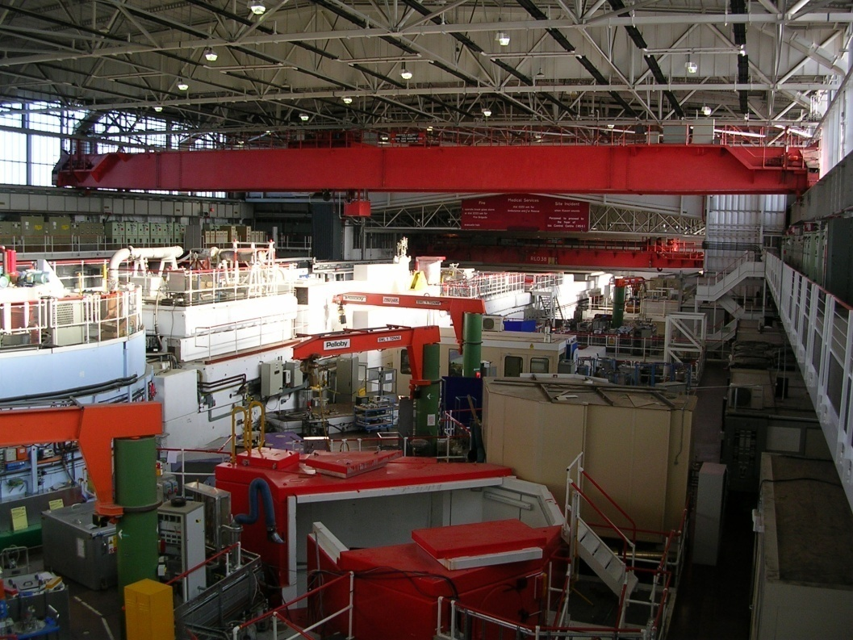
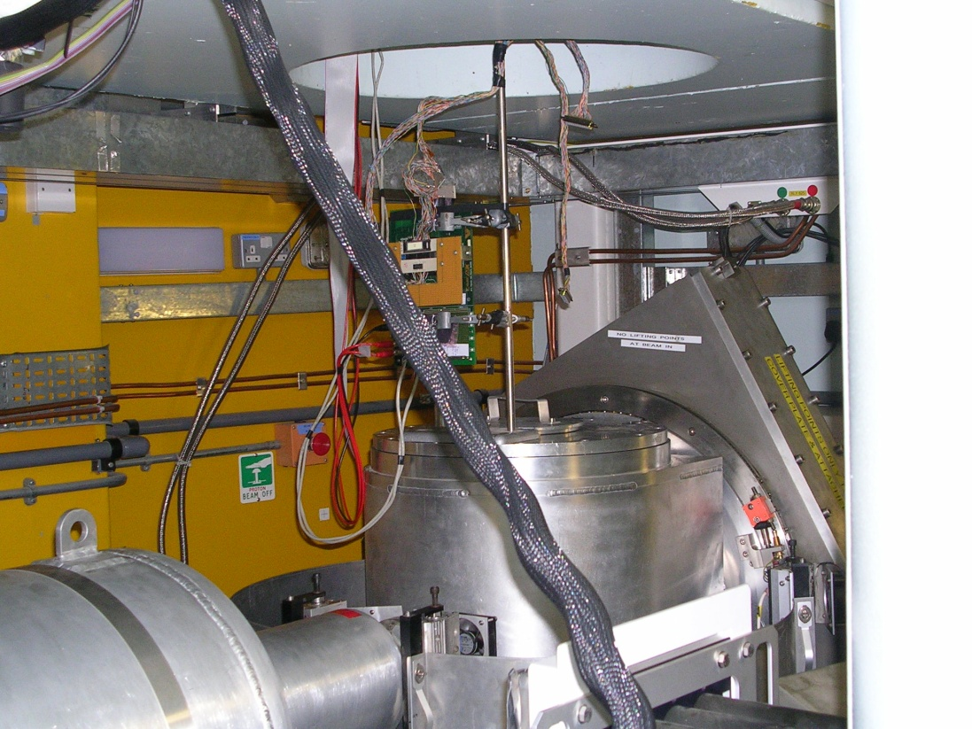
Neutron/muon beam test facility
The first SEE testing of electronic components under a continuous energy spectrum in Europe has been recently performed at the ISIS-RAL labs, Didcot,UK, by the Padova group

Slide 47
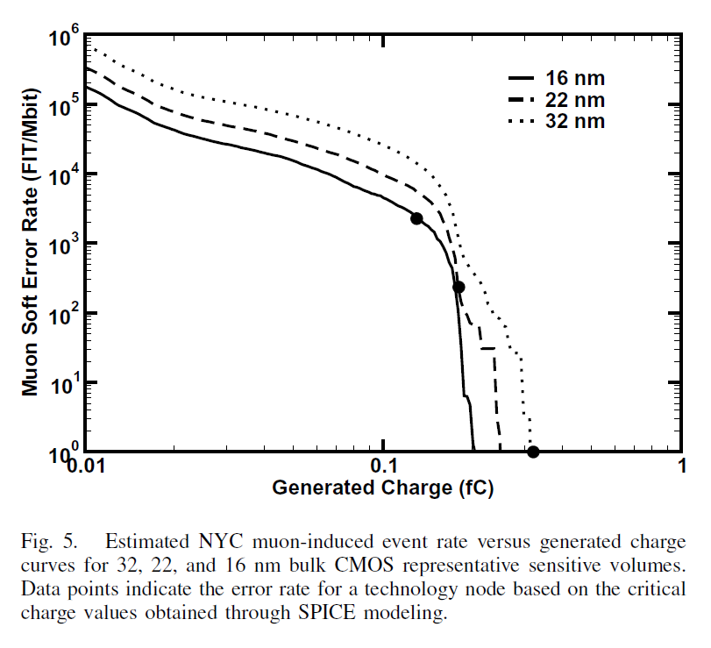
Future Mechanisms?
R. Baumann, Radsol 2012
Proton SER
Muon SER
σ for direct ionization
σ for prior technologies
n + α SER
Terrestrial Protons may also dominate as Q_{crit} is reduced due to the much higher cross-section for direct ionization.
When Q_{crit} reaches 0.2 fC SER will double from muons alone and at 0.1 fC SER will be 5-10x higher. Note: Q_{crit} for 40nm is ~ 0.6 to 1.2 fC

Slide 48
Summary
Single event effects are produced by collecting the charge generated (usually in the semiconductor) by a single ionizing particle: charge > critical charge
The e-h track may include more than one active device (e.g., MOSFET)
Different SEE’s may occur depending on the device type, being either soft or hard in nature
Each SEE for a specific device is characterized by its cross section and threshold LET
SEE’s are expected not only in radiation harsh environments but also at sea level
SEE sensitivity may decrease as the CMOS minimum size is reduced to the deca-nm scale
Irradiation facilities: an open issue

