Slide 1

Nuclear Physics for Hadron Therapy
G. Battistoni, INFN Milano

Slide 2
Outline
Introduction: the basics of hadron therapy
The role of Monte Carlo in particle therapy
The Bragg peak and related physics
The fragmentation of nuclear projectiles
The control of treatment:
  production of β⁺ emitters
  emission of prompt gamma rays
  emission of charged particles

Slide 3
Credits
U. Amaldi, Tera Foundation
V. Patera, Univ Roma 1 and INFN
A. Ferrari, CERN
T. Böhlen, CERN
P. Sala, INFN
A. Mairani, CNAO
M. Durante. GSI

Slide 4
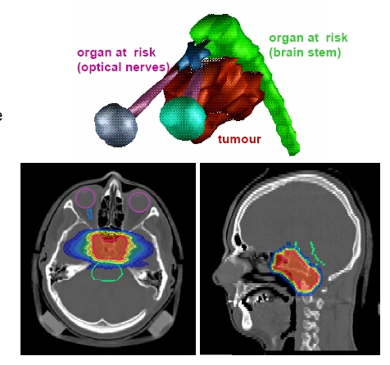
Oncological Radiotherapy
“Conventional”: photons (from accelerated electrons)
Hadron Therapy (“Particle Therapy”): protons or Light Ions (Z<18)‏
Purposes
Deliver a high dose to tumoral tissue
”Conformal” dose distribution on the target volume
Spare as much as possible healthy tissues and “Organs at Risk”

Slide 5
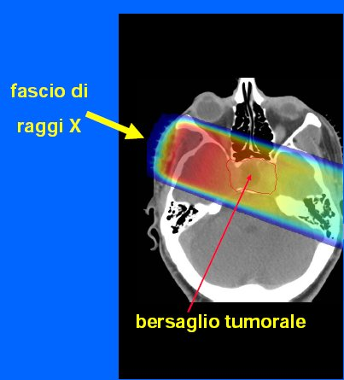
Basic strategy of radiotherapy
(fonte: Prof. U.Amaldi)

Slide 6
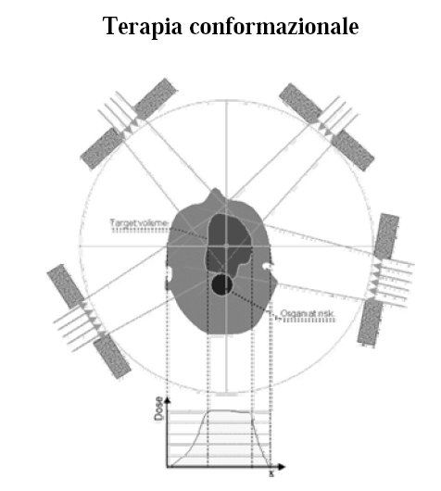
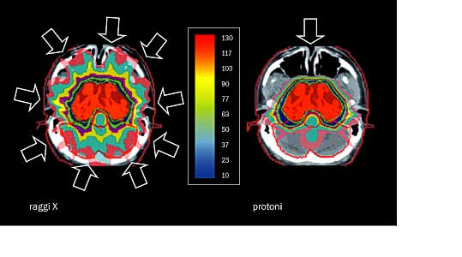
Use of multiple beams (different directions)
Also:
Modulation of intensities

Slide 7
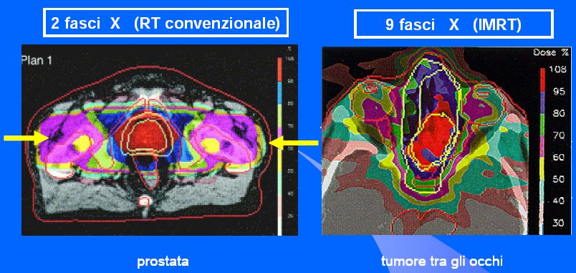
Examples of different solutions
(fonte: Prof. U.Amaldi)

Slide 8
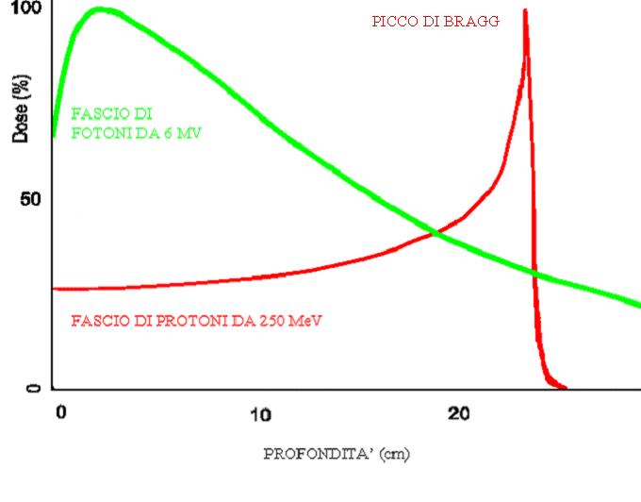
Motivation of Particle Therapy (hadrontherapy)

Slide 9
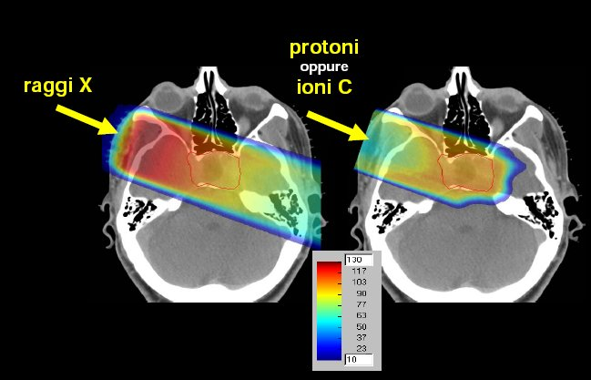
(fonte: Prof. U.Amaldi)
“Charged Particle Therapy” to better preserve healthy tissues ans organs at risk

Slide 10
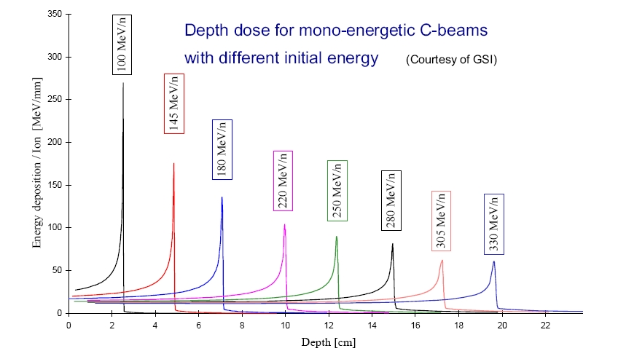
Release of dose modulated in depth
Beams at edifferent energies delever dose at different depths

Slide 11
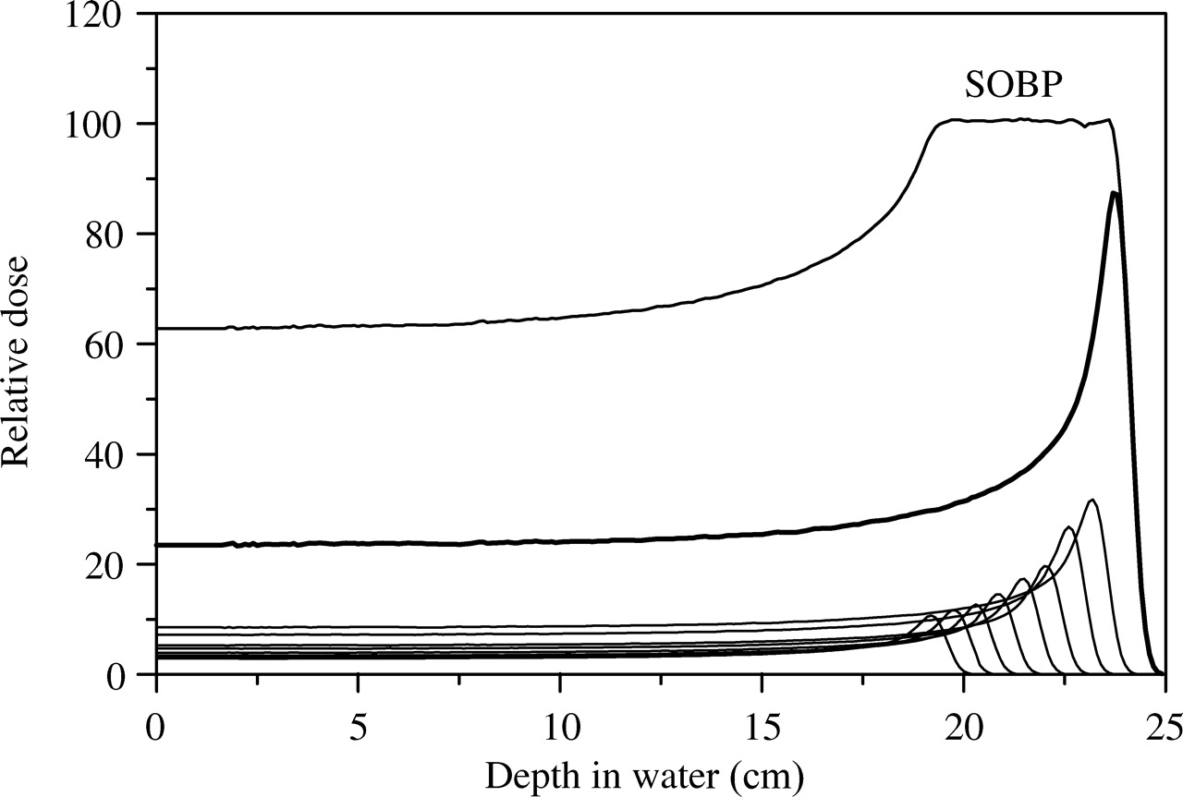
Longitudinal conformation: the concept of Spread Out Bragg Peak (SOBP)

Slide 12
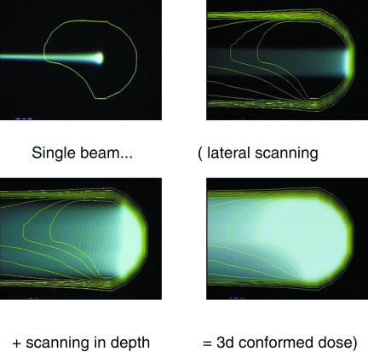
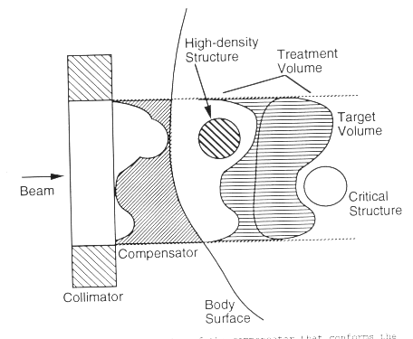
Different ion beam delivery strategies
Passive conformation of scattered
broad beam with compensator (distal
edge) and collimator (lateral shaping)
Active conformation via energy
variation and lateral magnetic
deflection of pencil-like beams
Broad
beam
Pencil
beam
Chu et al, Rev Sci Instrum 1993
http://p-therapie.web.psi.ch/
Notes:
12

Slide 13
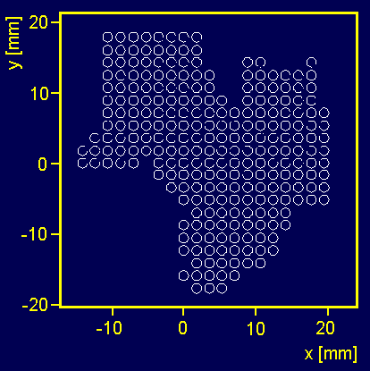
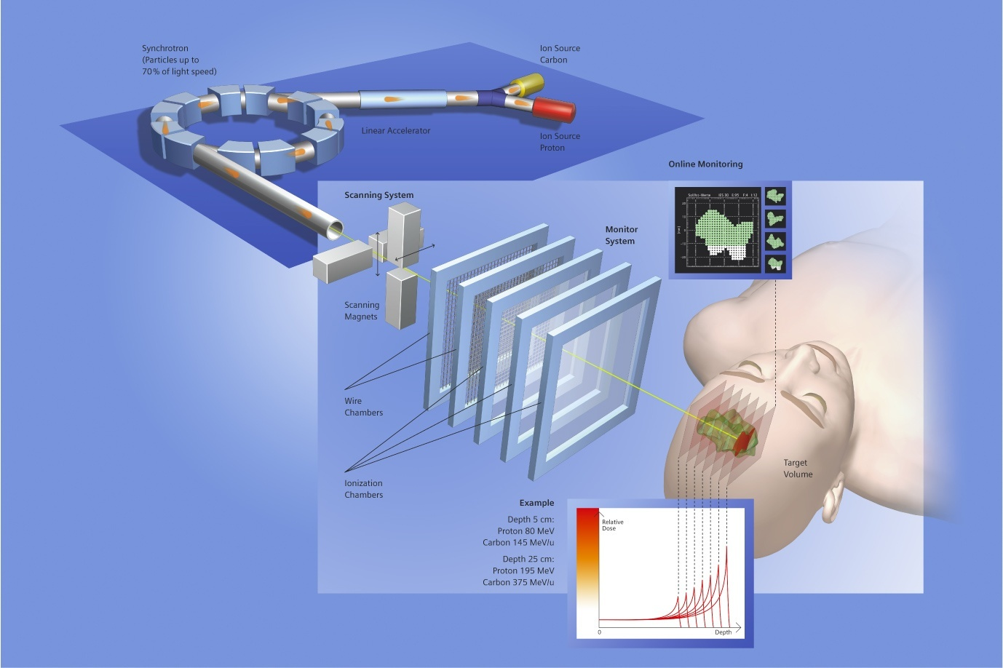
Rasterscan Method @ GSI / HIT/ CNAO
scanning of
focussed
ion beams
in fast
dipole magnets
active variation
of the energy,
focus and
intensity in the
accelerator and
beam lines
Haberer et al., NIM A , 1993
Notes:
13

Slide 14
The Fundamental Formula
area A
N protons
Δx
The equation relating dose to fluence and stopping power is the starting point of most beam line design problems. From the figure :
dose = fluence × mass stopping power

Slide 15
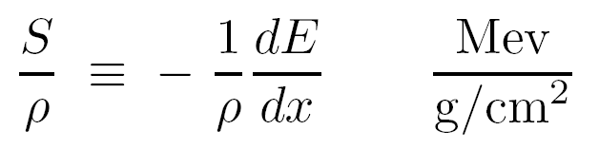
Basic physics ingredients
Knowledge of Stopping power: S ≡ – dE/dx (MeV/cm) mass stopping power:

Slide 16
Charged particle dE/dx: Bethe-Bloch and corrections
∼ln β⁴γ⁴ relativistic rise
Spin 0
(spin1 is similar):
I : mean excitation energy , material-dependent;
δ : density correction;
C : is the shell correction, important at low energies
T_{max} : maximum energy transfer to an electron (from kinematics);
L₁ : Barkas correction (z³) responsible for the difference in stopping power for particles-antiparticles;
L₂ : Bloch (z⁴) correction
G : Mott corrections
Valid for m>>m_{e,} However, the formulation for electron/positrons is similar, except for the “energetic” collisions with atomic electrons.
16
16

Slide 17
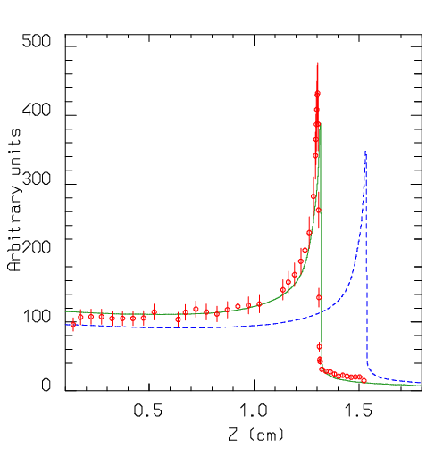
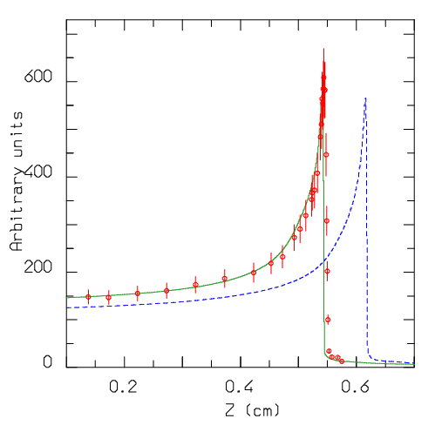
Mott corrections
Example of effect of Mott corrections implementation in the stopping power, in its fluctuations and in the delta-ray spectrum in the FLUKA MC code.
σ_{Mott} parametrization adapted from by T. Lijian, H. Qing and L. Zhengming, Radiat. Phys. Chem. 45 (1995) 235
Remarkable effects are found for high Z ion beams,
effect non negliglible for C beams at therapy energies
²³⁸U range in copper
500MeV/n
950MeV/n
[data from A.A. Golubev et al, NIMB 263 (2007) 339]
17
17
Notes:
M.C.Morone, IEEE 2012M.C.Morone, IEEE 2012
M.C.Morone, IEEE 2012
17

Slide 18
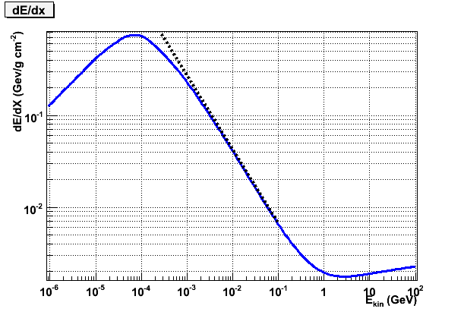
Different behavior at very low energy
p on Carbon (FLUKA Monte Carlo)
Bethe-Bloch behaviour

Slide 19
Coulomb collisions: “nuclear” stopping power
The “nuclear” stopping power is the energy loss due to Coulomb collisions with atomic nuclei, rather than with atomic electrons
The nuclear stopping power is usually negligible with respect to the electronic stopping power, apart at low energies/heavy ions

Slide 20
“Nuclear” (S_{n}) vs “Electronic” (S_{e}) stopping power
The total (S), nuclear (S_{n}) and electronic (S_{e}) stopping power for Oxygen ions in Silicon (left), and Silver ions in Gold (right). The abscissa is the ion total kinetic energy. The partition function S_{n}/(S_{n}+S_{e}) is also plotted

Slide 21
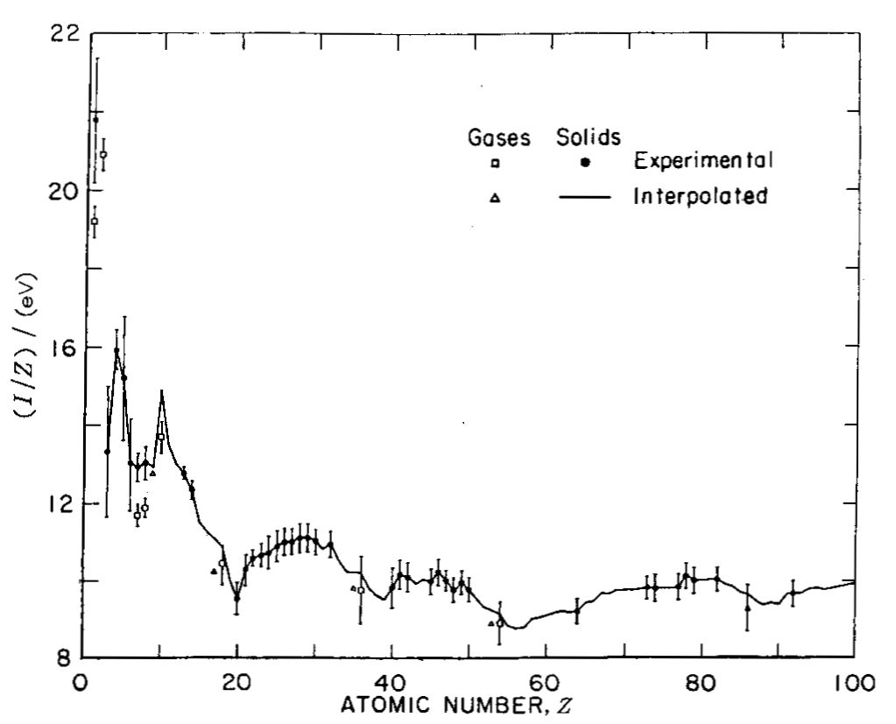
Mean Excitation Energy: I
This graph from ICRU 49 [2] shows the dependence of I on atomic number Z. Irregularities in I/Z vs. Z are caused by atomic shell structure. It’s obvious that interpolating I accurately between measured values (from range or stopping power measurements) is not easy.
Compounds and molecules are more complicated because I is affected by chemical bonding. Water turns out to be a particularly difficult case, which is unfortunate.
Mixtures obey the Bragg additivity rule, which is easily derived by assuming the absorber to be composed of several discrete sheets:

Slide 22
The Physics of Bragg Peak
The shape of the Bragg peak depends on:
variation of stopping power with energy
the transverse size of the beam,
range straggling: the peak of the depth-dose distribution increases in absolute width as beam energy increases.
beam energy spread,
nuclear interactions,
low energy contamination,
effective source distance,
Experimentally: on the dosimeter used in the measurement.

Slide 23
Prom PTCOG lectures: Anatomy of the Bragg Peak
1/r² and transverse size set peak to entrance ratio
overall shape from increase of dE/dx as proton slows
width from range straggling and beam energy spread
nuclear buildup or low energy contamination
nuclear reactions take away from the peak and add to this region
depth from beam energy

Slide 24
Nuclear Buildup
The ‘local energy deposition’ approximation fails at the entrance to a water tank where longitudinal equilibrium has not yet been reached. You can see this if you measure a Bragg peak vertically so that the proton beam enters from air. This scan, courtesy of IBA, is from the Burr Center.

Slide 25
Transverse Equilibrium
The fluence on the central axis of a pencil beam decreases with depth because of out-scattering of the protons. The dose on axis (fluence × stopping power) therefore goes down; the Bragg peak vanishes. A scan along the axis with a small ion chamber would show this; a scan with a large one would not.
In a broad beam the axial fluence is restored by in-scattering from neighboring pencils (transverse equilibrium). A scan along the axis with a small ion chamber will therefore measure the ‘true’ Bragg peak.

Slide 26
Measurements are fundamental but a calculation tool is necessary: the role of Monte Carlo
Realistic description of particle interactions, especially in complex geometries and inhomogeneous media where analytical approaches are at their limits of validity
Possibility to investigate separate contributions to quantities of interest which may be impossible to be experimentally assessed and/or discriminated
Startup and Commissioning of new facilities: e.g., shielding calculations; beamline modeling, generation of input data for Treatment Planning (↓ meas. time)
Validation of dose calculations: in water-equivalent system and in patient anatomy (CT)
Dedicated applications: imaging of secondary emerging radiation for treatment verification (PET, prompt gamma…)
KEY ISSUES: reliability of physics models

Slide 27
The case of FLUKA code. Short description:
FLUKA is a general purpose tool for calculations of particle transport and interactions with matter
All Hadrons (p, n, π, K, pbar, nbar, (anti)hyperons…)
Electromagnetic (γ, e^{+/-}) and μ and ν
Nucleus-nucleus
Low energy neutrons (0-20 MeV, multigroup, ENDF… )
Full mixed field capability
Transport in magnetic field
Combinatorial (boolean) and Voxel geometries
Double capability to run either fully analogue and/or biased calculations
On-line evolution of induced radioactivity and dose
Radiation damage predictions (NIEL, DPA)
User-friendly GUI interface thanks to the Flair interface
1 keV-1000 TeV
More than 5000 users all over the world
http://www.fluka.org

Slide 28
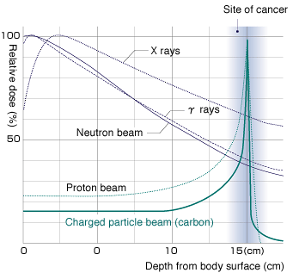
Charged Particle Therapy with Light Ions heavier than protons
Light ions advantages in radiation treatments of tumor wrt IMRT:
Better Spatial selectivity in dose deposition: (p,¹²C)
Reduced lateral and longitudinal diffusion (¹²C)
High Biological effectiveness (¹²C)
Treatment of highly radiation resistent tumours, sparing surrounding OAR
Additional involved nuclear physics:
nuclear reactions of projectile ➔ fragmentation,…

Slide 29
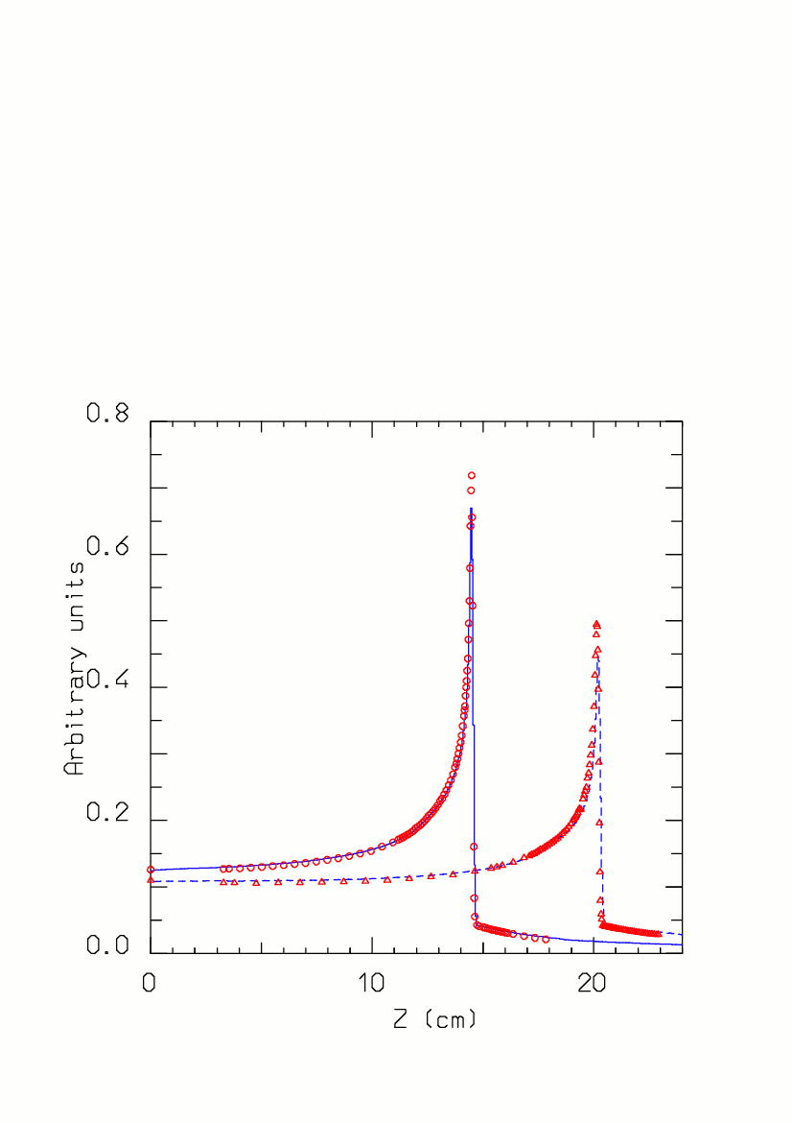
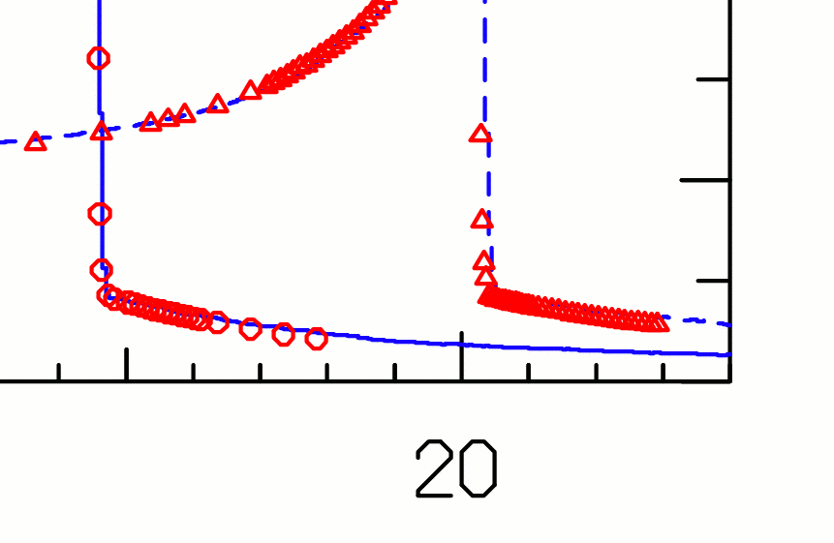
¹²C Bragg peaks vs exp. data
Experiment: circles (270 AMeV) and triangles (330 AMeV)
FLUKA: lines
Sommerer et al: Phys. Med. Biol. 51 2006

Slide 30
Accurate MC calculations: playing with a proton beam
Dose vs depth
energy deposition
in water for a 200 MeV p beam with various approximations for the physical processes taken into account

Slide 31
The relevant aspects of Nuclear Physics
Proton therapy (p, E: 10-250 MeV):
  Reaction cross sections (beam attenuation) +++
  Elastic cross sections +
  Particle (p,n,α..) emission + (mostly for background, ++ radiobiology)
  Positron emitter production + (“+” only because data available)
  gamma de-excitation
Therapy with light ions (ions, E: 10-400 MeV/n):
  Reaction cross sections (beam attenuation) +++
  Fragment (α included) production +++
  Particle emission, p +++, others +
  Positron emitter production +++
  gamma de-excitation
Conventional therapy (γ, E: 3-30 MeV)
  (γ,x) (particularly (γ,n)) + (mostly for background)

Slide 32
Playing with a proton beam II part
Dose vs depth
energy deposition
in water for a 214 MeV real p beam under various conditions.
Exp. Data from PSI

Slide 33
Bragg peaks vs exp. data: ¹²C @ 270 MeV/n
Close-up of the dose vs depth distribution for 270 MeV/n ¹²C ions on a water phantom.
The green line is the FLUKA prediction with the nominal 0.15% energy spread
The dotted light blue line is the prediction for no spread, and the dashed blue one the prediction for I increased by 1 eV
Exp. Data Jpn.J.Med.Phys. 18, 1,1998

Slide 34
The case of nuclei:
Bragg peaks vs exp. data: ¹²C @ 270 & 330 MeV/n
Dose vs depth distribution for 270 and 330 MeV/n ¹²C ions on a water phantom.
The full green and dashed blue lines are the FLUKA predictions
The symbols are exp data from GSI
Exp. Data Jpn.J.Med.Phys. 18, 1,1998

Slide 35
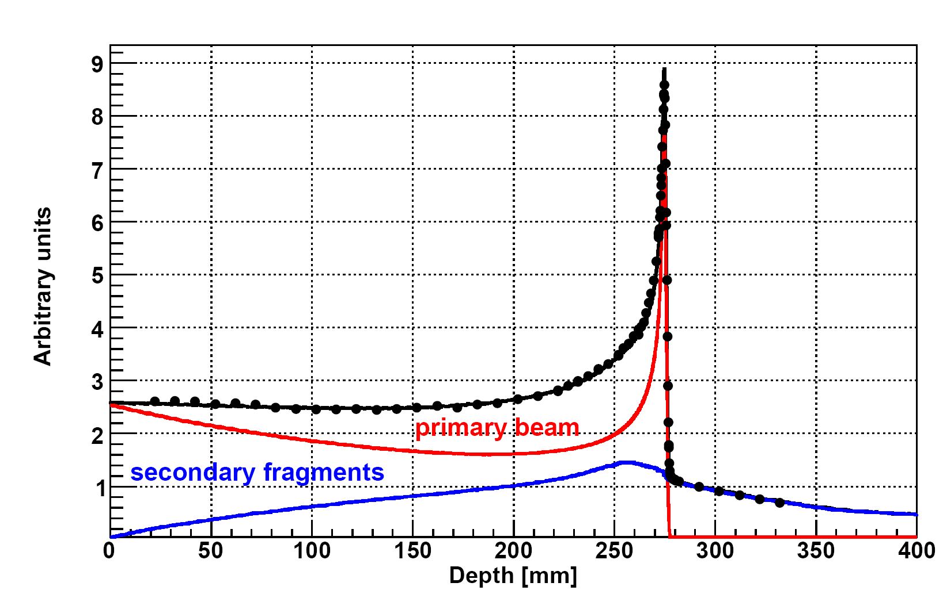
FRAGMENTATION OF ¹²C in biological tissue
Dose release in healthy tissues with possible long term side effects, in particular in treatment of young patients ➔must be carefully taken into account in the Treatment Planning System
Production of fragments with higher range vs primary ions
Production of fragment with different direction vs primary ions
Mitigation and attenuation of the primary beam
Different biological effectiveness of the fragments wrt ¹²C
¹²C (400 MeV/u) on water
Bragg-Peak
Dose over the Bragg Peak :
p ~ 1-2 %
C ~ 15 %
Ne ~ 30 %
Exp. Data (points) from Haettner et al, Rad. Prot. Dos. 2006
Simulation: A. Mairani PhD Thesis, 2007, Nuovo Cimento C, 31, 2008
Courtesy of Andrea Mairani

Slide 36
Bragg peaks vs exp. data: ²⁰Ne @ 670 MeV/n
Dose vs depth distribution for 670 MeV/n ²⁰Ne ions on a water phantom.
The green line is the FLUKA prediction
The symbols are exp data from LBL and GSI
Exp. Data Jpn.J.Med.Phys. 18, 1,1998
Fragmentation products
mostly α’s and p’s

Slide 37
What should we know about ¹²C fragmentation?
Production yelds of Z=0,1,2,3,4,5 fragments
d²σ/dθdE wrt angle and energy, with large angular acceptance
For any ¹²C energy of interest (100-300 MeV/nucl)
Measurements on thin target of all materials crossed by C beam
Detect the correlation between emitted fragments
Not possible a complete DB of measurements
We need to train a nuclear interaction model with the measurements!!
X,E_{x},θ_{x},φ_{x}
ρ,A,Z
¹²C , E
¹²C , E'
ρ',A',Z'
Y,E_{y},θ_{y},φ_{y}

Slide 38
What we already know: thick target measurement
A lot of integral measurements measurements are already around.. But very few for the correct triplet of projectile,target and energy
Projectile Energy[MeV/N] Target
⁴He 100, 180 C, Al, Cu, Pb
¹²C 100, 180,400 C, Al, Cu, Pb
²⁰Ne 100, 180,400 C, Al, Cu, Pb
²⁸Si 800 C, Al, Cu, Pb HIMAC by Kurosawa et al.
⁴⁰Ar 400 C, Al, Cu, Pb
⁵⁶Fe 400 C, Al, Cu, Pb
¹²⁶Xe 400 C, Al, Cu, Pb
²⁰Ne 337 C, A, Cu and U BEVALAC by Schimmerling et al.
⁹³Nb 272 Al, Nb BEVALAC by Heilbronn et al.
⁹³Nb 435 Nb
⁴He 155 Al NSRL by Heilbronn et al.
¹²C 155 Nb
⁴He 160 Pb SREL by Cecil
⁴He 180 C, H₂O, steel, Pb
¹²C 200 H₂O GSI by Günzert-Marx et al.
¹²C 400 H₂O GSI by Haettner et al.
Tentative & incomplete list
Courtesy of M. Durante
Notes:
38
Thank you, Mr. Chairman. It’s my great pleasure to give a talk to you. I’ll be speaking about some of the overview of the fragmentation of heavy charged particles in relation to radiotherapy.

Slide 39
What we already know: thin target measurement
A lot of measurements on thin target are already around.. but not wrt production angle and energy
Projectile Energy[MeV/N] Target
⁴He 135 C, Poly, Al, Cu, Pb
¹²C 135 C, Poly, Al, Cu, Pb Sato et al.
²⁰Ne 135 C, Poly, Al, Cu, Pb
⁴⁰Ar 95 C, Poly, Al, Cu, Pb
¹²C 290, 400 C, Cu, Pb
²⁰Ne 400, 600 C, Cu, Pb Iwata et al.
⁴⁰Ar 400, 560 C, Cu, Pb
⁴He 230 Li, C, CH₂, Al, Cu, Pb
¹⁴N 400 Li, C, CH₂, Al, Cu, Pb
²⁸Si 60 Li, C, CH₂, Al, Cu, Pb Heilbronn et al.
⁵⁶Fe 500 Li, C, CH₂, Al, Cu, Pb
¹²C 400 C, Poly Toshito et al.
Tentative & incomplete list
only with
detectors
at ~ 0°
Emulsion Chamber: angle ok
E ~OK, low stat, no corr

Slide 40
The IDEAL detector
On an event by event basis, the ideal detector should:
Identify all the fragment produced, i.e. detect charge , with 0 < Z < 6 and detect mass, on all the solid angle
Detect the energy of the fragments ( from 0 to 700 MeV p)
Measure the emission angle of the fragments (0-90 deg)
Detect all the correlations, with systematic below few % (rescattering in TG, out of TG fragmentation, etc..)
Starting from scratch, such a detector would be VERY, VERY expensive , would take LONG, LONG time and a VERY LARGE group to be designed and built.

Slide 41
The FIRST collaboration
INFN: Cagliari,LNF,LNS,Milano,Roma3,Torino: C.Agodi, G.Battistoni, M.Carpinelli, G.A.P.Cirrone, G.Cuttone , M.De Napoli, B.Golosio, Y.Hannan, E.Iarocci, F.Iazzi, R.Introzzi, A.Mairani, V.Monaco, M.C.Morone,P.Oliva, A.Paoloni, V.Patera, L.Piersanti, N.Randazzo, F.Romano, R.Sacchi, P.Sala, A.Sarti, A.Sciubba, C.Sfienti, V.Sipala, E.Spiriti
DSM/IRFU/SPhN CEA Saclay, IN2P3 Caen, Strasbourg, Lyon: S.Leray, M.D.Salsac, A.Boudard, J.E. Ducret, M. Labalme, F. Haas, C.Ray
GSI: M.Durante, D.Schardt, R.Pleskac, T.Aumann, C.Scheidenberger, A.Kelic, M.V.Ricciardi, K.Boretzky, M.Heil, H.Simon, M.Winkler
ESA: P.Nieminem, G.Santin
CERN: T.Bohlen
FIRST stands for: Fragmentation of Ions Relevants for Space and Therapy ➔ S371 is the GSI label

Slide 42

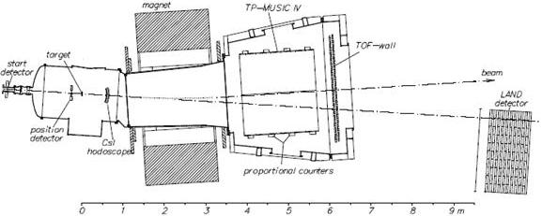
The ALADIN setup @GSI
New IT
Ptagger
Start
Target
First data taken in 2011
under analysis
Bmon
Vertex
TPC MUSIC IV
TOF
WALL
Beam
Beam
ALADIN
MAGNET
Interaction
region
Neutron detector

Slide 43
From an example of MC model comparison

Slide 44
Charge changing cross sections on Water and Polycarbonate

Slide 46
“Typical” modeling of nuclear interactions:
Target nucleus description (density, Fermi motion, etc)
t (s)
10⁻²³
10⁻²²
10⁻²⁰
10⁻¹⁶
Glauber-Gribov cascade with formation zone
Cross sections: absorption/quasi-elastic
Transition from single to multiple chains/collisions
Transition (hN) from resonance production to quark string models
Onset of formation zone
Fast light fragments
(Pion interactions below 1 GeV)
(In medium cross-sections)
(Generalized) IntraNuclear cascade
Preequilibrium stage with current exciton configuration and excitation energy
(all non-nucleons emitted/decayed + all nucleons below 30-100 MeV)
Spin and parity…
Statistical multi-fragmentation or binary emission?
Evaporation/Fragmentation/Fission model
γ deexcitation

Slide 47
10¹⁰
5
0.1
E (GeV/A)
Example: Heavy ion interaction models in FLUKA
DPMJET-III
  DPMJET (R. Engel, J. Ranft , S. Roesler¹): Nucleus-Nucleus interaction model. Used in many Cosmic Ray shower codes. Based on the Dual Parton Model and formation zone Glauber cascade, like the high-energy FLUKA h-A event generator
FLUKA
Evaporation- fission- fragmentation module
handles fragment deexcitation
Tested and benchmarked in h-A reactions
(Projectile-like evaporation is responsible for the most energetic fragments)
Electromagnetic dissociation
Modified and extended version of rQMD-2.4
  rQMD-2.4 (H. Sorge et al^{.2}) Cascade-Relativistic QMD model
  Successfully applied to relativistic A-A particle production
BME (BoltzmannMasterEquation)
  FLUKA implementation of BME from E.Gadioli et al (Milan)
¹proc. MC2000 , p 1033 (2001)
²NPA 498, 567c (1989), Ann.Phys. 192,266 (1989), PRC 52, 3291 (1995)

Slide 48
THE BME* (Boltzmann Master Equation) – FLUKA interface for nucleus – nucleus interactions below 150 MeV/n
A version of the BME-FLUKA event generator considering two different reaction mechanisms is implemented in FLUKA
2. PERIPHERAL COLLISION
three body mechanism
or
“inelastic scattering” (for high b)
The complete fusion cross section decreases with increasing bombarding energy. We integrate the nuclear densities of the projectile and the target over their overlapping region,, and obtain an excited “middle source” and two fragments (projectile and target-like). The kinematics is suggested by break-up studies.
1. COMPLETE FUSION
Preequilibrium according to the BME theory
In order to get the multiplicities of the pre-equilibrium particles and their double differential spectra, the BME theory is applied to a few representative systems at different bombarding energies and the results are parameterized
*M. Cavinato et al., Nucl. Phys. A 643, 15 (1998); 679, 753 (2001)

Slide 49
BME event generator benchmarks
¹²C + ¹²C @ 16.5 MeV/n
Fragment energy distribution at different emission angles
Histo: BME in FLUKA
Dots : Data
exp. data
S.V. Förtsch (iThemba LABS, SA)
et al.
silicon detector telescope
(low energy threshold of ~ 5 MeV/n)

Slide 50
How can we monitor a treatment?
Courtesy of K.Parodi

Slide 51
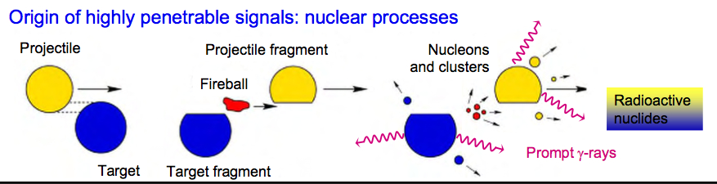
Spec’s of hadrontherapy monitor
Measure shape and absolute value of dose to check the agreement between the planned target volume and the actually irradiated volume
The measurement should be done during the treatment (in-beam)
Must rely on a given secondaries generated by the beam that comes out from the patient, to spot the position of the dose release
Must be able to deal with the other secondaries that come out that acts like background

Slide 52
baseline dose monitoring in HT : PET
Baseline for monitor in HT is PET : autoactivation by p & ¹²C beam that creates β⁺ emitters.
Isotopes of short lifetime ¹¹C (20 min), ¹⁵O (2 min), ¹⁰C (20 s) with respect to conventional PET (hours)
Low activity in comparison to conventional PET need quite long acquisition time (few minutes)
Metabolic wash-out, the β⁺ emitters are blurred by the patient metabolism
No direct space correlation between β⁺ activity and dose release ( but can be reliable computed by MC)

Slide 56
Correlation between β⁺ activity and dose
Projectiles & target fragmentation
Target fragmentation

Slide 57
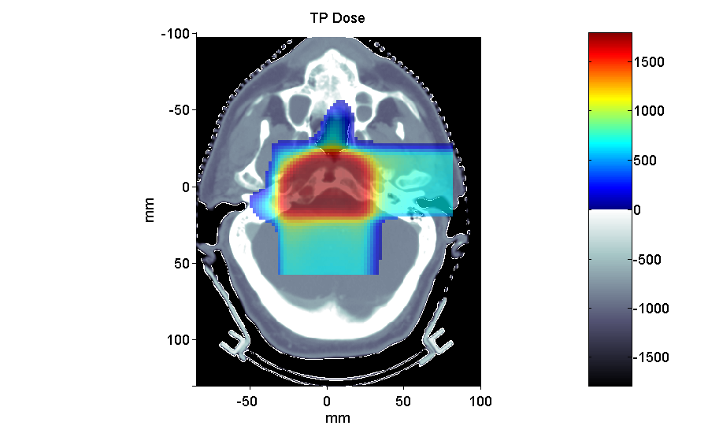
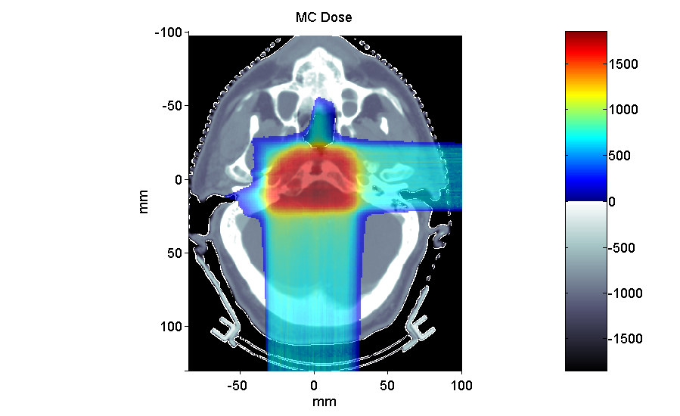
Applications of FLUKA to p therapy @ MGH
Planned dose
Clival Chordoma, 0.96 GyE / field
mGy
mGy

Slide 58
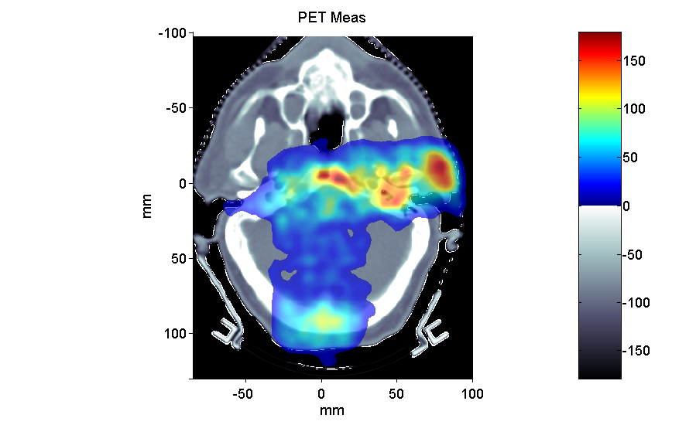
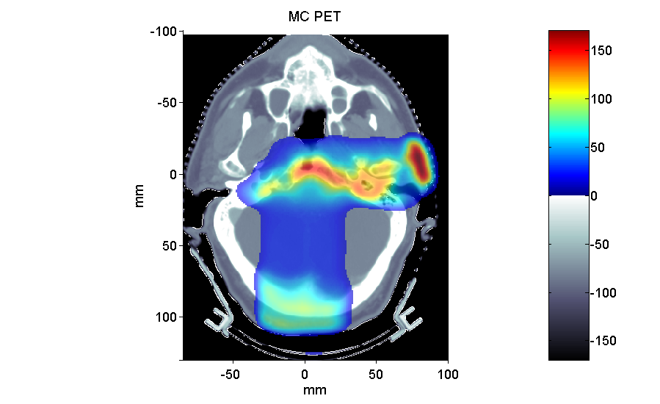
Post-radiation PET/CT @ MGH
Average Activity
Clival Chordoma, 0.96 GyE / field, ΔT1 ~ 26 min, ΔT2 ~ 16 min
Bq / ml
Bq / ml
2 Field
1 Field
K. Parodi et al, IJROBP 2007
… and FLUKA-voxel functionalities being also used at HIT …

Slide 59
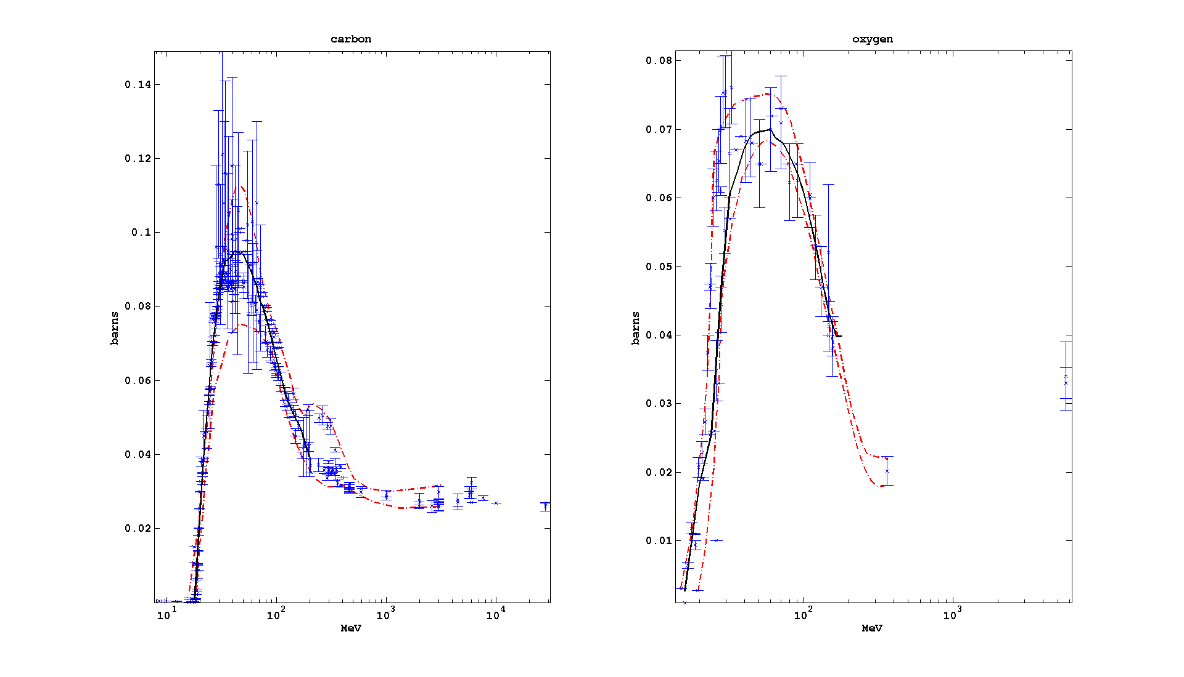
¹²C(p,x)¹¹C and ¹⁶O(p,x)¹⁵O cross sections.

Slide 60
Recent Model Development:
Spin/parity: isomers… etc
Spin/parity dependent evaporation (Hauser-Feshbach) is still too complex to be implemented in MC codes
As a consequence isomer production wrt ground state production cannot be reliably computed
Individual level population → gamma emission are hard to predict
Furthermore, it is difficult to keep track of the total angular momentum and parity evolution of the system during the cascade and pre-equilibrium stages, particularly at medium/high energies
Some work going on at least for the Fermi break-up part (light systems) when conditions are well defined

Slide 61
Spin-parity in Fermi Break-up in FLUKA code:
The probability of splitting into n fragments of given masses, m_{i}, spins, s_{i}, … is given by:
… however it implicitly assumes that the emission takes place in L=0. Now in FLUKA when the compound nucleus spin and parity, J^{π}, are known*:
The minimum orbital momentum, L_{min}, required to match J^{π} is computed
S_{n} is restricted to the subset of spin combinations compatible with L_{min}
If L_{min} > 0, then E_{Coul} → E_{Coul} + B_{centrifugal}
* At present only the cases where no emission has taken place before Fermi break-up are considered

Slide 62
Spin-parity in Fermi-Break-up in FLUKA code
In most MC’s, for A<16, evaporation is substituted by Fermi break-up
In cases where spin and parity of the residual nucleus are known, conservation laws, constraints on available configurations and centrifugal barrier (if L=0 is forbidden), are enforced in the fragment production
Straightforward example : photonuclear reaction in the GDR region
Effect : residual nuclei production
Application: background from induced activity in underground experiments
¹²C +γ in GDR
J^{π} = 1⁻
3α and α + ⁸Be impossible in L=0
Factor 3 on ¹¹C production

Slide 63
(p,d), (n,d) reactions:
Excitation functions for the production of ¹¹C (left), ¹⁵O (right): now deuteron formation at low energies is treated directly and no longer through coalescence (Data: CSISRS, NNDC, blue Fluka2011.2, red Fluka2012.2)

Slide 64
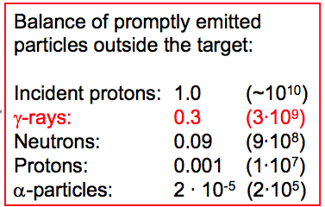

Background or Signal?
The p, ¹²C beams generate a huge amount of secondaries.. expecially prompt single γs. and neutrons in the 1-10 MeV range. Can be used to track the beam inside the patient
G4
The nuclear models inside MC (FLUKA&G4) are becoming able to fully describe this physics ➔ huge development effort ongoing

Slide 65
The prompt gamma saga…
The gamma are quite copiously produced by proton and ¹²C beam.
The emission region stretches along all the beam path but has been shown to ends near the Bragg peak for both beams.
There is a huge background due to neutrons & uncorrelated gamma produced by neutrons. This background is beam, energy and site specific
It’s not simple backpointing the γ direction: take profit by the SPECT technique… but the energy of these γ is in the 1-10 MeV range-> much more difficult to stop and collimate!!

Slide 66
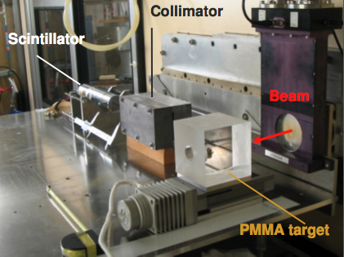
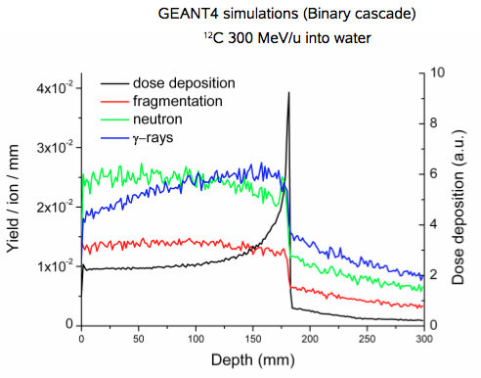
Prompt γs @GANIL
73 AMeV carbon beam
γ peak correlated with BP
MC one order of magnitude off but it’s improving fast)
Neutrons background (TOF rejection ?)
BP position

Slide 67
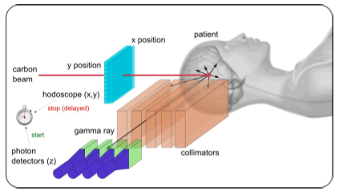
Possible prompt γ monitoring: Gamma camera
Large flux, maybe enough stats for in-beam
Collimation like Anger camera in SPECT (? 1<E_{γ}<10 MeV )
Well known technique, robust, compact
Wide γ energy spectrum ➔ careful design
Neutron background rejection? TOF not so easy to exploit.
Collimation reduces stats

Slide 68
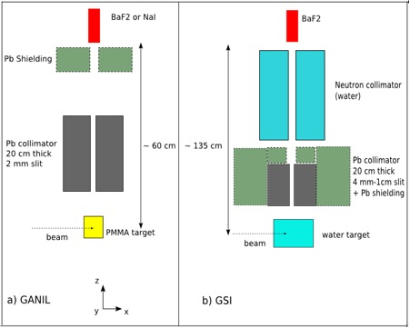
Lyon group: GANIL/GSI data
[figures and exp. data taken from F. Le Foulher et al IEEE TNS 57 (2009),
E. Testa et al, NIMB 267 (2009) 993]

Slide 69
Gamma De-excitation in Fluka
At the end of evaporation: cascade of γ transitions
At high excitation: assume continuous level density and statistical emission:
At low excitation: through discrete levels
  Tabulated experimental levels (RIPL-3) and branchings
  Rotational approximation outside tabulations
  Account for discrete levels in evaporation and the fast (cascade and/or pre-equilibrium) stages (to be extended to rQMD and DPMJET))
  Photon angular distribution according to multipolarity and spin (→ effort to estimate residual spin value and direction)
See A. Ferrari et al., Z. Phys C 71, 75 (1996)
L= multipole order
ρ=level density at
excitation energy U
f = strength from single
particle estimate (c)+ hindrance (F)

Slide 70
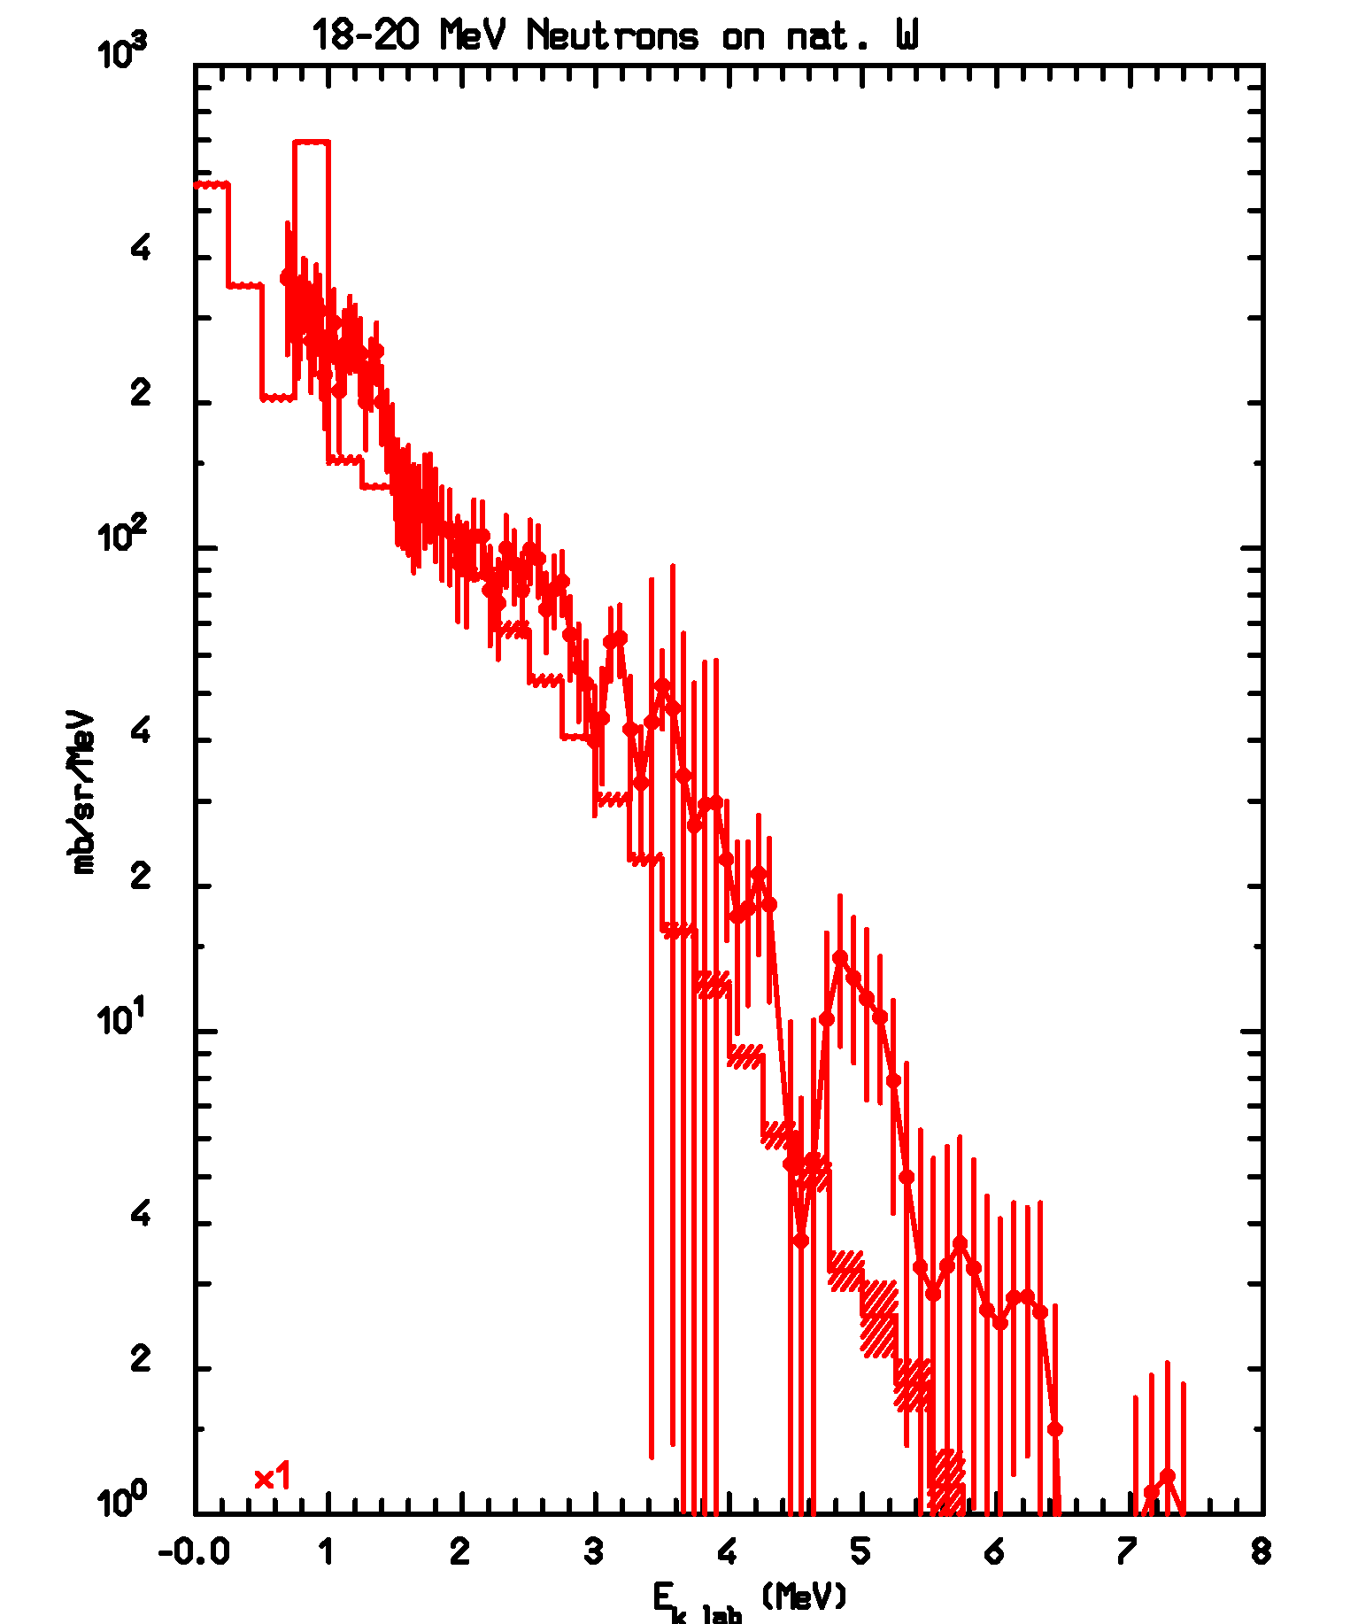
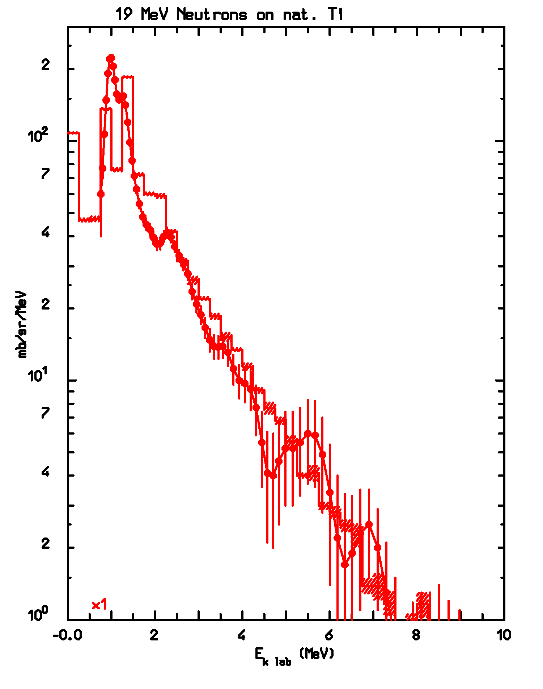
Examples: photon spectra, pre-2011 status
W((n.x) at 18-20 MeV
Ti(n,x) at 19 MeV
Histograms: FLUKA results with stat errors. Dots: expt data from Dickens et al. report ORNL-4847 (1973) and G.L.Morgan, report ORNL-5563 (1979)

Slide 71
Improved model: example
Overall shape
Unchanged
More details are evident

Slide 72
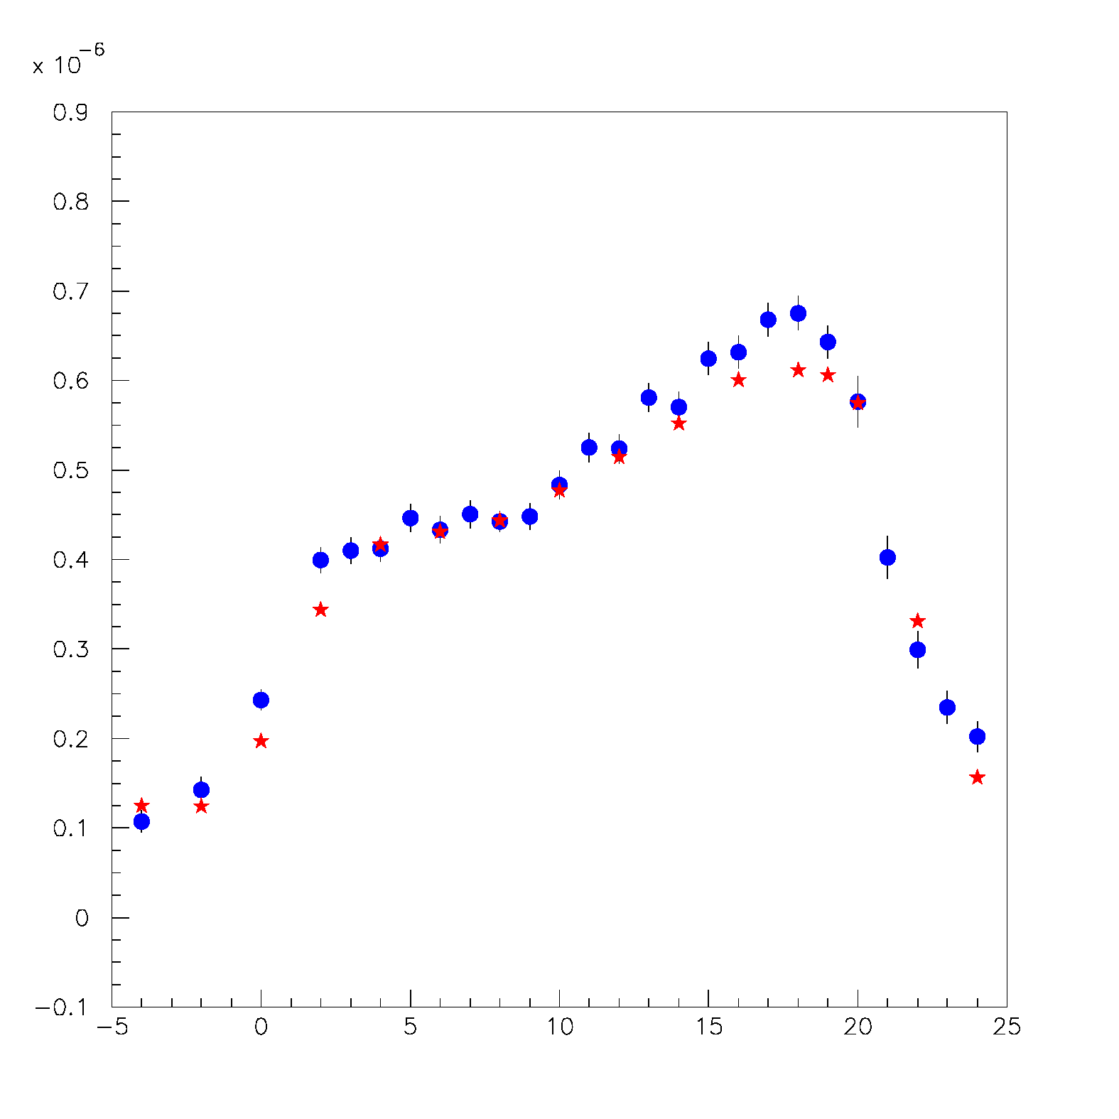
GANIL: 90 deg photon yields by 95 MeV/n ¹²C in PMMA
Ganil after correction of the data
Blue: fluka
Red: data
Exercise: subtract from data only the amount of background needed to get to the same level as simulation in the first two points
Preliminary

Slide 73
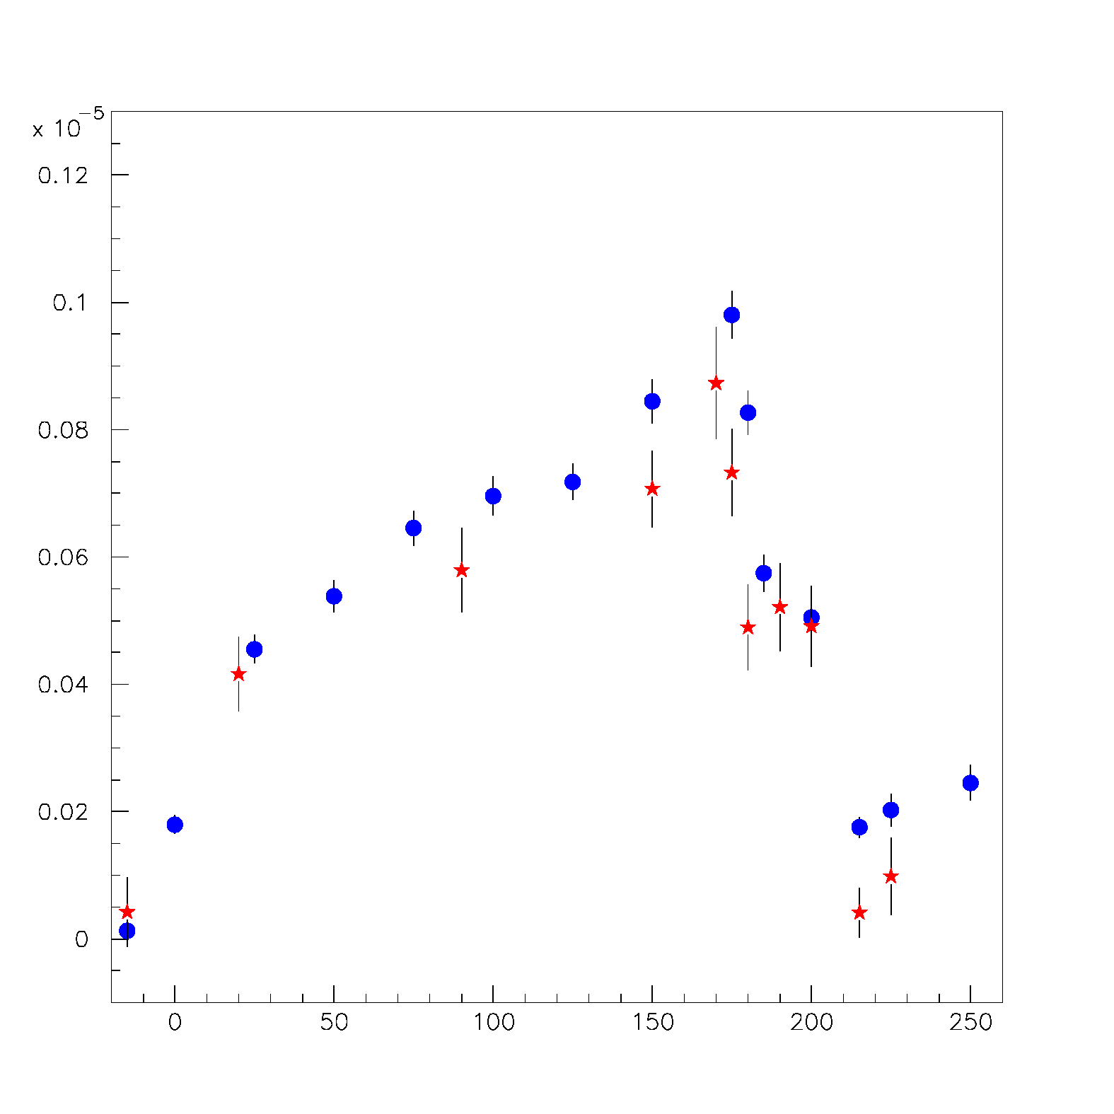
GSI: 90 deg photon yield by 310 MeV/n ¹²C in Water
Here the simulation plots changed, because of a technical mistake in
the normalization
(factor 9/12 )
And a correction in the detector distance from target (small)
Preliminary

Slide 74
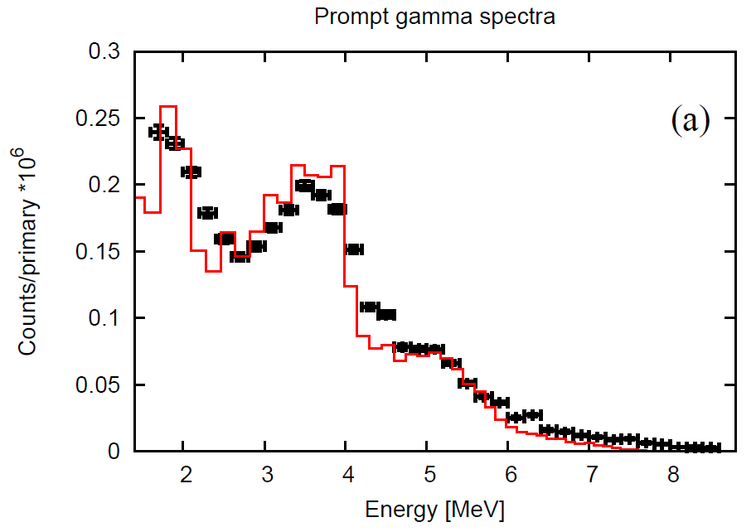
Photon yields by 80 MeV/n C in PMMA
LYSO crystals
Absolute comparison
γ
Preliminary
¹²C
PMMA
Energy spectrum of “photons” for 160 MeV p on PMMA. FLUKA red line, data black dots (C.Agodi et al., JINST 2012 in press)

Slide 75
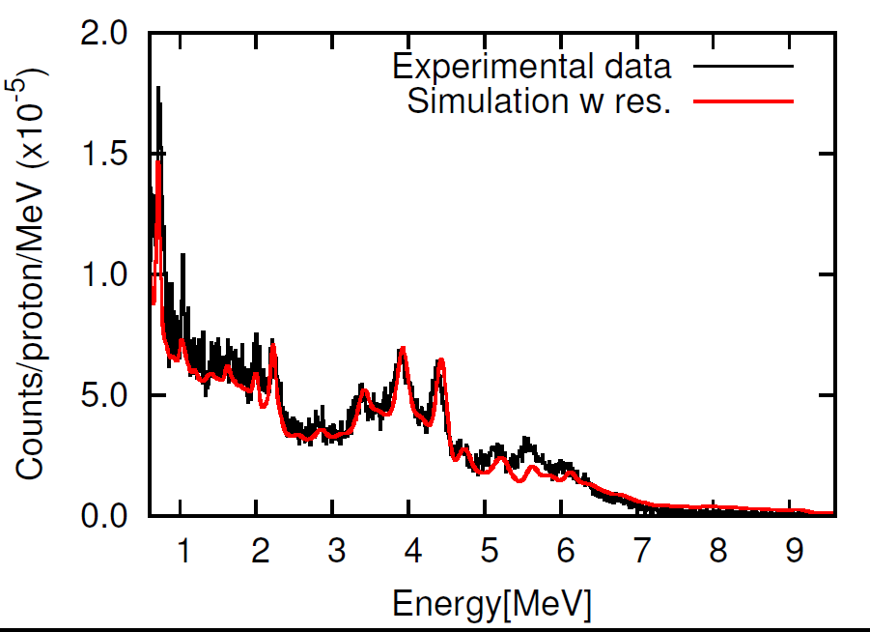
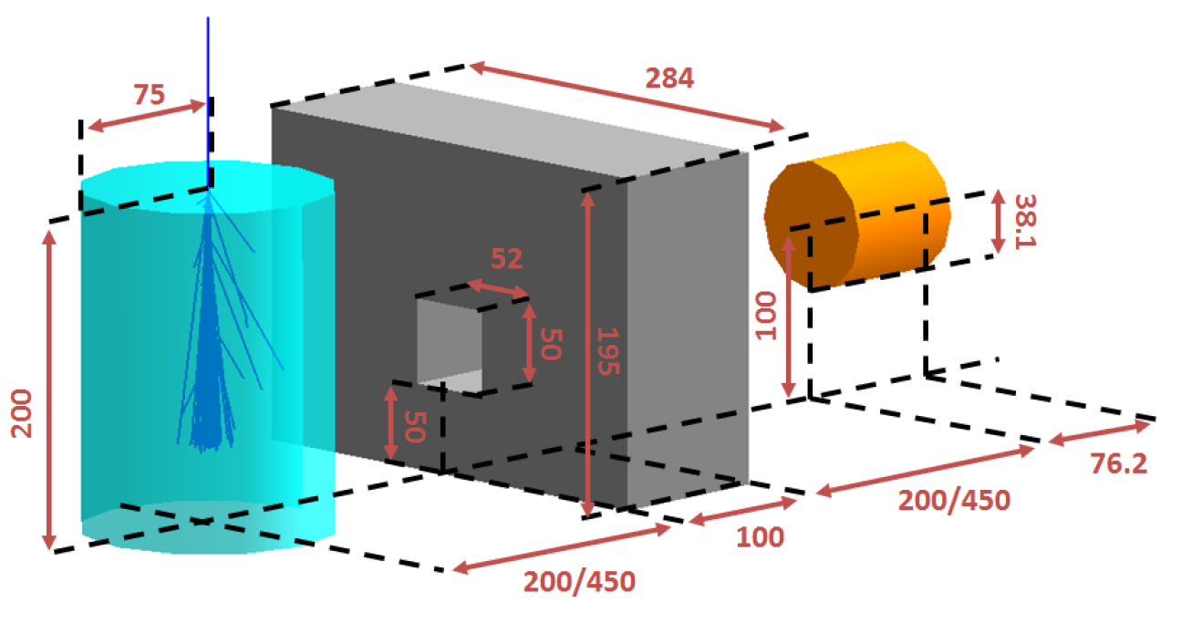
Photon yields by 160 MeV p in PMMA
Pb
Collimator
NaI detector
Absolute comparison
Preliminary
PMMA
target
Schematic layout
(dimensions mm)
from J.Smeets et al., IBA
Energy spectrum of “photons” after background subtraction (collimator open – collimator closed) for 160 MeV p on PMMA. FLUKA red line, data black line (J.Smeets et al., IBA, ENVISION WP3)

Slide 76
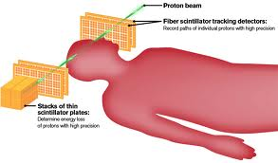
What about charged particles??
Charged particles have several nice features as
The detection efficiency is almost one
Can be easily back-tracked to the emission point-> can be correlated to the beam profile & BP
BUT…
They are not so many
Energy threshold to escape ~ 100 MeV
They suffer multiple scattering inside the patient -> worsen the back-pointing resolution
proton
beam

Slide 77
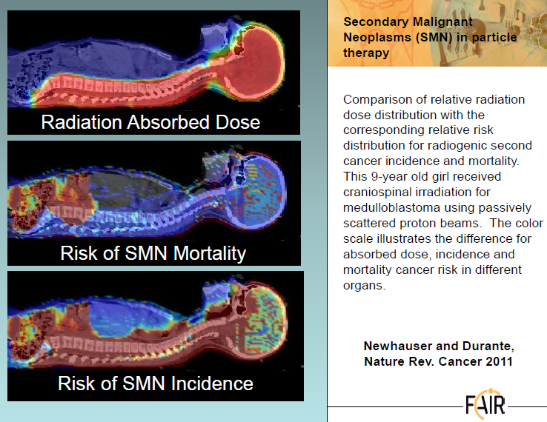
MC is essential to investigate long term effects to healthy tissues…
Important Issue ➔ Secondary Neutrons…

Slide 78
Again example from FLUKA: Thick target examples: neutrons
^{nat}C(p,xn) @ 68 MeV, stopping target
Data: JAERI-C-96-008, 217 (1996)
^{nat}C(p,xn) @ 113 MeV, stopping target
Data: NSE110, 299 (1992)

Slide 79
Neutron interaction: typical cross section
Resonances ⇒ energy levels in compound nucleus ^{A+1}Z*
σ_{tot}
unresolved resonance region
thermal σ∝ 1/v
Evaluated nuclear data files (ENDF, JEFF, JENDL...)
  typically provide neutron σ (cross sections) for E<20MeV for all channels
  σ are stored as continuum + resonance parameters
resolved
resonance
region
1eV
1keV
1MeV
E_{kin} incident neutron
resonance
spacing
few eV
Resonance spacing too dense ⇒ overlapping resonances

Slide 80
Neutronics (below 20 MeV)
All codes make use of Evaluated Nuclear Data Files for neutron propagation below 20 MeV → inclusive and uncorrelated.
New requirements @ LANL:
Correlated n and γ emission from fission → advances in endf and/or event generators
Modeling delayed n, γ emission in simulations, from photon and particle interrogation
Crititicality: well reproduced in many fast, intermediate, and thermal assemblies. However well known compensating errors in fission, inelastic scattering and capture data…. → new precision measurements/theory for fission (cross sections, n spectra, products) and capture

Slide 81
Photonuclear interaction: example
Reaction:
²⁰⁸Pb(γ,x n)
20≤Eγ ≤140 MeV
Cross section for multiple neutron emission as a function of photon energy, Different colors refer to neutron multiplicity ≥ n , with 2≤n≤8
Symbols: exp data (NPA367, 237 (1981) ; NPA390, 221 (1982) )
Lines: FLUKA

Slide 82
Just published

Slide 83
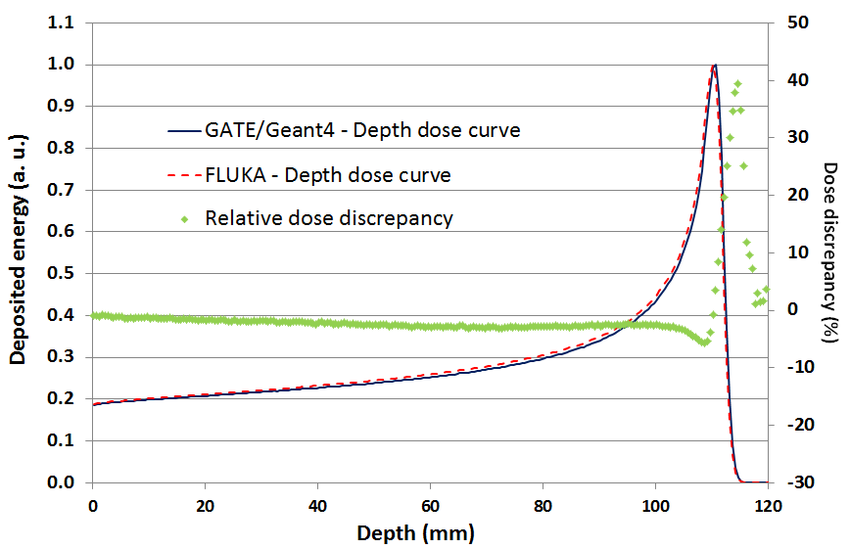
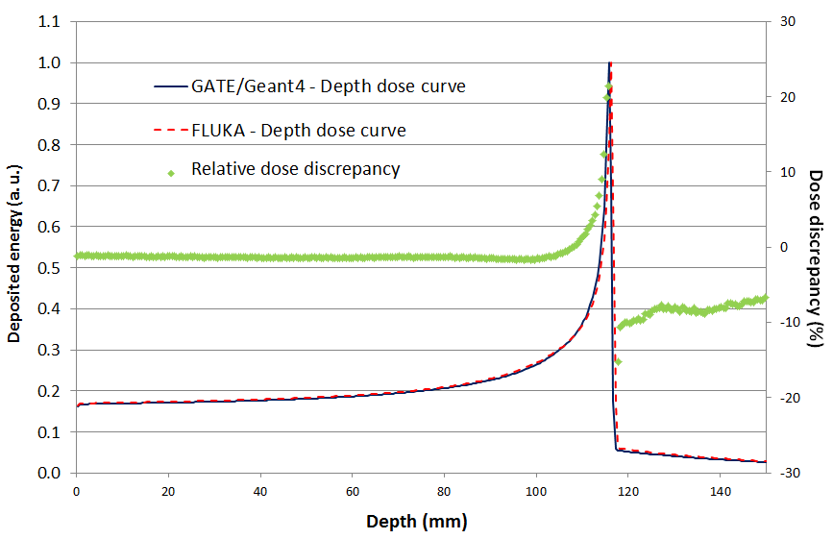
Depth dose curves in PMMA obtained using GATE/Geant4 and FLUKA for monoenergetic (up) protons (134 MeV) and (right) carbon ions (260 AMeV). Point-to-point relative dose discrepancies between the two codes are superimposed.

Slide 84
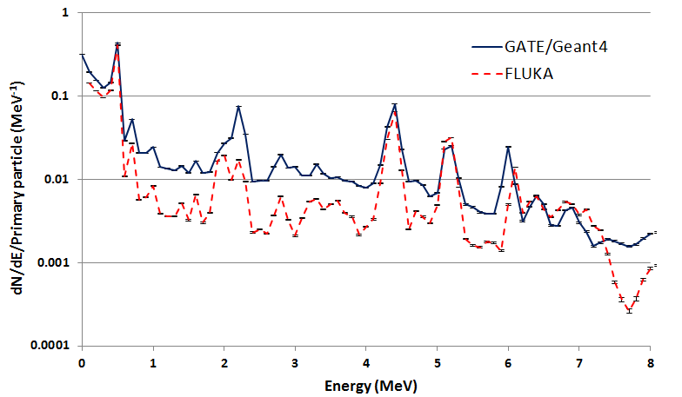
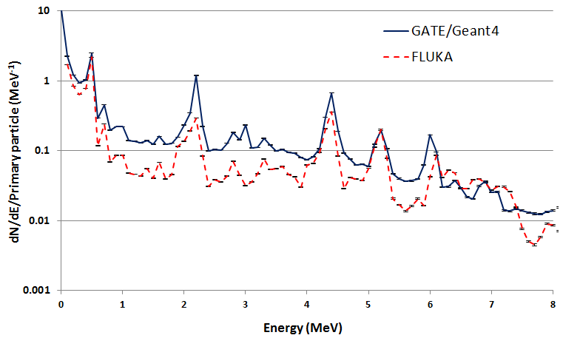
Outgoing gamma energy distributions per primary particle obtained with GATE/Geant4 and FLUKA for monoenergetic (up) protons (134 MeV) and (right) carbon ions (260 AMeV) irradiating a PMMA target. Neither energy nor time selection were used

Slide 85
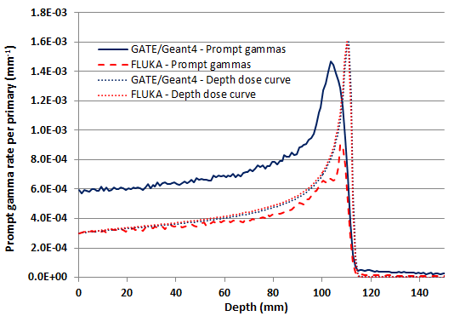
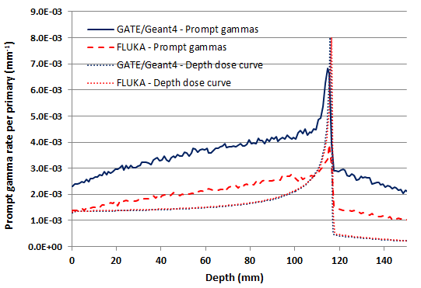
Comparison of the location of production of the prompt gammas exiting from the target obtained using GATE/Geant4 and FLUKA for (a) the proton beam (134 MeV) (b) the carbon ion (260 AMeV) beam.

Slide 86
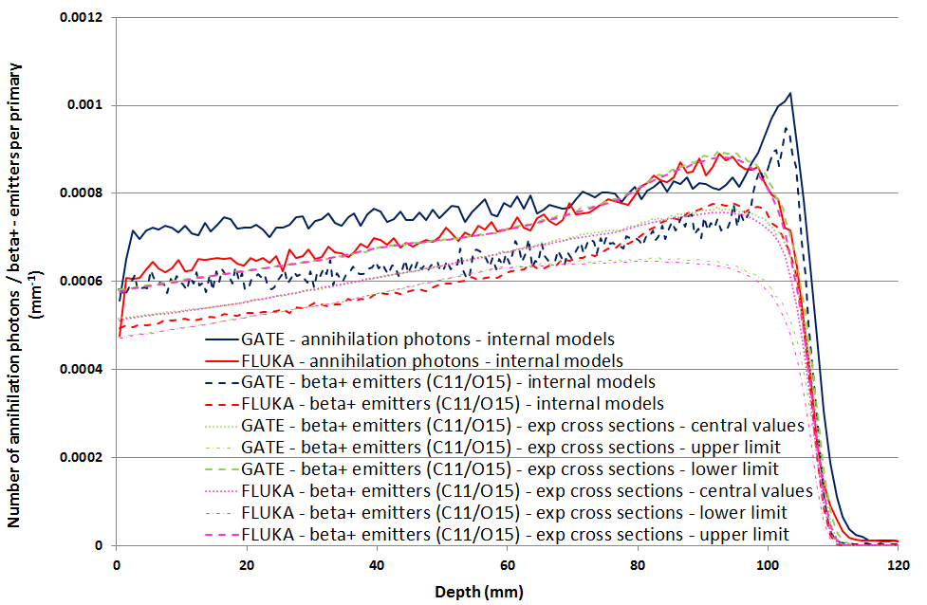
Depths of production of the β+ emitters (¹¹C, ¹⁵O) obtained combining the fluence of the protons in the PMMA target (GATE/Geant4 and FLUKA) to experimental cross-sections compared to the depths of production of the annihilation photons and depths of production of the β+ emitters (¹¹C, ¹⁵O) obtained using the internal models of GATE/Geant4 and FLUKA.

Slide 87


Outgoing proton energy distributions per primary particle obtained with GATE/Geant4 and FLUKA for monoenergetic (up) protons (134 MeV) and (right) carbon ions (260 AMeV) irradiating a PMMA target.

Slide 88


Energy spectra of secondary protons corresponding to 0°, 10°, 20° and 30° angles obtained using GATE (left) and FLUKA (right) for the carbon ion beam (260 AMeV) configuration.

Slide 89


Lethargy plots corresponding to outgoing neutrons obtained using GATE/Geant4 and FLUKA for monoenergetic (up) protons (134 MeV) and (right) carbon ions (260 AMeV) irradiating a PMMA target.

Slide 90
Thank you for the attention

Slide 91
Thick/Thin target examples: neutrons
⁹Be(p,xn) @ 256 MeV, stopping target
Data: NSE110, 299 (1992)
Pb(p,xn) @ 3 GeV, thin target
Data: NST32, 827 (1995)

Slide 92
FLUKA (BME+preeq): (α,xn) examples
Excitation functions for the production of radioisotopes from α interactions on Au (left) and Bi ( right) (Data: CSISRS, NNDC)

Slide 93
Cascade/preequilibrium transition:
Angle-integrated ⁹⁰Zr(p,xn) at 80.5 MeV (INC+preeq left, preeq only right). The lines show the total, INC, preequilibrium, and evaporation contributions. Exp. data: M. Trabandt et al., Phys. Rev. C39, 452 (1989).

Slide 94
Equilibrium particle emission (evaporation, fission, and nuclear break-up)
From statistical considerations and the detailed balance principle, the probabilities for emitting a particle of mass m_{j,} spin S_{j,}ħ and energy E, or of fissioning are given by:
(i, f for initial/final state, Fiss for fission saddle point)
Probability per unit time of emitting a particle j with energy E
Probability per unit time of fissioning
ρ’s: nuclear level densities
U’s: excitation energies
V_{j}’s: possible Coulomb barrier for emitting a particle type j
B_{Fiss}: fission barrier
Q_{j}’s: reaction Q for emitting a particle type j
σ_{inv}: cross section for the inverse process
Δ’s: pairing energies
Neutron emission is strongly favoured because of the lack of any barrier
Heavy nuclei generally reach higher excitations because of more intense cascading

Slide 95
Isotope production for ²⁰⁹Bi(n,xn)*:
FLUKA (lines with dashing) vs exp. data (symbols).
Data: CSISRS database, NNDC (BNL)
The reliability of (p,xn) reactions should be comparable given the similarities

Slide 96
AA reaction cross sections
Improvements in the AA reaction cross sections (finalized beginning 2011) and inter-comparison with other codes
[L. Sihver et al, Adv Space Res 49 812 (2012)]
96
M.C.Morone, IEEE 2012
Notes:
96

