Slide 1
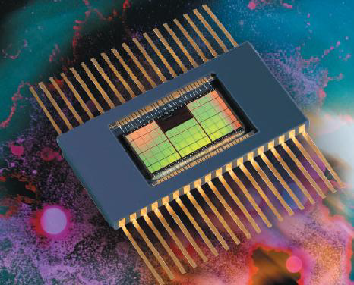
Radiation testing of electronic components for space applications
Véronique FERLET-CAVROIS
ESA / ESTEC
INFN Laboratori Nazionali di Legnaro
18/04/2013

Slide 2
Few dates
31 January 1958: launch of Explorer I, first US satellite, built by JPL; carries a Geiger counter proposed by J. A. Van Allen
  discovery of the Van Allen belts, confirmed by Explorer III (March 1958) and Sputnik III (May 1958)
  first scientific output of the Space Age
10 July 1962: launch of Telstar, built by the Bell Telephone Labs with AT&T funds and NASA support; first active telecom satellite: live television
  one day before (9 July 1962): Starfish 1Mt US nuclear test, electrons injected in the radiation belts, extremely high radiation levels
  End of Oct. – beginning of Nov. 1962: USSR nuclear tests
  21 February 1963: early loss of Telstar; first spacecraft loss due to radiation effects
1962-1963: 10 satellites successively failed (dose and displacement damage)
  Exo-atmospheric tests banned in 1967
[R. Ecoffet, TNS June 2013]

Slide 3
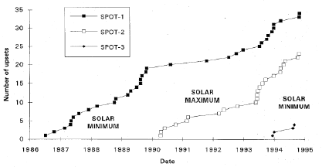
Few dates (cont.)
1975: [Binder] first reported “single event effect” SEE anomalies; unexpected triggering in bipolar digital circuits due to cosmic rays
1978 – 1985: SEUs in Pioneer 12 (Venus), in a 1024 bit PMOS shift register
SEU example in the OBC of Spot1-2-3; Half of these SEUs lead to operational problems, including switching the satellite to safe mode.
[R. Ecoffet, TNS June 2013]

Slide 4
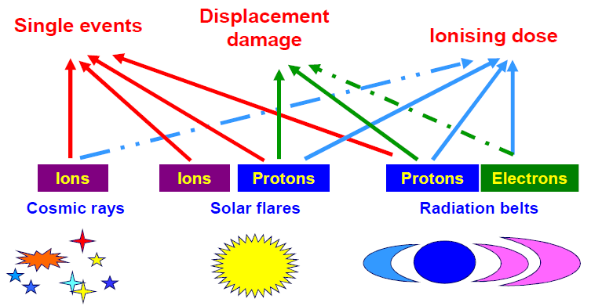
Main radiation effects in electronic components
[R. Ecoffet, TNS June 2013]

Slide 5
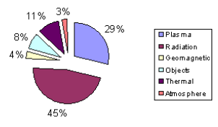
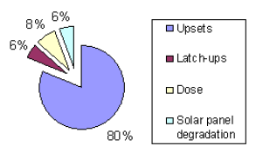
The two major sources of spacecraft anomalies are plasma and radiation effects
Both plasma and radiation effects are related to charged particles
The “Upsets” category includes several types of SEE (SEU, SET, SEFI)
[R. Ecoffet, NSREC 2011]

Slide 6
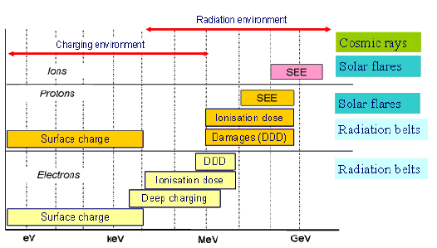
Continuum of energy between the plasma charging and the radiation environment
[R. Ecoffet, NSREC 2011]

Slide 7
Radiation testing
Radiation effects
  TID
  TNID
  SEE
Guidelines

Slide 8
TID
Total Ionizing dose

Slide 9
Example of the Laplace Radiation Environment - TID
~200 krad behind 10mm Al
After [Ch. Erd, “Laplace environment specification, 14 June 2011]

Slide 10
Typical TID effect in CMOS: charge buildup in gate and field oxides induces leakage currents
CMOS technology 0.8um,
LOCOS isolation
Leakage Path
Experiment
Source
Simulation
Gate
Drain
Drain current (A)
Source
Gate
Drain
LOCOS
Field Oxide
P-type
Substrate
Gate voltage (V)
Positive Trapped Charge
[V. Ferlet-Cavrois HDR05]

Slide 11
Highly scaled CMOS technologies,
with standard design, are less sensitive to TID
Design with rad-hard libraries, like DARE, improves TID hardness, compared to standard designs
Compilation from [Lacoe03, Anel97, Kerwin98,
Shaneyfelt98, Brady99, Lacoe99, Lacoe00, Lacoe01, Nowlin04]

Slide 12
However, real systems use a wide variety
of IC technology generations,
for which TID hardening is not granted
[P. E. Dodd, 2009]
200 krad
Compilation from data workshops between 2002 and 2004

Slide 13
Laplace Radiation Environment - TNID
Preliminary data
For information only
~5.5E10 p/cm² 50 MeV eq. behind 10mm Al
Simulations with OMERE (solid-sphere) from data in [Ch. Erd, “Laplace env. spec.”, 14 June 2011]
NIEL in Si [Summers93]

Slide 14
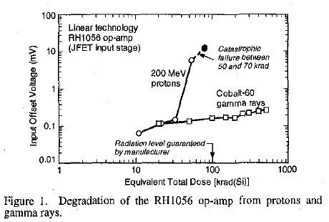
Because of displacement damage, some circuits fail at much lower equivalent total dose levels compared to gamma rays
50-70 krad corresponds to 2E10 cm⁻²
50MeV protons
[B. G. Rax et al.
TNS Dec. 1999]

Slide 15
What is Radiation Hardness Assurance (RHA) ?
RHA consists of all activities undertaken to ensure that the electronics and materials of a space system perform to their design specifications after exposure to the space radiation environment
Deals with environment definition, part selection, part testing, spacecraft layout, radiation tolerant design, mission/system/subsystems requirements, mitigation techniques, etc.
Radiation Hardness Assurance goes beyond the piece part level

Slide 16

RHA radiation hardness assurance
ECSS-Q-ST-60-15C 1 October 2012
MISSION/SYSTEM
REQUIREMENTS
RADIATION
ENVIRONMENT
DEFINITION
SYSTEM AND
CIRCUIT DESIGN
RADIATION
LEVELS WITHIN
THE SPACECRAFT
PARTS AND
MATERIALS
RADIATION
SENSITIVITY
ANALYSIS OF THE CIRCUITS, COMPONENTS, SUBSYSTEMS AND
SYSTEM RESPONSE TO THE RADIATION ENVIRONMENT
[C. Poivey, Short-Course RADECS 2011]

Slide 17
TID / TNID - Analysis Flow
Mass,
Function
TID/DD
ENVIRONMENT
DEFINITION
MISSION
REQUIREMENTS
SUBSYSTEM REQUIREMENTS
SHIELDING ANALYSIS
COMPONENT REQUIREMENTS
TID/TNID REQUIREMENT
TEMPERATURE
RADIATION
RADIATION DESIGN MARGIN
PART TID/TNID
SENSITIVITY
DESIGN WORST CASE
ANALYSIS
Requirements
Satisfied?
AGING
NO
[C. Poivey, Short-Course
RADECS 2011]
YES
DESIGN VALIDATED

Slide 18
TID test standards
ESCC 22900
  Total Dose Steady-State Irradiation Test Method
Others
  MIL-STD883G Method 1019.8 “Ionizing Radiation (Total Dose) Test Procedure”
  ASTM F 1892-06 “Standard Guide for Ionizing Radiation (Total Dose) Effects Testing of Semiconductor”
  MIL-STD750E Method 1019.5 “Steady-state Total Dose Irradiation Procedure”

Slide 19
ESCC 22900 splits into two domains
Evaluation
  Main objectives to establish worst case conditions for TID qualification (specific for device/technology).
    Dose level, Dose rate effects
    Bias dependency, Critical parameters
    Annealing effects
    Etc.
Qualification and Procurement Lot Acceptance
  RVT: radiation verification test
  RADLAT: radiation lot acceptance test
  Main objectives to qualify or verify a specific device and/or diffusion lot
    Test conditions defined in TID evaluation testing

Slide 20
TID RHA, Scope
EEE part family | Sub family | TIDL
Diodes | Voltage reference | all
 | Switching, rectifier, schottky | > 300 Krad-Si
Diodes microwave |  | > 300 Krad-Si
Integrated Circuits |  | all
Integrated Circuits microwave |  | > 300 Krad-Si
Oscillators (hybrids) |  | all
Charge Coupled devices (CCD) |  | all
Opto discrete devices, Photodiodes, LED, Phototransistors, Opto couplers |  | all
Transistors |  | all
Transistors microwave |  | > 300 Krad-Si
Hybrids |  | all

Slide 21
TNID RHA Scope
Family | Sub-Family | TNIDL
CCD, CMOS APS, opto discrete devices | all | all
Integrated circuits | Silicon monolithic bipolar or BiCMOS | > 2x10¹¹ p/cm² 50 MeV equivalent proton fluence
Diodes | Zener Low leakage Voltage reference | > 2x10¹¹ p/cm² 50 MeV equivalent proton fluence
Transistor | Low power NPN Low power PNP High power NPN High power PNP | > 2x10¹¹ p/cm² 50 MeV equivalent proton fluence

Slide 22
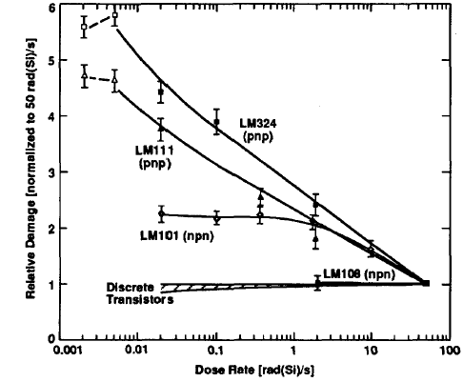
  ELDRS in Linear - bipolar based – components: Enhanced Low Dose Rate Sensitivity
Laplace mission receives most of its TID in the vicinity of Jupiter’s moons.
For example, 200krad received within ~40 days results in an average dose rate of ~200rad/h
The low dose rate window in ESCC22900: 36-360 rad/h (10-100mrad/s) is well adapted to the Laplace environment
[A. H. Johnston, et al. TNS Dec. 1994]

Slide 23
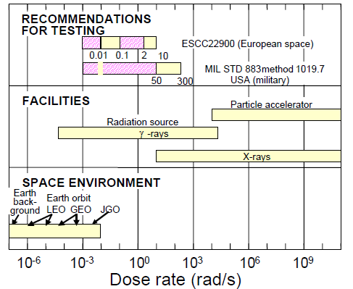
TID testing: radiation sources and dose rate
1
0.001
0.01

Slide 24
Example of RHA analysis: statistical approach part-to-part variation in the same lot
25 DUTs OP484
[Ph. Adell, JPL Short-Course RADECS 2011]

Slide 25
Assumption: The degradation of electrical parameters induced by radiation follows a Log-normal distribution
[Ph. Adell, JPL Short-Course RADECS 2011]

Slide 26
One-Sided Tolerance Limits, KTL, for 90% Confidence Limit
Confidence Limit (CL) and Probability of survival (Ps) are defined by the mission
After R Pease, Rad Phys Chem 43, 1994

Slide 27
Statistical analysis of TID results: extraction of the normal distribution parameters: mean – standard deviation
Statistical analysis: determination of worst-case parameter deltas for Worst-Case-Analysis
[R. L. Pease, Short-Course NSREC 2004]

Slide 28
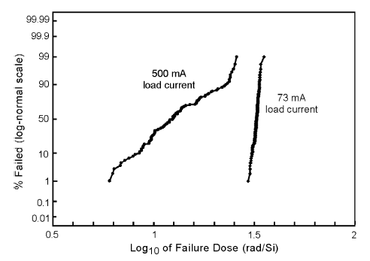
Example of statistical TID analysis:
LM117 voltage regulator
Large distributions of output voltage failure doses
4krad
20krad
The operating conditions have a strong impact on the radiation response
System designers will have to work closely with radiation effects engineers
Sample size: 100
[Johnston and Rax, TNS Aug. 2010]

Slide 29
Displacement Damage in bipolar technologies
Voltage Regulator
5 DUTs: large variability
[B. G. Rax et al.
TNS Dec. 1999]

Slide 30
Worst-case approach
RDM: Radiation Design Margin
Worst-case approach: Total Dose level TIDL at which the worst case part of the worst case lot exceeds its limits
RDM is the ratio of device radiation tolerance TIDS out of device radiation requirement TIDL
  Uncertainties, variability in radiation environment
  Part to part variations
  Lot to Lot variations
Applies also to TNID
[C. Poivey, Short-Course
RADECS 2011]

Slide 31
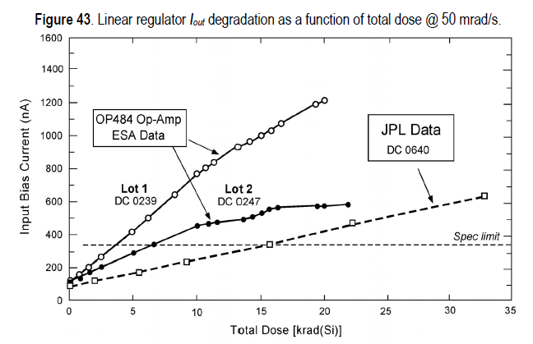
Example of Lot-to-lot variability
The test of the flight lot is mandatory
for accurate statistical analysis
Average input bias current degradation for 3 Date Codes (lots)
TID/TNID irradiation tests to be performed on same lot as FM lot
[Ph. Adell, JPL Short-Course RADECS 2011]

Slide 32
Typical RDMs and RADLAT-RVT policy used in programs
ESA RHA
  DM > 2 on the WC failure level + systematic lot testing policy
  Part categorization criteria defined to guarantee a Ps of 90% with a CL of 90% + systematic lot testing policy
The RDM of 2 can be reduced to 1 if
  Statistical radiation analysis performed on large sample size
  Test of the Flight lot
  In the flight operating conditions or worst-case
ESA internal RHA are tailored to projects

Slide 33
SEE
Single event effects

Slide 34
Several classes of single event effects
Soft Errors (no permanent damage)
• SEU Single-Event Upset
• MBU, MCU Multiple Bit (or Cell) Upset
• ASET Analog Single Event Transient
• DSET Digital Single Event Transient
• SEFI Single Event Functional Interrupt
Hard Errors (permanent damage to device/circuit)
• SEL Single-Event Latchup
• SEHE Single-Event Hard Errors
• SEDR Single-Event Dielectric Rupture
• SEB Single-Event Burnout
• SEGR Single-Event Gate Rupture
This is not a complete listing of all possible single-event effects!!

Slide 35
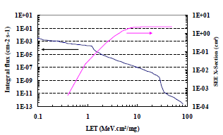
SEE: Why radiation testing?
Prepare SEE rate prediction
Goal: Providing good data for SEE rate prediction
Principle
– Bombard the device
with accelerated ions
– Count the number of
events
– Calculate SEE cross
section for used LET
– Repeated with a
number of ions (and/or
LET values)
=> SEE cross section
versus LET

Slide 36
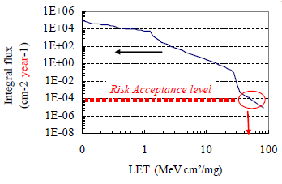
SEE: Why radiation testing?
SOA (safe operating area) and Go/No Go Test
Goal: Verify that a certain type of event will not happen within a satellite mission time
• SOA: Define voltage levels where no SEE achieved
–SEB - SEGR in power MOSFETs
• Go/No Go test: Verify that no SEE achieved or within acceptance criteria
– e.g SEL, SEFIs, SETs
• Typical values (varies in different space programs)
> 10⁶ - 10⁷ particles/cm²
LET > 60-120 MeV.cm²/ mg

Slide 37
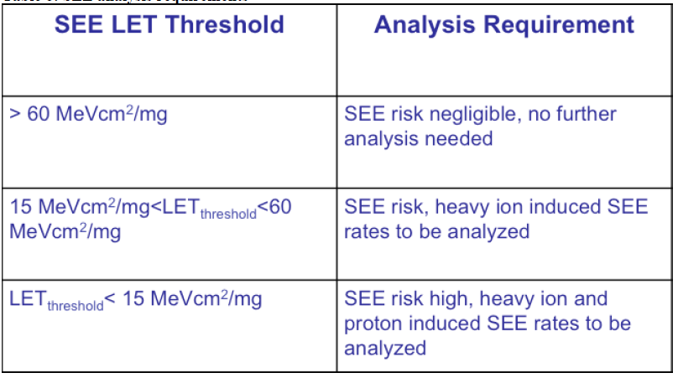
Typical SEE Radiation Hardness Assurance requirements for European missions
[ECSS-Q-ST-60-15C]

Slide 38
Standard Test Methods and
Guidelines for SEE testing
ESCC 25100
  Single Event Effects Test Method and Guidelines
Others
  JESD57 “Test Procedures for the Measurement of Single-Event Effects in Semiconductor Devices from Heavy Ion Irradiation”
  JESD89-1A “Test Method for Real-Time Soft Error Rate”
    Heavily used for SER testing for ground level applications
  ASTM F1192M-95 “Standard Guide for the Measurement of SEP Induced by Heavy Ion Irradiation of Semiconductor Devices”
  MIL-STD750F Method 1080 “Single Event Burnout and Single-Event Gate Rupture”
    Specific for SEB and SEGR in power MOSFETs

Slide 39
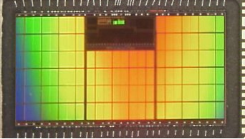
How can I check the beam:
The SEU monitor
Contribution of secondaries from nuclear interactions below threshold
4Mbits SRAM
250nm technology
ATMEL
[R. Harboe-Sorensen,
TNS Dec. 2008]
[S. Hoëffgen, Radecs 2011]
[V. Ferlet-Cavrois, TNS Oct. 2012]

Slide 40
How can I check the beam:
Charge collection in a SSBD
Silicon Surface Barrier Detector, or PIN diode
RADEF cocktail
Energy deposited in the PIN diode (MeV)
[V. Ferlet-Cavrois, TNS Oct. 2012]

Slide 41
Heavy Ion SEE Rate Calculation
Integral Rectangular Parallelepiped (IRPP)
# SEU / ion/cm²
# ions / cm² / s
Xsat
SEU rate/ s
Sensitive volume
Z
(SV) geometry
https://creme96.nrl.navy.mil/

Slide 42
Comparative Upsets Rates, Uncertainties in SEE predictions are significant
10⁻⁴
Geosynchronous GCR Solar Minimum, CREME 96
10⁻⁵
CS = 1000 μm²
10⁻⁶
CS = 100 μm²
10⁻⁷
Upset rate (upsets/bit-day)
10⁻⁸
CS = 10 μm²
Thickness Z of SV
10⁻⁹
Z = 0.5 μm
Z = 1 μm
Z = 2 μm
Z = 4 μm
Cross Section = 1 μm²
10⁻¹⁰
10⁻¹¹
0
5
10
15
20
25
30
35
40
Device LET threshold (MeV cm²/mg)
After E Petersen, NSREC 1997 short course

Slide 43
Proton SEE Rate Calculation
# SEU / proton / cm²/bit
SEU rate/ bit s
# protons / cm² / s
https://creme96.nrl.navy.mil/

Slide 44
ONE Example
AboArd Proba-2

Slide 45
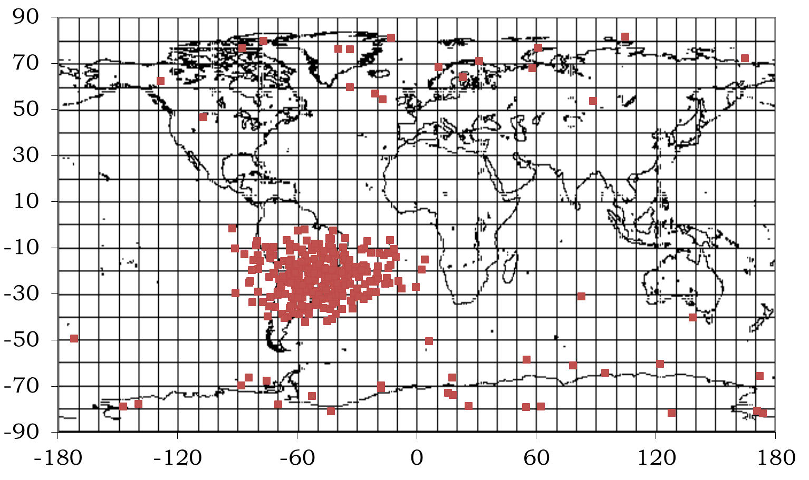
GPS receiver: latch-up events in 512kx8 SRAM Samsung K6R4016V1D-TC10
The GPS counts two redundant receiver units and a current limiter; in cold redundancy logic
Proba-2: polar LEO
Samsung
K6R4016V1D-TC10
DC 220
TANO6EE KOREA
[M. D’Alessio, et al. RADECS 2013]

Slide 46
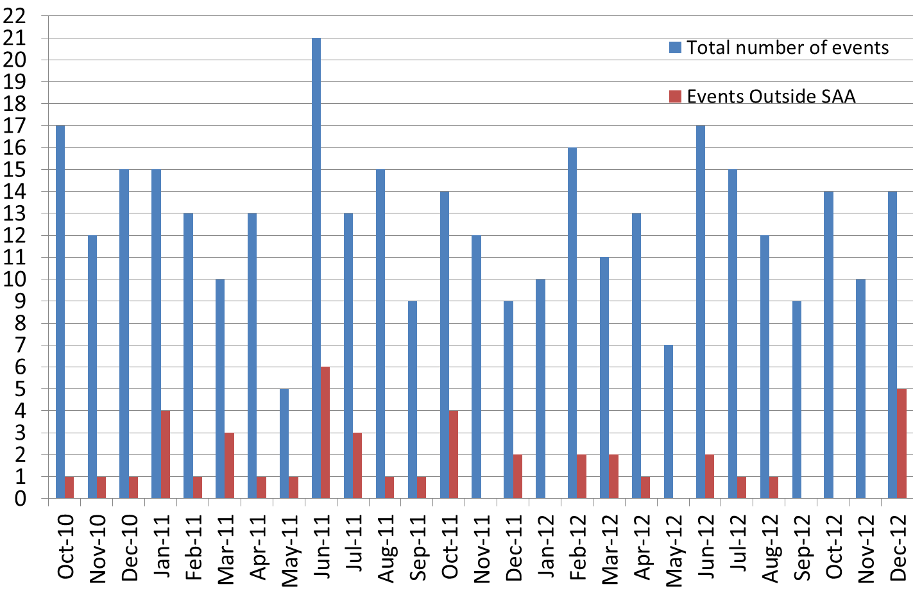
Statistical analysis of the GPS latch-up events from Oct-10 to Dec-12
Average upset rate of 12 SELs/month (0.4 SEL/day)
Large variability, from 6 to 27 SELs/months
87% SELs are in the SAA

Slide 47
Statistical analysis of the GPS latch-up events (cont.)
Slope of 1:
Signature of random single event effects

Slide 48
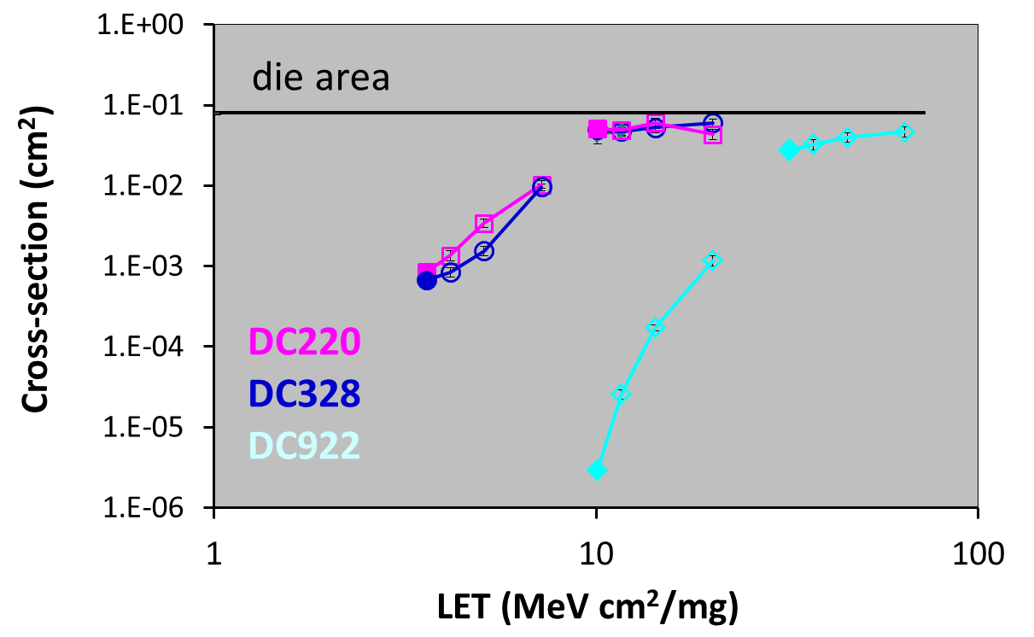
The ground tests of the Samsung K6R4016V1D-TC10 shows large differences vs. Date Code
Heavy ions

Slide 49
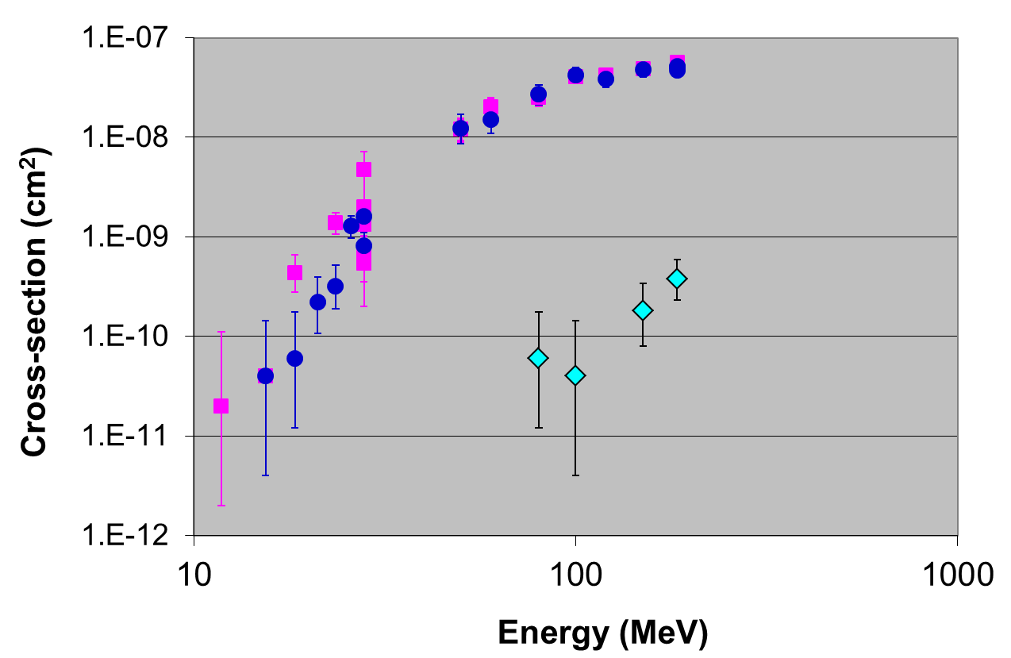
The ground tests of the Samsung K6R4016V1D-TC10 shows large differences vs. Date Code
High energy protons
DC220
DC328
DC922

Slide 50
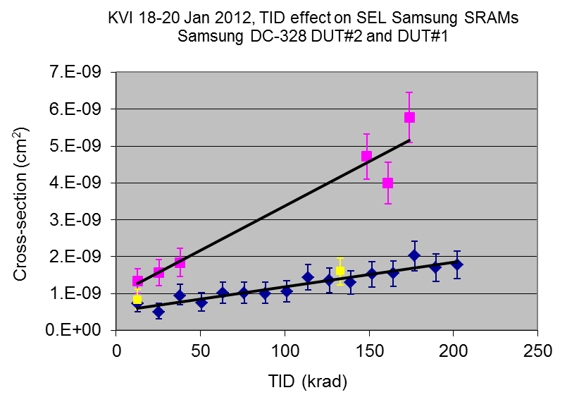
Experimental artefact during proton testing: The SEL rate increases with TID
DC220 #1
DC328 #1
DC328 #2

Slide 51
GPS Proba-2: Upset rate prediction
CREME96: 0.21 SEL/day
  Multiple sensitive volumes (1/bit), thickness 1um
  To be compared to the in-flight rate 0.4 SEL/day
Origin of the discrepancy
  Inhomogeneity of the FM lot? sample-to-sample variation: Possible
  Thinner sensitive volume? Unlikely
    Proba-2 is a polar LEO orbit, mainly protons
Better prediction rate is obtained in other devices (TDM) aboard Proba-2

Slide 52
Links to
ESCC web site
  https://spacecomponents.org/
  EPPL
ESCIES web site
  https://escies.org/
  Test facilities
  Standards and handbooks
  Radiation database

