Slide 1
Standard Model Higgs searches in ATLAS and CMS
Marco Pieri
University of California San Diego
Firenze,
27th November 2012

Slide 2
Outline
Introduction
The discovery of the new boson
Analysis in the various channels
Measurement of the properties of the new boson
Mass
Couplings
Spin-parity
Summary and outlook

Slide 3
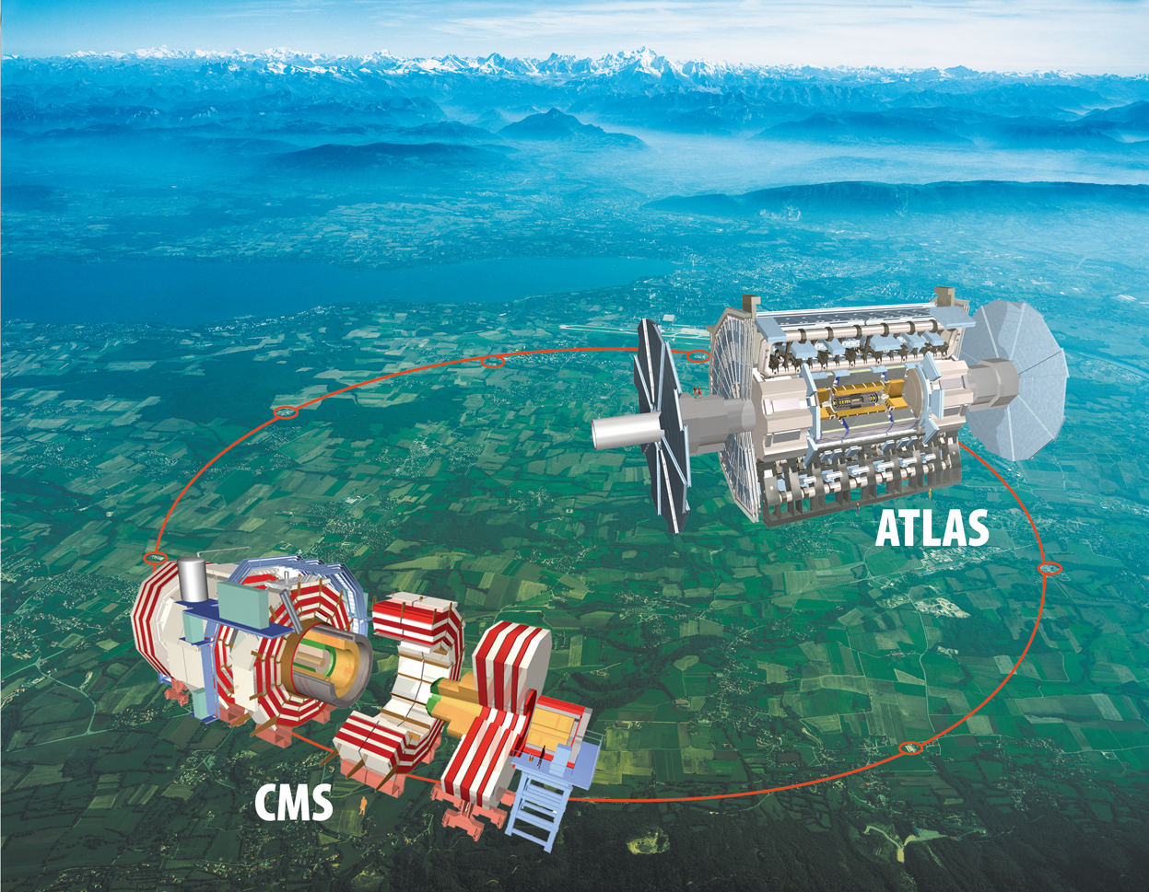
LHC and detectors
CMS

Slide 4
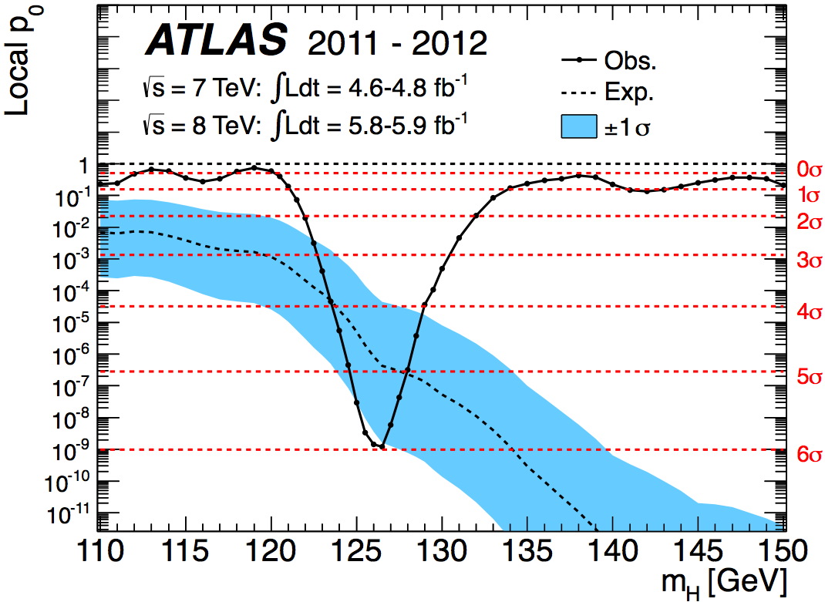
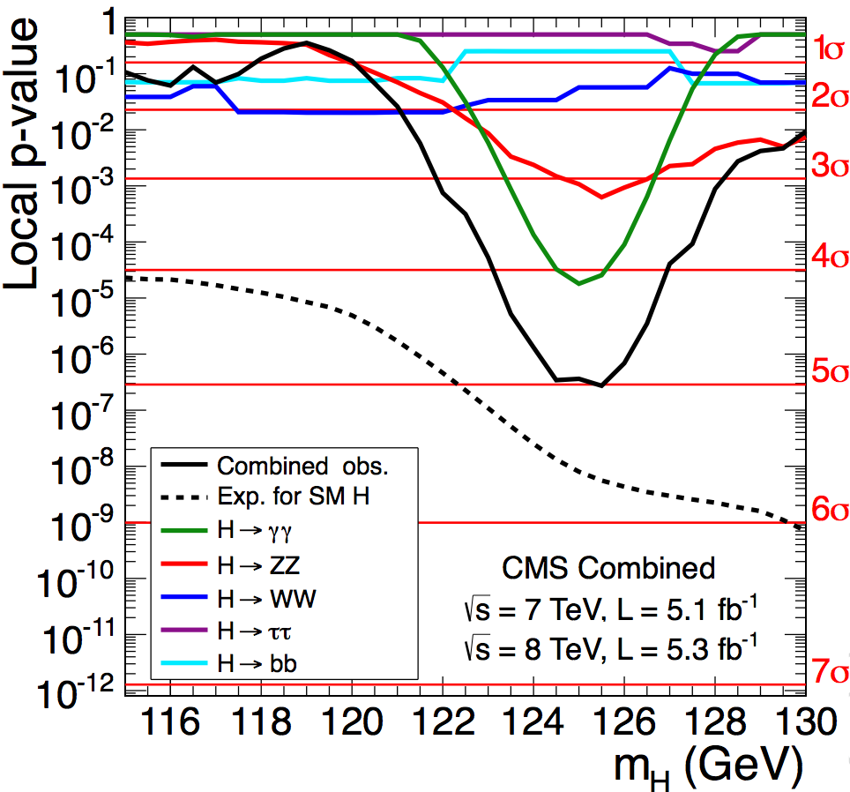
The discovery of the new Higgs-like boson
In March 2012 ATLAS and CMS presented some excess at ~125 GeV
On July 4th 2012 CMS and ATLAS reported the observation of a new boson with mass about 125 GeV that is consistent with the SM Higgs boson
5 main channels in CMS:
H → γγ
H → ZZ → 4l
H → WW → 2l2ν
H → ττ
H → bb

Slide 5
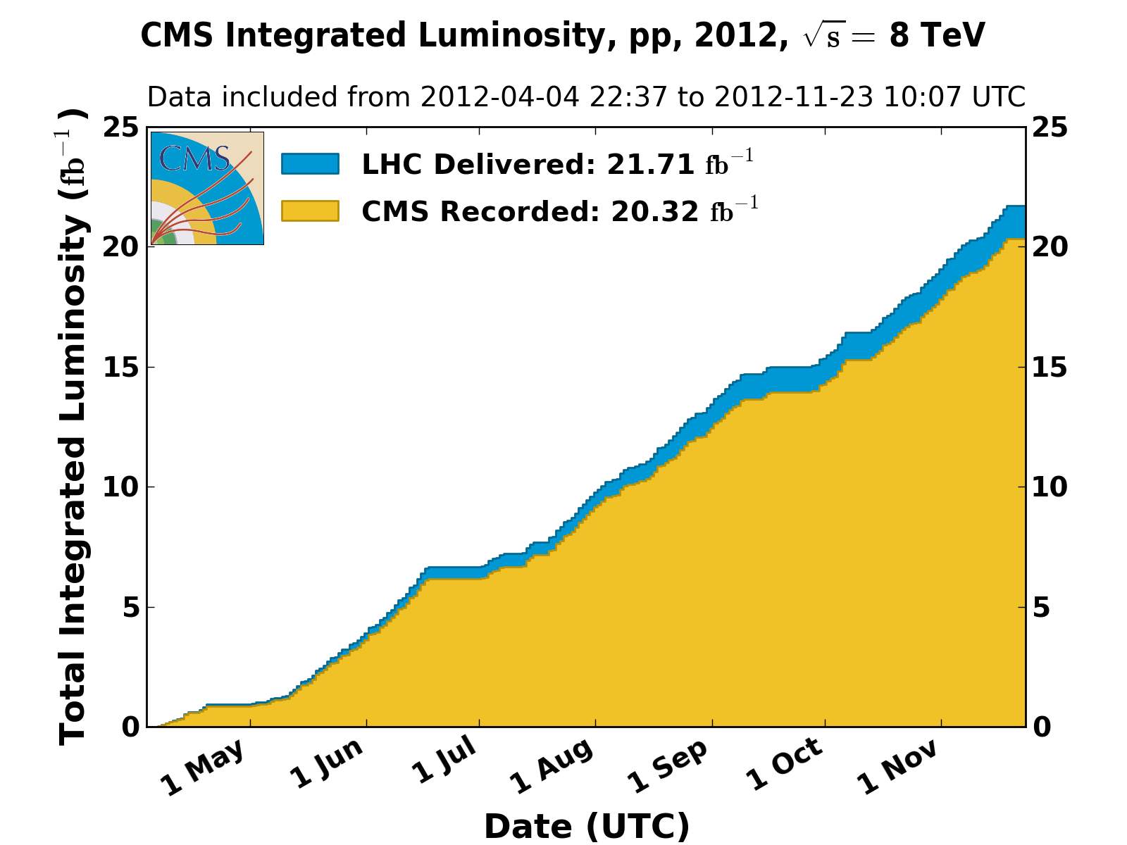
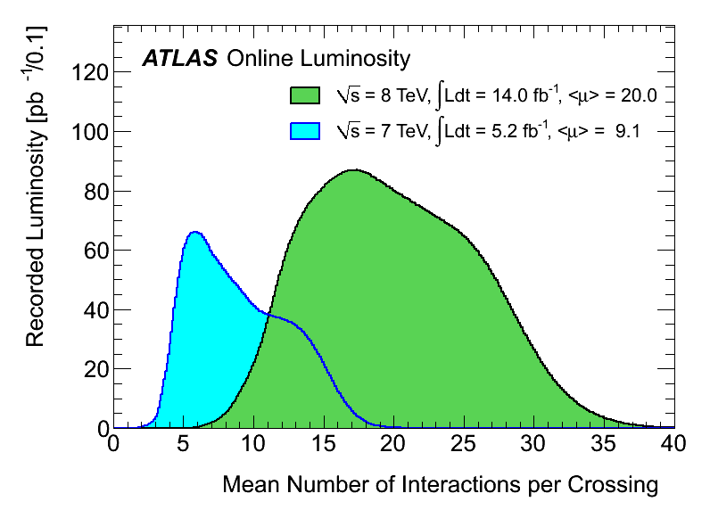
2012 data taking
LHC is running at 8 TeV since beginning of April
Already exceeded 20 fb⁻¹ per experiment of collected data
Maximum luminosity 7.5 x 10³³ cms⁻²s⁻¹
Multiple interactions occur for each bunch crossing (in-time and out-of-time pileup)
Mean PU ~10 events in 2011 and ~20 events in 2012

Slide 6
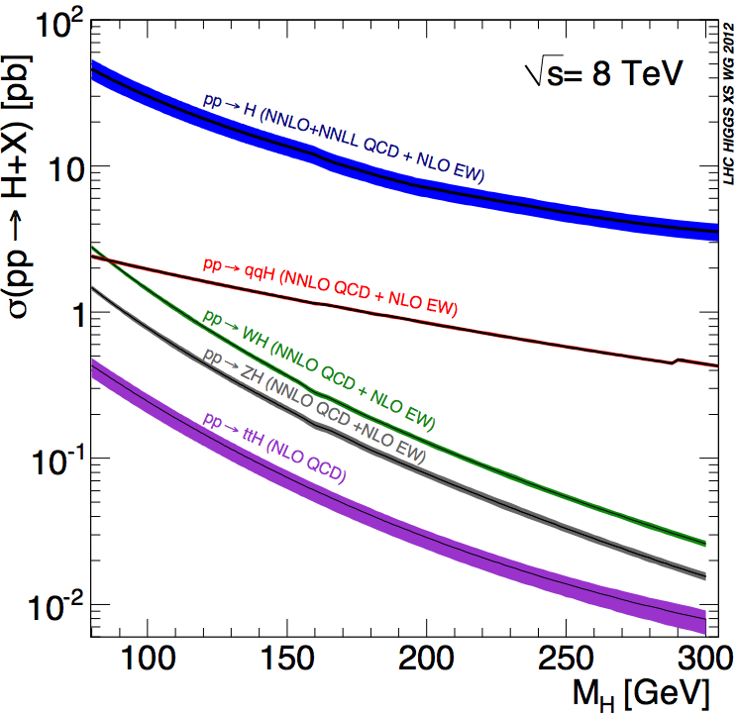
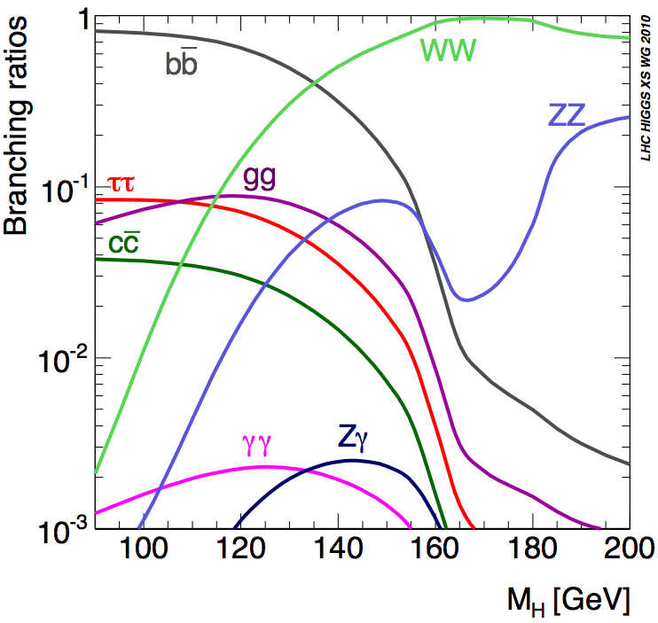
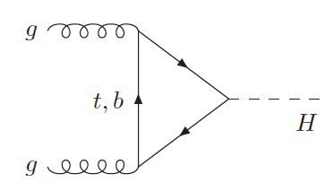
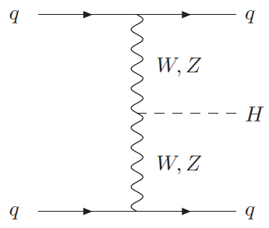
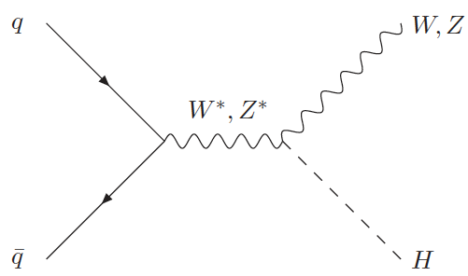
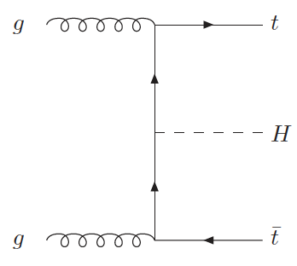
SM Higgs production and decay
ggH
VBF
VH
ttH
Exploit all four production modes

Slide 7
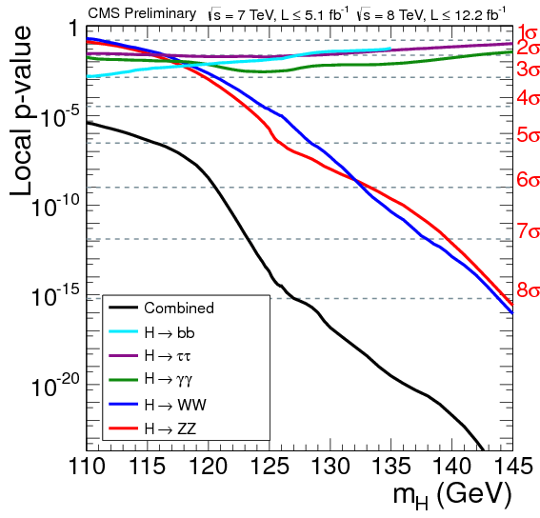
Most sensitive search channels at 125 GeV
2 channels with excellent mass resolution (1-2%)
γγ and ZZ -> 4l
Search for mass peak over the BG
3 channels with worse mass resolution (10-20%)
WW -> 2l2ν, ττ and bb
Search for excess above estimated BG
Illustrative CMS for ICHEP dataset 5 + 5 fb-1
Channel | σ x BR (7-8 TeV) (pb) | Mean Efficiency | Number of signal events | Average s/b | Mass resolution
γγ untagged | 0.045 | 40% | 180 | 3.5% | 1%
γγ VBF | 0.003 | 20% | 6 | 20% | 1%
ZZ->4l untagged | 0.002 | 30% | 8 | 150% | 1.5%
WW->2l2ν untagged | 0.2 | 5% | 100 | 15% | 20%
WW VBF | 0.015 | 3% | 4 | 25% | 20%
ττ untagged | 1.3 | 2.5% | 300 | 1% | 15%
ττ VBF | 0.088 | 2% | 15 | 10% | 15%
bb VH | 0.13 | 4% | 50 | 3% | 9%
M_{H} = 125 GeV
Approximate values, only for illustration

Slide 8
Updates of the analysis
Channel | Int Lumi CMS (fb⁻¹) | Int Lumi ATLAS (fb⁻¹)
γγ (untagged, VBF tag) | 5 + 5 | 5 + 5
ZZ->4l (untagged) | 5 + 12 | 5 + 5
WW->2l2ν (0-1 jet) | 5 + 12 | 13
WW->2l2ν (VBF tag) | 5 + 12 | 5 + 5
ττ (untagged, VBF tag, VH tag) | 5 + 12 | 5 + 13
bb (VH tag) | 5 + 12 | 5 + 13
Results that have been updated for the HCP conference in November are indicated in red
2012 analyses have been ‘blind’
All analyses have been developed before looking at the signal region
This avoids possible experimental bias

Slide 9
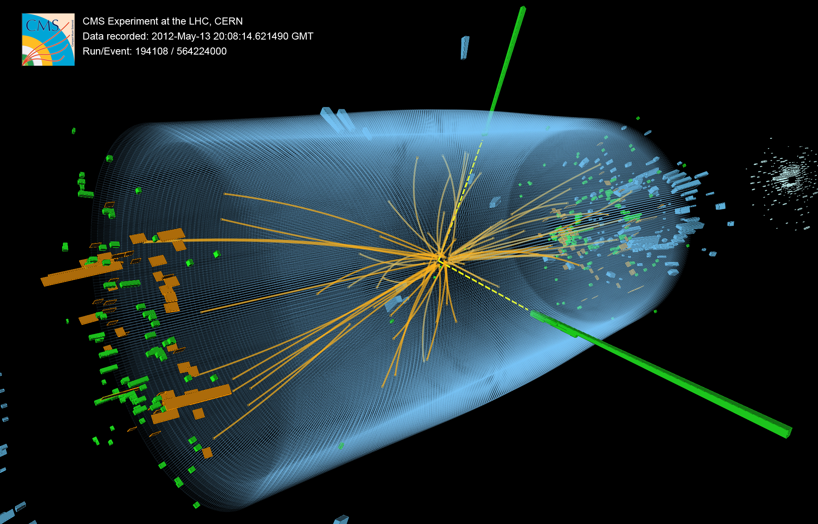
H→γγ
M_{γγ}=125.9 GeV σ_{M}/M=0.9%

Slide 10
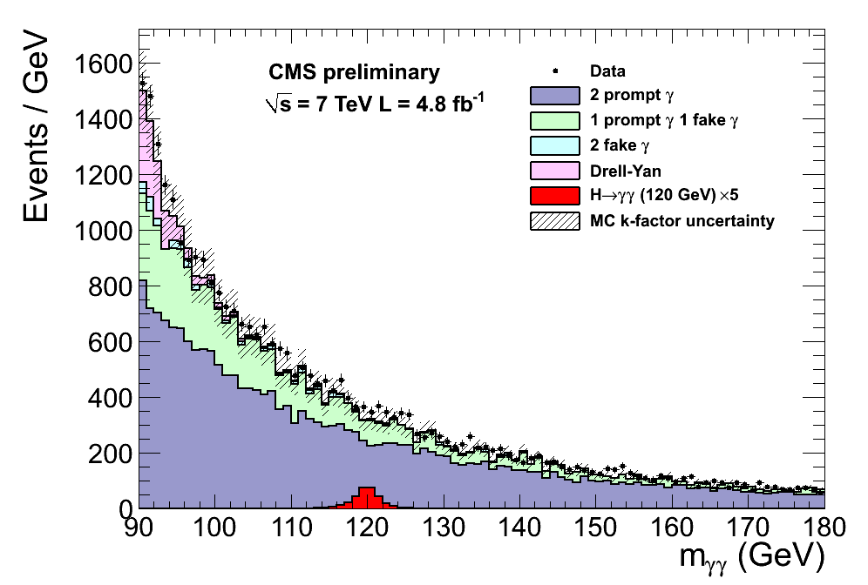
H→γγ analysis strategy
Search for a small mass peak over large and smooth background
Irreducible: 2γ QCD production
Reducible: γ+jet with 1 additional fake photon, QCD with 2 fake photons, DY with electrons faking photons
Narrow mass peak
mass resolution 1-2%
Studied mass range: 110-150 GeV
Split into event classes to enhance the sensitivity
M_{H}=120 GeV
signal x 5
BG MC only not used for CL estimation
ATLAS
Split into 9 categories
Diphoton P_{Tt}, η, converted/unconverted
CMS
Cut based and MVA based analyses
Split into 4 categories + VBF analysis

Slide 11
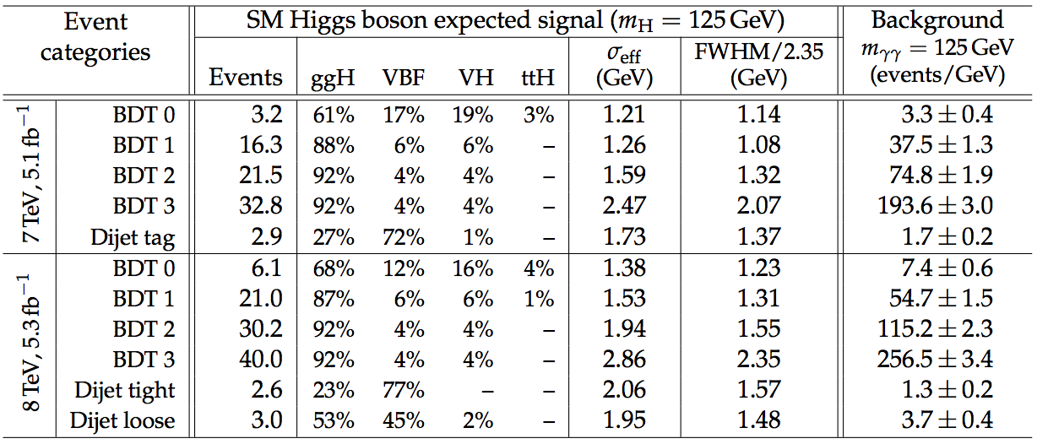
CMS H→γγ analysis
4 non-VBF event classes split based on a diphoton Boosted Decision Tree (BDT) classifier output + dijet tag classes
BG is estimated by fitting to a polynomial in the full mass range (3rd to 5th order)
Possible BG bias is always less than 20% of the statistical error
Different BG estimation in cross check analysis gives consistent results
Resolution in 2012 somewhat worse that 2011 because for now used prompt-reco

Slide 12
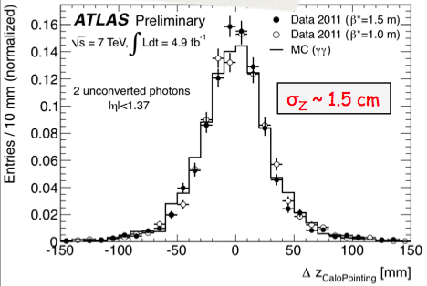
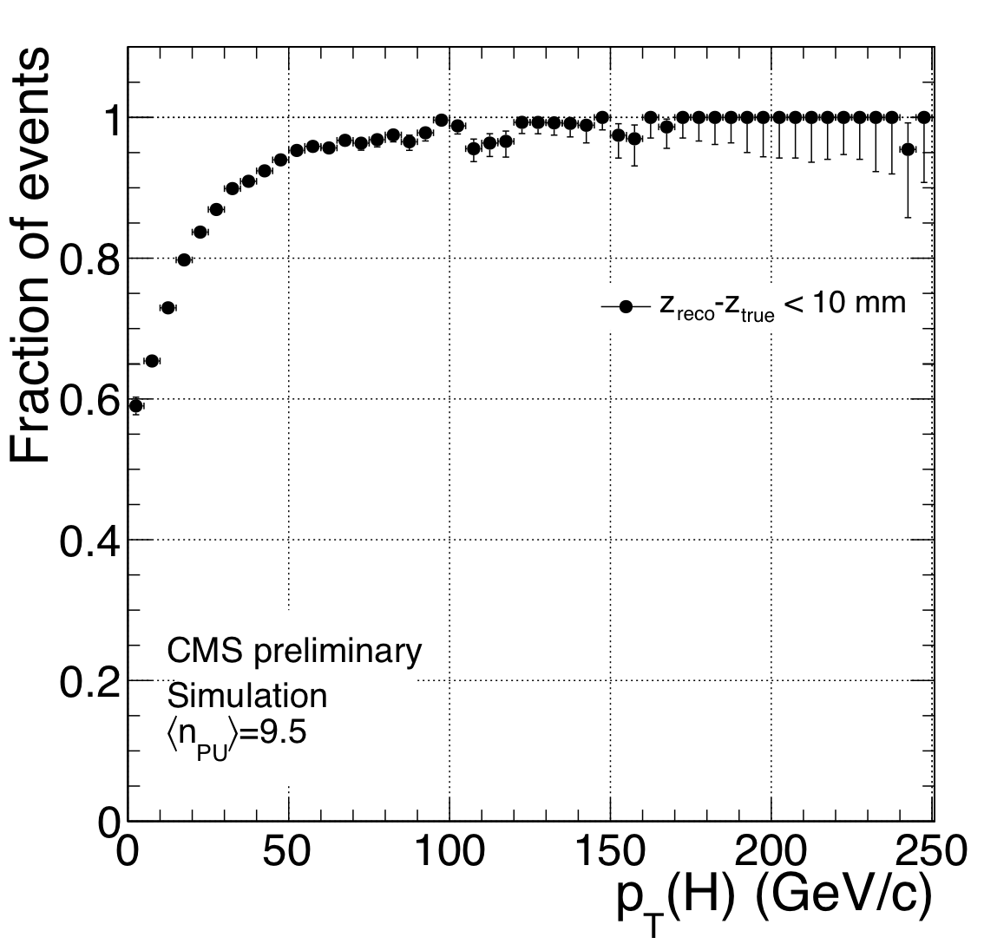
H→γγ vertex determination
Primary vertex Z position
ATLAS has pointing calorimetry
Z resolution 1.5 cm for two unconverted photons, good enough to have negligible contribution to mass resolution
CMS uses underlying event and recoil jets,
Affected by pileup
checked with Z->μμ
Overall efficiency >80%
Both also exploit tracks from converted photons

Slide 13
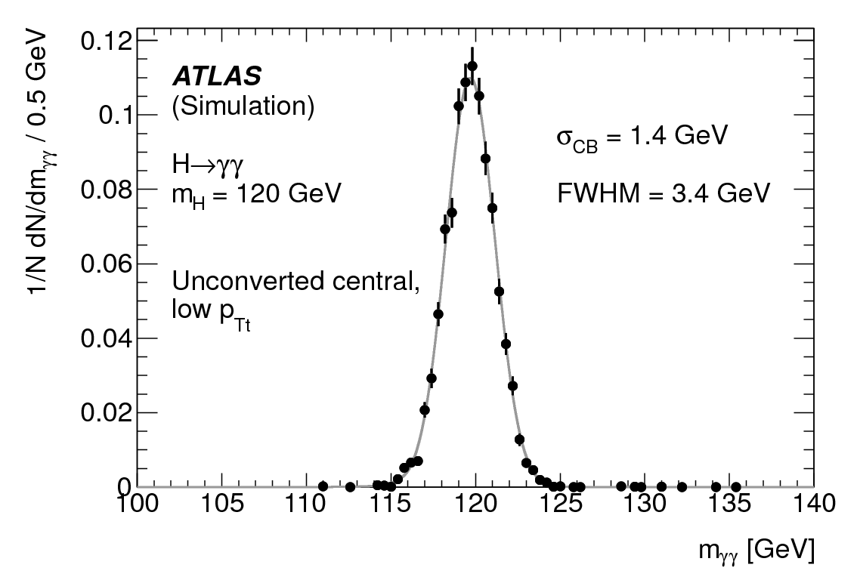
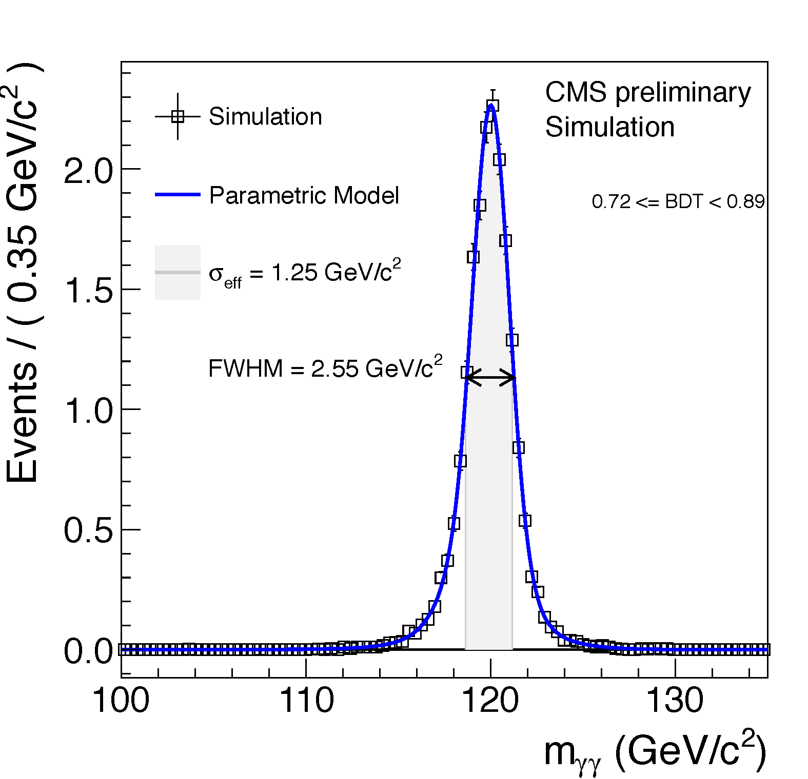
H→γγ energy resolution
Energy resolution extremely important
Need precise ECAL calibration
CMS uses MVA energy regression
Energy scale and resolution measured with Z->ee
Exploit similarities between electron and photons
Precision from tagged photons from Z->μμγ would be smaller
Examples of high resolution event classes

Slide 14
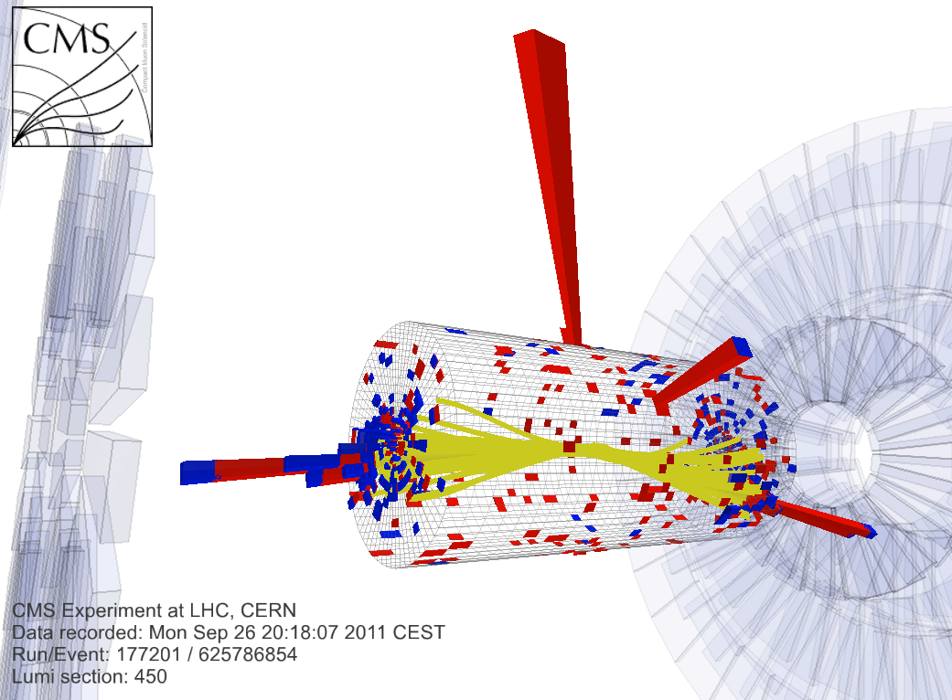
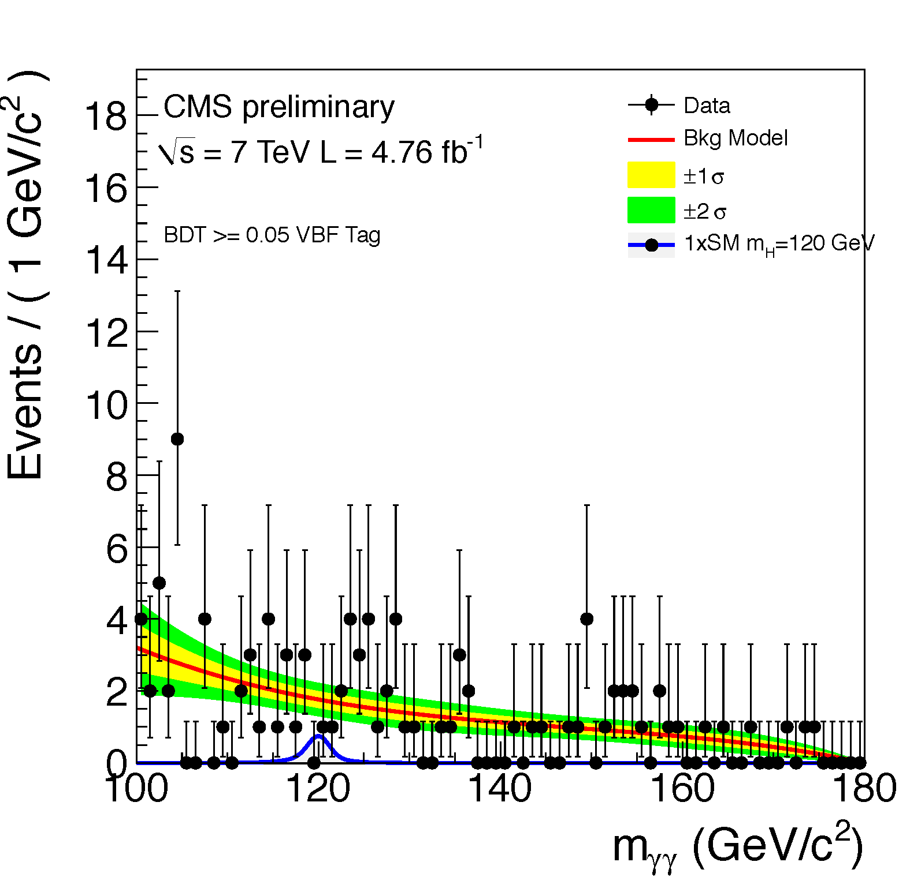
H→γγ VBF analysis
Exclusive dijet tag improves sensitivity by ~10%
Photon identification is the same
tighter lead photon E_{t} cut (E_{t} lead/M_{γγ} > 55/120)
Dijet tag selection on dijet variables
exploits two additional VBF high p_{T} jets at large rapidity
Contamination of gg-fusion ~25%, syst. error 50-70% dominated by underlying event
Dijet tag selection has high s/b, ~1/3
M_{γγ} = 121.9 GeV
M_{jj} = 1460 GeV

Slide 15
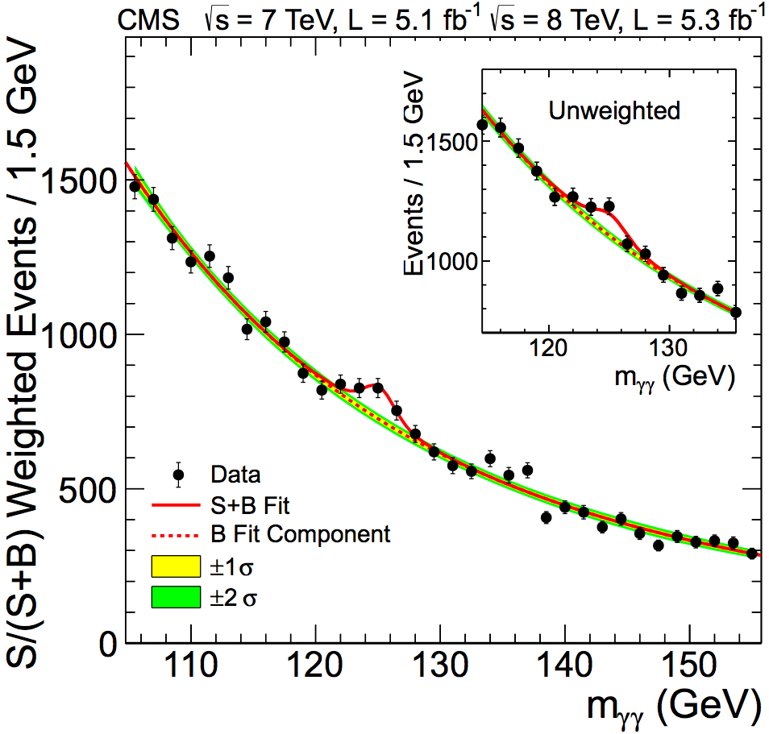
H→γγ combined mass spectrum
Unweighed
data events
and BG model
parametrizations
Weighed
data events
and BG model
parametrizations
Sum of mass distributions for each event class, weighted by S/(S+B)
B is integral of background model over a constant signal fraction interval
This plot is not used in the analysis and it is for illustration only, it adds all event classes together

Slide 16
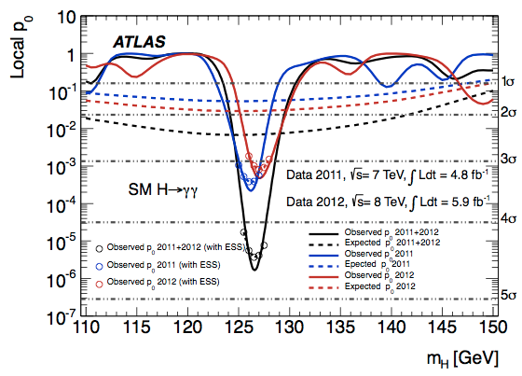
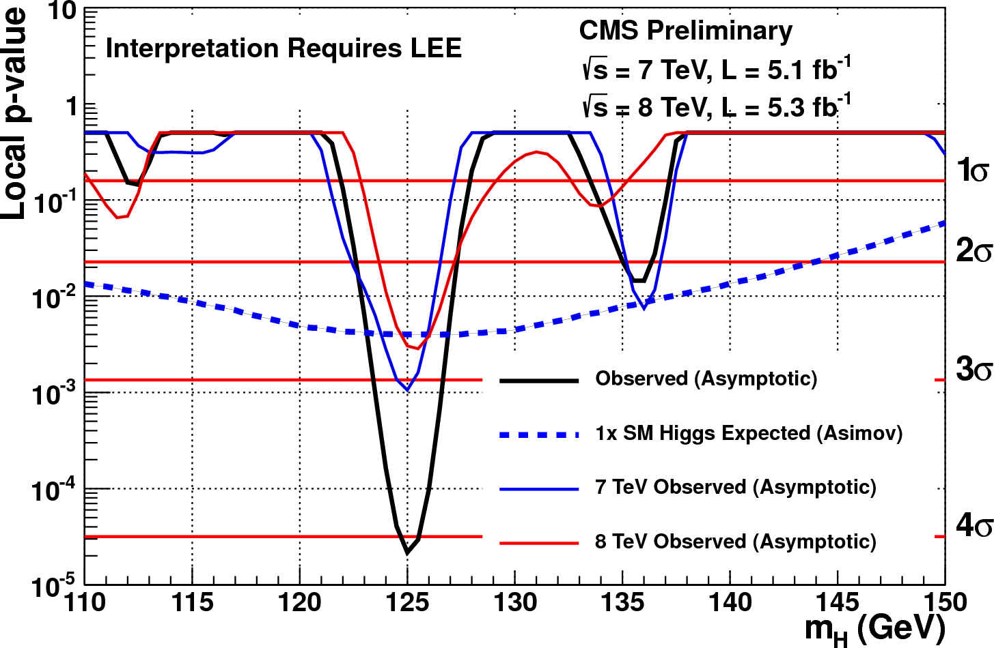
H→γγ results: p-values
P-value: probability that a BG only fluctuation is more signal-like than observation
TO BE FIXED
Similar results from cut based and cross
Check MVA analysis (3.7 and 4.6 σ)
 | ATLAS | CMS
Mass position of minimum local p-value | 126.5 GeV | 125 GeV
Local significance at minimum | 4.5 σ | 4.1 σ
Fitted value of μ | 1.8 ± 0.5 | 1.56 ± 0.43
μ is the signal strength modifier μ = σ/σ_{SM}

Slide 17
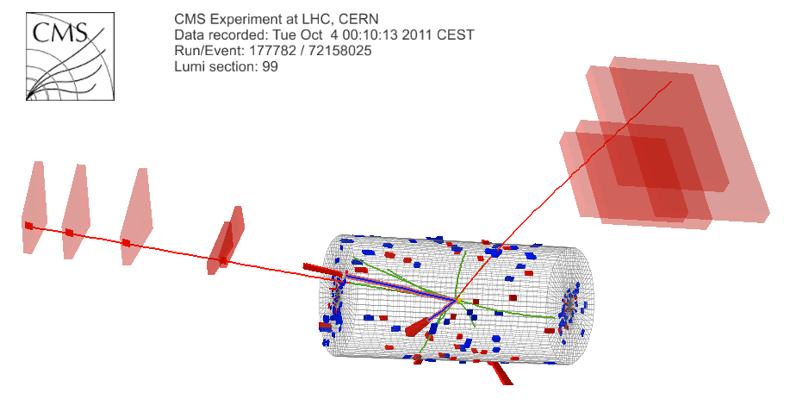
H → ZZ → 4l (4μ, 4e, 2e2μ)
Clean channel: 2 high mass pairs of opposite sign isolated electrons or muons coming from PV
Narrow mass peak
Very good mass resolution 1-2 %
Background
irreducible: ZZ
reducible: Z+jets, Zbb, tt, WZ
Very small BR ~10⁻⁴ at 125 GeV
μ⁻(Z₂) p_{T} : 15 GeV
e⁺(Z₁) p_{T} : 28 GeV
4-lepton Mass :
125.8 GeV
μ⁺(Z₂) p_{T} : 12 GeV
e⁻(Z₁) p_{T} : 14 GeV

Slide 19
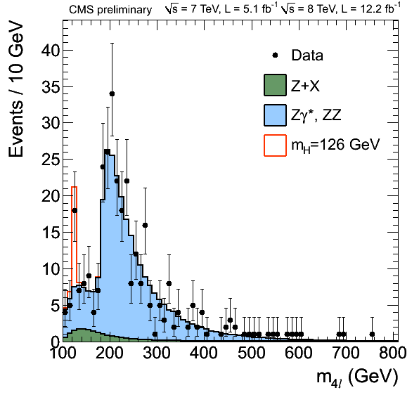
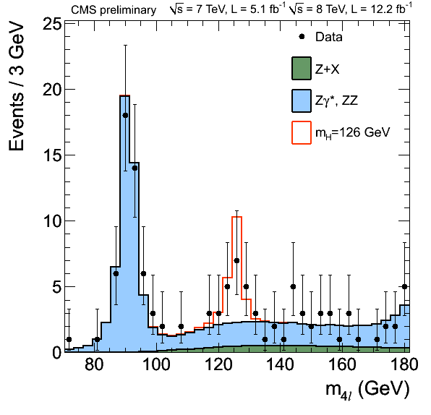
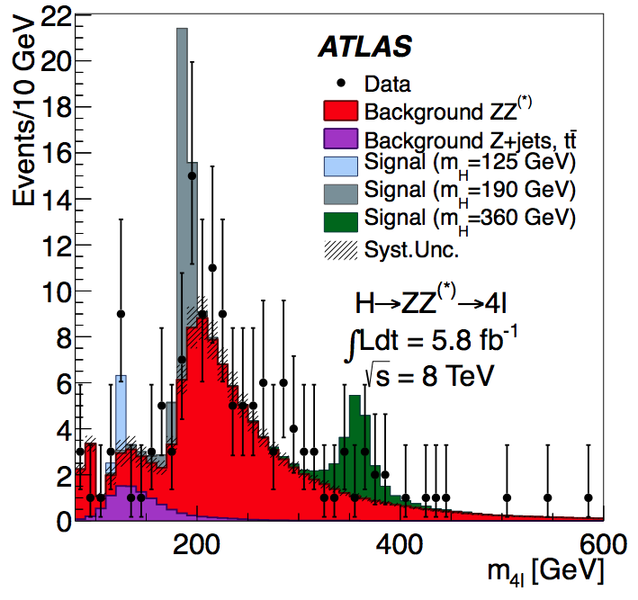
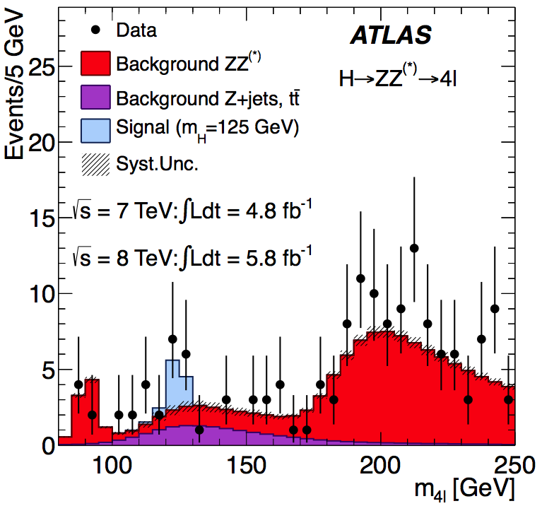
H→ZZ→4l: invariant mass spectrum
Full mass range
Low mass
Only
8 TeV

Slide 20
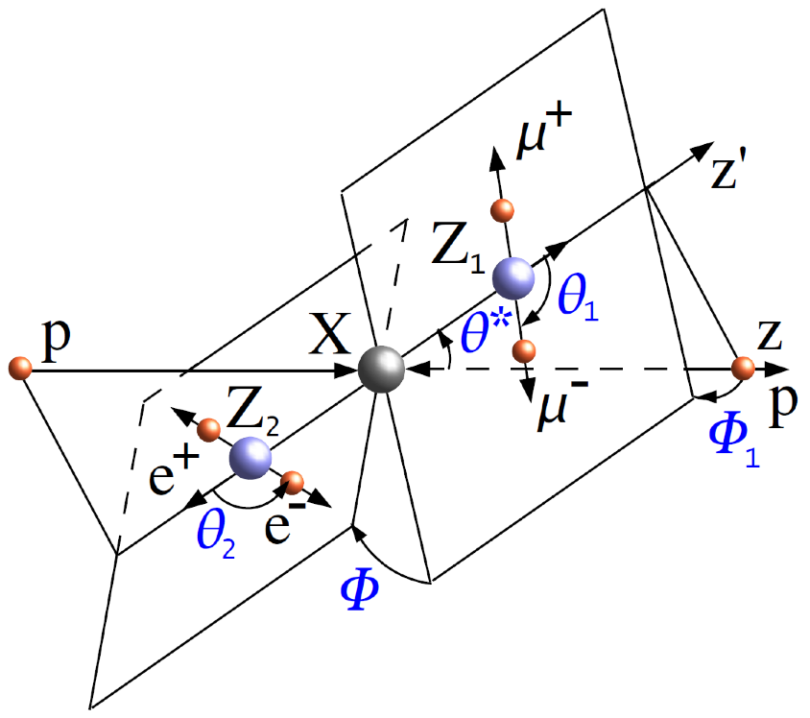
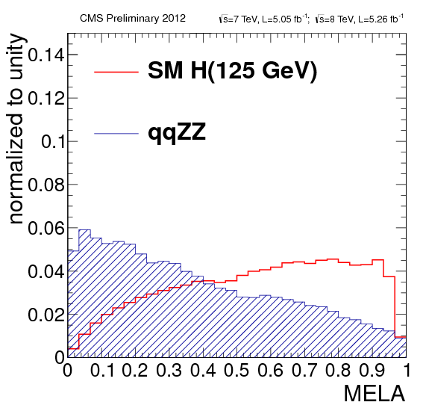
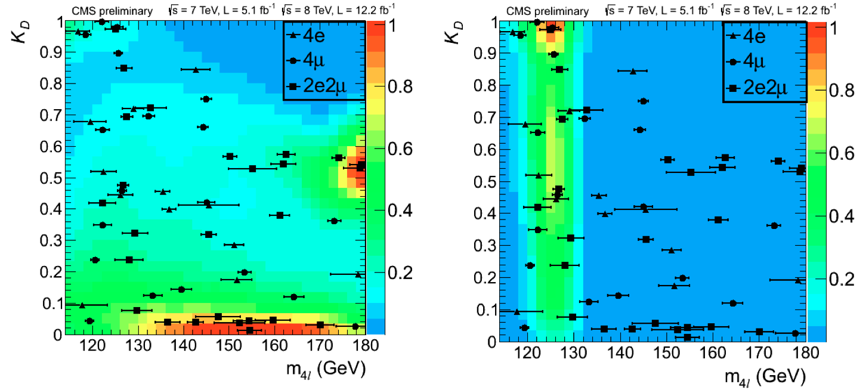
CMS: use other kinematical variables
MELA: Matrix Element Likelihood Analysis:
uses kinematic inputs for signal to ZZ background discrimination
{m₁,m₂,θ₁,θ₂,θ*,Φ,Φ₁}
Improves the sensitivity by ~20% compared to using the mass alone
BG MC
Signal MC

Slide 21
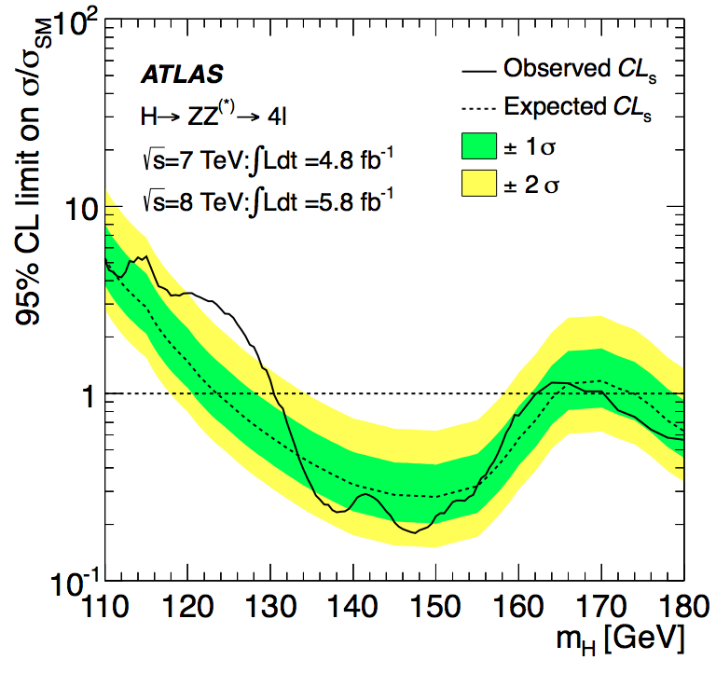
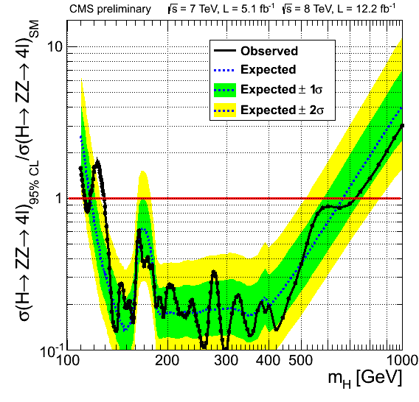
H→ZZ→4l exclusion
ATLAS: Not updated after
discovery papers in July
 | ATLAS | CMS
Expected exclusion 95% CL | 124 - 164 and 176 - 500 GeV | 120 - 680 GeV
Observed exclusion 95% CL | 131 - 162 and 170 - 460 GeV | 113 – 116 and 129 - 720 GeV

Slide 22
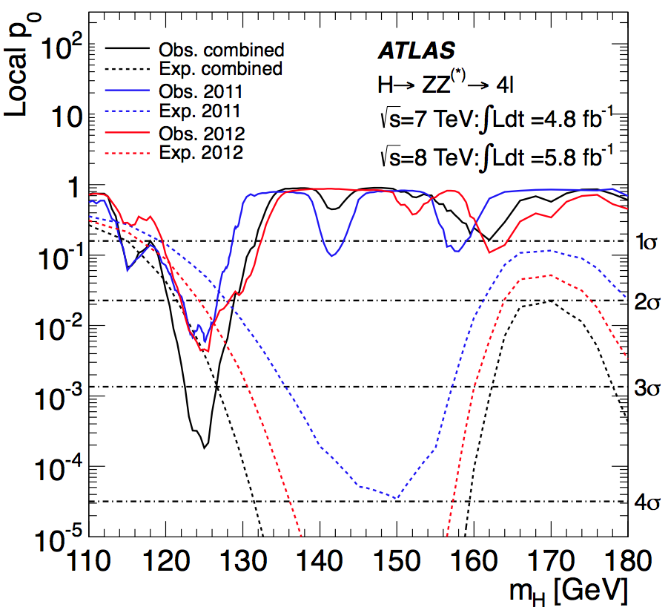
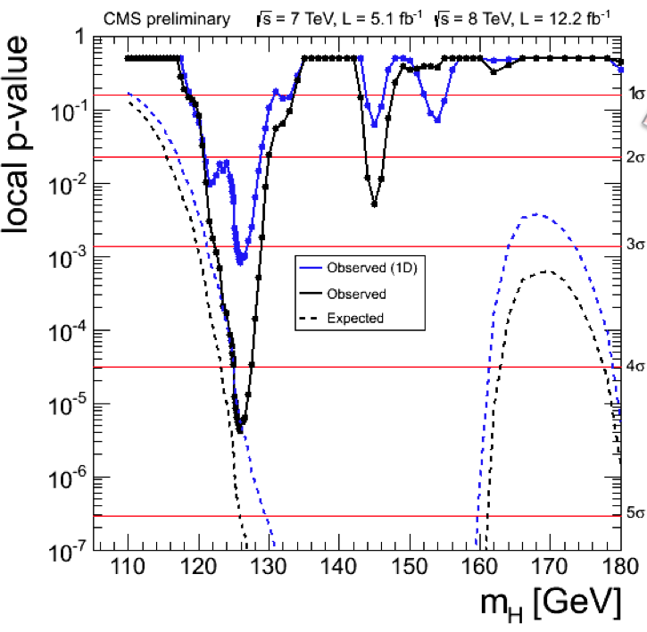
H→ZZ→4l p-value
 | ATLAS | CMS
Mass position of minimum local p-value | 125 GeV | 126.0 GeV
Local significance at minimum | 3.6 σ | 4.5 σ
Expected | 2.7 σ | 5.0 σ
Fitted μ | 1.4 ± 0.6 | 0.8 ± 0.3

Slide 23
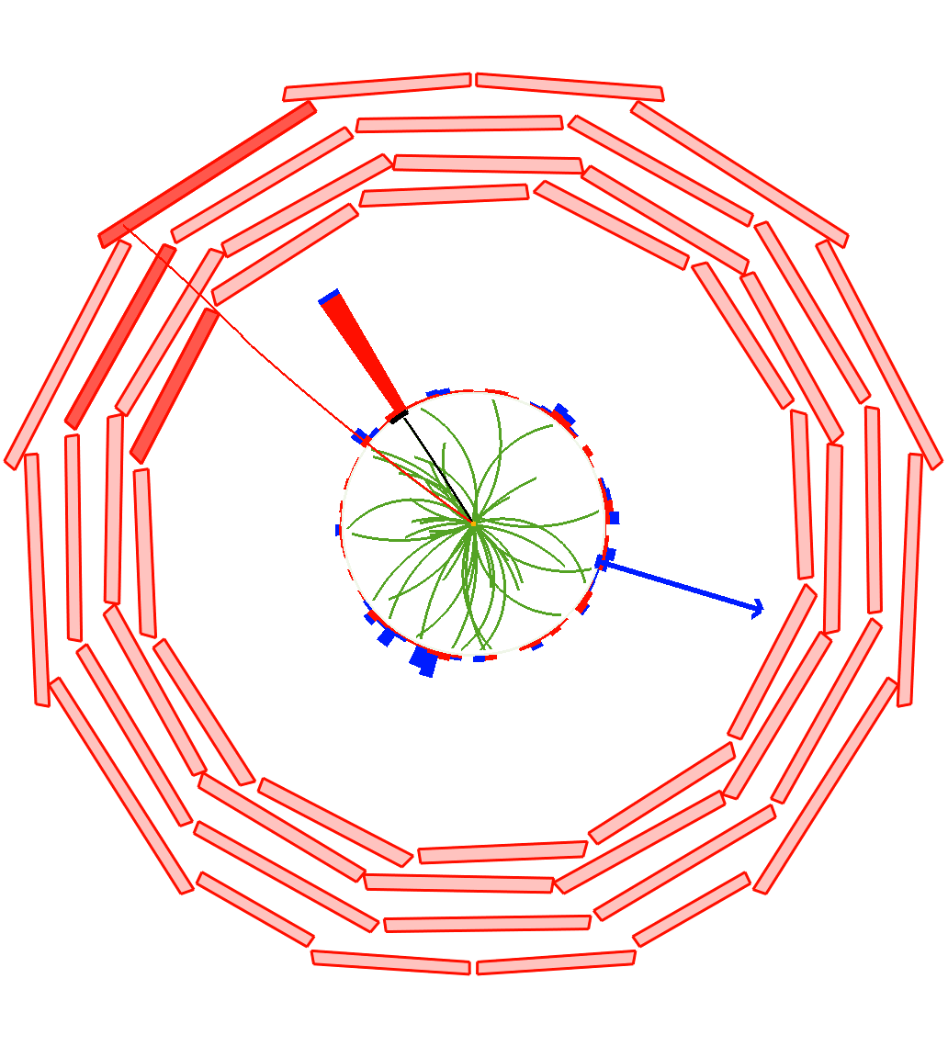
H→WW→lνlν
Most sensitive channel around 2 x M_{W} (125 <~ M_{H} <~ 200 GeV)
No narrow mass peak (mass resolution ~20%)
Main backgrounds
WW (irreducible but signal tends to have smaller angle between leptons)
Z+jets, WZ, ZZ, tt, W + jets
Analysis can be performed in exclusive jet multiplicities (0, 1, 2-jet bins) and flavour (ee, μμ, eμ)
Different BG
2 jet bin mainly corresponds to VBF dijet tag
H->WW->eμνν candidate in CMS
μ P_{T}
32 GeV
e P_{T}
34 GeV
ME_{T}
47 GeV

Slide 24
WW→lνlν analysis strategy
CMS
0 Jets (SHAPE)
1 Jet (SHAPE)
2 Jets (Cuts)
Different flavour (eμ)
0 Jets (Cuts)
1 Jet (Cuts)
2 Jets (Cuts)
Same flavour (ee, μμ)
Same flavour has much larger BG and larger systematic errors (cut based analysis used)
ATLAS only uses different flavour signature
Due to PU effect on MET resolution
Define 4 categories: eμ and μe (first is highest PT) and 0-jet and 1-jet categories
New for CMS: 2D shape analysis in M_{ll}, M_{T} variables

Slide 25
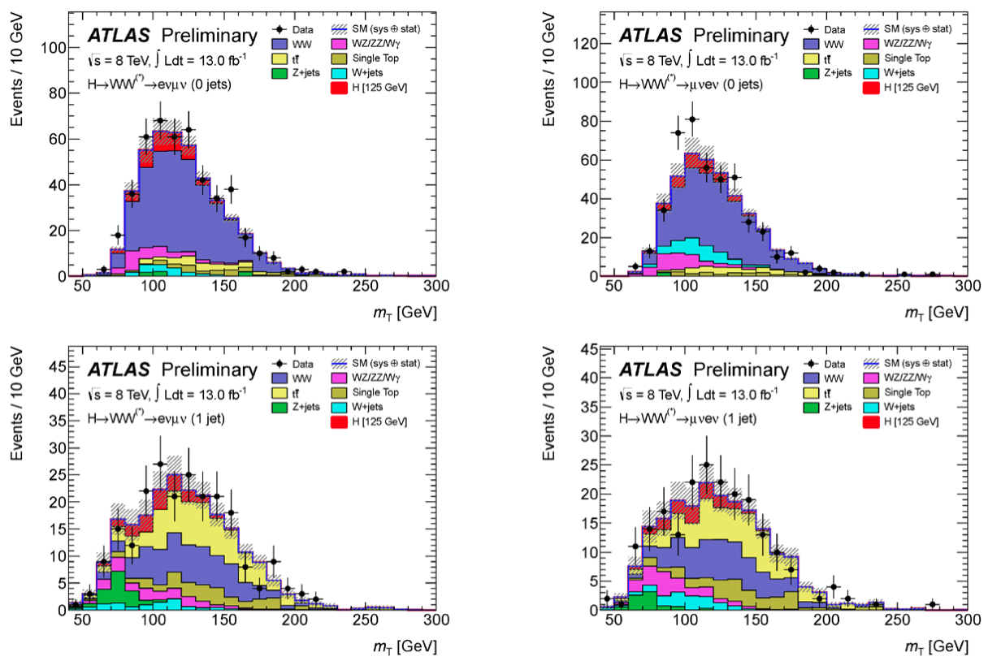
ATLAS 4 categories at 8 TeV

Slide 26
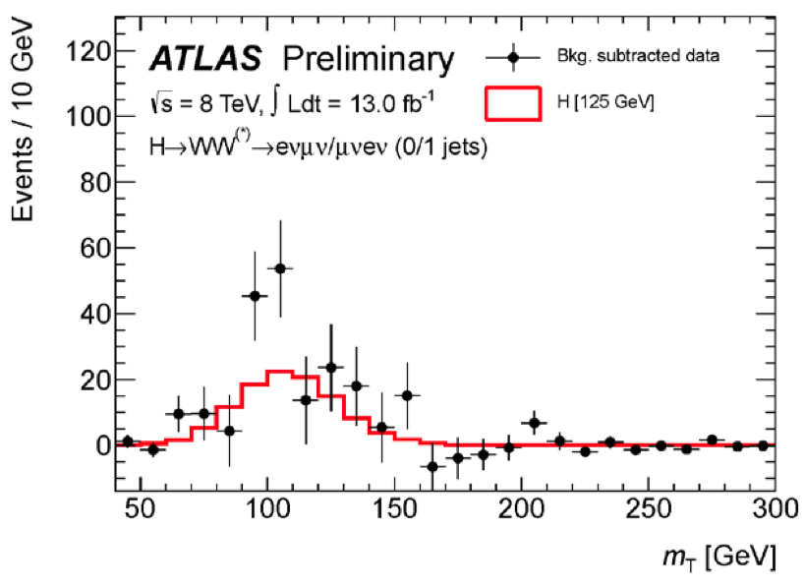
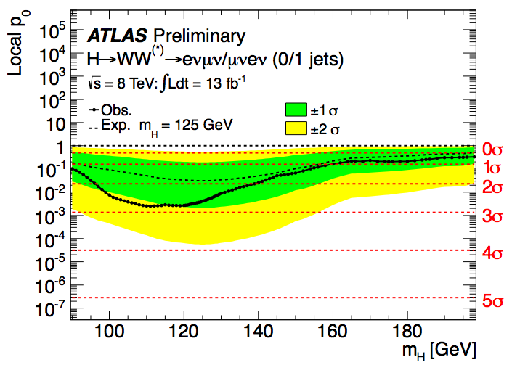
ATLAS WW 4 channels combined
Background subtracted data for the
4 channels combined
Only 8 TeV data, tot yet combined
with 2011 7 TeV data
Observed 2.6 σ at 125 GeV (1.9 σ expected)
Fitted μ =1.5 ± 0.6

Slide 27
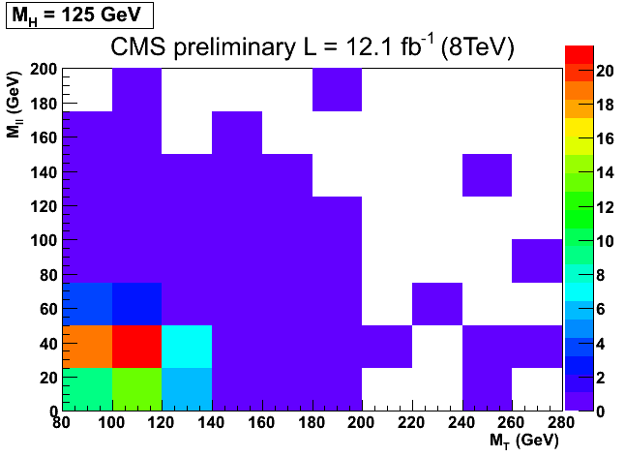
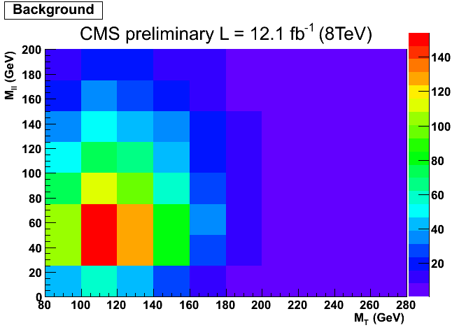
CMS: 2D shape analysis
Only for most sensitive channels
Use M_{ll} vs M_{T}
Different types of BG have different distributions
2D fit is able to constrain the BG in different regions
Simpler than previous MVA analysis because it is the same for all masses

Slide 28
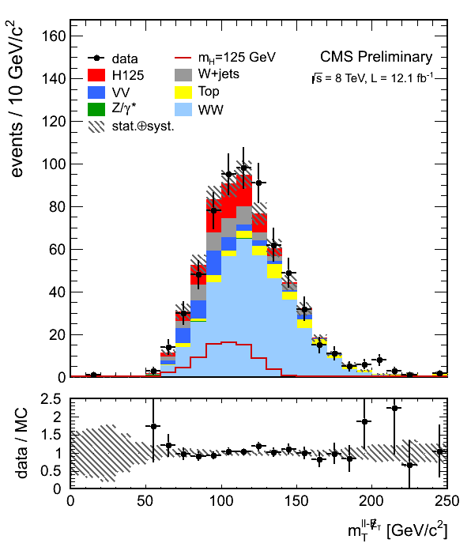
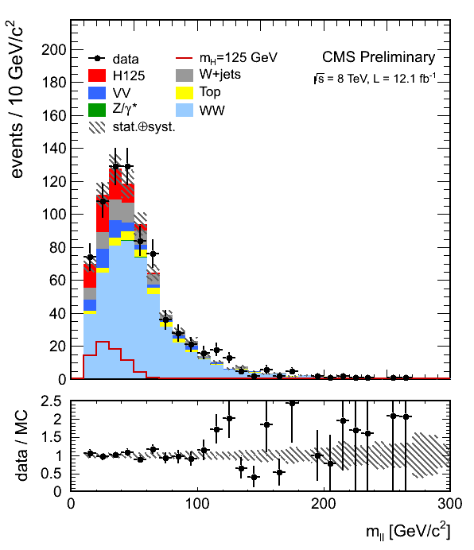
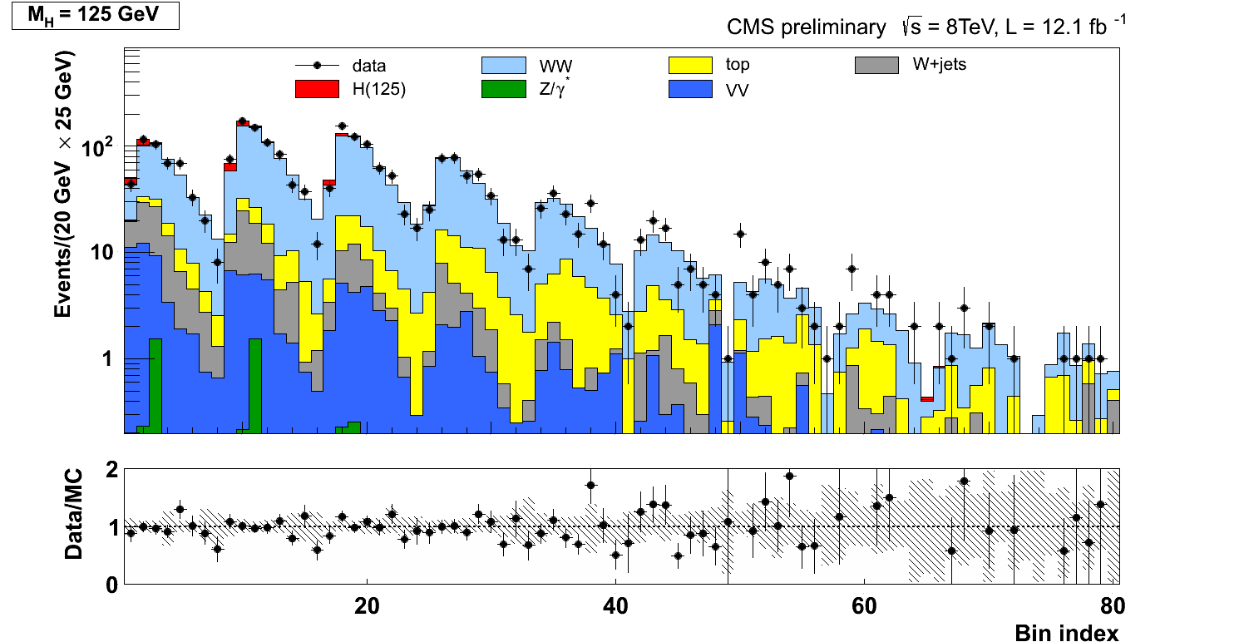
2D analysis
Combine the
two variables
Unfold to visualize
In 1 dimension

Slide 29
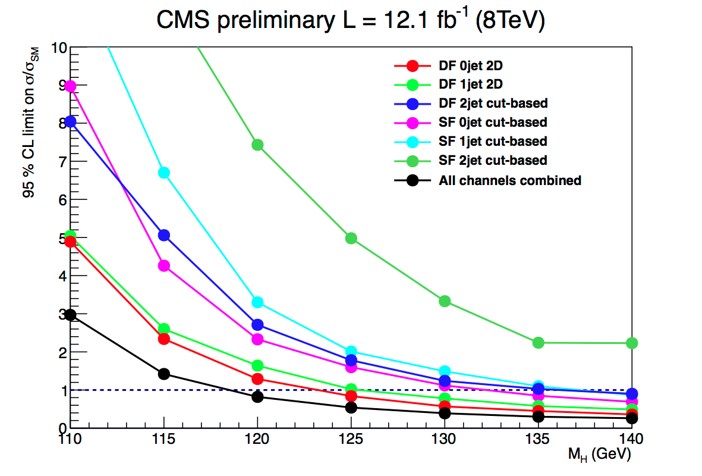
CMS WW results
Combine published 7 TeV cut based with 8 TeV 2D shape analysis
Observed: 3.1 σ at 125 GeV (expected: 4.1 σ )
Evidence of H->WW->lνlν decay
Signal strength μ = 0.74 ± 0.25 at 125 GeV

Slide 30
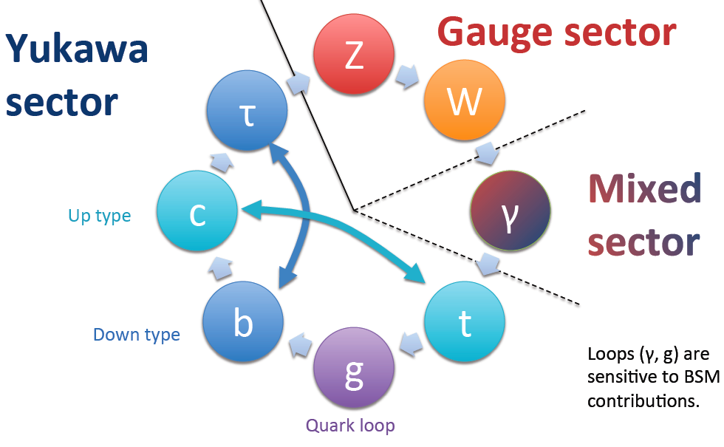
New boson’s decays to fermions
Couplings of the new boson in the Yukawa sector are not yet directly observed
H(125) presumably couples to quarks, indicated by presence of gg-fusion
H->ττ decay not yet established

Slide 31
H→ττ analysis
Complicated analysis, combination of many different sub-channels
Decay
Production/signature
0-jet (ATLAS only)
1-jet boosted
2-jet VBF
VH (ATLAS 2-jet, CMS leptonic decays of V)
Also split e and μ in the analysis
More than 10 sub-channels for each of the experiments
Njets
CMS
p_{T} (τ,μ)
0 Jets low pT
Only to fit BG
1 Jet low pT
VBF
VH
0 Jets high pT
Only to fit BG
1 Jet high pT
Z->ττ main BG
Stopped using 0-jet category in CMS
Only kept to fit BG normalization

Slide 32
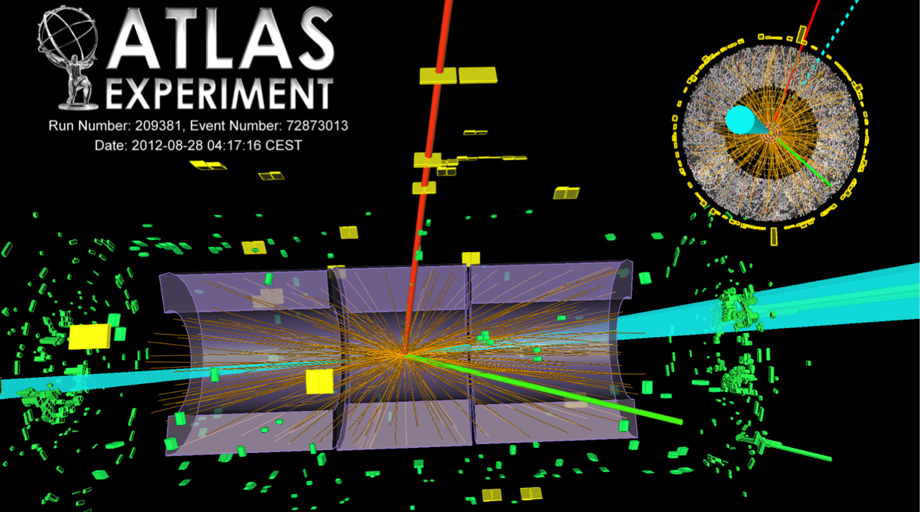
H→ττ VBF candidate

Slide 33
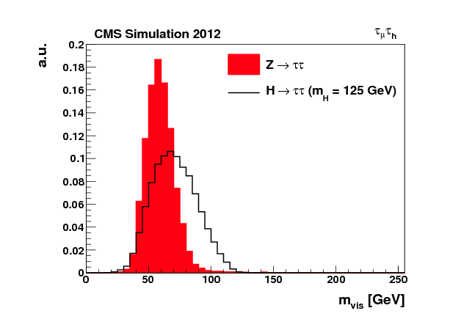
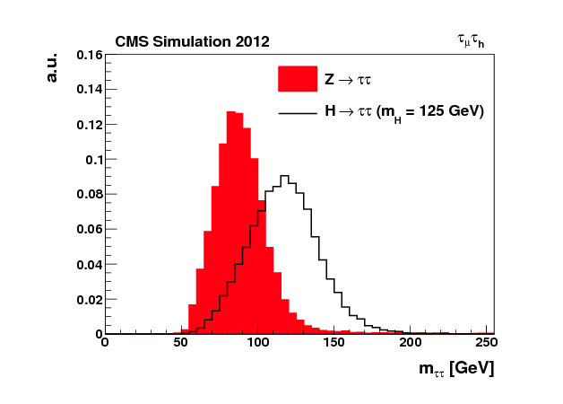
H→ττ mass
Invariant mass calculation
Use full kinematical fit
Mass resolution: 15-20%
Visible mass
Fitted mass

Slide 34
Reconstructed ττ mass spectrum

Slide 35
H→ττ results
 | ATLAS | CMS
Expected 95% CL exclusion | 1.2 | 1.0
Observed exclusion 95% CL | 1.9 | 1.6
Fitted μ | 0.7 ± 0.7 | 0.72 ± 0.52

Slide 36
Three views of channel compatibility plots
Fitted signal strength in different categories/channels/run periods
By production tag
By decay channel
By year/CM energy
Not yet evidence of ττ decay

Slide 37
H→bb channel
BR in SM at 125 GeV ~60%
BG too large (7-8 orders of magnitude larger, needs additional tag
Both ATLAS and CMS use VH associated production
Z->ee, μμ, νν
W->e,μ
Mass resolution ~10%
Also start exploiting ttH production
Much less sensitive and for now only 2011 data analyzed

Slide 38
H→bb all channels combined
Both experiment observe ZV with Z->bb
~5 times larger cross section
All BG except diboson ‘signal’ subtracted in the plots
CMS sees larger excess than ATLAS at 125 GeV
4 sigma significance of ZV
Tighter cut based selection

Slide 39
H→bb results
 | ATLAS | CMS
Expected 95% CL exclusion | 1.9 | 1.1
Observed exclusion 95% CL | 1.8 | 2.4
Observed significance | 0.64 | 2.2 σ
Expected significance | 0.15 | 2.1 σ
Fitted μ | -0.4 ± 0.7 ± 0.8 | 1.3 ± 0.7
Some excess observed in CMS

Slide 40
Combination of channels
Method for CL calculation is LHC-type CLs
Frequentist CLs with profiled likelihood test statistics and log-normal treatment of nuisance parameters
ATL-PHYS-PUB/CMS NOTE 2011-11, 2011/005, (2011)
To extract the values of the parameters, we scan the profile likelihood ratio:
where and are the values of the parameters and the nuisances that maximize the likelihood
To parametrize the couplings, follow LHC working group prescription (arXiv:1209.0040)
SM dependent models, search for small deviations

Slide 41
Observation of a new boson at ~126 GeV
No new combination after the observation
paper
Observation is confirmed with excesses of 6 - 7 σ in the 2 experiments at a mass near 126 GeV

Slide 42
Exclusion in the rest of the mass range
At high mass most sensitive channels are WW and ZZ decays
CMS
 | ATLAS | CMS
Expected exclusion 95% CL | 110 – 580 GeV | 110 - 680 GeV
Observed exclusion 95% CL | 130 - 560 GeV | 129 - 720 GeV

Slide 43
New boson’s properties
After the discovery the questions we ask are:
What is the mass?
Is this particle a Higgs boson?
Is it consistent with the SM Higgs boson?
To answer these we should:
Measure the production cross sections and BR
Measure the couplings
Measure spin and parity
Spin 1 excluded by the observation of the diphoton decay
Both ATLAS and CMS are now starting to address all these questions

Slide 44
Signal strength μ in different channels
Overall μ
ATLAS: 1.3 ± 0.3
CMS: 0.9 ± 0.2
Everything consistent with SM within errors, no large deviations observed
χ² probability of channel compatibility with SM ~50%

Slide 45
Mass measurement
From γγ and ZZ -> 4l mass spectra
2D scan μ vs mass
1D scan: mass
Results
ATLAS 126.0 ± 0.4(stat.) ± 0.4 (syst.)
CMS 125.8 ± 0.4(stat.) ± 0.4 (syst.)
Dominant systematic error is the absolute energy scale
largely uncorrelated between CMS and ATLAS

Slide 46
Global Fits – gfitter results
M_{H} was the last SM parameter to be directly measured
Important for EW precision test
SM p-value of global fit 7%
Was 9% without direct measurement of MH
Including M_{H} in the SM M_{W} and sin²θ_{eff} are predicted with a precision superior to the direct measurements and are compatible with them
arXiv:1209.2716

Slide 47
Production cross sections
Measurement of production cross sections in the different channels
Decay BRs are fixed to the SM
ttH, WH and ZH couplings
ZZ has no tagged channel
All decay modes are within ~1σ of SM.

Slide 48
κ_{V}, κ_{F} limits
Vector and fermion couplings are scaled by two scale, κ_{V} and κ_{F}
Agree with SM at ~ 1 σ
Fermiophobic scenario excluded at >4σ level
Similar conclusions from ATLAS
CMS

Slide 49
Invisible width
Allow for new particles in the loops: parameterize the photon and the gluon loops with effective scale factors (κ_{γ}, κ_{g})
Allow contribution of invisible decays to the total width
Other couplings are fixed to the SM
CMS obtains limit BR_{Inv} < 0.62 at 95% CL
Similar results from ATLAS

Slide 50
All fitted couplings
CMS
CMS

Slide 51
First measurement of the parity
CMS use the ZZ to 4 leptons channel where all decay angles are measured
Carry out 2D analysis with versus s/b discriminant combined with mass versus parity discriminant :
Plot shows log-likelihood ratio between the signal models for 0⁺ and 0⁻
CMS excludes pseudo-scalar hypothesis at 2.5 σ level (CL_{S} for 0⁻ is 3%)
Also possible to use WW, γγ and VBF, analyses are in progress
The green arrow indicates the
measurement

Slide 52
Summary
After the discovery of the new boson ATLAS and CMS have started to measure its properties
Branching ratios, couplings and mass have been measured and (unfortunately) they all agree quite well with the SM
First measurement of the parity disfavours the 0⁻ hypothesis

Slide 53
Outlook
A few weeks left of running LHC at 8 TeV
Followed by two years of LHC shutdown to prepare the higher energy, resume data taking in 2015:
CM energy should be between 13 and 14 TeV
Expect most final results on SM Higgs physics at 8 TeV by next summer
Current projections for 300 fb⁻¹ at 14 TeV indicate a precision of O(10%) on the couplings and BRs

Slide 54
Backup
Backup

Slide 55
Detectors
CMS
ATLAS

Slide 56
2012 data taking
LHC is running at 8 TeV since beginning of April
Already exceeded 20 fb⁻¹ per experiment of collected data
Maximum luminosity 7.5 x 10³³ cms⁻²s⁻¹

Slide 57
Pileup
Multiple interactions occur for each bunch crossing (in-time and out-of-time pileup)
Mean PU ~10 events in 2011 and ~20 events in 2012
Effects of pileup:
Slightly deteriorates energy resolution for electrons and photons and jets
Apply corrections event by event for photons and jets
Adds energy in isolation cones
corrected for pileup energy estimated event by event
PU jets affect central jet veto and VBF jet tagging
Try to reject PU jets (wider and with tracks coming from different PV)
Hard interaction jet
Pileup jet

Slide 58
H→γγ results: exclusion
Results not updated after discovery papers in July
 | ATLAS | CMS
Expected exclusion 95% CL | 0.8 x SM at 125 GeV | 0.76 x SM at 125 GeV
Observed exclusion 95% CL | 112.0-122.5, 132.0-143.0 GeV | 110.0-111.0, 114-121, 129-132, 138-149 GeV

Slide 59
H→ττ strategy
Trigger important, not fully efficient for hadronic τ decays
Invariant mass calculation
Use full kinematical fit
Mass resolution: 15-20%
Visible mass
Fit mass
Background in all channels is dominated by Z -> ττ
Use real Z -> μμ events. Replace muons in data with fully simulated τ, referred as “τ embedding”

Slide 60
ATLAS H→bb channel
1-lepton tag, categorize in p_{T}^{W}
μνbb Candidate

Slide 61
CMS, other combination compatibility plots
Tagged modes
Tagged modes and
separate decays

Slide 62
Couplings CMS at ICHEP
First measurement of new boson couplings when interpreted as a Higgs boson
Scale vectorial and fermionic couplings by C_{V} and C_{F} (use LO)
Best fit: (C_{V},C_{F}) = (1,0.5)
Consistent within 2σ with the SM Higgs boson
HIG-12-020
Solid contour: 68% CL
Dashed contour: 95% CL
From inclusive ZZ→4l and WW→2l2ν
R_{WW/ZZ} = 0.9
+1.1
-0.6

Slide 63
Vacuum stability
arXiv:1205.6497

Slide 64
CMS H→bb

Slide 65
ATLAS ZZ additional
Best fit value at m_{H}=125 GeV (lowest p-value): 1.4 ± 0.6

Slide 66
CMS H->ZZ->4l MZ2 vs MZ1

Slide 67
Custodial symmetry
Couplings to W and Z boson scale together in SM.
Parameterization:
κF, κZ, λ_{WZ}=κW/κZ
κF, κZ profiled
Result are consistent with SM:
λ_{WZ} in [0.68-1.55] at 95% CL

Slide 68
ATLAS H -> γγ

Slide 69
ATLAS ZZ mass resolution

Slide 70
Coupling scale factors
aaa

Slide 71
Individual couplings
6 scale factors:
κV, κt, κb, κτ, κg, κγ
Fit them individually while profiling the others

Slide 72
Glossary
BG: background
MVA: MultiVariate Analysis
usually Boosted Decision Tree (BDT), could also be Neural Network (NN)
VBF: Vector Boson Fusion process
P-value: probability to observe a background fluctuation from background only, larger that the one observed in data
VH: WZ, HZ associated production

