Slide 1
The first prototype of the FE analog channel
for outer Layers of SVT(L4 & L5)
Bayan Nasri, Carlo Fiorini

Slide 2
Remind of chosen architecture
FE-Block Diagram
Third order complex-pole shaping

Slide 3
ASIC Architecture (1)
Features:
6 Test points for the FE
Opportunity to apply Ex signal to test buffers
2 Test points for the Bias block
Opportunity to operate external trimming

Slide 4
ASIC Architecture (2)
Power Supply & Biasing:
Analog
Digital
Buffer
4 external bias points
Control signals:
15 input control signals
2 output control signals
Output signals:
7 test points
T.o.T output
Total PADs: 40

Slide 5
FE Channel
Features:
Two polarity operations
Four Peaking times (250ns,375ns, 500ns, 750ns)
Two Bias currents for input FET (500uA, 750uA)
Two different gain operations for the shaper

Slide 6
Bias Block
Features:
Produce 200mV reference voltage
Produce 4 bias points for FE
by help of external resistors
Produce a reference voltage for DAC_Precise

Slide 7
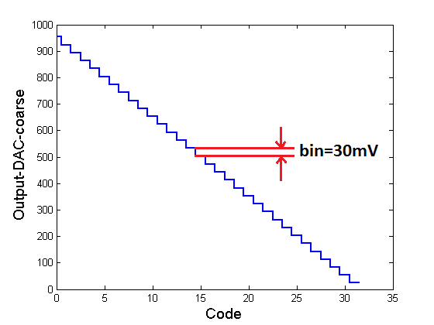
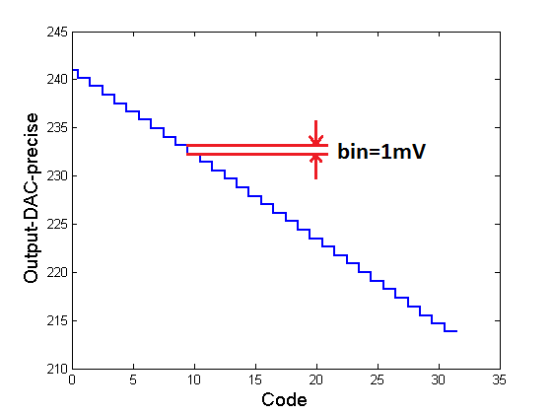
Trimming the Threshold level of T.o.T
First Step
Fine trimming with DAC_Coarse
30mV resolution
Second Step
Precise trimming with DAC_Precise
1mV resolution
The bin_Precise= noise(rms)/2

Slide 8
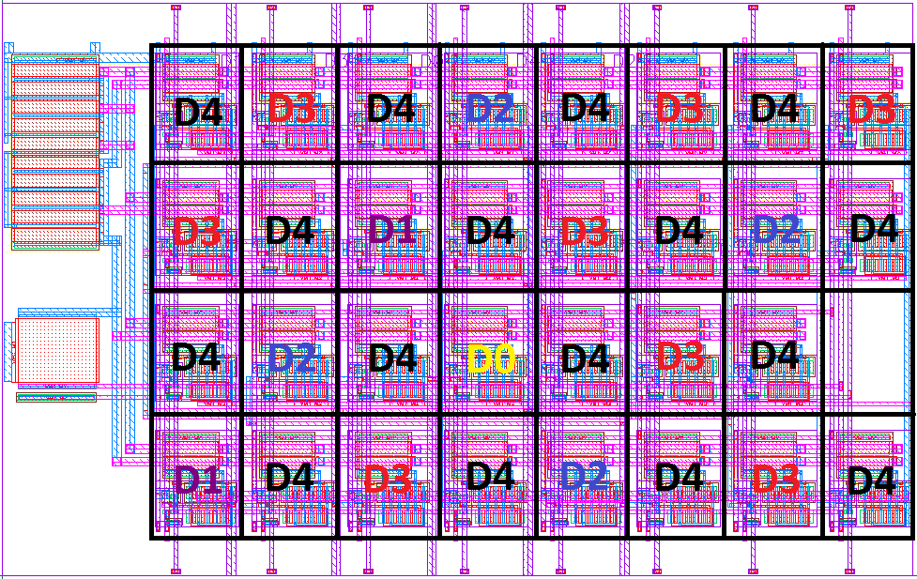
Current generation for DACs
Features:
Binary based cell
The same basic cell for all codes
Randomizing the cell placement due to minimize the offset

Slide 9
Layout of ASIC (submitted on 5th of November 2012)

Slide 10
Backup slides

Slide 11
ENC Estimation before radiations damage
Phi-Strip
Layer 4
Z-Strip
Layer 4
Tp(ns) | 250 | 375 | 500 | 750
ENC_FET | 596 | 491 | 437 | 376
ENC_Rs | 483 | 392 | 343 | 288
ENC_RB | 207 | 251 | 288 | 345
ENC_Rf | 600 | 644 | 646 | 640
ENC_Leakage | 234 | 282 | 324 | 388
ENC_others | 695 | 638 | 586 | 507
ENC_Total | 1237 | 1166 | 1121 | 1077
Tp(ns) | 250 | 375 | 500 | 750
ENC_FET | 533 | 463 | 406 | 346
ENC_Rs | 389 | 320 | 280 | 233
ENC_RB | 200 | 249 | 283 | 330
ENC_Rf | 384 | 427 | 425 | 418
ENC_Leakage | 128 | 170 | 194 | 228
ENC_others | 581 | 427 | 396 | 384
ENC_Total | 988 | 879 | 836 | 810
Phi-Strip
Layer 5
Z-Strip
Layer 5
Tp(ns) | 375 | 500 | 750 | 1000
ENC_FET | 591 | 525 | 452 | 405
ENC_Rs | 546 | 477 | 401 | 351
ENC_RB | 261 | 300 | 360 | 415
ENC_Rf | 648 | 651 | 653 | 655
ENC_Leakage | 543 | 622 | 745 | 859
ENC_others | 648 | 600 | 505 | 471
ENC_Total | 1360 | 1328 | 1316 | 1359
Tp(ns) | 375 | 500 | 750 | 1000
ENC_FET | 496 | 441 | 375 | 336
ENC_Rs | 377 | 330 | 273 | 240
ENC_RB | 222 | 256 | 303 | 351
ENC_Rf | 429 | 428 | 420 | 420
ENC_Leakage | 350 | 398 | 471 | 546
ENC_others | 472 | 429 | 389 | 359
ENC_Total | 983 | 946 | 925 | 947

Slide 12
ENC Estimation after 7.5 years (without safety factor)
Phi-Strip
Layer 4
Z-Strip
Layer 4
Tp(ns) | 250 | 375 | 500 | 750
ENC_FET | 596 | 491 | 437 | 376
ENC_Rs | 483 | 392 | 343 | 288
ENC_RB | 207 | 251 | 288 | 345
ENC_Rf | 600 | 644 | 646 | 640
ENC_Leakage | 956 | 1160 | 1330 | 1592
ENC_others | 695 | 638 | 586 | 507
ENC_Total | 1545 | 1620 | 1709 | 1883
Tp(ns) | 250 | 375 | 500 | 750
ENC_FET | 533 | 463 | 406 | 346
ENC_Rs | 389 | 320 | 280 | 233
ENC_RB | 200 | 249 | 283 | 330
ENC_Rf | 384 | 427 | 425 | 418
ENC_Leakage | 878 | 1166 | 1326 | 1566
ENC_others | 581 | 427 | 396 | 384
ENC_Total | 1316 | 1450 | 1555 | 1749
Phi-Strip
Layer 5
Z-Strip
Layer 5
Tp(ns) | 375 | 500 | 750 | 1000
ENC_FET | 591 | 525 | 452 | 405
ENC_Rs | 546 | 477 | 401 | 351
ENC_RB | 261 | 300 | 360 | 415
ENC_Rf | 648 | 651 | 653 | 655
ENC_Leakage | 1309 | 1498 | 1797 | 2071
ENC_others | 648 | 600 | 505 | 471
ENC_Total | 1808 | 1903 | 2099 | 2324
Tp(ns) | 375 | 500 | 750 | 1000
ENC_FET | 496 | 441 | 375 | 336
ENC_Rs | 377 | 330 | 273 | 240
ENC_RB | 222 | 256 | 303 | 351
ENC_Rf | 429 | 428 | 420 | 420
ENC_Leakage | 1140 | 1295 | 1532 | 1772
ENC_others | 472 | 429 | 389 | 359
ENC_Total | 1465 | 1553 | 1727 | 1934

Slide 13
ENC Estimation after 7.5 years (Safety factor=5)
Phi-Strip
Layer 4
Z-Strip
Layer 4
Tp(ns) | 250 | 375 | 500 | 750
ENC_FET | 595 | 491 | 437 | 376
ENC_Rs | 483 | 392 | 343 | 288
ENC_RB | 207 | 253 | 288 | 348
ENC_Rf | 600 | 644 | 646 | 640
ENC_Leakage | 2080 | 2530 | 2898 | 3470
ENC_others | 704 | 635 | 588 | 505
ENC_Total | 2411 | 2771 | 3091 | 3613
Tp(ns) | 250 | 375 | 500 | 750
ENC_FET | 533 | 463 | 406 | 346
ENC_Rs | 389 | 320 | 280 | 233
ENC_RB | 198 | 249 | 283 | 335
ENC_Rf | 385 | 427 | 425 | 418
ENC_Leakage | 2046 | 2578 | 2930 | 3462
ENC_others | 581 | 427 | 396 | 384
ENC_Total | 2269 | 2718 | 3041 | 3548
Layer 5
Layer 5
Tp(ns) | 375 | 500 | 750 | 1000
ENC_FET | 591 | 525 | 452 | 405
ENC_Rs | 546 | 478 | 401 | 351
ENC_RB | 262 | 301 | 360 | 415
ENC_Rf | 648 | 651 | 653 | 655
ENC_Leakage | 2700 | 3092 | 3703 | 4266
ENC_others | 647 | 596 | 507 | 472
ENC_Total | 2974 | 3306 | 3859 | 4395
Tp(ns) | 375 | 500 | 750 | 1000
ENC_FET | 496 | 441 | 375 | 336
ENC_Rs | 377 | 330 | 273 | 240
ENC_RB | 225 | 256 | 303 | 351
ENC_Rf | 429 | 428 | 420 | 420
ENC_Leakage | 2439 | 2772 | 3280 | 3799
ENC_others | 472 | 429 | 389 | 359
ENC_Total | 2607 | 2902 | 3376 | 3877

