Slide 1
PV e Fisica oltre il Modello Standard: PREX, SOLID, MOLLER, HPS
G.M. Urciuoli

Slide 2
Lead ( Pb) Radius Experiment : PREX
208
Elastic Scattering Parity Violating Asymmetry
E = 1 GeV, electrons on lead
Spokespersons
Krishna Kumar
Robert Michaels
Kent Pascke
Paul Souder
Guido Maria Urciuoli
²⁰⁸Pb
Hall A Collaboration Experiment

Slide 3
Electron - Nucleus Potential
electromagnetic
axial
is small, best observed by parity violation
neutron weak charge >> proton weak charge
Proton form factor
Neutron form factor
Parity Violating Asymmetry

Slide 4
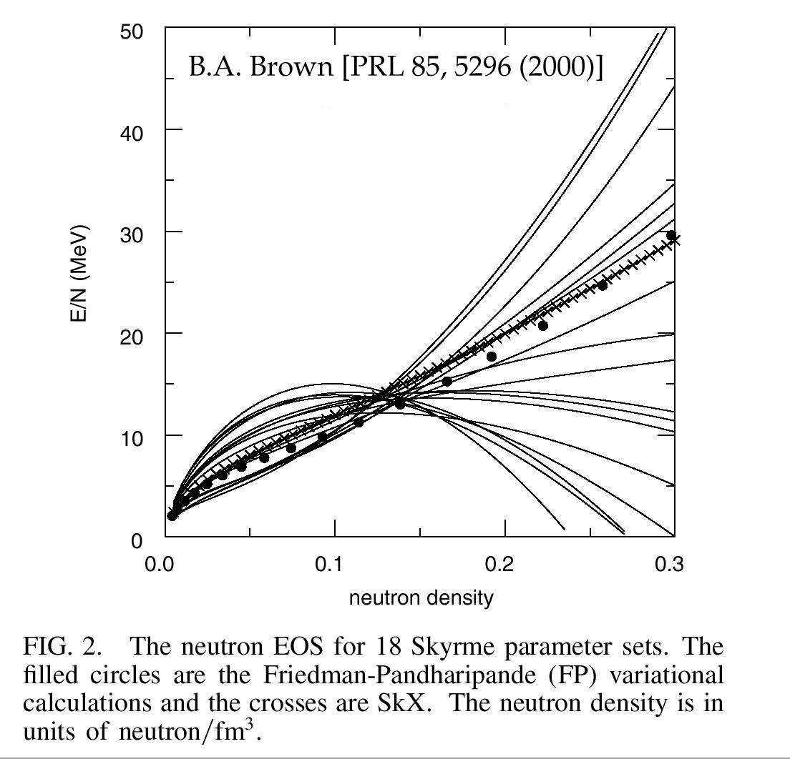
Nuclear Structure: Neutron density is a fundamental observable that remains elusive.
Reflects poor understanding of symmetry energy of nuclear matter = the energy cost of
n.m. density
ratio proton/neutrons
Slope unconstrained by data
Adding R from Pb will eliminate the dispersion in plot.
208
N

Slide 5
2
Measurement at one Q is sufficient to measure R
Pins down the symmetry energy (1 parameter)
N
( R.J. Furnstahl )

Slide 6
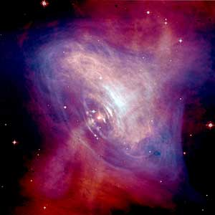
PREX & Neutron Stars
( C.J. Horowitz, J. Piekarweicz )
R calibrates EOS of Neutron Rich Matter
N
Crust Thickness
Explain Glitches in Pulsar Frequency ?
Combine PREX R with Obs. Neutron Star Radii
N
Phase Transition to “Exotic” Core ?
Strange star ? Quark Star ?
Some Neutron Stars seem too Cold
Cooling by neutrino emission (URCA)
Crab Pulsar
0.2 fm URCA probable, else not

Slide 7
PREX
Measured Asymmetry
Physics Impact
Correct for Coulomb
Distortions
2
Weak Density at one Q
Mean Field
Small Corrections for
n
s
& Other
Atomic Parity Violation
G
G
MEC
E
E
Models
2
Neutron Density at one Q
Assume Surface Thickness Good to 25% (MFT)
Heavy
Neutron
Stars
Ions
R
n

Slide 8
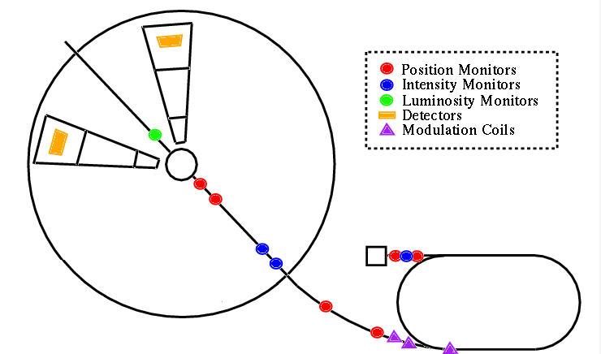
PREX in Hall A at JLab
Spectometers
Lead Foil Target
Pol. Source
Hall A
CEBAF

Slide 9
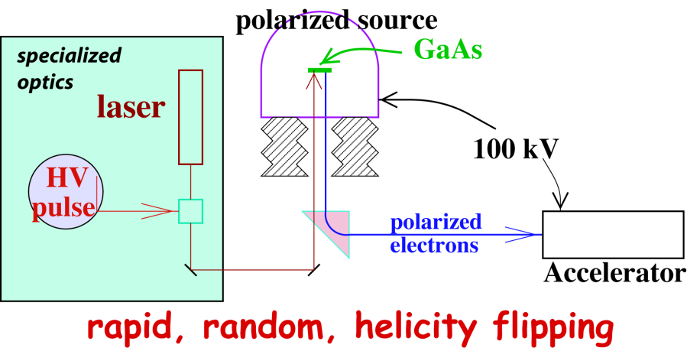
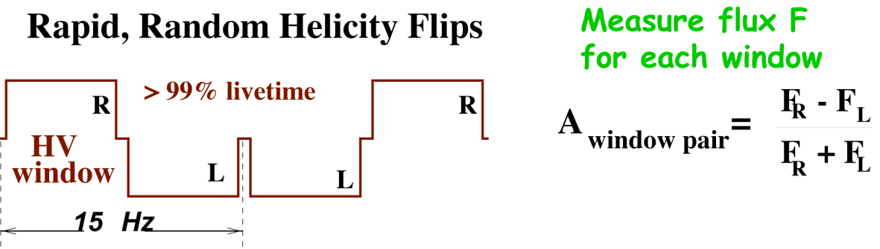
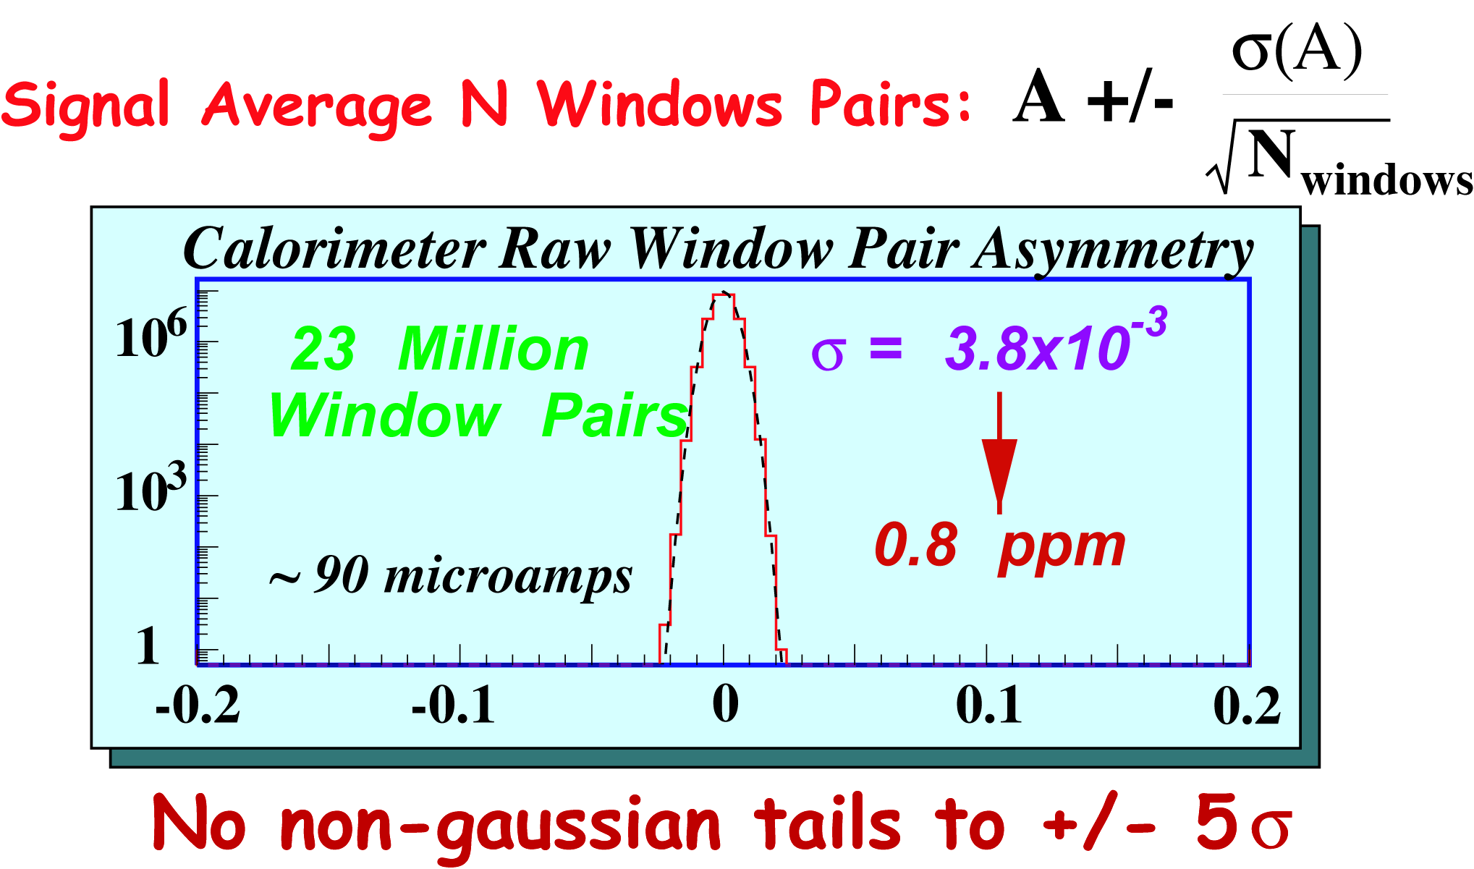
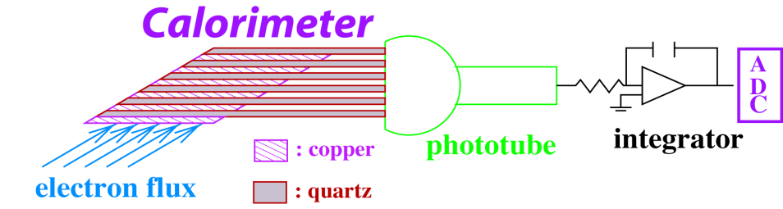
Experimental Method
Flux Integration Technique:
HAPPEX: 2 MHz
PREX: 850 MHz

Slide 10
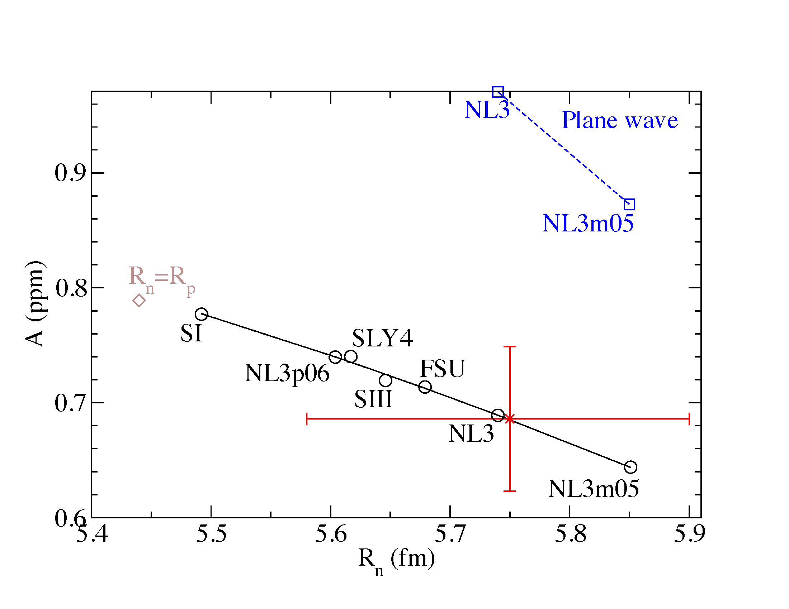
Statistics limited ( 9% )
Systematic error goal achieved ! (2%)
PREX data
Asymmetry leads to R_{N}
R_{N} = 5.78 + 0.16 - 0.18 fm
Neutron Skin = R_{N} - R_{P} = 0.33 + 0.16 - 0.18 fm

Slide 11
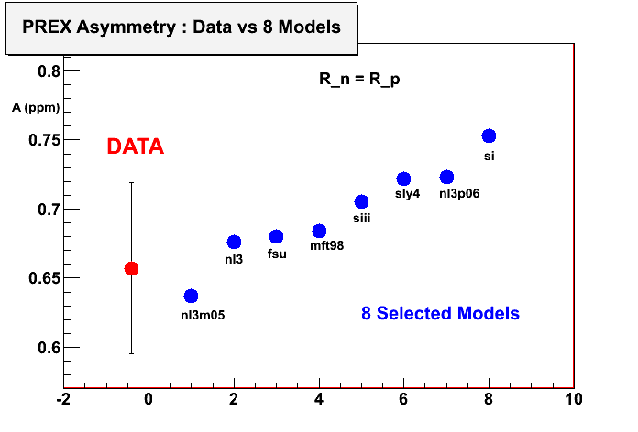
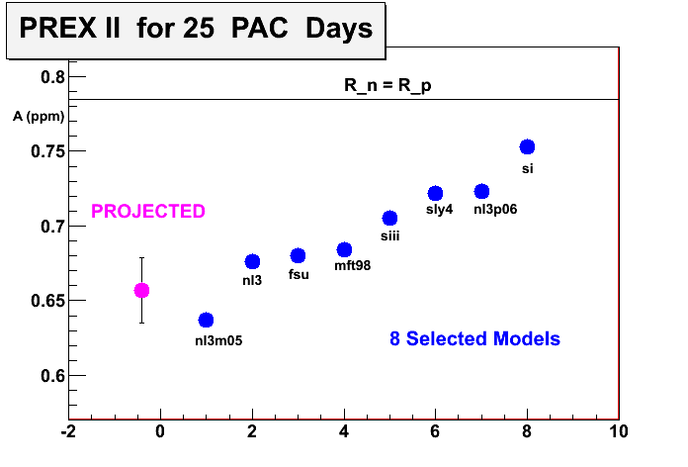
PREX-I
PREX-II
Approved by PAC (Aug 2011)
“A” Rating 35 days run in 2013 / 2014

Slide 12
SOLID
(PVDIS at 12 GeV)

Slide 13
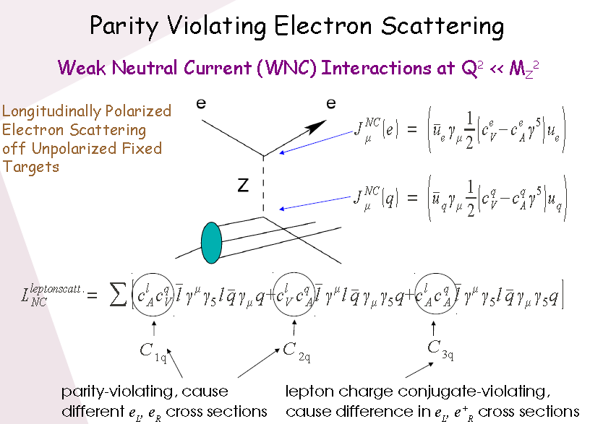

Slide 14
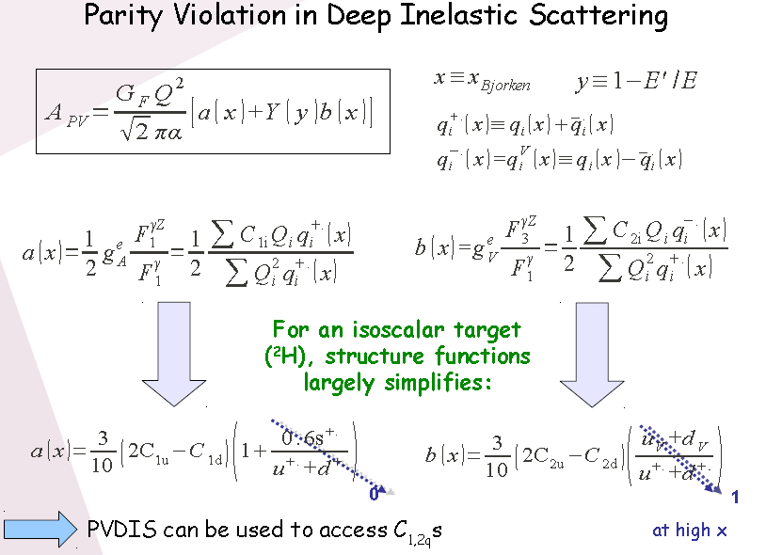


Slide 15
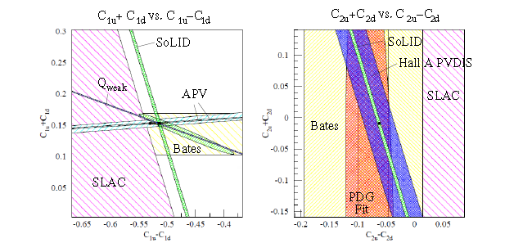

Slide 16

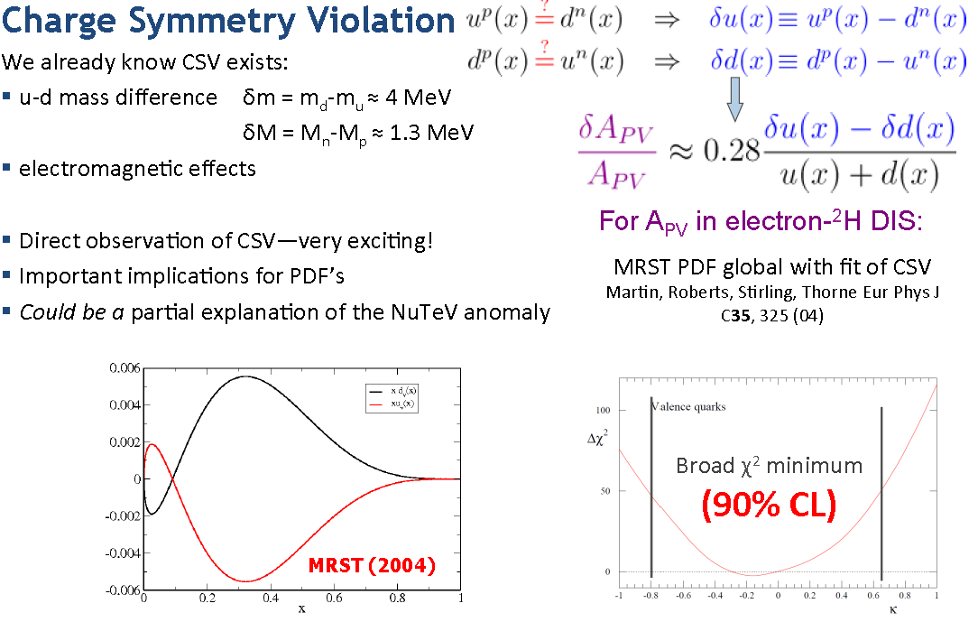

Slide 17
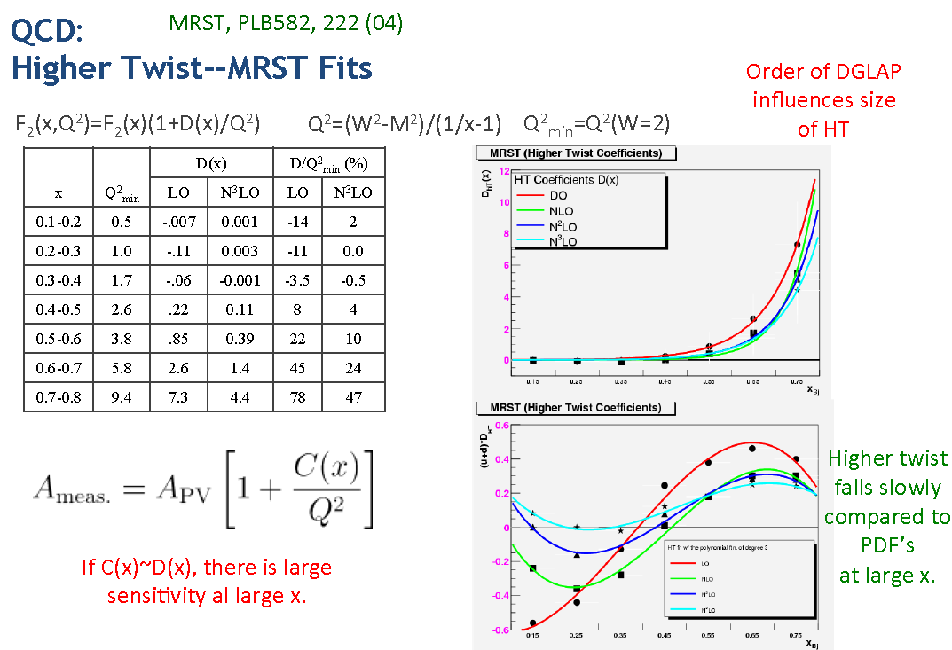

Slide 18
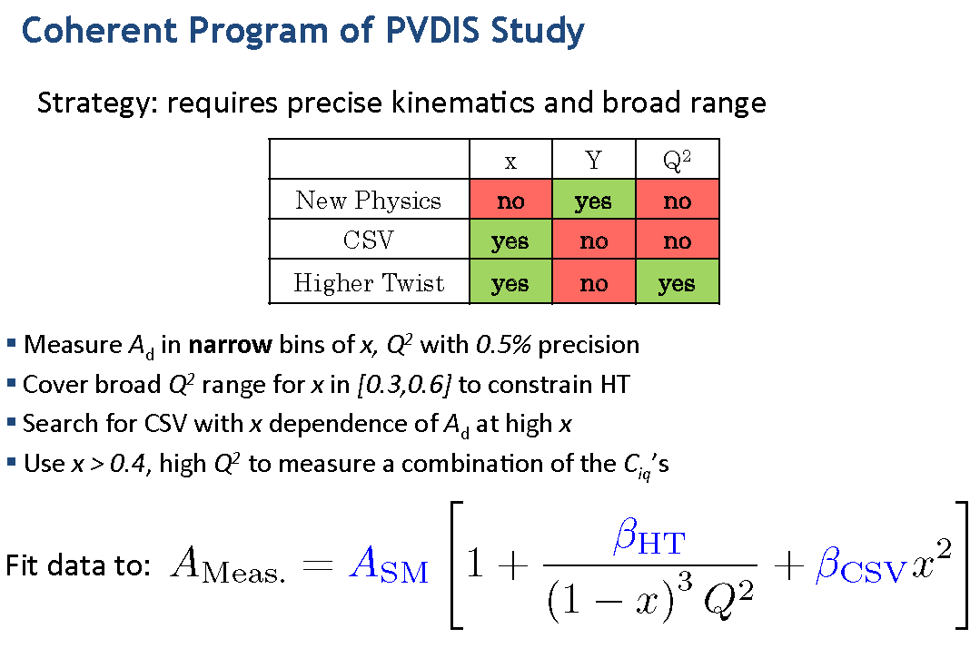
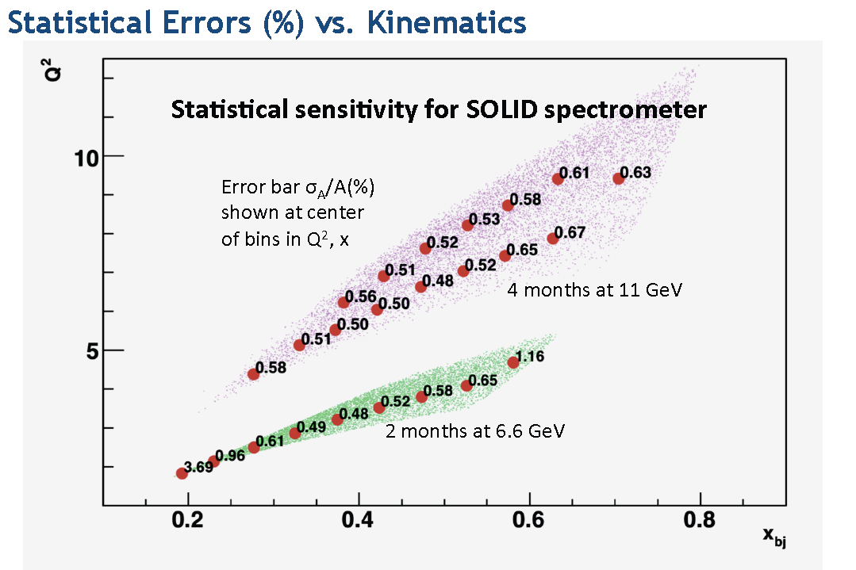

Slide 19
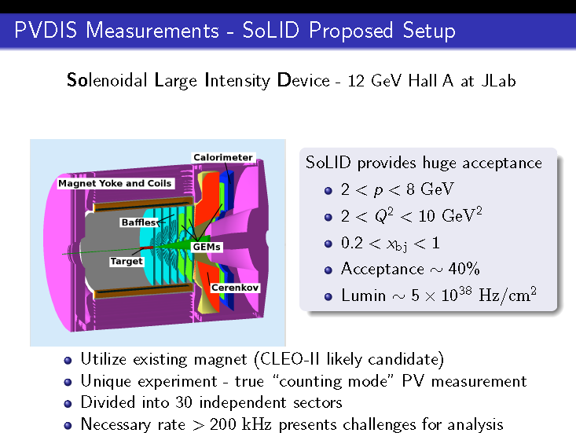

Slide 20
The MOLLER Experiment
MOLLER = Measurement Of Lepton Lepton Elastic Reaction

Slide 21
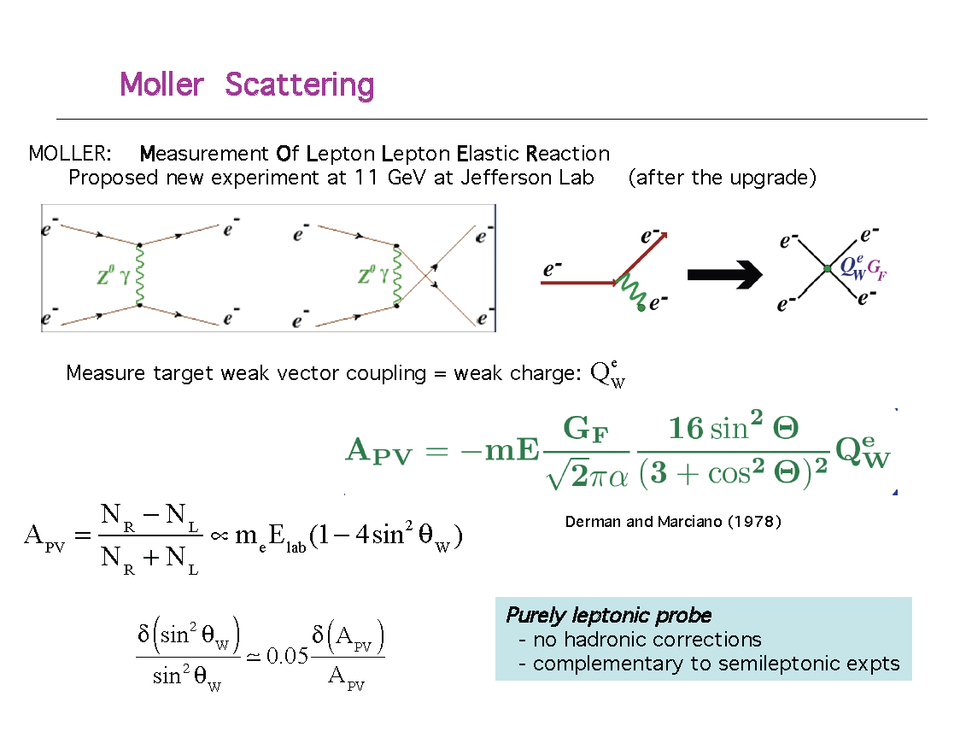

Slide 22
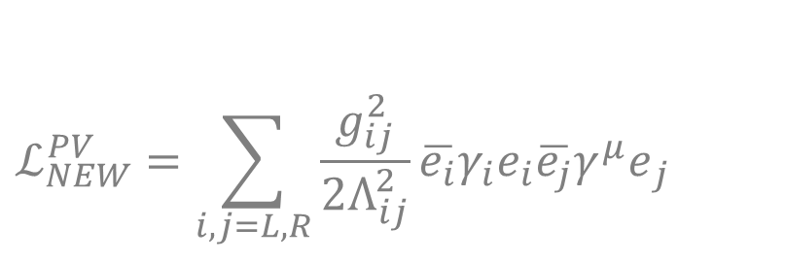

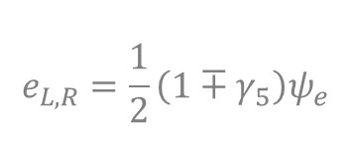
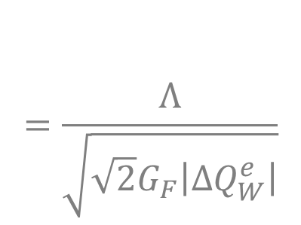
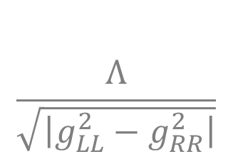
Contact Interactions
Coupling constants
Mass scale
e⁻
e⁻
e⁻
e⁻
2.3% MOLLER uncertainty -> 7.5 TeV

Slide 23
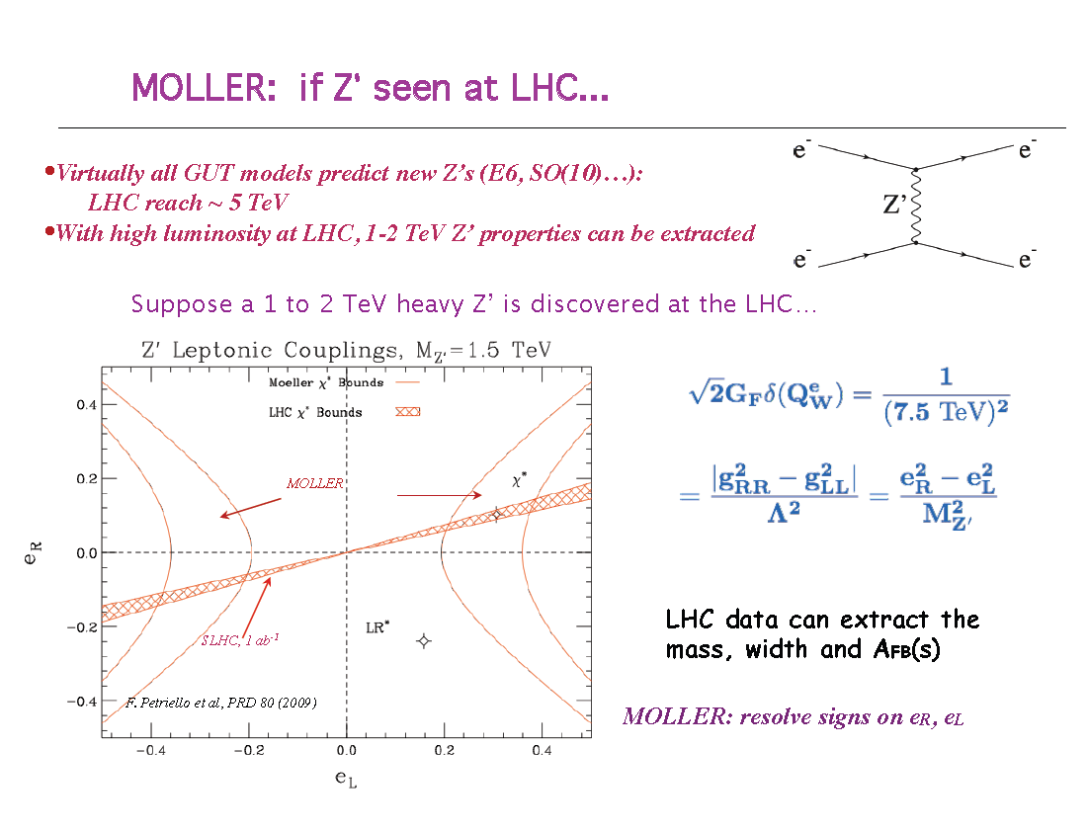

Slide 24
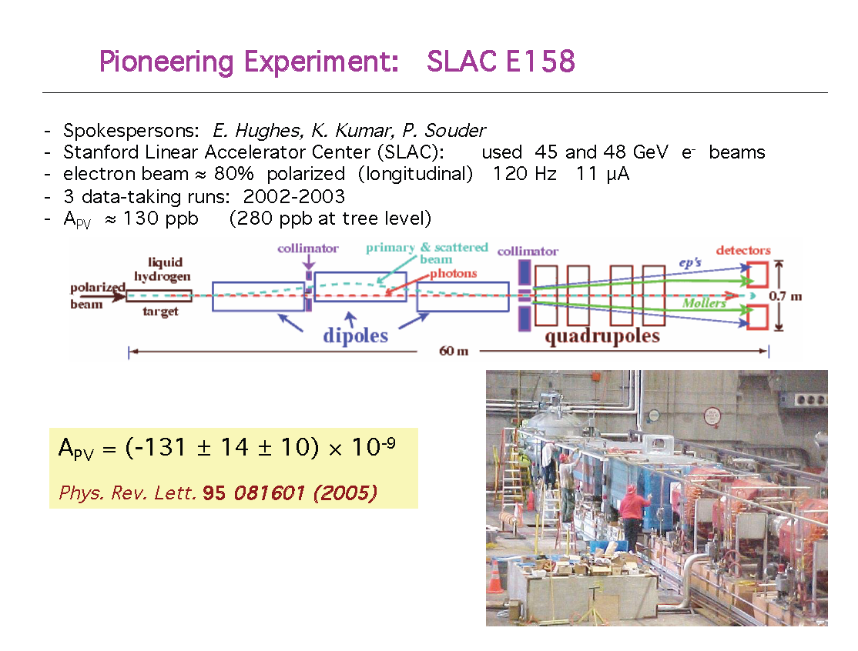

Slide 25
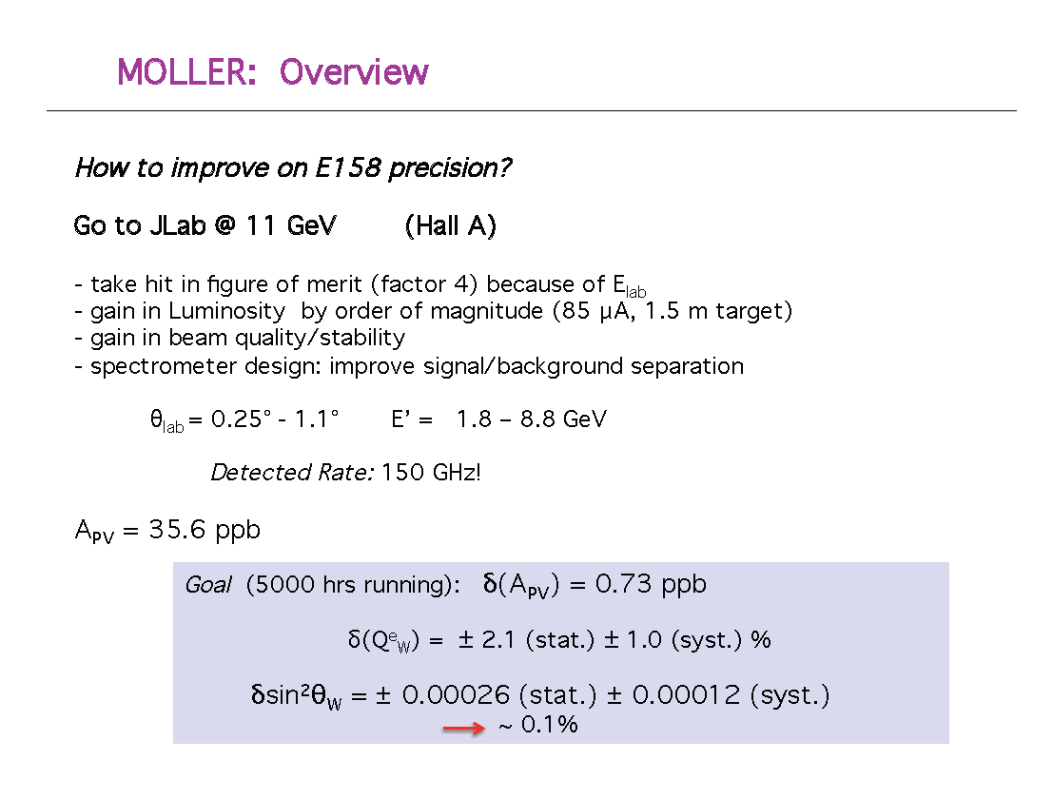

Slide 26
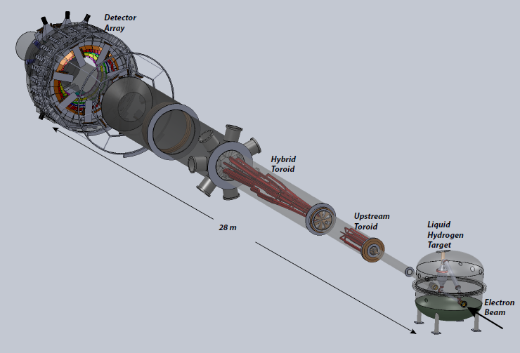
The Experiment
collimators

Slide 27
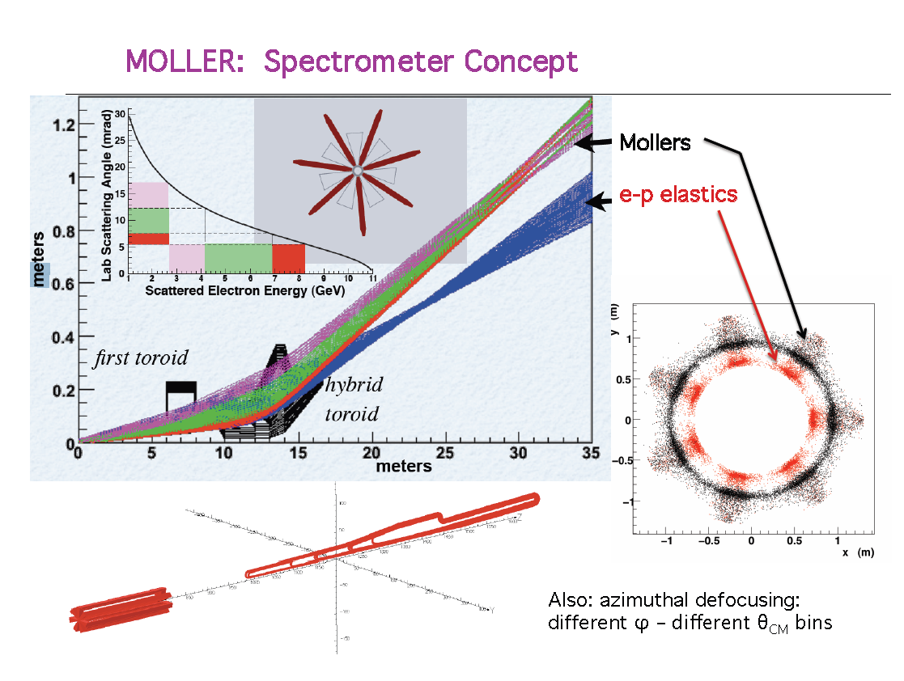

Slide 28

John Jaros
for the Heavy Photon Search Collaboration
Dark 2012 Frascati
October 16, 2012

Slide 29
Illuminating Dark Matter
HPS searches for hidden sector gauge bosons (“heavy photons” or A’s) in a unique region of parameter space with unparalleled sensitivity by exploiting both separated vertex and invariant mass signatures.
HPS explores new experimental territory as well, looking at very forward angles, large acceptances, and high rates in high energy electro-production.
HPS will also search for other hidden sector particles and can discover “true muonium”.

Slide 30
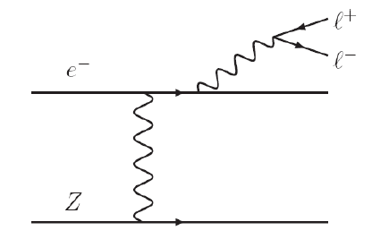
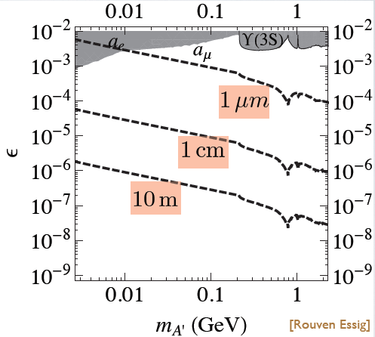
Heavy Photon Signatures
Resonance Bump.
In electro-production, a heavy photon (A’) appears as a narrow e⁺e⁻ resonance on a copious background of QED tridents.
Secondary Decay Vertices
Heavy photons in the mass range 10-1000 MeV
can have decay lengths ranging from millimeters
to 10’s or 100’s of centimeters for suitable couplings,
providing a distinctive signature.
Sensitivity to small couplings
Using resonance and vertex signatures together
greatly enhances experimental reach.
Bump Hunt
A’ Signal
Trident Background
Trident Background
γ*
A’ Signal
εe
γ
Decay Length cτ

Slide 31
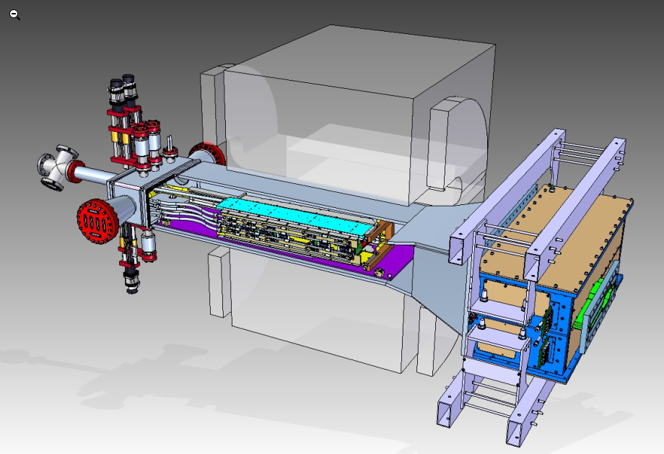
HPS Test Run
The HPS Test Run is the first stage of HPS. It was designed to demonstrate the
experiment’s technical feasibility, measure backgrounds, and begin our search for
heavy photons. Installed and run at JLAB during Spring 2012
.
Designed to electro-produce A’s on a thin W target upstream of the tracker.
Measure A’ mass and decay point in a compact spectrometer- vertex detector
placed inside a dipole magnet. Use high rate electronics.
Trigger with a fast EM Calorimeter .
Dipole Magnet
Motion controls
ECal
e- beam
Tracker/Vertexer

Slide 32
HPS Next Steps
JLAB PAC has approved HPS for 6 weeks of electron running on CEBAF-12
Now completing analysis of Test Run data and performance studies.
Now preparing a new Proposal to JLAB and DOE for an upgraded detector.
Upgraded detector re-uses parts of the Test Run apparatus, includes some
minor reworks, will add a muon system, and will have increased acceptance
and momentum resolution for greater reach. Presently under design.
Performance expected to be ~ that of our original proposal, “Full HPS”.
Hope proposal is approved Spring 2013.
Hope for HPS construction start mid 2013. Some work has already started.
Installation, commissioning and data taking would follow in Fall 2014. Good prospects for an extended run in 2015.

Slide 33
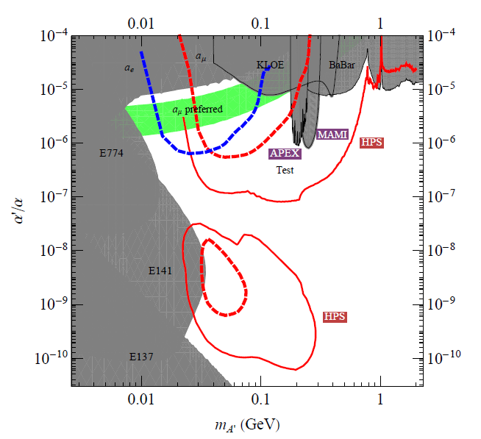
HPS Reach ≈”Full HPS” Reach
1 week 1.1 GeV
1 week 2.2 GeV
3 months 2.2 GeV
3 months 6.6 GeV

Slide 34
Spare

Slide 35
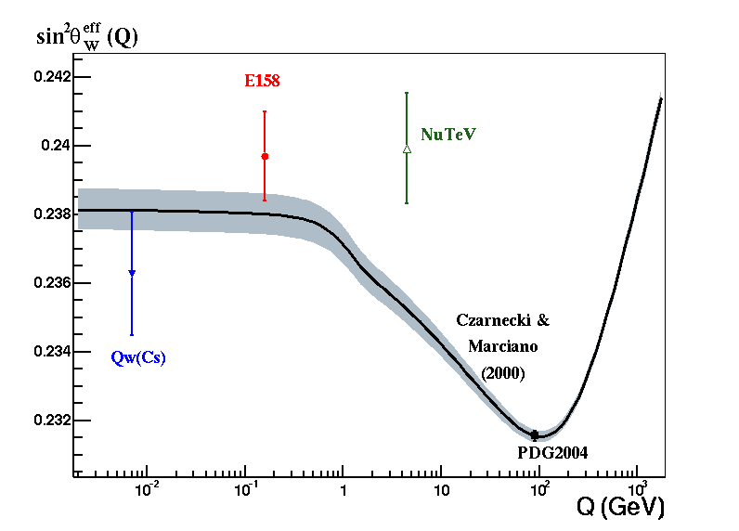
Atomic Parity Violation
Low Q test of Standard Model
Needs R to make further progress.
2
Isotope Chain Experiments e.g. Berkeley Yb
N
APV

Slide 36
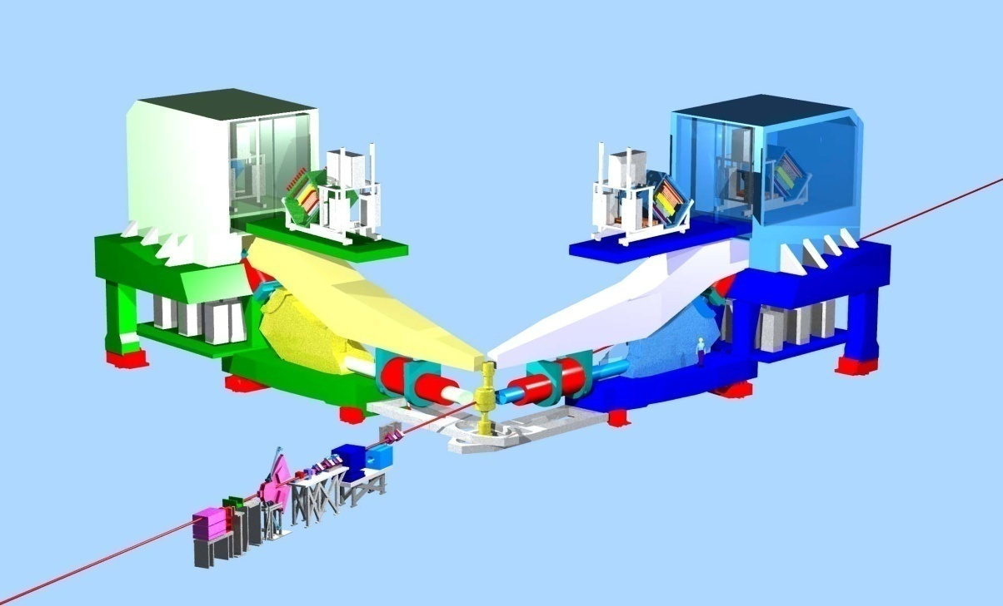
High Resolution Spectrometers
Spectrometer Concept:
Resolve Elastic
Elastic
detector
Inelastic
Left-Right symmetry to control transverse polarization systematic
Quad
target
Dipole
Q Q

Slide 37
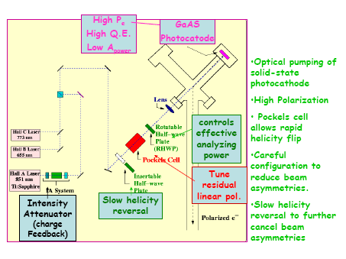
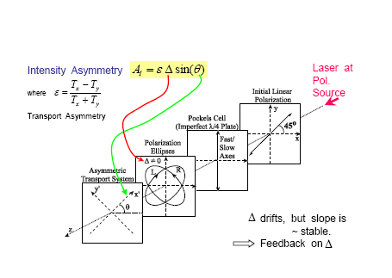
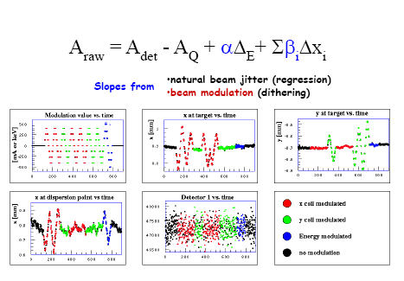
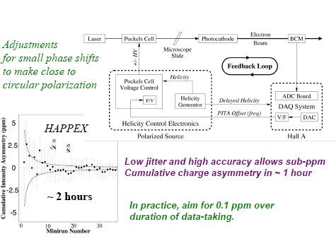
Consolidated techniques from the previous Hall A parity violating electron scatttering experiments (HAPPEX)
Polarized Source
P I T A Effect
(Polarization Induced Transport Asymmetry)
Intensity Feedback
Beam Asymmetries

Slide 38
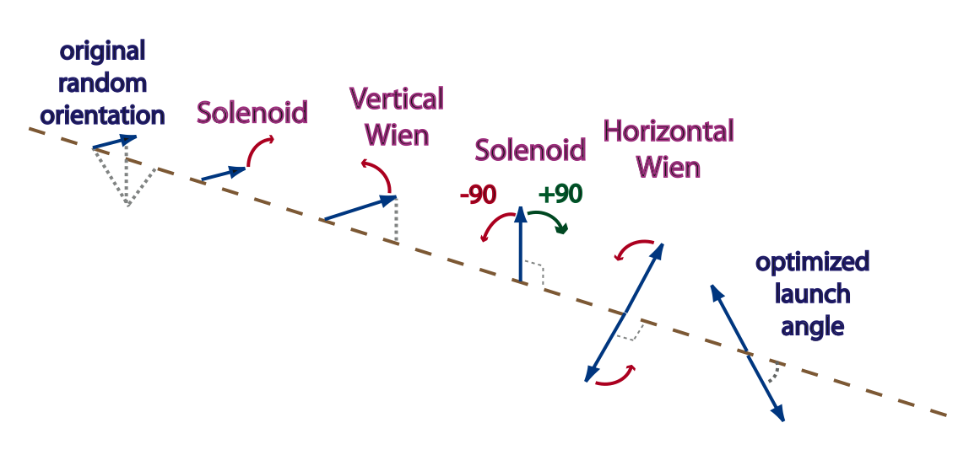
Double Wien Filter
Crossed E & B fields to rotate the spin
Two Wien Spin Manipulators in series
Solenoid rotates spin +/-90 degrees (spin rotation as B but focus as B²).
Flips spin without moving the beam !
Electron Beam
SPIN
Joe Grames, et. al.

Slide 39
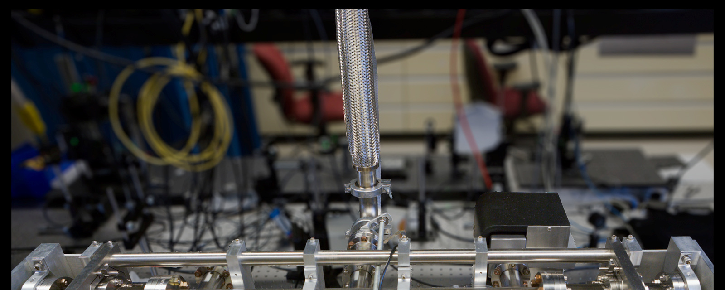
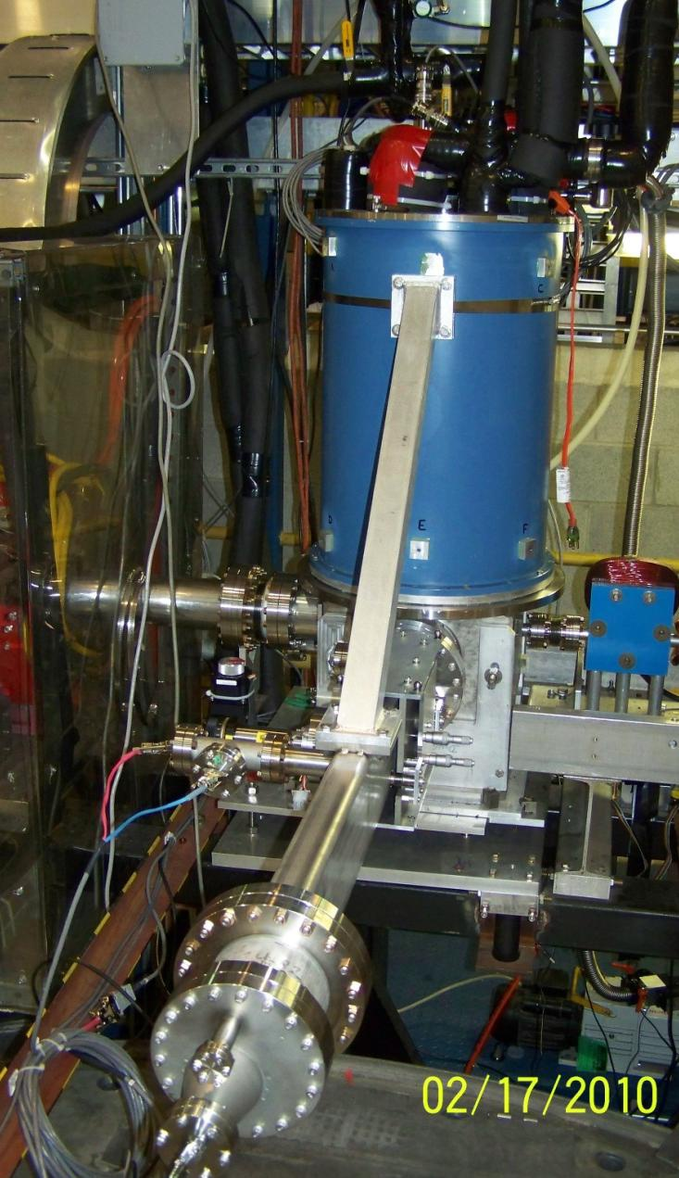
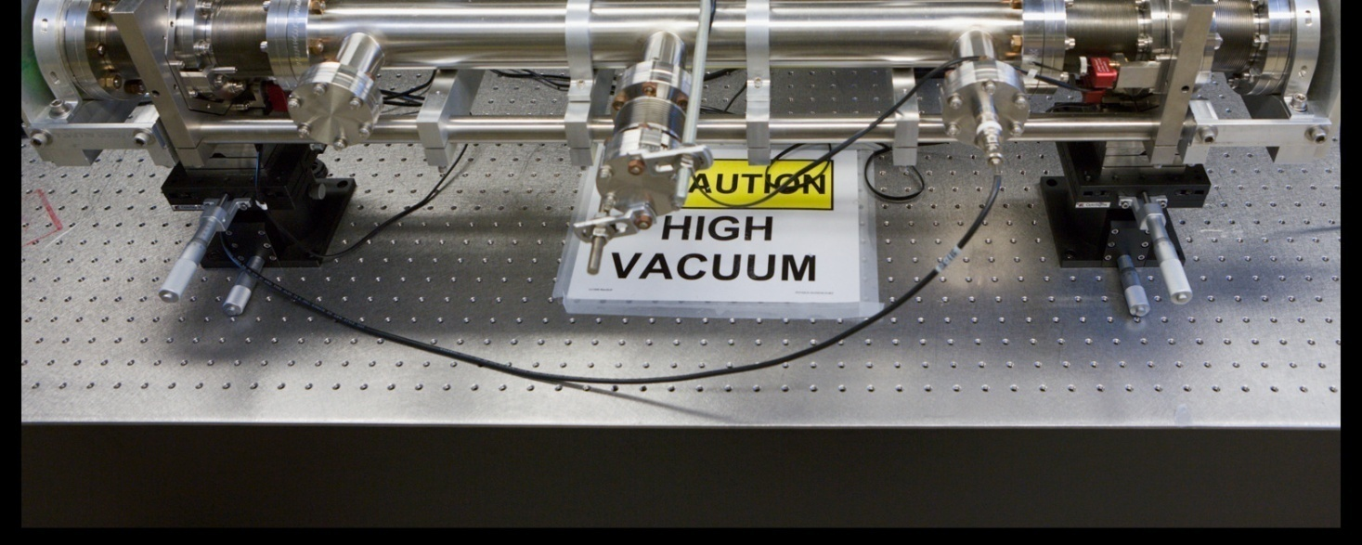
Moller Polarimeter (< 1 % Polarimetry)
Upgrades:
Magnet ➔ Superconducting Magnet from Hall C
Target ➔ Saturated Iron Foil Targets
DAQ ➔ FADC
Upgraded Polarimetry
(Sirish Nanda et al.)
Compton Polarimeter (1 % Polarimetry)
Upgrades:
Laser → Green Laser

Slide 40
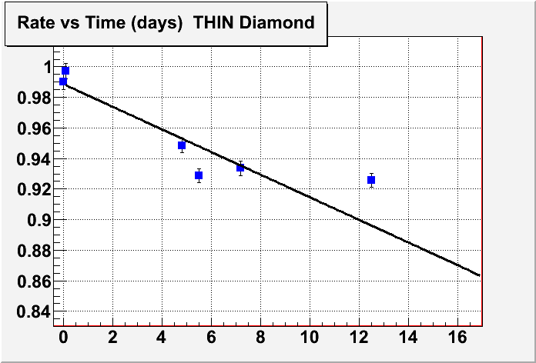
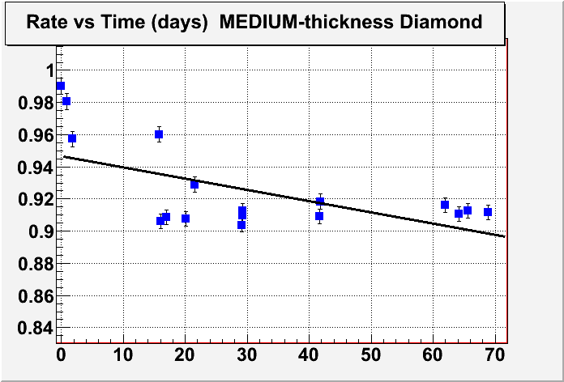
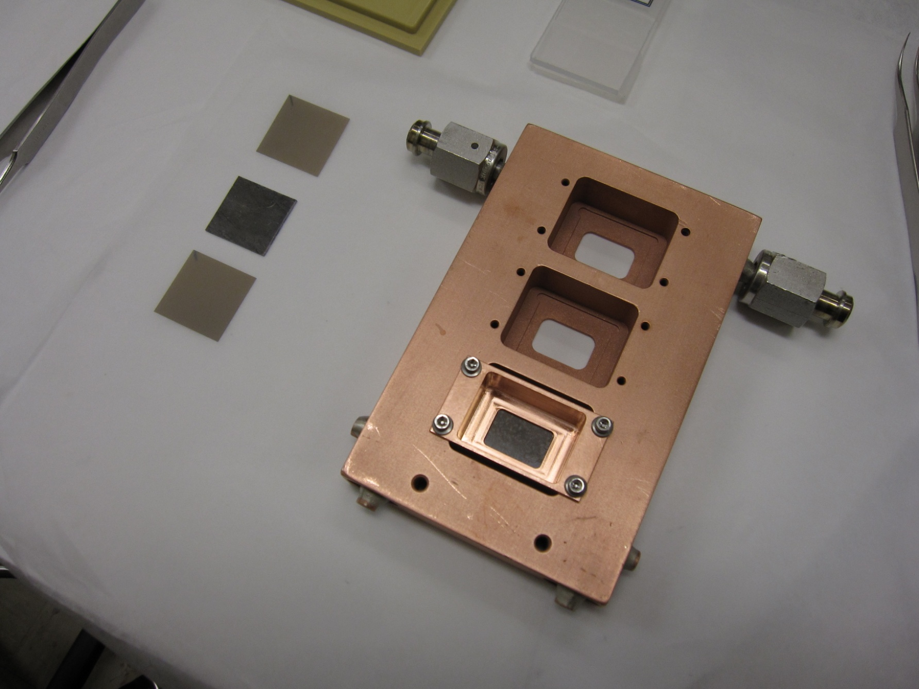
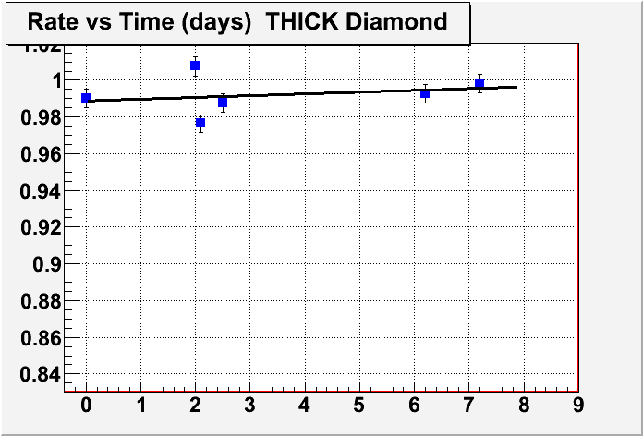
Lead Target
Three bays
Lead (0.5 mm) sandwiched by diamond (0.15 mm)
Liquid He cooling (30 Watts)
melted
LEAD
Diamond
melted
NOT melted

Slide 41
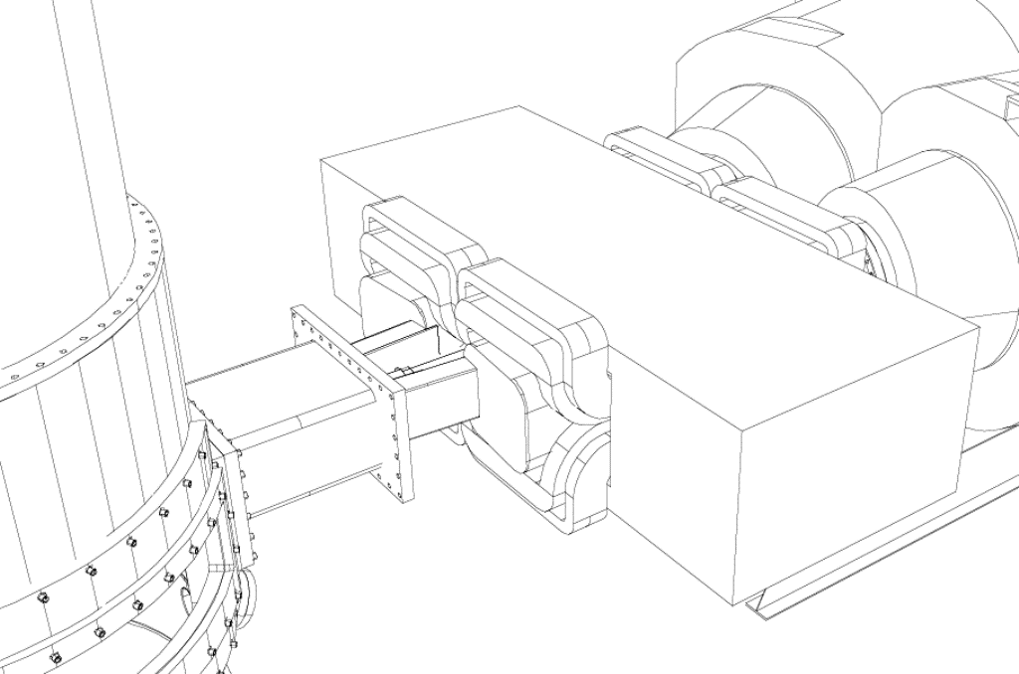
5⁰ Septum magnet
(augments the High Resolution Spectrometers)
(Increased Figure of Merit)
HRS-L
HRS-R
collimator
Septum Magnet
collimator
target

Slide 42
Beam-Normal Asymmetry in elastic electron scattering
i.e. spin transverse to scattering plane
y
A_{T} > 0 means
+
-
x
Possible systematic if small transverse spin component
z
New results PREX
Preliminary !
Publication in preparation
Small A_{T} for ²⁰⁸Pb is a big (but pleasant) surprise.
A_{T} for ¹²C qualitatively consistent with ⁴He and available calculations (1) Afanasev ; (2) Gorchtein & Horowitz

Slide 43
New for PREX
(to achieve a 2% systematic error)

Slide 44
PREX Result

Slide 45
Systematic Errors
Error Source | Absolute (ppm) | Relative ( % )
Polarization (1) | 0.0071 | 1.1
Beam Asymmetries (2) | 0.0072 | 1.1
Detector Linearity | 0.0071 | 1.1
BCM Linearity | 0.0010 | 0.2
Rescattering | 0.0001 | 0
Transverse Polarization | 0.0012 | 0.2
Q² (1) | 0.0028 | 0.4
Target Thickness | 0.0005 | 0.1
¹²C Asymmetry (2) | 0.0025 | 0.4
Inelastic States | 0 | 0
TOTAL | 0.0130 | 2.0
(1) Normalization Correction applied
(2) Nonzero correction (the rest assumed zero)

Slide 46
Future: PREX-II

Slide 47
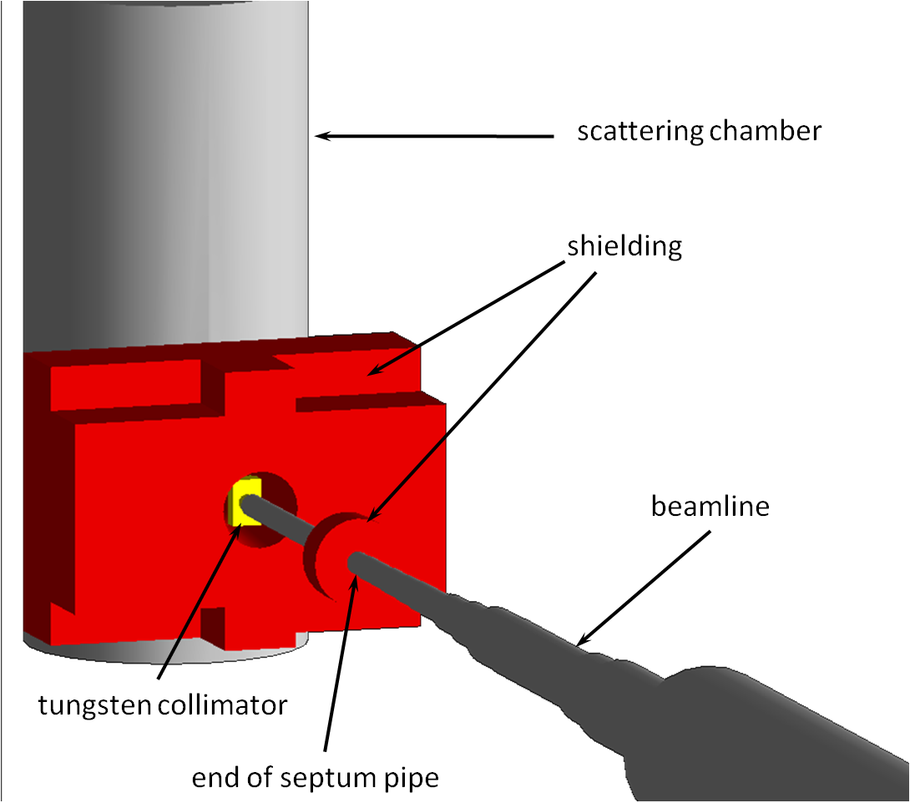
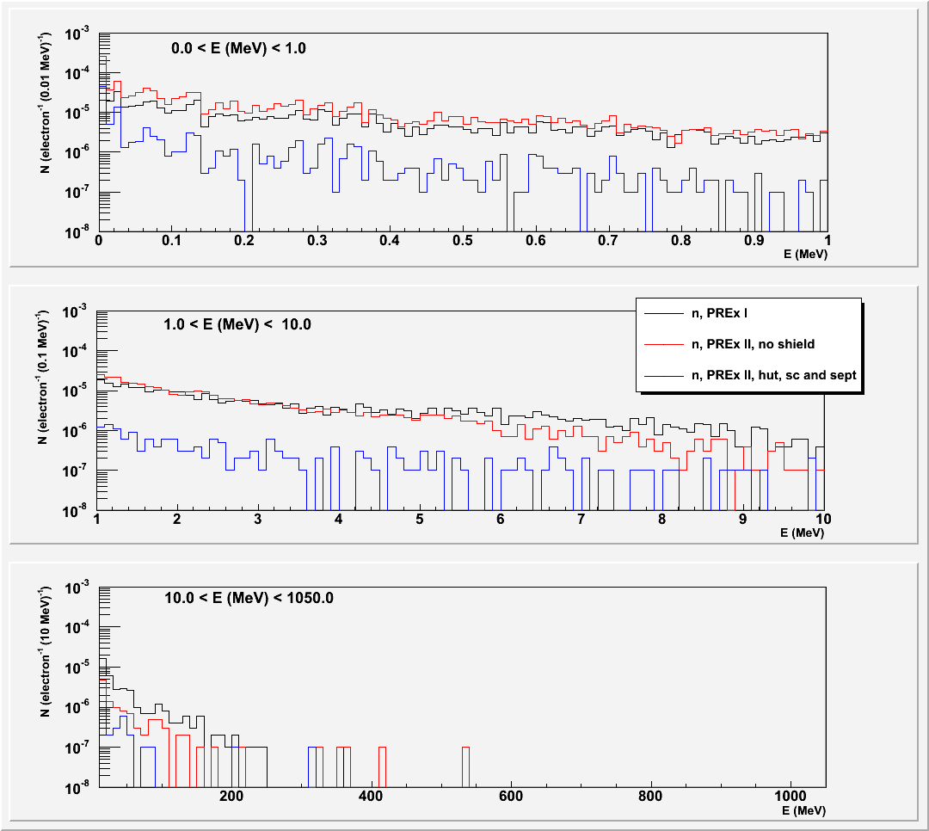
Geant 4 Radiation Calculations
PREX-II shielding strategies
scattering chamber
J. Mammei, L. Zana
shielding
Number of Neutrons per incident Electron
0 - 1 MeV
beamline
Energy (MeV)
--- PREX-I
--- PREX-II, no shield
--- PREX-II, shielded
1 - 10 MeV
Strategy
Tungsten ( W ) plug
Shield the W
x 10 reduction in
0.2 to 10 MeV neutrons
Energy (MeV)
10 - 1200 MeV
Energy (MeV)
26

Slide 48
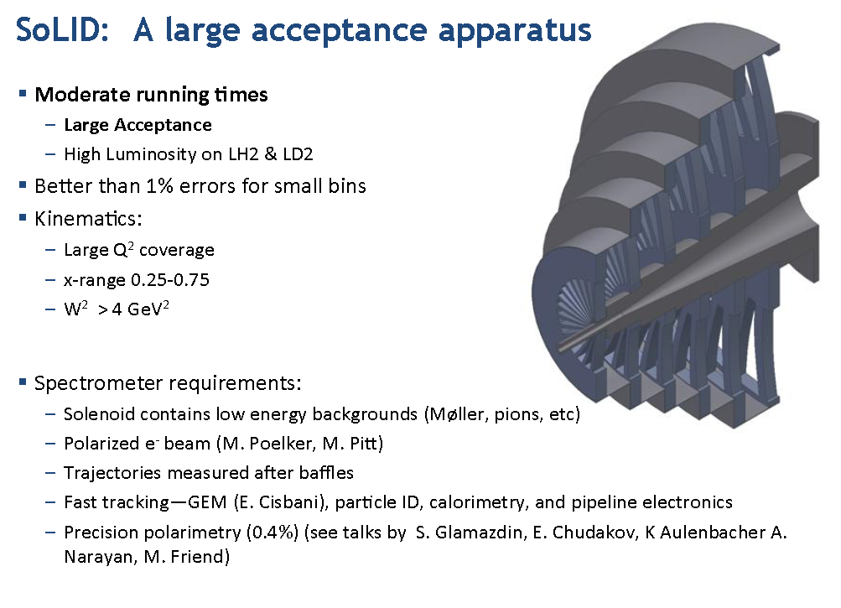

Slide 49


Slide 50


Slide 51


Captivated by Hidden Sector Physics

Slide 52


Controlling Beam Backgrounds
Silicon sensors and EM Cal must be positioned as close to the beam as possible to maximize low mass acceptance. Backgrounds matter!
Design constraints
* Avoid Multiple Coulomb Scattered (MCS) beam
* Avoid photons radiated in target
* Avoid “sheet of flame”, the beam electrons which
have radiated, lost energy, and been deflected
* Avoid beam gas interactions.
HPS splits detectors to avoid the “Dead Zone”, and puts SVT in vacuum.
Side view
Beam’s eye view
photons
B ⊗
e-
MCS beam
“sheet of flame”
target
“Dead Zone”

Slide 53


Optimize Target, Current, and Beam Size
Minimize target thickness (4-8 μm) and boost beam current (few x 100 nA) This minimizes the multiple coulomb scattering (MCS) tails which dominate tracker occupancy and trigger rates.
Minimize Beam Spot Size
Small beam spots help define track angles and improve mass resolution in the bump hunt region, and improve vertex resolution and reduce vertex tails.
Beam Stability and Halo
Since detectors are close to the beam, beam stability is at a premium, and beam halo must be minimized.
Mass Resolution
unconstrained
constrained

Slide 54

Hall B Beamline Meets HPS Requirements

Slide 55


Split Design/Motion Control
Both the Silicon Vertex Tracker (SVT) and the Ecal are split vertically, to avoid the “sheet of flame”.
The first layer of the SVT comes within 0.5 mm of the beam, so precision movers, working in vacuum, are needed to position it accurately wrt the beam
.
The beam passes between the upper and lower halves of the Ecal through the Ecal vacuum chamber, which accommodates the photons radiated at the target, the multiple scattered electron beam, and the “sheet of flame”.

Slide 56


High Rate DAQ
SVT DAQ uses SLAC ATCA-based architecture
* Sensor hybrids pipeline data at 40 MHz and send trigger-selected data to
COB for digitization, thresholds, and formatting. COB transfers formatted
data to JLAB DAQ.
* Record data up to 16kHz in pipeline mode.
Will push this up to 50 kHz with upgrades.
.
* One ATCA crate with 2 COBs handled the full
HPS Test Run SVT (20 modules, ~10k channels).
Ecal DAQ and Trigger
* Data recorded in 250 MHz JLAB FADC.
PH and time transferred every 8ns to
Trigger Processors.
* Trigger sent to SVT DAQ and FADC
for data transfer.
* Ecal FADC and DAQ can trigger and
record data up to 50 kHz.
Cluster on Board (COB)
Ecal DAQ/Trigger

Slide 57
HPS Test Run Results
Scheduling conflicts in Hall B prevented HPS Test Run getting a dedicated electron run. Instead, HPS Test ran parasitically with another experiment using a photon beam.
Photon running, with a thin conversion target in front of HPS, let us fully commission the detector and DAQ and prove its technical feasibility
A dedicated photon run during the last 8 hours of CEBAF-6 running, let us take high quality data for detailed performance studies, and measure normalized trigger rates.
These data lets us make the case that HPS Test performs as advertized, and that the backgrounds expected in electron running are understood.

Slide 58


HPS Design
A’ kinematics ⇒ need good forward coverage down to ~ θ_{decay}/2.
This puts detectors close to the beam.
E_{A’} ≈ E_{beam}
θ_{A’} ≈ 0
θ_{decay} = m_{A’}/E_{A’}
Vertexing A’ decays requires detectors close to the target. Bump hunting
needs good momentum/mass resolution. Both need tracking and a magnet.
Want Δm/m ~ 1% for bump hunt
Want Δz ~ 1mm
Beam’s Eye View
e⁺ and e⁻
Trigger with a high rate Electromagnetic Calorimeter
downstream of the magnet to select e⁺ and e⁻.
entering ECal

Slide 59

Silicon Vertex Tracker (SVT)

Slide 60

Electromagnetic Calorimeter
Layer of PbWO₄ crystals

Slide 61





SVT Performance
Elevation
MIP Cluster PH ~ 1600 ADC counts
Bend Plane
S/N ~ 20
σ_{x} ~ 7 µm
Record pulse shape in 6-25ns bins
⇒ track time
Track Time Resolution
σ_{t} ~ 3 ns

Slide 62



Tracking Refinements Underway
Adding magnet fringe fields and improving alignment
Improving track reconstruction efficiency and purity ( > 90%)
Studies of e+e- pairs shown below:
Track Momentum in GeV/c
Extrapolated Track Positions at Target
Accurate to few mm
Fringe field corrects
+/- displacement
Pair Invariant Mass in GeV/c²
Alignment will correct
top/bottom displacement
100 MeV/c²

Slide 63


Small cross-sections, large backgrounds need high luminosity
σ(e⁻ + W → W + A’ + e⁻)
How to minimize occupancy in a forward detector
* Maximize accelerator duty cycle
CEBAF has 100% duty cycle!
* Minimize detector response times
Pulse lengths in the SVT and Ecal are ~ 60ns
* Maximize the readout and trigger acceptance rates
SVT has 40 MHz readout
Ecal has 250 MHz FADC
Trigger can handle input every 8 ns
E = 6 GeV → 12 GeV
High currents ≤ 100 μA
Continuous! 500 MHz

Slide 64



Ecal Performance
Color shows average crystal PH over Face of ECal
Vertical Crystal Number
Dead Zone
Horizontal Crystal Number
Missing Channels
Cluster Size for
tracks with p>0.6 GeV/c
Cluster Energy Data/MC
Data ≈ MC
Number of Crystals Hit

Slide 65
Is HPS Ready for Electron Beams?
Full Monte Carlo simulation shows MCS of beam electrons is the principal HPS background
The tails of the multiple Coulomb scattering of beam electrons in the
target hit the innermost layers of the tracker and Ecal and are
the principal cause of tracker occupancy and ECal trigger rate.
EGS5 simulations accurately describe MCS tails from thin targets.
They agree with formal MCS Theory (Moliere, and Goudsmit-Saunderson)
and available thin target data. (Not true for GEANT4!)
Moliere integral vs. EGS5
HPS Acceptance

Slide 66


HPS is ready for electron beams!
Photon conversions in the test run produce pairs whose angular distribution depends on two effects, of roughly equal importance:
1) pair opening angle distribution
2) Multiple Coulomb Scattering of electrons through the target
With a photon beam incident, the HPS trigger rate is almost entirely due to pair production in the target. The observed rate is given by the pair angular distribution, integrated over the Ecal acceptance.
Trigger Rate Data
agrees with EGS5
simulation.
Background estimates
using the EGS5 simulation
are reliable.
HPS ready for e- beams

Slide 67

Simulated Vertexing Performance
Accurate knowledge of SVT occupancy gives us confidence that stand alone
pattern recognition will work in the presence of realistic backgrounds.
Simulated tracking efficiency is ~ 98% with beam backgrounds included.
Only 5% of tracks have miss-hits, which can cause vertex tails, and spoil
reach.
Track quality, vertex quality, and trajectory cuts nearly eliminate vertex tails.
Vertex Resolution along the beam direction, Z_{v}
Before quality cuts
m_{A’}= 200 MeV
E_{beam}= 5.5 GeV
After quality cuts
Tracks with miss-hits make tails

Slide 68

Trigger Rates
Accurate knowledge of electron backgrounds allows reliable estimates
of trigger rates. Use full Monte Carlo with backgrounds .

Slide 69

Snowmass 2013
http://www.snowmass2013.org/tiki-index.php?page=New+Light%2C+Weakly+Coupled+particles
Heavy Photons were discussed at last year’s Intensity Frontier Workshop in the Hidden Sector Photons, Axions, and WISPs subgroup. http://www.intensityfrontier.org/
The working group is being revived in preparations for Snowmass 2013, the US particle physics community planning meeting.
Planning has just started, but we expect to update last year’s report with a full review of the field, make our science case for the community, and prepare a white paper.
Please join us in surveying the field. Register at the website given above.

Slide 70

Conclusions
HPS Collaboration has designed, built, installed, and commissioned the HPS Test Run experiment at JLAB.
The experiment incorporates several design features to accommodate running a large acceptance, forward spectrometer in an intense electron beam.
Detector and DAQ capabilities needed to search for heavy photons have been demonstrated.
EGS5 simulations of multiple coulomb scattering tails have been confirmed with Test Run data, leading to a good understanding of electron beam backgrounds in HPS.
A proposal for an upgraded experiment will be submitted late this year.
HPS hopes to begin physics running in Hall B at JLAB in Fall 2014 and extend the search for heavy photons into virgin territory.

Slide 71
The Heavy Photon Search Experiment (HPS) is a new experiment at Jefferson Lab designed to look for massive vector gauge bosons (heavy photons) in the mass range 20-1000 MeV that couple to electrons with couplings ’/ in the range 10-5 to 10-10 . The experiment utilizes a compact forward spectrometer employing silicon microstrip detectors for vertexing and tracking and a PbWO4 electromagnetic calorimeter for fast triggering, and is designed to measure the invariant mass and decay vertex location of electro-produced heavy photons. Following initial approval in January 2011, the HPS Collaboration has mounted the HPS Test Run Experiment, which ran parasitically in Hall B at JLAB during Spring 2012, and commissioned the tracker, ECal, high rate trigger, and DAQ, and succeeded in testing background assumptions for the full experiment. On the basis of this successful test run, the experiment has been approved for physics running. The design, performance, and results from the Test Run apparatus will be discussed, along with the collaboration’s plans for future construction and data taking.

