Slide 1
Struttura del nucleone: TMD
Il RICH e HD-Ice per CLAS12
Marco Mirazita (LNF)

Slide 2
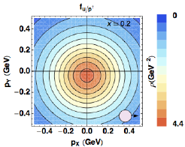
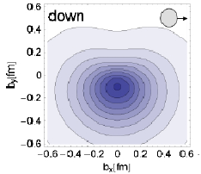
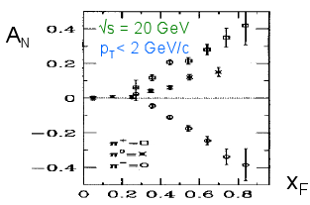

Parton distribution functions
Wigner “mother” functions
TMD PDFs
GPDs
Semi-inclusive measurements
Momentum transfer to quarks
Momentum distributions
Exclusive measurements
Momentum transfer to target
Spatial distributions
may explain SSA
may solve proton spin puzzle
collinear PDFs
Angular momentum sum rule

Slide 3
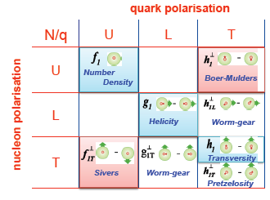
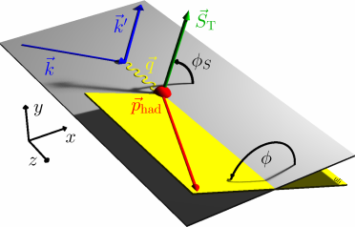
TMDs at leading order
TMDs can be accessed in Semi-Inclusive DIS reactions by looking at specific azimuthal modulations in φ and φ_{S} of the cross section with polarized beam and target
σ = σ_{UU} + S_{T} σ_{UT} sin(φ – φ_{S}) + λ σ_{UL} sinφ + ....

Slide 4
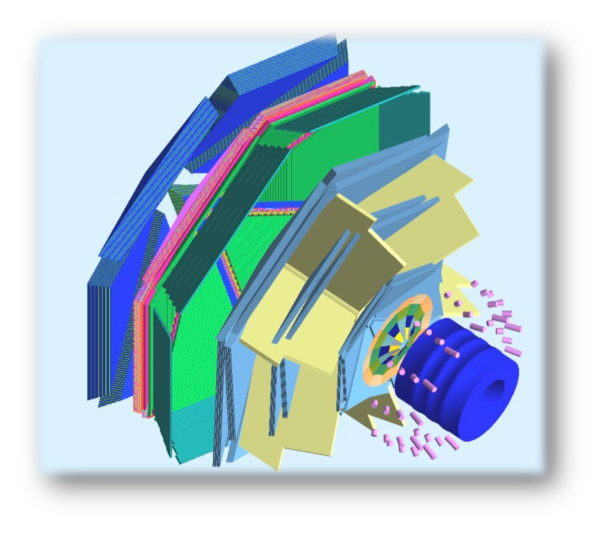
CLAS12 in Hall B
Luminosity up to 10³⁵ cm⁻¹ s⁻¹
Highly polarized electron beam
H and D polarized targets
Broad kinematic coverage, from target to current fragmentation
FORWARD
DETECTOR
torus field
TOF
RICH
Required upgrades for nucleon 3D investigation:
LTCC
EC
HTCC
RICH: Hadron ID from 3 to 8 GeV/c for flavor separation
HD-Ice
HD-Ice: new concept of transversely polarized target
PCAL
CENTRAL
DETECTOR
solenoid
DC
PAC30 report (2006):
Measuring kaon asymmetries is likely to be as important as pions…… The present capabilities of the CLAS12 design are weak in this respect and should be strengthened

Slide 5
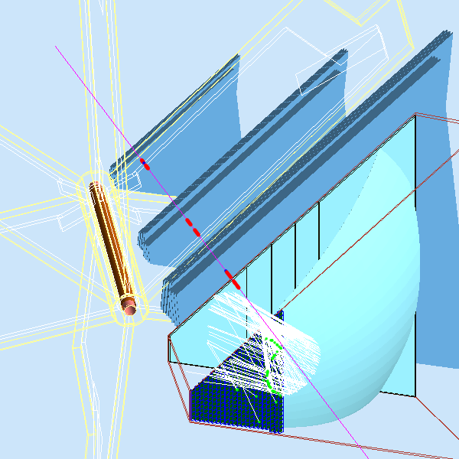
Layout of the RICH
Requirements:
π/k/p separation in the 3-8 GeV/c range
π rejection >500
ONE CLAS12 SECTOR
target
particle’s trajectory
Constraints:
the detector must fit in 1m
low material budget
large area for the photodetectors (several m²)
increasing azimuthal angle → decreasing momentum
DC3
θ
DC1
DC2
Solutions:
mirrors to focalize the light in small area
variable aerogel thickness from 2 to 6/8 cm
beam
pipe
Different pattern:
Cerenkov photons from small angle, high momentum particles directly detected
photons from large angle and lower momentum particles are reflected toward the photodetectors and pass twice through the aerogel

Slide 6
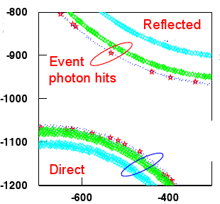
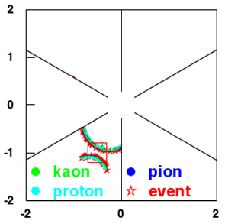
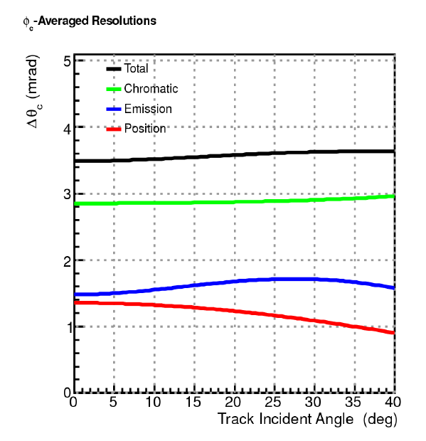
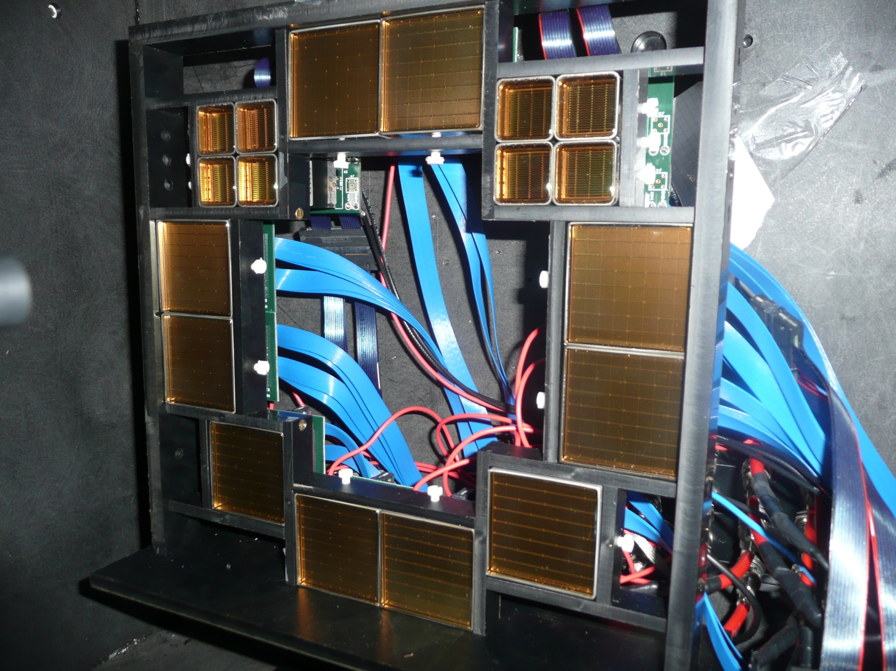
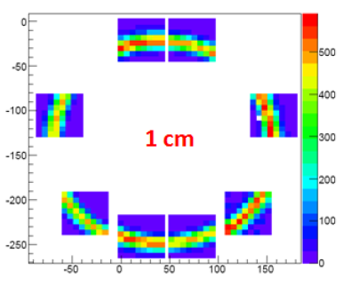
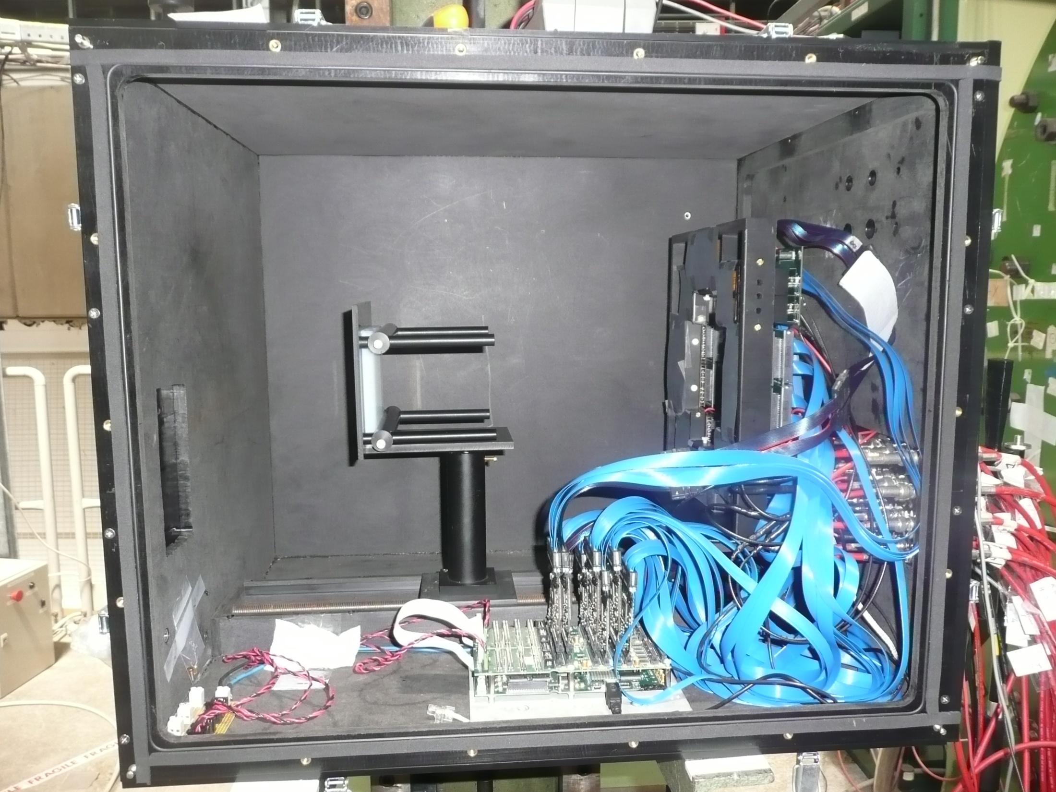
Particle ID
Images are no more rings
  need high level reconstruction algorithms
  study backgrounds (Rayleigh)
“Ring” reconstruction
  single photon resolution
  number of photons
First preliminary test at CERN (summer 2011)
10 GeV/c pions
2cm aerogel, n=1.05 ⇒ more than 10 p.e.
H8500 MAPMTs

Slide 7
RICH simulations
Full simulation of the RICH detector
tuned with lab. and beam tests data
positive particles
negative particles
High efficiency in most of the kinematic plane
Low contamination

Slide 8
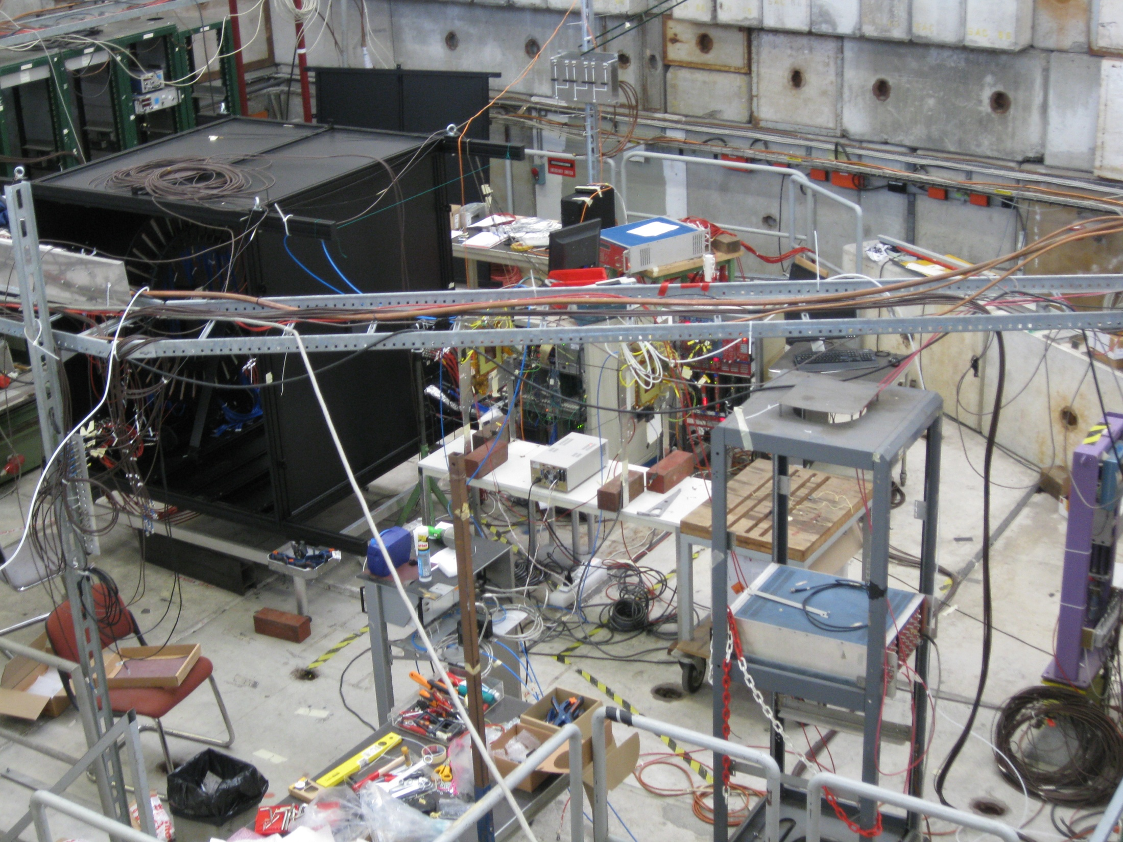
New Test Beam at CERN (2012)
RICH
beam
GEMs

Slide 9
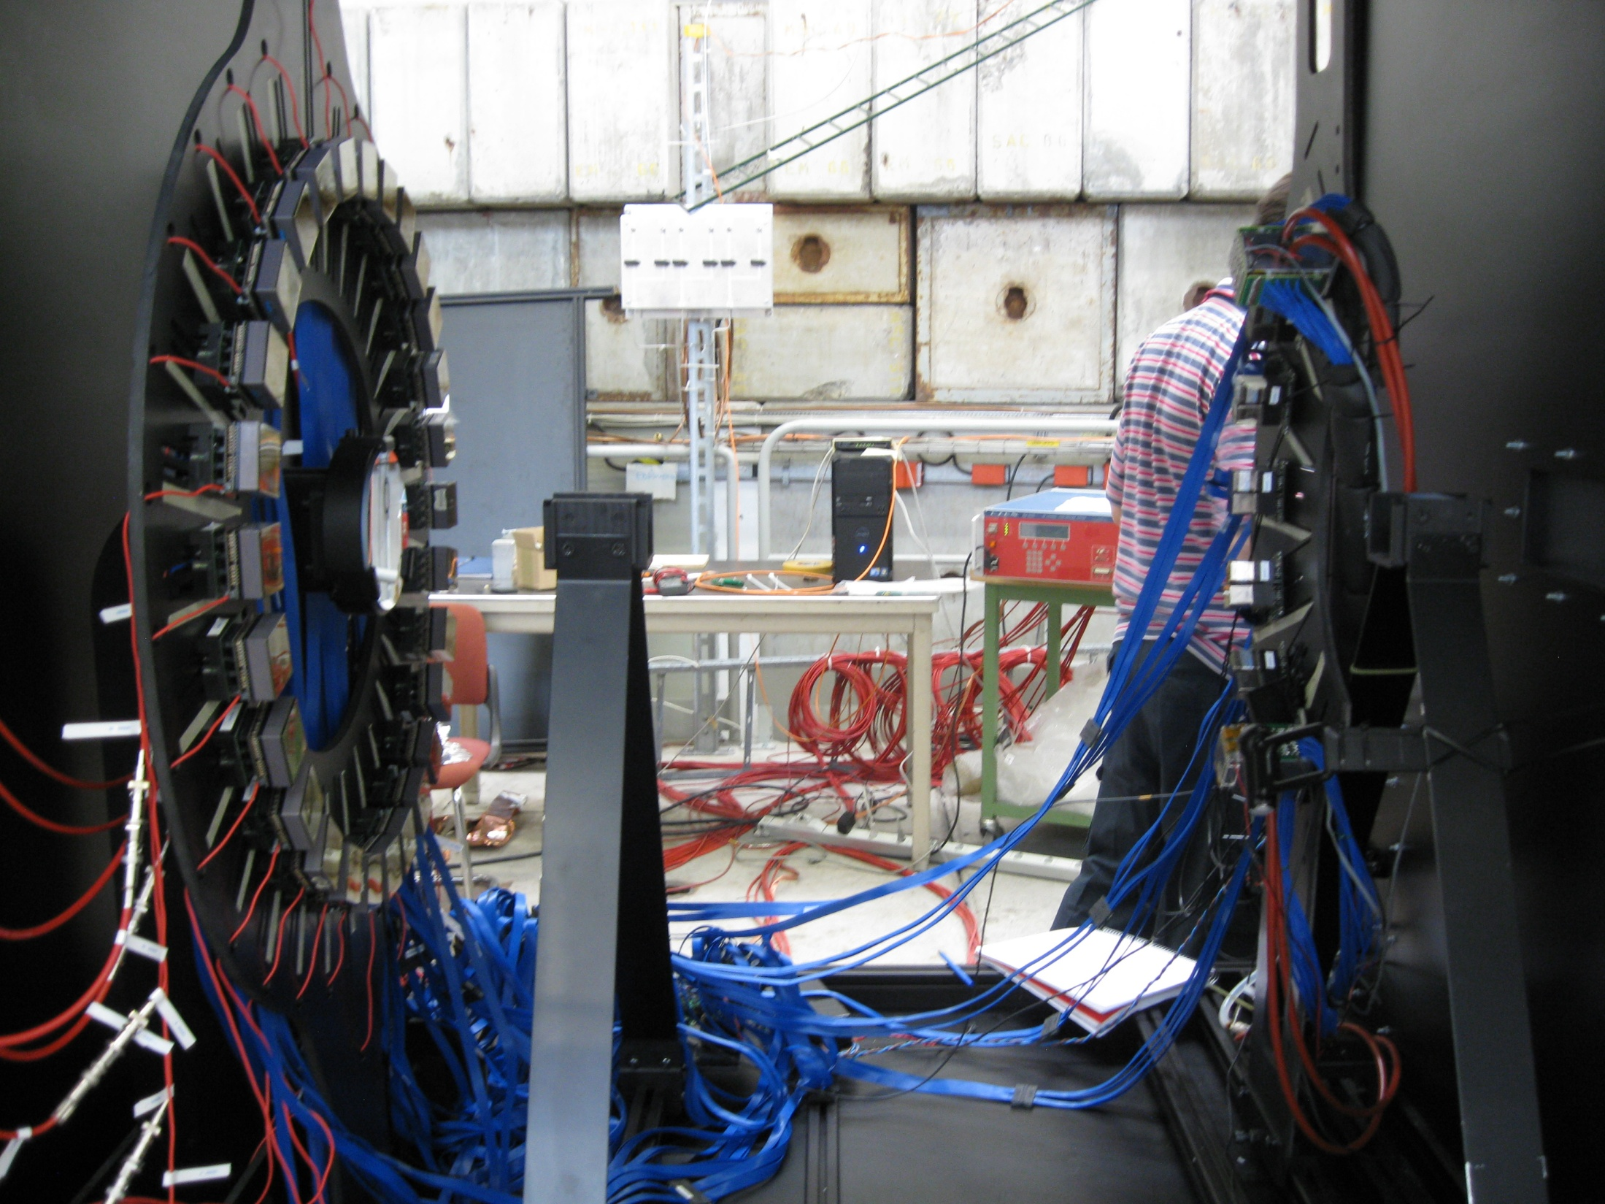
Direct light configuration
H8500
radiator
H8500
Radiator
beam

Slide 10
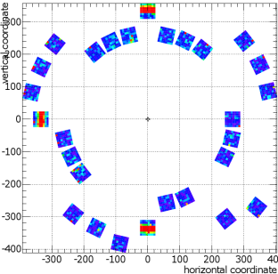
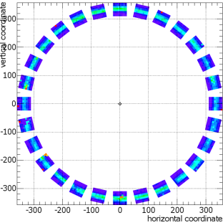
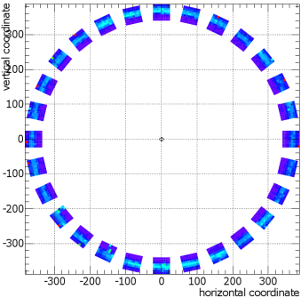
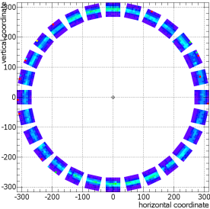
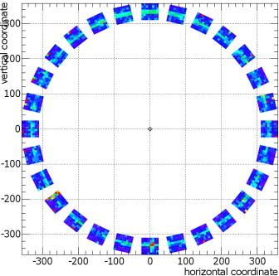
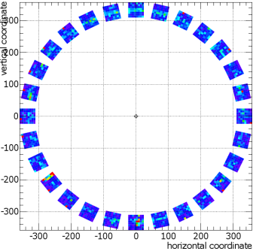
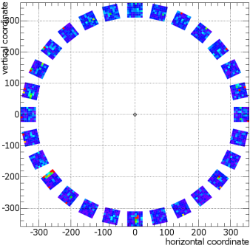
Some “on line” analysis
DIRECT LIGHT
different refractive index and thickness
DIRECT LIGHT
Rayleigh scattering study
3 PMTs on the ring
others off-ring
n=1.04
n=1.05
n=1.06
background
π/K separation
DIRECT LIGHT
chromatic effects study selecting Cerenkov photon wave length
σ_{chr}
λ=400÷450nm
λ=500÷550nm
λ=550÷600nm

Slide 11
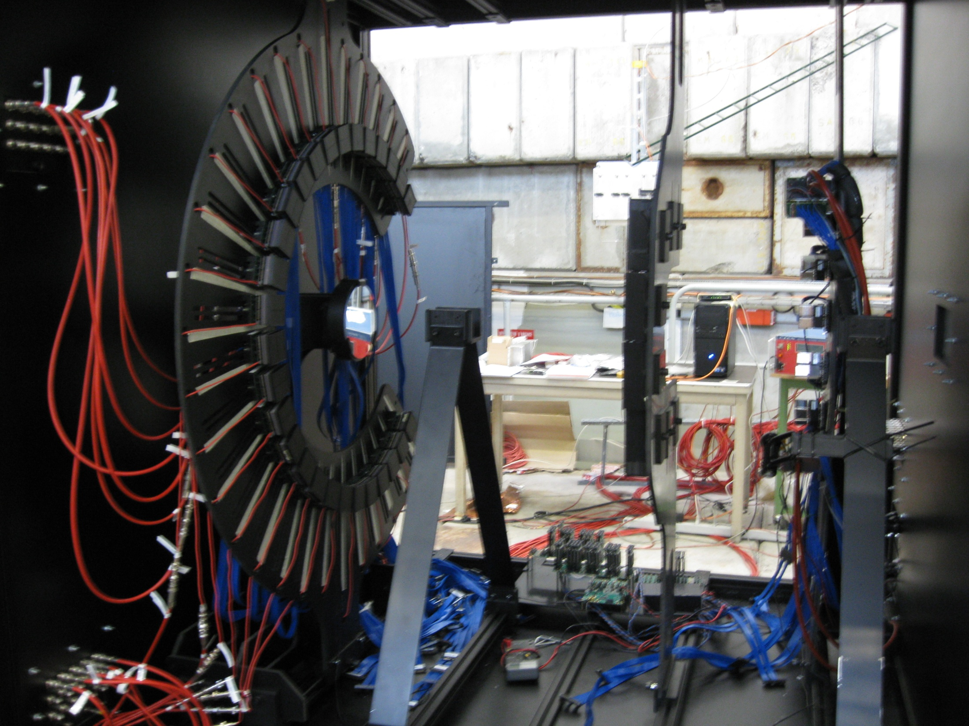
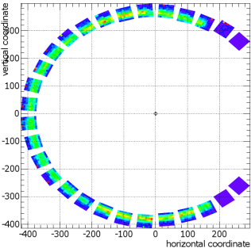
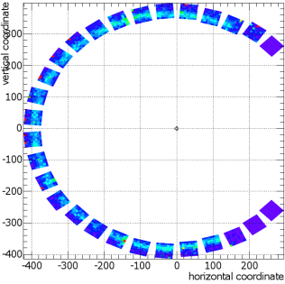
Reflected light configuration
planar mirrors
aerogel absorber
H8500
no
absorber
with
absorber
radiator
spherical mirror
H8500
mirrors + aerogel
beam
Radiator
spherical mirror

Slide 12
The RICH project
INFN groups:
  Bari/Lecce, Ferrara, Frascati, Genova, ISS/Roma1
Many International Institutions:
  JLab (USA)
  Argonne National Laboratory (USA)
  Christopher Newport University (USA)
  University of Glasgow (UK)
  Universidad Tecnica Federico Santa Maria (Chile)
Timeline:
middle 2015: installation of one sector in CLAS12
second RICH sector for transverse physics (2018?)

Slide 13
JLab milestones for the next 5 years
The physics using the RICH detector is strongly supported by Jefferson Lab. Projected science highlights for the next 5 years submitted to NSAC/DOE:
A first generation of exclusive and semi-inclusive deep inelastic lepton scattering experiments worldwide promises a novel multi-dimensional view of nucleon structure in the valence quark region in terms of spatial and momentum tomography. However, virtually nothing is known concerning these quantities when strange quarks come into play. Experiments will provide for the first time precision measurements adding strangeness information for deep virtual kaon production. Further experiments will provide (transverse) momentum tomography for charged-kaon production, precisely measuring the strange quark momentum distribution for which recent HERMES data uncovered a surprising shape, and precisely constraining the spin/flavor structure of the light quark sea.
NSAC Subcommittee Meeting - September 7-9, 2012
Support for the first RICH sector is included in the Lab’s budget planning starting in FY13 and funds projected in FY14 and FY15
 | FY13 | FY14 | FY15
RICH Hall B | 200K$ | 500K$ | 500K$

Slide 14
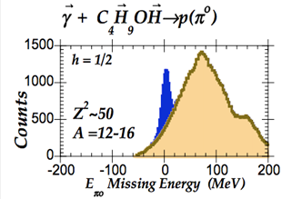
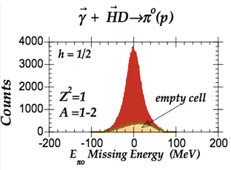
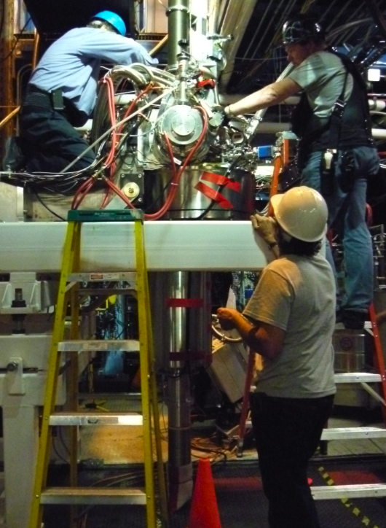
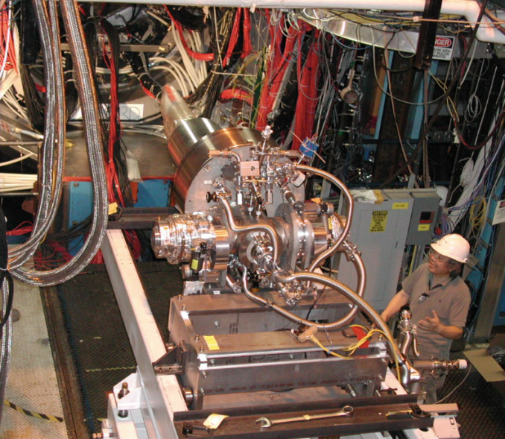
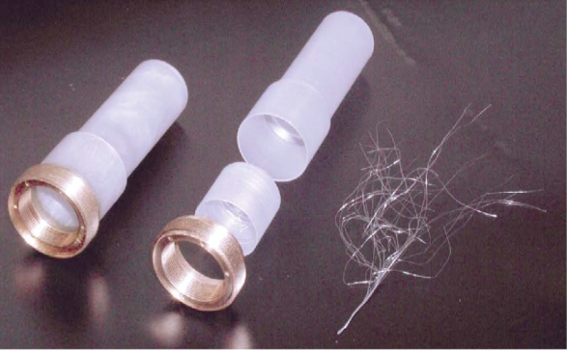
HD-Ice: polarized frozen spin target
Advantages:
large acceptance
minimize nuclear background
high polarization, up to 75% H and 40% D
Disadvantages:
long polarizing time (months)
sensitive to local heating
lower max luminosity: ~5 10³³ cm⁻² s⁻¹
Production process:
dilution of HD gas
polarization of the HD at 23mK and 15 T
transfer to IBC at 2.8K and 0.5T
Target cell
Target
Transfer
In-beam
cryostat

Slide 15
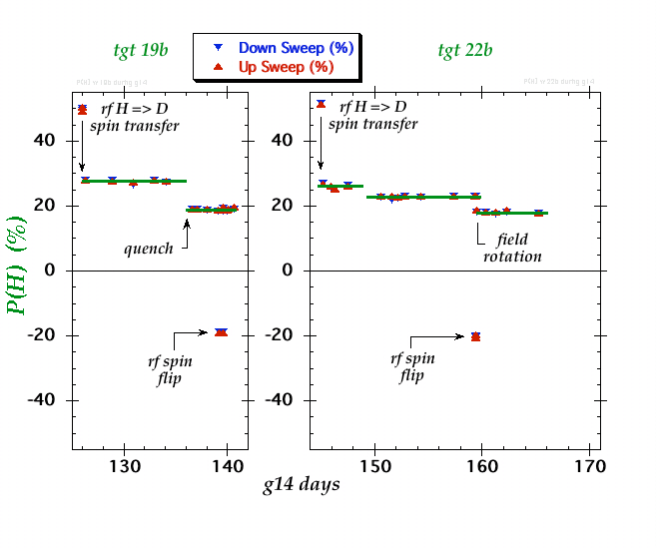
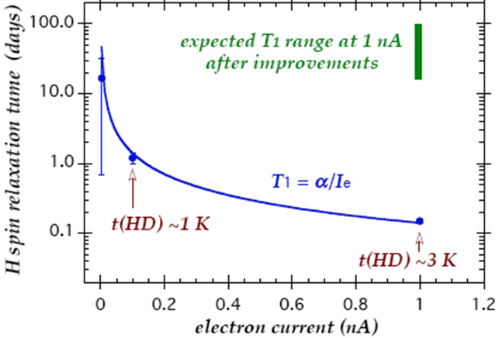
6 GeV runs with HD-Ice
Photon runs from Nov. 2011 to May 2012
photon flux ~10⁸ γ/s
relaxation time T1 ~ years
Electron runs Feb. and Mar. 2012
Short relaxation time during beam exposure
heat removal needs improvement
faster raster
new cell geometry
Commissioning run foreseen with early Beam, before CLAS12 operations

Slide 16
Conclusion
TMD measurements are one of the main items of the JLab physics program at 12 GeV.
Large activity from INFN groups to provide CLAS12 with the necessary upgrades:
RICH detector
simulations
test of photodetectors: Multi-Anode PMT and SiPM
characterization and development of aerogel
Electronics: MAROC2 and MAROC3
Design and construction of a detecor prototype
Test beams
HD-Ice target
characterization of the HD gas and relative concentration of H² and D²
contribution to the realization of cryostat for the gas concentration and of the In-Beam Cryostat
NMR measurements
design of the transverse holding magnet operating within the CD solenoid

Slide 18
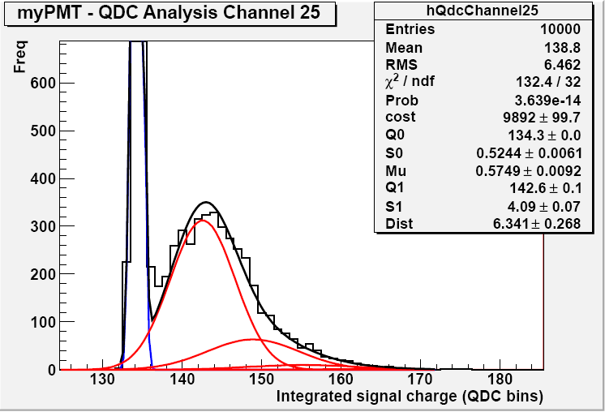
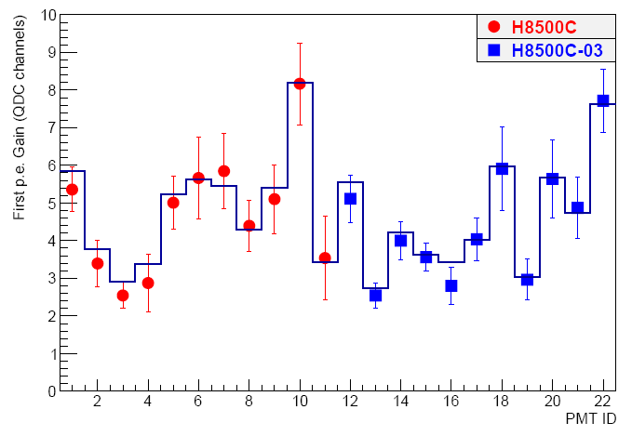
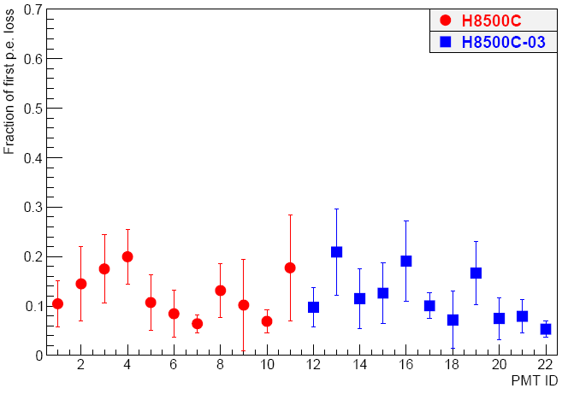
Laser test of H8500 MAPMTs
Laser intensity adjusted via the remote control and using neutral density filters
The laser head remotely moved to scan the PMT surface
Conventional electronics for data acquisition (CAEN V792)
H8500 are good single photoelectron detectors
below threshold, HV=1075 V
GAIN, HV=1000 V

Slide 19
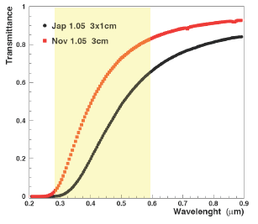
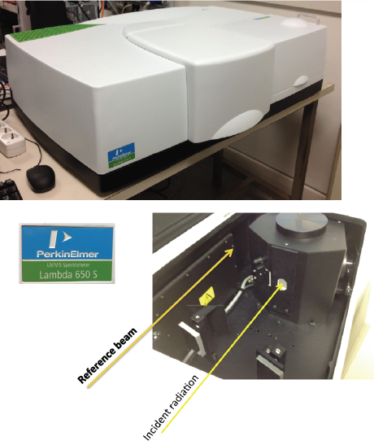
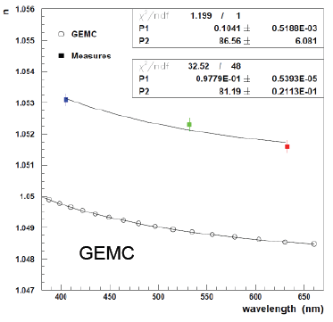
Aerogel characterization
Collaboration with Budker Institute for high transmission aerogel production, with different thickness and refractive index
Budker
Japan
improvement in the transmittance
MEASUREMENT
0.003 offset but same trend

Slide 20
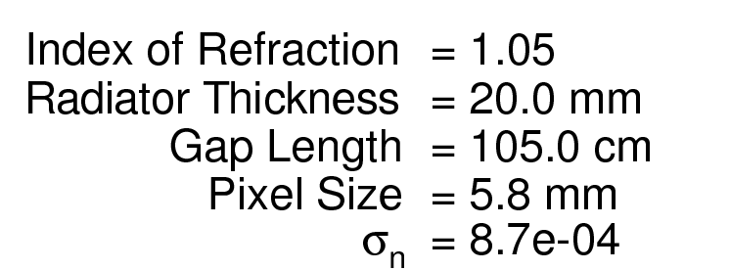
Single Photon Resolution
Calculation from Monte Carlo
Simulation tested with experimental data in different configuration
Notes:
9 vs 8

Slide 21
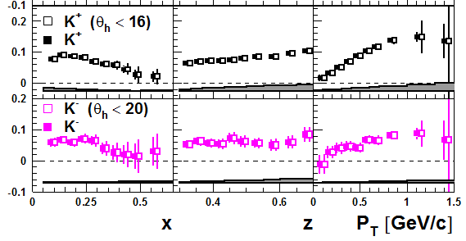
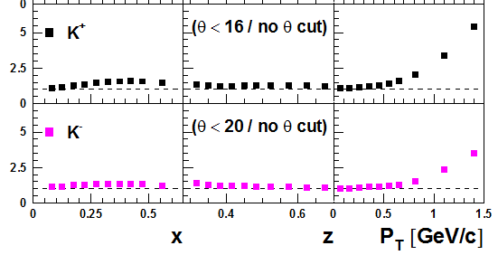
A_{UT} measurement with RICH
A_{UT}
Empty symbols: direct only
Full symbols: direct+reflected
Relative error increase

Slide 22
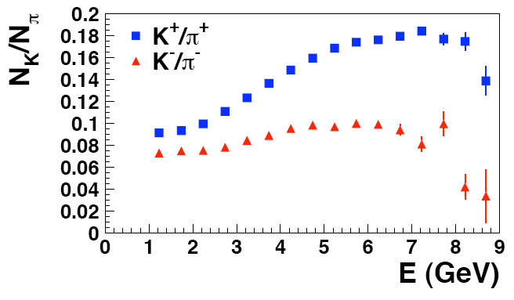
Kaon to pion production rates in CLAS12

