Slide 1
Cosmic rays studies, in the 10¹⁶-10¹⁸ eV energy range, with the KASCADE-Grande experiment
Andrea Chiavassa
Universita` degli Studi di Torino
4th Workshop on Air Shower Detection at High Altitude Napoli, 31 January 2013

Slide 2
Experimental results
Proton+Helium spectrum agrees with direct measurements
Knee observed in the spectra of all EAS components
Primary chemical composition gets heavier crossing knee energies
Knee is due to light primaries
Change of slope of the heavy elements spectrum observed at ~8x10¹⁶ eV
Radiation is highly isotropic.

Slide 3
Open Issues in the knee Energy Range:
Single Element Spectra?
Rigidity Dependent knee?
Composition at the knee?
End of Galactic Spectrum?
Transition Galactic-Extragalactic radiation?
Anisotropy?
Hadronic Interaction model

Slide 4
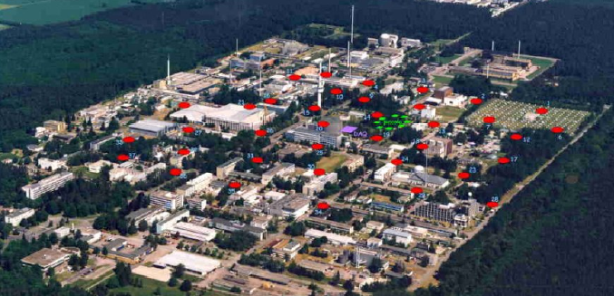
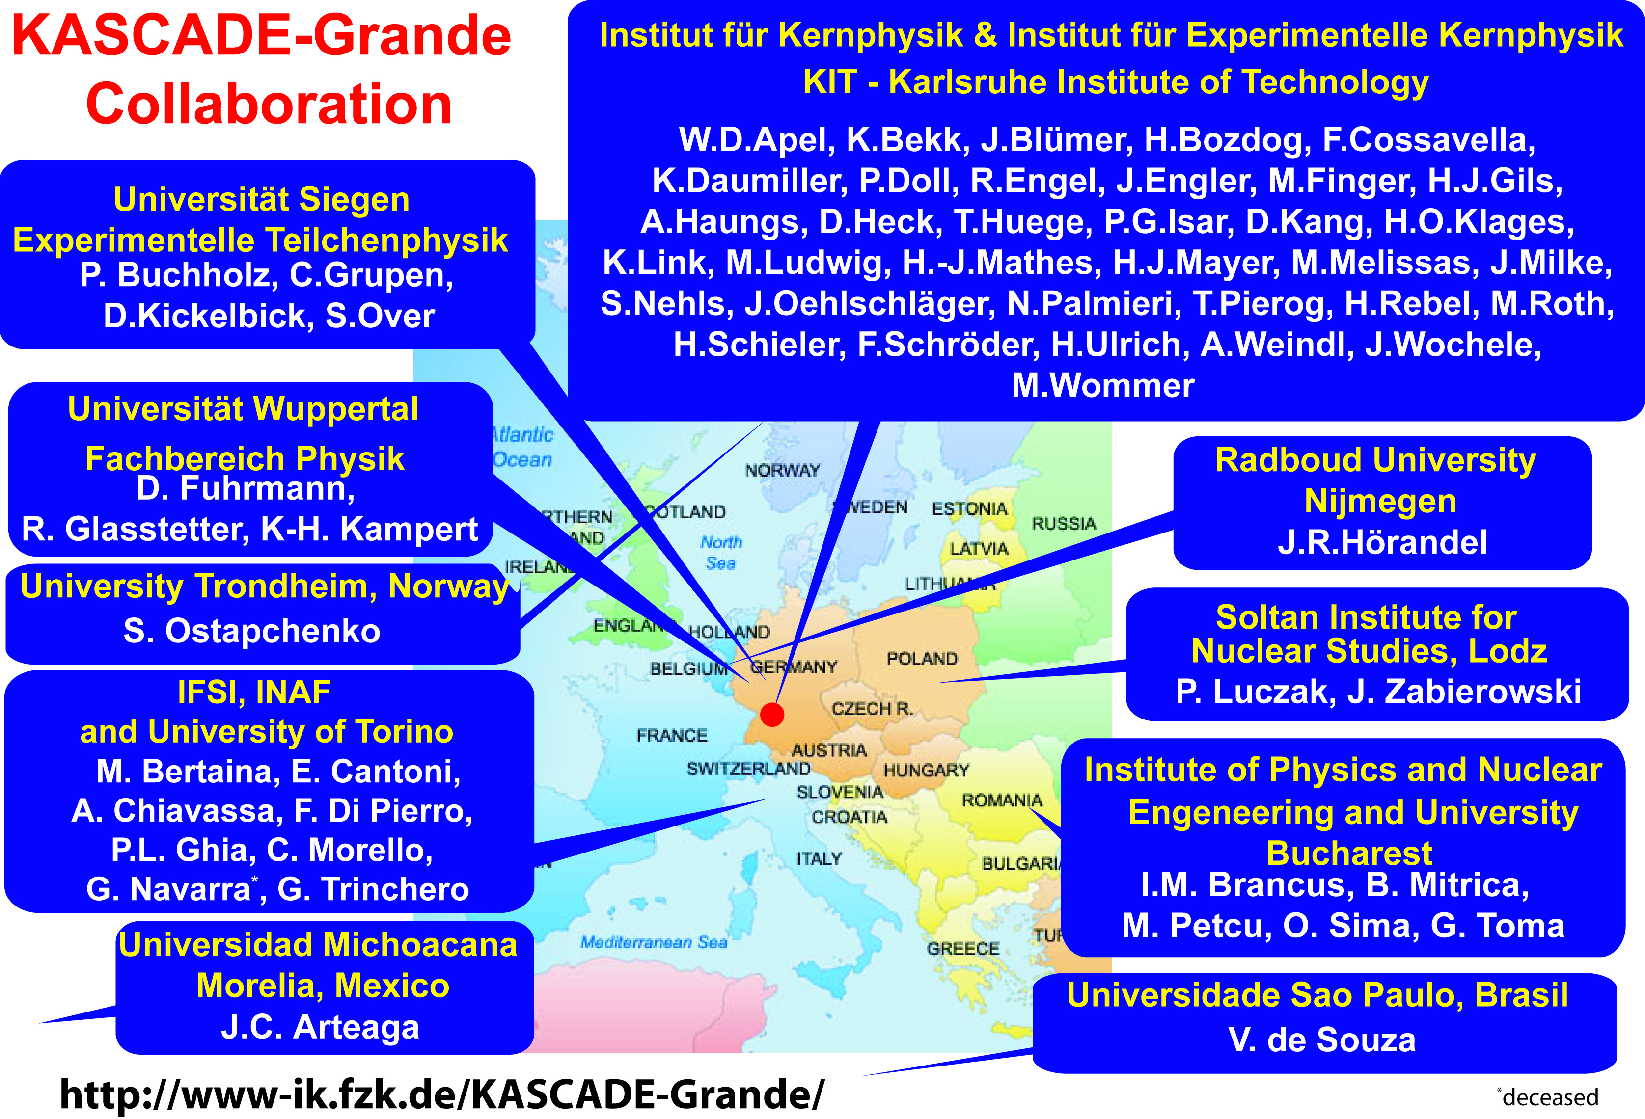
KASCADE-Grande experiment

Slide 5
KASCADE-Grande detectors & observables
Grande array → cover an area of 0.5 km², detecting EAS with high resolution
Detector | Detected EAS component | Detection Technique | Detector area (m²)
Grande | Charged particles | Plastic Scintillators | 37x10
KASCADE array e/γ | Electrons, γ | Liquid Scintillators | 490
KASCADE array μ | Muons (Eμ^{th}=230 MeV) | Plastic Scintillators | 622
MTD | Muons (Tracking) (Eμ^{th}=800 MeV) | Streamer Tubes | 4x128
Shower core and arrival
direction
  Grande array
Shower Size (N_{ch} number of
charged particles)
  Grande array
    Fit NKG like ldf
μ Size (E_{μ}>230 MeV)
  KASCADE array μ detectors
    Fit Lagutin Function
μ density & direction (E_{μ}>800 MeV)
  Streamer Tubes

Slide 6
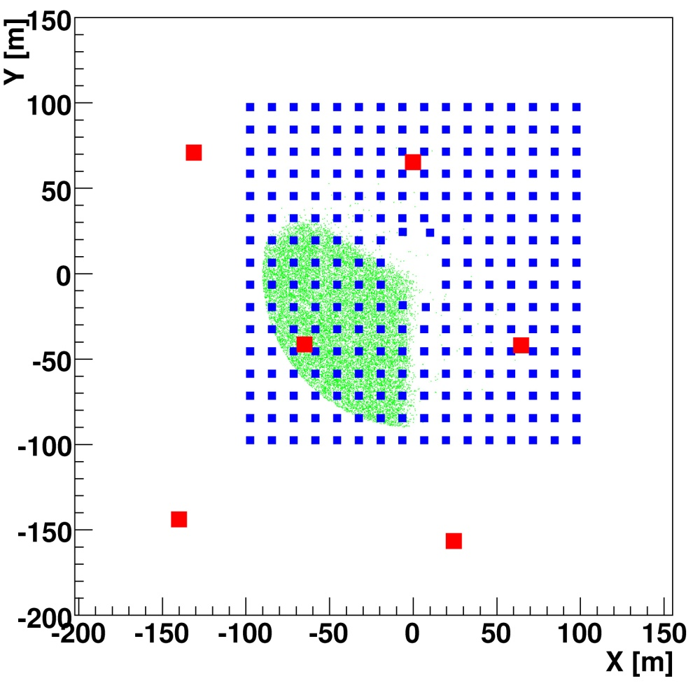
KASCADE-Grande accuracies with a subsample
of common events KASCADE + Grande
■ KASCADE stations
■ Grande stations
Apel et al. NIMA 620 (2010) 202-216

Slide 8
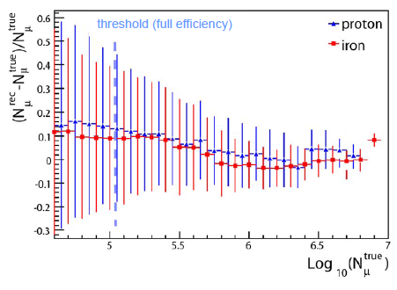
N_{μ} accuracy studied with simulated events
Accuracy ~20% for N_{μ}

Slide 9
All particle energy spectrum
Combination of N_{ch} and N_{μ}
Five different angular bins
K parameter evaluates chemical composition
Based on QGSJet II-02
Astroparticle Physics 36, (2012) 183

Slide 10
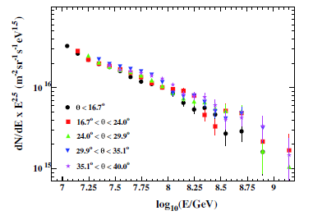
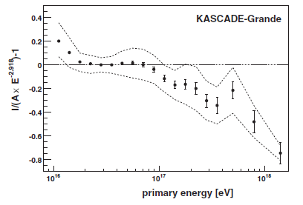
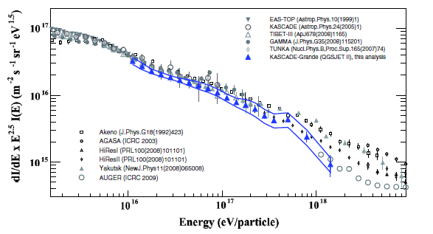
Spectrum cannot be described by a single power law
Hardening above 10¹⁶ eV
Steepening close to 10¹⁷ eV
significance 2.1σ
Astroparticle Physics 36, (2012) 183

Slide 11
Residual plot of all particle spectrum measured by various experiments
Each spectrum is fitted by a single slope power law in the energy range between
the spectral features claimed by KASCADE-Grande
Features can be observed in almost all spectra

Slide 12
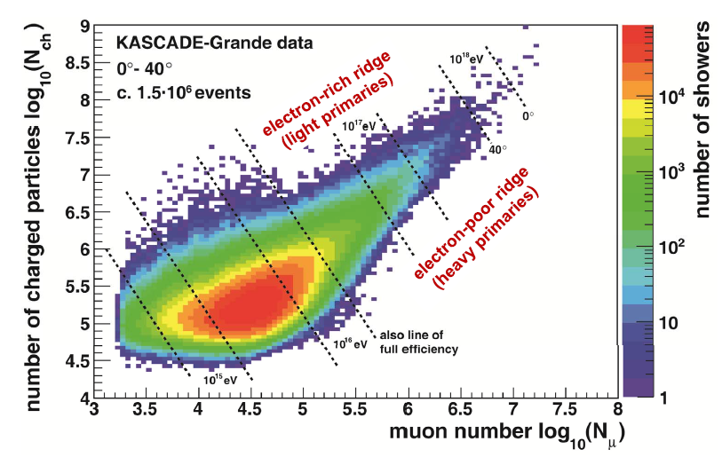
Approach to Chemical Composition

Slide 13


Unfolding
Analysis objective is to compute the spectra of N_{Nucl} mass groups.
N_{i} number of events expected in the bin :
p_{n} is obtained from full EAS and detector simulation (based on QGSJet II)
s_{n} EAS development fluctuations
r_{n}, reconstruction resolution, including systematic reconstruction effects
ε_{n}, trigger efficiency

Slide 14
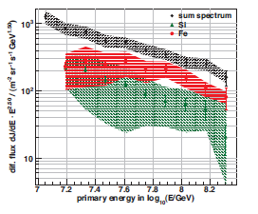
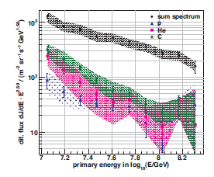
QGSJet II-02
Spectra of five mass groups obtained applying the unfolding technique to the KASCADE-Grande data. Only the heavier mass group spectrum (Fe) shows a significant steepening

Slide 15
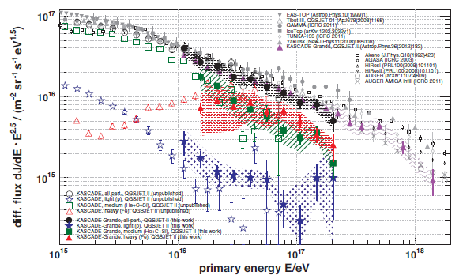
Spectra agree well with those obtained applying the unfolding technique to KASCADE data.
Both data sets are analyzed with the QGSJetII-02 hadronic interaction model

Slide 16
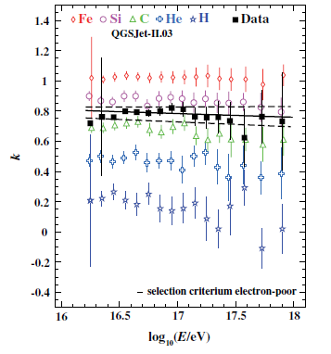
Event separation in two mass groups by the N_{ch}/N_{μ} ratio
Two different ways of taking into account the EAS attenuation in atmosphere
QGSJet II-02
k parameter

Slide 17
QGSJet II-02
EPOS 1.99
Y_{CIC} increases with primary mass → if calculated with the same model
Same model → cut on Y_{CIC} → cut on primary mass
Y_{CIC} calculated with different model
→ constant with E
→ different for the same primary mass

Slide 18
k parameter event selection
All particle spectrum → steepening at 10¹⁷ eV →
2.1σ significance
Spectrum of the electron
poor sample→ steepening
observed with increased
significance → 3.5σ
Spectrum of electron rich events → can be described by a single power law → hints of a hardening above 10¹⁷ eV
Phys. Rev. Lett. 107 (2011) 171104

Slide 19
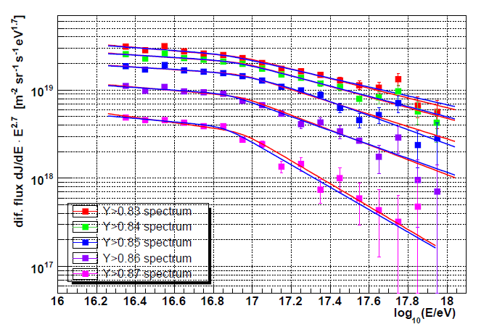
Spectra obtained with the two different strategies agree
Steepening observed at the same energy independently of the cut choice
The steepening of the electron poor sample is enhanced cutting at higher Y_{CIC} values
Y_{CIC} event selection

Slide 20
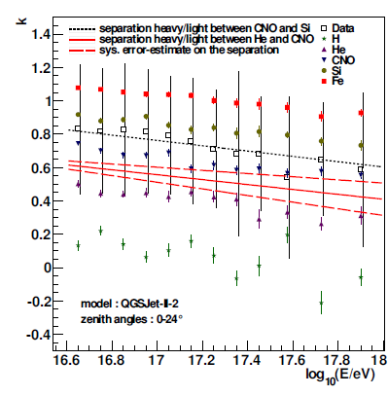
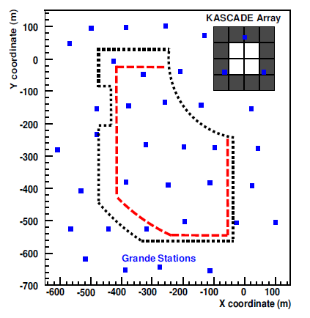
Investigations of the possible hardening of the electron rich sample
Statistics increased by 36% adding new data sets and increasing the effective area
To enhance possible structures of the electron rich sample a different cut value can be used

Slide 21
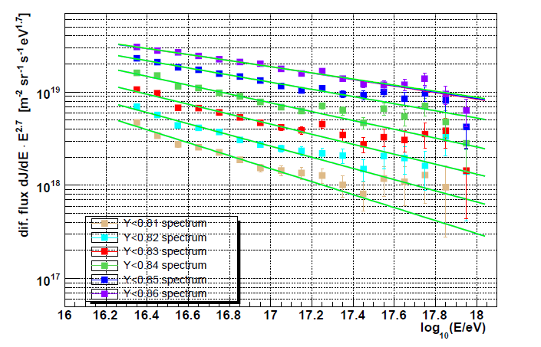
PRL cut
QGSJet II
Spectra obtained enhancing the electron-rich event selection (i.e. cutting at lower Y_{CIC} values) show a clearer hardening above 10¹⁷ eV

Slide 22
Conclusions
KASCADE-Grande data taking stopped in November 2012.
Grande detectors dismantled
All particle spectrum cannot be described by a single slope power law spectrum
  Hardening ~10¹⁶ eV
  Steepening ~8x10¹⁶ eV
Steepening at 8x10¹⁶ eV is due to heavy primaries
Hints of an hardening, above 10¹⁷ eV, of the spectrum of light primaries. Details are under investigation

