Slide 1
Status of LHAASO
Zhen Cao, IHEP, China
Facility and its scientific goals
Proposing status
Site
Schedule and prototyping
4th Workshop on Air Shower Detection at High Altitudes, Naples, Italy, 2013

Slide 2
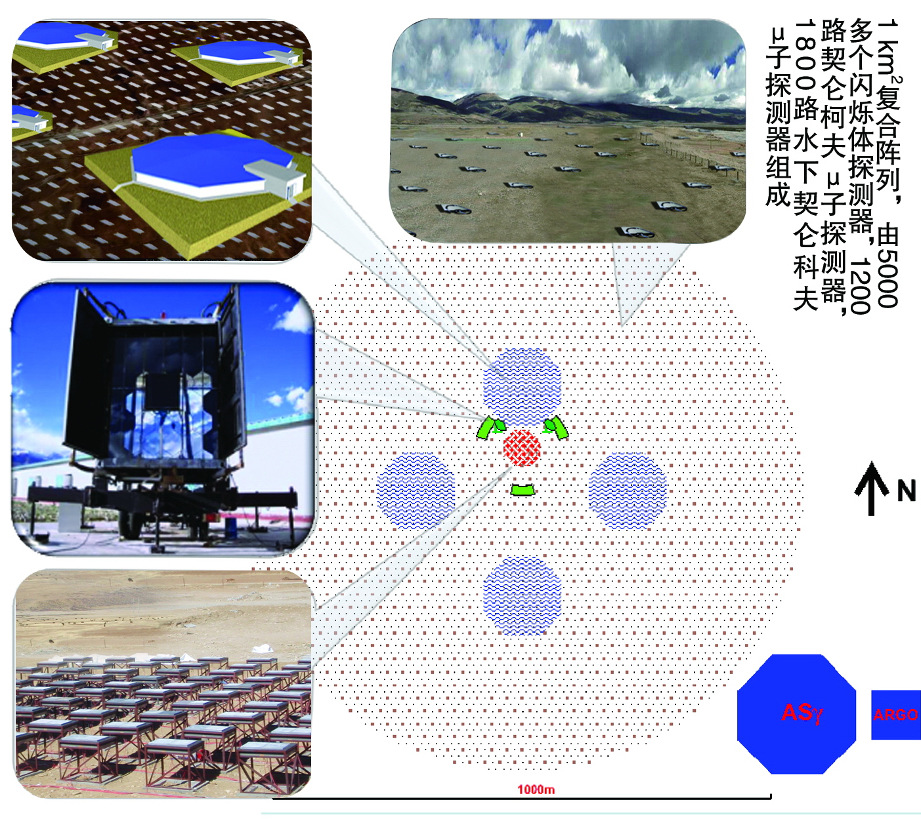
LHAASO——The third generation of survey facility for VHE γray sources
90k square meter
Water Cherenkov
Deter array. Each
one has a size of
HAWC
6100
scintillator
detectors
and 1200
μdetectors
form an
array covering
1 km²
LHAASO Layout in 1 km² at 4300m a.s.l.
24 Wide FOV air
Cherenkov image
Telescopes. For
Air Fluorescence
measurement
above 0.1 EeV also
400 burst detectors
For high energy
Secondary particles
Near the core of air
showers

Slide 3
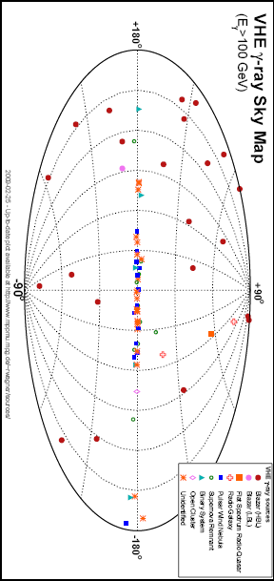
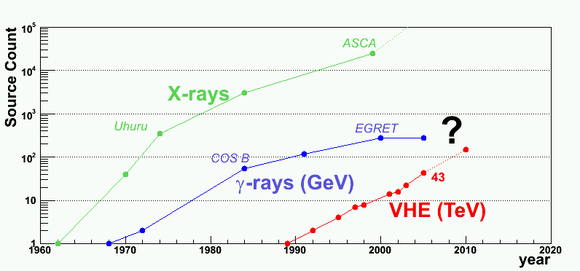
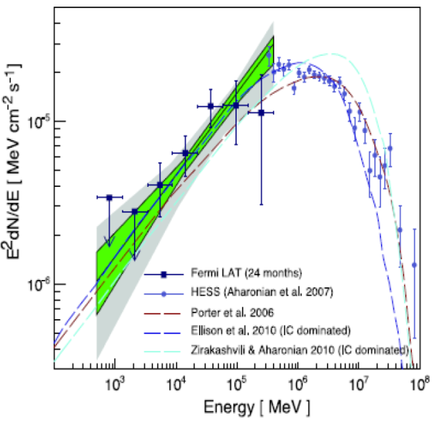
Survey for γ-sources very detailed spectroscopy investigation
( a few hundred extra-galactic sources are expected )
？
1000
Ev/yr
10

Slide 4
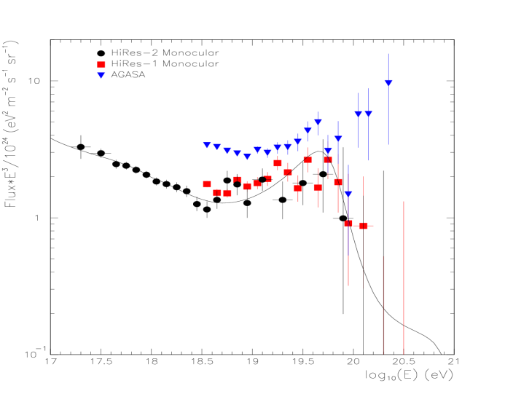
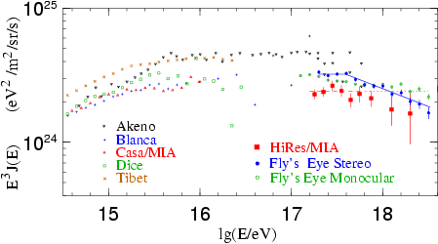
CR spectra of individual spices over two knees with uniform energy scale and direct measured composition in the space
Tower CT: 16
μ : 100x400m²
Side Trigger CT: 2x4
W S
C C
D D
A A
+
W
F
C
T
A
K
M
2
A
+
T
U
N
K
A
K T
M U
2 N
A K
A
+
F
T
A
A
R
G
O
+
W
F
C
T
A
A
R
G
O
Multi-parameter hybrid
observation of showers

Slide 5
Following Talks
Hybrid Measurement on p+He spectrum <1PeV, by Zhang, SS
LHAASO for spectra of individual species above 0.1PeV, by Ma, XH
LHAASO for composition and spectrum above 10PeV, by Ma, LL
LHAASO for the 2nd knee with hybrid measurement, by Zha M

Slide 6
Status of LHAASO
16 projects for 5 years as a package has been formally approved by the council of state 2 weeks ago
A draft of the formal proposal to the CCDR is almost ready
A couple of steps ahead: environment impact evaluation, feasibility reviewing, TDR reviewing
Selected site has been approved by the local land management. Trade negotiation is under going with province government
Construction is expected to start next year
All technologies are tested

Slide 7
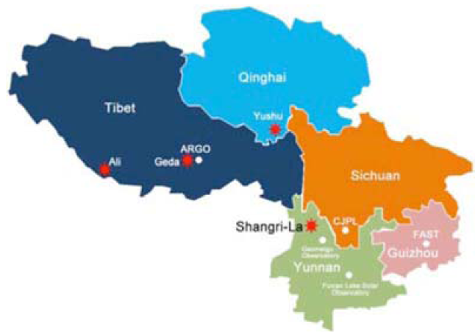
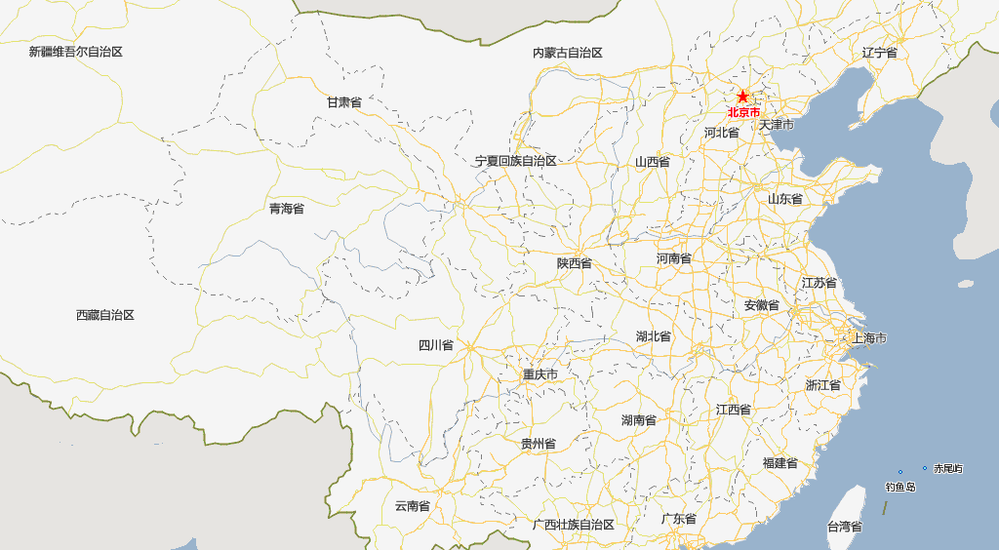
The Best Candidate Sites
ARGO-YBJ
site
LHAASO
site

Slide 8
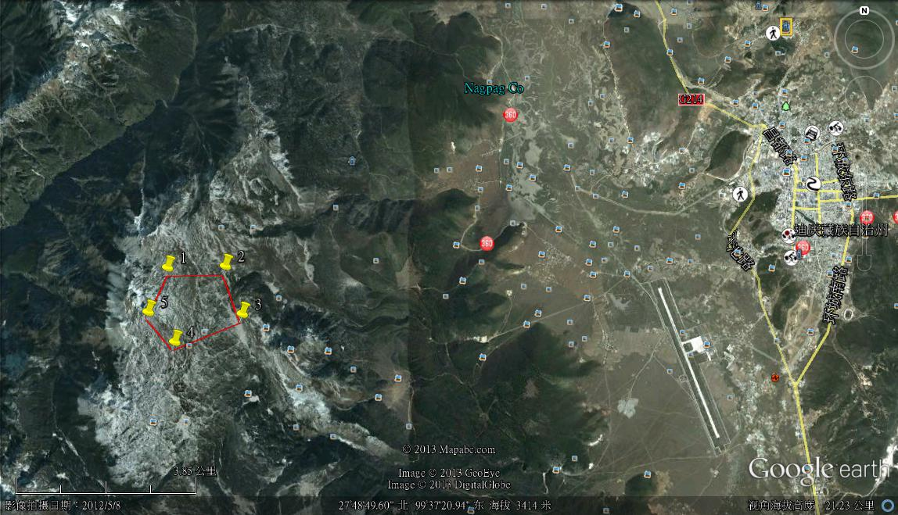
石卡雪山站址地理位置
13km
10km

Slide 9
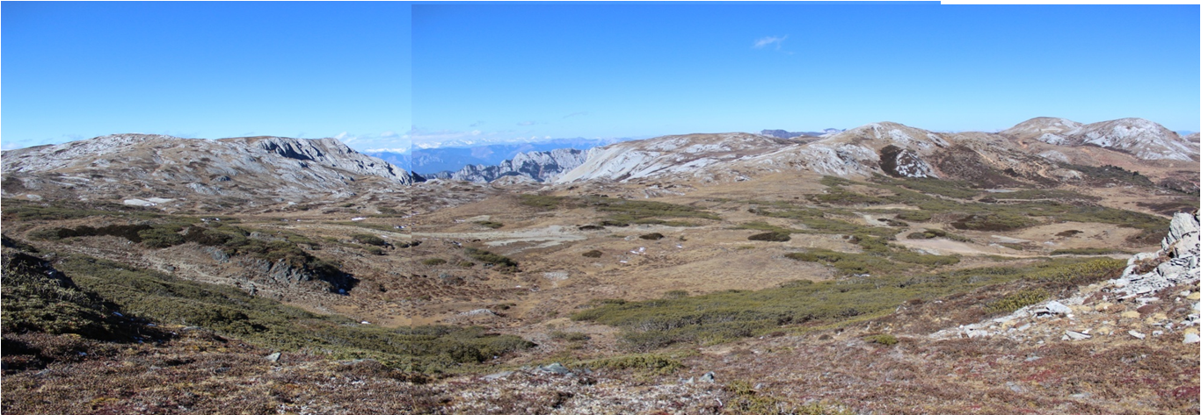
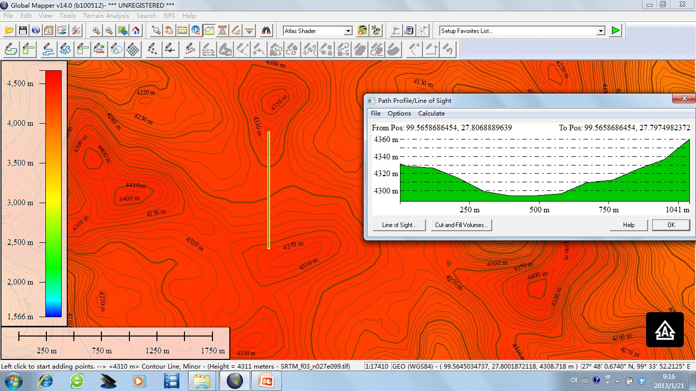
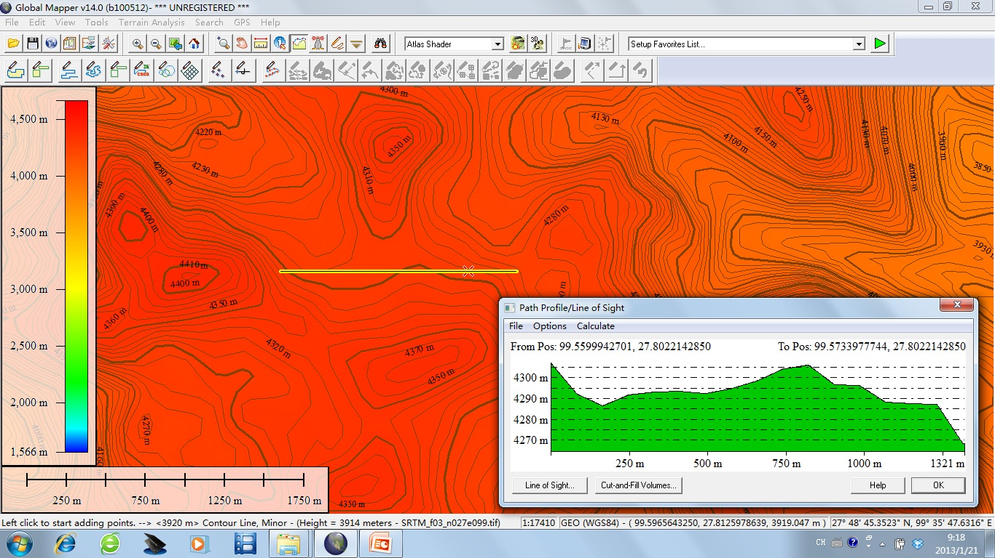

Slide 10
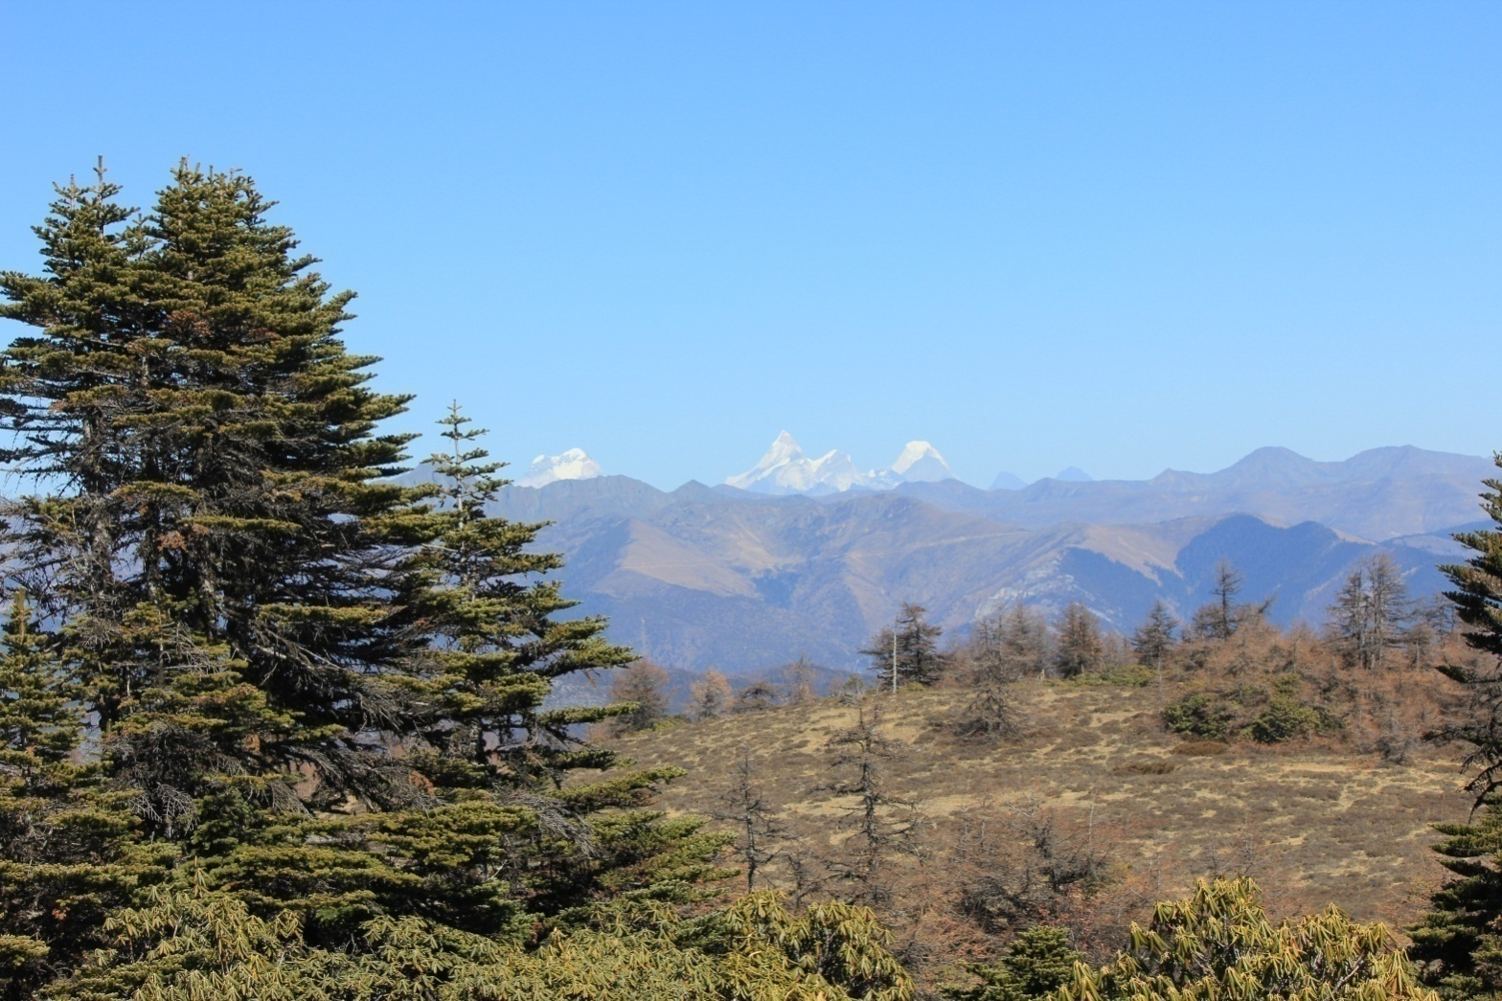
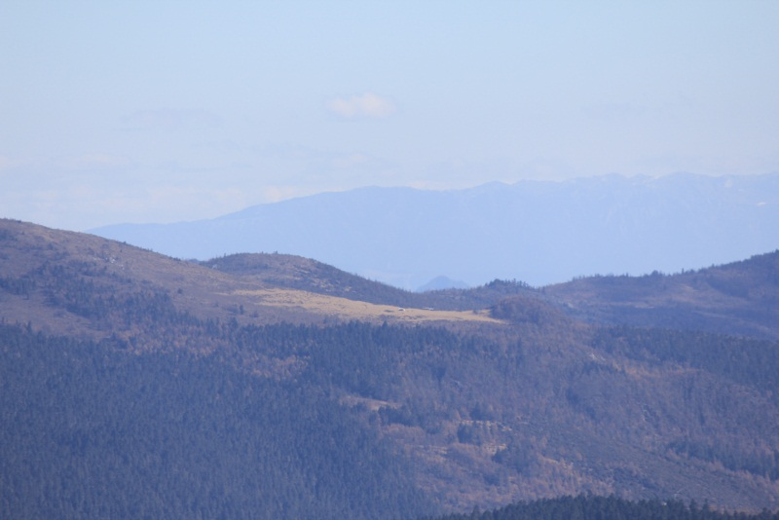
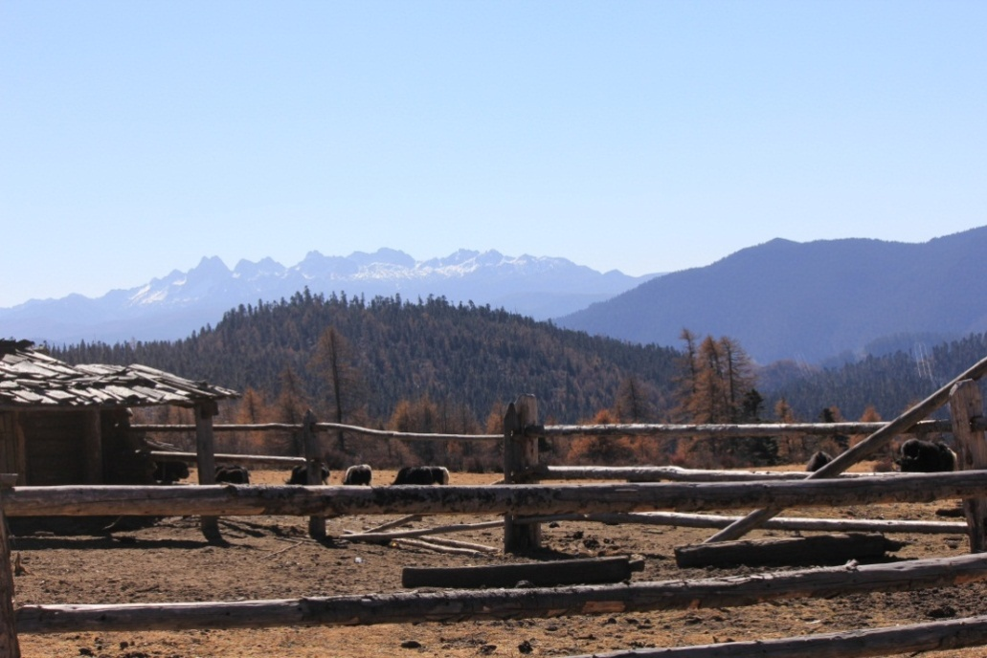
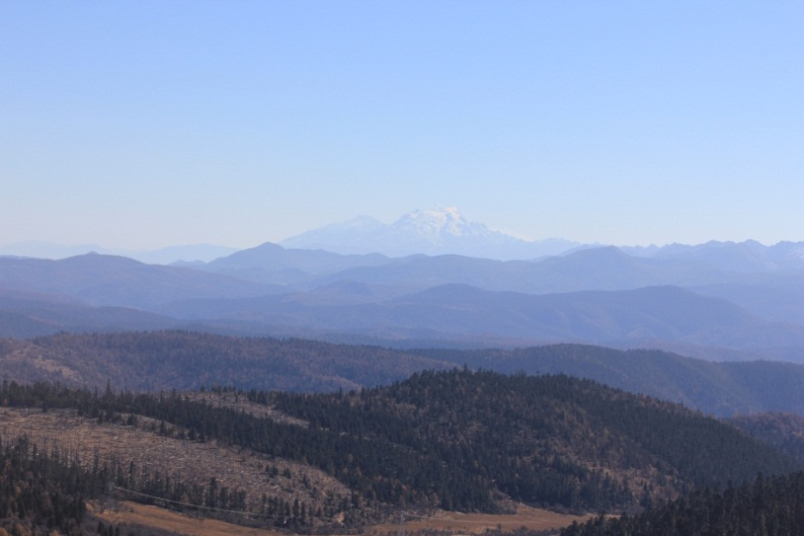
Mt.Gongga, 260km away
Another possible site ,10km away
Mt. Duobao，40km
Mt. Haba，70km

Slide 11
Observatory Construction
It is planned for a construction of 5-6 years
yrs
Detector R/D： 1.5
FEE R/D: 2
FEE Production: 1.5
DAQ & installation: 0.5
Detector deployment: 4
1% array test run: 1
now
6 yrs
All technology that will be used in LHAASO are
tested with engineering arrays at scales of
1%-10% of the full project

Slide 12
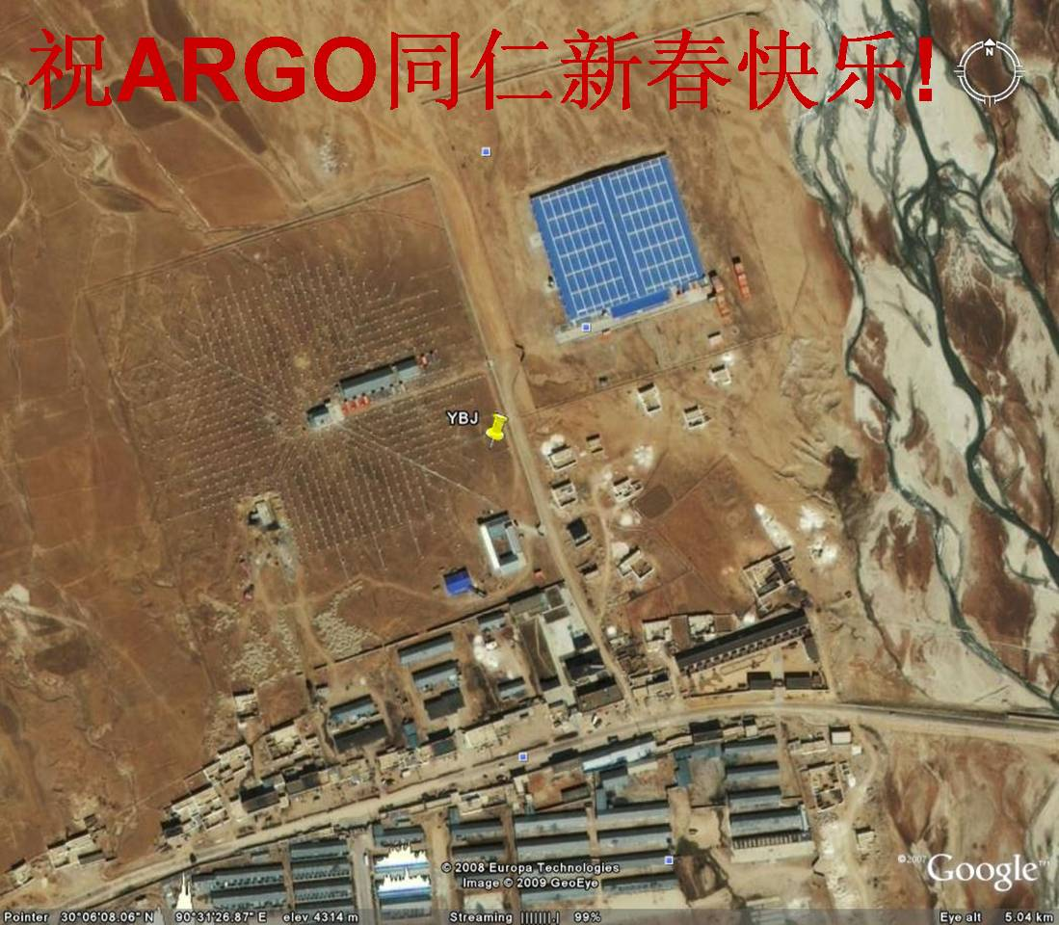
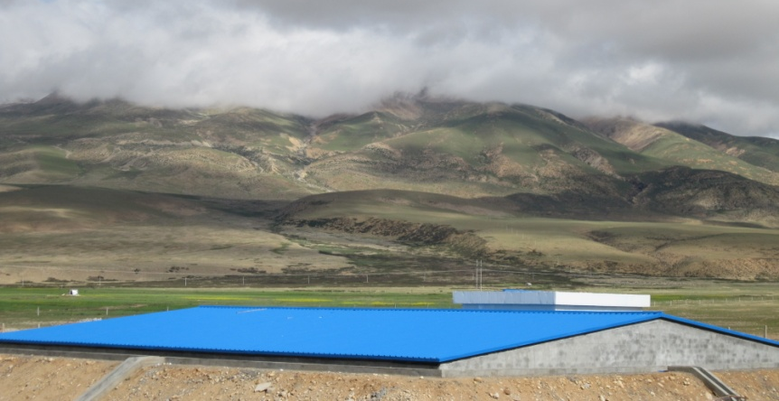
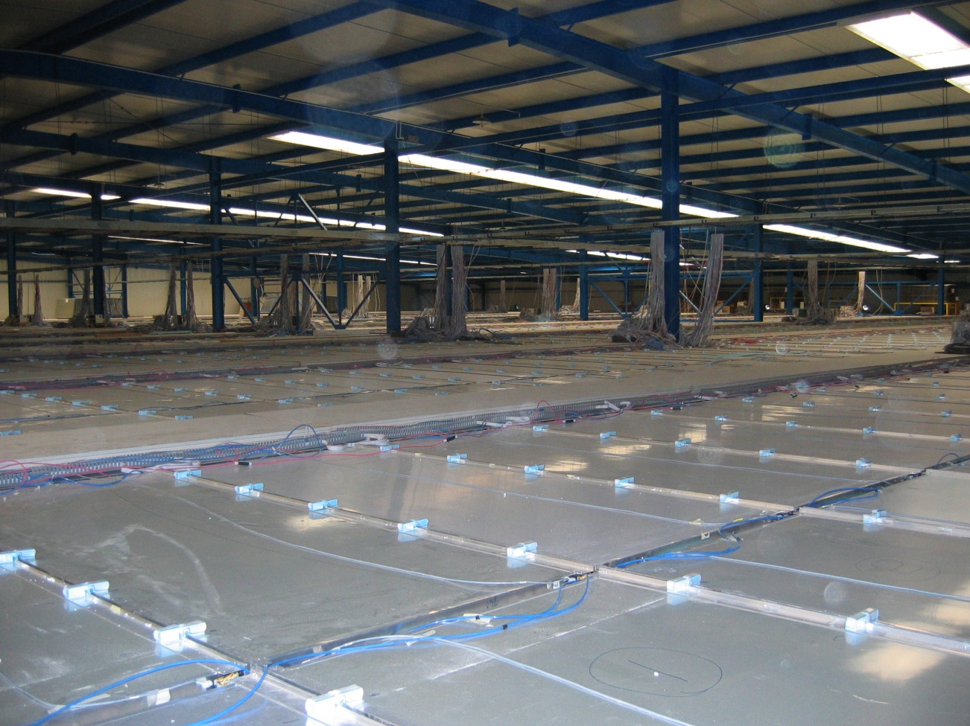




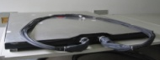


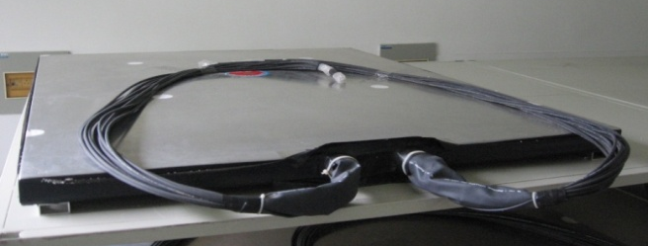
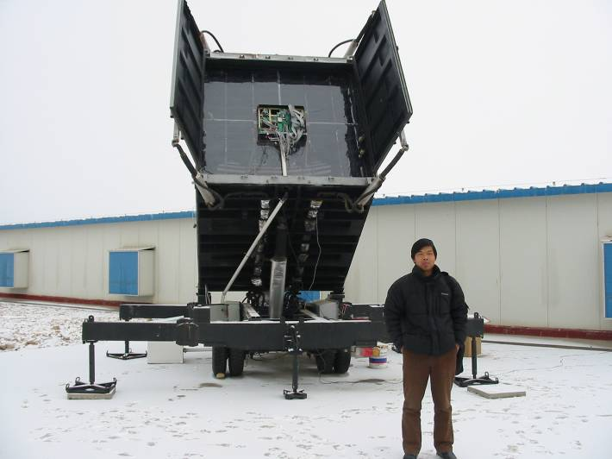
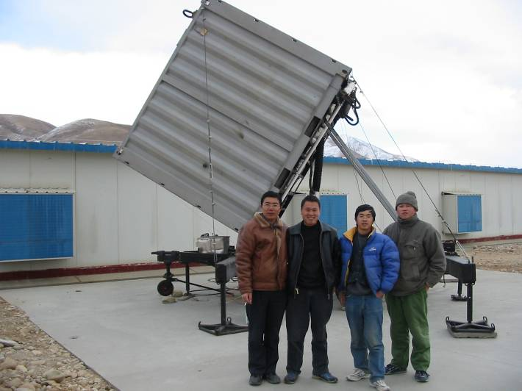
Prototype of LHAASO at Tibet site
1% engineering array near the ARGO detector with a budget of ~1M euro since 2009
μ

Slide 13
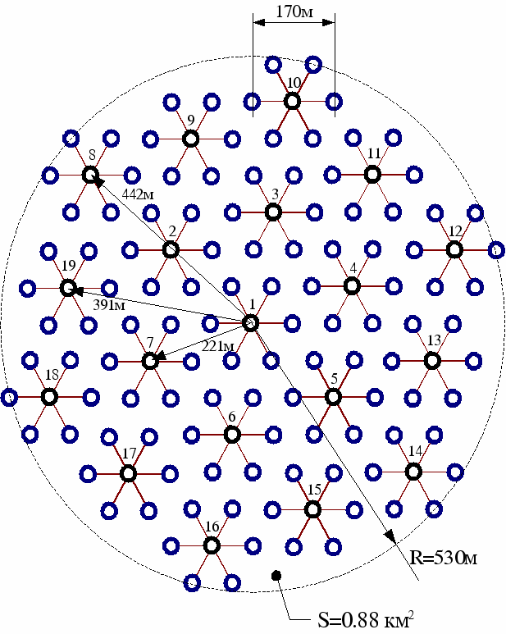

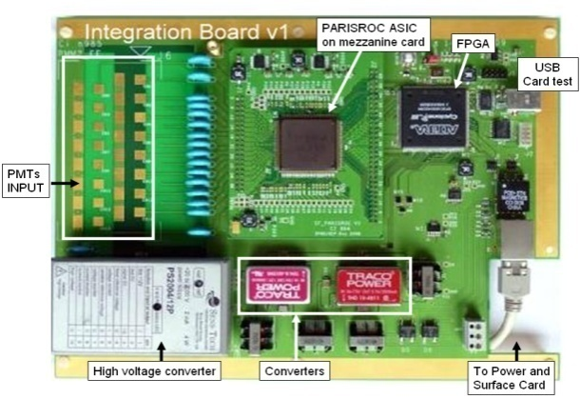


International Collaboration for LHAASO
IPNO /LALon ASIC
electronics for LHAASO
TUNKA on top of LHAASO-KM2A
for high energy extension (>10¹⁶eV)
ARGO upgrading
for low energy extension
R/D of ASIC for LHAASO, by Chen, YT
2nd Workshop on Air Shower Detection at High Altitudes

Slide 14
Keep in tuned ……

Slide 15
international collaboration
LHAASO will play a role in CR measurement over a wide energy range between direct measurement and UHECR, such as AUGER
Many interesting open topics with an enormous data volume and great potential collaboration possibilities, e.g. TUNKA and PRISMA from Russia and AUGER group from France are joining
In gamma ray astronomy, a potential collaboration with HAWC by observing a same flaring source in relay from east to west hemispheres. A strong complementary with CTA in regions, temporal zones, observational manners and energy ranges. Many potential collaboration opportunities
Attempts of forming a US collaboration with LHAASO are greatly welcomed

