Slide 1
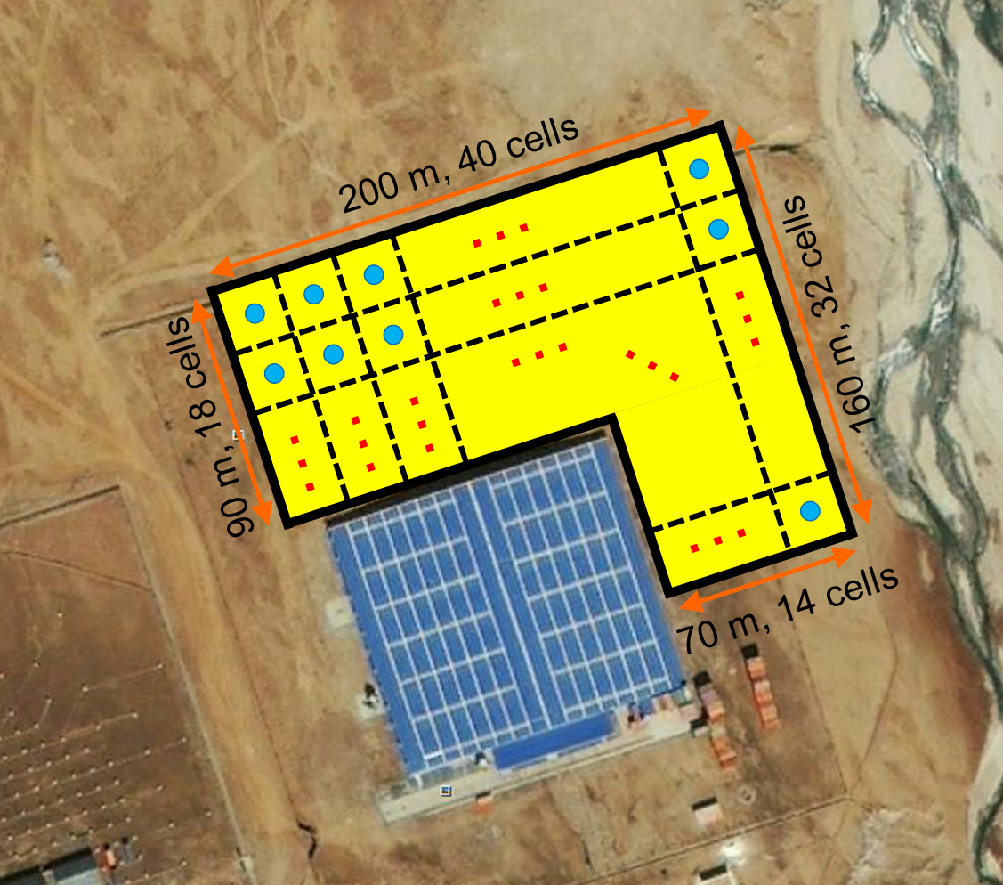
a TeV-gamma ray observatory implemented with water Cherenkov array at YBJ
LAWCA (Large Area Water Cherenkov Array)
Huihai He, IHEP, CAS
2013/2/1

Slide 2
Outline
Introduction
Detector design
Performances and physics expectations
Prototype detector and array
Schedules
Summary

Slide 3
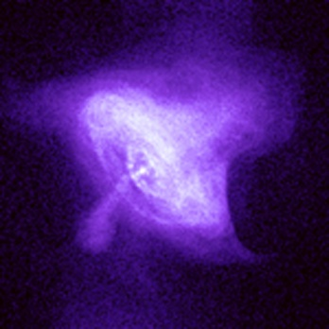
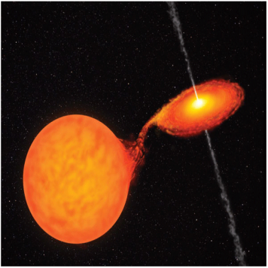
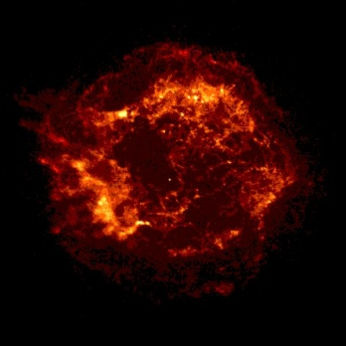
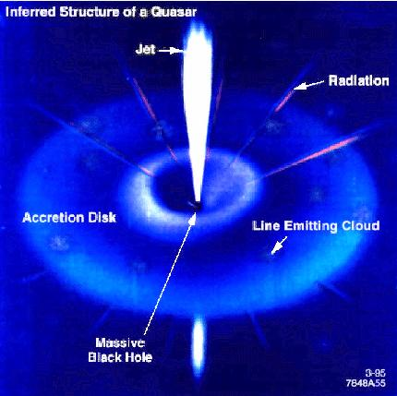
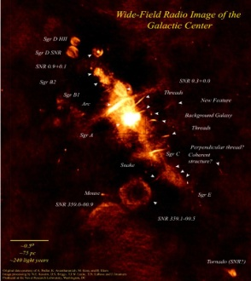
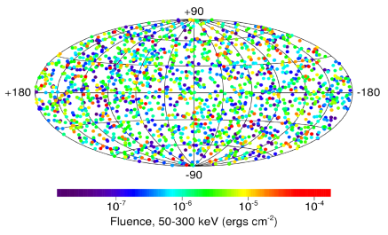
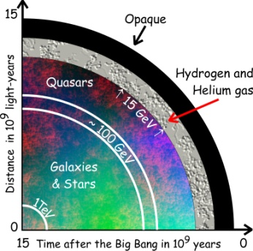
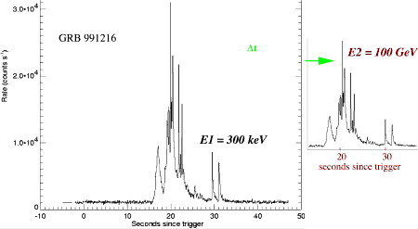
The VHE γ-ray Physics Program
SNRs
Pulsars
Origin of Cosmic Rays
Microquasars
AGNs
GRBs
Cold Dark Matter
cosmological
γ-Ray Horizon
Test of the speed of light invariance

Slide 4
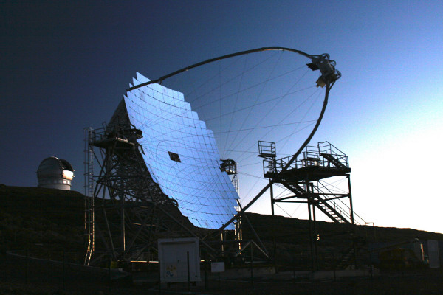
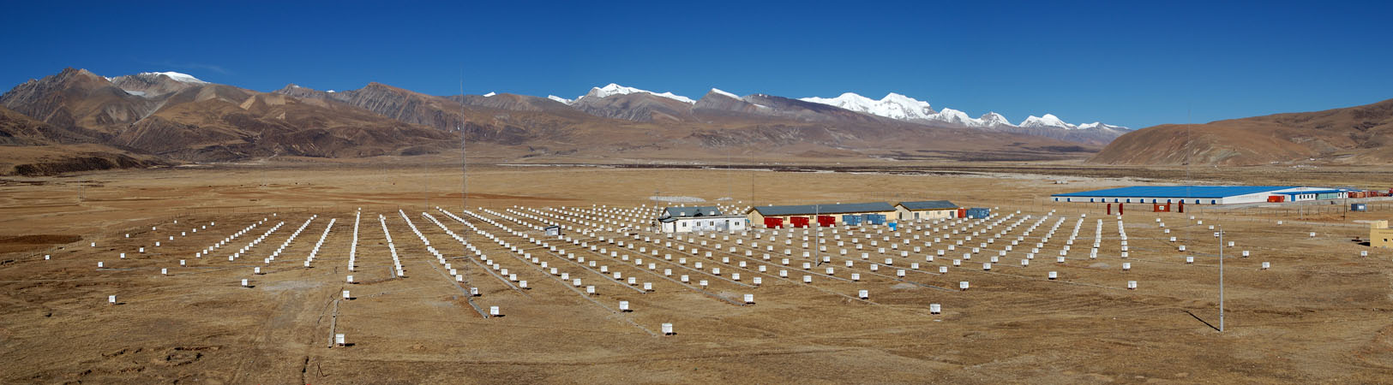
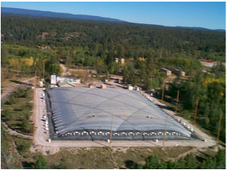
VHE γ-Astronomy: Air Shower Detection
IACTs: H.E.S.S., VERITAS, MAGIC, …
  fair angular resolution (~0.1°);
  good background rejection power;
  short duty cycle (10%);
  narrow FOV (<5°);
Mainly focus on deep observation.
Ground particle array: ASγ, ARGO-YBJ, Milagro, …
  not-so-good angular resolution (~0.5°);
  not-so-good background rejection power (much improved by Water Cherenkov)；
  full duty cycle (>95%，10× IACT);
  Wide FOV（>2/3π，150× IACT);
Good at sky survey, extended sources, flares.

Slide 5
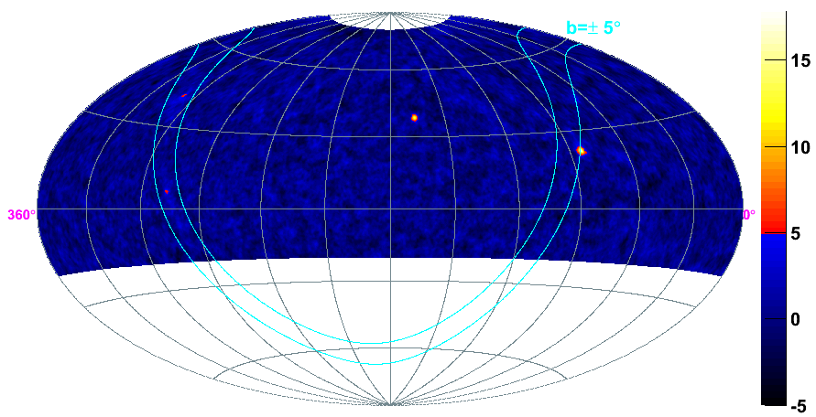
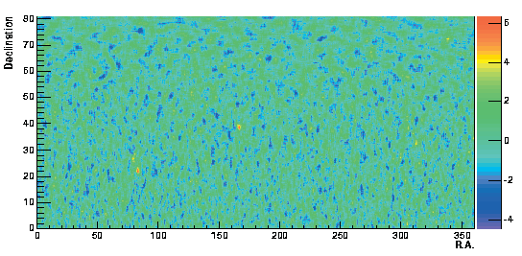
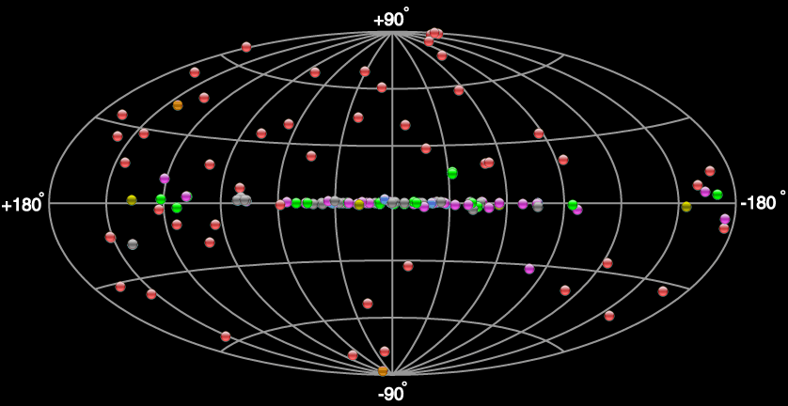
VHE γ-Sky
MILAGRO
ARGO-YBJ
~0.3 CRAB (ARGO, integral);
Limited by sensitivity: detected 4 galactic and 2 extra-galactic sources.
➔If the sensitivity is 10× improved (e.g., <0.06 CRAB), much more sources would be detected.
143 sources, 60% extra-galactic.

Slide 6
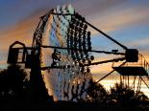
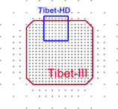
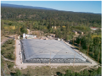

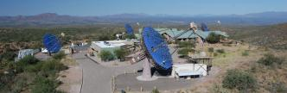
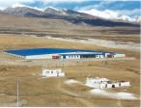
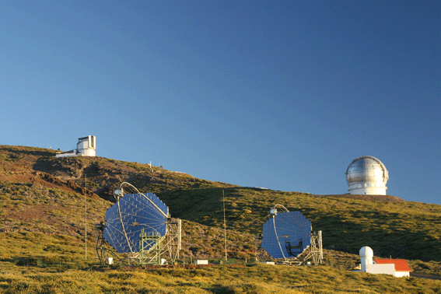
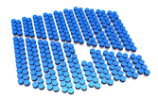
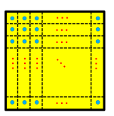
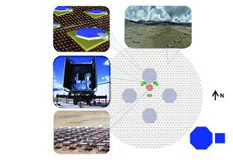
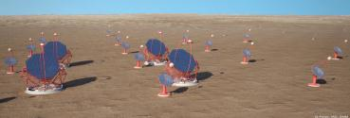
VHE γ-Astronomy
Pointing 10-20× difference! Survey
past, present & future
Whipple
0.2 Crab
1980
Tibet-ASγ
1.5 Crab
Crab detected!
1989
HEGRA, CANGAROO
2001
Milagro
0.9 Crab
H.E.S.S.
0.008 Crab
2004
VERITAS
0.008 Crab
ARGO-YBJ
0.6 Crab
2007
MAGIC
0.02 Crab
2009
10 years delay!
6 Sources
2012
143 Sources
HAWC
0.06 Crab
LAWCA
0.06 Crab
2015
CTA
0.001 Crab
LHAASO-WCDA
0.02 Crab
201?

Slide 7
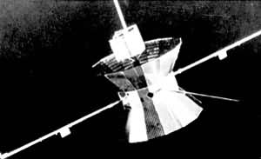
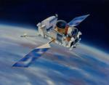
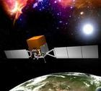
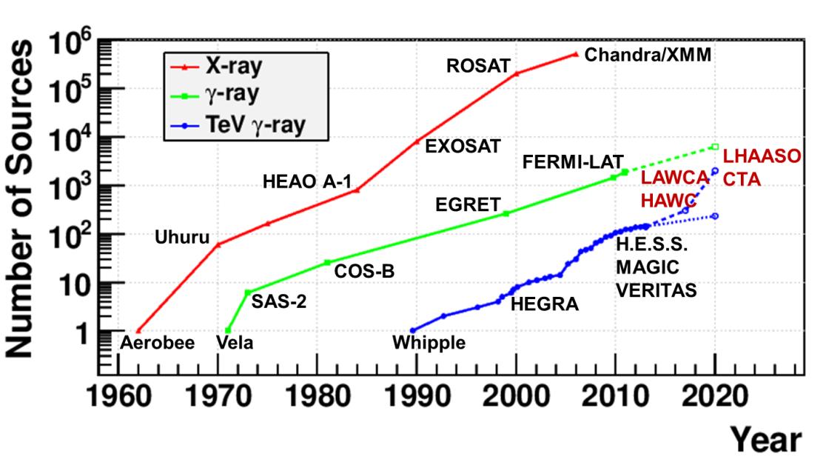
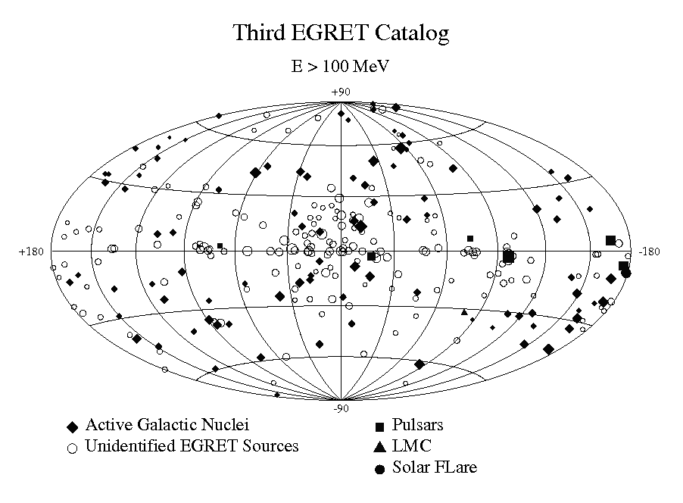
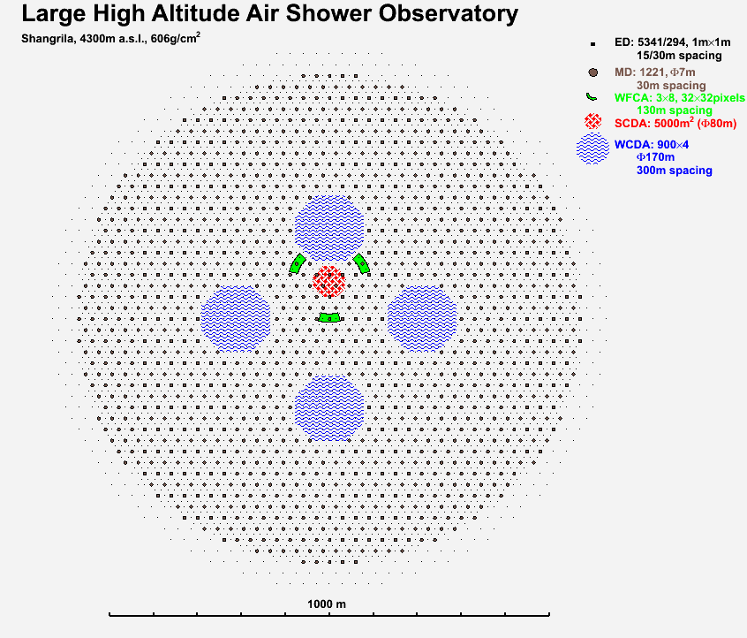
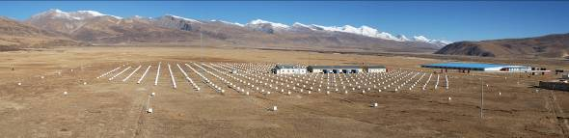

Slide 8
Detector Design

Slide 9

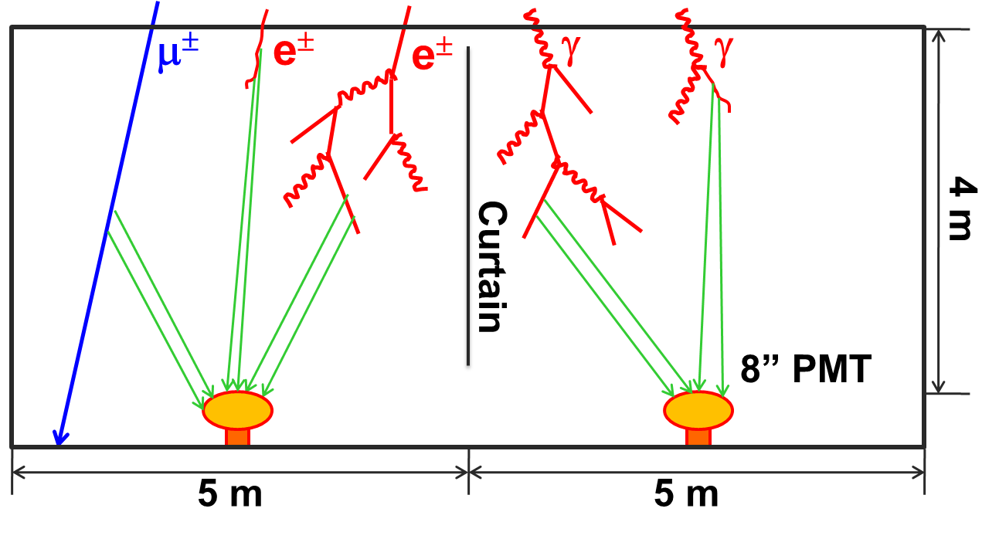
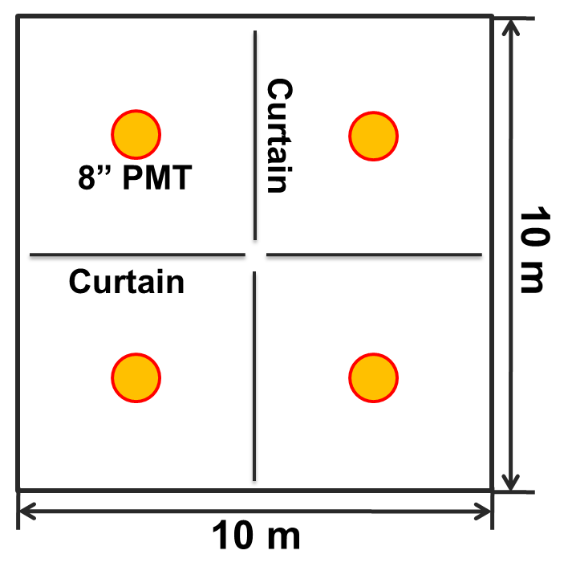
Detector Layout
An L-shaped water pool:
  North-East of ARGO-YBJ hall;
  23,000 m²;
  4.5 m depth;
  916 cells, with an 8” PMT in each cell;
  Cells are partitioned with black curtains.

Slide 10
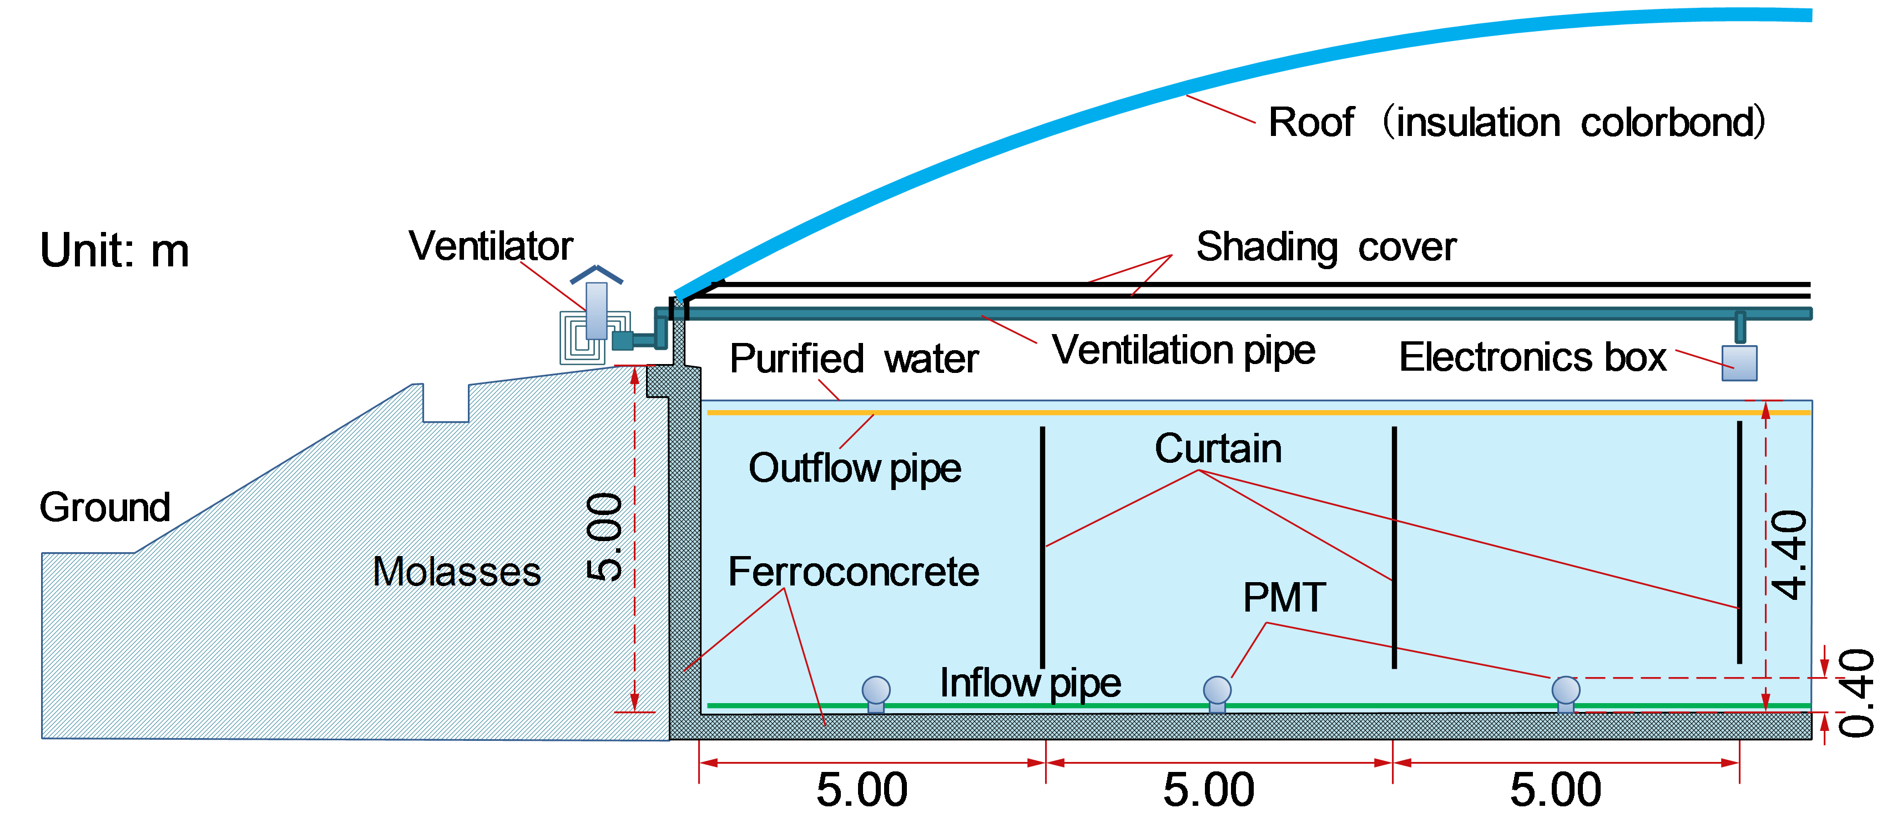
Water Pool
Requirements:
  water-proof: loss <1/1000 volume/day;
  light-proof: luminous flux (300-650 nm) <100k photons/m²/s;
  tolerance to snow, rain, wind, dust, earth-quake;
  anti-icing;
  clean water compatible;

Slide 11
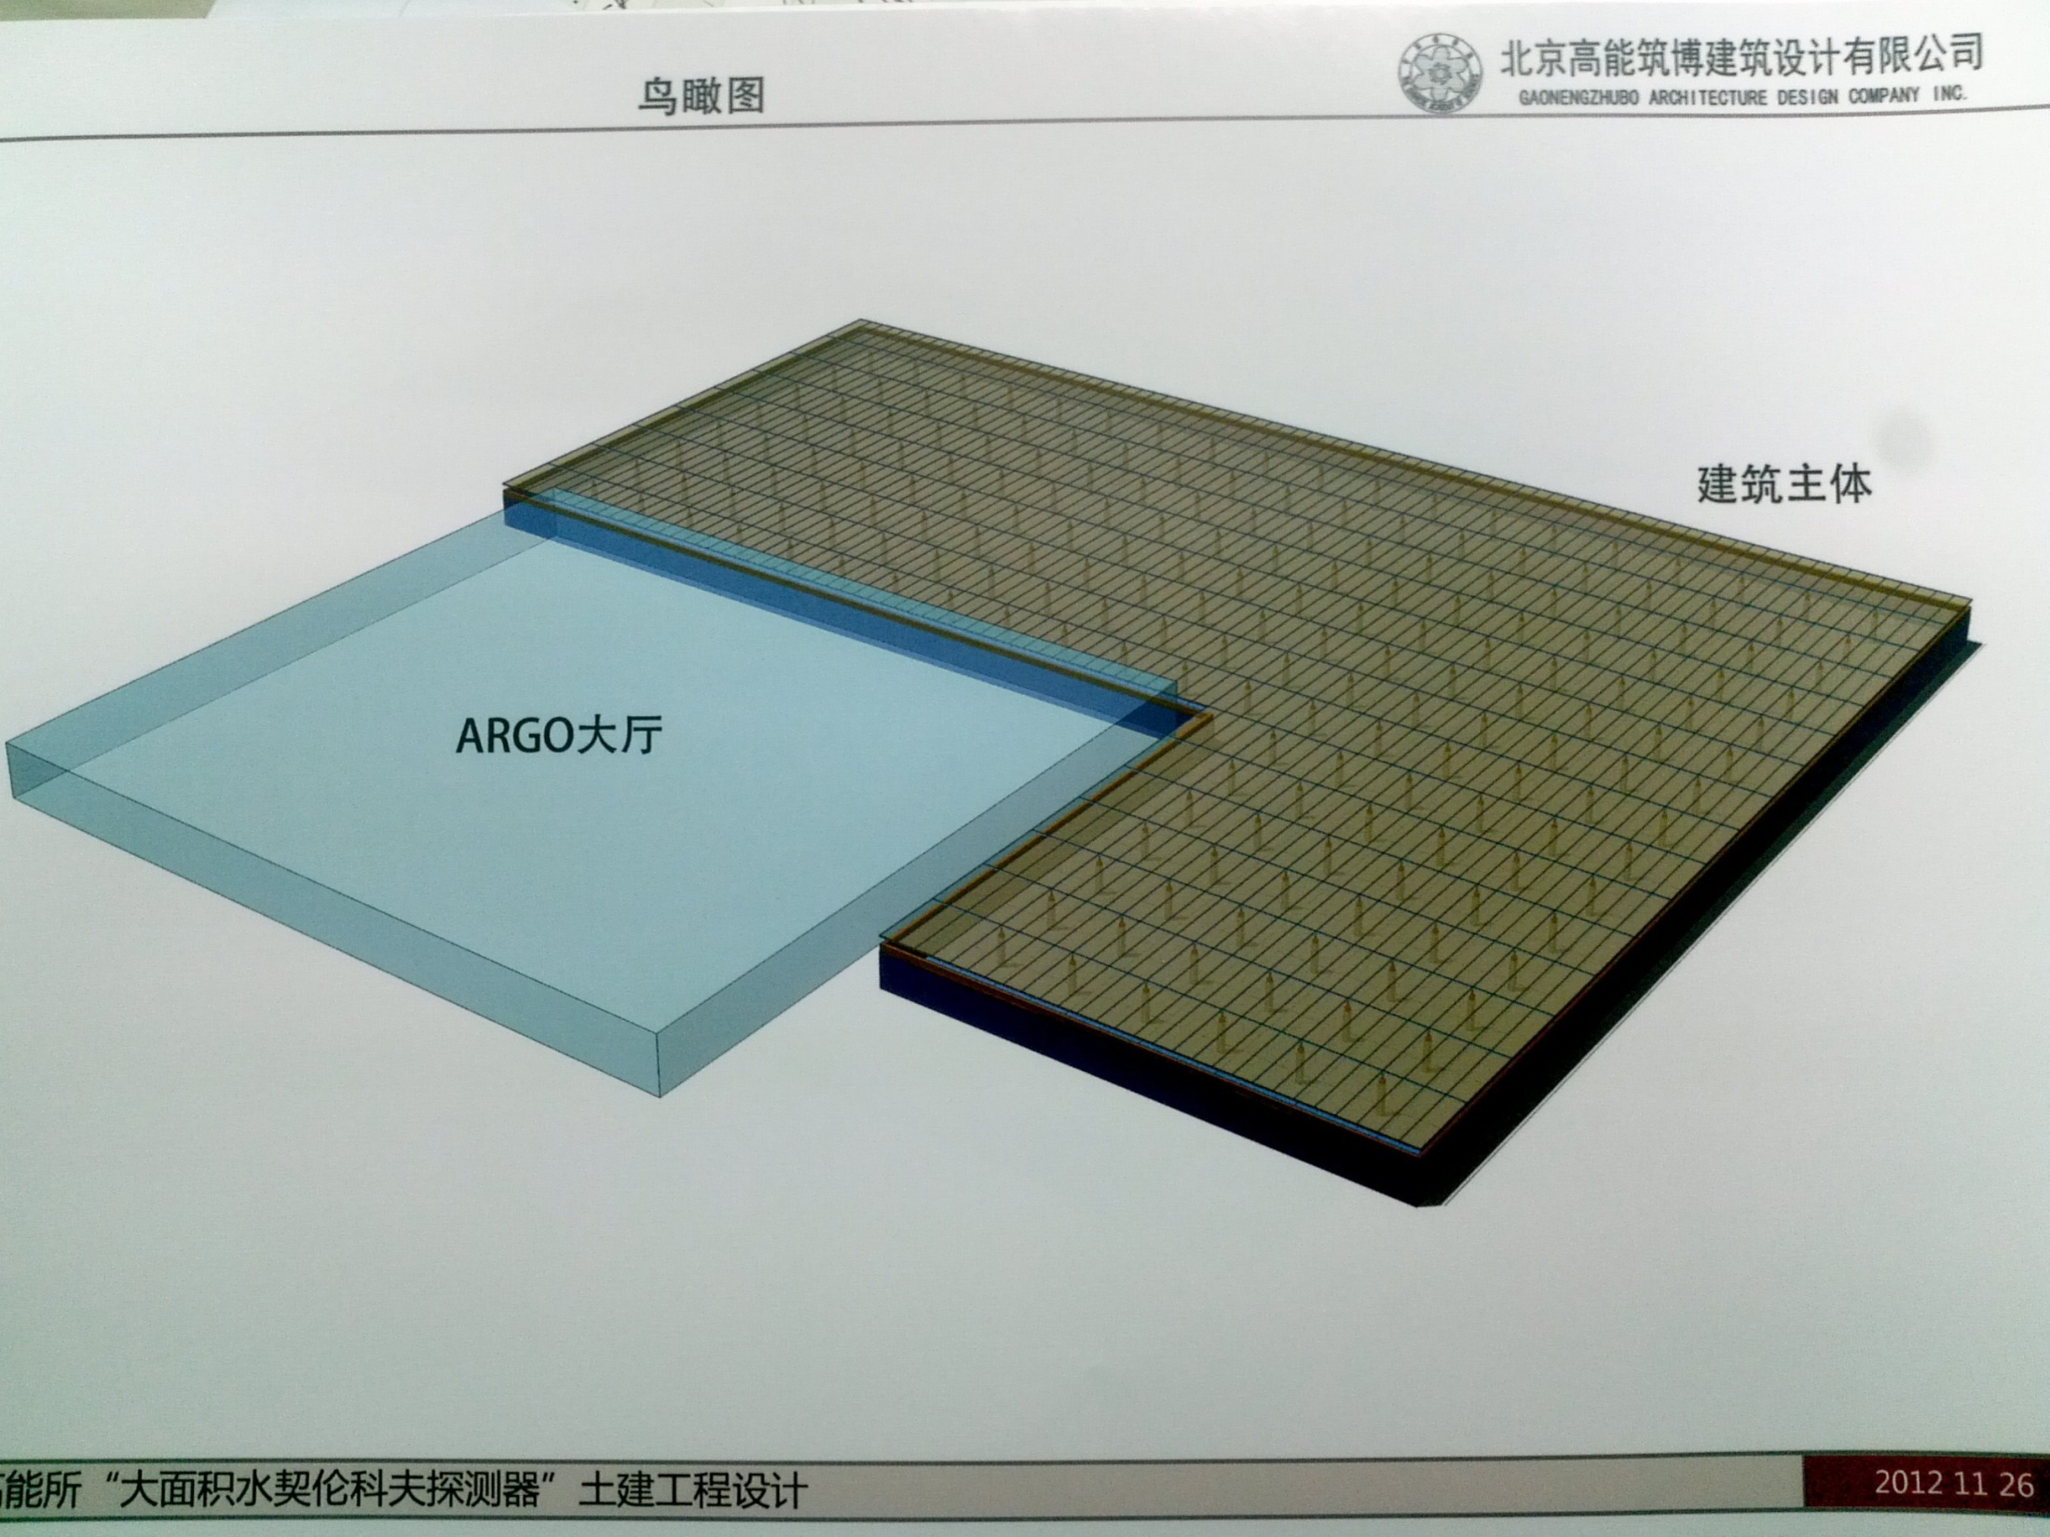

Slide 12
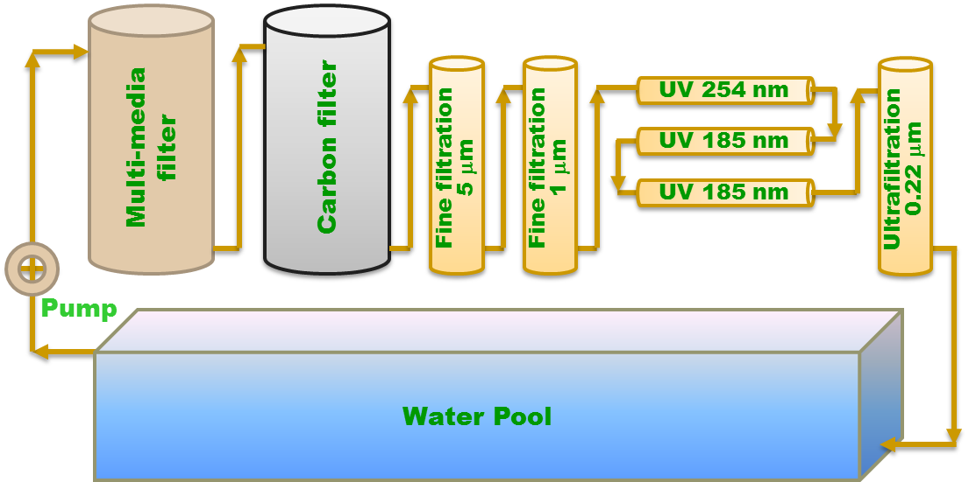
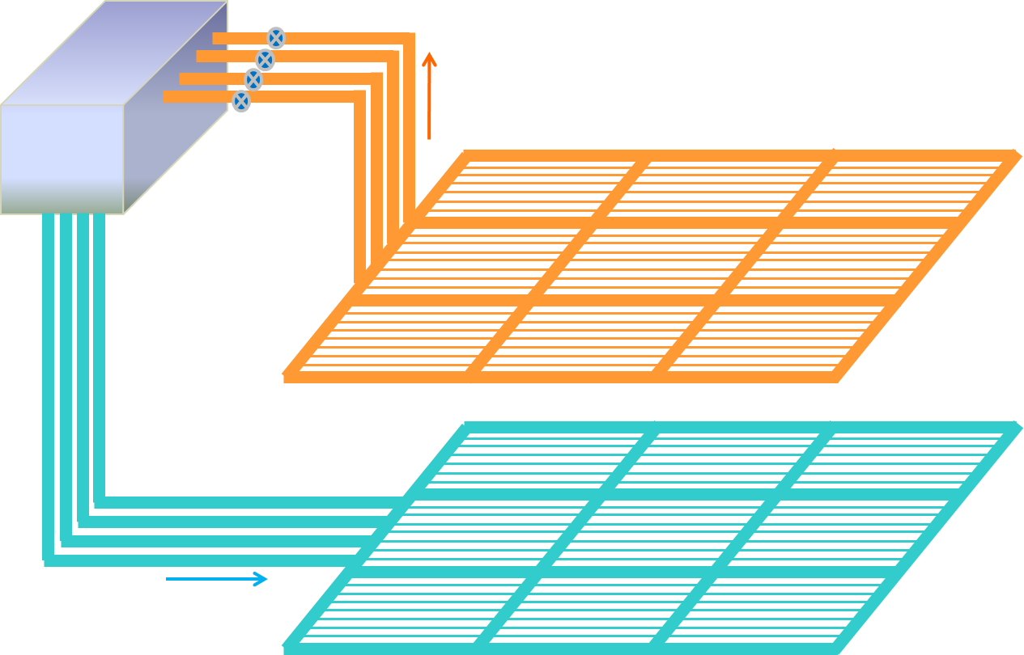
Water Purifying & Circulation
Purifying:
  Absorption length >30 m @ 400 nm;
Water in pool:
  Absorption length >20 m @ 400 nm;
  Uniformity: >85%.
Circulation speed:
  30 days per pool volume.

Slide 13
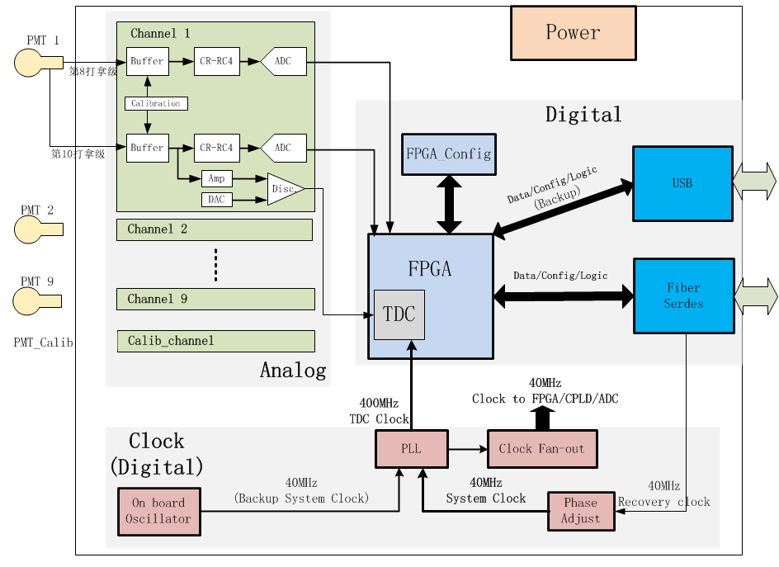
Electronics
Charge: analog shaping, digital peak detecting;
Timing: pulse front discrimination;
9 PMTs share 1 FEE board;
FEEs are synchronized with central station via White Rabbit protocol;
Hit signals are transferred to the central DAQ system via TCP/IP network, shared with WR;
DAQ: based on Atlas TDAQ software framework (soft trigger compatible).
DY8
DY10

Slide 14
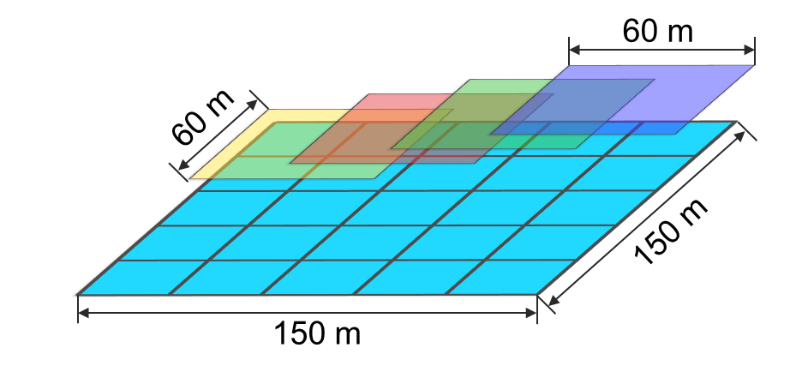
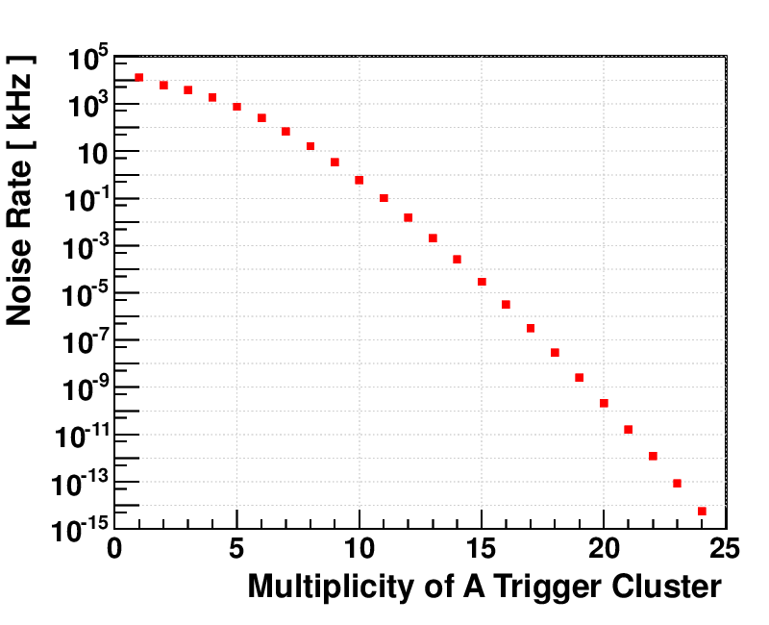
Trigger
Cluster-based;
Neighboring clusters are half-overlapped;
Pattern:
  Multiplicity during 250 ns of any cluster ≥12;
  Noise trigger <1 kHz.
Hardware trigger has been designed as backup, while trigger will performed offline.
Noise trigger

Slide 15
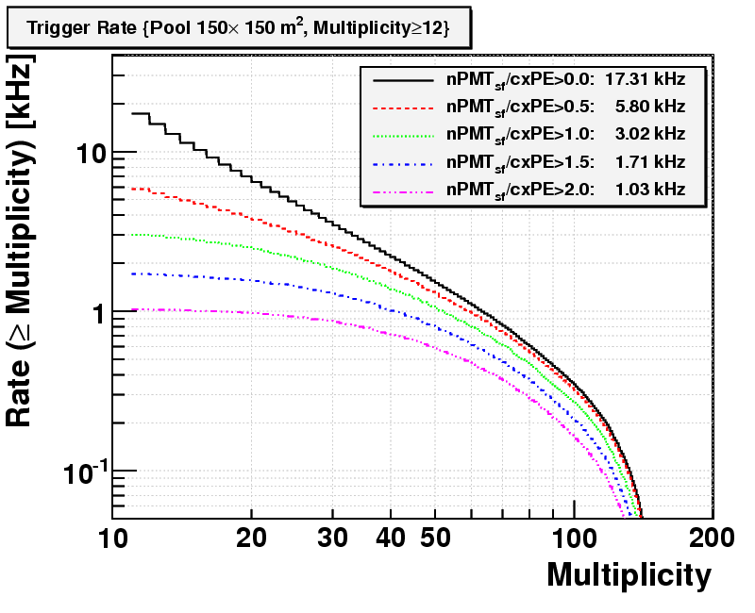
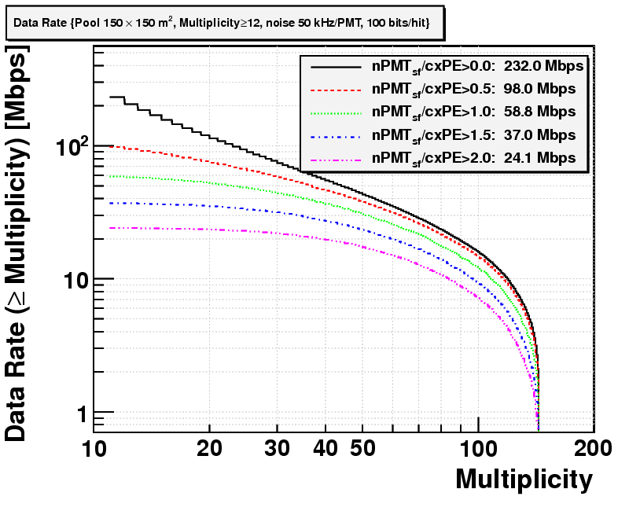
Trigger Rate & Data Volume
Trigger rate:
  ~17 kHz.
Data volume after trigger:
  240 Mbps = 1 PB/year.
DAQ data volume (soft triger):
  4.6 Gbps = 18 PB/year.
Trigger rate
    Huge amount of data: an online- reconstruction solution is under investigation.
Data volume

Slide 16
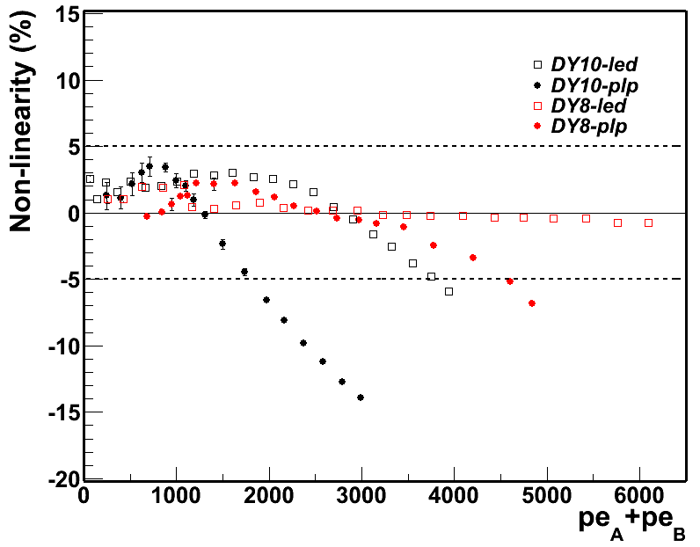
PMT Readout
Tapered voltage divider circuit;
A specialized decoupling circuit to reduce the effect of charge piled-up;
Two dynode outputs set for SPE resolution and dynamic range;
Dynamic range 1-4000 PE can be achieved with non-linearity<5%.

Slide 17
Calibration
Water attenuation length
Detector units
  Time
    LED+Fiber
    Characteristic plane method
  Charge: SPE (HG) , muon peak (LG), overlap
Array
  Geometric pointing: shadow of the sun/bright star (<0.02º)
  Pointing: moon shadow
  PSF: moon shadow (cosmic ray), Crab Nebula (gamma)
  Shower energy: moon shadow (cosmic ray), Crab Nebula (gamma)
Cross check with ARGO-YBJ (event by event)

Slide 18
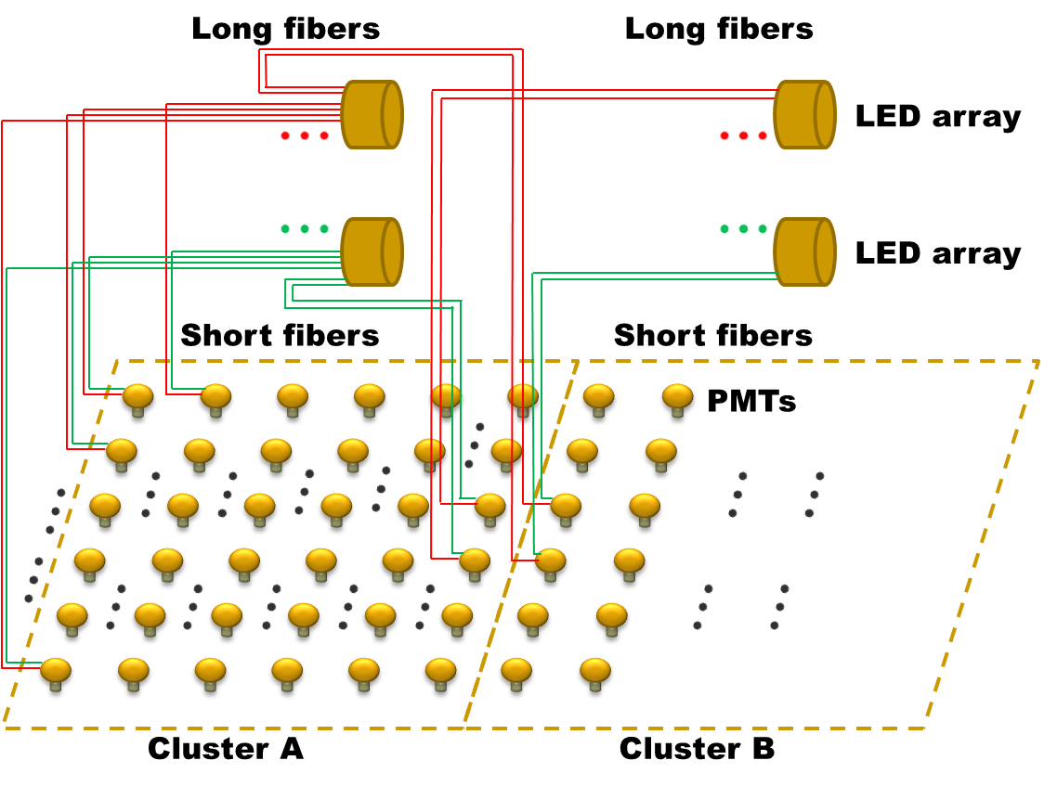
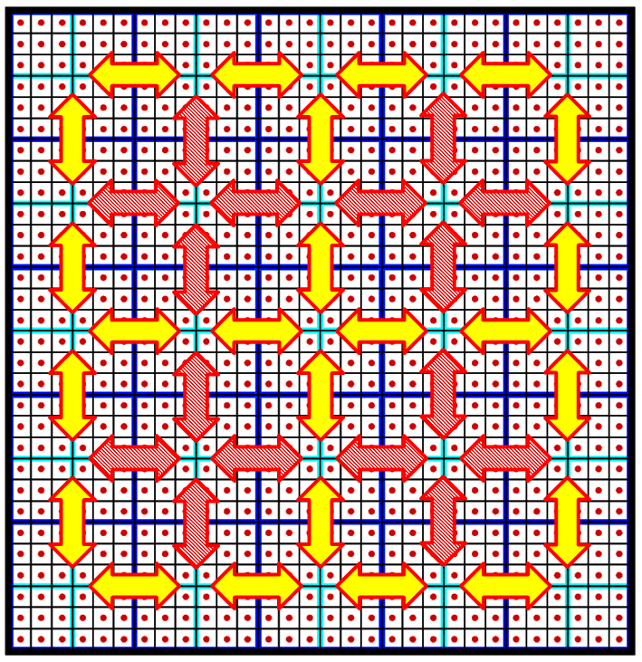
Time Calibration
Cluster-based, cross-calibrated:
  2 fibers per PMT (naming: short & long);
  2 LEDs per cluster;
  2-4 fibers are crossed among neighboring clusters;
  Frequency of LED pulsing: 5-10 Hz.
Requirements:
  Time offset measurement: ~0.1 ns.

Slide 19
Performances and Physics expectations

Slide 20
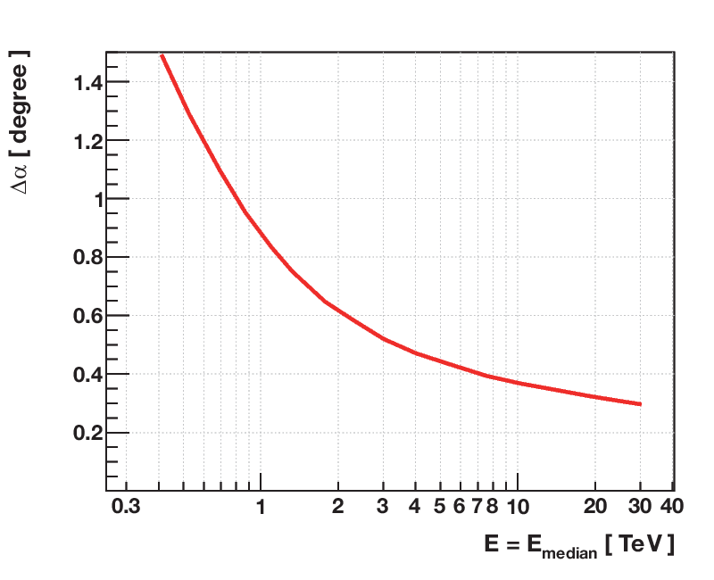
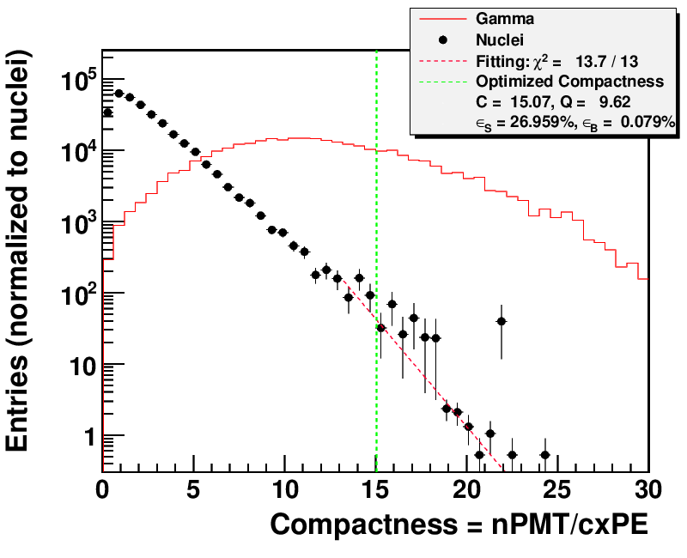
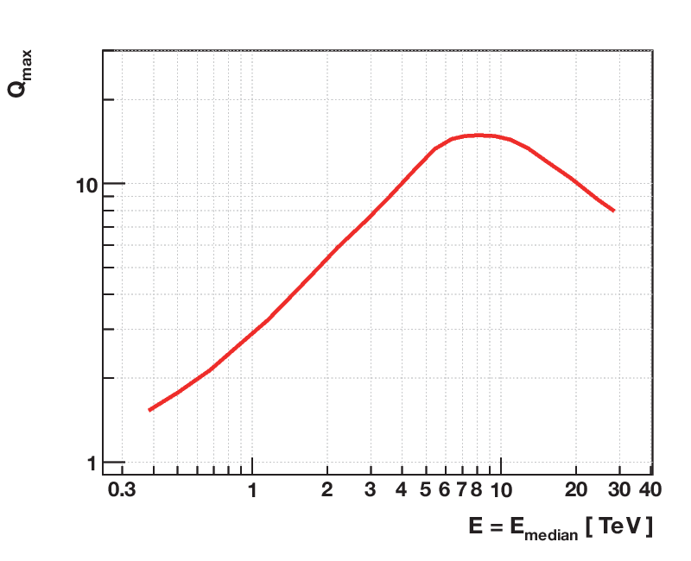
Angular Resolution & Background Rejection
Good angular resolution:
  Optimized bin size: 0.85° @ 1 TeV; 0.45° @ 5 TeV.
Fair background rejection power:
  Q-factor: 3 @ 1 TeV; 14 @ 5 TeV.

Slide 21
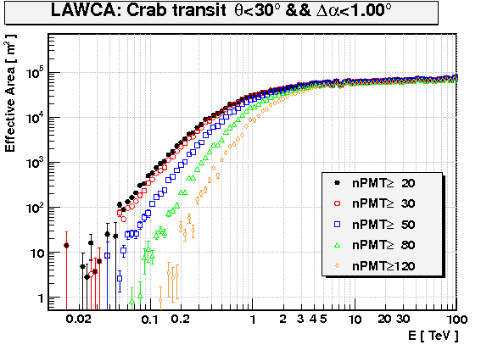

Effective Area & Sensitivity
Effective area:
  500 m² @ 100 GeV;
  30,000 m² @ 1 TeV;
  60,000 m² @ 5 TeV.
Sensitivity:
  0.1 CRAB @ 1 TeV;
  0.06 CRAB @ 5 TeV。
  ~10x better than ARGO-YBJ.
4个¼ 阵列

Slide 22










Physics Goals
VHE gamma sky survey (100 GeV-30 TeV):
  Extragalactic sources & flares;
  VHE emission from Gamma Ray Bursts;
  Galactic sources;
  Diffused Gamma rays.
Cosmic Ray physics (1 TeV-10 PeV):
  Anisotropy of VHE cosmic rays;
  Cosmic electrons / positrons;
  Cosmic ray spectrum;
  Hadronic interaction models.
Miscellaneous:
  Gamma rays from dark matter;
  Sun storm & IMF.

Slide 23

LAWCA@TeV Sky Survey
---Discovery of VHE γ-sources (especially transient and extended)
Detection of Crab Nebula in 1 day
Reaching 30% Icrab in 10 days
  ARGO-YBJ accumulative sensitivity
Reaching 10% Icrab in 90 days → discovery?
ARGO sky map in 3 years
LAWCA one week!

Slide 24




Extended Sources
MGRO J1908+06
MGRO J2031+41
Suffered from the narrow FOV, background estimation may be problematic.
  lower flux measurement?
For big extended sources (>0.1°), the sensitivity of IACT turns worse; But no problem with Ground particle array;
➔Ground array works well on extended sources.
HAWC Expectation

Slide 25


Flares (AGN/GRB)
ARGO-YBJ
MKN 421
MKN 501
Time & position is not predictable: difficult for IACT to detect;
IACT’s following-up observation with other wavelenghths:
  But, more failure than success;
  In addition, only <1/2 flares is away from Sun;
  Furthermore, the population is biased.
Ground particle array can do better job!
Feb 16
Apr 28

Slide 26


LAWCA@Transient sources
Real time alarm
Light curve: day→hour
Whipple+VERYTAS
ARGO
Mrk421
RXTE/ASM

Slide 27
Improvements by ARGO
Improvement in sensitivity:
  ARGO will become a standard (even better) “water Cherenkov detector” with an area of >5500m² (a Q factor of >1.2 for LAWCA), a Q factor of >10 for ARGO@1.6TeV→~0.07 Icrab.

Slide 28
Improvements by ARGO
Better energy resolution: to see, to measure
  Events with core inside ARGO
  Events with core inside LAWCA: ARGO external showers with known core location
SED of sources and flares
Anisotropy vs. energy
Moon and sun shadows
Geomagnetic storm
Cosmic rays
…

Slide 29
Complementary with HAWC
Latitude: 30ºN (LAWCA) vs. 19ºN (HAWC)
  Sky coverage overlaps, cross-check
Longitude: 91.5ºE (LAWCA) vs. 97.3ºW (HAWC)
  Relay observation to transient phenomenon

Slide 30
Prototype Detector and Array

Slide 31





Prototype Detector (2009-2010)
2 layers of 1 m×1 m Scintillators
5 m
7 m
Single rate: 16 kHz
➔ 30-50 kHz (4300 m a.s.l.)
1 layer of 1 m×1 m Scintillator
μ-peak is first observed.

Slide 32







Engineering Array (2010-now)
9 cells, effective area 225 m².

Slide 33






Installation
2011/03: dry run
2011/07: wet run
12 TB test and physics data obtained so far.

Slide 34




Charge Calibration: SPE
Variation in a month
Fitted with a convolution of power law ⊗ Poisson ⊗ Gaussian + SPE noise
Method: single rate
  ~50 kHz;
  SPE signal dominated;
  Including PMT Gain + cable + pre-amp + electronics HG;
Precision:
  2% per 30 seconds;
  Real time (hardware trigger): 2% per 30 minutes.
Consistent with PMT temperature effect

Slide 35



Charge Calibration: High Range
Variation in a month
Method: muon peak
  ~10 Hz;
  muons hitting the photo-cathod;
  PMT gain + QE + CE + cable + pre-amp + electronics LG.
Precision:
  2% per 30 minutes;
  Real time (hardware trigger): 2% per day.
Consistent with PMT temperature effect

Slide 36


Time Calibration: Test Results
Distribution of mean offset, 3 months.
Mean value: 10 minutes @ 5 Hz.
Short fibers of 2 PMTs: σ = 0.07 ns.
Long fibers of 2 PMTs: σ = 0.12 ns.
unit: 5.6 ns

Slide 37










Event Reconstruction and
Offline Coincidence with ARGO-YBJ

Slide 38
LAWCA Schedules
2012 |  |  |  |  | 2013 |  |  |  |  |  |  |  |  |  |  |  | 2014
8 | 9 | 10 | 11 | 12 | 1 | 2 | 3 | 4 | 5 | 6 | 7 | 8 | 9 | 10 | 11 | 12 | 1 | 2 | 3 | 4 | 5 | 6 | 7 | 8 | 9 | 10 | 11 | 12
First
Lights
Start
T1
T2
T3
T4
T5
T6
Run
Land Lease
Field Prep.
Pool construction
Others and
Leak check
(water, light)
Installation of:
PMT (15/day), electronics, calibration,
Slow control,
DAQ
Dry run and debug
Filling and debug
Design
Light & Water-proof
Water recycling group: water recycling system
Operation
group
Detector installation group: detector installation
Slow control group: slow control system
IHEP calibration group: detector calibration
Hamamatsu: PMT production and coating (1/1.5 years)
USTC PMT group: PMT test (16/day)
USTC electronics group: electronics production
IHEP DAQ group: DAQ
IHEP computer center: networking, computing & storage
Software structure, MC and data analysis groups

Slide 39
Summary
A Large Area Water Cherenkov Array is proposed to be built at YBJ in 2 years.
Through hybrid observation with ARGO-YBJ, it will survey the northern hemisphere for new source, filling the time gap before LHAASO and CTA, being at the same time a good complimentary to HAWC
The detector has been designed and partially tested with the prototype and the engineering array.
LAWCA is ongoing as scheduled.

Slide 40


Trigger rate
Trigger rate at different multiplicity can be roughly re-produced by simulations;
The simulation rate is 35-50% lower than data:
  Only proton, Helium are simulated

