Slide 1
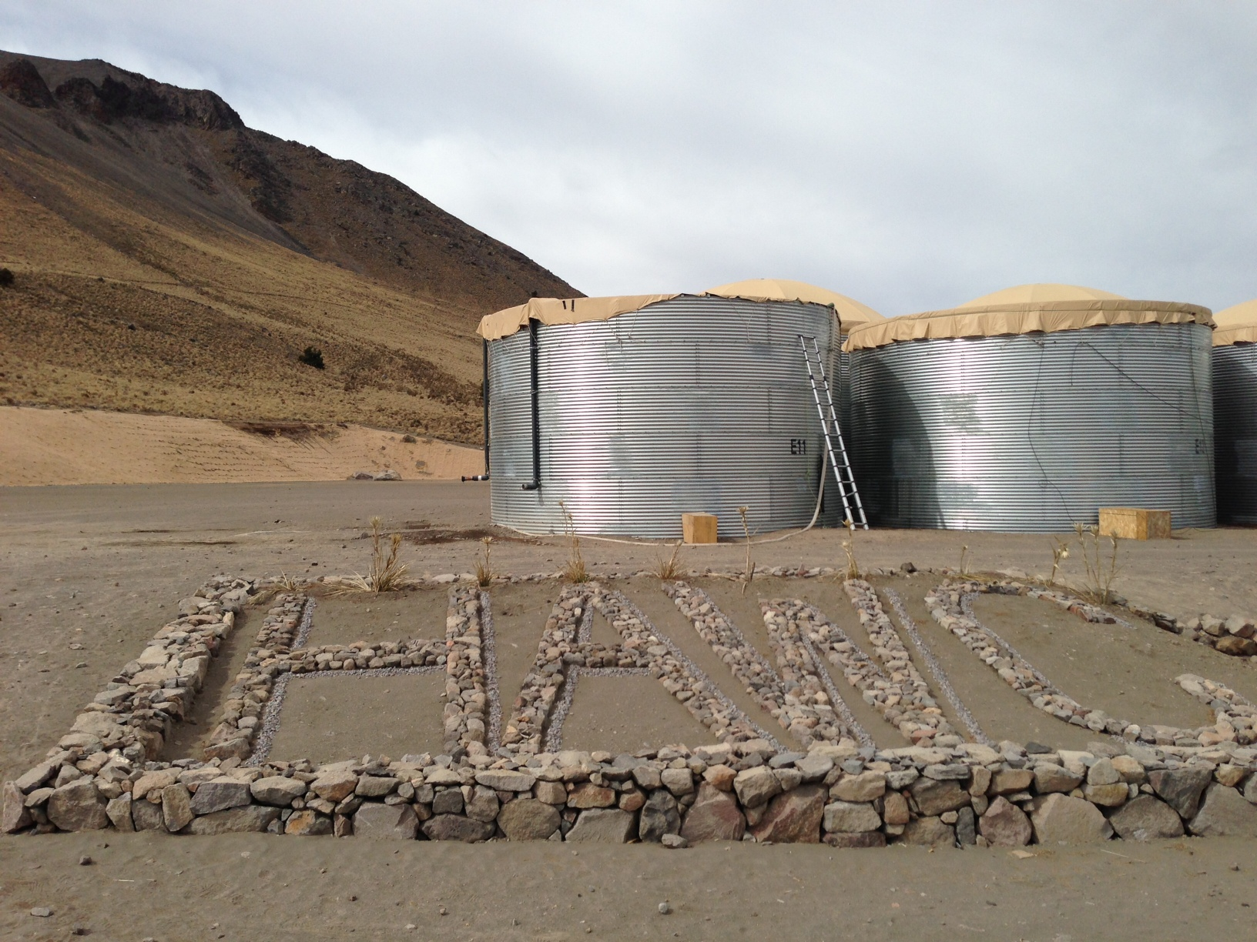
HAWC
(High Altitude Water Cherenkov) TeV Gamma-Ray Observatory
Andrew Smith
University of Maryland

Slide 2
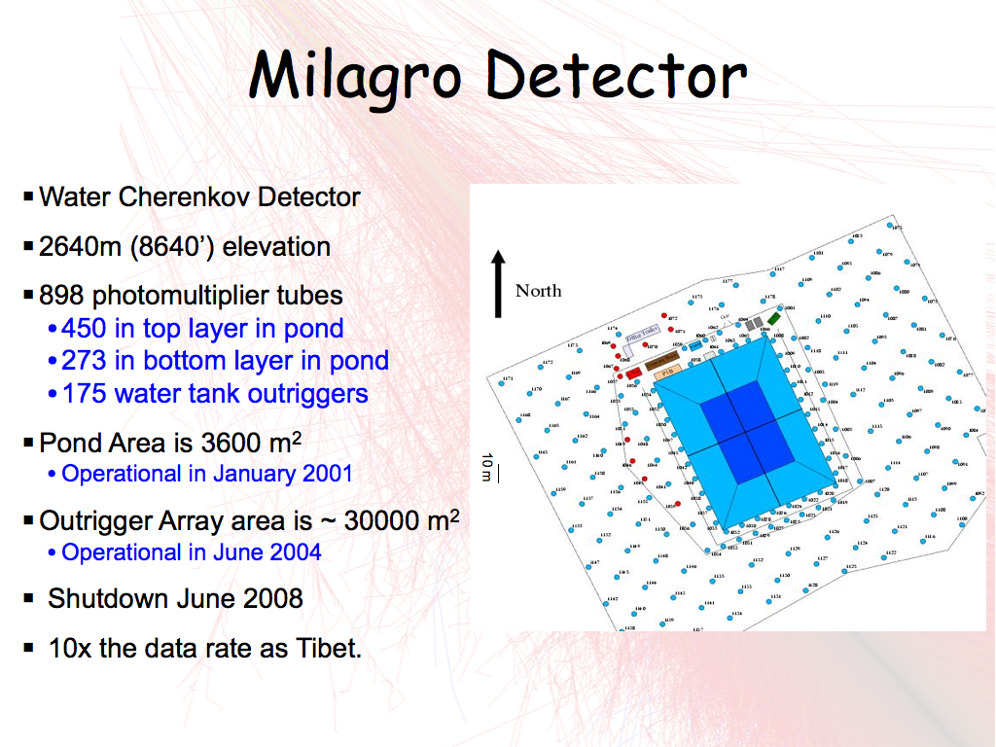

Slide 6
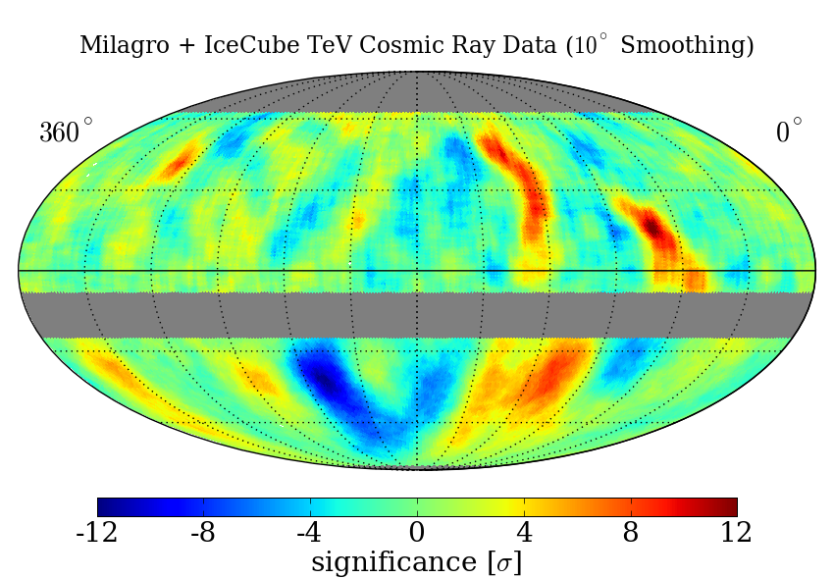
CR Anisotropy
Milagro Observed Anisotropy in ~10 TeV Cosmic Rays
Localized excess of ~ 5º (15σ) of hadronic cosmic rays (7σ)
Explanations are difficult due to Gyroradius of 10TeV proton in 1μG field is 0.01parsecs=2000 AU
Solar effect? Propagation effect? Unknown nearby source?
Abdo, et al. PRL, 2009
R. Abbasi, et al., ApJ 2011

Slide 7

Milagro shutdown on 15 March 2008
“Ides of March”
2052 years after Julius Caesar

Slide 8
Milagro TO HAWC
Milagro is too low (2650m)
Can improve detector response with PMT optical isolation.
Gamma/hadron separation depends on a large deep area. Need larger deep
Reuse some Milagro parts. PMTs, electronics.
Milagro:
2650m a.s.l.
3600m² pond area
2500m² deep area
Outrigger array to 30,000m²
HAWC:
4100m a.s.l.
20,000m² array area
Whole detector 4m deep
Detector large enough, no outriggers needed.

Slide 9
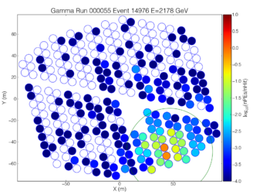
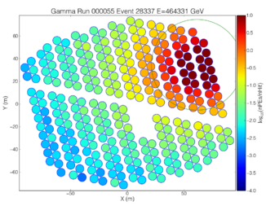
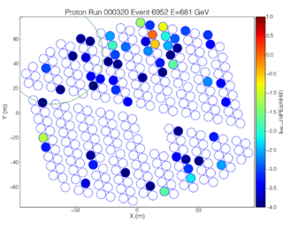
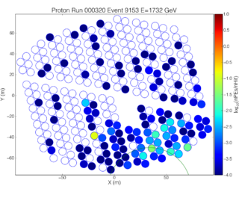
Gamma/Hadron Separation
gammas
gamma
hadrons
Separation Parameter: N_{hit}/(Max Hit in PEs w/R_{core}>40m)
γ
γ
γ
γ
γ
γ
γ
γ
γ
γ
γ
γ
γ
γ
γ
γ
γ
γ
γ
γ
γ
γ
P
P
P
P
P
P
P
P
P
P
P
P
P
P
P
P
P
P
P
P
P
P

Slide 10
HAWC Performance
Much Better Low Energy Response
Much Better Background Rejection
(b)
(a)
HAWC
Milagro
Milagro
HAWC
Milagro
Much Better Angular Resolution
HAWC
Milagro
(d)
Better Energy Resolution
(c)
HAWC

Slide 11
HAWC Performance at 2 TeV
HAWC
(b)
(a)
7X
HAWC
10X
Milagro
Milagro
HAWC
Milagro
2.5X
2X
HAWC
Milagro
(d)
HAWC
(c)
HAWC

Slide 12
HAWC Differential Sensitivity
(Flux per ¼ decade for 5 σ detection)
Insufficient simulated hadronic data at highest energies to know the hadron rejections above 10 TeV

Slide 13
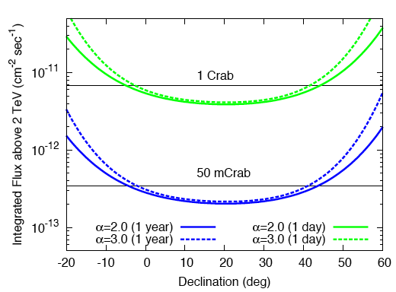
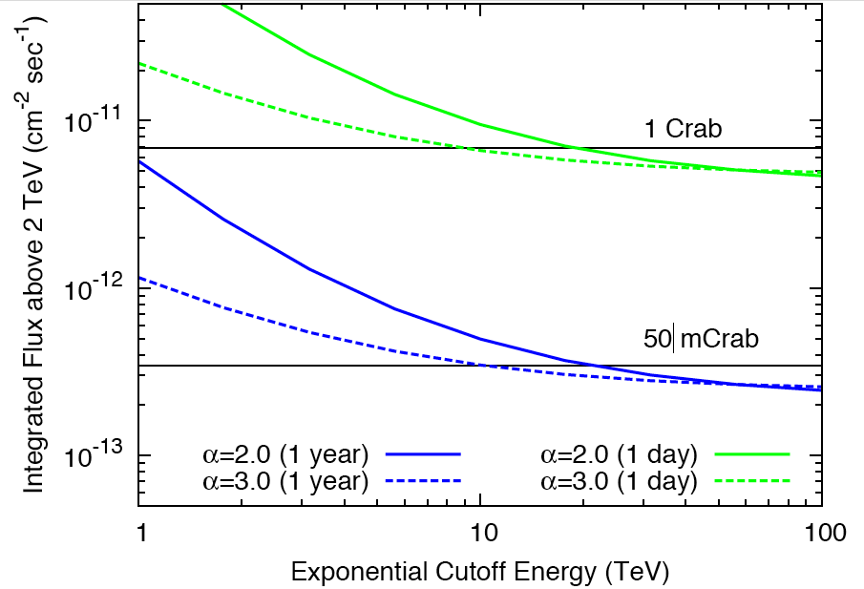
HAWC Integral Sensitivity
Flux (E>2TeV) for 5-sigma vs. Declination, 1 day and1 year
Flux (E>2TeV) for 5-sigma vs. Cut off Energy, 1 day and1 year

Slide 14
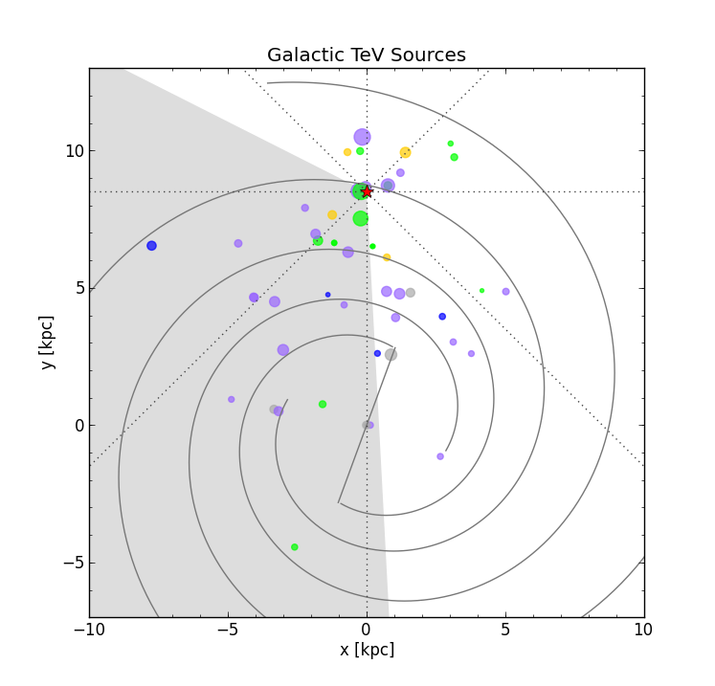
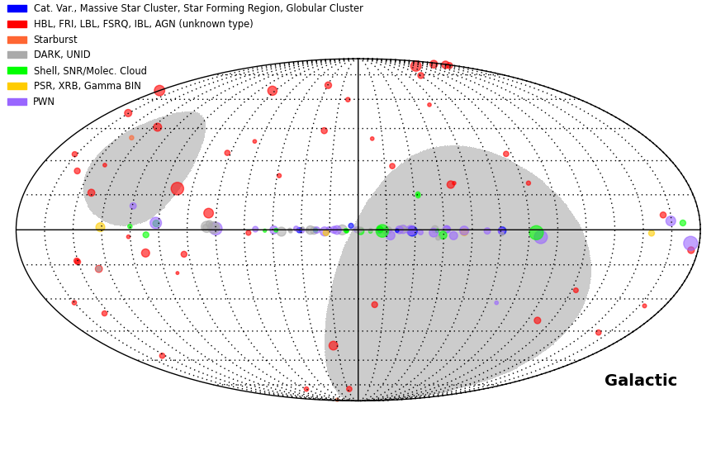
Known TeV Sources in HAWC FOV
And most of the high latitude sky has not been observed at TeV energies
White is within 45º of HAWC’s Zenith
From TeVCAT.uchicago.edu plotted by Segev BenZvi

Slide 15
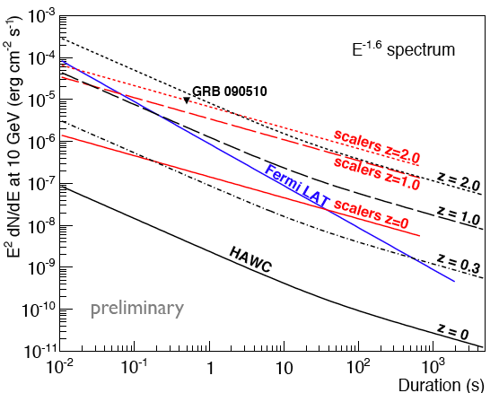
HAWC GRBs Sensitivity
Fermi LAT sensitivity assumes 1 gamma-ray > 10 GeV
Scaler sensitivity uses sum of single photoelectron rates in individual PMTs to observe shortest and most distant transients
Assume cutoff due to Extragalactic Background Light (Gilmore, 2009)
Abeysekara et al., Astroparticle Physics, 2011

Slide 16
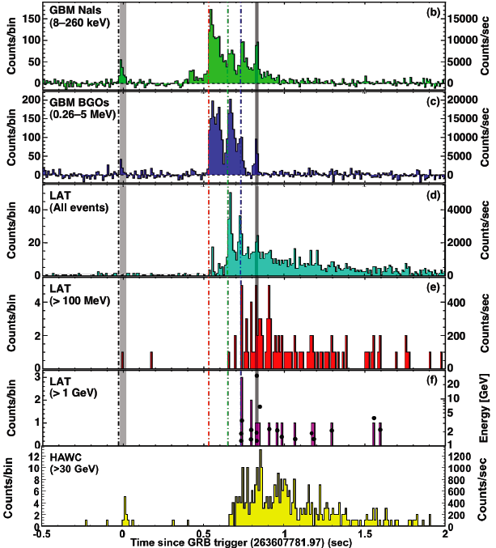
HAWC could detect GRB090510
Fermi observation of GRB090510, z=0.9
Highest Observed Energy
was 33 GeV with
16 γ-rays >1 GeV
HAWC would see hundreds of events from this GRB assuming Gilmore EBL model and internal cutoff at 100GeV.

Slide 17
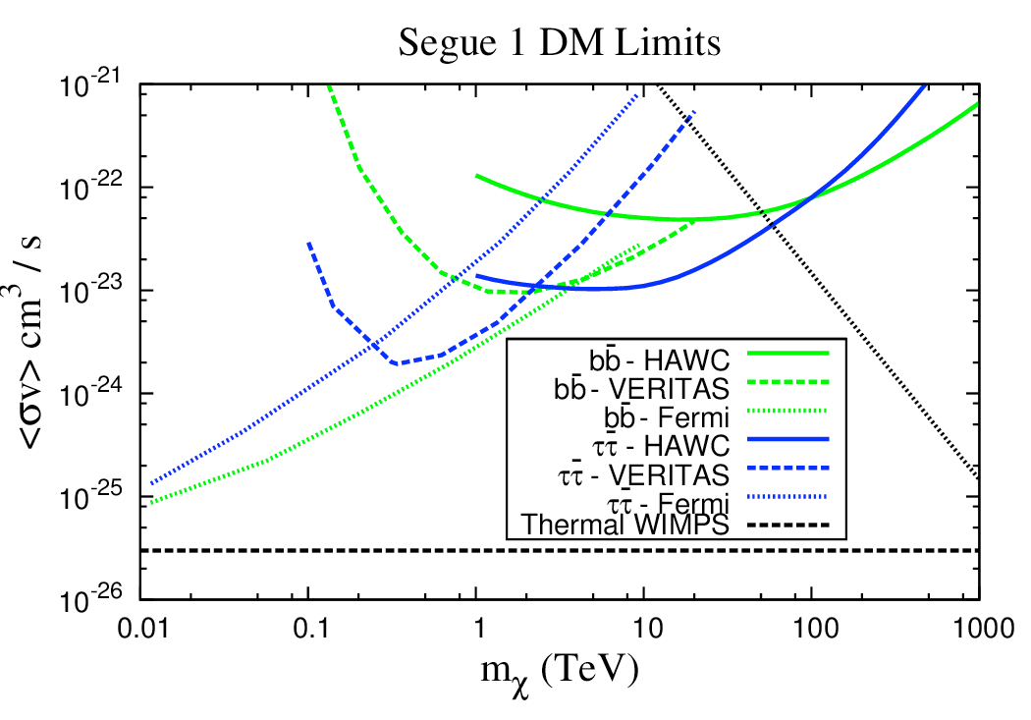
WIMPS
Annihilation of WIMPs produces gamma rays (E continuum and line)
Nearby satellite galaxies have large Mass, but small Luminosity and are thus dark matter rich
  Recently higher M/L galaxies have been found by Sloan Deep Survey
  HAWC will observe all M/L galaxies in half the sky, even if L=0
  HAWC has sensitivity to higher mass WIMPS

Slide 18
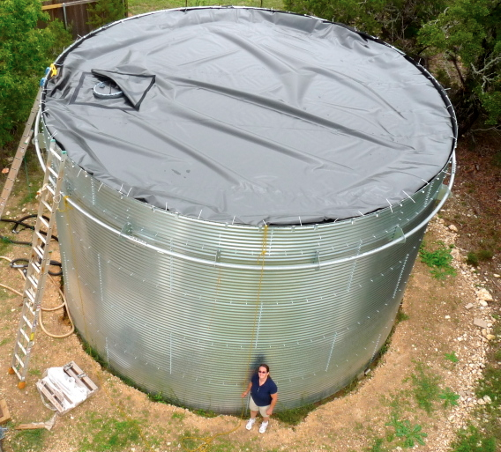
Considered Several Design Options

Slide 19


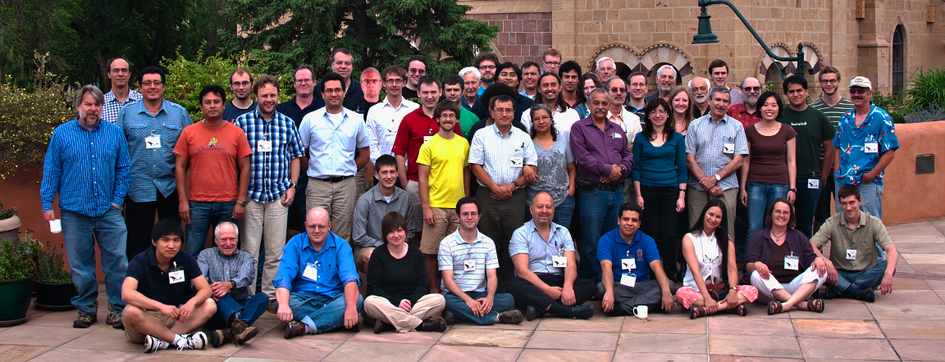
The HAWC Collaboration
Los Alamos National Laboratory
University of Maryland
University of Wisconsin
University of Utah
Univ. of California, Irvine
Michigan State University
George Mason University
University of New Hampshire
Pennsylvania State University
University of New Mexico
Michigan Technological University
NASA/Goddard Space Flight Center
Georgia Institute of Technology
University of Alabama
The Ohio State University
Colorado State University
University of California Santa Cruz
Instituto Nacional de Astrofísica Óptica y Electrónica (INAOE)
Universidad Nacional Autónoma de México (UNAM)
  Instituto de Física
  Instituto de Astronomía
  Instituto de Geofisica
  Instituto de Ciencias Nucleares
Benemérita Universidad Autónoma de Peubla
Universidad Autónoma de Chiapas
Universidad Autónoma del Estado de Hidalgo
Universidad de Guadalajara
Universidad Michoacana de San Nicolás de Hidalgo
Centro de Investigacion y de Estudios Avanzados
Universidad de Guanajuato
145 Members
Mexico
USA

Slide 20
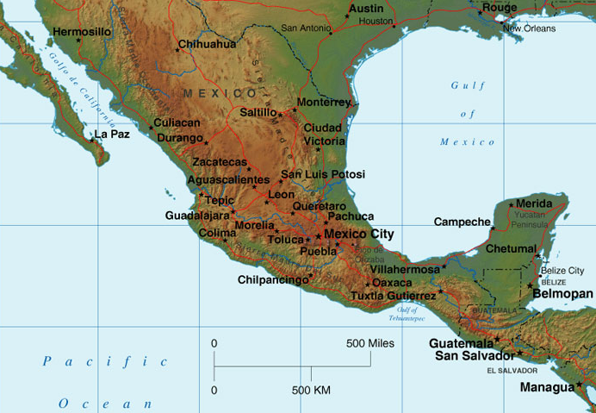
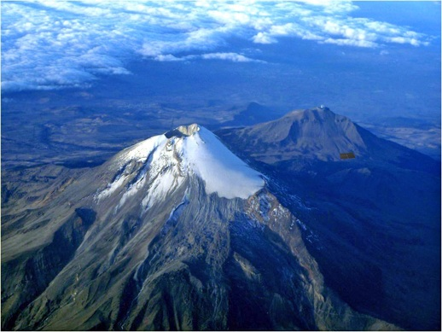
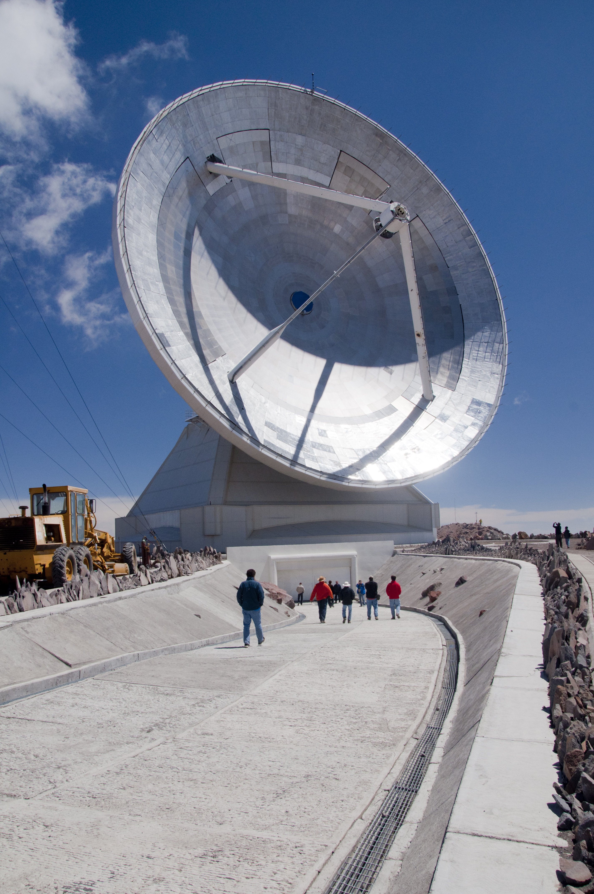
HAWC Site Location in Mexico
4100 m (13,500’) above sea level
Latitude of 19 deg N
Temperate Climate
Existing Infrastructure
HAWC
Large Millimeter Telescope
(50m dia. dish)
Pico de Orizaba 5600 m (18,500’)

Slide 21
Location of HAWC
HAWC

Slide 22
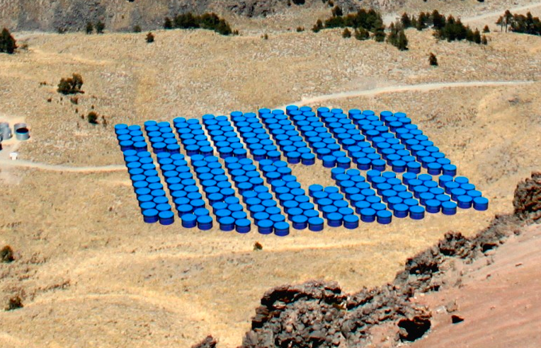
HAWC Design
Instrumented area: ~20,000 m², 63% coverage with water
180 meters
140 meters

Slide 23
Prototype Tank
Dimensions:
7.32m diameter
4.5m depth
189,000 liters/tank
10 X₀
This is a 56 kton
Calorimeter
(larger than Super-K)

Slide 24
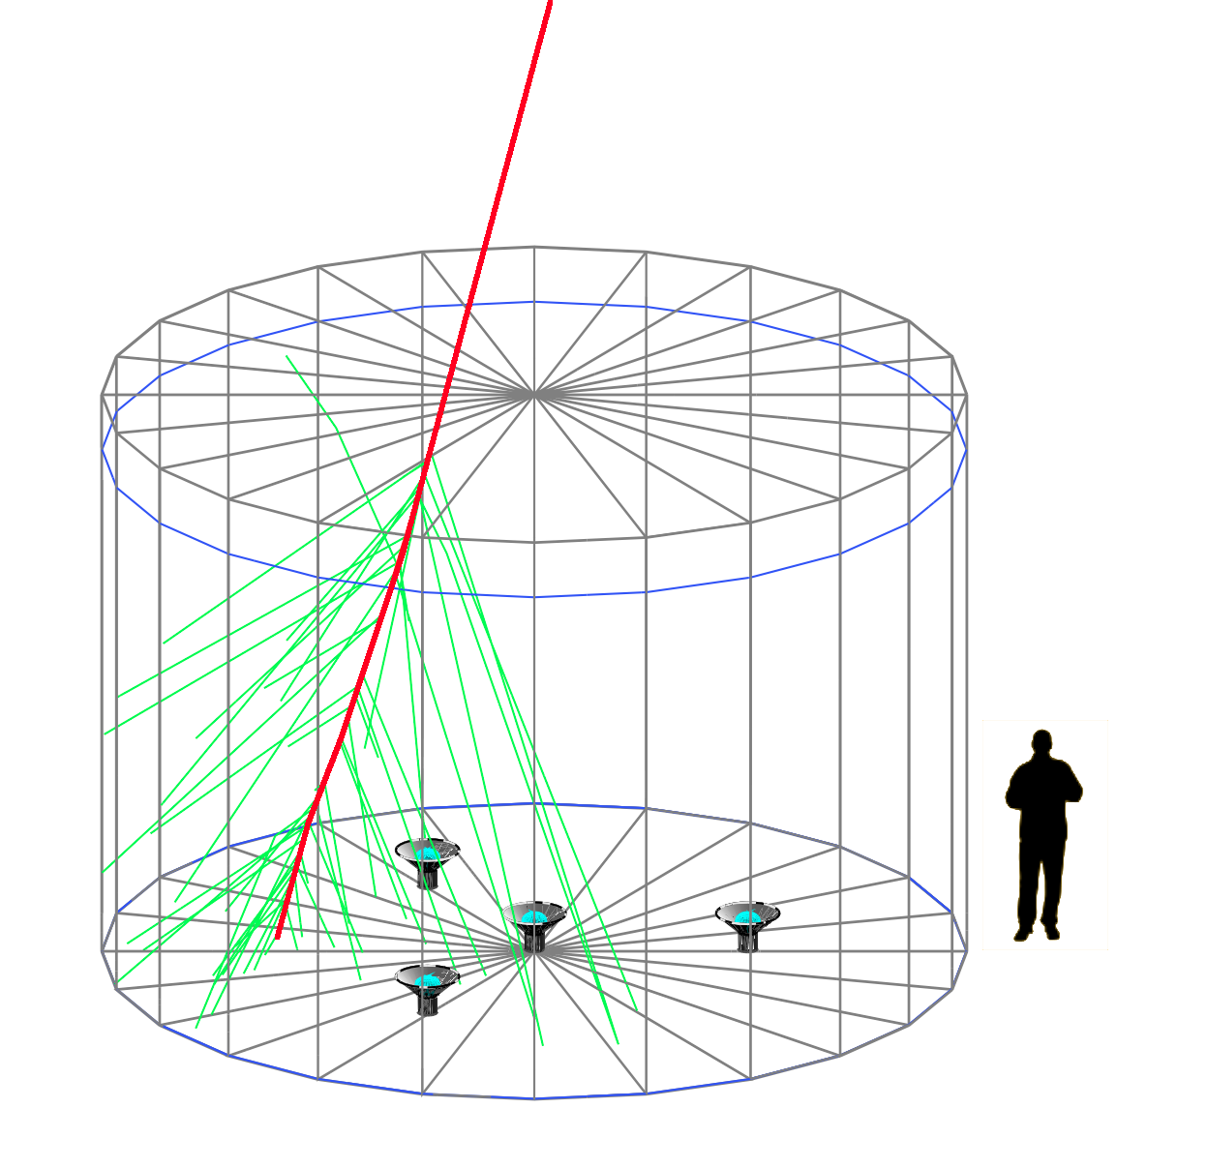
Tank Design
4 PMTs/tank
3 x Hamamatsu R5912
1x Hamamatsu R7081 HQE
~1 PE/30MeV of EM energy
Single thru-going muons produce ~100 Pes
Particle hit rate from CRs (total singles rates also includes noise and afterpulsing)
8”: ~15k Hz
10in: ~30 kHz

Slide 25
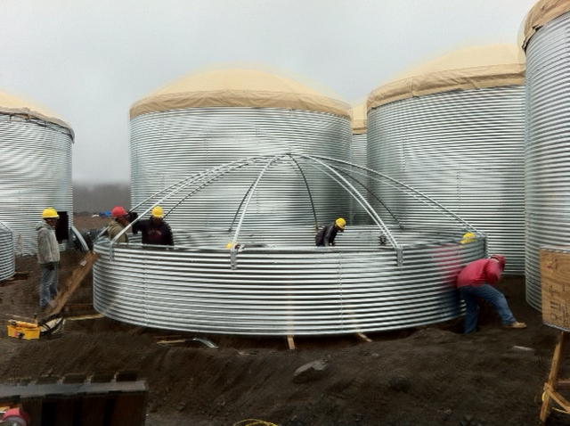
Concave fabric roofs

Slide 26
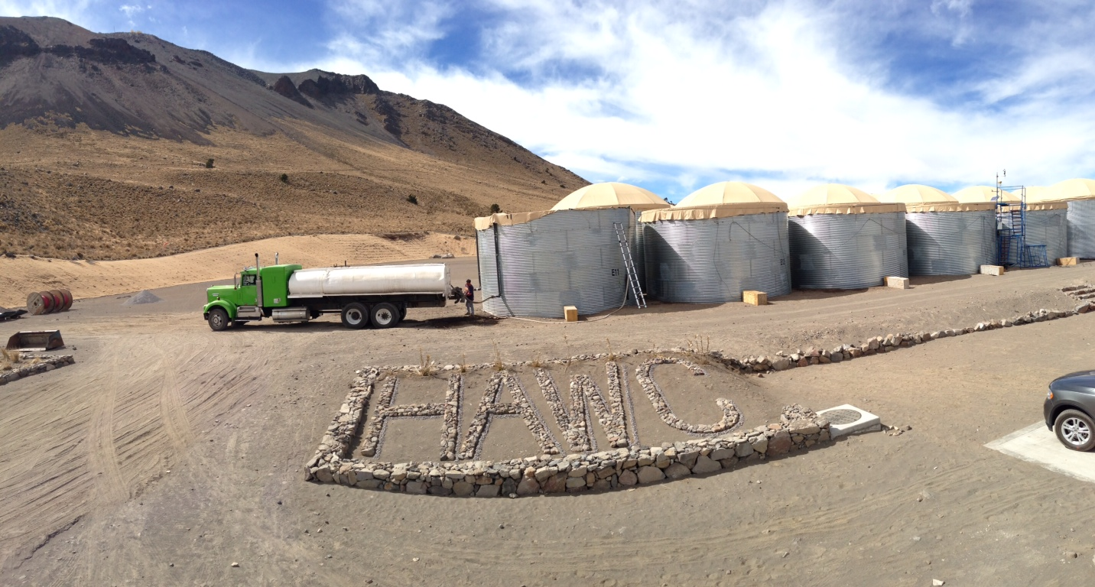
HAWC Design
Water delivered via Truck. 13 trucks/tank.
Maintain schedule of 8 trucks/day 6 days/week

Slide 27
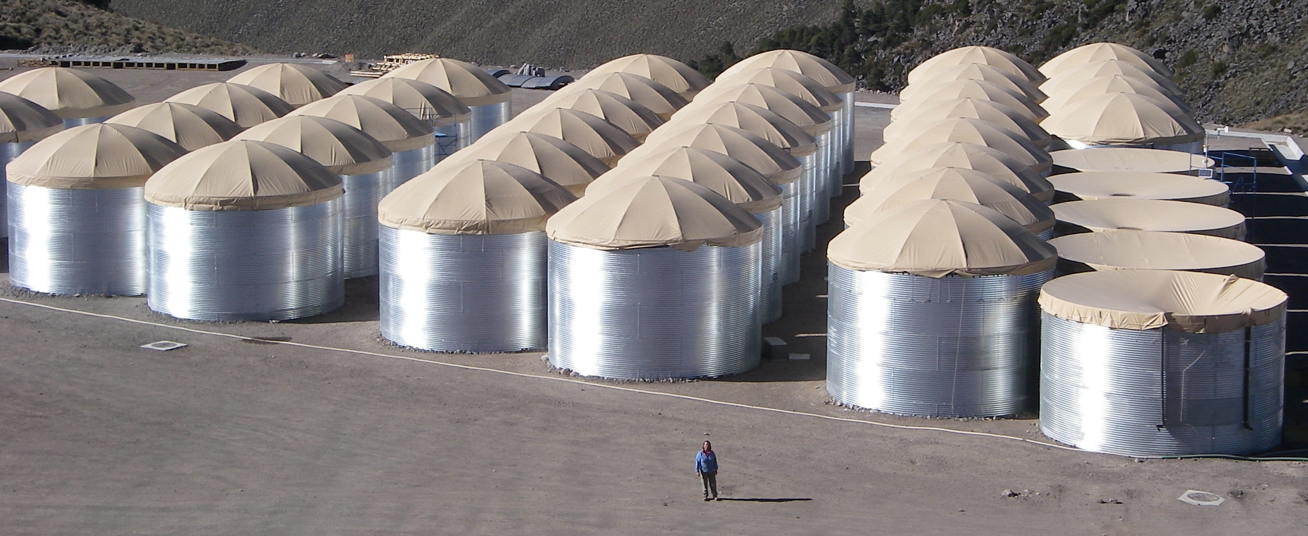
HAWC Design

Slide 28
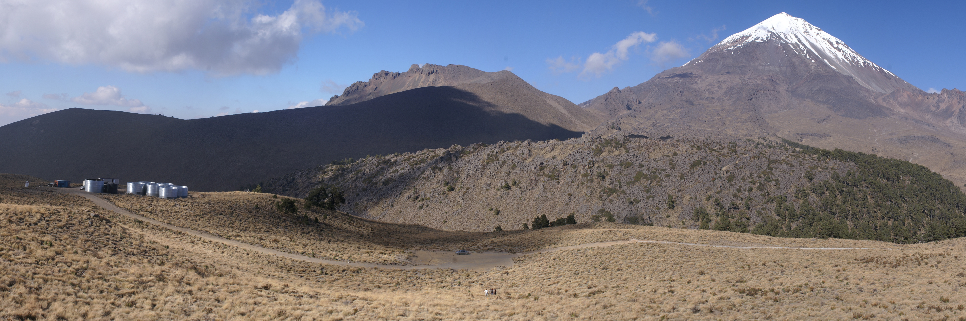
Construction – May 2011

Slide 29
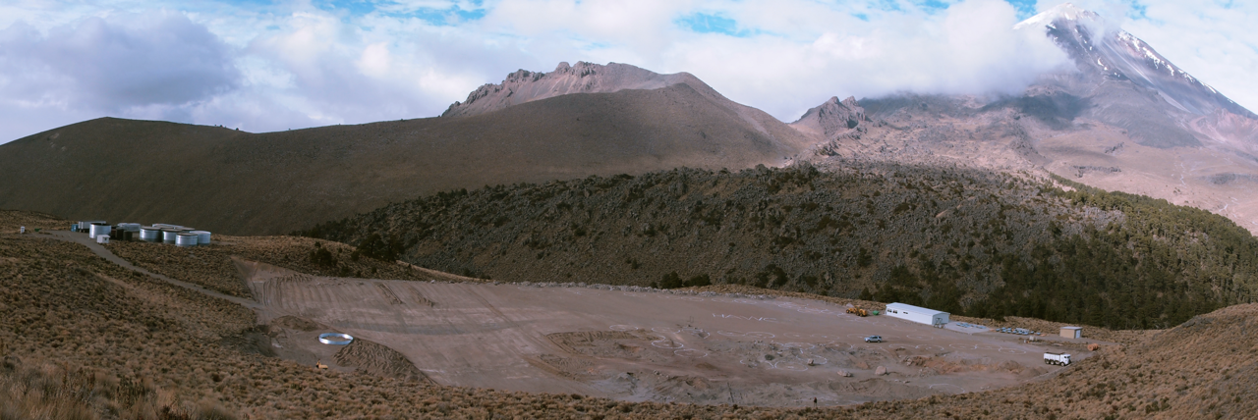
Construction – November 2011

Slide 30
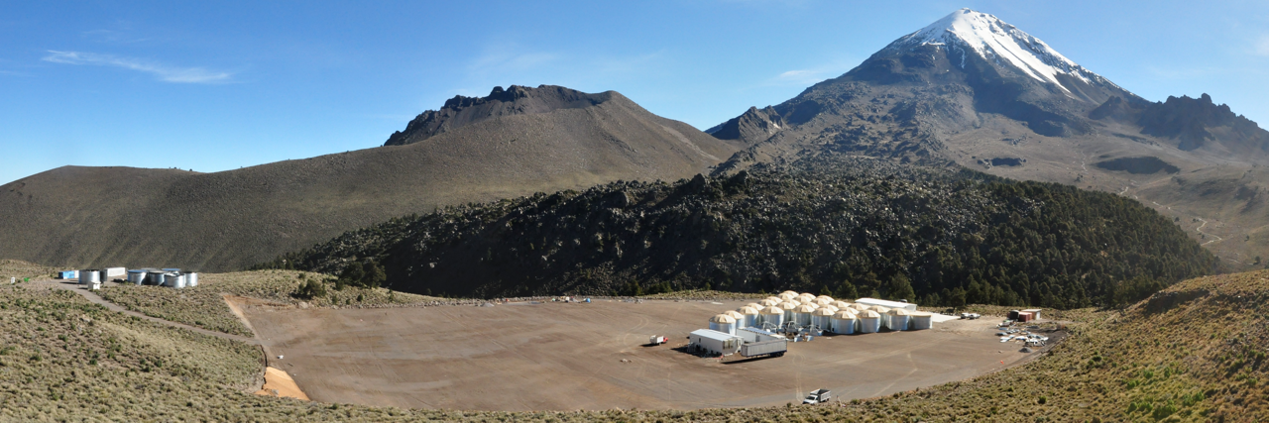
Construction – August 2012

Slide 31
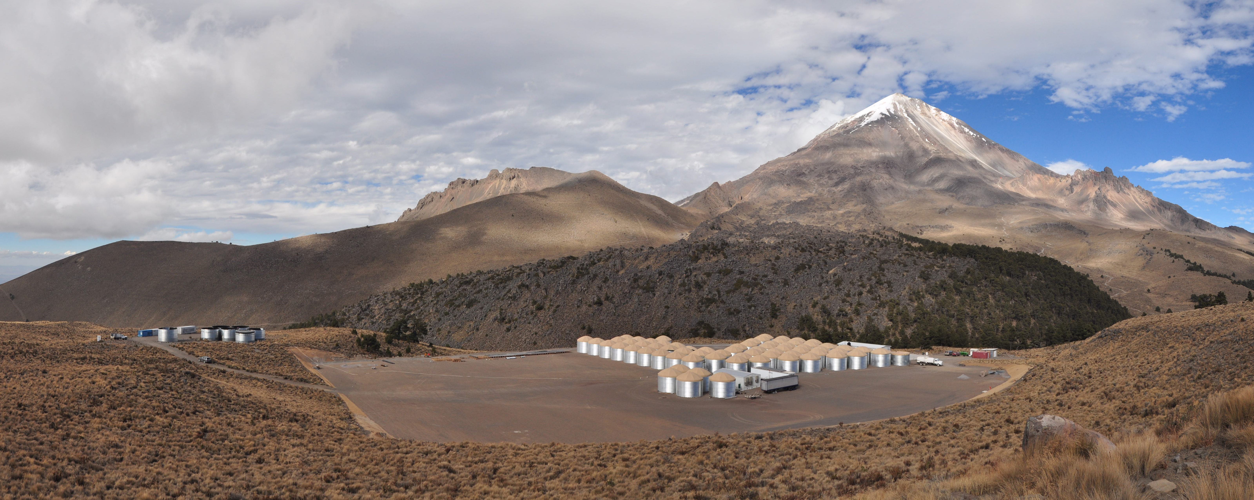
Construction – January 2013

Slide 32
Data Collection & Electronics
4 PMTs/tank PMTs read
through 165m RG-59 cable.
Analog processing shapes
pulses to have RC time
~70ns for pulse. Pulse
decay time used to
measure amplitude.
“Time over Threshold” method.
Digitize level crossings at ~0.25 and 5 PEs.
Read level crossing times with CAEN VX1190A 128-channel TDC.
Charge measured from 0.25PEs to 10,000 PEs
GPS time sent to TDC input. Only one instrument!

Slide 33
Data Flow
Operate without a hardware trigger, digitize all level crossings. ~25kHz for 8” PMTs, ~60kHz for 10” HQE PMTs.
Full 300-tank array will readout at ~400MB/s.
Parallel online computer farm will trigger and reconstruct raw data stream in real time.
Software trigger, ~20kHz, ~20MB/s Archived data set
Will buffer 400MB/s data stream for 1-2 days (~50TB). Will save data for times of exceptional events.
Real-time analysis: Performance, Skymaps, GRB search
Can produce and respond to alerts.
Data archives at University of Maryland in US and UNAM Instituto de Ciencias Nucleares.

Slide 34
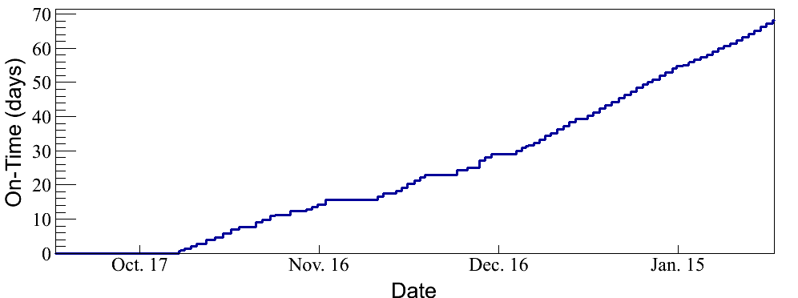
Operational Now!
On-time since engineering data taking began in October 2012
Early data 2-4kHz, now 8kHz
Data shown based on 23 days collected in October, November.

Slide 35
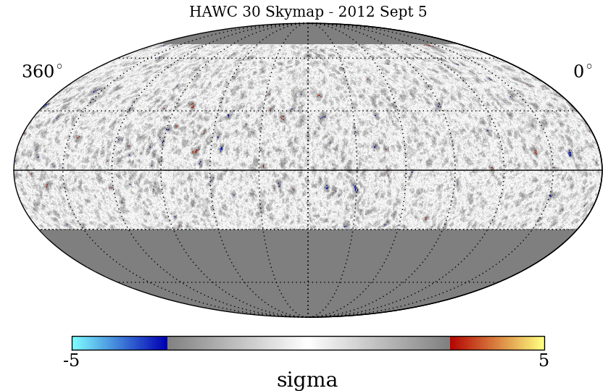
HAWC-30 Completed Sept 2012
HAWC 30 Events and one day Skymap

Slide 36
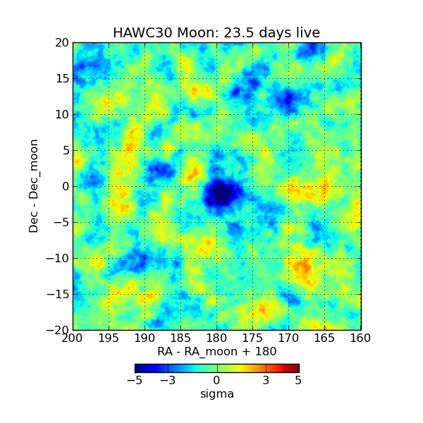
Moon with HAWC
Note, array under construction during data taking. No calibration system yet.

Slide 37
Schedule
Building at 4 tanks/week
May 2013 – Complete 100-tank array (5x more sensitive than Milagro)
August 2013 – After completion of calibration system and engineering tests, begin science operations.
August 2014 – Complete 250-300 tank array as funding permits.

Slide 38
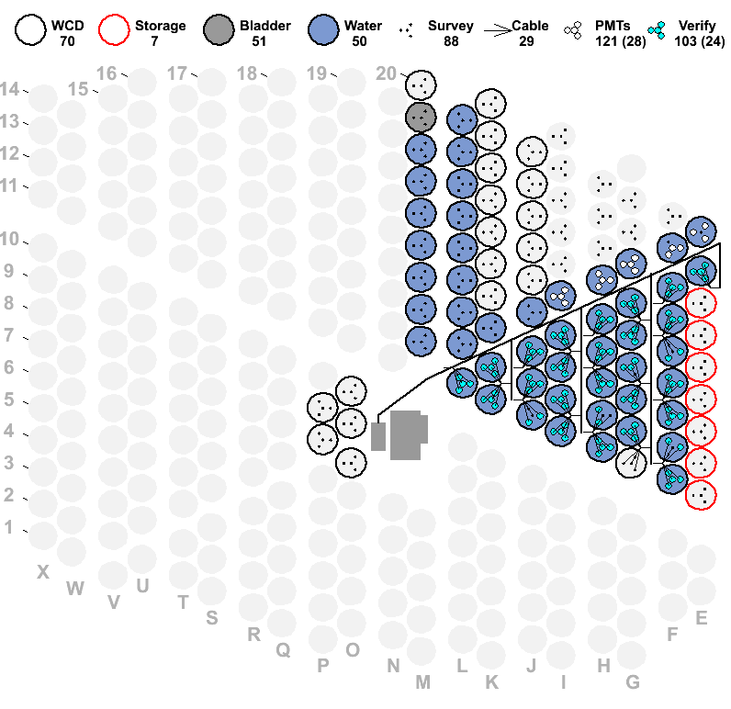
Progress as of 31 January 2013

Slide 39
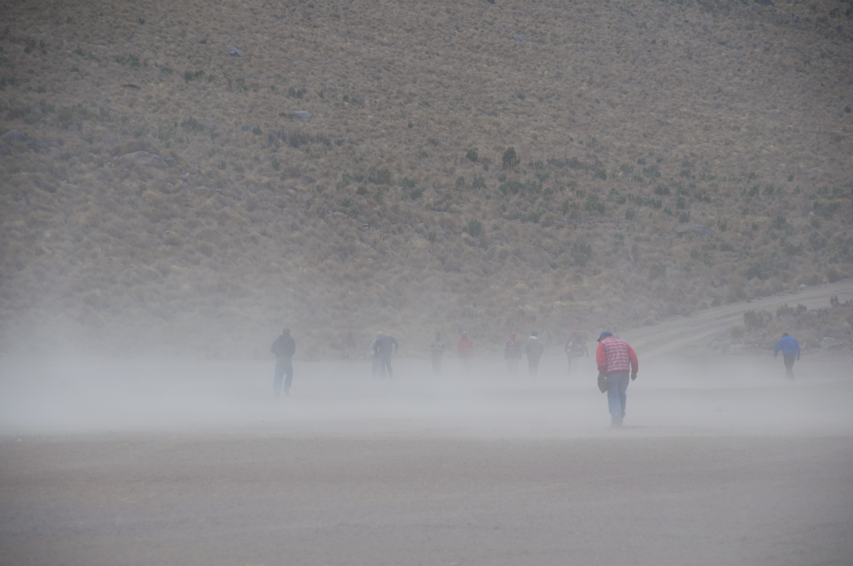
Conclusion:
On our way to 10¹² cosmic rays
Look for great results from HAWC soon!

Slide 40
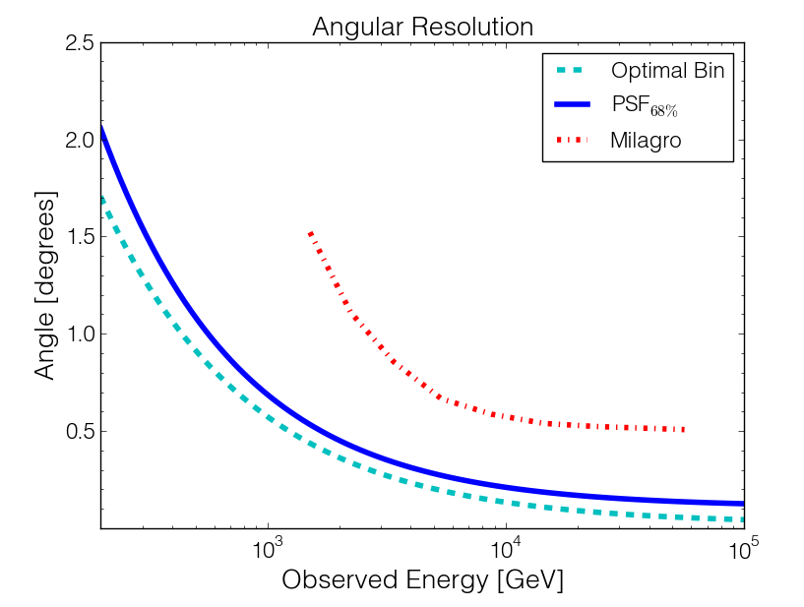
Angular Resolution
Improved Angular Resolution from Milagro with larger detector and more particles detected at higher altitude
0.2 deg

Slide 41
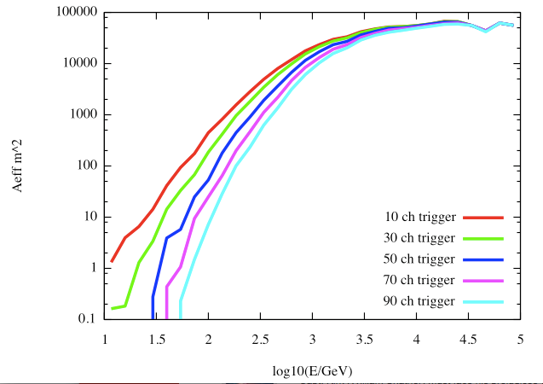
Pushing HAWC’s Low Energy Response
Monte Carlo Simulation which has been confirmed with Milagro observations.
Gamma-ray air showers with angular reconstruction better than 1.5 degrees.
10 PMT trigger
30 PMT trigger
50 PMT trigger
70 PMT trigger
90 PMT trigger
Fermi Effective Area

