Slide 1
The KM3NeT Phase-1 Memorandum of Understanding

Slide 2
Un po’ di storia
Preparazione di un MoU decisa alla fine del 2011
Bozza di MoU presentata all’ASC ed alla collaborazione nella riunione conclusiva del Preparatory Phase a Catania in febbraio 2012
Avviate anche le procedure di elezione del management con la nomina di un search commitee (Coyle, Taiuti, de Wolf)
Ad aprile brusco stop
Ripresa delle discussioni con una riunione ad Erlangen il 22-23 giugno 2012
Al search committee affidato il management “ad interim” della collaborazione con obiettivo primario il completamento del MoU
Sulla base del’agreement, preparata una nuova versione del MoU
Draft presentato alla collaborazione nel meeting di Bologna del 5 ottobre
Nuova versione presentata all’ASC a Catania il 4 dicembre 2012

Slide 3
The “Erlangen agreement”
The string design is considered as the baseline KM3NeT detection unit subject to its validation;
Italian groups will contribute to the validation of the string detection unit;
The Italian PON budget will be used for a seafloor network at the Capo Passero site, and several detection units (towers and strings); the seafloor network will be designed to be compliant with both strings and towers;
The seafloor network at the Capo Passero site will accommodate an additional number of strings produced by the KM3NeT Collaboration, at least equal to the number of strings realized with the PON budget;
The tower construction will be planned in a staged way in order to switch to the string design at any time and as soon as it has been validated;
The French budget for a neutrino telescope in the scope of the KM3NeT-MEUST project will be used to realize a shore station, a seafloor network in the Toulon area and several string detection units;
The seafloor network at the Toulon site will be designed to accommodate string detection units;
The Netherlands and Romania budgets will be used for the construction of string detection units.

Slide 4
KM3NeT Memorandum of Understanding
Current version is 7.0, presented to the ASC on december 4 2012
Memorandum of Understanding for collaboration in the implementation of the first phase of the KM3NeT Research Infrastructure
Core MoU
Annexes
List of Funding Agencies and names of their representatives
List of Institutes in the KM3NeT-phase1 Collaboration and names of their representatives to the Funding Agencies
Present Participants in the KM3NeT-phase 1 Collaboration by Country and Institute
Oversight and organizational structure of the KM3NeT-phase1 project
Facilities of the KM3NeT-phase1 RI
Subsystems of the KM3NeT-phase1 Research Infrastructure
Technical Participation of the Parties in the KM3NeT-phase1 project
Implementation schedule and milestones
Definition of cost categories and Common Fund
Values of Deliverables and Commitments of the Parties
Publication Strategy and Conference Policy
User Access Policy
List of Acronyms
Some annexes are ready, some needs still to be prepared

Slide 5
Preamble (… i punti principali …)
…
(f) The Parties concerned have established the baseline technology for the KM3NeT Detection Unit, which is described in the KM3NeT Technical Design Report as the flexible string option.
(g) The Parties concerned have demonstrated that the optimal configuration for detection of neutrinos from Galactic sources consists of several instrumented volumes.
(h) The Parties concerned have initiated joint actions to validate by means of field tests of Pre-Production Models the basic KM3NeT Detection Unit of the neutrino telescope.
(k) The recent interest of the international particle and astroparticle physics community in a possible neutrino mass hierarchy measurement to be performed with the first phase of the KM3NeT neutrino detector.
(m) The need to establish an international framework to coherently employ the available funds for implementation of the first phase of the KM3NeT Research Infrastructure.
(q) The interest of institutes involved in the KM3NeT Design Study and the KM3NeT Preparatory Phase to form an international collaboration in order to build, install and operate the first phase of the KM3NeT Research Infrastructure in the Mediterranean Sea which houses a neutrino telescope and instrumentation for Earth and Marine science research as an essential step toward a second phase of extension of the neutrino telescope volume to several cubic kilometers.
(r) The intention of the Funding Agencies involved in the KM3NeT Preparatory Phase to establish a European Research Infrastructure Consortium (ERIC) as the legal framework for KM3NeT.

Slide 6
1. Purpose
1.1 This Memorandum of Understanding (MoU) defines the first phase of the KM3NeT Research Infrastructure. Its purpose is to define the programme of work to be carried out for this phase and the distribution of charges and responsibilities among the Parties and Institutes for the execution of this work. It sets out organizational, managerial and financial guidelines to be followed by the Collaboration and the external scientific and technical review processes.
1.2 The first phase comprises the final prototyping and preproduction, engineering, construction, calibration, transportation, assembly, installation and commissioning of the elements which form the basis of the KM3NeT neutrino detector and the seafloor and shore station infrastructures and the operation of the installed neutrino detectors.
1.3 The first phase includes the preparation for the next phase of the KM3NeT neutrino detector with an instrumented volume of several cubic kilometers.
1.4 The first phase includes the installation of a node for connection of instrumentation for Earth and Sea Sciences (ESS-node) at the KM3NeT installation sites, which will be included in the intended EMSO network of cabled observatories.
…
1.7 This MoU is the first step toward the intended establishment of a KM3NeT-ERIC (European Research Infrastructure Consortium), of which this MoU will form the basis for its statutes.

Slide 7
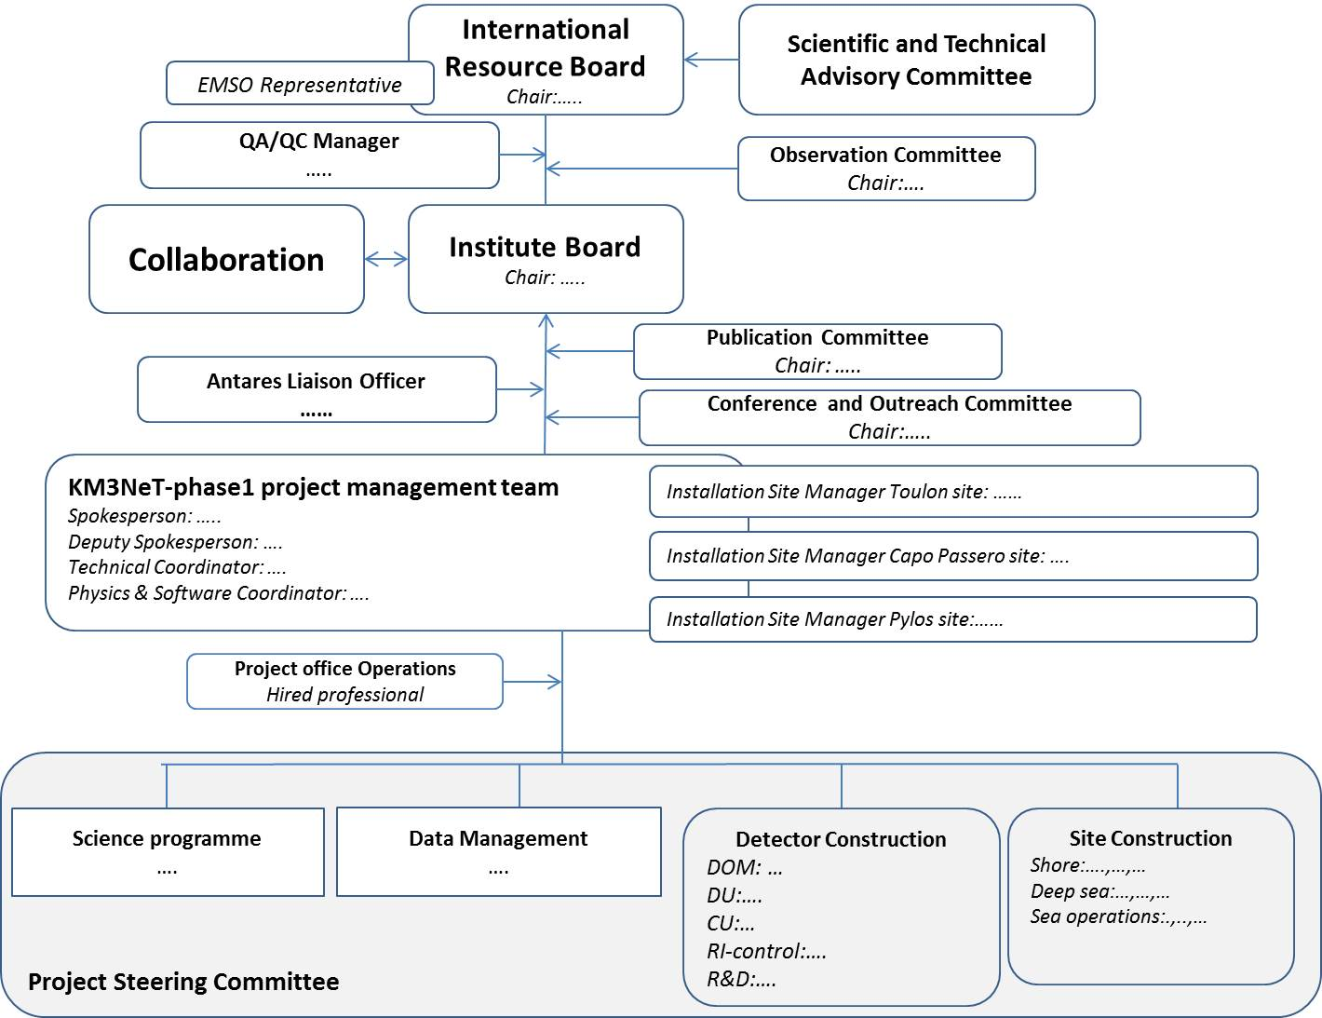
Governance (dettagliata nell’annex 4)
Antares Liaison Officer → GNO liaison Officer

Slide 8
Technical participation (1)

Slide 9
Technical participation (2)

Slide 10
Values of deliverables and committments (TBD)

Slide 11
Altri annessi sono pronti
Descrizione delle facilities (annex 5)
Descrizione dei sottosistemi (annex 6)
Publicatiion strategy and conference policy (annex 11)
User access policy (annex 12)
Alcuni hanno bisogno di altre iterazioni:
Annex 4: oversight and management
Extra: Multidiscipline Officers
Antares Liaison Officer → GNO liaison Officer
Annex 9 Common Fund: out
Annex 10 Commitments to be filled

